Slide 1
Target Safety System Interfaces
Ola Ingemansson
Electrical & Instrumentation Engineer
www.europeanspallationsource.se
5 April, 2019

Slide 2
General overview of TSS Interfaces
TSS & Target wheel drive and shaft
TSS & Helium cooling system
TSS & Cover, penetrations and monolith vessel systems
TSS & Accelerator
TSS & TSS Monitoring system (ICS)
TSS & Infrastructure
TSS & Electrical system
TSS & Machine Protection

Slide 3
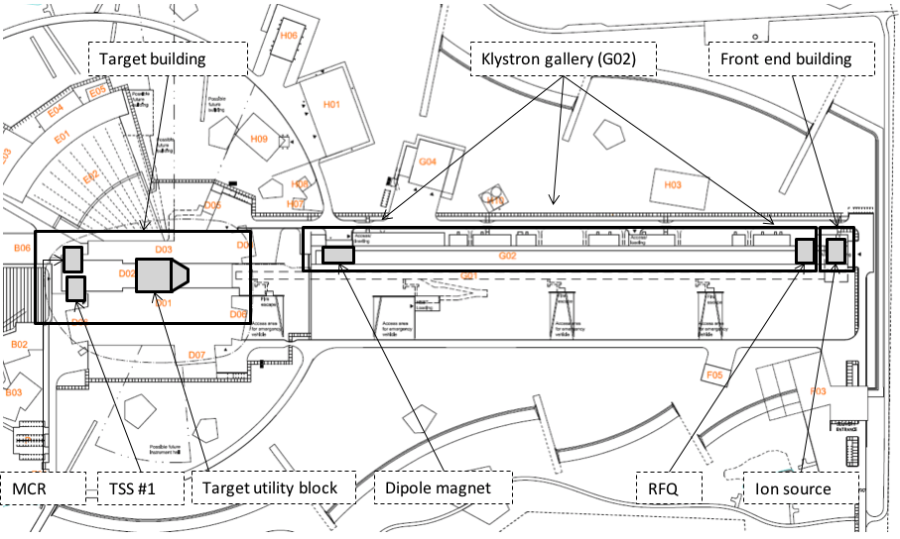
Overview of ESS

Slide 4
TSS & Target wheel drive and shaft (System number 1000), ESS-0022915
Include the sensors for detection
1 general requirement states the system borderlines
  Mechanical structure belongs to S1000
  Electrical components belong to TSS
8 requirements from TSS on S1000
  Defines who is going to do what
  Defines that we shall approve each others design & choice of components
  Defines tolerances and maintainability
4 requirements from S1000 on TSS
  Easy access
  Maintainability aspects

Slide 5
TSS & Helium cooling system (System number 1010), ESS-0016380
Covers
  Mechanical borderlines
  Summarizes the measuring points connecting the 2 systems
  Defines where & how the connections are located
  Defines the process parameters
  Cover system operation and maintenance aspects
    i.e. decontamination possibilities

Slide 6
TSS & Covers, penetration and monolith vessel, (System number 1067), ESS-0032009
2 requirements from TSS to S1067
  Provide penetrations & connection points
  Defines dimensions
2 requirements from S1067 to TSS
  Defines dimensions on instrument piping
  Combability to vacuum components

Slide 7
TSS & Accelerator, ESS-0030068
Requirements from TSS to accelerator
  Ion source & RFQ
    Stop the beam
    Response time
    Space
    Electrical supply
    Cable paths
  Bending Magnet
    Space
    Electrical supply
    Direction of beam
Requirements from Accelerator to TSS
  Defines that beam shall be possible to run without a target station ready for operation

Slide 8
TSS & TSS Monitoring system (ICS), ESS-0249257
Functional Requirements
  Operator Interface (OPI)
  Archiver
  Monitor the communication
Constrain Requirements
  TSS shall not be impacted by the TSSMS
  OPI shall not be used for alarm handling
  Epics Input/output controller (IOC) designed according to ICS standard
Radiation Safety Requirements
  Classifies the TSSMS – An SSC important to radiation safety
Interface Requirements
  Saying that there are no interface requirements

Slide 9
TSS & Site Infrastructure, ESS-0030063
Describes
  Rooms needed for TSS
  Location of rooms
  Level of fireproof (1 hour)
  Electrical outlet requirements, 16A
  Room environment requirements
  Access rules (access control room)
  Grounding bars needed
  Occupation
  LAN (Local Area Network)
Describes electrical
  Surge protection
  Independent underground raceways for TSS

Slide 10
TSS & Target Electrical system, ESS-0198545
Describes (TSS to Target electrical in target utility area)
  Cable routing
  Electrical Supply distribution
  Grounding
  Raceways

Slide 11
TSS & MP – at the moment not written
TSS believe that MP needs
  To know if or when TSS trips
  To know if TSS is ready to operate (closed contacts on actuators)
  Is TSS in Bending magnet position?
  And probably more

