Slide 1
TSS Design
Ola Ingemansson
Electrical & Instrumentation Engineer
www.europeanspallationsource.se
5 April, 2019

Slide 2
TSS basic design rules
TSS system design is governed by SSM conditions
Diversity
Redundancy
Separation
Functional
Physical
Fail safe
Manual safety stop button
System design based on IEC61226 & IEC 61513

Slide 3
TSS – Main Interfaces
Input- Conditions
Mass Flow in Target Primary Cooling System
Pressure in Target Primary Cooling System
Temperature in Target Primary Cooling System
Rotation speed in Target Wheel system
Pressure in Monolith Vessel
Manual Safety Stop Button in Main Control Room
Output- Actions
2 Actuators for cutting the power supply to the Ion Source
2 Actuators for cutting the power supply to the RFQ

Slide 4
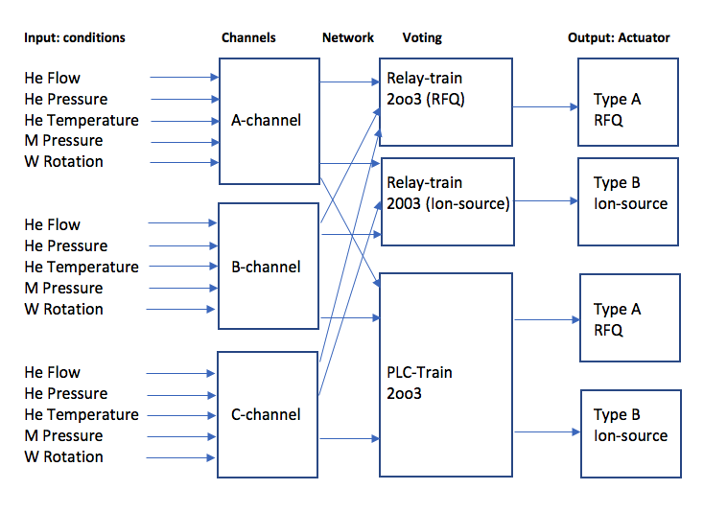
Simplified block diagram TSS

Slide 5
TSS Main Components
Field Instrumentation
Primary logic in A, B & C-channel,
Separated networks for Safety trains (Relay/PLC)
Relay-train including a HW-based 2oo3 voting
Safety PLC-train including a SW-based 2oo3 voting
Actuator type A & B
Dipole Magnet
Gateway PLC- Non Safety functions

Slide 6
TSS – Non Safety Interfaces
TSS Operator Panel in MCR
Part of TSS, owned by TSS
Must be designed together with ESS Operations Group
Gateway PLC
The TSS tool for interfacing with non-safety tasks & other systems
Ongoing definition of the interface with EPICS for OPI, Archiving, Operator Notification via the Gateway PLC – currently PDR-ready for ICS-owned TSS Monitoring System (TSSMS)
The technical base (protocol) is designed together with ICS
Operator work station in MCR (EPICS)
Full scope of User Interface is not decided yet
Read only interface, alarm displaying, no alarm handling
Must be designed together with ESS Operations Group

Slide 7
TSS components - location

Slide 8
TSS General design
Any questions?

Slide 9
TSS Field Instrumentation
Ola Ingemansson
Electrical & Instrumentation Engineer
www.europeanspallationsource.se
5 April, 2019

Slide 10
General requirements on field instruments - conditions
Qualified for use in the environment that can occur
Components Of The Shelf - COTS
Proven design
Well known suppliers
Aiming for simplicity
The same sensing equipment provides both the trains with the process status

Slide 11
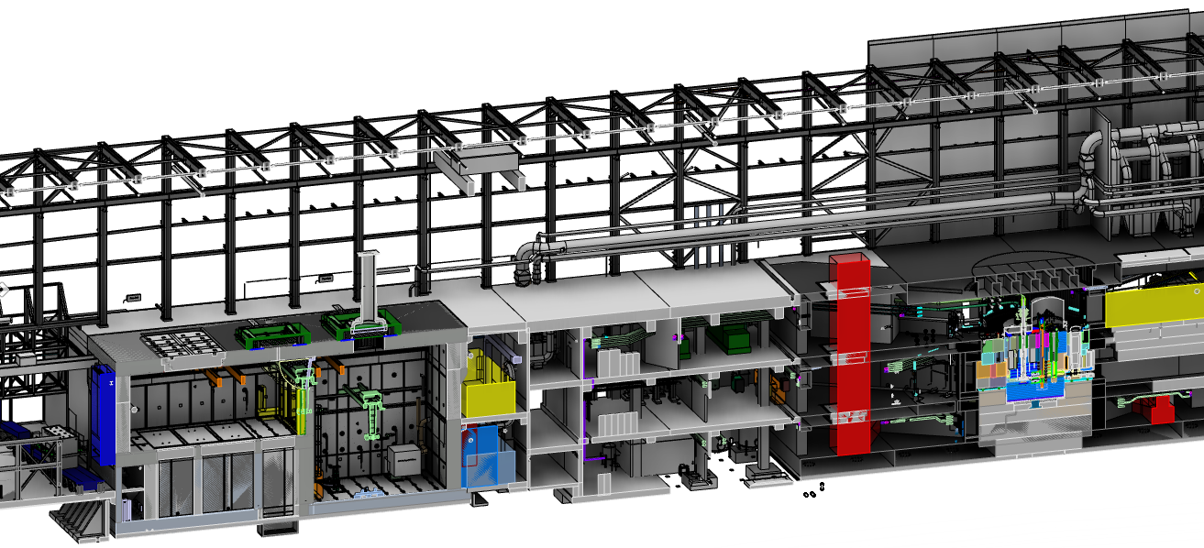
Overview TSS equipment
Relay 2oo3
Actuators
Ion source and RFQ
PLC 2oo3
TSS room #1

Slide 12
Mass Flow in Helium cooling circuit I

Slide 13
Mass Flow in Helium cooling circuit II
The process connections are in D02.115.4003, Venturi principle is used
Shared venturi between the 3 transmitters
Impulse piping used to transfer the pressure to a non radiation area
The transmitter provides a calculated mass flow value based on
static pressure measured from – leg
dP measured from + & - leg
temperature measured by independent Pt-100 element attached to process in D02.115.3067
The mass weight of Helium 4 gas
The 3 transmitters will be located in D02.115.3064, D02.103.3064 & D02.085.3064
Each transmitter connects to a signal conditioner that interfaces towards Relay-train & PLC-train electrical independent of each other

Slide 14
Pressure in Helium cooling circuit
The process connections are in D02.115.3064
The pressure switch provides open/closed switches towards the Relay-train & PLC-train electrical independent of each other
The 3 pressure switches will be located in D02.115.3064, D02.103.3064 & D02.085.3064
Impulse piping used to transfer the pressure to a non radiation area
This pressure switch will not be the same type and brand as the one measuring monolith vessel pressure due to CCF

Slide 15
Temperature in Helium cooling circuit
The process connections are in D02.115.3064
4-wire technique is used to get high resolution
The 3 temperature transmitters will be located in D02.115.3064, D02.103.3064 & D02.085.3064
Each transmitter connects to a signal conditioner that interfaces towards Relay-train & PLC-train electrical independent of each other

Slide 16
Rotation speed in Target Wheel system
The process connection is in D02.115.4001
Inductive sensor connected to electrical units in D02.115.4005
The 3 main electronic units will be located in D02.115.3064, D02.103.3064 & D02.085.3064
Each main electronic unit connects to a signal conditioner that interfaces towards the Relay-train & PLC-train electrical independent of each other

Slide 17
Pressure in Monolith Vessel
The process connections are in D02.115.4001
The pressure switch provides open/closed switches towards the Relay-train & PLC-train electrical independent of each other
The 3 pressure switches will be located in D02.115.3064, D02.103.3064 & D02.085.3064
Impulse piping (Dimension DN25) used to transfer the pressure to a non radiation area
This pressure switch will not be the same type and brand as the one measuring monolith vessel pressure due to CCF

Slide 18
TSS Field Instrumentation
Any questions?

Slide 19
TSS Channels
Ola Ingemansson
Electrical & Instrumentation Engineer
www.europeanspallationsource.se
5 April, 2019

Slide 20
TSS Channels
The channels collect the input sub-conditions
i.e. Helium Mass flow is a condition
Channel A (B,C) Helium mass flows are sub-conditions
Channel A (B,C) collects the 5 sub-conditions
Built in series like a chain, logic OR-gate
The design is picked up from Nuclear Industry
Channels in Relay-train & PLC-train shall have the same basic behavior
The Logic for Relay-train is based on HW
The logic for PLC-train is based on SW

Slide 21
Relay 2oo3
Actuators
Ion source and RFQ
PLC 2oo3
TSS room #1

Slide 22
TSS Channels
Any questions?

Slide 23
TSS Network
Ola Ingemansson
Electrical & Instrumentation Engineer
www.europeanspallationsource.se
5 April, 2019

Slide 24
TSS networks
3 Separated networks for Relay-train, PLC-train & Gateway
Example:
Safety CPU <-> To its own Cabinet
Safety CPU <-> Channel A Cabinet
Safety CPU <-> Channel B Cabinet
Safety CPU <-> Channel C Cabinet
Safety CPU <-> Main Control Room Cabinet (MCR)
Safety CPU <-> Dipole Magnet Cabinet (DM)
Safety CPU <-> RFQ Control Cabinet
Safety CPU <-> ION Source Control Cabinet.
2 of the networks, Relay-train and PLC-train uses different type and brand of components

Slide 25
TSS overview

Slide 26
TSS Network
Any questions?

Slide 27
TSS Voting
Ola Ingemansson
Electrical & Instrumentation Engineer
www.europeanspallationsource.se
5 April, 2019

Slide 28
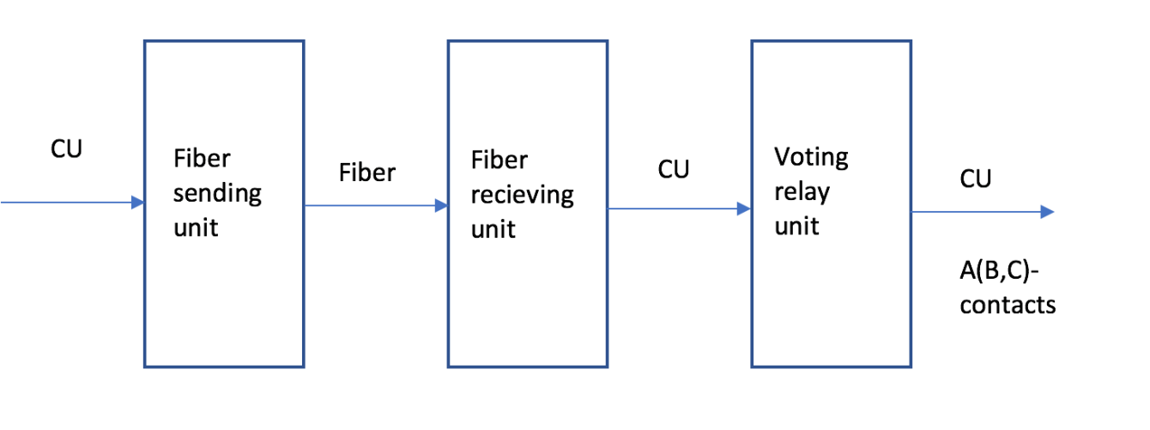
TSS Channels to voting
Channel information communicated for voting
Fiber optics are used to transfer signals long distance
The relays perform the voting logic for the Relay train
This is done by SW in the PLC-train

Slide 29
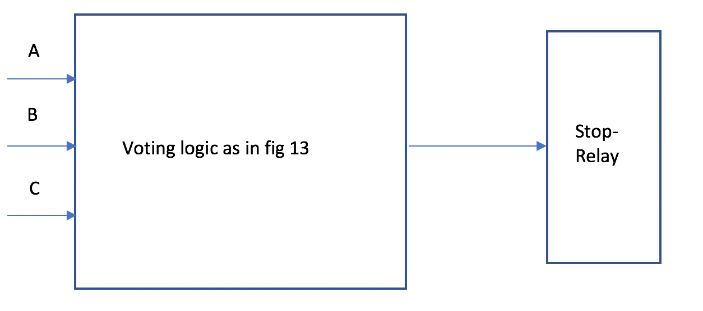
TSS logic
2oo3 Created close to the actuators in Relay-train
Created by SW in PLC-train
Connects to 2+2 actuators that performs the power break up of feeding the Ion-source and the RFQ

Slide 30
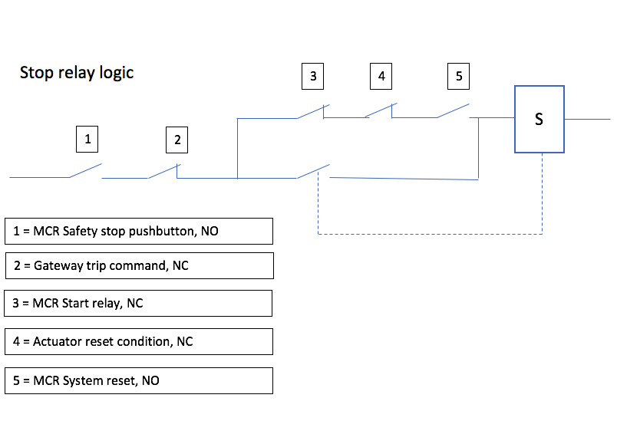
TSS logic II
Stop relay logic includes the manual safety stop button

Slide 31
TSS Voting
Any questions?

Slide 32
TSS Actuators
Ola Ingemansson
Electrical & Instrumentation Engineer
www.europeanspallationsource.se
5 April, 2019

Slide 33
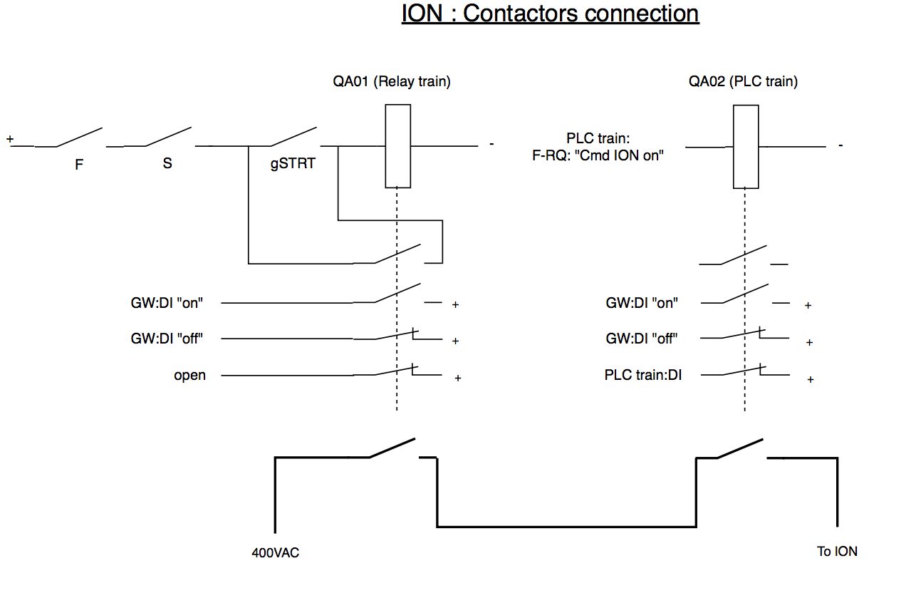
TSS Actuators
Ion-source, both contactors shown

Slide 34
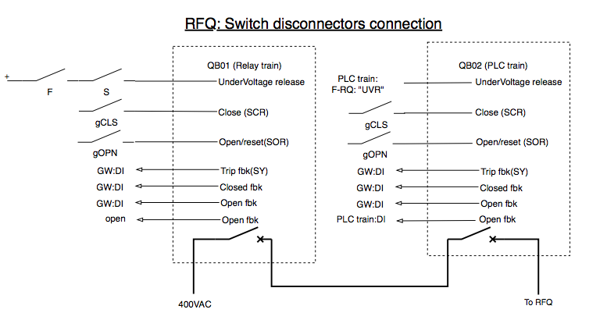
TSS Actuators
RFQ, both Switch disconnectors shown

Slide 35
TSS Actuators
Any Questions

Slide 36
TSS Dipole Magnet
Ola Ingemansson
Electrical & Instrumentation Engineer
www.europeanspallationsource.se
5 April, 2019

Slide 37
TSS Logic for Dipole magnet DM I

Slide 38
TSS Dipole magnet DM II
When activated it overrides the 2oo3-voting
Activation is done in 3 independent steps
Turn off the two local switches at power supply to DM
Turn on (confirmation) the two local switches at RFQ & Ion-source cabinets
Start by turn local dial in MCR to activate
Doing it the wrong way will not override the 2oo3
When reversing the same order but dial for start TSS

Slide 39
TSS Dipole Magnets
Any questions?

Slide 40
TSS Gateway
Ola Ingemansson
Electrical & Instrumentation Engineer
www.europeanspallationsource.se
5 April, 2019

Slide 41
Gateway PLC – typical use
Feedback of signals from the actuators

Slide 42
Gateway PLC- GW
Gateway PLC is the TSS operational system
Handles non safety signals
Internal supervision in cabinets
Controlled signals
Interface between TSS & EPICS (MCR)
Have its own network connecting the TSS cabinets
If GW breaks down, no impact on TSS safety function

Slide 43
Gateway PLC - Functional separation
What is functional separation (Independence)?
SSMFS, Guiding document C18:
The purpose of functional separation is to achieve a design where SSC (Structure, System or Components) which are part of safety groups are sufficiently separated, for example through isolation devices, switches, valves, diodes, etc., so that the risk of common cause failures is minimised
IEC61513:
The ability to perform a required function is unaffected by the other equipment
Means to achieve independence in the design are electrical isolation
How can functional separation be solved?
Galvanically separated from Relay-train & PLC-train
Uses relay components to separate
Uses an independent network
Used for feedback of signals
Used for controlled actions in the TSS

Slide 44
TSS Gateway
Any questions?

Slide 45
TSS Test facilities
Ola Ingemansson
Electrical & Instrumentation Engineer
www.europeanspallationsource.se
5 April, 2019

Slide 46
TSS Test-bench
In the workshop we have a condensed version of the TSS
We can
Run process simulations using real field instruments
Run test sequences
Run test HMI together with Operations group
We will
Be able to verify the chosen logic
Be able to produce operational instructions
Be able to produce maintenance instructions

Slide 47
TSS Design
That completes the TSS design presentation
Any Questions?

