Slide 1
How to operate TSS
Ola Ingemansson
Electrical & Instrumentation Engineer
www.europeanspallationsource.se
5 April, 2019

Slide 2
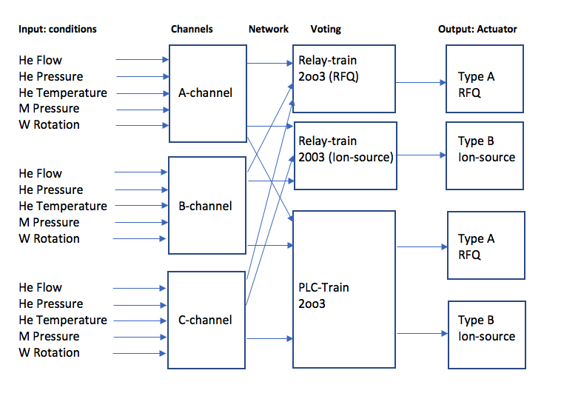
General overview of TSS

Slide 3
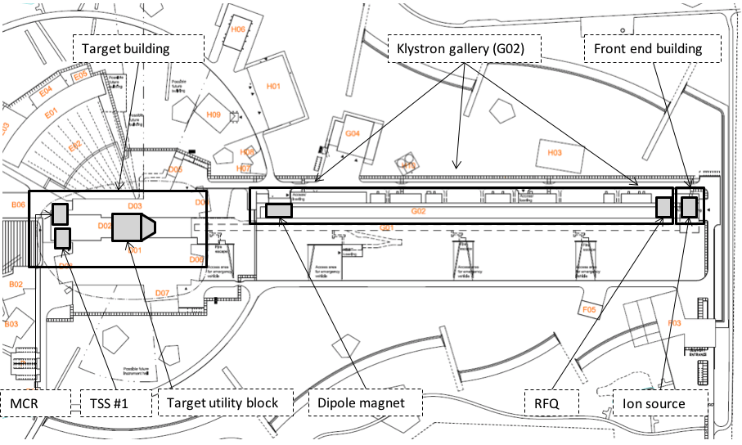
Overview of ESS

Slide 4
Basic TSS modes
Open contacts on actuators:
  Safety Stop
  Operational stop (maintenance)
  TSS stop
Closed contacts (operation) on actuators:
  Permit Beam on Target
  Permit Beam on Dump

Slide 5
General TSS Operations Strategy
Who is authorized to change TSS modes?
  MCR operators, Lead operator, TSS maintenance personnel
Who is authorized to maintain TSS HW in the field?
  TSS maintenance team, CM + IT security rules will guideline, work order system
Who is authorized to change TSS SW?
  Selected TSS team personnel, CM + IT security rules will guideline, work order system
Does TSS need to be functional in order to operate the ion source?
  Yes
Can the ion source generate beam if the TSS is in open contacts mode?
  No
Does the entire target station need to be functional in order to operate the ion source?
  No
Is it possible to send beam to a stopped wheel?
  No
Is it possible to send beam to a target without circulating helium?
  No

Slide 6
General TSS Operations Strategy
In relation to SSM
Who is authorized to change TSS modes?
  MCR operators or Lead operator, TSS team personnel
Who is authorized to maintain TSS HW in the field?
  TSS team
Who is authorized to change TSS software?
  Selected TSS team personnel
Does ESS need to notify SSM when the TSS trips beam?
  Yes, if TSS actually trips beam
  therefore – ESS needs to be able to determine and demonstrate which system stopped beam propagation
Does ESS need to notify SSM when the TSS contactors actuate?
  Not necessarily – ex. normal ramp down of systems – wheel will slow down if it is being stopped in order to open the monolith – could trigger the TSS contactors, but beam should already be off

Slide 7
TSS panel in MCR
Includes
  Safety stop button, touch protected but open to be used
  Feedback light indicator for actuator status
  HMI panel, touch screen, open to be used
    Event list
    Alarm list
    Status
    Feedback signals
  Control switches/dials behind a keylock controlled hatch
    Channel reset, a dial
    System reset, a dial
    Operation or maintenance mode, mainly for maintenance purposes, a switch
    Start permit for beam, a dial

Slide 8
TSS start up sequence, Beam on Target
All operations done from MCR
It is assumed some operational prework to be done
Start helium cooling system, He Flow >1,7kg/s, He P > 8 bar(a), He T < 65°C
Start wheel rotation, Speed > 9RPM
Start to decrease pressure in Monolith vessel, M P < 0,5 bar(a)
Reset channels (A,B,C)
Reset system (Relay-train & PLC-train)
Operation /Maintenance switch in “Operation”
Start permit for beam – closes the actuators and allow power to RFQ/ION-source

Slide 9
Typical start up sequence, Beam on dump
Operations made from Field & MCR
It is assumed some operational prework to be done
Beam must be shut off using the operational system
Put both switch disconnectors in dipole magnets cabinet in Beam on Dump mode
  This changes the direction of beam
  Performs the first step in overriding 2oo3-voting in RFQ & ION-source cabinets
Put local switch on RFQ-cabinet in Beam on Dump mode
  This is the second step needed to override the 2oo3 voting in RFQ-cabinet
Put local switch on ION-source cabinet in Beam on Dump mode
  This is the third step needed to override the 2oo3 voting in ION-source cabinet
Reset system (Relay-train & PLC-train) in MCR
Operation /Maintenance switch in “Operation”
Start permit for beam – closes the actuators and allow power to RFQ/ION-source
Turn on beam using other operational system

Slide 10
How to maintain TSS
Ola Ingemansson
Electrical & Instrumentation Engineer
www.europeanspallationsource.se
5 April, 2019

Slide 11
Typical Maintenance mode scenario
Operations made from MCR & field devices
Assumed we have a workorder system
Beam is shut off
  via normal operating procedures/systems
Ion source and RFQ are powered down
  via normal operating procedures/systems
In MCR
  Put Operation/Maintenance mode switch in “Maintenance”
    This stops power feeding to RFQ/ION-source
At A(B,C) channel cabinets
  Possibility to put local, key controlled switches in
    “Override”
    “Normal”
    “Forced”
Perform planned maintenance

Slide 12
Planned Maintenance for TSS
Assumed we have a workorder system
Field instrumentation to be tested periodically based on OLC-requirements (Planned)
  Proposed interval every 6 months
  Or when a change of HW has been performed
Logic (Relay & PLC) to be tested periodically based on OLC-requirements (Planned)
  Proposed interval every 12 months
  Or when a checksum value has been changed
Actuators to be tested periodically based on OLC-requirements( Planned)
  Proposed interval every 6 months
  Or when a change of HW has been performed

Slide 13
Unplanned maintenance (repair work) for TSS
Assumed we have a workorder system
Whenever an operator suspects a fault he/she shall initiate a test. (Unplanned maintenance)
  To help the operator:
    He flow compare the 3 channels
      Interval for checking once / shift
    He Temperature compare the 3 channels
      Interval for checking once / shift
TSS can allow beam to dump & repair work on TSS field instrumentation performed at the same time
TSS measuring device is built to be able to do maintenance during running of the beam (to target)
  Put local key-controlled switch in “Forced” position
  Consequence- voting will be 1oo2, safety level is not degraded
  One channel is tripped, during unplanned maintenance
  Perform maintenance
  Proposed maximum time from OLC: only 1 sub-condition & max time 24hours
  Put local key-controlled switch in “Normal” position
  After repair, reset is done using channel reset dial

Slide 14
That completes the operation & maintenance presentations
Questions
We will now run a logic presentation of the TSS

