Slide 1
IKC in Operation and Potential for Co-Creation
ILO Strategy Meeting
Mauro Zambelli
European Spallation Source ERIC
Budapest, June 24th, 2019

Slide 2
Potential for Co-Creation Ik-Kind Contribution in the Technology and Technology Transfer Ecosystem (T&TT Ecosystem)

Slide 3
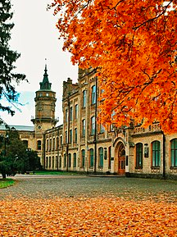

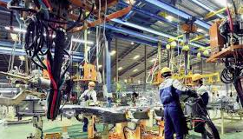

Technology Transfer?

Slide 4

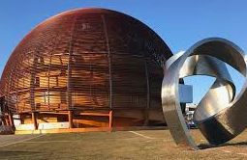
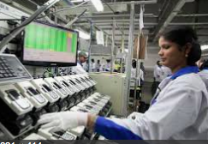
Big Science Business?

Slide 5
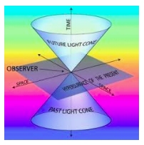
T&TT in space and time
Technology Transfer and Technology Supply
are not single shot events
that happen in a
specific point
in space and time.

Slide 6
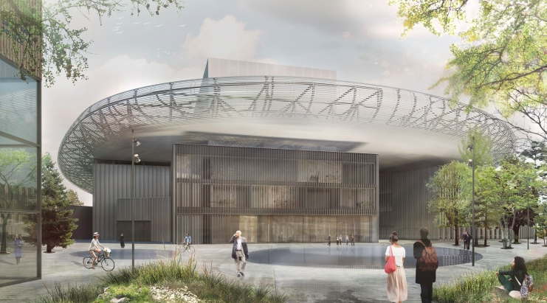
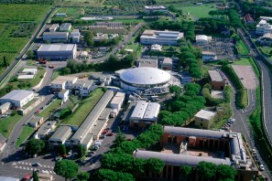
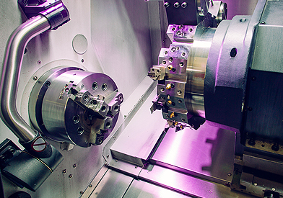
In-Kind Contributions?
Knowledge
Prototypes

Slide 7
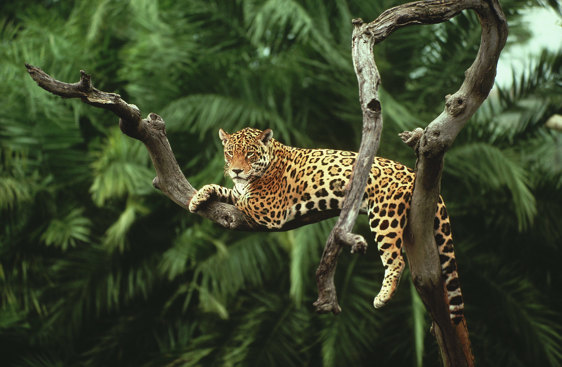
The T&TT Ecosystem
Each element cannot be considered separated by the general T&TT context

Slide 8

The T&TT Ecosystem
Many interacting elements in a unique environment

Slide 9
The T&TT Ecosystem
Many aspects, a unique environment
In-Kind Contributions
Patenting
Intellectual Property Protection
Co-Creation
Knowledge Management
Co-Development
Technology
Transfer
Invention
Industrial
Liasion
Innovation

Slide 10
The T&TT Ecosystem
Many aspects, a unique environment
Technology
and Technology Transfer
Ecosystem
In-Kind Contributions
Patenting
Intellectual Property Protection
Co-Creation
Knowledge Management
Co-Development
Technology
Transfer
Invention
Industrial
Liasion
Innovation

Slide 11
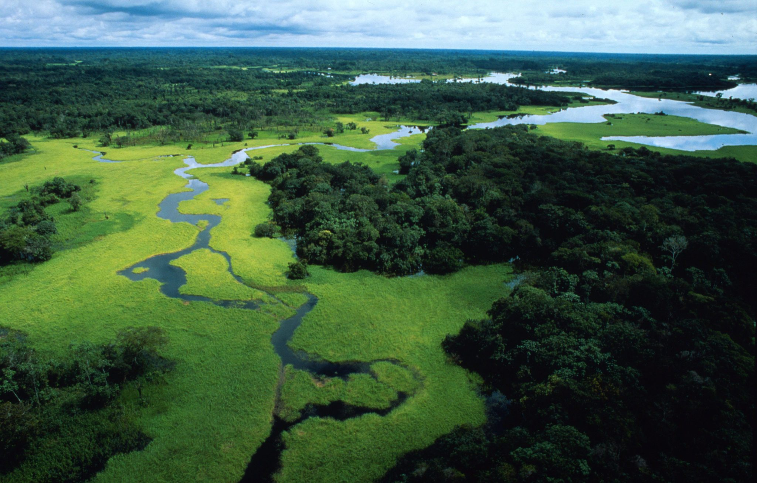
The T&TT Ecosystem
A complex landscape: many concepts, a unique view

Slide 12
Where Technology Transfer occurs
A double way process
Basic research
RI
Applied research
Industry
Innovation
Prototyping
Prototyping
Production
Invention
Marketing

Slide 13
The role of ILOs
RI
Industry
Innovation
Prototyping
Prototyping
Invention
ILO

Slide 14
Potential for Co-Creation Conclusions

Slide 15
Conclusions
In-Kind Contributions
are a special example and a particular opportunity
for co-creation,
in the more general environment
of technology development and technology transfer

Slide 16
Thank you!
Mauro.Zambelli@esss.se

