Slide 1
IKC in Operation and Potential for Co-Creation
ILO Strategy Meeting
Mauro Zambelli
European Spallation Source ERIC
Budapest, June 24th, 2019

Slide 2
In-Kind Contributions @ ESS
Contracts, Construction, Operation

Slide 3
In-Kind @ ESS
From the ESS website
ESS is working with more than 40 European partner institutions, and more than 130 collaborating institutions worldwide under the in-kind model.
As the success of ESS to a great extent depends on schedule performance, in-kind agreements are on the critical path. In total, about 30% of the €1 843 M ESS construction cost will be supplied through in-kind contributions (IKCs). In particular, significant parts of the scientific instruments, the Target Station, and the Accelerator will be delivered as IKCs.

Slide 4

IKC: Do not call it “Procurement”
  In-Kind is not “Procurement”
  In-Kind Contributors are “Partners” and not “Suppliers”
  However, the end of the story is exactly the same

Slide 5
IKC: Let’s see it as “Procurement”
  IK Contributions shares with Procurement
  an important part of the supply chain
    Logistics (to be never underestimated)
    Transport & Delivery
    Site acceptance
    Transfer of ownership (??)
  In order to finalize IK contributions, a strong cooperation and interaction is needed with the Supply, Procurement and Logistics Division
    SPL Division to give rules for and manage IK deliveries

Slide 6
New challenges for IK management
  IK Management @ ESS is rapidly moving from the Contractual phase to the Implementation phase, starting to look forward to the Operation phase
    This requires a progressively different approach to the relation of IK Officers both with the IK Partners and with the relevant Functions inside ESS
    Complex issues are coming into play: logistics, VAT on delivery and installation, quality documentation, CE marking

Slide 7
ESS – IK Provider relationship
  The operative relationship between ESS and the IK Provider is essentially (and usefully) focused on the scientific/technical channel (WP Leader)
    However, IK is a far more complex process, which requires a “multi-channel” communication and interaction between ESS and the IK Provider

Slide 8
ESS In-Kind essentials
ESS Project
Work Package
WP Leader
In-Kind
Provider
ESS Project
Project Advisory Committee

Slide 9
ESS In-Kind System – The Stakeholders
ESS Council
Universities, Research Infrastructures
Partner States
FC
FC
FC
FC
FC
BrightnESS² WP3
In-Kind Group
Funding Agencies
IK
ACCSYS
IK
Operations
EMT
AFC
Industry
IK
TARGET
IK
ICS
IK
NSS
ESS In-Kind System
National and
European Research
Centres and Institutes
In-Kind PARTNERS
In-Kind Review Committee

Slide 10
Multi-channel communication
  IK Contribution Agreements
  Technical Annexes and TA amendments
  Relationship with Ministries / Funding Agencies
  Administrative issues (i.e. Call-Offs payments)
  VAT issues (particularly on delivery and installation)
  Logistics (transport, delivery)
  Quality Control and quality documentation
  CE marking / DOI

Slide 11
A relational approach
  Closer and stronger interactions with all relevant Company Functions:
    Sub-Projects and Work Packages
    Administration & Finance
    Quality management
    Procurement
  Develop mutual TRUST among IK System,
  IK Partners and ESS Operative and Support Functions

Slide 12
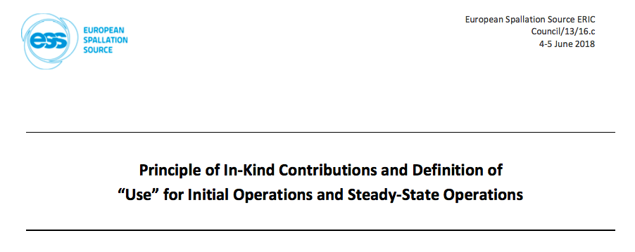
In-Kind in Operations
Principles presented to and approved by Council#15 – 19/02/2019

Slide 13
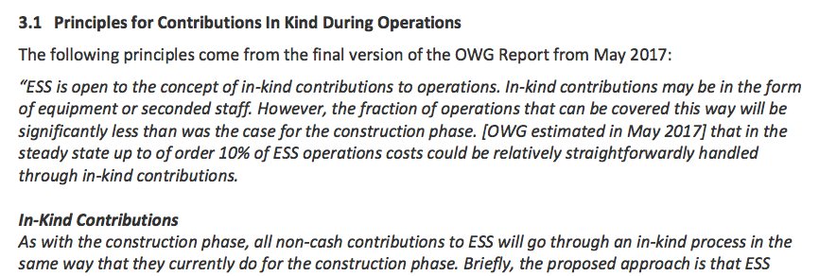
In-Kind in Operations
Principles presented to and approved by Council#15 – 19/02/2019

Slide 14
In-Kind Contributions @ ESS
Facts & Figures

Slide 15
IK Status
Key Points
To date
242 M€ (85 TAs) approved by Council (including 19 accredited).
132 M € (44 TAs) endorsed by IKRC.
Almost all IK for Accelerator, ICS and Target
is approved by Council or endorsed by IKRC.
2015
2017
Ongoing
156 M€ to be agreed for NSS – mostly Instruments
(Sample Environment + Neutron Technologies)
Agree 4 remaining IKCAs; STFC (UK), ESS Bilbao (ES), CNR (IT) and LLB (FR).
Following 15th Council approval of IK Principles, next step is to establish Procedures for IK Contributions during Operations
End of ESS Construction
550 M€ estimated IK.
Additional c.26 M€ in collaborations (SE/DK) and c.15 M€ in direct contracts placed with German Institutes.

Slide 16
IK Status
Status of Agreements

Slide 17
Yearly progress of In-Kind
Instruments

Slide 18
In-Kind Contributions @ ESS
Conclusions

Slide 19
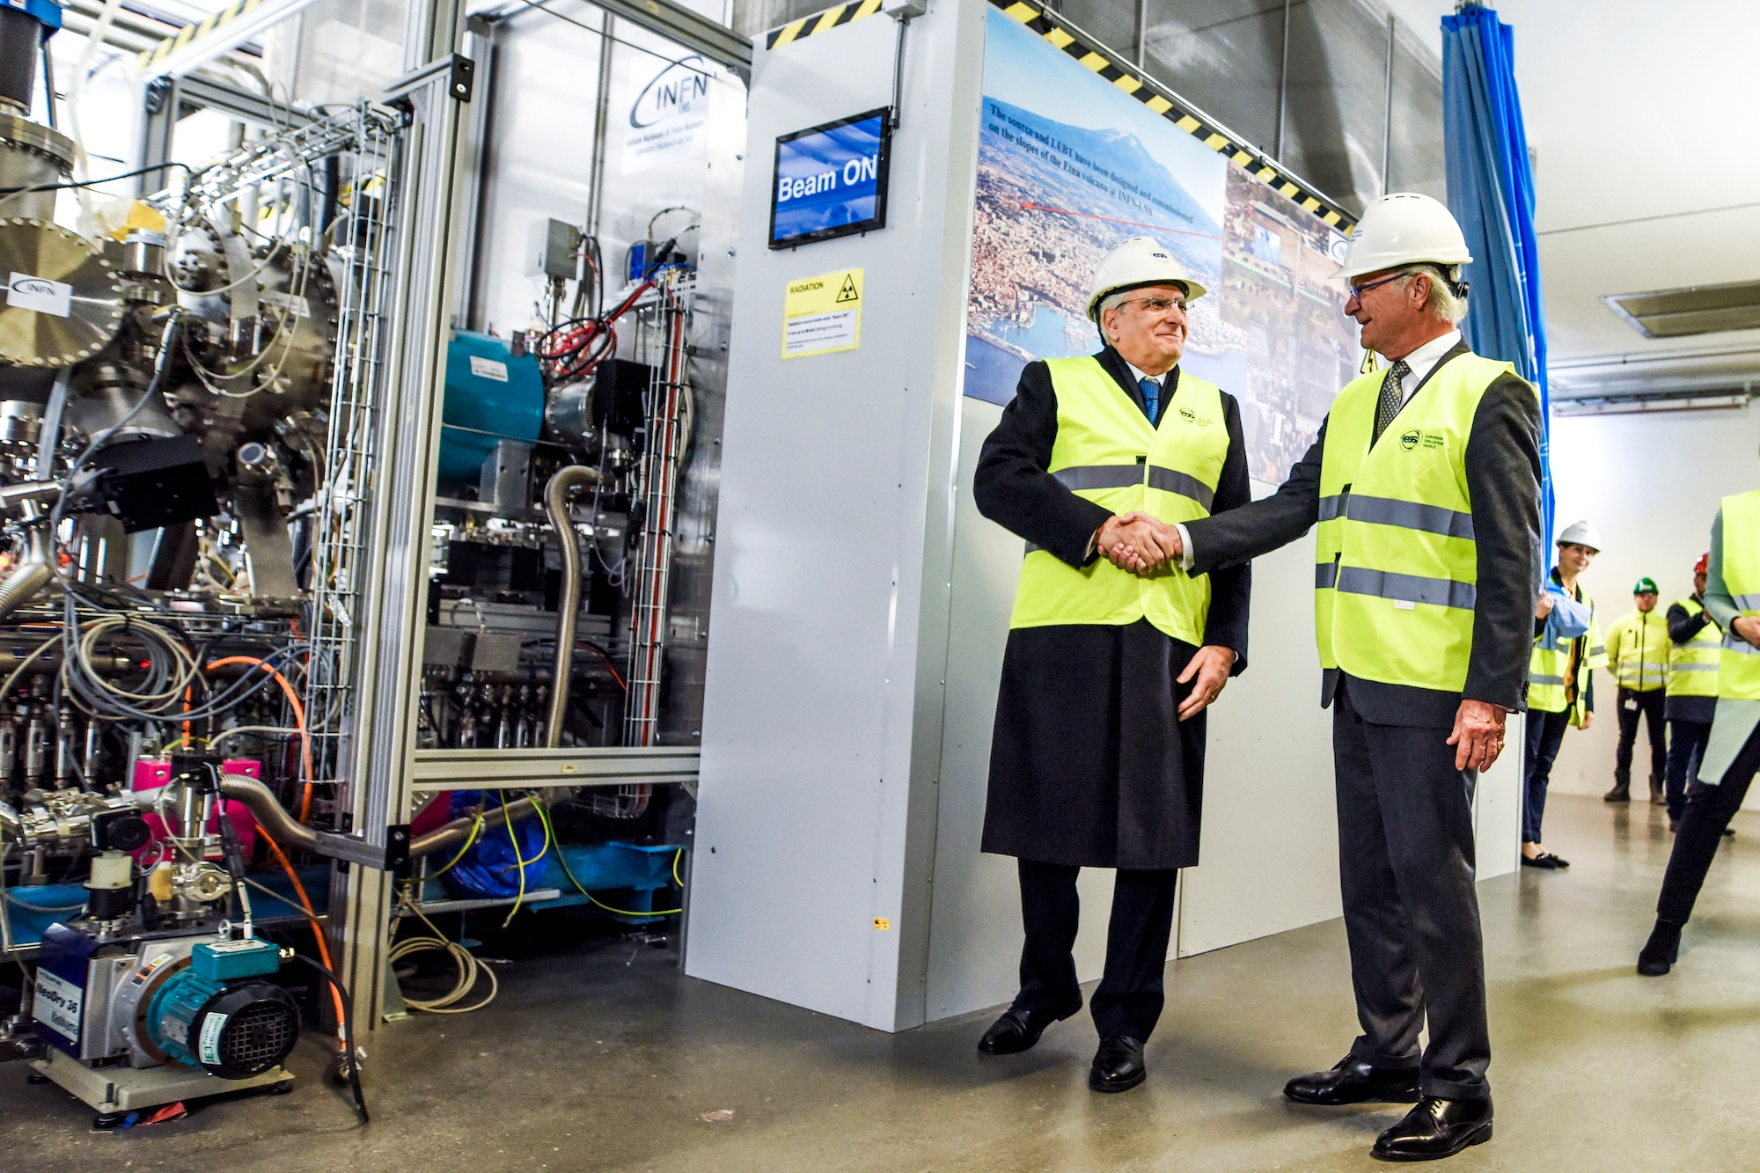
Conclusions
New management for and special focus to IK
Alignment of IK to implementation
IK during Operations being established
Specific issues to be solved (VAT, etc.)

Slide 20
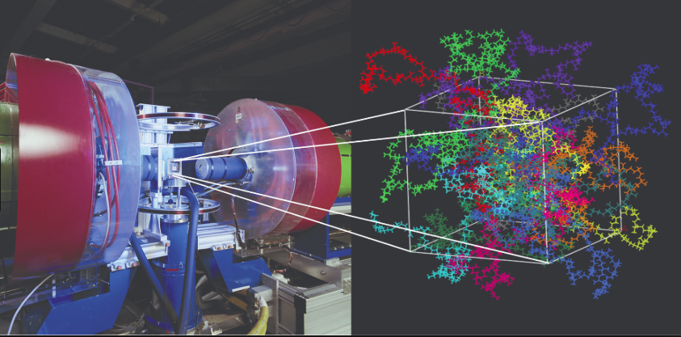
The commitment
ESS In-Kind System
is fully committed to achieve
FIRST SCIENCE in 2023

Slide 21
Thank you!
Mauro.Zambelli@esss.se

