Slide 1


IKC in operations and potentials for co-creation
Mauro Zambelli (ESS), Anna Hall (Big Science Sweden),
Milos Davidovic (ESS)

Slide 2
AGENDA
Intro to session (Anna Hall)
IKC in construction phase & short IKC in OPS (Mauro Zambelli)
In-kind Contribution - 4 examples
(Ghaleb Natour (DE), Dariusz Bocian (PL), Christof Niedermayer (CH), Carol Watts (UK))
  Brief introduction of organization, key in-kind contributions, involvement as ILO
  Benefits of IKC for the partner country and the contributing organization
  Challenges associated with IKC
Intro Co-creation & Tech transfer - In-kind is the Top of techtransfer: RI-Institute-University-Industry (Mauro Zambelli)
Workshop/Round table discussions
Results (30 min)
Summing up (5 min)

Slide 3
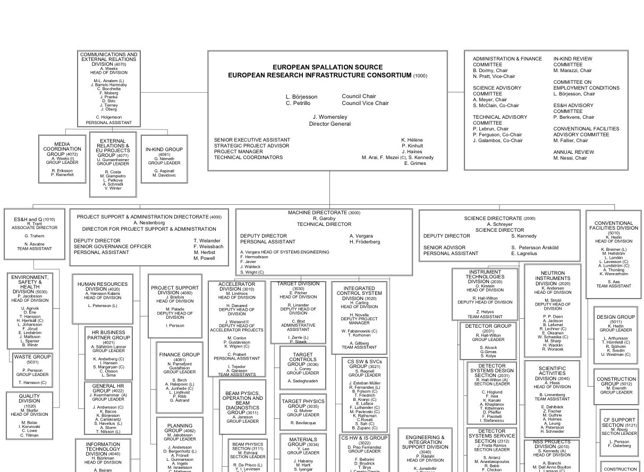


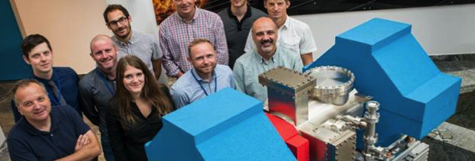
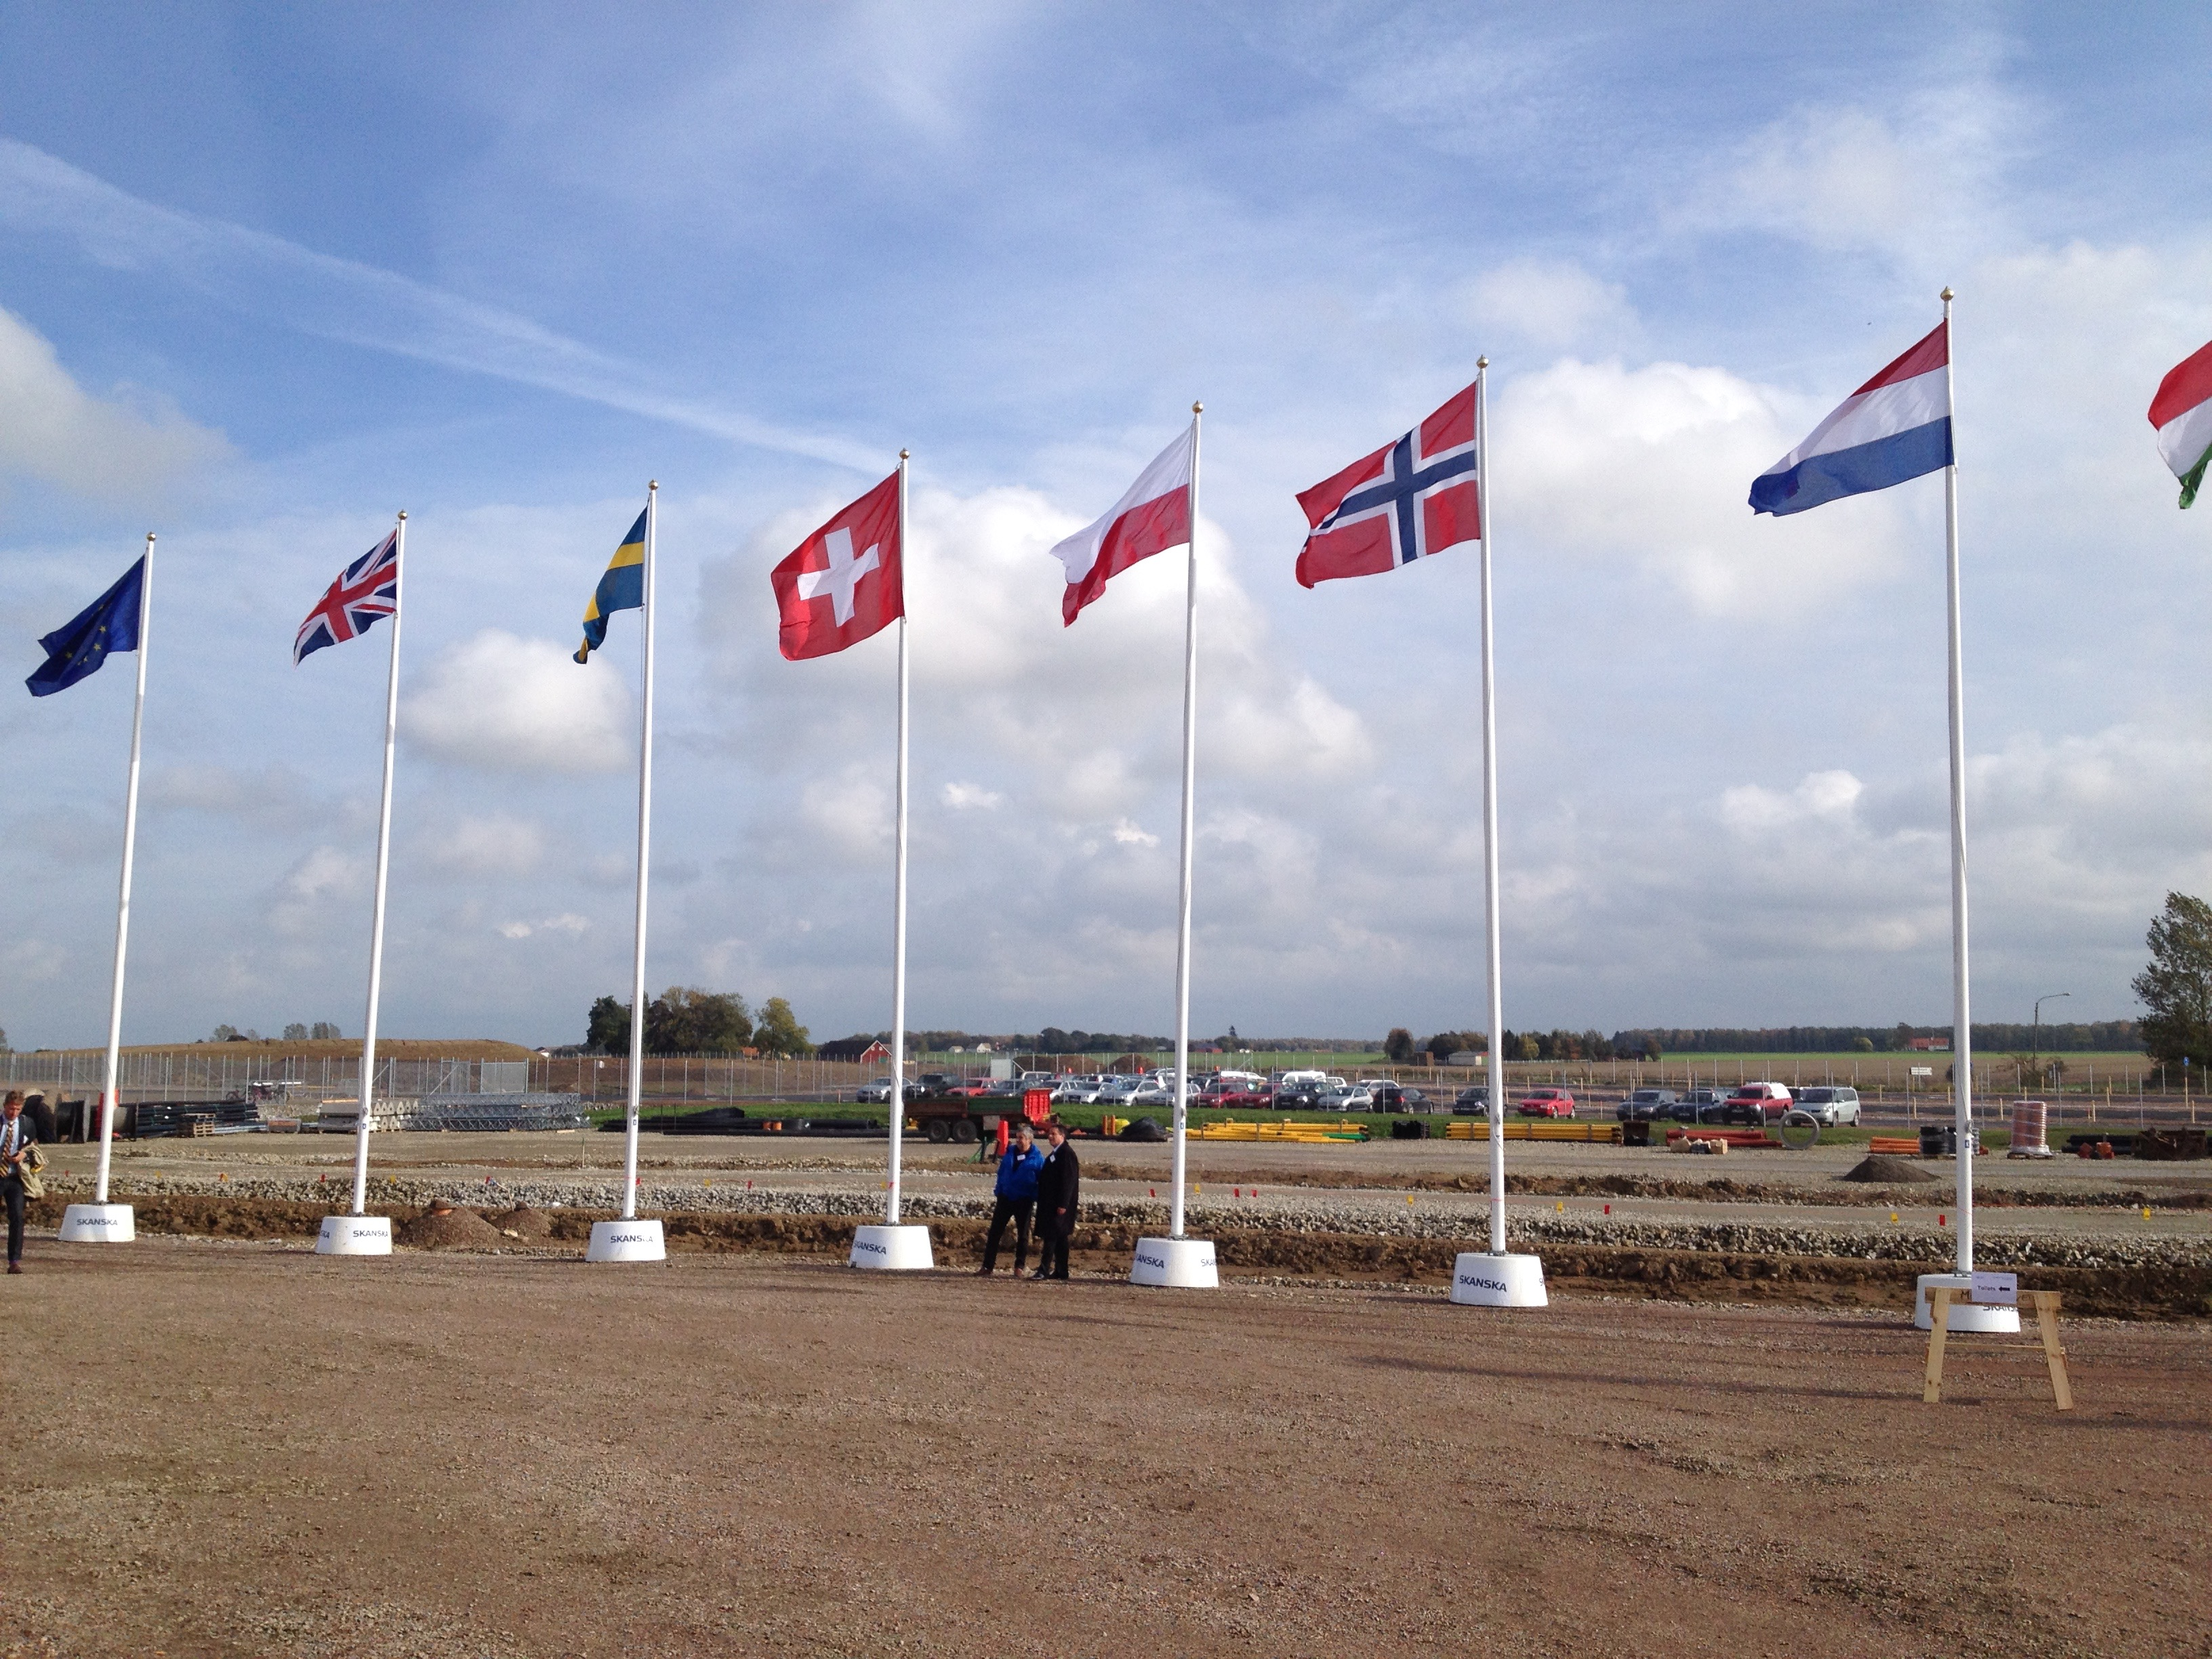
Organisation and People
~ 470
Employees
48
Nationalities
~ 100
Collaborating Institutions
Notes:
Updated September 2017

Slide 4













Unique international project
How will it be built?
Aarhus University
Atomki - Institute for Nuclear Research
Bergen University
CEA Saclay, Paris
Centre for Energy Research, Budapest
Centre for Nuclear Research, Poland, (NCBJ)
CNR, Rome
CNRS Orsay, Paris
Cockcroft Institute, Daresbury
Elettra – Sincrotrone Trieste
ESS Bilbao
Forschungszentrum Jülich
Helmholtz-Zentrum Geesthacht
Huddersfield University
IFJ PAN, Krakow
INFN, Catania
INFN, Legnaro
INFN, Milan
Institute for Energy Research (IFE)
Rutherford-Appleton
Laboratory, Oxford(ISIS)
Copenhagen University
Laboratoire Léon Brillouin (CEA/CNRS/LLB)
Lund University
Nuclear Physics Institute of the ASCR
Oslo University
Paul Scherrer Institute (PSI)
Polish Electronic Group (PEG)
Roskilde University
Tallinn Technical University
Technical University of Denmark
Technical University Munich
Science and Technology Facilities Council
UKAEA Culham
University of Tartu
Uppsala University
WIGNER Research Centre for Physics
Wroclaw University of Technology
Warsaw University of Technology
Zurich University of Applied Sciences (ZHAW)
Host Countries Sweden and Denmark
Construction 47.5% Cash Investment ~ 97%
Operations 15%
Non Host Member Countries
Construction 52.5% In-kind Deliverables ~ 70%
Operations 85%
JOINT COMMITMENT
JOINT INVESTMENT
COLLABORATION
PARTNER LABS
& UNIVERSITIES
13 EUROPEAN MEMBER COUNTRIES

Slide 5
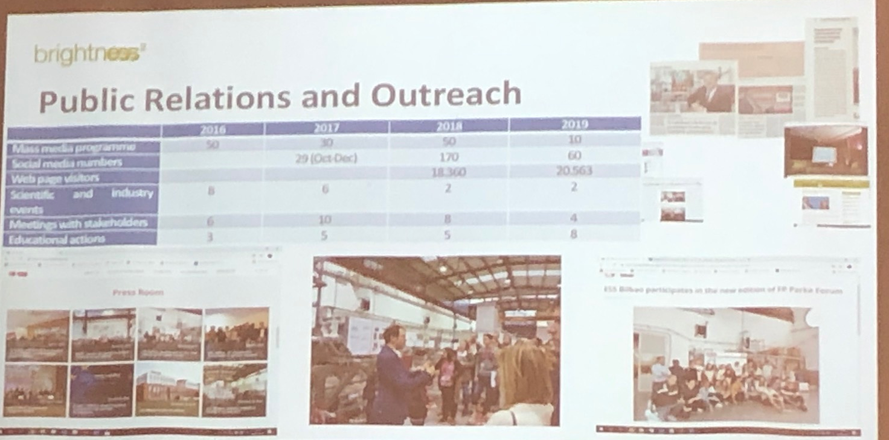
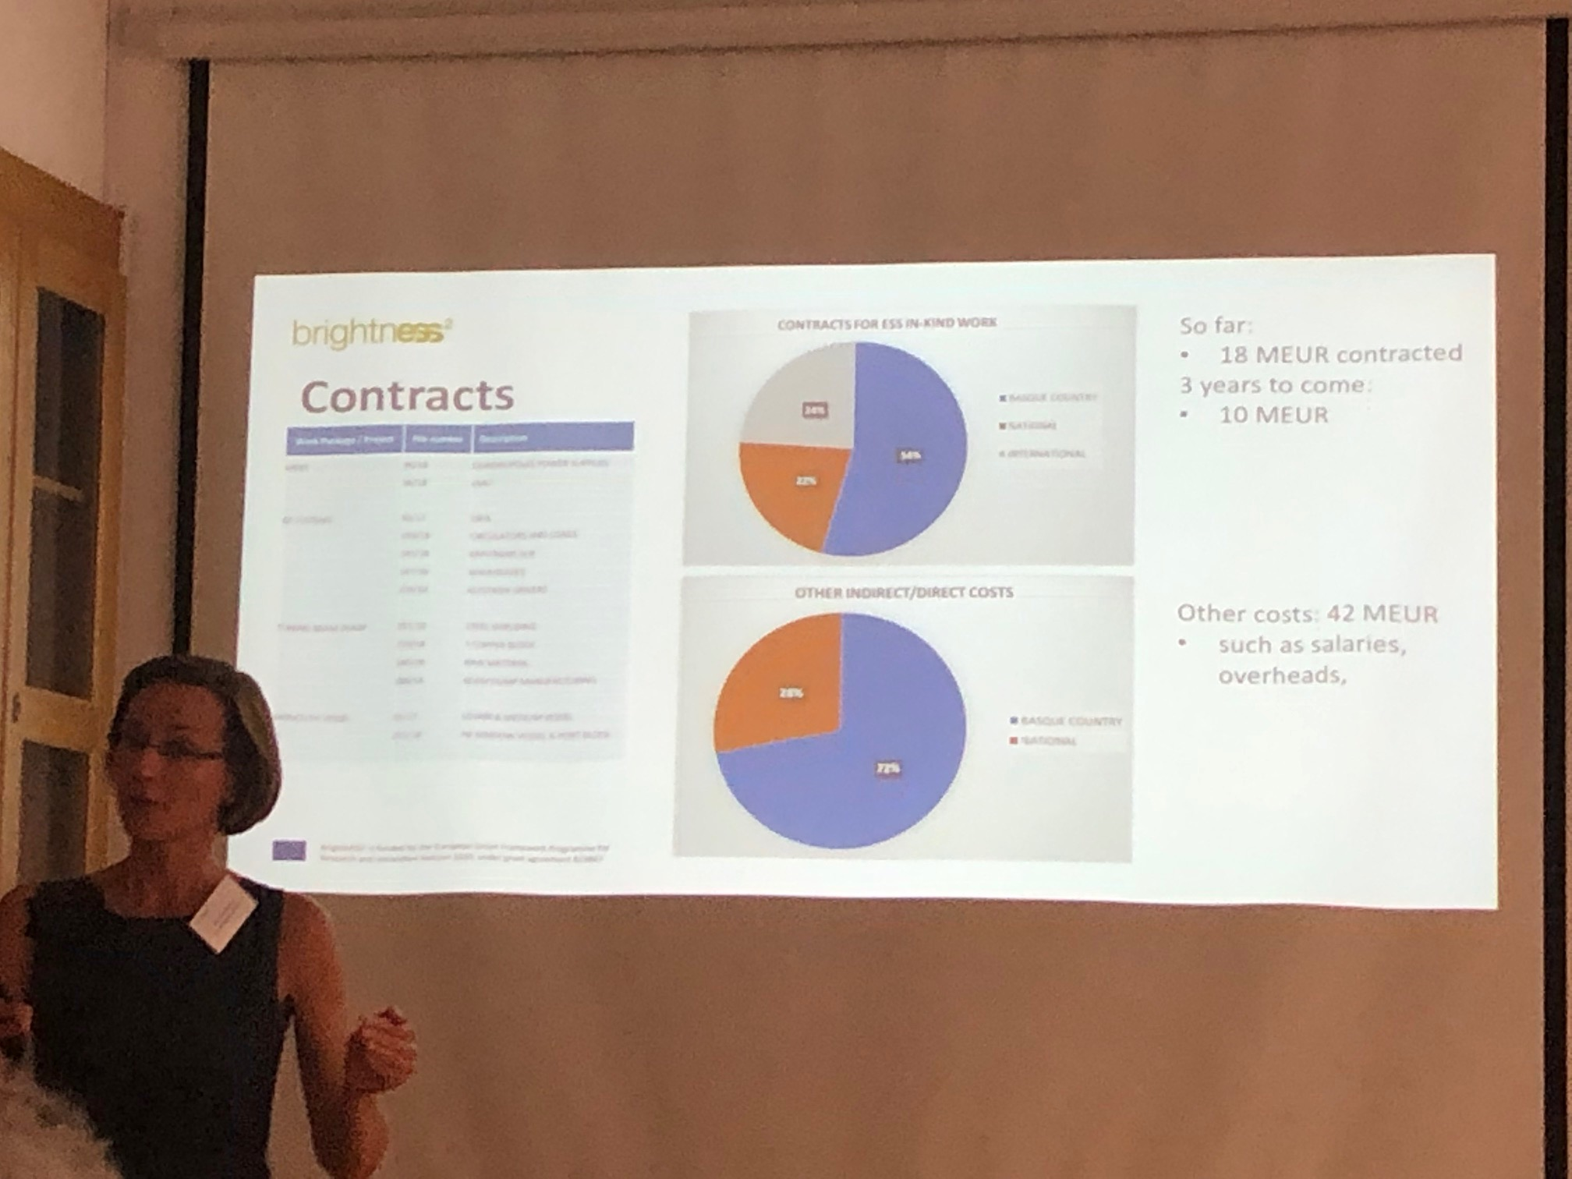
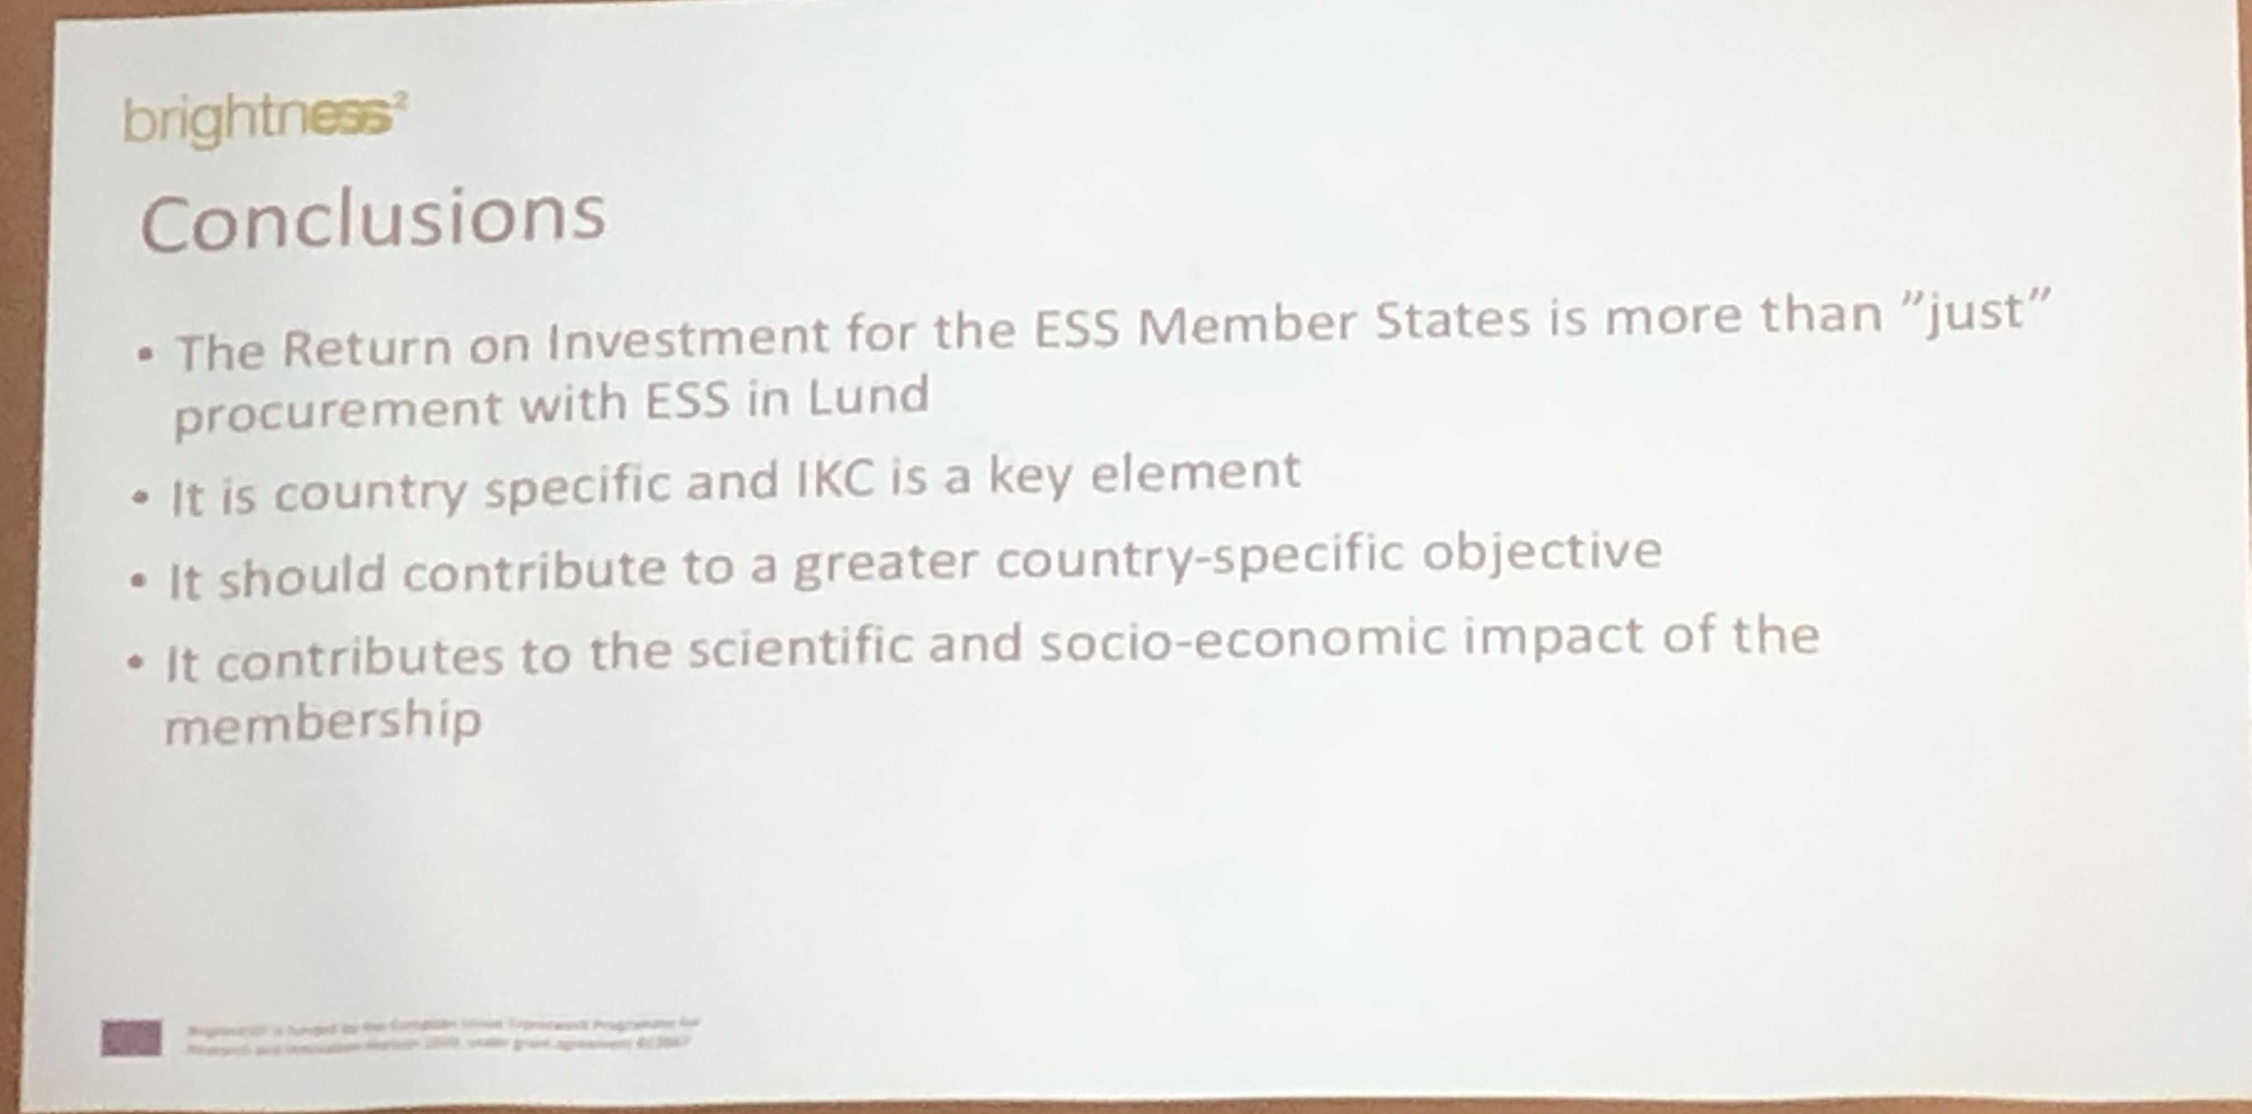
Spain

Slide 6
Organisation and Industry Engagement
Industry as supplier
Industry as user
Tech transfer
In-kind contribution
Innovation Ecosystem
Other…?

Slide 7
AGENDA
Intro to session (Anna Hall)
IKC in construction phase & short IKC in OPS (Mauro Zambelli)
In-kind Contribution - 4 examples
(Ghaleb Natour (DE), Dariusz Bocian (PL), Christof Niedermayer (CH), Carol Watts (UK))
  Brief introduction of organization, key in-kind contributions, involvement as ILO
  Benefits of IKC for the partner country and the contributing organization
  Challenges associated with IKC
Intro Co-creation & Tech transfer - In-kind is the Top of techtransfer: RI-Institute-University-Industry (Mauro Zambelli)
Workshop/Round table discussions
Results (30 min)
Summing up (5 min)

Slide 8
In-kind Contribution - examples
Ghaleb Natour (DE),
Dariusz Bocian (PL),
Christof Niedermayer (CH)
Carol Watts (UK)
  Brief introduction of organization, key in-kind contributions, your involvement as ILO
  Benefits of IKC for the partner country and the contributing organization
  Challenges associated with IKC

Slide 9
Workshop/Round-table Discussions
What are the best practice for political/ Scientifical/ Industrial infrastructure enabling smooth in-kind contribution?
A. What are the best practice for political/ Scientifical/ Industrial infrastructure enabling smooth tech transfer/Co-creation?
B. What can you do to create avenues of opportunity for technology co-creation in your Communities/Countries/Regions?

Slide 10
Summing up

