Slide 1
ESS ILO Strategy Workshop BrightnESS² / WP 4
Budapest, 24 / 25 June 2019

Slide 2
Historical Overview
ESS / ILO Inter-actions
Autumn 17 Set-up of ESS-ILO (CH/NO/SE) WG on Impl. of Proc. Rules
01 March 18 Presentation of results at ILO meeting
Autumn 2018 ESS proposal for TOR + iteration with ILOs
05 March 19 No formal ILO response during reg. ILO meeting
April 19 ILO Letter to AFC
BrightnESS 1 + 2 Activities
March 18 ILO Survey for B-2 submission
28/29 June 18 1st Strategy Workshop in CPH
August 18 BrightnESS² award
January 19 Project start
05 March 19 Presentation at 12th ILO meeting

Slide 3
Agenda
Day 1
Session 1 / ESS Procurement: Rules and Results
Session 2 / IKC in operations and potential for co-creation
Day 2
PERIIA
Terms of Reference
Session 3 / Long-term education activities

Slide 4


Setting the Scene / Example Spain
Pathways for socio-economic impact assessment of RIs in the framework of H2020 project ACCELERATE (co-ordinator CERIC)
Collaboration with Dutch Rathenau-Institute
Pilot: assessing the socio-economic impact of Spanish IKC
Collaboration with Spanish IKC partner ESS Bilbao

Slide 5

Spanish IKC contribution through ESS Bilbao
ESS Bilbao:
public consortium of Central and Basque Governments
2018-2025: manage the ES contribution to the construction of the ESS.
April 2018: Spain became a full member
Contribution of 3% = 55,29 M€₂₀₁₃ / 90% In-kind (49,76 M€) and 10% cash (5,53 M).

Slide 6
ESS Bilbao: Vision and Mission
VISION
To become a centre of excellence in particle accelerator and neutron scattering science and technologies by leveraging our In-Kind Contribution works on the European Spallation Source project.
MISSION
To achieve this Vision, ESS Bilbao´s Mission revolves around the following three goals:
To promote the generation of knowledge in neutron technologies in the widest sense, from the accelerator to the target and instruments.
To achieve excellence in the fields of neutron science and technologies, taking a position as a centre of international standing.
To contribute to the European Spallation Source project while simultaneously seeking to participate in other projects so as to guarantee our long-term sustainability beyond 2025.

Slide 7
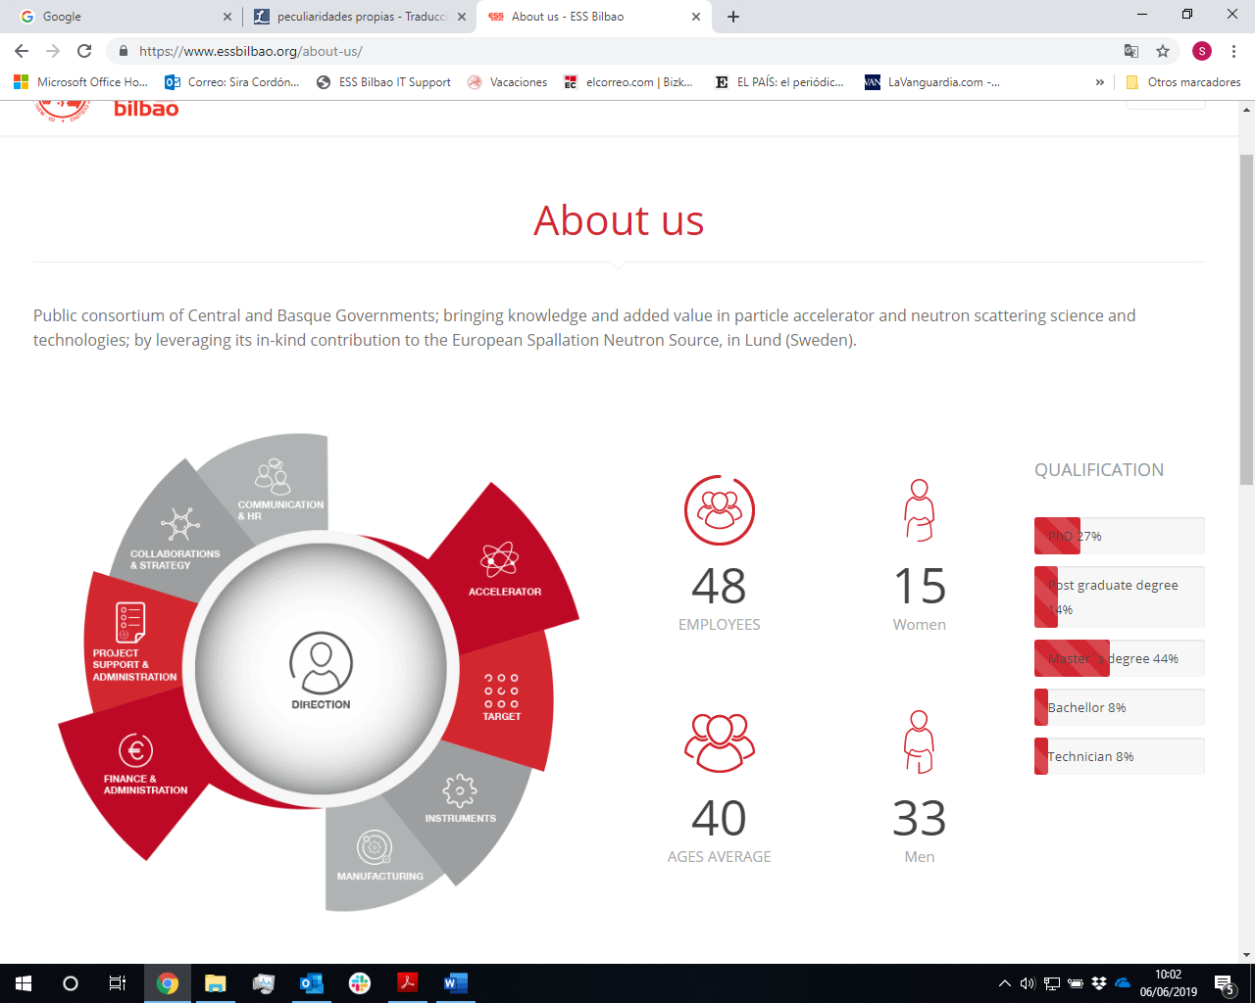
Staff

Slide 8
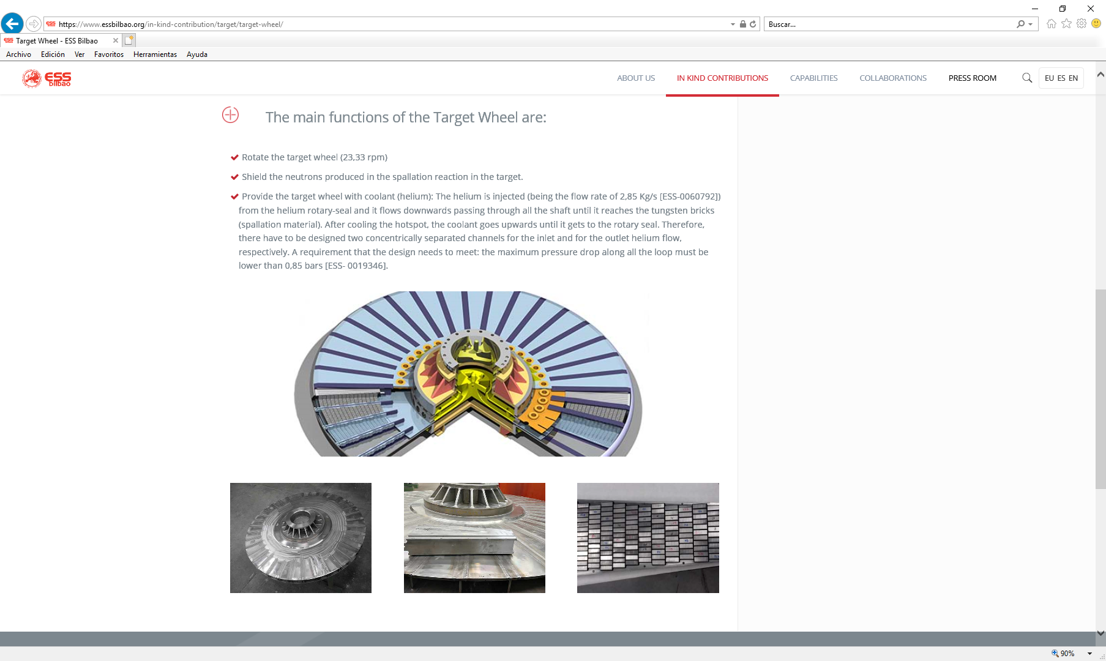
Split of Spanish IKC

Slide 9
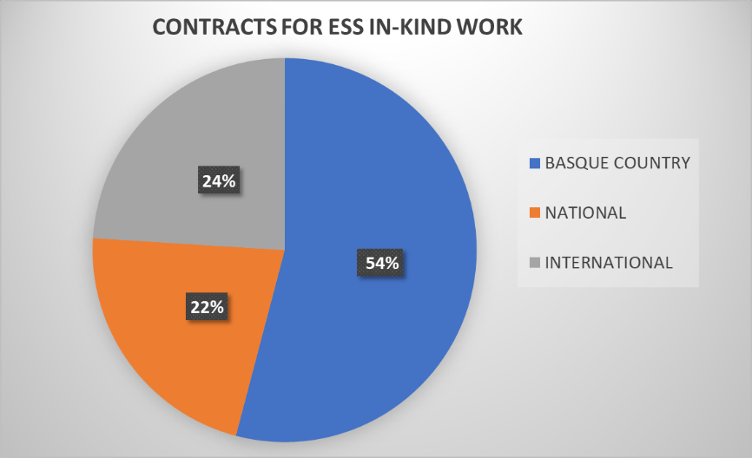
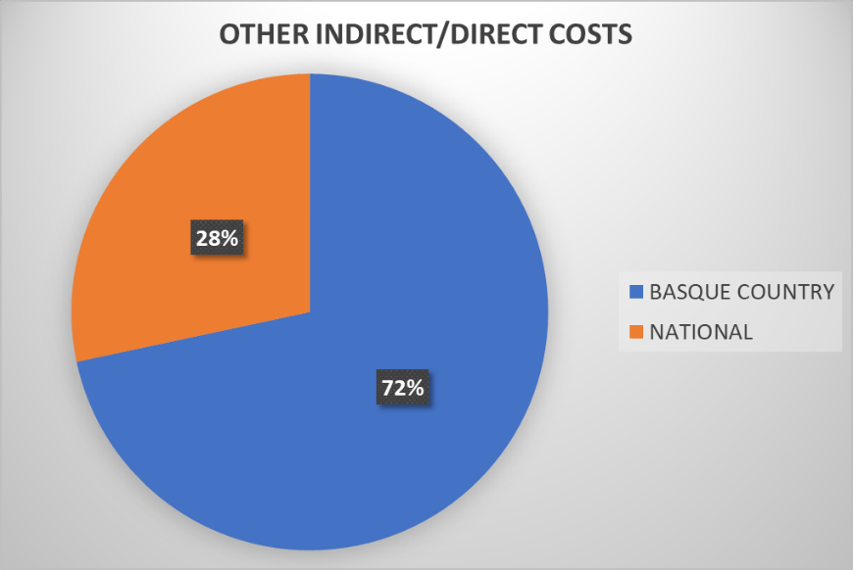
Contracts
So far:
18 MEUR contracted
3 years to come:
10 MEUR
Work Package / Project | File number | Description
MEBT | 84/18 | QUADRUPOLES POWER SUPPLIES
 | 86/18 | EMU
RF SYSTEMS | 93/17 | SSPA
 | 193/18 | CIRCULATORS AND LOADS
 | 145/18 | KRYSTRONS (x3)
 | 147/18 | WAVEGUIDES
 | 229/18 | KLYSTRON DRIVERS
TUNING BEAM DUMP | 157/18 | STEEL SHIELDING
 | 159/18 | T COPPER BLOCK
 | 180/18 | RAW MATERIAL
 | 188/18 | BEAM DUMP MANUFACTURING
MONOLITH VESSEL | 61/17 | LOWER & MEDIUM VESSEL
 | 251/18 | PB WINDOW VESSEL & PORT BLOCK
Other costs: 42 MEUR
such as salaries, overheads,

Slide 10
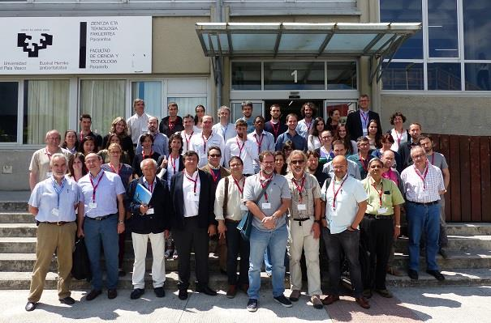
Scientific Impact
 | 2016 | 2017 | 2018 | 2019
Number of scientific publications (JCR) | 5 | 4 | 9 | 1
Conference proceedings | 4 | 6 | 5
Oral presentation in conferences | 2 | 1 | 3 | 1
Number of PhD theses |  | 2 | 1
Number of Master Thesis | 1 |  | 1
The Spanish institutions are, mainly: University of Castilla La Mancha UCLM; Politechnic University of Madrid, UPM; Centro Superior de Investigaciones Científicas, CSIC, Madrid; Instituto de Fusión Nuclear IFN, Madrid; Research Institute CEIT-IK4, San Sebastián; ALBA-CELLS, Barcelona; University of Córdoba; TECNUN-University of Navarra;
Also, the foreigner institutions are: ISIS Facility, Rutherford, STFC, United Kingdom; University College, United Kingdom; ILL, Grenoble, France; CERN, Geneva, CH; INFN-LNS, Catania, Italy; Catania University, Catania, Italy; University of Jyväskylä, Finland; CNRS-SPCTS, Limoges, France; Max-Planck-Institute, Germany; ESS ERIC, Sweden, and the colleagues involved in the construction of the facility at Lund.

Slide 11
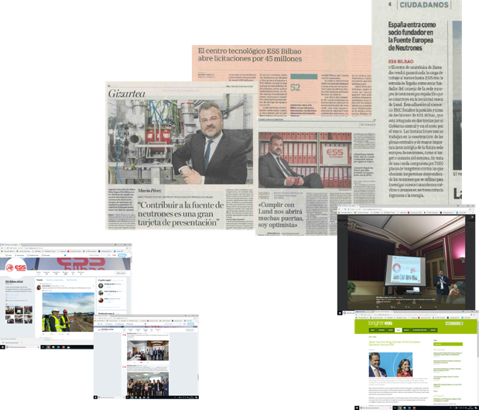
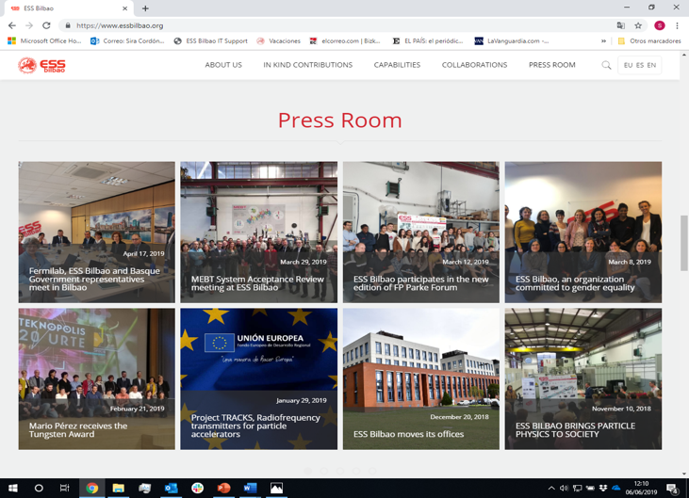
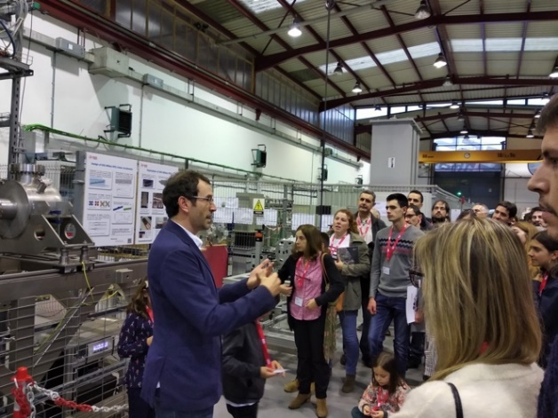
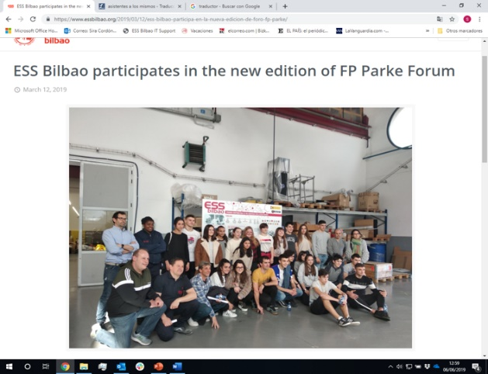
Public Relations and Outreach
 | 2016 | 2017 | 2018 | 2019
Mass media programme | 50 | 30 | 50 | 10
Social media numbers |  | 29 (Oct-Dec) | 170 | 60
Web page visitors |  |  | 18.360 | 20.563
Scientific and industry events | 8 | 6 | 2 | 2
Meetings with stakeholders | 6 | 10 | 8 | 4
Educational actions | 3 | 5 | 5 | 8

Slide 12
Conclusions
The Return on Investment for the ESS Member States is more than ”just” procurement with ESS in Lund
It is country specific and IKC is a key element
It should contribute to a greater country-specific objective
It contributes to the scientific and socio-economic impact of the membership

