Slide 1
Quality assurance for diagnostics
Clement Derrez
Beam Diagnostics
European Spallation Source ERIC
2019-10-03

Slide 2
Diagnostics overview
Present count of equipment:
Diagnostic systems: 514
466 diagnostic systems with ~µs protection capability
22 types of beam diagnostic systems
Beamline elements: 1008
~ 50 equipment racks in gallery
MTCA crates: 77
Electronics: 1143
~ 10000 tracked assets
We focus in this talk on traceability and data flows

Slide 3
Diagnostics overview
Tunnel: 514 diagnostic systems shown in synoptic display
Stubs: 1740 long-haul cable runs (ion chamber BLM cables highlighted)
Gallery: 2260 named devices (rack-mounted electronic devices for ion chamber BLM highlighted)

Slide 4
Naming tool and assets
What is an asset?
Every unique component or piece of equipment we want to keep track on.
Assets can be coupled to FBS-nodes, but they do not have to be.
Assets are beam line equipment, electronics, lab equipment, tools, etc…
Assets can be created as placeholders before they are bought and delivered.
FBS structure for PBI systems now:
Level 1: Instrument type (e.g. Beam current monitors)
Level 2: Control group (All equipment that is controlled and powered together)
Level 3: Individual diagnostic systems (e.g. LEBT BCM), Control systems in rack
Level 4: Beam line elements, Rack mounted crates, Cables
Level 5: Sub-components (e.g. uTCA-mounted cards)

Slide 5
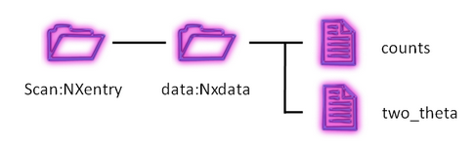
Intro to EAM
Every Field Replaceable Unit (FRU) is named as an asset. It can be a simple part or an assembly.
EAM as central tool
  Data export / import with other software tools
  Ensures traceability between tests and production data,
  system components and laboratory devices.
  Systems and subsystems tests results coming from
  different locations (ESS, IK Partner, commercial partners…)
  SciCat is a good candidate to complete EAM
Data files format: NeXus on top of HDF5
  Files, groups and datasets minimum mandatory
  attributes are defined
Code on github
EAM
Labels
System FRUs list
Tests report
Test plan
Laboratory devices
FBS, LBS
Data (scicat)
CHESS

Slide 6
Data files format
File attributes
  Field Replaceable Unit Manufacturer Serial number
  Production date (%Y-%m-%d)
  Measurement date (%Y-%m-%d-%Hh%Mm%Ss GMT)
  Operator name
  Facility / institute name (Where was the measurements performed: lab name or so)
Group attributes (NXentry → NXdata):
  NX_Class: NXentry or NXdata
  Possible sweep conditions
  Data type: Measurement data or Calculated data
  Device Channel Number: A channel group will be created for each available channel
Dataset attributes:
  Experimental setup devices: tag to be able to trace data back to the device(s) that were used to obtain this data.
  Physical Units
  Sample rate Hz
  Trigger samples (represents the number of samples which have been recorded due to a trigger event)
  For deployed FRUs: PV name
  Fw, Sw versions
  For EAM assets: Asset ID
  For Systems level measurement: ESS System name
  Measurement timestamp
Examples available, support at https://confluence.esss.lu.se/display/PBITECH/Systems+status+and+data+files+definition & http://download.nexusformat.org/doc/html/introduction.html
Notes:
Firmware versions informations

Slide 7
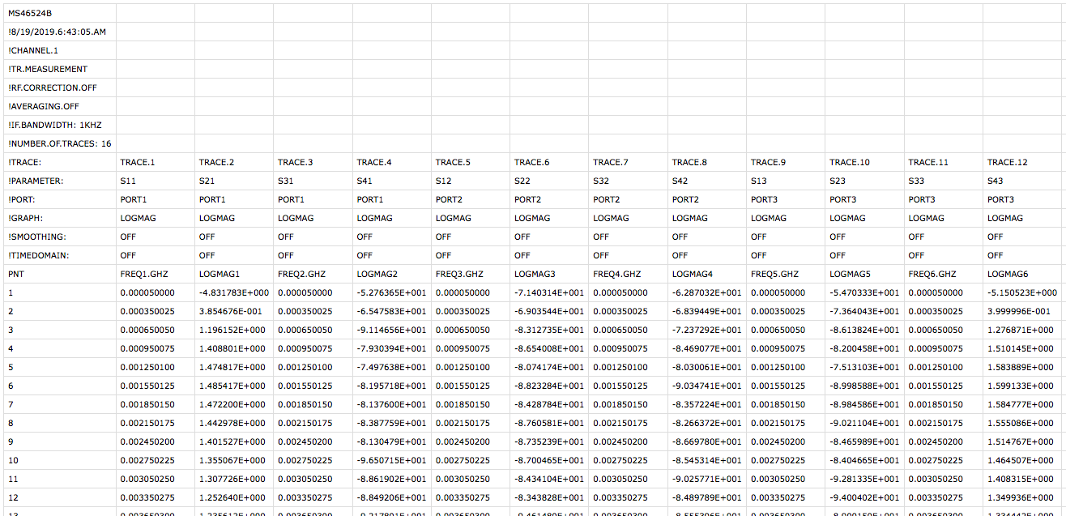
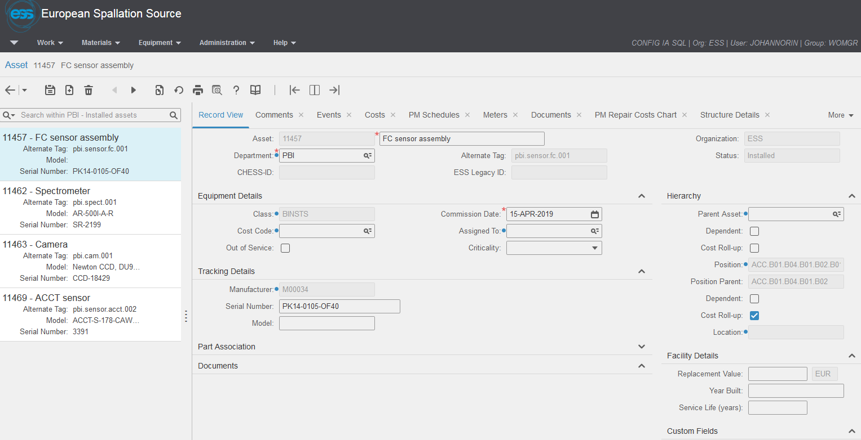
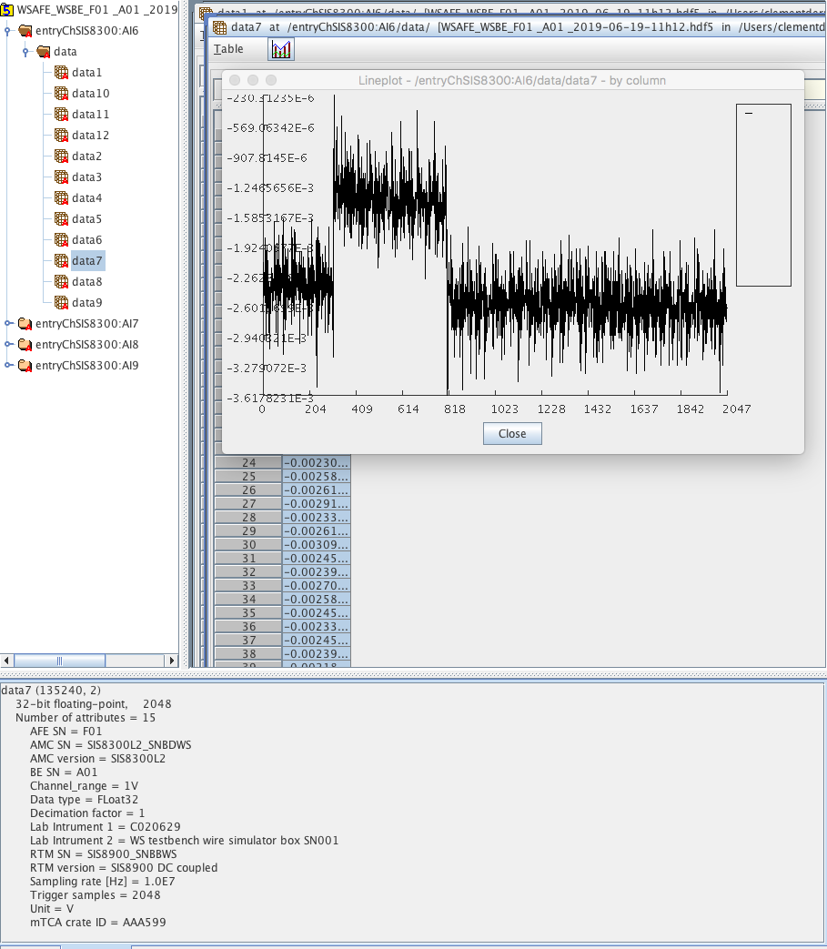
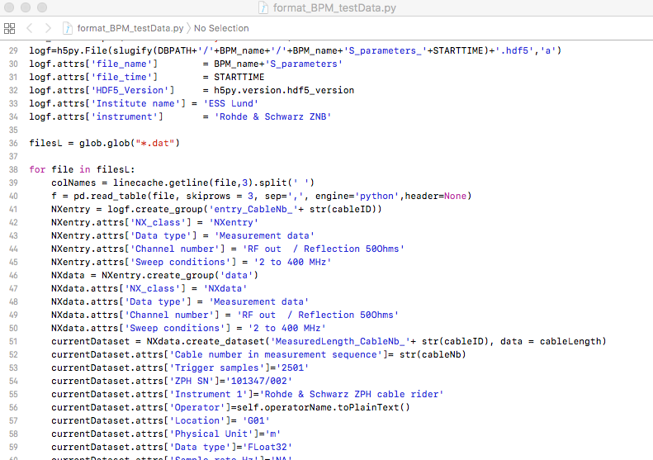
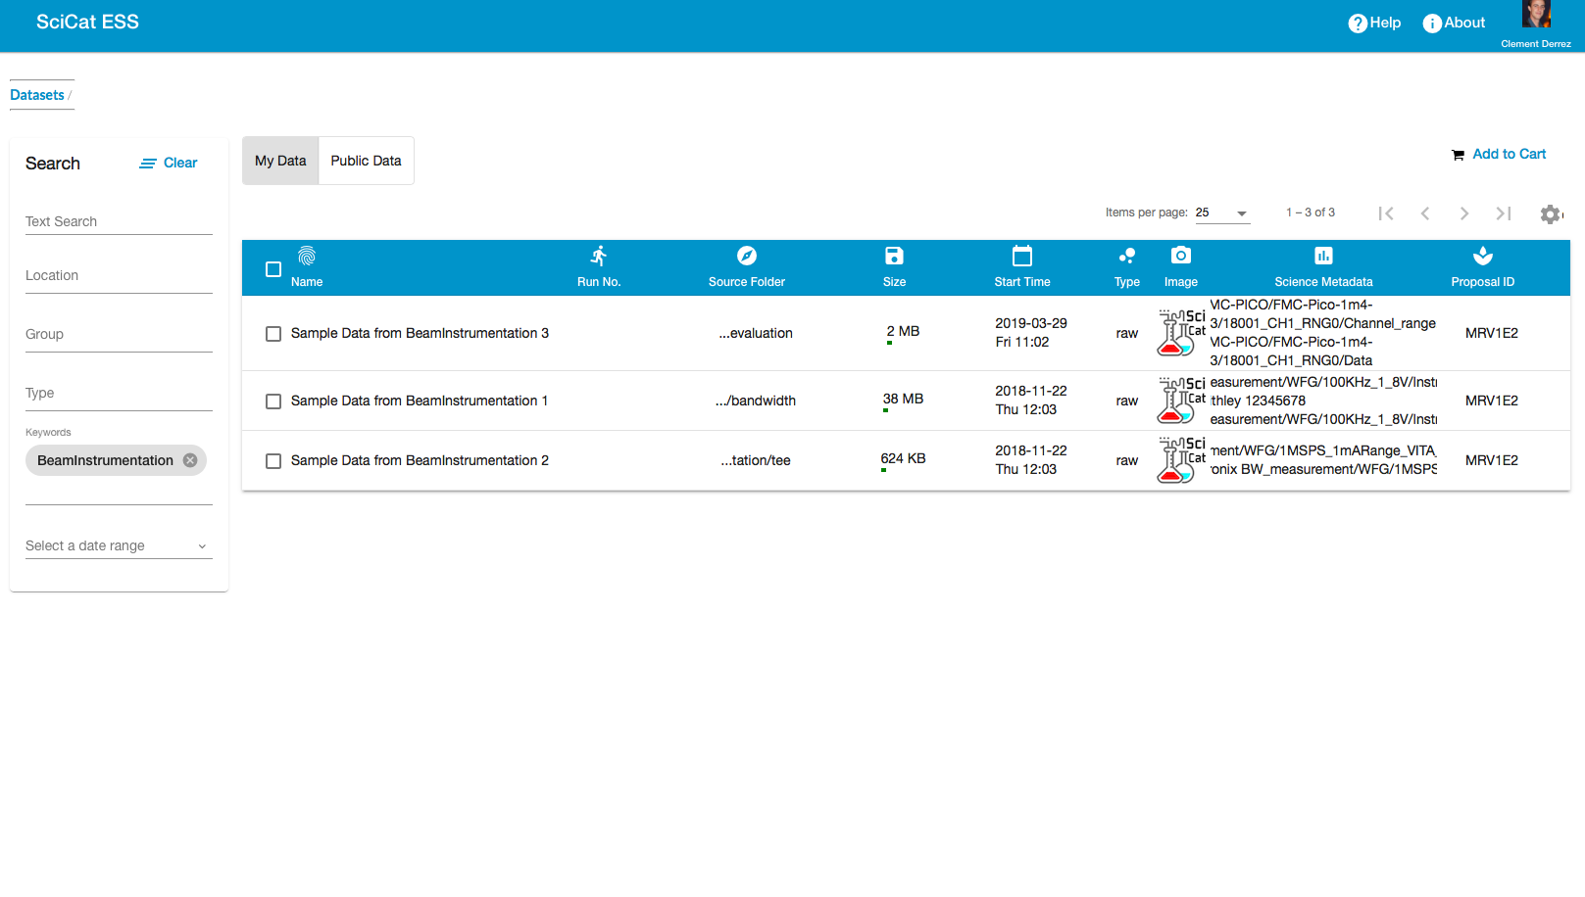
Diagnostics Data flow
Data source
Data source
ESS User
Data flow
Ext. ESS
Test Bench at ESS
Assets management
https://confluence.esss.lu.se/display/PBITECH/Systems+status+and+data+files+definition
Expert User
Reformatting
EAM
QR Scanning tool
ESS User
Meas01
SciCat
Embedded HDF viewer
Data storage
Cataloguing
Notes:
Test benches produce data from the lab and the tunnel, from single unit acceptance to instruments cold check out.
Data is stored in hdf5 format in meas01, files definition can be found in https://confluence.esss.lu.se/display/PBITECH/Systems+status+and+data+files+definition
Beam Diagnostics folders in meas01 are automatically analysed and catalogued by SciCat
A custom field in EAM links assets to their data, visualized in SciCat.

Slide 8
Diagnostics systems acceptance workflow
System requirements
System Verification plan
Validation of verification plan
System requirements are analyzed for each system and its components
Verification document is validated by system lead: we make sure test requirements are correctly translated
Test coverage is reviewed.
Describes subsystems' test setup and characterization procedures
Tests IDs defined for each measurements
When not COTS: test plan is prepared/discussed and agreed with IK partner
Run tests
Acceptance tests performed in BI lab, possibly compared with IK results.
System verification performed after installation, without beam and with beam from the LCR
Assets are received, labelled
Assets are tested before reception at ESS, results are exchanged with ESS BD
CHESS
meas01
EAM
Metech
EAM
System hand over

Slide 9
Diagnostics systems acceptance - Experience
ISRC-LEBT verification done 90 % “manually”. Often skipping steps in the workflows to reach partial availability. Leads to a significant amount of work still needed now.
Practically: Test framework needed, in development and python based
More automated benches needed for gallery & lab, including scalable ECAT based systems.
Standard sequencer tool: WeTest is the main candidate

Slide 10
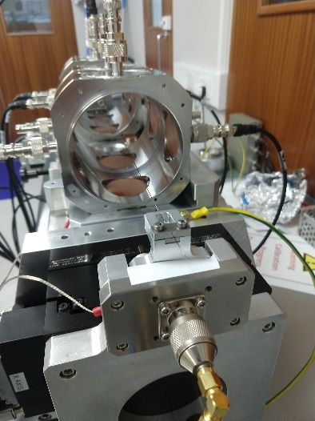
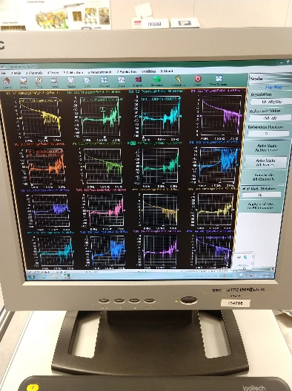
Diagnostics Data flow - examples
Data traceability (large amount of data from external sources)
Completing verification plans at ESS after delivery
IK support after delivery
Even if it works it does not mean it is reliable
Examples where traceability/documentation has been critical already: LEBT Chopper, MEBT BPM, LWU BPM...
Manufacturing
FRU TEST
Integration
System test
REWORK
Shipment to ESS
Tests at ESS
ISSUE detected
Notes:
BPMs on their way to ESS:
Manufacture the feedthroughs - DESY
Perform vacuum tests, RF tests on the feedthroughs - DESY
Weld the feedthroughs on the BPM body - DESY
Test the complete BPM assembly with 4 buttons -DESY
Ship the BPM to STFC Daresbury
Daresbury performs BPM wire mapping in some BPM’s
Weld the BPM into the LWU - Daresbury
Perform vacuum and RF tests on the BPM after welding – Daresbury
Ship to ESS
ESS performs vacuum and RF tests on LWU’s.

Slide 11
EAM – Single asset view
Data - Scicat
Status

Slide 12
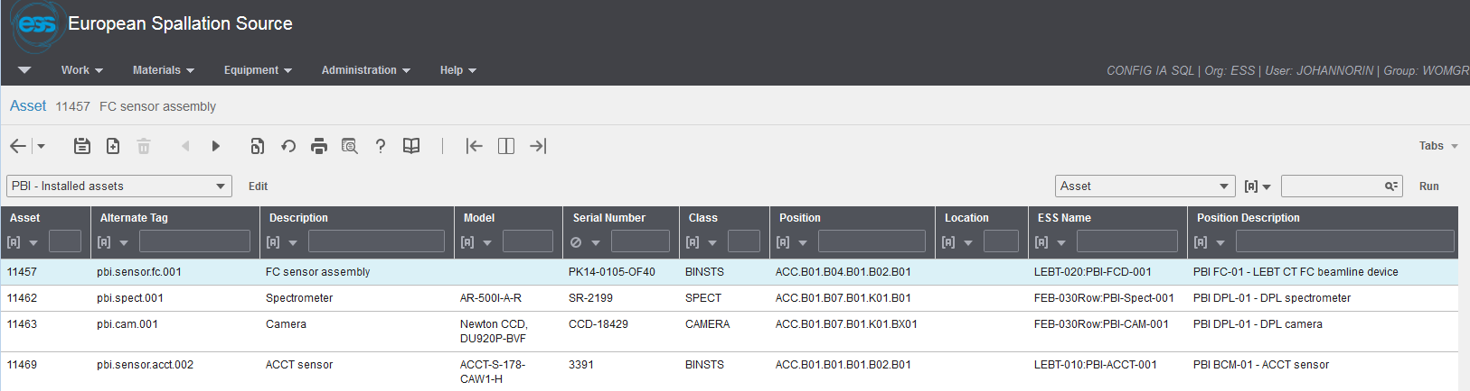
EAM – Asset table view
Automatically populated from FBS

Slide 13
Labels
Label requirements are described in ESS-0094091, ”ESS Generic Requirements for Marking and Labelling”.
Asset labels and FBS labels are not the same.
EAM will have a asset label ordering service, but it does not exist yet.
Discussions are ongoing on which label sizes that are needed. There will eventually be a number of templates for asset labels.
Examples:
  Really small (5 mm x 12 mm) for uTCA cards and similar.
  Small (11 x 12 mm) for rack equipment.
  Larger (30 mm x 30 mm) for tunnel equipment that must be read from a distance.

Slide 14
EAM: Thoughts and experiences
EAM is an excellent LBS and FBS viewer. Far superior to chess.
EAM is mainly intended for running and maintaining ESS. It is not an installation tool.
Neither the program itself nor the data is final. Functionality is still worked upon. We are in a start-up phase.
Development is going on: data storage links, user classes, status field, parallel hierarchies…

Slide 15

Questions?

Slide 16
Diagnostics overview
Variant | System | ISrc | LEBT | RFQ | MEBT | DTL | Spk | MBL | HBL | HEBT | DMPL | A2T | Target | Sum | Tunnel | Gallery
APTM | APTM |  |  |  |  |  |  |  |  |  | 1 | 1 | 2 | 4 | 9 | 10
BCM | BCM | 1 | 1 | 1 | 2 | 5 |  | 1 | 1 | 2 | 2 | 3 |  | 19 | 57 | 79
FBCM | BCM |  |  |  | 1 |  |  |  |  |  |  |  |  | 1 | 1 | 6
ICBLM | BLM |  |  |  |  | 5 | 52 | 36 | 84 | 49 | 6 | 34 |  | 266 | 266 | 335
nBLM | BLM |  |  |  | 4 | 42 | 26 | 2 | 2 | 2 |  | 4 |  | 82 | 107 | 201
BPM | BPM |  |  |  | 7 | 15 | 14 | 9 | 21 | 16 | 4 | 12 |  | 98 | 196 | 280
FBPM | BPM |  |  |  | 1 |  |  |  |  |  |  |  |  | 1 | 2 | 8
COLL | COLL |  |  |  | 3 |  |  |  |  |  |  |  |  | 3 | 24 | 17
DPL | DPL |  | 1 |  |  |  |  |  |  |  |  |  |  | 1 | 4 | 11
EMUAS, EMUSG | EMU |  | 1 |  | 1 |  |  |  |  |  |  |  |  | 2 | 28 | 37
FC | FC |  | 1 |  | 1 | 2 |  |  |  |  |  |  |  | 4 | 33 | 18
GRD | GRD |  |  |  |  |  |  |  |  |  |  |  | 1 | 1 | 1 | 20
IBS | IBS |  |  |  |  |  | 1 | 1 |  |  |  |  |  | 2 | 8 | 18
IMG | IMG |  |  |  |  |  |  |  |  |  | 1 |  | 2 | 3 | 3 | 31
LBM | LBM |  |  |  | 1 |  | 1 | 1 |  |  |  |  |  | 3 | 6 | 15
BIF | NPM |  | 2 |  | 2 |  |  |  |  |  |  | 1 |  | 5 | 102 | 26
IPM | NPM |  |  |  |  |  | 1 | 3 | 1 |  |  |  |  | 5 | 10 | 23
FWS | WS |  |  |  |  |  |  |  |  | 3 |  |  |  | 3 | 27 | 26
WS | WS |  |  |  | 3 |  | 3 | 3 | 1 |  |  | 1 |  | 11 | 74 | 93
XRS | XRS |  |  |  |  |  |  | 1 |  |  |  |  |  | 1 | 1
totals |  | 1 | 6 | 1 | 26 | 69 | 98 | 57 | 110 | 72 | 14 | 56 | 5 | 515 | 959 | 1254

Slide 17
Reminders: After-installation tests sequence
After-installation tests sequence:
  cold check-out
  commissioning with beam
  quick self-check
Sequential testing is important (tests timestamps are checked automatically). Otherwise the statement: “the instrument is installed and working properly” has less confidence.
During debugging:
  Relevant tests in each architectural layer are repeated until satisfactory results are obtained.
  If the problem is identified and can be isolated within its layer, there is normally no need to repeat all of the tests which are sequentially following. Depending on the situation, some test might become mandatory nevertheless (for instance a software recompilation might entail a standard interface check, and a repaired connector might entail a signal transmission check).
Notes:
Cold check out: Testing of the whole instrument on all architectural layers:
monitor, front-end electronics, cables, mTCA-electronics, timing, data treatment, publishing, network transmission and machine protection interface.
Commissioning with beam: Aims at verifying the correctness of the integration for machine operations.
Includes initial comparisons and cross-calibrations in order to gain confidence in the instrument. Performance limiting factors are identified.
Quick self test: The self-test procedure includes testing of calibration, machine protection and data transmission.

