Slide 1
Lessons, status and plans of installation
Viatcheslav GRISHIN
European Spallation Source ERIC
24 October 2019 , BI & WUT forum

Slide 2
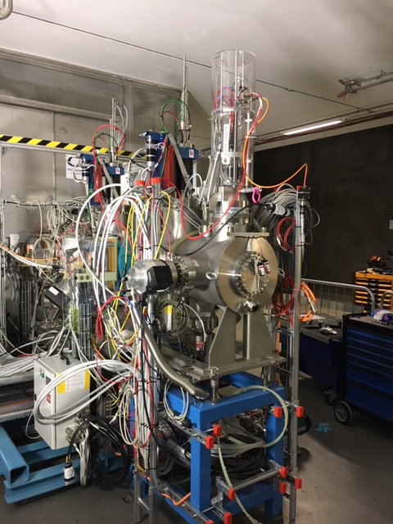
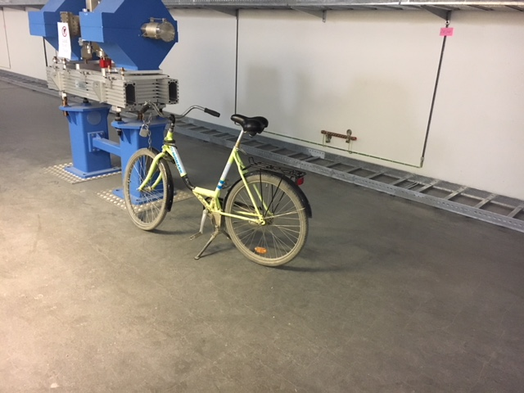
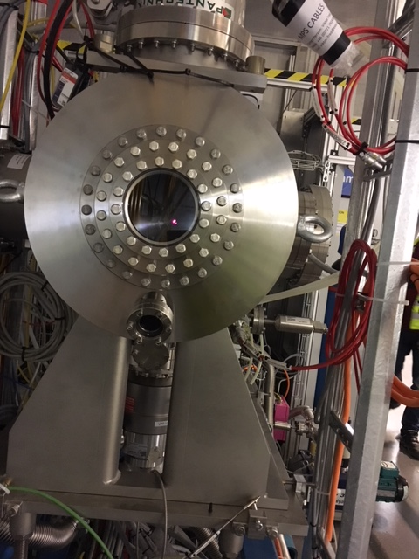
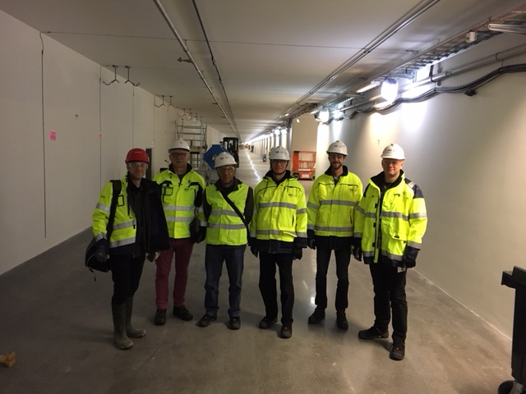
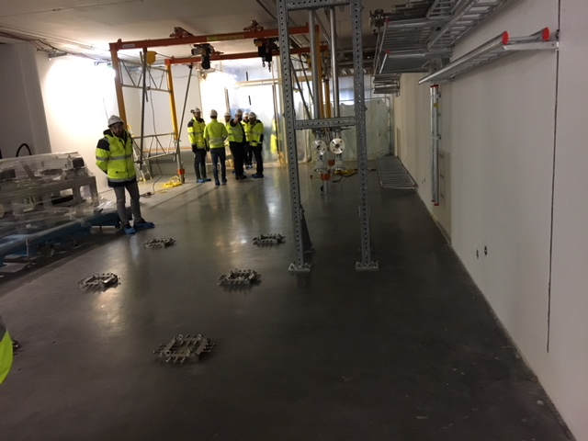
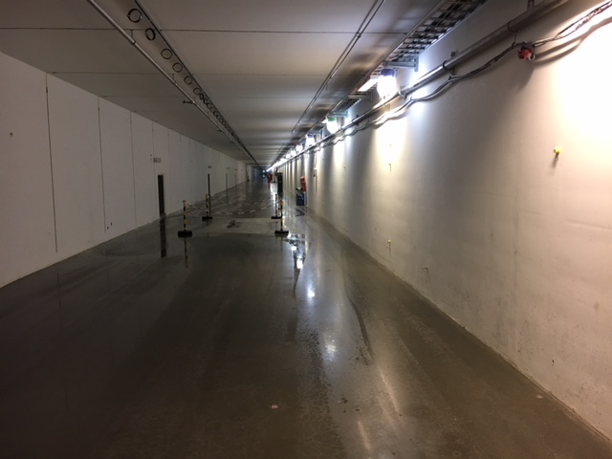
BD team and IS&LEBT 2018

Slide 3
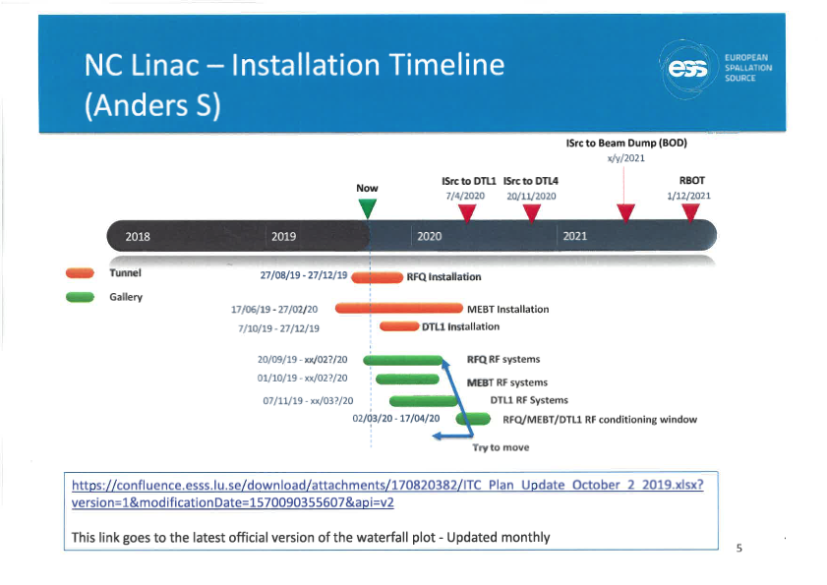
ESS Project – The Big Picture
2018
Beam on Dump (BOD)
Accelerator Ready for Beam on Target (RBOT)
ISrc to DTL1
End of Construction
ISrc to LEBT
ISrc to DTL4
Beam on Target (BOT)
2019
2018
2019
2020
2021
2022
2023
2024
2025
Courtesy Ciprian Plostinar
Start Of User Program (SOUP)

Slide 4
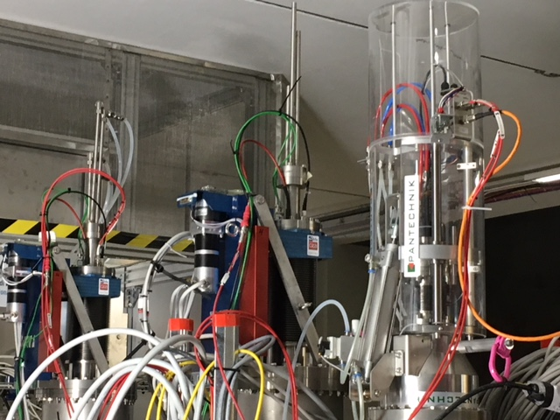
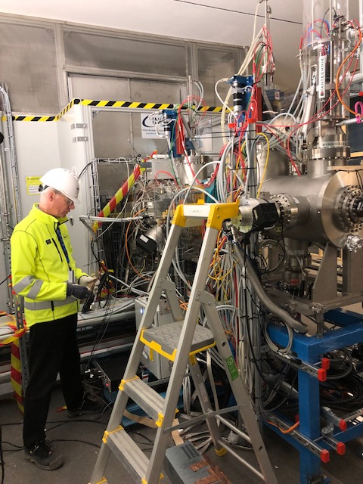
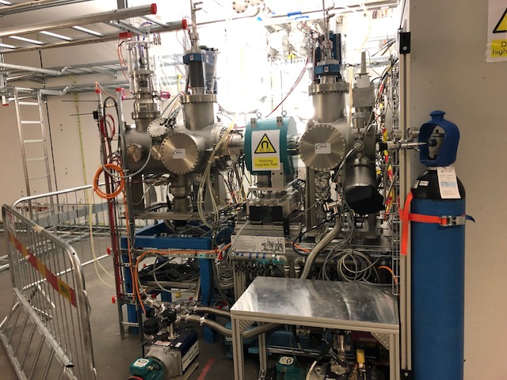
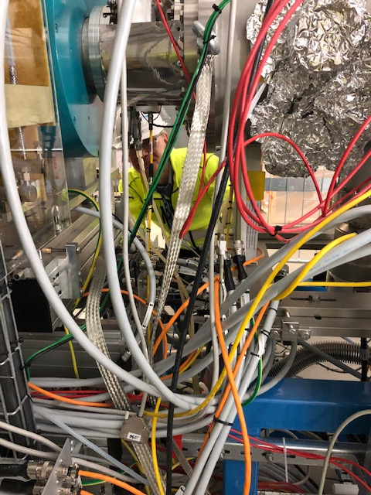
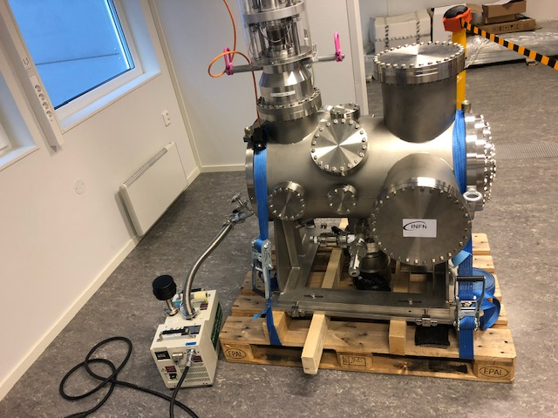
Lessons from IS&LEBT
2019
2018

Slide 5
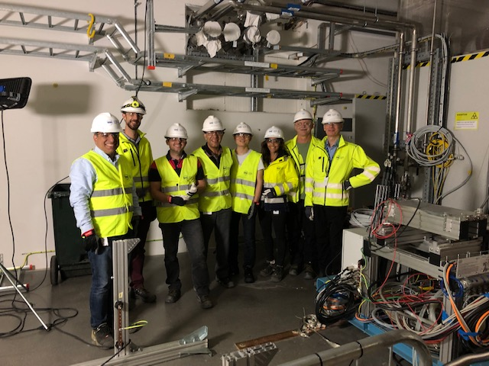
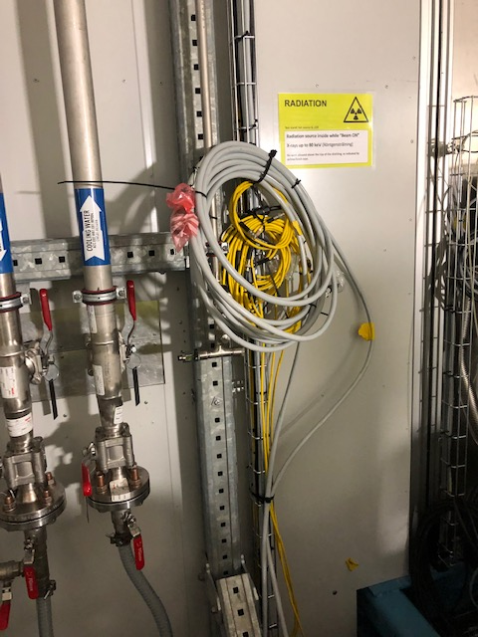
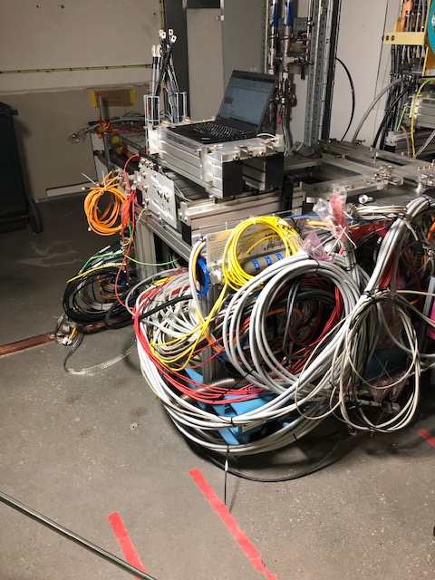
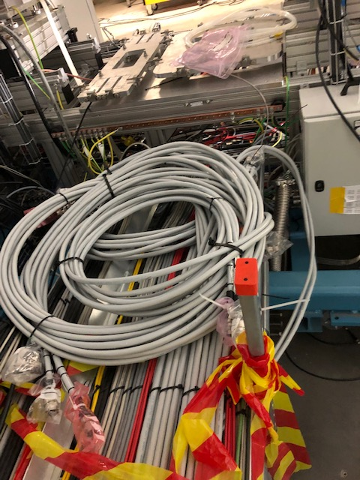
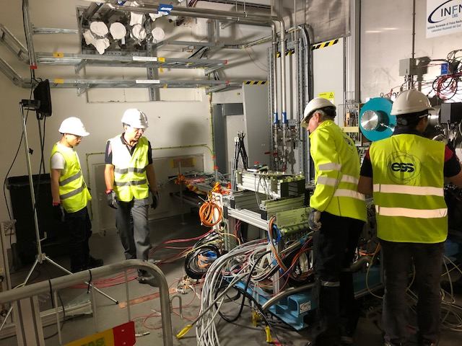
1) Cables

Slide 6
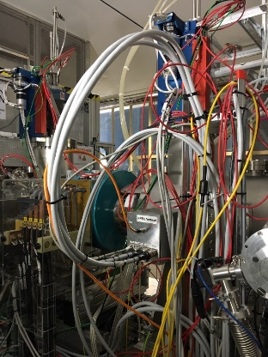
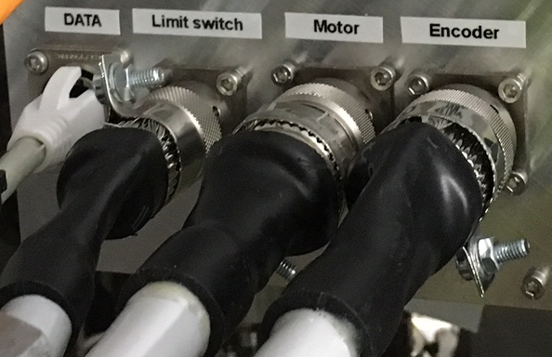
1) Cables
The presently installed cable is 4P18IOSLSHF. This cable is rigid, hard to bend and twist, and difficult to connect in many places due to the large bending radius. Additionally, the wires tend to slip out after some disconnections and connections. The weight and stiffness also makes the wires to slip out of the connectors. We have the same problem on rack side too, the rack crates are not that strong so these cables need extra support.
Big bending radius necessary
Braid wires fasten with metal strap and nut. The wires tend to slip out after a while.

Slide 7
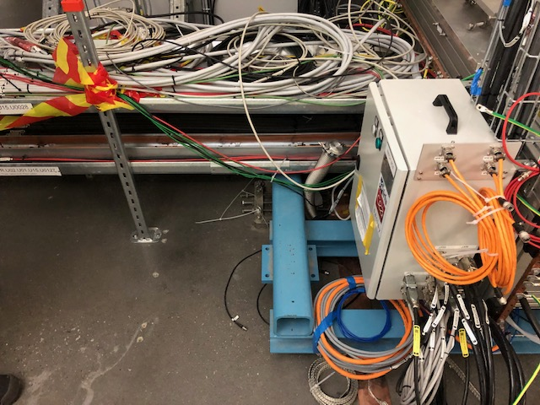
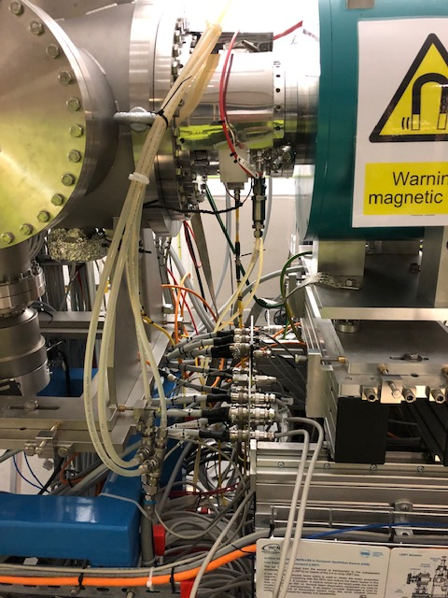
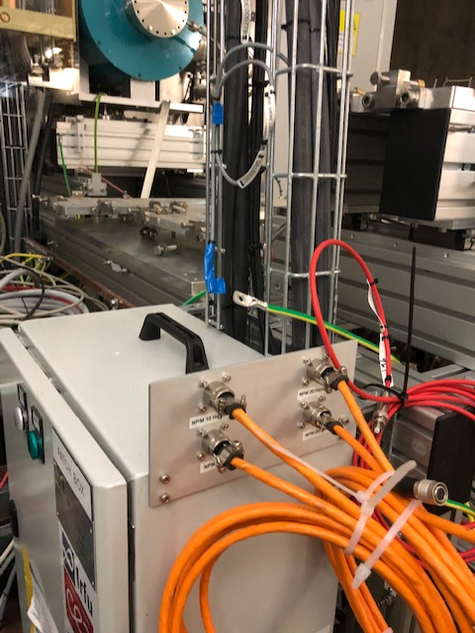
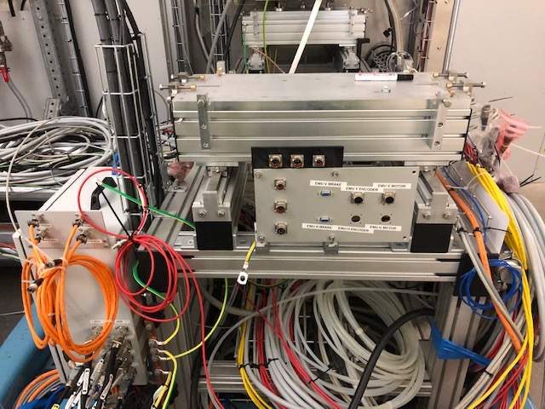
2) Patch panels
Former patch-panel to be able to connect NPM & EMU.

Slide 8
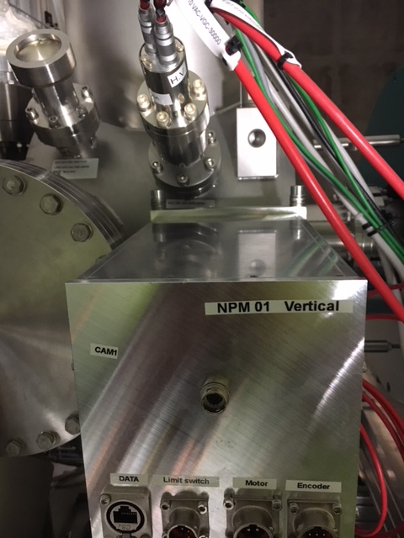
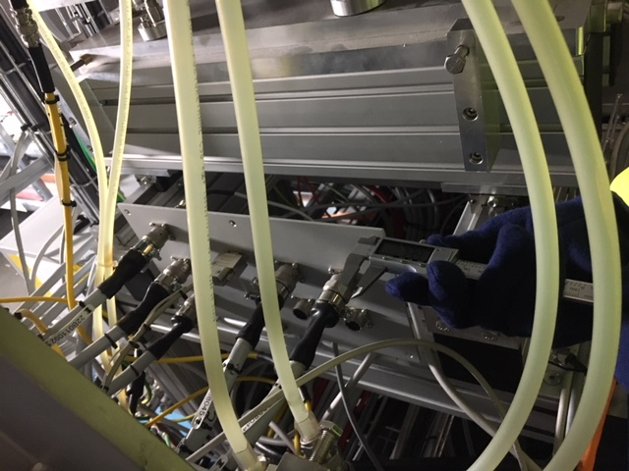
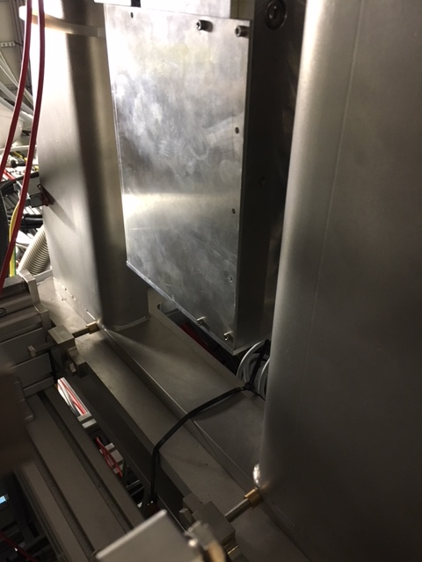
3) 3D integration
NPM PP LEBT 2018
PP
3D drawings
are not all absolutely correct
WUT PP!

Slide 9
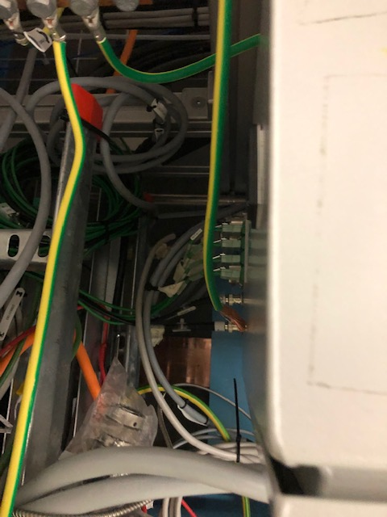
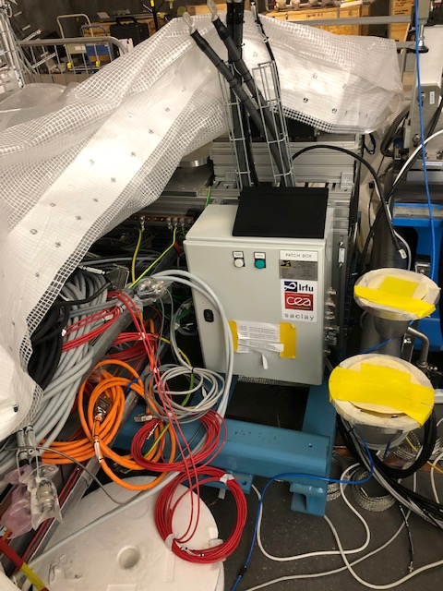
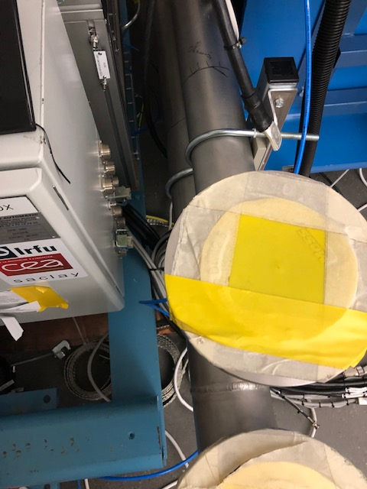
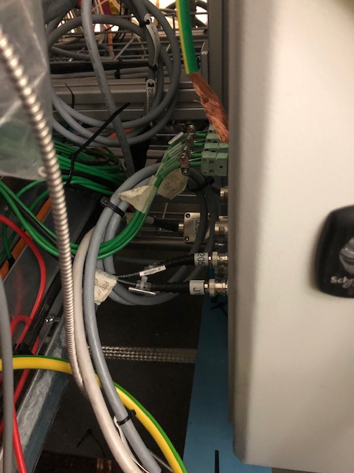
3) 3D integration 2019

Slide 10
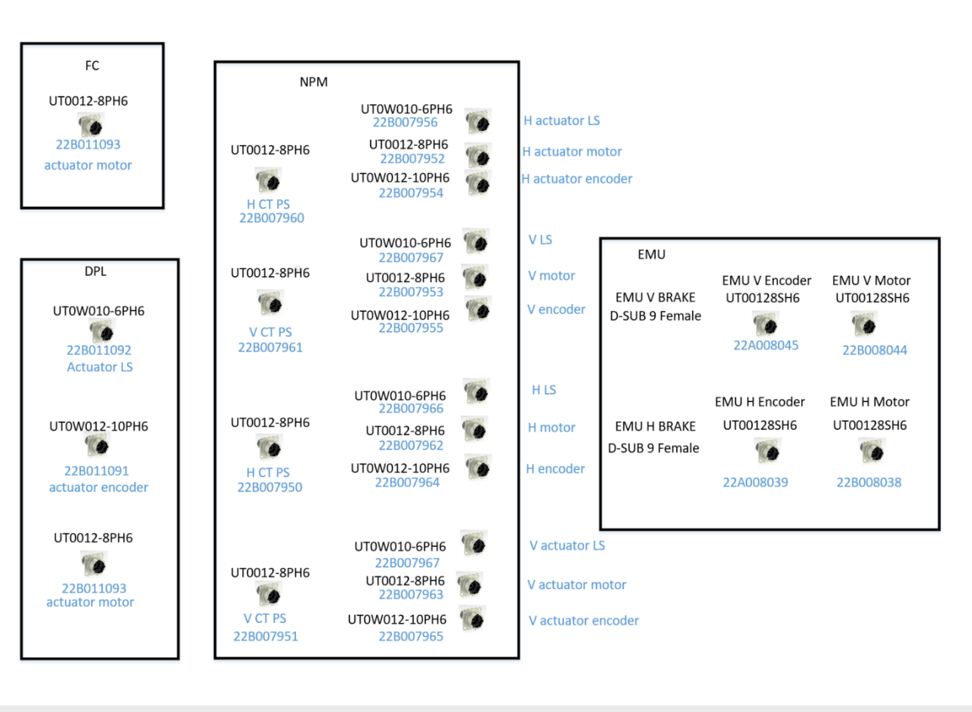
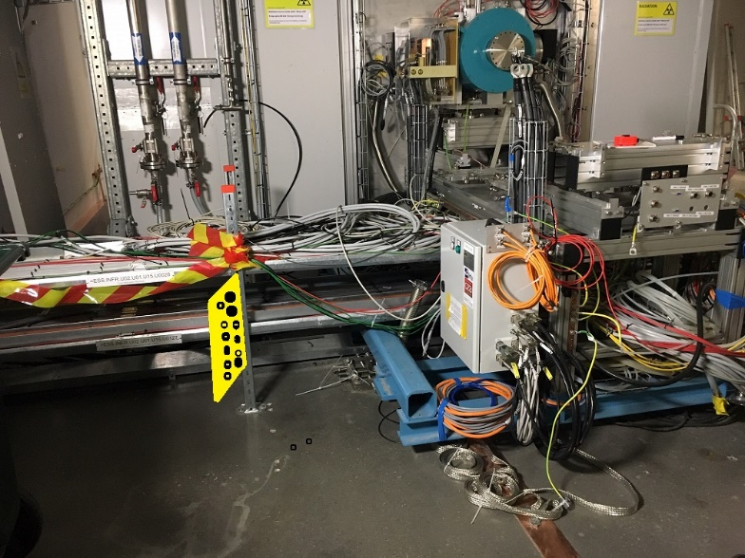
Solution 1 . (Mounting a new patch-box/panel “Yellow figure”)
A solution is to making the cables shorter by cutting and re-mounting the heavy cables to one side of a new patch box/panel. New smoother patch cables will connect the beam line elements with the patch panel.
Patch-box/panel design. For 26 connectors

Slide 11
Solution 2. (Best option!)
The replacement cables are already ordered. For the rest of LINAC the heavy cables have been replaced with smaller ones, as an extra quantity of cables are already ordered by default. Routing are rather easy since the cables simply will replace already existing ones.
This solution makes it possible to skip the patch panel for all of the cables, except 4 (EMU), as the replacement cable can connect directly to the beam line elements. There will be some savings in patch panel design and termination costs.
In total 24 Cables for the NPM, DPL, EMU and FC systems are affected. The total cable length can be estimated to approximately 1km.

Slide 12
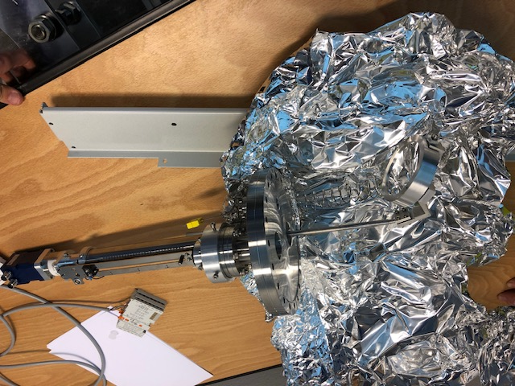
4) Repair in time
the Doppler actuator was stuck in inserted position in the LEBT permanent tank , removed and moved to the BI lab.

Slide 13
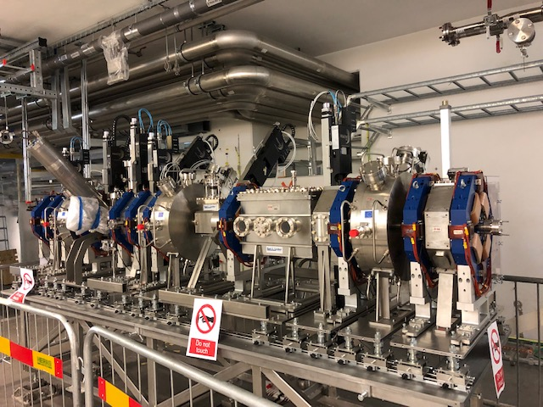
MEBT

Slide 14
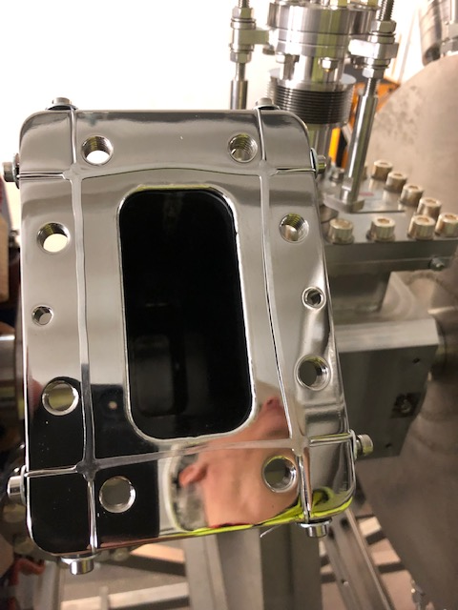
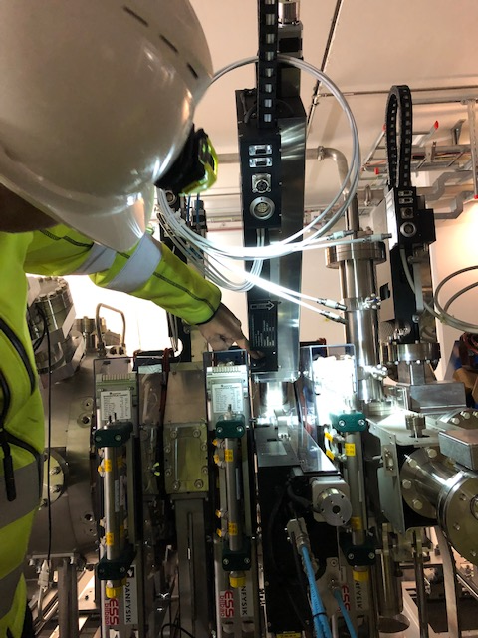
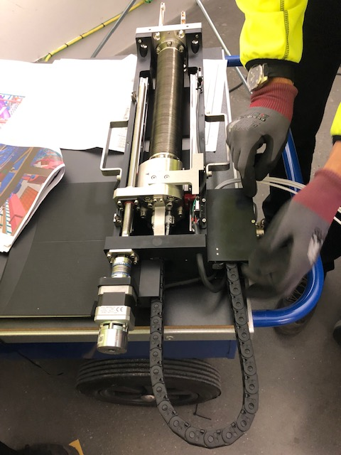
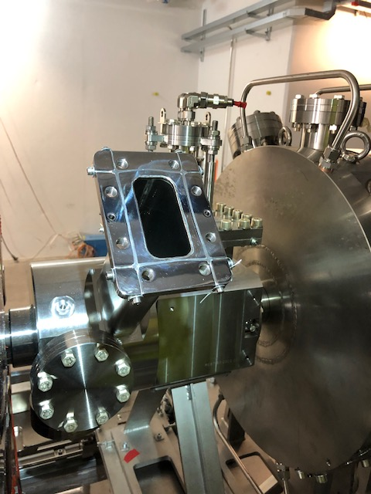
MEBT BD check

Slide 15
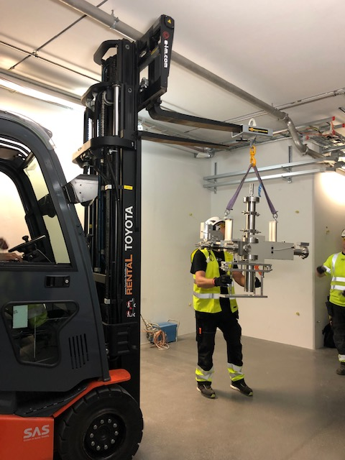
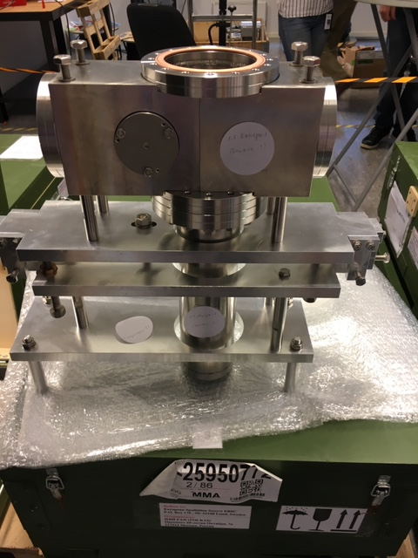
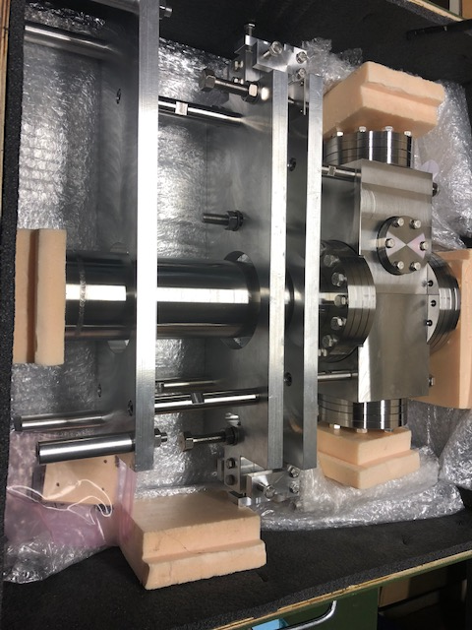
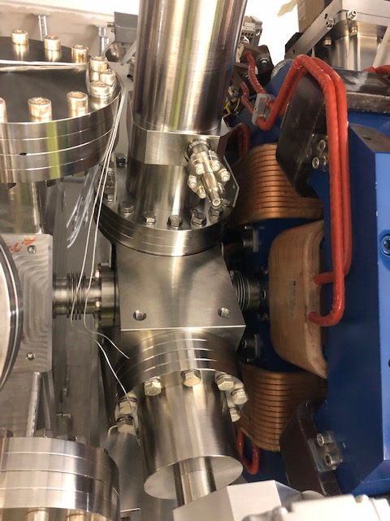
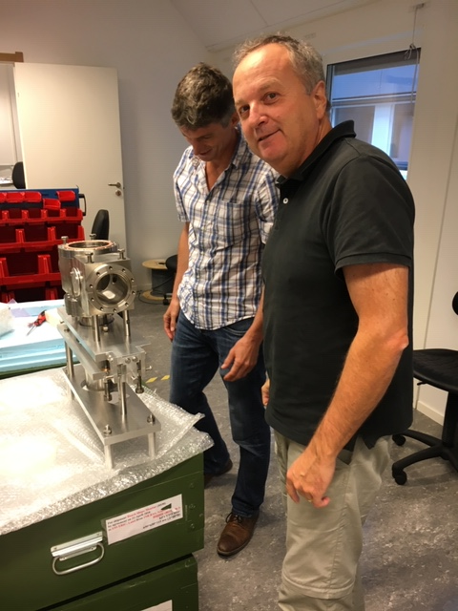
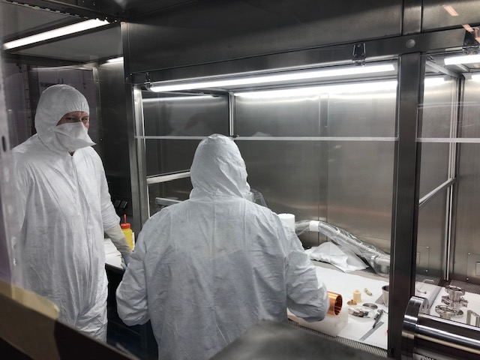
MEBT: BSM and Bilbao

Slide 16
MEBT manifold and BD

Slide 17
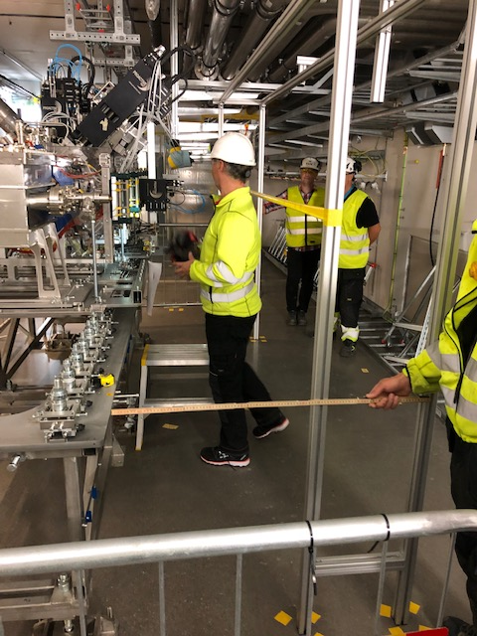
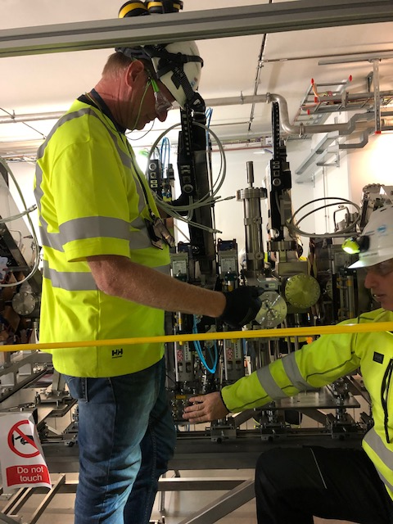
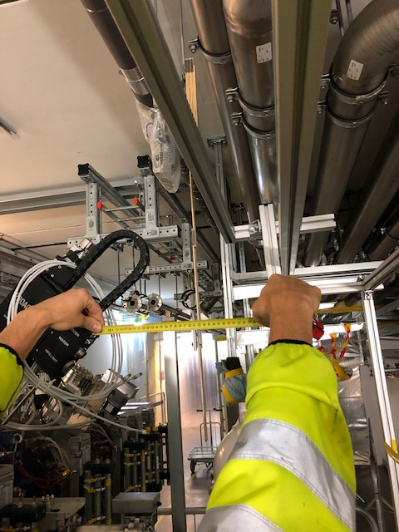
MEBT manifold and BD

Slide 18
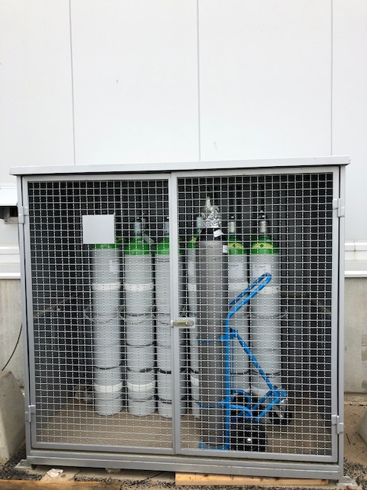
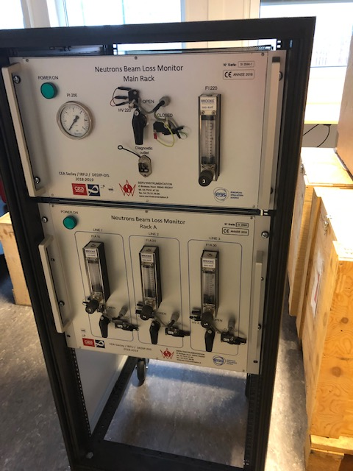
Infra structure support

Slide 19
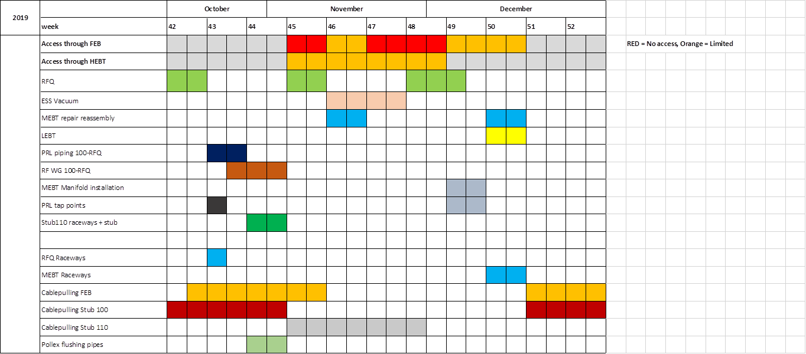
Installation schedule

Slide 20


Installation schedule

