Slide 1
THE STATE OF BEAM DIAGNOSTICS
Tom Shea
for the ESS Beam Diagnostics Team

Slide 2
Organization
>20 Partners and Collaborators
Aarhus University
CEA Saclay, Paris
CERN, Geneva
Cockcroft Institute, Daresbury
DESY, Hamburg
Elettra – Sincrotrone Trieste
ESS Bilbao
INFN, Catania
INFN, Legnaro
Lund University
University of Oslo
DTU, Denmark
STFC, Daresbury
WUT, Warsaw
Lodz U. of Technology, Lodz
Chinese ADS
J-PARC, Japan
ORNL, USA
LANL, USA
IHEP, Russia
INR, Moscow
Högskola Väst, Trollhättan
Stony Brook U., New York
BNL, New York
At ESS Lund, the team consists of staff, consultants, students, and matrixed staff
Lead system design and deployment
Cover all technical disciplines
Tom Shea
System Leads
Rafael Baron
Clement Derrez
Elena Donegani
Hooman Hassanzedagen
Irena Dolenc Kittelmann
Roxana Tarkeshian
Cyrille Thomas
Technical Team
All system leads contribute technical expertise
In addition:
Edvard Bergman
Thomas Grandsaert
Slava Grishin
Maria Hoflund
Hinko Kocevar
Mehdi Mohammednezhad
Johan Norin
Kaj Rosengren

Slide 3
System Leads
Updated
System | System Lead
Aperture Monitor(fixed and moveable) | Cyrille Thomas
BCM (BCM, fast BCM, IS supply current) | Hooman Hassanzadegan
BLM (nBLM, ICBLM, X-Ray spectroscopy) | Irena Dolenc Kittelmann
BPM (BPM, fast BPM) | Rafael Baron
Doppler | Cyrille Thomas
EMU (Alison, slit-grid) | Roxana Tarkeshian
FC | Elena Donegani
Imaging | Cyrille Thomas
Insertable Beam Stops | Elena Donegani
LBM (BSM) | Irena Dolenc Kittelmann
NPM (IPM, BIF) | Roxana Tarkeshian
Scraper(MEBT) | Cyrille Thomas
Target Grid | Cyrille Thomas
WS(scanning, fast) | Clement Derrez
https://confluence.esss.lu.se/display/BIG/Organization+of+Beam+Diagnostics

Slide 4
Technical Leads
(same as 2018, but updates are in progress)
Technical Area | Responsible
Cabling | Edvard Bergman
Commissioning (LEBT) | Cyrille Thomas
Data Management | Johan Norin
Electronics | Clement Derrez, Hooman Hassanzadegan
FPGA, digital architecture | Kaj Rosengren
Installation Manager | Viatcheslav Grishin
Laboratory Manager | Edvard Bergman
Mechanical | Thomas Grandsaert
Motion Control | Clement Derrez
Project Planning | Johan Norin
Protection | Irena Dolenc Kittelmann, Thomas Grandsaert
Radiation effects | Irena Dolenc Kittelmann ,Elena Donegani
Software, EPICS integration | Hinko Kocevar
Verification | Clement Derrez
https://confluence.esss.lu.se/display/BIG/Organization+of+Beam+Diagnostics

Slide 5
Personnel news in Lund
Maria Hoflund
  Returned and completed Master thesis
  Off to Lund University for PhD
Roxana Tarkeshian
  Arrived in Diagnostics Scientist position
  EMU, NPM System lead
Rafael Baron
  Returned from academic leave
  BPM system lead
  Electronics, EMC
Henrique
  accepted Technician position

Slide 6
Accelerator Controls Program Forum
BI resources in place, partners delivering, but…
Still impacted by limited ICS resources, both labor and non-labor
Too late to fully recover
We needed a way to support deployment for commissioning with limited resources
Focus on “first proton functionality”, prioritized by stakeholders across the organization

Slide 7
Proposal developed with ICS
Manage objectives across teams
  We have a plan in P6. We manage execution
  with team boards containing detailed tasks.
  Focus on first proton functionality: Features, not systems - Avoid a priori rejection of entire measurement systems
    Take advantage of remaining flexibility to prioritize features for first protons
Tighten communications
  The most successful diagnostics projects have been executed by multidisciplinary teams that integrate early: (Examples: J-PARC experiment, BPM, …)
  Take a more lean approach to documentation and procedures. Rely on data, intra-team communications.
P6 Plan (Milestones, Earned Value)
~2 months
One Program Board
Add a program board that contains the objectives
~2 weeks
Many Team Boards
Add a program forum that periodically prioritizes and agrees on objectives. Includes ICS, Diagnostics, Ops, Linac group, and other key stakeholders.*
Probability of effective communication
On same project team
Physical separation

Slide 8
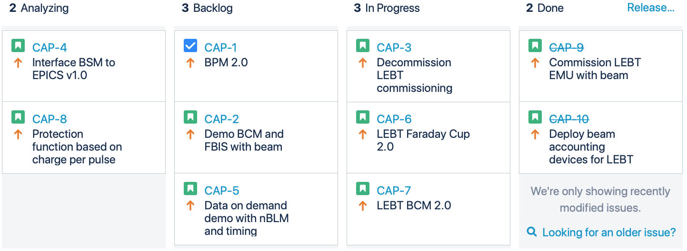
Accelerator Controls Program Board
The program objectives are Jira issues in the CAP project
In Diagnostics:
system leads choose objectives to analyze
Every 2 months, program forum agrees what to do next
Anybody can suggest
Experts analyze
Managers decide what to do
Managers accept results
99 Suggested

Slide 9
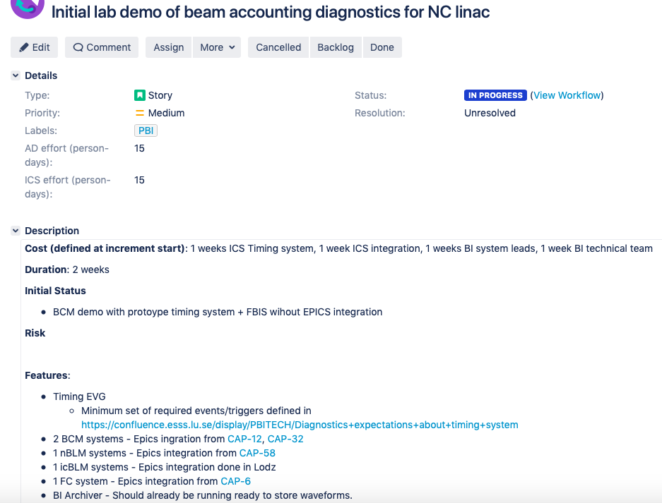
Example objective

Slide 10
FBS – Functional Breakdown Structure
The FBS is a database that contains a functional breakdown of ESS. Nodes can be both systems and components.
FBS-nodes are referred to as “positions” in EAM.
FBS node Description
ESS ESS
ESS.ACC Accelerator
ESS.ACC.B01 Proton Beam Instrumentation Systems
ESS.ACC.B01.B03 Wire Scanners
ESS.ACC.B01.B03.B02 Control Group ’PBI WS-02’ (Spoke wire scanners)
ESS.ACC.B01.B03.B02.B01 SPK WS1 diagnostic system (Spk-020LWU:PBI-WS-001)
ESS.ACC.B01.B03.B02.B01.B02 SPK WS1 horizontal beamline device

Slide 11
FBS – Functional Breakdown Structure
A position (FBS node) can be identified with an ESS name or a cable name, but the FBS is a much larger structure. Most of the system level FBS nodes (the ‘skeleton’ of the structure) does not have ESS names.
Assets can be assigned to FBS nodes in EAM.
Present count:
 | ESS | PBI | Comment
ESS names | 41722 | 2841
Cables | 28649 | 2672 | Only the NCL cables are added to FBS so far.
FBS nodes | 75673 | 4497
Assets in EAM | 4220 | 858

Slide 12
Schedule
This table contains some key accelerator milestones that affect beam instrumentation (2019-10-22)
Beam Section | Beam line installation completed | SRR | Start of comissioning | End of commisioning
Up to DTL1 | 2020-03-13 | 2020-04-29 (SRR2) | 2020-05-15 | 2020-08-07
Up to DTL4 | 2020-11-05 | 2020-11-19 (SRR3) | 2021-01-13 | 2021-04-19
Beam on dump | 2021-06-10 | 2021-09-16 (SRR4) | 2021-09-24 | 2021-11-30
Beam on target | 2021-06-10 | 2021-11-30 (SRR5) | 2021-12-01 (RBOT)

Slide 13
Naming tool and FBS History – Development
Original
Level 1: Instrument types
Level 2: Individual instruments
Now
Level 1: Instrument type (e.g. Beam current monitors)
Level 2: Control group (All equipment that is controlled and powered together)
Level 3: Individual diagnostic systems (e.g. LEBT BCM), Control systems in rack
Level 4: Beam line elements, Rack mounted crates, Cables
Level 5: Sub-components (e.g. uTCA-mounted cards)
Can have assets

Slide 14
WP7 Status – October 2019
WP 7 construction and installation project is around 70 % done.
Much of the remaining material cost for construction is tied to end-of construction milestones and a few large deliveries.
There will be a substantial decrease in burn rate in 2020 due to transfers to the initial operation budget.

Slide 15
Putting the systems together
Data analysis Machine learning
Adaptation
Analysis
Updates to analysis layer managed by trigger system
Gigabit/s
Terabit/s
Multi input Control and
Protection functions
Low latency data link
Low latency processing
trig
trig
Single input functions
Continuous buffering
Trigger annunciation
Acquisition
Acquisition
Acquisition
Actuators
Machine

Slide 16
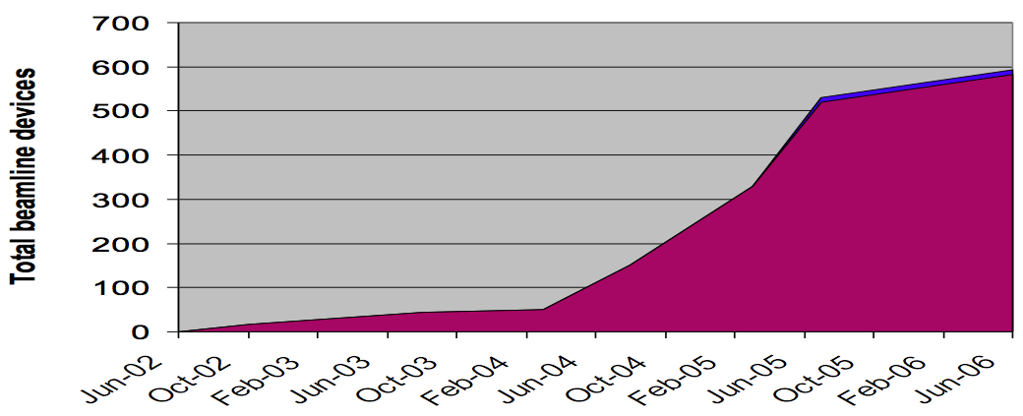
Comparison
DTL5
+ Spokes
+ Medium Beta
To target
Source/LEBT
at Catania
RFQ/MEBT/DTL1
Source/
LEBT
DTL 2-4
ESS
2017
2018
2019
2020
2021
2022
SNS
2002
2003
2004
2005
2006
1
2
3
4
5
6
7
8
9
MEBT
improve
DTL 1
improve
Elliptical
Deployment at scale: superconducting linac devices
In years past, the ESS plan appeared too aggressive.
In 2018, it looked achievable and similar to RHIC and SNS.
Now, the pace appears slow

Slide 17
2019 Goals
Explicitly linked goals of diagnostics to overall goals of ESS

Slide 18
Focus Areas for 2019
(copied from 2018 presentation)
Deploy normal-conducting linac diagnostic systems [ongoing, slow start]
Wrap up most prototype testing and remaining design reviews [ongoing]
Project management
  Biggest issue: Projected budget gap of 2 to 5% [projected gap remains]
  Soliciting ideas for cost savings/deferral
Technical
  V 1.0 firmware and software architecture [see FPGA and system presentations]
  Data on demand [firmware implemented]
  Timing integration [soon]
  MPS integration [firmware implemented]
  Low latency link [firmware implemented]

Slide 19
Focus Areas for 2020
(builds on 2019)
Normal-conducting linac deployment (still)
Enter fabrication and installation phase for remaining systems
Evolve the organization to support commissioning and operations
  System lead team to collectively own diagnostics suite.
  Technical team(s) to consolidate and improve underlying components
Data (full stack)
  Integrate components like DoD, timing, links, etc into data acquisition solution
  Common data exchange format (Clement) for verification. Also beam tests, machine studies
  Data analysis, visualization, machine learning (Irena)
  Requires collaboration: within diagnostics, beam physics, ops, controls, DMSC, ... SNS, …

Slide 20
thanks

