Slide 1
FPGA roadmap and some BPM status
Kaj Rosengren
FPGA Designer – Beam Diagnostics
www.europeanspallationsource.se
22 October, 2019

Slide 2
Agenda
FPGA development roadmap
  Comparison with last year
  FPGA framework progress
  Data-on-demand status
FPGA systems roadmap
BPM firmware status

Slide 3
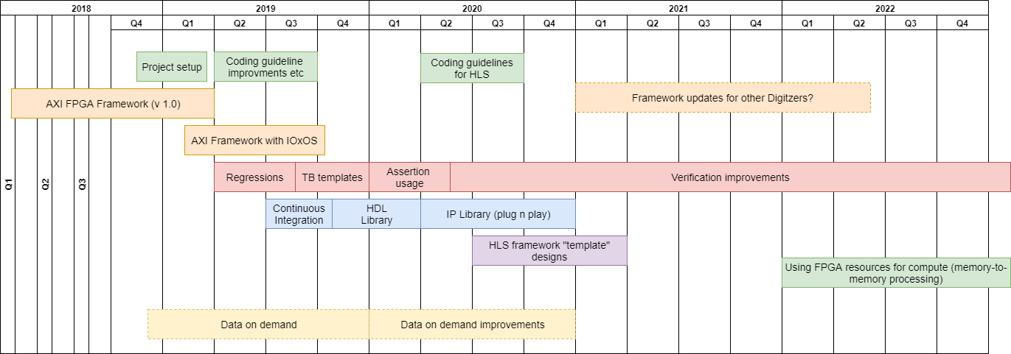
FPGA Roadmap - 2018

Slide 4
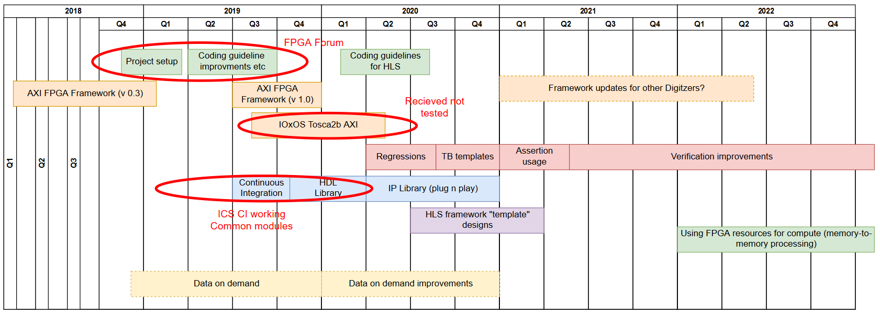
FPGA Roadmap - 2018

Slide 5
FPGA Developers forum
Started in April this year
https://confluence.esss.lu.se/display/HAR/FPGA+Developer+Forum
Coding guidelines, directory structure etc is in place.
  They are pretty much agreed.
  Gitlab as official repository (BI firmware projects have yet to move)
Continuous integration has been setup in gitlab by ICS.
  Using gitlab runners to upload results to https://artifactory.esss.lu.se/
The architecture discussions are ongoing. Mainly how to deal with IOxOS.
  Many complaints about Tosca, but no real action taken…
  Will come back to this in the framework slides
Notes:
Note: I have no idea how-to browse artifactory and find the bitfile once its up there..unless you wrote the script and knows where it was stored.

Slide 6
FPGA Roadmap - 2018

Slide 7
AXI FPGA Framework
V0.3 was just a stabilization release.
  Still uses the Struck DMA
  It’s the version LLRF, BCM, BPM is using at the moment.
V1.0 is ongoing and is using the Xilinx DMA
  Gives us complete freedom of defining registers.
  It also has good performance, but that more of a positive side-effect.
Notes:
The struck version is tied to use the struck register space. So the little “generic” functionality is tied to the old definitions
Also no more struck code, so we are no longer reliant on struck for firmware

Slide 8
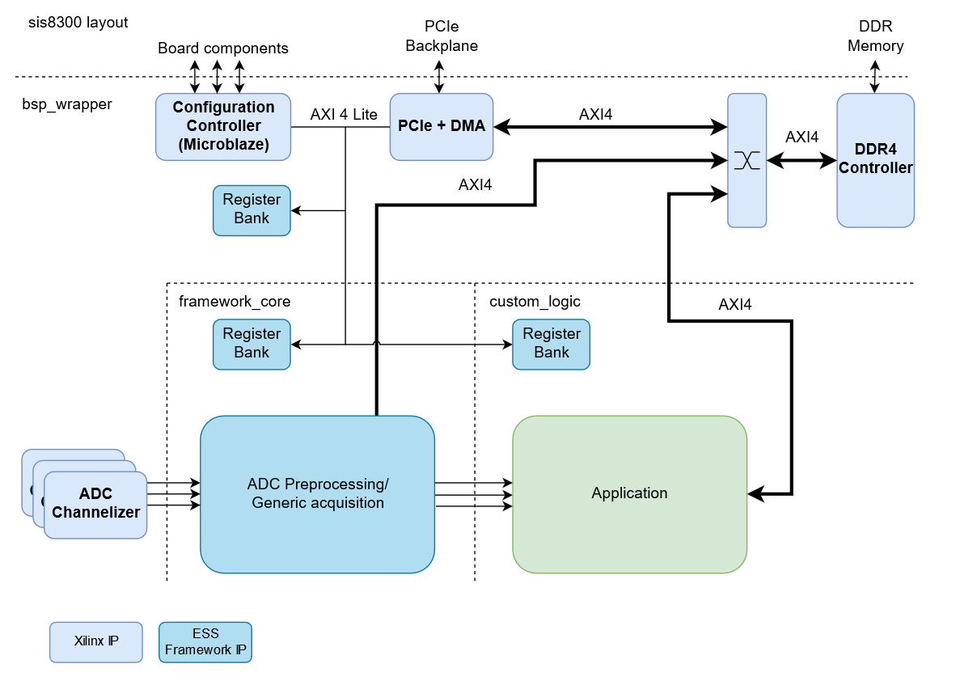
AXI FPGA Framework – SIS8300
Notes:
Note: Picture is missing the RTM board

Slide 9
AXI FPGA Framework – Register Map
0x00_0000 - Framework registers
  Identification of features and support packages
  Shared components, many can be enabled/disabled by constants.
  Generic acquisition (data channels, trigger selection)
0x40_0000 - Board support package registers
  Board component configuration. Microblaze can be used as “abstraction”.
0x80_0000 - RTM support package registers (if board has RTM)
0x90_0000 - FMC0 support package registers (if board has FMCs)
0xA0_0000 - FMC1 support package registers (if board has FMCs)
0xC0_0000 - Application registers

Slide 10
AXI FPGA Framework – Register map
Developed by Christian. Available here: https://confluence.esss.lu.se/display/RFG/Register+Bank+Generator
Script currently generates VHDL AXI4-lite register banks.
The definitions can be re-used in python:
  import sis8300ku_bsp_regbank
  board_under_test = essffw.Device(essffw.SIS8300XilDrv())
  board_under_test.add_register_bank(sis8300ku_bsp_regbank.sis8300ku_bsp_regbank)
  passed_tests = board_under_test.test_registers_after_reset()
  board_under_test["BSP_CLK_DISTR_MUX"]["CLK_SEL"].write(0x0)
Has worked pretty flawlessly.
But there are a lot of features that we could use to improve

Slide 11
AXI FPGA Framework – Register map
Missing field definitions, descriptions.
More targets of generation
  C Header files
  Confluence or other documentation output
Need support of hierarchical inclusion. I.e. generate one register map and re-use it multiple times (needs workaround at the moment).
Currently the register definition is done directly in python.
  Hinko has been exploring the usage of TOML “Tom's Obvious, Minimal Language” as an alternative for defining registers.
  There are similar systems available. Example from CERN: https://gitlab.cern.ch/cohtdrivers/cheby
Notes:
Note the hierarchical inclusion problem has already been seen with the SIS8160 version

Slide 12
AXI FPGA Framework – SIS8300
Generic firmware pretty much complete. What is left:
Some board component control.
Microblaze code stability
Driver/EPICs development
Test multiple systems in single crate
DMA performance (transfer 2MB or larger):
WR: ~2.8 GB/s
RD: ~2.2 GB/s
Notes:
Note: DMA setup latency

Slide 13
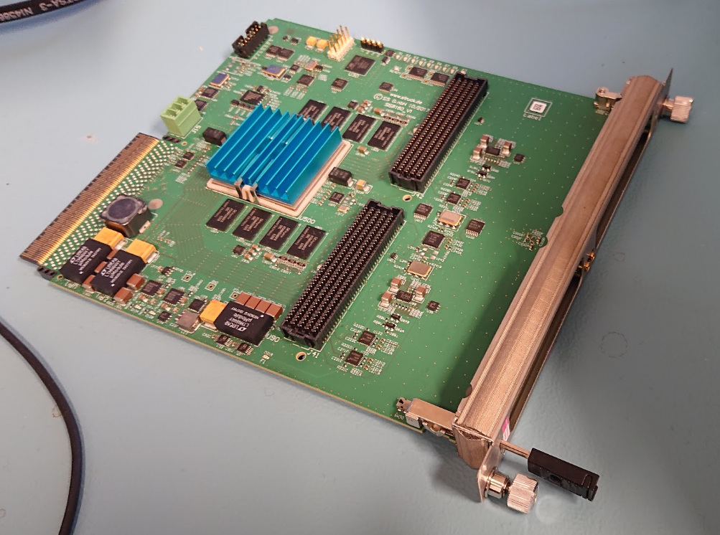
Struck SIS8160
Low-pin count FMC carrier from Struck
Made for high-speed applications so not a “generic” carrier.
Is using a similar firmware configuration as sis8300ku.
Decided to use this as a proof-of-concept of the AXI FPGA framework portability.
Mounted CAENels FMC-Pico-1M4 for use in APT/GRID
Notes:
Proof of concept in this case as we have decided to buy in on Xilinx and not be vendor independent.

Slide 14
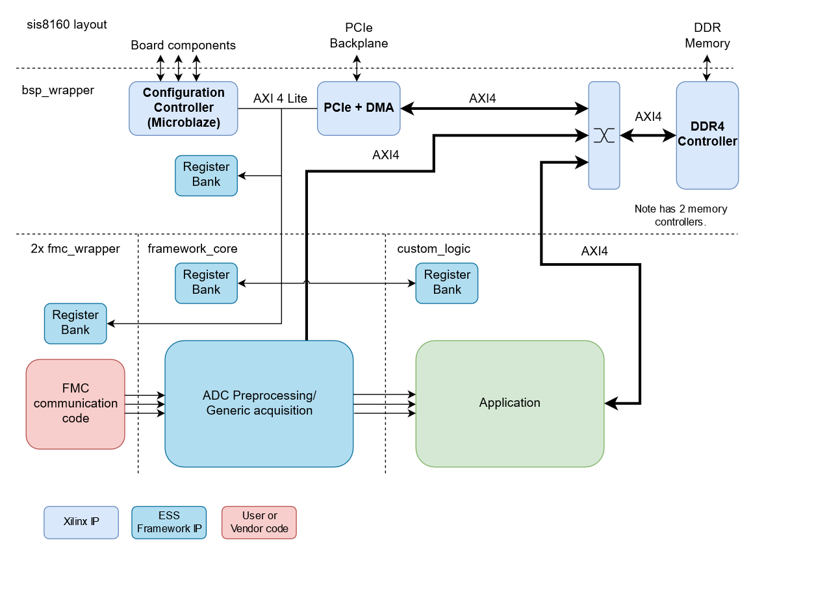
AXI FPGA framework – sis8160
Notes:
Note: 2 memory controllers which gives access to 4 GB of memory.

Slide 15
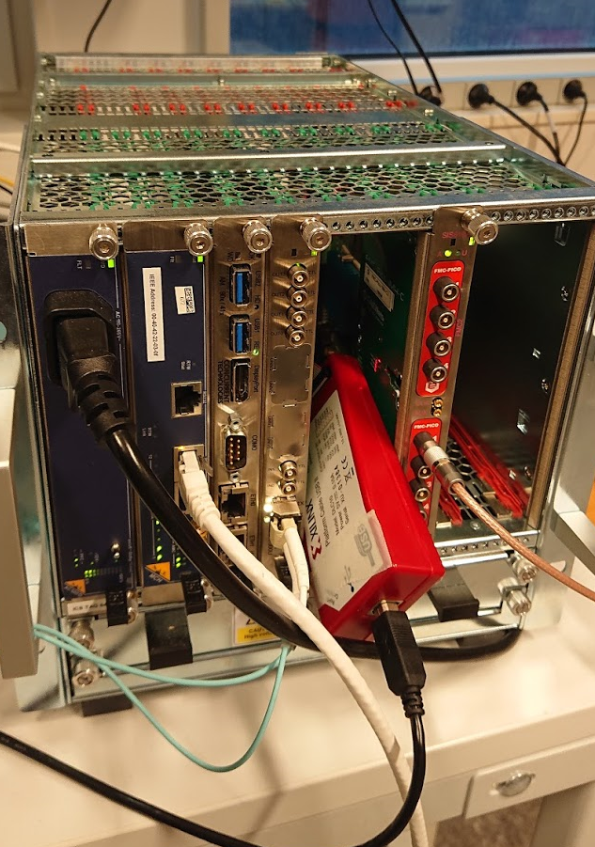
AXI FPGA framework – sis8160
Received the Struck example firmware of the board in July.
  Roshan, student from LTH (not working full time) started porting it to the framework and exploring how pico integration would look like.
End of august. Project selecting two pico FMCs can be built in the framework and read data read from registers (using Struck driver)
Mid September started ported the project to Xilinx DMA
  Basically whole BSP built of Xilinx components in block diagrams.
  Microblaze + I2C hooked up to FMCs to read calibration coefficients.
  Board flashing same as sis8300.

Slide 16
AXI FPGA framework – sis8160
Generic acquisition is complete. Features missing:
  Setup of board components (not needed for PICO application)
  As 8300ku need driver/EPICS development. But can be shared.
Notes:
Main point is that an off the shelf system using FPGA with standard components can easily be adopted, compared to certain other approaches….

Slide 17
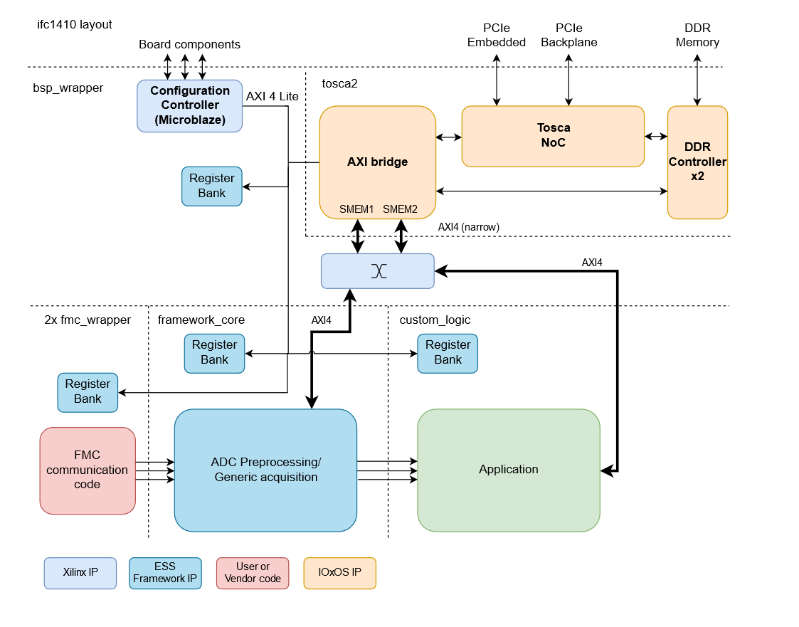
AXI framework – IFC1410 (suggestion)
Notes:
Note the bus structure is not optimal. We would probably need to bring both AXI ports to application for performance.

Slide 18
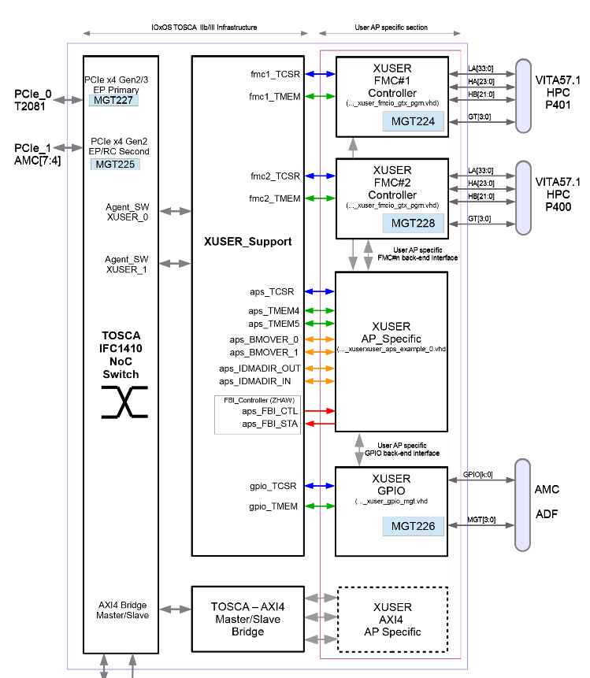
AXI FPGA Framework – IFC1410
Goal would be to try to get rid of as much of Tosca as possible.
  Removal of “XUSER_support” parts of Tosca.
  Control FMCs through framework code. Would need porting of FMC control into framework.
Another question mark is SW sharing between Xilinx DMA and Tosca2 versions.
Of course the preferred solution would be if we could get rid of it all together…

Slide 19
FPGA Roadmap - 2018

Slide 20
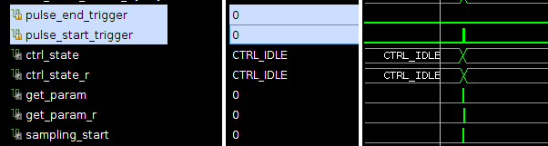
Verification topics from last roadmap
Simulation
Evaluate the simulator situation.
  FPGA Forum has decided to get more Questa licenses
Ability to run regressions.
TB templates – How-to deal with System models and golden references
Assertions (PSL or SystemVerilog) – could at least be used for simulation of standard interfaces.
  Neither of these topics have gotten any attention yet
”top-level” test benches – would be nice to have
  Xilinx DMA solution comes with example testbench. So we now have chip-level testbenches for sis8300/8160
  Currently its only used for sanity checks. On questasim testbench runs fine, on Vivado simulator terribly slow.
  Could quite easily generate register test from python. Not a priority though.

Slide 21
FPGA Roadmap - 2018

Slide 22
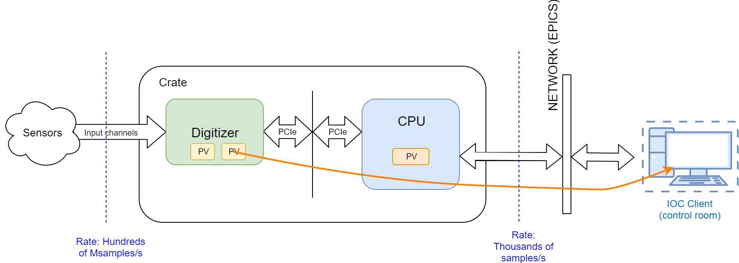
Reminder – normal PV procesing
The ”Normal” case is that the IOC clients are updating small PV:s with heavily processed items or shorter waveforms
But we do acquire a lot more data than this and it would be very useful to have it available for analysis.

Slide 23
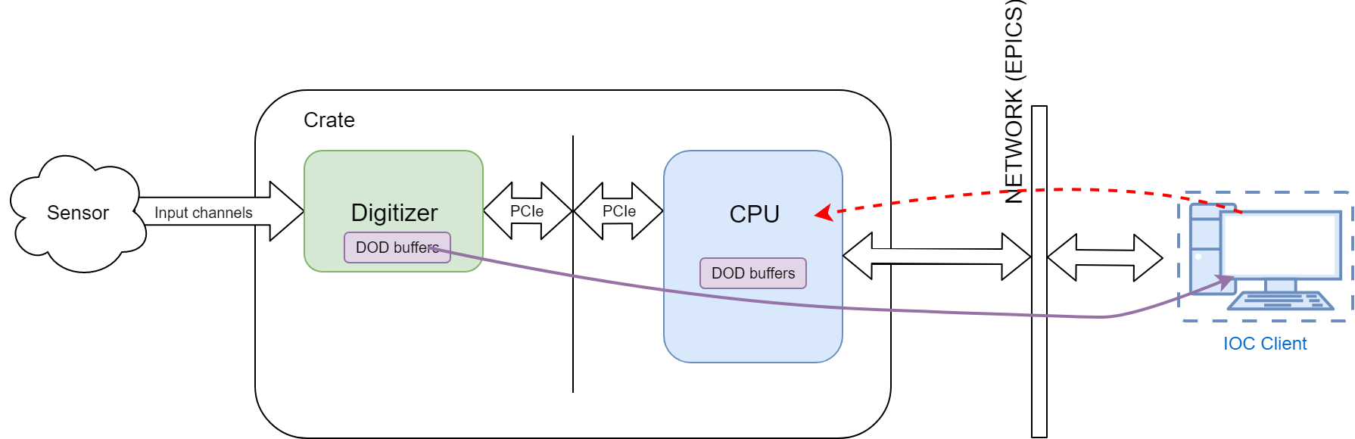
Reminder – Data-on-demand
The digitizer/CPU we use have quite a bit of DDR.
  Store incoming data (from RAW input channel or processed data) into circular buffer.
  On a “trigger” read the data from the digitizer and move it into CPU memory. Where it could be published as a PV or stored in local storage.
Notes:
Note: Could be pure SW buffering as well

Slide 24
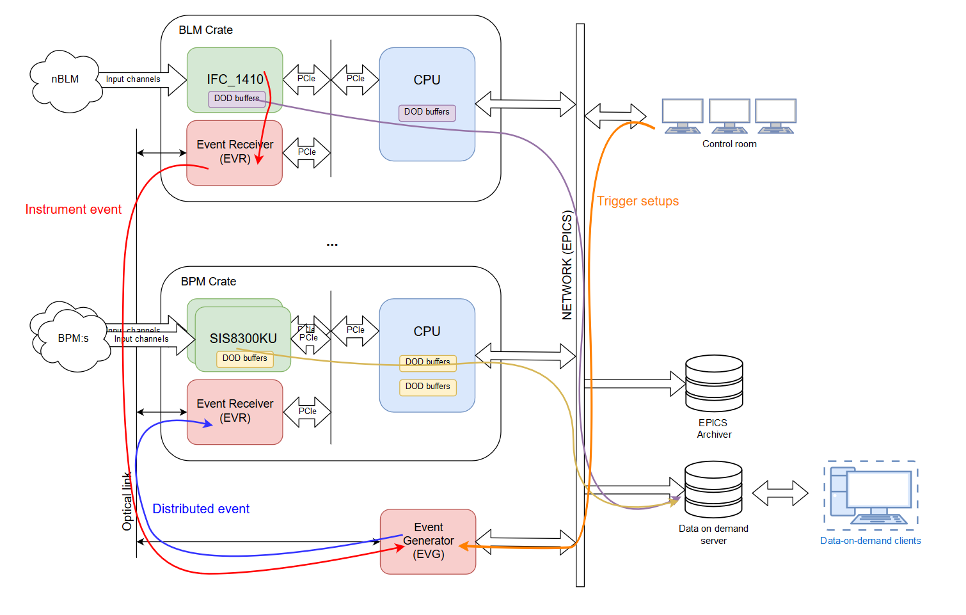
Reminder of use-case

Slide 25
Current status
Systems implementing circular buffering
  nBLM, icBLM, BPM, BCM
  Will also be available for RAW data in generic firmware
Timing system integration and EPICs layers needs work.
  Lab setup with multiple systems connected with timing system that can generate DOD events.
  BPM/BCM circular buffering needs SW support, only tested in python scripts.
  All systems needs EPICS integration to support read-out on events.

Slide 26
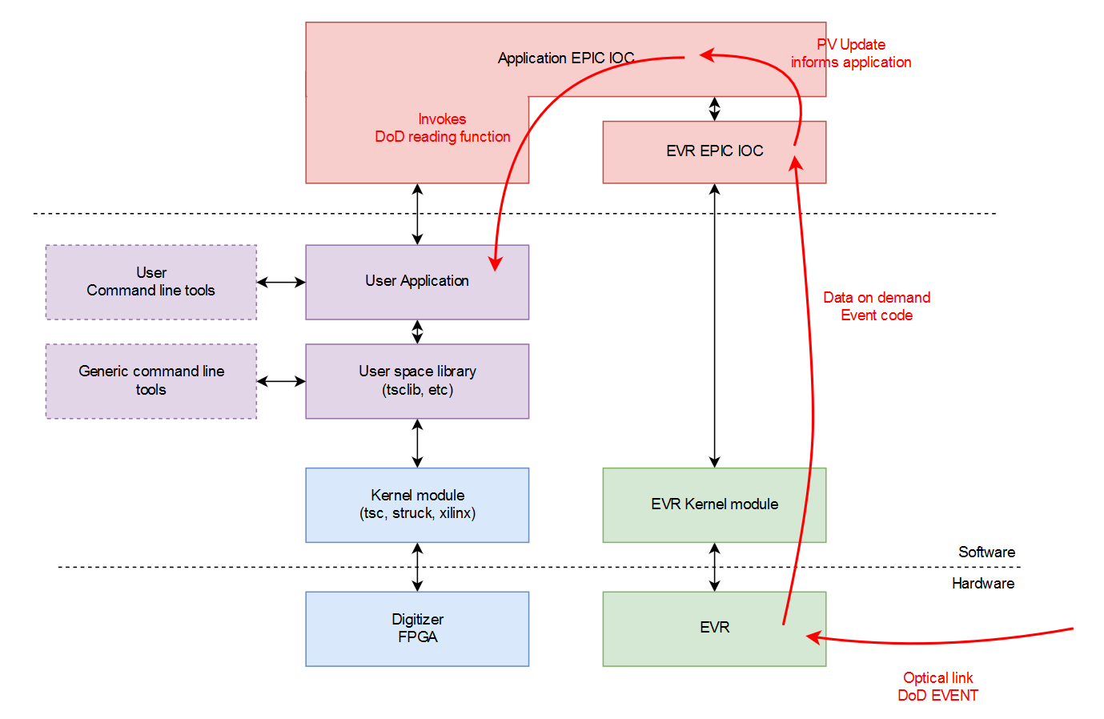
Data-on-demand – EPICS layer

Slide 27
Data-on-demand - Timestamping
Once an event has been detected and waveforms read out these are published as PV arrays and timestamp attached.
Timestamps for the data in the circular buffers needs to stored as well:
  icBLM/nBLM SW approach (SW buffering)
  BCM/BPM HW approach (timestamps pushed to firmware)
Notes:
Note the read out is probably fast, but publishing to PVs may be slow. The PV publishing may take a lot of time.

Slide 28
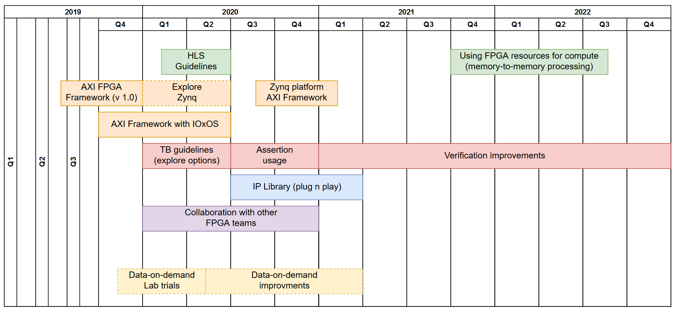
FPGA roadmap - 2019
Notes:
Priority between framework “work” is all about the money. We will avoid the extra work with the IOxOS platform unless we see benefit in the investment (some systems could perhaps run on the IFC1420).
Zynq platform hasn’t been mentioned.

Slide 29
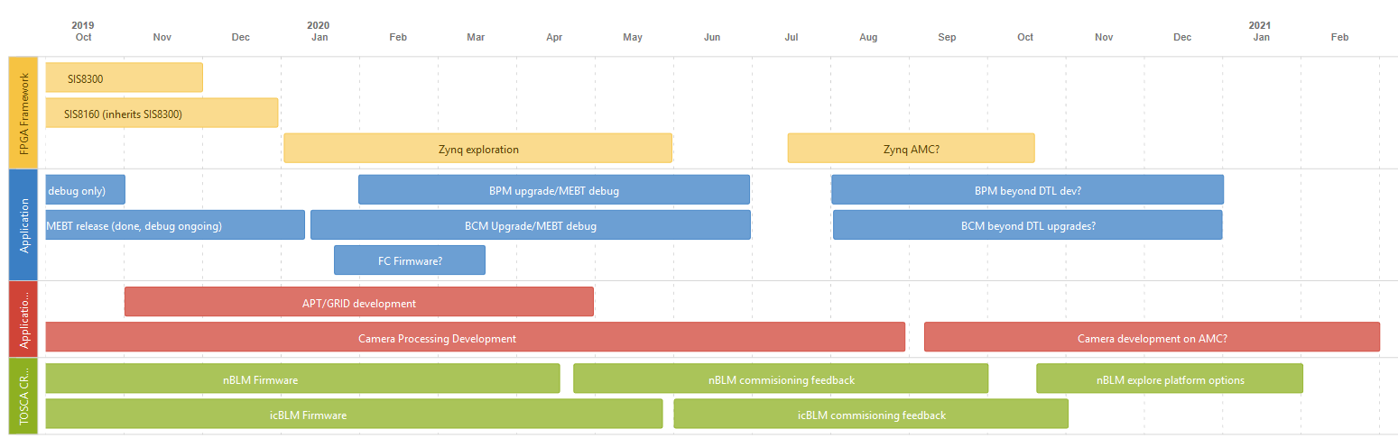
FPGA Systems roadmap
Started a FPGA systems summary page here: https://confluence.esss.lu.se/display/PBITECH/FPGA

Slide 30
BPM Firmware status
BPM MEBT Version
  9U Crate
  1 x 1000W Wiener power supply
  1 x NAT MCH
  1 x Concurrent Tech AM 900/412 CPU
  4 x SIS8300KU + 4 DWC8300 RTMs
  1 x EVR-300
  In total 8 BPM inputs for MEBT
MEBT version of firmware/IOC has been deployed.
  No Data-on-demand support in IOC
  Running on Timing system loop-back cable.

Slide 31
BPM Firmware
Based on BPM firmware from Fredrik Kristensen, the firmware itself its inherited from LLRF.
  Firmware was basically “duct taped” into the demo firmware from Struck.
  The processed data channels where interleaved into the default Struck output channels.
  The main problem with the firmware version is that parsing the waveforms and publishing on PVs consumes a lot of CPU.
Development started last autumn, main items to fix
  Port to ESS FPGA framework (IQ sampling in framework)
  Waveform channels with data conversion, gain/offset correction, decimation.
  Averaging of region-of-interest within waveform for pulse X/Y/PHASE/MAG
Some late changes
  Add second reference line.
  Change the back-plane trigger selection to be more flexible.

Slide 32
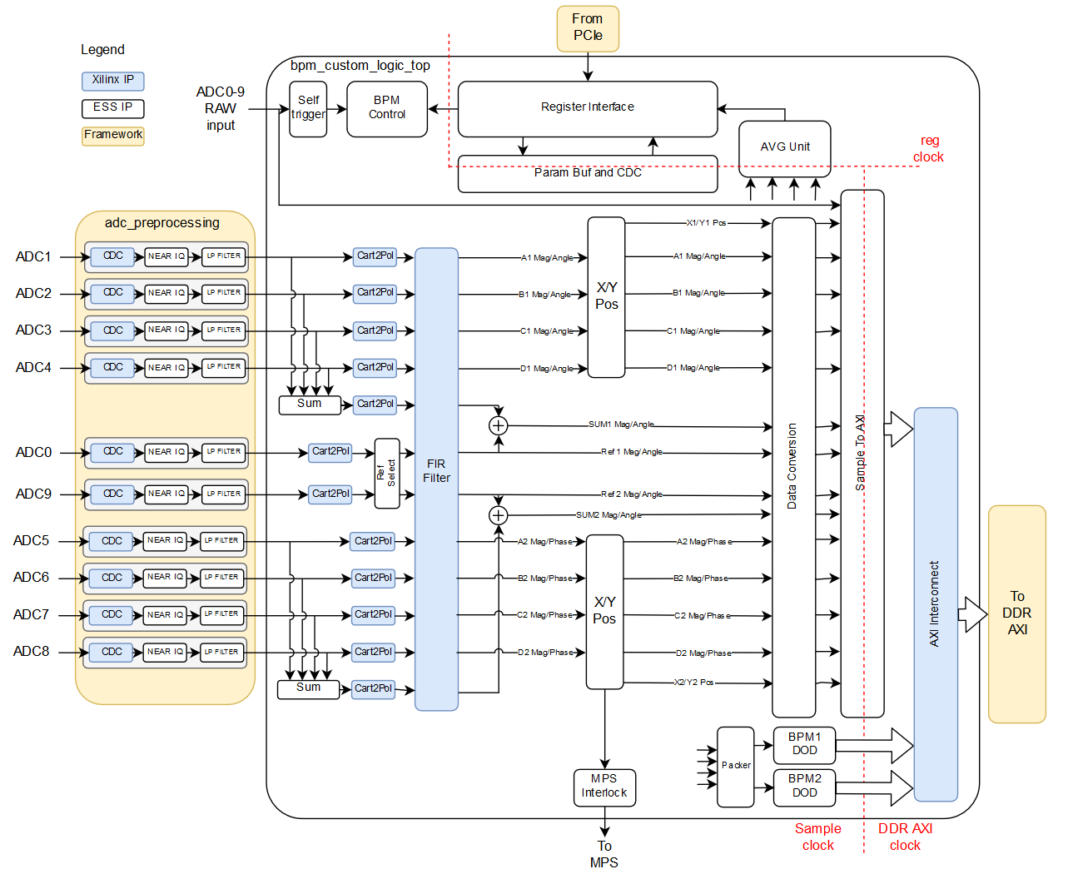
BPM Firmware overview

Slide 33
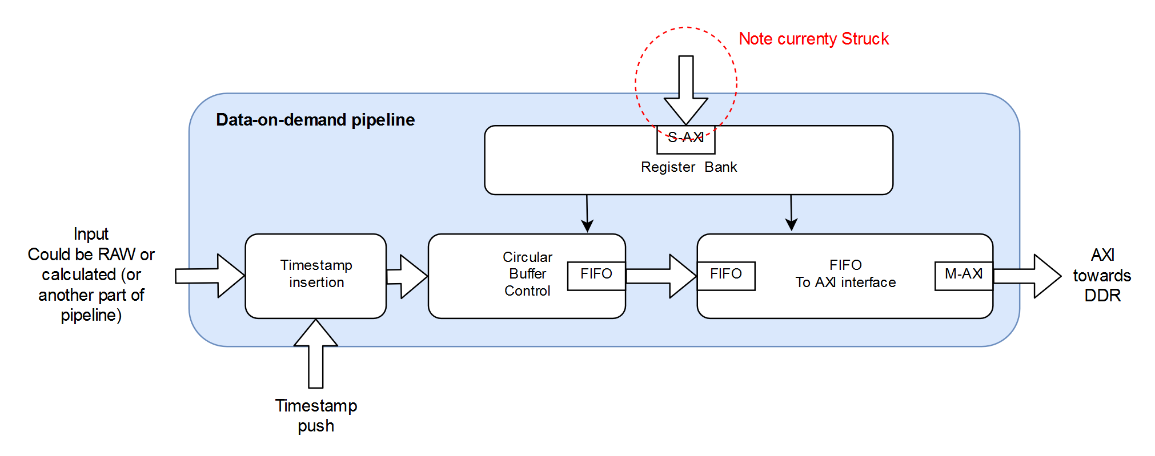
BPM Firmware - components
Goal is to have components that ”plugs” somewhat simply into the framework.
  Register bank generated from scripts, note that the current version has a “Struck” version
  Components can be added in BD, register banks connected with AXI-lite interconnect (and decoding). More investigation needed to how we handle this in the register bank scripts.
  Components can be identified through registers. Version, which features are enabled etc.
Notes:
Note: The amount of data rea

Slide 34
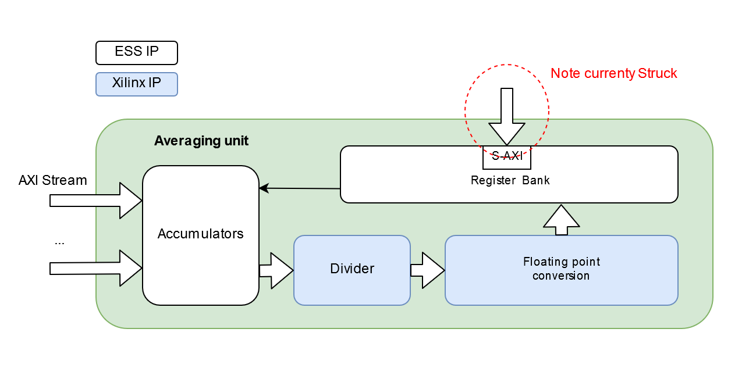
BPM firmware – components
Components should have:
  Preferably some documentation in confluence.
  Testbench that tries the main configuration. It should be modifiable for other applications.
  Be IP packaged for Vivado. (still todo)
Currently mainly small components or larger ones are planned for the “common” components.
HLS components is another question mark.

Slide 35
Closing
Overall BI FPGA strategy
  We are buying into Xilinx components/tools. No change in foreseeable future.
  We want to be open source. The plan is to eventually open the framework and components to everyone.
  We don’t have enough manpower for larger IP developments (and we don’t have a lot of money..). So we have to do a bit of thinking about:
    Optical link development (Robustness, more generic)
    JESDB204C/B
    GigE Vision camera.
  Collaboration with other institutes.
Notes:
Compared to for instance CERN we can’t really afford being vendor independent.

Slide 36
Thank you!
Questions?

