Slide 1
BCM Status Hooman Hassanzadegan BI forum, 22-24 Oct. 2019, Warsaw
www.europeanspallationsource.se

Slide 2
BCM summary
Hardware:
BCM sensors (ACCT and FCT toroids)
Sensor cables
ACCT FE units
ACCT Interface Units (AIUs)
uTCA crate including RTM, AMC and infrastructure modules
Electronics for measuring the platform voltage and FCT readout
Firmware
Core FW
Integration FW
Software
BCM IOC development
OPI
BCM machine protection functions
Next steps

Slide 3
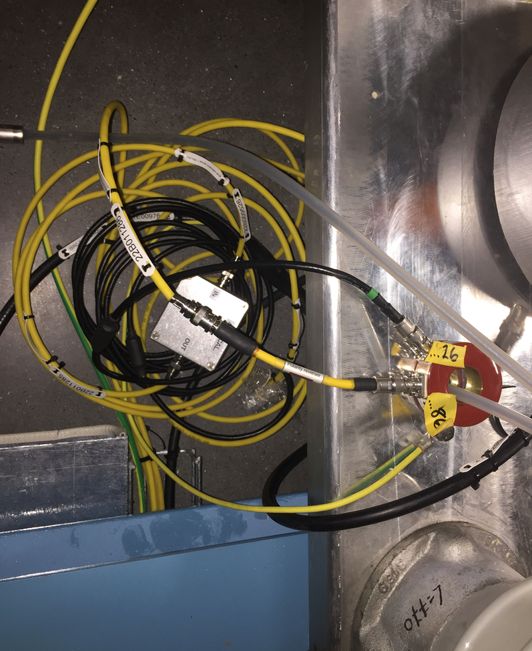
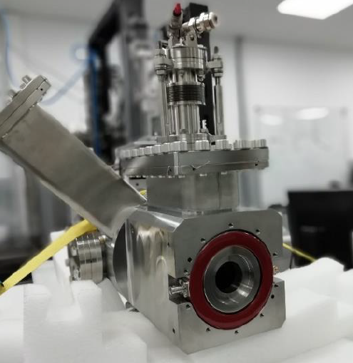
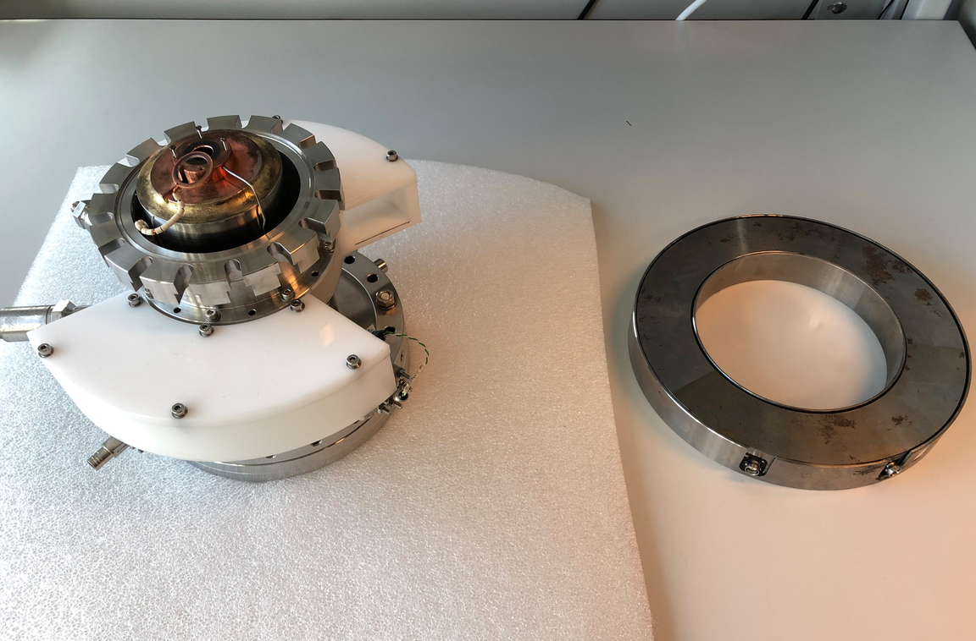
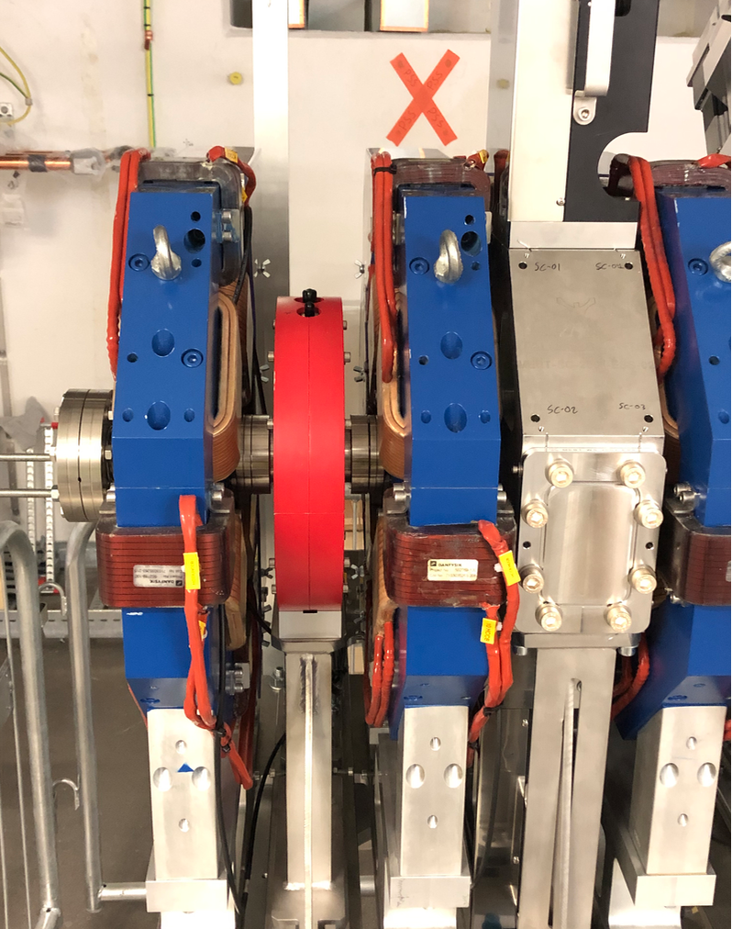
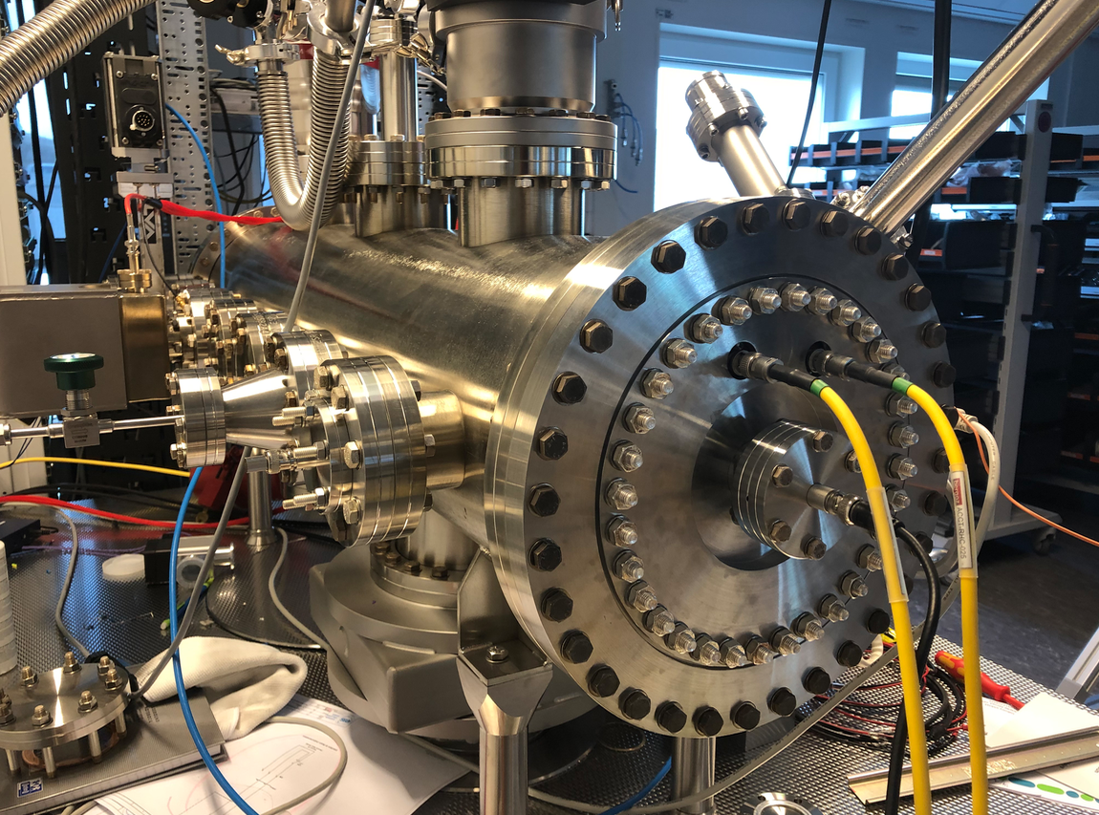
BCM sensors
ISrc: 1x ACCT → Commissioned
LEBT: 1x ACCT → Commissioned (current dismounted for collimator repair work)
REQ: 1x ACCT → Installed in the RFQ flange and successfully tested
MEBT: 1x ACCT, 1x ACCT/FCT → Installed in the MEBT
DTL: 5x ACCT → Delivered to Legnaro in June 2019
MB: 1x ACCT → Delivered to STFC in June 2019
HB: 1x ACCT → Delivered to STFC in June 2019
HEBT: 2x ACCT → Delivered to STFC in June 2019
A2T: 3x ACCT → Delivered to STFC in June 2019
DmpL: 2x ACCT → Delivered to STFC in June 2019

Slide 4
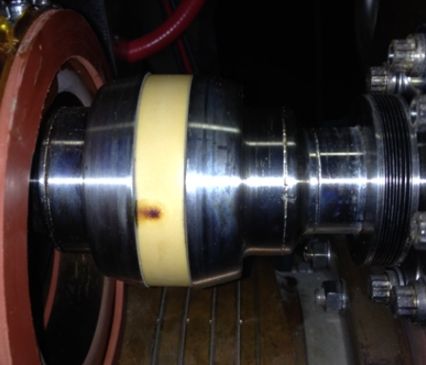
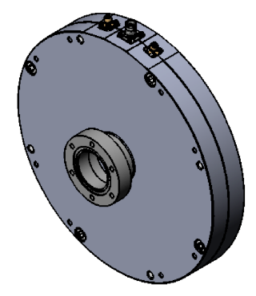
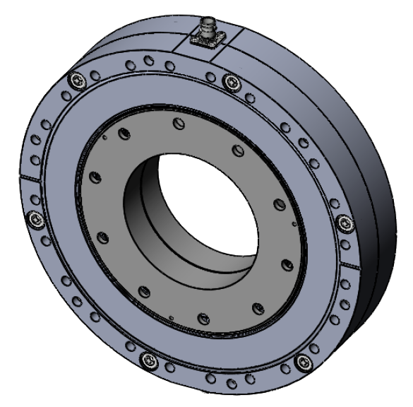
Non-standard ACCT sensors
SNS experience: “suspected RF electrons” can burn a hole in the ACCT ceramic. → a decision was then made to protect the ESS ACCT ceramic by a metallic piece inside the toroid. Because of this and due to the sizes of the beam tube, 2 customized ACCT sensors (qty: 6 + 2) were produced by Bergoz for ESS.
The second current sensor in the MEBT is a combined ACCT + FCT with a design meeting the ESS requirements.
Also, the DTL ACCT sensor is a special design. Twisted pairs are used to connect the ACCT windings to BNO connectors outside the DTL tanks.
Source: W. Blockland paper, MOPP025, IBIC’19

Slide 5
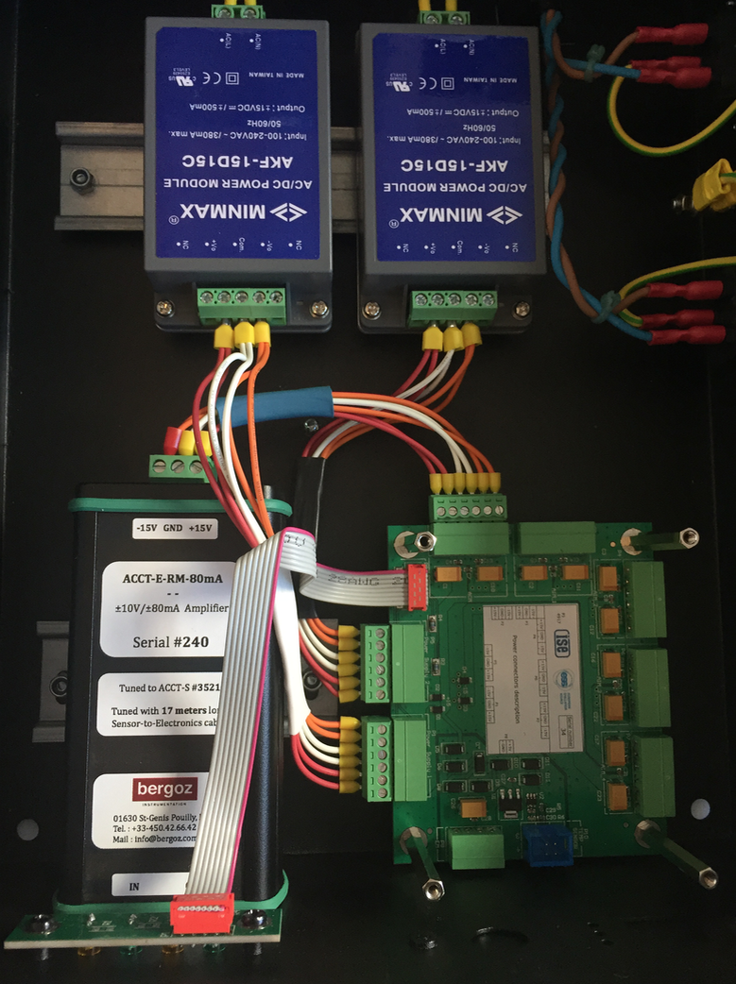
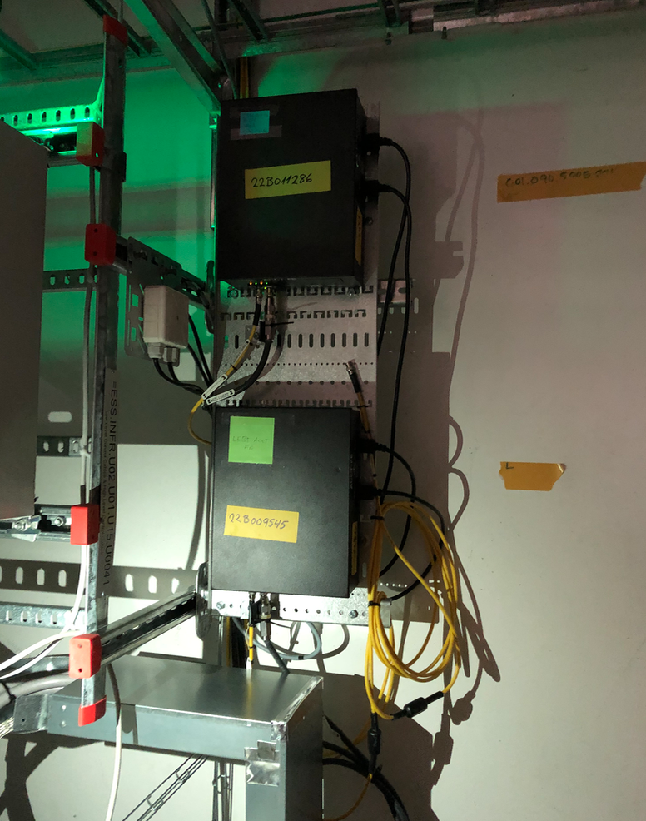
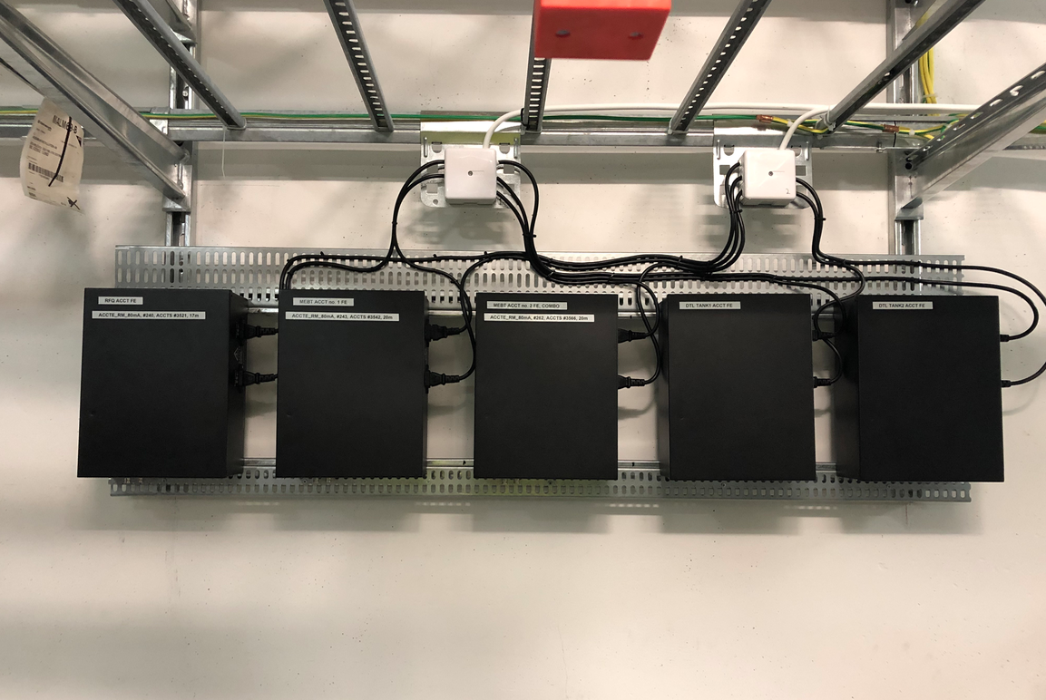
ACCT Front-end units
The FE boxes (22 in total) have been produced by WUT and delivered to ESS.
2 FE units were previously installed above the isolation transformer to receive the output signals of the ISrc and LEBT ACCTs.
5 more FE boxes (currently, only 3 including Bergoz ACCT-E modules) were recenly installed in the FEB for the ACCTs belonging to the RFQ, MEBT and DTL tanks 1-2.
The FE unit includes the Bergoz ACCT-E, a redundant power supply and an optional differential driver module.

Slide 6
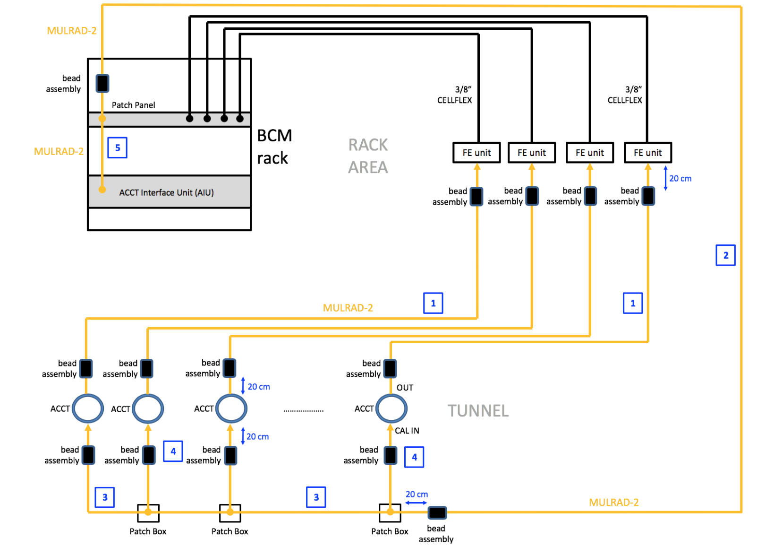
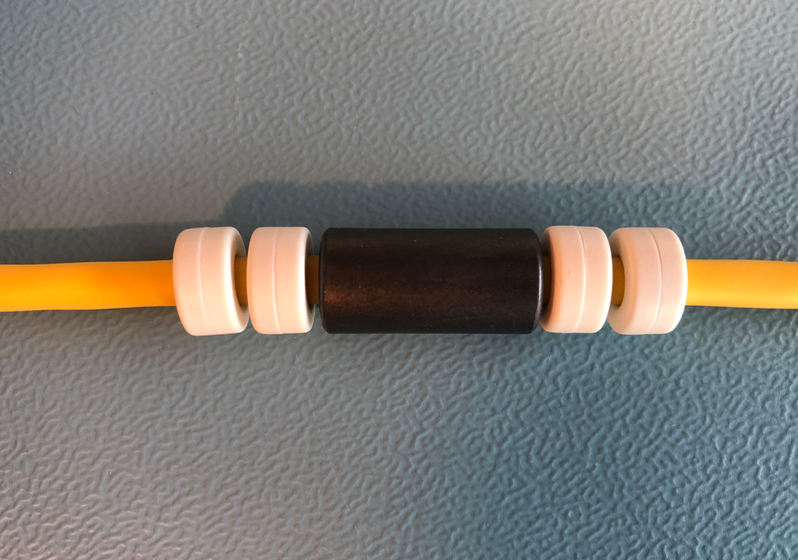
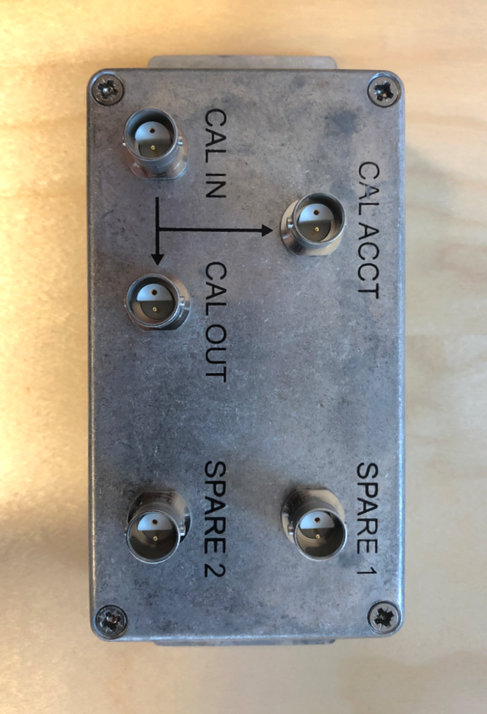
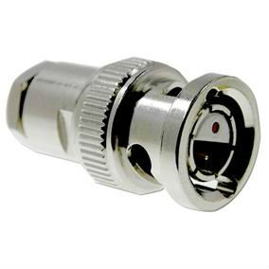
BCM cabling
The ISrc and LEBT ACCTs are cabled.
Cabling of the RFQ, MEBT and DTL tank 1-2 ACCTs are expected in Nov. 2019.
Bead assemblies will be needed on Mulrad-2 cables.
BCM patch panels (already delivered to ESS) will be used in the BCM rack to connect to the long-haul sensor cables.
For the series-connection of the ACCT cabilration windings, a BCM patch box will be installed near the ACCT sensor. The patch boxes are already delivered to ESS.
The cables internal to the rack are standard cables including: LEMO, BNC, ethernet, optical and power.

Slide 7
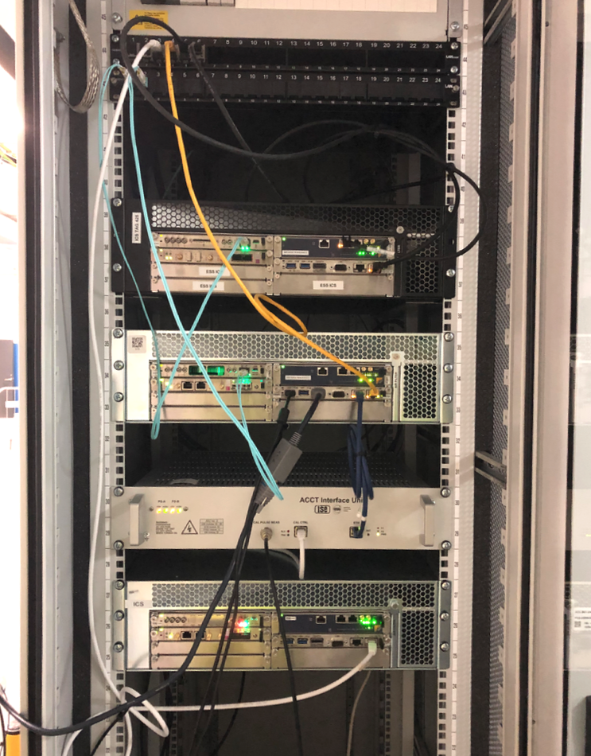
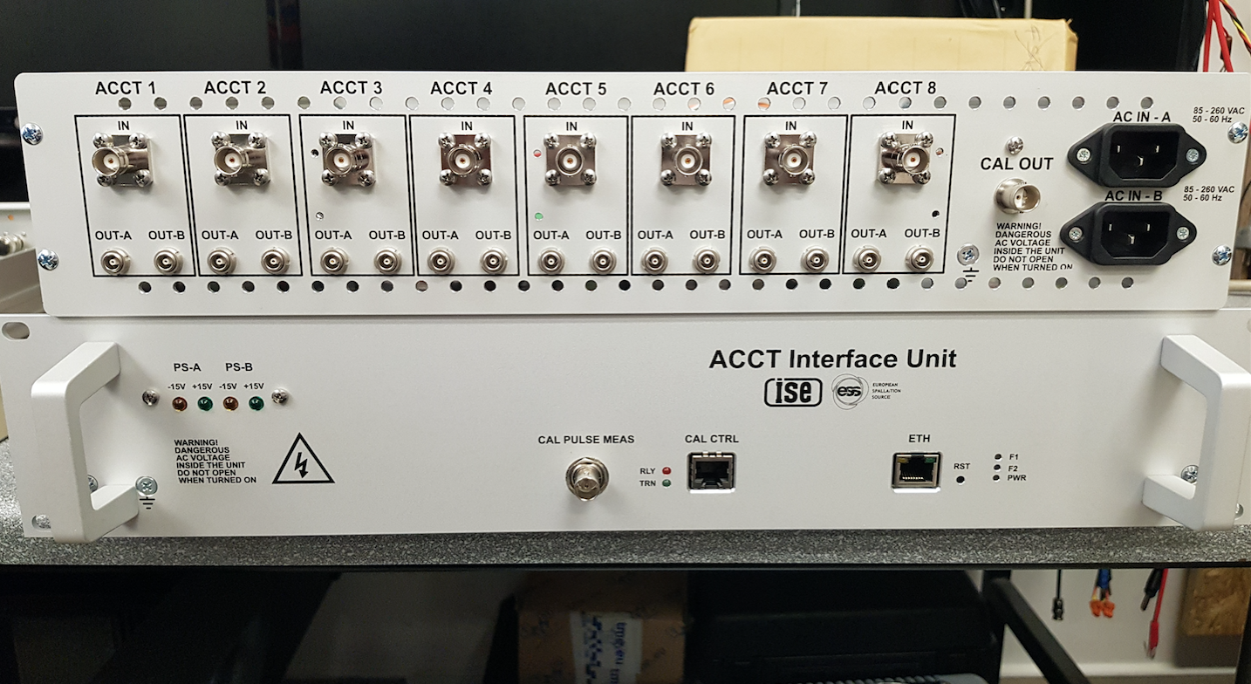
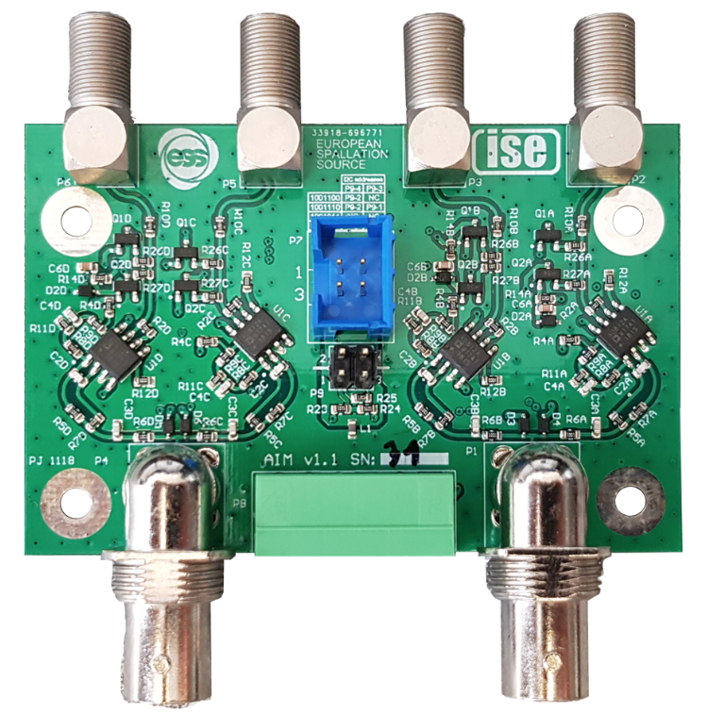
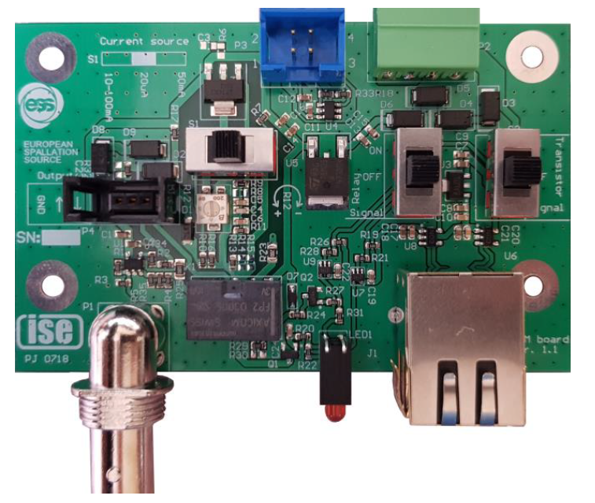
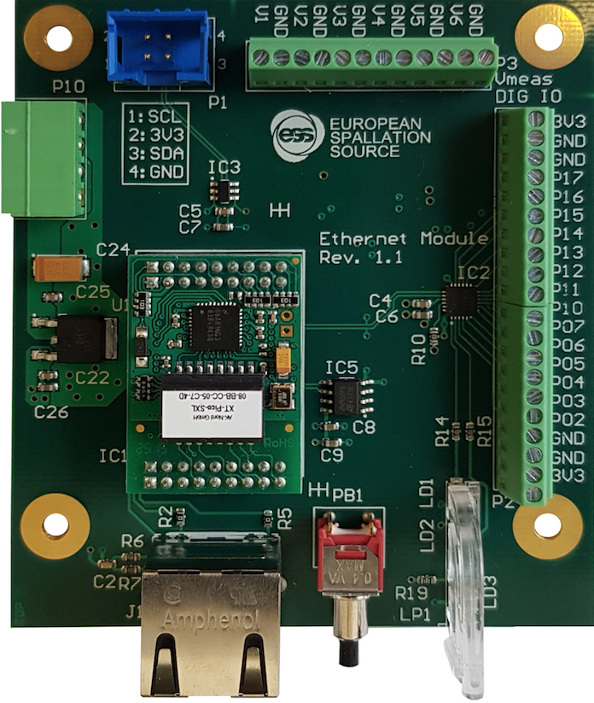
ACCT Interface Unit (AIU)
Final AIUs (3 variants, 12 in total) have been produced by WUT and delivered to ESS.
Paweł Jatczak and Maciej Urbanski from WUT were at ESS during April 8-14th 2019 and helped with the BCM electronics tests and on-site installations.
One AIU (covering ACCTs from the ISrc to DTL tank 2) is now installed on site.
A second one is installed in the BI lab and is being used for the ongoing tests and verifications.

Slide 8
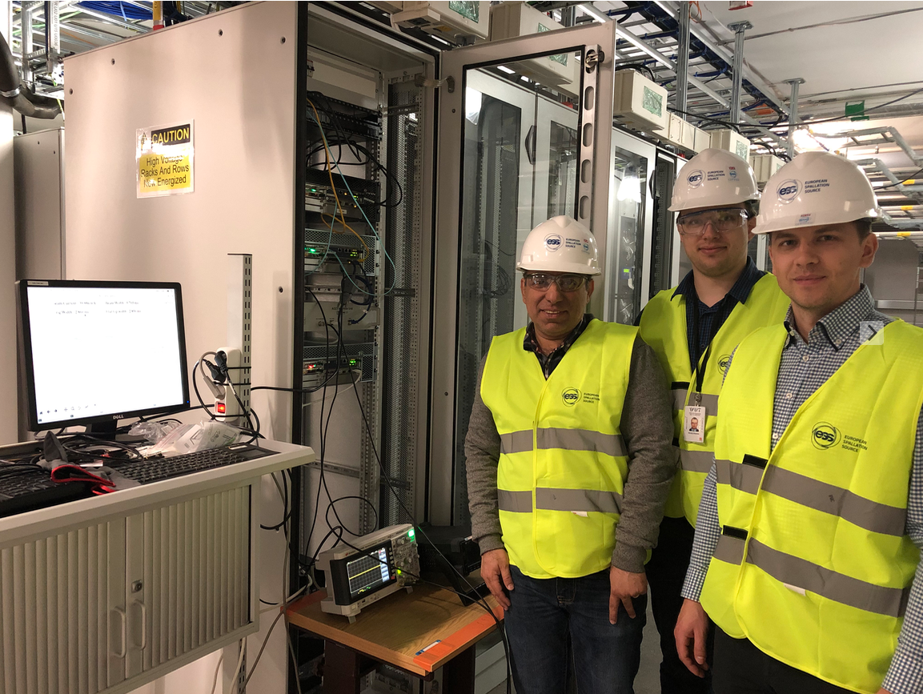
Installation of the 1st AIU
Delivery of the BCM electronics by WUT and site installation of the first AIU (10 April 2019)

Slide 9
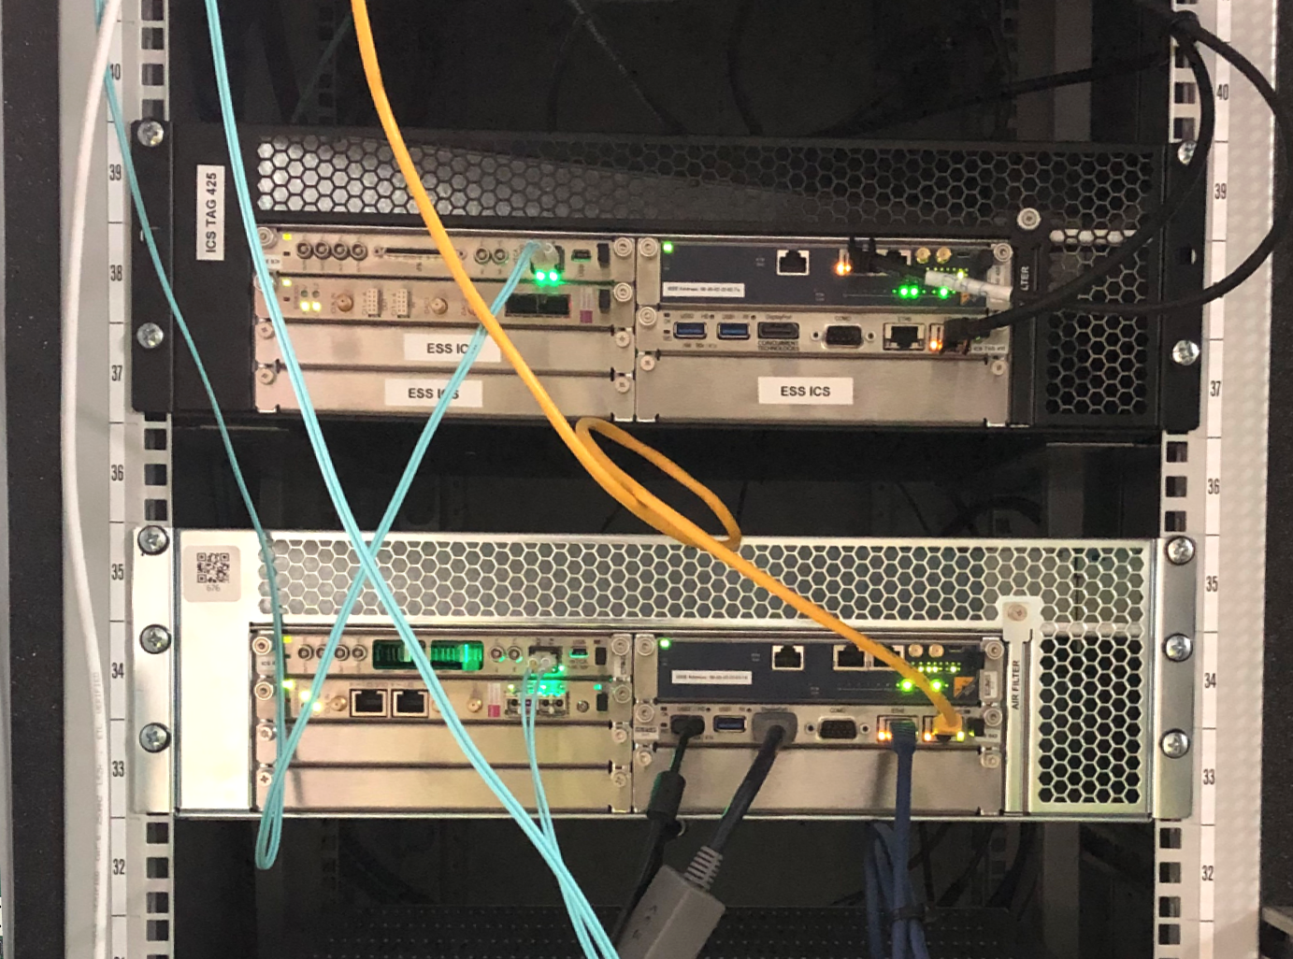
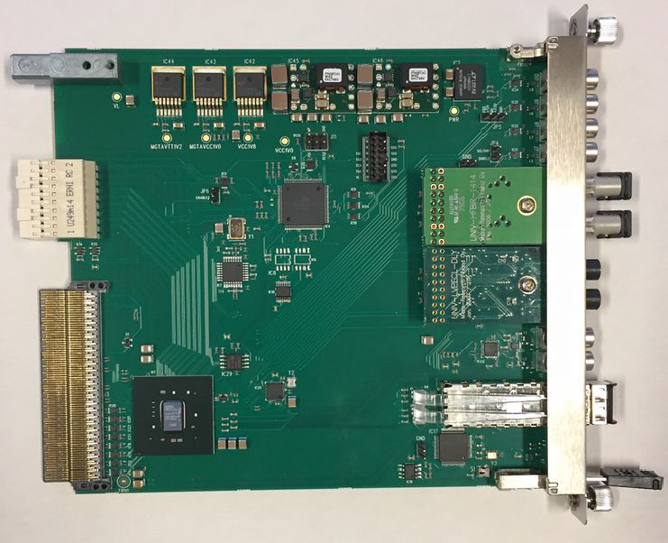
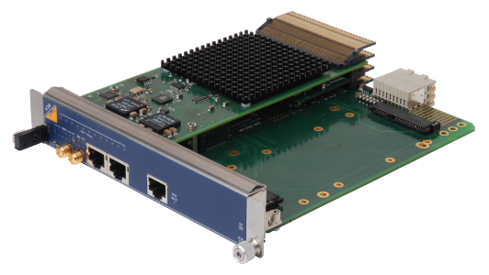
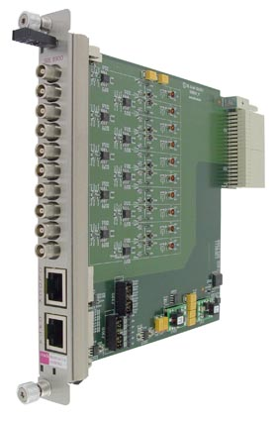
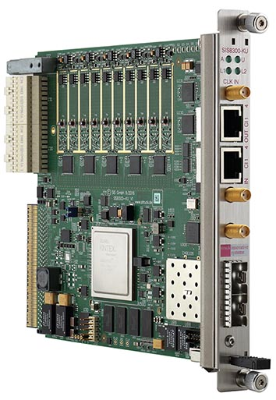
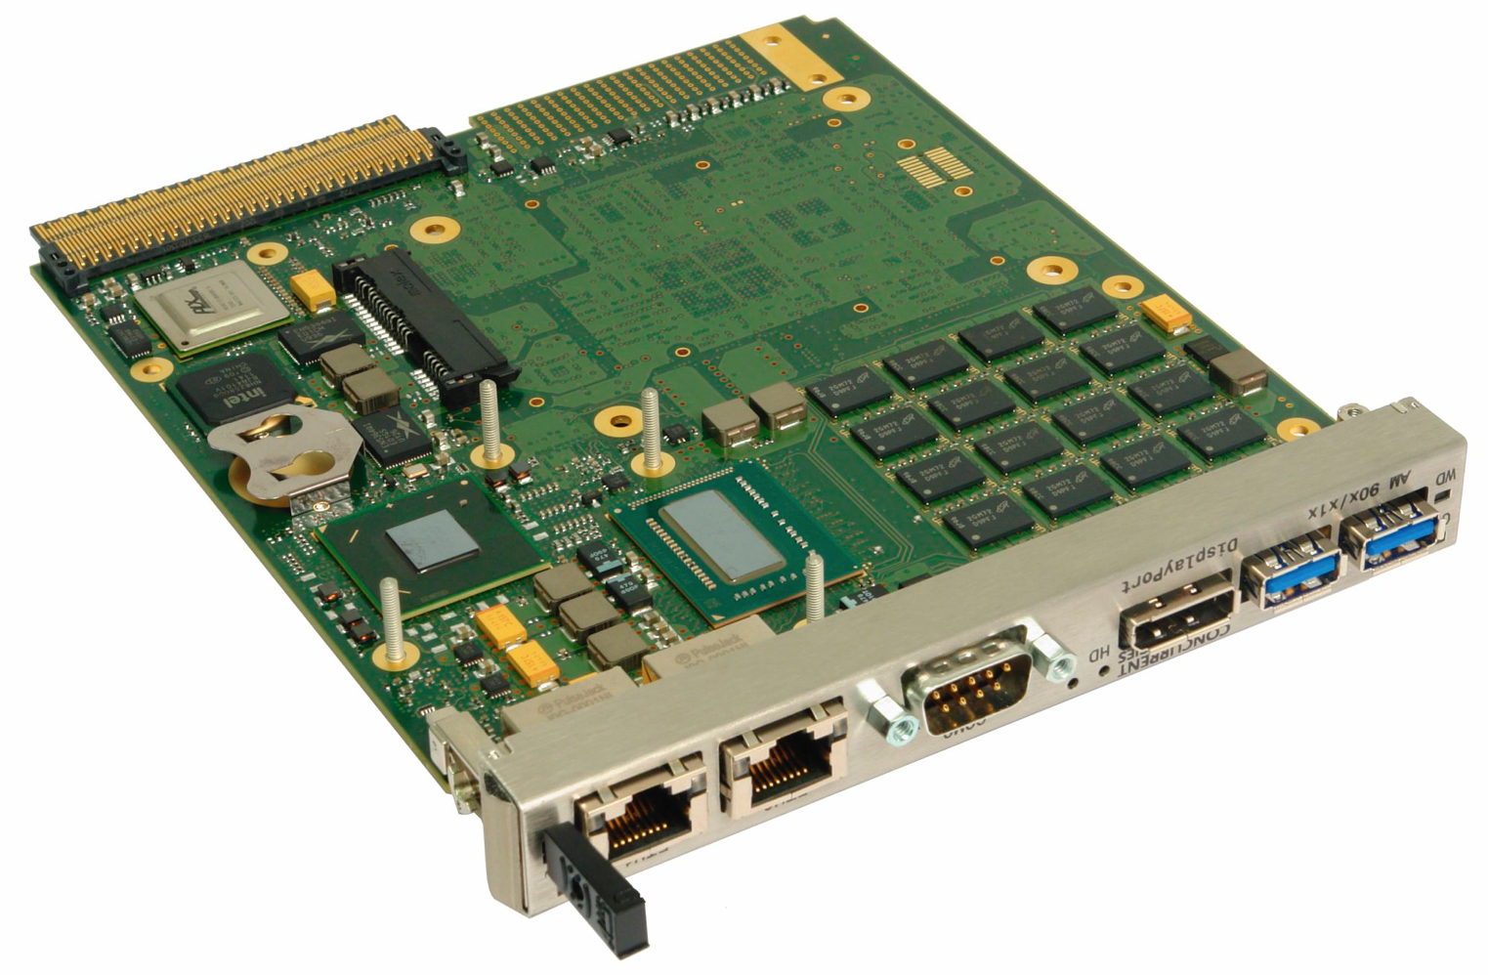
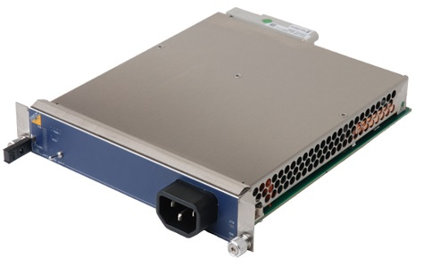
uTCA crate and infrastructure cards
Struck SIS8900 and SIS8300-KU boards for the BCMs in the warm linac have been purchased by ESS-BI.
Delivery of the uTCA crates and the infrastruture cards are expected from ESS-ICS.
A uTCA crate running the BCM rev. 1 (used during the first round of ISrc/LEBT commissioning in Lund) is still in the BCM rack (should be replaced with a redundant BCM rev. 3).
Another uTCA crate running BCM rev. 3 FW is now installed on site and is currently being used for the BCM FW and the BCM-FBIS interface tests.
A few more uTCA crates are being used in the BI lab for the ongoing BCM tests, verifications and bug fixings.

Slide 10
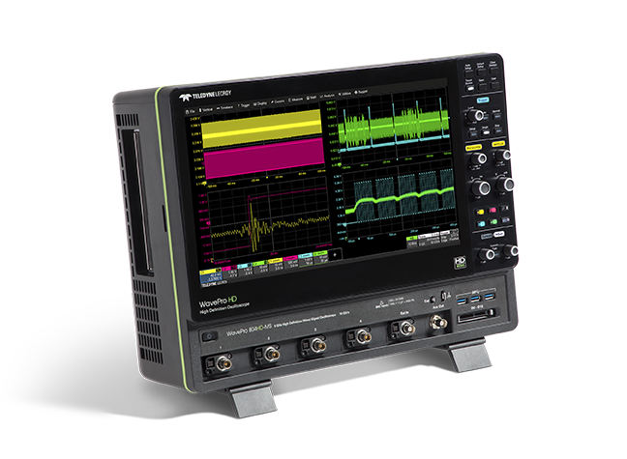
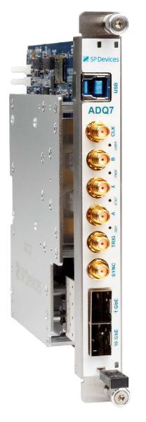
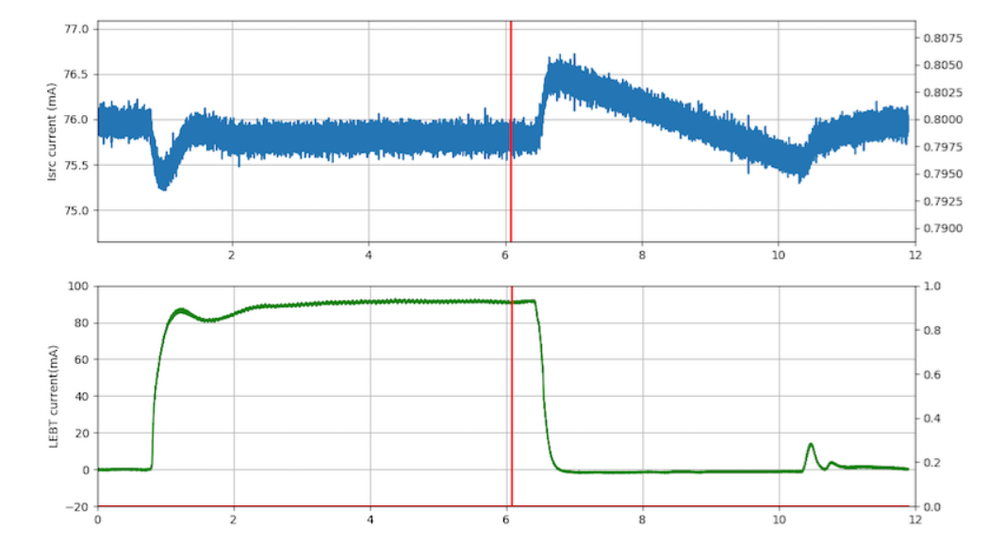
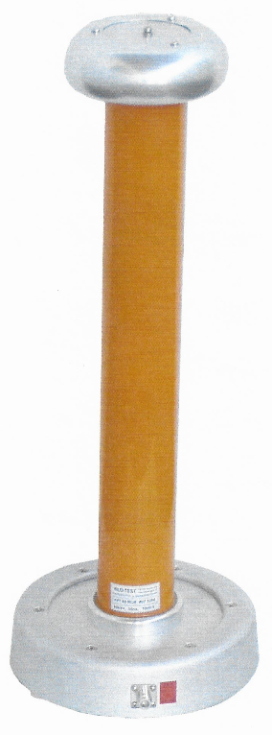
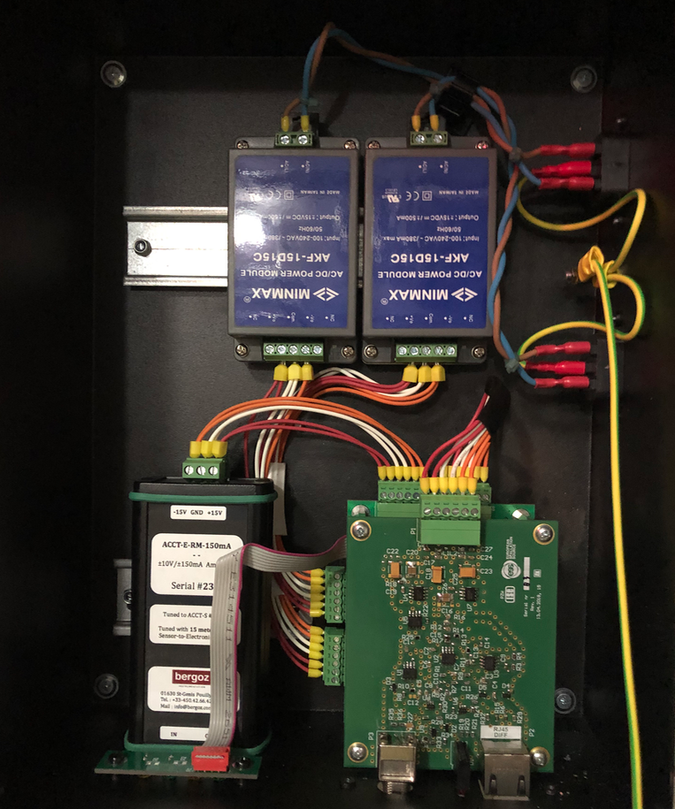
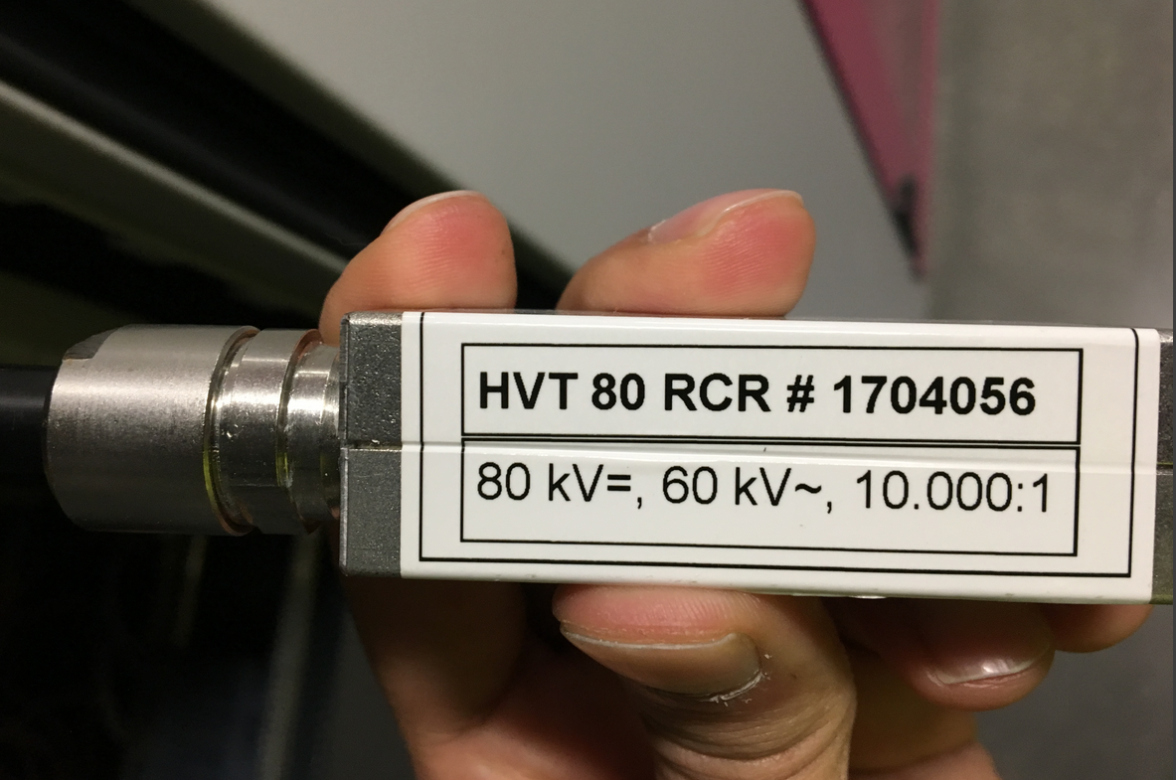
Other items
FCT readout: the FCT has a bandwidth of 620 MHz and it is foreseen for measuring the pulse rise/fall time after the MEBT chopper. As a quick and simple solution, a high-speed desk-top oscilloscope (available) can be used for measuring the FCT output signal. Other options include a fast digitizer AMC and a rack-mount oscilloscope.
HV platform voltage measurements: a spare channel of the BCM electronics has been used for measuring the voltage of the ISrc HV platform (~76 kV). Two differential driver boards (WUT collaboration) were slightly modified and used for measuring/transmitting the voltage divider output signal to the BCM rack-mount electronics.

Slide 11
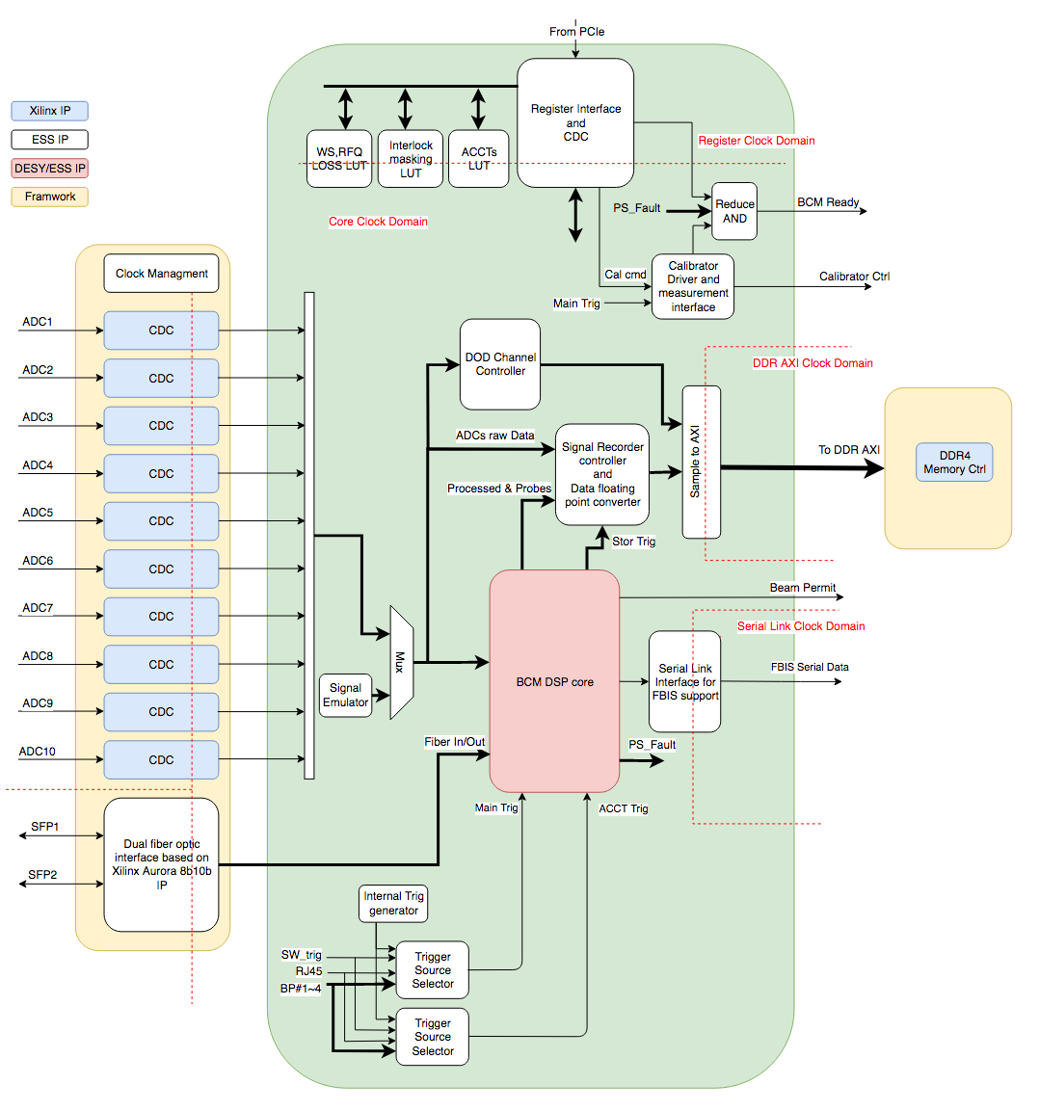
BCM firmware – top level
Mehdi Mohammadnezhad (consultant from SIGMA) and Matthias Werner (DESY) have been contributing to the development of the BCM FW rev. 3.

Slide 12
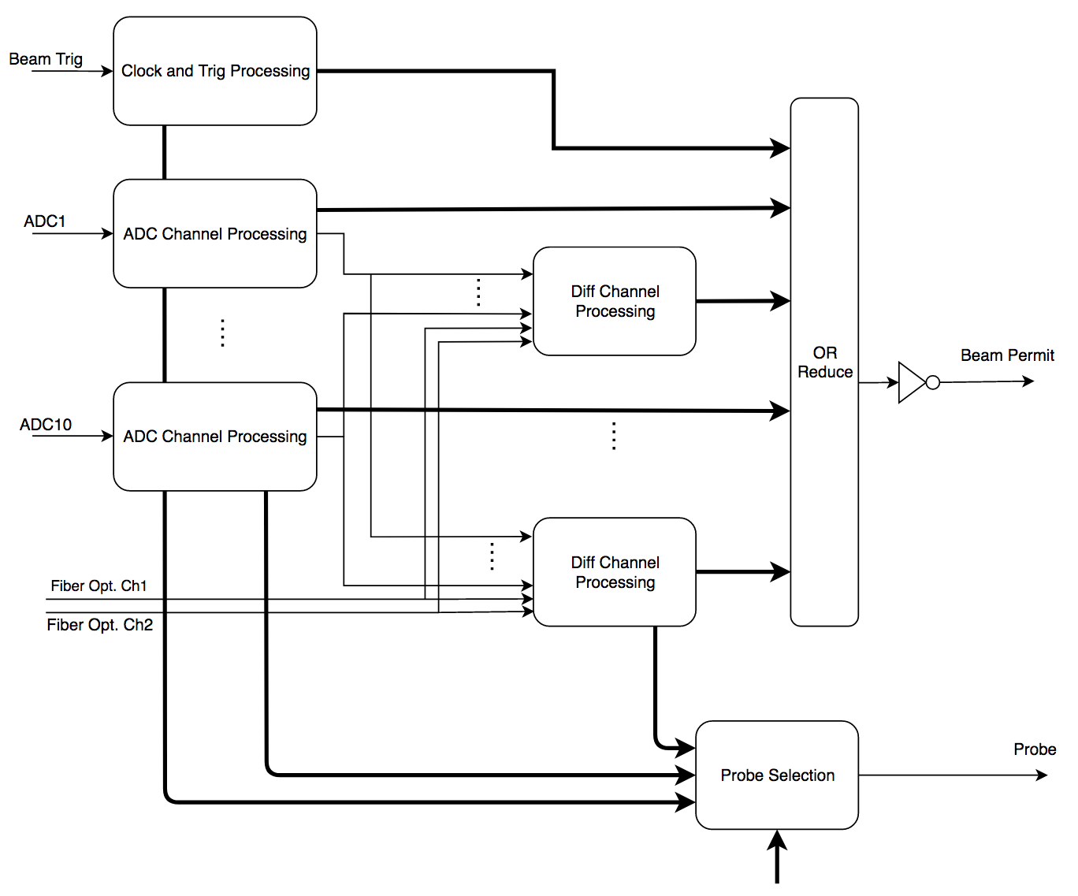
BCM firmware – Beam Permit signal

Slide 13
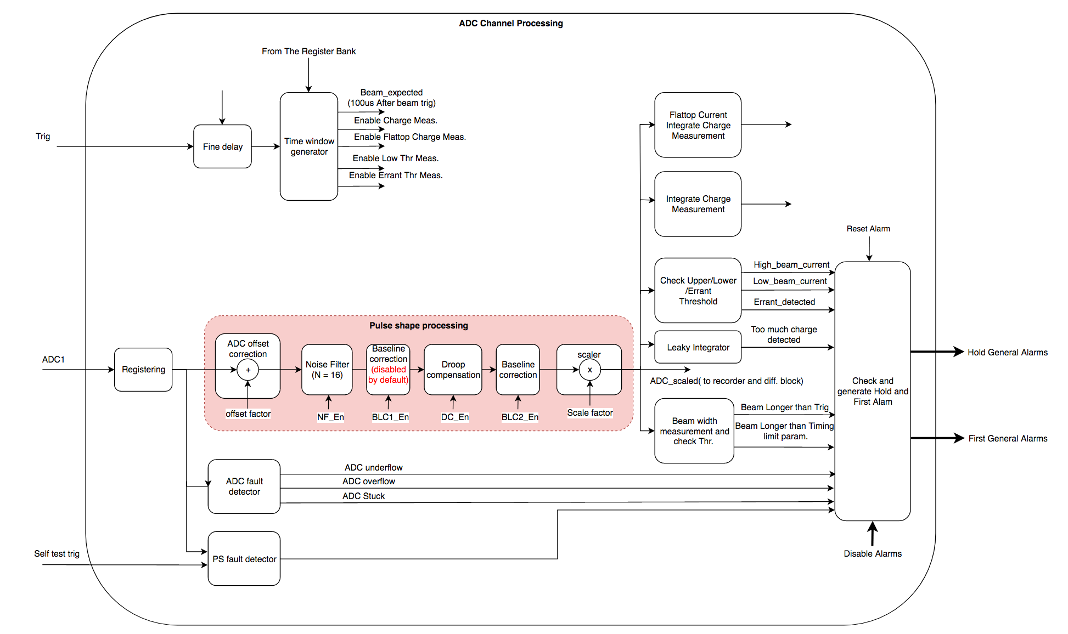
BCM firmware – ACCT data processing

Slide 14
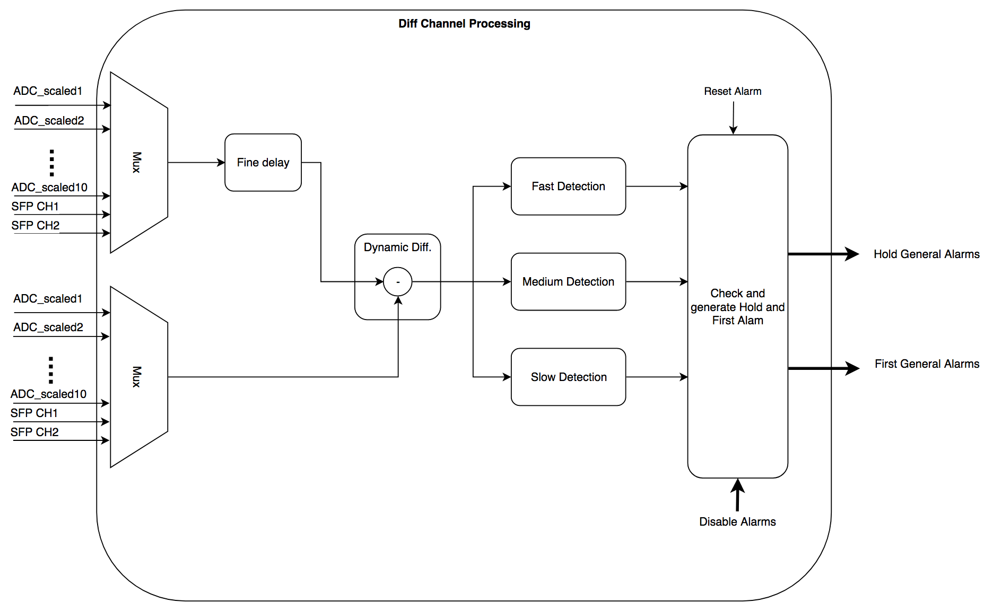
BCM firmware – differential alarms

Slide 15
BCM software
Software development for the BCM rev. 3 (current revision) is divided in 4 stages. This covers the most urgent needs for the upcoming beam commissioning.
Stage 1:
Pulse shape (Shows pulse shape on the OPI)
Charge per pulse (Measures total charge in one pulse including pulse rise/fall times)
10 input channels (Processes signal from max 10 input channels)
Average pulse current (Measures average current over a configurable time window)
engineering OPI for the above features
Stage 2:
10x processed channel data
Auto baseline restoration (Automatically re-baselines the measured pulse to zero current during no-pulse period)
Droop compensation (Compensates ACCT droop based on an inserted droop rate)
Moving averager (Applies a low pass filter (if enabled) to reduce ACCT signal noise)
engineering OPI for the above features
Stage 3:
Interlock on too-high current, too-low current, inconsistent pulse rate, inconsistent pulse width, errant beam, integrated charge (LI),
BCM READY (for the BCM-FBIS interface)
BCM-FBIS interface (BEAM_ABORT, BCM_READY and serial data link in the BCM-FBIS interface)
Probe channels (1-4)
engineering OPI for the above features
Stage 4:
MPS parameters restoration (design and development of controlled parameter restoration scheme)
ACCT calibration (Generates a calibration pulse with a precise timing after receiving an ACCT CAL event from the Timing system, precisely measures the pulse amplitude and the droop rate, and re-adjusts the BCM parameters to compensate for any drifts)
ACCT calibration (Timing system sends out an ACCT CAL event every 20 min; all the ACCTs will then get calibrated during the next immediate no-pulse after receiving this event)
Data on demand continuously writes most recent BCM data on the AMC memory and freezes the data upon receiving a beam abort event from the Timing system)
OPI for the above features
Stages 1-2: are nearly done (Probe channels are required to complete the FW verification).
Stage 3: work is ongoing.
BCM rev. 3 SW by: Hinko Kocevar (ESS-BI)

Slide 16
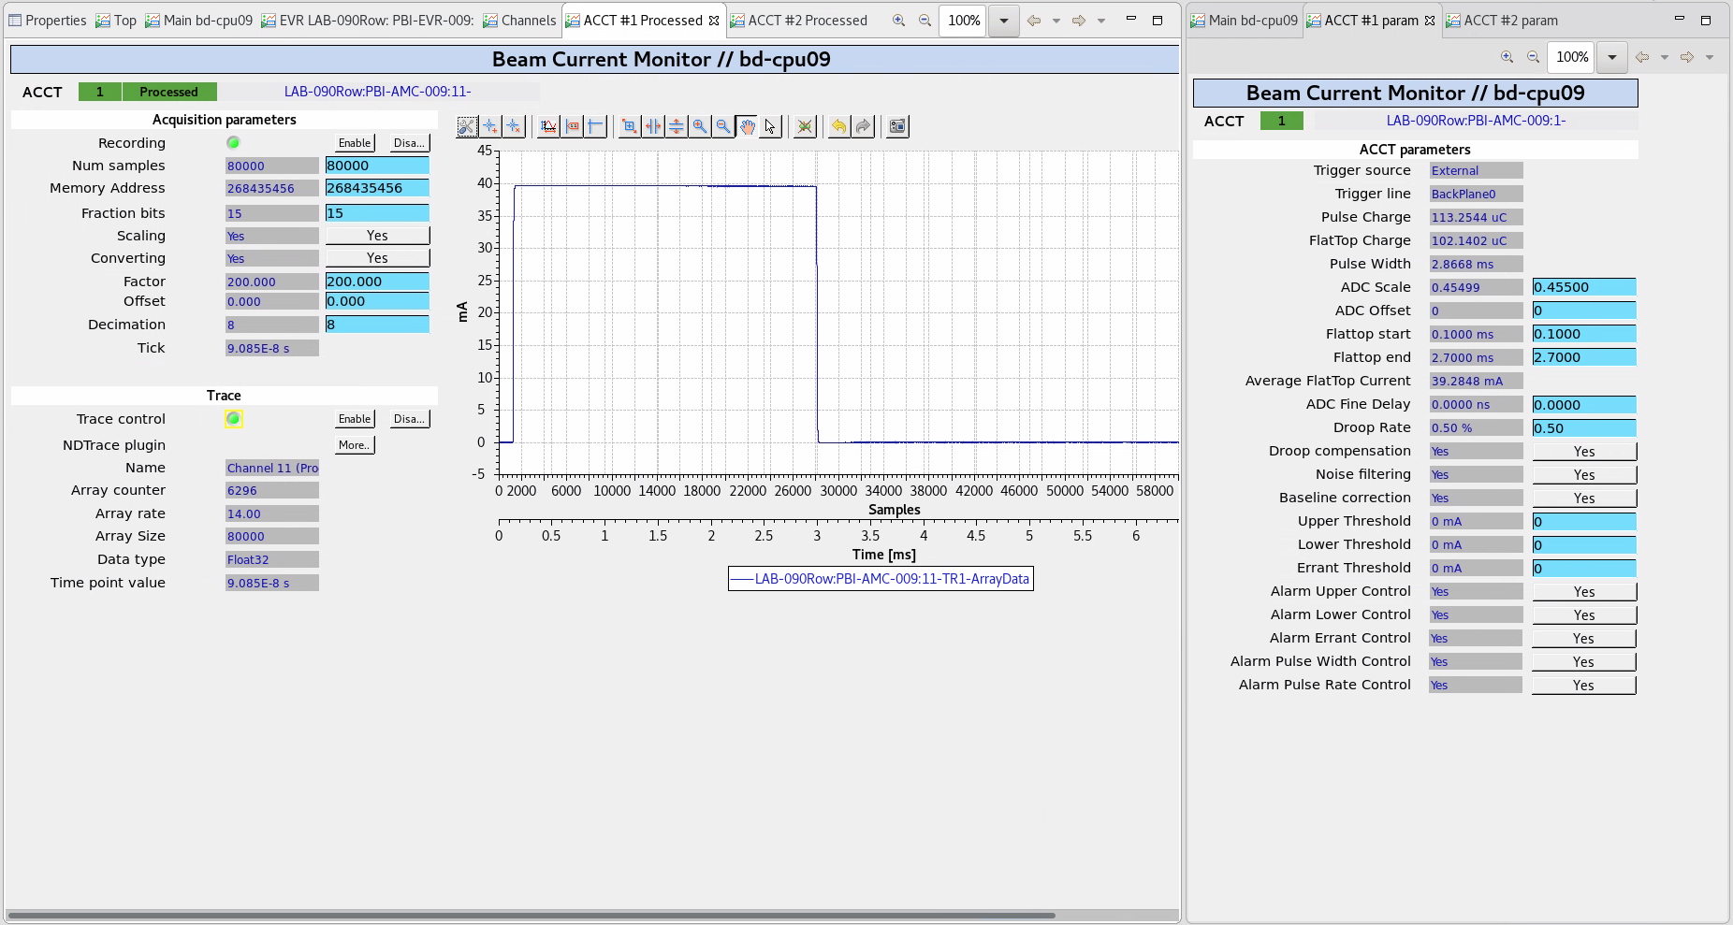
Engineering OPI for the ongoing SW development – ongoing work

Slide 17
MPS-agreed BCM machine-protection functions
Upper thresh.
BEAM
BEAM-NOT-ALLOWED ZONE
Errant thresh.
Lower thresh.
(opt)
BEAM-ALLOWED ZONE
Based on the existing agreement with the MPS group, the BCM system provides the following machine protection functions:
Too-high beam currents
Errant beams
Inconsistent pulse rate
Inconsistent pulse length
Differential current (at least 6 differential pairs)
The activation time windows of these thresholds are based on an external trigger from the ESS Timing System.
Before changing to a new beam mode, the BCM FW needs to automatically switch to a new threshold setting based on an interrupt from the Control System.
As the pulse width and ampliude is not always the same along the linac, at least part of the thresholds needs to be specific to each ACCT.

Slide 18
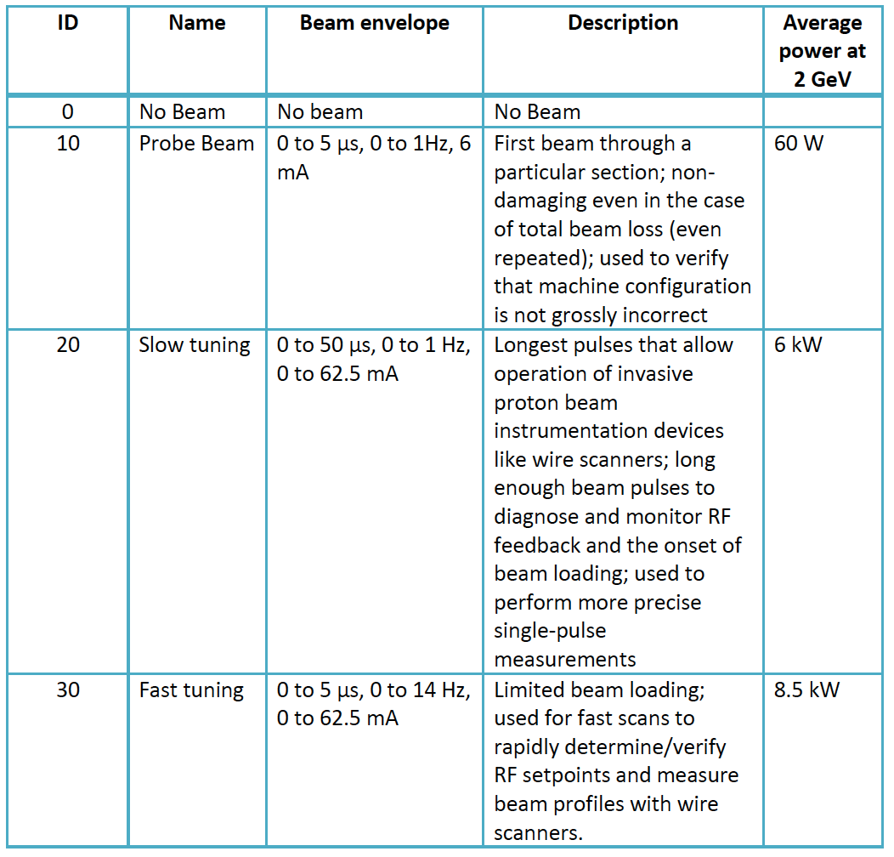
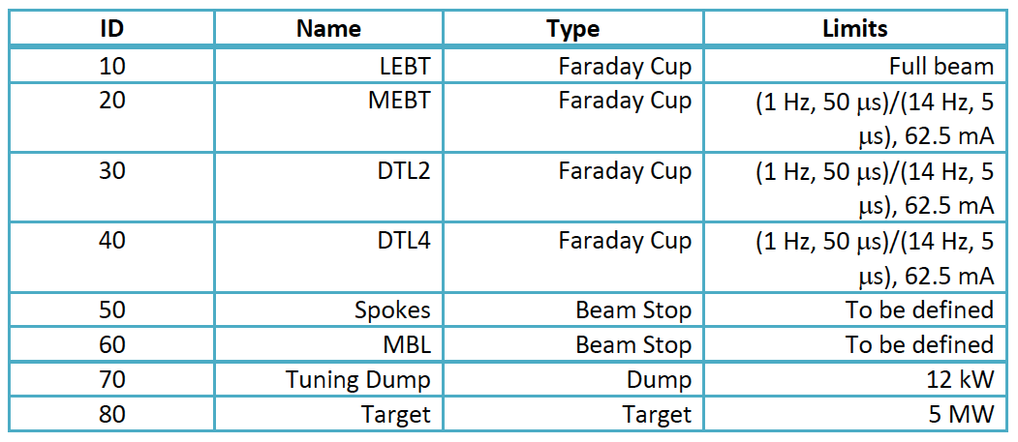
ESS Beam and destination modes
Definition of ESS beam modes and beam destinations: ESS-0038258
The beam mode table defines an envelope for the beam properties in each beam mode. These parameters are used in the BCM FW to automatically set the MPS thresholds for each mode.
The beam destination table table tells where the beam should be stopped in each destination mode. This table is used in the BCM FW to automatically mask in / out the BCM protection functions based on the beam destination.

Slide 19
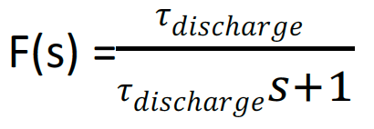
Proposal 1: a new model-based differential machine protection function
Principle: assuming that the beam hits a point (ex. the beam tube) due to a fault, the beam will deposit part of its energy on that point and the temperature will quickly increase, but in the same time, heat starts scaping tending to reduce the temperature. This dynamics, in its simplest form, can be modeled by a leaky integrator. The transfer function of the charge build-up as a function of a differential current can be implemented on the BCM FPGA and a machine-protection threshold can be applied to the integrated charge. In case of a beam loss, the beam can then be stoped before the temperature reaches a damaging level.
ACCT
ACCT
ISrc
Linac section
Linac section
Linac section
Target
+
-
FPGA
Charge build-up model
q
YES
ABORT
△i
> thresh. ?
FBIS
Incident beam
metal

Slide 20
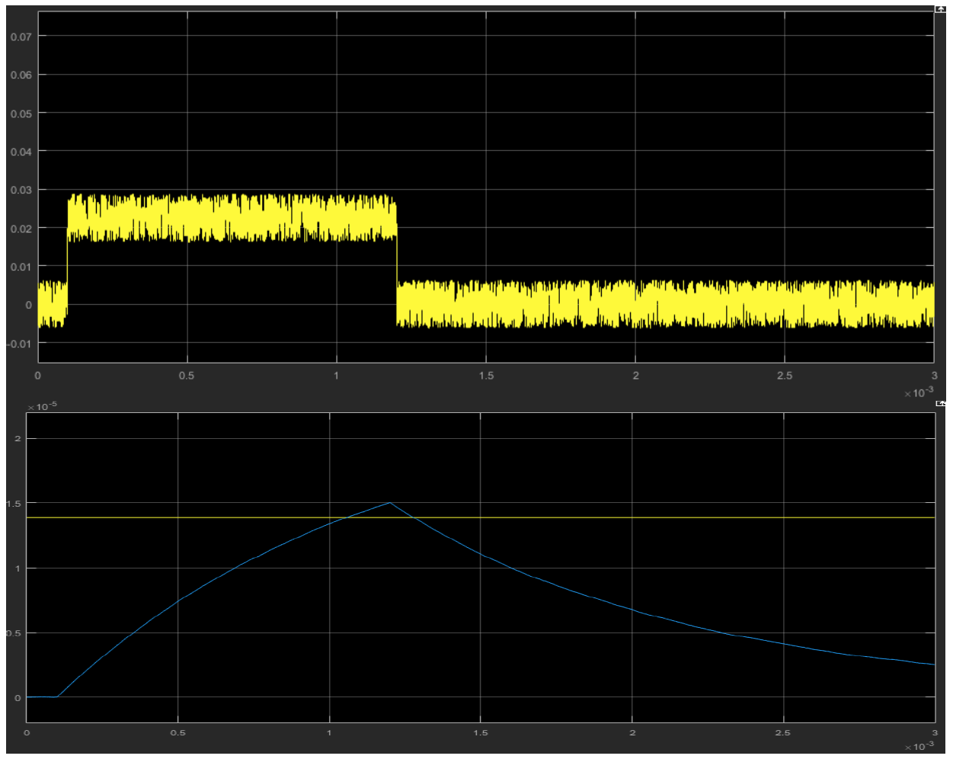
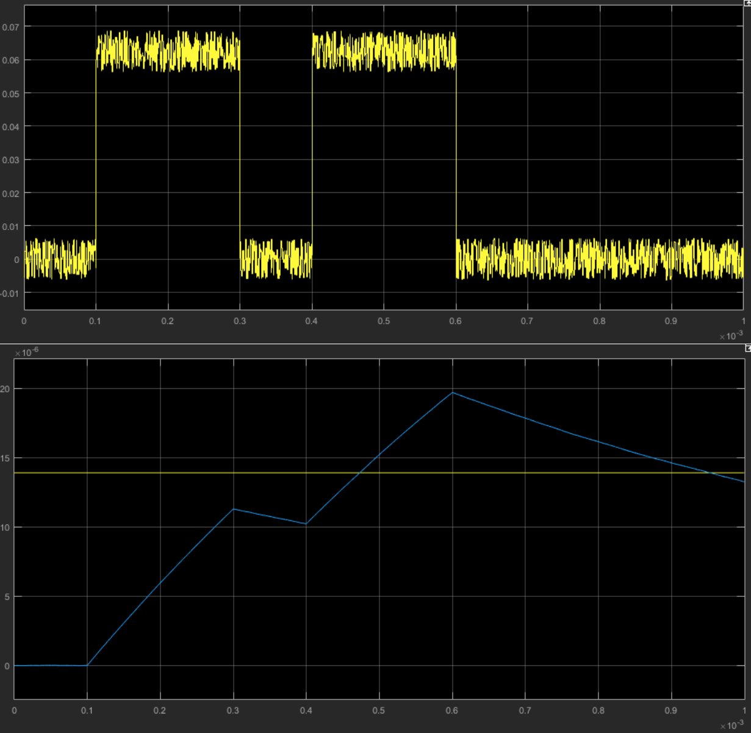
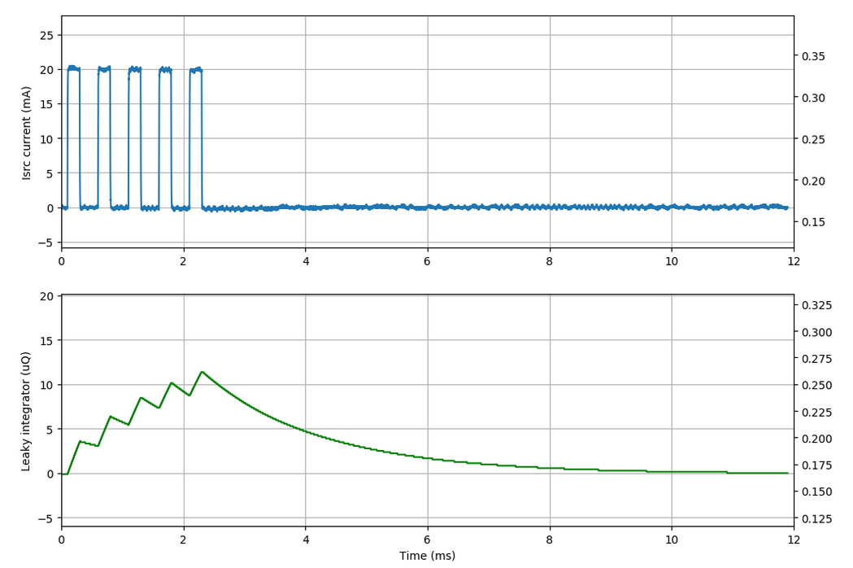
Proposal 1: a new model-based differential machine protection function
Advantages of the MB method include:
Simplicity
No dependency on the timing system
Reduced number of unnecessary beam stops ex. due to short and non-destructive errant beams
Improved machine protection functionality.
FPGA implementation
Two examples (simulation) of potentially destructive errant beams, being 1) small and persistent and 2) two consecutive short pulses that can be detected with the model-based method.

Slide 21
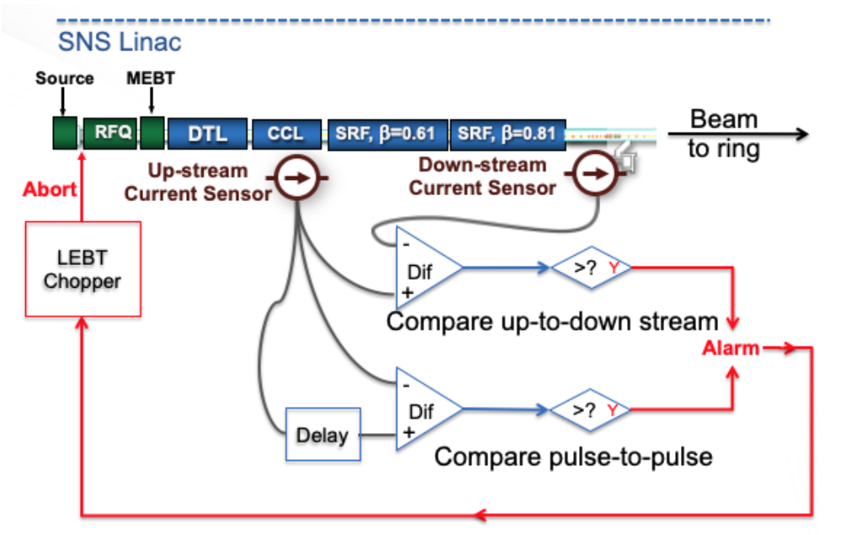
Proposal 2: a protection function based on pulse-to-pulse waveform comparisons
SNS now uses an upgraded differential beam interlock system that compares, sample by sample, the incoming beam pulse profile with the previous beam pulse profile. This is reported to improve the beam ON time by reducing beam losses due to RF faults and ion source arcings.
Source: W. Blokland’s paper MOPP025, IBIC’19 - Malmo

Slide 22
Issues / next steps
LEBT collimator ACCT should be re-installed to correct for the signal polarity.
Noise-reduction beads needed on the BCM long-haul cables.
BCM patch boxes to be added to the 3D model installed near the first 5 ACCT toroids.
Awaiting ACCT-E units for the DTL tank 1-2 FE units
uTCA crate and infrastructure boards for the BCM crate 1B (redundant crate) expected from ICS.
A decision should be taken for the FCT readout electronics (similar to the ”fast BPM” electronics).
External trigger for the ISrc downstream ACCTs.
Machine protection thresholds need to be stored on a remote server.
SW development for the BCM rev. 3 (ongoing work)
OPI for the BCM rev. 3

