Slide 1
Low latency link development and MPS interface
Hooman Hassanzadegan on behalf of:
Mehdi Mohammednezhad
(SIGMA connectivity)
BI forum, 22-24 Oct. 2019, Warsaw
www.europeanspallationsource.se

Slide 2
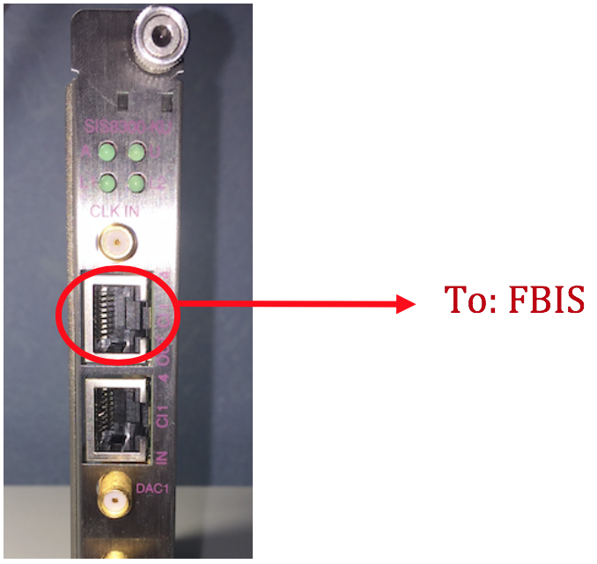
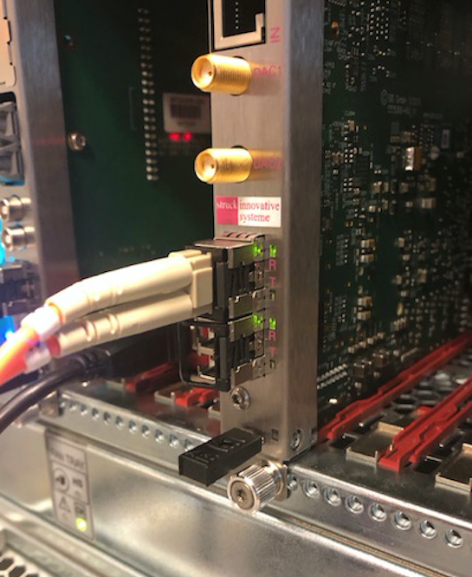
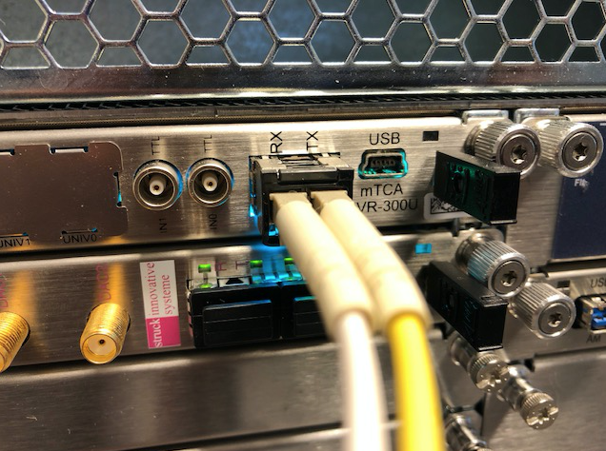
Background
BCM system has 3 special interfaces to external systems:
BCM-FBIS interface:
LVDS port on the SIS8300-KU
Optical interface for sending BCM data to other crates:
SFP port on the SIS8300-KU
Timing:
From EVR over the crate backplane

Slide 3
BCM – FBIS interface
The BCM system sends the following signals to the FBIS:
Beam Permit (redundant): OK / NOK
BCM Ready (redundant): OK / NOK
Beam Mode: 6 bits
Beam Destination: 6 bits
Beam Presence (crate 1A): YES / NO
HV Presence (crate 1B): YES / NO
The FBIS uses this information to ensure that the BCM system has been configured for the correct beam and destination modes.
See ESS-0105298 for more details

Slide 4
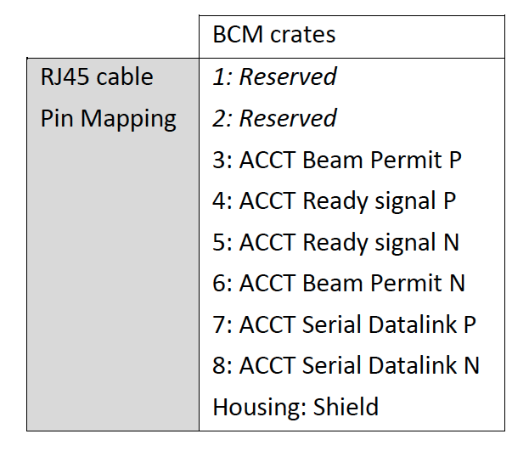
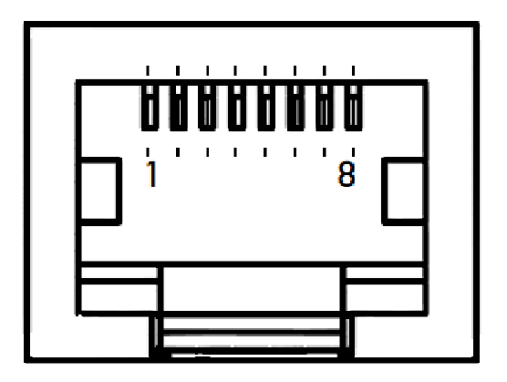
BCM – FBIS interface
Beam Permit and BCM Ready are discrete signals
The RJ-45 OUT port on the SIS8300-KU provides 4 LVDS channels.

Slide 5
Serial data link – packet structure (draft)
Data packet
0-1 train
header
Data (D0, D1, D2, D3)
CRC8
Manchester-encoded
D0: Beam Permit, BCM Ready
D1: Beam Destination
D2: Beam Mode
D3: Beam presence, HV presence
DC-balance is provided by:
D0-D3 and CRC bytes are Manchester encoded
A balanced train of 0-1 is sent in between each 2 consecutive packets
The Header has the same number of 0 and 1 bits

Slide 6
Serial data link – FPGA implementation
Line driver: LVDS
Line rate: 11 Mbps
Line encoding: Manchester
Error detection: CRC-8
Ref clock: 8 * bitrate
Transmitter
(clock_sync+code_violation+preamble+start_sequence )
Header
11 bits
91 bits
FBIS Data
(4 bytes)
Framer
(D0,D1,D2,D3)
32 bits
Manchester encoder
40 bits
80 bits
CRC-8
Receiver
91 bits
Find Header
and
Frame sync
Manchester deccoder
Deframer
(D0,D1,D2,D3,CRC8)
Check
CRC
FBIS Data
Sync clk
CRC-8
Clock synchronization

Slide 7
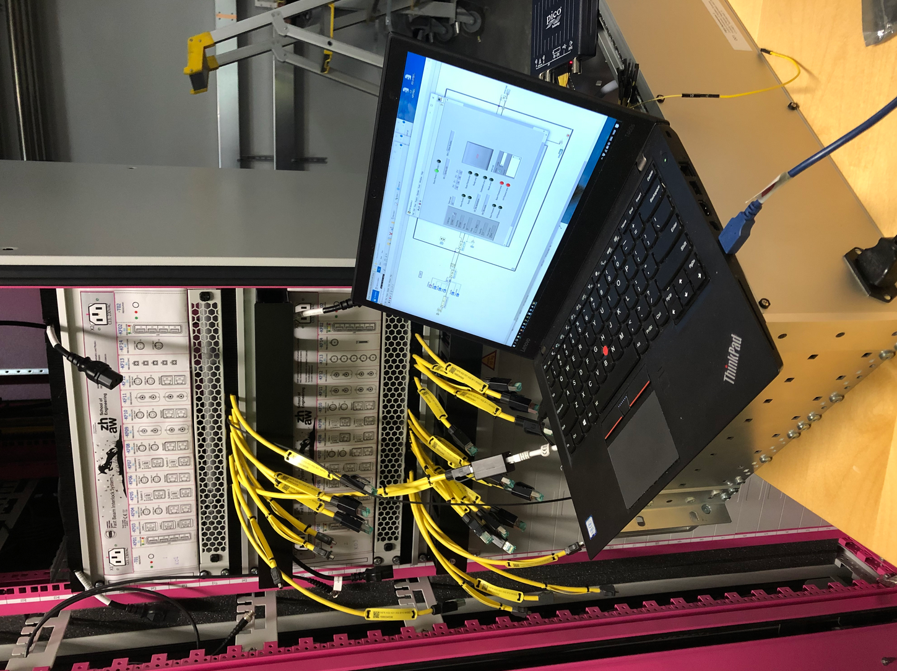
Endurance tests of the BCM-FBIS interface
The BCM and FBIS crates are hosted by two separate rack with a cable distance of ~20 m.
The BCM electronics sends a data packet to a prototype FBIS every 10 us.
BEAM_PERMIT and BCM_READY values are toggled and the BEAM_MODE and BEAM_DESTINATION values are incremented in each packet.
A tester application is being used at the FBIS side for decoding the packets and measuring packet error rates.
After 100 hours of run (i.e. 36 billion packets) in a ’quiet’ environment, 2 CRC errors were detected.
An LVDS protection module has also been developed with a prototype being used in the datalink tests.

Slide 8
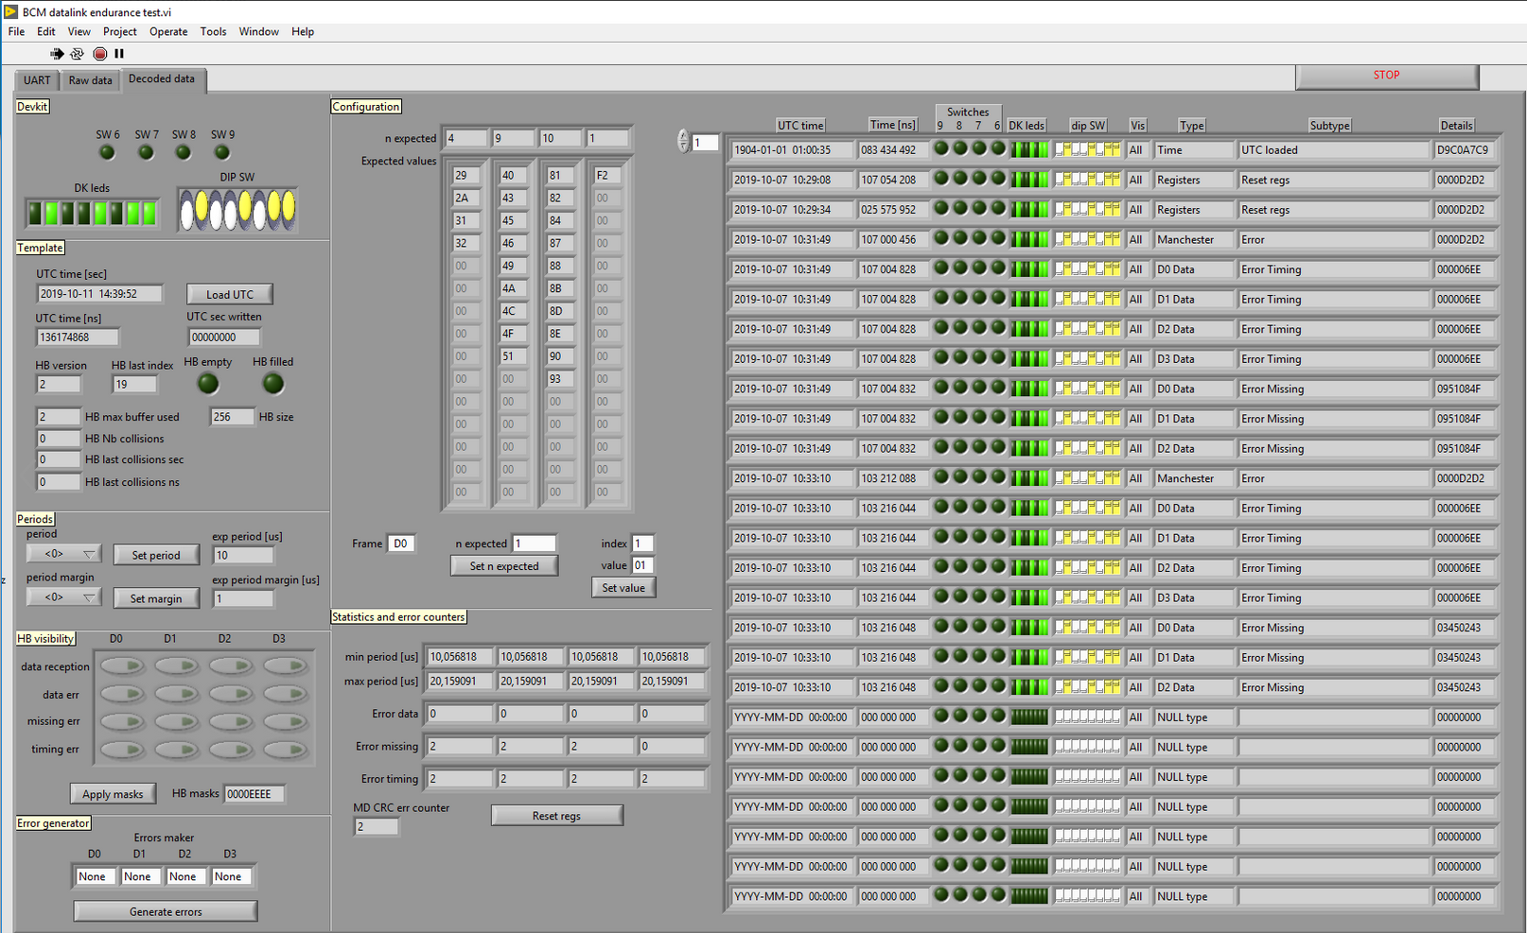
On-site tests of the BCM-FBIS datalink
BCM-FBIS tester application developed by: Stephane Gabourin, ESS-MPS

Slide 9
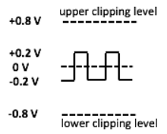
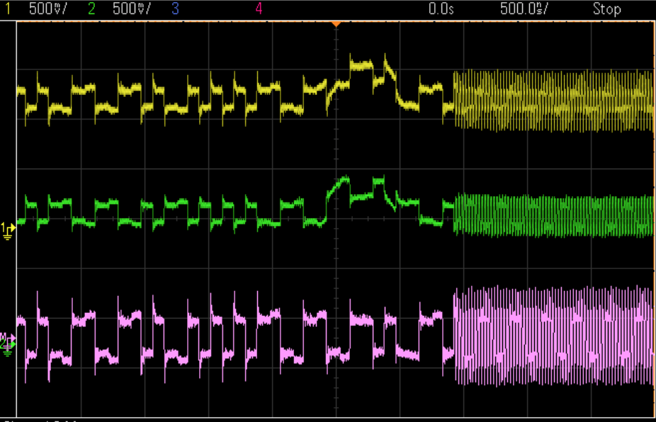
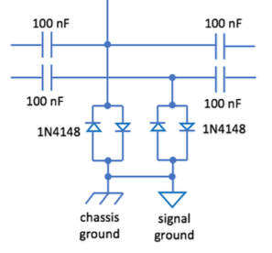

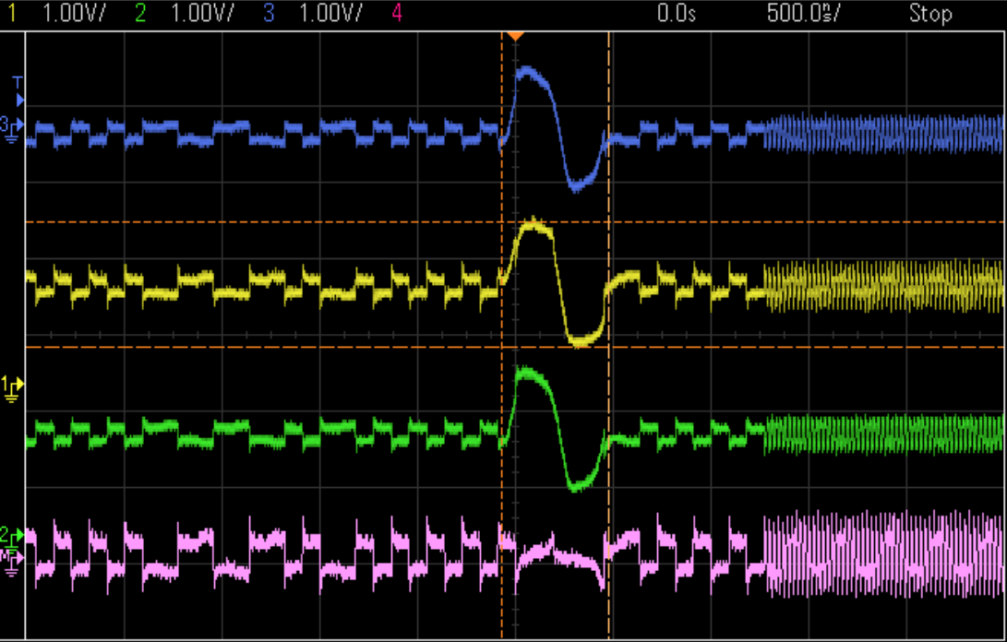
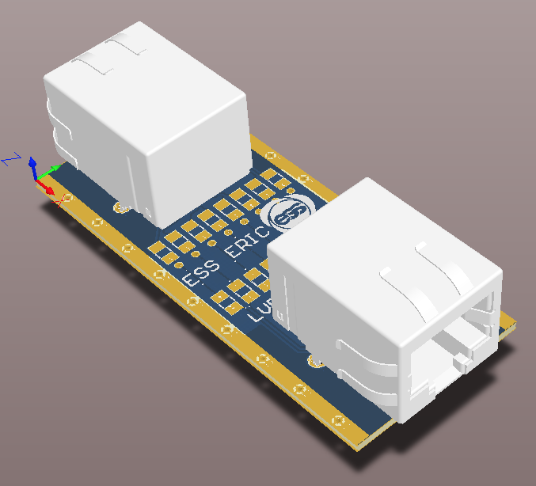
Protection module for the BCM-FBIS interface
The protection module protects the LVDS buffers against DC currents and too-high / too-low voltages.

Slide 10
Forward Error Correction (FEC)
FEC using Reed Solomon codes is being studied as future improvement
Reed Solomon
  A powerful burst error correcting code
  The Reed-Solomon encoder takes a block of digital data and adds extra "redundant" bits.
  The advantage of using Reed-Solomon codes is that the probability of an error remaining in the decoded data is (usually) much lower than the probability of an error if Reed-Solomon is not used. This is often described as coding gain.
Interleaver
  Makes forward error correction more robust with respect to burst errors.
Data in
Scrambler
RS-encoder
Interleaver
Channel
Data out
Descrambler
RS-decoder
DeInterleaver

Slide 11
The optical link
Optical link use cases for the BCM system include:
Sending BCM data to a downstream crate for differential current measurements
Sending BCM data to other systems such as LLRF and Neutron Instruments
Receiving beam data from other systems ex. FC for comparisions against BCM data
Future upgrade of the BCM-FBIS interface

Slide 12
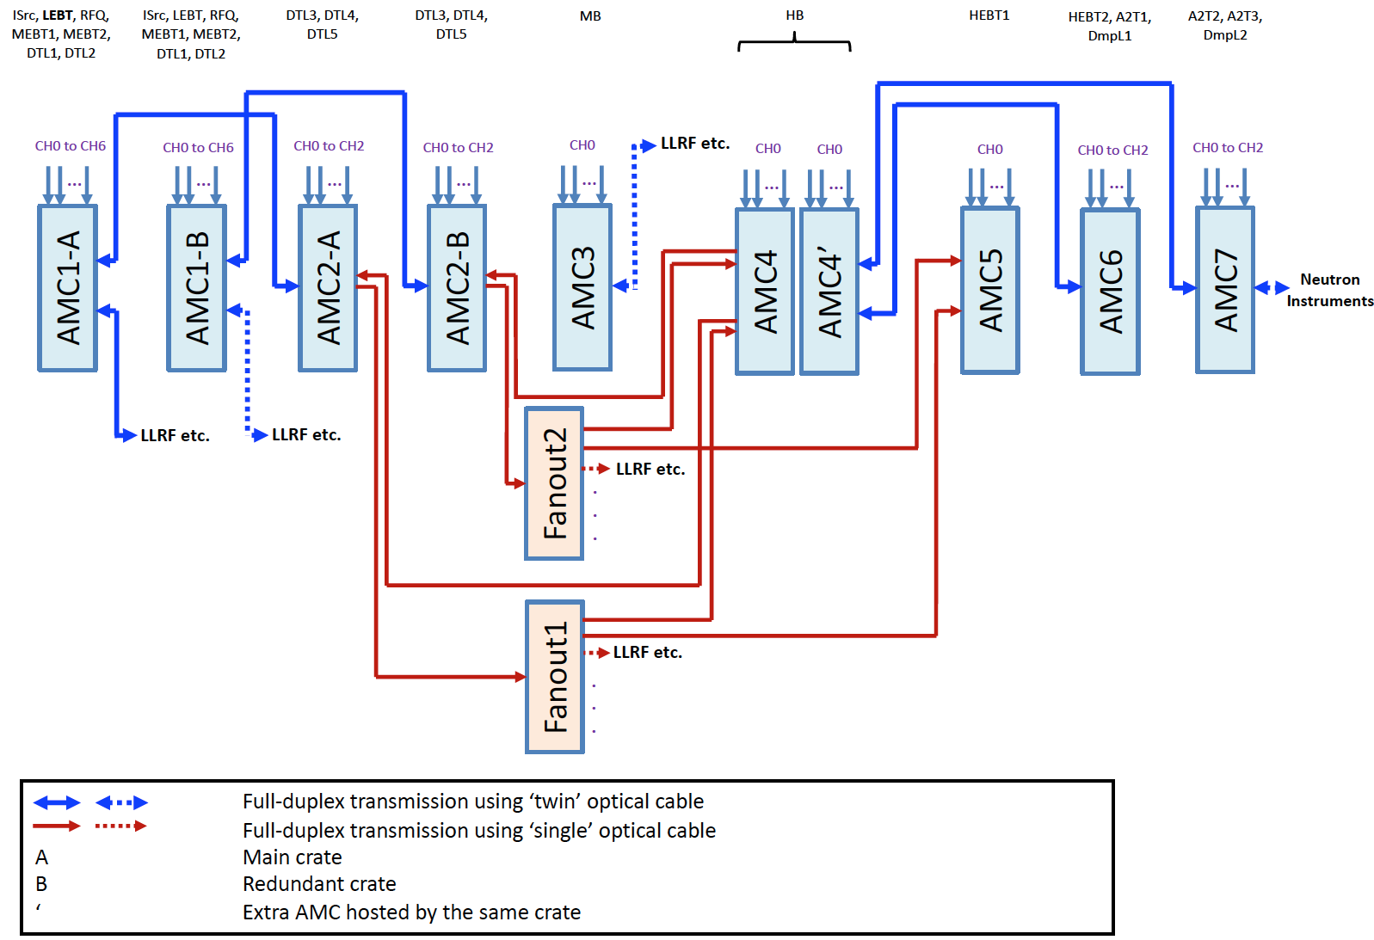
BCM optical cabling diagram
Total no. of ways to select 2 ACCTs out of 19 = C(19,2) = 171
Total no. of ways to define a differential pair using the above scheme = 57

Slide 13
GBTx / Rx block diagram
Transmitter
  Transfer a stream 16-bits data @ fs<125 Msps
  CDC FIFO for synchronization between data source clock domain and link user clock domain
  Framer: make a frame from stream data. Length of frame : 10 samples
  Transfer high priority 16-bits message
  Rate of Msg < rate of stream data/10.
  Synchronizer and controller to give interrupt to Aurora for transfer Msg over the link.
  Msg can have own application layer protocol in order to transfer a packet with an error detection method.
  CRC-32 just works for stream data
Receiver
  Rx EQ/Rx DFE/CDR done inside of Aurora
  CRC is checked inside of Aurora
  N delay in order to align data frame with crc ok signal
  CDC fifo for synchronizing extracted data and CRC with user space clock domain
  Msg data is directly extracted by Aurora just needs to be synchronized with the user domain clock
data clock domain
link clock domain
Transmitter
Stream Data
Source
e.g BCM/FC data
Data @ fs
CDC
FIFO
Framer
Tx data
Aurora
8b10b
Axi stream
Fiber optic Cable
Tx User Clock
UFC clock domain
Synchronizer
And
controller
Tx Ready
UFC interface
UFC
Source
e.g FBIS
UFC data
UFC data valid
Extracted
Stream Data
CDC
FIFO
N Delay
To Align data
with CRC
Aurora
8b10b
Synchronizer
CRC_OK
Extracted
UFC
data
Synchronizer
UFC data
UFC data valid
Receiver

Slide 14
Low latency link IP bank
Giga Transceiver IP @ 3.125 Gbps with encoding
Aurora 8b10b IP core
Tx and Rx 16-bits stream data @ fs < 125 Msps
Transfer and receive a 16 bits Msg
CRC-32bits Error check
Detect channel and lane Error
Ability of recovering the link after lane/channel error detection
Tx_CLK
GBTx/Rx
Bank
Stream_Tx_In
AXI-stream
MSG_Tx_In
TxP
AXI-stream
Txn
Rx_CLK
RxP
Stream_Rx_out
Rxn
AXI-stream
Rx_CRC_IS_OK
MSG_Rx_Out
AXI-stream
Link status
- Lane up
- Channel up
- Soft Err
- Hard Err

Slide 15
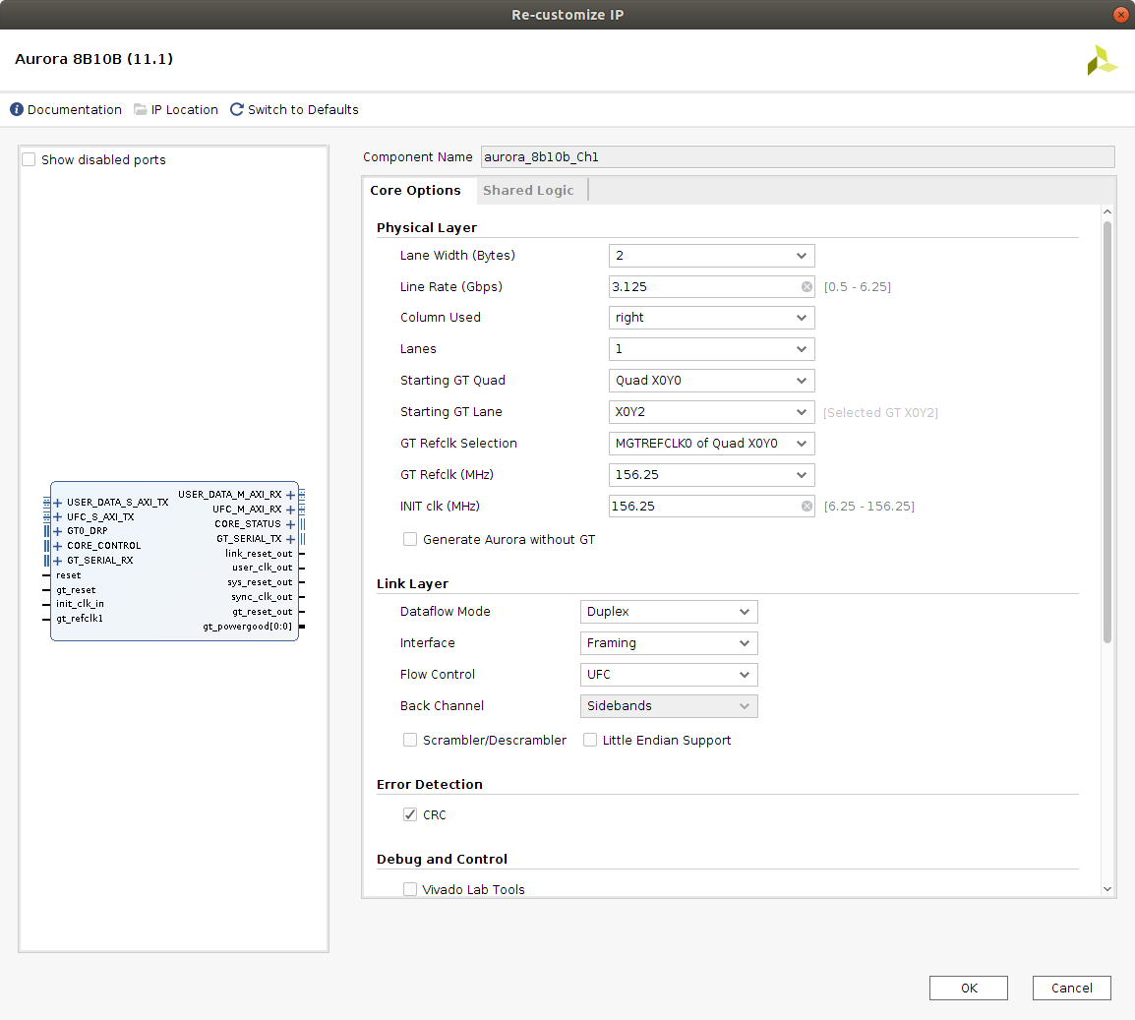
Aurora configuration
Lane width: 2 byte
Line Rate: 3.125 Gbps
Lanes: 2
Refclk: 156.25 MHz
Dataflow Mode: Duplex
Interface: Framing
Flow control: UFC
Error Detection: CRC

Slide 16
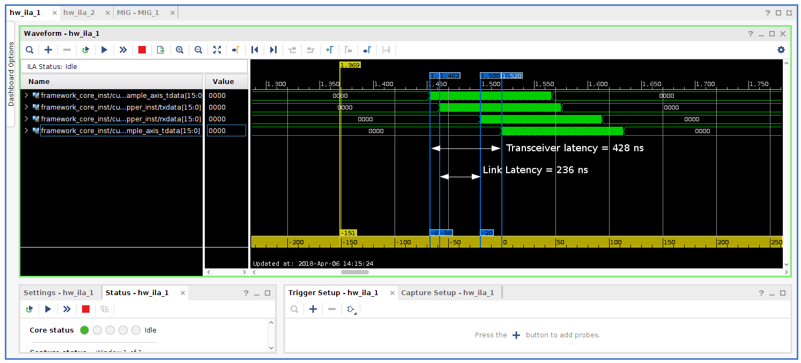
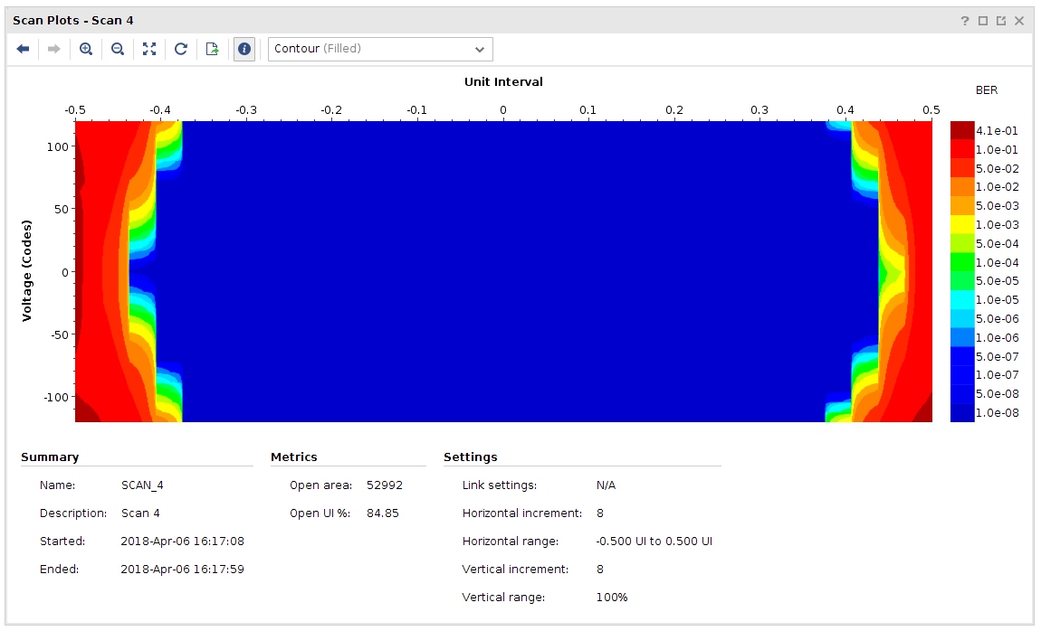
Performance analysis of a 3.125 Gbps optical link on the SIS8300-KU
Line rate: 3.125 Gbps
IP core: Aurora 8b/10b
Latency of the optical link transceiver based on Aurora 8b/10b Xilinx IP core
The EYE diagram on a SFP port
Data path latency without CRC detection: 428 ns
Bit error rate: < 2e-15.

Slide 17
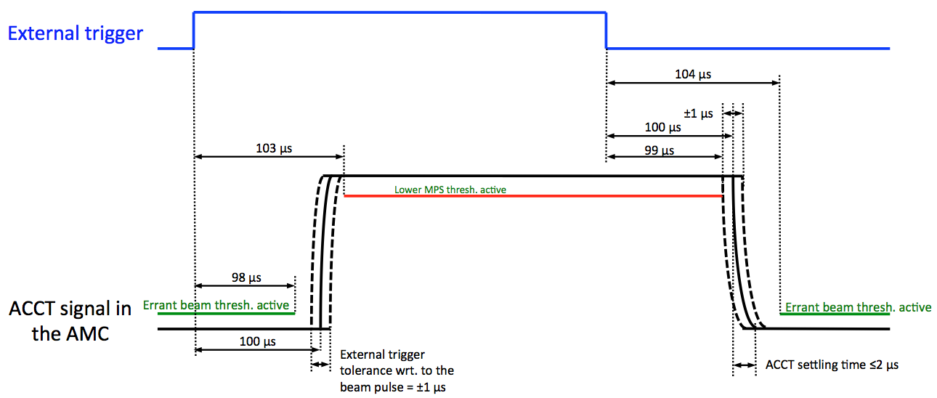
BCM timing requirements
ADC clock (from EVR over backplane): 88.0525 MHz, locked to RF
Pulse trigger (from EVR over backplane): same width and frequency as the beam pulse; should be received by the BCM FPGA 100 us before the beam pulse.
Beam mode: pulse current, width and repetition rate; upon changing to a new beam mode, the BCM FW reads/sets new MPS thresholds corresponding to that mode (lookup table in the FPGA); mode no. and definition based on ESS-0038258
Beam destination mode: beam destination
Calibration announcement: ACCT auto calibration starts at a well-defined time after receiving the announcement.

Slide 18
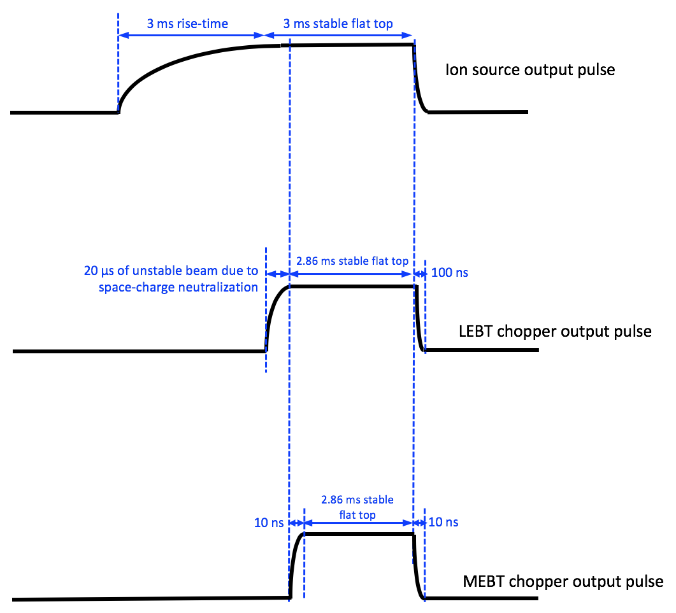
Pulse width changes from the ISrc to the MEBT
The ISrc, LEBT and MEBT pulses have different lengths and this will require 3 triggers with different lengths / timing for the BCM FW.

Slide 19
Summary / next steps
BCM-FBIS interface has been discussed and agreed with the MPS group (little changes may still happen).
Endurance tests with the final BCM electronics, final CAT-6A cable and a prototype FBIS are ongoing in the FEB.
An LVDS protection module has been developed for the BCM-FBIS interface with a prototype being currently used in the tests.
FEC and Reed-Solomon is being studied as a future upgrade.
The optical link has successfully been used for testing the differential alarms.
Adding FBIS data to the optical link is being studied as a future upgrade of the BCM-FBIS interface.

