Slide 1
Aperture monitor and grid readout status
Anders J Johansson, Lund University

Slide 2
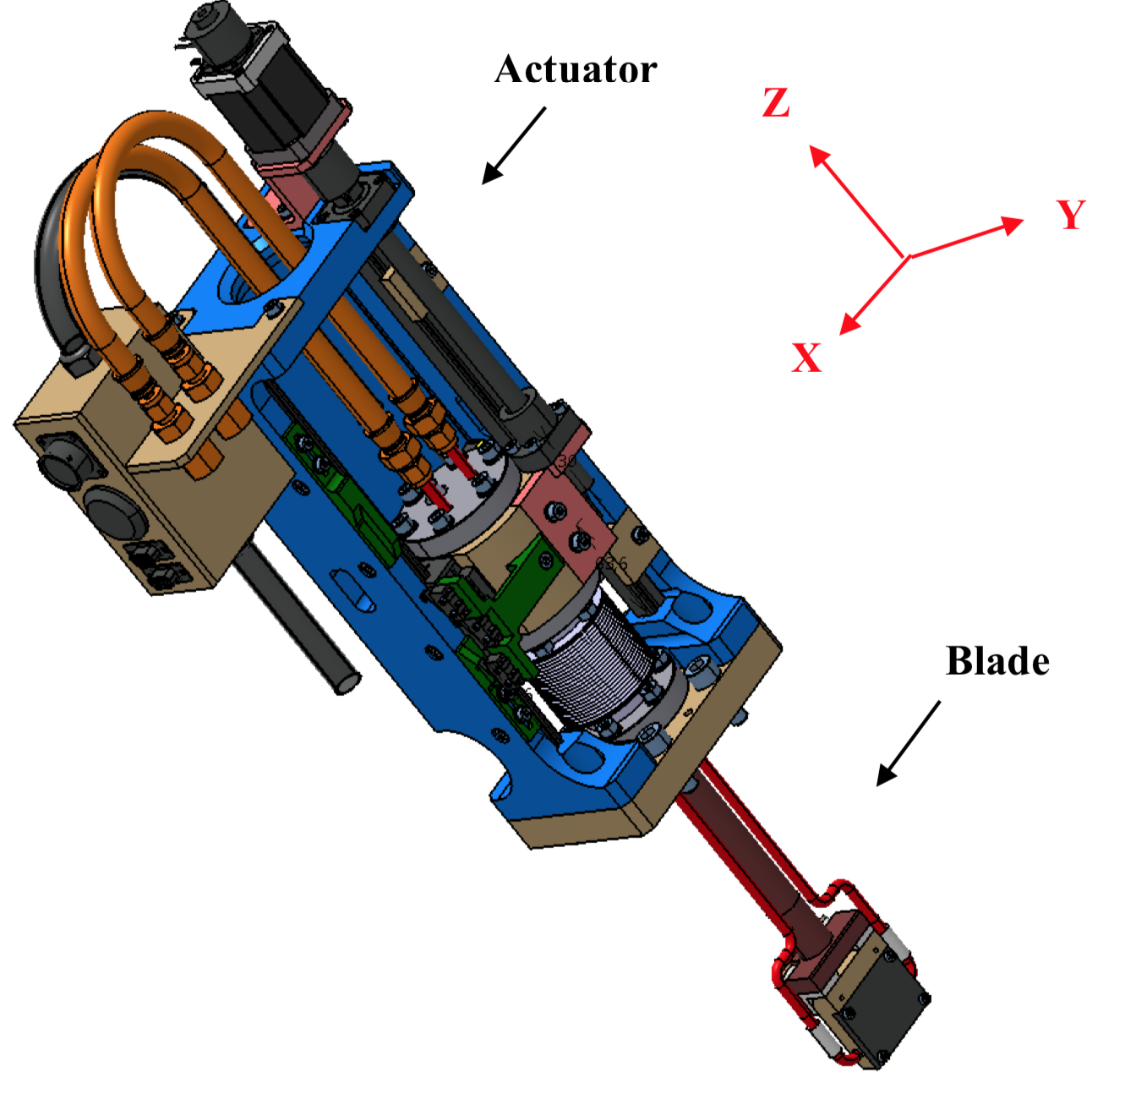
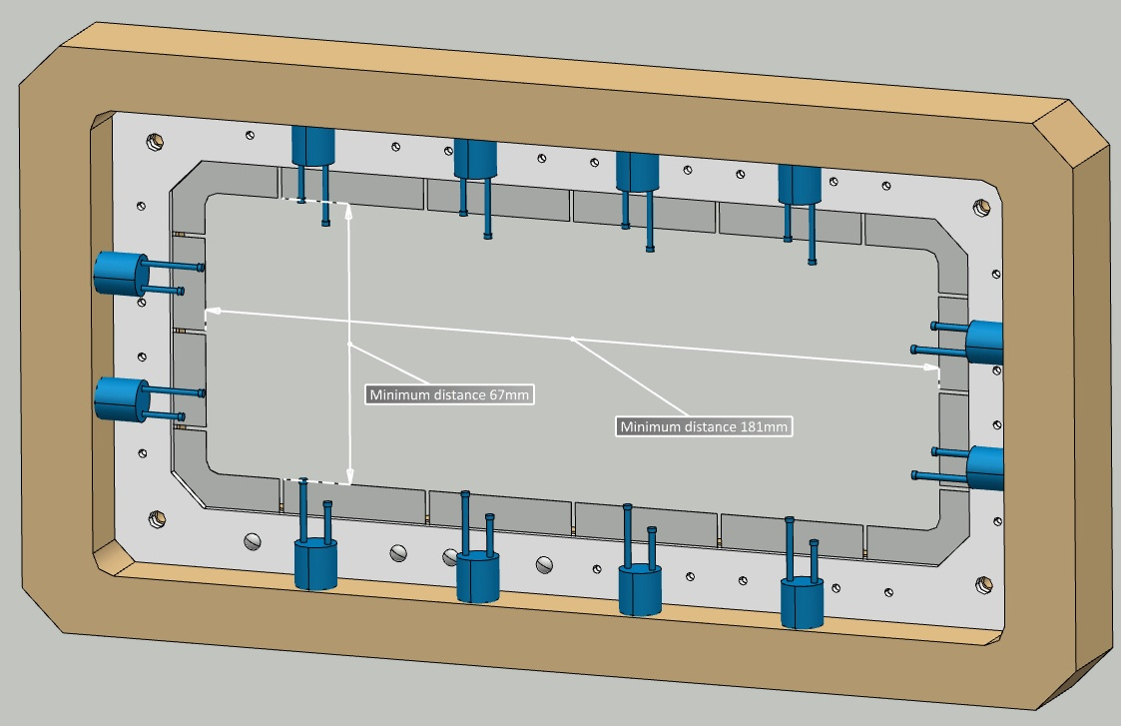
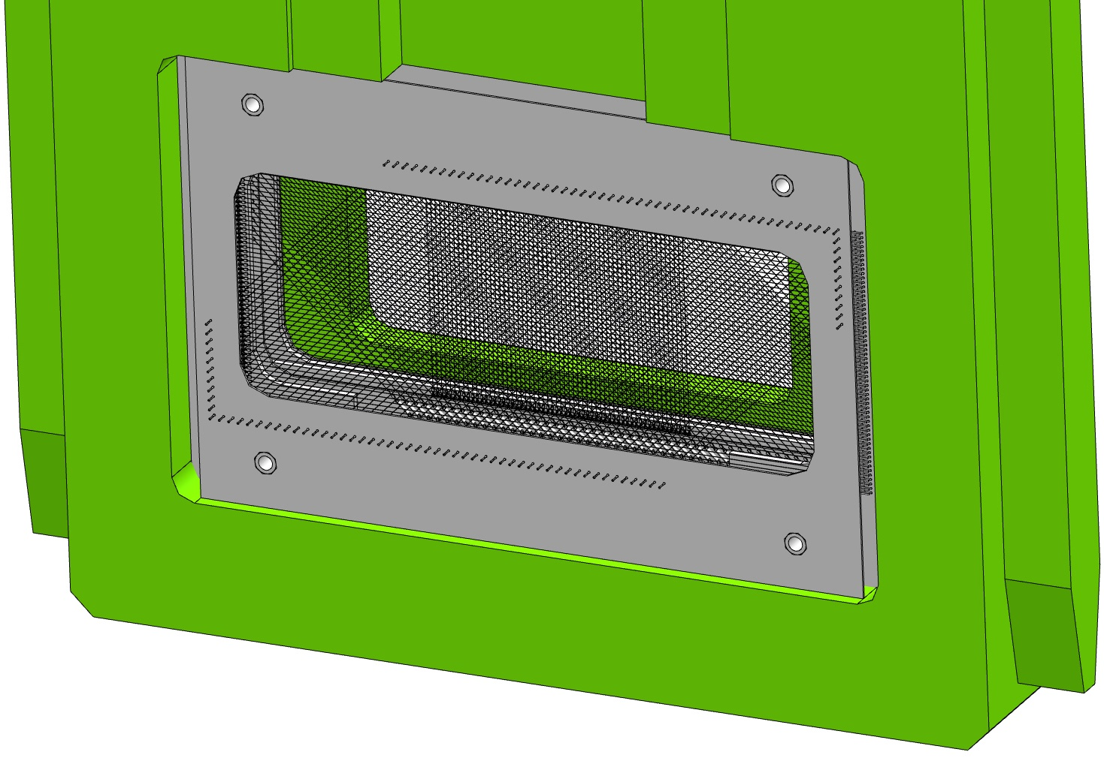
Scrapers, Aperture Monitors and Grid
APTM
Scrapers
Grid
All three of these instruments intercepts the beam and generates a current in a connected conductor.

Slide 3
Current measurement: FMC module
CAENels AMC-Pico-1M4
Range: max +/- 10 mA
300 kHz bandwidth
+/- 300 V floating input
1 MSPS
Conversion time: 650 ns
20 bit ADC
Effective number of bits: 16.3 / 14.7

Slide 4
MTCA-system
FMC Carrier Struck SIS8160
Xilinx XCKU060 or XCKU040 FPGA
4 GB memory
MRF timing receiver
Concurrent CPU board
MPS interface (TBD)
Handles 2 FMC cards, 8 current sensing channels in total.

Slide 5
MTCA crate loadout
Backplane
Backplane
FPGA + FMC
FPGA + FMC
FPGA + FMC
FPGA + FMC
FPGA + FMC
FPGA + FMC
FPGA + FMC
CPU
FPGA + FMC
Timing
FPGA + FMC
CPU
FPGA + FMC
Timing
FPGA + FMC
Minimum 3 slots
8 channels
Maximum 12 slots
80 channels

Slide 6
MTCA crate loadout, separate MPS interface
Backplane
Backplane
MPS
FPGA + FMC
FPGA + FMC
FPGA + FMC
FPGA + FMC
MPS
FPGA + FMC
FPGA + FMC
CPU
FPGA + FMC
Timing
FPGA + FMC
CPU
FPGA + FMC
Timing
FPGA + FMC
Minimum 4 slots
8 channels
Maximum 12 slots
72 channels

Slide 7
Number of channels
 | Scraper | APTM | Grid
# Systems |  | 3 | 1
# Channels / system |  | 12 | 144 TBC
# FMC Cards / system |  | 3 | 36
# FPGA cards / system |  | 2 | 18
# Crates / system |  | 1 (5-slot) | 2 (12-slot)

Slide 8
Bias-unit
Adding bias to detector plates.
Size of bias TBD (se Wednesday talk on J-Parc experiments )
Implementation of bias generator TBD.
Implementation of Bias-T’s TBD for different systems.

Slide 9
Software architecture Overview
Procedure
What: GUI, data archiving, statistics
Implementation: Python
Excecution: CPU in control room / server hall
Algorithm
What: Beam profile matching
Implementation: Python
Excecution : CPU in crate
Function
What: MPS trigger by channel thresholding
Implementation: VHDL
Excecution: FPGA

Slide 10
Firmware
Framework running
Records data from ADCs
Saves data to memory
Development of application firmware started
Threshold detectors
For details: see talk by Kaj Rosengren

Slide 11
Misc.
Scraper also needs motion control
4 motors / scraper
Implemented using ESS standard in Beckhoff modules.
Aperture monitors include thermal sensors
24 sensors per APTM
Implemented using ESS standard in Beckhoff modules.

