Slide 1
Status of 2D and 3D racks designs
Łukasz CZUBA
Krystian BEC
WUT
22 October 2019 , BI forum

Slide 2
Scope of Work
1. Design and preparation of infrastructure documentation and rack cabling for BD:
- 3D rack occupation designs of ~ 50 BD racks (collect all necessary models of each parts)
- all cables connections between devices and modules inside racks,
- list of all types of cables and connectors in each rack.
2. Design and production of BD racks patch panels.
3. Installation support for BD racks.
4. Laboratory works: devices testing, lab organization, etc.

Slide 3

Work description and duties
One of the most time consuming part of our job is to collect all necessary CAD models of all devices,
electronics and mechanic parts inside rack.
What is more, all electronics have to be uploaded to „E-Plan Electric P8” program database,
where all 2D wiring diagrams are created.

Slide 4
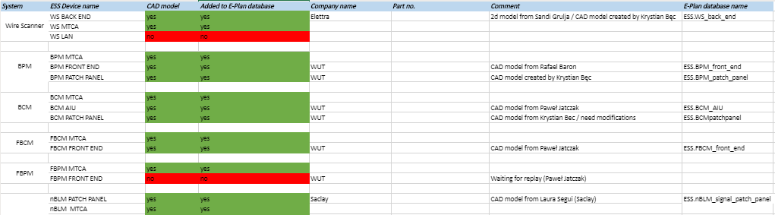
Work description and duties
Status of all 3D models can be checked in online table, as it is shown below
Source:
https://elkapw-my.sharepoint.com/:x:/r/personal/k_bec_elkapw_onmicrosoft_com/_layouts/15/doc2.aspx?sourcedoc=%7BFD3F32A7-1A42-43D9-BF78-9D1B85F0AAD7%7D&file=Skoroszyt.xlsx&action=default&mobileredirect=true&cid=7c38670a-49f9-48d5-9c8c-8cc7416a6416

Slide 5
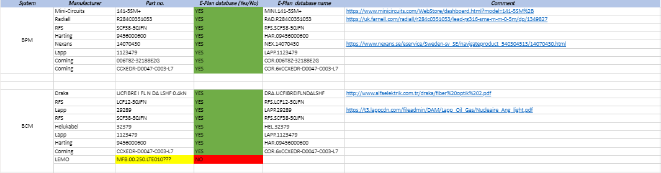
Work description and duties
All internal rack cabling nedds to be added to E-Plan database as well
Source:
https://elkapw-my.sharepoint.com/:x:/r/personal/k_bec_elkapw_onmicrosoft_com/_layouts/15/doc2.aspx?sourcedoc=%7BFD3F32A7-1A42-43D9-BF78-9D1B85F0AAD7%7D&file=Skoroszyt.xlsx&action=default&mobileredirect=true&cid=7c38670a-49f9-48d5-9c8c-8cc7416a6416

Slide 6
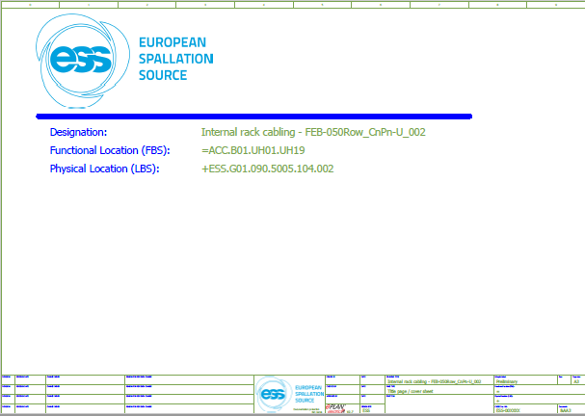
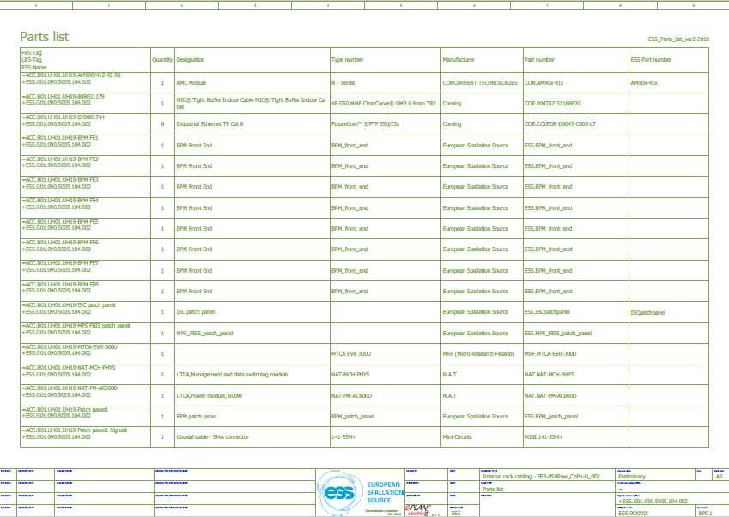
Work description and duties
Preparation of documentation for few racks (mainly from FEB building) – 2D electrical scheme in E-Plan P8

Slide 7
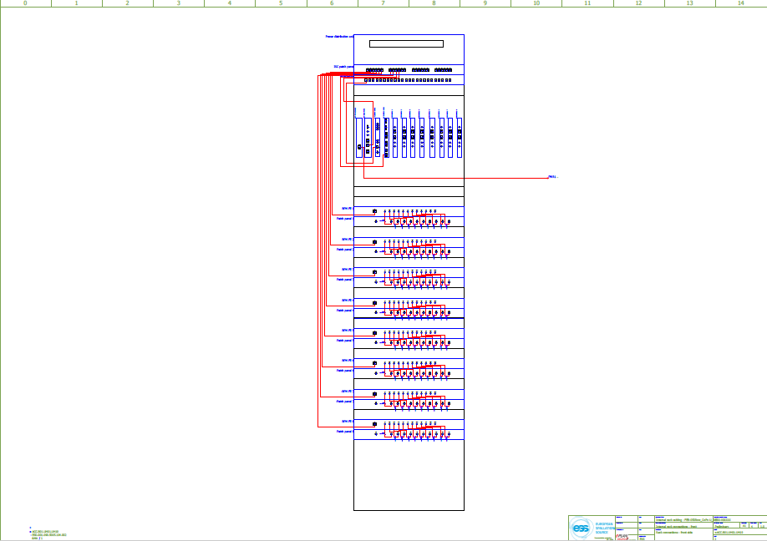
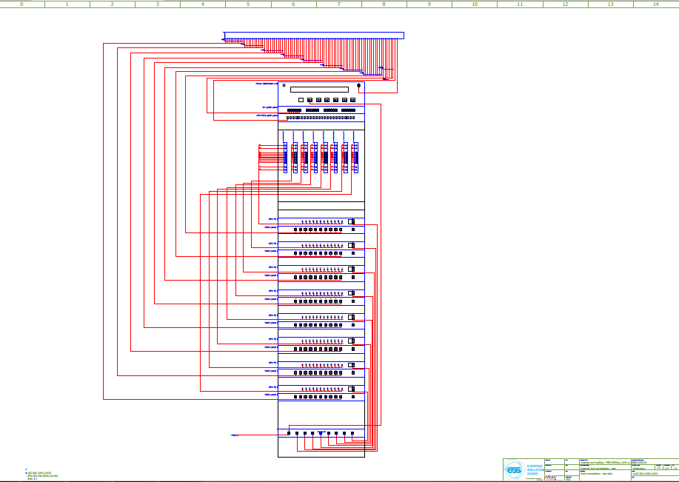
Work description and duties
Preparation of documentation for few racks (mainly from FEB building) – 2D electrical scheme in E-Plan P8

Slide 8
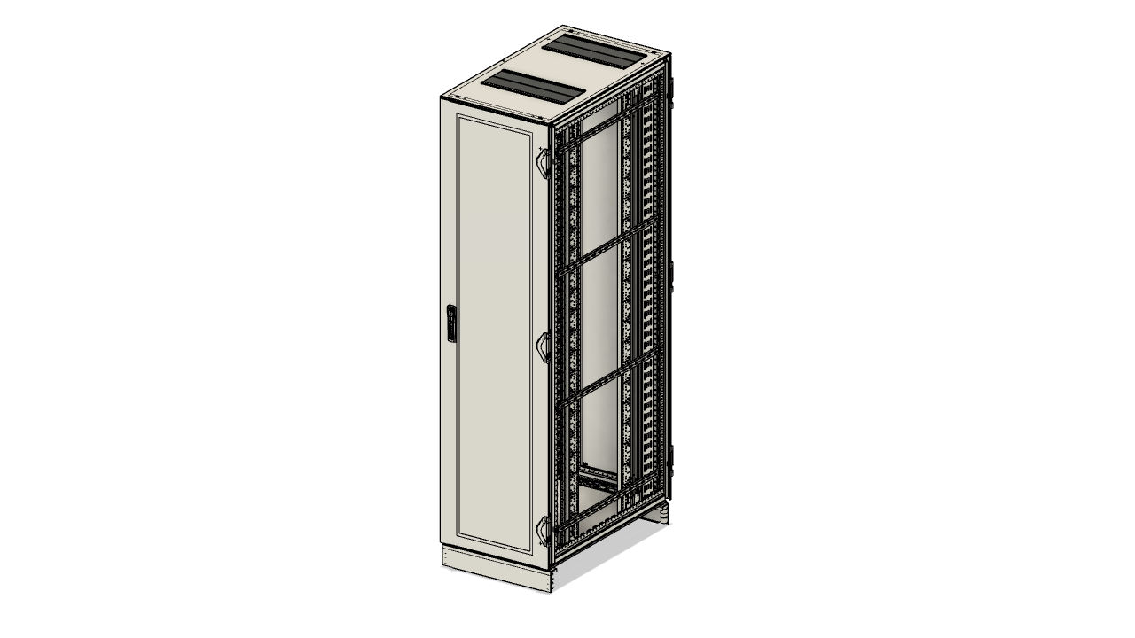
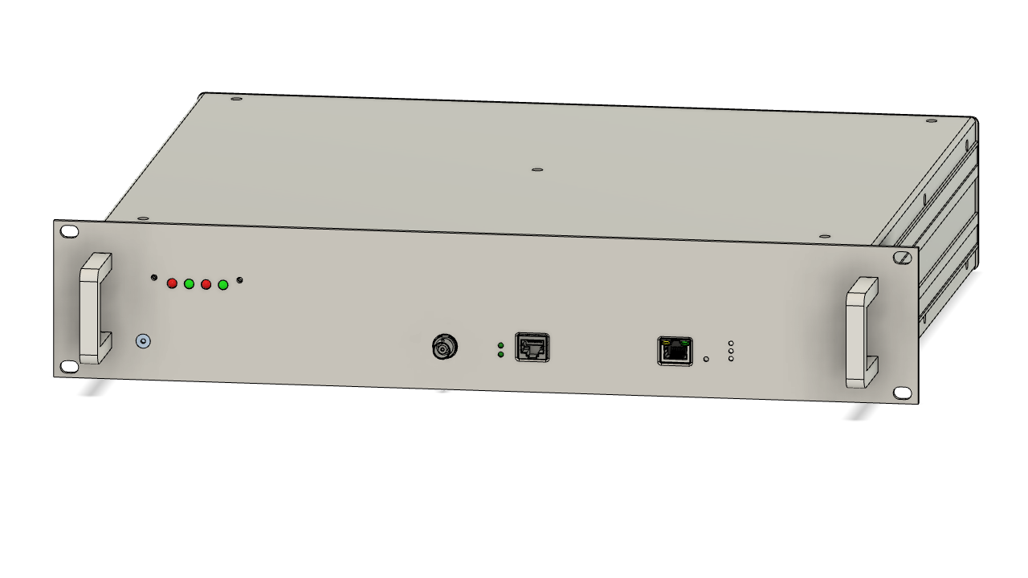
Work description and duties
3D samples of racks components

Slide 9
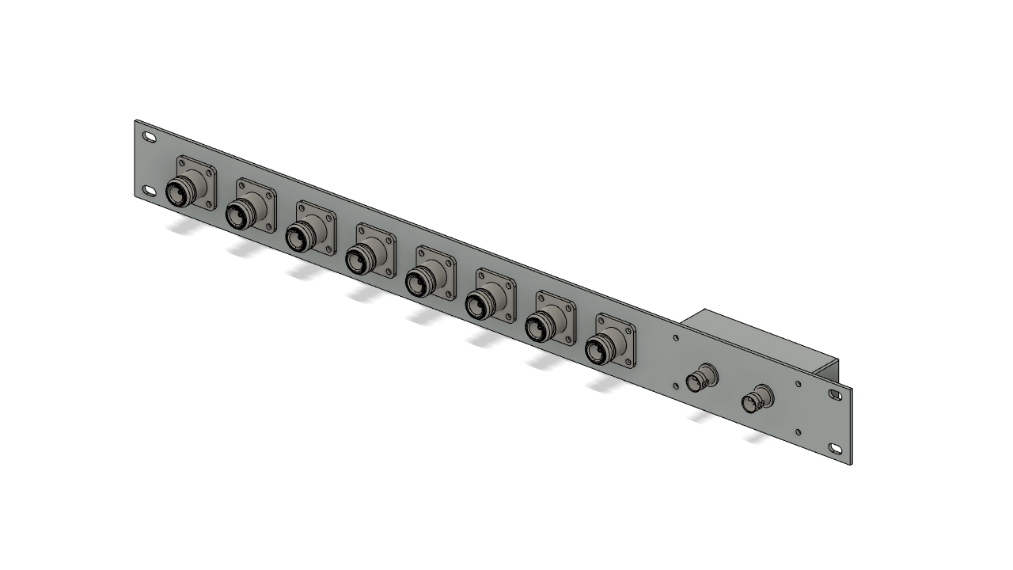
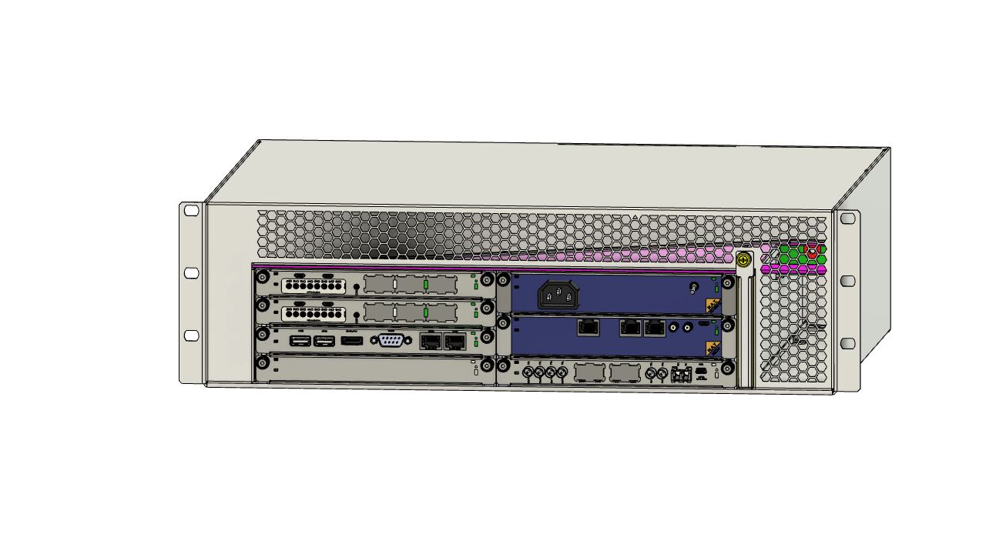
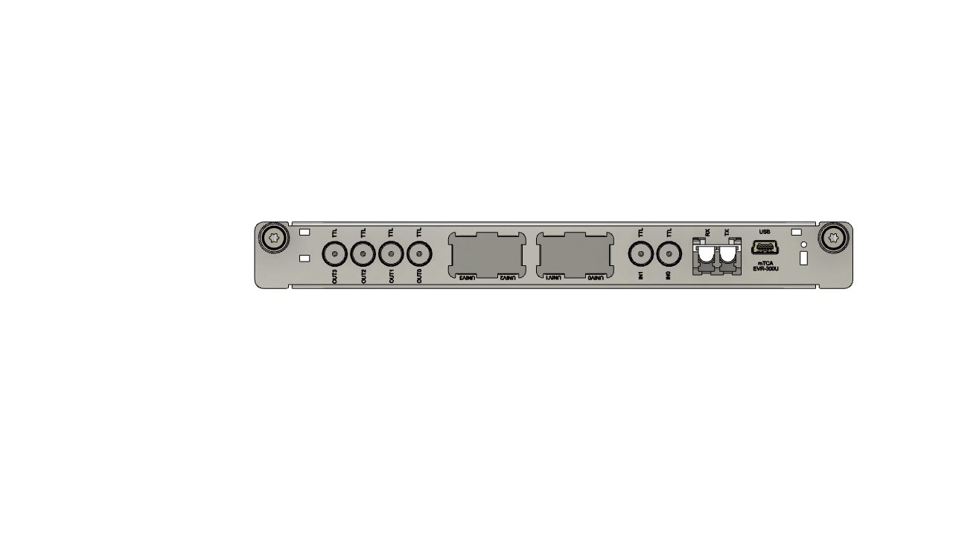
Work description and duties
3D samples of racks components

Slide 10
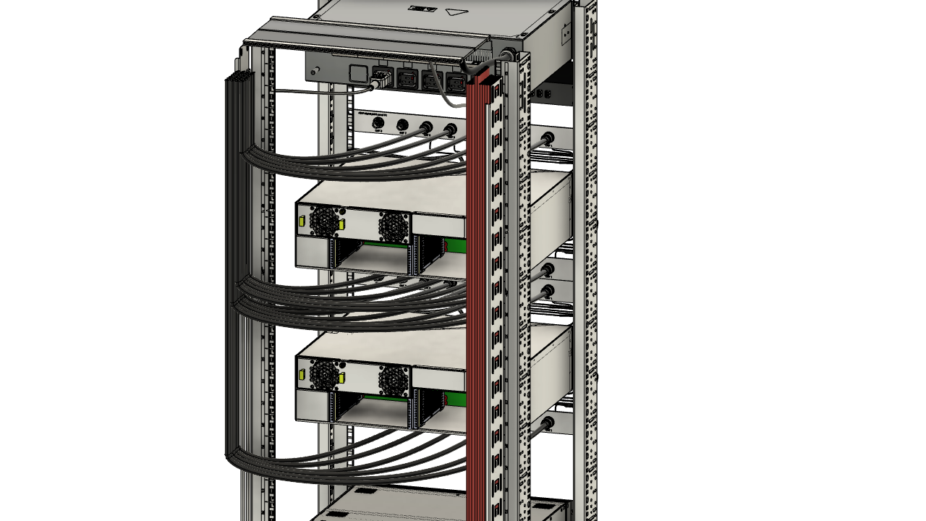
Work description and duties
nBLM rack 3D cabling – examples

Slide 11
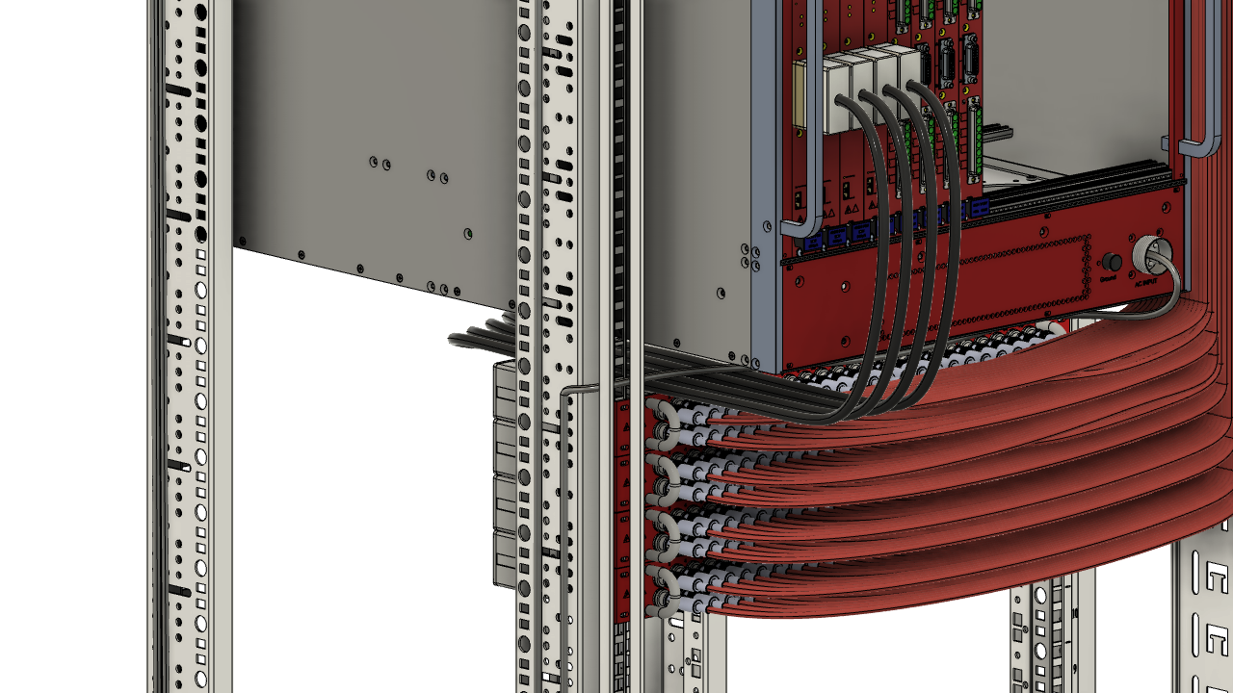
Work description and duties
nBLM rack 3D cabling – examples

Slide 12
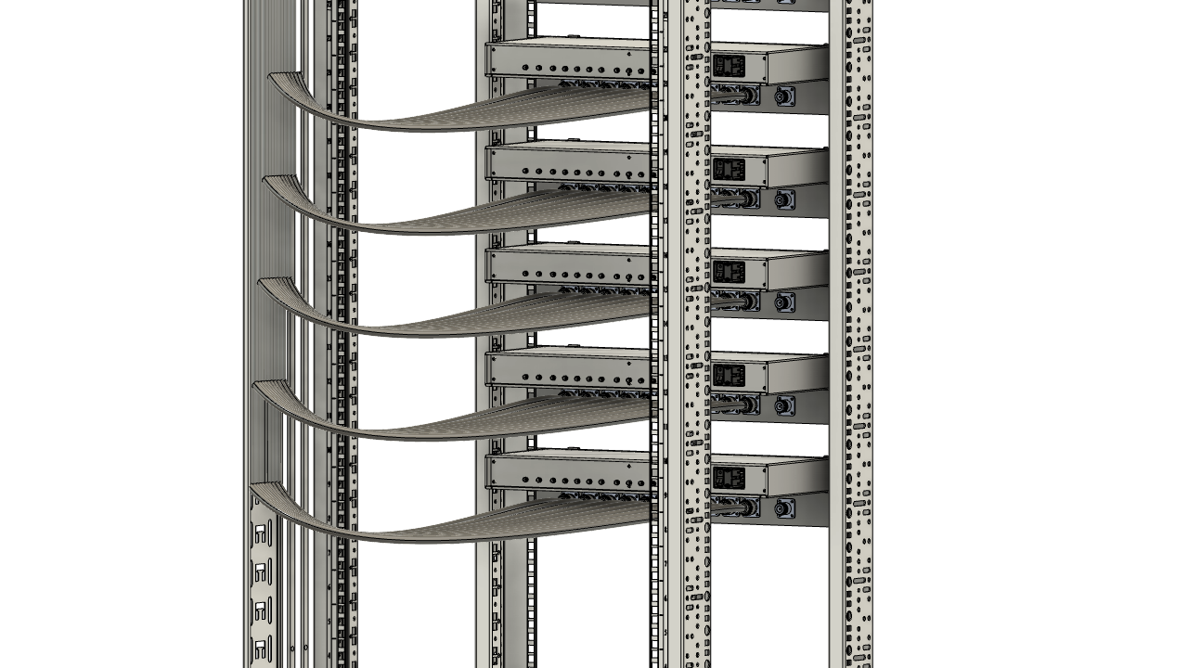
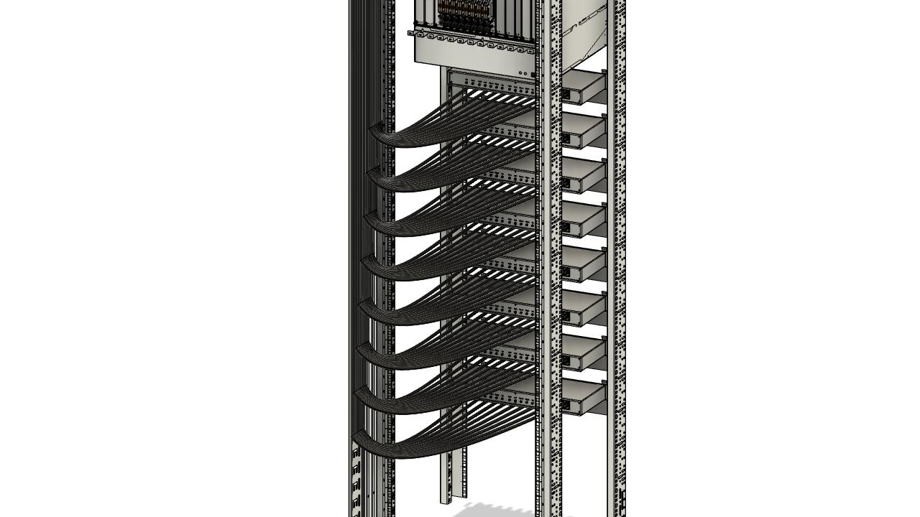
Work description and duties
BPM rack 3D cabling (80x 3/8”CELLFLEX cables coming through the top of the rack to BPM Front End Units).

Slide 13
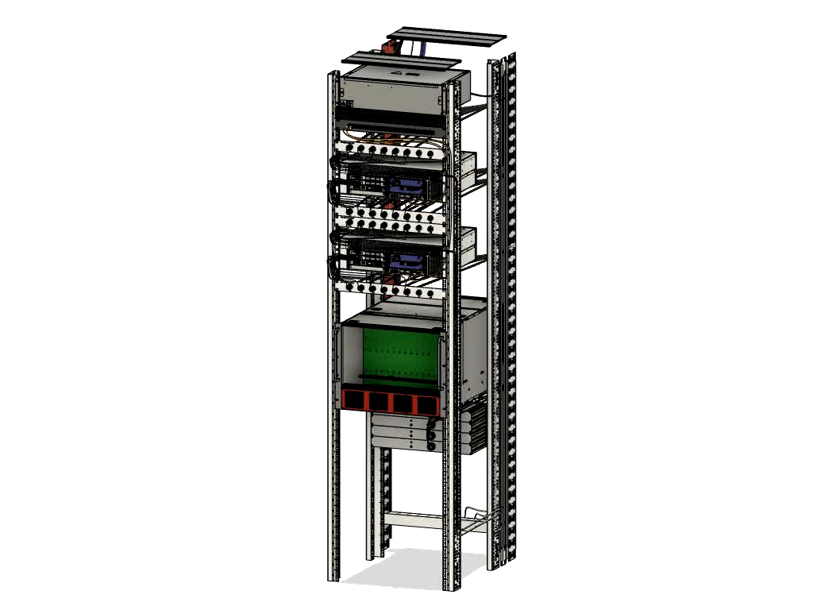
3D visualization – nBLM rack

Slide 14
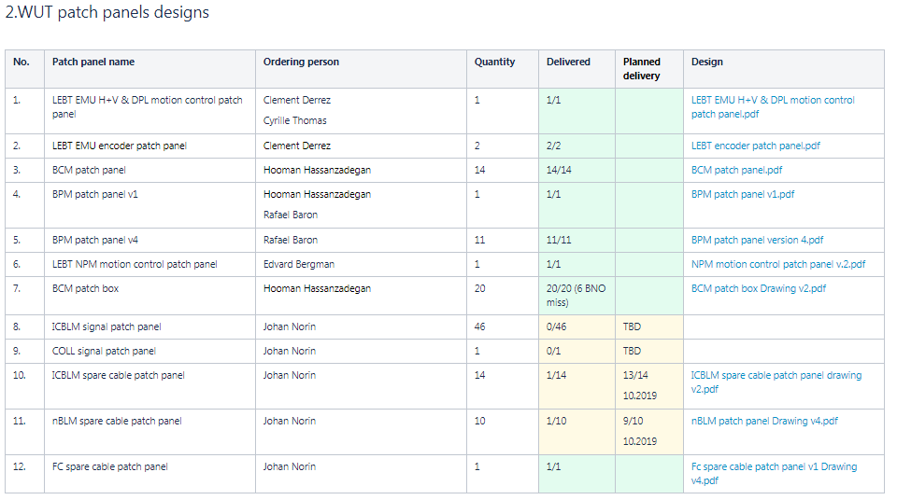
Patch panels for BD – status list
Design and production of patch panels for BD systems by WUT.
Status list of patch panels designed and produced for BD systems until October 2019.

Slide 15
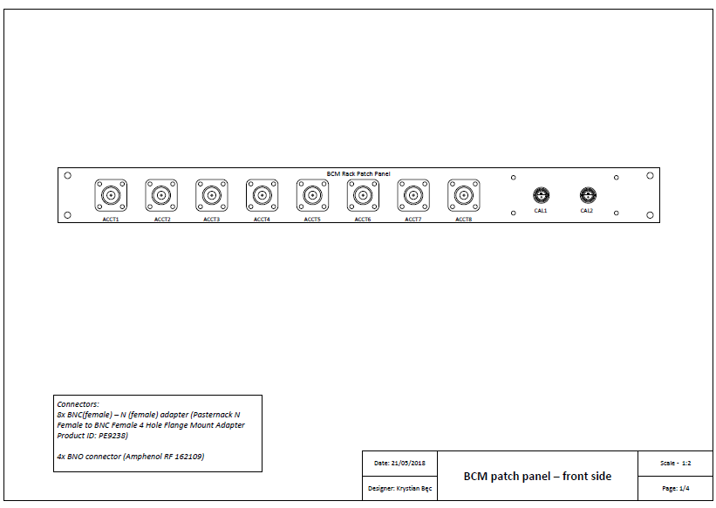
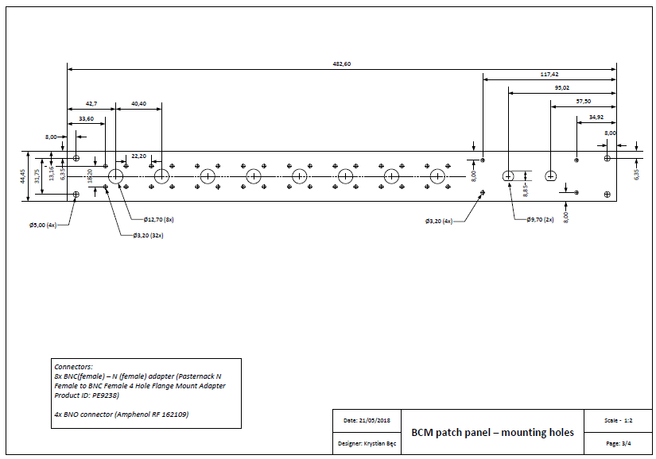
2D patch panels design
Design and production of patch panels for BD systems by WUT

Slide 16
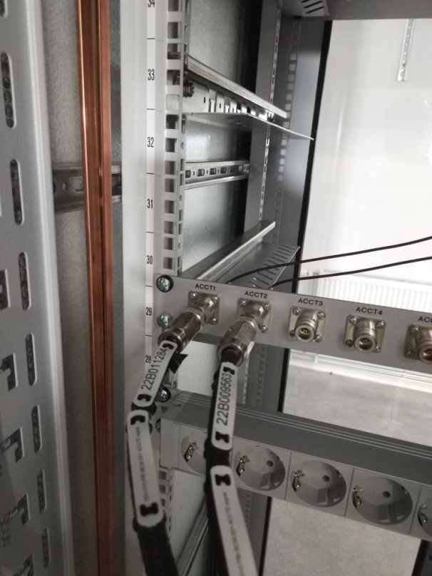
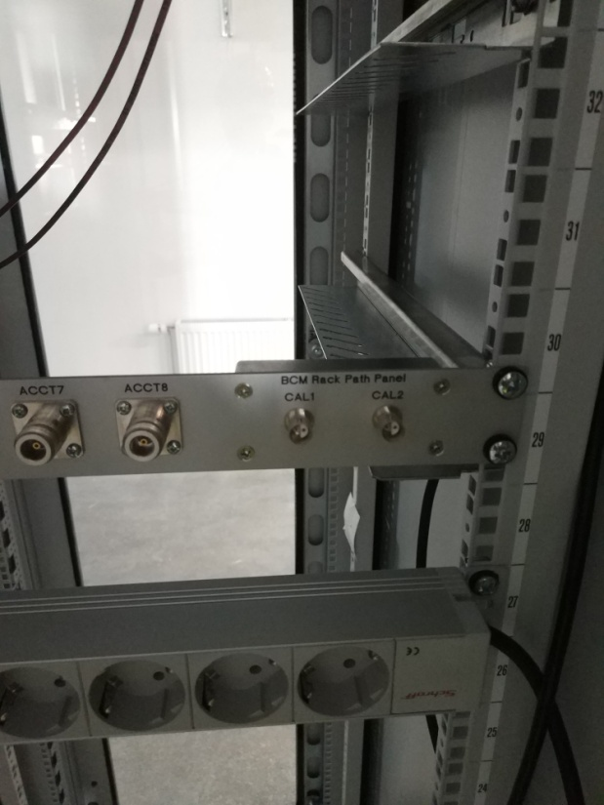
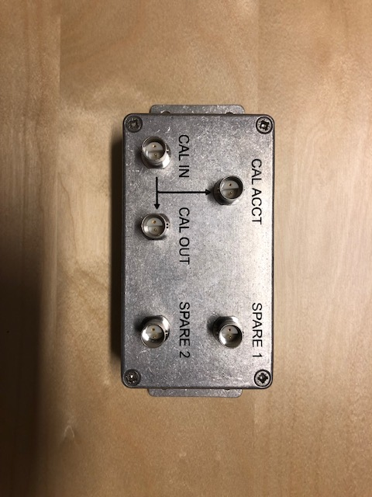
Manufactured patch panels
Design and production of patch panels for BD systems by WUT.
BCM patch panel from rack no. FEB-050ROW:CNPW-U-013 and BCM patch box

Slide 17
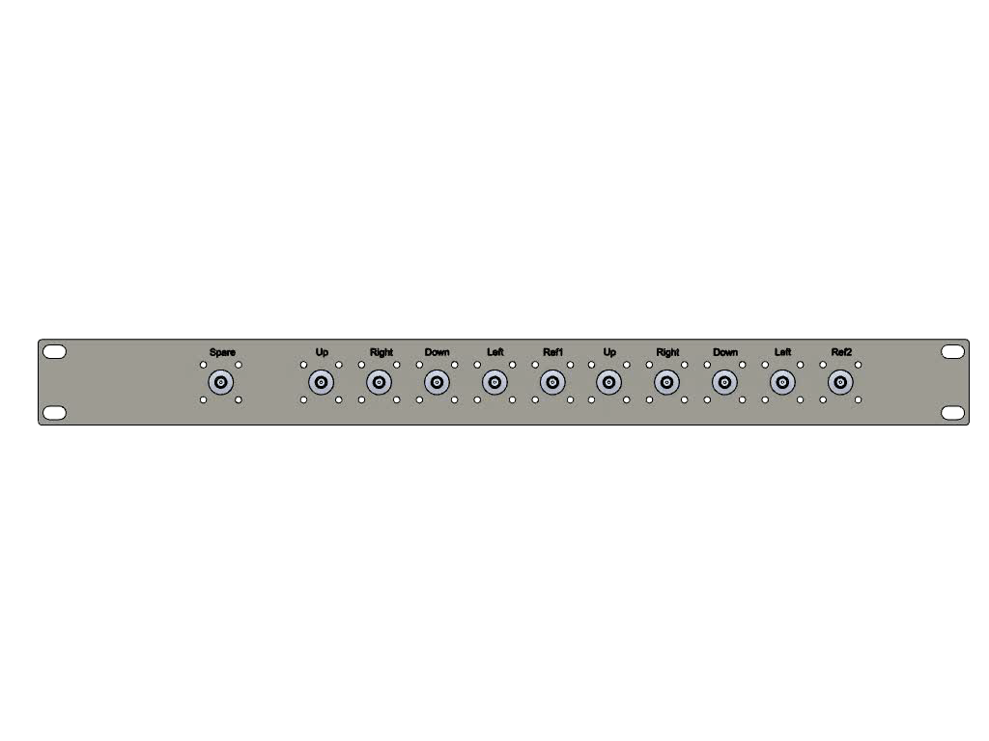
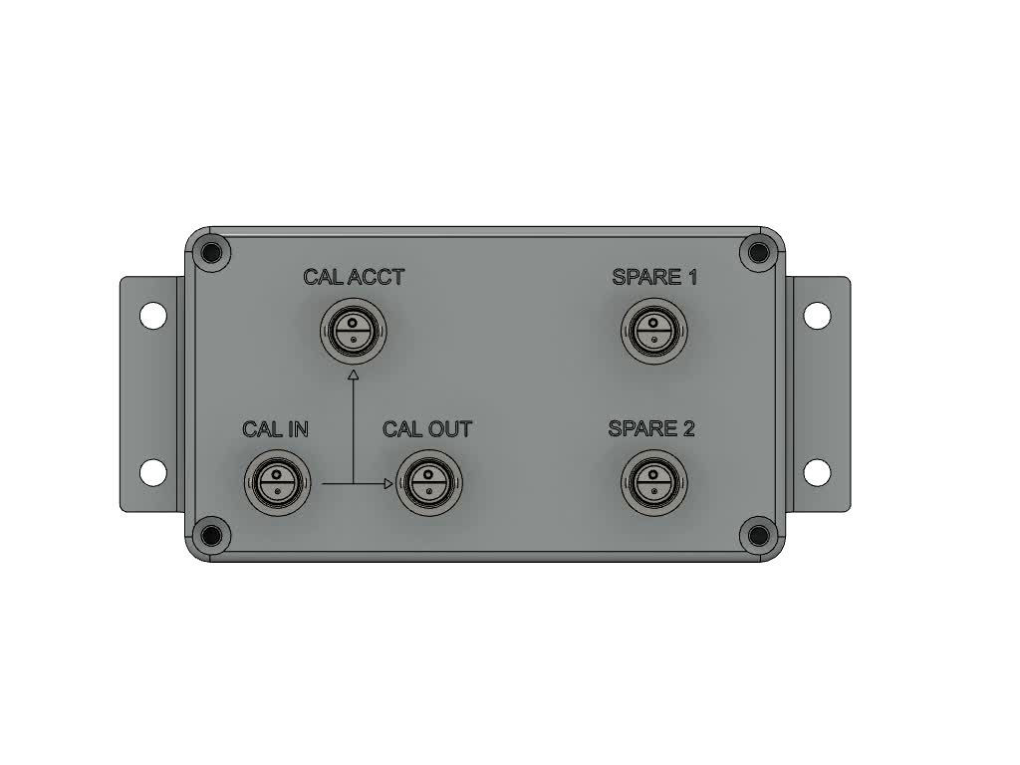
3D visualization – patch panels

Slide 18
Thank you for your attention!

