Slide 1
European Spallation Source
WebPV
Thomas Grandsaert
Development Engineer
European Spallation Source ERIC
October 23rd, 2018

Slide 2
Outline
The idea
  Why a web viewer?
  Baselines (SNS, CERN Vistar)
Realization
  Backend Infrastructure: (python, pyepics)
  Clientside Infrastructure: JSON object format
  Result
Wrapup
  Future plans
  Questions

Slide 3
The Idea
Why a web viewer?
Good PR
PBI focused use cases
Internal education
To show off our hard work
Validation for IK partners post-comissioning
????
It’s cool.

Slide 4
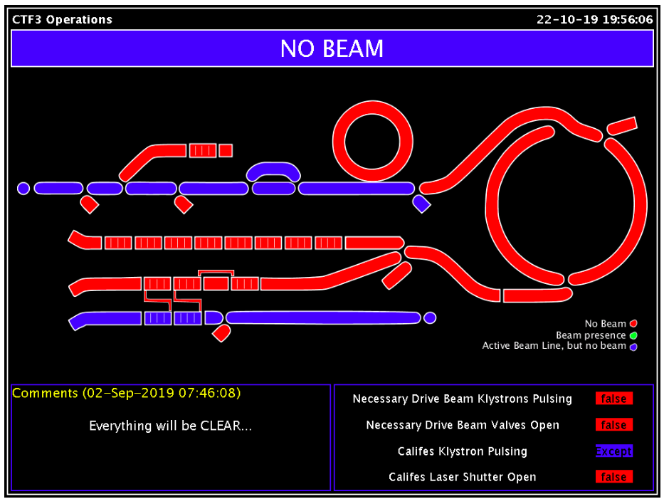
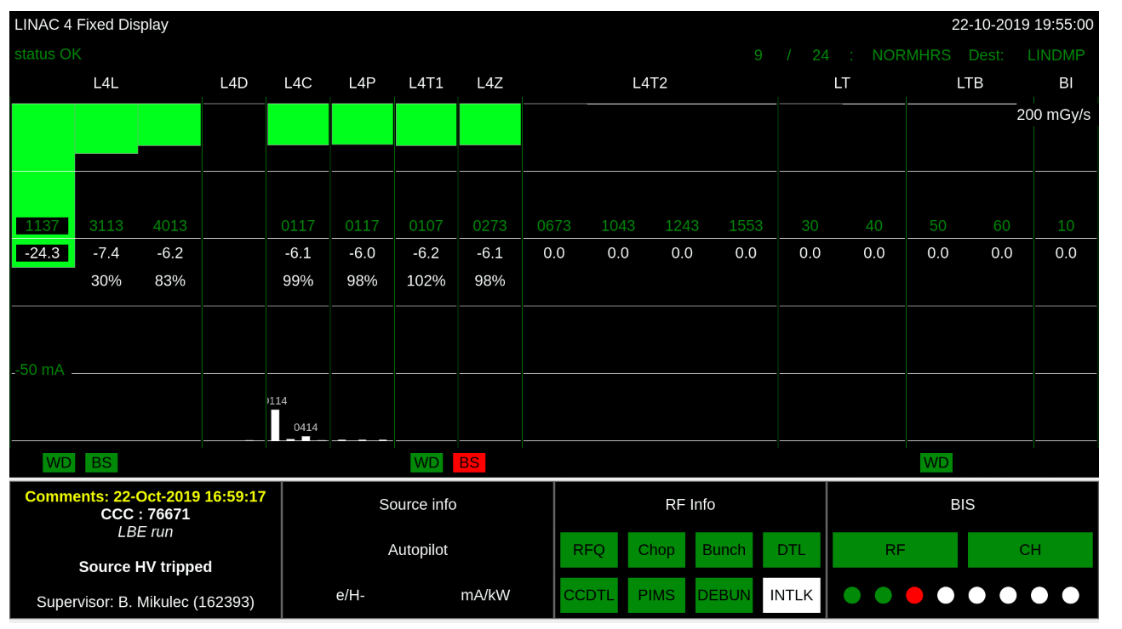
The Idea
Baselines (SNS, CERN Vistars)
CERN Vistars
SNS

Slide 5
Realization
Some Backend/frontend details
Backend
  Based on webEPICS from ORNL/SNS (https://github.com/klemenv/WebEPICS)
  Adapted for python3 and pyepics3 on top of EPICSv3 (not EPICSv4 / pva)
  Read-only (no ”caput”)
Frontend
  No conversion of OPI/BOB files to HTML/JS (hand crafted web pages)
  Basic JS/HTML for text and graphics, plotly.ly for plots
  Can connect directly to live IOC PV
    Also with a python3 based IOC (using pcaspy) that performs proton counting
  Websocket communication between the web server and the client

Slide 6
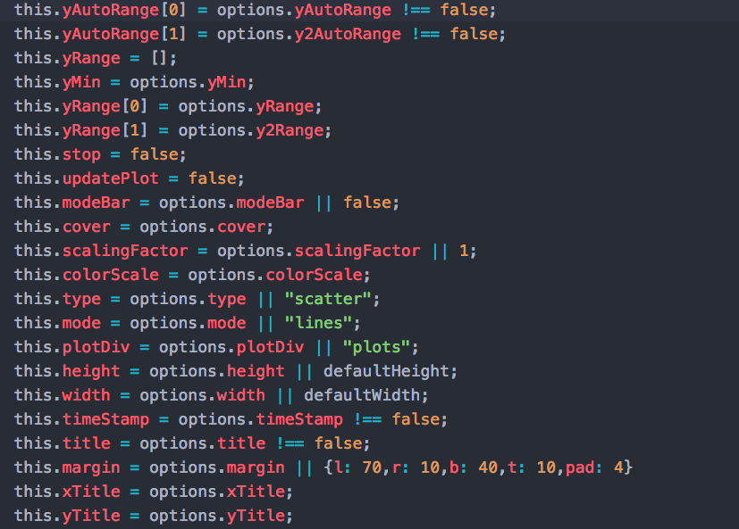
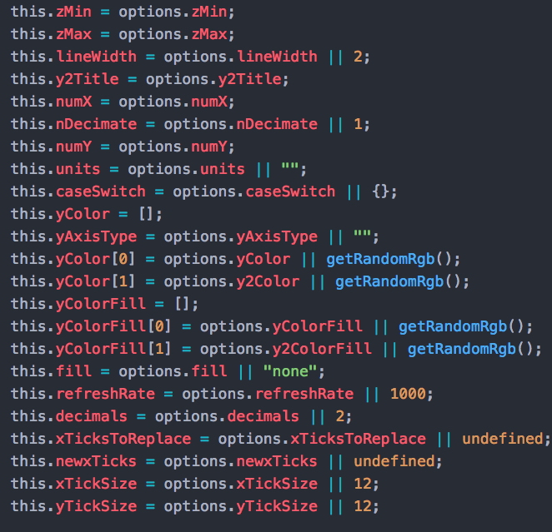
Realization
More frontend details

Slide 7
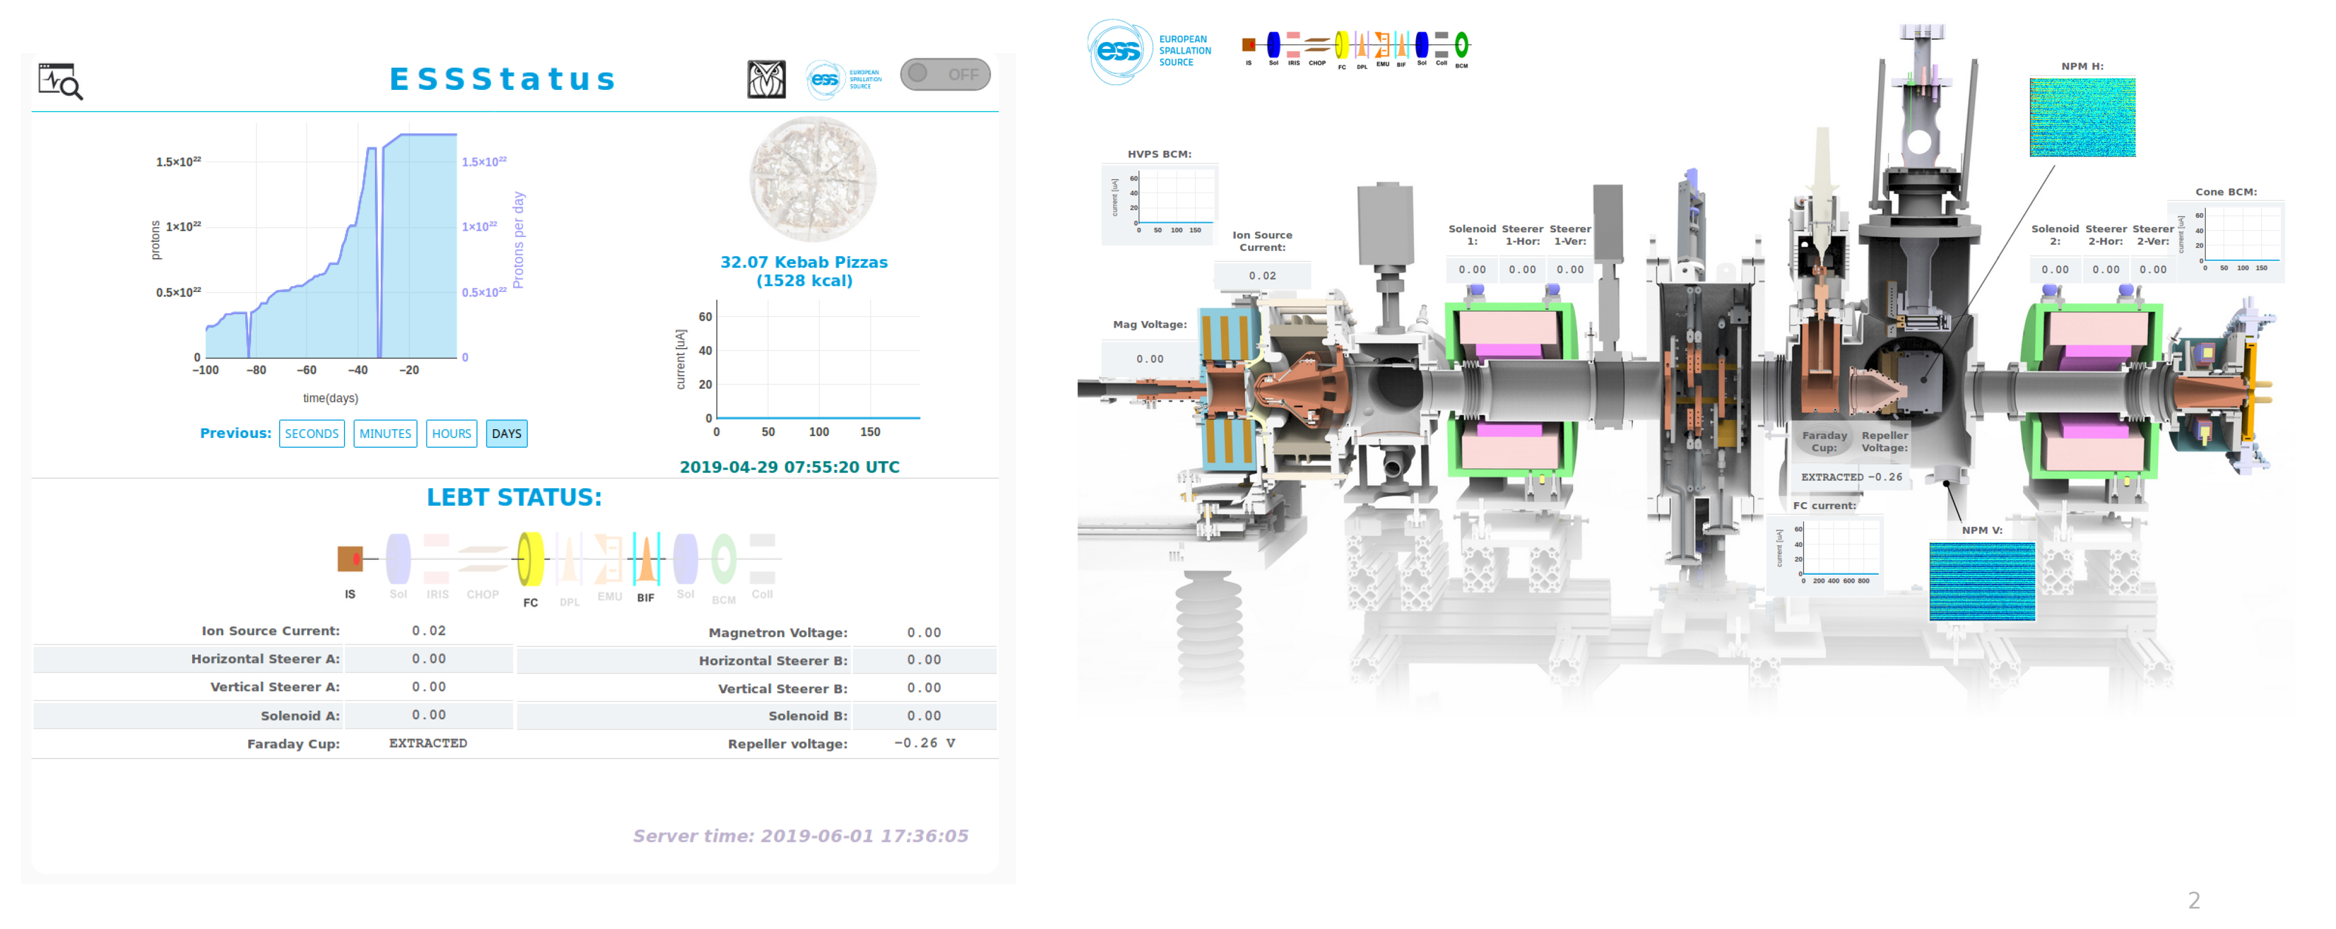
Realization
Result
http://webpv.esss.lu.se
http://webpv.esss.lu.se/LEBTTV.html

Slide 8
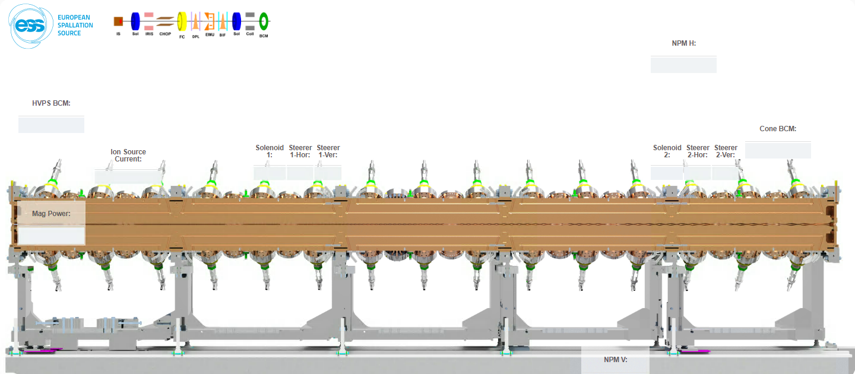
Wrapup
Future plans
http://webpv.esss.lu.se/RFQTV.html

Slide 9
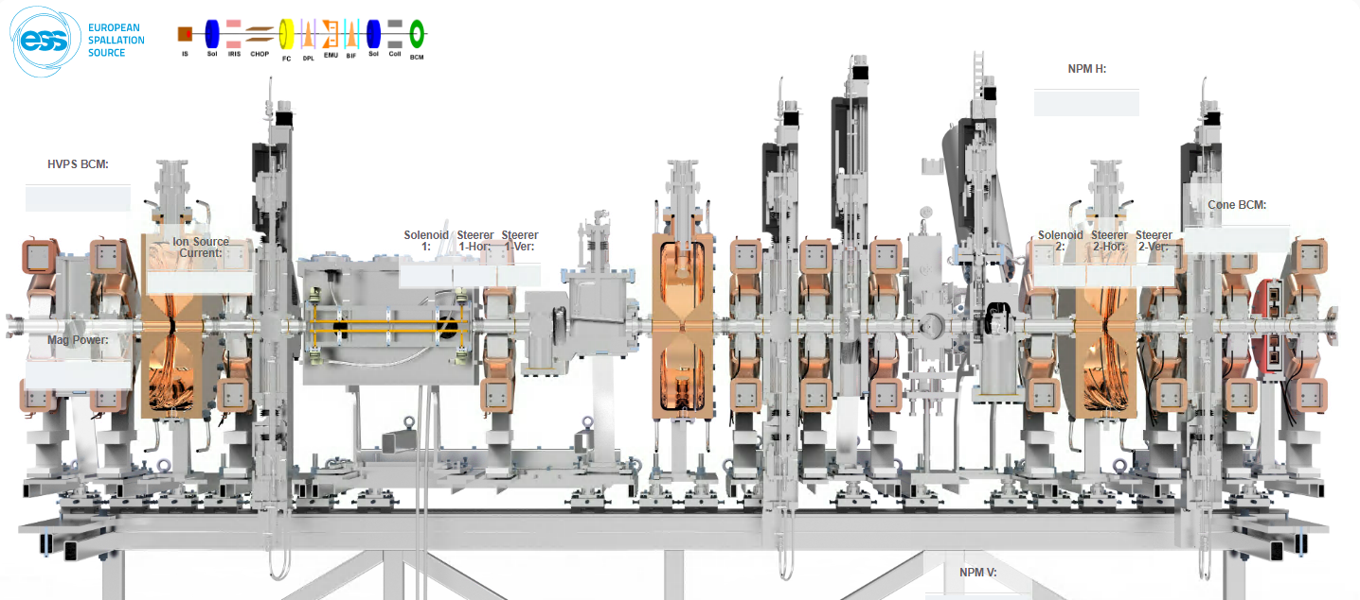
Wrapup
Future plans
http://webpv.esss.lu.se/MEBTTV.html

