Slide 1
Beam Physics Application of Diagnostics
Natalia Milas
Beam Physics Section
Beam Instrumentation Forum
23.10.2019
Warsaw, Poland

Slide 2
Overview
Beam Physics and Diagnostics are in a long term relationship…
  What is important
  Location. Location. Location
Most common use cases
Non-standard uses
Conclusion

Slide 3
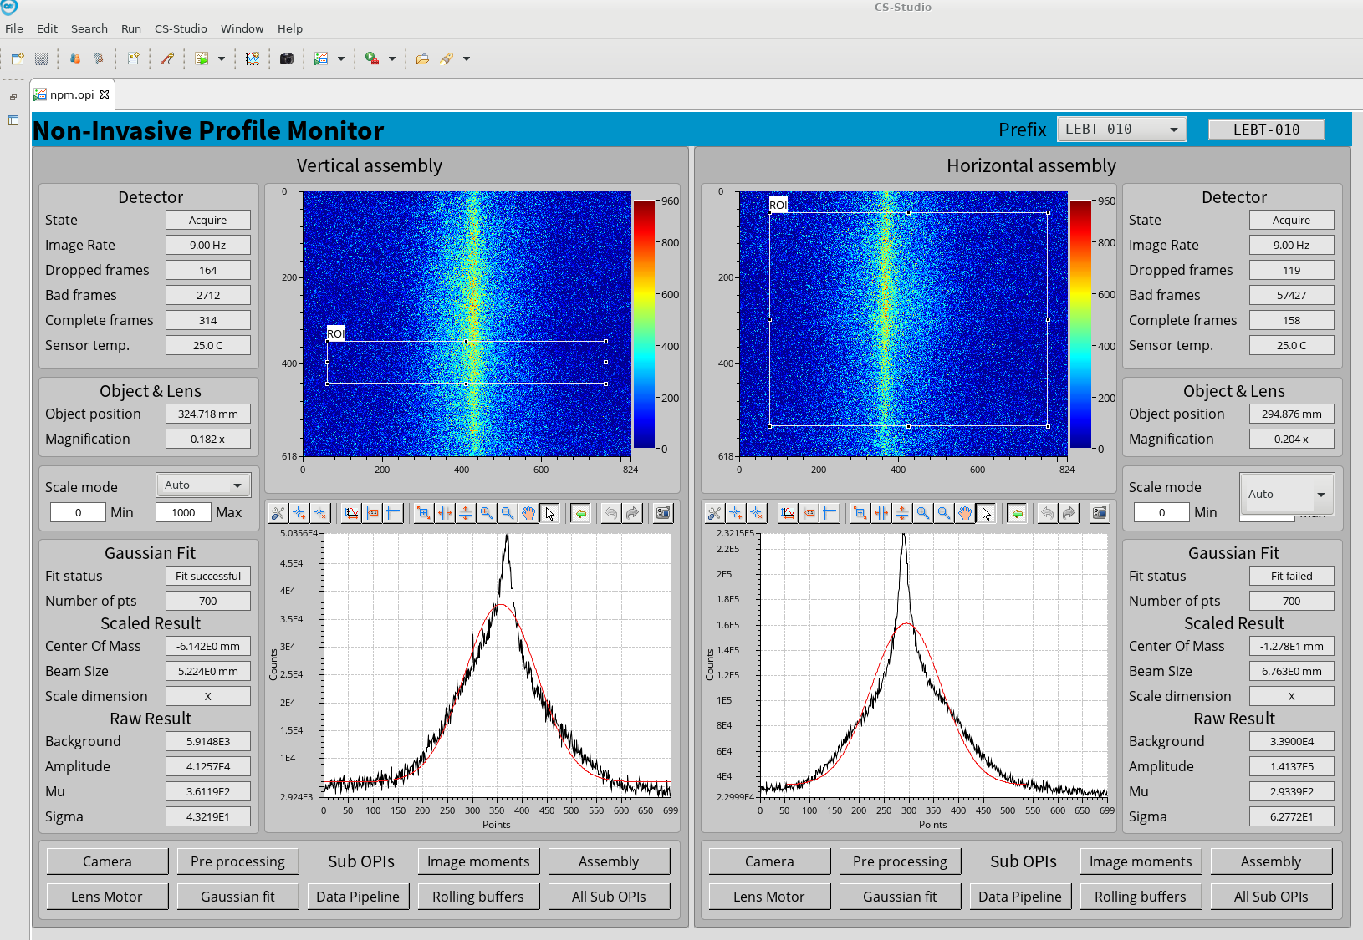
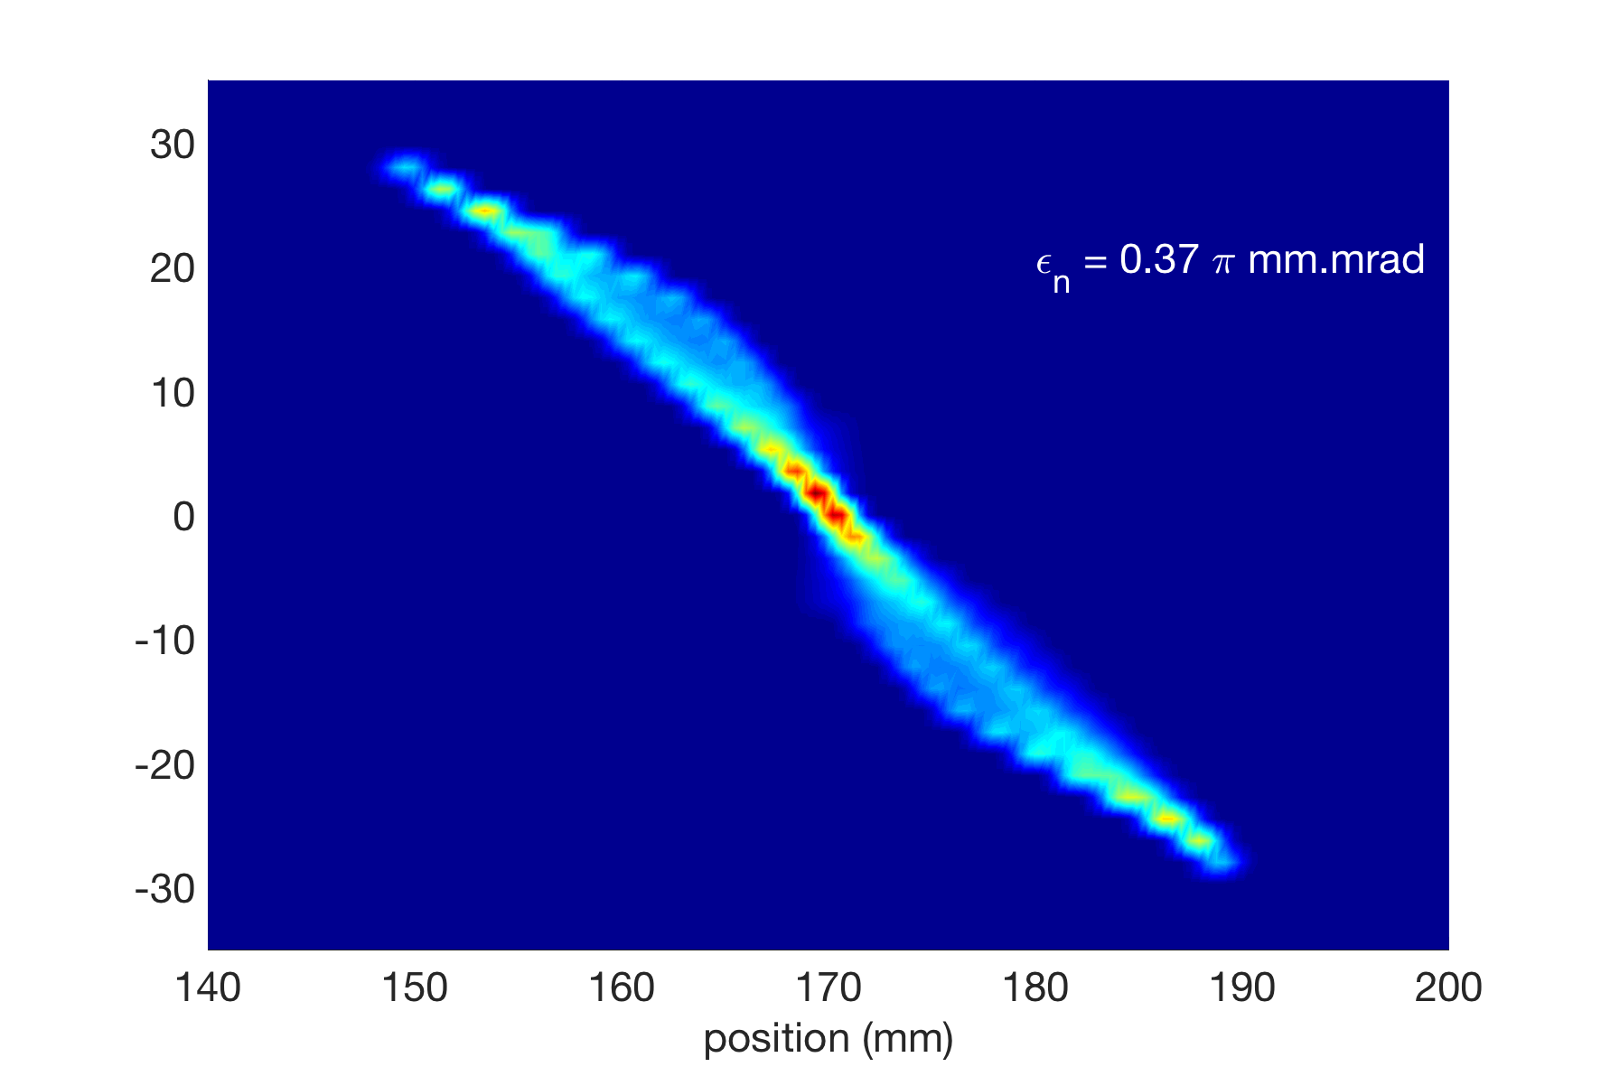
Beam Physics and Diagnostics are in a long term relationship…
Diagnostics are the only direct interaction we have with the beam.
The only indirect measurement we have are losses, which give us a lot of information but not the whole picture
We did a lot of simulations of the machines and tested various scenarios however we never know what we will really get in the end
Two types of measurements:
  Non-destructive: used during the run concomitant with the beam, constant monitoring over some beam properties
  Destructive: used during tuning periods
Angle (mrad)
Position (mm)

Slide 4
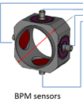
What is important to Beam Physics
Goal: 5MW proton beam at the target with an (almost) even power density distribution without making the whole linac radioactive or drilling holes on important components during the process.
Meaning:
  Know the beam path and be able to correct it
  Know the beam size along the machine (or the optics) so we don’t scrape part of it away
  Know the cavities’ Amplitude and Phase to achieve the right energy
  Know the beam current
BPM
Profile Monitor
Emittance Monitor
BPM
BCM
FC
BLM

Slide 5
Interlude: Beam Physics
Crash course
To simplify and get some feeling for the beam behaviour it is useful to think that the beam particles behave as a harmonic oscillator.
Since we have 3 dimensions we can think as 3 decoupled oscillators each with its specific constants of motion.
Looking at only one dimension we have some properties that can be drawn:
  Volume in phase space should be a constant of the motion (in the absence of non-linear forces)
  In phase space the particles describe a circle (in our case since variables are not normalized it is an ellipse)
  For an ensemble of particle we can think of an envelope function that describes the evolution of the beam as it goes through the accelerator.
  Quads define the restoring force in our oscillator thus defining the envelope function boundaries
In our case (non-relativistic hadrons) we have to account for space charge effects, i.e., the fact that the electrostatic force between particles is pushing them apart.

Slide 6
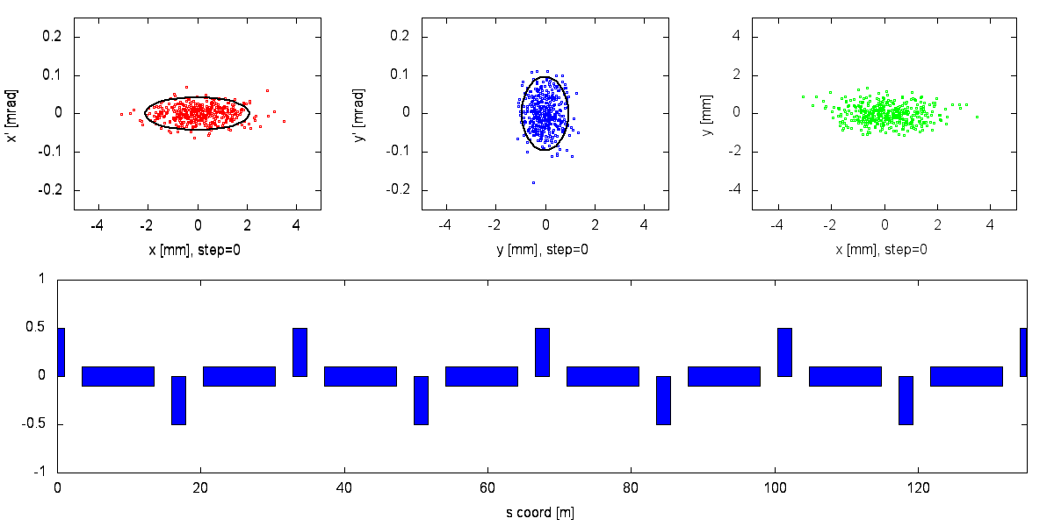
Envelope
from Tod Satogata (http://toddsatogata.net/)

Slide 7
Where to place Beam Diagnostics?
The position of most diagnostics is connected to the type of measurement we need to do weighted by: cost and machine real state
Trajectory corrections:
  Phase relation among BPMs and correctors
Transverse matching:
  Phase advance between profile monitors
  Locations of the monitor (measurable sizes, usually the bigger the better)
  Interfaces
RF Phase scan
  BPM pairs separated enough to measure ToF precisely but not too far to let the beam debunch
x’
x’
∆t < ∆t
x
x
E
A
φ
x

Slide 8
Most common use cases of Beam Diagnostics
Beam Position Monitors
Initial
m = BPM
measurement
BPM offset
Quad offset
Re-define trajectory
x = beam
displacement
Reference
axis
“Real” trajectory
and Correction

Slide 9
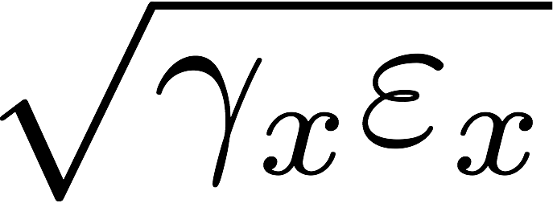
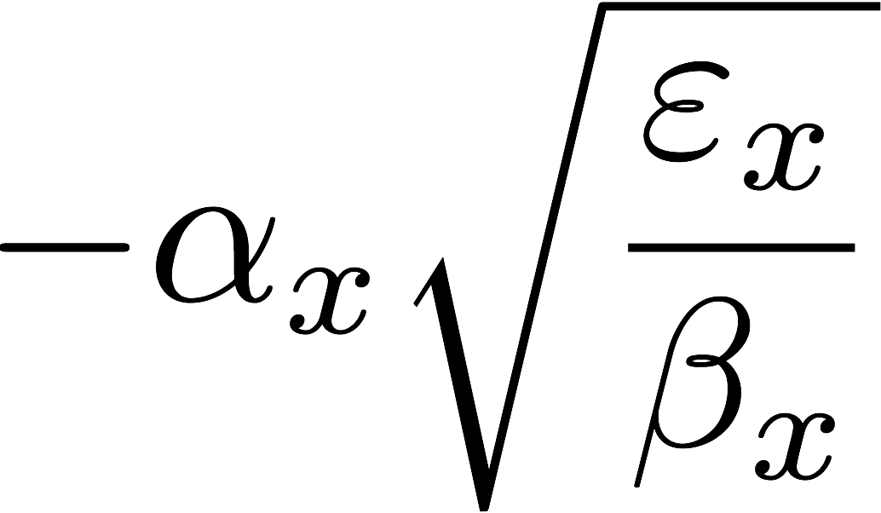
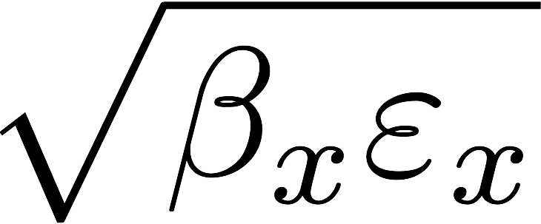
Most common use cases of Beam Diagnostics
Profile Monitor / Emittance Monitors
Lattice Functions
Profile measurements are mainly for beam characterization.
LEBT: NPM and EMU
  Projections (profiles on real space) like NPMs and Wire Scanners
  Phase space density like the Emittance monitors
x’
x
Angle (mrad)
A
Beam parameters
Position (mm)
x

Slide 10
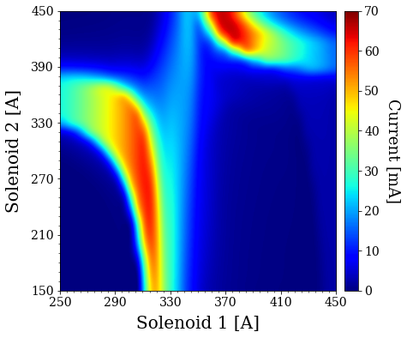
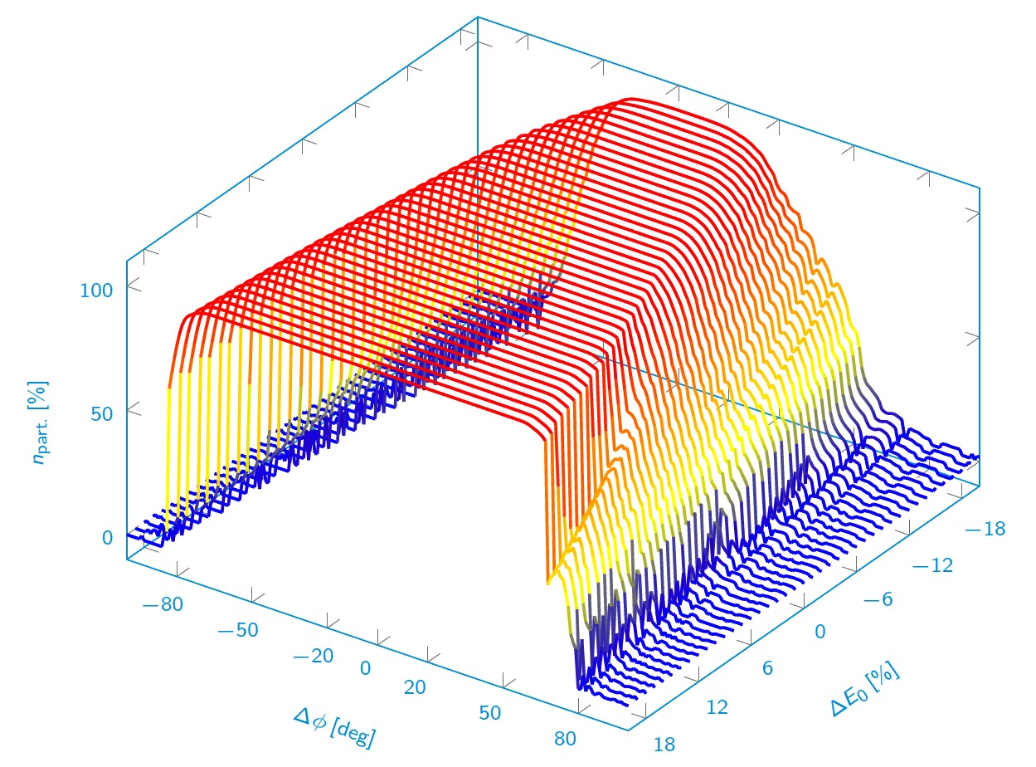
Most common use cases of Beam Diagnostics
Beam Loss Monitor and Beam Current Monitor
Those two types of diagnostics are usually closed related to machine protection as well.
Their measurements are complementary in the sense that one measures what is transported and the other what is lost.
”You do not need a BLM-System as long as you have a perfect machine without any problems. However, you probably do not have such a nice machine, therefore you better install one”
What do they tell us:
  Transmission/loss measurements can give us a feel of how matched the beam is to the lattice (RFQ transmissions)
  Give us an idea of the RF optimum position -> planned transmission curve measured for DTL1
  BLM loss pattern can help us understand halo formation and also diagnose sections that might have poor matching.
  Fast and reliable diagnostics for machines issues (vacuum leaks, obstructions, etc..)
Courtesy E. Nilsson and R. de Prisco

Slide 11
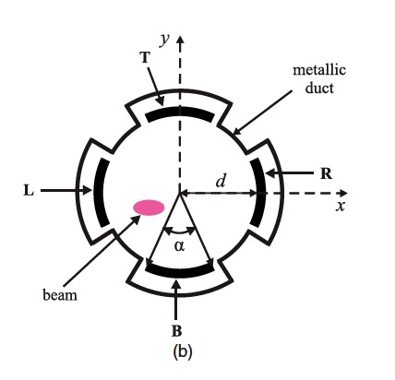
Unconventional uses
Beam Position Monitors
BPMs give us the position of the beam centroid along the Linac, is that the only information in the measured signal?
Quadrupolar terms carry information about the beam rms sizes.
“free” measurement of the beam ellipticity
Usages:
  Monitor changes in the relative beam sizes along machine
  Matching fine tuning and optimization

Slide 12
ESS example
Nice and periodic makes life simple for monitoring
optics in long term

Slide 13
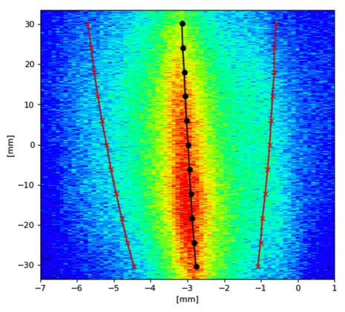
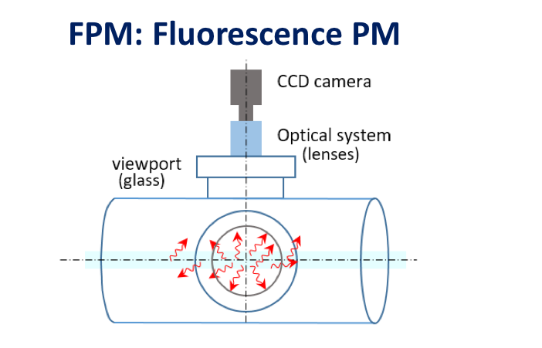
Unconventional uses
Profile Monitor (NPM in the LEBT section)
courtesy of Cyrille Thomas
angle
position
envelope
13

Slide 14
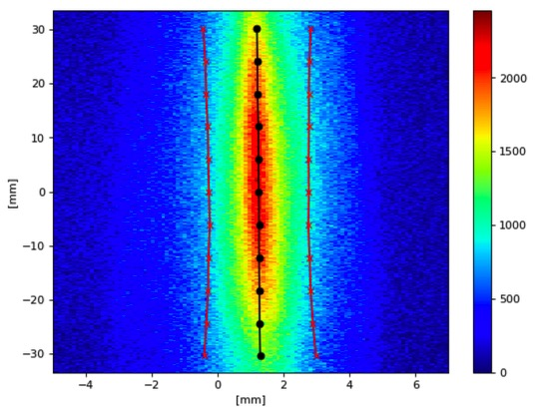
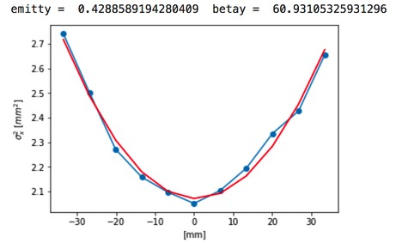
Unconventional Uses
Profile Monitor (NPM in the LEBT section)

Slide 15
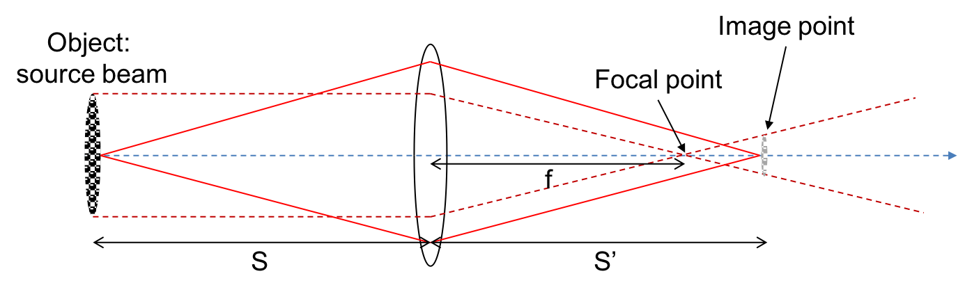
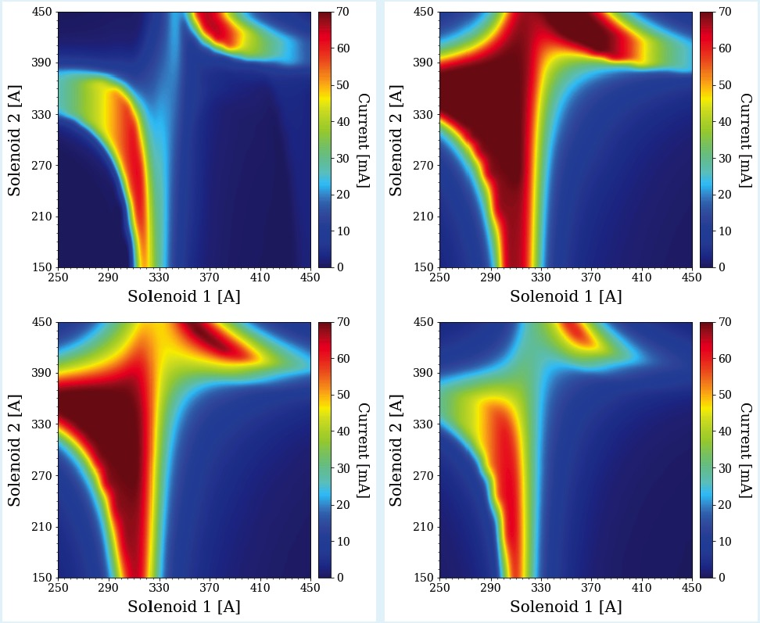
Unconventional Uses
Profile Monitor (NPM in the LEBT section)
Estimate misalignments and initial conditions and
try to explain BCM measurement

Slide 16
Conclusion
Diagnostics enable us to verify that the machine we actually put together corresponds to the one we modelled.
Usually they don’t match 100%, again we use BI to make model and reality to get closer together or, in some cases, to find another set point in which the machine works better
Bottom line: We need diagnostics to do anything Beam Physics related. We will always push it to the limit. Very often we will ask from it more than we have previously defined, just to make your life more exciting!

Slide 17
Thank you!
Questions?

Slide 18


x’
x’
∆t < ∆t
x
E
x
A
φ
x

