Slide 1
Status report on EMC
Rafael Baron, Edvard Bergman, Thomas Shea
Lund - Sweden
2019 - Oct

Slide 2
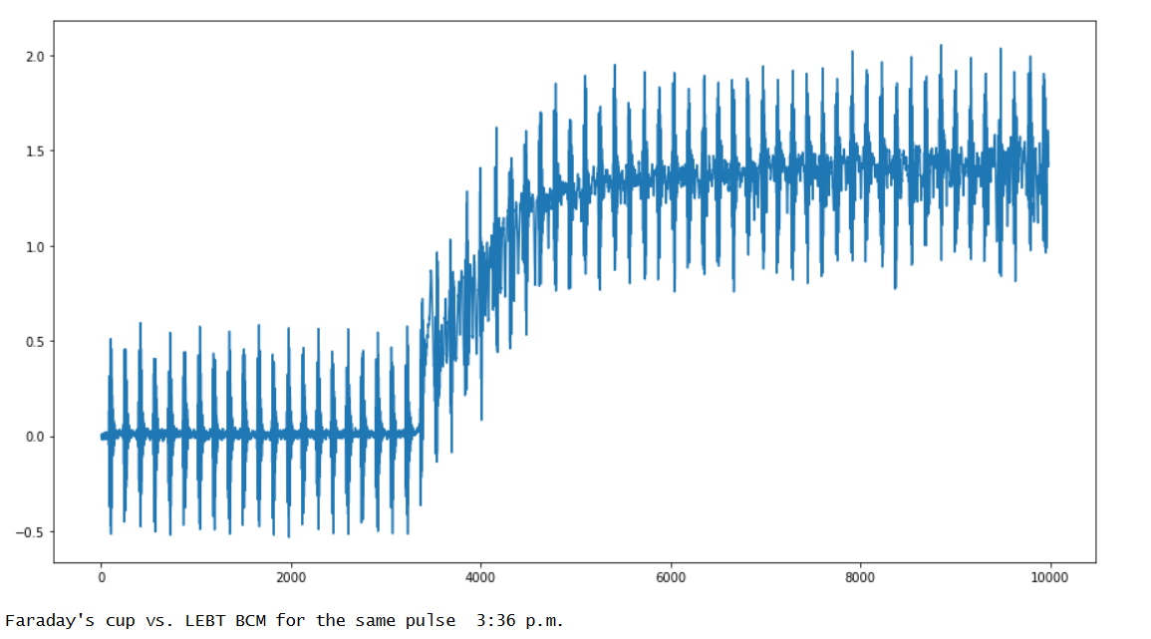
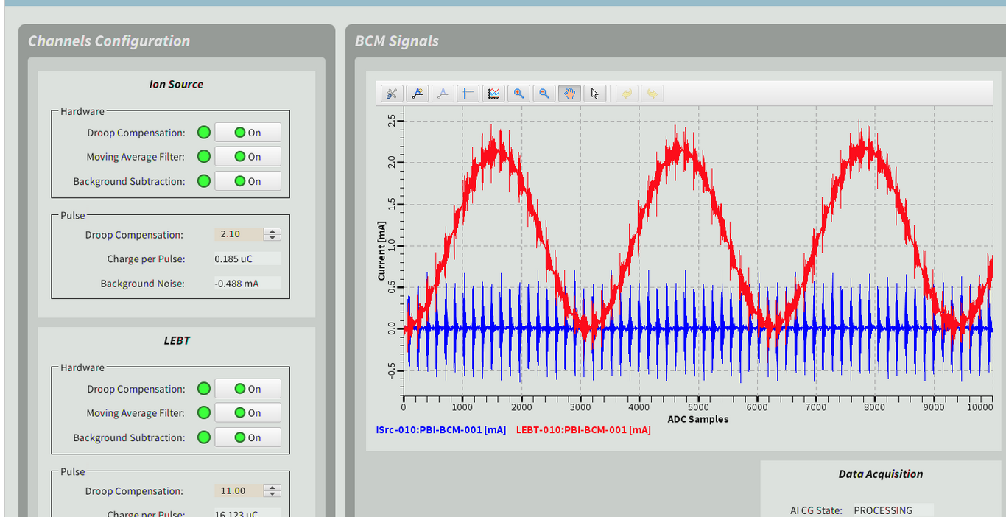
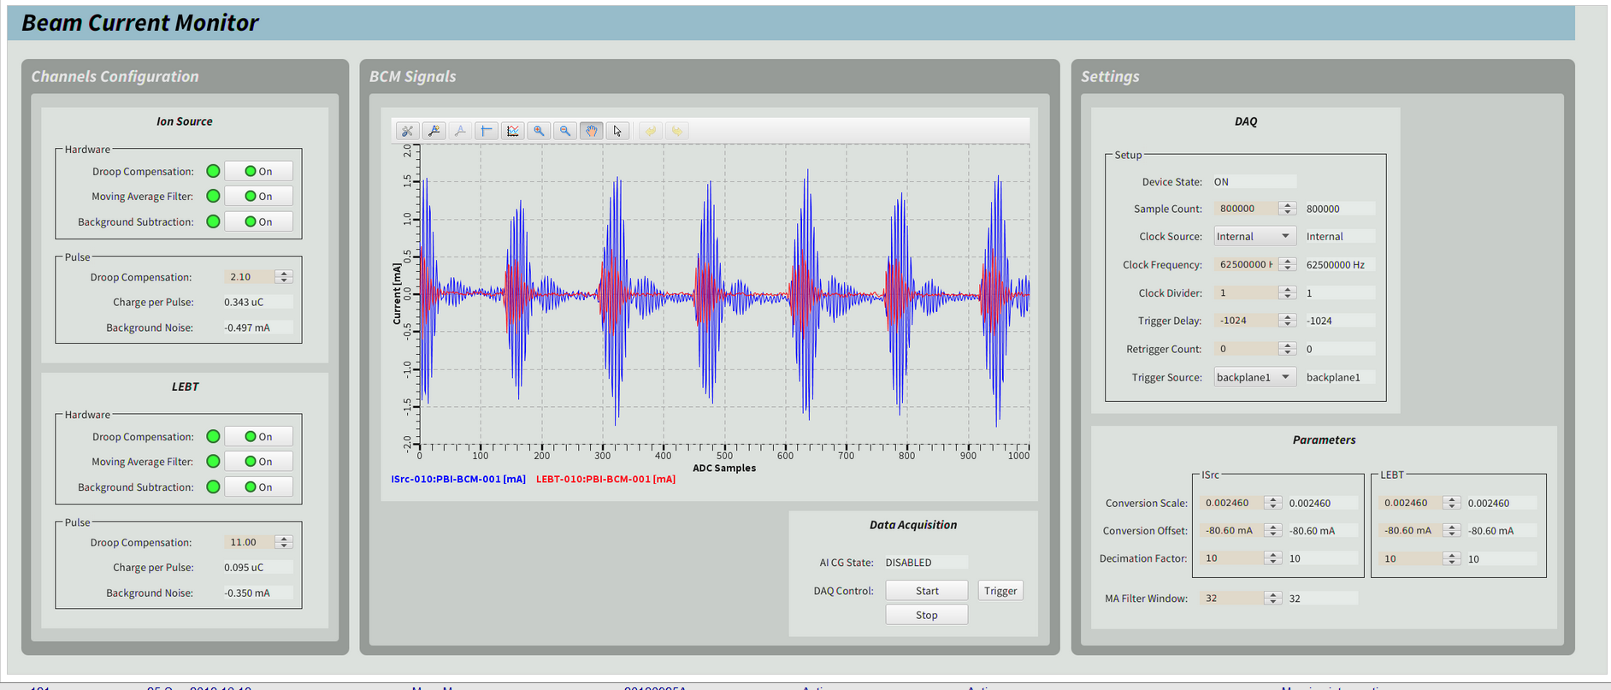
EMI – EMC Issues observed during LEBT commissioning
Several EMI/EMC issues have been observed during the LEBT commissioning due to poor grounding and shielding. From operators logbook:

Slide 3
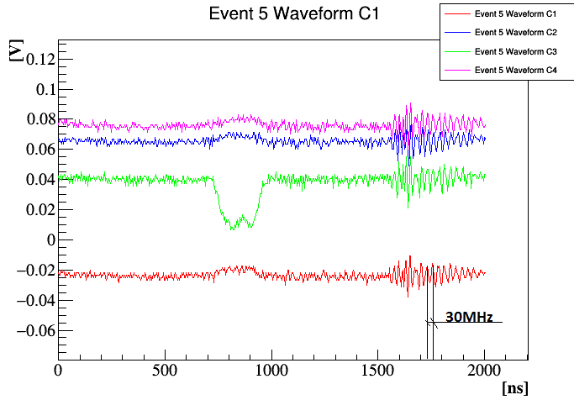
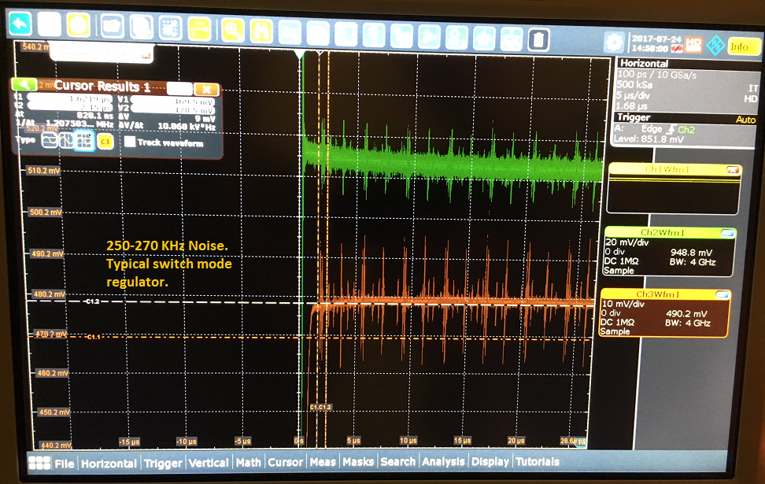
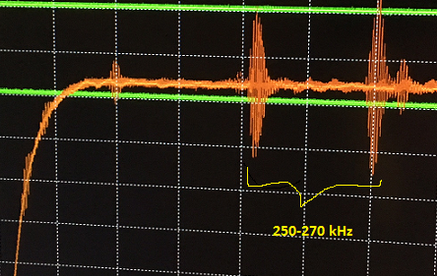
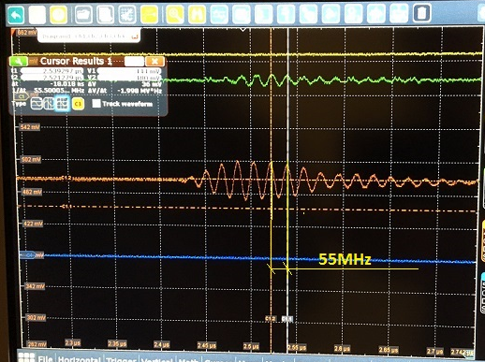
EMI – EMC Issues observed during LEBT commissioning
EMI/EMC issues observed in several ESS systems (BCM, nBLM, RF interlock, LEBT Chopper, Cryomodules temperature readouts and others)

Slide 4
EMI – EMC Theoretically: poor vs good ground on a signal receiver input noise
Single ended, shield not grounded →
Single ended, shielding grounded in one side →
Differential, shielding grounded in one side →
Single ended, shielding grounded in both ends →
Differential, shielding grounded in both ends →

Slide 5
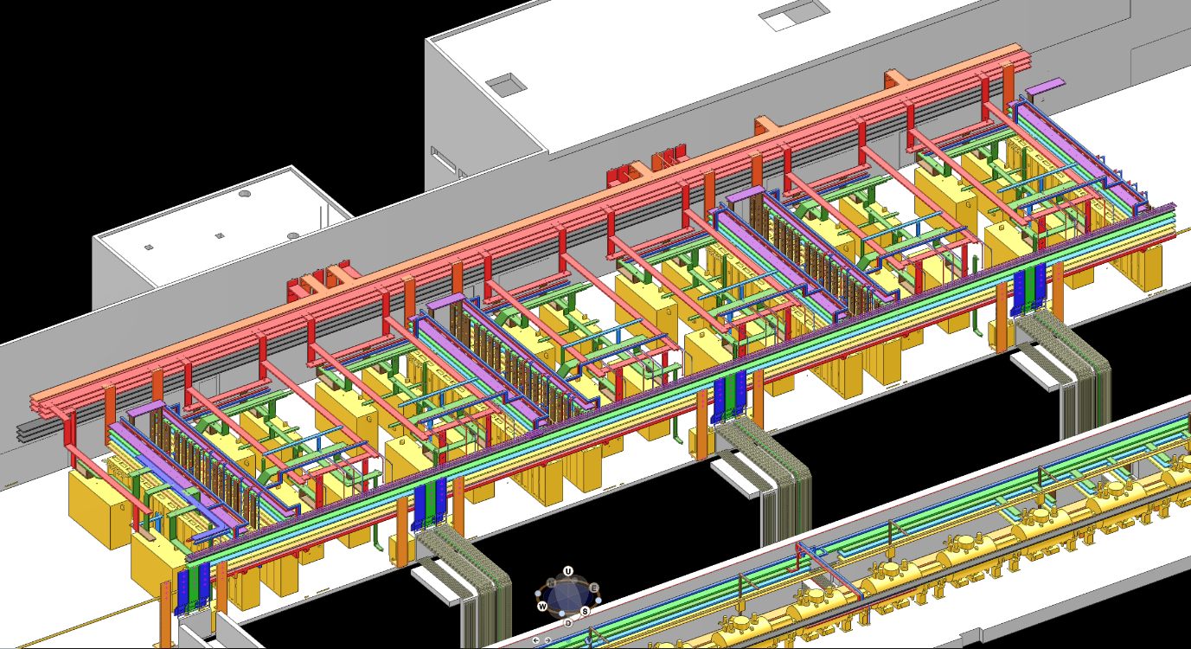
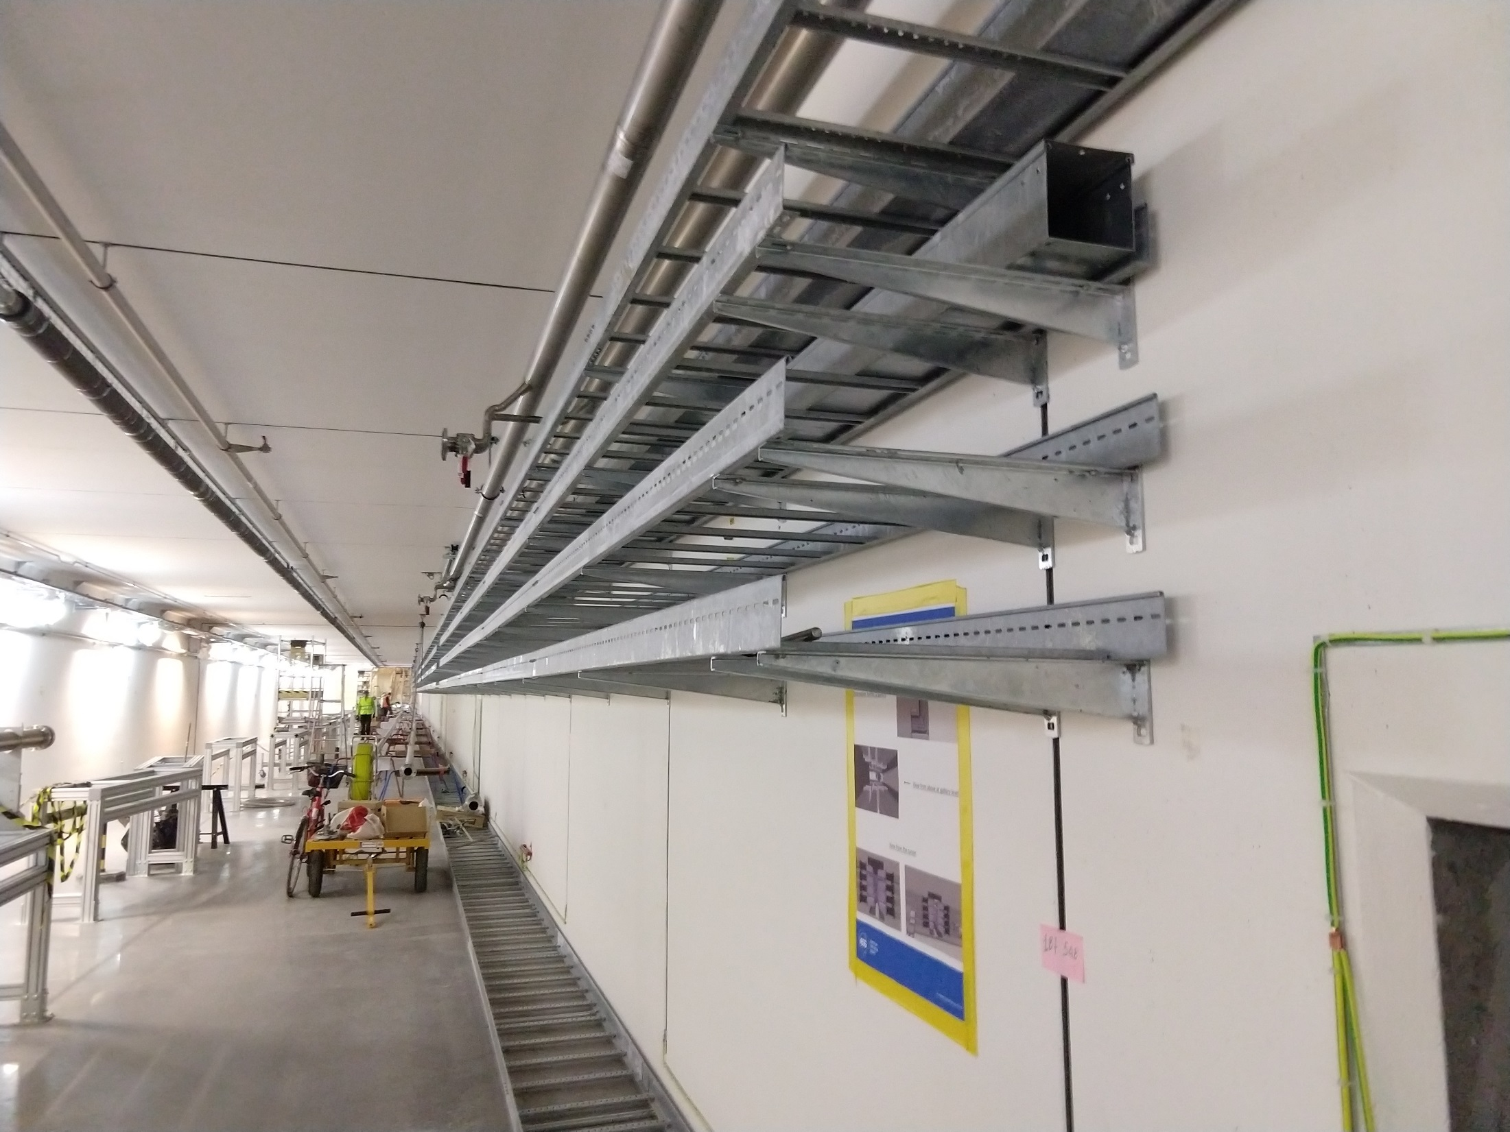
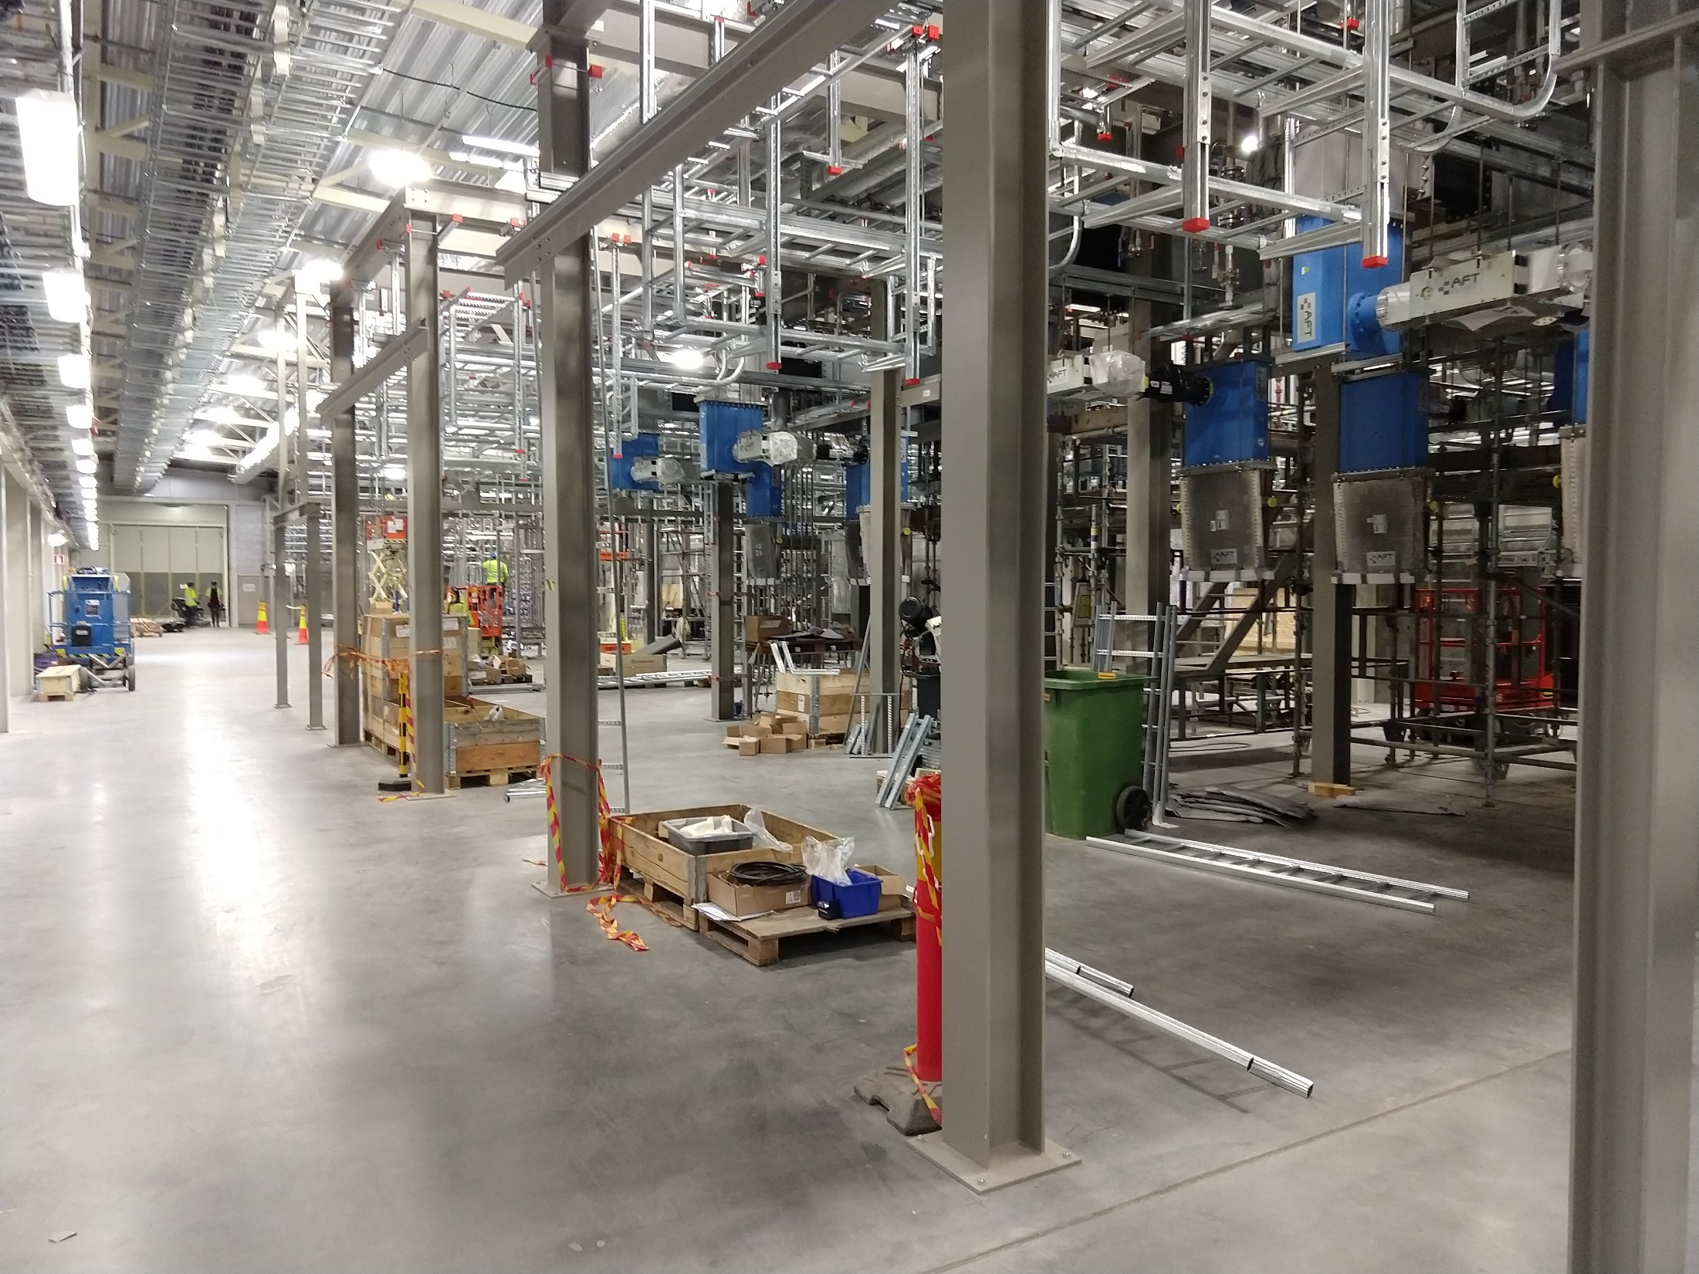
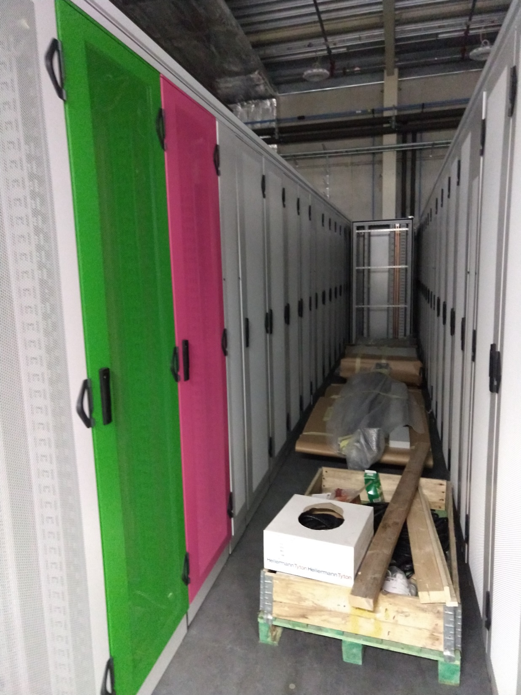
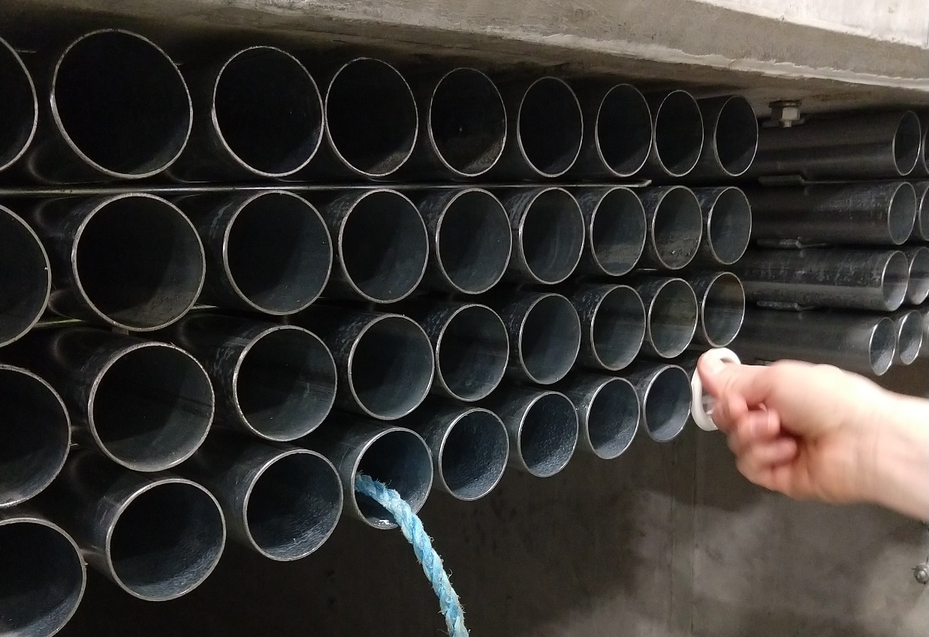
EMI – EMC EMC building improvements
Only safety ground was planned!

Slide 6
EMI – EMC The plan (since May/2019)
An EMC task force was started to find solutions for the poor EMI/EMC design of the machine
https://confluence.esss.lu.se/pages/viewpage.action?spaceKey=~thomasshea&title=Electromagnetic+Compatibility
https://confluence.esss.lu.se/display/AI/EMC+Task+Force
Infra-structure team is working on the improvements and they now understand the importance of EMI/EMC.
Low impedance copper foils are being used to interconnect racks and tunnel.
Improvements on the racks grounding – thousands of racks were ordered painted. We are now working to cover their frames with aluminium tapes to allow a low impedance ground connection of the equipment.
Improvements on the grounding between accelerator, racks and cable ladders is in progress.
Improvements on the connections of racks to the building grounding mesh.
We already spent almost 150 kEUR on EMI/EMC improvements on the installation.
Recommendations to in-kind partners:
Analyse case by case if enclosures or patch panels should be painted, anodized or be conductive.
Cables with improved shielding should be selected to avoid EMI issues.
We have an installation with devices that operate with few kA pulses over microseconds rise/fall time and high power switching power supplies

Slide 7
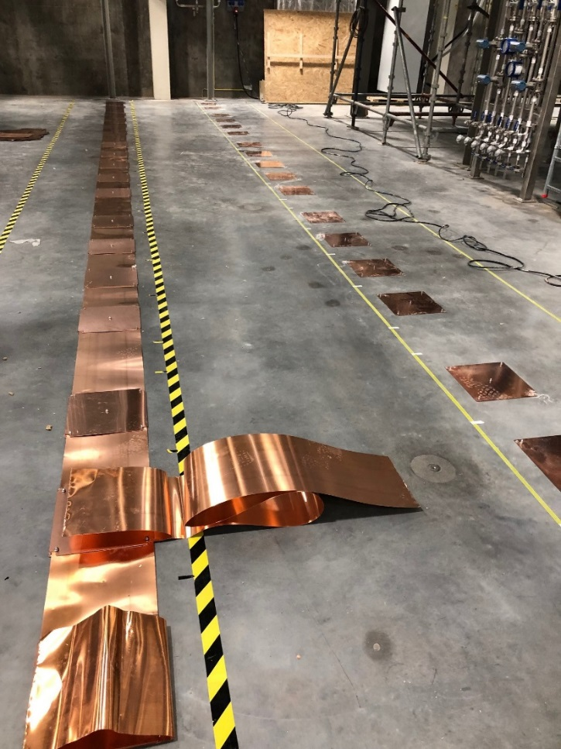
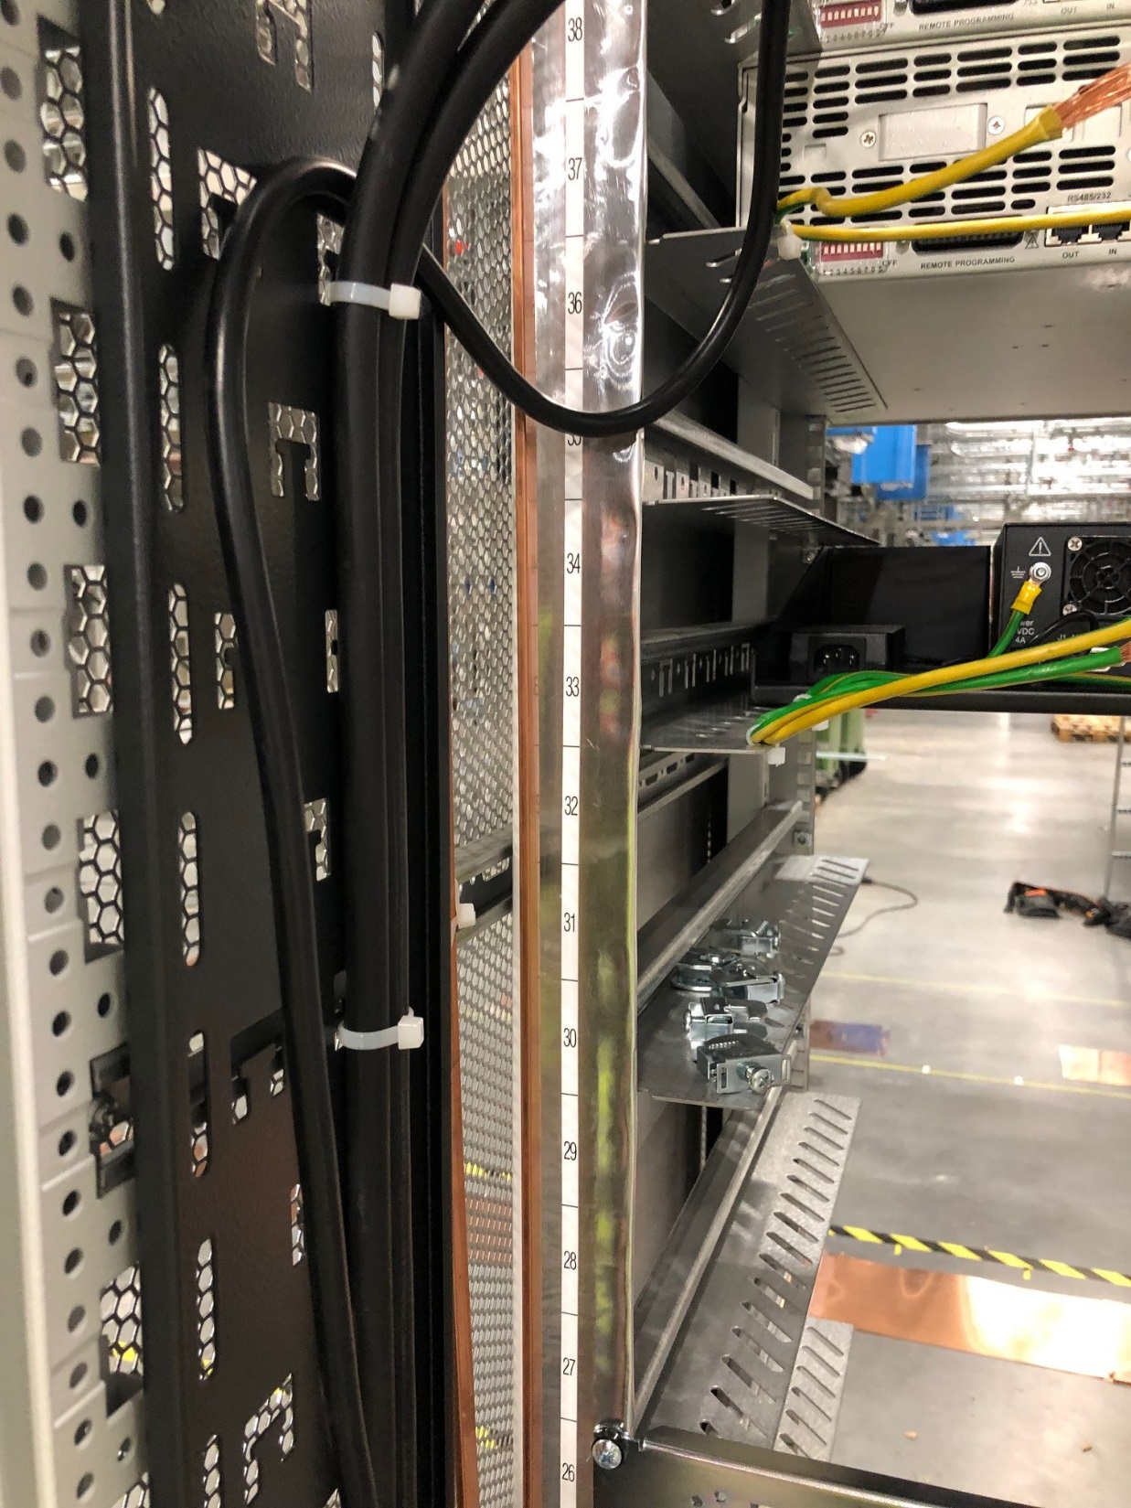
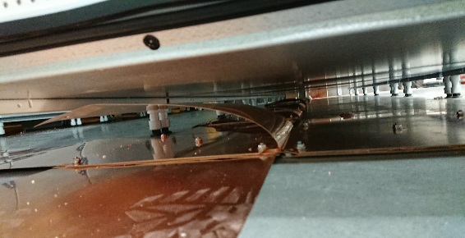
EMI – EMC EMC rack improvements
Racks are being connected to the ground mesh by the use of ground planes in the floor.
Low impedance copper foils are connecting racks
Aluminium tapes covering the rack painted frames
Copper foils are connected to the bottom of the rack

Slide 8
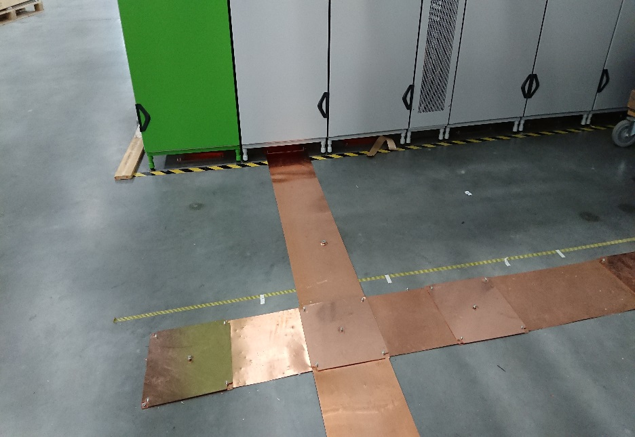
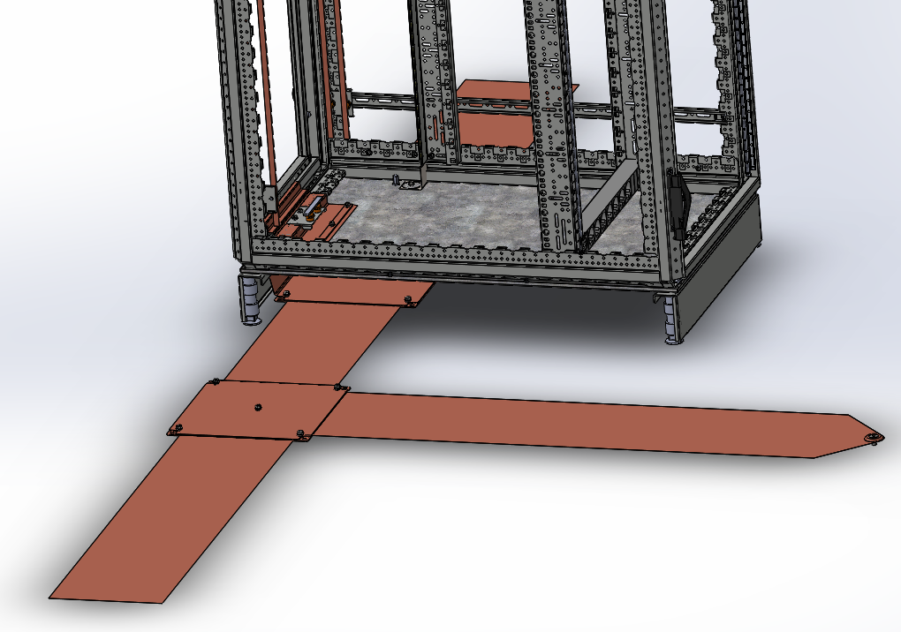
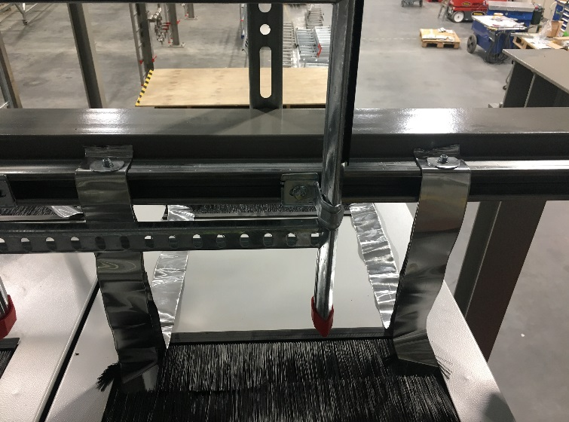
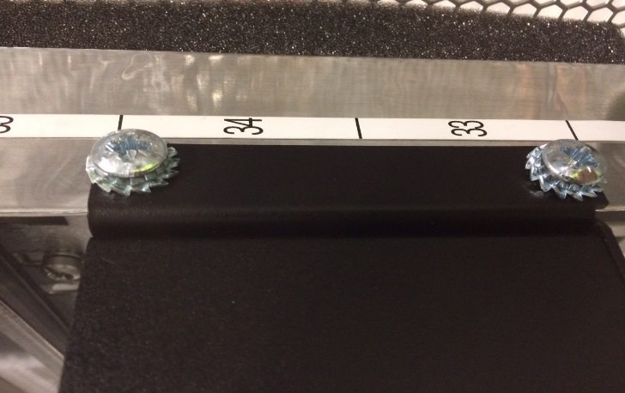
EMI – EMC EMC rack improvements
Racks are being connected to the ground mesh by the use of ground planes in the floor.
Low impedance copper foils are connecting racks
For painted enclosures, washers with teeths can be used to perform ground contact.
Rack ground connected to the cable ladders (top of the rack)

Slide 9
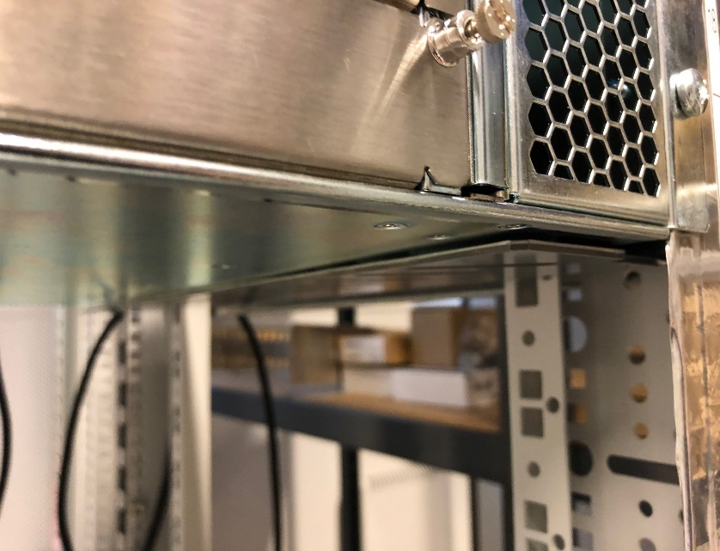
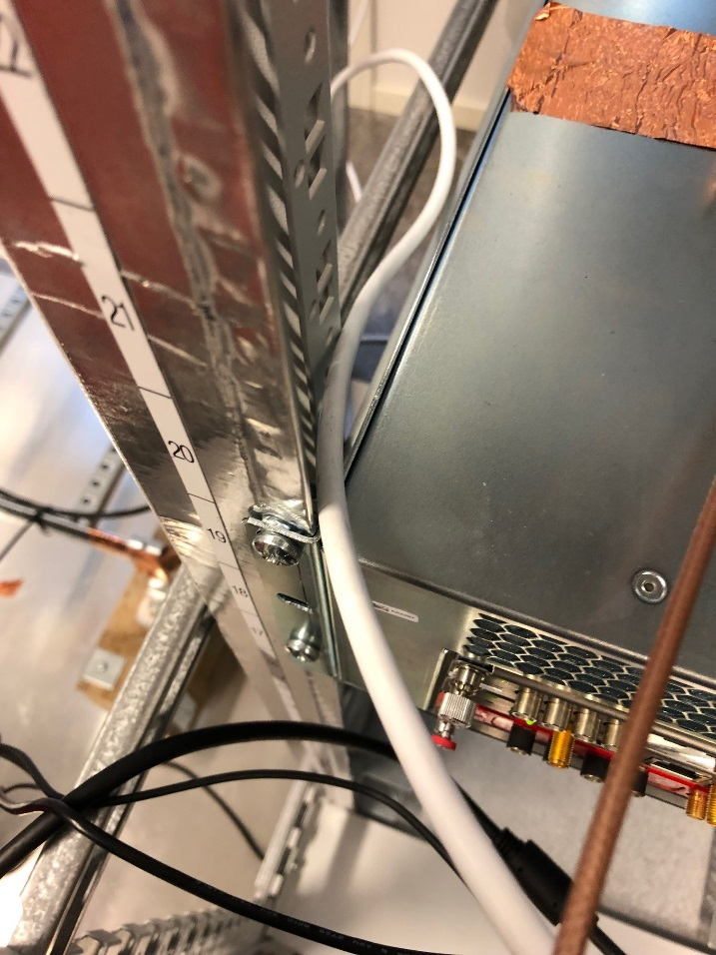
EMI – EMC EMC rack improvements
Racks are being improved by adding aluminium tapes to make the frames a low impedance ground connection
- Aluminium foils are connected to the bottom of the rack
- Crate to rack interface is done through the chassis

Slide 10
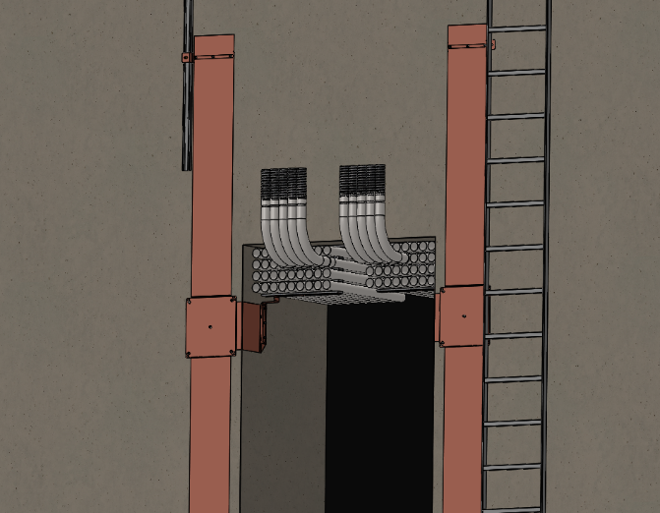
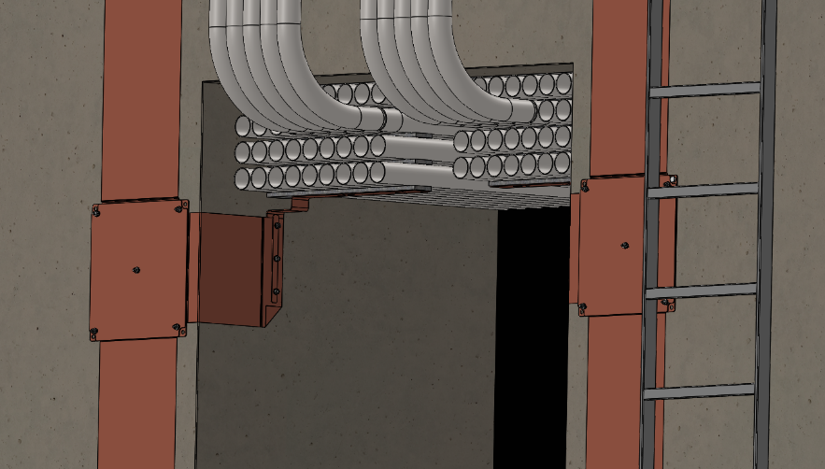
EMI – EMC STUBs improvements
Cable ladders to stubs are connected with copper foils
Stub pipes are connected to copper foils
Stubs are the low impedance ground interface from gallery to tunnel

Slide 11
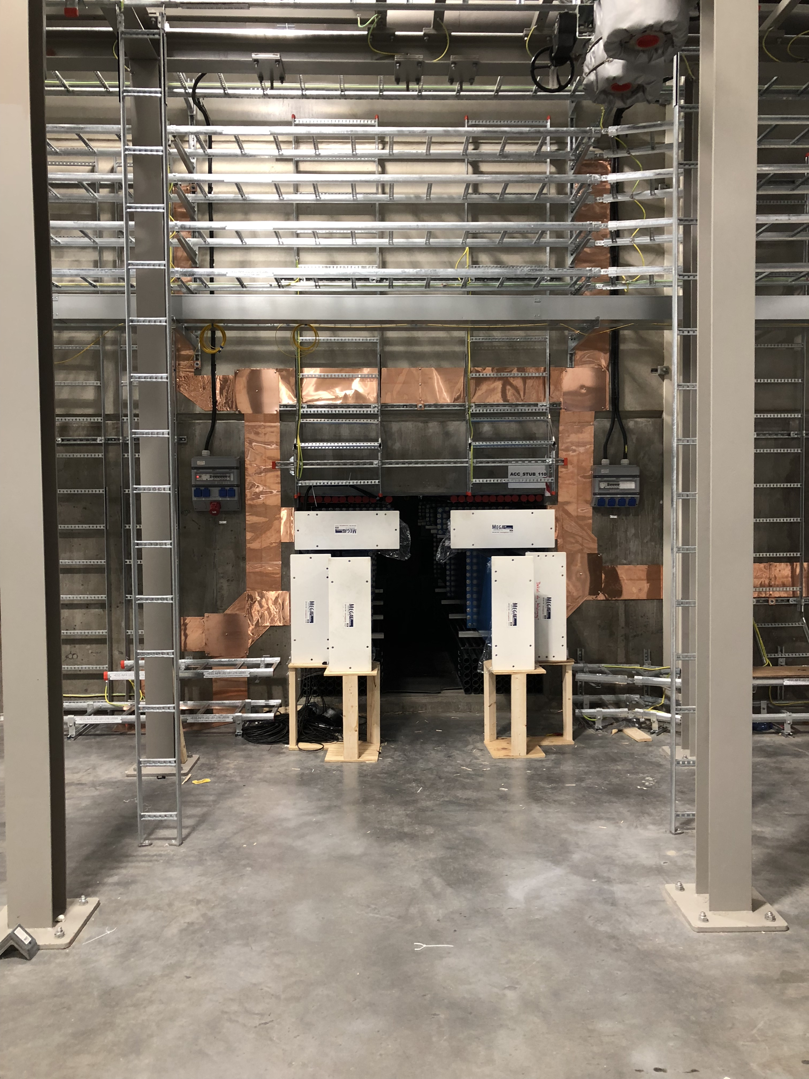
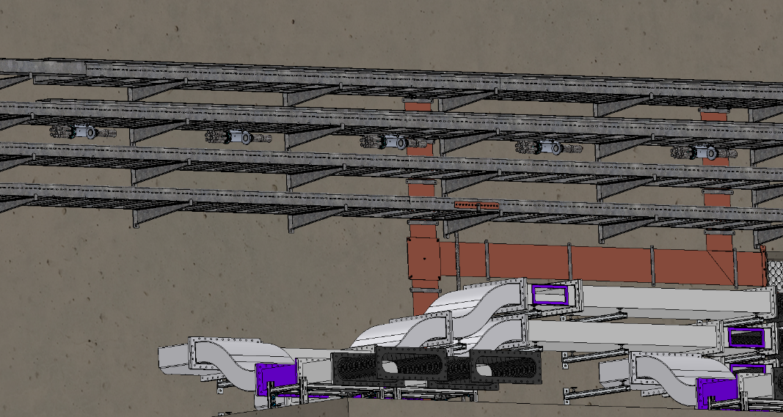
EMI – EMC EMC building improvements
Copper foils to cable ladders (gallery side)
Stubs to cable ladders and Stub conduits to accelerator
Low impedance copper foils are connecting stub pipes to cable ladders in gallery and tunnel side
STUB’s pipes are connected to Copper foils in gallery side

Slide 12
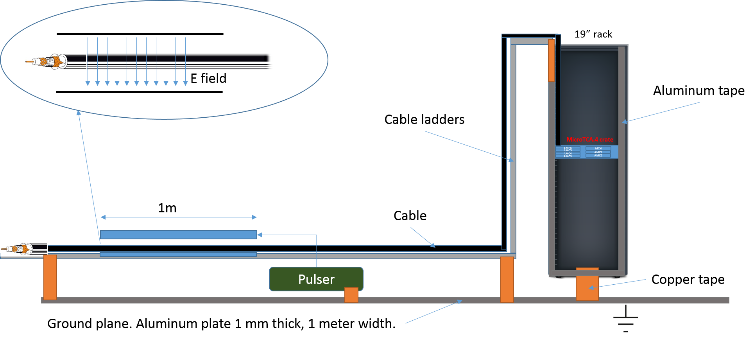
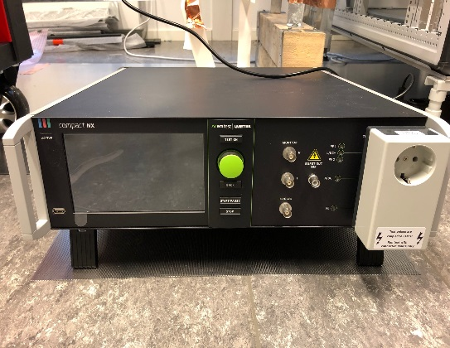
EMI – EMC EMI / EMC lab test setup for checking cables shielding and ground connections
Test setup with a pulser on the cables
- Several pulses with few nanoseconds rise time and amplitude up to 2 kV

Slide 13
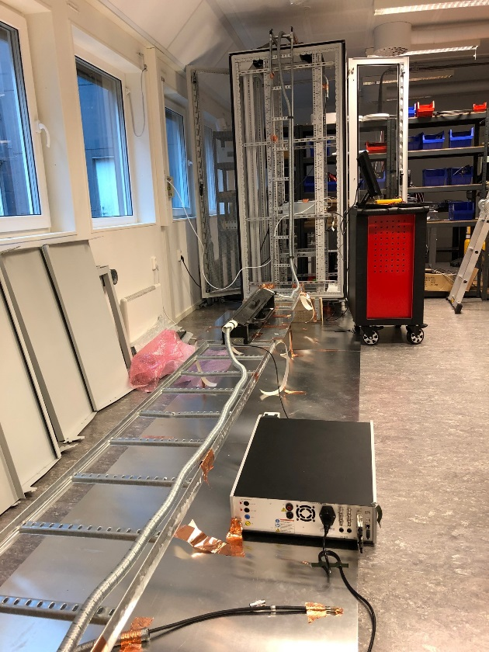
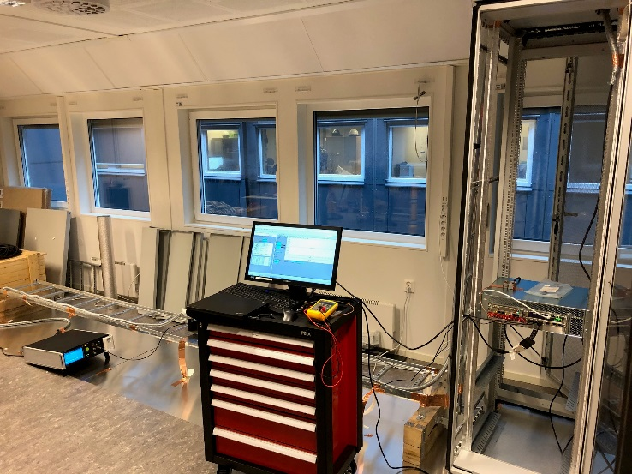
EMI – EMC EMI / EMC lab test setup
Cables are placed through the clamp
Grounding connections are tested.
The test can help determine:
how to terminate and connect the cables in both rack and sensor side.
Improve the cable shielding

Slide 14
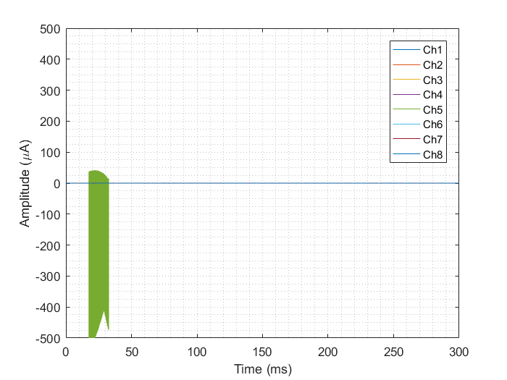
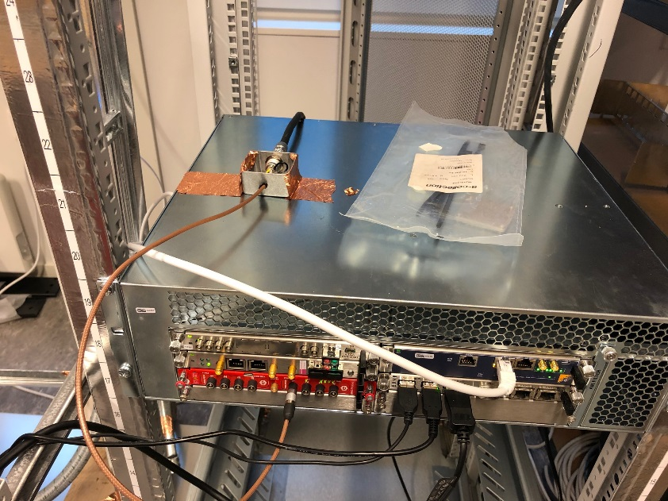
EMI – EMC EMI / EMC lab test setup: example with FMC Pico
MicroTCA.4 crate ground floating
Sensor shield floating.
Signal ground floating.
2kV Pulser on.
Noise excited on the inputs
Full range

Slide 15
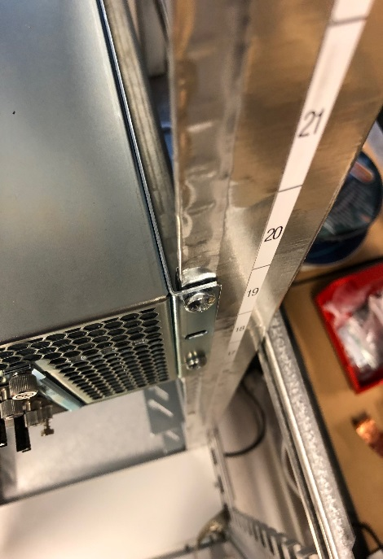
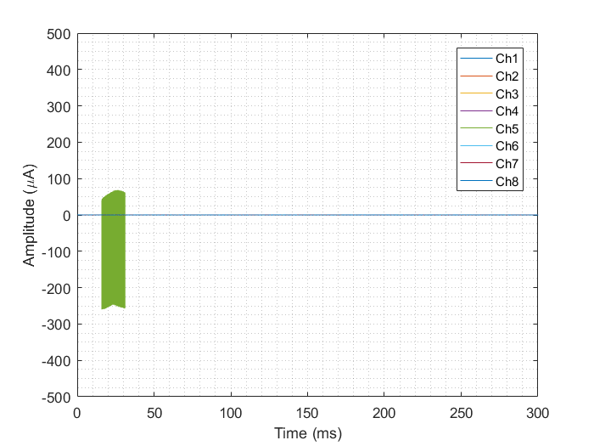
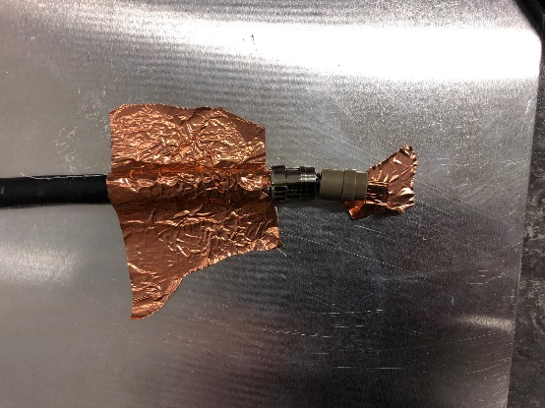
EMI – EMC EMI / EMC lab test setup
MicroTCA.4 crate grounded
Cable shield grounding on sensor side not connected.
Signal ground connected to the rack ground on FMC side.
2kV Pulser on.

Slide 16
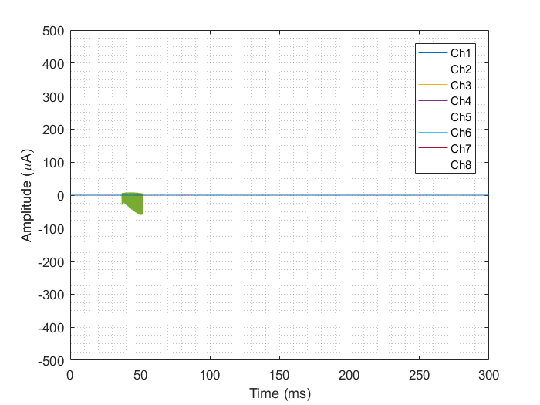
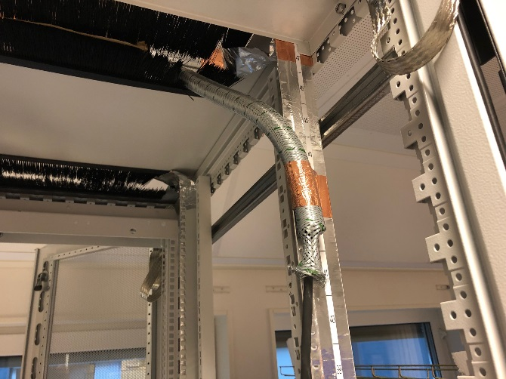
EMI – EMC EMI / EMC lab test setup
MicroTCA.4 crate grounded
Conduit added to the cable.
Cable shield on sensor side is not grounded.
Signal ground is not connected to rack ground.
Connector box is grounded on receiver side (cable shield).
2kV Pulser on.

Slide 17
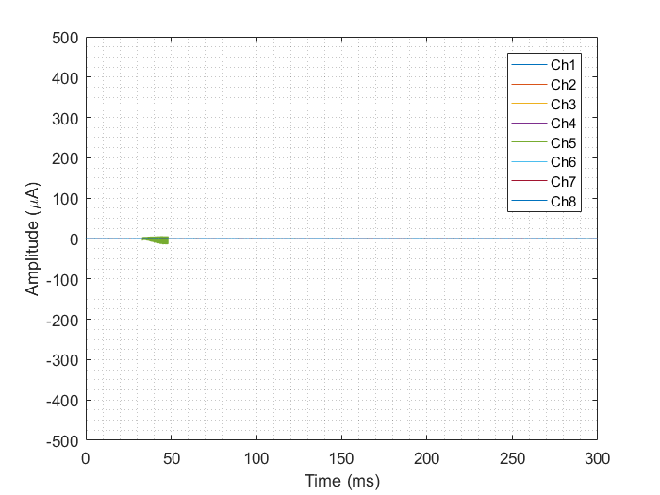
EMI – EMC EMI / EMC lab test setup
MicroTCA.4 crate grounded.
Conduit is protecting the cable.
Signal ground is connected to rack ground on receiver side.
Connector box on receiver side is grounded (cable shield).
Signal ground is not connected to rack ground on the sensor side.
2kV Pulser on.
2% of the value measured before EMI/EMC improvements

Slide 18
EMI – EMC EMI / EMC lab test setup

Slide 19
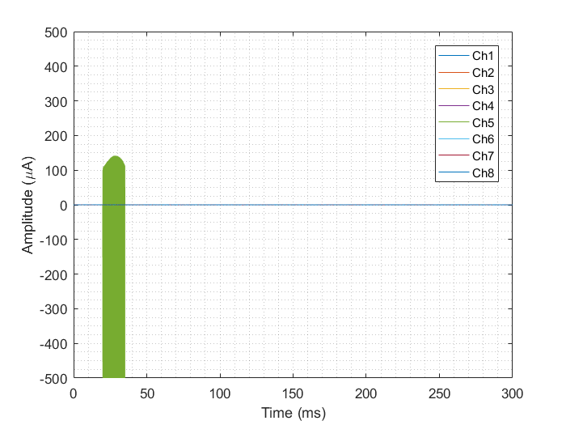
EMI – EMC EMI / EMC summary
1
Improved grounding
2
Conduit protecting the cable
4
Conduits and improved grounding
3

Slide 20
Conclusion
EMI / EMC improvements ongoing on the building
Thousands of racks are being improved
Cable trays under design for sensitive cables
The noise in the readout signals can increase by a factor of approximately 4000 % when proper EMI and EMC improvements are not taken into account.

