Slide 1
ESSnuSB WP 2, 3, 4 meeting
A brief introduction to Radiation Safety at ESS
François JAVIER and Thomas HANSSON
Radiation safety engineer - ESH
European Spallation Source ERIC
June 11th 2019

Slide 2
Outline
Radiological hazards at ESS: orders of magnitude
ESS radiation safety framework - GSO
ESS process for radiation safety analysis and safety functions identification/classification
List of useful ESS Radiation Safety documentation
Conclusion

Slide 3


Radiological hazards orders of magnitude for Accelerator
Radioactive inventory from activated air – Prompt radiation
Beam on - full beam loss
400 mSv/h max on berm
Closest area off site – max 4 mSv/h
Beam on - 1 W/m loss
2 μSv/h max on berm
Closest area off site – max 2 nSv/h
Shielding
(concrete + earth)
15 DAC max (14 GBq) in the tunnel during operation and beam on (1 W/m loss) with renewal HVAC = 0
(with rHVAC = 0.5, 10 GBq corresponding to 9 DAC)

Slide 4
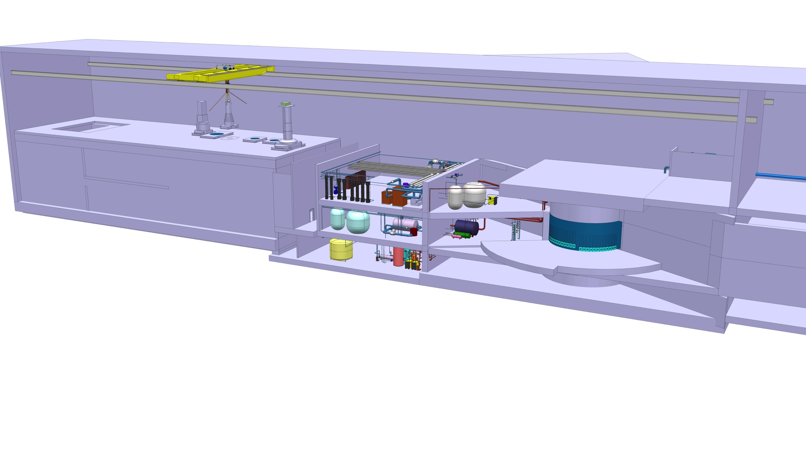
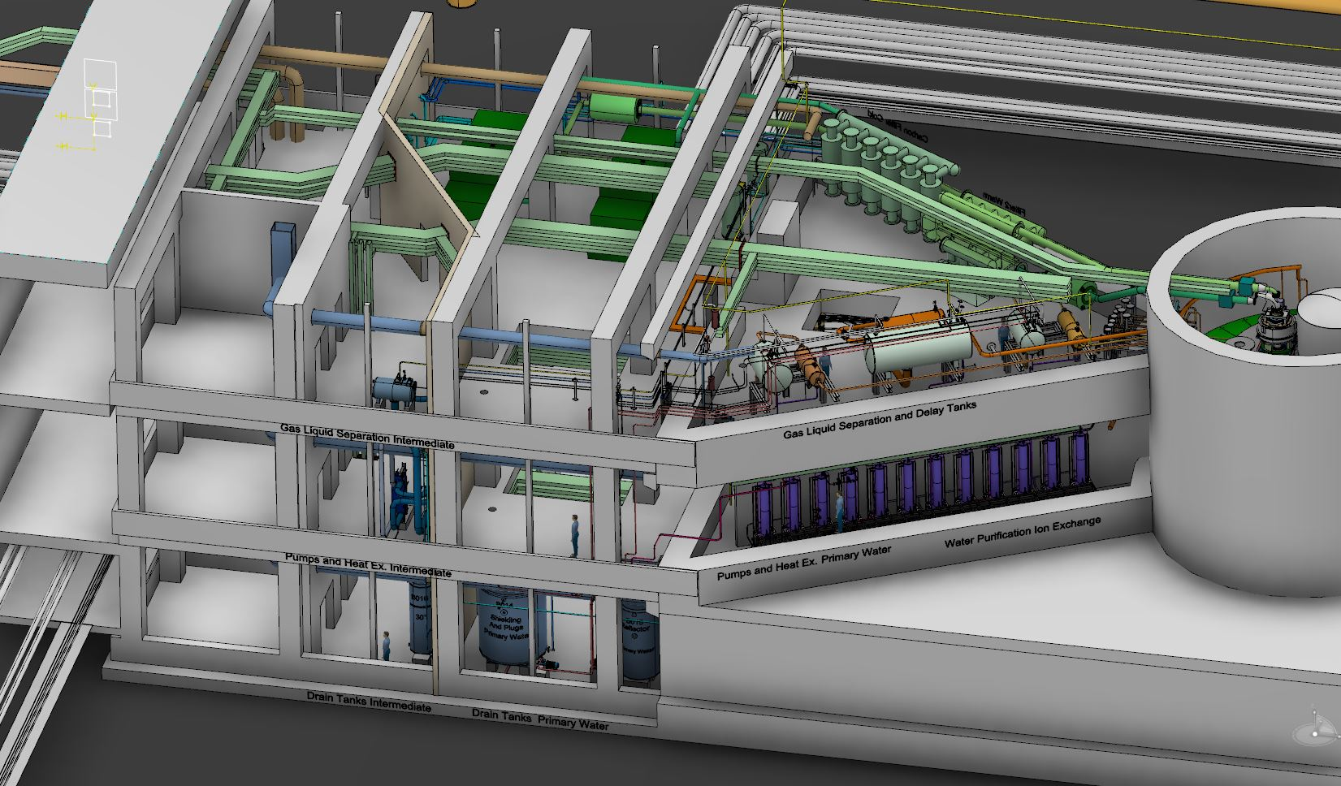
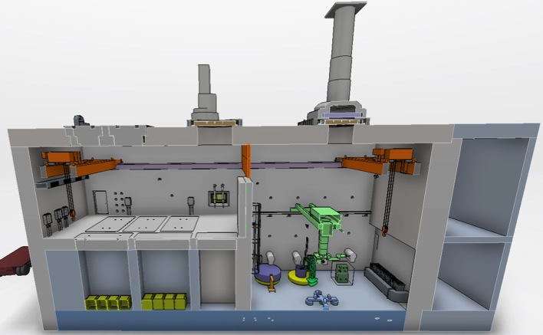
Radiological hazards orders of magnitude for target station
Radioactive inventory– Prompt and residual radiation
Monolith area
∼ 4.10¹⁷ Bq
Utility area
shielding
Designed to attenuate with a criterion of 3 μSv/h
∼ 4.10¹²Bq
Active cells facility
Dose map of the target wheel (irradiated 5 years + 14 days of cooling time) in the active cell.
(2000 Sv/h contact)
∼ 8.10¹⁶ Bq

Slide 5
ESS radiation safety framework
The protection level expected is defined through dose limits, dose constraints and design criteria provided by the national regulation and Swedish Radiation Safety Authority (SSM) conditions.
The radiation safety functions are the functions implemented to stay below these limits
Events and circumstances that affect the facility shall be divided in 5 event classes based on frequencies
The radiation safety functions are identified through the radiation safety analysis

Slide 6
ESS radiation safety framework – detailed GSO
The workers radiation safety functions WRSF are the functions implemented to stay below the limits defined for the workers
The radiation safety functions RSF are the functions implemented to stay below the limits defined for the public
The WRSF are identified through a general risk assessment and deterministic approach is not required.
The DiD is limited to 3 levels.
The RSF are identified through the radiation safety analysis using deterministic approach and DiD principle
with 5 levels.
Events and circumstances that affect the facility shall be divided in 5 event classes based on frequencies

Slide 7
Defence in Depth and Radiation Safety Functions RSF grouping
10⁻⁷
The DiD shall be tailored to the activities and associated safety stakes
A failure of one level shall not be able to propagate to a subsequent level
DiD level 3 shall be independent of DiD level 1 and 2
DiD level 4 shall be independent of DiD level 1-3

Slide 8
Additional Radiation Safety Functions RSF grouping

Slide 9
Additional Radiation Safety Functions RSF grouping

Slide 10
Radiation Safety Functions identification process
Step 1 :
Radiological hazard induced by the facility and its operation
  Radiation Safety Functions to be performed for normal/planned operation
  Additional Radiation Safety Functions or additional requirements on the Radiation Safety Functions identified
  in step 1
Step 2 :
Accident analysis
  The combination of the set of functions identified in step 1 and 2 must show, as far as practical and reasonable, a proper implementation of a number of consecutive and independent levels of protection that would have to fail before harmful effects could be caused to people or environment
Step 3 :
Robustness of defence in depth

Slide 11

Step 1:
Target station radiological hazards and basic
Radiation Safety Functions for normal operation
Radioactive inventory generated inside monolith and partially transferred to cooling/purification circuits and active cells.
Residual radiation
Radioactive inventory
Residual radiation
Radioactive inventory
Prompt radiation
Residual radiation
Radioactive inventory
Active cells facility
Shield
Manage access
Confine
Utility area
Shield
Manage access
Confine
Monolith area
Shield
Manage access
Confine
Cool
Manage spallation process
Inputs:
Facility design description
Modes of operation
Performances
Radiological hazards identification (qualitative & quantitative)
Radiation Safety Functions needed for normal operation
Notes:
Made text in boxes at the bottom bigger

Slide 12
Step 2:
Accident analysis – qualitative assessment
Events and circumstances :
Identification : external aggressors to the site, internal aggressors on site, component failures and human errors
Characterization : likelihood, threat level and corresponding physical parameters
Consequences assessment (qualitatively) on :
the already identified radiological hazard
the already identified safety functions
350 Top Events from qualitative HAs
At least one event from each of the major types identified in HA
If prevented or mitigated, the group does not require additional safety functions
22 enveloping accidents identified for target station for further study
(some maintenance phases still to be treated)

Slide 13
STEP 2:
Accident Analyses
Bounding Events for Operations
Monolith/Utility Block Events
Active Cells Facility Events
Target wheel rotation stop during beam on
Beam Event: Focused & non-rastered beam
Loss of target wheel cooling during beam on
Leakage from target cooling circuit into monolith
Global bypass or local blockage of wheel cooling
Increased radiation level in target helium cooling system
Leakage between target He cooling system & intermediate water system
Loss of confinement in target He system – release into utility rooms
Moderator hydrogen combustion
Water leakage in monolith
Water leakage in connection cell and utility rooms
NBG/Chopper failure – projectile effect on monolith system
High power beam on beam dump
Earthquake scenario – monolith
Fire in He purification getters
Active Cells: Worker inside maintenance cell when intrabay door opens
Active Cells: Worker exposed to worst case inventory in process cell
Active Cells: Worker exposed to worst case inventory in maintenance cell
Active Cells: Loss of HVAC (loss of dynamic confinement)
Active Cells: Loss of confinement – open doors/hatches
Active Cells: Fire
Active Cells: Earthquake scenario
Target & He Cooling
Describe system & event evolution
Identify internal source term, leak paths, point of emission
Calculate dose to workers & to public reference person
Compare to GSO and determine if need for prevention/mitigation

Slide 14
Step 2:
Overview of RSF and DiD for target station
A set of RSF with a unique ID number (RSFxxx), the scenarios (AA1 to AA22) in which they play a role, and at what level of DiD they act.
Numerous RSF in DiD L1 and L2
1 RSF in DiD L3
No RSF in DiD L4
(public perspective)

Slide 15
STEP 3: Robustness of defense in depth
Holistic approach to optimize selection of safety functions and SSCs
  Collect all RSF and WRSF identified in accident analyses
  Evaluate how different options fit with other analyses
  Check consistency in approach and balance between prevention and mitigation
  Based on outcome optimize choice and combination of RSF and WRSF respectively, and ranking within DiD
DiD analysis example – Spread of contamination from ACF
Notes:
Explain SF for normal ops
Events – unmitigated consequences
Additional safety functions – mitigated consequences
Why no need for DiD level 4

Slide 16
List of useful ESS Radiation Safety documentation
ESS-0322687 SSMFS 2018:1 "The Swedish Radiation Safety Authority regulations on basic provisions for practices with ionising radiation subject to licence”
ESS-0333252 SSMFS 2018:3 "The Swedish Radiation Safety Authority regulations on exemptions from the Swedish Radiation Protection Act and on clearance of materials, building structures and areas”
ESS-0458231 "Special conditions for the ESS facility in Lund”
ESS-0055446 ”ESS procedure for graded approach”
ESS-0000004 ”ESS General safety objectives”
ESS-0016468 ”ESS rule for identification and classification of safety important components”
ESS-0000050 ”Radiation safety assessment at ESS”
ESS-0041755 ”ESS guideline for radiological hazard analysis”
ESS-0037524 ”ESS procedure for ALARA”
ESS-0150296 ”ESS rule for radworkpermit and implementation of ALARA in operation”
ESS-0440582 ”Charter for radiation safety committee”
ESS-0246757 ”Barriers for ESS”
ESS-0273080 ”Pipe breaks and cracks – event classification”
ESS-0475364 ”ESS human factor approach related to radiation safety”
ESS-0309993 ”Application of manual action”
ESS-0001786 ”ESS rules for supervised and controlled radiation areas”
ESS-0066594 ”ESS procedure for temporary Zoning changes in sections of defined workspaces””
ESS-0019931 ”ESS procedure for designing shielding for safety”
ESS-0051491 ”ESS procedure for activation calculations”
ESS-0092033 ”ESS activity transport and dose calculation models and tools used in safety analyses at ESS”
ESS-0131704 ”Considerations in the design of facilities and areas for storage of radioactive substances and radioactive wastes”
ESS-0000002 ”Preliminary Safety Analysis Report, PSAR”

Slide 17
Conclusion
ESS has established a well-defined, systematic process to identify, evaluate, and control potential radiation hazards and accidents.
This process is in alignment with regulatory body (SSM) conditions but a close relationship with authority is needed to clarify expectation and get agreement on the approaches used (to be managed at the right time to minimize project risk)
The implementation of the methodology is on going and have to face:
  Different stage of maturity in the different systems of ESS,
  Needs of iterations for:
    refinement of analyses based on updated inputs,
    optimization of radiation safety functions choice and corresponding classification,
  Increase need for coordination in order to get consistency and holistic view

Slide 18
Thank you!
https://confluence.esss.lu.se/display/ESH/Radiation+Safety

Slide 19
Backup slides

Slide 20
RSF and WRSF for the Normal Conducting Linac Beam Commissioning Phase
Extract from the current PSAR rev 9

Slide 21
Step 1 :
RSF and WRSF/SSCs needed in normal operation
Area Radiological hazard | Active cell | Utility area | Monolith area
Prompt radiation | Not concerned | Not concerned | Shielding in monolith vessel (RSF 105) Shielding around mon. vessel (RSF105) Monolith concrete structure(RSF105) Bunker shielding(RSF105) Control access to areas (RSF 102)
Residual radiation from activated components | Shielding in outer walls and openings of active cell (RSF 105,39,40)) Shielding in intrabay doors and wall (RSF105); Casks Shielding blanket on wheel (RSF 105) Intrabay door drive system & controls including γ monitoring (RSF 38) Access control system for ACF (RSF 37) | Triangular utility rooms walls, floors and doors (RSF 105) Shielding for filters getters and ion exchangers (RSF 105) Local system and component shielding(RSF105) Access control system (RSF 35,102) | Shielding in monolith vessel (RSF 105) Shielding around mon. vessel(RSF 105) Monolith concrete structure(RSF 105) Bunker shielding(RSF 105) Light shutters(RSF 105) casks(RSF 105)
Spread of contamination | Active cell enclosure (RSF83,85) Active cell HVAC and controls (RSF 85) Access, hatches and openings control system for active cell (RSF37,39,40) | Primary cooling systems and associated boundaries + normal control system (RSF-55,57,59,60,61,63,64,103) Purification systems in cooling systems (filters, getters, ion exchangers)(RSF56) Connection cell leak rate, HVAC & controls (RSF106) Utility rooms leak rate, HVAC, controls(RSF106) High bay leak rate, HVAC and controls (RSF106) Control access to areas(RSF102) | Primary cooling systems and associated boundaries + normal control system (RSF-55,57,59,60,61,63,64,66,103) Purification systems in cooling systems (filters, getters, ion exchangers)(RSF56) Monolith vessel up to isolation components (RSF 76) Atmosphere system & controls(RSF 67) Choppers and beam guides (RSF 53)
WRSF/RSF in normal operation for target station
Notes:
Made the font as big as possible in the table and shortened some RSF descriptions to fit

