Slide 1
Target Station Facility
Safety ASPECTs

Slide 2



TARGET Station Facility - Global Working Plans
Target Station Facility Features*
*Inspired from
ESS Target Station Report
Efficiency
Safety
Reliability
Target Station Facility Sub-Systems
Target Station
Target + integration
Horn
Four Horn Support
Proton Beam extraction
Power Supply System
Target Station
Power Supply Unit
Cooling System
Stripline Connection
Fluid System
Closed cooling Fluid
(Helium gas, Water)
Radioactive Effluents
Confinement System
Handling and Logistic
Active Cell
Casks
Remote Handling

Slide 3

TARGET Station Facility - Global Working Plans
Target Station Facility Features*
*Inspired from
ESS Target Station Report
Efficiency
Safety
Reliability
Target Station Facility Sub-Systems
Target Station
Target + integration
Horn
Four Horn Support
Proton Beam extraction
Power Supply System
Target Station
Power Supply Unit
Cooling System
Stripline Connection
Fluid System
Closed cooling Fluid
(Helium gas, Water)
Radioactive Effluents
Confinement System
Handling and Logistic
Active Cell
Casks
Remote Handling

Slide 5
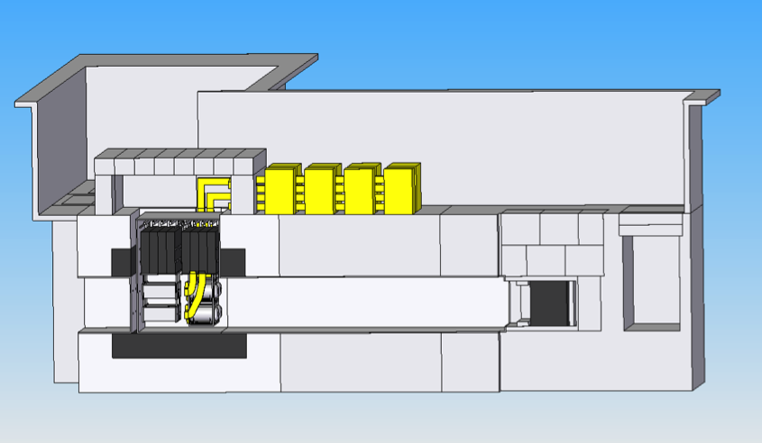
TARGET Station Facility - Global Working Plans
ALARA Approach:
Anticipate and reduce individual and collective exposition to radiations.
External Shield Blocks
Horn Power Supplies
Dosimetry
Objectives
Vessel Lid
Beam Direction
ALARA
Approach
Iron Shield
Concrete Shield
Building “rooms”
Open Top geometry for the Target Station Room, Decay Tunnel, Beam Dump
Hot Cell (Repair Target Station elements)
Morgue (Store radioactive wastes)
Horn Power Supply Room , Power supply outside of the main building ?
=> Energy Deposition and Dose Rate Estimation with FLUKA Simulation
Analyse
Dosimetry
Performances
Feedback from previous experiments is crucial

Slide 6
Safety : Preparation Phase ⬄ Design Study
  Non-radiological risks
    Electrical risk, cooling system, maintenance operation….
    Earthquake
  Radiological risks
    Determine the radiological risks (external or internal contamination) for each part of the facility.
    Investigate biological protections with respect to the prompt dose and residual dose
    Environmental impact studies (Tritium, ²²Na,..)

Slide 7
Target Station Facility
Building Structure:
Proton Driver line
Experimental Hall
  MW Target Station
  Decay Tunnel
  Beam Dump
Maintenance Room
Service Gallery
  Power supply
  Cooling system
  Air-Ventilation system
Waste Area

Slide 8
Target Station Facility
MW Target Station :
Focusing System
Crane System
Automated robot
Mechanical structure for the for horn
Dose Rate Monitoring System
Residual Dose Rate Plateform
Operation under helium Atmosphere
  flushing with air
  filter to measure radioactive pollution (dust, tritium …)
Investigation of other radionucleides transport (environmental constraint)
…

Slide 9
Non Radiological Risks

Slide 10
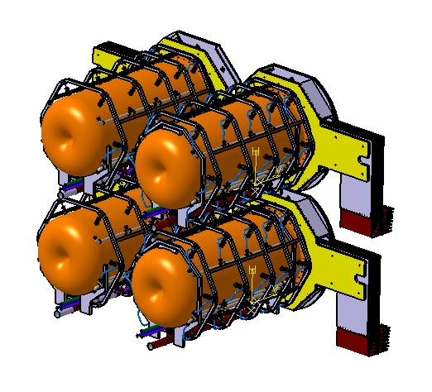
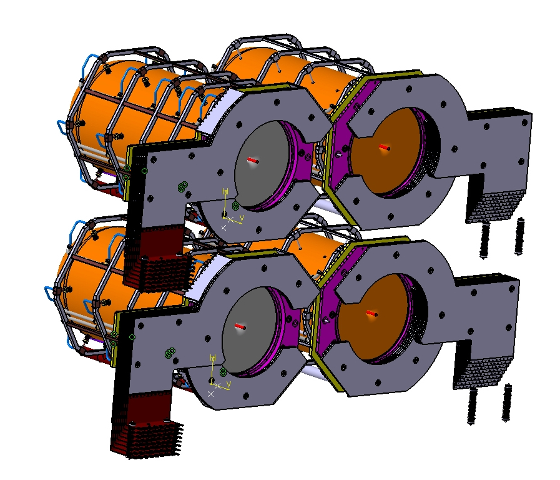
Target Station
Four horns station:
Solid Static target (Titanium)
Use multiple 4 targets+ horns
Beam frequency 56 Hz
Cooling
Power distribution due to Joule losses & secondary particles
Energy balance, to maintain working temperature
Flow rate
Jet distribution along the outer conductor
h correlation for jets’ geometry

Slide 11
TARGET Station : Feed Back from other experiments
Recommandations from others facilities:
  Cracks in welds
  Use flexible pipes to reduce stress and fatigue
  Water leaks due to galvanic corrosion => avoid trapped water and choose material carefully
  Use semi flexible conductor because of important magnetic force between stripline => can break cable
  Heat dissipation of the stripline
  Remote design for repairing/exchange
  Need Spares
  …
Striplines plate with soft
transition

Slide 12
HORN INVESTIGATION FAILURES
Failure | Causes | Consequences | Solution | Action/Safety
Cracks, weld junction | Material faults In the weld junction | Water leaks Current discontinuity | Check quality of weld junctions | Electrical shutdown Water flow shutdown
Cracks in the aluminium all, pipes connections | Peak stress too high | Water leaks Large displacement Crack growth Horn destruction | Stress analysis of the pipes connections; Of the details connections | Electrical shutdown Water flow shutdown
Cracks in the aluminium wall | High cyclic stress Fatigue cracks | Water leaks Large displacement Crack growth | R&D studies | Electrical shutdown Water flow shutdown
Striplines/horn connection cracks | Localised high cyclic Stress Corrosion Fatigue cracks | Electrical discontinuity Change in the magnetic field | R&D studies in the stripline horn/connection | Electrical shutdown Water flow shutdown
Striplines/connections Cracks initiation | Stress corrosion | Electric resistance increase | R&D studies | Electrical shutdown

Slide 13
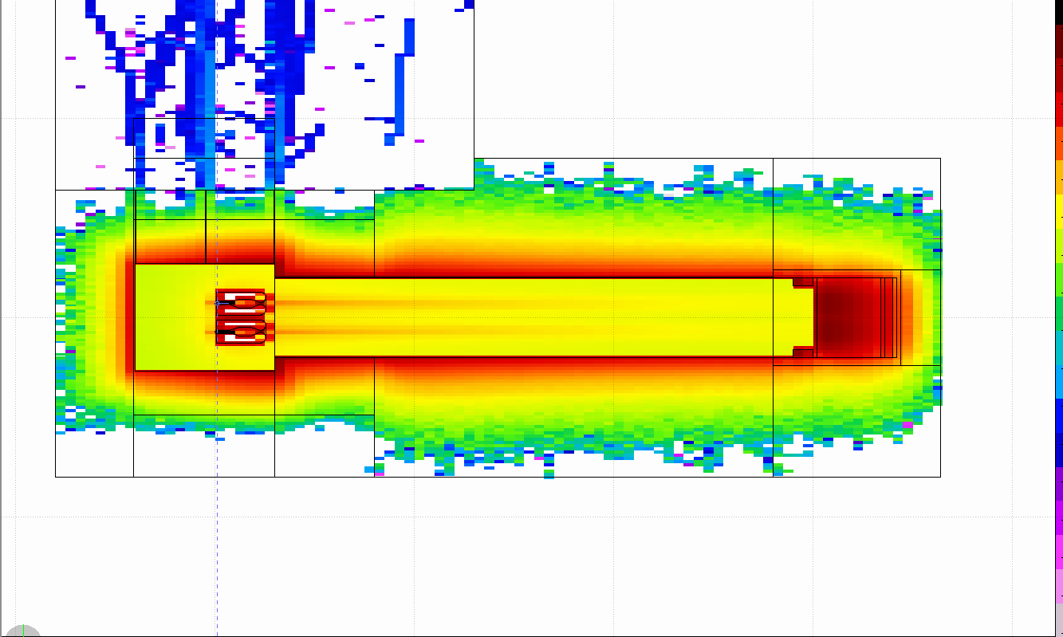
Energy Deposition : Cooling Power (5MW/4MW)
Beam dump :
Graphite = 950/778 kW
Iron = 195/229 kW
Surr. concrete = 4/4 kW
P tot = 4.2 / 3.4 MW
Horns/Target gallery
Iron = 613/437 kW
Horn = 50/ 32 kW
Target = 168/ 85 kW
Decay tunnel
Iron vessel = 424/390 kW
Upstream iron = 670/610 kW
Surr. concrete = 467/485 kW
IPAC’17 Proceedings: E. Bouquerel et al, “Energy deposition and activation studies of the ESSnuSB Horn Station”, MOPIK029

Slide 14
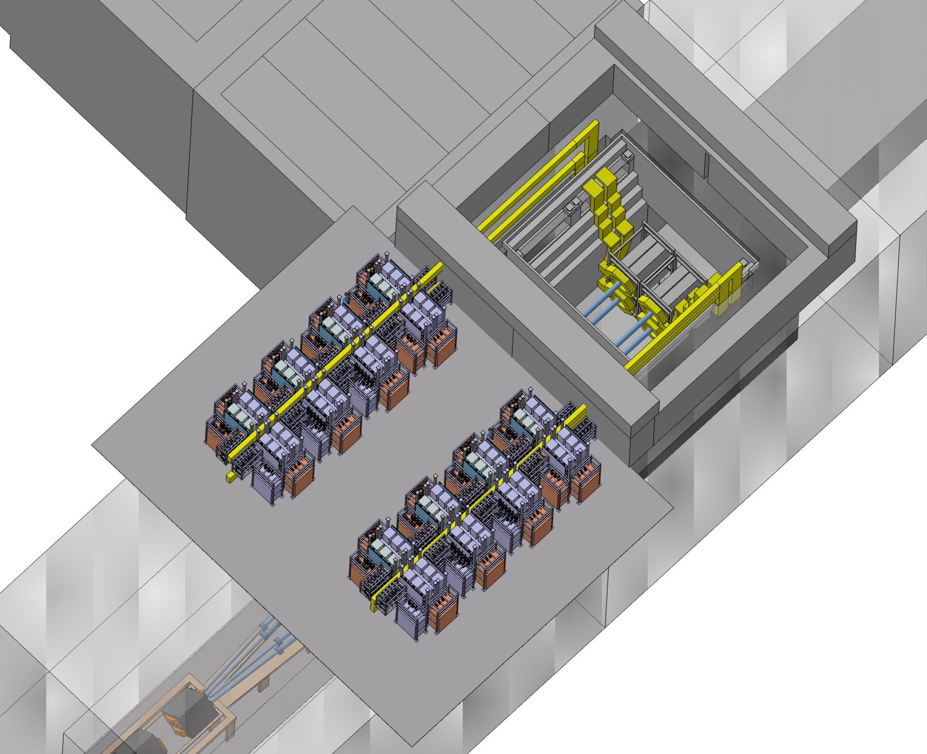
Power Supply
This is a first estimation:
 Length of strip-lines limited to 34,3M
 Cost of PSU: X2,23 Euronu
 Consumption of 580KWRMS power on 380VAC
 335KW refreshed by water cooling, 136KW by air cooling
(study chargers refreshed on
water cooling)
Dimensions 20X12M, hight of 3,2m, could be decrease to 2,7m
Need a crane of 3 tons
Width 16m
PSU room
length 20m

Slide 15
Radiological Risks

Slide 16
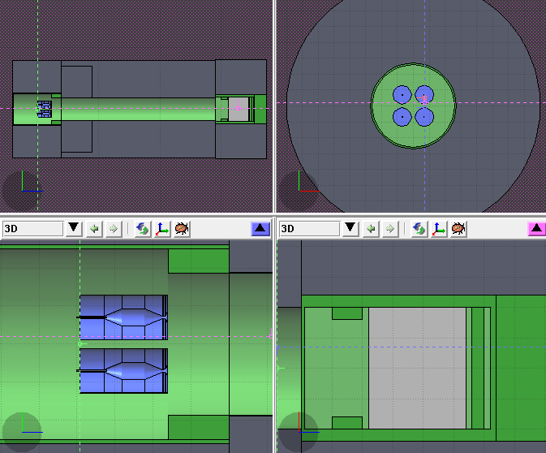
Target Station Facility
Chemical composition of Material*:
Target => Ti(100%)
Horn => Anticorodal 110 alloy
Al (95.5%), Si(1,3%), Mg(1,2%), Cr(0.2%), Mn(1%), Fe (0.5%), Zn(0.2%), Cu(0.1%)
Decay Pipe => Steel P355NH
Fe(96.8%), Mn(1.65%), Si(0.5%), Cr(0.3%), Ni(0.3%), C(0.2%)
Tunnel => Concrete
O(52.9%), Si(33.7%), Ca(4.4%), Al(3,49%), Na(1,6%), Fe(1.4%), K(1,3%), H(1%), Mn(0.2%), C(0.01%)
Surrounding Environment => Molasse
O(49%), Si(20%), Ca,(9.7%), Al(6.4%), C(5%), Fe(3.9%), Mg(3.2%), K(1%), Na(0.5%), Mn(0.1%)
Four horn station layout
*TO BE UPDATE FOR ESSNUSB

Slide 17
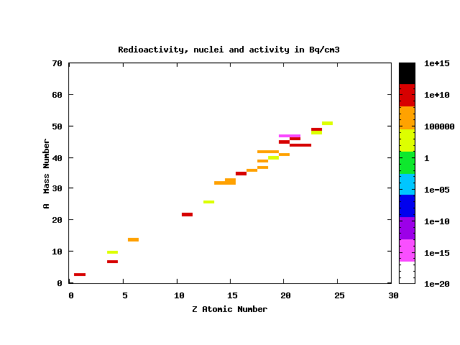
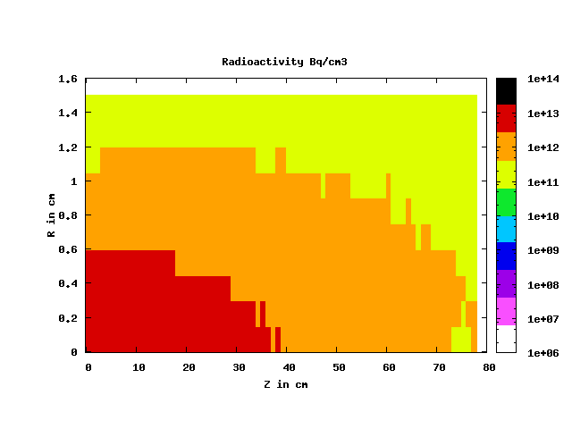
RADIATION SIMULATION (FROM EURONU)
Evolution of the target activity with cooling time:
(Titanium density 66%)

Slide 18
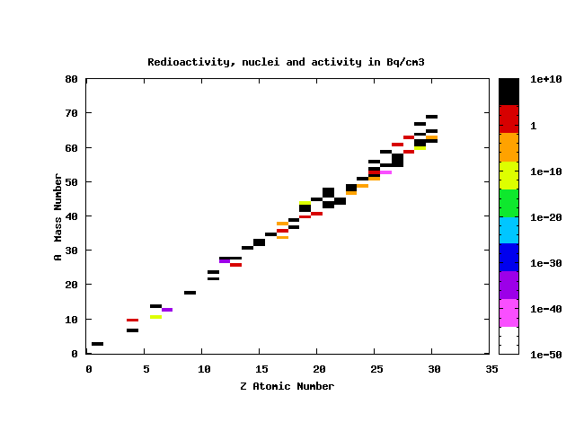
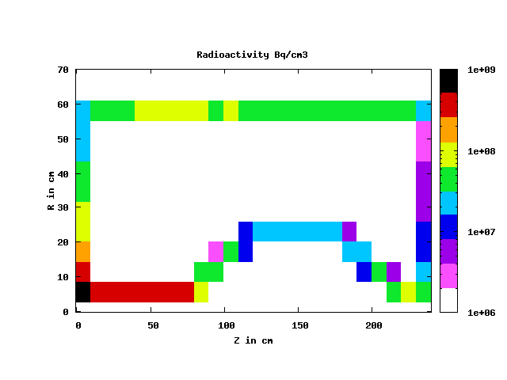
RADIATION SIMULATION (FROM EURONU)
Evolution of the horn activity with cooling time:
Radionucleides after 1 day (Z,A)
Radioactivity after 1 day (Bq.cm⁻³)

Slide 19
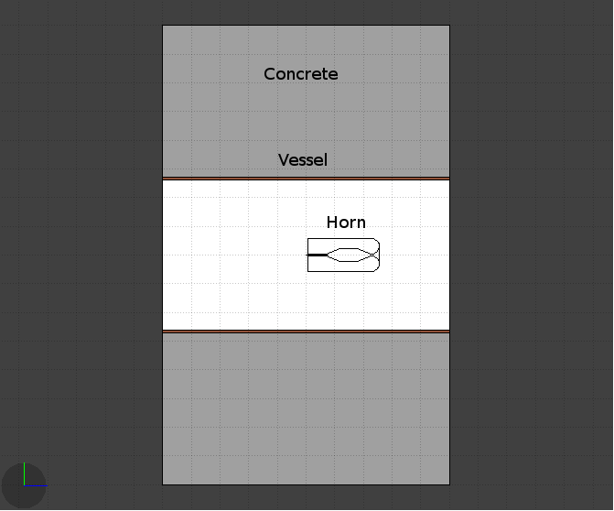
Radiation LAyout
Simulation Parameters :
Beam Power : 4MW
Irradiation Times : 200 days
One Horn : Geometry Updated
Cooling times : 1d,1w,1m, 6m,1y, 10y
Chemical composition of Material:
Target => Titanium
Horn => Anticorodal 110 alloy
Al (95.5%), Si(1,3%), Mg(1,2%), Cr(0.2%),
Mn(1%), Fe (0.5%), Zn(0.2%), Cu(0.1%)
Decay Pipe => Steel P355NH
Fe(96.8%), Mn(1.65%), Si(0.5%), Cr(0.3%),
Ni(0.3%), C(0.2%)
Tunnel => Concrete
O(52.9%), Si(33.7%), Ca(4.4%), Al(3,49%),
Na(1,6%), Fe(1.4%), K(1,3%), H(1%),
Mn(0.2%), C(0.01%)
Scoring Region : [-200,200]x[-200,200] [-500,500], cell dimension 20cm*20cm*20cm
Radiation layout

Slide 20
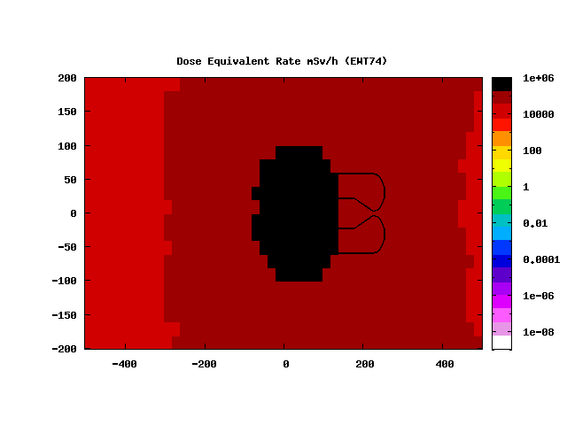
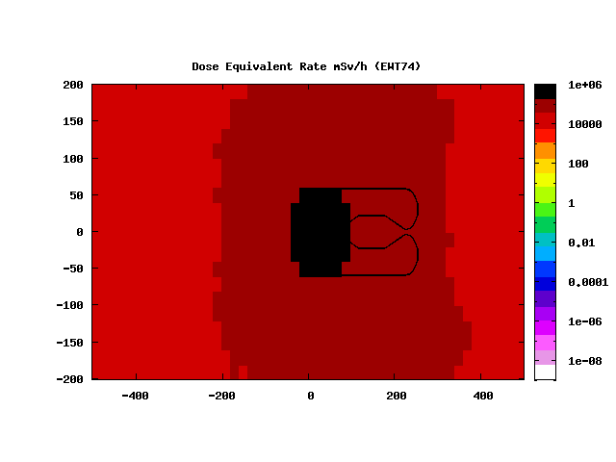
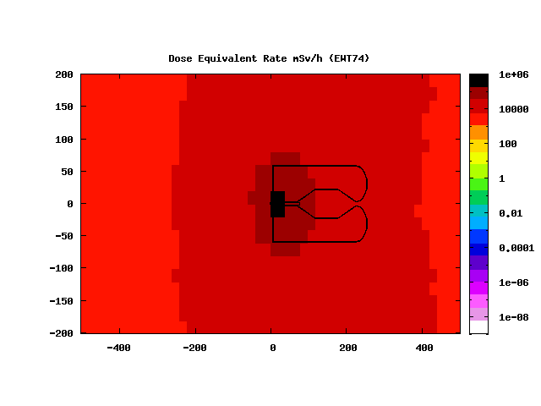
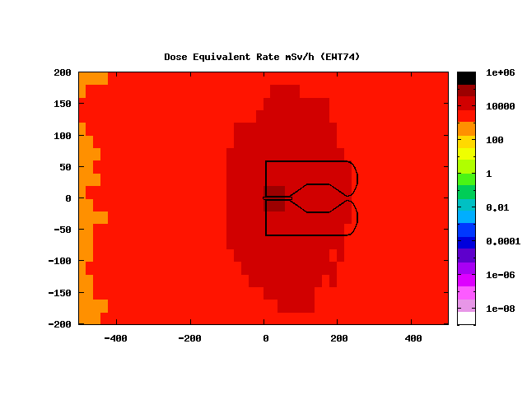
Dose Equivalent Rate (All Layout)
After 1day
After 1 week
After 6m
After 1y

Slide 21
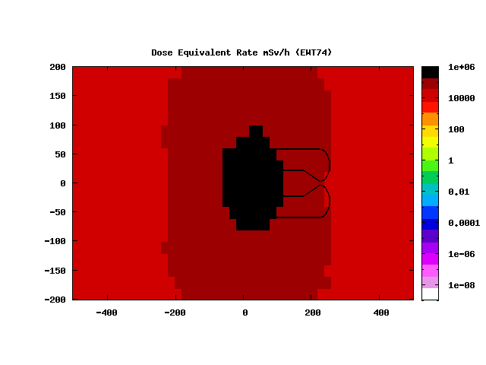
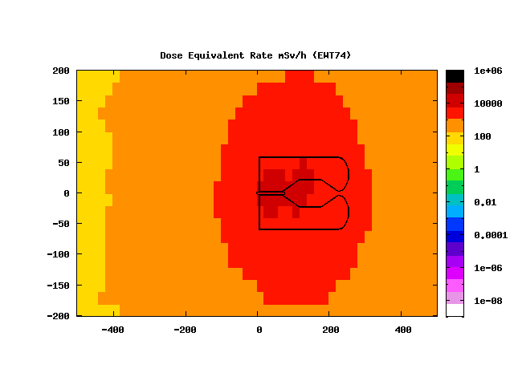
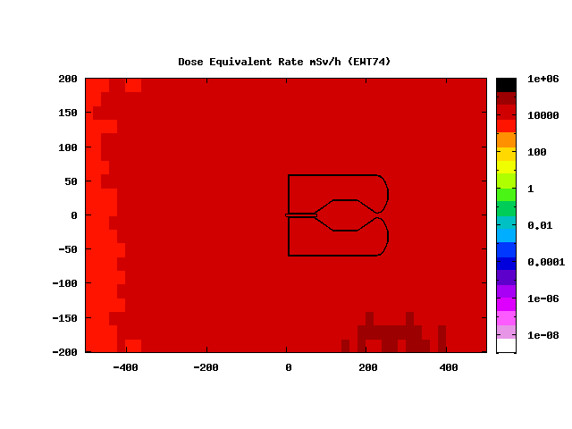
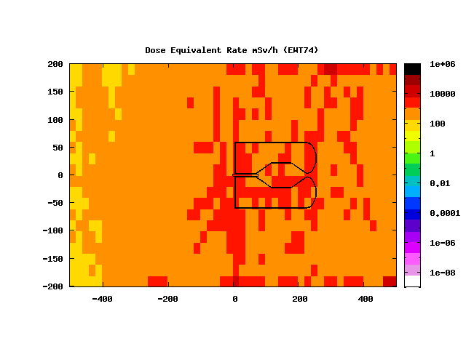
Dose Equivalent Rate contribution (cooling time 1d)
Target Contribution
Horn Contribution
Vessel Contribution
Tunnel Contribution

Slide 22
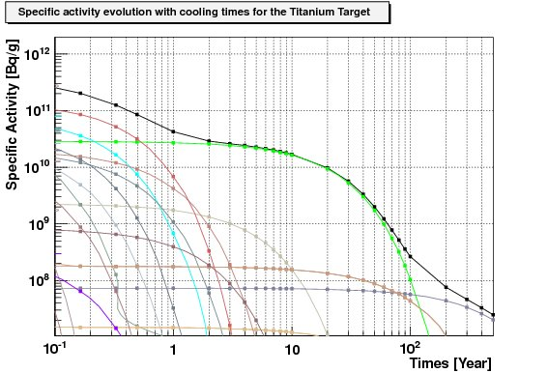
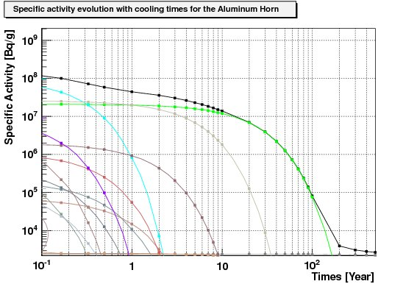
Nuclear WASTE MANAGEMENT
IAEA Waste Classification:
HLW High Level Wastes
  Highly Radioactive liquid
  Heat Generating (>2kw/m3)
LILW Low and Intermediate Wastes
  LL Long Lived,
    ‘Half-life > 30 years
    Long lived alpha emitters >400Bq/g average
    >4000Bq/g individual package
  SL Short Lived
    Half-life <30 years
EW Exempted Wastes
Clearance Levels:
Clearance Index :
Classification of Radioactive Waste – Safety Series
No 111-G-1.1

Slide 23
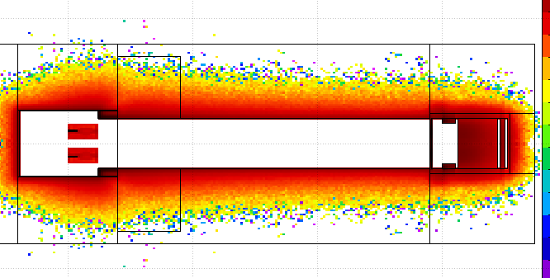
Environmental impact
Activation in molasse
molasse @ CERN
concrete
concrete
of all the radionuclide's created ²² Na and tritium could represent a hazard by contaminating the ground water. Limits in activity after 1y=200days of beam:

Slide 24
Outline
  Adapt Study with ESSνSB Parameters on going
  Feedback from other experiments crucial !!!
    Regular meetings with ESS people in charge of the safety is necessary
    Safety Meeting between Safety people has been organized at CERN during EUROnu and should be renewed

