Slide 1
Layout options for the ESS + ESSnuSB site
ESSnuSB WP2,3,4 meeting https://indico.esss.lu.se/event/1263/
Nick Gazis, Rasmus Johansson
Mechanical Engineering & Technology (MET) Section
European Spallation Source ERIC
11 June 2019

Slide 2
Index
Linac upgrade proposal
Boundary Conditions for the layout options and mechanical design
Status of the ESS site overview (Q2-2019)
ESSnuSB Layout option 1
ESSnuSB Layout option 2
ESSnuSB Layout option 3
Open points for the layout

Slide 3

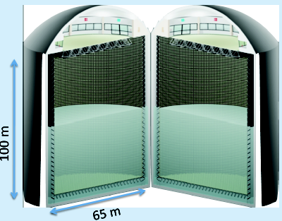
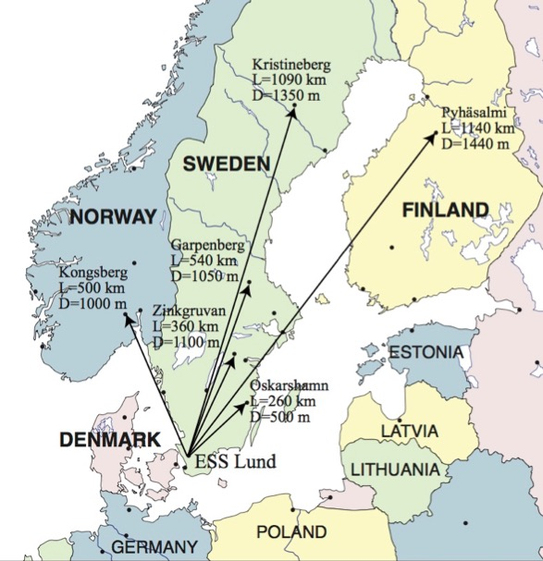
B. Gålnander, M.Eshraqi for ESSnuSB
ESS neutrino Super-Beam--ESSnuSB
Courtesy of
B. Gålnander, ESSnuSB
Study CP violation by ν_{μ}→ν_{e} oscillations
Cherenkov detector in Garpenberg mine, 540 km north, at the
second oscillation maximum.
5 MW for neutron production, add 5 MW to neutrino generation.

Slide 4
Boundary Conditions for the layout options and mechanical design
Addition of eight (8) new elliptical CM, at the end of the existing High Beta Linac.
Transfer line of minimum 110m of radius, starting from new Linac going to the Accumulator Ring, avoiding the tunnel Dog-Leg elevation and the Target Building.
Accumulator Ring of
  384m of circumference
  40m of arc length
  25.5m of arc radius
  Straight section length of 56m
Injection angle for beamline at 8.75°.
Extraction angle for beamline at 16.8°.
2-floor Target station, 1 ground level, 1 underground (underground depth tbd).
Site direction of Target station pointing towards Garpenberg (north).

Slide 5
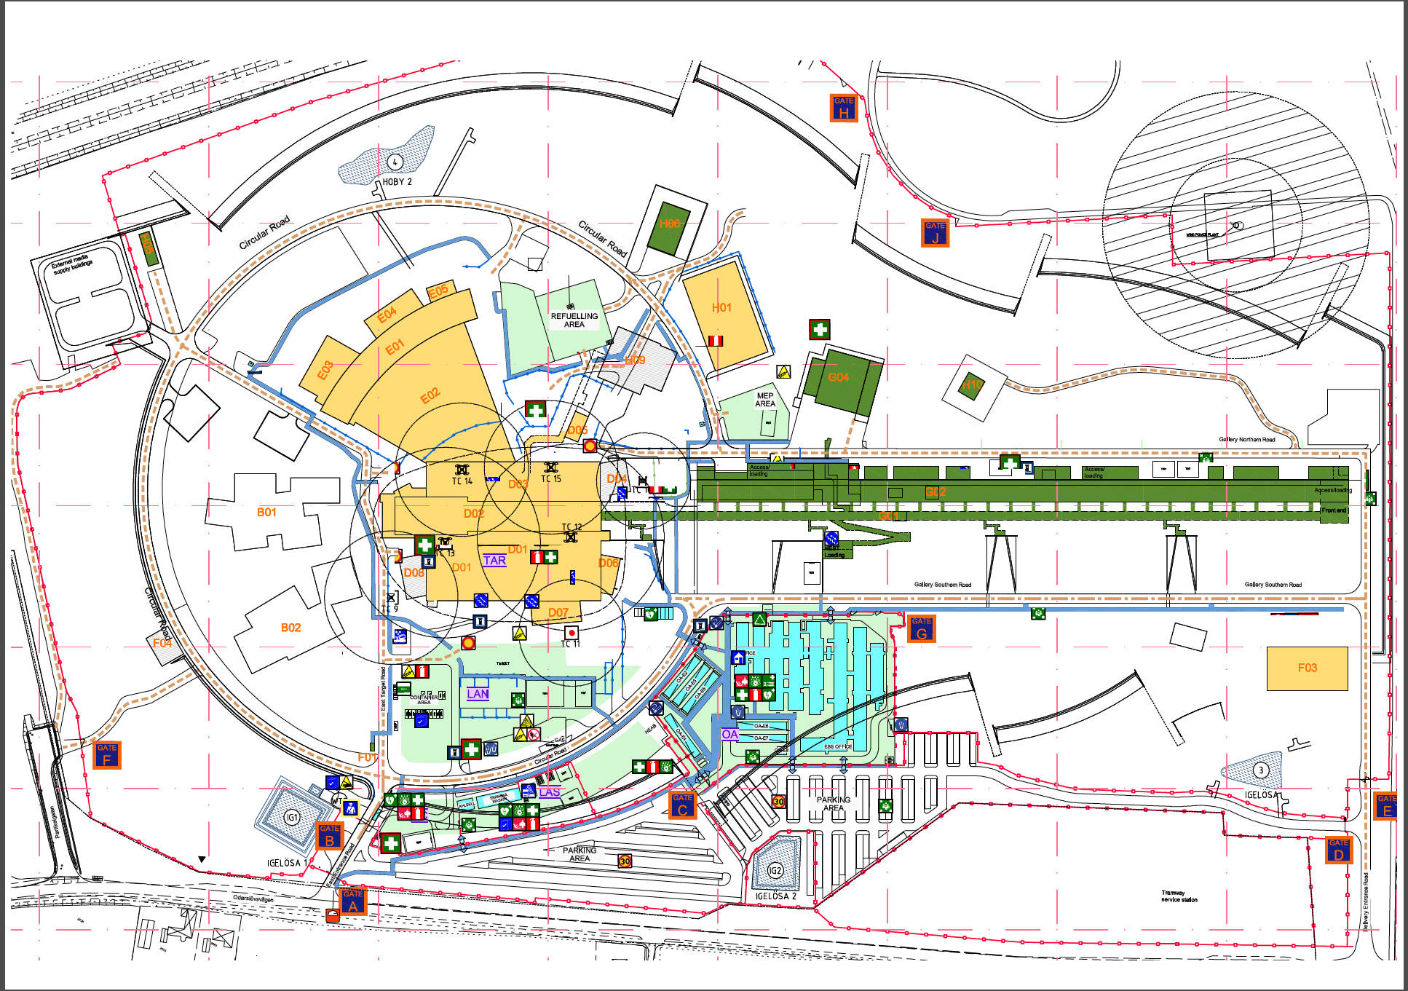
Status of the ESS site overview (Q2-2019)

Slide 6
Status of the ESS site overview (Q2-2019)
Last HBL-CM (2GeV)
Possible extraction point with additional 64m of accelerator
(new 8 CMs)

Slide 7
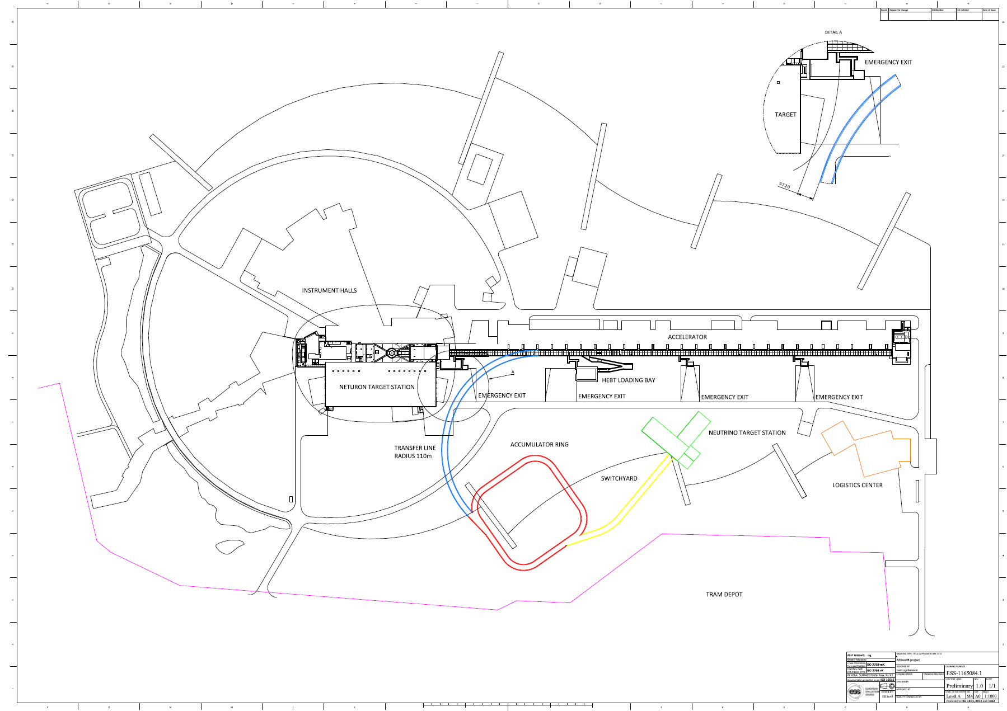
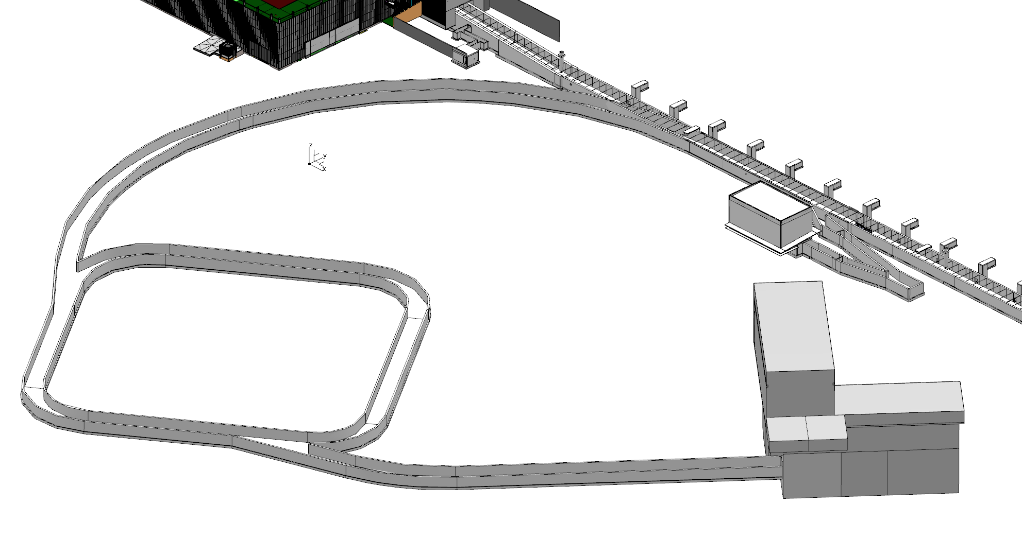
ESSnuSB Layout option 1
<10m to target building
Injection and extraction point
as in ESSnuSB proposal.
Long transfer line needed.
Switchyard possible lenght is long.
Target station position flexible.

Slide 8
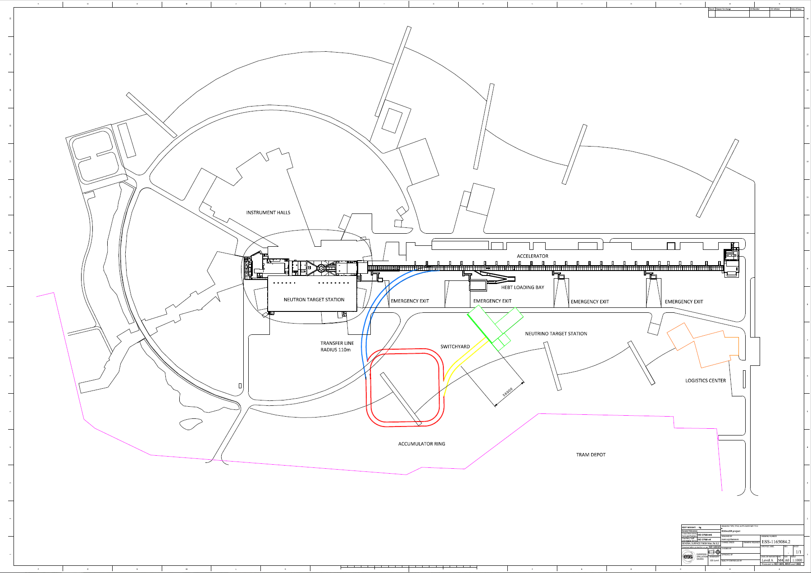
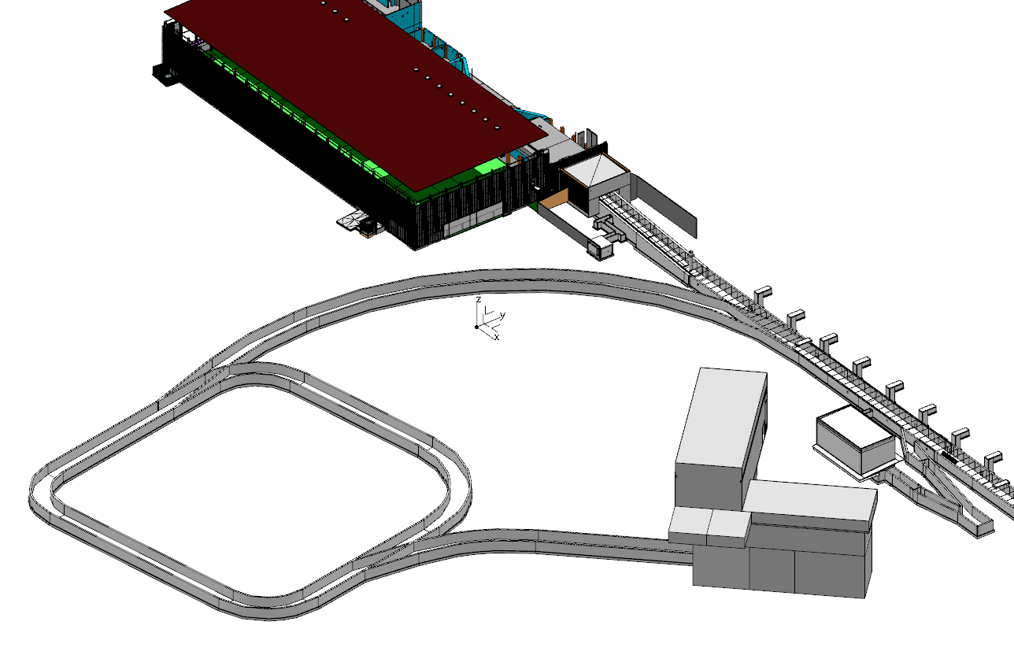
ESSnuSB Layout option 2
Injection and extraction point as at SNS.
Shorter transfer line.
Shorter possible switchyard lenght.
Target station position flexibility low.

Slide 9
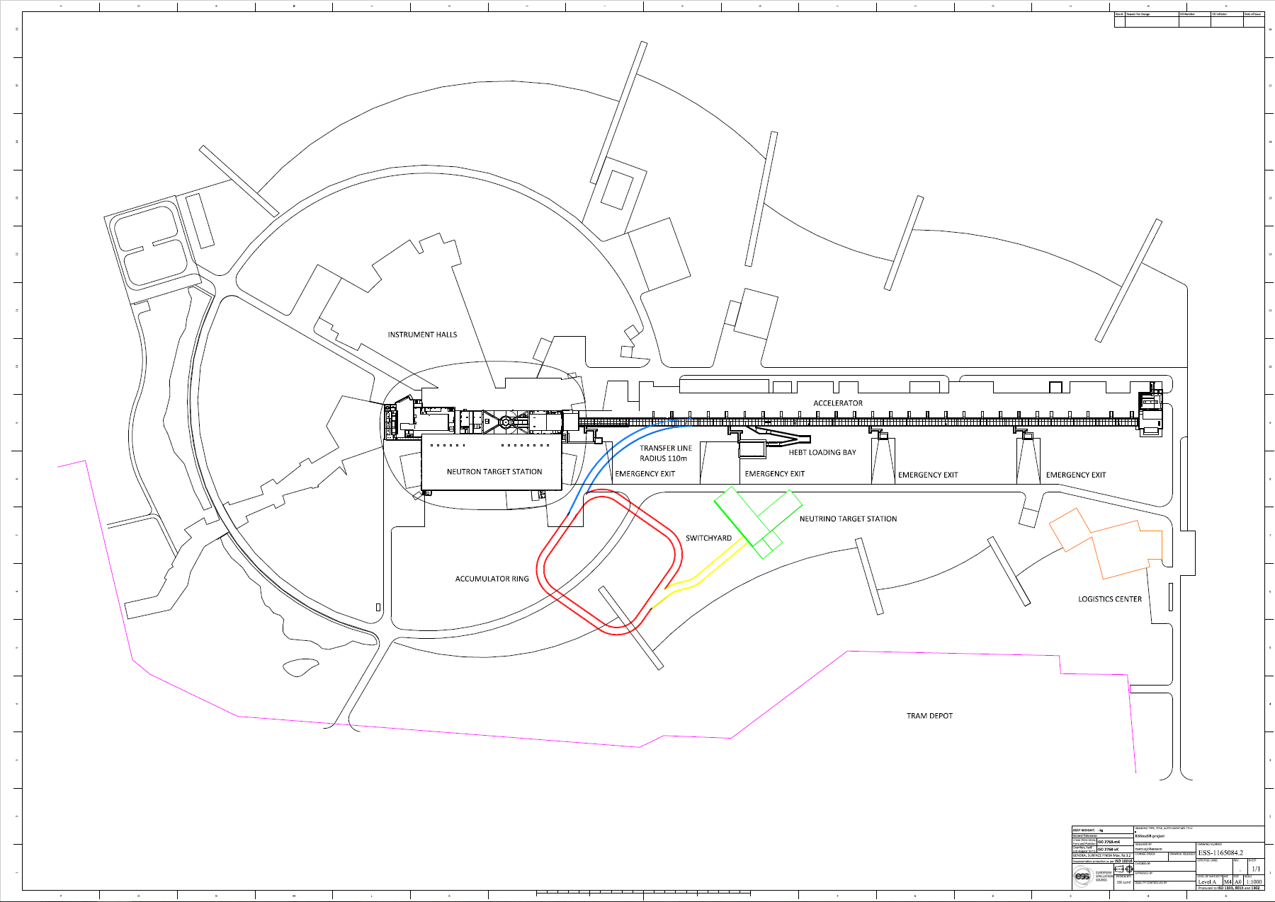
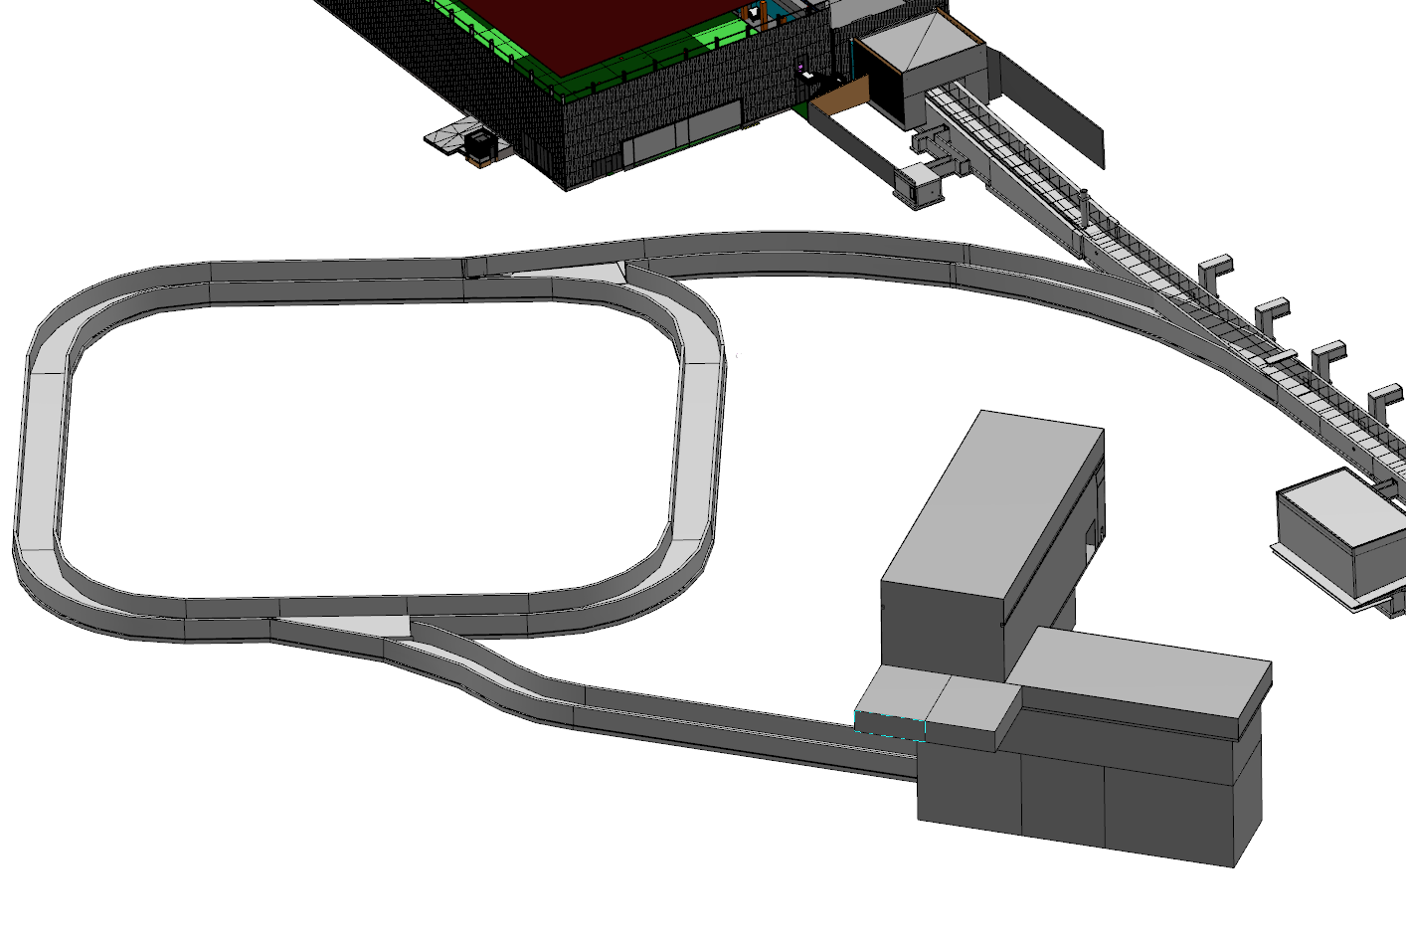
ESSnuSB Layout option 3
Injection and extraction point as at SNS.
Shortest possible transfer line used.
Target station position flexibility
and switchyard possible lenght
depends on what can be done with
switchyard section.

Slide 10
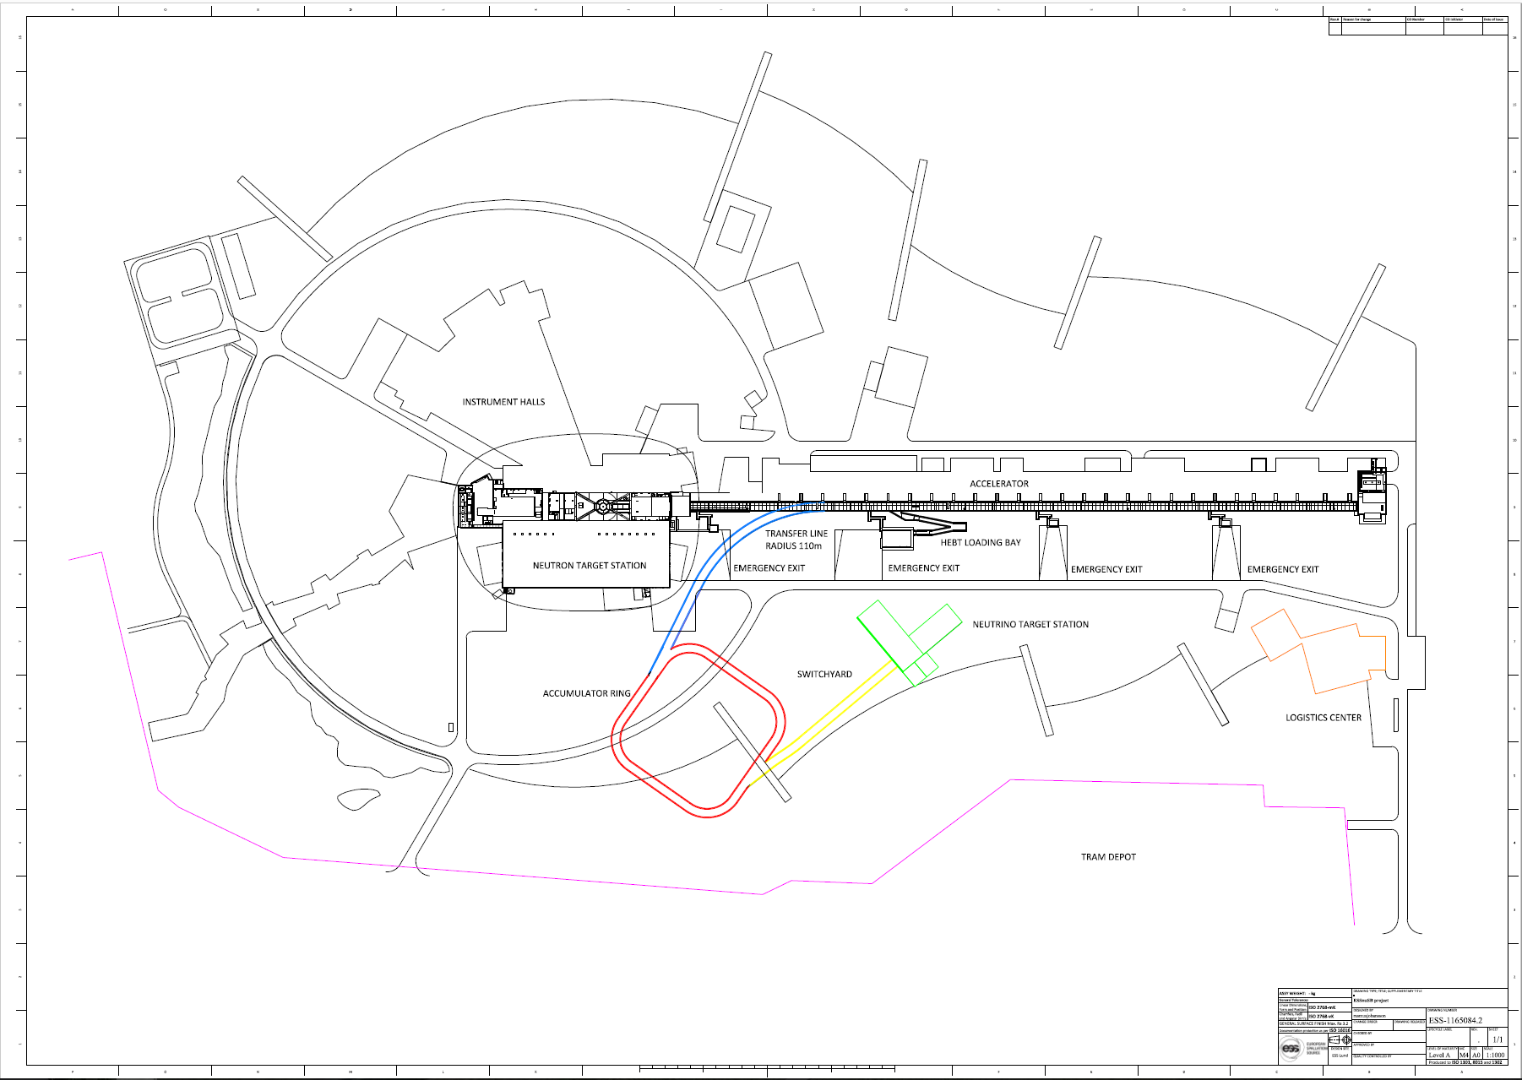
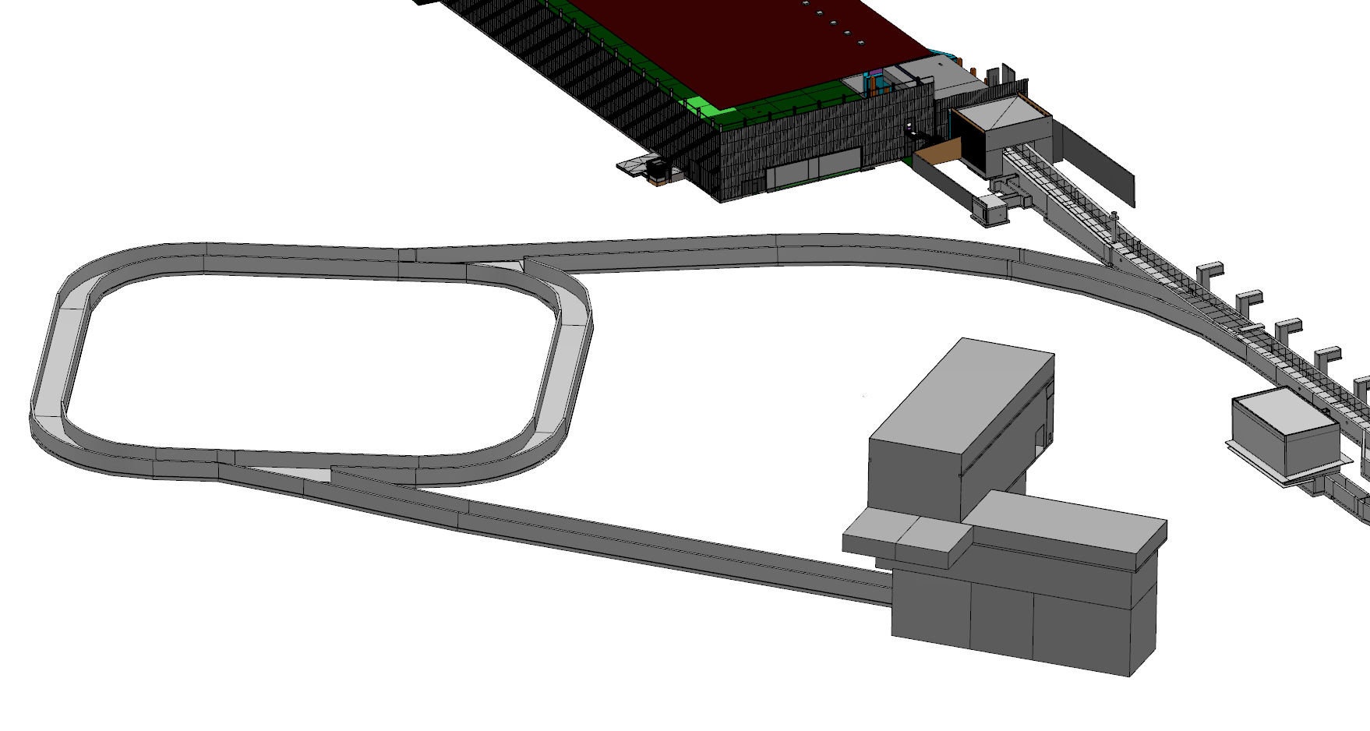
ESSnuSB Layout option 3, extended transfer line
Transfer line straight end.
Longer possible switchyard lenght.
Target station position flexibility increased.

Slide 11
Open Points for the layout
ESSnuSB accumulation ring and target station depth.
Impact on existing Surface Infrastructure (roads, buildings, etc.).
Emergency Exits on surface.
Radiation shielding above transfer line and accumulation ring.
Potential connection of the ESSnuSB tunnel to the HEBT Loading Bay (HLB) for access, logistics and installation capabilities.
Other auxiliary buildings (i.e. vertical access shafts etc.).
New roads for accessing the new Target station.

Slide 12
SNS ORNL
SPARE SLIDE

