Slide 1
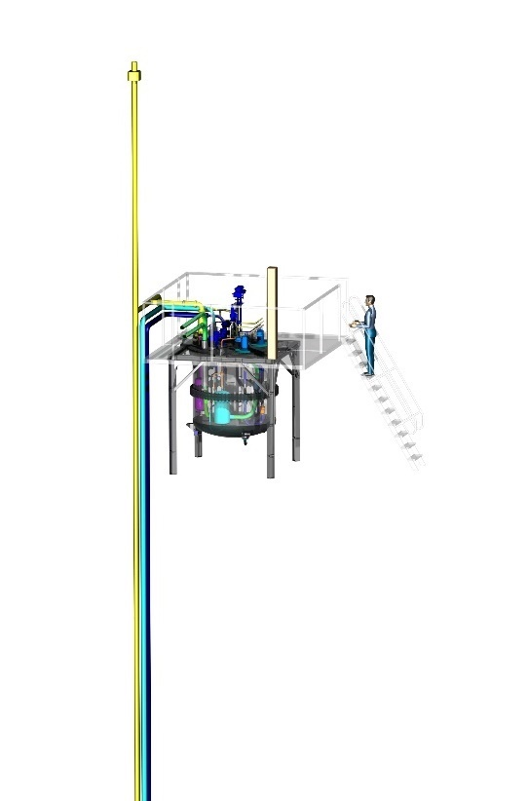
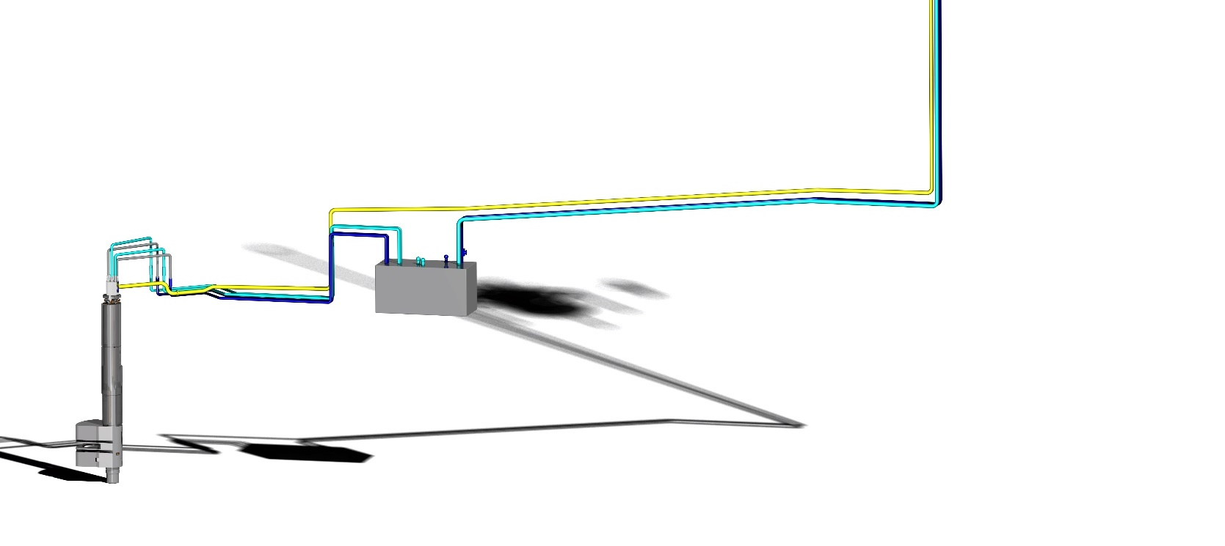
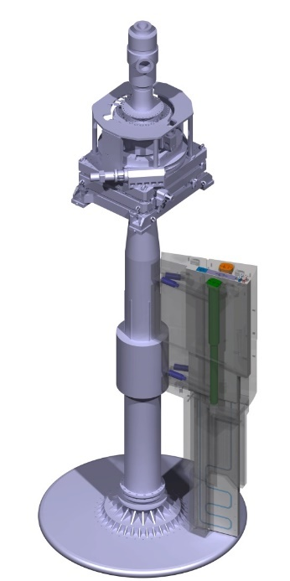

System design solution
CDR Target Monitoring Plug (TMP)
2019.05.27 I Christoph Happe

Slide 2
OUTLINE
ESS – Target Monitoring Plug – System Design Solution
Target Monitoring Plug System Overview & Description
Overview of main body assembly
Overview functional group 100 (XY-measurement)
Overview functional group 200 (Z-measurement Insert)
Overview functional group 300 (IR-measurement Insert)
Interface Description
Documentation example

Slide 3
OUTLINE
ESS – Target Monitoring Plug – System Design Solution
Target Monitoring Plug System Overview & Description
Overview of main body assembly
Overview functional group 100 (XY-measurement)
Overview functional group 200 (Z-measurement Insert)
Overview functional group 300 (IR-measurement Insert)
Interface Description
Documentation example

Slide 4
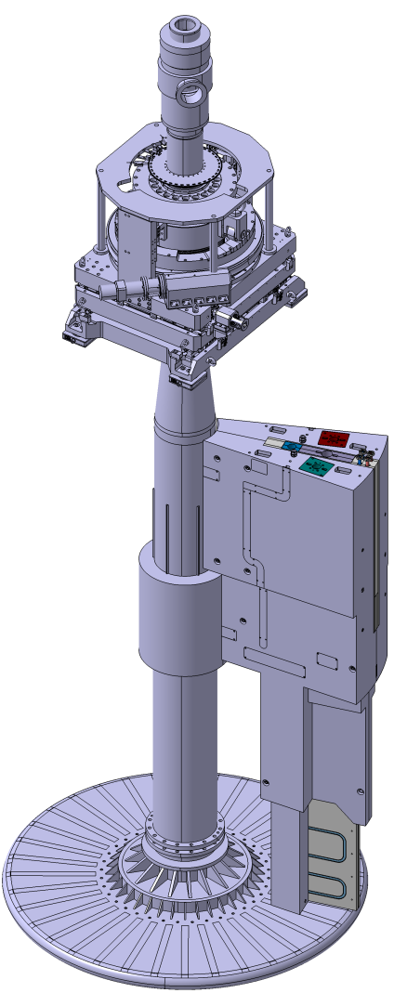
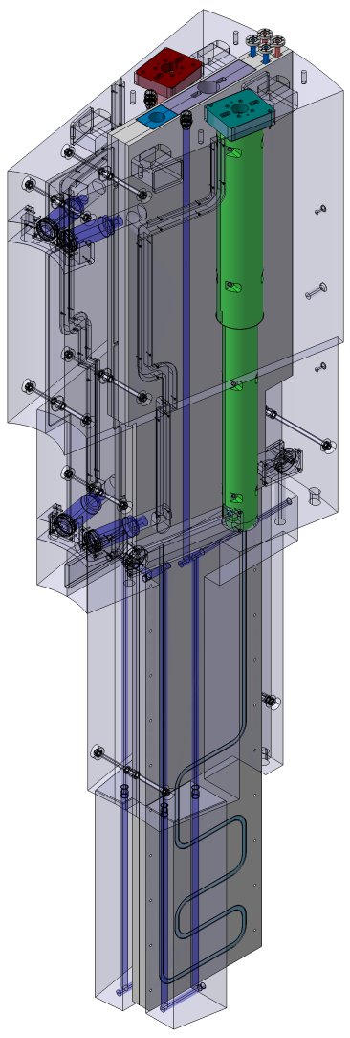
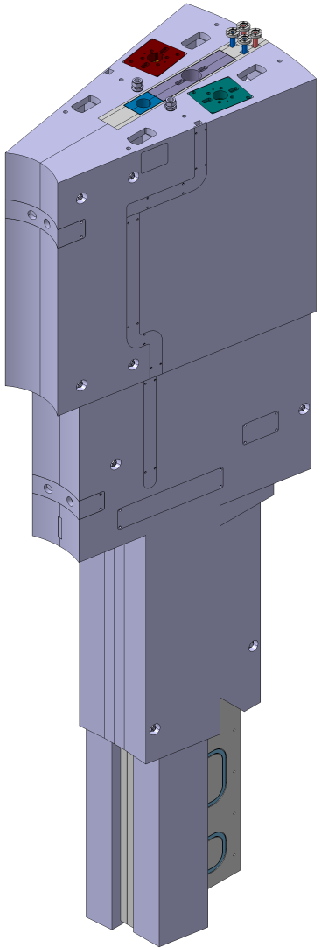
ESS - Target monitoring plug
Target Monitoring Plug System Overview & Description
Z-Insert
Collimator Insert
XY-Measurement
Optical Heads
IR-Insert
Main Body
XY-Measurement
Optical Heads
Proton beam
Collimator Package

Slide 5
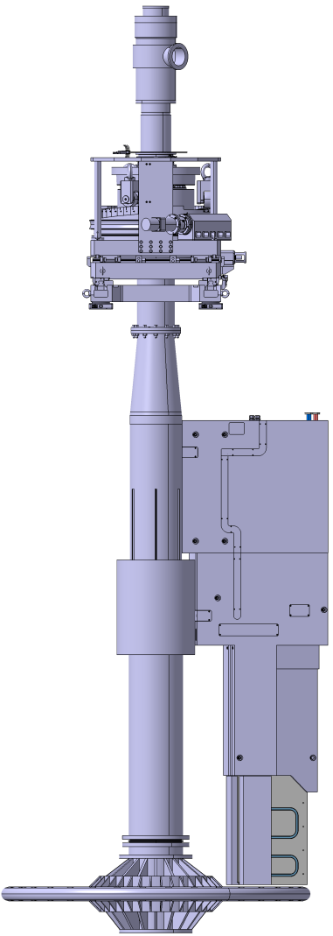
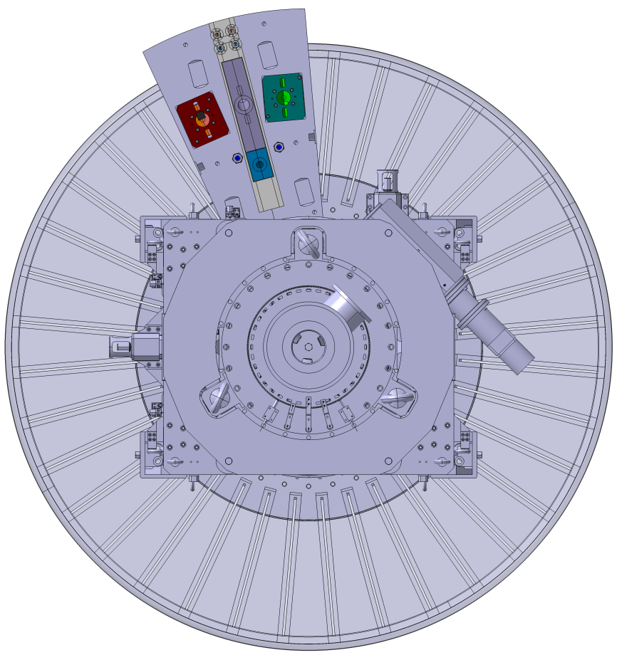
ESS - Target monitoring plug
Target Monitoring Plug System Overview & Description
The Target Monitoring Plug (TMP) is positioned right above the target wheel
It is located at the opposite side of the target wheel, turned away from the spallation center and angled by 15° off-axis to the proton beam
165°
Proton beam

Slide 6
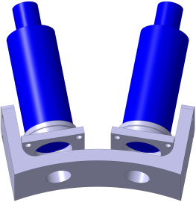
ESS - Target monitoring plug
Target Monitoring Plug System Overview & Description
Functional Group 100:
Measurement and calculation of x- and y-position of the target wheel center
Two pairs of confocal optical heads
Each pair has an internal angle of 20°
The measuring planes are 1380mm apart in height
XY-Measurement
Optical Heads
XY-Measurement
Optical Heads

Slide 7
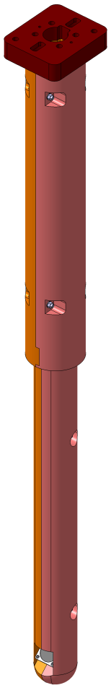
ESS - Target monitoring plug
Target Monitoring Plug System Overview & Description
Z-Insert
Functional Group 200:
Measurement and calculation of z-position (height) of the target wheel
The sensor beam is guided through the insert and the TMP main body to the target wheel surface via mirrors
Inside the TMP, the beam is folded four times

Slide 8
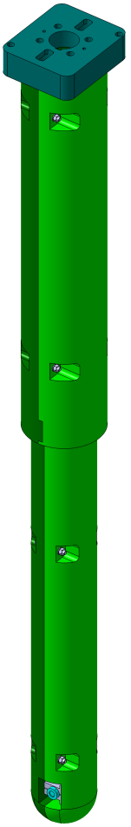
ESS - Target monitoring plug
Target Monitoring Plug System Overview & Description
IR-Insert
Functional Group 300:
Measurement of temperature of the target wheel
The measurement takes place at two different locations, the target wheel cups and the outer shroud
The pyrometer beams are redirected via one mirror inside the TMP
The measurement spots are at R580 and R1250 of the target wheel

Slide 9
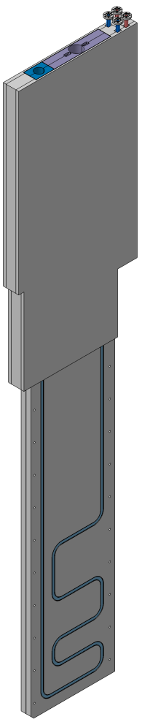
ESS - Target monitoring plug
Target Monitoring Plug System Overview & Description
Functional Group 400:
Render images by conversion of gamma radiation from the target wheel’s tungsten bricks
This system is not in the scope of work of FZ Jülich and is just implemented in the design as a “black box”
Collimator Insert
Collimator Package

Slide 10
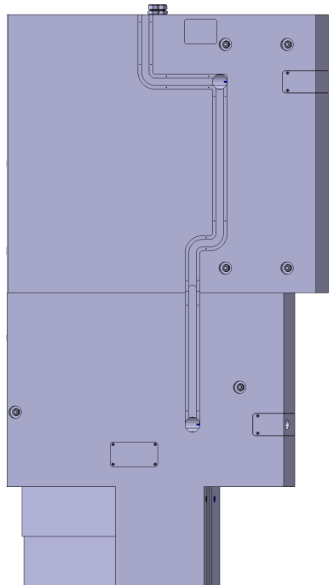
ESS - Target monitoring plug
Target Monitoring Plug System Overview & Description
Functional Group 700:
Measurement of temperature of the TMP to ensure proper internal cooling
The measurement takes place in the middle section of the TMP via a small bore and the temperature is monitored by a PT-100 thermocouple and the cable is routed through an outside groove to the top of the TMP
More details will be released after the final version of the sensor is selected
PT-100
Thermocouple

Slide 11
OUTLINE
ESS – Target Monitoring Plug – System Design Solution
Target Monitoring Plug System Overview & Description
Overview of main body assembly
Overview functional group 100 (XY-measurement)
Overview functional group 200 (Z-measurement Insert)
Overview functional group 300 (IR-measurement Insert)
Interface Description
Documentation example

Slide 12
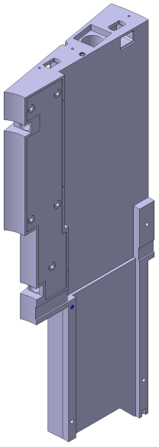
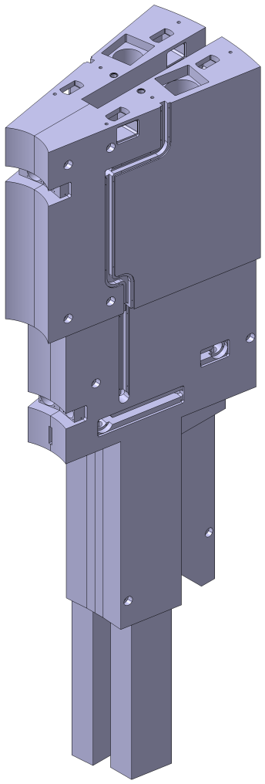
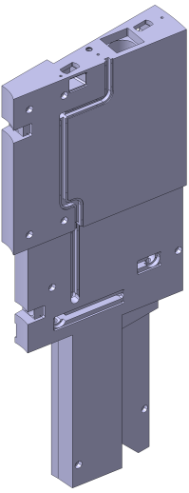
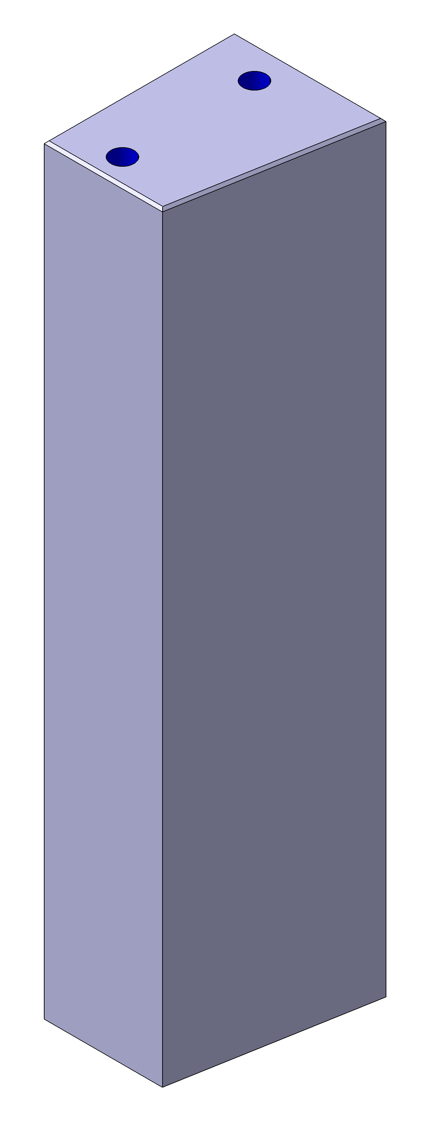
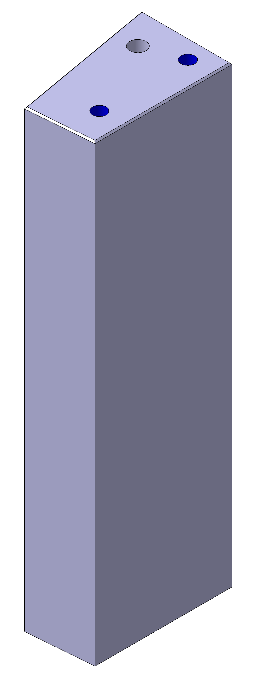
ESS - Target monitoring plug
Overview of main body assembly
The main body consists of four individual parts, that are joined to one assembly.
722
1
1268
Body Assembly (1.4306):
m_{total} = 8667kg
4 Component Parts:
No.1: m₁ = 4084kg
3140 x 361 x 1268
No.2: m₂ = 4003kg
3140 x 361 x 1268
No.3: m₃ = 314kg
922 x 184 x 290
No.4: m₄ = 266kg
922 x 184 x 231
2
3922
3
4

Slide 13
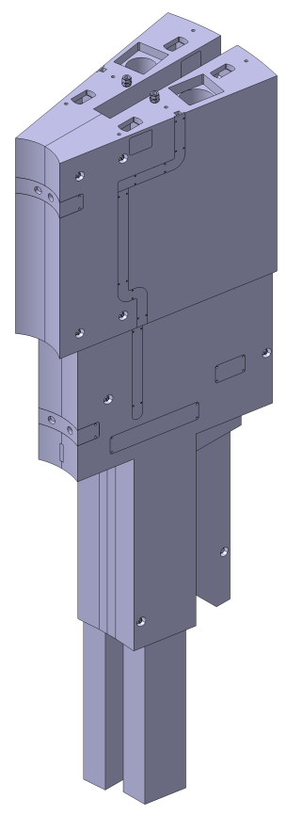
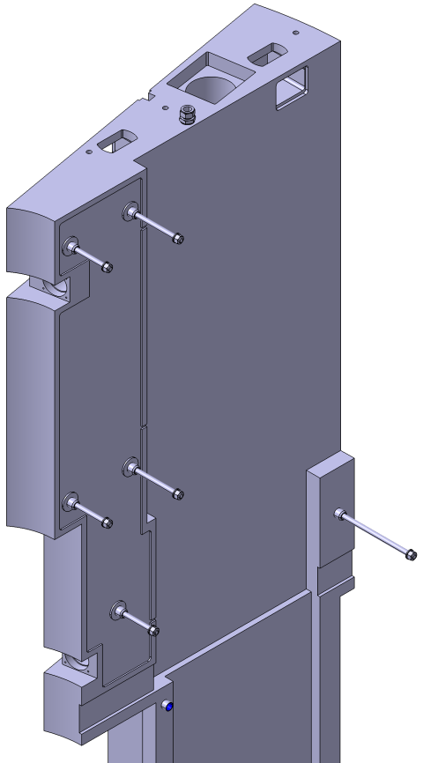
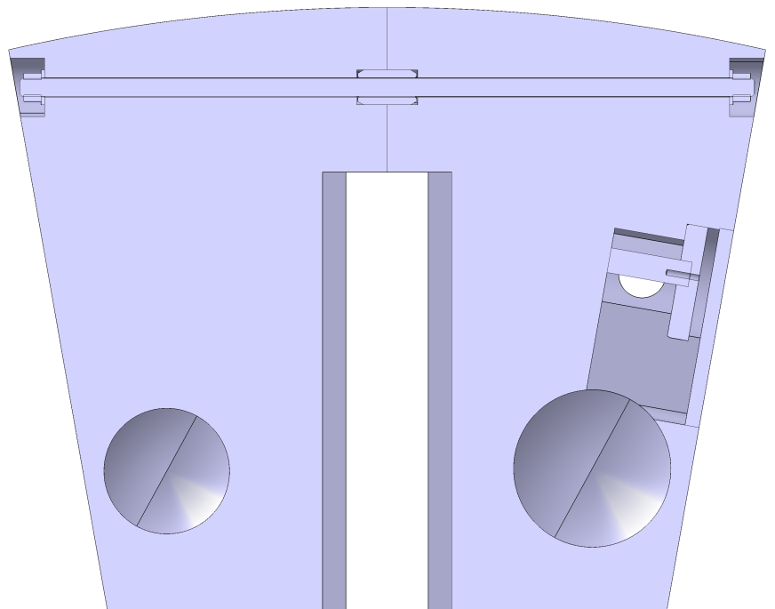
ESS - Target monitoring plug
Overview of main body assembly
The two main halves are connected via thread bars and bushings.
The contact surface of the main halves is minimized for vacuum application and provides proper ventilation for the vacuum evacuation process.
Minimized Contact Surface
Streaming
Bar Groove

Slide 14
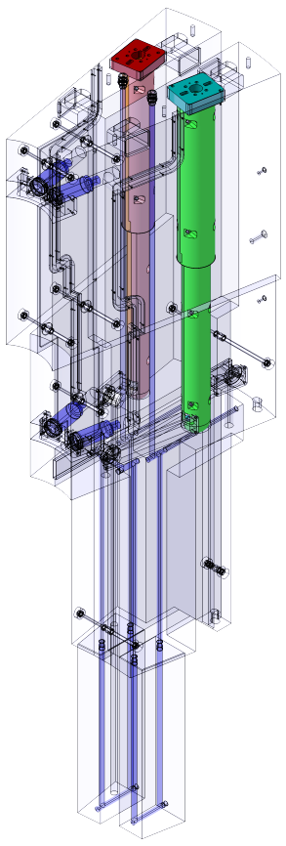
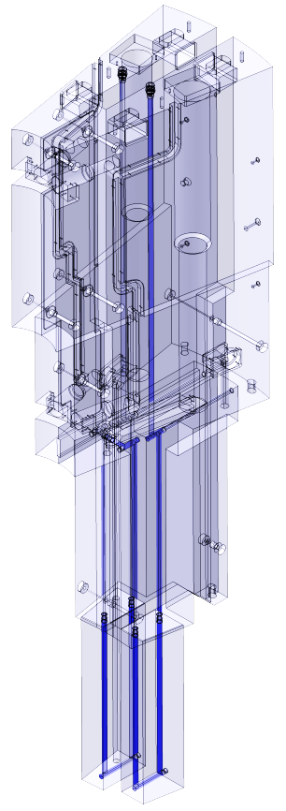
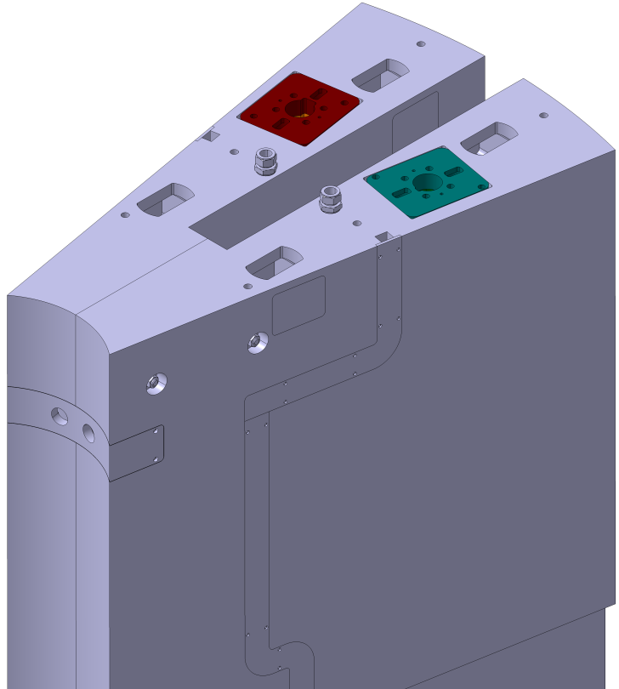
ESS - Target monitoring plug
Overview of main body assembly
Screwed connectors from Swagelok with internal thread to connect the TMP’s internal cooling channel to the permanent water pipework.
The coordinates of the connectors can be seen in the interface drawing “260-000067 CoG & Position Inside The Monolith”
Water Outlet
Water Inlet
Fitting: SS_1610_1_RS
Sealing: SS-16SRSD-2V

Slide 15
OUTLINE
ESS – Target Monitoring Plug – System Design Solution
Target Monitoring Plug System Overview & Description
Overview of main body assembly
Overview functional group 100 (XY-measurement)
Overview functional group 200 (Z-measurement Insert)
Overview functional group 300 (IR-measurement Insert)
Interface Description
Documentation example

Slide 16
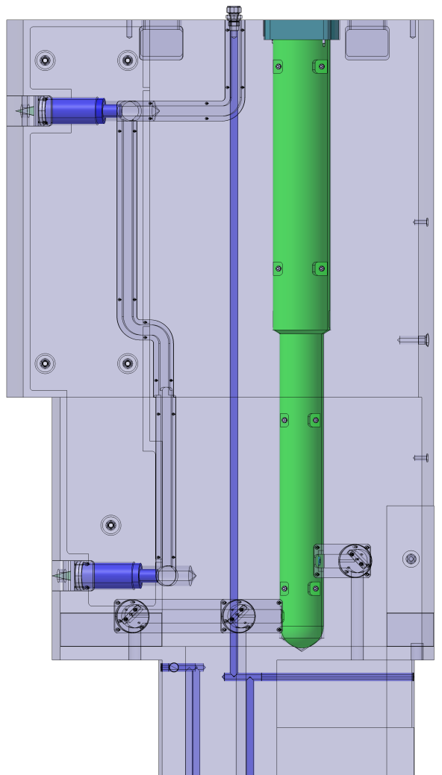
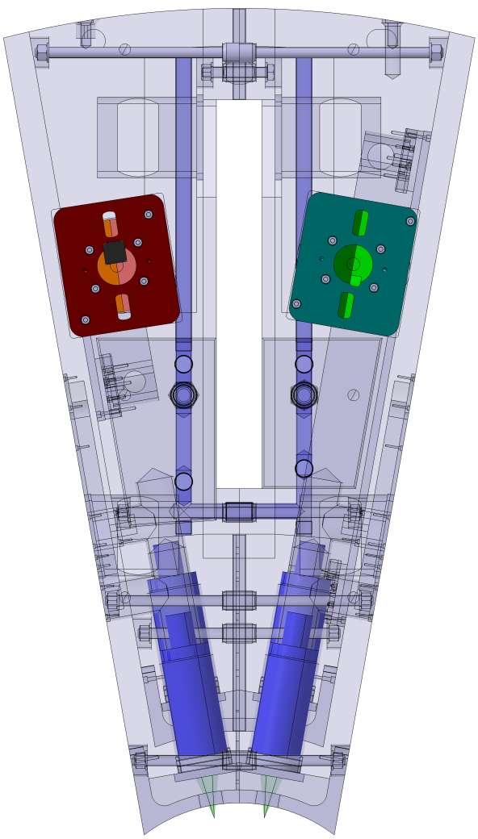
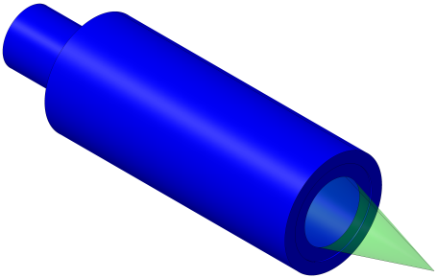
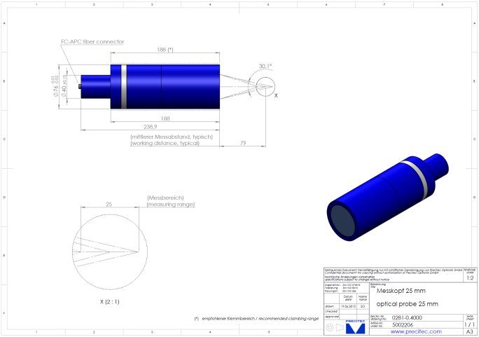
ESS - Target monitoring plug
Overview functional group 100 (XY-measurement)
Design Solution for: Precitec optical probe 25mm - Order No. 5002206
1380 mm
20°

Slide 17
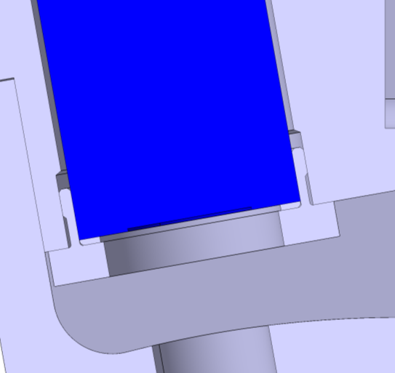
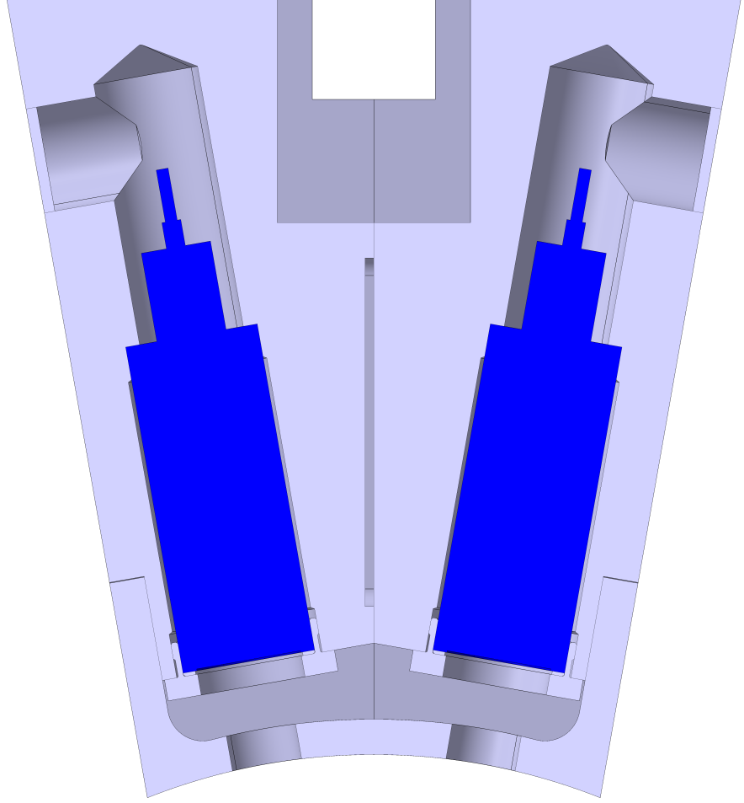
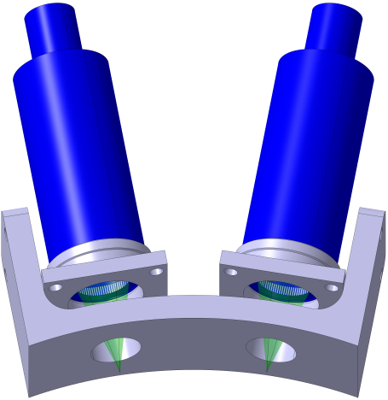
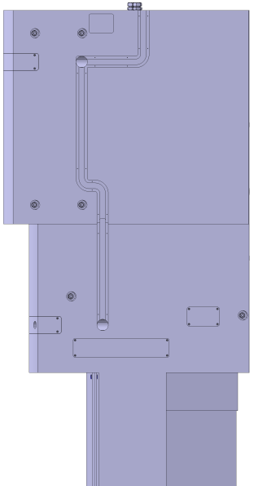

ESS - Target monitoring plug
Overview functional group 100 (XY-measurement)
Design Solution for: Precitec optical probe 25mm - Order No. 5002206
Mounting
Plate
Spacer
Lens Cover

Slide 18
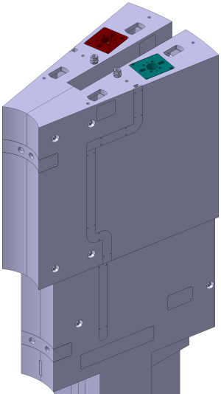
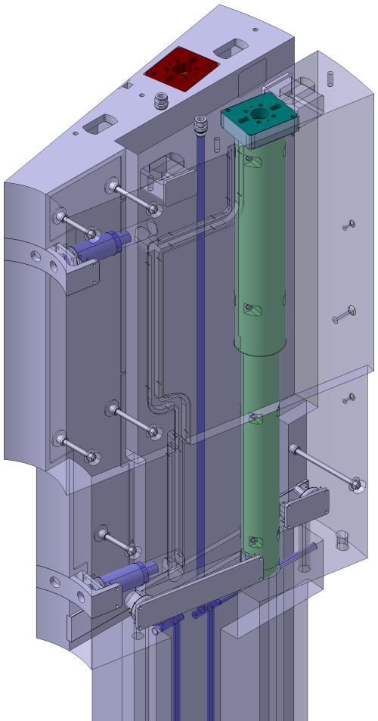
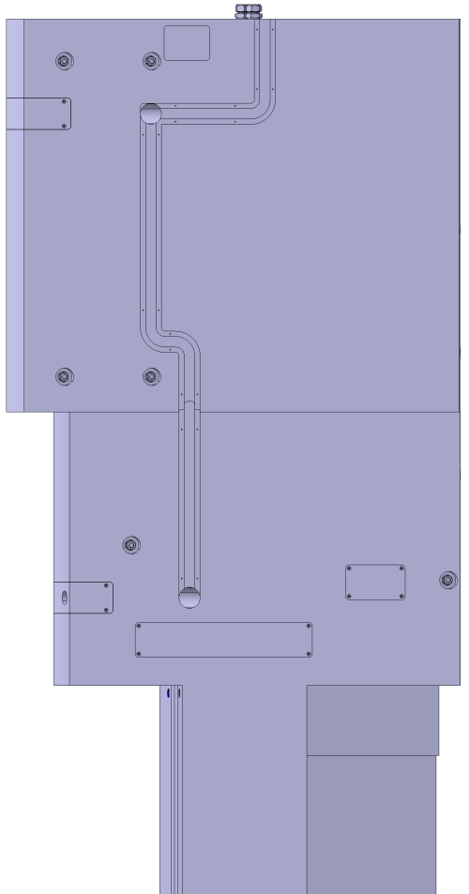
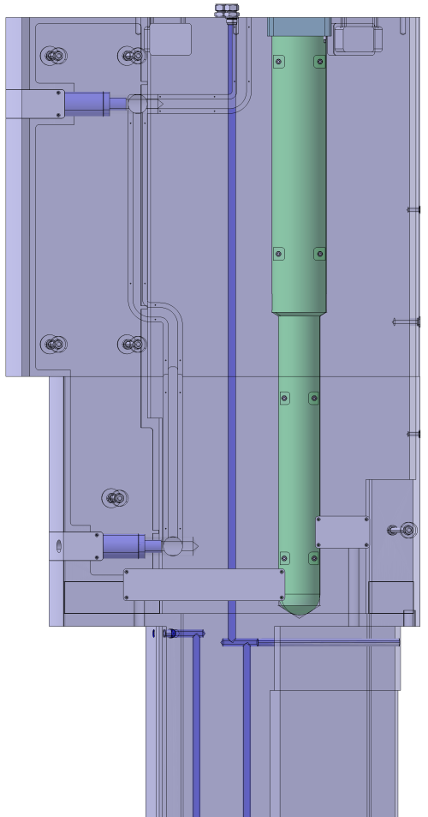
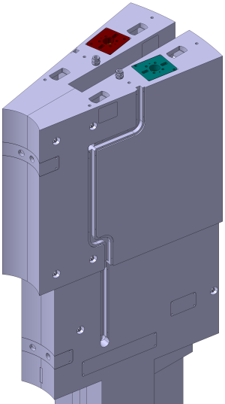
ESS - Target monitoring plug
Overview functional group 100 (XY-measurement)
Fibre cable routing for XY-measurement inside the TMP

Slide 19
OUTLINE
ESS – Target Monitoring Plug – System Design Solution
Target Monitoring Plug System Overview & Description
Overview of main body assembly
Overview functional group 100 (XY-measurement)
Overview functional group 200 (Z-measurement Insert)
Overview functional group 300 (IR-measurement Insert)
Interface Description
Documentation example

Slide 20
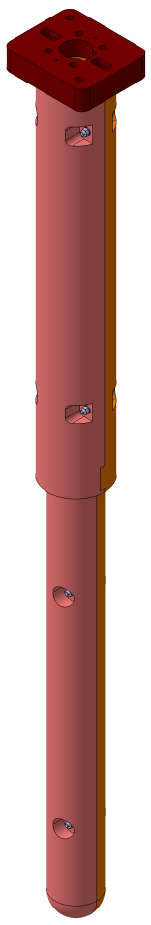
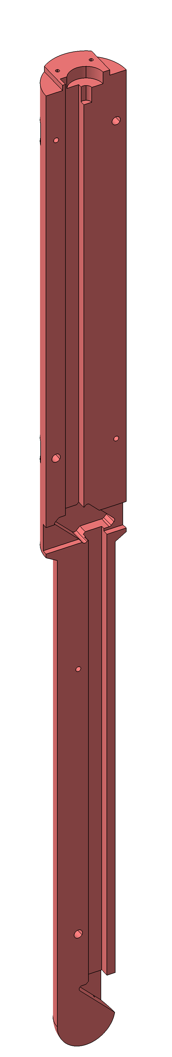
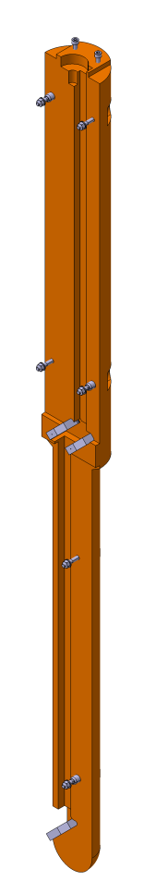
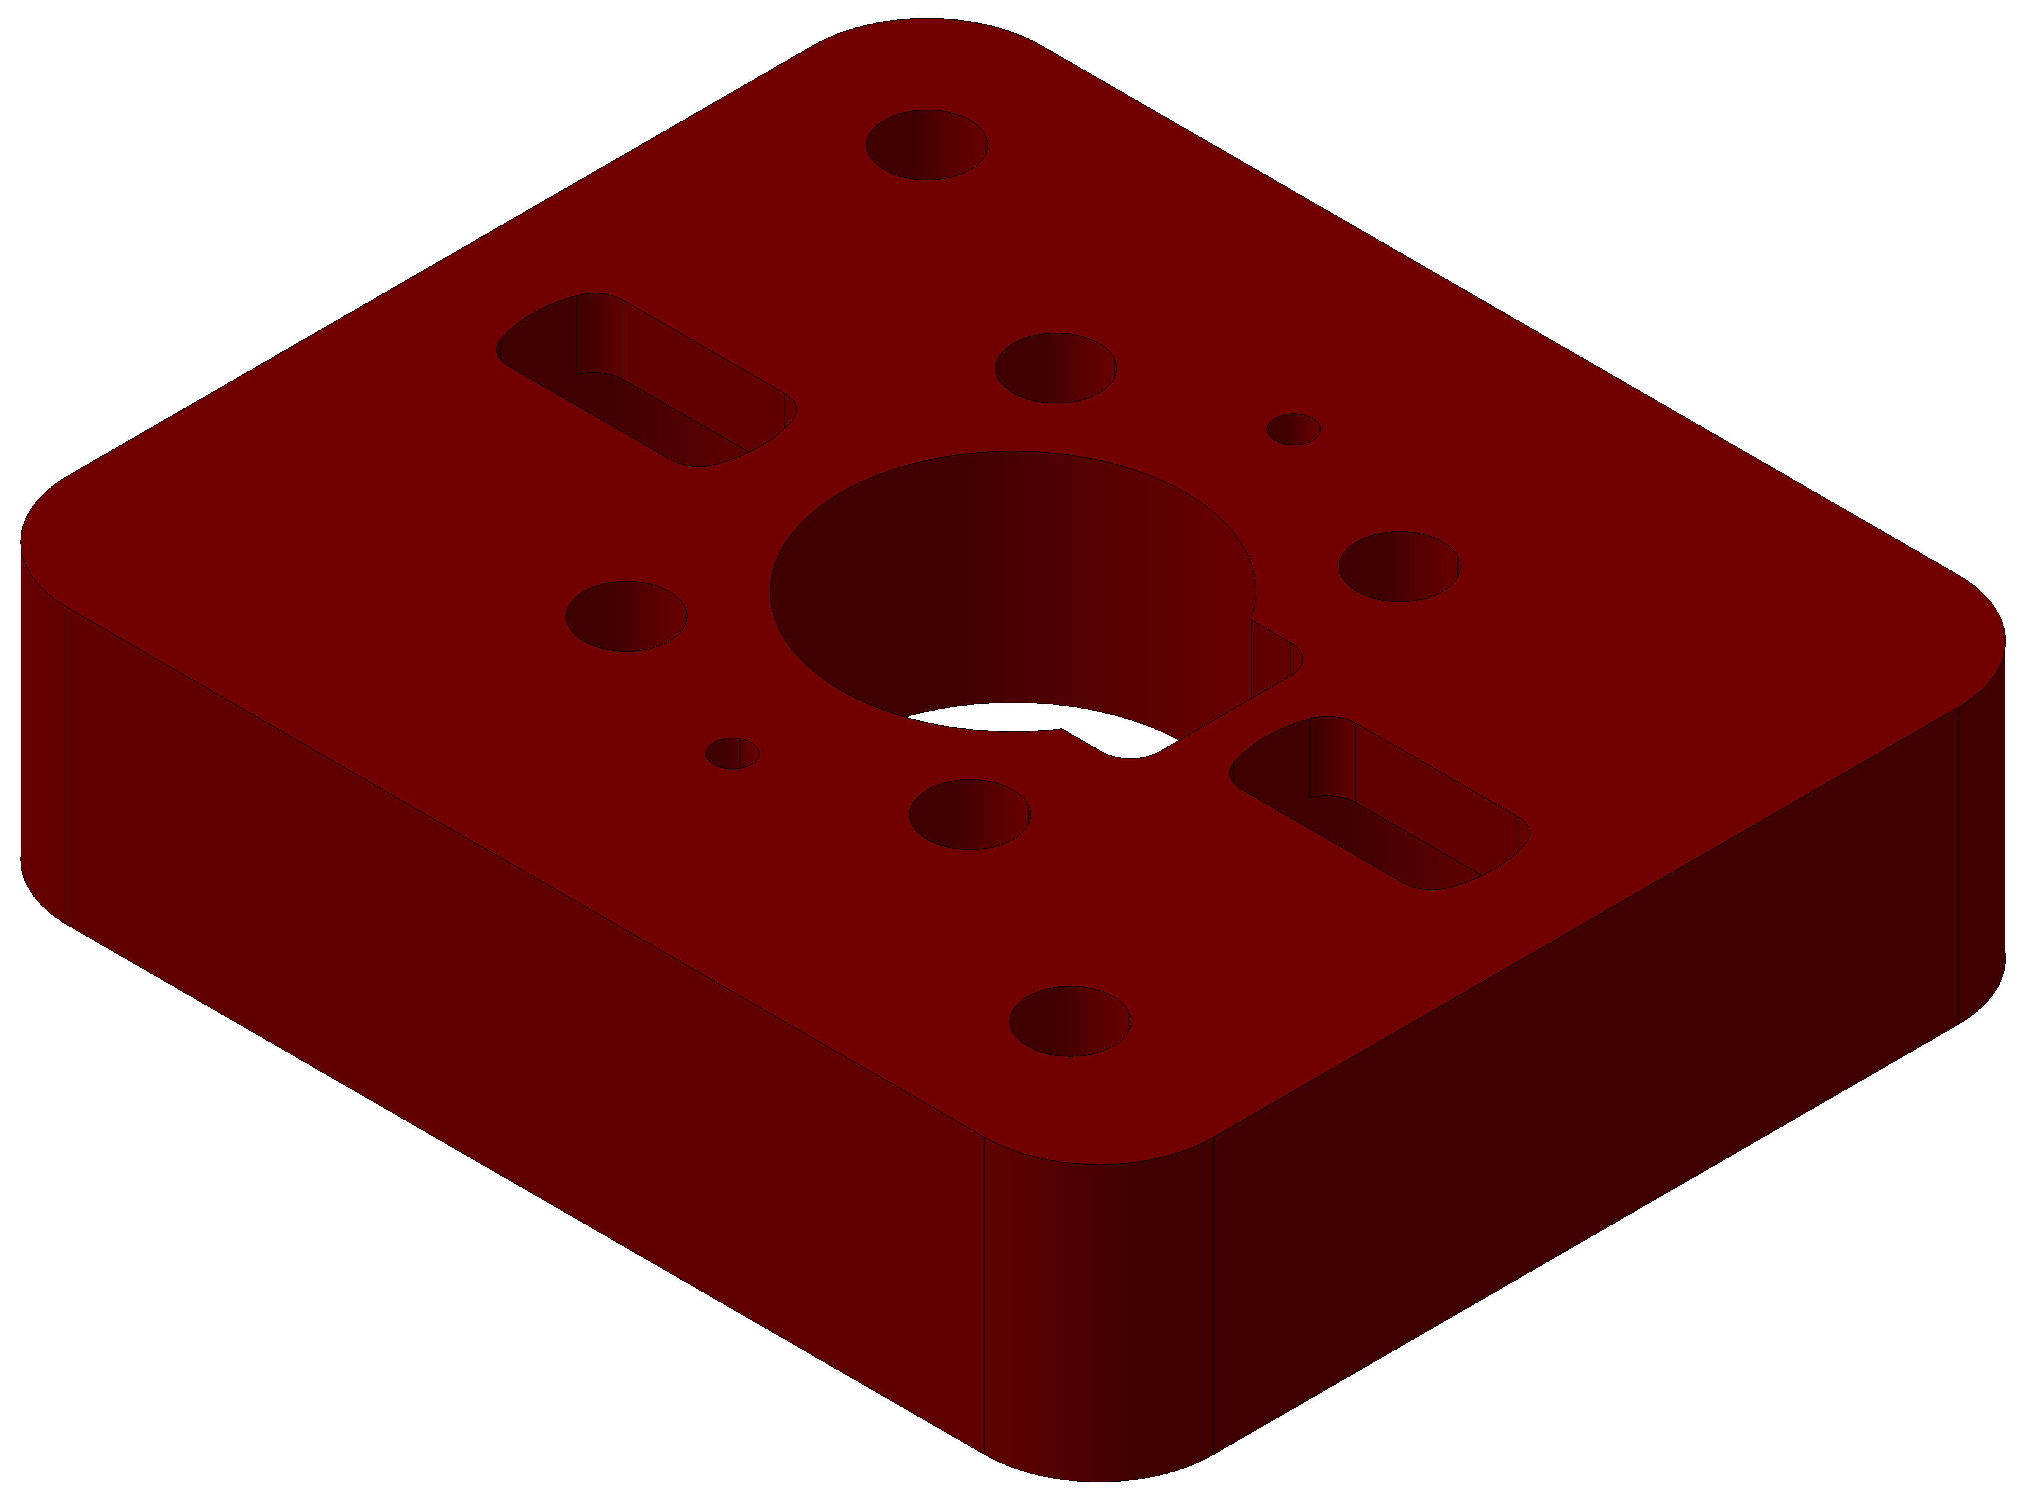
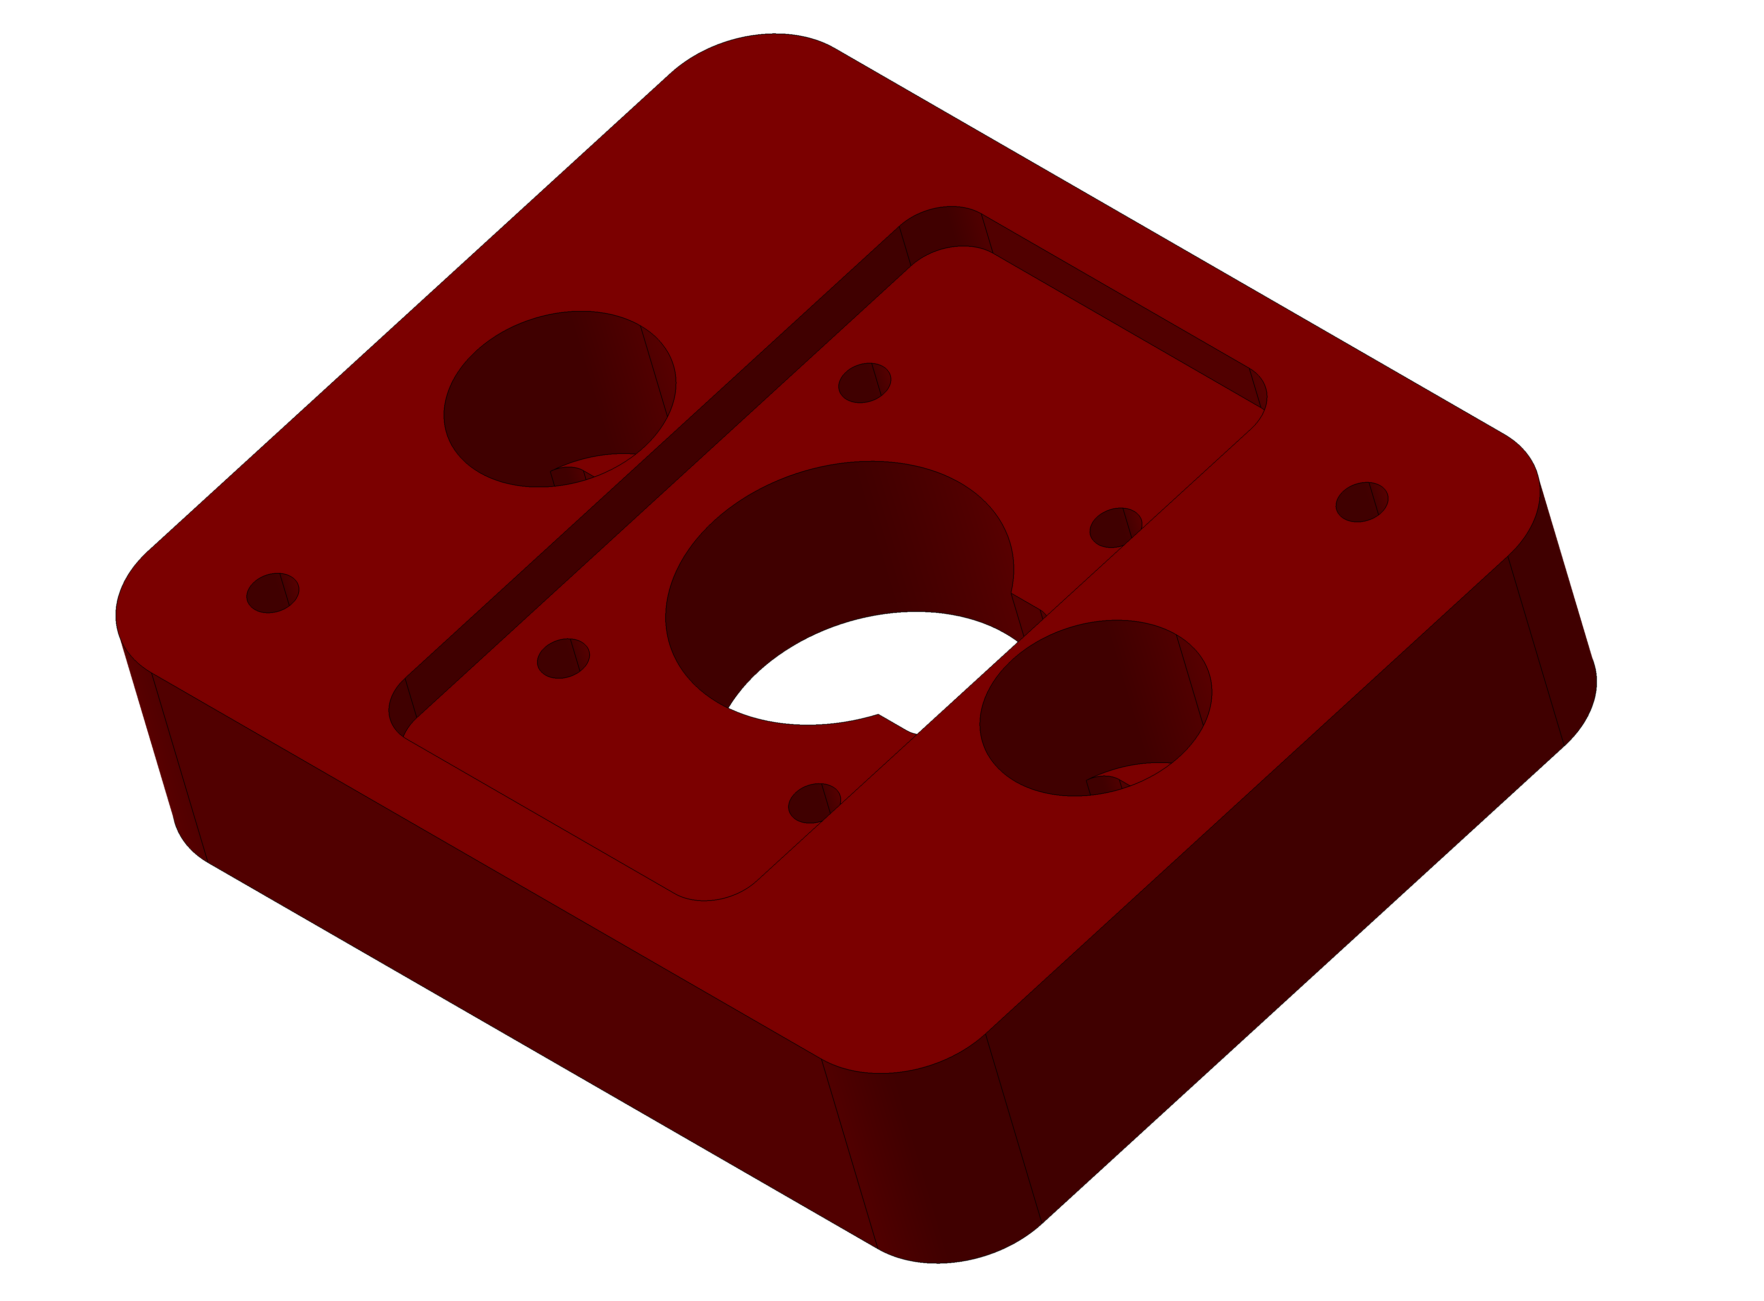
ESS - Target monitoring plug
Overview functional group 200 (Z-measurement Insert)
The Z-Insert consists of three individual parts, that are joined to one assembly
1
2
Z-Insert Assembly (1.4306):
m_{total} = 162kg
3 Component Parts:
No.1: m₁ = 76kg
1826 x Ø143
No.2: m₂ = 76kg
1826 x Ø143
No.3: m₃ = 10kg
200 x 170 x 48
Ø143
3
1864
Ø2" Mirrors
Ø103

Slide 21
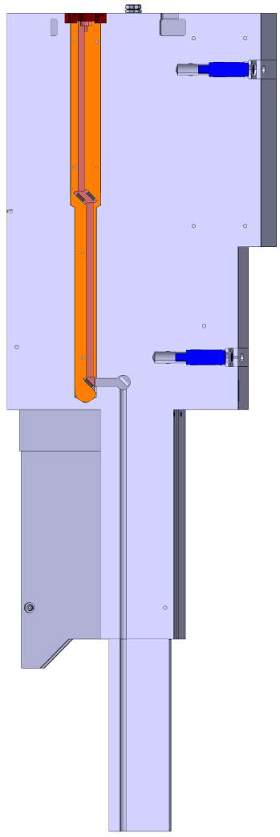
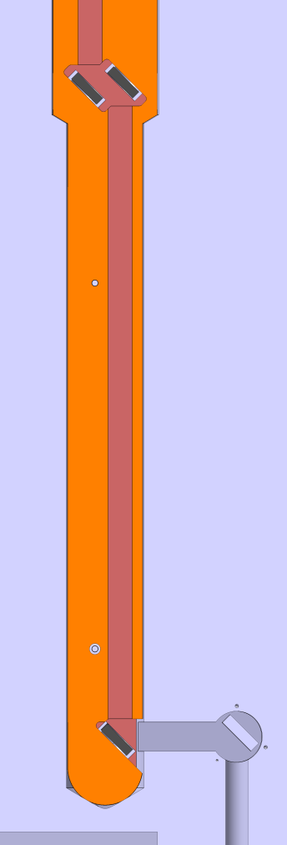
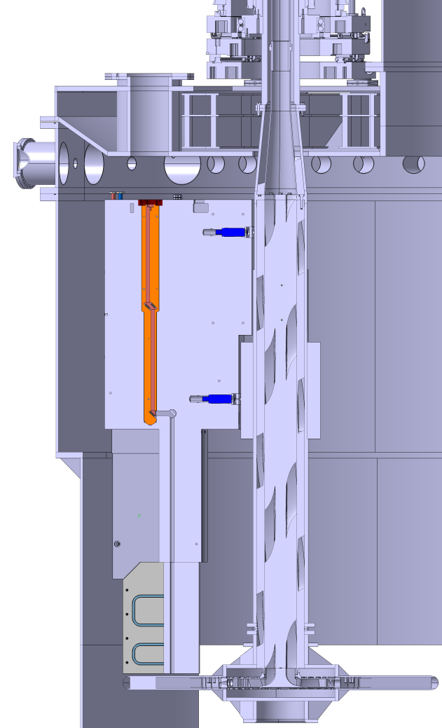
ESS - Target monitoring plug
Overview functional group 200 (Z-measurement Insert)
Routing of the Z-measurement laser beam through the Insert and the TMP
Space required for sensor unit and optical gear

Slide 22
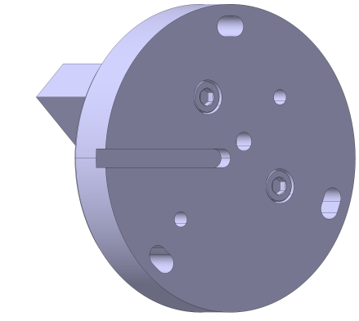
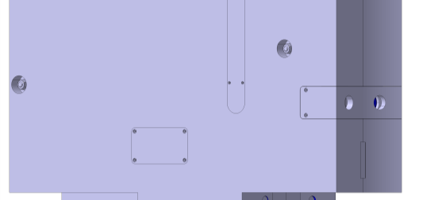
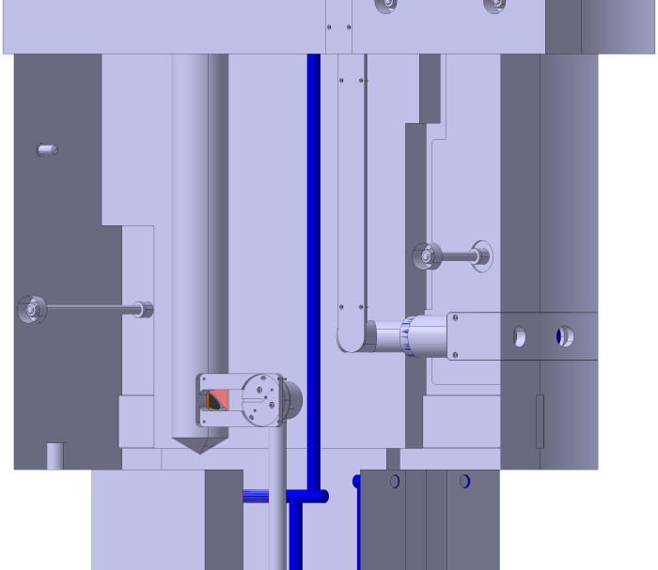
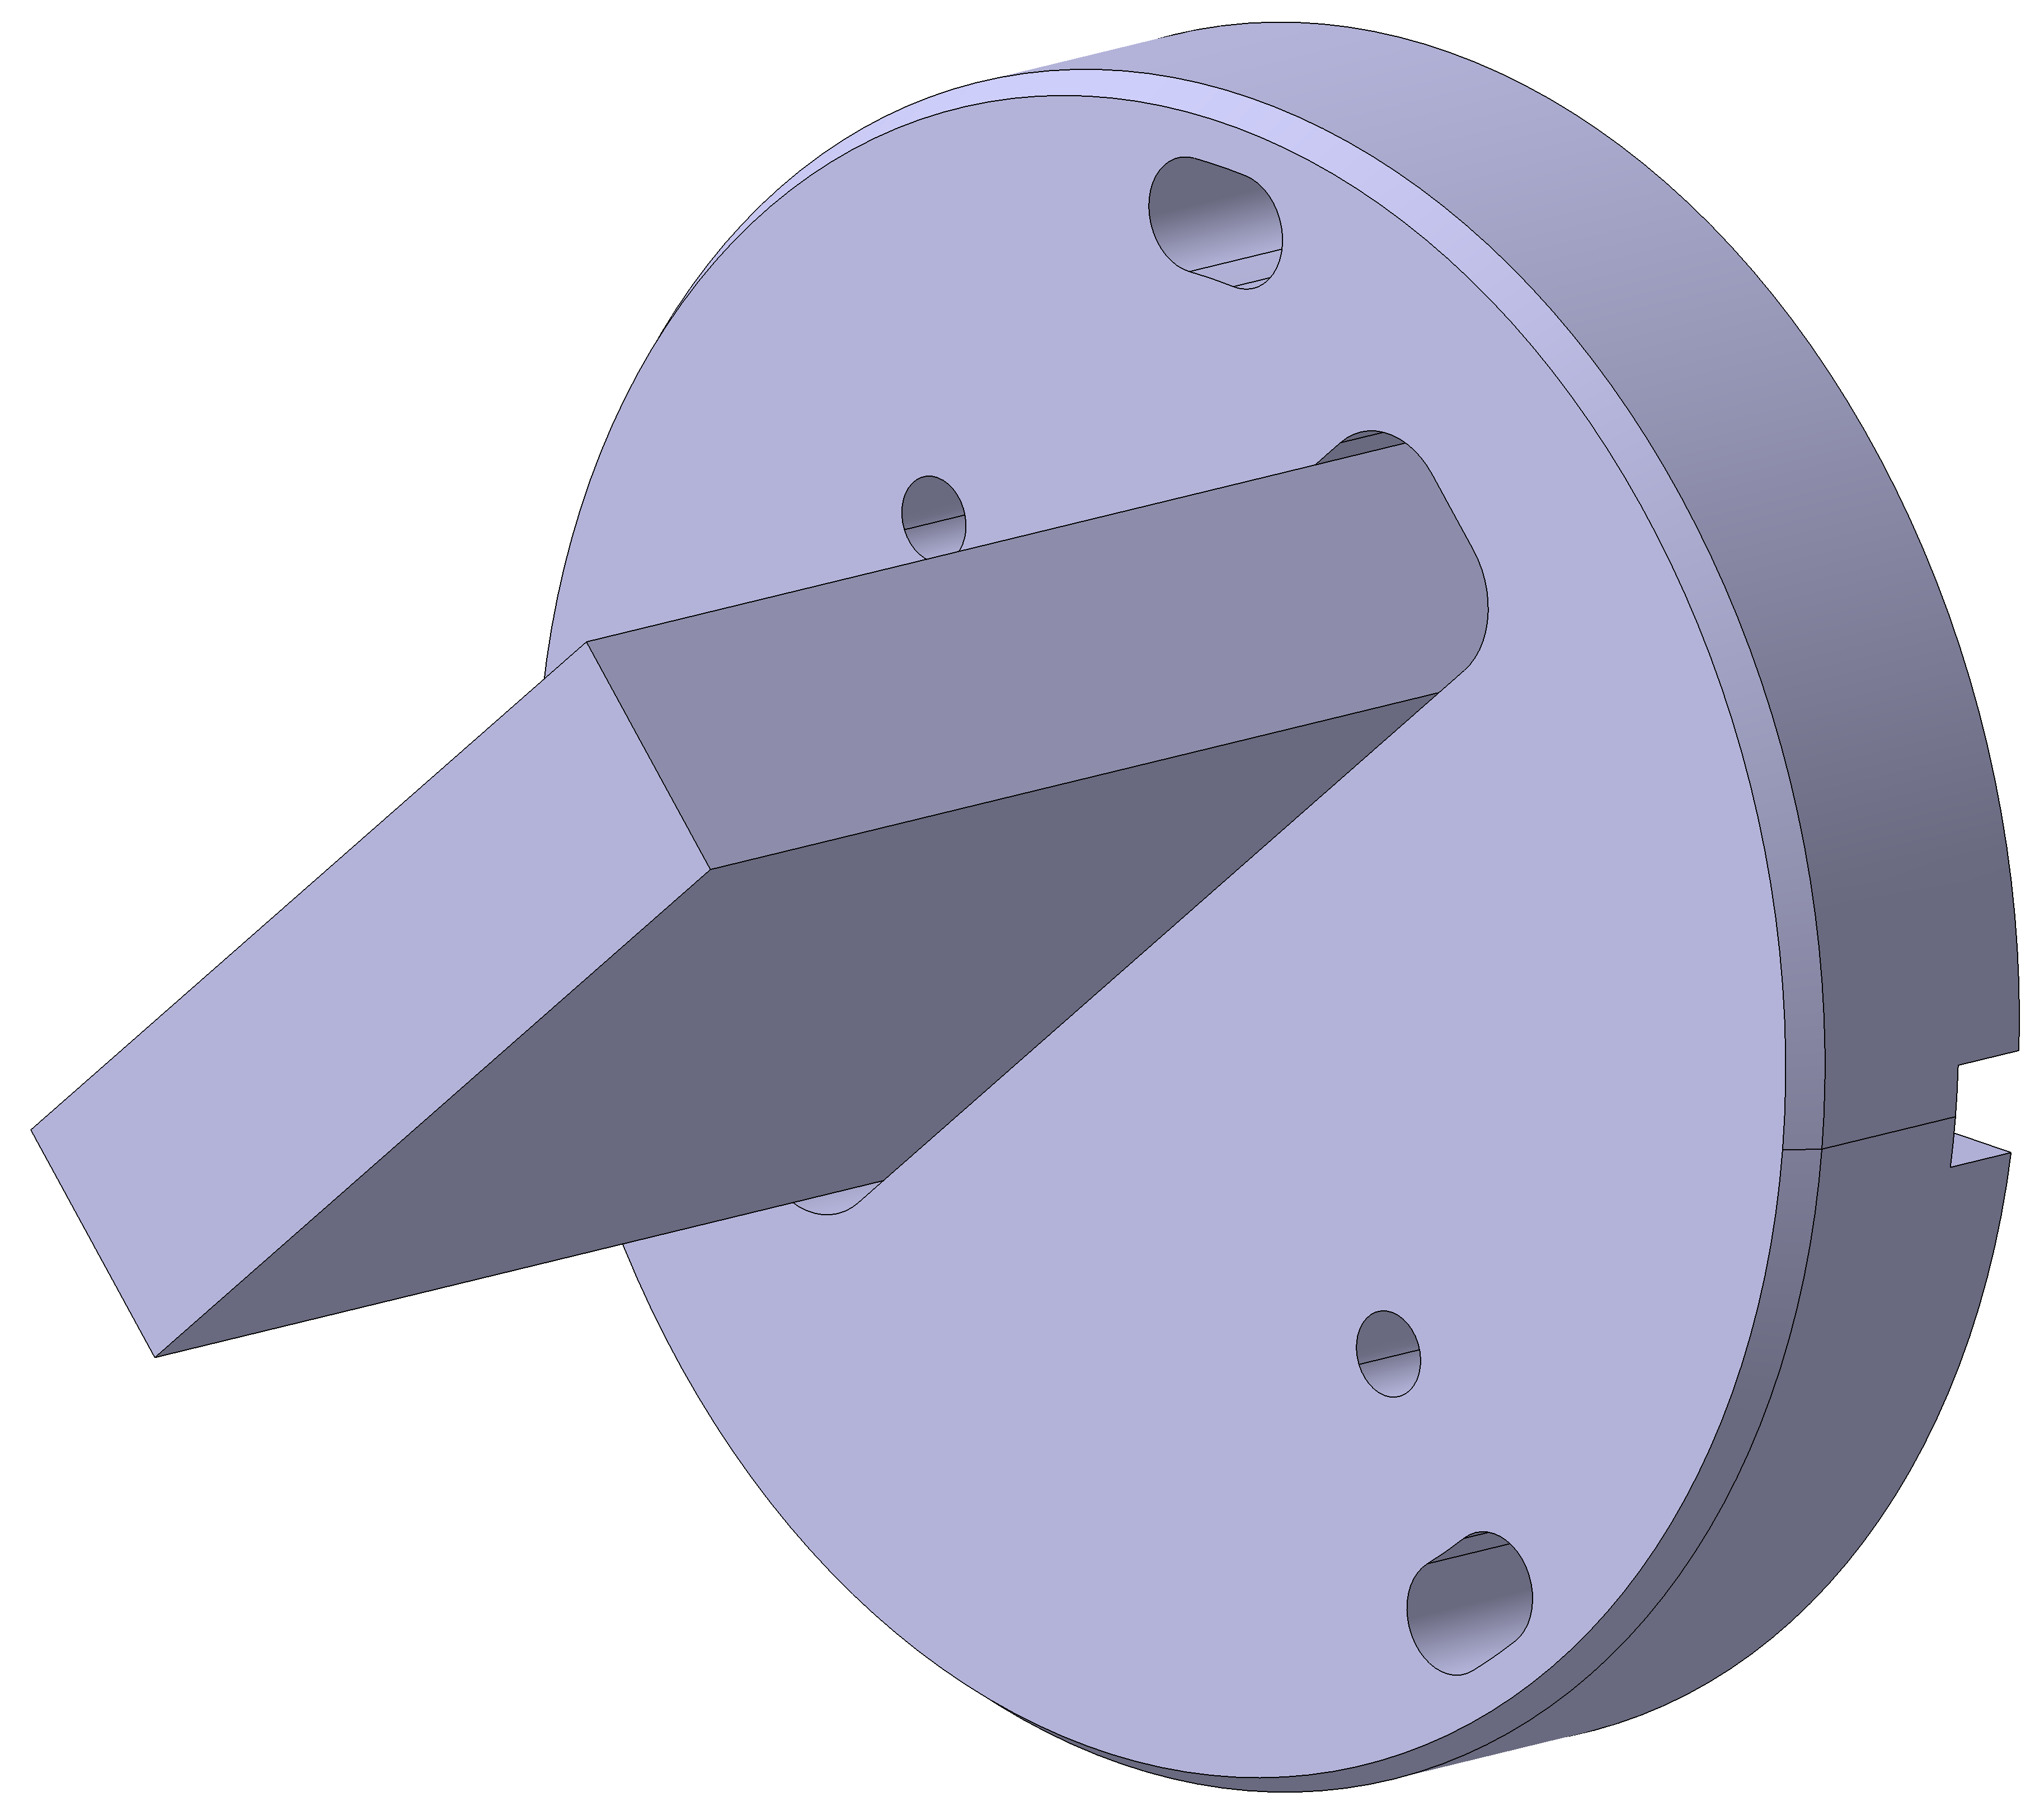
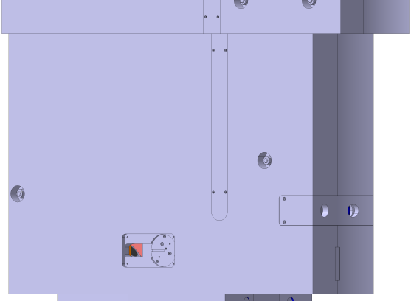
ESS - Target monitoring plug
Overview functional group 200 (Z-measurement Insert)
The “last” mirror for the Z-measurement system are located inside the TMP main body.
They are designed to be accessible, adjustable and exchangeable from the side.
A decision if polished stainless steel or gold coated mirrors will be used is postponed until the radiation damage calculations for the location of the mirrors are carried out.

Slide 23

ESS - Target monitoring plug
Overview functional group 200 (Z-measurement Insert)
The “last” mirror for the Z-measurement system are located inside the TMP main body.
They are designed to be accessible, adjustable and exchangeable from the side.

Slide 24
OUTLINE
ESS – Target Monitoring Plug – System Design Solution
Target Monitoring Plug System Overview & Description
Overview of main body assembly
Overview functional group 100 (XY-measurement)
Overview functional group 200 (Z-measurement Insert)
Overview functional group 300 (IR-measurement Insert)
Interface Description
Documentation example

Slide 25





ESS - Target monitoring plug
Overview functional group 300 (IR-measurement Insert)
The IR-Insert consists of three individual parts, that are joined to one assembly
1
2
IR-Insert Assembly (1.4306):
m_{total} = 253kg
3 Component Parts:
No.1: m₁ = 118kg
1827 x Ø170
No.2: m₂ = 125kg
1827 x Ø170
No.3: m₃ = 10kg
200 x 170 x 58
Ø170
3
1865
Ø130
2x Ø25mm Pyrometer

Slide 26





ESS - Target monitoring plug
Overview functional group 300 (IR-measurement Insert)
The “last” mirror for the IR-measurement system are located inside the TMP main body.
They are designed to be accessible, adjustable and exchangeable from the side.
A decision if polished stainless steel or gold coated mirrors will be used is postponed until the radiation damage calculations for the location of the mirrors are carried out.

Slide 27

ESS - Target monitoring plug
Overview functional group 300 (IR-measurement Insert)
The “last” mirror for the IR-measurement system are located inside the TMP main body.
They are designed to be accessible, adjustable and exchangeable from the side.
R580
(Target Wheel Surface)
R1250

Slide 28
OUTLINE
ESS – Target Monitoring Plug – System Design Solution
Target Monitoring Plug System Overview & Description
Overview of main body assembly
Overview functional group 100 (XY-measurement)
Overview functional group 200 (Z-measurement Insert)
Overview functional group 300 (IR-measurement Insert)
Interface Description
Documentation example

Slide 29





ESS - Target monitoring plug
Interface Description – Location Inside The Monolith
The coordinates of the TMP and the center of gravity can be seen in the interface drawing “260-000067 – CoG & Position Inside The Monolith”

Slide 30



ESS - Target monitoring plug
Interface Description – Service Opening Lid
According to “ESS-0135246” the service opening lid has a free opening of Ø600mm
This slide shows the accessibility of the inserts through the lid and the coverage of the TMP front by the target shaft drive unit

Slide 31


ESS - Target monitoring plug
Interface Description – Service Opening Lid
According to “ESS-0135246” the service opening lid has a free opening of Ø600mm
This slide shows the accessibility of the inserts through the lid and the coverage of the TMP front by the target shaft drive unit
IR-Mirror2
IR-Insert
Z-Insert
Z-Mirror
IR-Mirror1
XY-Measurement
Optical Heads

Slide 32




ESS - Target monitoring plug
Interface Description – Mechanical Lifting Interfaces
Mechanical lifting interfaces according to “ESS-0098693”
The coordinates of the lifting interface of the TMP can be seen in the interface drawing “260-000067 - Lifting Interface Of The TMP”

Slide 33






ESS - Target monitoring plug
Interface Description – Mechanical Lifting Interfaces
Mechanical Lifting Interfaces according to “ESS-0098693”
The coordinates of the lifting interfaces of the Z- & IR-Inserts can be seen in the interface drawing “260-000067 - CoG & Position Inside The Monolith”
IR-Insert
Z-Insert

Slide 34




ESS - Target monitoring plug
Interface Description – Mounting Interface
Mounting Interface according to “ESS-0135246”
Chain of tolerances through the different shielding layers will be challenging for alignment of the TMP inside the monolith
Source: “ESS-0135246 - SDD-sol Target Monitoring System2019.04.15.docx”

Slide 35


ESS - Target monitoring plug
Interface Description – Cooling Water Connection
Screwed connectors from Swagelok with internal thread to connect the TMP’s internal cooling channel to the permanent water pipework.
The coordinates of the connectors can be seen in the interface drawing “260-000067 CoG & Position Inside The Monolith”
Water Outlet
Water Inlet
Fitting: SS_1610_1_RS
Sealing: SS-16SRSD-2V

Slide 36
OUTLINE
ESS – Target Monitoring Plug – System Design Solution
Target Monitoring Plug System Overview & Description
Overview of main body assembly
Overview functional group 100 (XY-measurement)
Overview functional group 200 (Z-measurement Insert)
Overview functional group 300 (IR-measurement Insert)
Interface Description
Documentation example

Slide 37





ESS - Target monitoring plug
Documentation example - BOM

Slide 38






ESS - Target monitoring plug
Documentation example – Assembly Drawing

Slide 39




ESS - Target monitoring plug
Documentation example – Part Drawing

Slide 40
ESS - Target monitoring plug
Thank you for your attention!

