Slide 1
Proton Beam Window and
Proton Beam Instrumentation Plug
Mattias Wilborgsson
Work Unit Leader, Monolith Systems
Sara Ghatnekar
Work Package Leader, Monolith Systems
www.europeanspallationsource.se
14 June, 2019

Slide 2
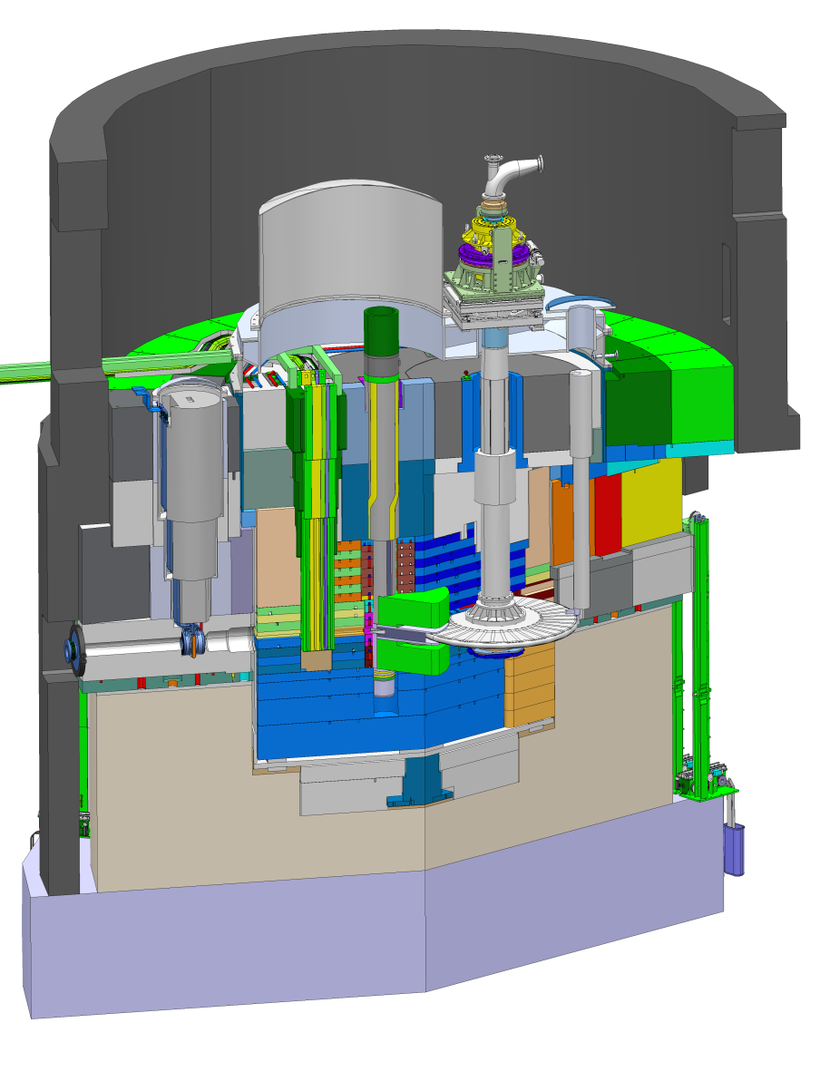
Target Station layout
Proton Beam Instrumentation Plug
Proton Beam Window
Neutron Beam Extraction
Proton beam envelope
representation
Target Wheel
Moderator and Reflector Plug

Slide 3
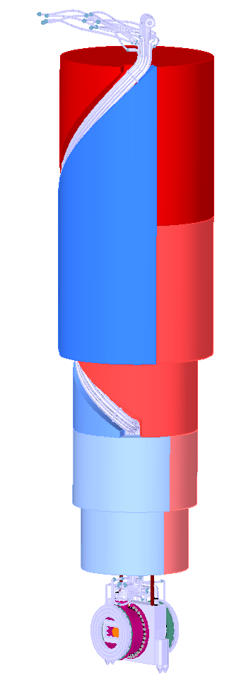
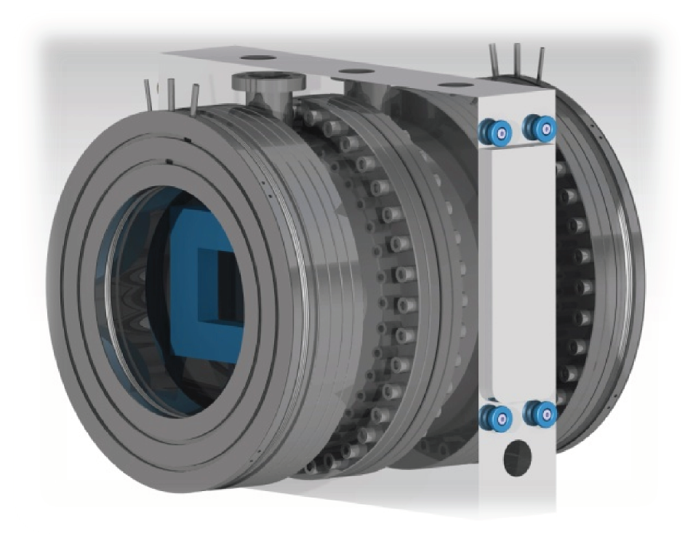
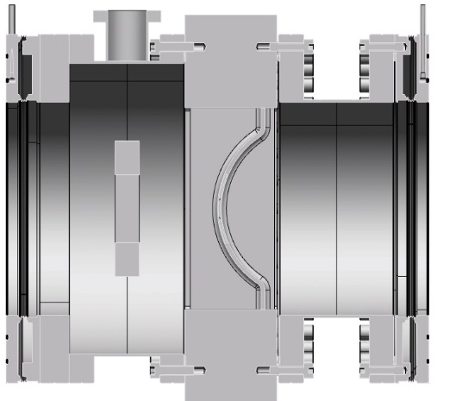
Target Station components
Proton Beam Window (PBW)
In-Kind delivery from ESS-Bilbao in Spain
Function
  Separating the monolith atmosphere from the high vacuum of the accelerator beam pipe
Expected lifetime
  A half year at full power operation (5 MW)
Beam Instrumentation (APTM)
Luminescent
Coating

Slide 4
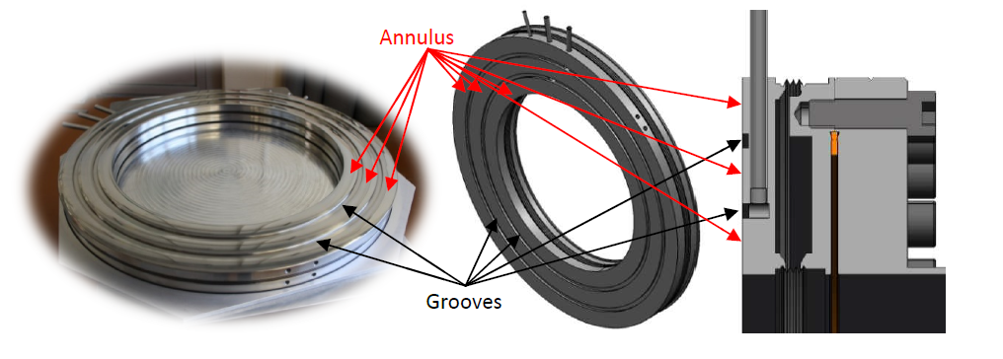
Proton Beam Window
Inflatable pillow seal
Bellows and pillows pressurized with air, up to 2 bar(g)
Maximum leak rate 5*10⁻⁴ mbar*l/s*m
Bellows stroke ± 3 mm

Slide 5
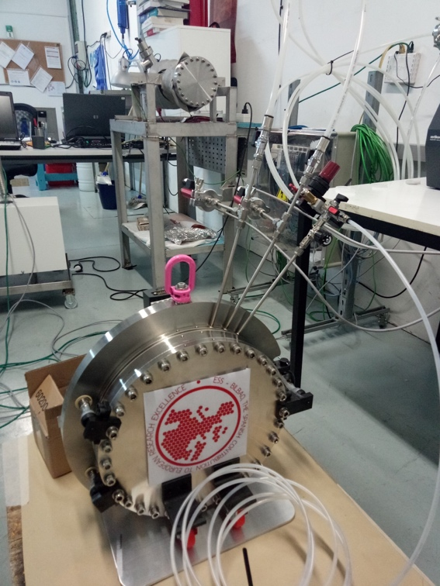
Proton Beam Window
Inflatable pillow seal
Inflatable pillow seal prototyping
Test show that the design fulfils the requirement

Slide 6
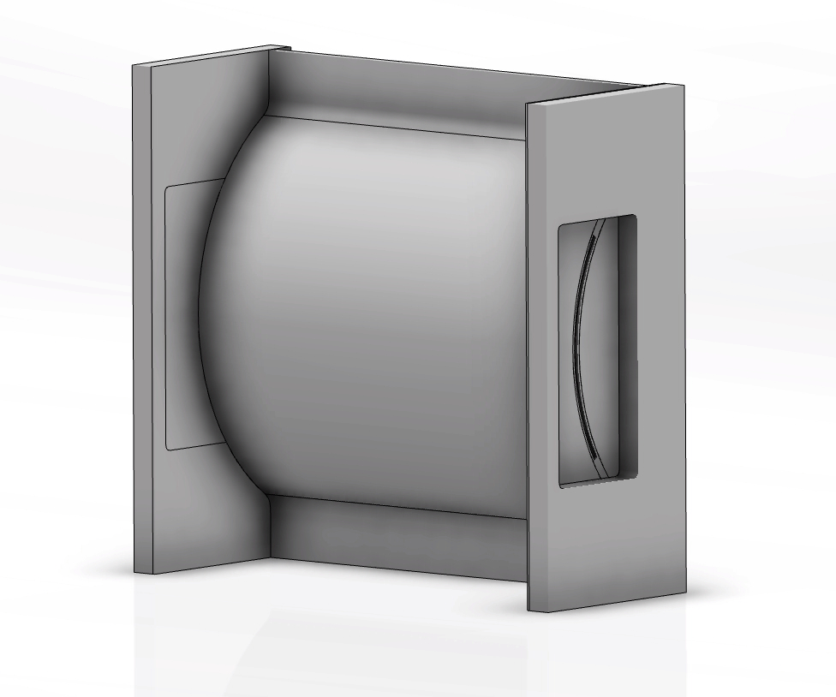

Proton Beam Window
Made in Al6061-T6
Demanding design
  Minimize material in beam, to reduce distortion and heat deposition
  1 mm plate thickness
  2 mm width of cooling channel

Slide 7
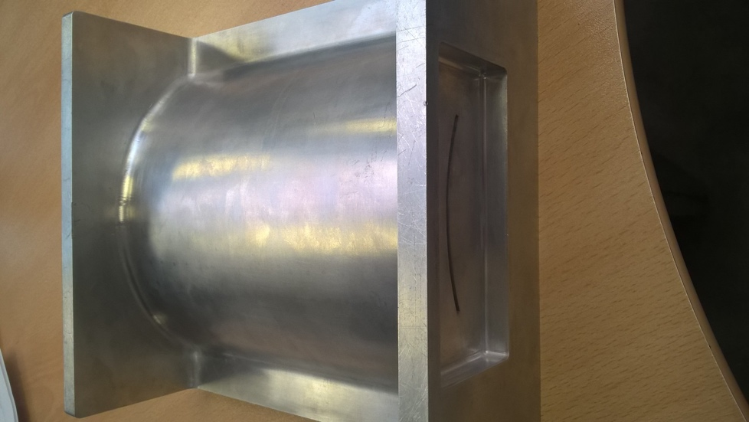
Proton Beam Window
PBW prototyping
  EDM technique
  Sparks generated during manufacturing creating pores
  New plan is to try EDM in thicker material and then WEDM the channel.

Slide 8
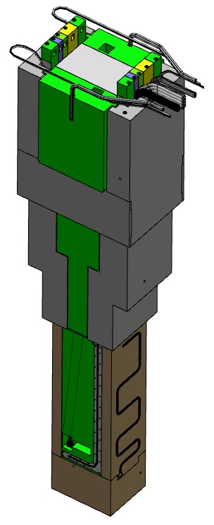
Target Station components
Proton Beam Instrumentation Plug (PBIP)
In-Kind delivery from ESS-Bilbao in Spain
Function
  Support, cool and align the PBI
  Allow an optical view of the PBW and the Beam Entrance Window
PBIP components
  Beam instrumentation slices (3)
  Optical slices (2)
Minimum lifetime of PBI part
  Two years at full power operation (5 MW)
Instrumentation slices
Shielding block
Optical slices
Actively cooled support structure
Position of first mirror

Slide 9
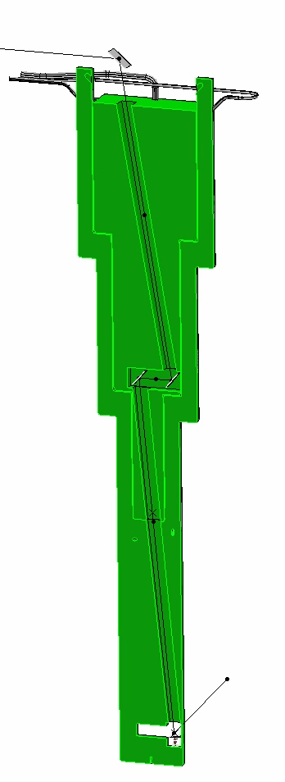
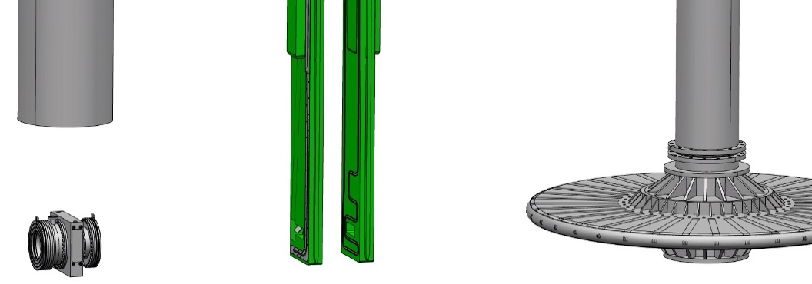
Target Station components
Proton Beam Instrumentation Plug (PBIP)
Target Imaging Systems
  Mirrors
    4 mirrors in each optical slice
    Demanding requirements for thermal deformation
  Antireflective coating of optical paths
    Grit blasted surface could be an alternative
PBW
BEW

Slide 10
Backup slide

