Slide 1
Bunker reloaded a strategic overview of current thinking
13/06/2019
Iain Sutton
On behalf of the NSS project team
Notes:
Operational standpoint
A systems standpoint

Slide 2
Approach
concious of the limits of the time available ….
rather than present an overview i have chosen to try to second guess the issues that may be of interest to you.
In principal i imagine these to be the strategic issues and solutions potentialy relevent to the design of your own systems

Slide 3
Game plan
overview instrument suite
overview bunker
bunker functions
  volume for instrument components
  safety
  background reduction
  access
safety
  radiological shielding
  conventional safety
  air activation / contamination
Background reduction
Intergration of instrument components
Operational issues
  access

Slide 4
The Bunker an important operational ‘node’
Logistics
Bunker
systems
Target systems
Instrument systems
NSS
  Bunker system
  Instrument systems
Target
  NBPI
  LSS / NBW
Facility
  Crane
  Utilities
Interdependencies
Bi-directional
Bunker is at once an ‘operational context’ and system within broader context …
Notes:
What equipment is there
Instrument coponent
Target systems
Services
PSS
Bunker itself

Slide 5
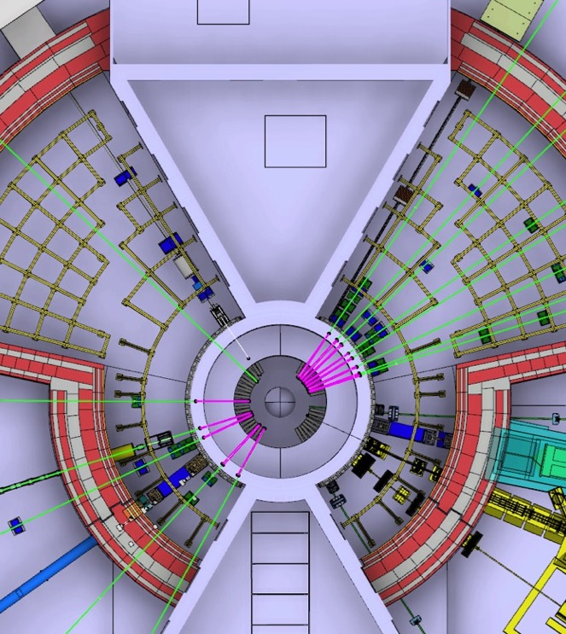
Installed systems
Inside / Outside / Feed through
Equipment
Target
Instruments
Utilities
Target
  16 Beam extraction systems
  16 Light shutter
  42 Beam windows
  Helium & Water cooling
Instruments
  Choppers 98 axis
  Optics 300 m
  Shutters 30
  Monitors 30
Service supplies
  Vacuum 350m
  Fluids 520m
  Cables 5-10 km
Notes:
Large open shielding volume reminiscing of reactor beamlines ILL FRM2
Contrary to reactors does not contain only neutron guides
But Large quantities of mechanical components with increase access requirements
Contrary to spallation sources it does not separate volumes
Long pulse source
2-3 time more choppers than earth short pulse or reactors
Shutters
In fact 60% of all of the maintenance heavy reqs

Slide 6

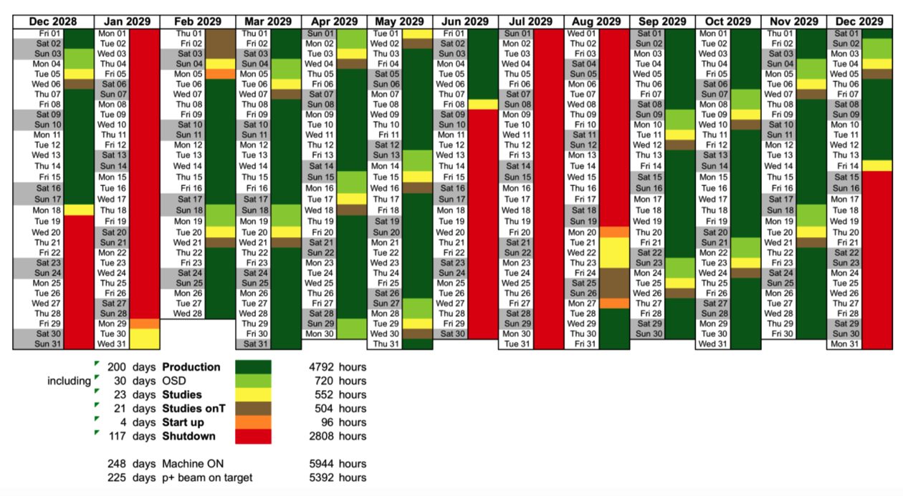
ESS unique source, setting unique boundary conditions.
2 -3 times more mechanical devices on a ‘long pulse instrument’ than at existing types
A challenging environment to operate equipment
Complex Installed systems
Hazardous environment
Limited access opportunities
60-70% of all ‘mechanical’ components on instruments are within bunker volume
Notes:
Not a usual source
Special source
Special constraints on operations
Constraints on design of equipment and installations

Slide 7
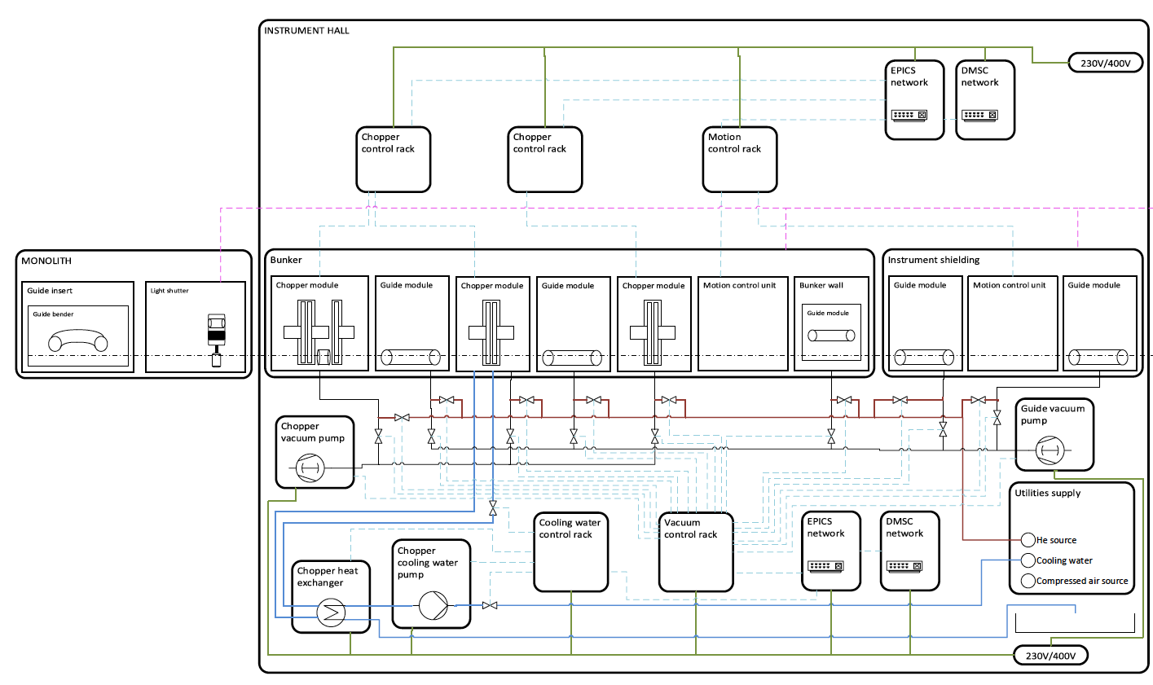
Installed systems
Inside / Outside / Feed through
Insert schematic of bunker components here
BUNKER Perimeter
In-monolith systems
‘Instrument systems’
Utilities
Feed through
Notes:
What equipment is there
Instrument coponent
Target systems
Services
PSS
Bunker itself

Slide 8
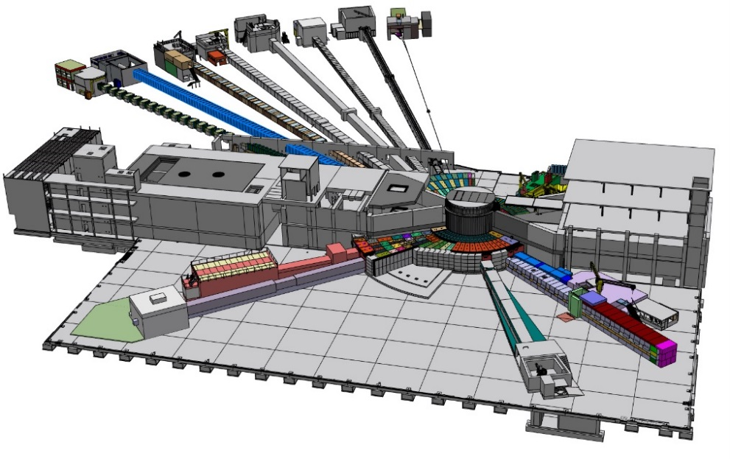
Overview
Bunker context
Long
Short
Straight
Curved

Slide 9
Long pulse instrument
Like short pulse instruments only more so …
3 times more choppers many in the first meters ie in bunker
Results in an elevated need for access for maintenance
Drive Bunker design

Slide 10
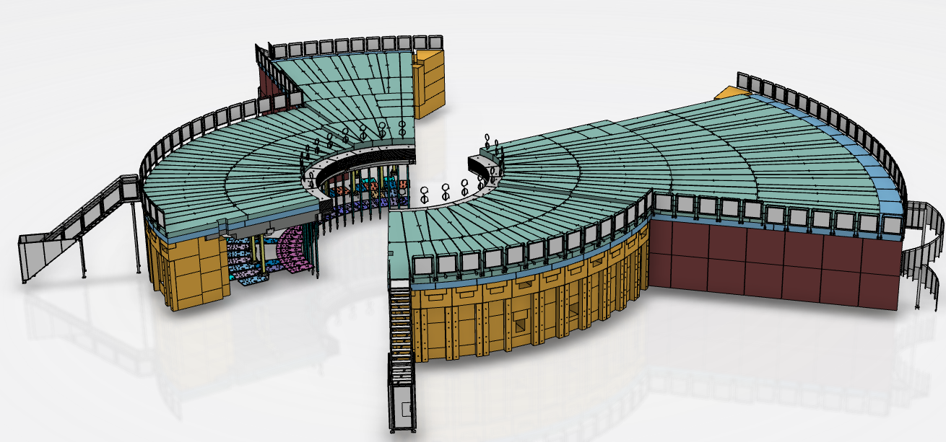
The bunker - content
Bunker (2)
Support frame
Shielding
  Roof
  Walls
Feed throughs
  Neutrons
  Utilities
Access
Safety Systems

Slide 11
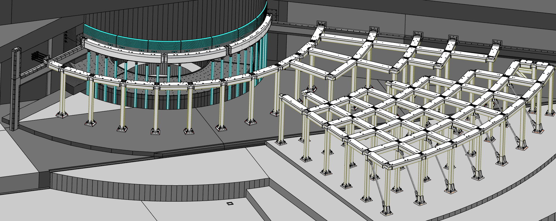
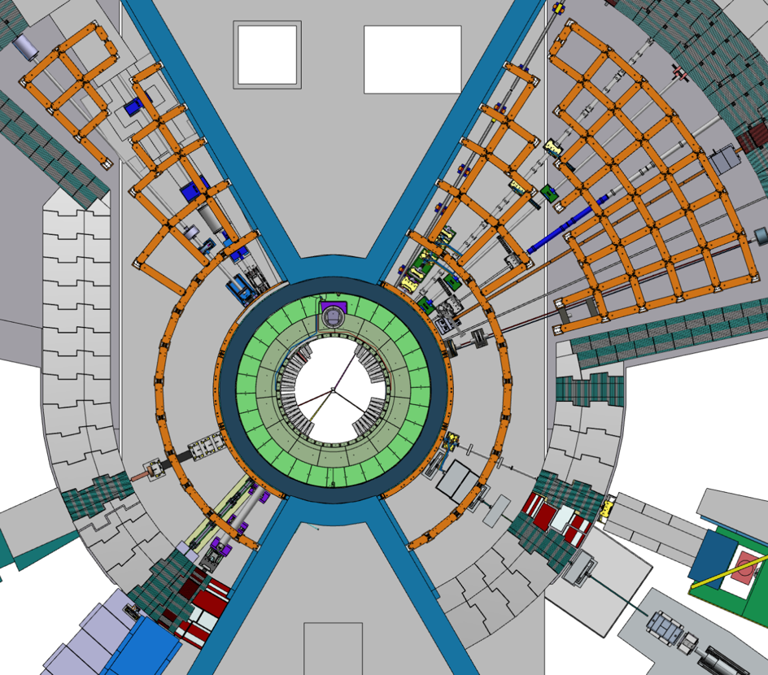
Bunker
Support Frame
R6m Frame
Target building frame
Instrument hall frame
North and West sector
Design considerations:
Support bunker roof load of ~6.6 t/m2
Support additional 3.3 t/m2 for removed roof block placement during maintenance
Prevent roof blocks impacting monolith during
an H4 seismic event
Provide minimal spatial constraints for beamlines & equipment
All elements to be removable as needed during maintenance

Slide 12
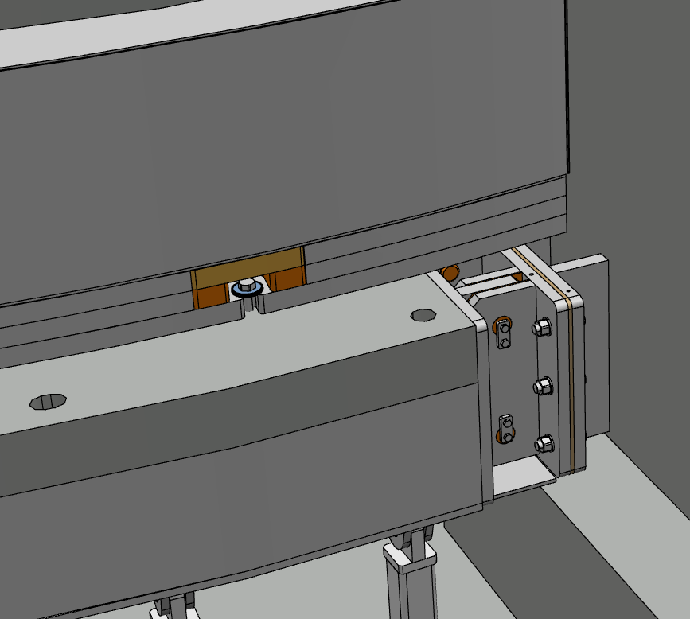
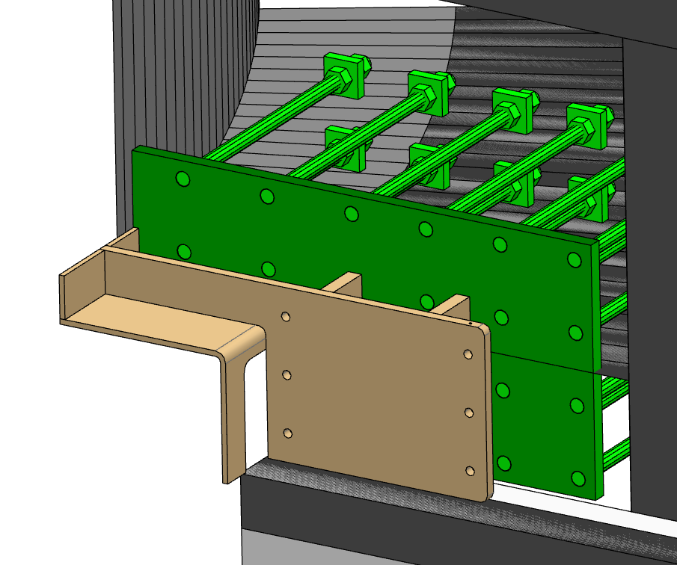
R6 Frame
R6 frame assembly contains:
Wall Brackets
Connection Flanges
R6 beams
Support Pillars and Brackets
Skirt Shield Blocks
The R6 beams will be fixed to the diagonal walls of the Monolith.

Slide 13
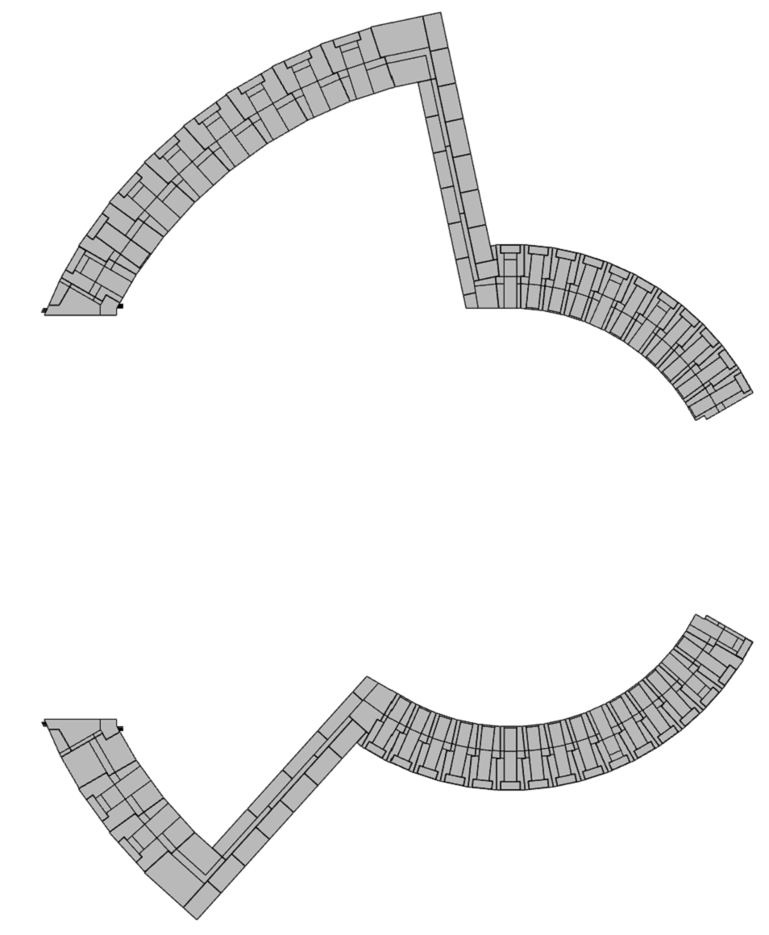
Wall
Sector | Wall thickness [m]
North | 3.5
West | 3.5
North-West | 2.0
South | 3.5
East | 3.5
South-East | 2.0
West
North-West
North
East
South
South-East

Slide 14
Wall
North sector shown
Every sector is build up from wall segments:
Every wall segment is made of heavy concrete blocks:

Slide 15
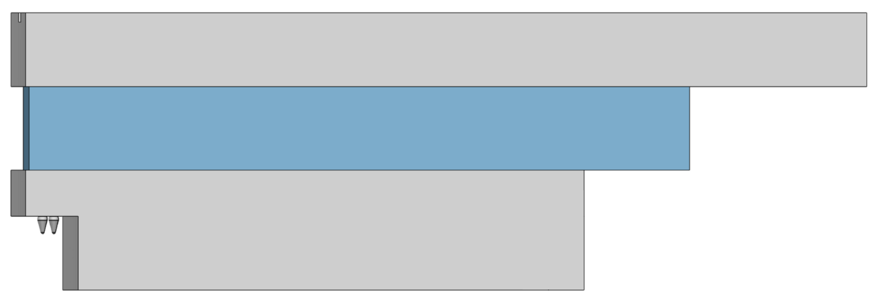
Roof
Level
 | The newest roof | Tender roof | Improved by
No. of different kind blocks | 70 | 151 | 53,6%
Total no. of blocks | 319 | 446 | 28,5%
Total volume [m3] | 867,1 | 1040,6 | 16,7%
Average block mass [t] | 11,5 | 9,8 | -16,5%
 | Roof thickness [m]
Area | North | West | South | East
R9-R15 | 1.3 | 1.5 | 1.3 | 1.4
R15-R21 | N/A | 1.2 | N/A | 1.2
R21-R28 | N/A | 1.0 | N/A | 1.0

Slide 16
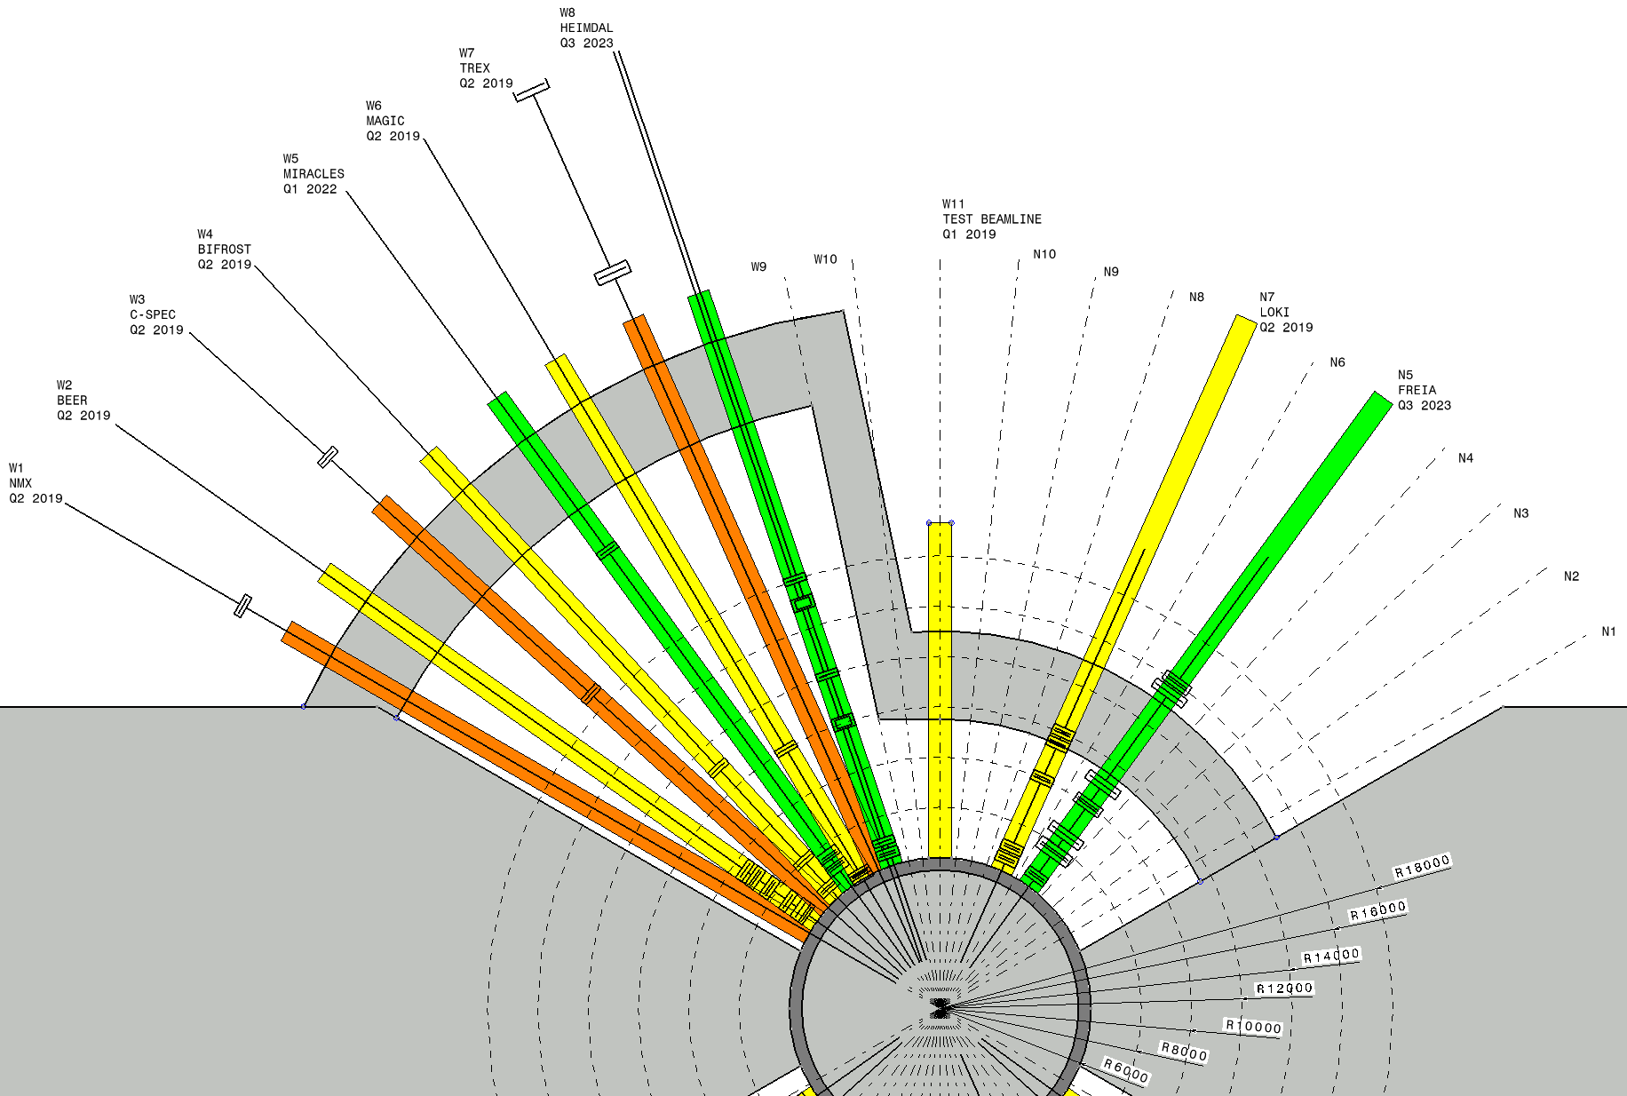
Blocks installation – access cases
The table presents illustrative access cases, as each one can be fully customized.
Location | Number of blocks to be removed
Long sector, R6-R28, (e.g. W4: BIFROST) | 44
Short sector, R6.2-R15, (e.g. N7: LOKI) | 23
Short sector, R6.2-R9, 6° (e.g. N7: LOKI) | 6

Slide 17
Function
House equipment

Slide 18
ESS-0060210, Bunker System, System Requirements Specification (SRS)
BS.SyR-09
Title: Installation/removal access for Target Systems elements.
Statement: The Bunker System shall provide safe restricted access into the bunker for the installation/removal of Target Systems elements.
Rationale: The Bunker System design shall be modular in design to allow for varying partial openings of sections of the bunker that suit the size for the handling of the Target Systems elements that need to be installed and removed in the bunker.
Traceability: ConOps [1].
Verification: Review of the system design.

Slide 19
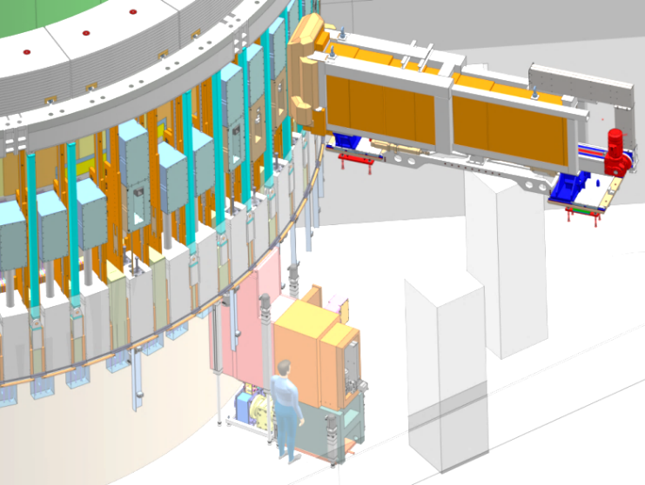
Unfolding the requirements
Access is required for the following Target systems
  Beam extraction (Insertion tool)
  Light shutter
  Beam-port window
  ‘Target utilities’
Principal requirement(s) on bunker
  Removable roof
  Work area within volume free from permanent structures
    Bunker support structure
    Instrument components
  Crane capacity
Insertion tool
Window
utilities
Light Shutter

Slide 20
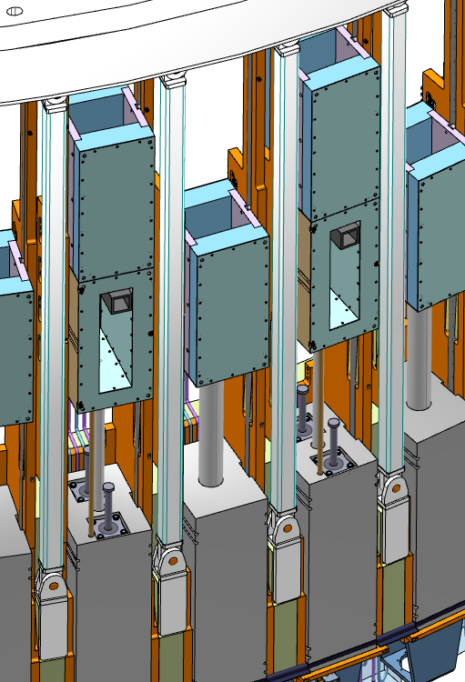
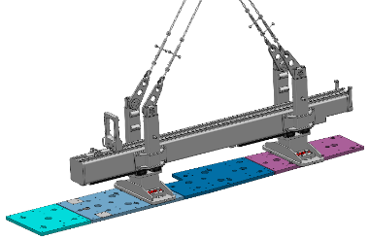
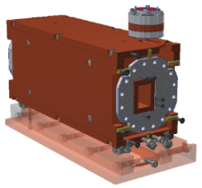
Construction phase
Target system Installation
Target systems installed from monolith face / instrument hall
Light Shutter system
NB Optics (NBEX)
Beam-port window
Target installations are primarily scheduled before bunker construction
Access
Free work area

Slide 21
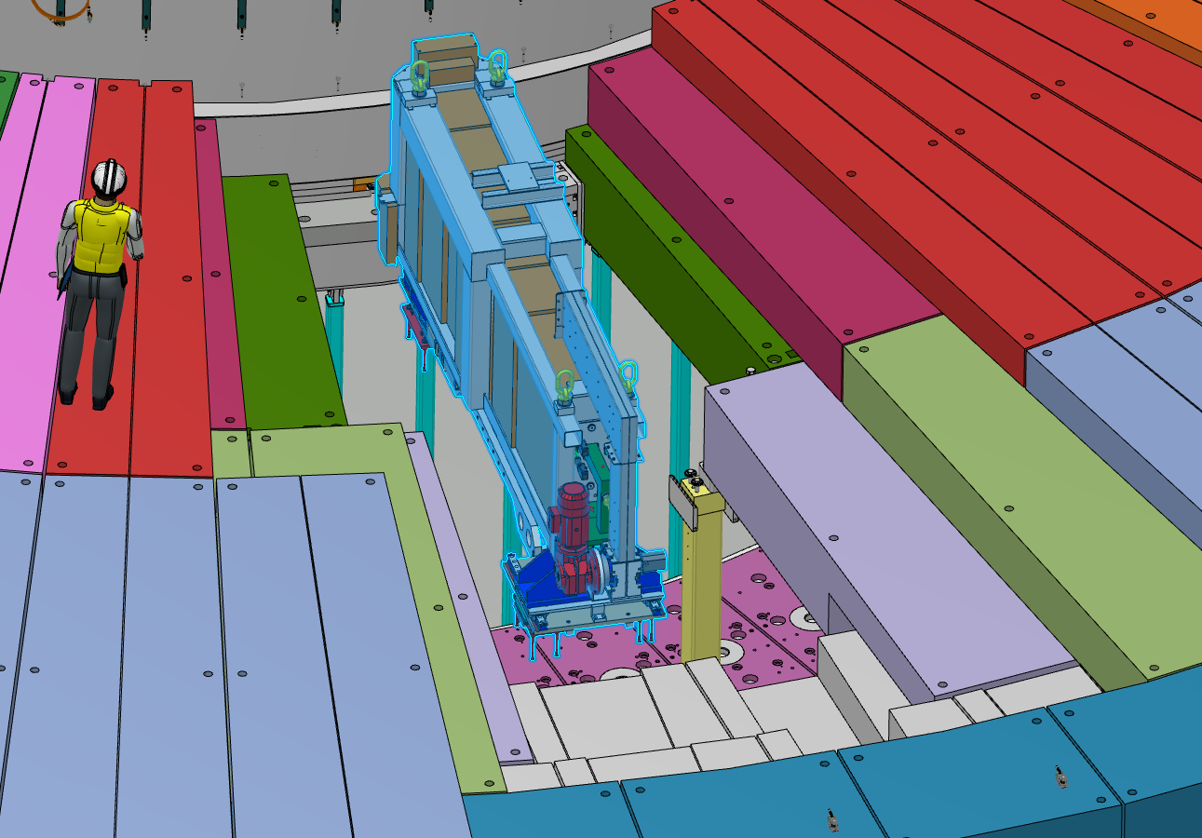
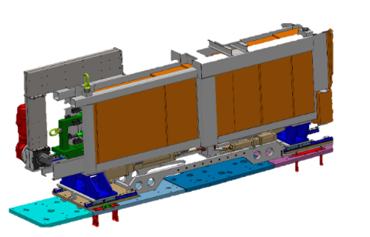
Operational phase
Target systems access
Operation :Beam port activation
Periodicity :yearly*
IET : Remote handling tool
& Cask for in-monolith plug
Mass 18+ tons
Length 5m
Requirement fulfilled
Access
Free work area
Roof removal
Level of effort
Blocks handled 23
Structural cross beams 1
Duration 12-16hrs

Slide 22
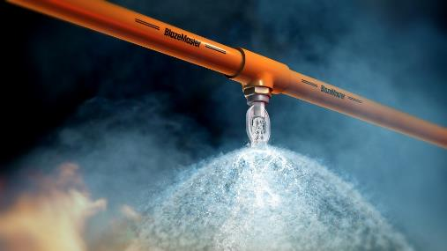
Conventional safety
Fire !
Fire load
Bunker
Instrument systems
Cables ~16km
  100g plastic per m (1600kg combustible)
Borated plastic shielding ~3000kg
  20% plastic by weight (600kg combustible)
Fire detection
Yes
Fire suppression
Decision is still out but current design is expected to compatible with most fire suppression systems
The real challenge will be to retain the maintainability of our systems

Slide 23
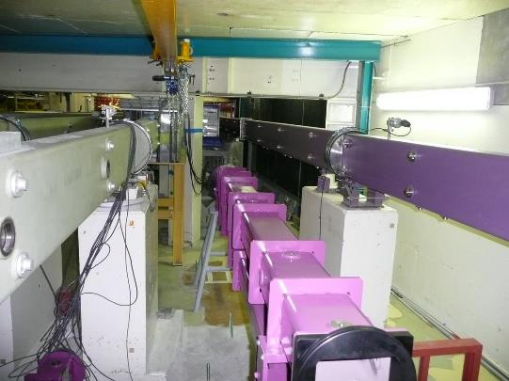
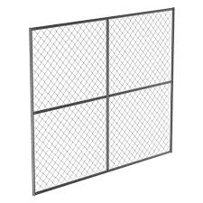
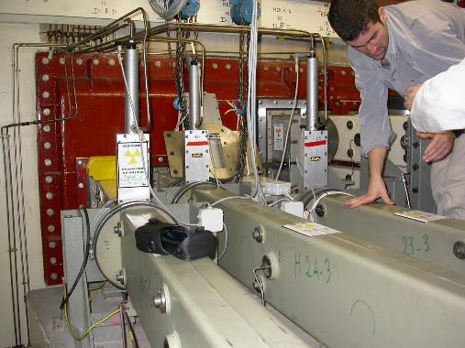
Conventional safety
Hazards
Electrical
ODH
Access
Physical division of space within bunker
@R11.5
Long sector between beamlines

Slide 24
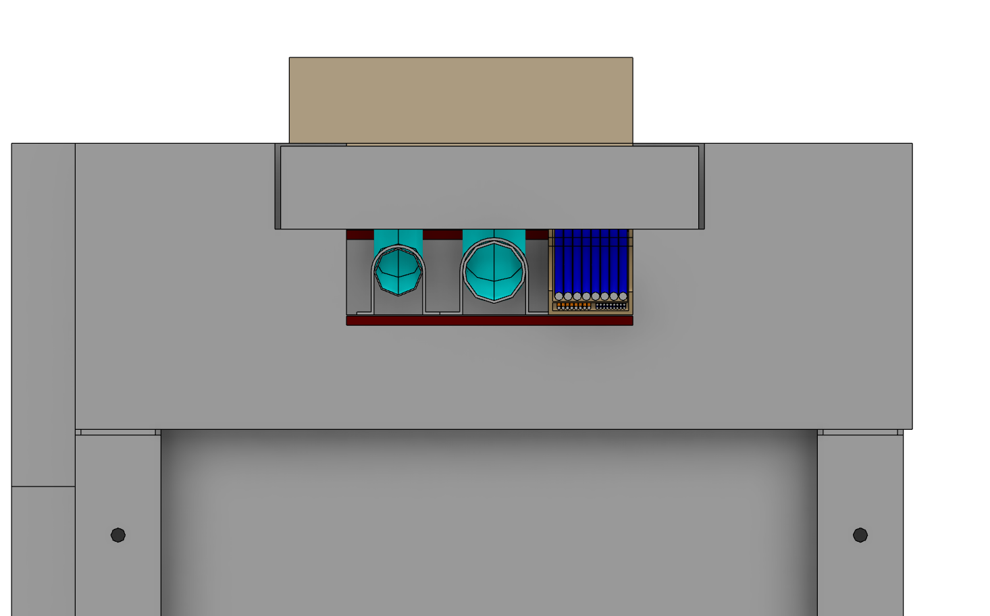
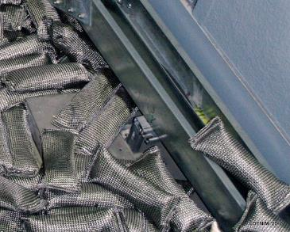
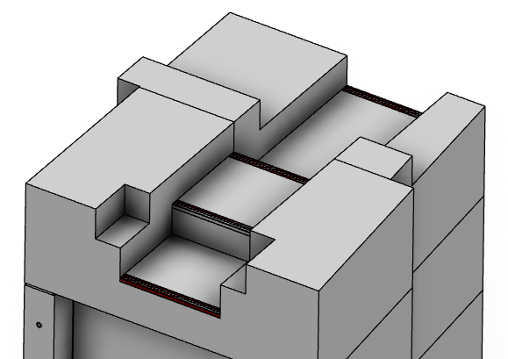
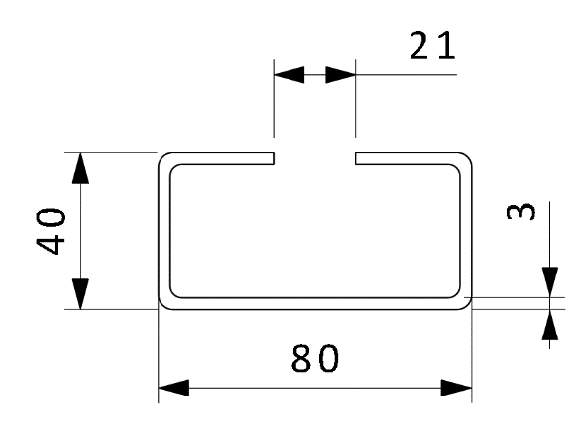
2 Feed through
Section is adequate for all instruments
Built in ‘halfen’ rails for attachment
Good access for installation
Vacant space to be filled with bagged shielding as required.
  Steel shot
  Borated poly
New neutronics underway but no significant changes expected

Slide 25
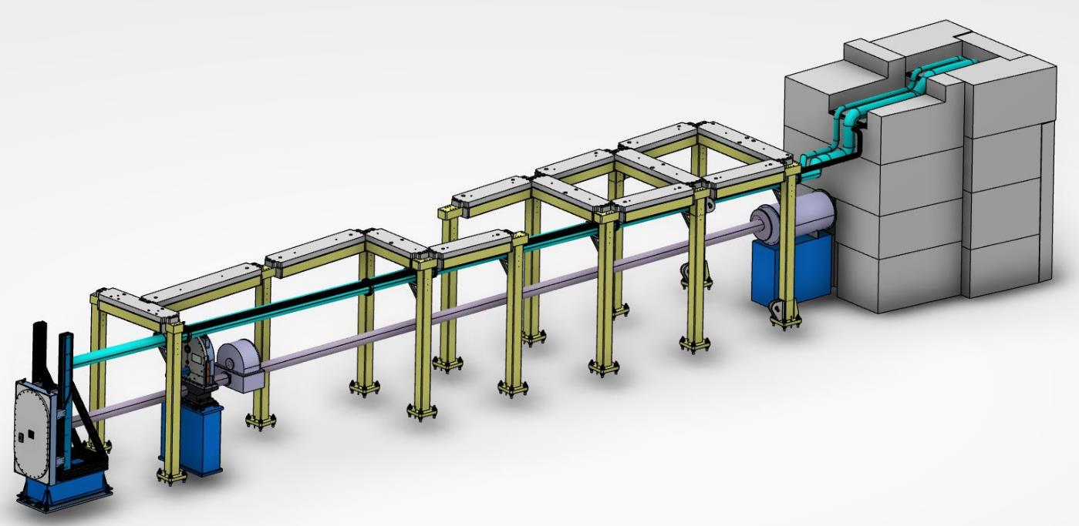
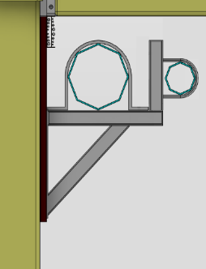
3 Run
Standard feed through
Custom connection
Standard section (4/2/1)
Custom feeder
Vertical
Cable
Chain Coupling
From feed through to POU it’s a Fixed installation
Route around access requirements
Exception for vacuum pipes (removable sections)
Compact
Support
Rail

Slide 26
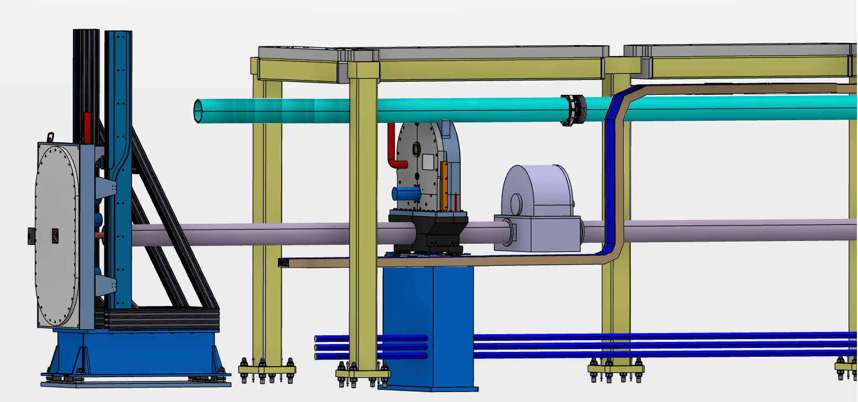
4 Point of Use going the last mile
R7 > Chopper
Flexible / Snorkel
R12-R7 Feeder
Removable
Accessable
Q. Couplings
R12 Quick Coupling
R12 >
Rigid

Slide 27
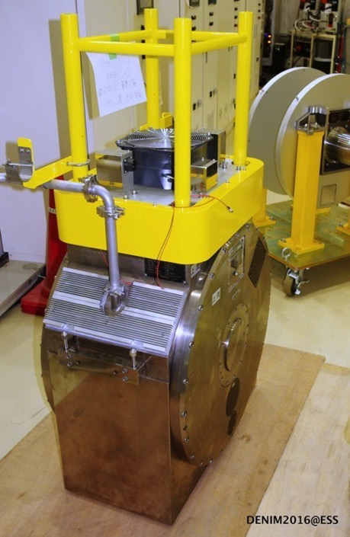
Which equipment should be equipped to be remote handled ?
Equipment which represents a significant hazard to personnel during interventions (due to activation). Eg >0.5mSv after 48hrs
PPS choppers
Shutters
Collimators
2. Equipment which requires regular intervention.
Overhaul or inspect period < 10 years.
Removed frequently i.e. is installed between R6 – R11.5
3. Equipment presenting a unacceptable risk of breakdown. Reliability < 98%

Slide 28
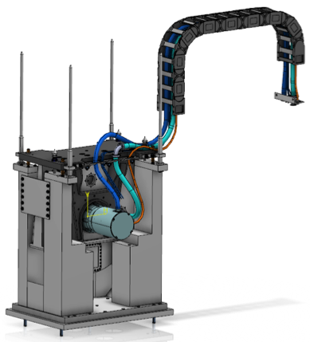
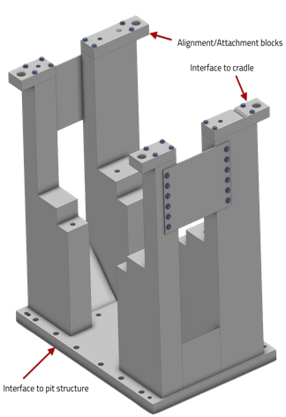
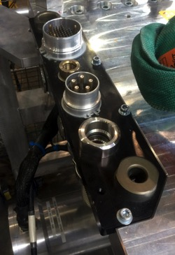
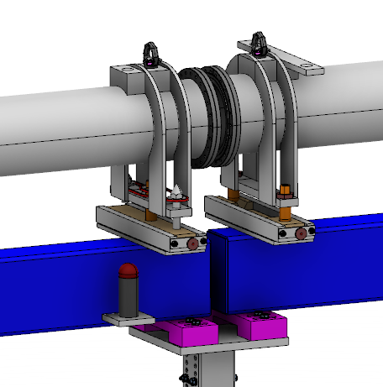
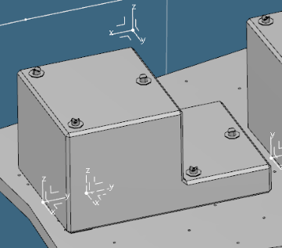




Zone I
Remote handling Ready
Solutions required for
Support structures
Fixations
Alignment & repeatability
Guidance in / out
Service connections
Developed in collaboration with
More effort required
Vacuum vessel couplings
Notes:
A lot of thinking has already gone into this area around the world
Internally
Also at other centers and more broadly in industry
We are not interested in re-inventing the wheel
Neither technical
Nor operationaly
Studied what has been done

Slide 29
Unscheduled
(breakdowns & unforseen)
Activity Incidence over 10yr period
Beam-port systems breakdown 4
Neutron chopper failure 40
Optics breakdown 20
Instrument shutter breakdown 20
Other component breakdown 60
Removal of hot components (neighboring work) 30
Accident scenarios (H2) 2
NOTE : Indicative figures – work in progress

Slide 30
Operational Environment
Zoning

Slide 31

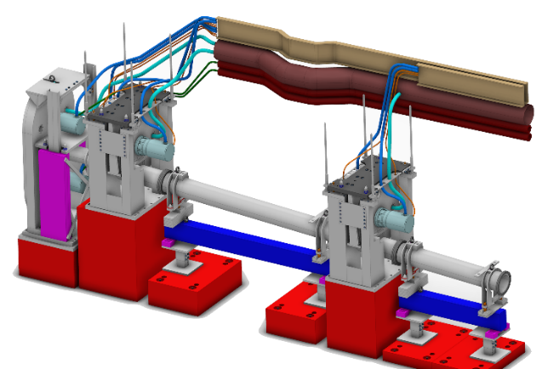
Conditions in the Bunker (beam off)
Component Activation
Three contributions
Bunker shielding ESS 0416081
Instrument components ESS 0087853
Target systems In progress
Target : hot spots <5 microSv/h@ 30cm
Target
Bulk shielding <2microSv/h (@30cm)
Target value <15microSv/h (on contact)
Notes:
Neutrons + Instruments = activation
A lot of work done by our neutronics group
Hazard due to activation will not be uniformly distributed concentrated in hotspots along the beamline
How hot after beam off
Hot for how long
Initial estimations of just after beam off are pretty unpleasant ROW 24hrs
And even following a week they remain sufficently high to pose a risk to work in proximity
Particularly close to the monolith face itself
Some devices may be removed but the density of equipment make this impracticle
As a result once the facility is functioning at high power activation present in the forward part of the CSB is expected to preclude group level access

Slide 32
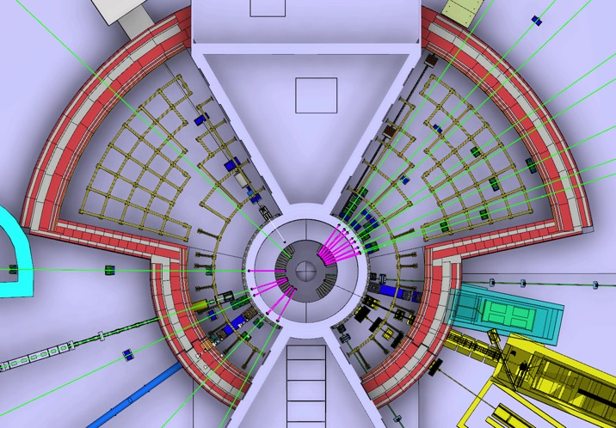
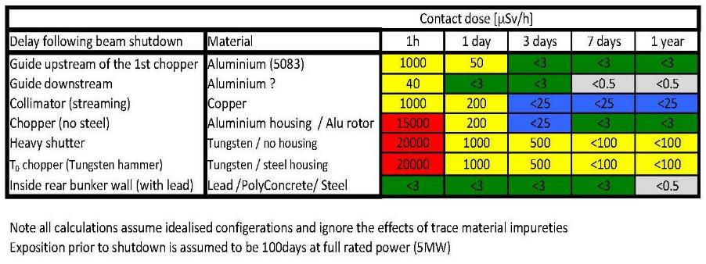
Accessibility during shutdown
- front of bunker
Tungsten
Assumptions Gamma shutters present
Aluminum guide housings
Number of sources (>0.5) ~50
Source ‘density’ >3 per m2
Exposure regime ‘in-contact’
Delay for personnel access
@Roof level ~ 48-72hr hotspot removal
@Floor level > 7days Highly restricted (Hotspot removal)
Gamma source distribution 3days after shutdown (@contact)
Notes:
Situation somewhat different
More and hotter sources
Importantly higher density
Remove some, not practicle to remove all
Impossible to stay away from all
Dose rate is expected to be significantly higher

Slide 33
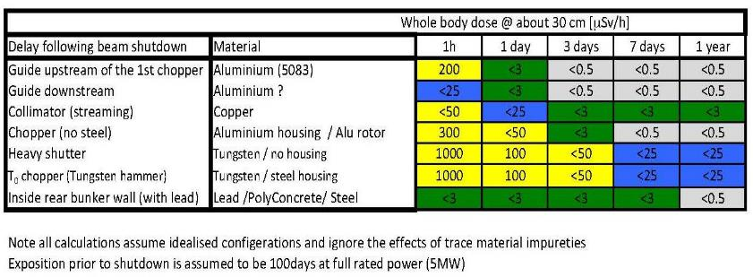
Accessibility during shutdown
- rear of bunker
Tungsten
Assumptions Gamma shutters present
Aluminum guide housings
Number of sources 20-40
Source ‘density 0.5 per m2
Exposure regime ‘whole body @ 30cm’
Delay for personnel access
@Roof level ~ 48hs hotspot removal or inspection
@Floor level > 72hrs most areas with precaution*
Gamma source distribution 72hrs after shutdown (@contact)
Notes:
Hotspots are ‘the usual suspects’ – read list
Wall activation 10 – 30 micro at 30cm a little less for the roof
Initial estimations of just after beam off are pretty unpleasant 24hrs
A few days later then the number of significant sources has dropped dramatically
These will require local shielding or removed but following this access is currently expected to be possible

Slide 34
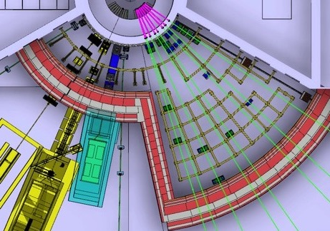
Access strategy
Divide and … protect
Yellow
>25 < 2500 microSv/h
Restricted controlled
R12 Access control fence
Blue
< 25 microSv/h
Unrestricted controlled
Entry point through roof - with access control
Target for long periods <10 microSv/h
Is this realistic ?
Notes:
Implementation
Zoned access
Interlocked entry gates
Grilled separations
Line of sight from door
Escape routes in each area
Search boxes
New proposal
Restrict ground level access
Provide access (and escape route) from above between each beam line such as to avoid ‘climbing’

Slide 35
INTERVENTIONS
IB - MINOR
Inspection & Maintenance

Slide 36
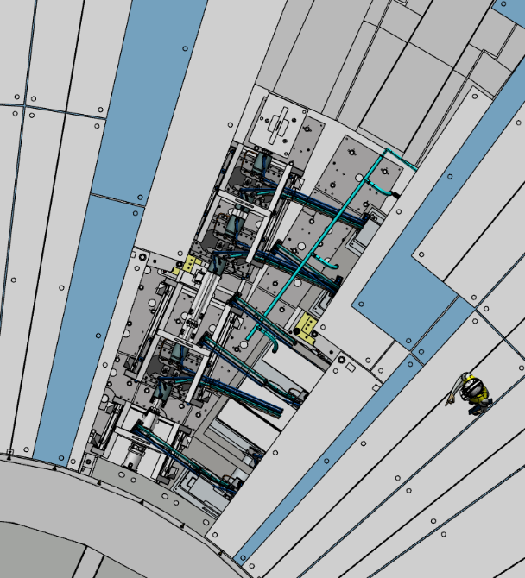
‘Quick’ access
- Short shutdown
R6-R9 (Access ‘hole’)
Number of blocks/lifts 9/18
Shielding mass 72t
Handling time 4 – 6 hr
R6-R11.5
Number of blocks/lifts 23/46
Shielding mass 190t
Handling time 10-12hr

Slide 37

Access
Short shutdown
Short shutdown 3-5d
Default mode of access
From above
Remote
N
Notes:
Remove highly active components
Activity of monolith

Slide 38

Access
Short shutdown rear II
Exceptional work mode
Access from above
Hot spot mitigation
Floor
Probably not feasible once operating at moderate or high power
N
Notes:
Remove highly active components
Activity of monolith

Slide 39
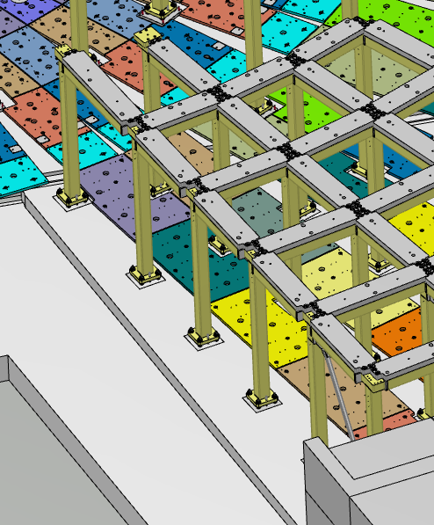
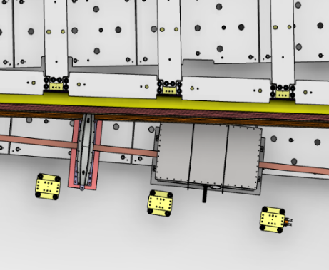
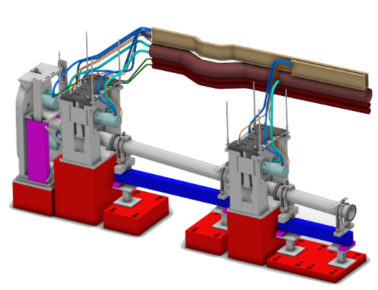
Design constraints - all systems
Principal constraints
Bunker
Modular roof
Removable roof beams
Frame stability
Materials (activation)
Utilities
Utilities routed around or removable
Instruments
Vertical extraction
Restricted Materials (activation)
RH compatible
Target
Materials (activation

Slide 40
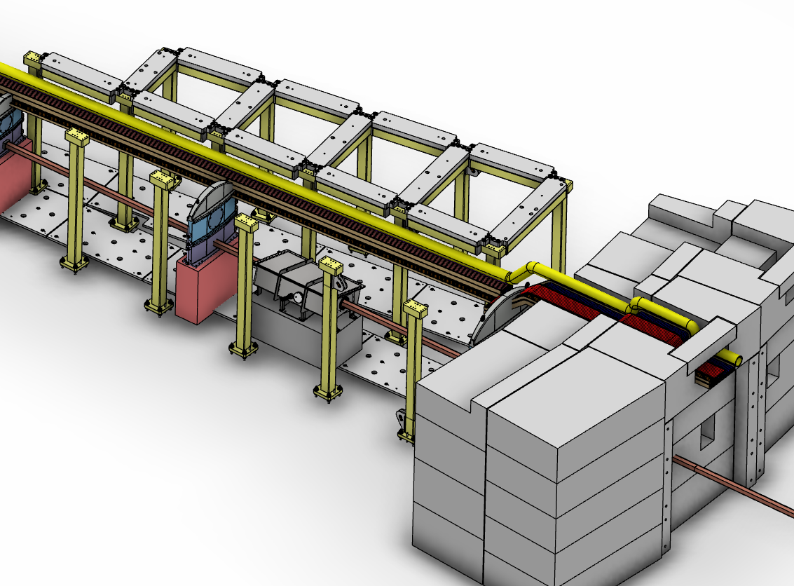
Utilities routing
USE
4
Iain slide
USE
3
USE
2
ENTRY
1
Scope
Within shielding ‘bunker’ from Point of entry to Point of use
  Bunker entry
  Technical feed through
  Run
  Point of use connection

Slide 41
INTERVENTIONS
I A - MAJOR
Installation & Overhaul

Slide 42
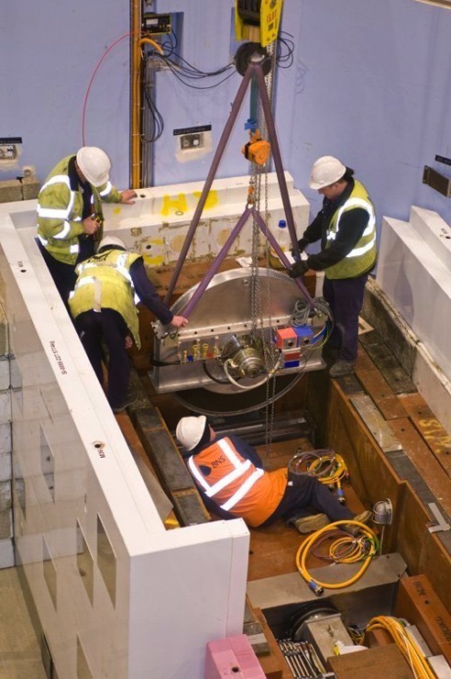
Interventions
IA Major
Type of activities
  Installation / Overhaul
  Duration: weeks > months
Principal activities Periodicity
Instrument
  Upgrade 10yr
  Installation/Replacement 15yrs
Target
  Beamport activation 10yr
  NBEX renewal 15yr
Operations per year 1,5-3
INTERVENTIONS
within Bunker
SCHEDULED
Type I(A)
MAJOR
Type II
BREAKDOWN
Type I(B)
MINOR
Inspection / Maintenance
UNSCHEDULED
Installation / Overhaul
Diagnostic / Repair

Slide 43
Access
Long shutdown / Part I
Cool down period
Cool down 3-5 days
Shielding removal 2 days
Hot spot removal
Local shielding placement
Shielding removal
Hot spot mitigation
N
Notes:
Remove highly active components
Activity of monolith

Slide 44
Access
Long shutdown
Floor level Access
N
Notes:
Remove highly active components
Activity of monolith

Slide 45
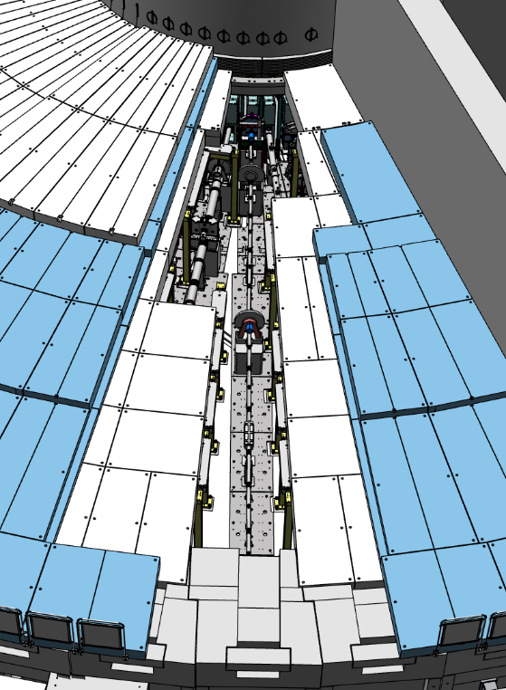
‘Full access’ Long instrument
- long shutdown
R6-R28
Number of blocks/lifts 52/104
Shielding mass 750t
Handling time 24-30 hrs
Frame beam removed ~11

Slide 46
Intervention Major
Design constraints - all systems
Principal constraints
Bunker
Modular roof
Removable roof beams
Frame Stability
Utilities
Utilities routed around or removable
Instruments
Vertical extraction
Restricted Materials
RH compatible

Slide 47
Logistics
Principal requirement
Free height below hook > 3m
2,3m
3,6m free height
6,7m from TCS
1,3m
1.8m
3,1m
N
Notes:
A hook height of 2.5m is a minimum for current equipment
2.7m preferred
Auxiliary hoist for instrument.
Special mountings will be required to ensure installation compatibility
Coverage
Side walls 800mm
Monolith face 400mm

Slide 48
Logistics
Implicit requirement on cranes (& instruments)
Experimental Hall crane coverage area
Cranes crossover (load interchange) area
Monolith crane coverage area

Slide 49
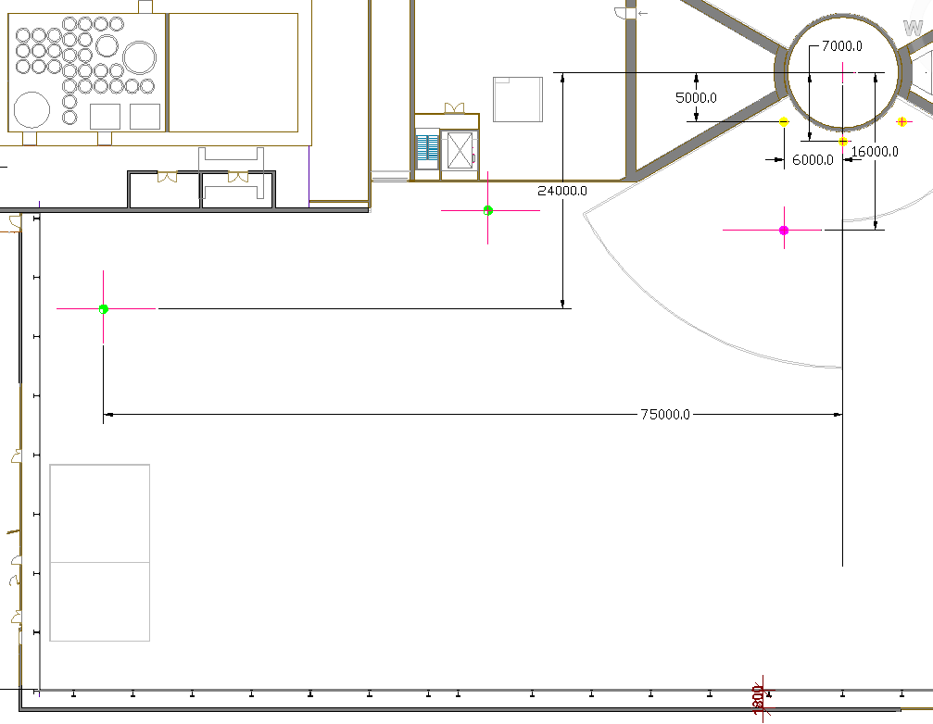
Crane route
Bunker crane
Exchange zone
Storage zone
Hall crane

Slide 50
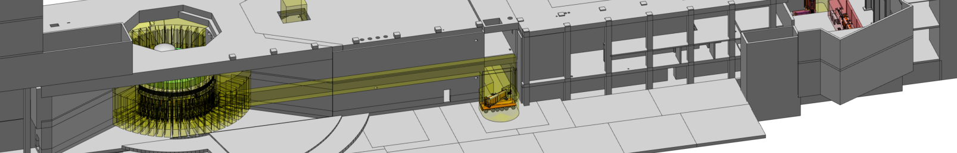
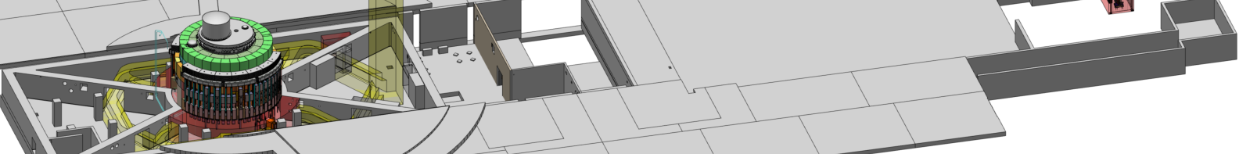
NBEX locations and transport
IET transport
ACF docking
IET handover on bunker roof from bunker crane to D01/D03 crane
Exchange route NBPI/NBPP
Vertical handling test stand
LSC transport
Horizontal handling test stand

