Slide 1
Data Systems and Technology
STAP September 2019
Brian Lindgren Jensen
- on behalf of DST Group Leader Jesper Rude Selknaes

Slide 2
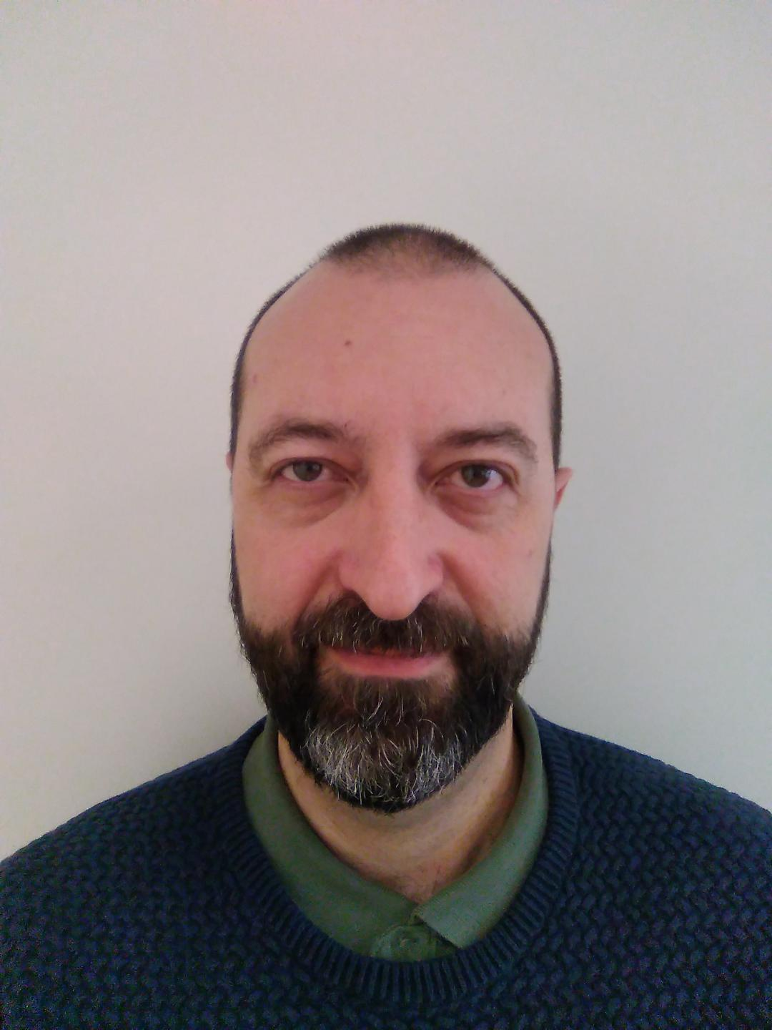


The team
Jesper Rude Selknæs
Jacinto Vera Garcia
Brian Lindgren Jensen
Alexandre Stefanov
Kareem Galal
Ashok Nulguda
Lottie Greenwoold
Notes:
3 new
Hiring IT
PaNOSC
Parental leave

Slide 3
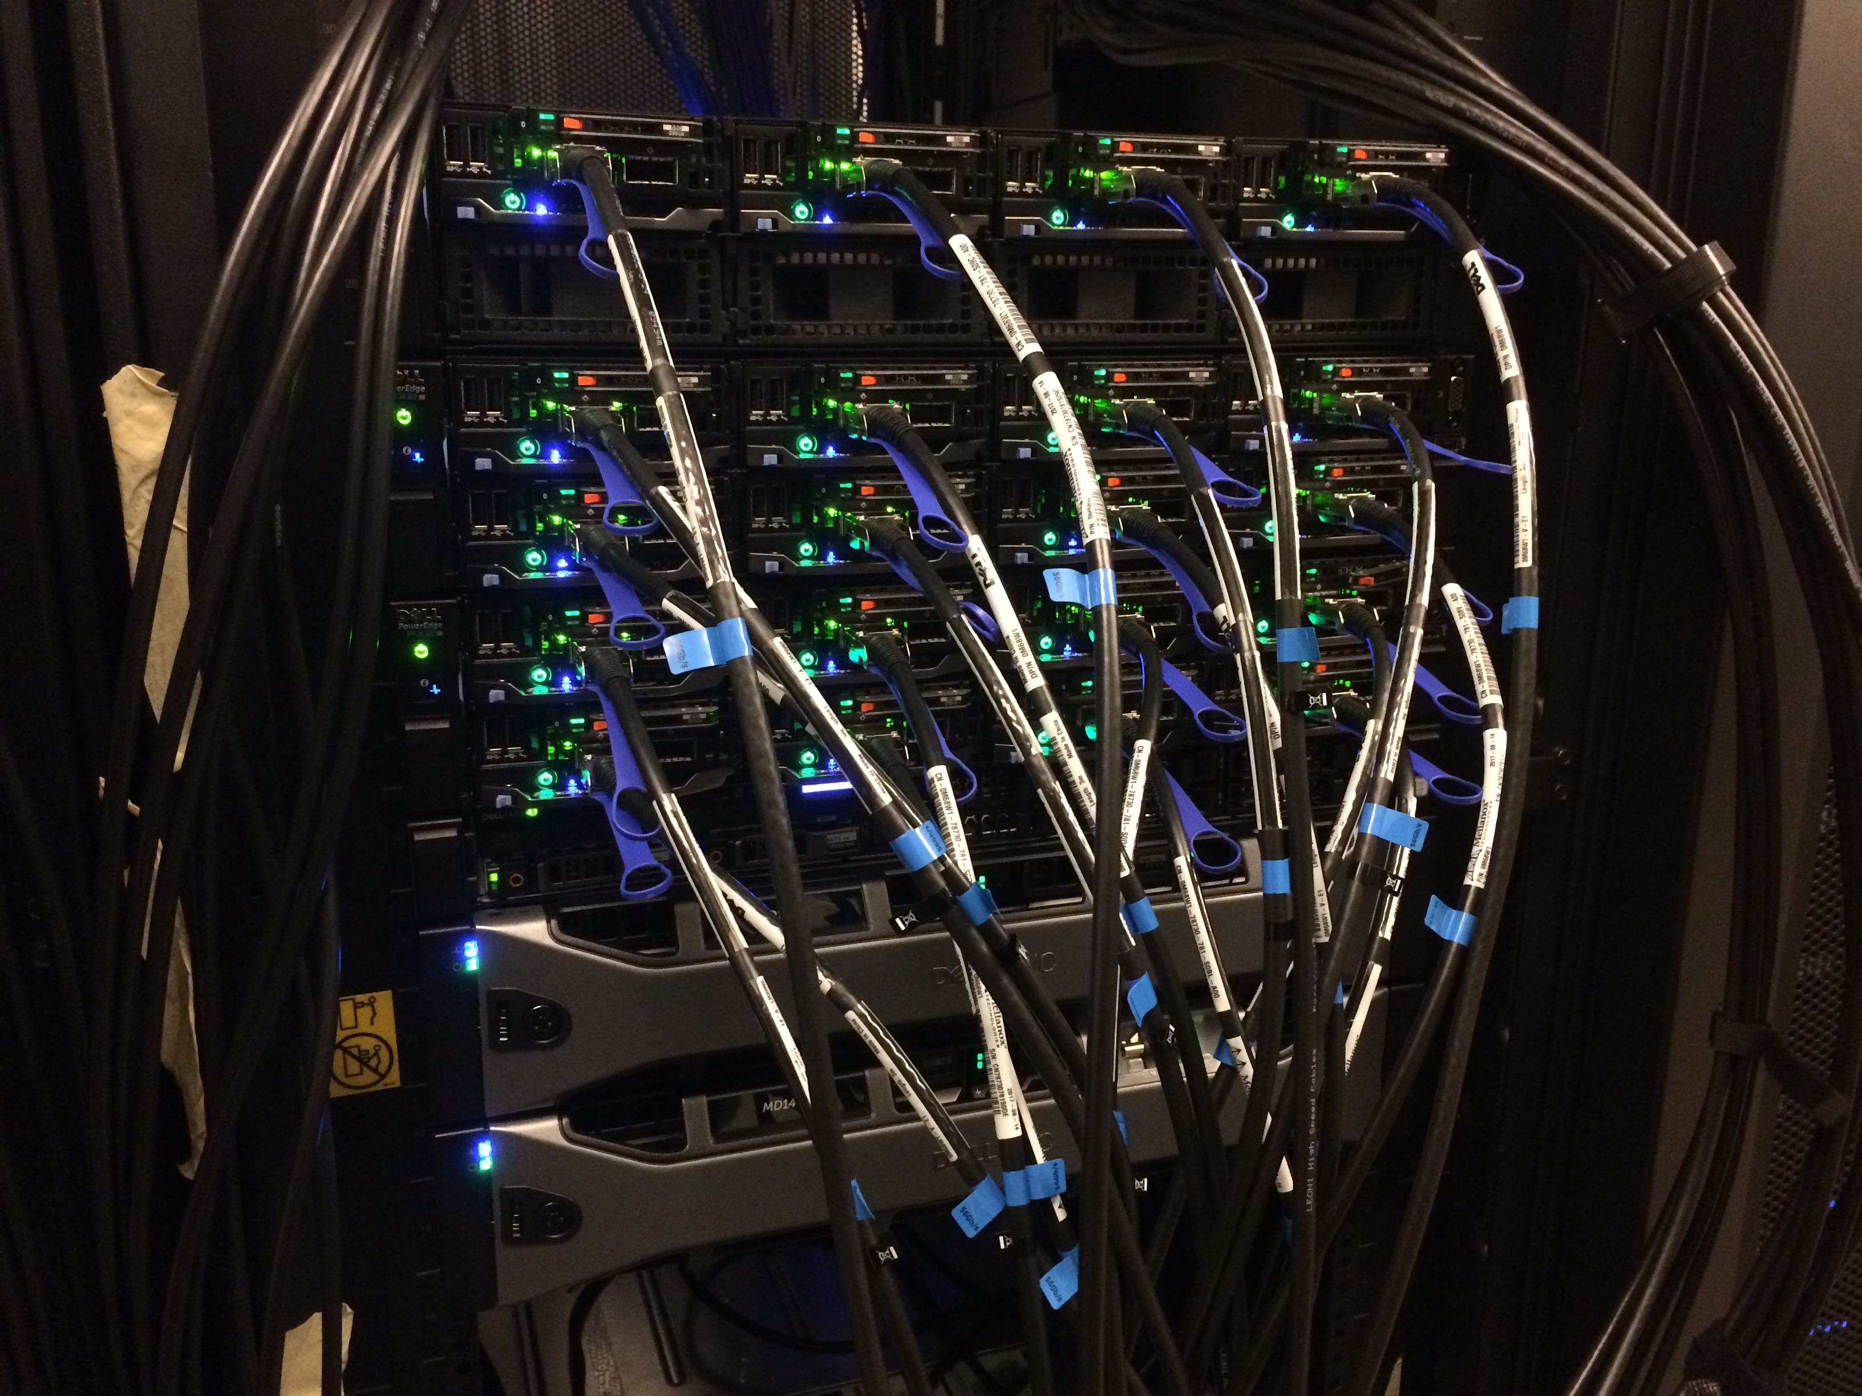
Planning our work
H1 2019 was completed with some minor tasks handled in H2
January
February
March
April
May
Data center design iteration #3
Install 10Gb/s network
Server room procurement CPH
Monitoring: HIDS
Instrument group user focus
Collaboration with DESY (EOSC)
Detailed network design
EOSC pilot
LDPC demo 2018
Cluster risk mitigation plan
Server room CUB procurement phase
PaNOSC preparations
Mapping current services to future network layout
Detailed network design
Design of service infrastructure
SPECTRE and MELTDOWN analysis
June
Merge deployments units (DevOPS improvements)
Detailed design of software development environment
Upgrade of main ZFS filesystem
July
Vacation
August
Improvements to the NTP service of DMSC
Server room CPH design
INFOSEC for SSM applications part #1
Establish workgroup on future technologies
The team completed the hiring for 2019 and followed up with onboarding of the new arrivals – the team grew from 4 to 7 FTEs during H1 2019.
Copenhagen server room online and first equipment installed.
Access date to the CUB (Lund) server room is expected to be February 2020 due to delays in the power connectivity to the server room.
Notes:
- Overview

Slide 4
Status of EoC Milestones
Milestone | Date | Description/Status | Notes
CUB ready for installation | 12/08 -19 | CUB server-room hand-over to ESS (1/4 -19) CUB server-room constructed and delivered (planned) External utilities connected (power/UPS, cooling) (planned) | Server-room construction in progress – expected handover/utilities Q1 2020
DMSC HW installed in CUB | 04/11 -19 | CUB ready and accessible/procedures in place (pending) CUB server-room network installed (pending) Hardware procured (pending) Hardware installed (pending) | Procurement of CUB hardware (storage/servers) deferred for delivery in Q1 2020.
E01 Building Access | 10/09 -19 | E01 hall hand-over to ESS (9/9 -19) DMSC access to E01 (pending) | DMSC access to E01 not needed in 2019
Comms room commissioning | 10/10 -19 | Comms room access and viability determined (30/4 -19) Procedures for access established (15/5 -19) | SEC comms room access and facilities provided by ICS
DMSC HW installed in comms room | 10/11 -19 | Equipment/HW for link installed (1/6 -19) HW for EoC test installed (pending) HW for EoC test deployed (pending) | HW in procurement (been delayed by legal issues with submitted tenders)
CPH server-room HW installed & configured | 30/09 -19 | CPH server-room constructed and delivered (23/8 -19) Phase A hardware installed (link equipment) (25/8 -19) Phase B hardware installed (VM environment) (planned) | Server-room on temporary power (90kW). Permanent power planned for Nov. 2019.
Link Tested & Validated | 30/11 -19 | Dedicated ESS<->DMSC link established (25/8 -19) Link connection tested (15/9 -19) Link validated (PoC neutron data file-transfer) (planned) | 10G L2 MPLS link via DeIC, NORDUNET, SUNET online

Slide 5
Work planned for 2019H2
End-of-Construction (2019)
Server-room (CPH) (dstk-1493) – w48
Move: Phase B (dstk-3271) – w39
Link ready (dstk-2006) – w40
LDPC 2019 (dstk-3232)
Beamline servers: (dstk-3331)
  Procurement – w41
  Installation – w43
  Deployment – w45
EoC Test (dstk-3795) – w46
EoC Report (dstk-3862) – w48
Services:
OwnCloud for ESS
InfoSec (ESS)
Integration with IT
Office expansion
Virtuel Desktop Env. for DMSC
Ubuntu provisioning
Cold Commissioning prep:
Network infrastructure (ESS)
Procurement:
  Storage
  HPC
  VM
Site installations
Server-hall (CUB)
Data Center Design IV
PaNOSC:
K8 Deployment
WP4
WP6
WP8
Systems/Technical Debt
DevOps Improvements
Cluster Upgrade
Asset mgt & lifecycle control
Standard Op. Procedures
Test harness (backup)
DevOps:
  VM (oVirt)
  LDAP
  DNS
Datacenter Operations
Monitoring 3
Provisioning (Foreman Smartproxy)
Local repo rolling update
LDAP password policies

Slide 6
Collaboration
Software deployment
  Strong collaboration across DMSC in the LDPC
  Discussion with IT and ICS - joint DMSC/IT puppet workshop planned for H2 2019
InfoSec
  DST is providing the LISO function for the division (chaired 2 InfoSec sessions at NSS retreat – June 2019)
  Engaging with the CISO on all matter of security in the ESS organization.
  DST has offered off site hosting to both IT and ICS – detailed planning is on-going.
Network
  Site-to-Site connection established – final configuration in progress
  Engaging in the network synergy group of ESS consisting of representatives from DMSC, Corporate IT and ICS
  Being an active stakeholder on the design and implementation of the General Purpose Network
  at the ESS site in Lund. This includes DMSC, Corporate IT and ICS.
External
  PaNOSC project on going with DST playing a part in WP4, WP6 and WP8. PaNOSC contacts has already proven valuable for experience on technologies.
  Engaging with UCPH on collaboration regarding masters students.
  Participated (with ICS) in IKON17, Utgaard Demo (‘Infrastructure – network, compute, storage’)

Slide 7
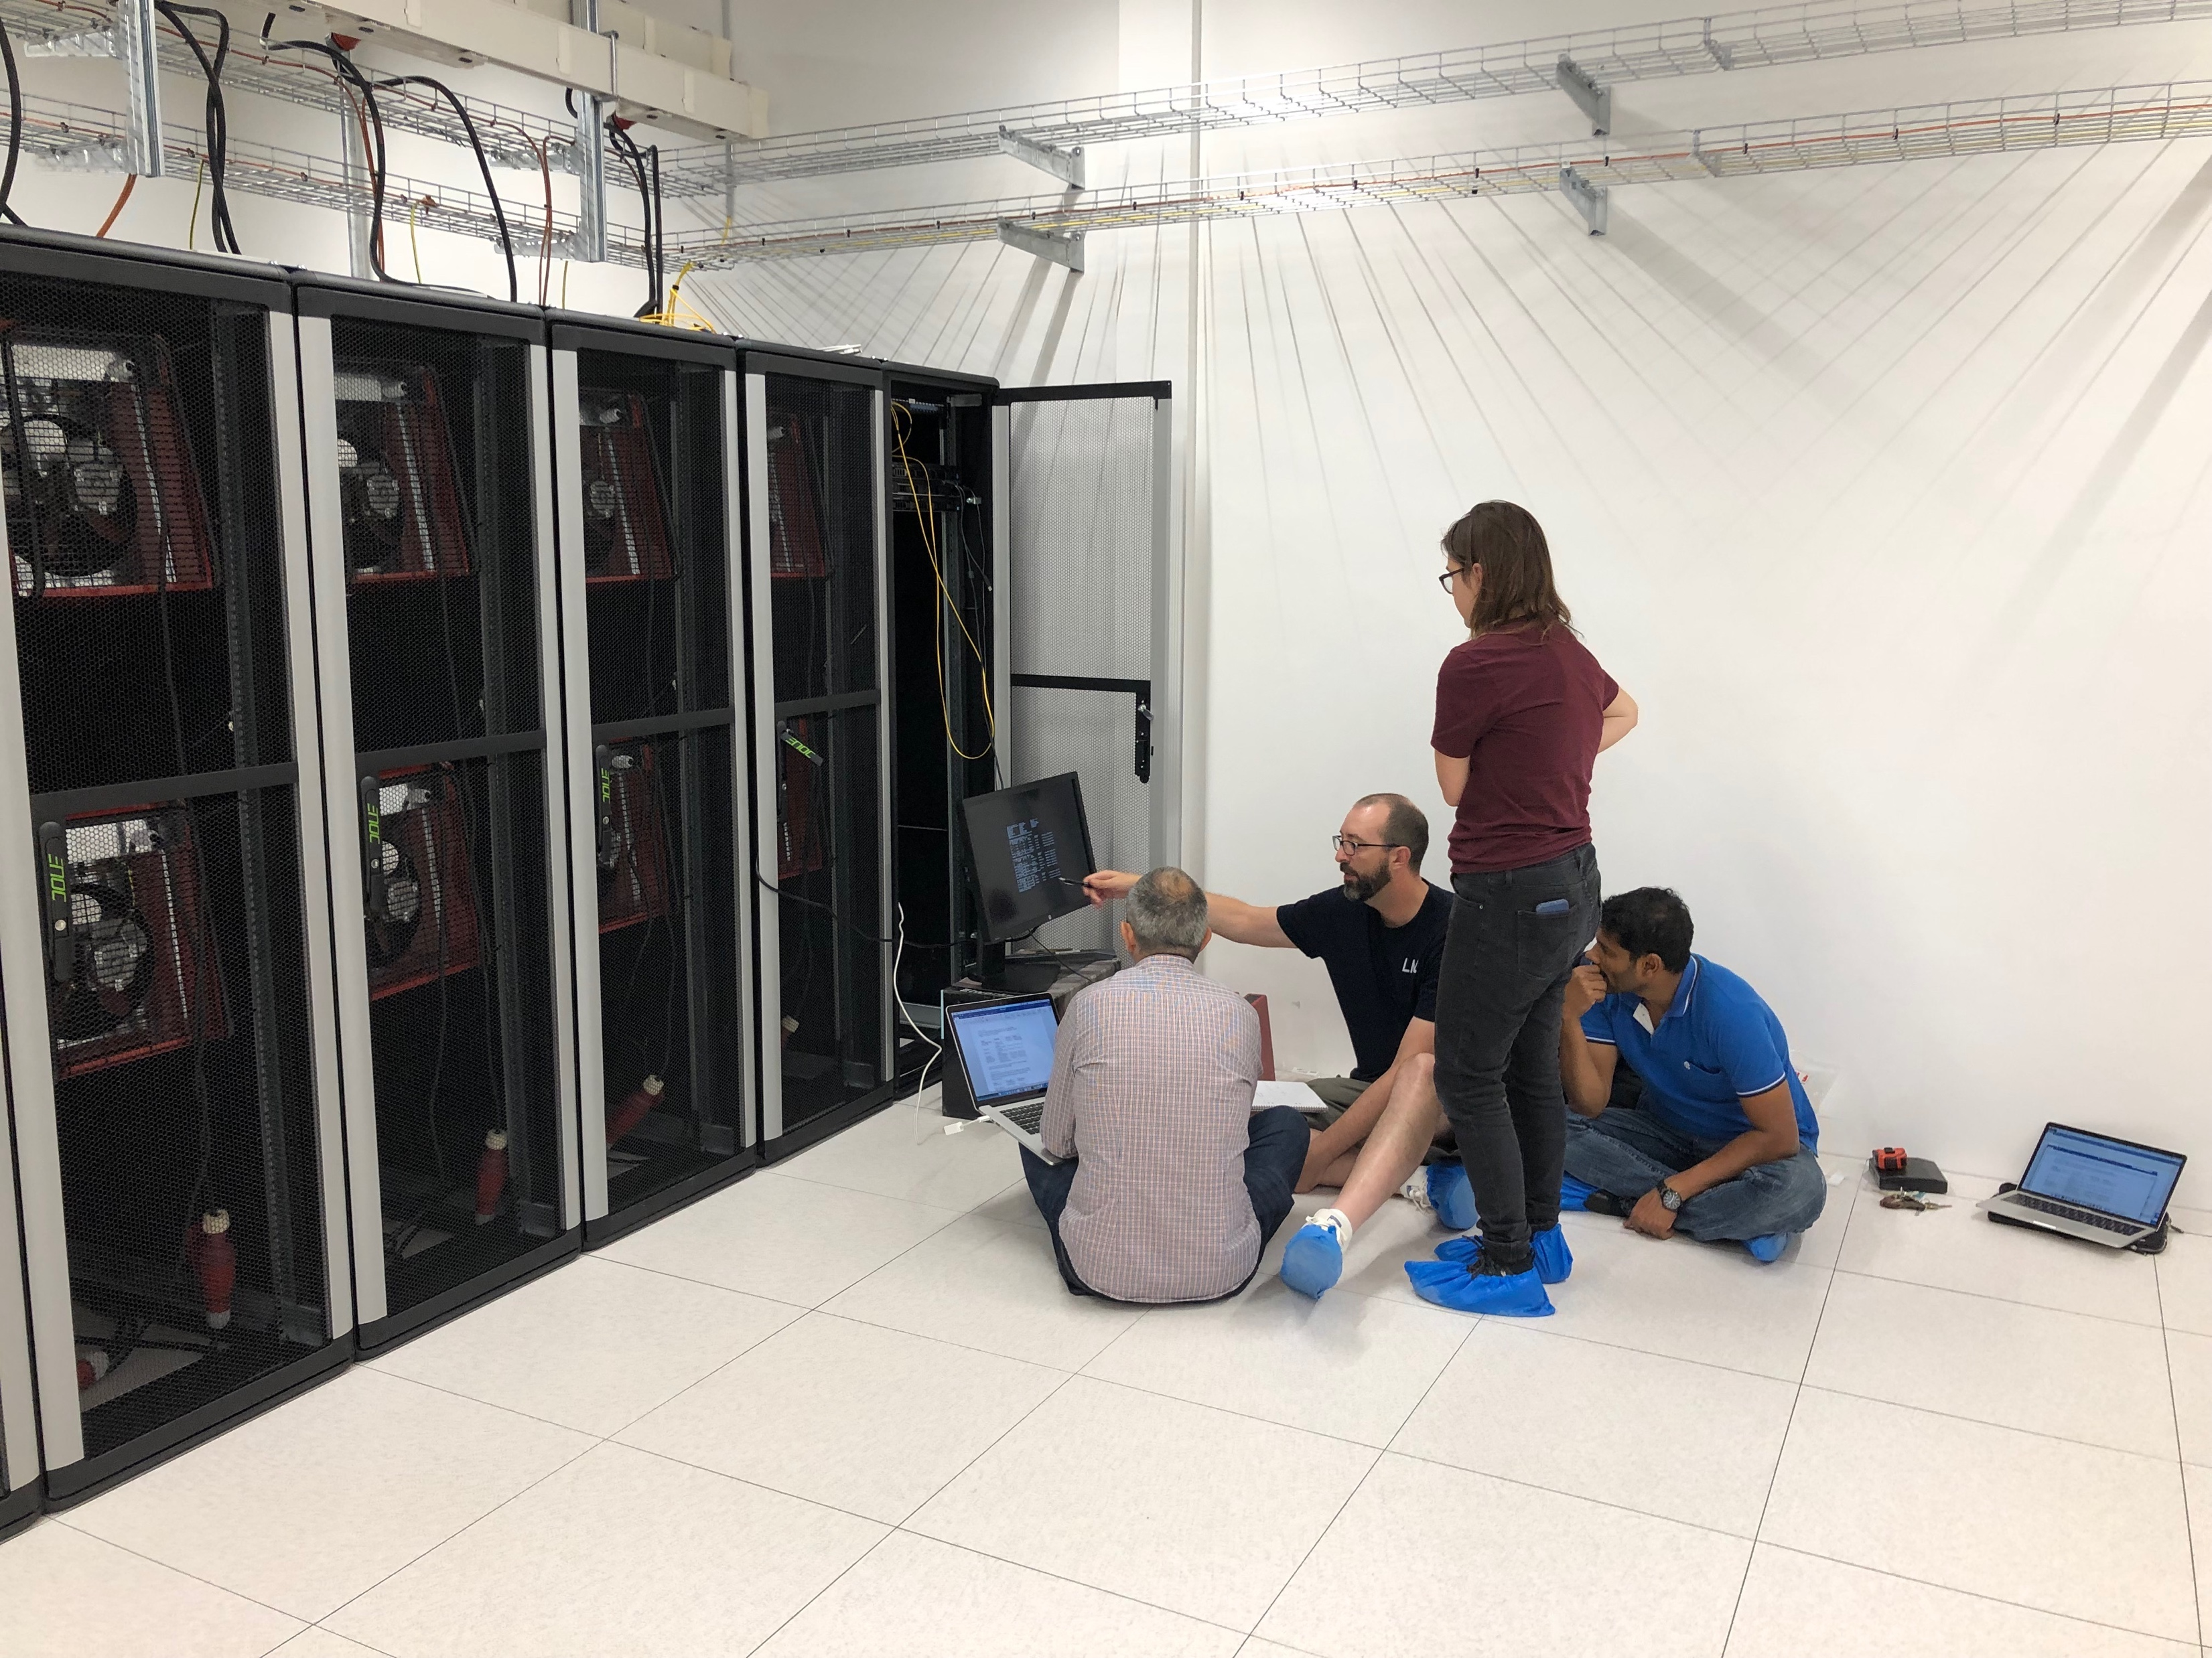
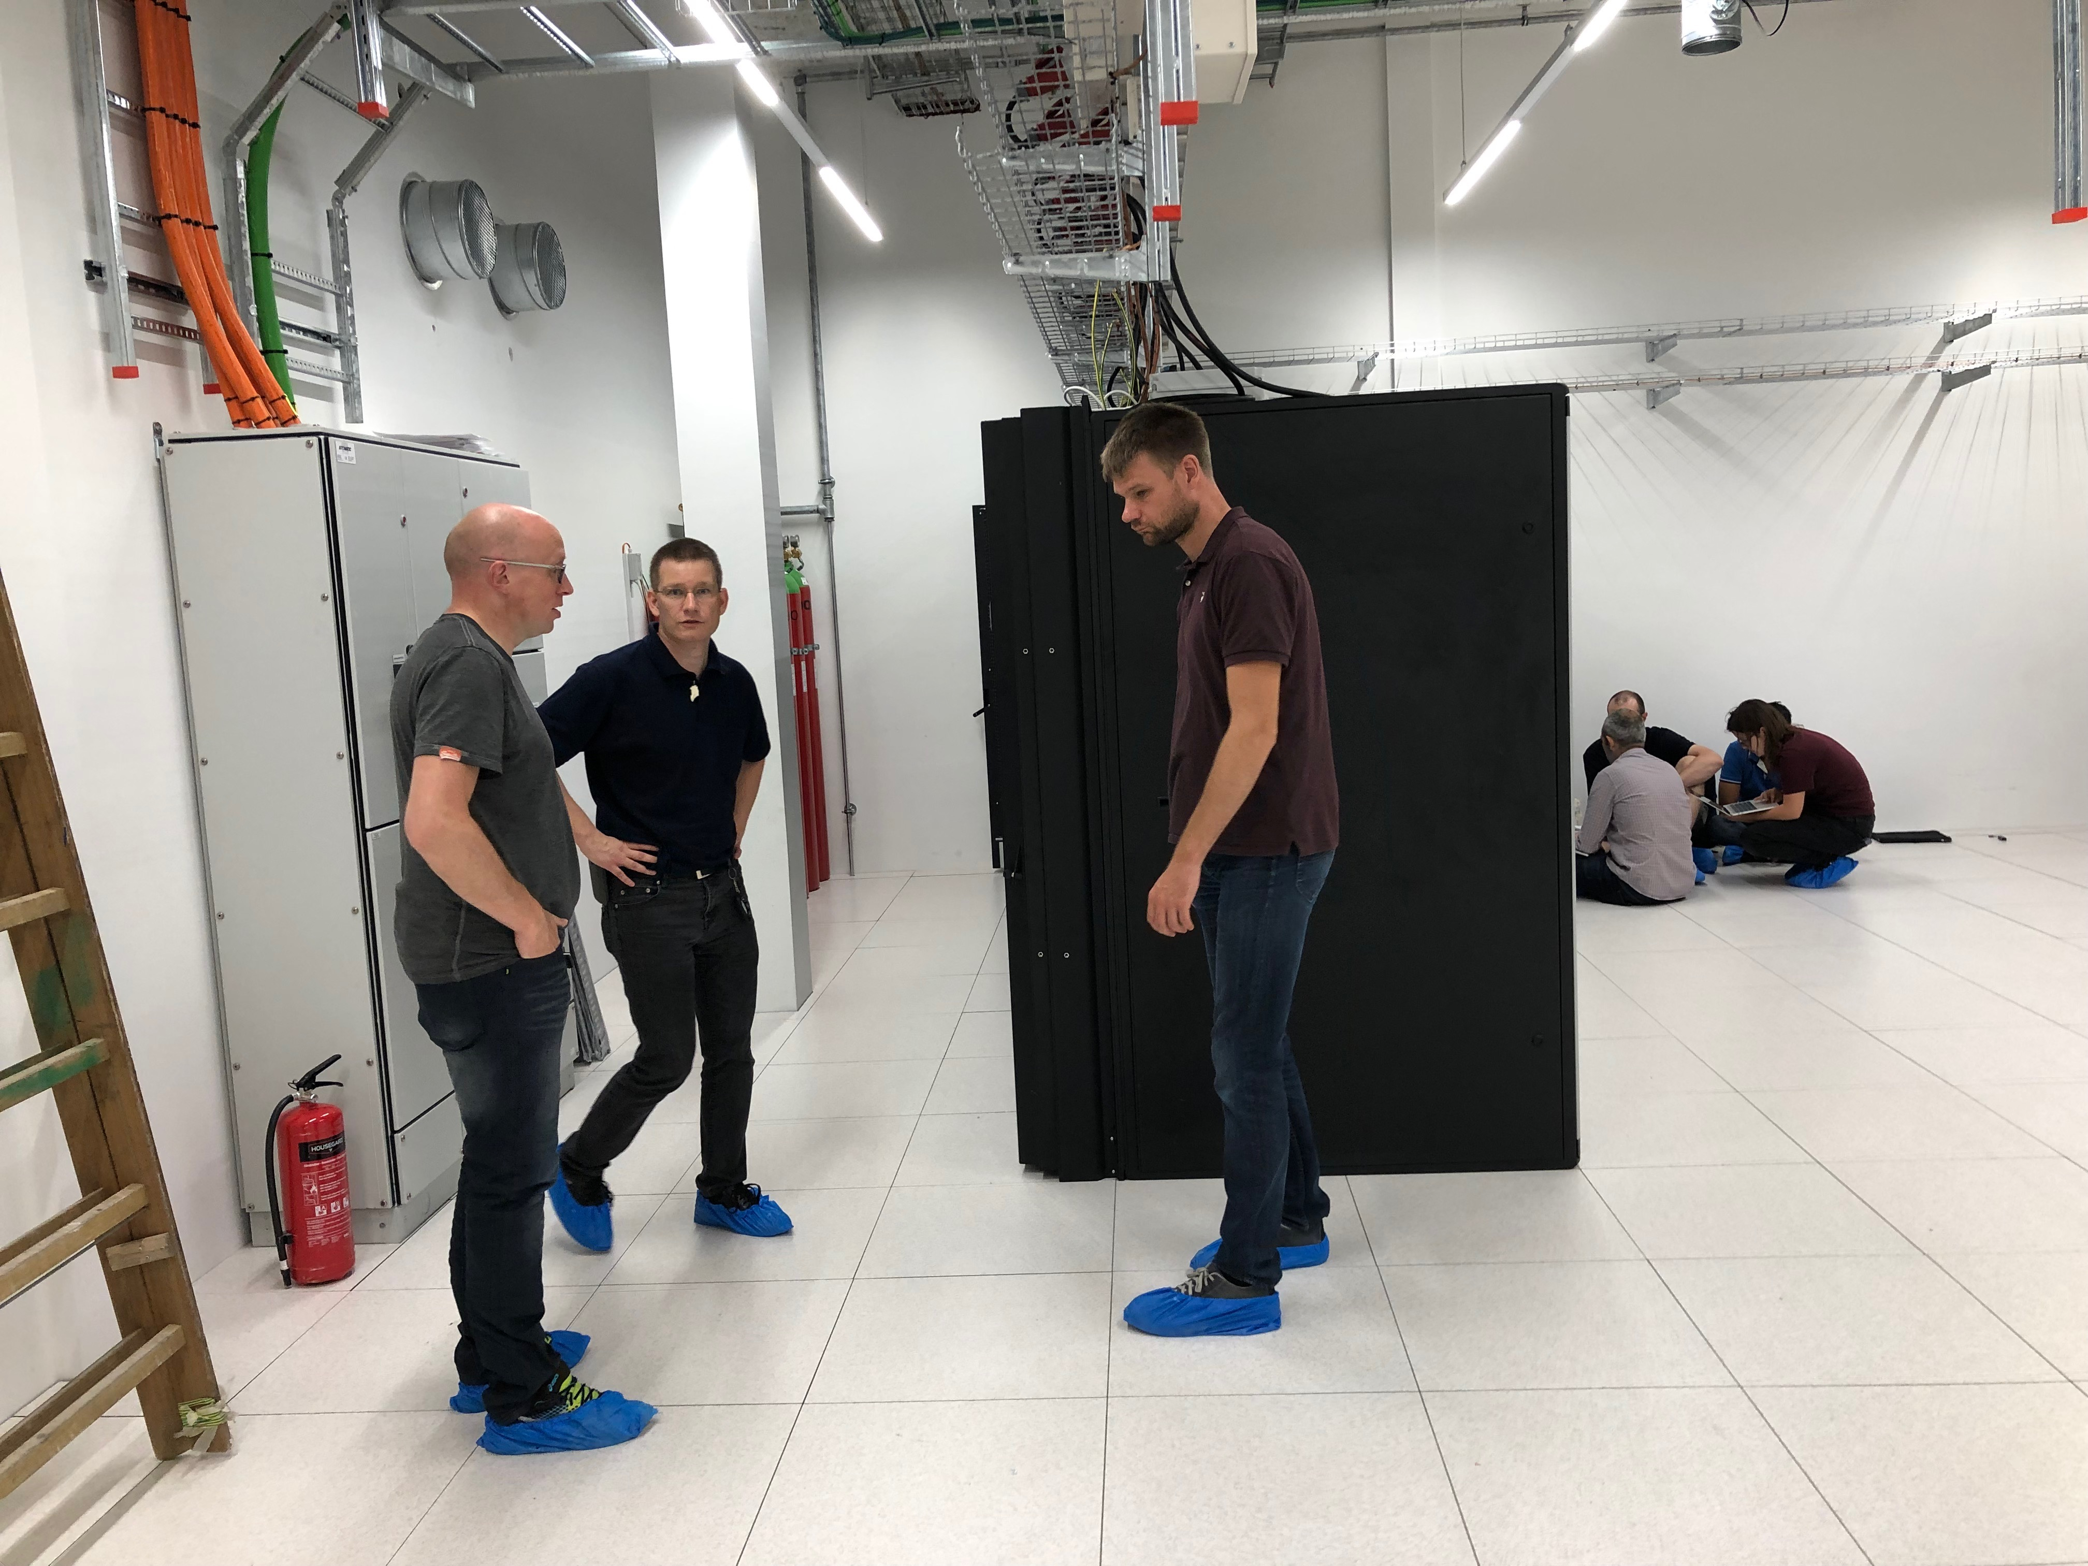
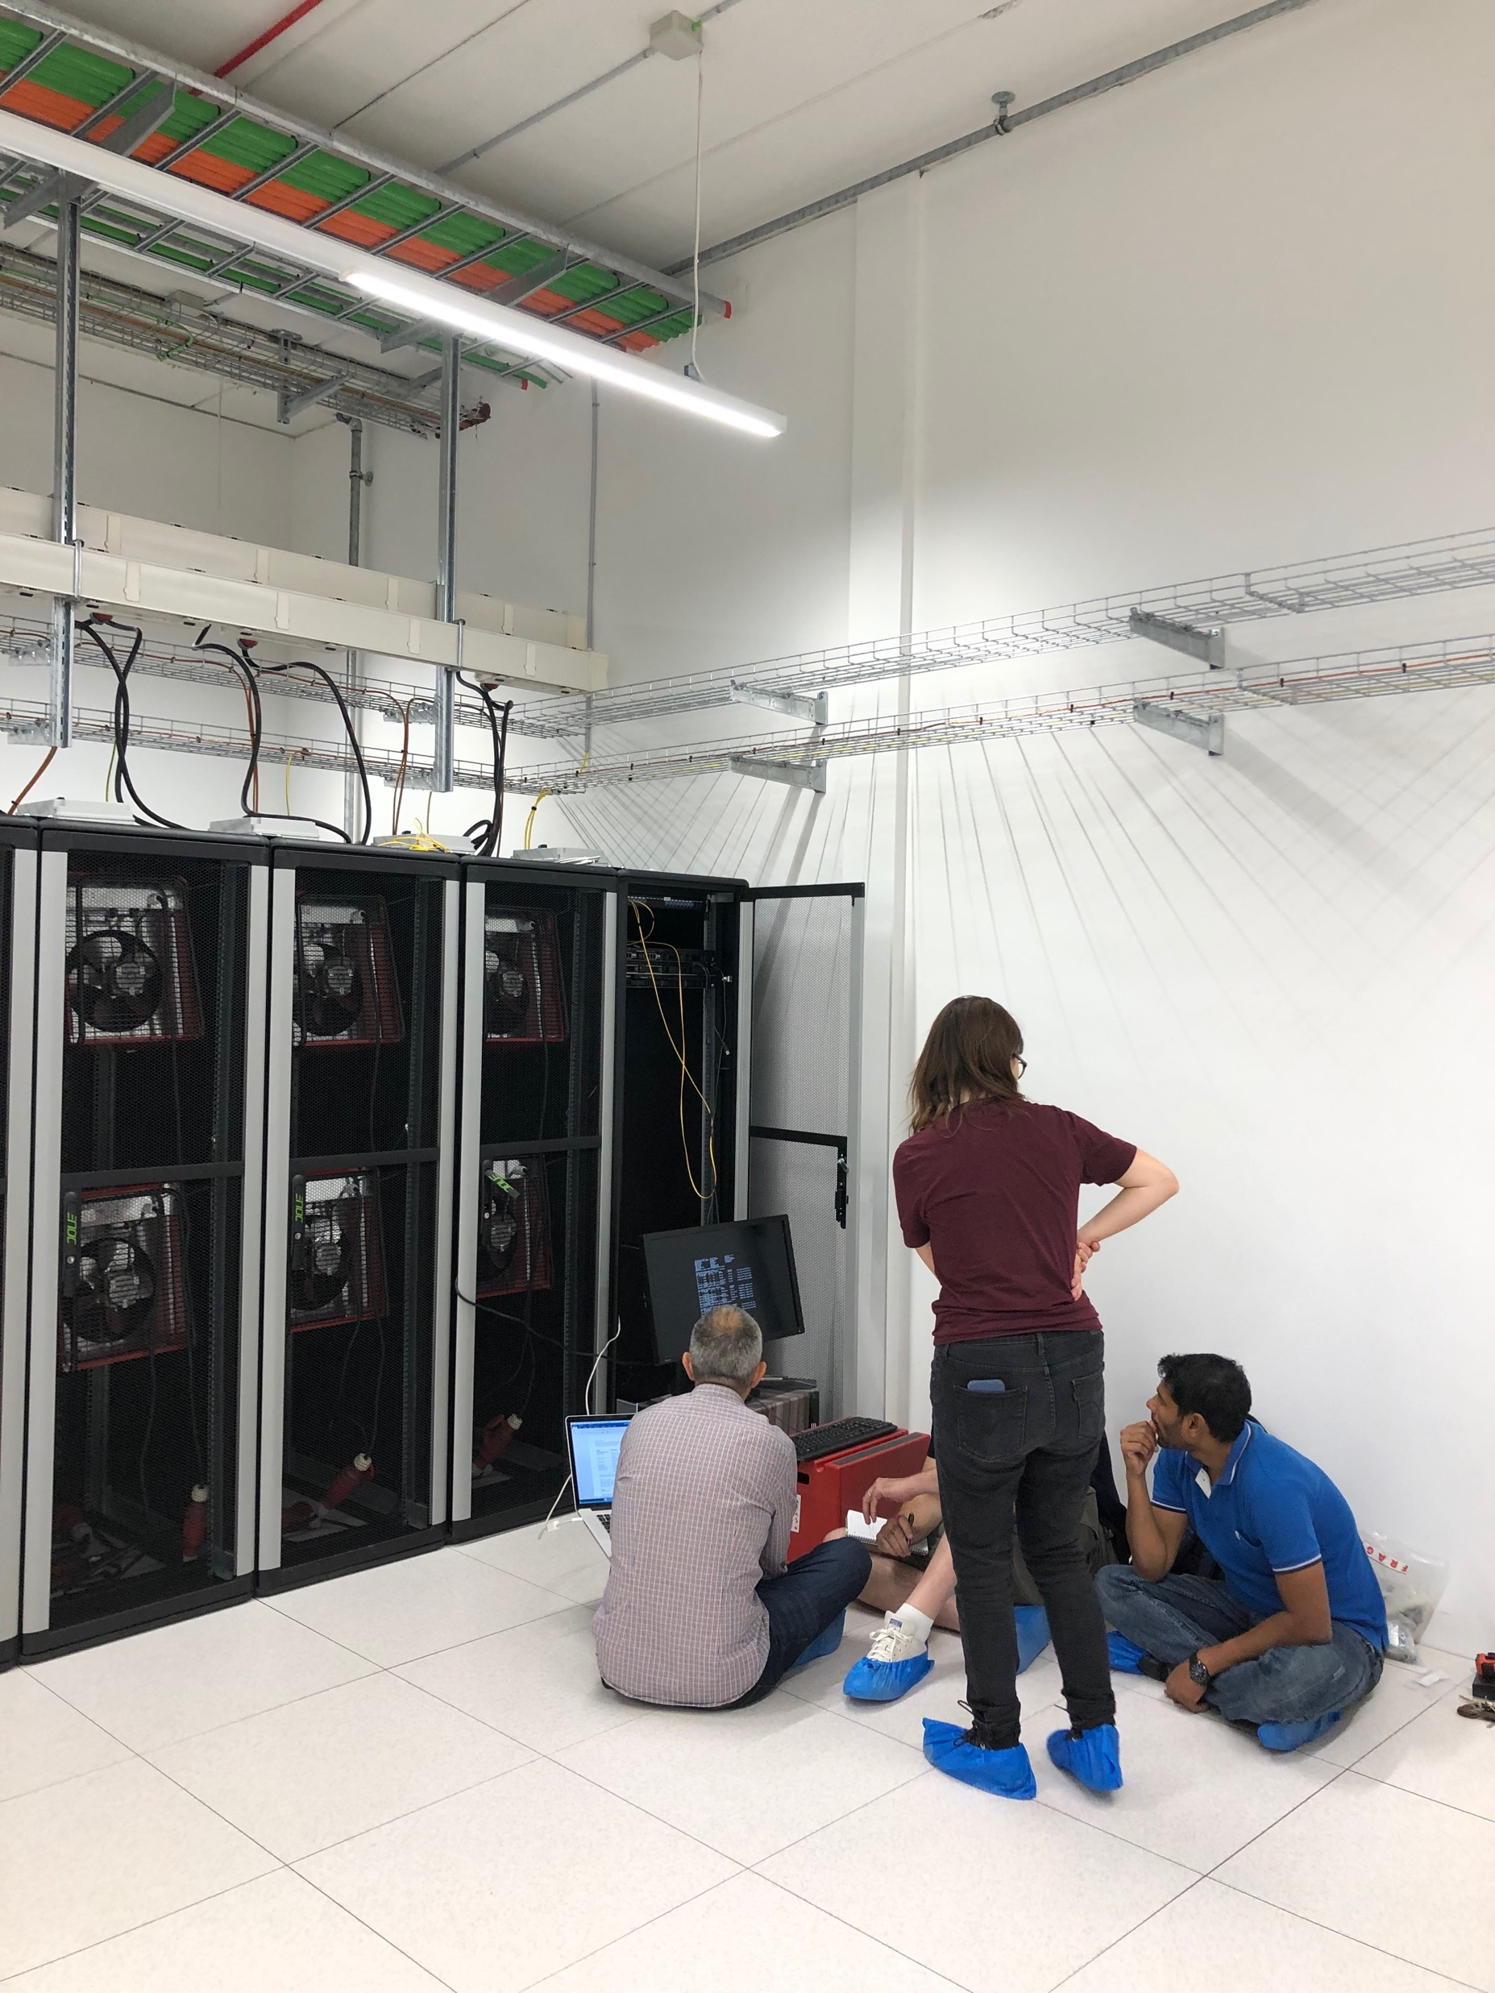
Data center design
Lund
A contract for construction of the server room has been awarded.
Ongoing discussions with CF to agree on scope.
Current realistic access date is February 1st 2020 due to power connectivity issues.
Initial arrangements has been made for temporary test space sufficient for reaching DMSC End of Construction milestones.
Copenhagen
Project completed – equipment is actively running in the server-room

Slide 8
Server room Copenhagen
Phase 1: 8 racks, 150KW, Redundancy level N,
Phase 2: 16 racks, 200KW, Redundancy level N+1 – Scheduled for 2022
Phase 3: 30 racks, 300KW, redundancy level N+1 – Scheduled for approx. 2027
Phase 4: 30 racks, 600KW, redundancy at level at least N+1 - Scheduled for beyond 2030.
Status:
  Phase 1 – Completed before time and on budget
  Service agreement being detailed – we expect to go with an option from the server-room vendor
  Initial equipment installed
  Provisions underway for running a two-site data center (UCPH and COBIS).

Slide 9
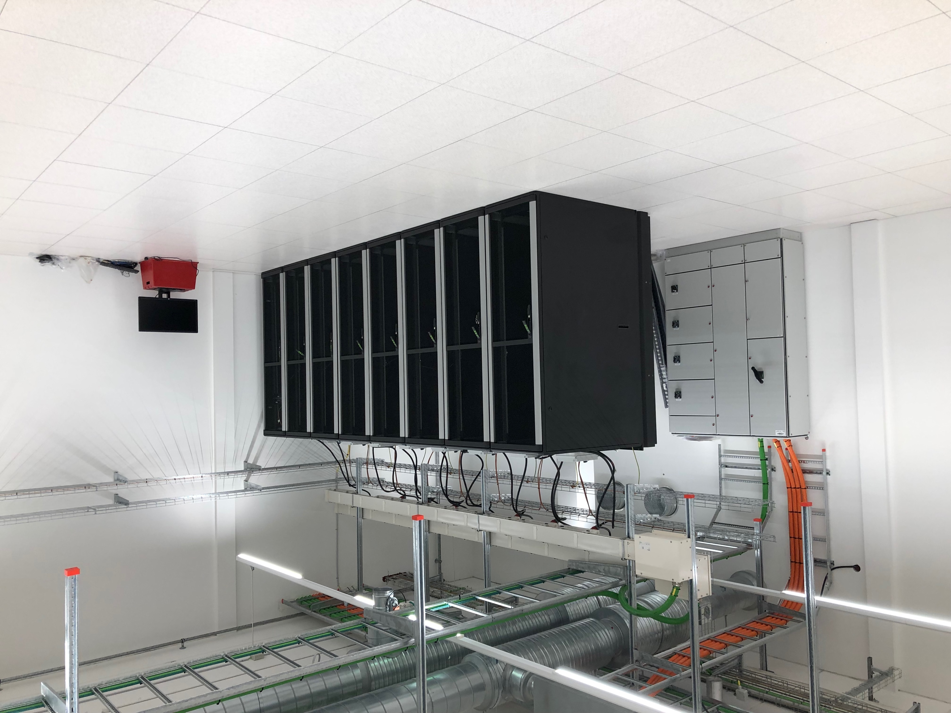
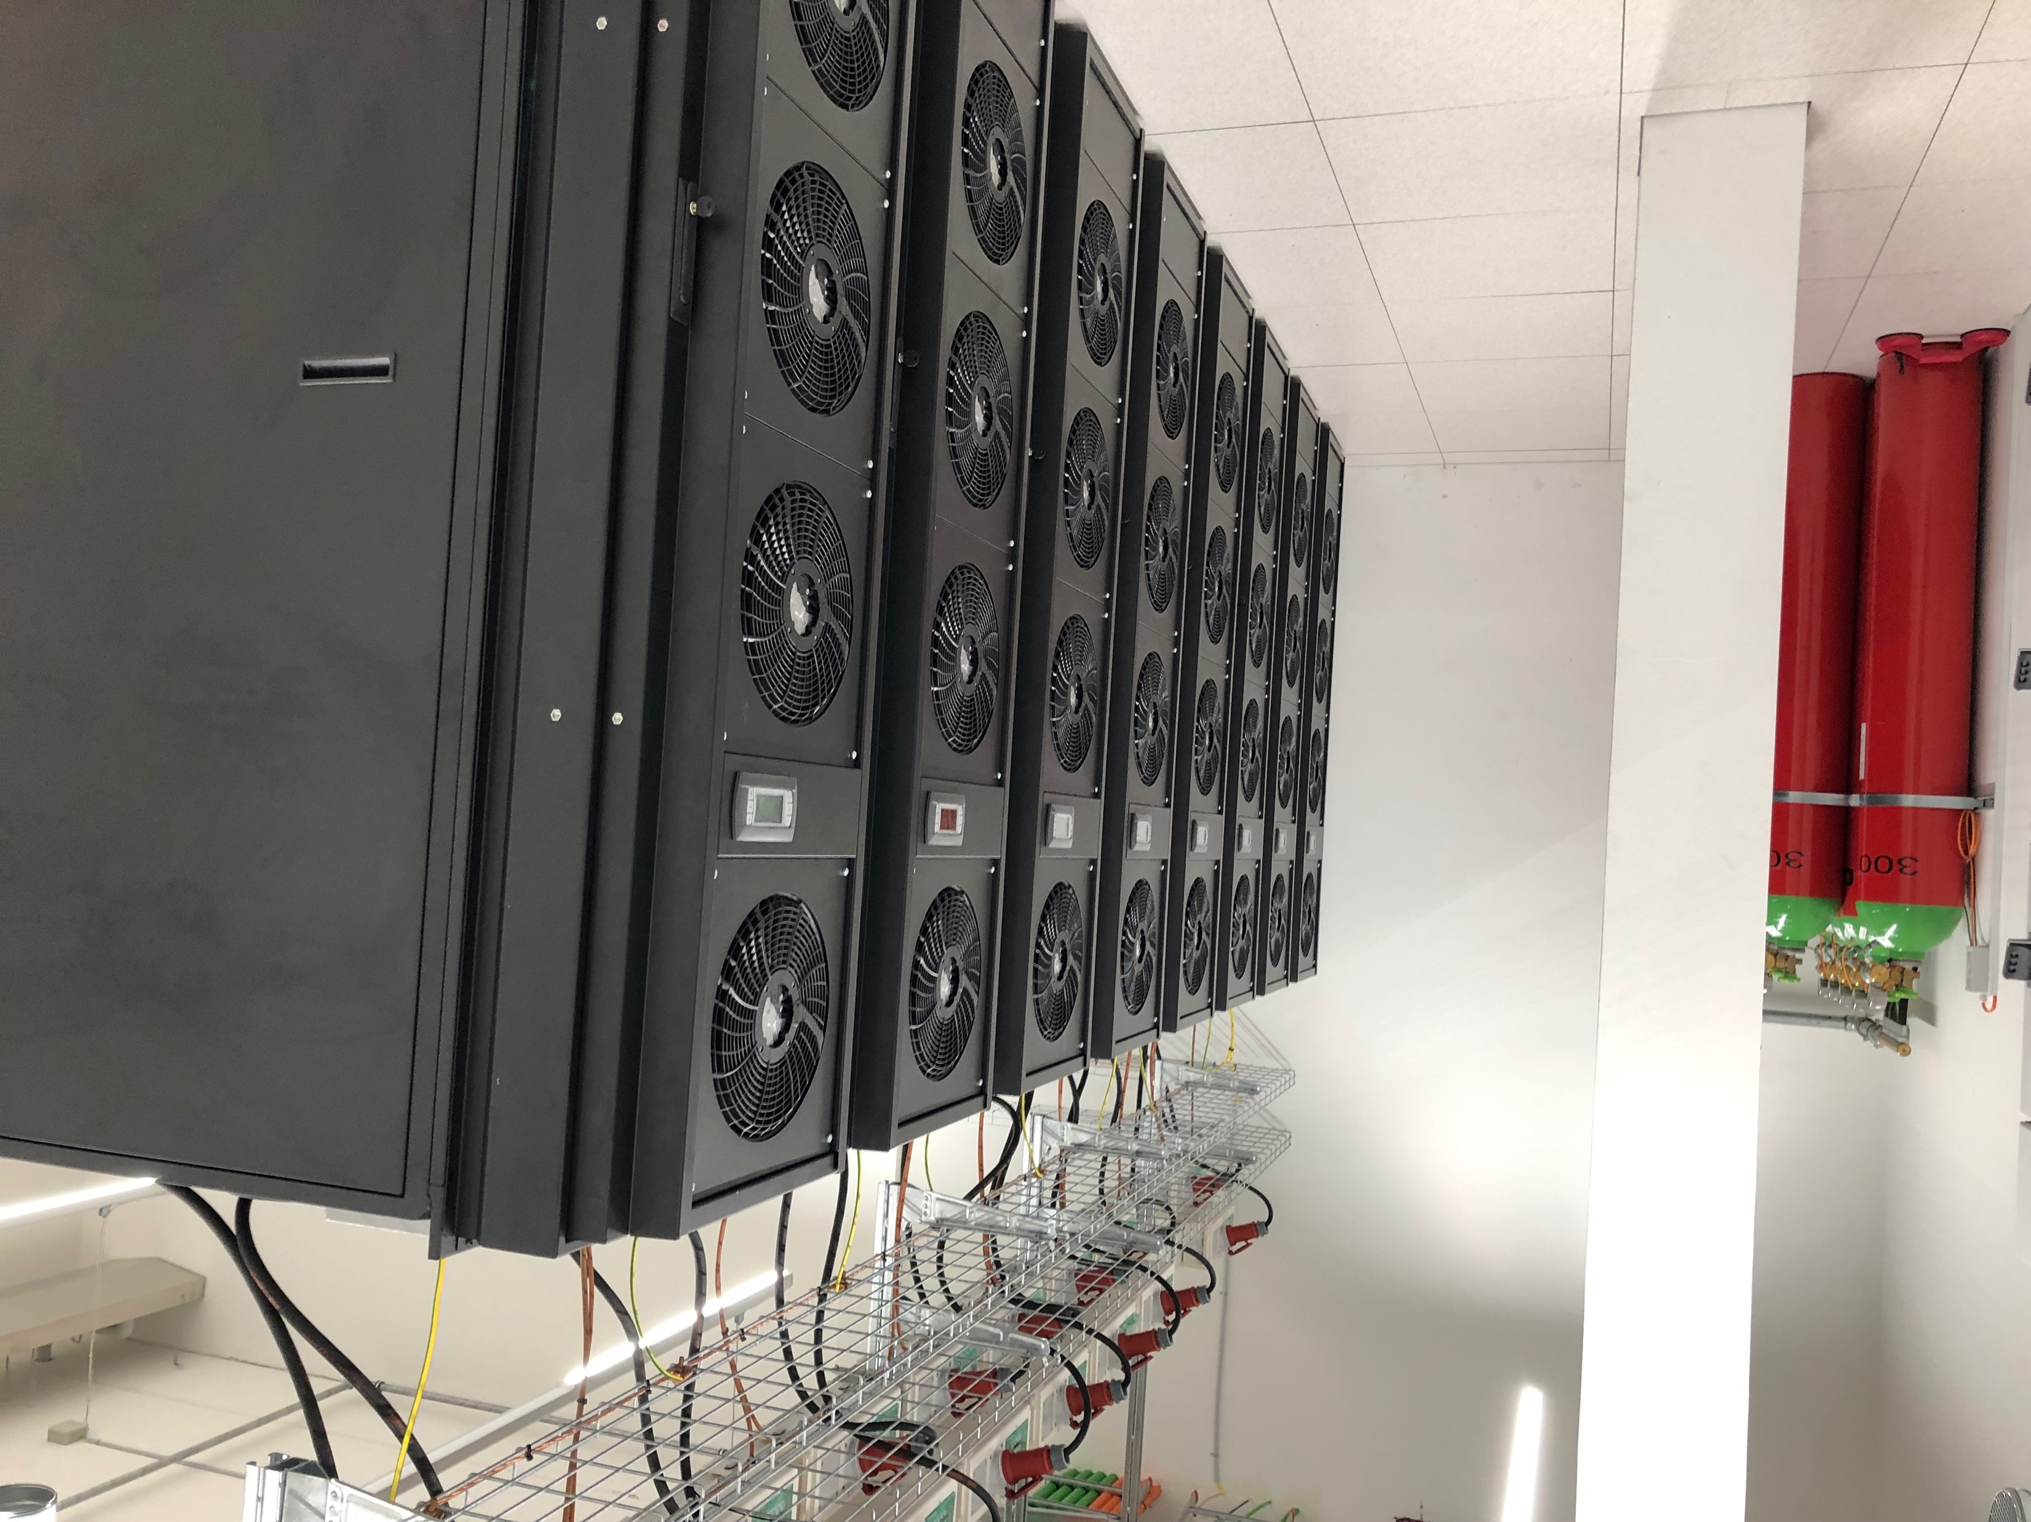
Data-center infrastructure
Server-room (CPH)
CPH data-center:
Main storage
Offline environment
Main infrastructure
Development env.
Services (e.g. data portal)
2019
8 racks
150kW
2025+
30 racks
Up to 600kW

Slide 10
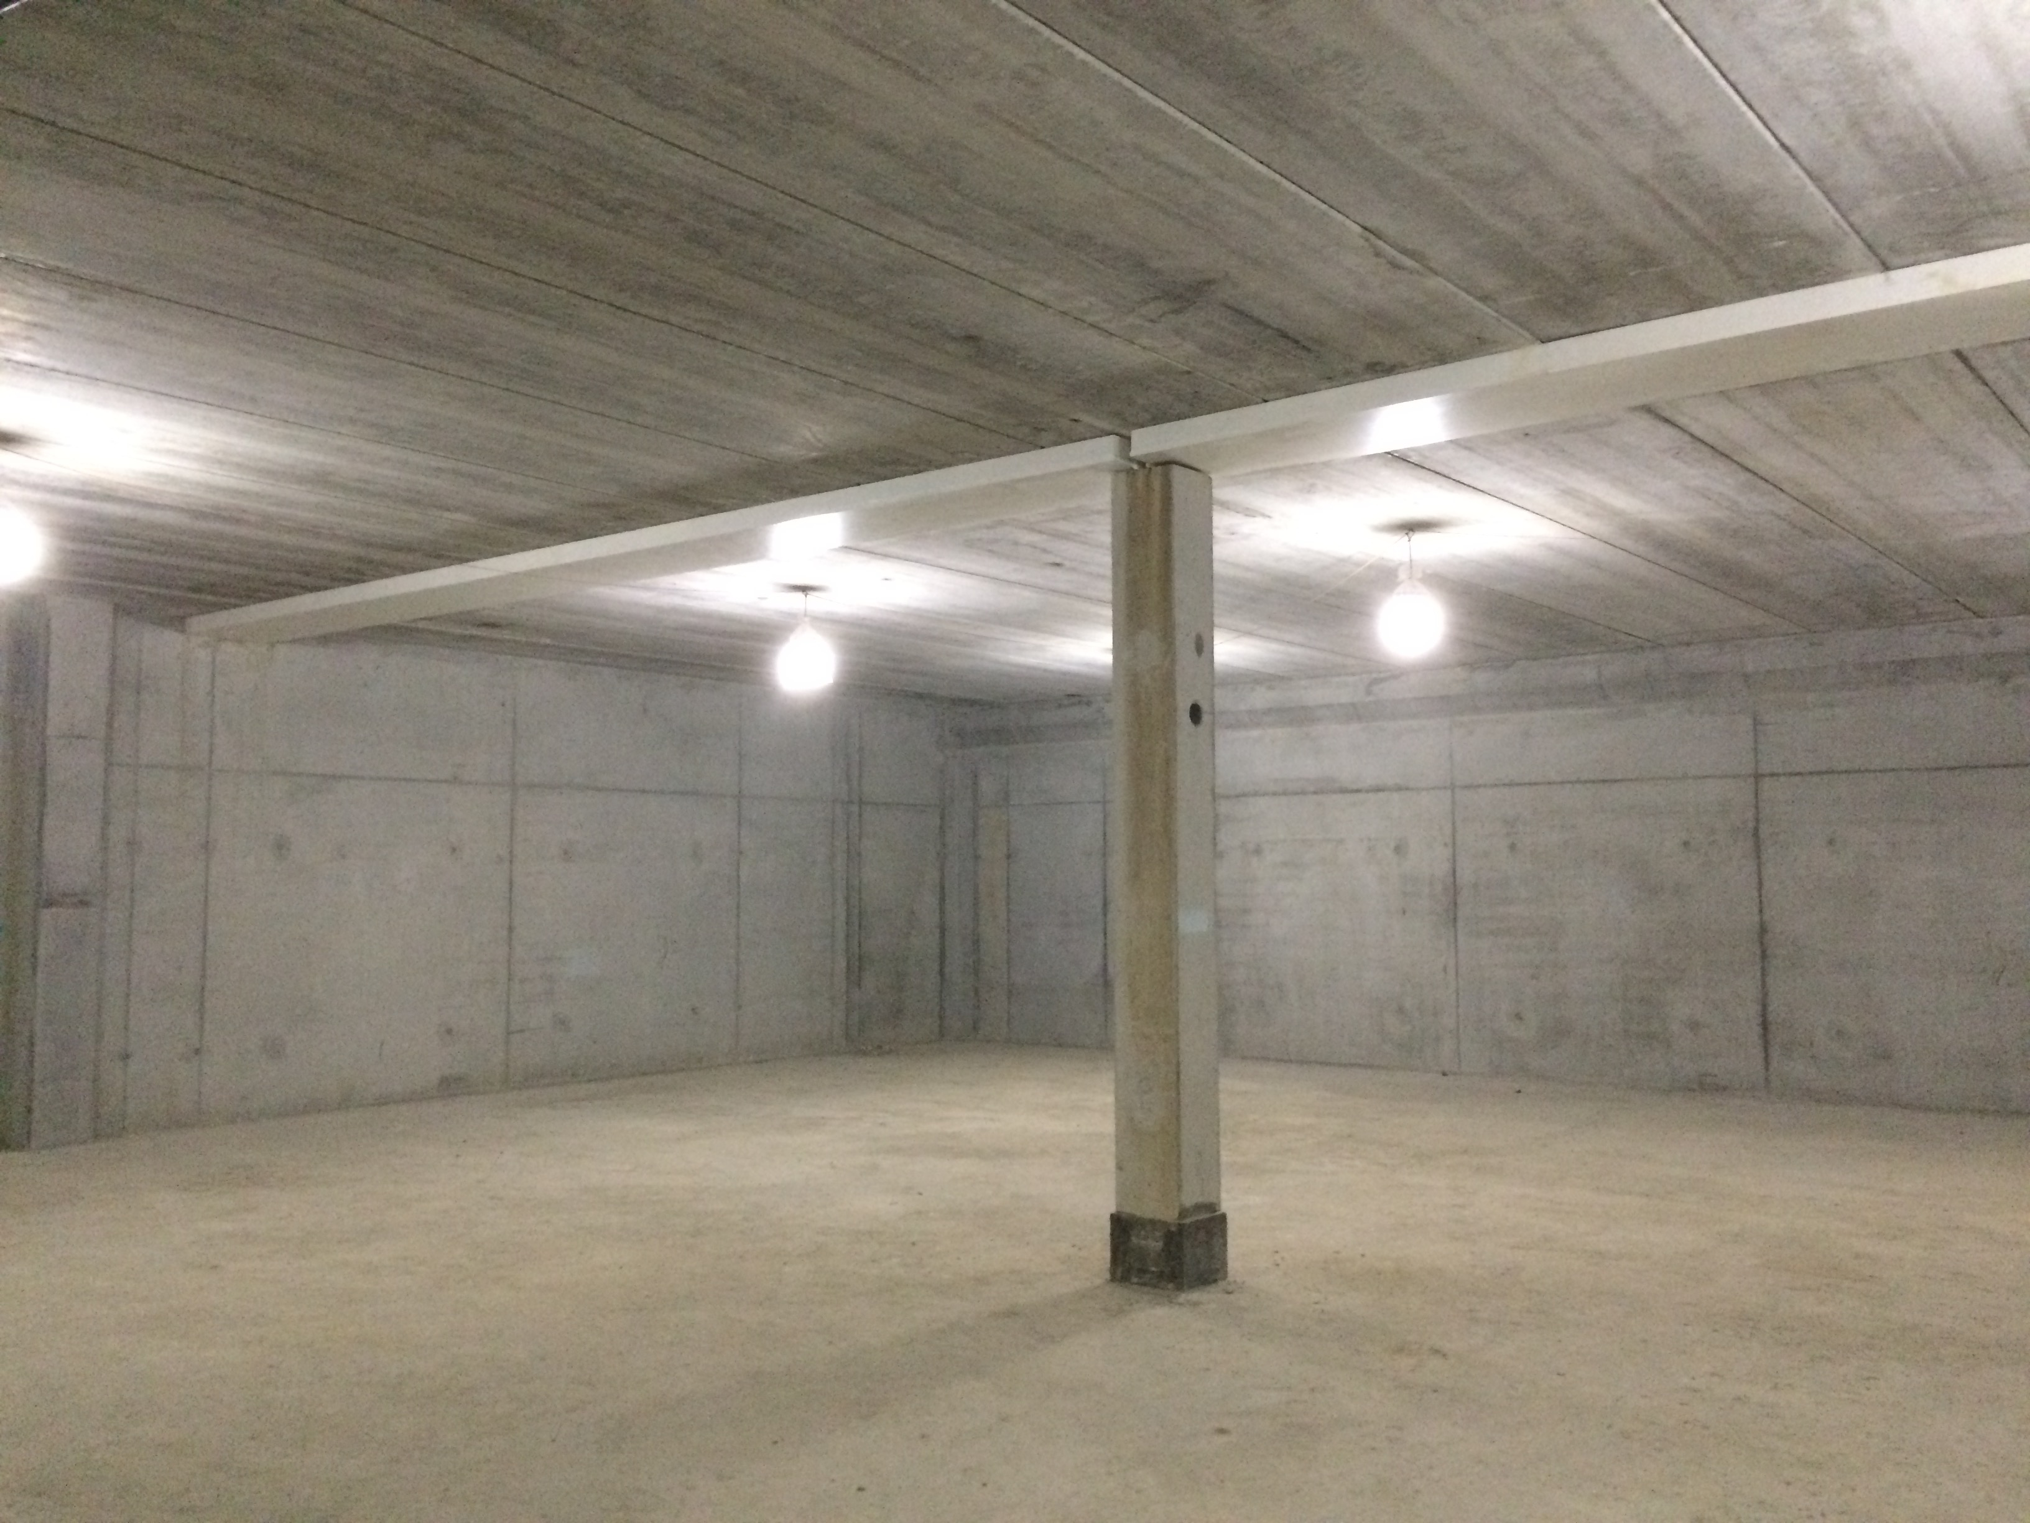
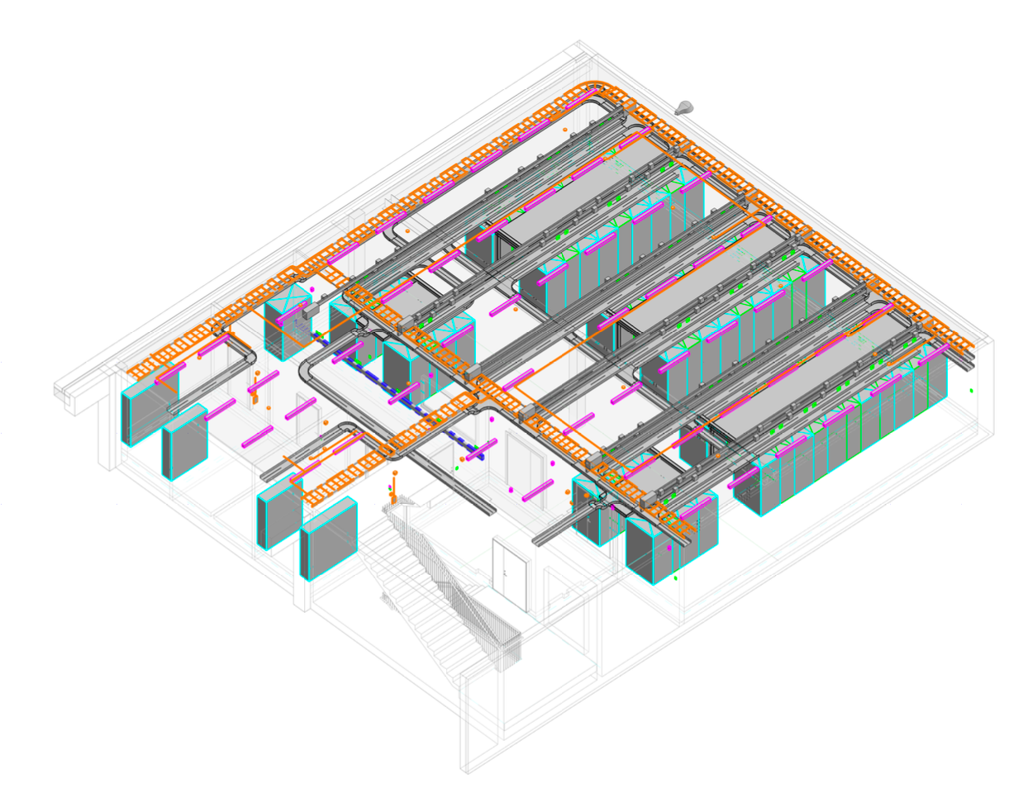
Data-center infrastructure
Server-room (CUB)
2020
3 x 12 racks
450 kW
CUB data-center:
ICS
IT
DMSC
  Online environment
  Failover services
  Secondary storage

Slide 11
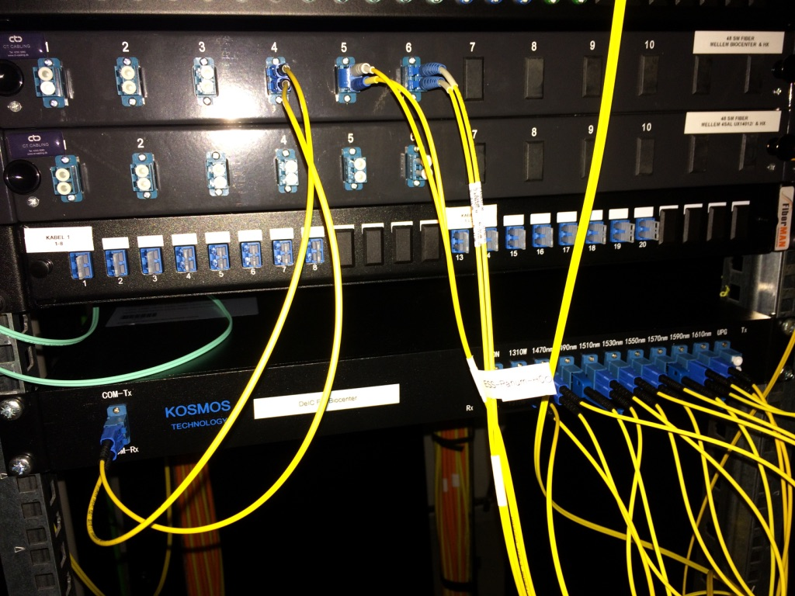
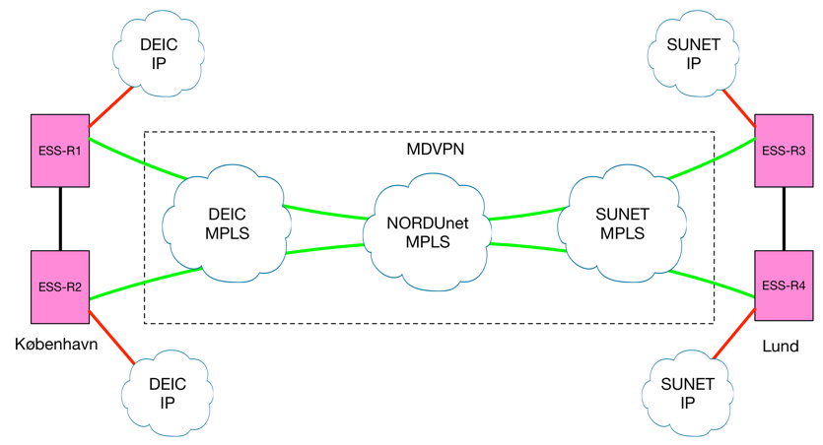
Site-to-site connection
10Gb/s L2 VPN – connection as a service – only 1 point of contact (NORDUnet)
Redundant and expandable to 400Gb/s
End routers is Juniper MX204 – installed both Lund and Copenhagen.
Connectivity has been confirmed – full testing & verification in H2 2019

Slide 12
Storage systems
Status:
Request for Information (RFI) for storage system solutions in preparation for tender. 16 replies was received – 8 vendors selected for presentation.
Replies to the RFI encompassed several technologies (Lustre, GPFS/Spectrum Scale, WekaIO and Isilon)
Detailed design work is on-going with lessons learned by the ECDC group using the IBM loaner system in Utgaard.
Storage RFQ expected to be issued in Q4 2019.
Solutions considered:
IBM ESS (Spectrum Scale)
DDN+Lustre
Lenovo DSS (Spectrum Scale)
DELL+Lustre
EMC+Isilon
SuperMicro+QuoByte
SuperMicro+WekaIO
Storage completeness and performance test suite (DAQ, Filewriter, online env.) for deployment on test storage systems being considered.

Slide 13
Future technologies
Participating in the LISA 2019 – Lottie Greenwood
Participation in the DeIC conference
Engaged with vendors presenting current and future solutions on the following subjects:
  Off-site hosting
  Recent development in using HPC for machine learning
  Recent developments within storages systems from 10 vendors since beginning of 2018.
  High performance network solutions
Participating in relevant courses:
  5 staffers on IBM Spectrum Scale course - IBM Spectrum Scale Expert (Level II):
    April 2019 (Brian Lindgren Jensen, Jacinto Vera Garcia, Kareem Galal)
    October 2019 (Alexander Stefanov, Ashok Nulguda)
  1 staff member on FitSim course (Lottie Greenwood)
Working group on future technologies being replanned using PaNOSC contacts – direct contact to a number of facilities resulted in only 1 reply – which was positive though.

Slide 14
Future hardware procurements
By engaging in the newly formed synergy groups on IT related topics at ESS, DST is working towards a more coherent set of hardware components which will help on procurement processes.
It has proven valuable to have upgrade options as parts of tenders (server room and 2017 compute cluster expansion)
DST has been working actively with procurement since 2013 and has established good relations to the procurement division – not that challenges do not exist but procurement processes seem to run smother and smoother and is to an extent well understood by DST.
Experiences from larger procurements is kept on record with DST.
Most recently DST has identified the correct way of circumventing normal procurement rules in the case of a catastrophic event.
DST has driven the work for a division wide procurement plan for the Intial Ops phase for capital investments. Work underway – many details/requirements still to be determined, e.g.:
  Requirements for Offline environment: Analysis reqs? How many simultaneous users to support?
  ODIN requirements for reduction/analysis (and location in data-flow)

Slide 15
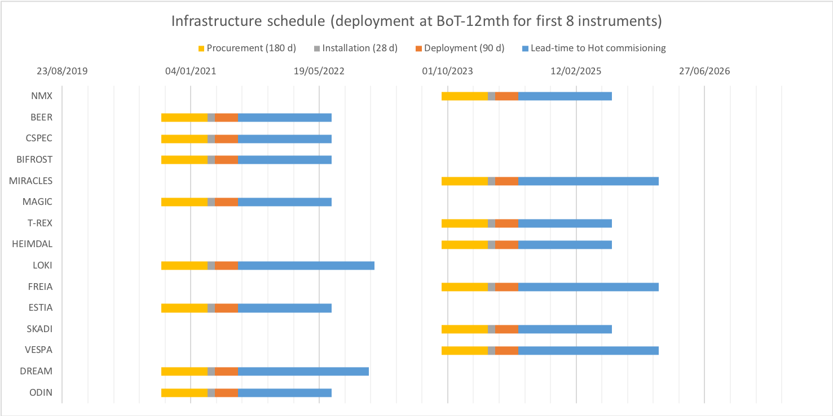
Infrastructure schedule
Procurement for infrastructure for first 8 inst. to start in Q3 2020.

Slide 16
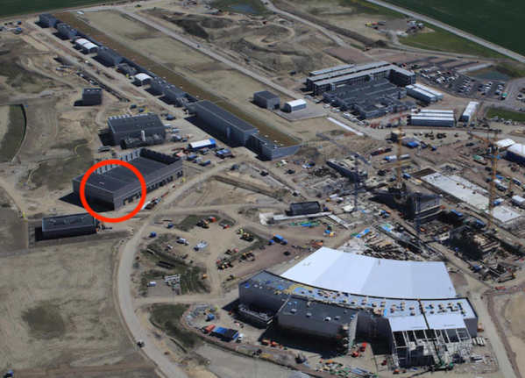
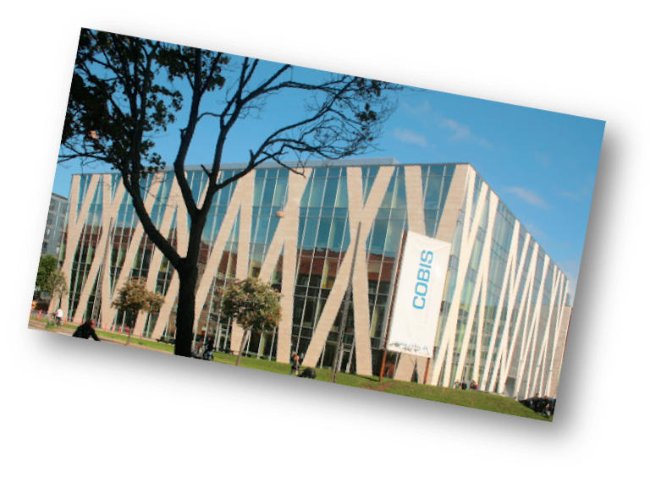
ESS Data flow (DMSC)
Site server room
Beamlines
Detector readout and EPICS Bridge
DAQ
Online Data reduction and analysis
Online
storage - raw
Online
storage - derived
Service Failover
External
Archive
Raw data
(read-only)
Derived data
(read/write)
Copenhagen server room
Data Portal
Offline environment

Slide 17
Data-flow for Data-Acquisition

Slide 18
Data-flow for Online environment

Slide 19
Data-flow for Offline environment

Slide 20
Procurement plan (larger procurements) – (draft – Sep., 2019)
Q3 2020:
- Servers (CUB): 36+ EFU (11+), EPICS (8), Kafka (11), Filewriter (6)
- VM (CUB): 500+ cores, 4TB+ RAM
- VM (CPH): 400+, 4TB+ RAM, GPU
- HPC (CPH): 1000 cores?
Q2 2022:
- server-room buildout (CPH): Phase 2 (redundancy+capacity)
Q3 2019:
- Servers (Lund): 5 (EoC test)
Q1 2020:
- Storage (CUB): 1PB
- Storage (CPH): 1PB
Q4 2019:
- Network (CUB): rack network infrastructure
Q3 2023:
- Servers (CUB): 36 EFU (16), EPICS (7), Kafka (10), Filewriter (3)
- VM (CUB): 500+ cores, 4TB+ RAM
- VM (CPH): 400+, 4TB+ RAM
- HPC (CPH): 1000 cores?
- Storage (CUB): 2PB
- Storage (CPH): 2PB
- Replacement HW
Q1 2022:
- HPC (CPH): ODIN (3000 cores)
Q1 2025
- Replacement HW

Slide 21
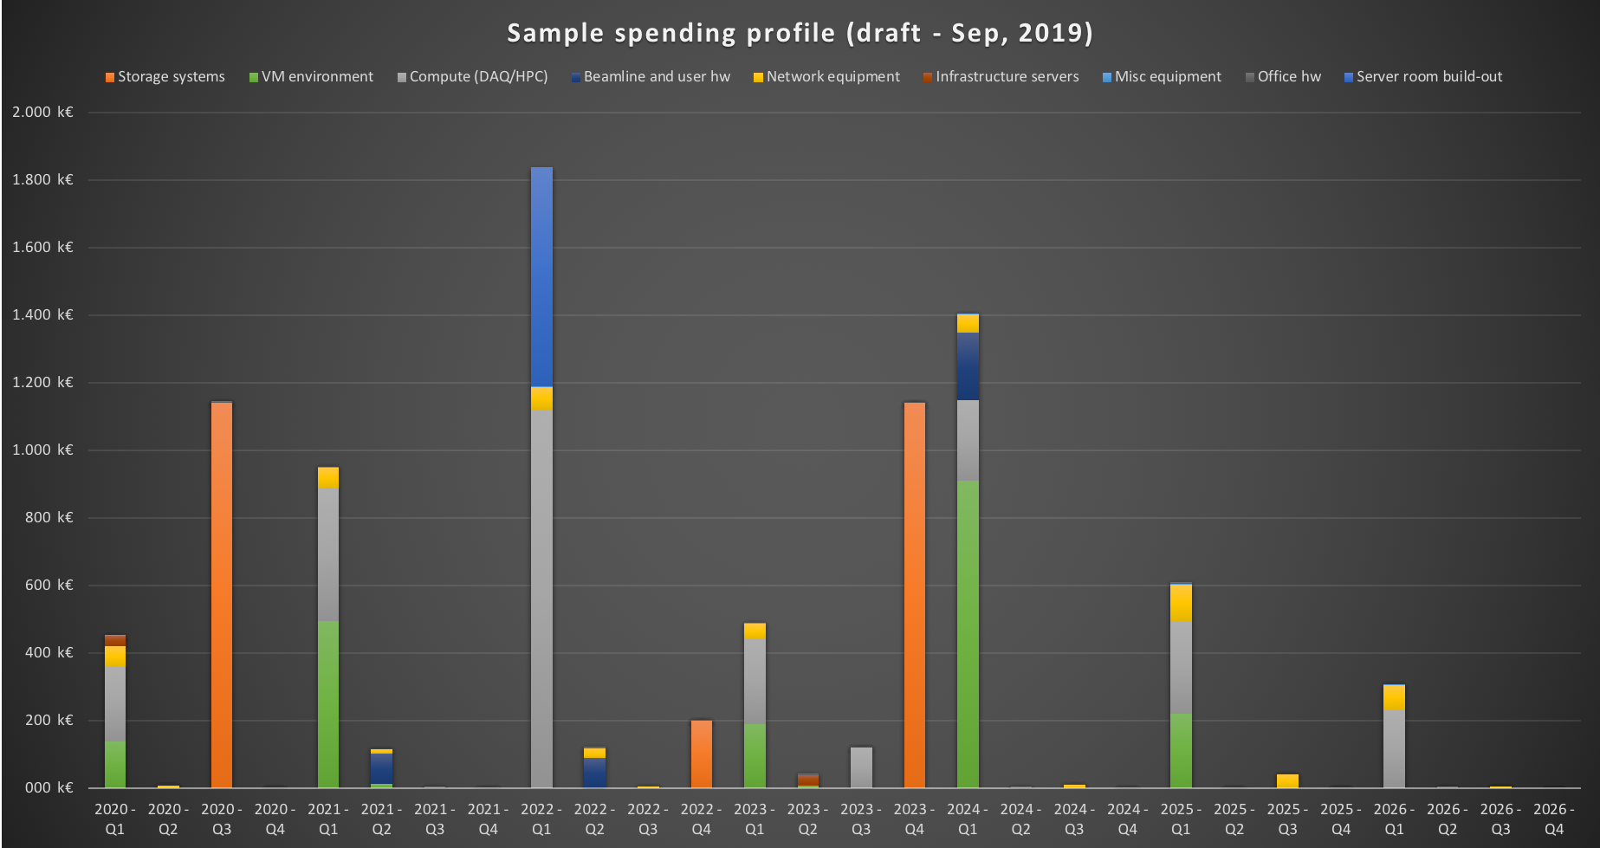
DST Sample spending profile (2020Q1 -> 2026Q1) - DRAFT

Slide 22
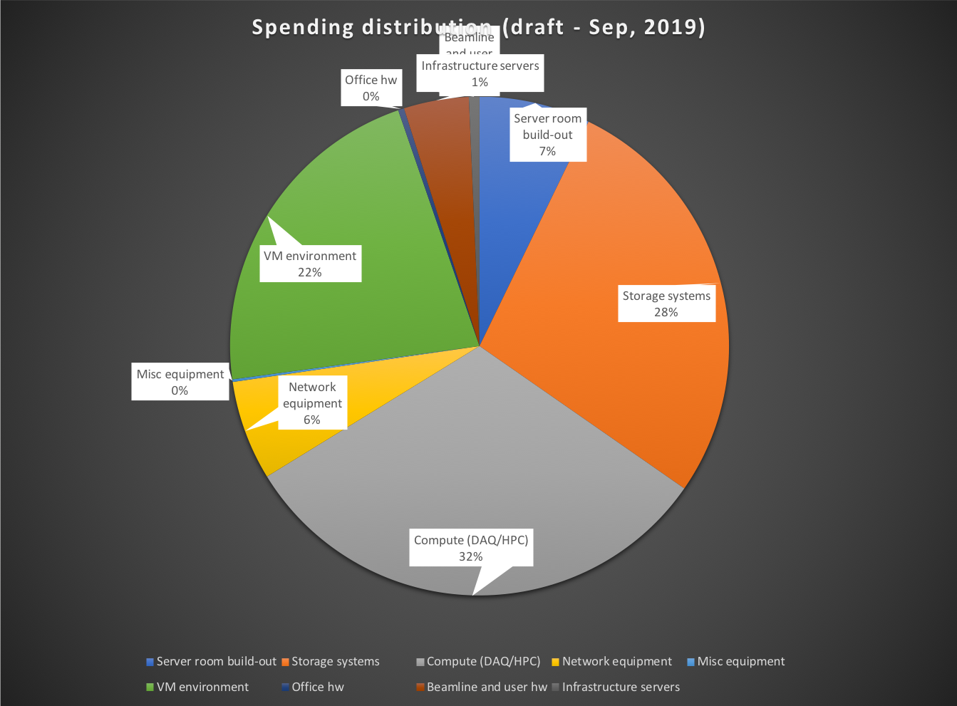
DST Sample spending distribution (2020Q1 -> 2026Q1) - DRAFT
Sample hardware:
VM host: 4x24cores, 2TB (75k)
Network: 100G (ethernet, IB)
Storage: 1PB, 20GB/s (570k)

Slide 23
Questions for the STAP 1:2
We request advice and recommendations on our procedures to identify core hardware technologies, specifically storage technologies.
  Storage tender
    Architecture (ought we to pre-select solution for tender or leave open (‘Innovation vs. Standard solution’)?)
    Invited or open Call for Tenders?
    Heterogenous or homogenous storage environment solutions? (i.e., ok with different solutions for e.g. CUB and CPH?)
    Worthwhile to use resources on pursuing completeness test on other solutions (or just focus all on ‘Standard’)?
  Network solutions? (e.g. Ethernet vs. InfiniBand or 40G vs. 100G backbone)
  Supply chain security? (or not an issue for research organisations like ESS?)
  Offline environment requirements?
    How much compute/service to provide? (e.g. how many/few concurrent users we could/should cater for?)
    How do we best nail down the requirements at this stage?
  ODIN?

Slide 24
Questions for the STAP 2:2
Requirements/expectations for Cold/Hot commissioning/Initial-Ops?
  How do we best keep expectations aligned with other stakeholders?
How to best handle shift/on-call requirements?
What level of resilience/redundancy should we aim for? (e.g. for DAQ, remote access, online/offline etc.)
How do we best support/facilitate First Science?

Slide 25
Thank You!
End of Presentation
Following slides are for information/reference only

Slide 26
STAP Recommendations for DST, Q1 2019 (1:2)
Identifying hardware technologies | Who | Notes/status
Strengthen engagement with hardware vendors (understand availible solutions) | Jesper Rude Selknaes | Since the April STAP DST has been in continuous contact with several vendors primarily within the field of storage systems. This contact has taken the form af an official Request for Information process securing that neither DST nor the vendors in question violates procurement rules which could prevent the vendor for biting on a an actual tender should it be submitted. DST has also had informal talks with vendors of hardware both for computing and for data center operations. • Feedback from IBM test system: Tobias Richter
Attend more external engagements on high performance computing etc | Jesper Rude Selknaes | In the fall of 2019 DST staff will participate in the LISA conference organized by the USENIX association. DST staff will also participate in the annual DeIC conference where DeiC stand for the Danish e-Infrastructure Consortium and is the organization organizing among other things HPC resources for the universities of Denmark.
Engage with XFEL to understand their operational model of -collectiing data -their initial processing -how data is transferred to DESY -Offline processing | Jesper Rude Selknaes | DST has utilized our contacts gained under the EOSC pilot project and has started discussions with DESY and XFEL on these matters. These talks are in a very early state due to the summer vacation period and increased focus on meeting the group end of construction milestones.

Slide 27
STAP Recommendations for DST, Q1 2019 (2:2)
DMSC, as part of central Networking activity, should deploy and manage own PerfSonar networking infrastructure at key points on the overall network, to ensure that performance can be monitored appropriatly | Jesper Rude Selknaes | DST is raising this point in the central networking group.
Get data rates from existing facilities ASAP (ISIS and SNS) to understand what level of compute and storage that will be needed on day 1 | Jesper Rude Selknaes | DST has started this process with collaborators in the PaNOSC project.
Consider to whom the storage will need to be presented to, and ensure that the tech solution chosen can operate in the way required by DMSC and for the end user's need | Jesper Rude Selknaes | DST in engaging with other the groups at DMSC and with other stakeholder as they become known to us on this matter. DST expects that the experiences gained by the ECDC group on the loaner IBM Spectrum Scale system deployed in the Utgaard lab will provide valuable information in this matter.
Adopt NFSv4 from day 1 if/when buidling a new storage solution | Jesper Rude Selknaes | While DST is currently hosting a number of storage systems exposed on a mix of NFSv3 and NFSv4, we take the STAPs recommendation to hart when formulating the tenders for future storage systems.

Slide 28
Infrastructure components – requirements and considerations
The following slides are only for information/reference (not to be included as part of the STAP presentation).
The slides presents the infrastructure components to support the neutron data flow from it leaves the detector until it enters and is processed in, the offline environment for re-reduction/analysis by users, and is based on requirements estimated by the relevant stakeholder groups at DMSC.
For each infrastructure component the following is discussed:
  Interfaces
  Specifications
  Network
  Implementation
  Cost (estimated)
  Considerations:
    Procurement
    Installation
    Deployment
    Reliability
For reference, please refer to Data-flow diagrams given earlier.
Please note that this is a very infrastructure-centric draft, is still preliminary, with significant unknowns/parts missing, and is subject to change.

Slide 29
Requirements: EFU (Sep 2019)
Type: | Event Formation Unit (EFU)
Function: | Creates events from digitized detector output
Interfaces: | In: | Digitized detector output [UDP] – direct fiber from detector(/switch) lead by passive patching (via comms rooms) to CUB
 | Out: | Event data fed into data aggregator (kafka-cluster) [UDP]
Specifications: | 10 core E5 64GB RAM (8x8) 4xSSD (480GB)
Network: | 100G ethernet
Implementation: | One or more (up to 5 expected) physical nodes per detector fiber (typically two nodes per instrument)
Cost (est.): | 10k€
Considerations: | Procurement: |  | Consider buying EFU nodes in 2 batches: 11+? for first 8 instruments (BEER (2), BIFROST (1), CSPEC (2), DREAM (1), ESTIA (2), LOKI (1), MAGIC (2), ODIN (?)) – (2020Q3) 16 for next 7 instruments (T-REX (2), HEIMDAL (2), SKADI (1), MIRACLES (2), FREIA (2), VESPA (2), NMX (5)) – (2024H1)
 | Installation: |  | Plan, implement and test/validate required fiber-connections from detectors.
 | Deployment: |  | Standardised base deployment assumed. May need instrument/detector specific configuration.
 | Reliability: |  | Service-failover not straightforward due to nature of input data (dedicated fiber for digitized detector output). Need to determine model for High Availability (e.g. will it be possible to enable a ‘smart’ switching layer in front of EFUs?) to avoid instrument downtime due to failed EFU (e.g. requiring manual replacing of fiber).
DRAFT

Slide 30
Requirements: Fast Sample Environment (Sep 2019)
Type: | Fast Sample Environment
Function: | Provides ‘fast’ experiment metadata (sample environment, beamline monitors etc.)
Interfaces: | In: | EPICS data from Technical Network (TN) [UDP] – likely through 1G copper cable
 | Out: | Meta-data fed into data aggregator (kafka-cluster) [UDP]
Specifications: | 8 cores 16GB RAM (4x4) 2xHDD (system disk)
Network: | 1G ethernet (in) 10G ethernet (out and management/deployment)
Implementation: | One physical node per instrument, may need to be close to instrument (due to dependence on TN/1G copper cable)
Cost (est.): | 4k€
Considerations: | Procurement: |  | Consider procuring small physical machines like Fast Sample Environment machines in a form of framework agreement (or similar) to be able to procure them as needed. 8 for first 8 instruments (BEER, BIFROST, CSPEC, DREAM, ESTIA, LOKI, MAGIC, ODIN) – (2020Q3) 7 for next 7 instruments (T-REX, HEIMDAL, SKADI, MIRACLES, FREIA, VESPA, NMX) – (2024H1)
 | Installation: |  | Installation complexity is dependent on the requirement of location of the node. If close proximity to instrument is needed, it may be a possibility to place in instrument-near comms-rooms (but will mess up data-path redundancy!)
 | Deployment: |  | Standardised base deployment assumed. Regardless of location, it will need to be connected to management network for maintenance/deployment etc. (may require planning for e.g. BMC access across grounding zones – e.g. decentralized copper switches). Known issue with data-producing FPGA requiring MAC address of Fast Sample Environment machine for data-transfer – this needs to be included in deployment.
 | Reliability: |  | Service-failover capability unclear due to location uncertainties and TN connection requirements. If the EPICS data can be switched (currently under investigation), there may be an option for providing some HA-capability (pooled across instruments) if comms-room hosting proves a viable option. Issue with MAC address hardcoding in FPGA complicates possible failover options.
DRAFT

Slide 31
Requirements: EPICS forwarder (Sep 2019)
Type: | Kafka to EPICS Forwarder
Function: | Provides ‘other’ experiment metadata
Interfaces: | In: | EPICS data from Technical Network (TN) [UDP] – likely through 1G copper cable
 | Out: | Meta-data fed into data aggregator (kafka-cluster) [UDP]
Specifications: | 8 cores 16GB RAM (4x4) 2xHDD (system disk)
Network: | 1G ethernet (in, from TN) 10G ethernet (out and management/deployment)
Implementation: | Can be virtualized – one instance per instrument – can be same VM data center for all instruments. Data from TN can be switched, but not routed.
Cost (est.): | (part of VM environment)
Considerations: | Procurement: |  | Initial VM environment (2020H2) should be able to handle all future required NICOS servers and clients (local and remote). 8 VMs (64 cores, 128GB) for first 8 instruments (BEER, BIFROST, CSPEC, DREAM, ESTIA, LOKI, MAGIC, ODIN) – (2020Q3) 7 VMs (56 cores, 112GB) for next 7 instruments (T-REX, HEIMDAL, SKADI, MIRACLES, FREIA, VESPA, NMX) – (2024H1)
 | Installation: |  | Some consideration (planning/coordination) must be taken on input to VM environment from TN for the individual instruments (e.g. how will TN data be transmitted (e.g. copper/fiber/switched))
 | Deployment: |  | Standardised base deployment assumed.
 | Reliability: |  | Service-failover (to other VM) can be handled within the VM environment – testing will need to be performed to determine how the stack handles interruptions from HA/failover.
DRAFT

Slide 32
Requirements: NICOS (Sep 2019)
Type: | NICOS
Function: | Experiment Control System
Interfaces: | In: | EPICS data from Technical Network (TN) [UDP] DRAM stack (Mantid)?
 | Out: | Meta-data fed into data aggregator (kafka-cluster) [UDP] Interactive GUI (NICOS client) for beamline/experiment control to experiment user through General Purpose Network [TCP/IP] DRAM stack (Mantid)?
Specifications: | 4 cores 8GB RAM (system disk)
Network: | 1G ethernet (in, TN) 10G ethernet (in/out, GUI to client, GPN) 10G ethernet (out and management/deployment)
Implementation: | Can be virtualized – one instance per instrument – can be same VM data center for all instruments. Will need proxy-connection for experiment user and remote access.
Cost (est.): | k€ (part of VM environment)
Considerations: | Procurement: |  | Initial VM environment (2020H2) should be able to handle all future required NICOS servers and clients (local and remote). 8 VMs (32 cores, 64GB) for first 8 instruments (BEER, BIFROST, CSPEC, DREAM, ESTIA, LOKI, MAGIC, ODIN) – (2020Q3) 7 VMs (28 cores, 56GB) for next 7 instruments (T-REX, HEIMDAL, SKADI, MIRACLES, FREIA, VESPA, NMX) – (2024H1)
 | Installation: |  | Some consideration (planning/coordination) must be taken on input to VM environment from TN for the individual instruments (e.g. how will TN data be transmitted (e.g. copper/fiber/switched))
 | Deployment: |  | Standardised base deployment assumed. Configuration/coordination work needed to ensure the serving of NICOS clients locally and remotely.
 | Reliability: |  | Service-failover (to other VM) can be handled within the VM environment – user-experience will need to be tested (e.g., can a new NICOS instance gracefully take over, and how is feedback to user handled)
DRAFT

Slide 33
Requirements: Kafka cluster (Sep 2019)
Type: | Kafka Cluster
Function: | Data/event aggregation (creation of ‘raw’ data files through aggregation of event files and relevant meta-data)
Interfaces: | In: | Providers: Event-data from EFU(s) EPICS data from Fast Sample Environment EPICS data from EPICS Forwarder BCS data from NICOS server DRAM stack? Kafka-broker data from Kafka-cluster/Zookeeper
 | Out: | Consumers: Filewriter Mantid (DRAM stack) Kafka-broker data from Kafka-cluster/Zookeeper
Specifications: | 2x8 cores (more needed?) 64GB RAM (8x8) 4xSSD (480GB), 8xHDD (4TB)
Network: | 4x25G ethernet (100G ethernet switches with 4x25G breakout)
Implementation: | One common Kafka-cluster for all instruments. 21 physical nodes expected (at 15 instruments) (21 nodes for equal balancing across 3 racks). Zookeeper integrated in Kafka-cluster.
Cost (est.): | 12k€
Considerations: | Procurement: |  | Consider buying kafka nodes in batches: 11 nodes - (BEER, BIFROST, CSPEC, DREAM, ESTIA, LOKI, MAGIC, ODIN) – (2020Q3) 10 nodes (T-REX, HEIMDAL, SKADI, MIRACLES, FREIA, VESPA, NMX) – (2024H1)
 | Installation: |  | For reliability, consider installing across 3 racks.
 | Deployment: |  | Standardised base deployment assumed.
 | Reliability: |  | Built-in high reliability/resiliency (e.g. 3-part replication) and failover. Replaying Kafka-logs enables experiments to be ‘resumed’ in case of temporary outages happening ‘down-stream’. Can be installed e.g. across 3 racks to increase reliability.
DRAFT

Slide 34
Requirements: Filewriter (Sep 2019)
Type: | Filewriter
Function: | Writing event-files to disk
Interfaces: | In: | Consumer of Kafka-cluster data
 | Out: | Writing of event-files to storage system
Specifications: | 8 cores 64GB RAM (8x8) 4xSSD (480GB)
Network: | 100G ethernet (in from Kafka-cluster) 100G EDR Infiniband (out to storage system)
Implementation: | One file-writer per instrument. Might be possible to virtualize filewriters for low data-rate instruments, and then use physical nodes for high data-rate instruments.
Cost (est.): | 7k€ (or part of VM environment)
Considerations: | Procurement: |  | Consider buying physical nodes for the 9 high data-rate instruments, and use VMs for remaining 6: 6 nodes - (BIFROST, CSPEC, DREAM, ESTIA, MAGIC, ODIN) – (2020Q3) 2 VMs (16 cores, 128GB) – (BEER, LOKI) – (2020Q3) 3 nodes (T-REX, HEIMDAL, FREIA) – (2024H1) 4 VMs (32 cores, 256GB) - (MIRACLES, NMX, SKADI, VESPA) – (2024H1)
 | Installation: |  | For reliability, consider installing across 3 racks.
 | Deployment: |  | Standardised base deployment assumed.
 | Reliability: |  | For virtualized Filewriters, failover can be handled gracefully. For physical Filewriter nodes, reliable failover process is still undetermined. In case of temporary Filewriter issues, the Kafka-log can be replayed to ensure against data-loss.
DRAFT

Slide 35
Requirements: DAQ Infrastructure (Sep 2019)
Type: | DAQ infrastructure
Function: | Secondary/support services for DAQ, e.g. monitoring (graphite/graphana), logging (greylog)
Interfaces: | In: | Monitoring data from all DAQ servers Logging data from all DAQ servers
 | Out: | Writing to storage system Monitoring/visualization (GUI)
Specifications: | 2 cores 4GB RAM (System disk)
Network: | 1G/10G ethernet (in from servers) 1G/10G ethernet (out through GPN (GUI))
Implementation: | Likely common servers for all instruments. Virtualised – low footprint.
Cost (est.): | (part of VM environment)
Considerations: | Procurement: |  | Initial VM environment (2020H2) should be able to handle all future required NICOS servers and clients (local and remote). 8 VMs (16 cores, 32GB) for first 8 instruments (BEER, BIFROST, CSPEC, DREAM, ESTIA, LOKI, MAGIC, ODIN) – (2020Q3) 7 VMs (14 cores, 28GB) for next 7 instruments (T-REX, HEIMDAL, SKADI, MIRACLES, FREIA, VESPA, NMX) – (2024H1)
 | Installation: |  | Standard VM install
 | Deployment: |  | Standardised base deployment assumed.
 | Reliability: |  | Standard VM environment service-failover/HA.
DRAFT

Slide 36
Requirements: Mantid (online) (Sep 2019)
Type: | Mantid
Function: | Online reduction of streamed data from Kafka-cluster
Interfaces: | In: | Consumer of Kafka-cluster data
 | Out: | Streaming of reduced data to analysis-stack/NICOS Writing of reduced data to storage system GUI to Mantid client (through GPN)
Specifications: | 16 cores (memory bandwidth may be preferred to number of cores) Varies – from 64GB to 256GB per instrument (128GB assumed on average) System disk?
Network: | 100G ethernet (in from Kafka-cluster) 100G EDR Infiniband (out to storage system) 100G EDR Infiniband (out to analysis-stack) 10G ethernet to GPN (for Mantid GUI)
Implementation: | One Mantid instance per instrument. Mantid runs in GUI mode, so cannot be run in batch-mode (e.g. standard HPC cluster scheduling cannot be used). Virtualisation of Mantid nodes (with required specs) seems advantageous. GPU-capability is not required for compute. GPU for limited visualization (e.g. InstrumentView (OpenGL))
Cost (est.): | ?k€ (part of VM environment)
Considerations: | Procurement: |  | Consider expanding VM environment in phases to handle relevant instrument groups (more info/discussion needed on data-rates for instruments): 8 VMs (128 cores, 1TB+) for first 8 instruments (BEER, BIFROST, CSPEC, DREAM, ESTIA, LOKI, MAGIC, ODIN) – (2020Q3) 7 VMs (112 cores, 1TB+) for next 7 instruments (T-REX, HEIMDAL, SKADI, MIRACLES, FREIA, VESPA, NMX) – (2024H1)
 | Installation: |  | Need to ensure sufficient bandwidth between hosts and storage system to avoid data-rate bottlenecks.
 | Deployment: |  | VM environment requires testing for performance (e.g. OpenStack, OpenNebula, oVirt)
 | Reliability: |  | Virtualised mantid nodes will have HA-capability from the VM environment. In case of temporary Mantid issues, the Kafka-log can be replayed to ensure against data-loss.
DRAFT

Slide 37
Requirements: Analysis stack (online) (Sep 2019)
Type: | Analysis stack
Function: | Online analysis of reduced data from Mantid nodes
Interfaces: | In: | Streamed reduced data from Mantid nodes Read data from storage
 | Out: | Visualisation data to GUI (via GPN) Writing of analysed data to storage system
Specifications: | 22 cores Varies – from 16GB to 384GB System disk? Some resources may be moved to offline env.
Network: | 100G EDR Infiniband (in from Mantid) 100G EDR Infiniband (out to storage) 10G Ethernet (out to GUI, via GPN)
Implementation: | One Analysis instance per instrument. Analysis should generally be assume to only run on a single node (e.g. standard HPC cluster scheduling cannot be used). Virtualisation of Analysis nodes (with required specs) seems advantageous. GPU-capability may be required (e.g. ‘one GPU per session’) – GPU resources can to some extent be managed in a virtual environment.
Cost (est.): | ?k€ (part of VM environment)
Considerations: | Procurement: |  | Consider expanding VM environment in phases to handle relevant instrument groups (more info/discussion needed on data-rates for instruments): 8 VMs (176 cores, 2TB??) for first 8 instruments (BEER, BIFROST, CSPEC, DREAM, ESTIA, LOKI, MAGIC, ODIN) – (2020Q3) 7 VMs (154 cores, 2TB??) for next 7 instruments (T-REX, HEIMDAL, SKADI, MIRACLES, FREIA, VESPA, NMX) – (2024H1)
 | Installation: |  | Need to ensure sufficient bandwidth between hosts and storage system to avoid data-rate bottlenecks.
 | Deployment: |  | VM environment requires testing for performance (e.g. OpenStack, OpenNebula, oVirt)
 | Reliability: |  | Virtualised analysis nodes will have HA-capability from the VM environment. Unclear what stateful information is available, in case of temporary issues with the analysis nodes.
DRAFT

Slide 38
Requirements: Online storage (Sep 2019)
Type: | Online storage
Function: | Online storage of raw and online derived data
Interfaces: | In: | Streamed raw data from Filewriter nodes Streamed reduced data from Mantid nodes Streamed derived data from Analysis-stack
 | Out: | Raw data synchronisation to CPH Derived data synchronisation to CPH Data read by Mantid nodes and Analysis-stack
Specifications: | Up to 40GB/s throughput Up to 5PB capacity
Network: | 100G EDR Infiniband (in from Filewriter) 100G EDR Infiniband (in from Mantid) 100G EDR Infiniband (in from Analysis-stack) 10G/100G Ethernet (synch to CPH)
Implementation: | One scalable storage system. Current options: IBM ESS (Spectrum Scale) Lenovo DSS (Spectrum Scale) DDN/Dell Lustre QuoByte WekaIO
Cost (est.): | 400k€
Considerations: | Procurement: |  | Storage system could be procured in phases (depending on solution, and I/O requirements): ~1 PB (BEER, BIFROST, CSPEC, DREAM, ESTIA, LOKI, MAGIC, ODIN) – (2020Q3) ~3PB (T-REX, HEIMDAL, SKADI, MIRACLES, FREIA, VESPA, NMX) – (2024H1)
 | Installation: |  | Need to ensure sufficient bandwidth between hosts and storage system to avoid data-rate bottlenecks.
 | Deployment: |  | Needs to be deployed and tested/verified well in advance.
 | Reliability: |  | Storage system needs to provide high reliability (e.g. 8+3 erasure coding or equivalent).
DRAFT

Slide 39
Requirements: Offline storage (Sep 2019)
Type: | Offline storage
Function: | Offline storage of raw and offline derived data
Interfaces: | In: | Raw data synchronized from CUB Derived data synchronized from CUB Derived data from offline environment
 | Out: | Raw data to offline environment Derived data to offline environment Data to data portal
Specifications: | Up to 40GB/s throughput Up to 5PB capacity
Network: | 100G EDR Infiniband (offline environment) 10G Ethernet (data portal) 10G/100G Ethernet (synch to CUB)
Implementation: | One scalable storage system. Current options: IBM ESS (Spectrum Scale) Lenovo DSS (Spectrum Scale) DDN/Dell Lustre QuoByte WekaIO
Cost (est.): | 400k€
Considerations: | Procurement: |  | Storage system could be procured in phases (depending on solution, and I/O requirements): ~1 PB (BEER, BIFROST, CSPEC, DREAM, ESTIA, LOKI, MAGIC, ODIN) – (2020Q3) ~3PB (T-REX, HEIMDAL, SKADI, MIRACLES, FREIA, VESPA, NMX) – (2024H1)
 | Installation: |  | Need to ensure sufficient bandwidth between hosts and storage system to avoid data-rate bottlenecks.
 | Deployment: |  | Needs to be deployed and tested/verified well in advance.
 | Reliability: |  | Storage system needs to provide high reliability (e.g. 8+3 erasure coding or equivalent).
DRAFT

Slide 40
Requirements: Offline environment (Sep 2019)
Type: | Offline environment
Function: | Offline environment for re-reduction and analysis of data, modelling Also includes ‘during experiment’ reduction/analysis
Interfaces: | In: | Raw data from storage Derived data from storage GUI/batch interface
 | Out: | Derived data to storage GUI/batch interface
Specifications: | TBD (info partly available) GPU (for some applications – up to ‘one per user’) Reduction (during experiment): 3-5 instances/instrument (2 instrument scientists, 1-3 users) 16-22 cores/instance 64GB-256GB/instance (128GB on average assumed)
Network: | 100G EDR Infiniband (to main storage) 10G Ethernet (GUI/batch interface)
Implementation: | Mix of HPC cluster and VM environment (predominantly VM compute to start with): HPC: Mantid (batch mode), modelling VM env.: Analysis applications, Mantid (VM) GPU for visualization JupyterNotebook may cause a larger switch to HPC
Cost (est.): | ?k€
Considerations: | Procurement: |  | Offline environment should be procured in phases: XX HPC nodes - (BEER, BIFROST, CSPEC, DREAM, ESTIA, LOKI, MAGIC, ODIN) – (2020Q3) ~30 VMs (500?? cores, 5TB??, ??GPU) – (BEER, BIFROST, CSPEC, DREAM, ESTIA, LOKI, MAGIC, ODIN) – (2020Q3) XX HPC nodes (MIRACLES, NMX, SKADI, VESPA, T-REX, HEIMDAL, FREIA) – (2024H1) XX VMs (?? cores, ??GB, ??GPU) - (MIRACLES, NMX, SKADI, VESPA, T-REX, HEIMDAL, FREIA) – (2024H1) Need to carefully ascertain the actual compute needs as schedules develop (and what form of resources are needed).
 | Installation: |  | Will likely need a dedicated VM environment.
 | Deployment: |  | Needs to be deployed and tested/verified well in advance.
 | Reliability: |  | Standard reliability for HPC and VM env., respectively.
DRAFT

