Slide 1
Scientific Web Applications Update
DMSC STAP – September 2019
European Spallation Source, Lund, Sweden

Slide 2
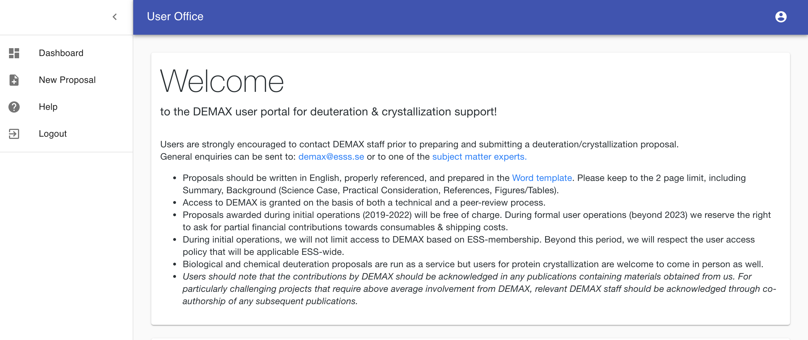
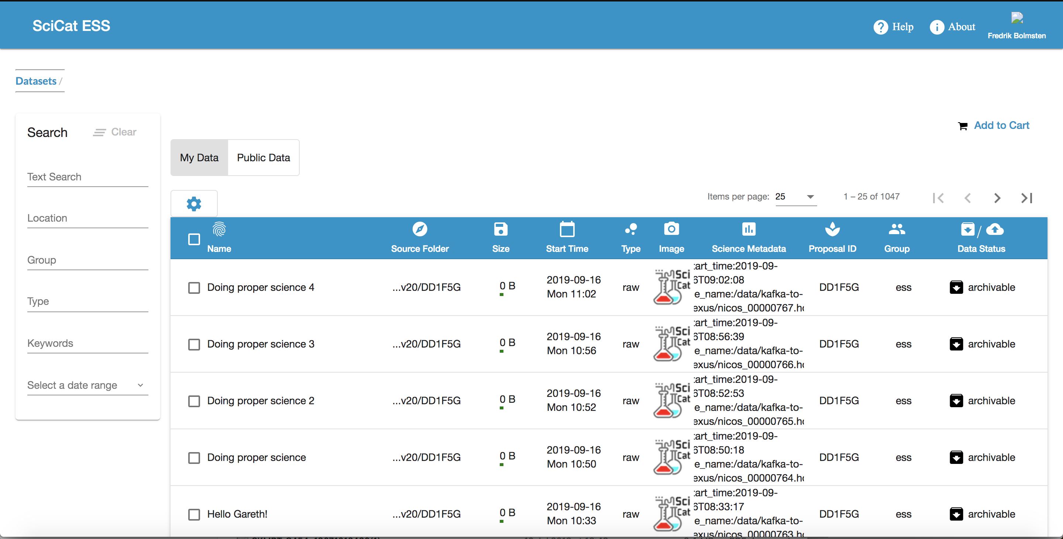
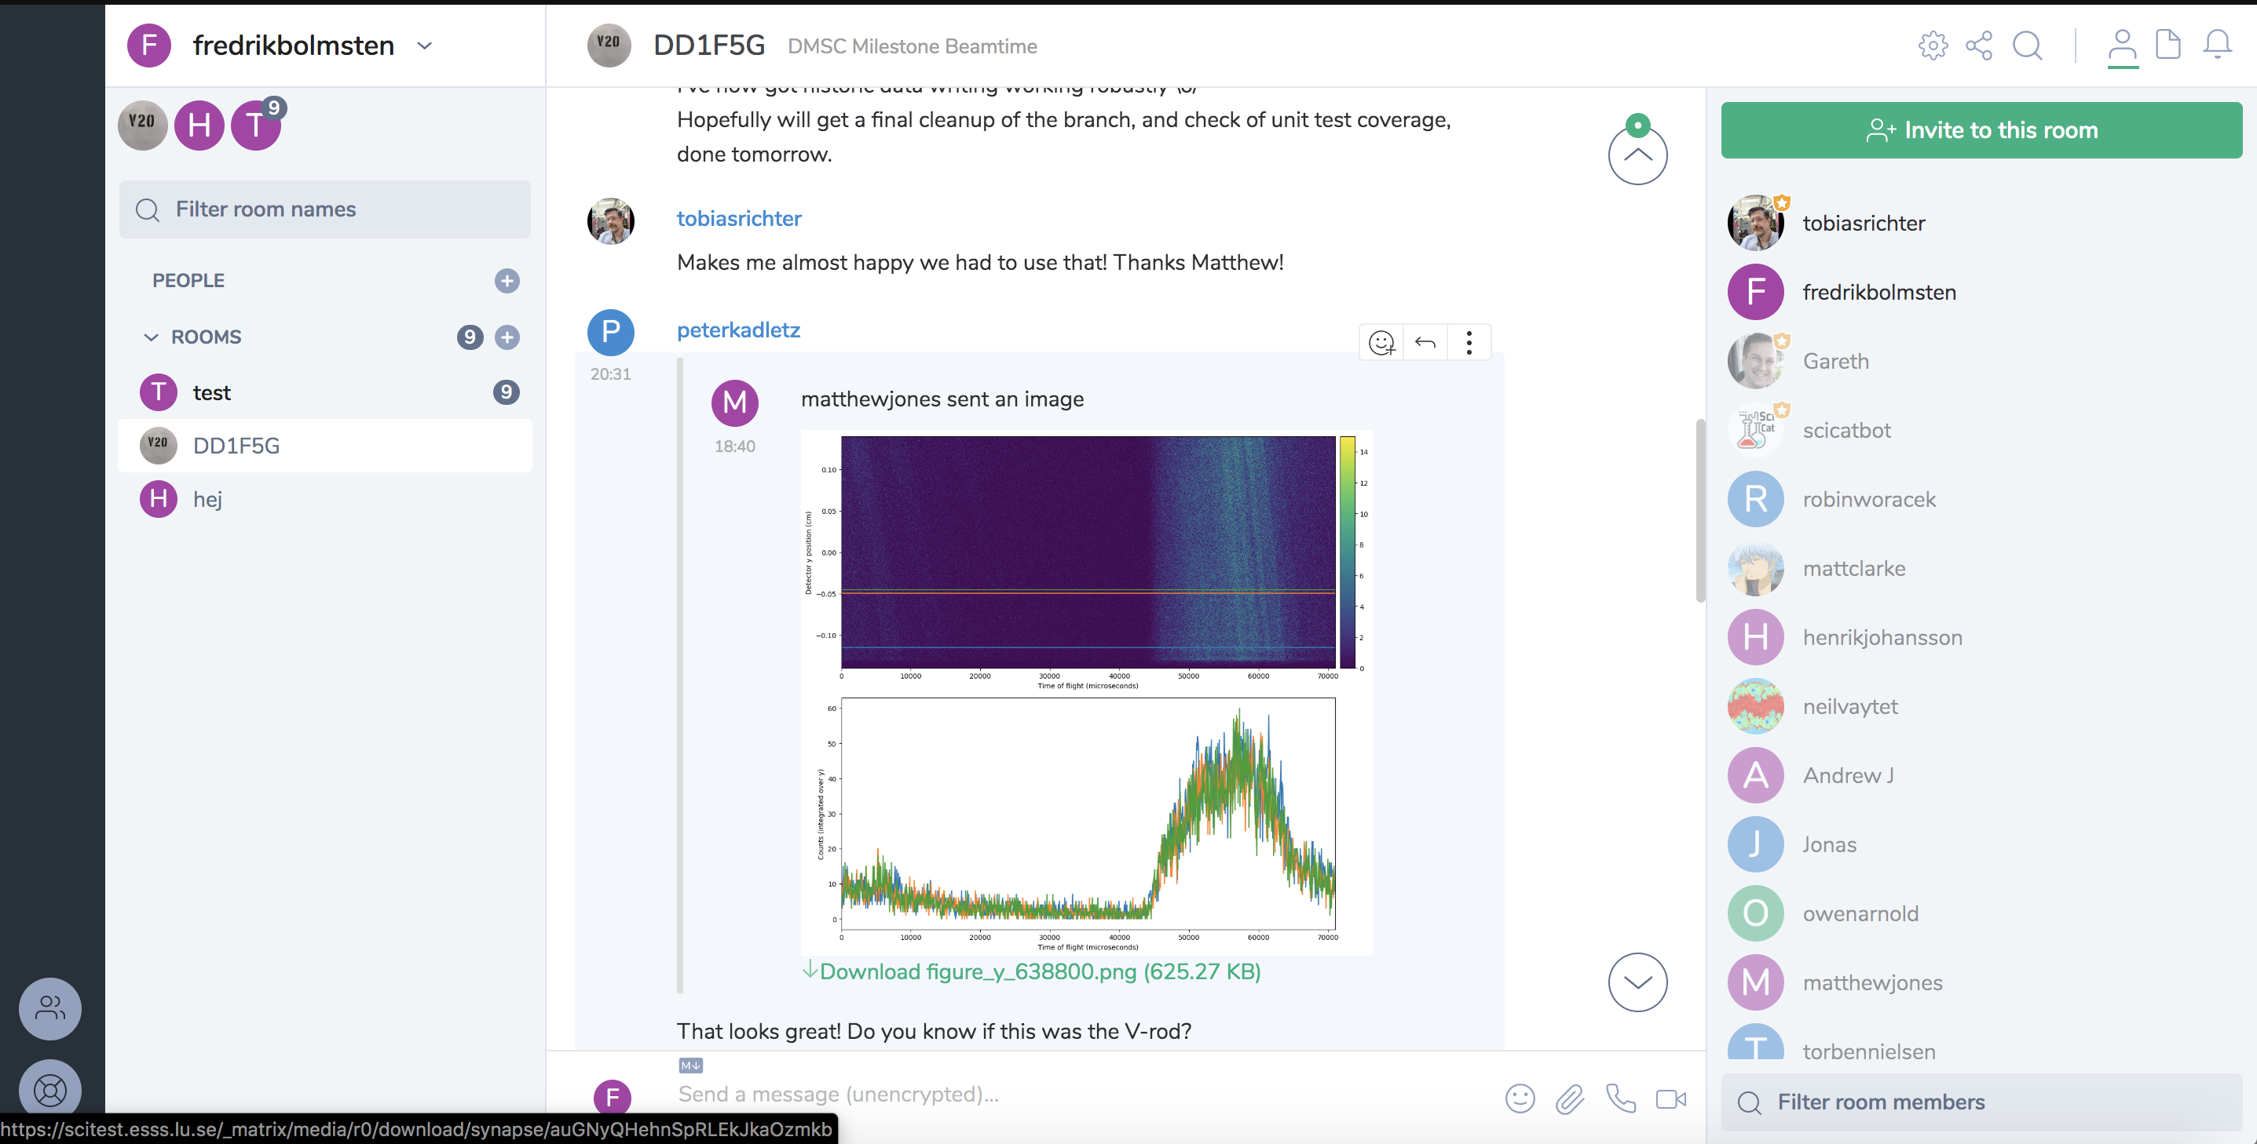
Web Team
Fredrik Bolmsten - Section lead (Started 6th May)
Gareth Murphy - Data Curation Scientist
Jekabs Karklins - Software Engineer (Started 1th of August )
Henrik Nilsson - Contractor (Junior Developer)

Slide 3
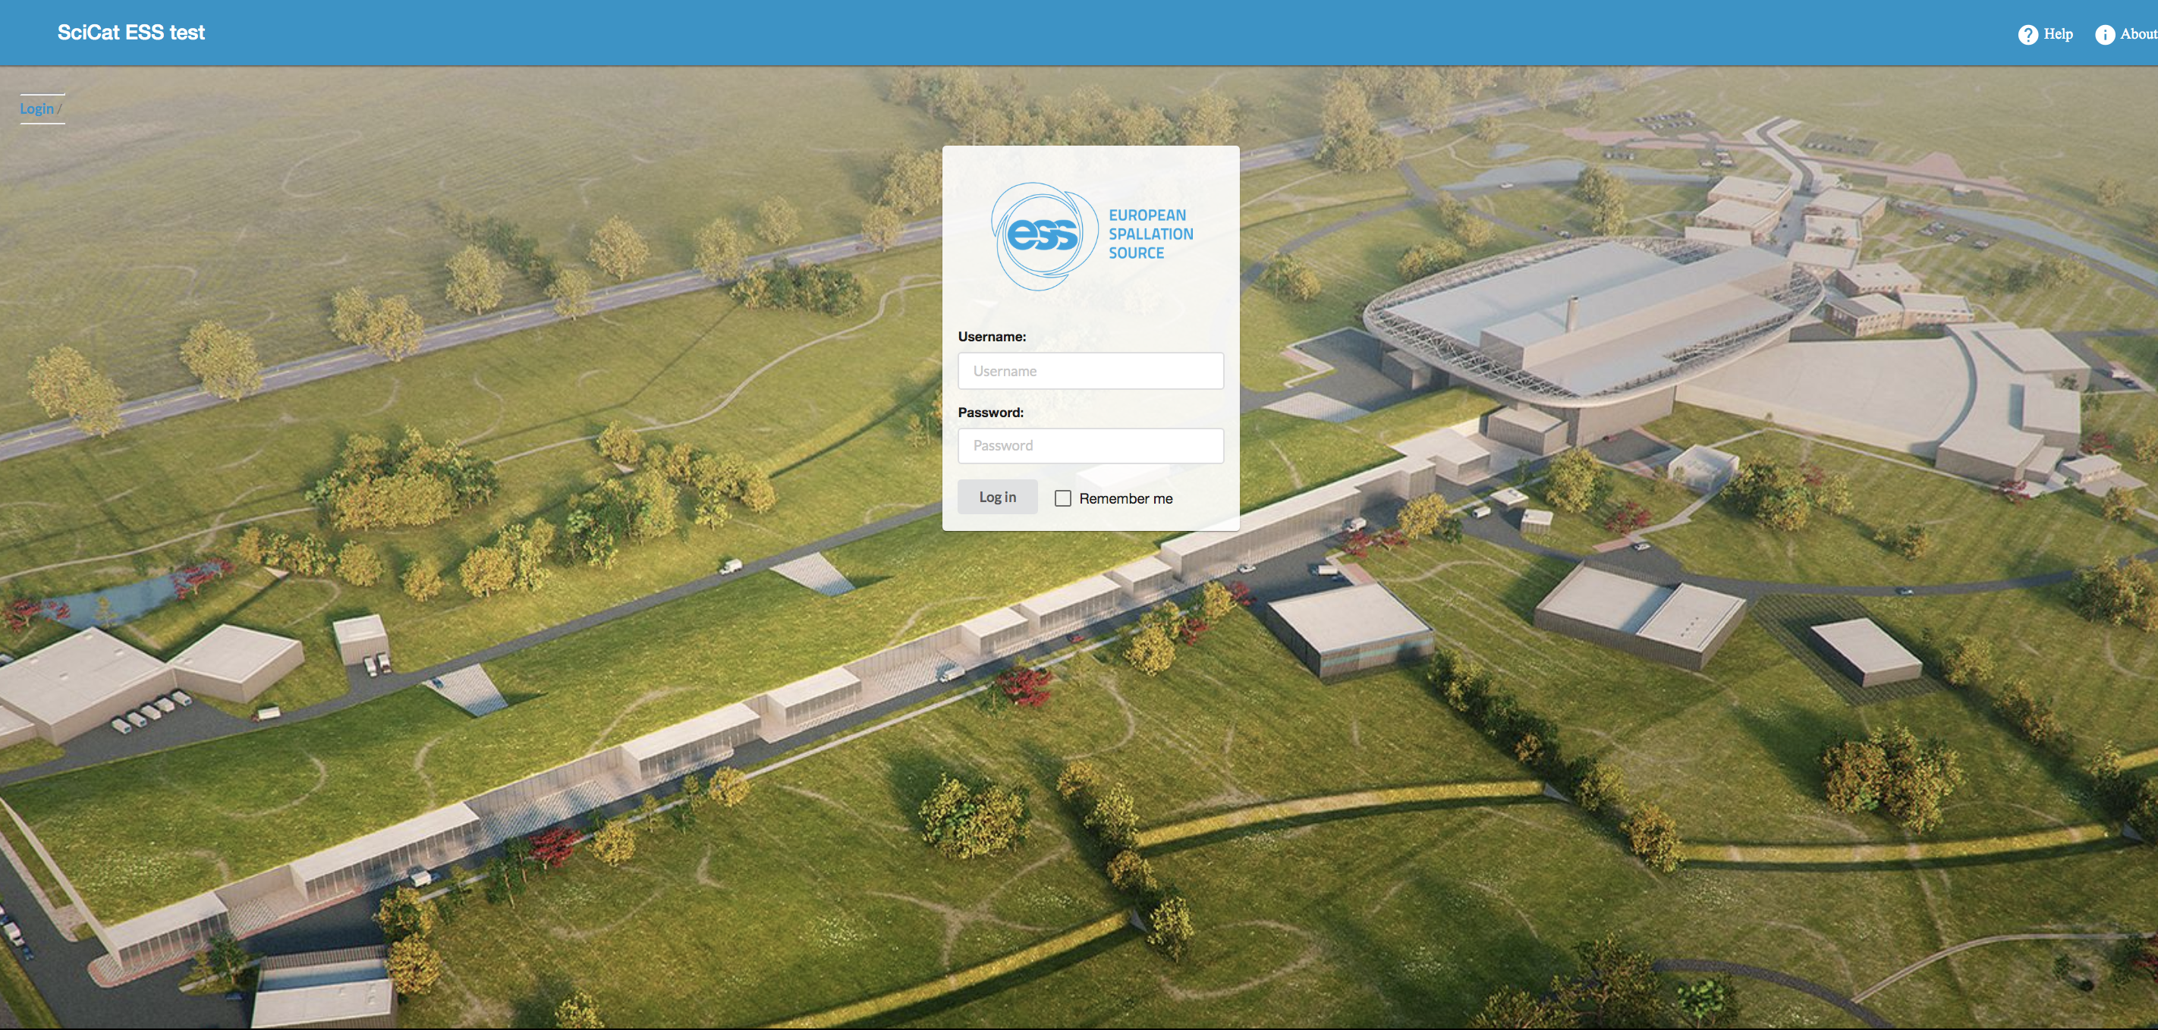
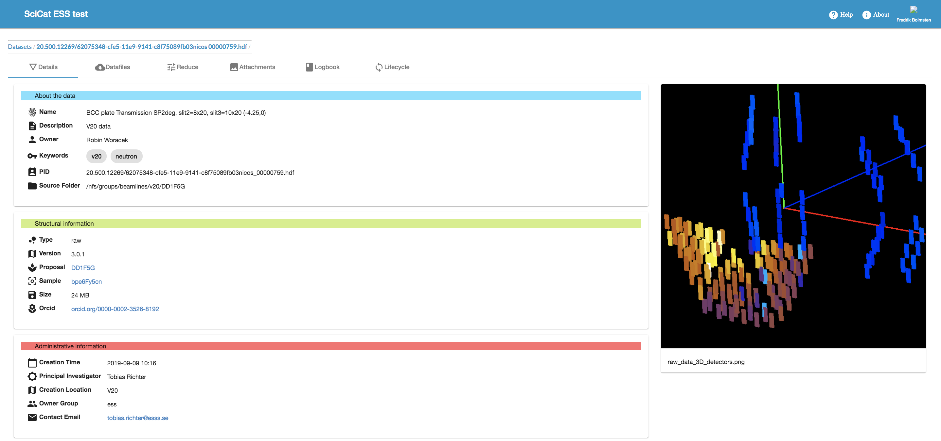
SciCAT
In production
Collecting data from V20
Big interest from other facilities
In-kind contribution from PSI coming to a close
Work for PaNOSC project started
Overall status looks good but a lot of work still remains

Slide 4
PaNOSC

Slide 5
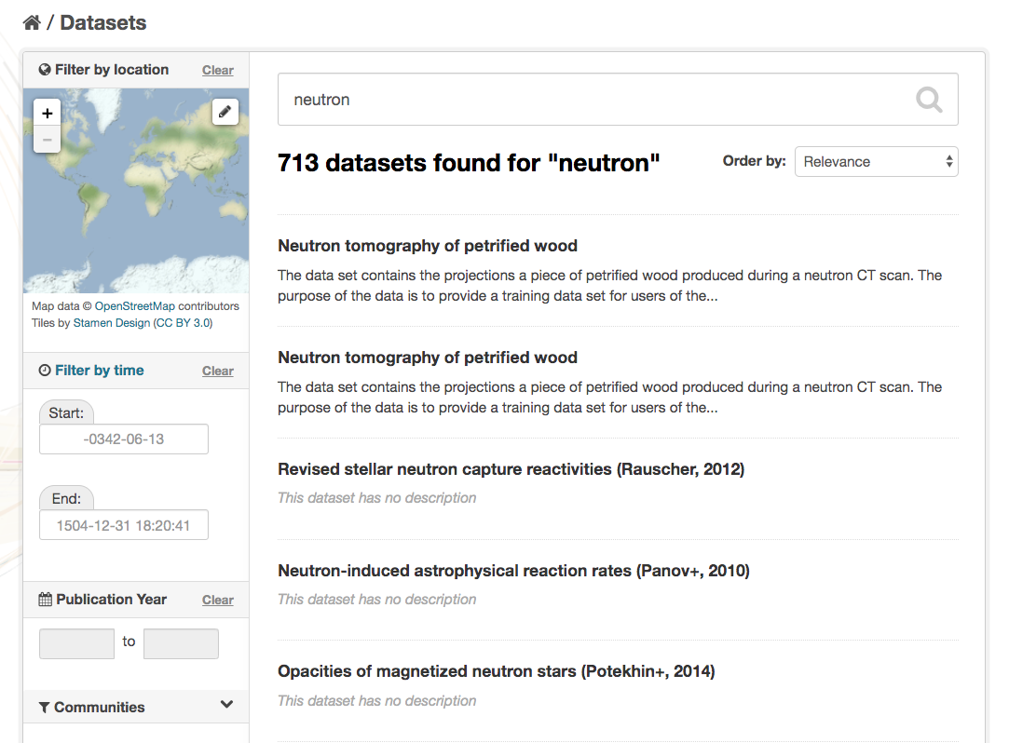
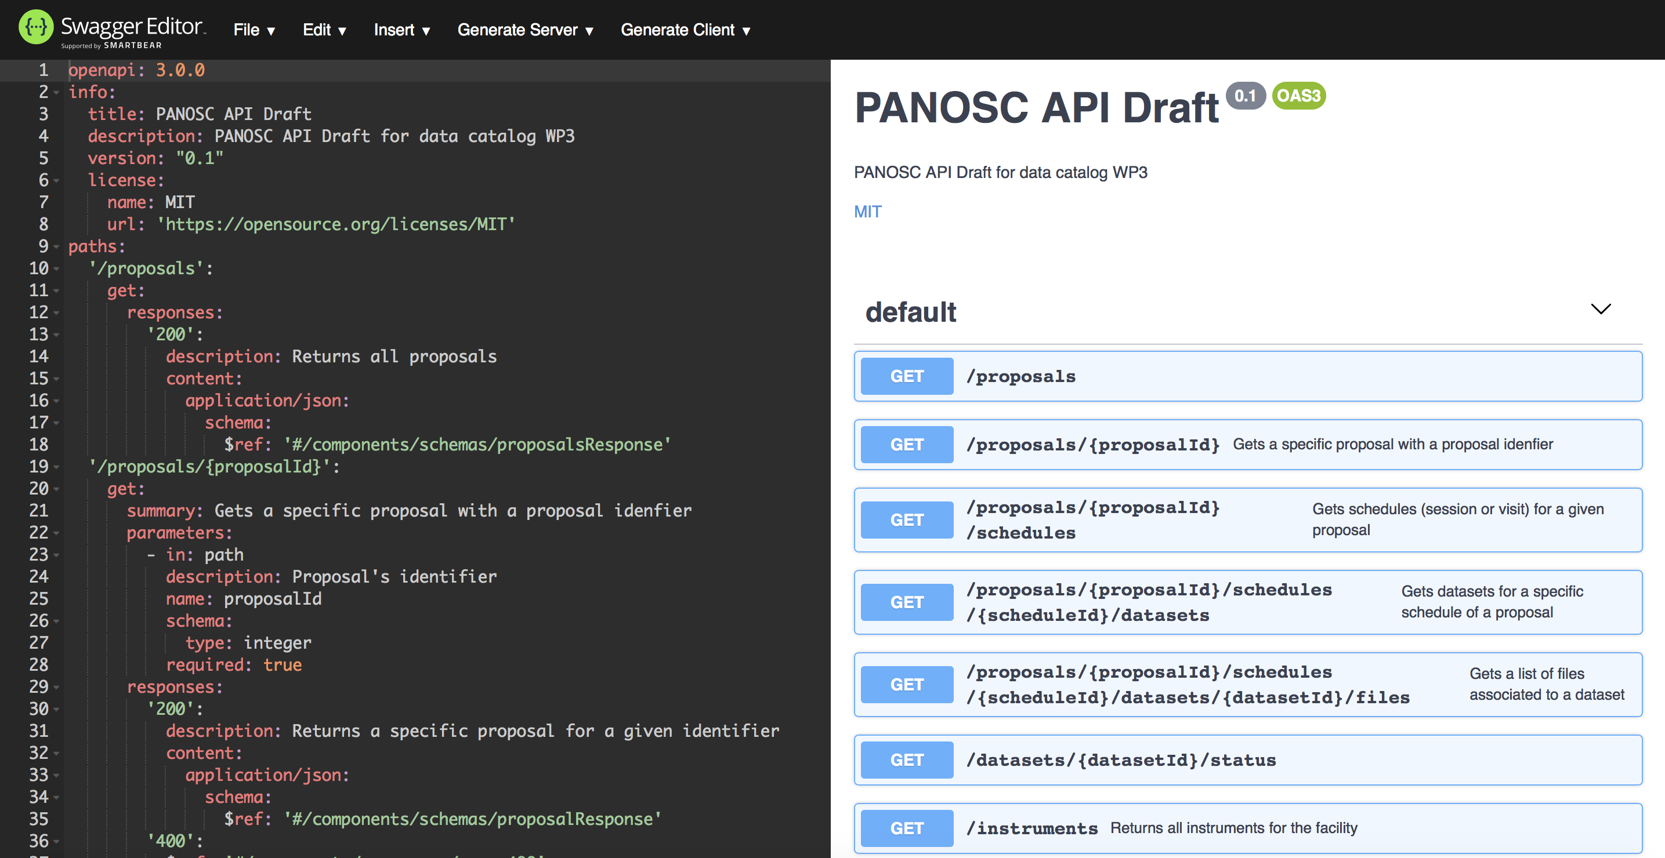
PaNOSC
Work Package 3 – Data Catalog Services – Tobias Richter WP Leader
In work package 3, the partners create means for users and third parties to find datasets from photon and neutron sources using domain specific search terms.
WP3 also contains an API for data harvesting, that can be harvested by EOSC services.

Slide 6
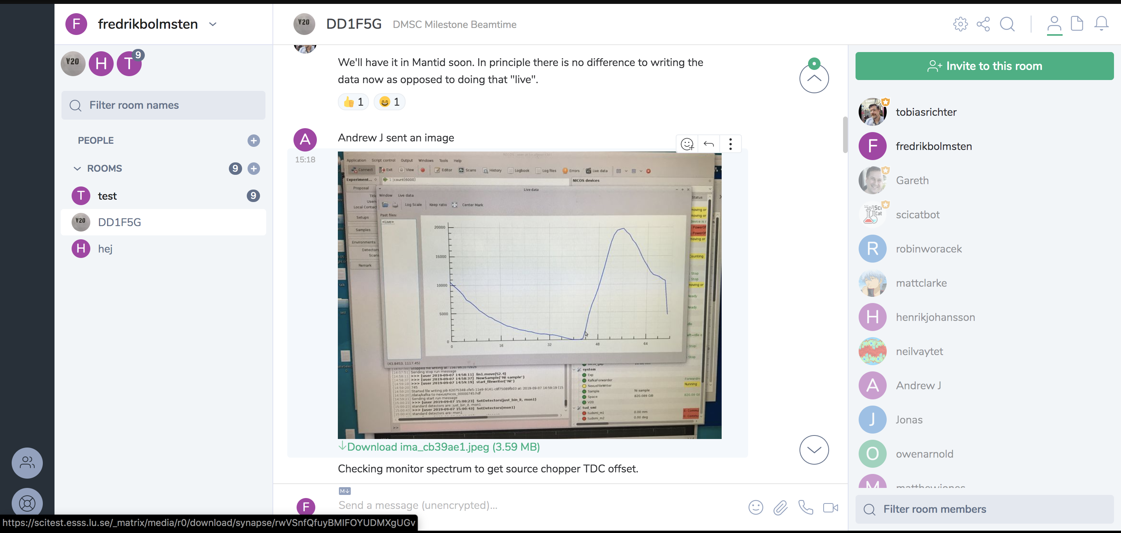
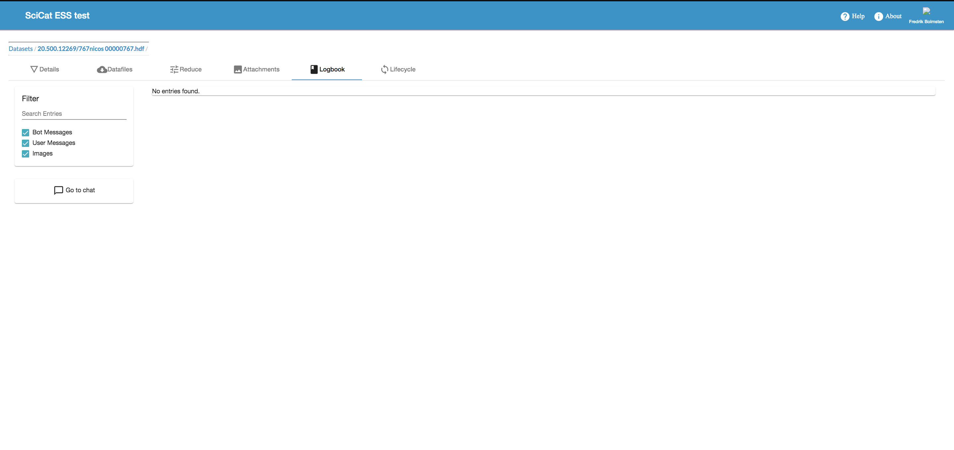
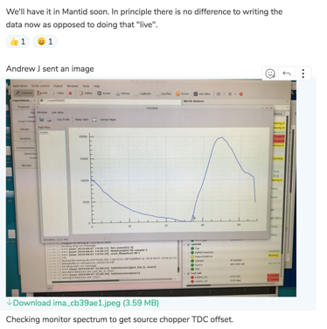
SciChat
New concept for logbook
Enables a more interactive logbook experience, like annotating messages from NICOS
Good channel for communication with beamline staff
Based on open source projects Riot and Matrix
Integrated with SciCat
Tested successfully at V20 run
Has emojis but lacks key one
App exists for both Android & iOS
Still more development and testing needed but looks promising

Slide 7
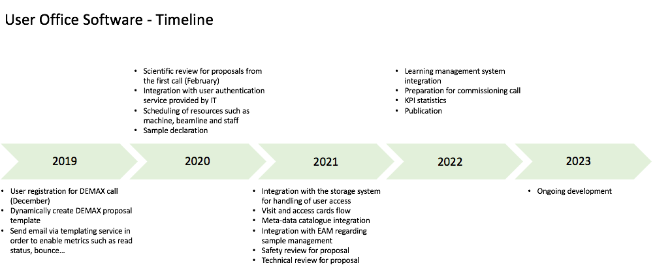
User Office
Based of lessons learned from DUO, UAS, VUO and PASS
Will handle second call for DEMAX (deuteration lab) proposals in December
Work started with new User Officer Carina Lobley
Collaboration with MAX IV
Recruitments delayed
Tight deadline in order to be ready for call 2023

Slide 9
User Journey with User Office Software
The user will input which scientist are actually coming and when they will arrive.
The user will complete required safety documentation and carry out necessary training.
The user will book required accommodation via ESS.
The user will ship their samples to ESS.
Access cards and any other required materials will be prepared.
Active Directory
Learning Management
Sample handling (EAM)
Email
Notification
Metadata
catalogue
Users will propose the scientific experiments they wish to carry out.
This will be reviewed for feasibility, safety and excellence.
The users will be notified of the success or otherwise for the proposal.
User Registration
Proposal Submission
Experiment Scheduling
Experiment Planning
Reporting
Users register with their personal information.
Registration is a pre-requisite to submission of a proposal.
With details of registered users, ESS has a database of interested people with whom we can communicate.
Registered users who also come to ESS will need to provide sufficient personal information for physical access to site and digital access to systems.
After a visit to ESS, this record will need to link to radiation dosimetry records to prevent further access once limits are reached.
The software will contain the ESS run schedule.
The user may be able to highlight dates that are not possible for them to attend or that are particularly good.
Instrument scientists will schedule the accepted experiments in time when ESS is running.
Scheduling will cover scheduling the instrument, a local contact, required sample environments and user labs.
The user and all those involved will be notified of the final schedule for them.
User will provide feedback about their experiment.
User will provide a brief scientific report of their results.
Legitimate costs need to be reimbursed and invoiced costs paid.
User costs should be recorded and reported against an experiment.
KPIs to be reported to ESS management.
And more…
Storage
System
Report
generation

Slide 10
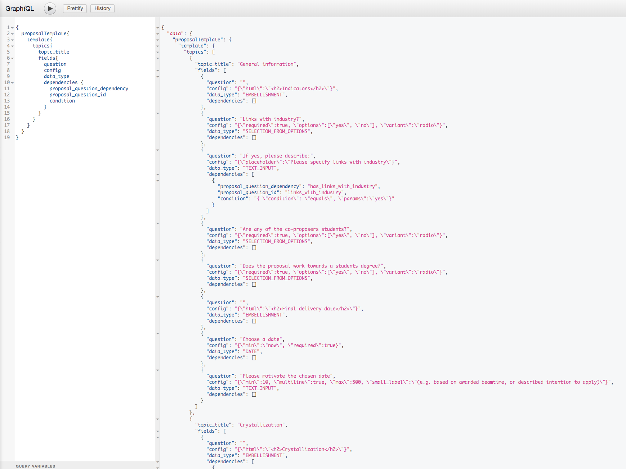
Technologies & Decisions

Slide 11
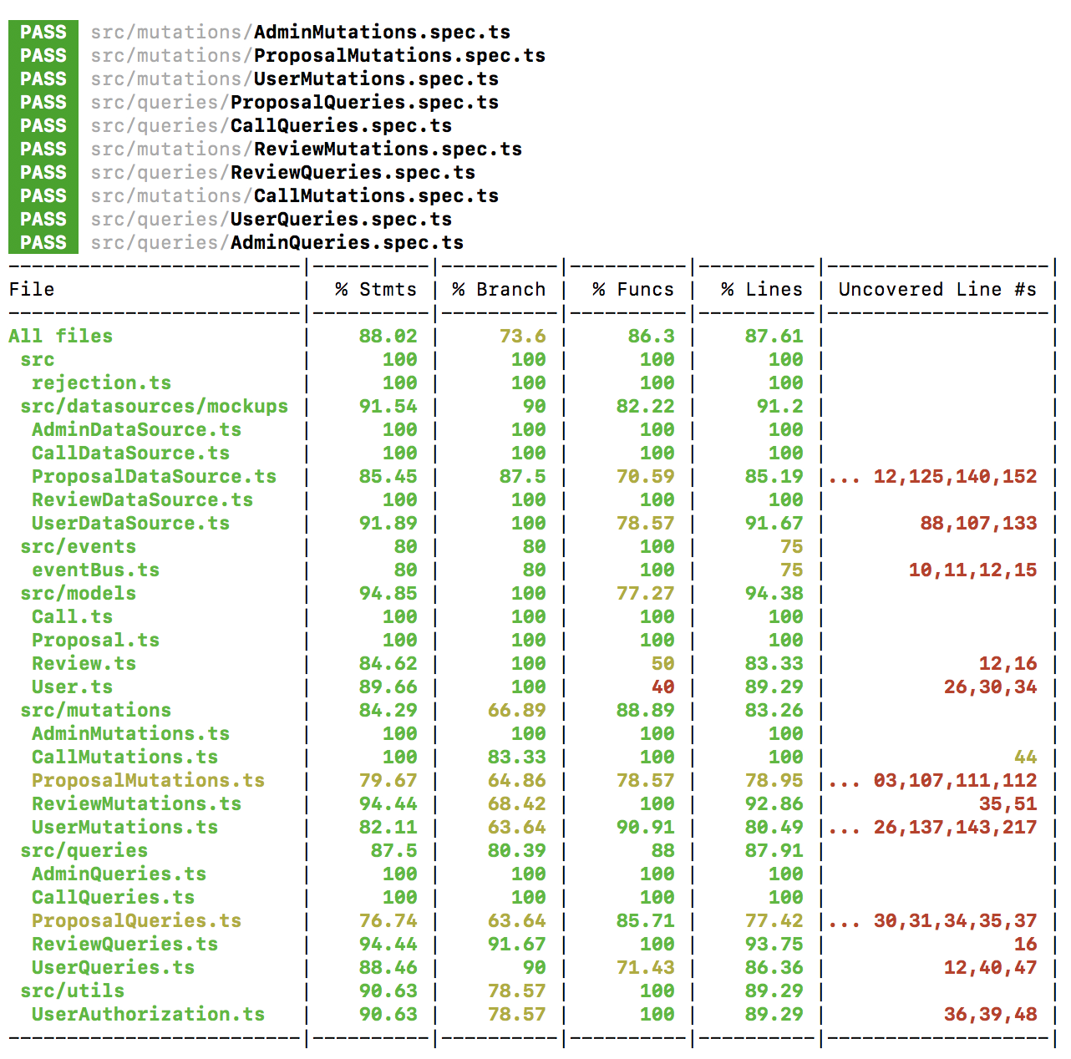
Tests and more tests

Slide 12
Risks & mitigations
Dependent on many internal resources | Will prioritize development on features that require third party integration
Lack of existing user office makes verification of software harder | Work with Max IV to deploy and test key features at their site
To little development resources to achieve full scope | Hopefully 2 filled positions spring 2020

Slide 13
Summary
Good start of forming new team
SciCat progress good and work with PaNOSC progressing well
SciChat looking promising, development continues
User Office ready for DEMAX call in December
Currently lacking resources to deliver full scope of User Office for first call in 2023

