Slide 1
Data Management Group Update Experiment Control and Data Curation (ECDC) Beamline Controls Team (BCG/BCT)
DMSC STAP – September 2019
European Spallation Source, Lund, Sweden

Slide 2
Who are we?
What have we done?
What are we planning?

Slide 3
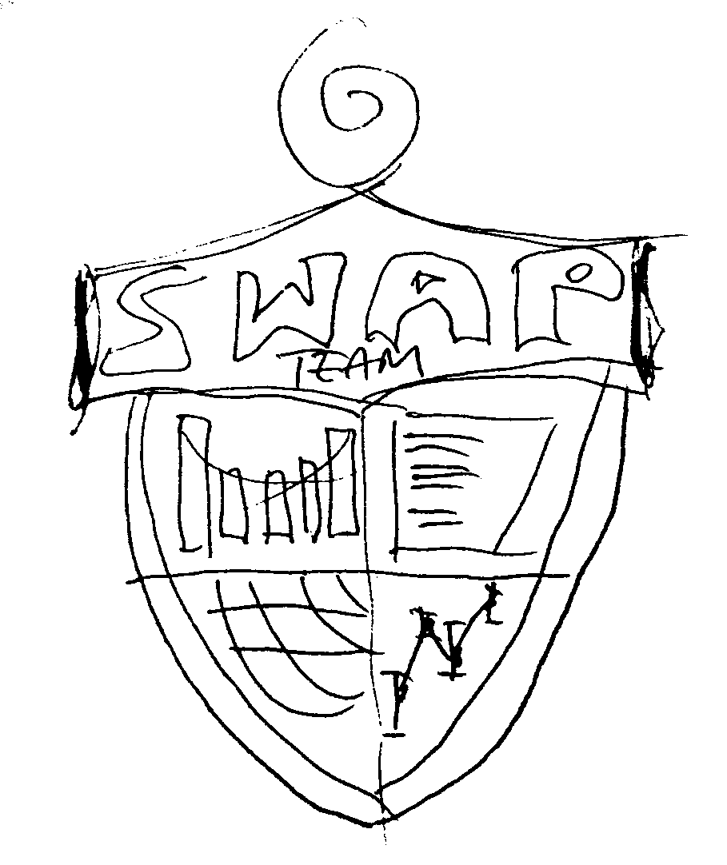
Welcome SWAP!
Scientific Web Applications
User Office / DEMAX
SciCat (data catalogue)
“SciChat” (experiment logbook)
Own section, also in the STAP
Fredrik

Slide 4
Who is in the group and what do they do?
 | Morten | EFU | Jonas | DAQ | Matt | Afonso
Event Formation | ● | ● | ○
Timing |  | ● | ● | ○
Streaming |  | ○ | ● | ○ | ● | ○
NICOS |  |  |  | ● | ●
BCT |  |  | ● | ● | ●
Testing | ● |  |  |  |  | ●
Deployment | ○ |  |  |  |  | ●

Slide 5
Milestones for Construction and Initial Operations
Status April
Date | Title | Description
2018-03 | NeXus file definition ready | ✅ - Example files for instruments available.
2018-06 | File writer complete | ✅ - Files according to the most up to date NeXus definition can be written by the streaming framework from simulated (or real) data.
2018-12 | DAQ & Experiment Control integrated on test beamline | ✅ Full prototype integration of NICOS, data streaming and detector readout. Not reliant on ICS infrastructure Integrating as much ICS scope as possible, e.g. timing.
2019-02 | Data view integrated in NICOS | ✅ Data on detector can be live-visualized (Widget from Mantid).
2019-03 | Reduction view integrated in NICOS | Reduced data can be live-visualized (Widget from Mantid).
2019-04 | Data available in SciCat | Metadata searchable, raw data downloadable from an automated ingestion that is integrated into an advanced data collection prototype.
2019-10 | Proof of experiment control and DAQ | Final version for construction phase with an amount of robustness.

Slide 6
Milestones for Construction and Initial Operations
Status at today
Date | Title | Description
2018-03 | NeXus file definition ready | ✅✅ - Example files for instruments available.
2018-06 | File writer complete | ✅✅ - Files according to the most up to date NeXus definition can be written by the streaming framework from simulated (or real) data.
2018-12 | DAQ & Experiment Control integrated on test beamline | ✅✅ Full prototype integration of NICOS, data streaming and detector readout. Not reliant on ICS infrastructure Integrating as much ICS scope as possible, e.g. timing.
2019-02 | Data view integrated in NICOS | ✅✅ Data on detector can be live-visualized (Widget from Mantid).
2019-03 | Reduction view integrated in NICOS | Reduced data can be live-visualized (Widget from Mantid).
2019-04 | Data available in SciCat | ✅ Metadata searchable, raw data downloadable from an automated ingestion that is integrated into an advanced data collection prototype.
2019-10 | Proof of experiment control and DAQ | ✅ Final version for construction phase with an amount of robustness.

Slide 7
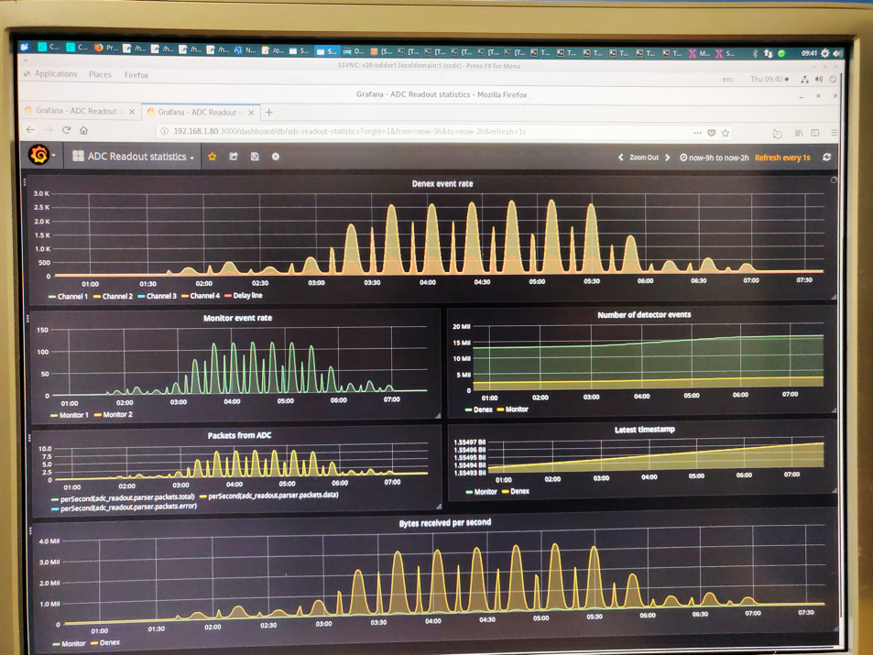
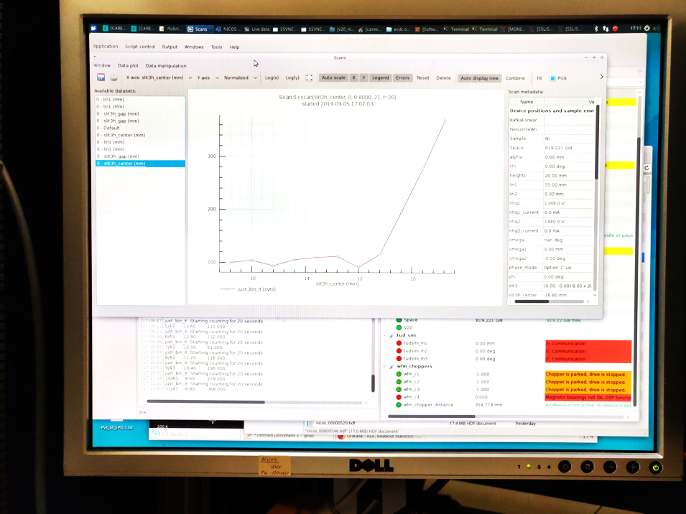
Progress connected to
Scanning Tests
Reflectometry
Tests of Detectors and Monitors
Integration Milestone Measurements (Diffraction)

Slide 8
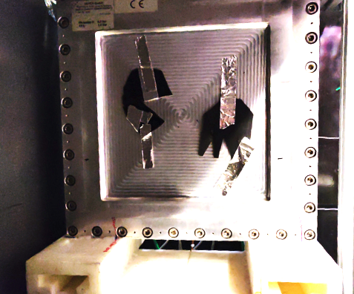
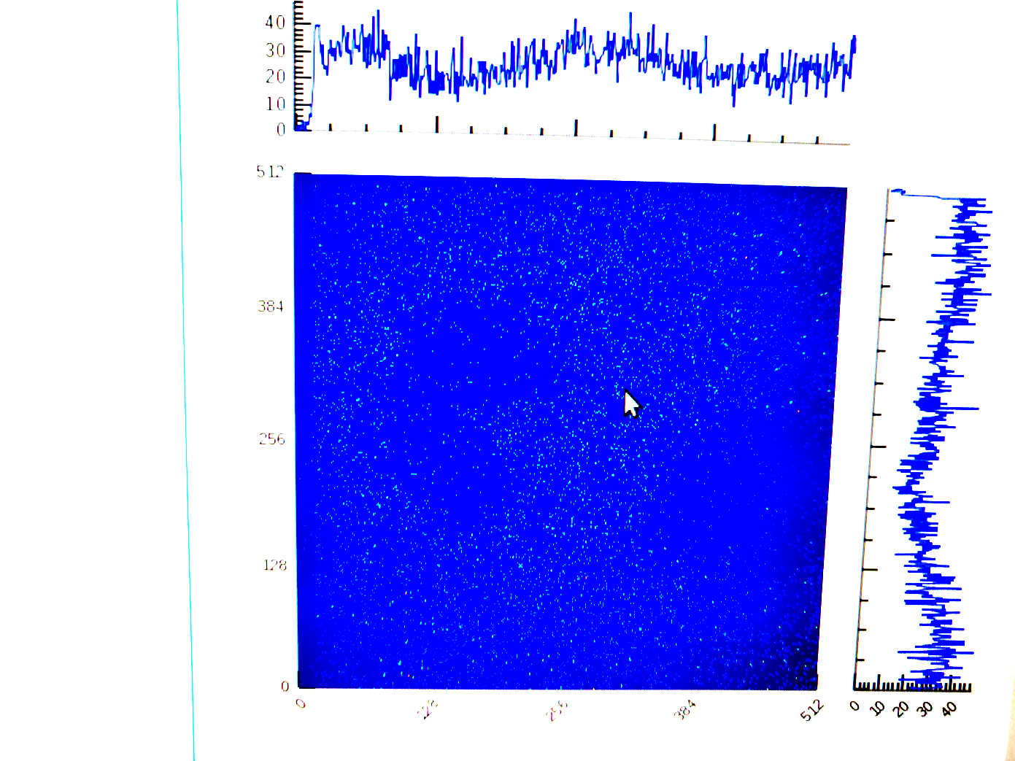
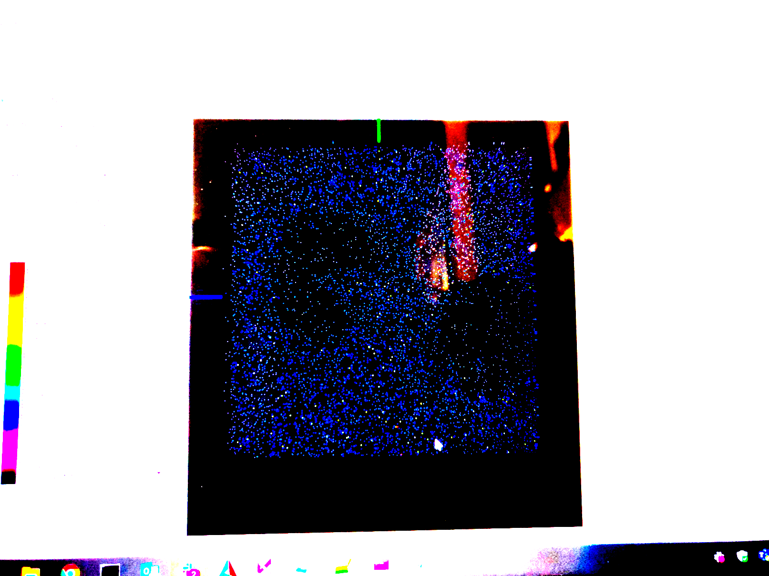
Milestone Beamtime September
Detector
Readiness Report: ESS-1511935 (draft)
SciChat
NICOS (just-bin-it)
Mantid

Slide 9
NICOS – Experiment Control
Michael (ISIS in kind) left for BNL – shared control and reduction in kind with DRAM ended for us
Michele (PSI in kind) took over V20 support, started working on UI improvements from UX course
NICOS Meeting with FRM/FZJ/PSI
Learned more about scanning, fitting and live view
Decided on collaborative workflow, code now also on Github
NICOS demonstration at IKON by Matt and Pascale
Upcoming tasks
Small fixes and improvements, based on V20 tests and input from instrument teams
Continuous scanning
Instrument specific UIs (initial operations scope)

Slide 10
Recent and Ongoing Streaming Work
Getting data to Mantid
Geometry constructor as tool to check and update the NeXus instrument geometry and the device configuration
Updates to file writer modules (how files are written) and for running file writers in a central pool
Testing and updating Kafka AD plugin for ODIN or sample cameras

Slide 11
Detectors
Martin left – Recruitment ongoing
No progress on the front end data format
Delays to the readout slow control
Source timing information available from prototype readout system (through from MRF) for ”TOF” referencing in the event formation unit
Continuous engagement with ESS DG, for example software engineering workshop, tests in the LU test facility, etc
Interactions with Instrument Teams
ODIN, DREAM, BIFROST
Loki test experiment in the next months at ISIS with most realistic readout setup to date

Slide 12
Beamline Controls Team
Still no official recognition from ICS management
ICS WP12 has three coordinators and three integrators (total of two ESS employees)
Mostly constructive relationship, processes and workflows are still developing on both sides.
Varying levels of engagement with other parts of ICS (for example Infrastructure and PSS)
Integration of NSS controls staff improving
Little progress on timestamping for motion (and sample environment) equipment

Slide 13
Utgård / Ymir
IBM Spectrum Scale on loan until March – guaranteed I/O 24 GB/s. Testing for
Performance
Scalability
Reliability
Deployment
Took time to set up networking and test cluster machines, buying odds and ends, good support from ICS.
Ymir demo beamline for hands-on work with BCT
sample area with infrastructure and supplies
devices to be integrated and operated
“cabin” with workstation & screens
ECDC VIP demo days

Slide 14
Roadmap
December: SANS as final experiment at V20 (HZB/BER)
DREAM may use DENEX as reference in November
Instrument specific NICOS UIs and workflows
Detector Readout integration and EFU implementation
Working with instrument teams on planning for installations and commissioning: BCT, TG3, Detectors
BCT hardware integration
Governance - ECP/BCT Steering Committee
Today: ICS, all NSS stakeholders, in kind + Andrew Jackson
Nimble is the future:
Andrew Jackson (LOKI, Neutron Instruments)
Rasmus Toft-Petersen (BIFROST)
Marie-Louise Ainalem (NSS Planner)
Need to ramp up staff for instrument integration (running recruitments are replacements)

Slide 15
Summary
Group is nimble and acts very agile.
Overall the current status of data acquisition and experiment control is more than acceptable and ready for initial operations, see ESS-1511935.
Good progress on core NICOS areas, like scanning and visualisation.
Testing of Data Acquisition Chain helps to identify a small number of bugs and to highlight areas to the can be improved.
Detector Readout development continues to be delayed. But good progress on timing could be made when that was essential.
Integration with Mantid works exclusively via NeXus both for live streaming and for data on disk.
Interactions with instrument teams are starting to ramp up, especially on detectors.
BCT has positive impact on NSS integration and ICS implementation and delivery, despite being continuously obstructed by ICS management.

Slide 16
Thank you.

