Slide 1
DRAM updates
Thomas Holm Rod
September 24, 2019

Slide 2
In brief
Staff;
  Reorganized how we work
  No new recruitments
Current in house dev projects;
  LoKI software ready for operation
  Scipp data reduction framework
  Analysis software for diffraction
Diffraction. Collaboration with LLB and ILL, several user groups interested in engaging.
Instrument data scientists. Planned onboarding.
Milestones. More or less on track.
External funding.
  SINE2020 ending
  PARADISE H2020 project rejected

Slide 3
Milestones and timeline

Slide 4
DRAM Time line and milestones (Fall 2018)
- Version: March 2018
Plann. | Antici. | Description | Status
’18-07 | ’19-05 | SasView ready for SOUP (aka SasView 5 released). SasView compliant with non-functional and functional requirements. | Delayed. SasView 5 demonstrated and tested at codecamp at ESS in September. ⍺-version presented at SAS2018 in October at dedicated workshop for ~40 persons. β1- and β2-version released. Final release expected in May.
’18-08 | ’19-05 | FullProf development begun. Collaboration with ILL kicked off | Delayed but started. Had ILL meeting in December. Two persons will visit ILL for a week in May to get collaboration started. LLB collaboration started in parallel.
’18-Q3 | ’18-11 | Recruitment of 2 persons for Mantid, 1 for SpinW, and 1 for analysis in general. | ✅ Neil, Igor, Simon W and Andrew Sazonov recruited (+ Mads for PaNOSC)
’18-09 | ’18-09 | Office move. | ✅ Presumably completed – now with curtains!
’18-09 | ’18-08 | Reduction on the fly. Data can be reduced on the fly for SANS2D for acceptance test but only low flux. | ✅ Demonstrated on local setup reading data from kafka stream.
’18-10 |  | Data reduction from NeXus. Data reduction of test workflow available from NeXus files. | ✅ have been possible for a long time
’18-11 | ’19-04 | Integration of reduction and analysis services. Data can be reduced and analyzed on the fly for limited flux for instrument(s) chosen for acceptance test. | ✅ Works, although not with Kafka
Notes:
SasView:
Serious QA (Richard Heenan) at codecamp revealed several bugs. Thus, only alpha version will be used at codecamp.
Proper resolution function for ToF is not implemented (version 5.1)
Lessons-learned for next STAP meeting
Fullprof:
We do not get the feeling that the diffraction group at ILL is embracing the collaboration or open sourcing the software. We have not been able to setup a meeting so far, they have a lot of requirements for such a collaboration. Scientific computing group has not been involved.
Conclusion:
1) We should collaborate with ILL diffraction group but not rely on this collaboration

Slide 5
DRAM Timeline and milestones (2019)
- Version: March 2019
Planned | Anticipated | Description
’19-01 | ’19-05 | PaNOSC recruit(s) started. Linda Udby and Peter Willendrup seconded. ✅ 1 person recruited.
’19-02 |  | ✅ Data view integrated. Data on detector can be live-visualized with EC (Widget from Mantid).
’19-03 |  | (✅) Reduction view integrated. Reduced data can be live-visualized with EC (Widget from Mantid).
’19-05 |  | ✅ Software performance and integration testing validated. Data can be reduced and analyzed on the fly for expected flux of LoKI when in full operation Post batch processing can be performed on CPH cluster
’19-06 |  | ✅ Proof of operation (reduction). Data can be reduced on the fly for expected flux of LoKI when in full operation. Data are received from DAQ & Streaming system. Data can be post rereduced on cluster Need to be able to define the scaling parameter for the architecture rather than actually physically demonstrate
’19-09 |  | SINE2020 completed

Slide 6


Data processing software ready for operation of LoKI
Mantid live reduction of > 10⁷ events/sec and > 1 M detector pixels
SasView 5.0 released
Improved maintainability
Python CLI
New GUI
Batch fitting (via scripting)
Live analysis
Store and retrieve data from SciCat
LoKI specific resolution functions (aiming for end of 2019)

Slide 7
Data pipeline
EFU
Kafka
Mantid
SasView
Results
Fast enough
event formation
Fast enough
event feed into
Mantid
Fast enough
data reduction
workflows
Fast enough
data analysis
workflows

Slide 8
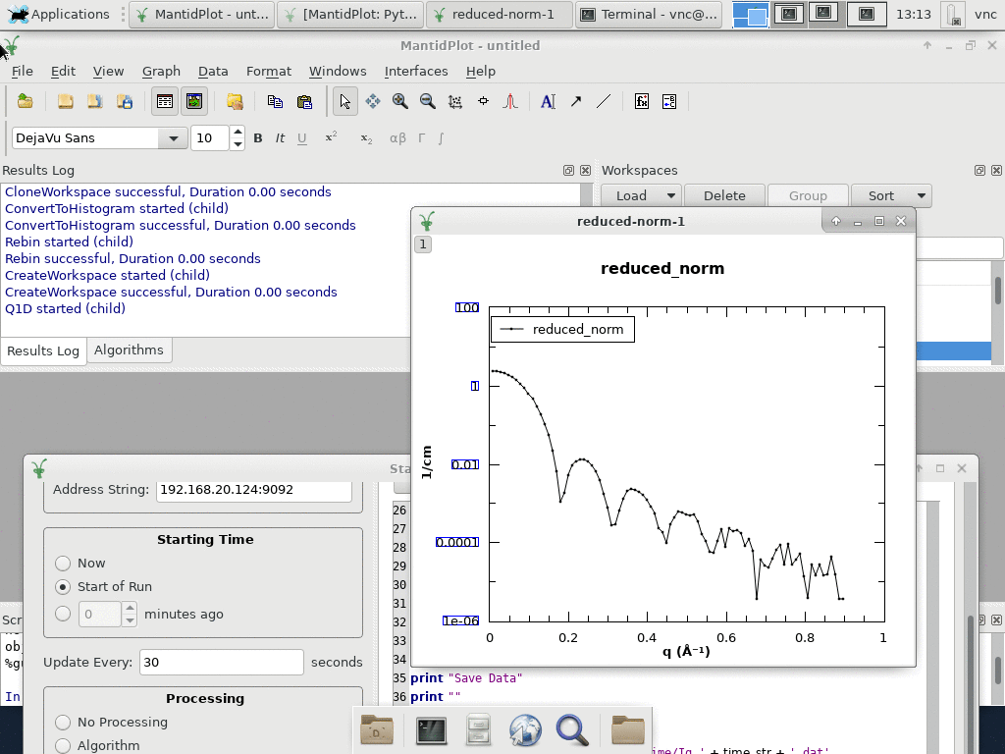
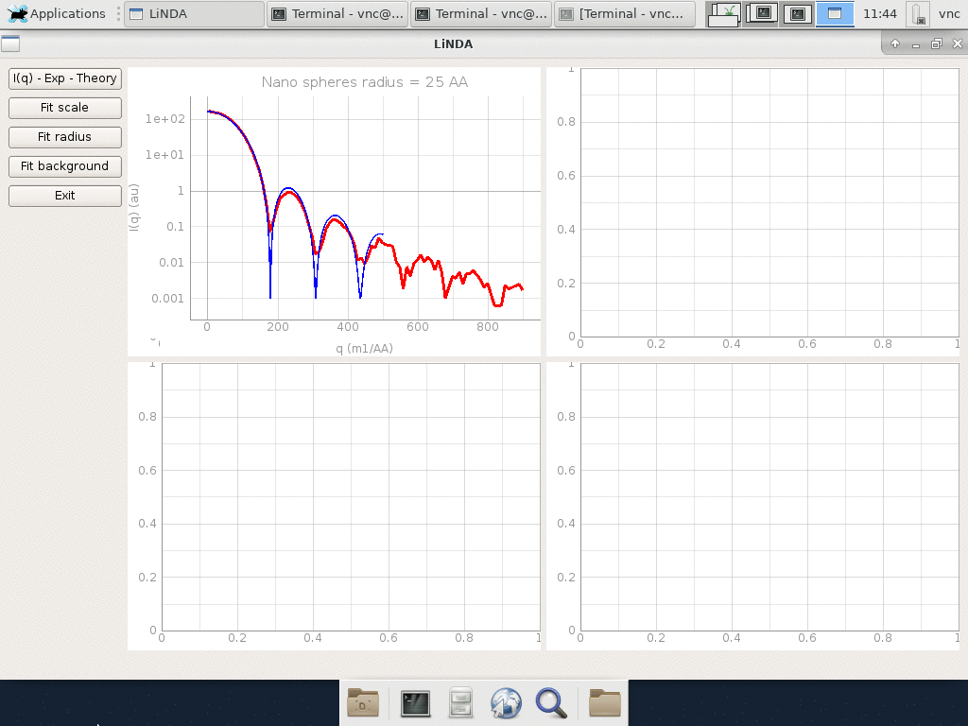
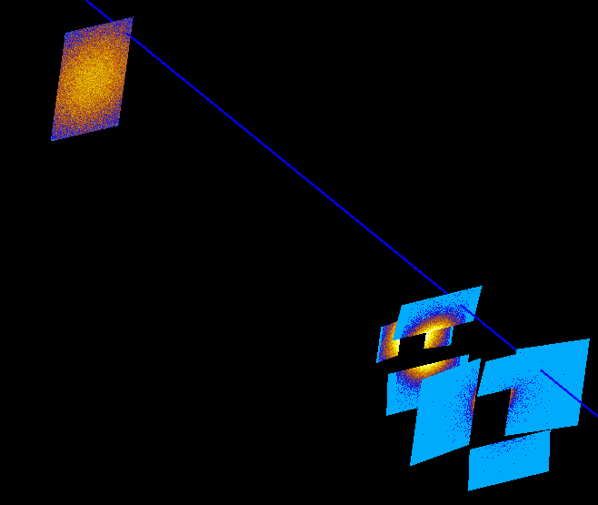
LoKI live data processing
nano spheres radius 25 Å

Slide 9
DRAM Timeline and milestones (2020 and beyond)
- Version: Sept. 2019
Data processing software ready for operation
 | 2019 | 2020 | 2021 | 2022 | 2023
LoKI | ✅
ESTIA |  | ✅
ODIN |  |  | ✅
BEER |  |  | ✅
DREAM |  |  | ✅
MAGIC |  |  | ✅
CSPEC |  |  | ✅
BIFROST |  |  | ✅
Associated milestones
2020: | 4 Instrument Data Scientists recruited
2022: | GUI support for data reduction ready
Same as in March, 2019
BOT
SOUP

Slide 10
Since last STAP

Slide 11
DRAM ”reorganization”; objectives
Ensure good working environment and efficient use of resources in growing group with large scope;
Avoding single point of failures and silos (people working alone on a project)
Ensure right prioritisation
Train new science oriented staff
Better integration of new members
Set direction for scipp project (maintainable data reduction software that can cope with ESS rates)
Mantid not drowning scipp and vice versa
Better integration between data reduction and analysis
Ensure focus in a noisy landscape of projects and requirements

Slide 12
”Reorganization”
Priority
DONKI | SCIPP | SWAT | E-learning
LoKI ready for operation, V20 and Mantid | 100% scipp development | Diffraction (& spectroscopy) Scipp support and everything else | PaNOSC WP8
Torben | Owen (Kanban) | Piotr (SCRUM) | Thomas/Jesper
Torben Wojtek (50%) Peter (33%) Lamar (ISIS) | Simon H Igor Dan (ISIS) | Piotr Simon W Andrew Mads | Linda (<10%) Peter (<10%) Mads (<10%) Kareem (DST) Alexandra (DST)
Neil
Owen (ISIS)
Céline
+ Imaging (Anders, Chiara | PSI in kind)
+ Reflectometry (Dmitry, Juan | FZJ in kind)
Céline instrument data scientist and Product Owner for diffraction

Slide 13
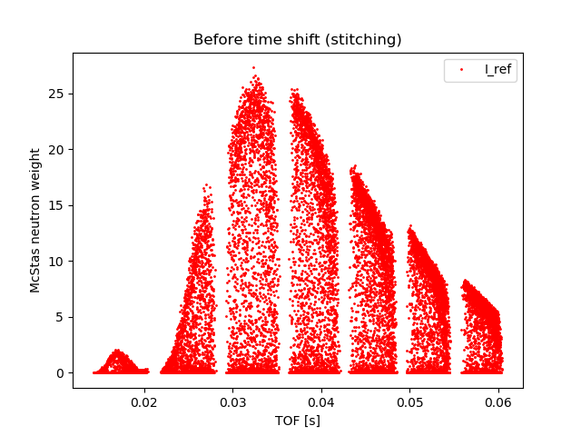
DONKI (SasView and Mantid)
SasView 5.0 released
Live streaming of instrument geometry demonstrated for IKON 17 and V20 September 2019
data streaming from Mantid +10^7 events/s
Support for NexusGeometry
Instrument team support
  V20
  LOKI
  FREIA
  MAGIC
Mantid training at DMSC
Oliver Löhmann
FREIA McStas simulations
Reflectometry @ V20

Slide 14
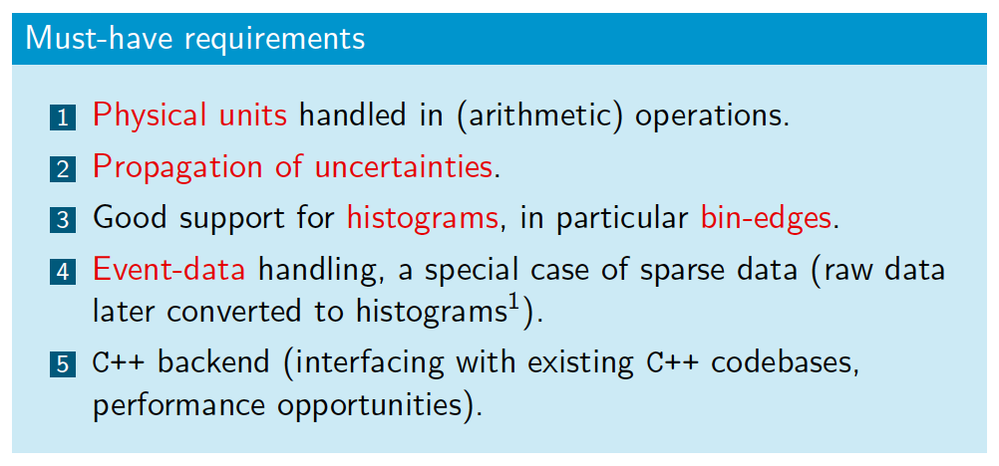
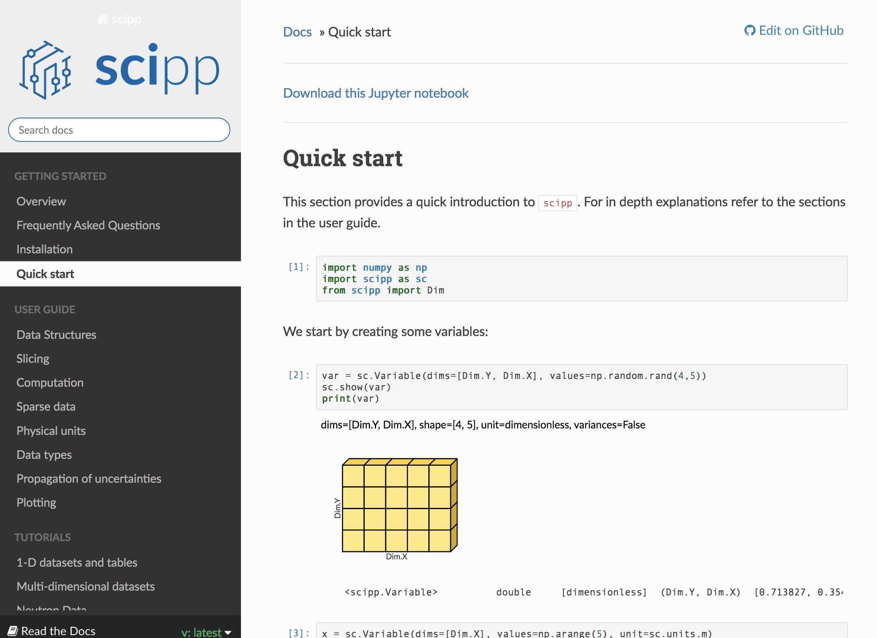
SCIPP (Data container)
Version 0.1 released
Currently three full time developers
Excellent Jupyter based documentation
Planning and prioritisation driven by DREAM
Outreach to other communities (e.g. XFEL.EU)
https://scipp.readthedocs.io

Slide 15
Diffraction (SWAT)
Collaborating with ILL and LLB (MAGIC)
Support from Oslo Univ., Uppsala Univ., and Columbia Univ.
Initial work on line profiles for BEER in CrysFML
Python bindings for CrysFML (ILL)
Minimum Viable Product for EasyDiffraction ready next week
  Continuous integration
  Documentation
EasyDiffraction (GUI)
CoDE (Python)
CrysPy (Python)
CCTBX (C++/Py.)
CrysFML (fortran)
LLB
Berkeley
ILL
Working on Python bindings

Slide 16
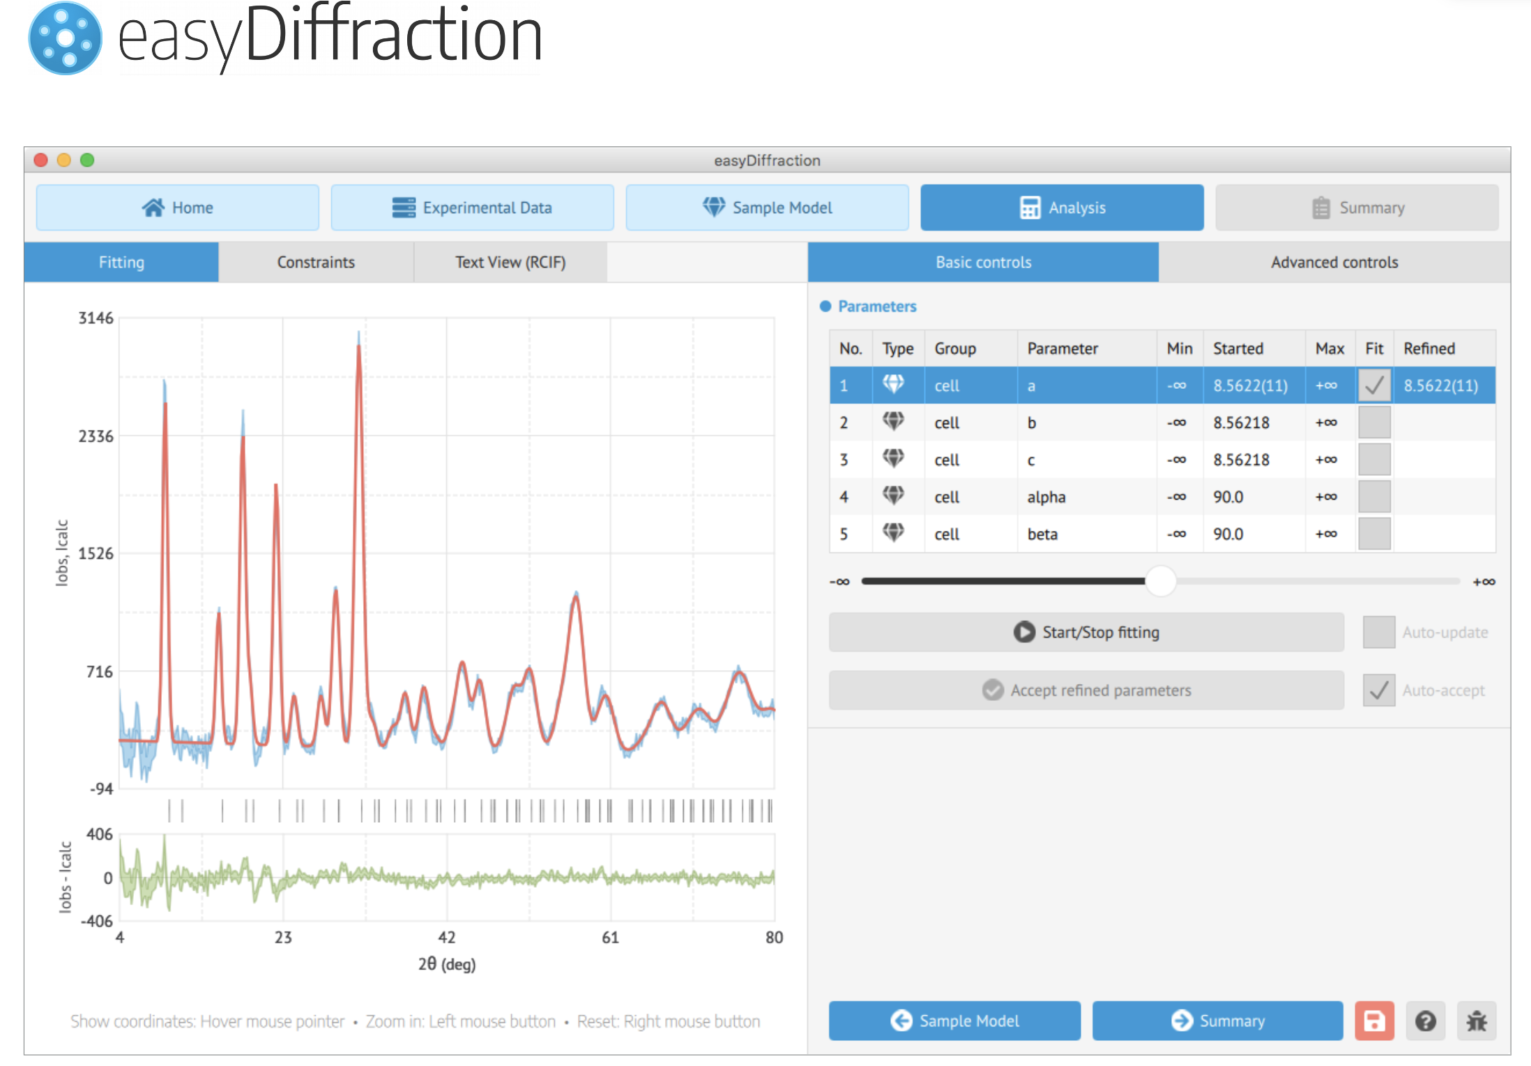
Minimum Viable Product and New (generic) GUI
Positive feedback form instrument teams and other potential users
Several university groups interested in contributing
Generic GUI can (in principle) be used for other techniques (SANS, reflectometry, QENS)
Work on standardization of visualization frameworks used across techniques

Slide 17
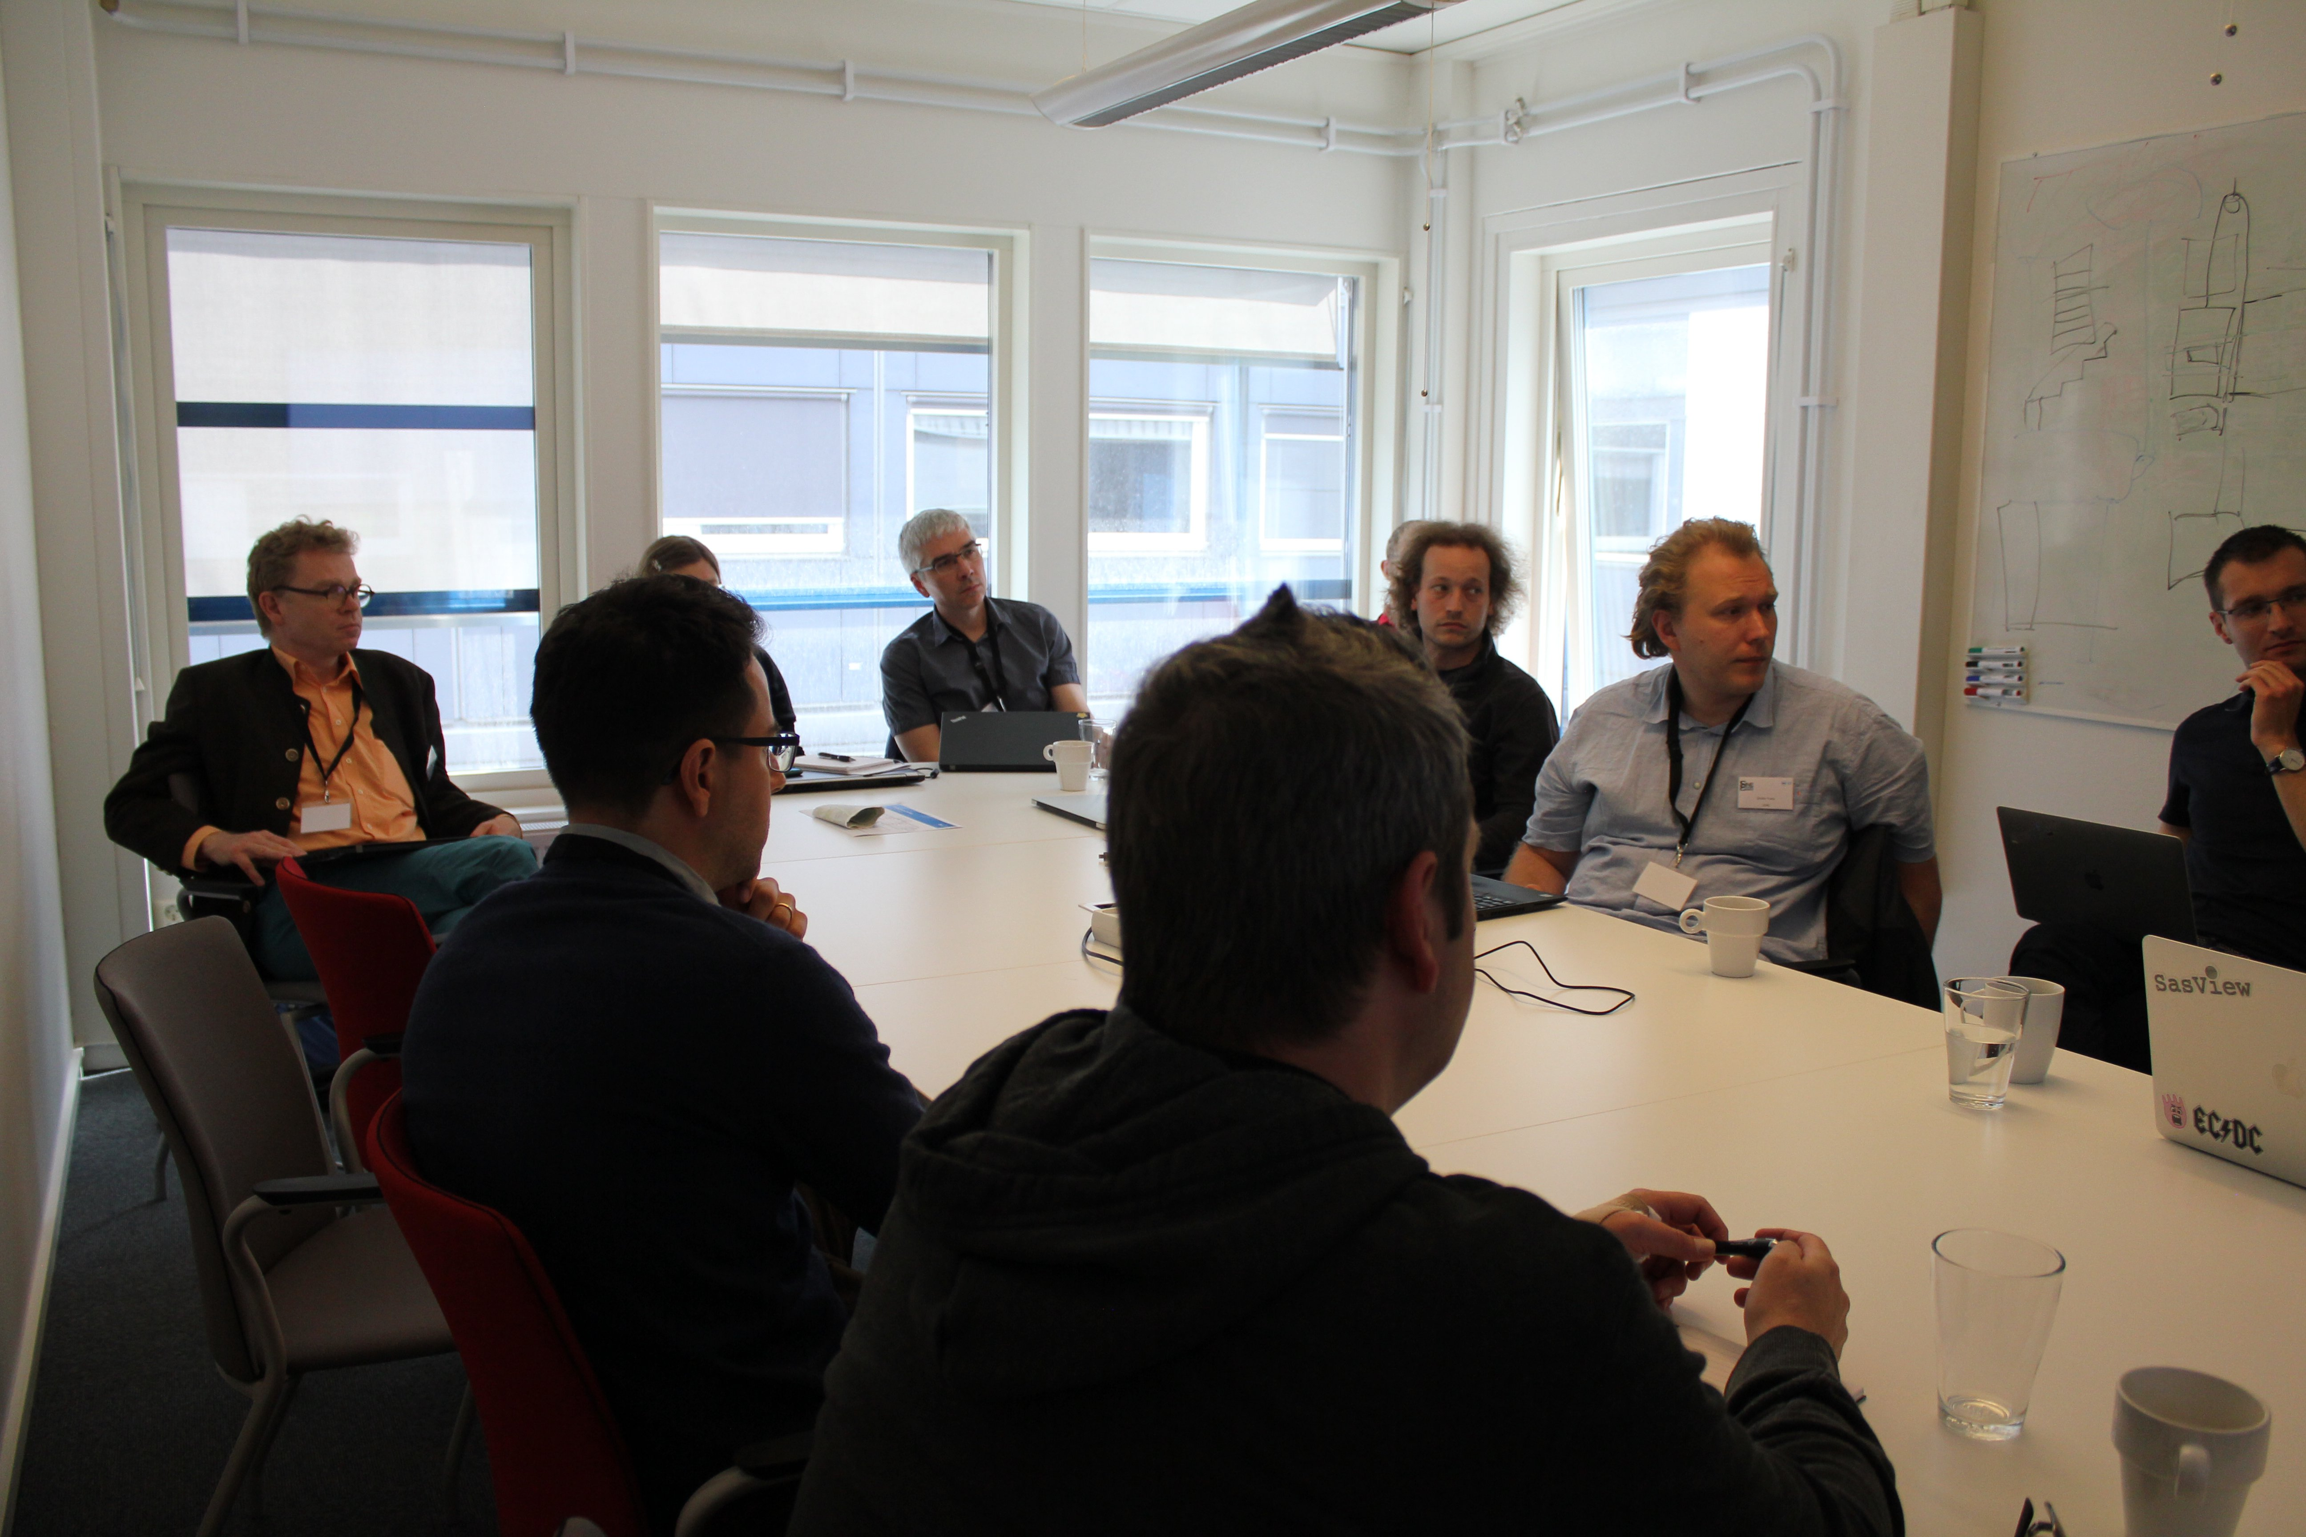
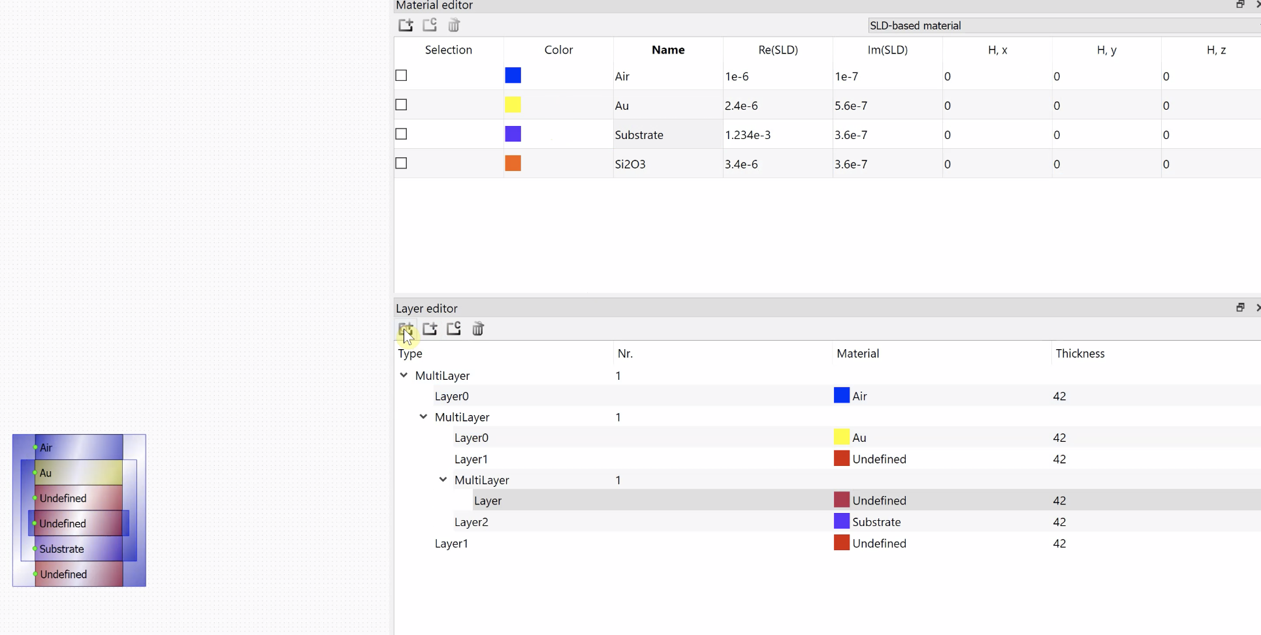
Reflectometry (FZJ in kind)
Break-out session at SINE2020 meeting.
Lund, May 2019 (FZJ, DMSC, NID)
Oct 2019: Standards for reflectivity meeting at ISIS (https://reflectivity.github.io/workshop/)
Spring 2020: Integrated layer model editor and polarization
Winter 2020: Data reduction based on scipp
May 2019: Data loader implemented
Jun 2019: Data errors implemented in BA core
Sep 2019: Layer model editor prototype
Prototype demonstrated at IKON17, Sept. 2019
Requirements: https://confluence.esss.lu.se/display/DAM/BornAgain+requirements+for+reflectometry

Slide 18
Imaging (PSI in kind)
Releases
  MuhRec release 4.2
  KipTool (major update on documentation).
  KipTool paper (SoftwareX)
Modelling
  Bragg edge fitting, validation on experiment data from ISIS. Publication in progress (target Applied Crystallography).
Python bindings
  A central selection of algorithms
  Collaboration with D. Tasev (ISIS)
Improved cleaning algorithms.
In particular scattering correction.
Work in progress:
  Transfer Grating interferometry reduction tool to GitHub.
  Bragg edge fitting in C++
  Core library revision → Speed-up to be expected
Manuscript in preparation (Carminata et al)
Wavelength (Å)

Slide 19




Spectroscopy
Fragmented contributions to spectroscopy so far
Simon W one-man army for SpinW
SWAT team
Externally funded
Simon W (SpinW)
SINE2020
New QENS GUI in Mantid (ISIS)
QENS model library (ISIS, ILL, ESS)
AbINS for lattice dynamics simulations
MDANSE for analysis based on MD simulations
PACE
HORACE
API
Swedish Research Council
MDMC (forcefield optimization)
New python interface
Interactive online workbooks (https://binder.pangeo.io/v2/gh/spinw/pySpinW/master)
Start of cluster computing capabilities
Teaching at modeling and simulation schools in Ispra and Tartu (25 participants each)

Slide 20
Summary
Good progress
Extensive outreach (instrument teams, users, teaching)
We can run (almost) everything from Python / Jupyter (incl. McStas)
Started to take lead in diffraction – good support from users
Try to continue SINE2020 collaboration in the realm of LENS
Need better planning / understanding of spectroscopy domain
What’s the budget the coming years?
Will we be able to recruit Instrument Data Scientists in 2020?

Slide 21
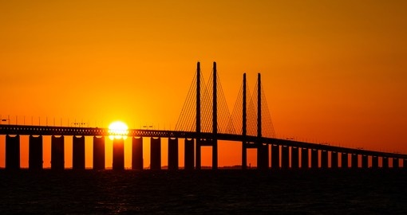
Questions?
QUESTIONS?

