Slide 1
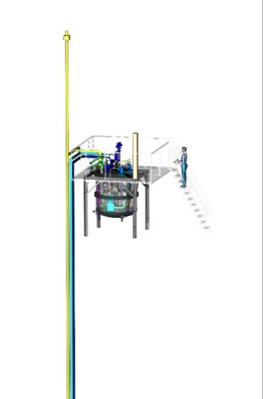
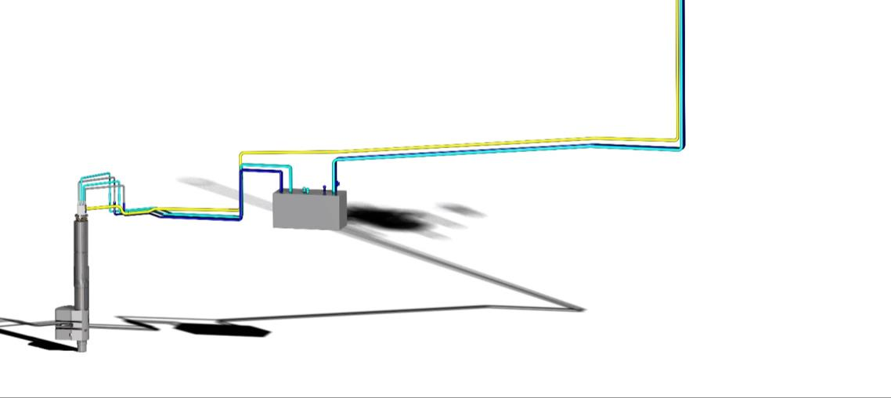
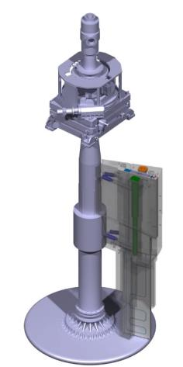
JÜLICH contribution (TIK3.1, TIK3.2, TIK4.1 and NBEX)
TCB / Copenhagen
2019.09.12 I M. Butzek (Y. Beßler)

Slide 2
OUTLINE
Technical status
Moderator & Reflector Plug -TIK3.1
Cryogenic Moderator System -TIK3.2
Target Monitoring Plug -TIK4.1
Neutron beam extraction system
Project 1 (Prototype phase)
Project 2 (Test phase)
Project 3 (NBPI series)
Contractual issues

Slide 3
MRP TIK3.1
Manufacturing complete
Manufacturing in progress
Rotation Unit
Twister overview
Crown
Shaft
Frame
Axial bearing
Bucket
Moderator &
Reflector Unit
FAT setup 1
FAT setup 2
Twister ready
for delivery

Slide 4
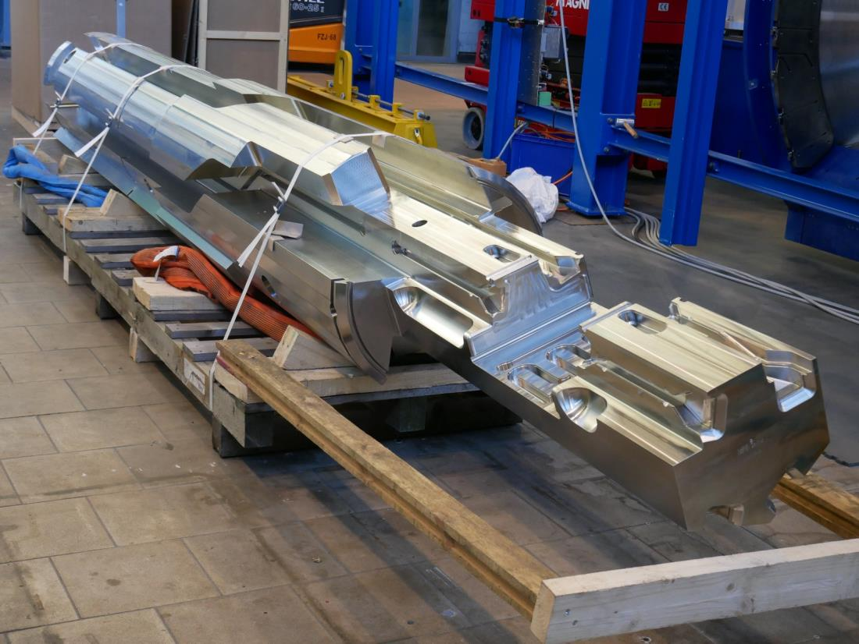
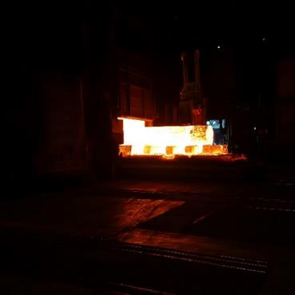
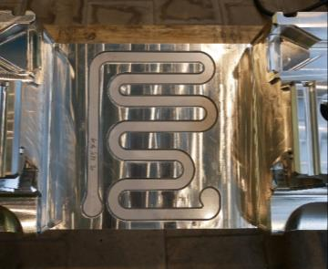
MRS TIK3.1
Twister components (Shaft)
Twister shaft forged
Welded cooling channels
Twister shaft at FZJ
forge the of Twister shaft

Slide 5
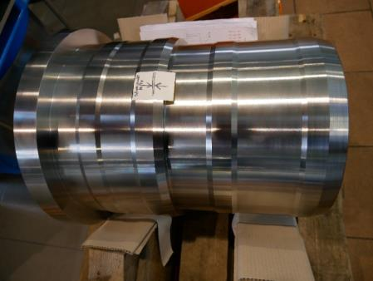
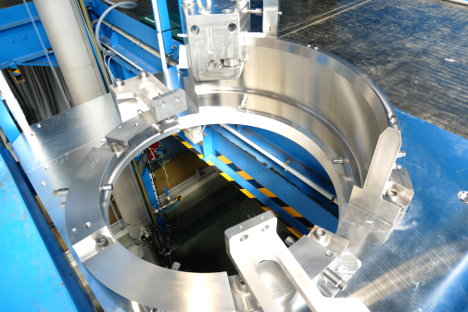
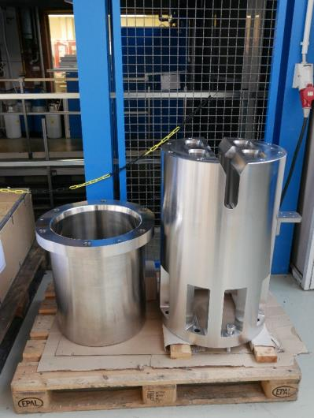
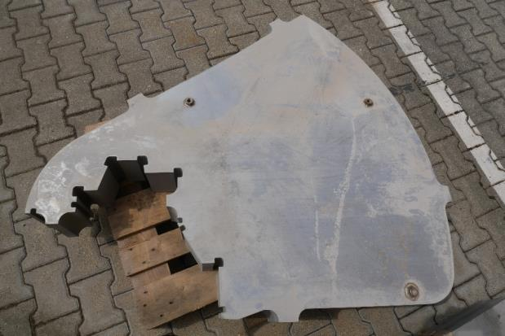
MRS Components
Twister components (bearing / crown / bucket / frames)
Upper radial
bearing
Axial bearing
Twister bucket and crown
Frame sheets water cuted

Slide 6
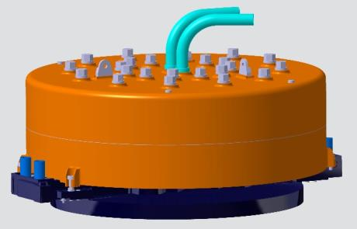
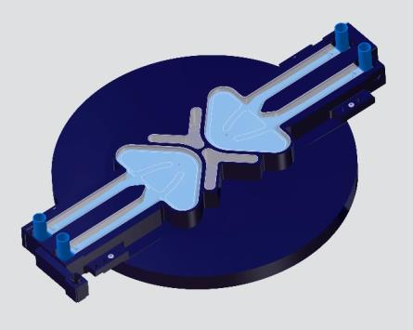
MRP TIK3.1
Moderator & Reflector Unit overview
Vacuum jacket
Beryllium Reflector
Cold Moderators
Thermal Moderator
Irradiation Module
Moderator &
Reflector Unit
FAT setup 1
Manufacturing complete
Manufacturing in progress

Slide 7
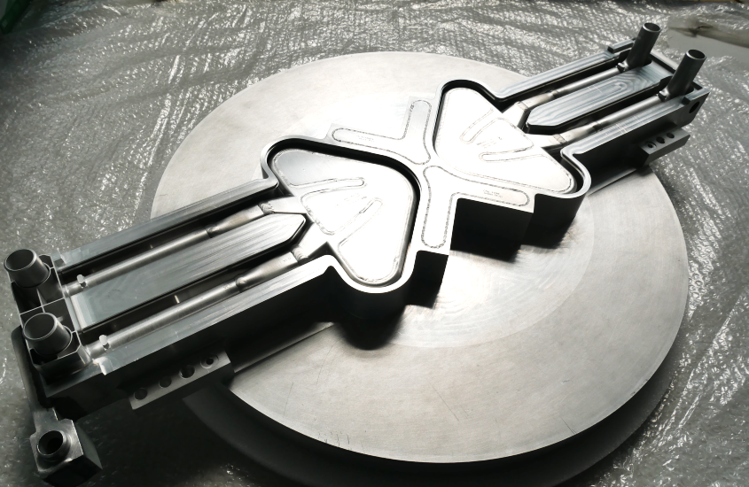
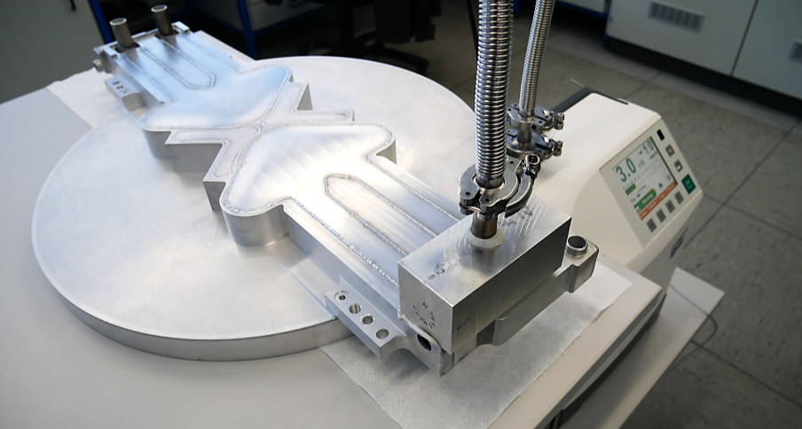
Thermal Moderator welding
and leak test
Thermal Moderator
+ cold Moderators
+ Irradiation module
Cold
Moderator
Position of irradiation module inside Thermal Moderator
Thermal Moderator

Slide 8
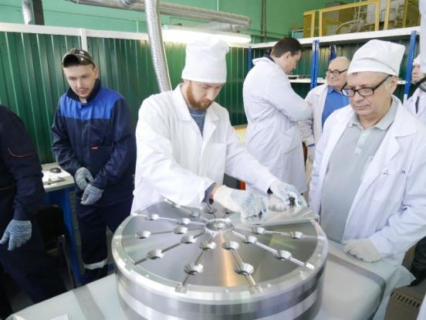
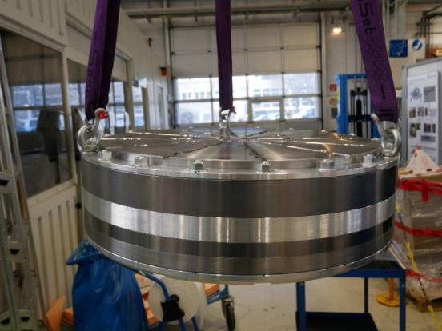
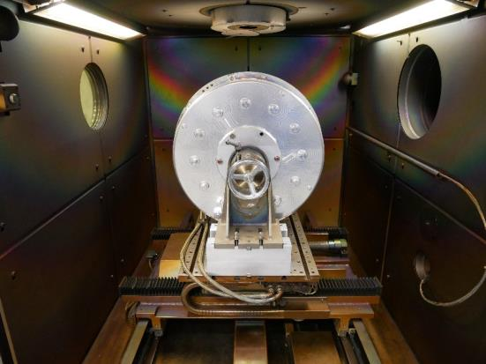
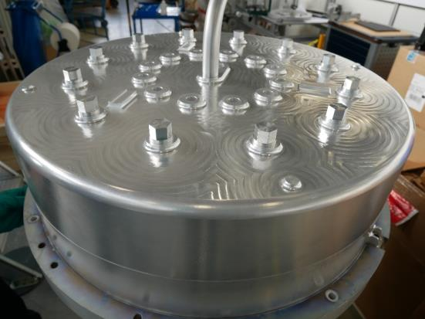
MRS TIK3.1
Reflector (Beryllium reflector)
Acceptance test (Moscow)
Beryllium assembly
Electron beam welding
TIC welding

Slide 9
MRS TIK3.1
Schedule status and outlook
Sub unit | Final design | CDR | Manufacturing | FAT | delivery | SAT
Cold Moderator | . | . | . | . | 07-20 | n.a.
Thermal Moderator | . | . | . | 10-19 | 07-20 | n.a.
Beryllium Reflector | . | . | . | 10-19 | 07-20 | n.a.
Vacuum Jacket | . | . | 12-19 | 01-20 | 07-20 | n.a.
Crown | . | . | . | . | 07-20 | n.a.
Bucket | . | . | . | . | 07-20 | n.a.
Rotation Unit | . | . | . | . | 07-20 | n.a.
Shaft assembly (welded) | . | . | 11-19 | 12-19 | 07-20 | n.a.
Radial bearing | . | . | . | 10-19 | 07-20 | n.a.
Axial bearing | . | . | . | 10-19 | 07-20 | n.a.
Frames assembly | . | . | 02-20 | 03-20 | 07-20 | n.a.
M&R Plug | . | . | 03-20 | 04-20 | 07-20 | n.a.

Slide 10
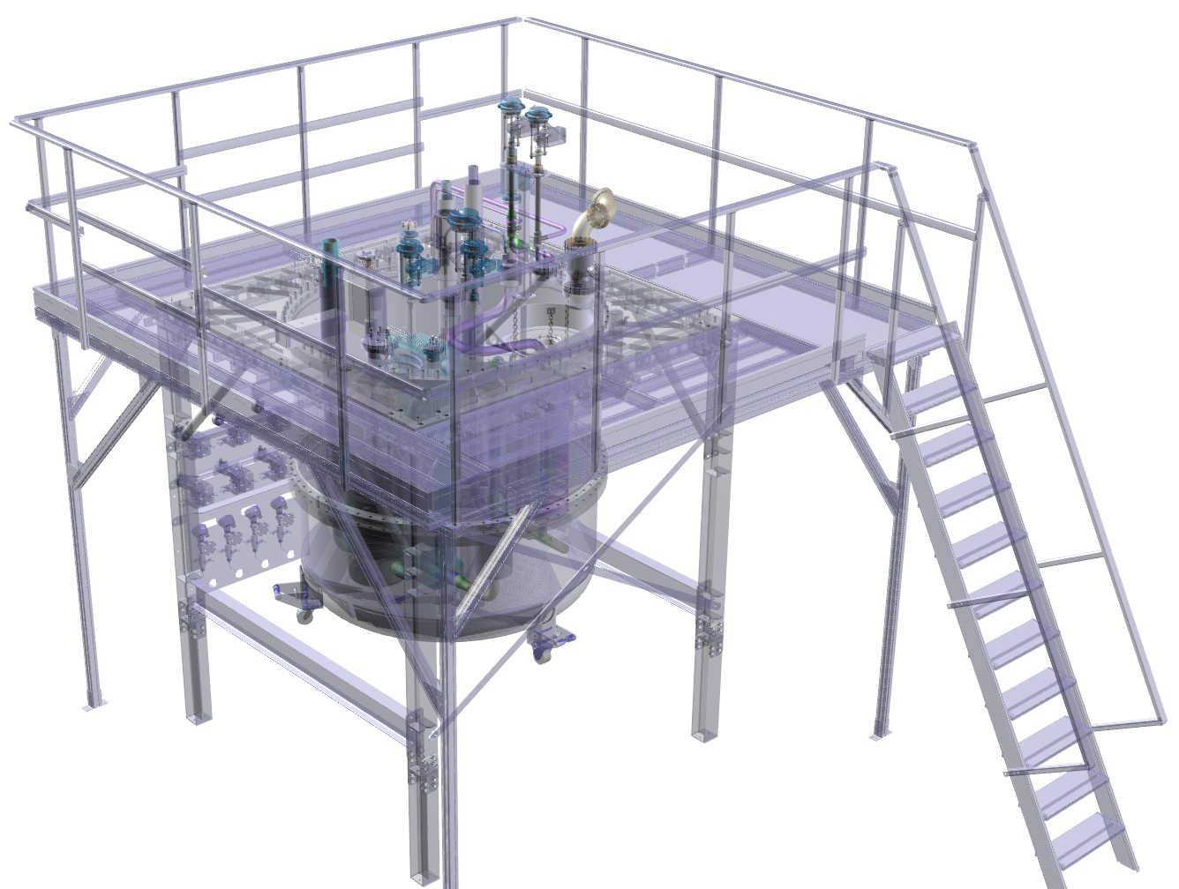
CMS TIK3.2
Top plate
Cryostat
overview
Pump unit
GMP
Pipework
Platform
Stand
Pressure vessels
Vacuum chamber
Manufacturing complete
Manufacturing in progress

Slide 11
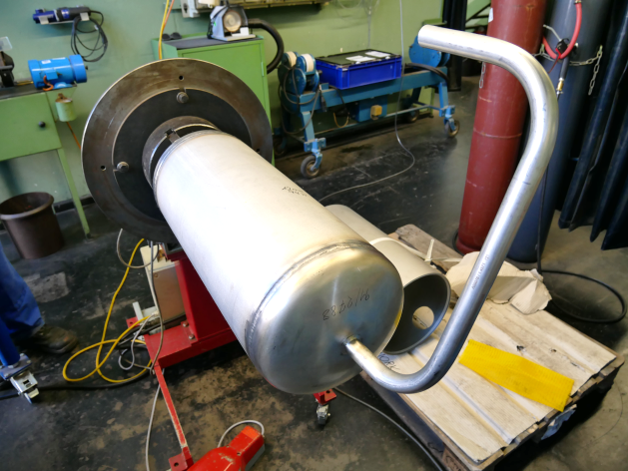
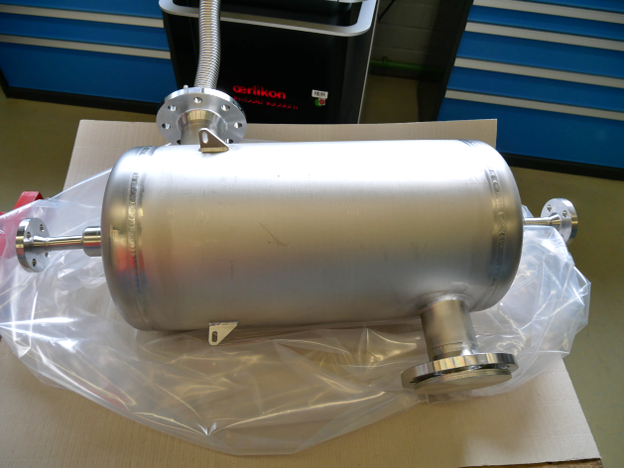
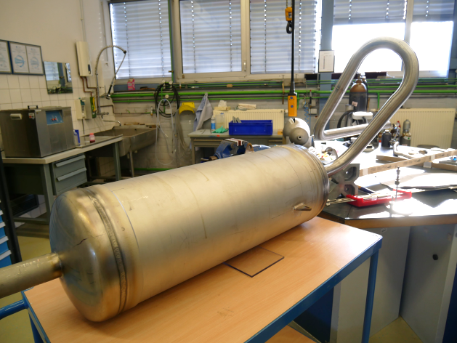
CMS TIK3.2
Pressure vessels
Ortho-para converter
HX2
Pressure control buffer

Slide 12
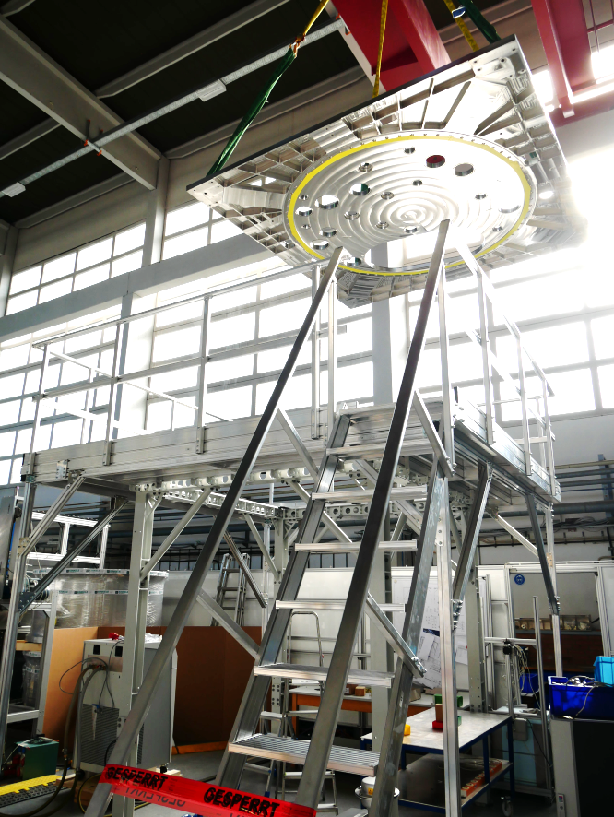
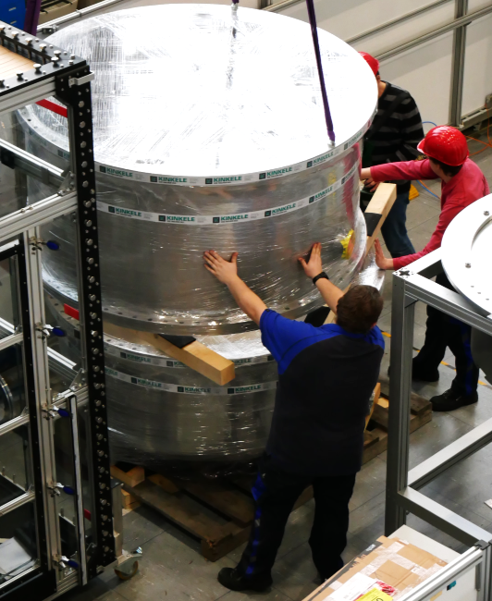
CMS TIK3.2
Stand, platform
and top plate
Top plate
+ stand
+ platform
+ vacuum chamber
Vacuum chamber

Slide 13
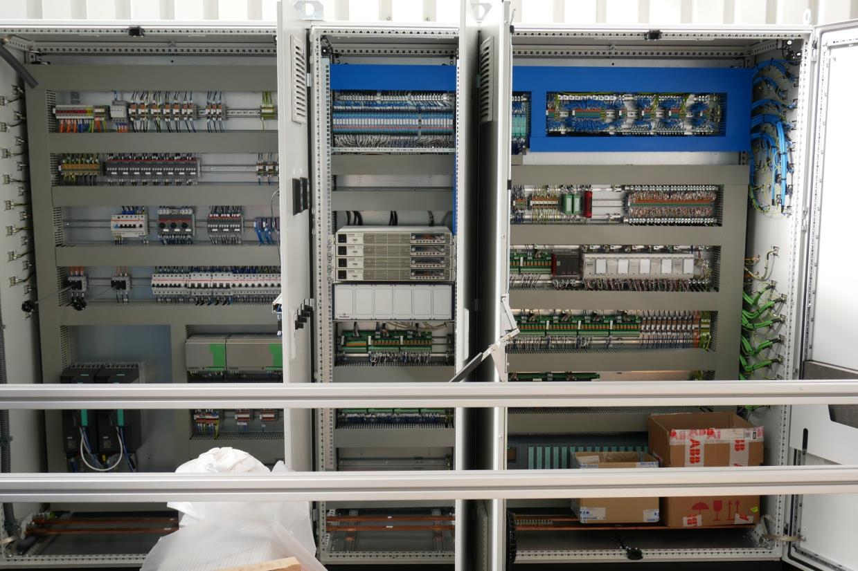
CMS TIK3.2
CMS control cabinet delivered
CMS control cabinet
3000 x 2000 0.5 t

Slide 14
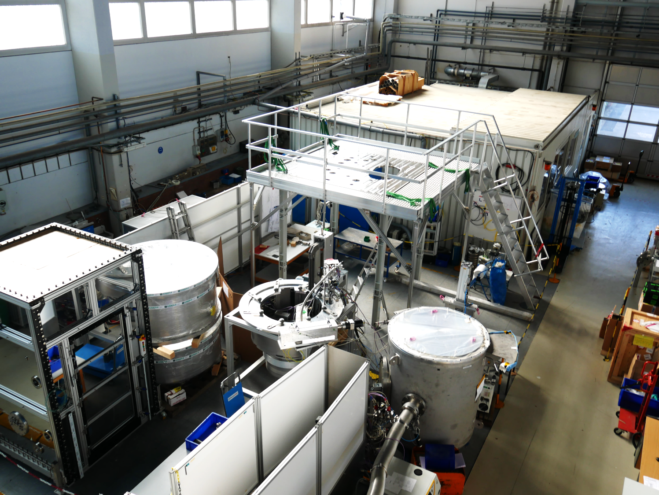
CMS TIK3.2
Stand, top plate and platform
Status CMS assembly
vacuum chamber
1.2 t / d=2m

Slide 15
MRS TIK3.2
Schedule status and outlook
Sub unit | Final design | CDR | Manufacturing | FAT | delivery | SAT
Vacuum chamber | . | . | . | n.a. | 09-20 | n.a.
Stand | . | . | . | n.a. | 09-20 | n.a.
Platform | . | . | . | n.a. | 09-20 | n.a.
Top plate | . | . | . | n.a. | 09-20 | n.a.
Pressure control buffer | . | . | . | . | 09-20 | n.a.
Ortho para converter | . | . | . | . | 09-20 | n.a.
Heat exchanger | . | . | . | . | 09-20 | n.a.
LH2 pumps | . | . | . | . | 09-20 | n.a.
Cold pipework | . | . | 12-19 | n.a. | 09-20 | n.a.
Gas management panel | . | . | 12-19 | n.a. | 09-20 | n.a.
Control cabinet | . | . | . | . | 09-20 | X
CMS Cryostat | . | . | 03-20 | 04-20 | 2020 | ???

Slide 16
MRS TIK3.2 / CMS SAT issue
CMS SAT issue
SAT of CMS is part of contract with Jülich
SAT of transfer lines, coyoplant and twister by ESS
Schedule unclear because all other systems have to be ready for CMS SAT
SAT of CMS cannot be performed without other systems working -> combined SAT?
Still unclear how much resources from Jülich have to be at ESS for how long. We can not afford to have people at ESS for several month if combined SAT takes longer
ESS needs to come up with concept and schedule for a “combined SAT“ soon to start planning

Slide 17
TMP TIK4.1
Overview and status
Task of Target Monitoring Plug (TMP)
Measure the x/y position of the wheel
Measure the z position of the wheel
Measure the helium coolant outlet
temperature from each cassette during operation
Measure shaft vibration during operation
Measure helium borne sound in the helium coolant for acoustic diagnostics of the target cooling system and for acoustic diagnostics
Measure the internal cooling system
inlet and outlet temperature
Status / issues
CDR
Procurement and manufacturing in progress
FAT will be in April 2020
Delivery will be in June 2020
Funding will not cover the full and extended SoW (≈ + 20%)
X,Y,Z Insert
Collimator Insert
X,Y,IR Insert
Main plug
Two half's
Collimator
package

Slide 18
MRS TIK4.1
Schedule status and outlook
Sub unit | Final design | CDR | Manufacturing/Procurement | FAT | delivery | SAT
T measurement | . | . | . | X | 06-20 | X
z measurement | . | . | . | X | 06-20 | X
IR measurement | . | . | . | X | 06-20 | X
x,y measurement | . | . | . | X | 06-20 | X
Main body | . | . | 02-20 | 03-20 | 06-20 | X
Inserts | . | . | 12-19 | 01-20 | 06-20 | X
Control cabinet | . | . | 12-19 | 01-20 | 06-20 | X
TMP | . | . | 03-20 | 04-20 | 06-20 | X

Slide 19
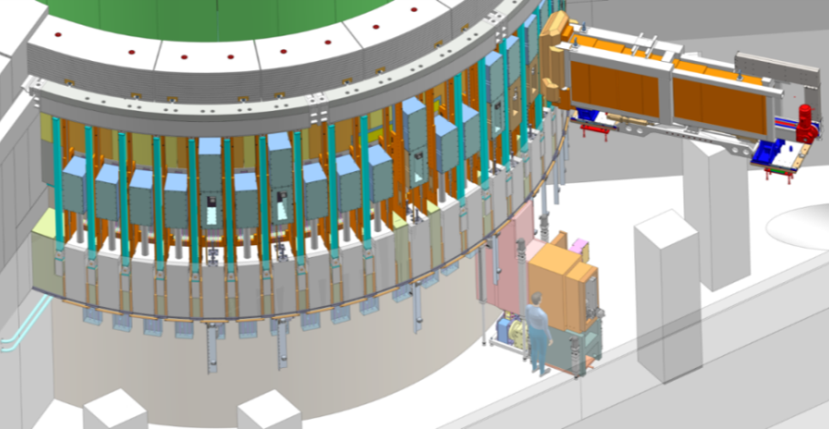
Neutron Beam Extraction System project 1 (Prototyp manufacturing)
NBEX Assemblies
Neutron Beam Port Insert (NBPI) prototype for LoKI instrument
Vertical Handling Teststand (VTS) & Light Shutter System (LSS)
Horizontal Test Stand (HTS)
Insert Installation Tool (IIT)
Media Connector prototype

Slide 20
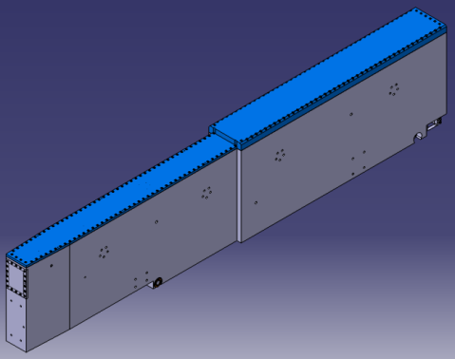
Neutron Beam Port Insert (NBPI) prototype for LOKI (project 1)
Design Update of NBPI prototype by FZJ has been finished in April 2019
Manufacturing at Kinkele has started in July 2019

Slide 21
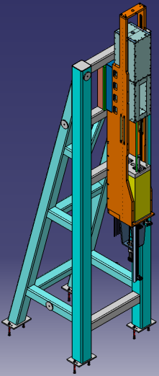
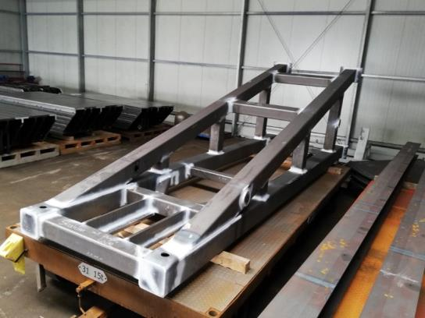
Light Shutter test stand (LSS) (project 1)
LSS
LSS Frame
LSS Blocks
Actuator Assy
Media Branch
GBS
BBG
Ball Screw
FFB
Manufacturing has started in June 2019
Manufacturing progress at Kinkele

Slide 22
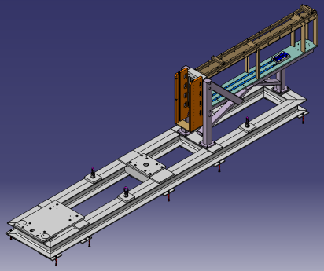
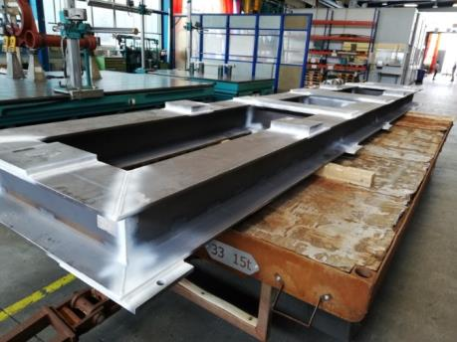
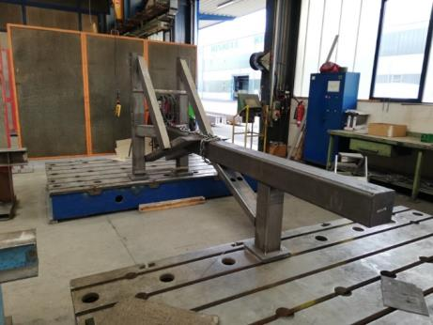
Horizontal Test Stand (HTS) (project 1)
Manufacturing has started
in June 2019
Manufacturing progress:
sub-frame
Manufacturing progress:
upper component

Slide 23
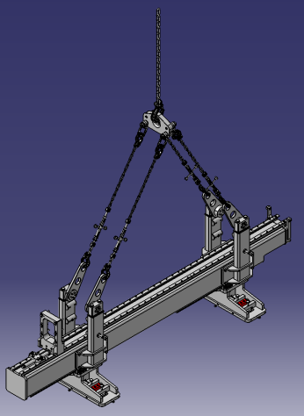
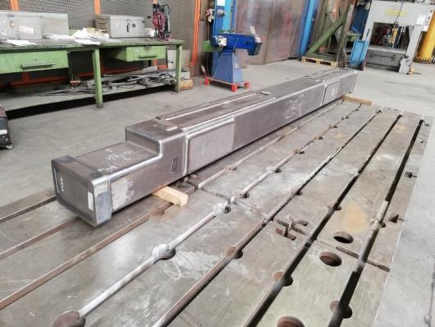
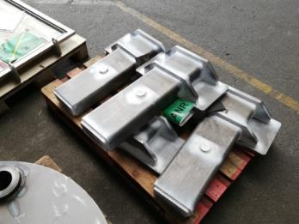
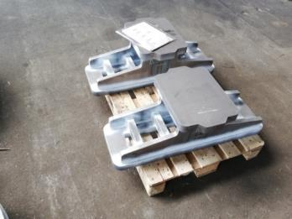
Insert Installation Tool (IIT) (project 1)
Manufacturing progress:
Beam, feet and side parts
Manufacturing has started
in June 2019

Slide 24
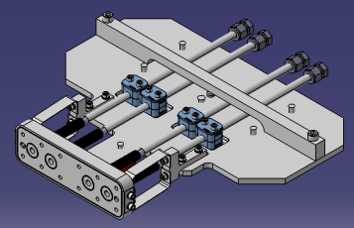
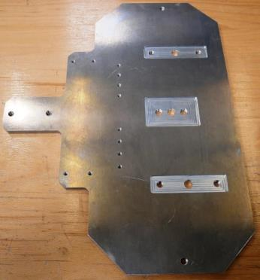
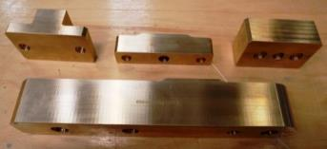
Media Connector (project 1)
Manufacturing of single components is finished
Media Connector Test Bed is currently manufactured in FZJ’s workshop
Delayed delivery of the metal bellows shifts back the completion date to October 2019

Slide 25
Neutron Beam Extraction System Schedule status and outlook (phase 1)
Name | Design Feedback from FZJ to ESS | Design Update | Status | Delivery Date to FZJ
NBPI LOKI Prototype | ☑ | ☑ (FZJ) | Manufacturing at Kinkele | week 46
LSS Prototype | ☑ | ☑ (ESS) | Manufacturing at Kinkele | week 43
VTS | ☑ | ☑ (ESS) | Manufacturing at Kinkele | week 43
HTS | ☑ | ☑ (ESS) | Manufacturing at Kinkele | week 39
IIT | ☑ | n.a. | Manufacturing at Kinkele | week 39
Media Connector | ☑ | n.a. | Manufacturing at FZJ | Week 39

Slide 26
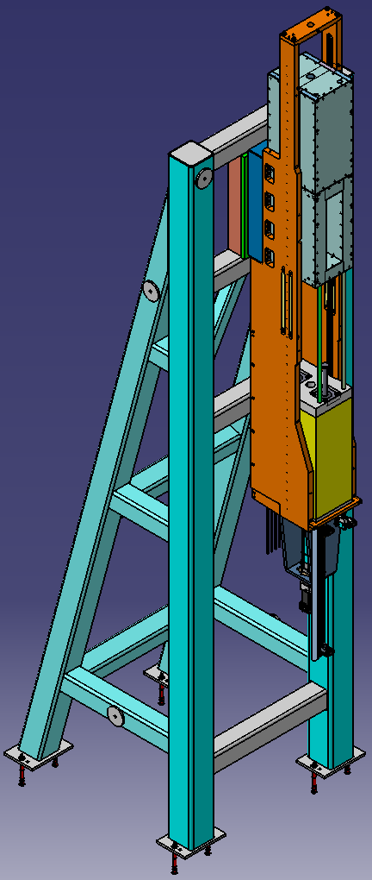
Test Phase (project 2)
Test phase is scheduled from October 2019 until April 2020
Planned Budget: 200.000 €
Test Programm:
Assembly test
Handling
Accuracy
Installation sequence
Tightness tests

Slide 27
NBPI Series (project 3)
Scheduled from October 2019* until April 2021
Planned Budget: 4 Mio. €
Scope of Work for 16 NBPIs:
NBOA integration into NBPI Design
Manufacturability check
Heat calculations
Commissioning of manufacturing
Supervision of manufacturing
Quality Management
Functional tests at Jülich
Cleaning
Delivery
*project has started already (phase 1 budget)
Notes:
Use week numbers
NBOA Design del = 3d model delivered to NBPI team as released chess file
NBOA Approval = ICD released for review TD+NSS
NBPI CDR = individual cdr of the NBPI performed by TD
FAT = Factory acceptance testing of the NBPI only (no NBOA)
Delivery to Site = Lund
NBOA Integration = tent integration
NBPI installation = installing NBPI in portblock in final position

Slide 28
NBPI Series Schedule status and outlook (project 3)
NBPI | NBOA design delivery to FZJ | NBOA integration and approval | Manufacturing Drawing | CDR
Test Beamline | ☑ (no NBOA) | ☑ | 90 %
MAGIC | ☑ (no NBOA) | ☑ | 90 %
LOKI | ☑ | ☑ | 75 %
VESPA | ☑ | ☑ | 0 %
DREAM | ☑ | ☑ | 0 %
ESTIA | ☑ | in progress | 0 %
BIFROST |  |  | 0 %
ODIN | ☑ | ☑ | 0 %
HEIMDAL |  |  | 0 %
FREIA |  |  | 0 %
CSPEC |  |  | 0 %
NMX | ☑ | in progress | 0 %
SKADI |  |  | 0 %
T-REX |  |  | 0 %
MIRACLES |  |  | 0 %
BEER |  |  | 0 %
Notes:
Use week numbers
NBOA Design del = 3d model delivered to NBPI team as released chess file
NBOA Approval = ICD released for review TD+NSS
NBPI CDR = individual cdr of the NBPI performed by TD
FAT = Factory acceptance testing of the NBPI only (no NBOA)
Delivery to Site = Lund
NBOA Integration = tent integration
NBPI installation = installing NBPI in portblock in final position

Slide 29
summery
TIK3.1 & TIK3.2 will be almost complete in 2019.
Full FAT will be in spring 2020
Delivery will be, as scheduled, in summer 2020
BF1 study is complete!
TIK4.1 will be complete around summer 2020
NBEX series will be complete (include tests) around
spring 2021

Slide 30
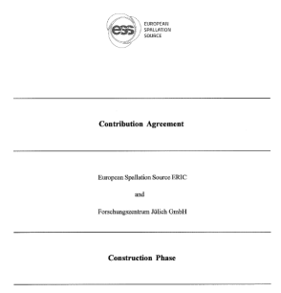
Contractual issues
Contribution Agreement for the Construction Phase between
ESS ERIC
and
Forschungszentrum Jülich GmbH
is finally agreed and signed!
(after just 5 years)

