Slide 1
Target Collaboration Board
Status of ESS Bilbao IKCs
Mario Pérez, ESS-Bilbao
Copenhagen, 12 September 2019

Slide 2

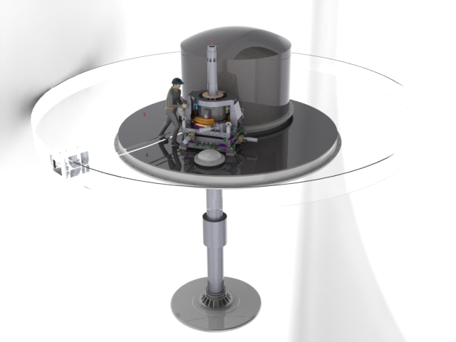
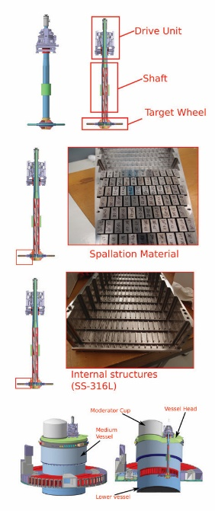
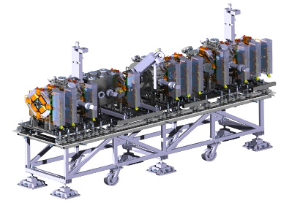
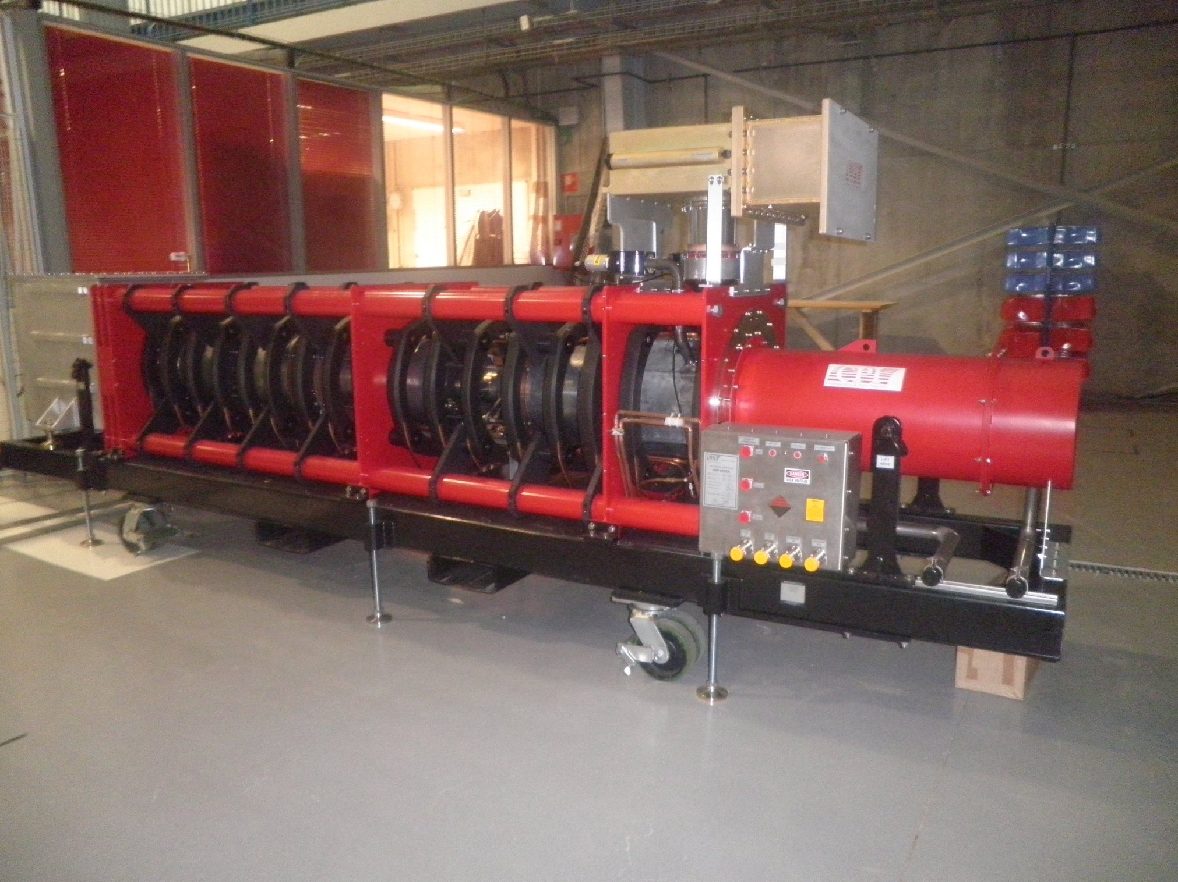
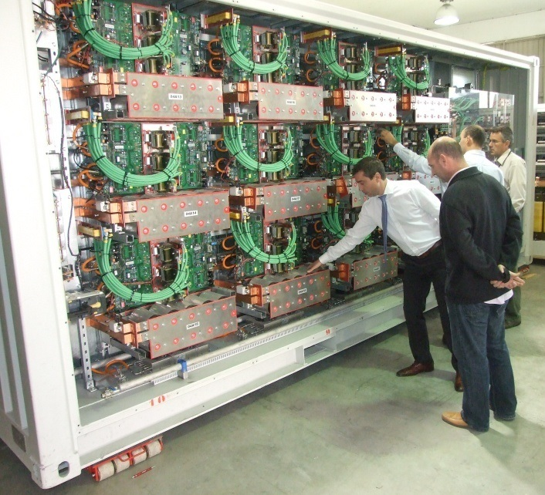
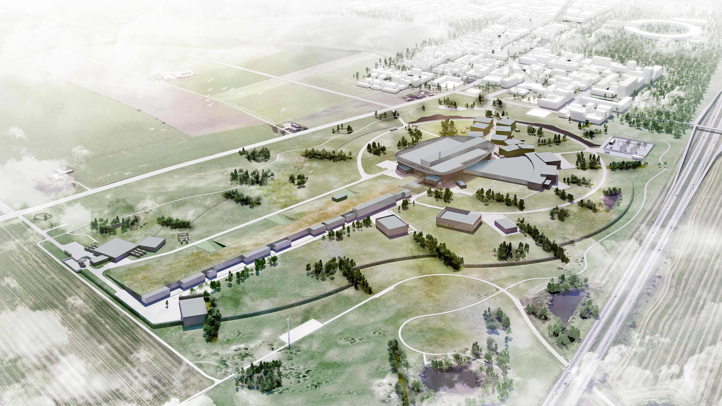
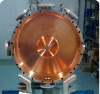
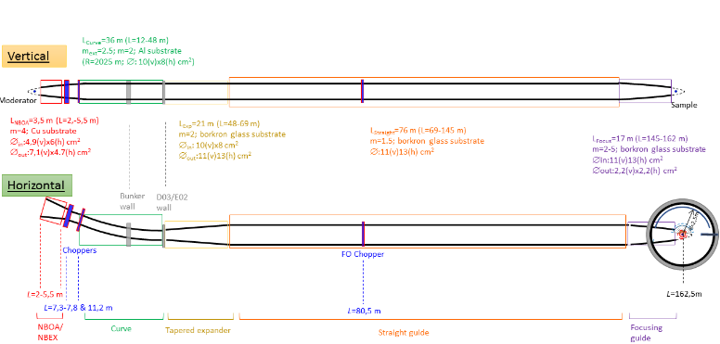
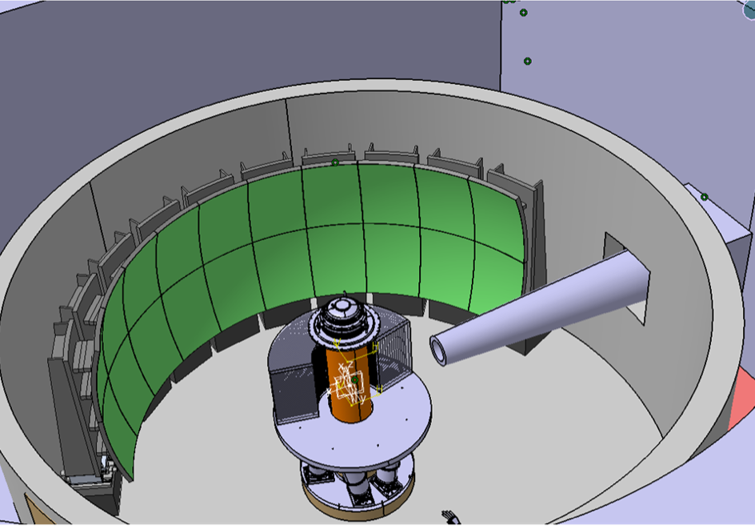



In-Kind Contributions to ESS
TARGET
MEBT
RF Systems
RF chains: 1 for RFQ and 5 for DTL. Composed by klystrons, modulators, loads, waveguides, interlocks and LLRF
Accelerating element: complete subsystem that goes after the RFQ and integrates design, manufacturing, diagnostics, control, assembly and testing.
4
5
3
The spallation process takes place when the accelerated proton beam hits the Tungsten bricks of the 11-tonne target wheel. This will produce neutron brightness for scientific experiments across multiple disciplines.
MIRACLES INSTRUMENT
Time-of-Flight backscattering instrument for polymer science, energy materials, and magnetism studies.
Prime contractors: design, manufacturing, assembly &cold commissioning

Slide 3
In-Kind Contribution in figures
ESS Project | WP description | CB Value (EUR) | Status | Date TA sign
ACCSYS | MEBT | 4.522.285 € | TA signed / IKC pending | 2017 Q2
ACCSYS | RF FOR WARM LINAC | 7.334.000 € | TA signed / IKC pending | 2017 Q2
ACCSYS | KLYSTRON MODULATORS (X3) | 3.370.000 € | TA signed / IKC pending | 2016 Q4
ICS | MEBT CONTROL SYSTEM | 863.258 € | TA signed / IKC pending | 2016 Q4
TARGET | TARGET WHEEL | 8.420.000 € | TA signed / IKC pending | 2015 Q4
TARGET | PROTON BEAM INSTRUMENTATION PLUG | 540.000 € | TA signed / IKC pending | 2017 Q2
TARGET | PROTOM BEAM WINDOW | 890.000 € | TA signed / IKC pending | 2016 Q2
TARGET | MONOLITH VESSEL | 4.680.000 € | TA signed / IKC pending | 2017 Q4
TARGET | TUNNING BEAM DUMP | 2.480.000 € | TA signed / IKC pending | 2016 Q2
NSS | BEAM TRANSPORT OPTIMIZATION | 20.000 € | Finished | 2014 Q4
NSS | TRAINING OF MOTION CONTROL ENG. (ES) | 97.000 € | Finished | 2015 Q4
NSS | SECONDMENT OF AN ENGINEER to LOKI | 54.000 € | Finished | 2016 Q1
NSS | MIRACLES INSTRUMENT : Phase 1 | 423.500 € | Finished | 2017 Q2
NSS | MIRACLES INSTRUMENT: Phase 2 - 4 | 13.045.250 € | TA under preparation | 2018 Q3

Slide 4
In-Kind Contribution in figures
ESS Project | WP description | CB Value (EUR) | Status | Date TA sign
ACCSYS | MEBT | 4.522.285 € | TA signed / IKC pending | 2017 Q2
ACCSYS | RF FOR WARM LINAC | 7.334.000 € | TA signed / IKC pending | 2017 Q2
ACCSYS | KLYSTRON MODULATORS (X3) | 3.370.000 € | TA signed / IKC pending | 2016 Q4
ICS | MEBT CONTROL SYSTEM | 863.258 € | TA signed / IKC pending | 2016 Q4
TARGET | TARGET WHEEL | 8.420.000 € | TA signed / IKC pending | 2015 Q4
TARGET | PROTON BEAM INSTRUMENTATION PLUG | 540.000 € | TA signed / IKC pending | 2017 Q2
TARGET | PROTOM BEAM WINDOW | 890.000 € | TA signed / IKC pending | 2016 Q2
TARGET | MONOLITH VESSEL | 4.680.000 € | TA signed / IKC pending | 2017 Q4
TARGET | TUNNING BEAM DUMP | 2.480.000 € | TA signed / IKC pending | 2016 Q2
NSS | BEAM TRANSPORT OPTIMIZATION | 20.000 € | Finished | 2014 Q4
NSS | TRAINING OF MOTION CONTROL ENG. (ES) | 97.000 € | Finished | 2015 Q4
NSS | SECONDMENT OF AN ENGINEER to LOKI | 54.000 € | Finished | 2016 Q1
NSS | MIRACLES INSTRUMENT : Phase 1 | 423.500 € | Finished | 2017 Q2
NSS | MIRACLES INSTRUMENT: Phase 2 - 4 | 13.045.250 € | TA under preparation | 2018 Q3

Slide 5
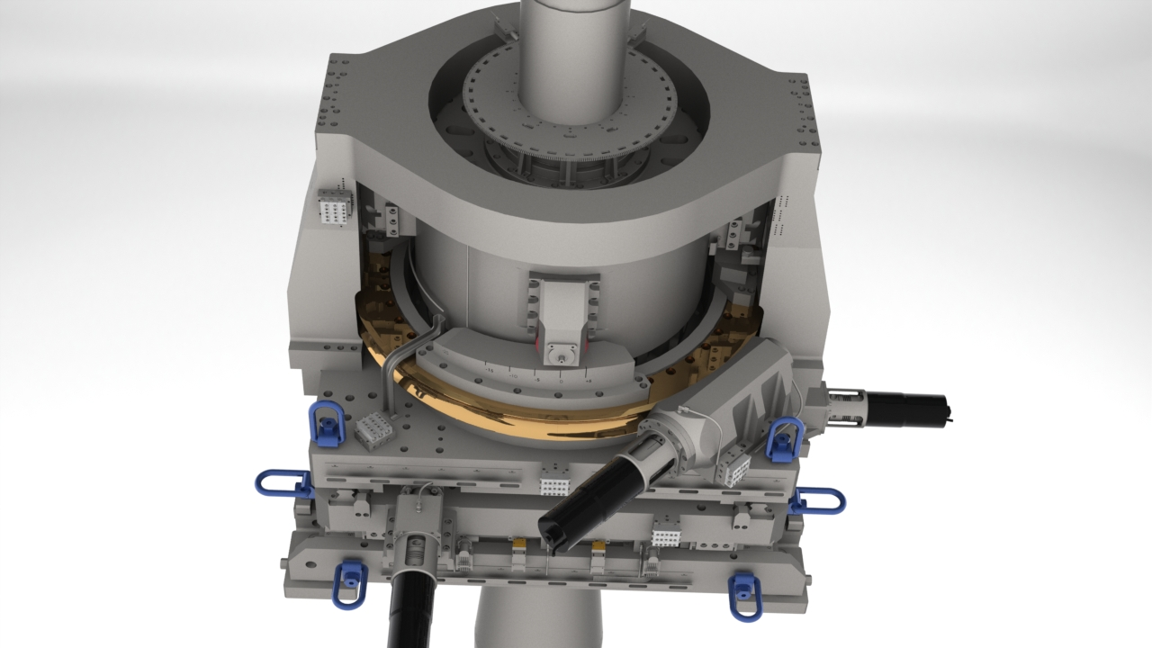

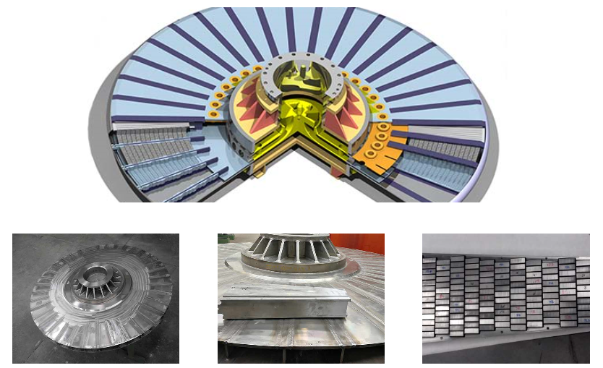
Target Vessel (TV)
DRIVE UNIT
SHAFT
TARGET WHEEL

Slide 6
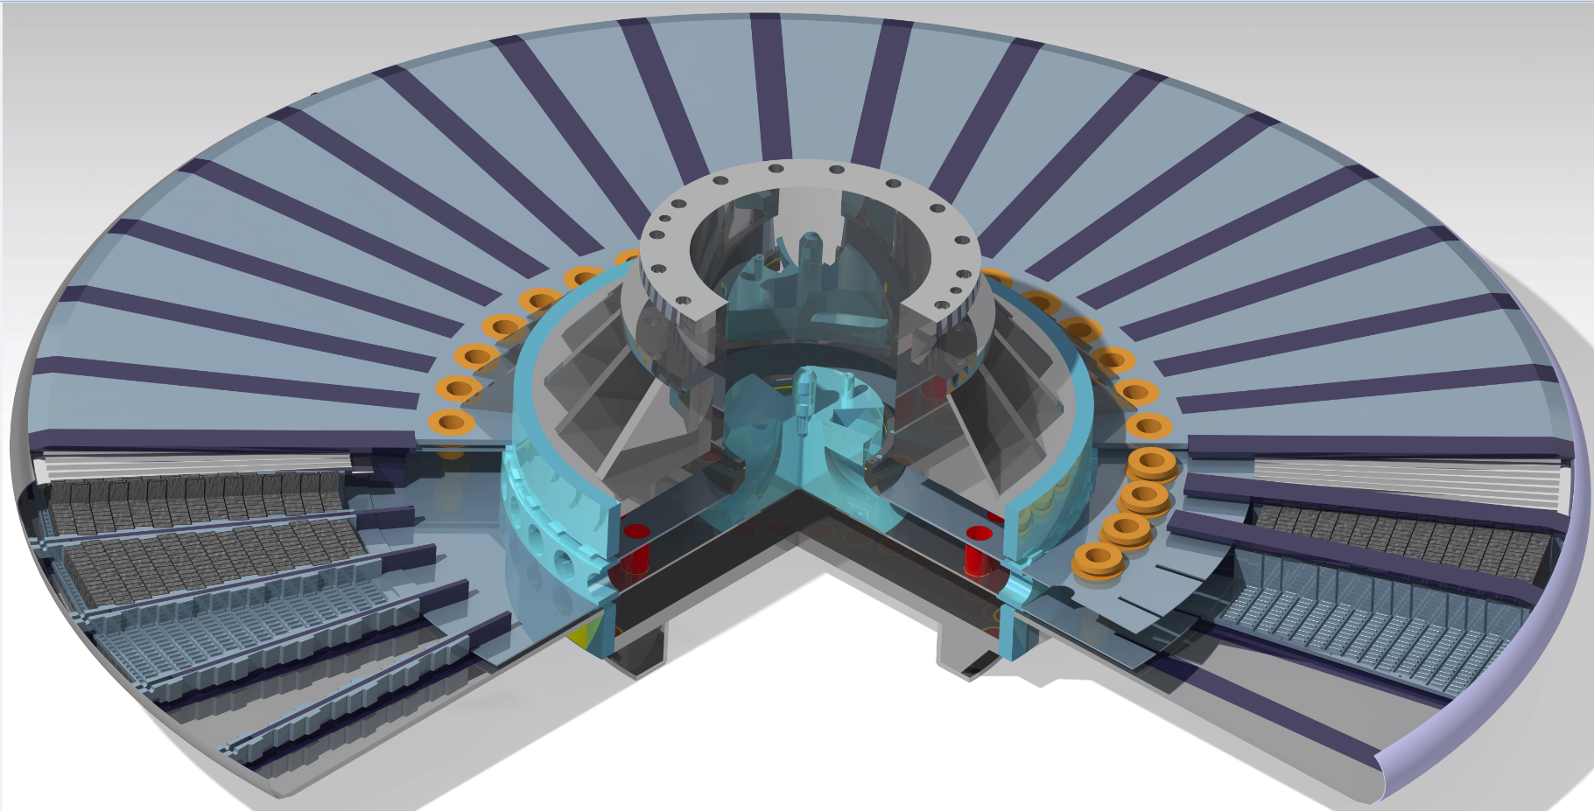
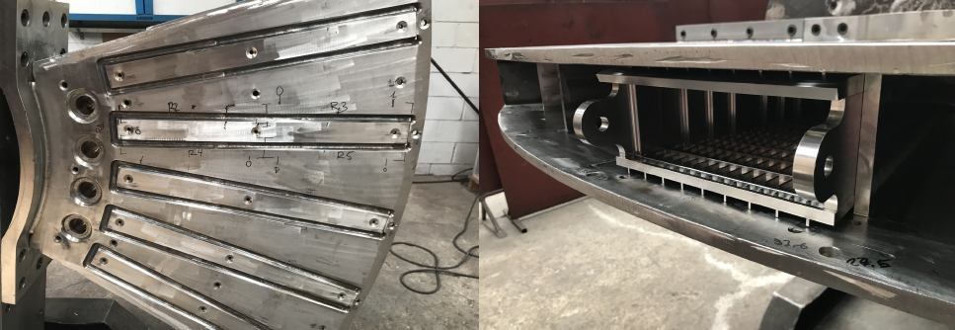
TV (Target Vessel)
  3 prototypes manufactured to clarify the welding process to ensure the compatibility between nuclear and vacuum requirements.
  ESS ERIC Ad-Hoc review on March 2019. Baseline design approved
  CDR held on June 2019
  Tender published in August. Contract to be awarded end October 2019.

Slide 7
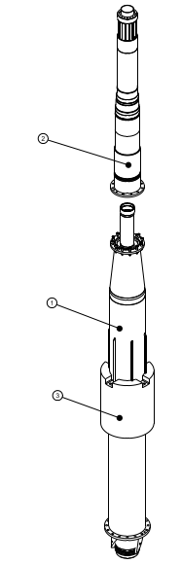
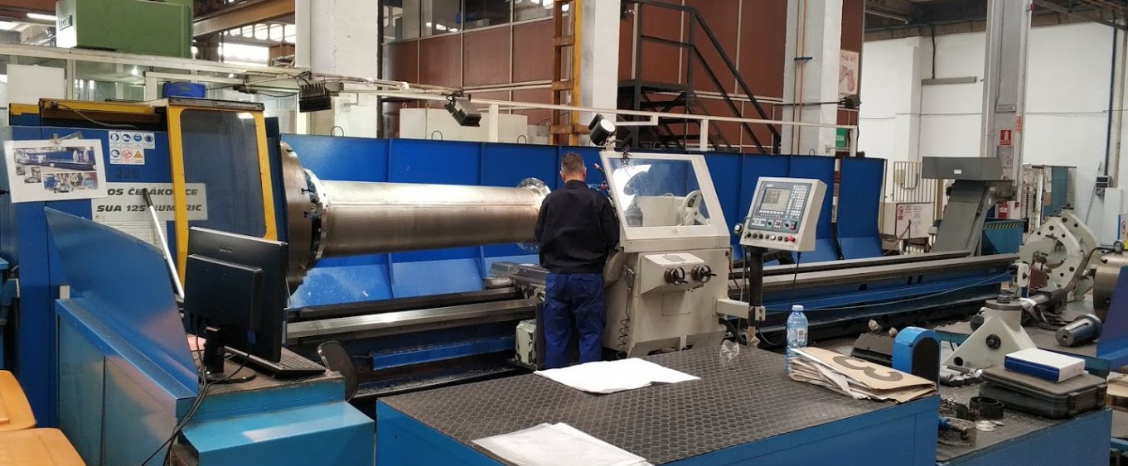
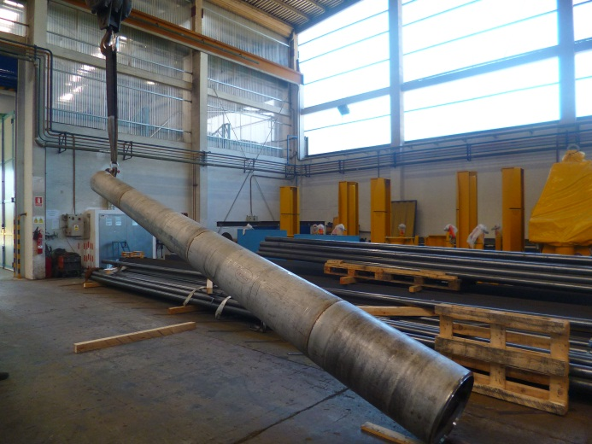
TV (Shaft)
  Contract awarded in April 2019.
  Manufacturing path has been defined in collaboration with the supplier. Drawings and tolerances has been reviewed and the production process is well understood.
  Design report sent for review to ESS ERIC in March 2019. Still no comments received. The procurement process was completed without ESS ERIC feedback.
  Notified Body approval for welding: The documents for NoBo must be approved prior to start welding

Slide 8
TV (Drive Unit)
  CDR was held in April 2018.
  Raw material is already procured. ESS Bilbao has asked ESS ERIC a waive to start machining before the CDR approval; waiting approval.
  CDR NOT yet approved due to lack of definition of IC from ESS ERIC control division.
  Definition of ESS ERIC sensors in the Drive Unit was finalized in June 2019.

Slide 9
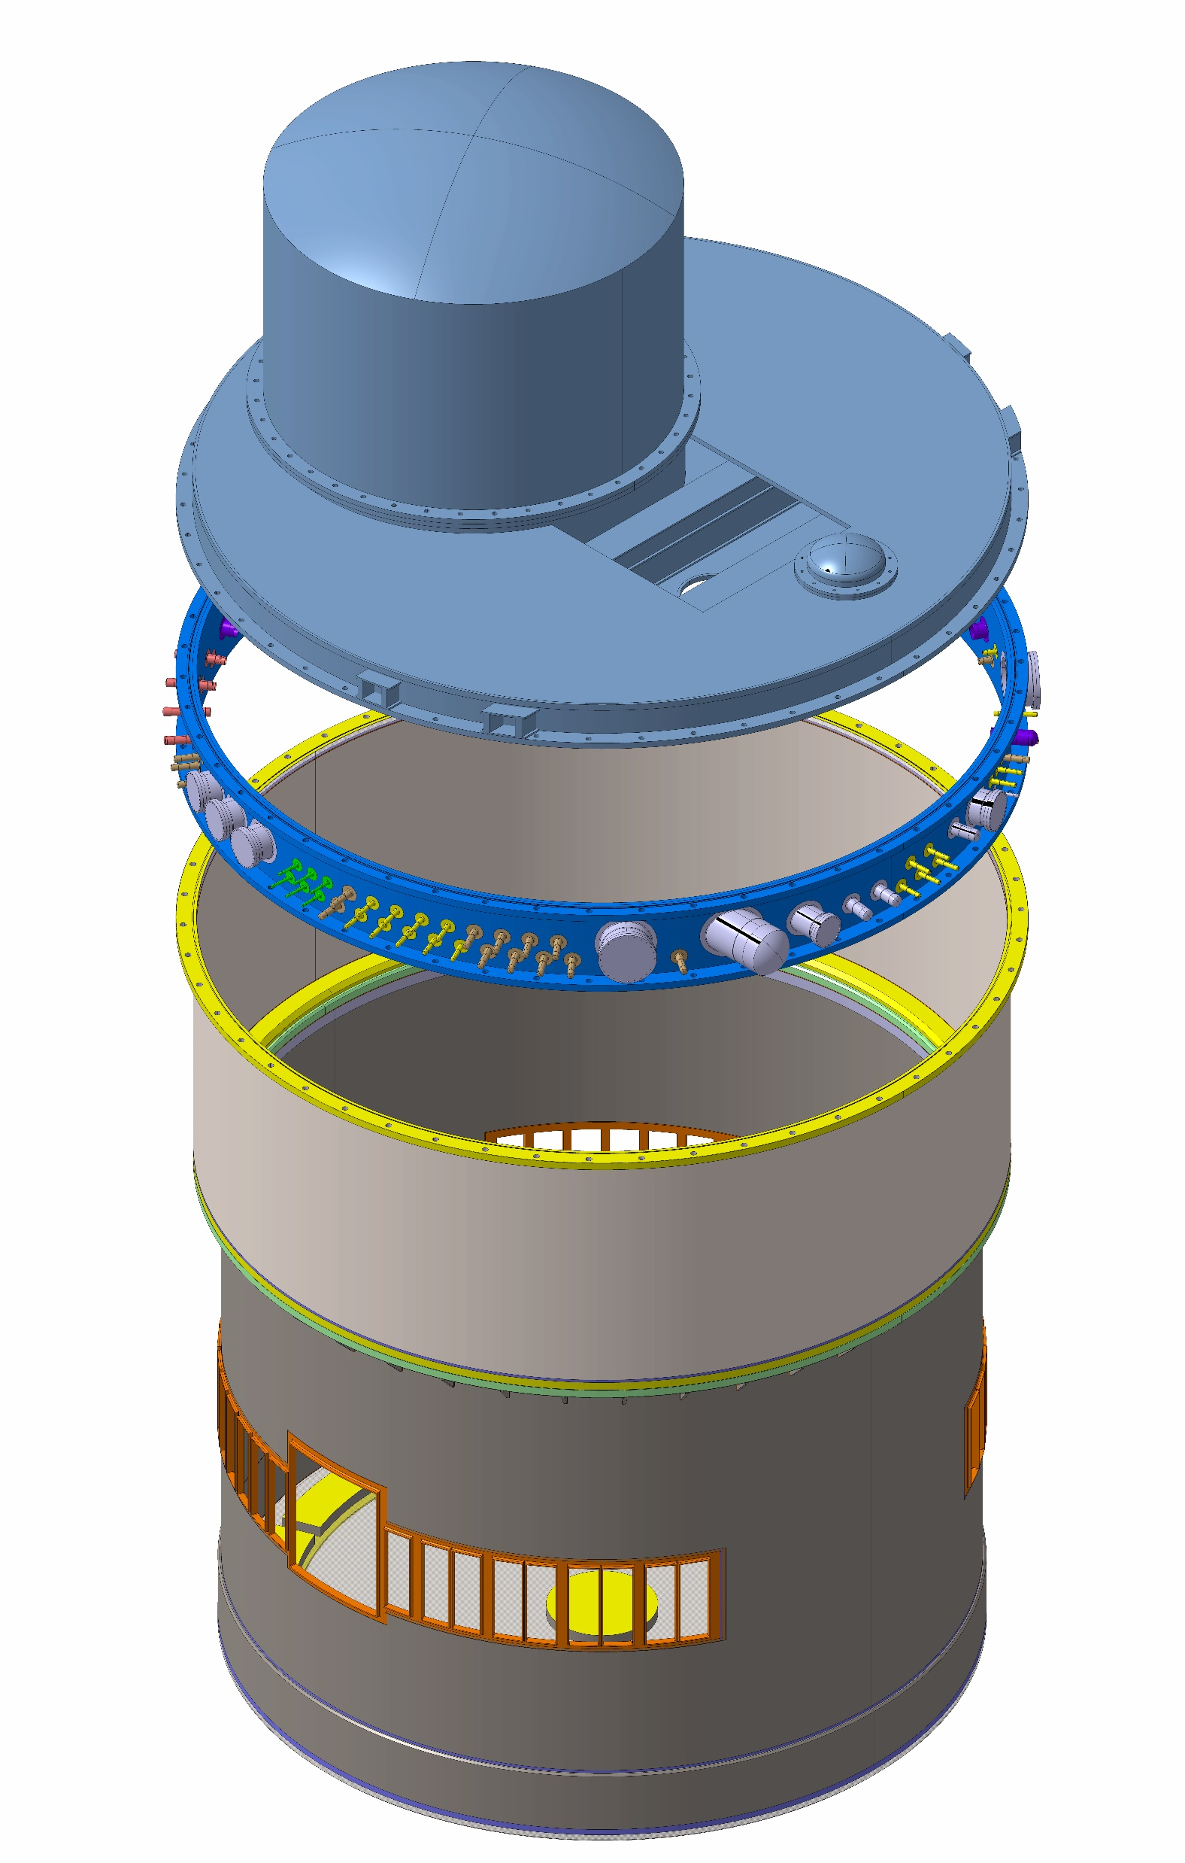
Monolith Vessel (MV)
Head of the Vessel and Cover
  Some interfaces still under discussion with ESS ERIC – need to be urgently frozen.
  Tender (incl. detailed engineering design) by Q4 2019?
Connecting Ring
  CDR successfully passed
  Call for tender to be published before end of Sep. 2019
    (tender docs. already under review by State Lawyer)
Lower and Medium Vessel
  Under manufacturing by AVS / CADINOX
  Component in the Critical Path (first to be installed in the target monolith
  Planned delivery date by Dec. 2019

Slide 10
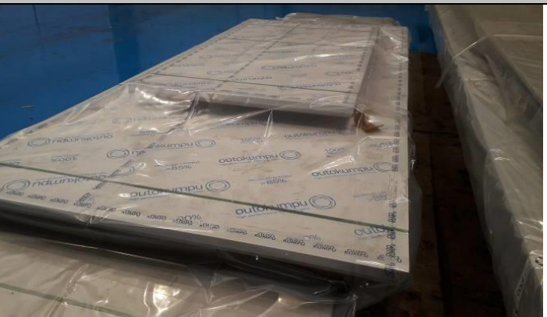
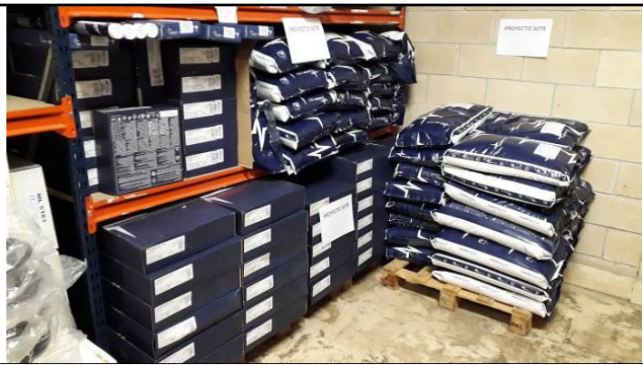
MV (Lower and Medium Vessel)
  CDR completed on September 2017
  Manufacturing contract awarded to AVS+CADINOX
  WPQR+WB completed in Aug. 2019
  Raw material delivered in Jul. 2019
  Notified Body approval for welding: Design report based on pressure test geometry under review by ESS ERIC NoBo. Should the approval will not be granted mid-September, delays will occur [HIGHT RISK]
  The interface between the vessel and the neutron ports is not yet frozen. Should this interface will not be frozen by end of October 2019, delays will occur [HIGHT RISK]
  Planned to be delivered by Dec. 2019

Slide 11
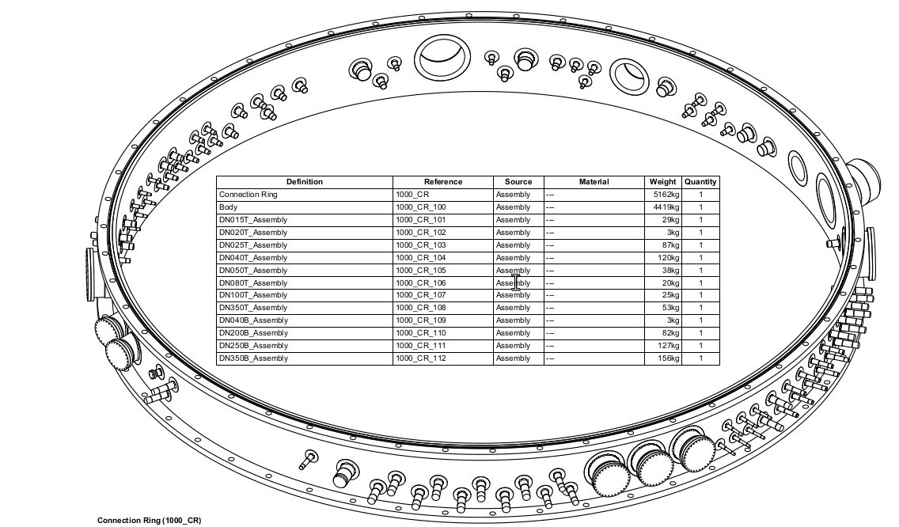
MV (Connection Ring)
  CDR held on December 2018.
  WPQR completed on August 2019
  Tender docs under review by State lawyer. Call for tender to be published end of September 2019.
  The design pressure of the component was modified to 1 bar(g) on May 2019.

Slide 12
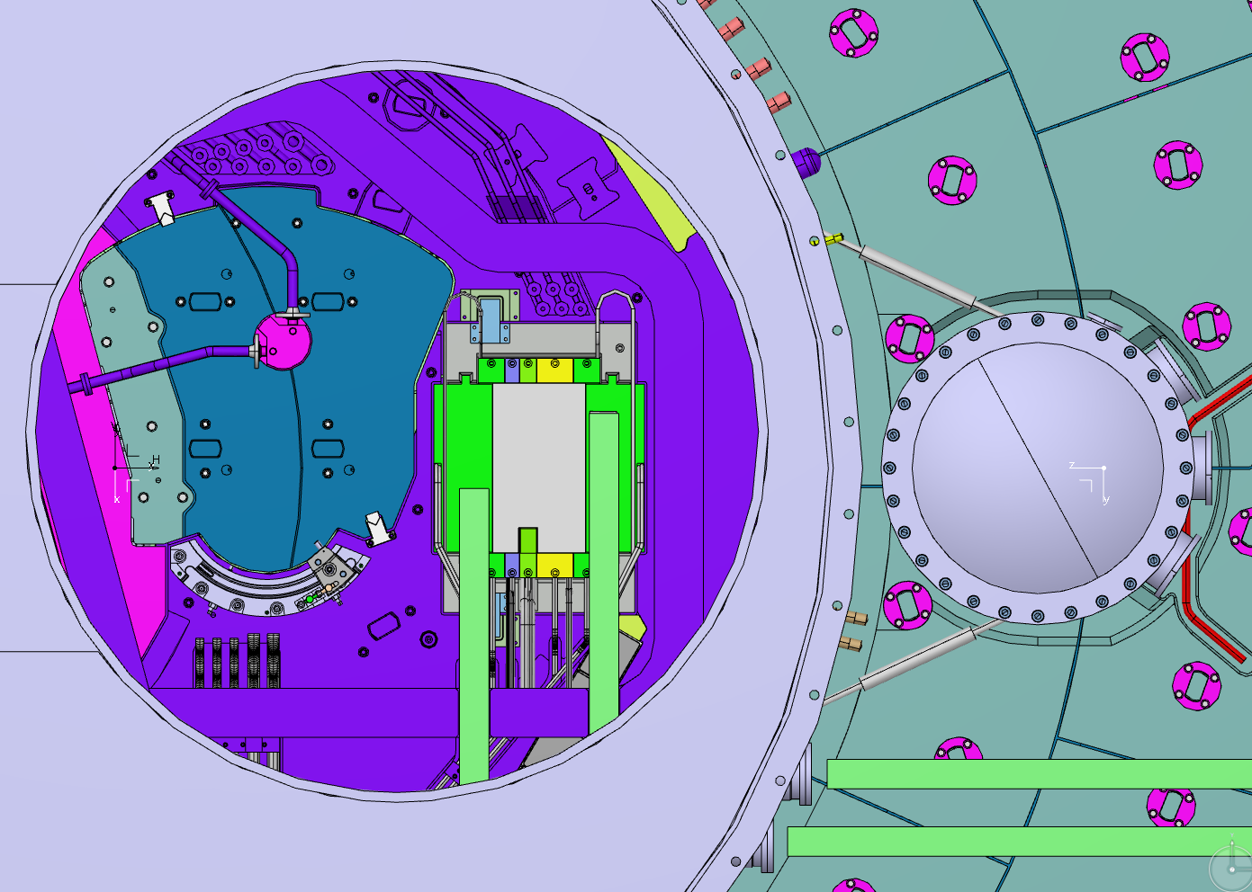
MV (Head of the Vessel)
  Call for Tender including the design and manufacturing of the component (turn-key) prepared back in December 2018.
  Tender on-hold until loads of transportation cask are defined by ESS ERIC.
  As soon as all the interfaces and input data are frozen by ESS ERIC, call for tender will be published.
Latest Communication
(August 2019)

Slide 13
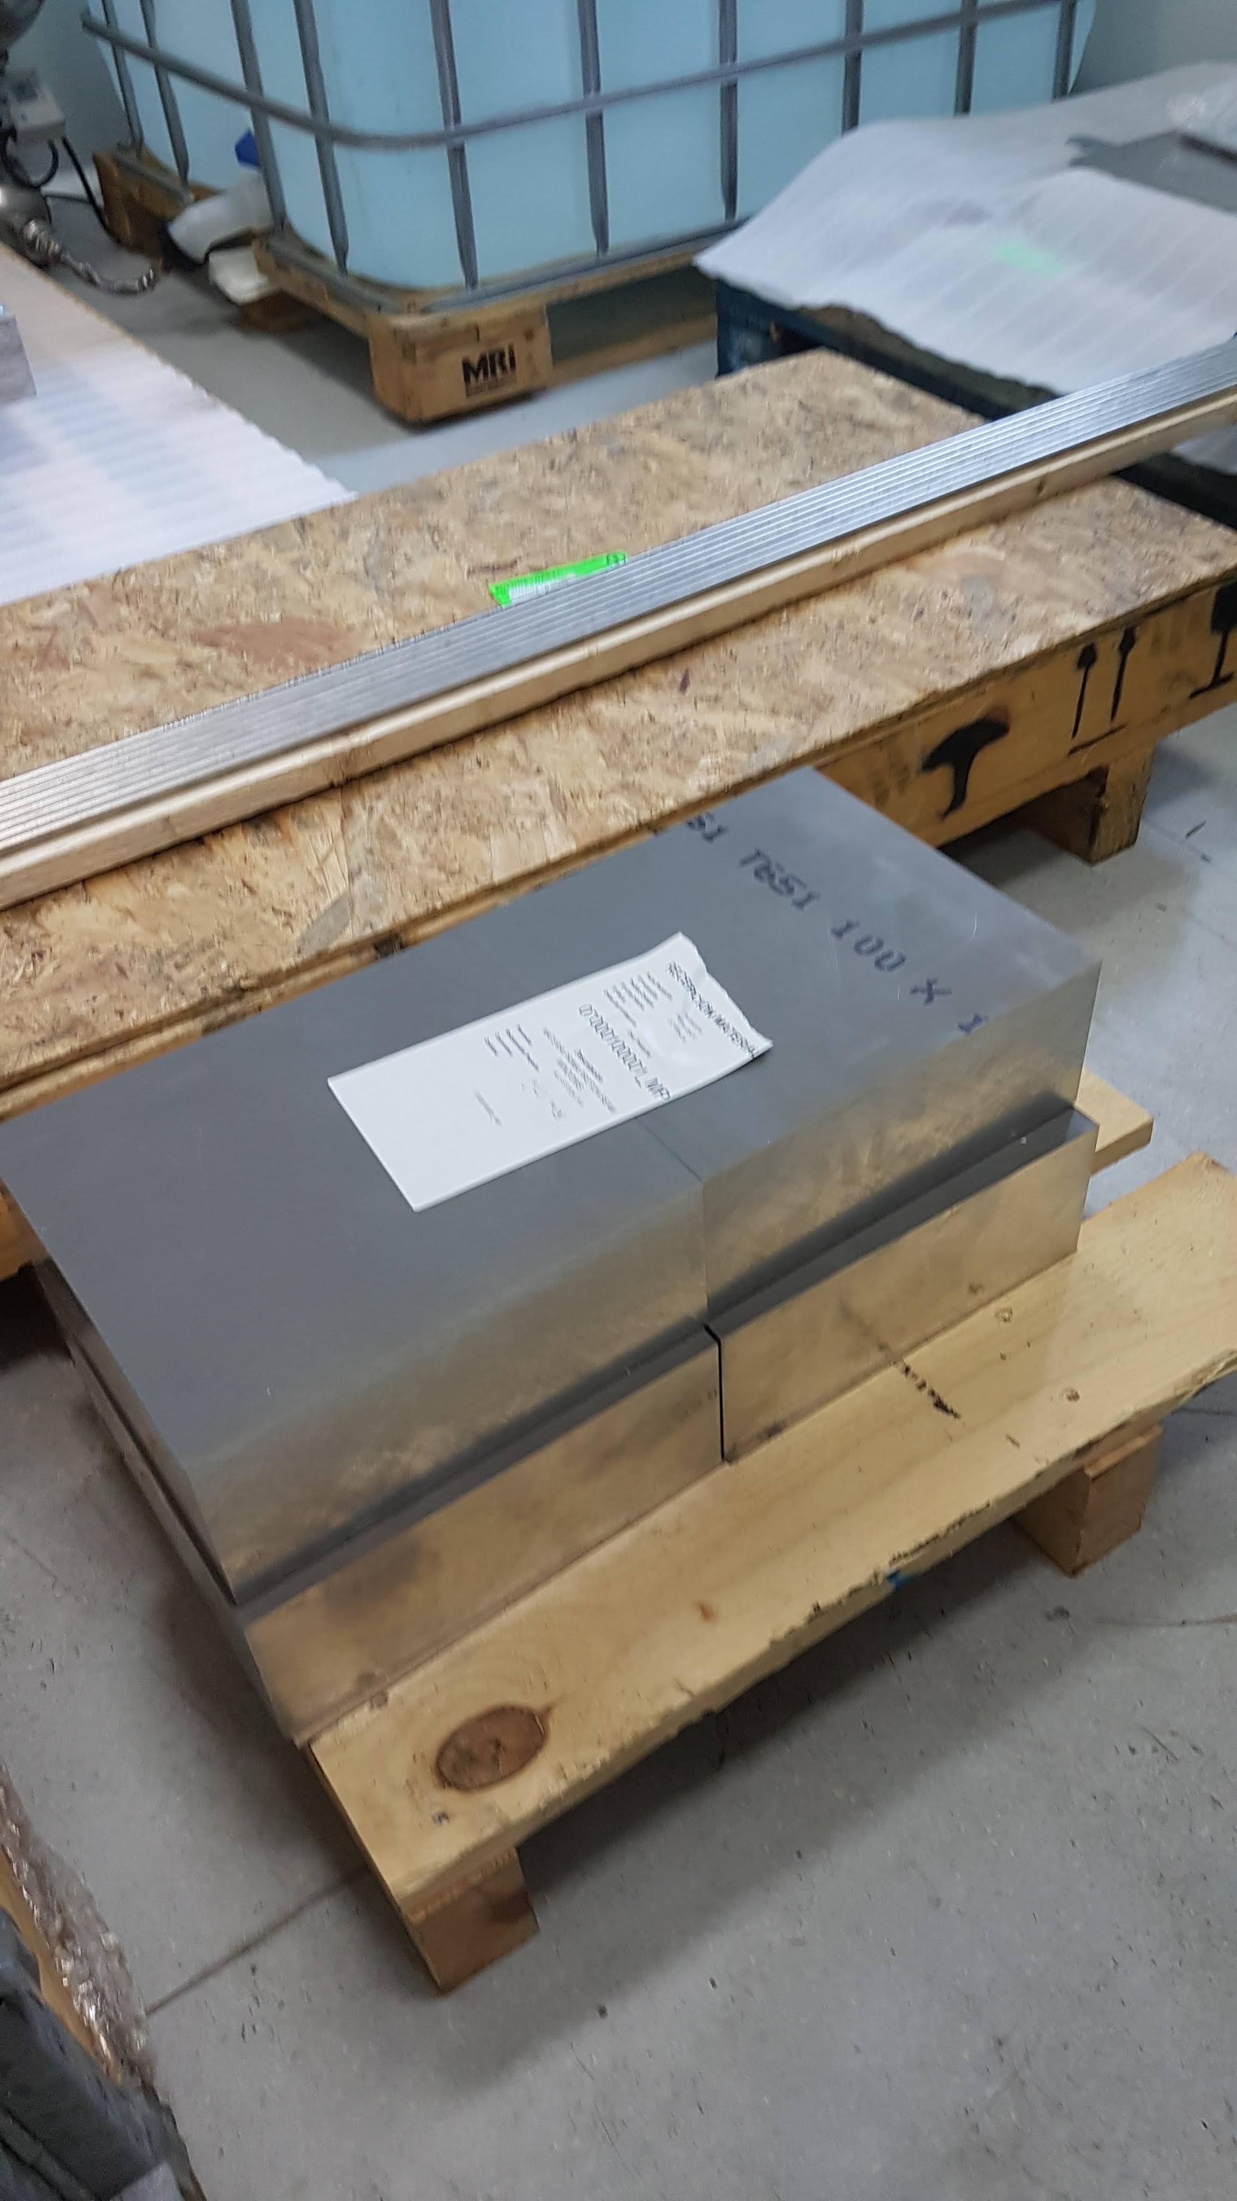
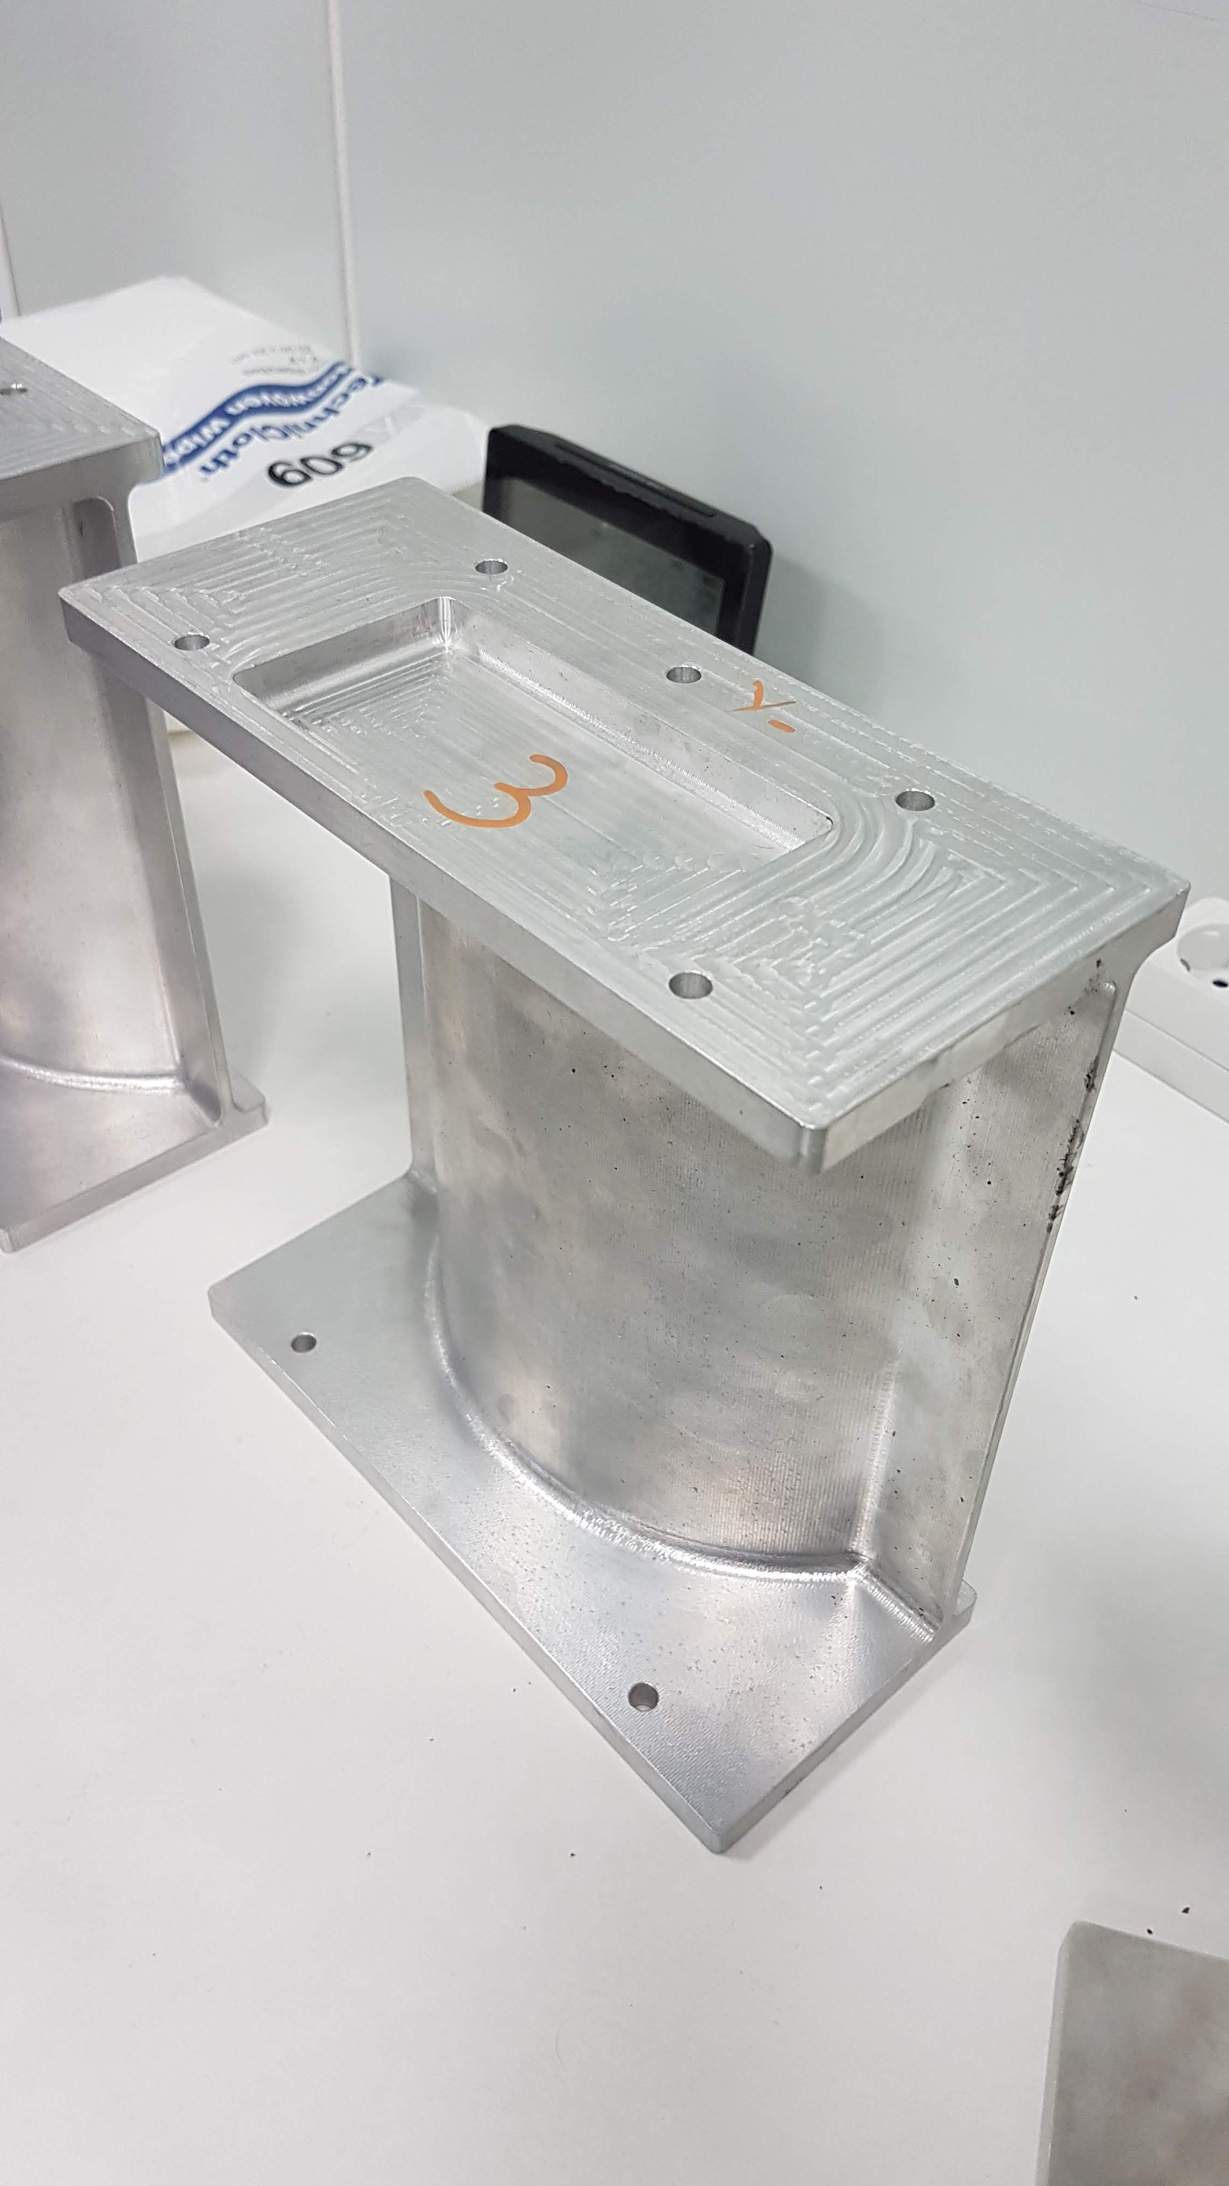
Proton Beam Window (PBW)
  Remote pillow seal to close accelerator and target vacuum atmospheres prototyped and tested by May-19. Design approved.
  Prototyping exhaustive control: UT of raw material to prevent imperfections. UT tests before, during and after each machining process. Comparison against FEM models to control deformations during pressure tests
  Challenging manufacturing process of PBW plates (1.05mm thickness in a 200mm long channel) already tested and validated. Latest prototypes by Leading finished by Aug-19.
  Hydrostatic test planned in Sep-19.
  CDR to be held by Jan-2020.
  Contract signature: May-20. Assembly & FAT: Nov-20. Delivery & SAT: Dic-20

Slide 14
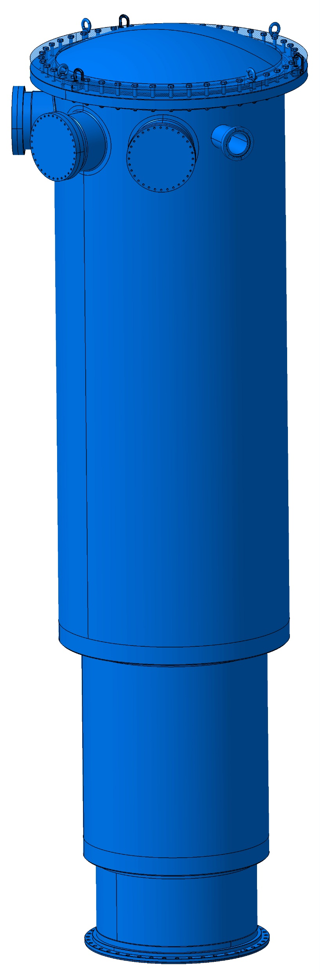
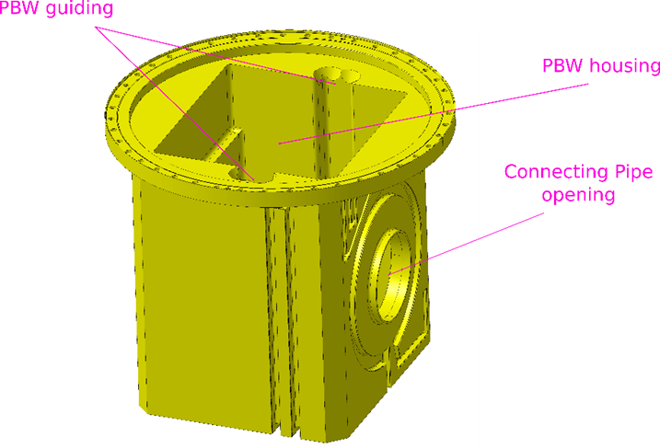
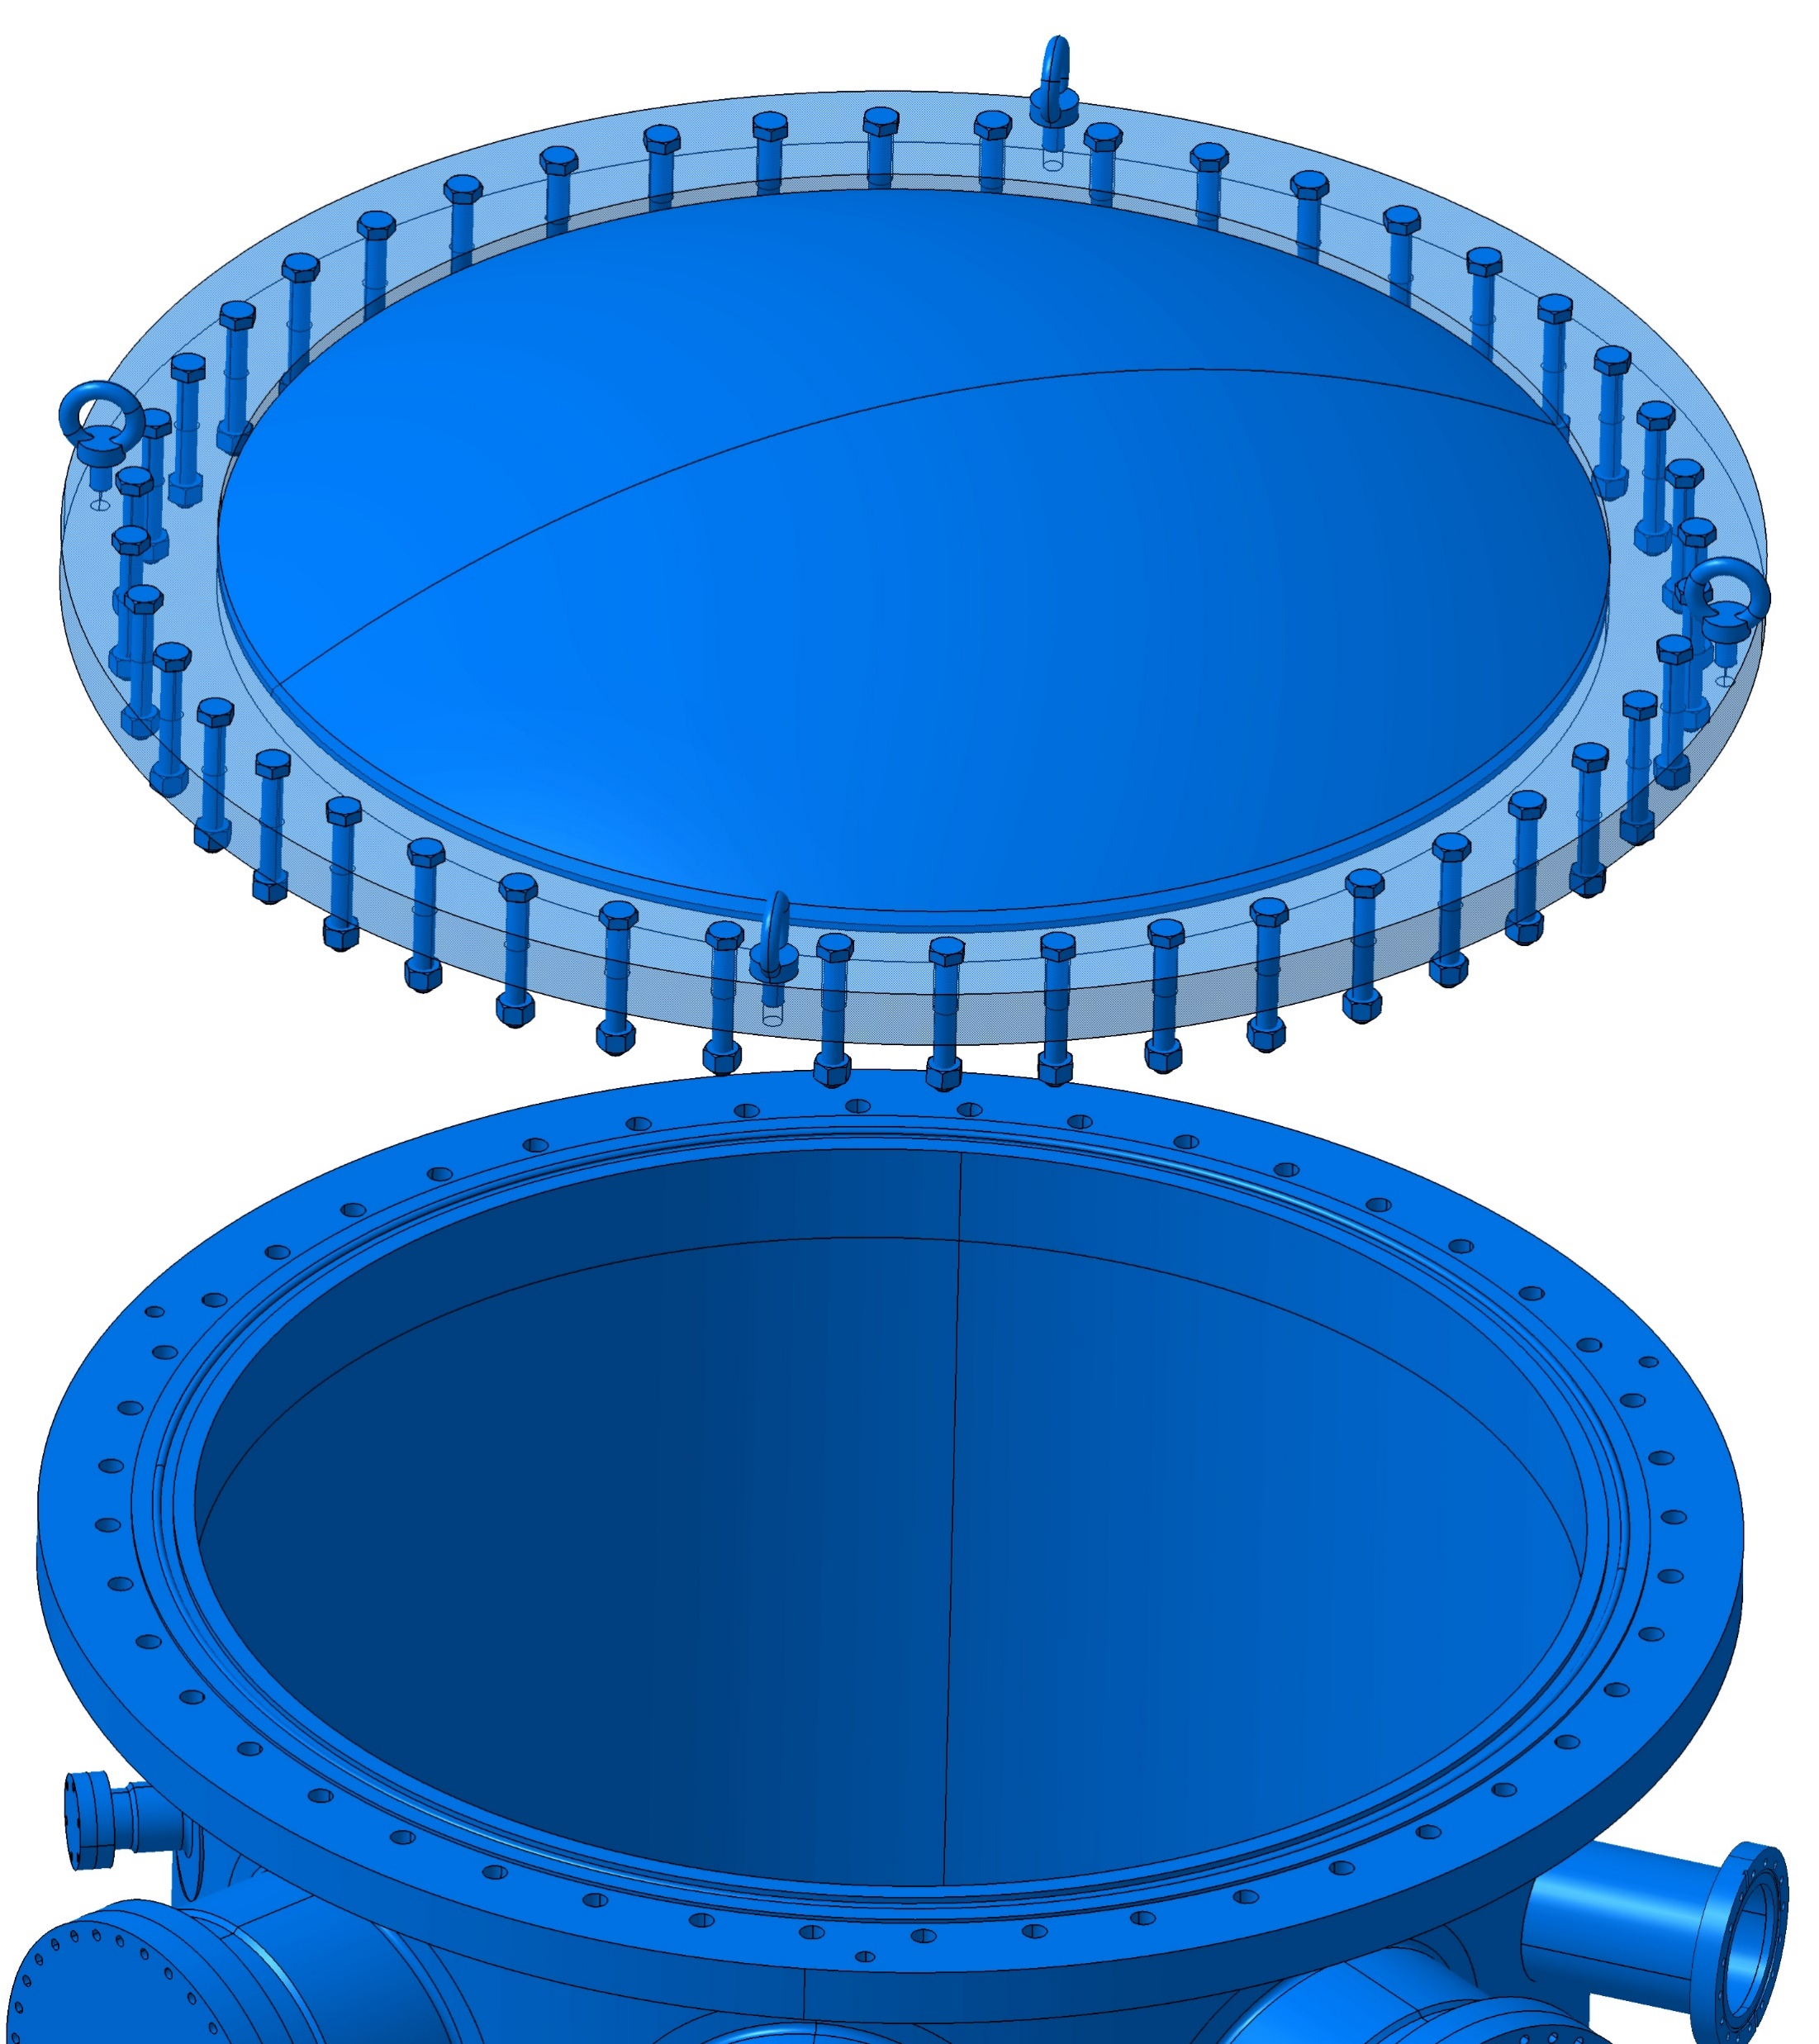
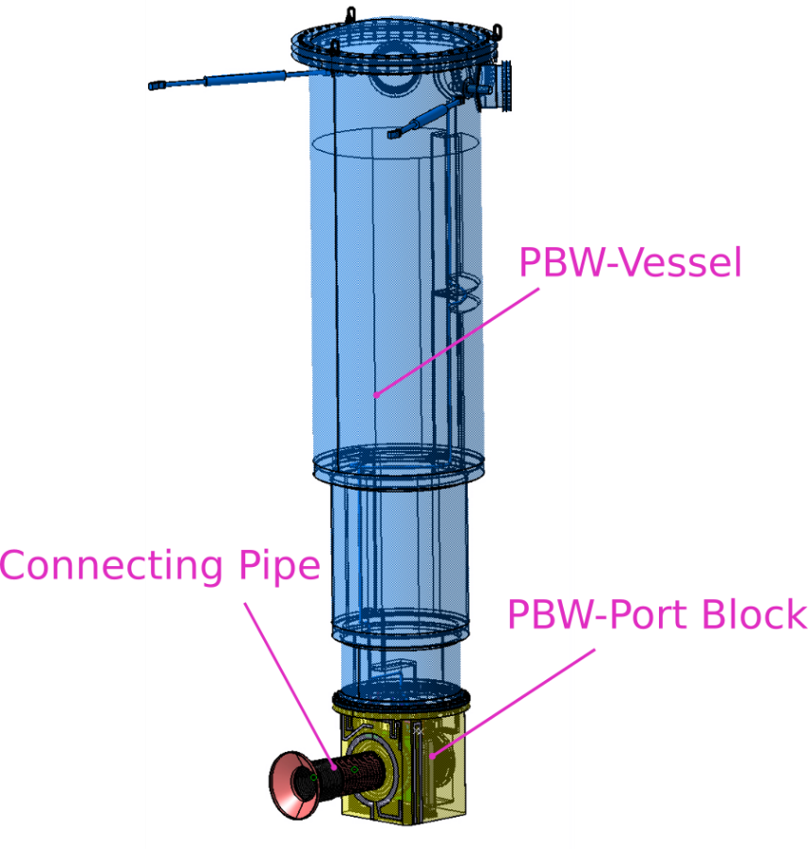
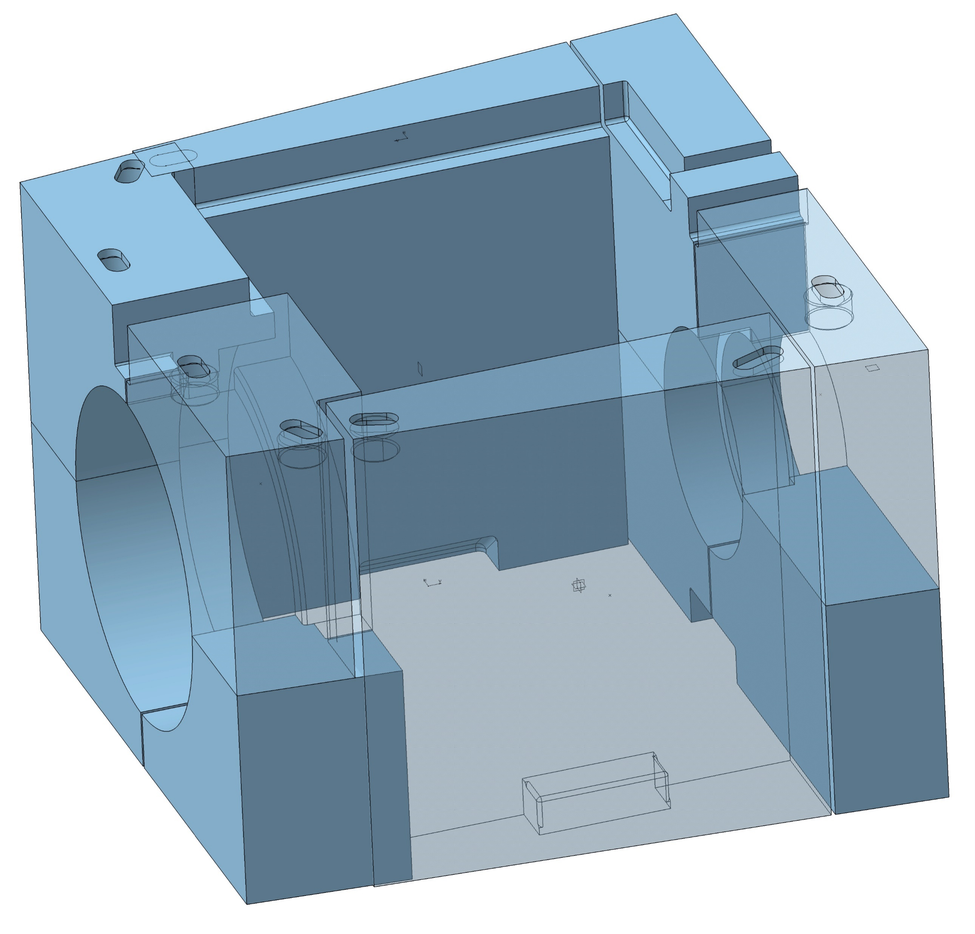
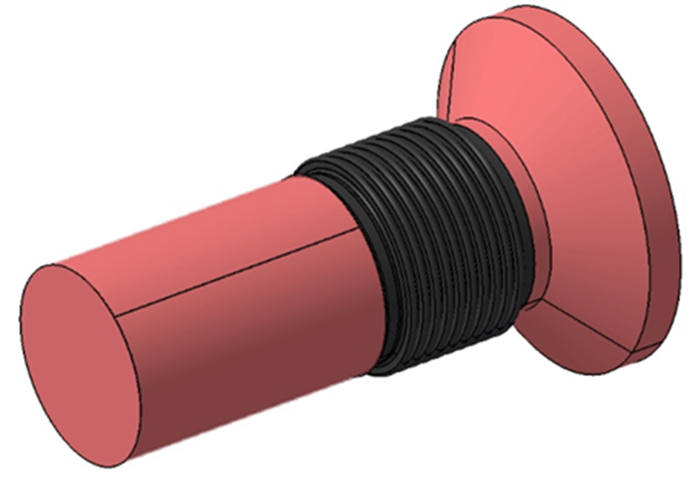
PBW Vessel and Port Block
  CDR took place in Jul-2019. Technical design is mostly approved, minor issues to be reviewed and updated.
  Manufacturing contract awarded to Nortemecánica S.A. Manufacturing review in progress.
  Material procurement of forged block has been ordered by W1-Sep.
  Assembly and FAT: Feb 2020. Planned delivery and SAT: March 2020

Slide 15
Proton Beam Inst. Plug (PBIP)
  Insertion and extraction sequence, including alignment and positioning, outsourced to ADYD Group.
  Lack of definition in remote handling casks has forced to re-evaluate design. Former contract to ADYD is invalidated by new input from ESS ERIC. Current design must be very flexible to adapt multiple solutions from RH Casks.
  Nuclear analysis to evaluate the required gaps between slices hasn't led to any practical conclusions. ESS ERIC Neutronic team didn't have a unified strategy to calculate the acceptable dose rates and required to ESS-Bilbao to calculate them under contradictory paths (solved).
  Need to complete the mechanical and thermal calculations.
  This component face delays caused by prioritization of tasks and resources to other projects. However, we believe that the maturity in the definition of the interfaces does not recommend carrying on working on this until those interfaces are frozen. High Risk of unnecessary redesign work

Slide 16
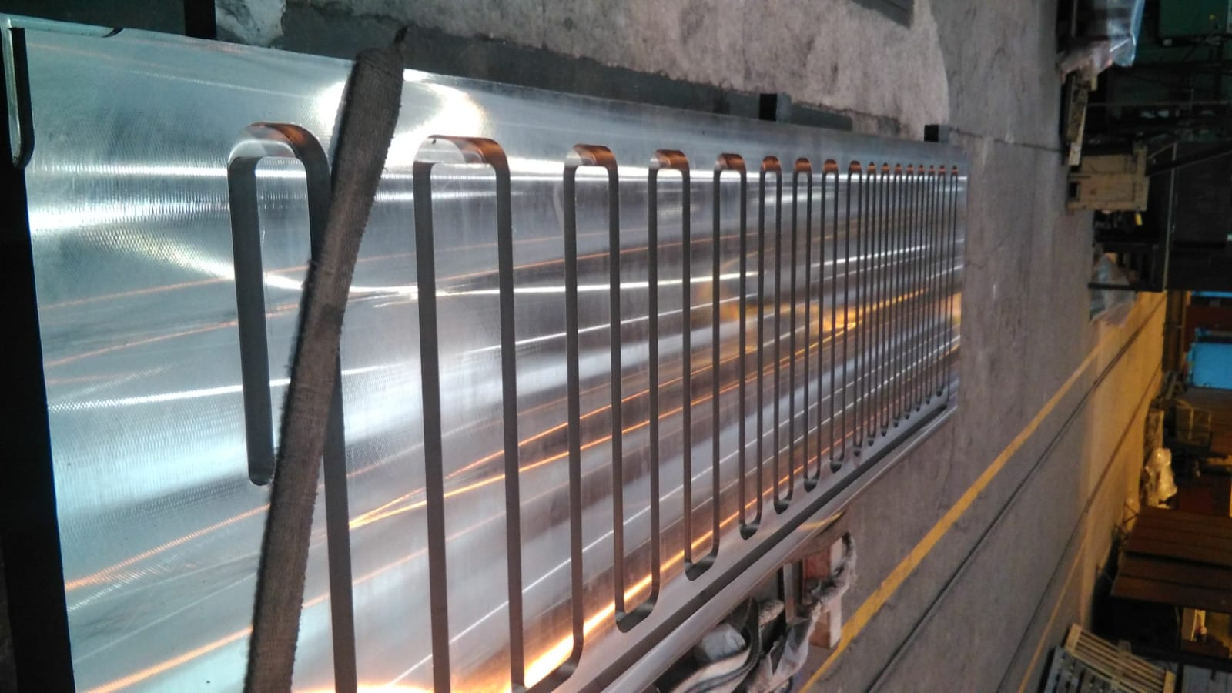
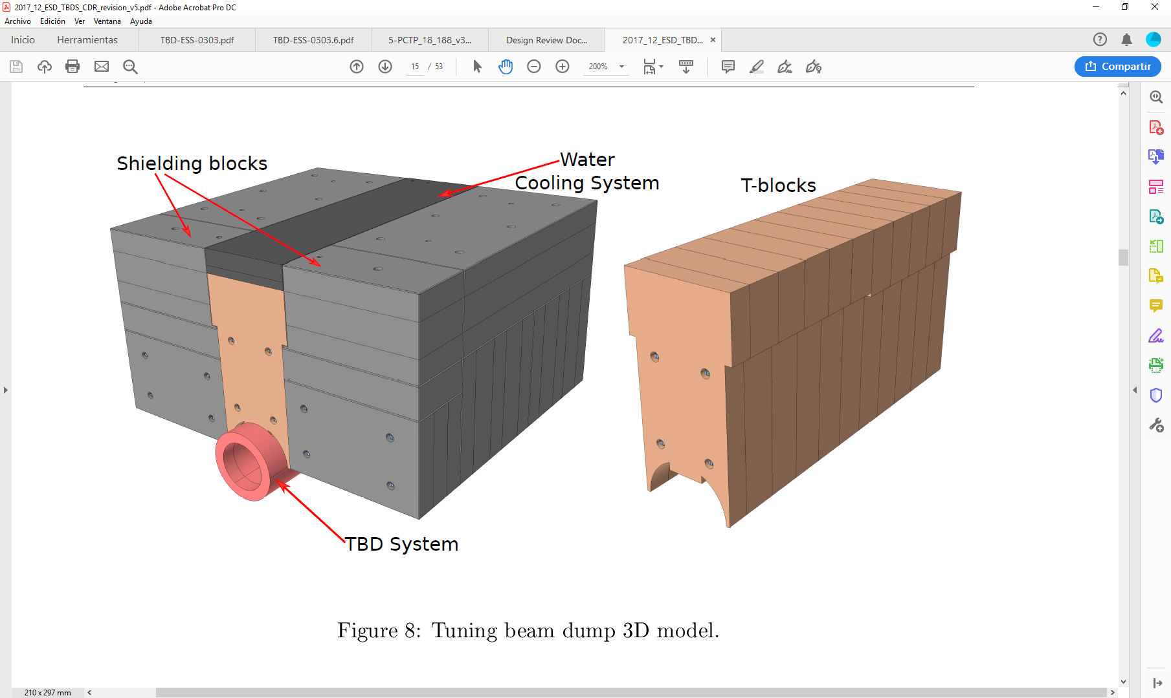
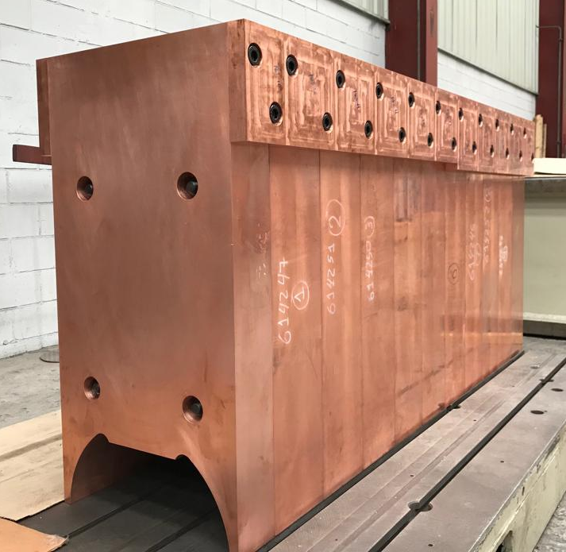
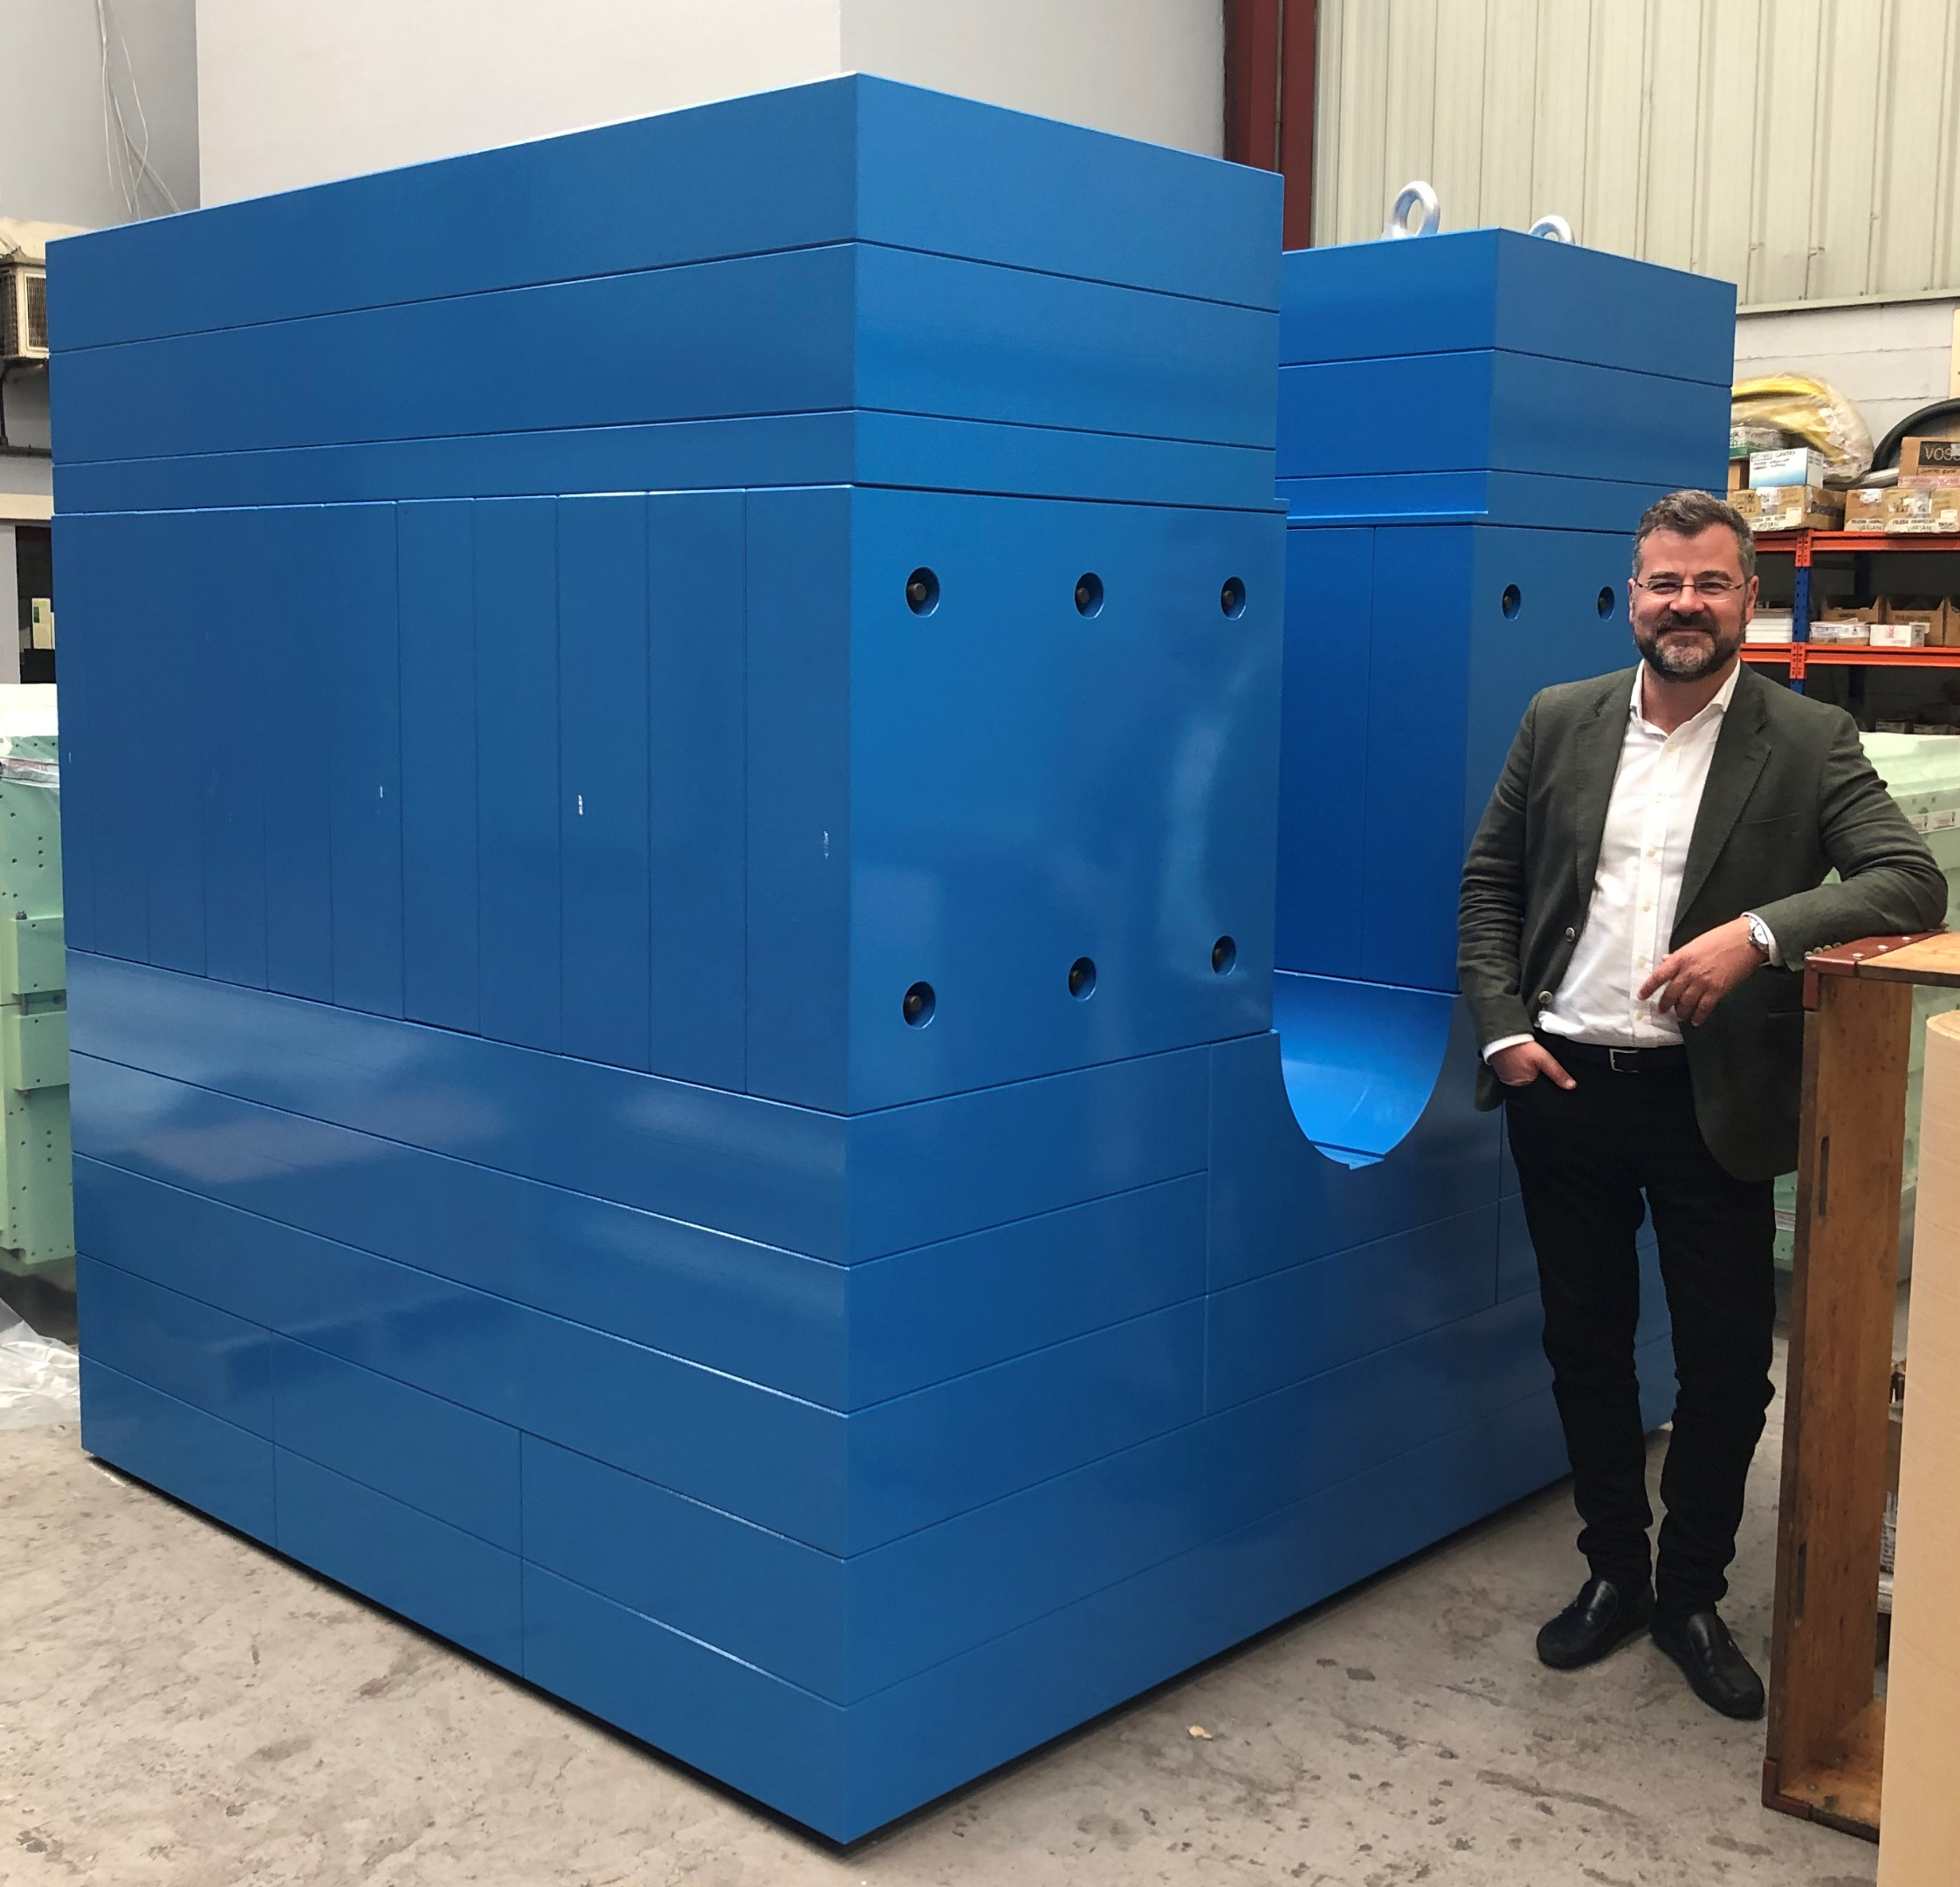
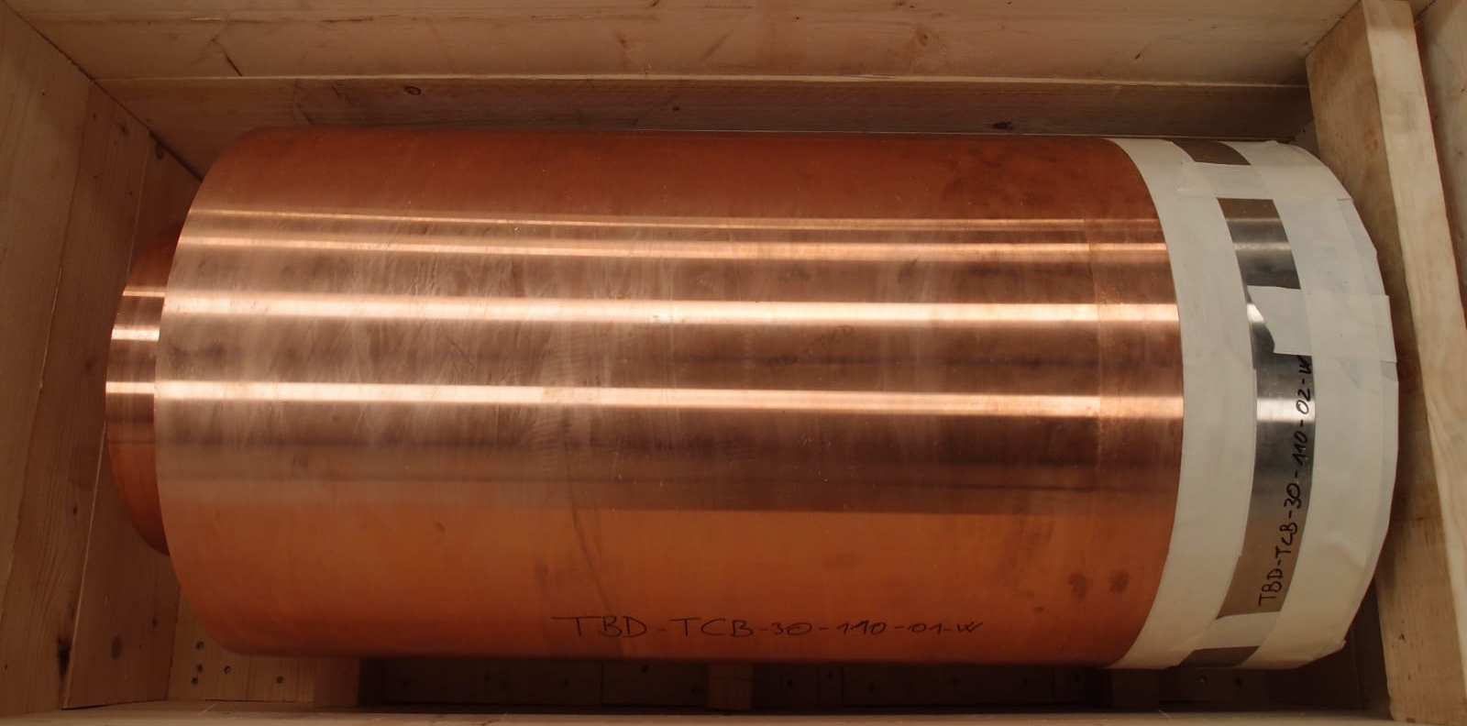
Tunning Beam Dump (TBD)
  CDR successfully passed mid-April 2019
  Manufacturing contract awarded to Nortemecanica (shielding ) / Thuneureka (TBD system)
  TBD shielding completed. TBD system (tube) welding on going.
  Assembly and FAT planned by 15 Oct 19.
  Planned delivery by mid-Dec 19.

Slide 17



