Slide 1
Target Sub-project Update TCB.09
Rikard Linander
Acting Head of Target Division
European Spallation Source ERIC
12th September 2019

Slide 2
Target sub-project is 47% complete
Current budget at completion for the ESS Target Sub-project is 222M€
Earned value end of August 2019 is 104M€
Since the re-baseline mid 2018 CF has held the site early access dates
Target Ready for Beam milestone is March 2022
Currently the sub-project is carrying a negative float of about 6 months.
Most Target WP installations are with < 40 days float to Critical Path.
Several heavy steel structures (~700 tonnes) have been installed, including monolith vessel supports, baseplate, ground shielding, and D2T shielding
Raw material for monolith vessel delivered to manufacturer. On track for delivery of this in-kind element by end of this year.
Commissioning of the Target Moderator CryoPlant has been completed.

Slide 3
High Level Schedule (CP items)
2017
2018
Q1 Q2 Q3 Q4
2019
Q1 Q2 Q3 Q4
2020
Q1 Q2 Q3 Q4
2021
Q1 Q2 Q3 Q4
2022
Q1 Q2 Q3 Q4
Tuning Beam Dump
17/4
7/10
Monolith Vessel
18/12
Target RBOT Mar -22
NBPB Part #1: 11/5 …
NBPB Part #5: 15/7
Neutron Beam Port Blocks
16/7
Monolith Inner Shielding
1/5
28/3
15/12
#1
15/5
#2
15/10
#3
15/2
#4
Moderator & Reflector
inst. MUTS
Ready for
delivery 12/3
test inst.
6/7
final inst.
22/12
inst. MUTS
10/9
Target Wheel Drive & Shaft
Complete unit
on site 31/7
test inst.
19/4
final inst.
11/6
22/2
Monolith Connection Ring
11/12
22/6
12/8
Target Monitoring System
1/5
9/6
Test inst. MUTS
Target Helium Cooling System
#1
#2 14-15/3
12/8
31/12
Inst piping in
connection cell10/1
1/10 Heat Ex.
Integrated System Tests Complete
Sep/Oct
-132 d
PDR
CDR
Delivery to site
Start of Installation
System test completed
Notes:
CP for WP2 is He system,

Slide 4
Target organisation

Slide 5
Target organisation
- Recent evolution
Mark Anthony left Target Division to be ESS Project Director
Consolidation of the ESS Spallation Physics and Analysis resources
Build-up of the Target installation coordination and support group
Streangthening of the Target Operations and Maintenance group being planned

Slide 6
Site Installation Progress

Slide 7
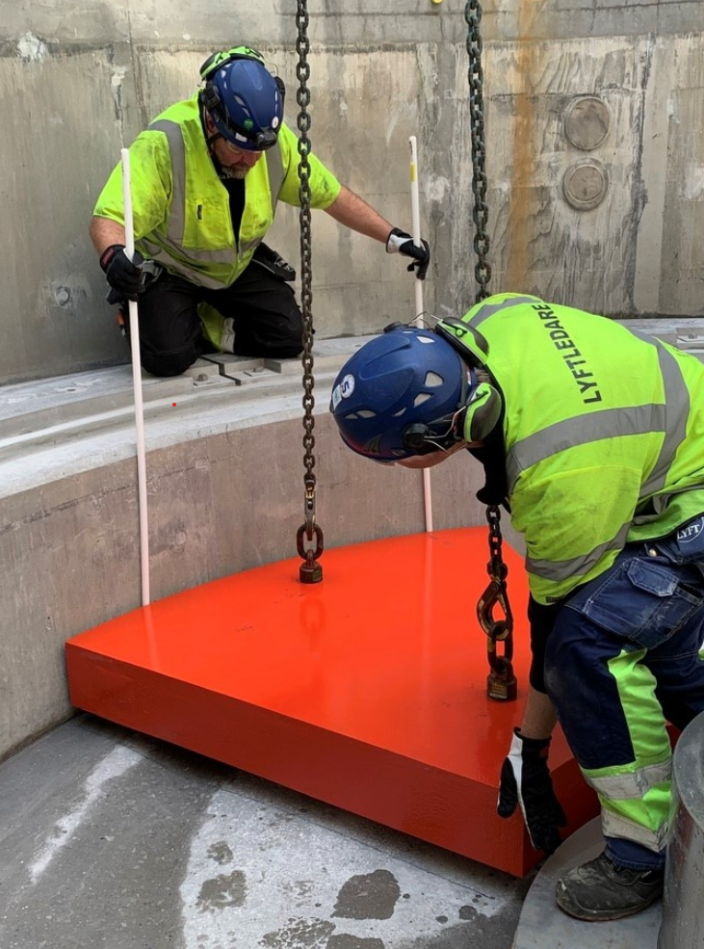
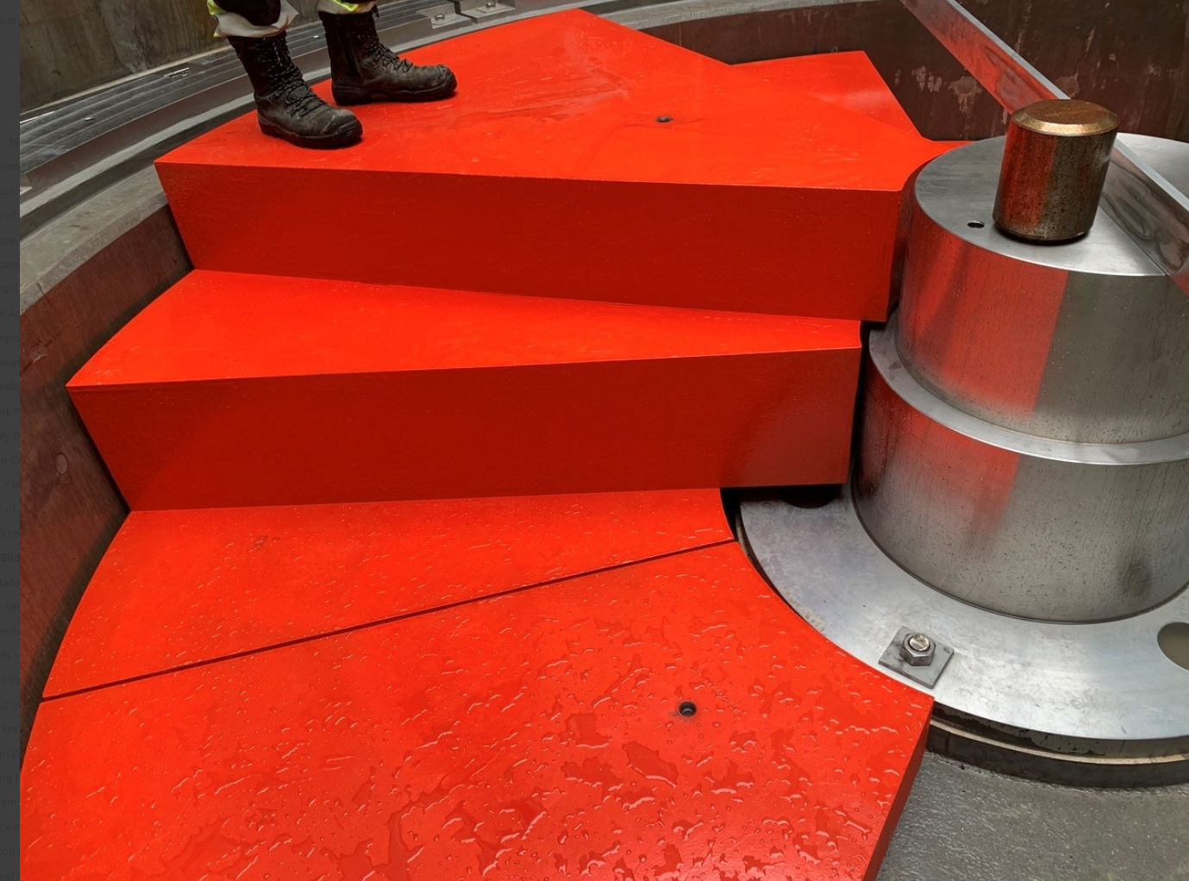
Site installations
- Ground Shielding

Slide 8
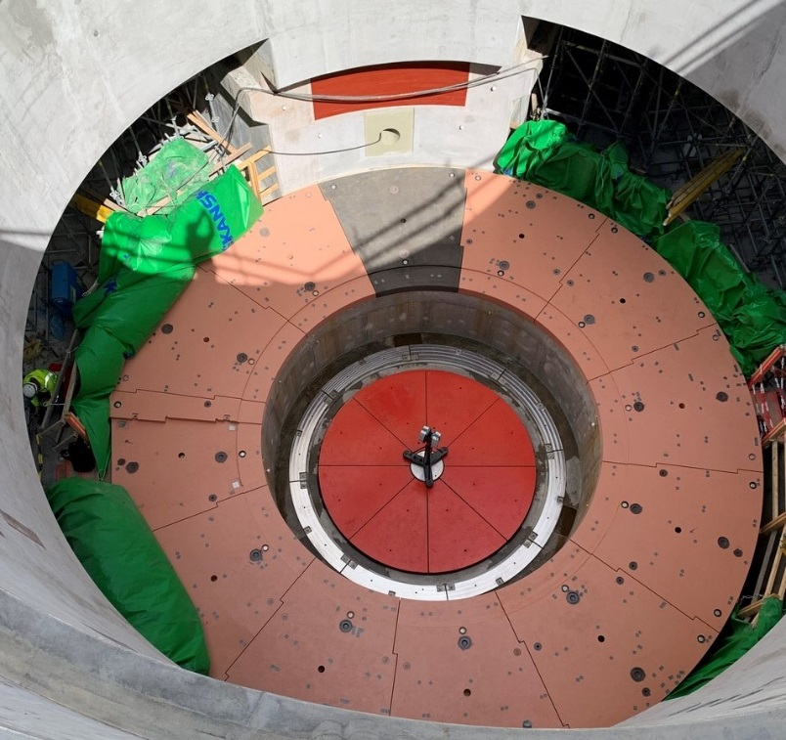
Site installations
- Monolith Vessel Supports, Monolith Baseplate, Ground Shielding, and Wall Embedments

Slide 9
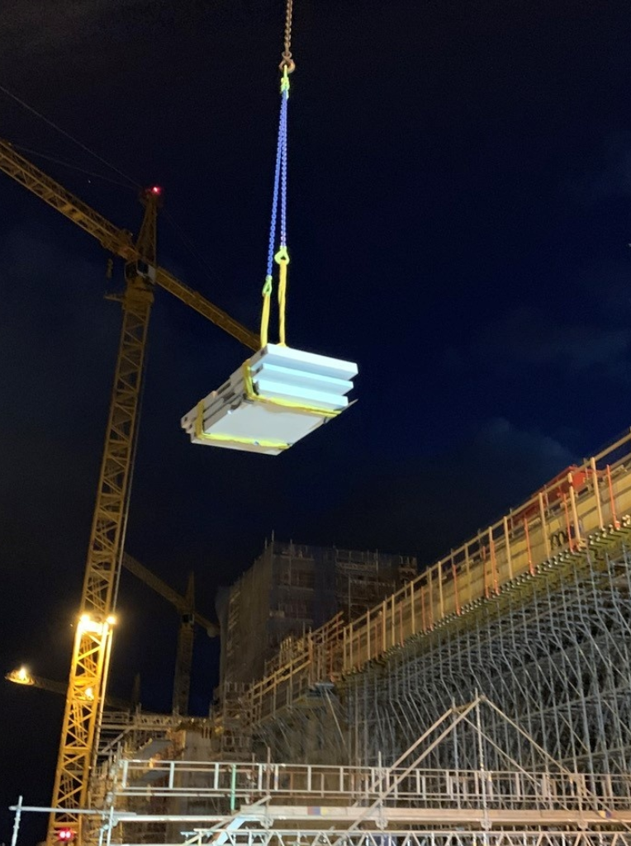
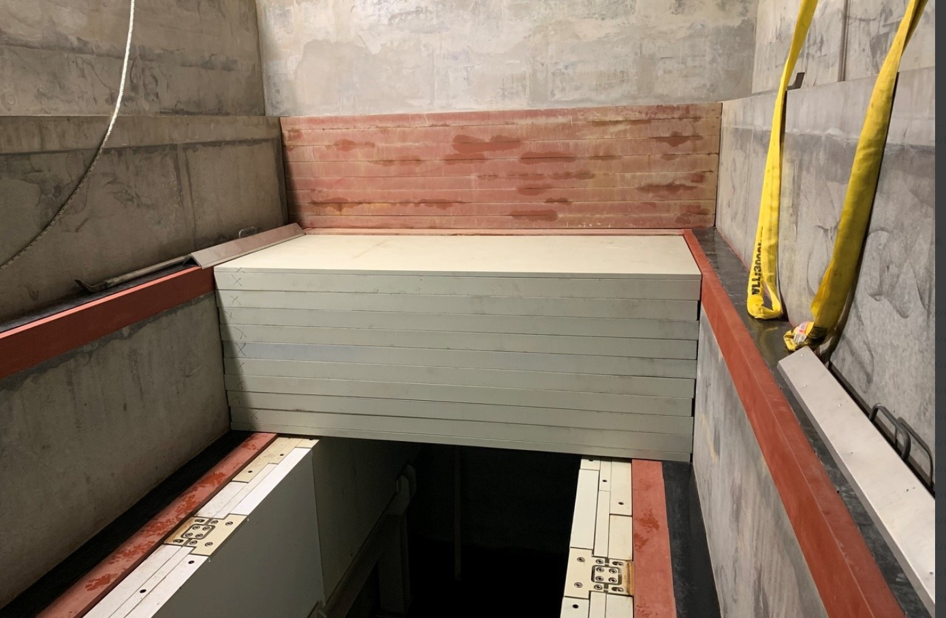
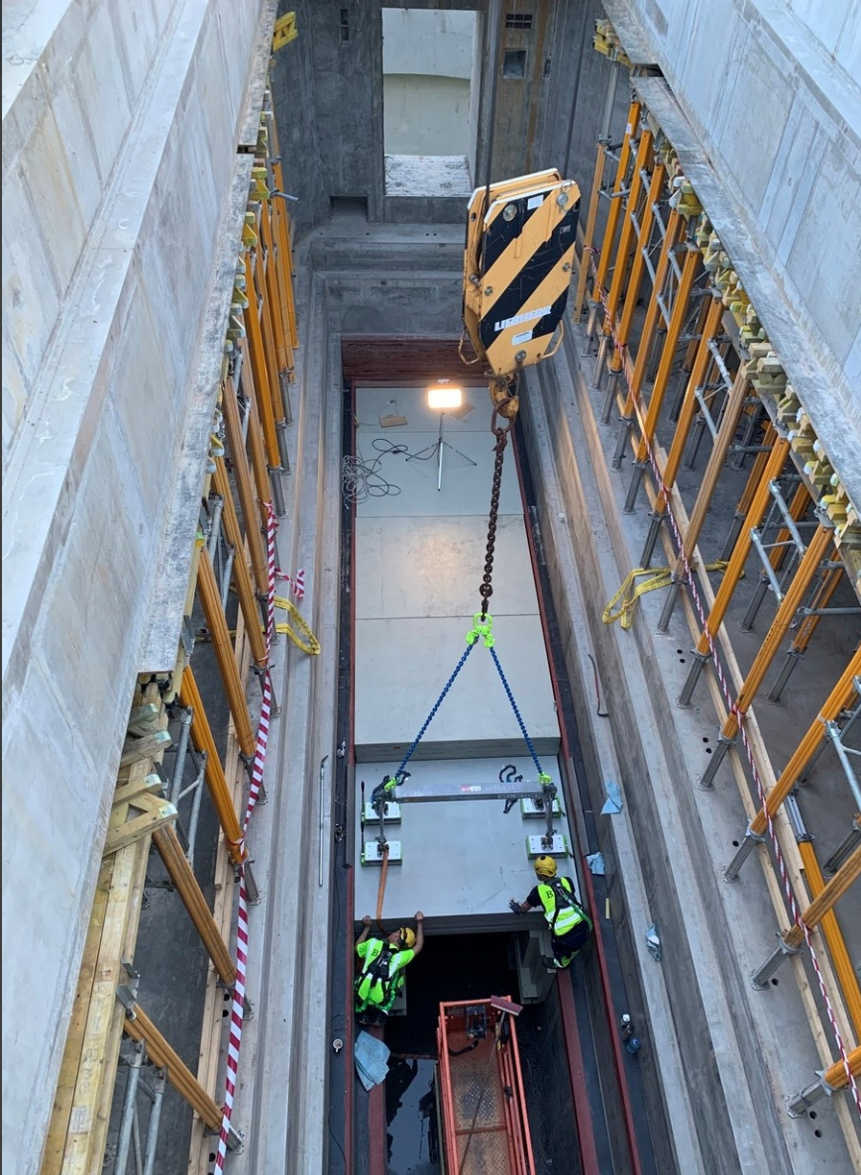
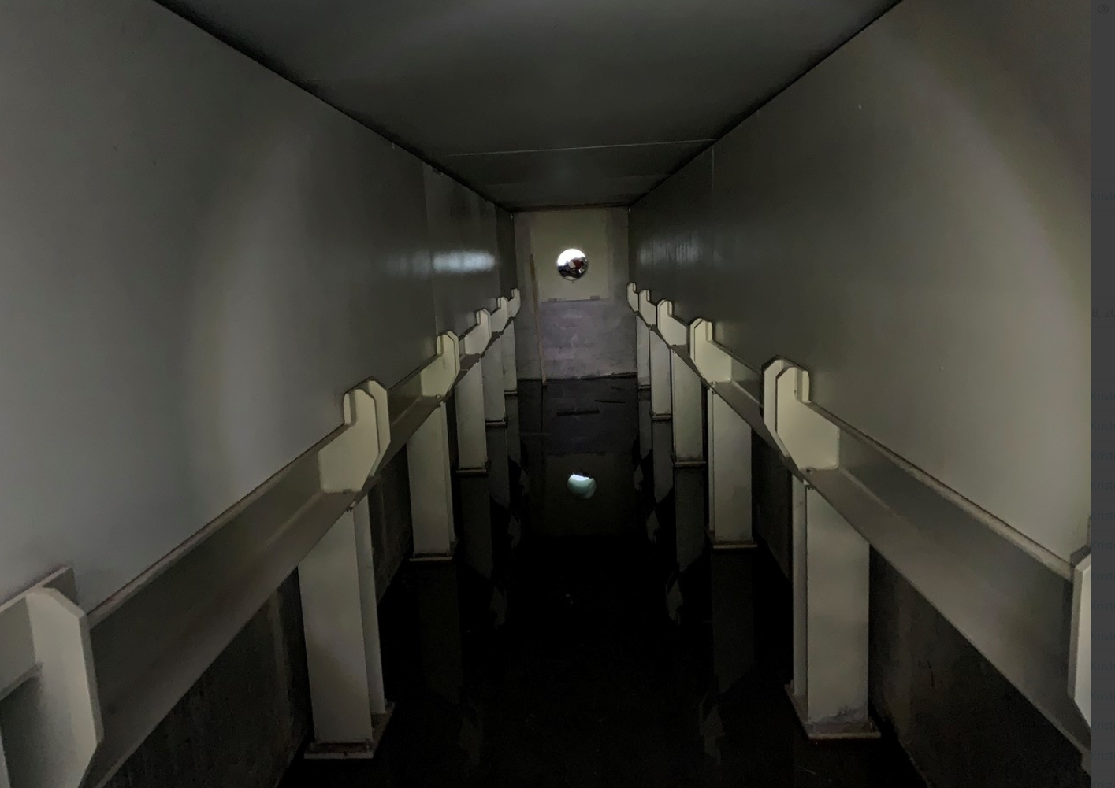
Site installations
- Bulk Shielding above D2T

Slide 10
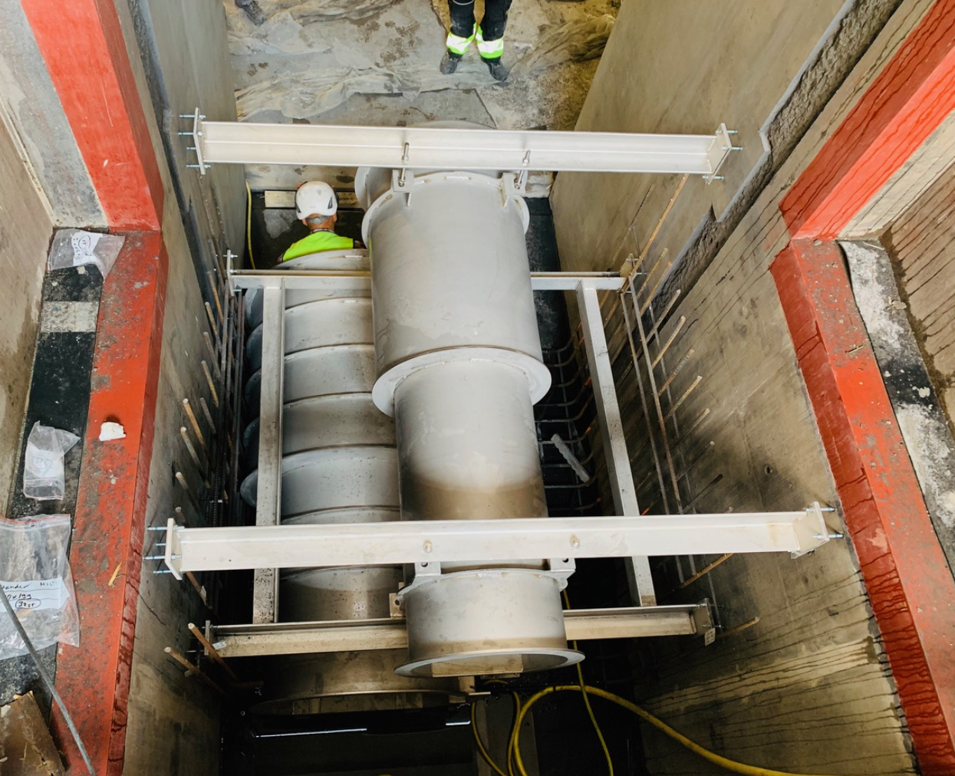
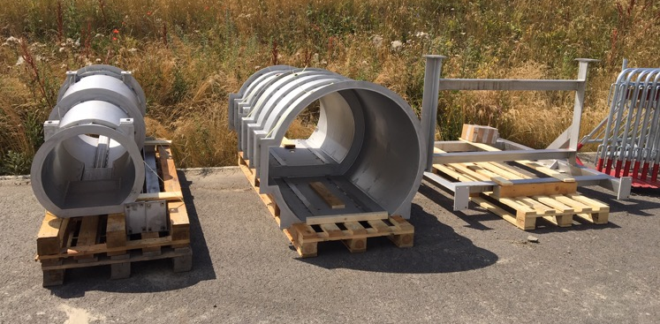
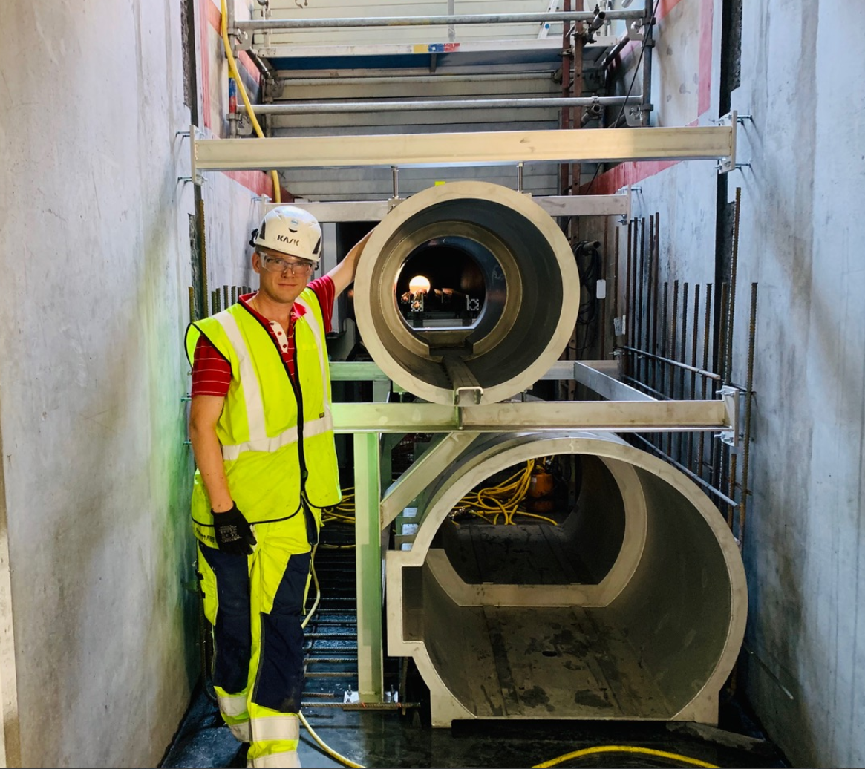
Site installations
- Embedments for Neutron Shield wall

Slide 11
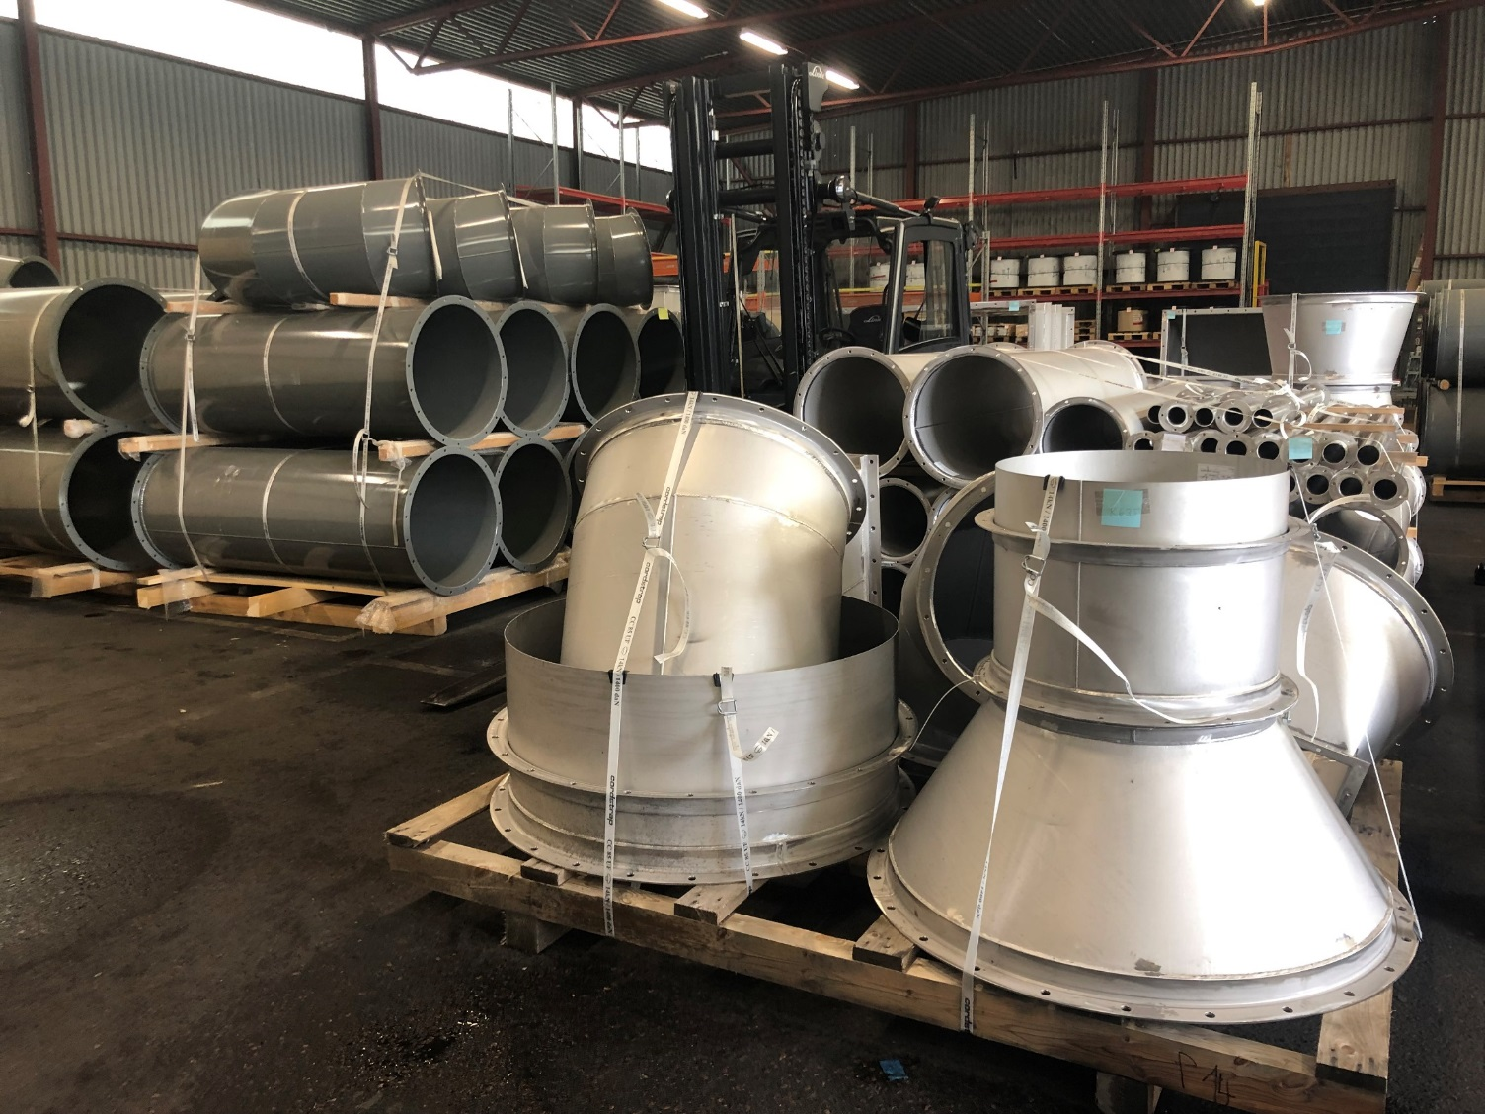
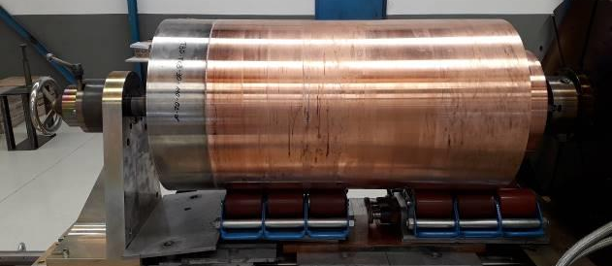
So, Target has entered installation phase!
- What’s next?
ACF liner plates will start being installed September
Tuning Beam Dump is scheduled for installation in October/November
Monolith Vessel installation activities begin in December/January.
Cooling systems and HVAC installation starts 2019 Q1

Slide 12
Target Deliveries Progress

Slide 13
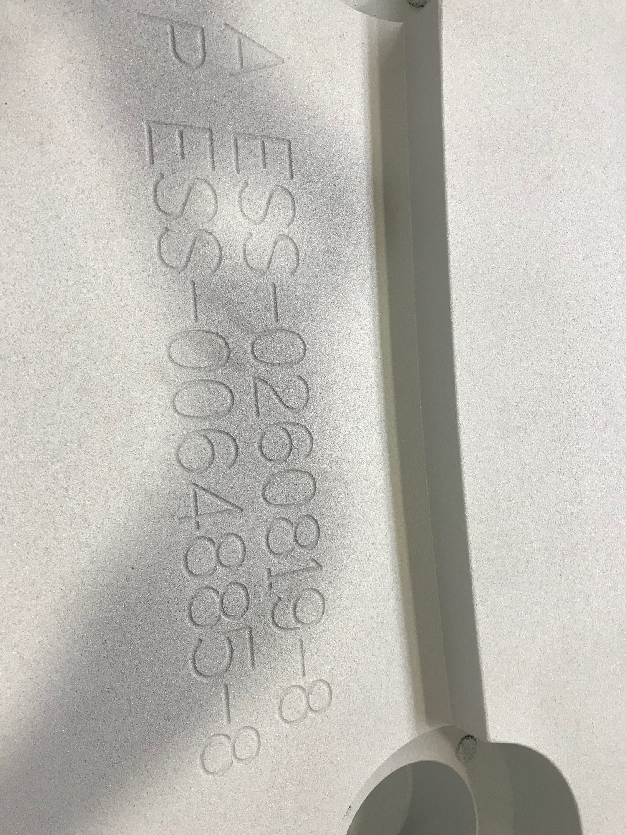
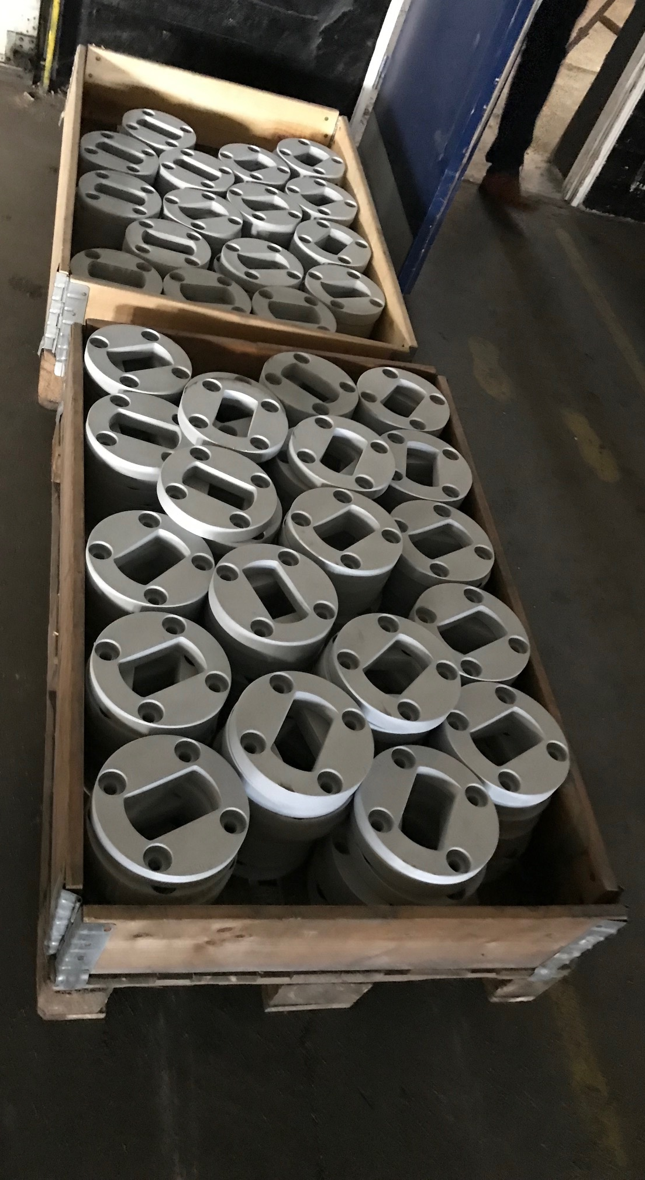
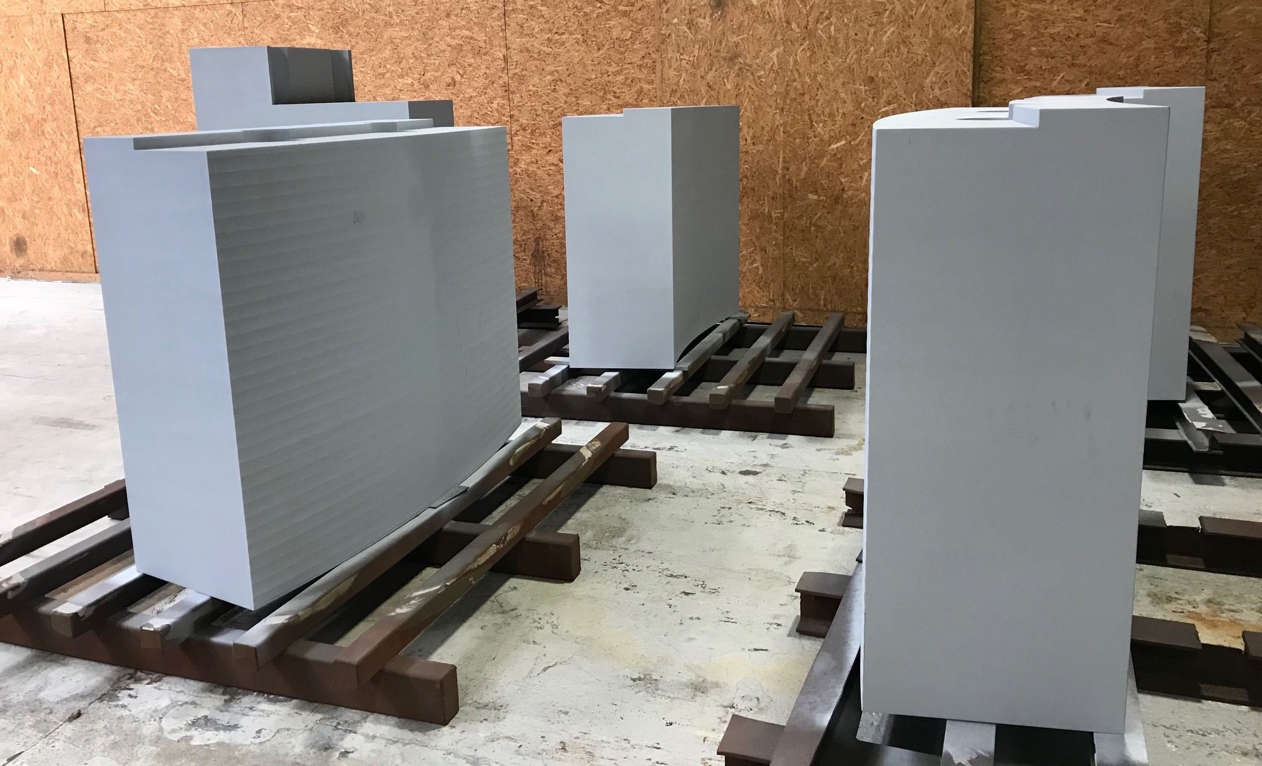
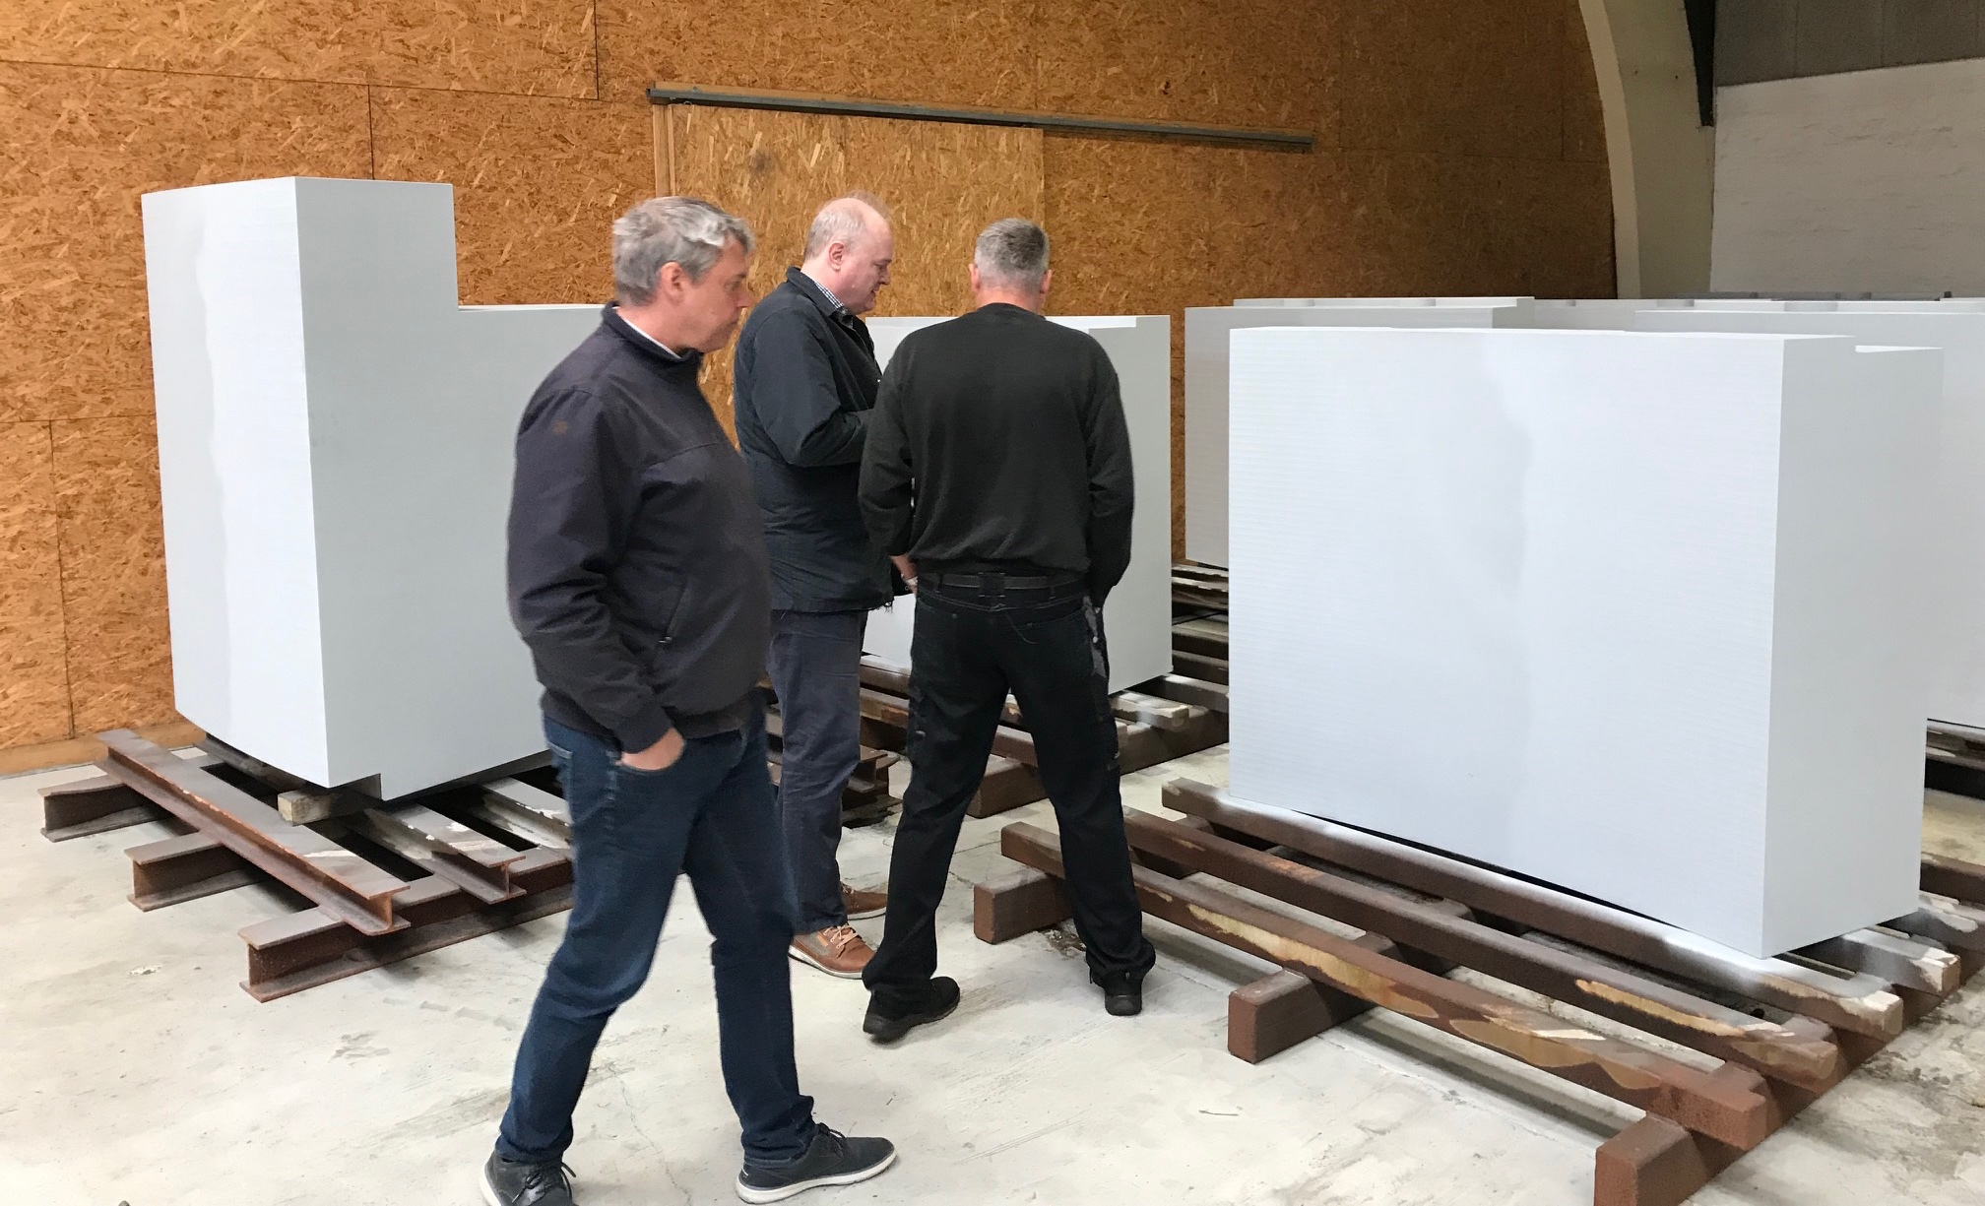
Monolith Outer Shielding
- Blocks ready for shipment

Slide 14
Steel supply challenges
- Ingot surface cracking

Slide 15
Steel supply challenges
- Ingot surface cracking

Slide 16
Steel supply challenges
- Current main Target sub-project schedule concern
Neutron Beam Port Blocks
Start of installation currently carrying a negative float of 132 days to Target RBOT
The lessons learned are that complicated, non-standard production requires more schedule contingency, and large industries are less agile and adaptive.
Material quality issues, with severe edge cracking, were encountered and caused delays.
The measures taken to mitigate further delays are weekly video meetings focusing on schedule, site visits, top management intervention, and enforcing agile decision making.
The manufacturer’s remedy for schedule recovery is to redistribute some production between different facilities. We see more stability in their plan and recovery of two weeks. Without actions, the delay could easily have become doubled from the original 13 weeks instead.
Further measures will be to secure flexible planning and coordination of the the subsequent workshop machining phase with the manufacturing company.

Slide 17
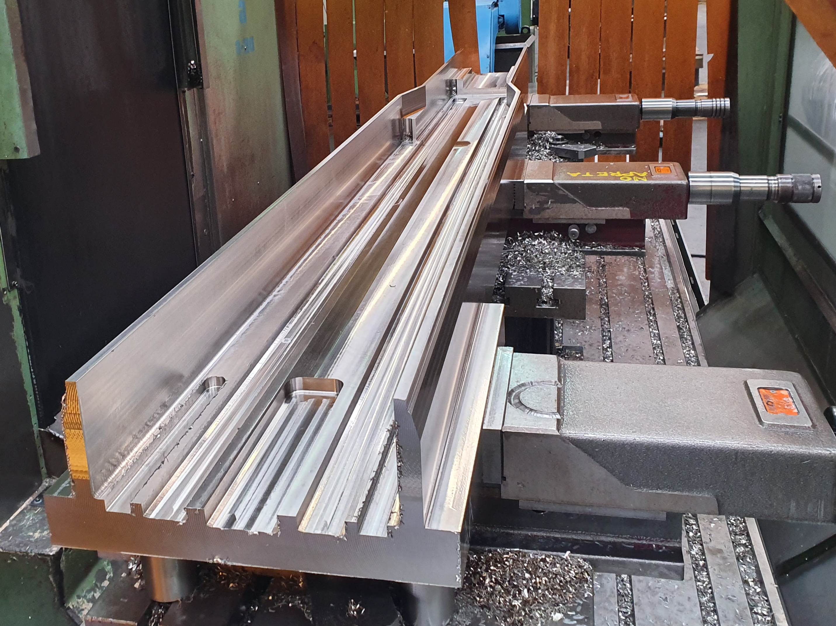
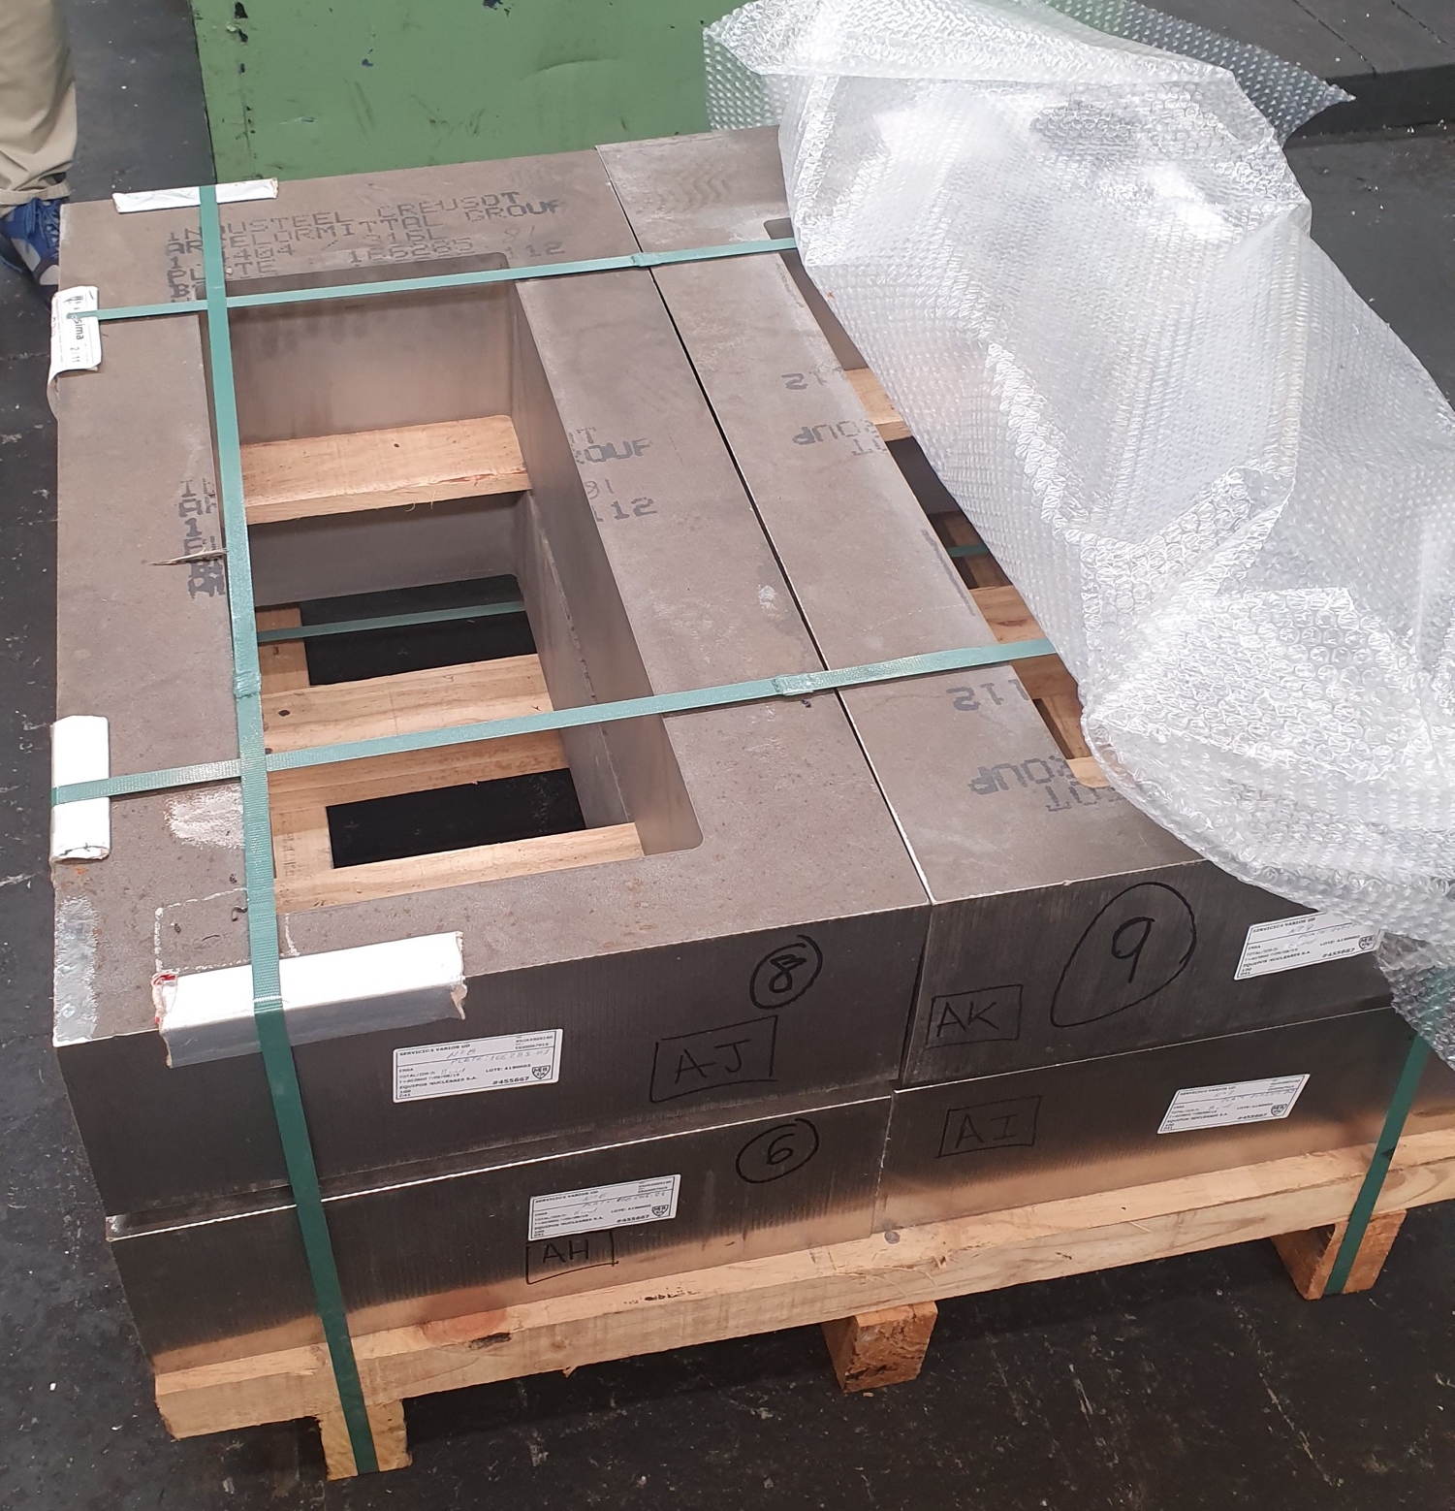
Neutron Beam Port Tubes
- In manufacturing
Port flange raw material
Bottom part of port tube, with insert alignment features
Top parts of port tubes

Slide 18
Neutron Beam Port Insert
- Manufacturing Prototype

Slide 19
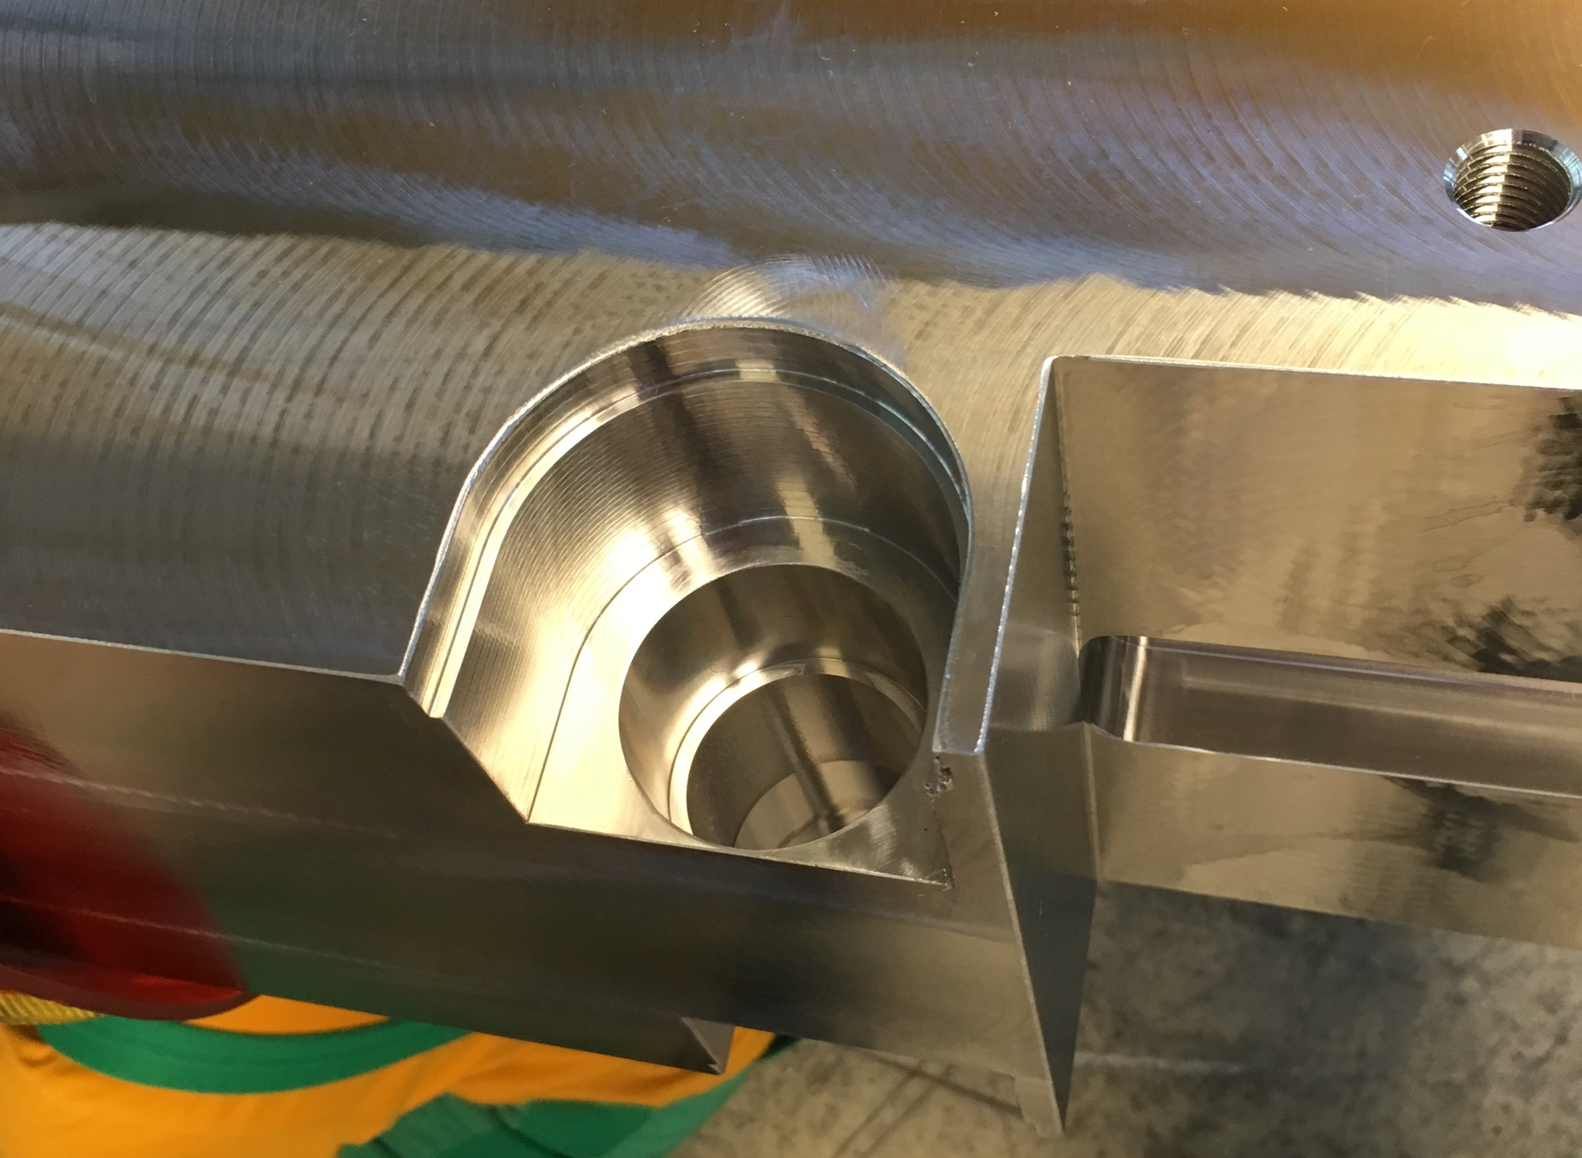
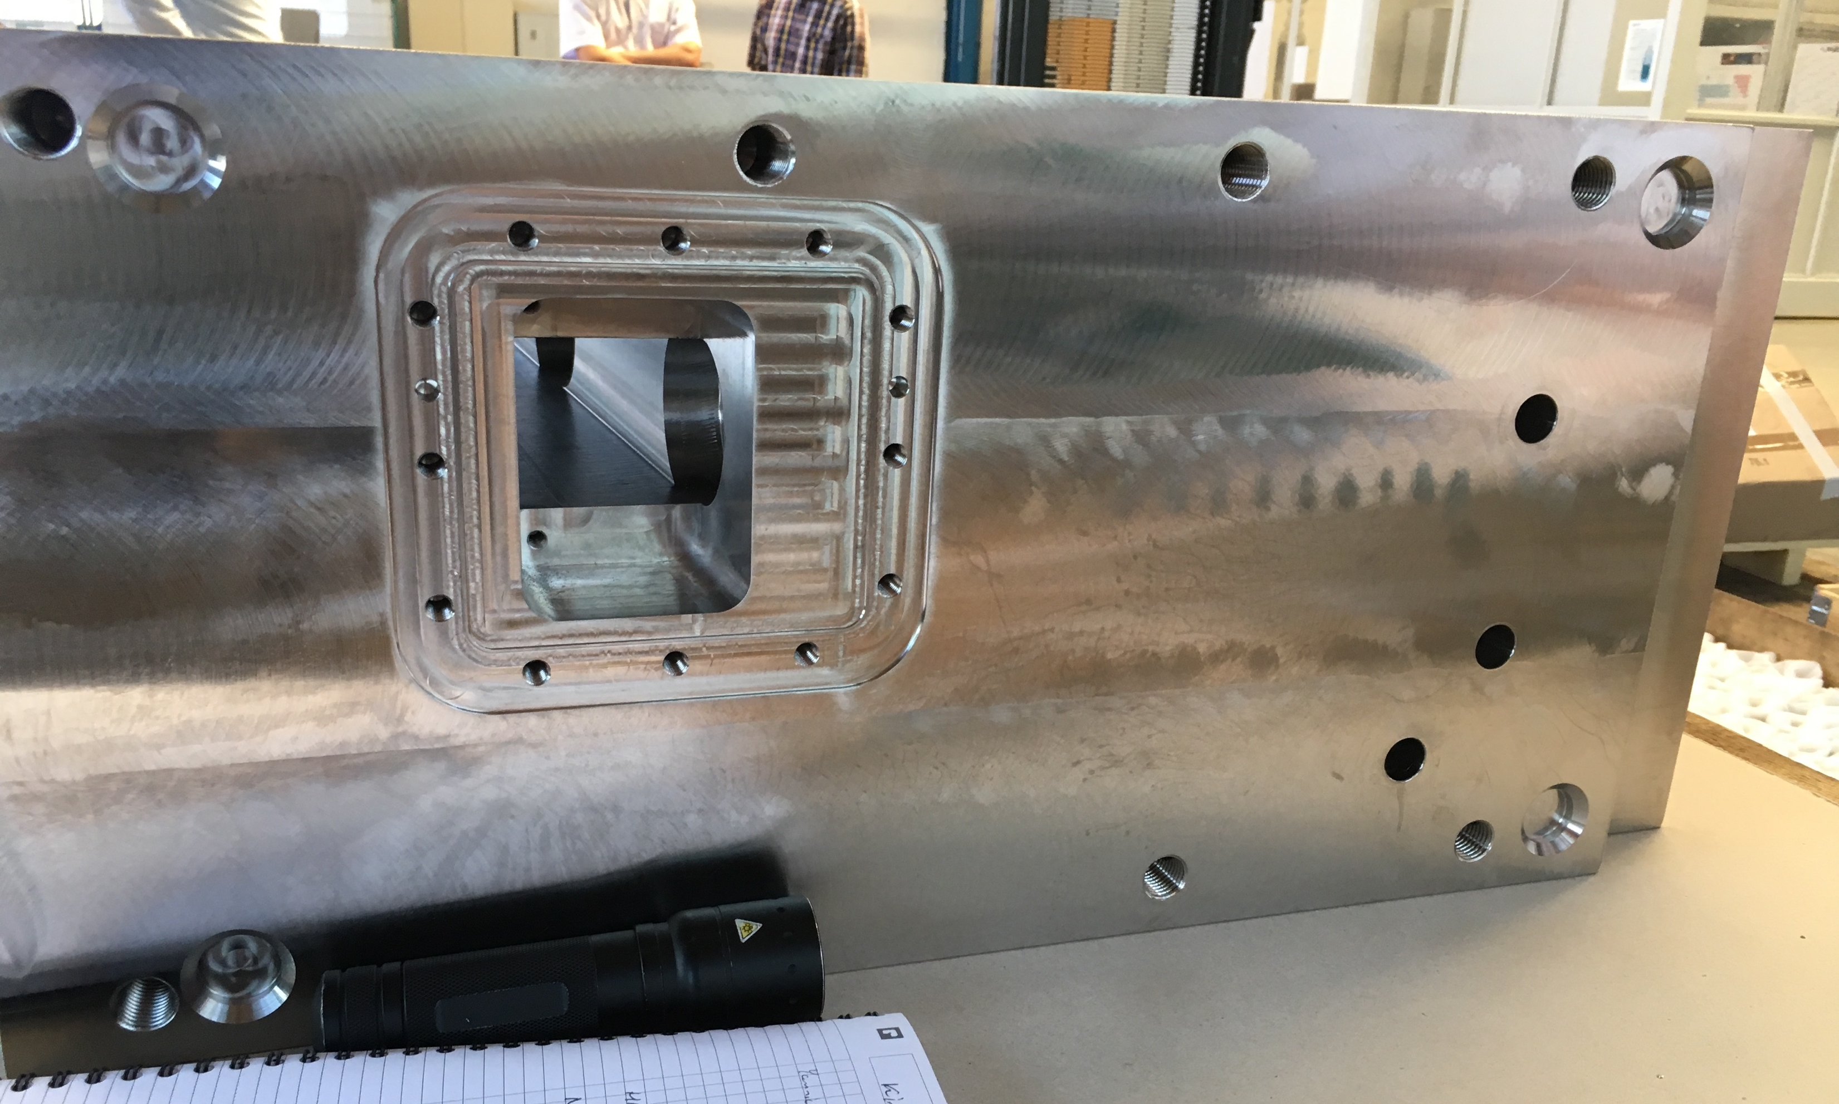
Neutron Beam Port Insert
- Manufacturing Prototype
Void for Neutron Beam Optics Assembly
Cut-out for rollers
Neutrons here!

Slide 20
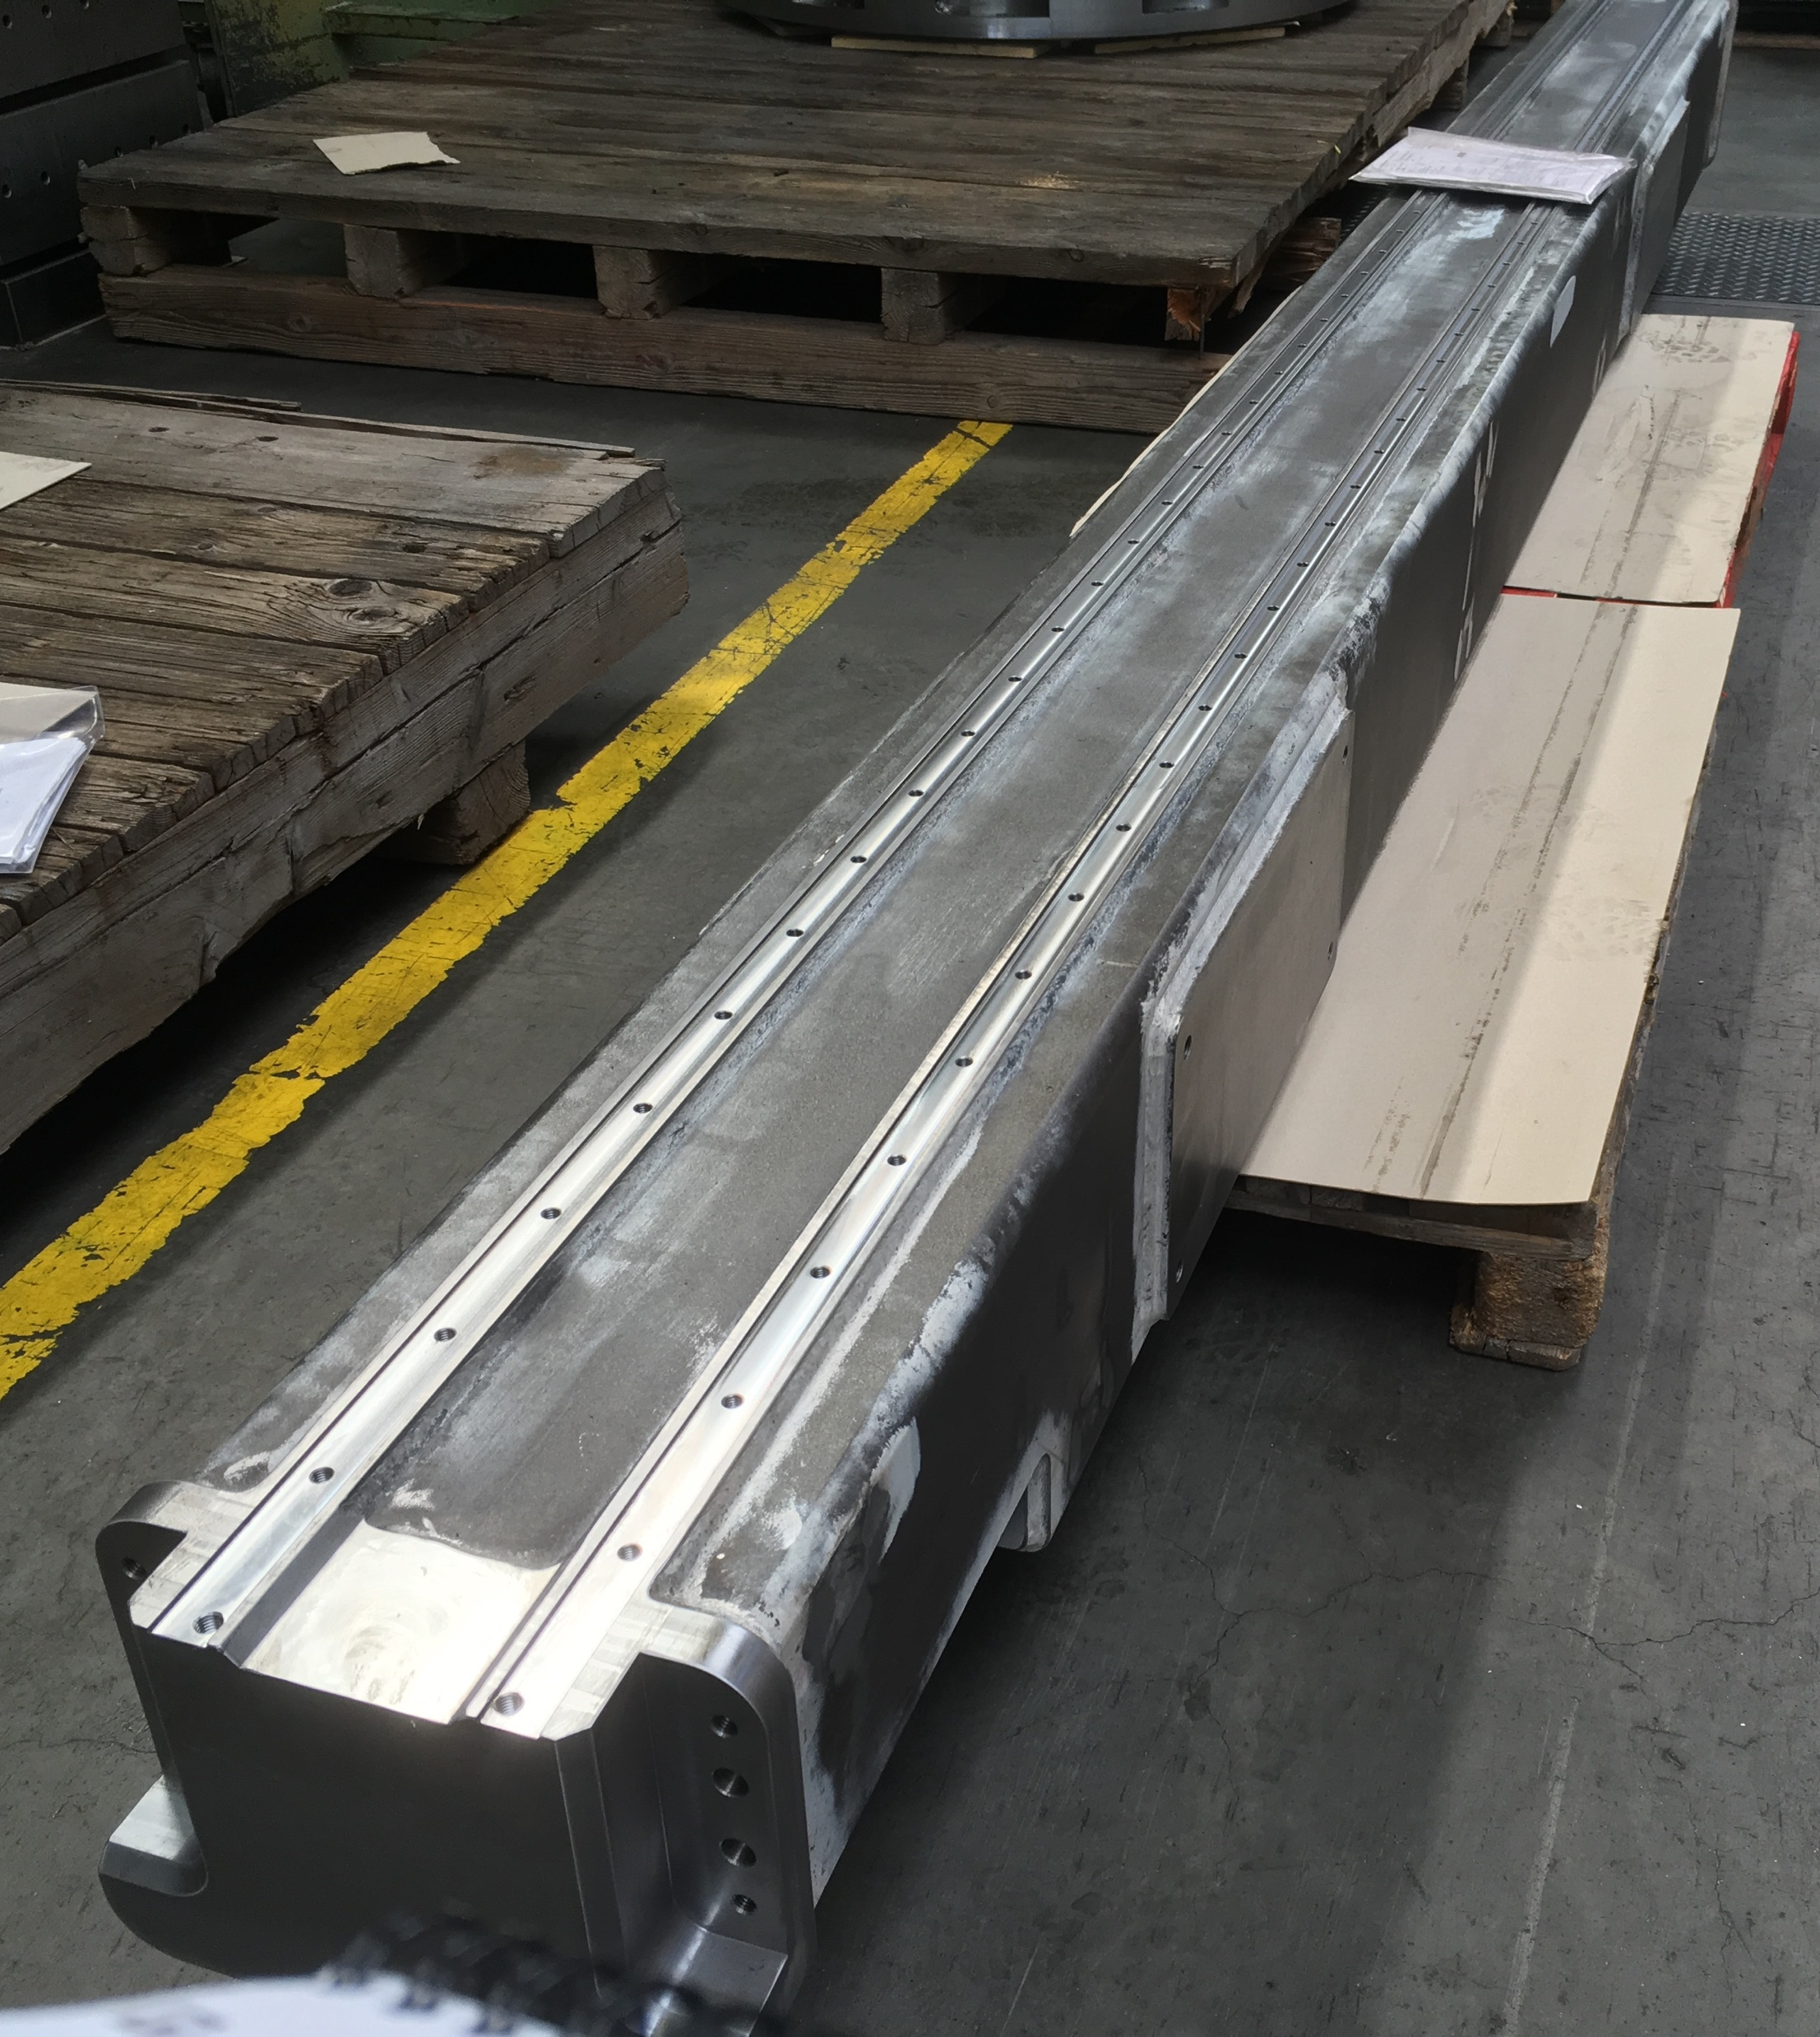
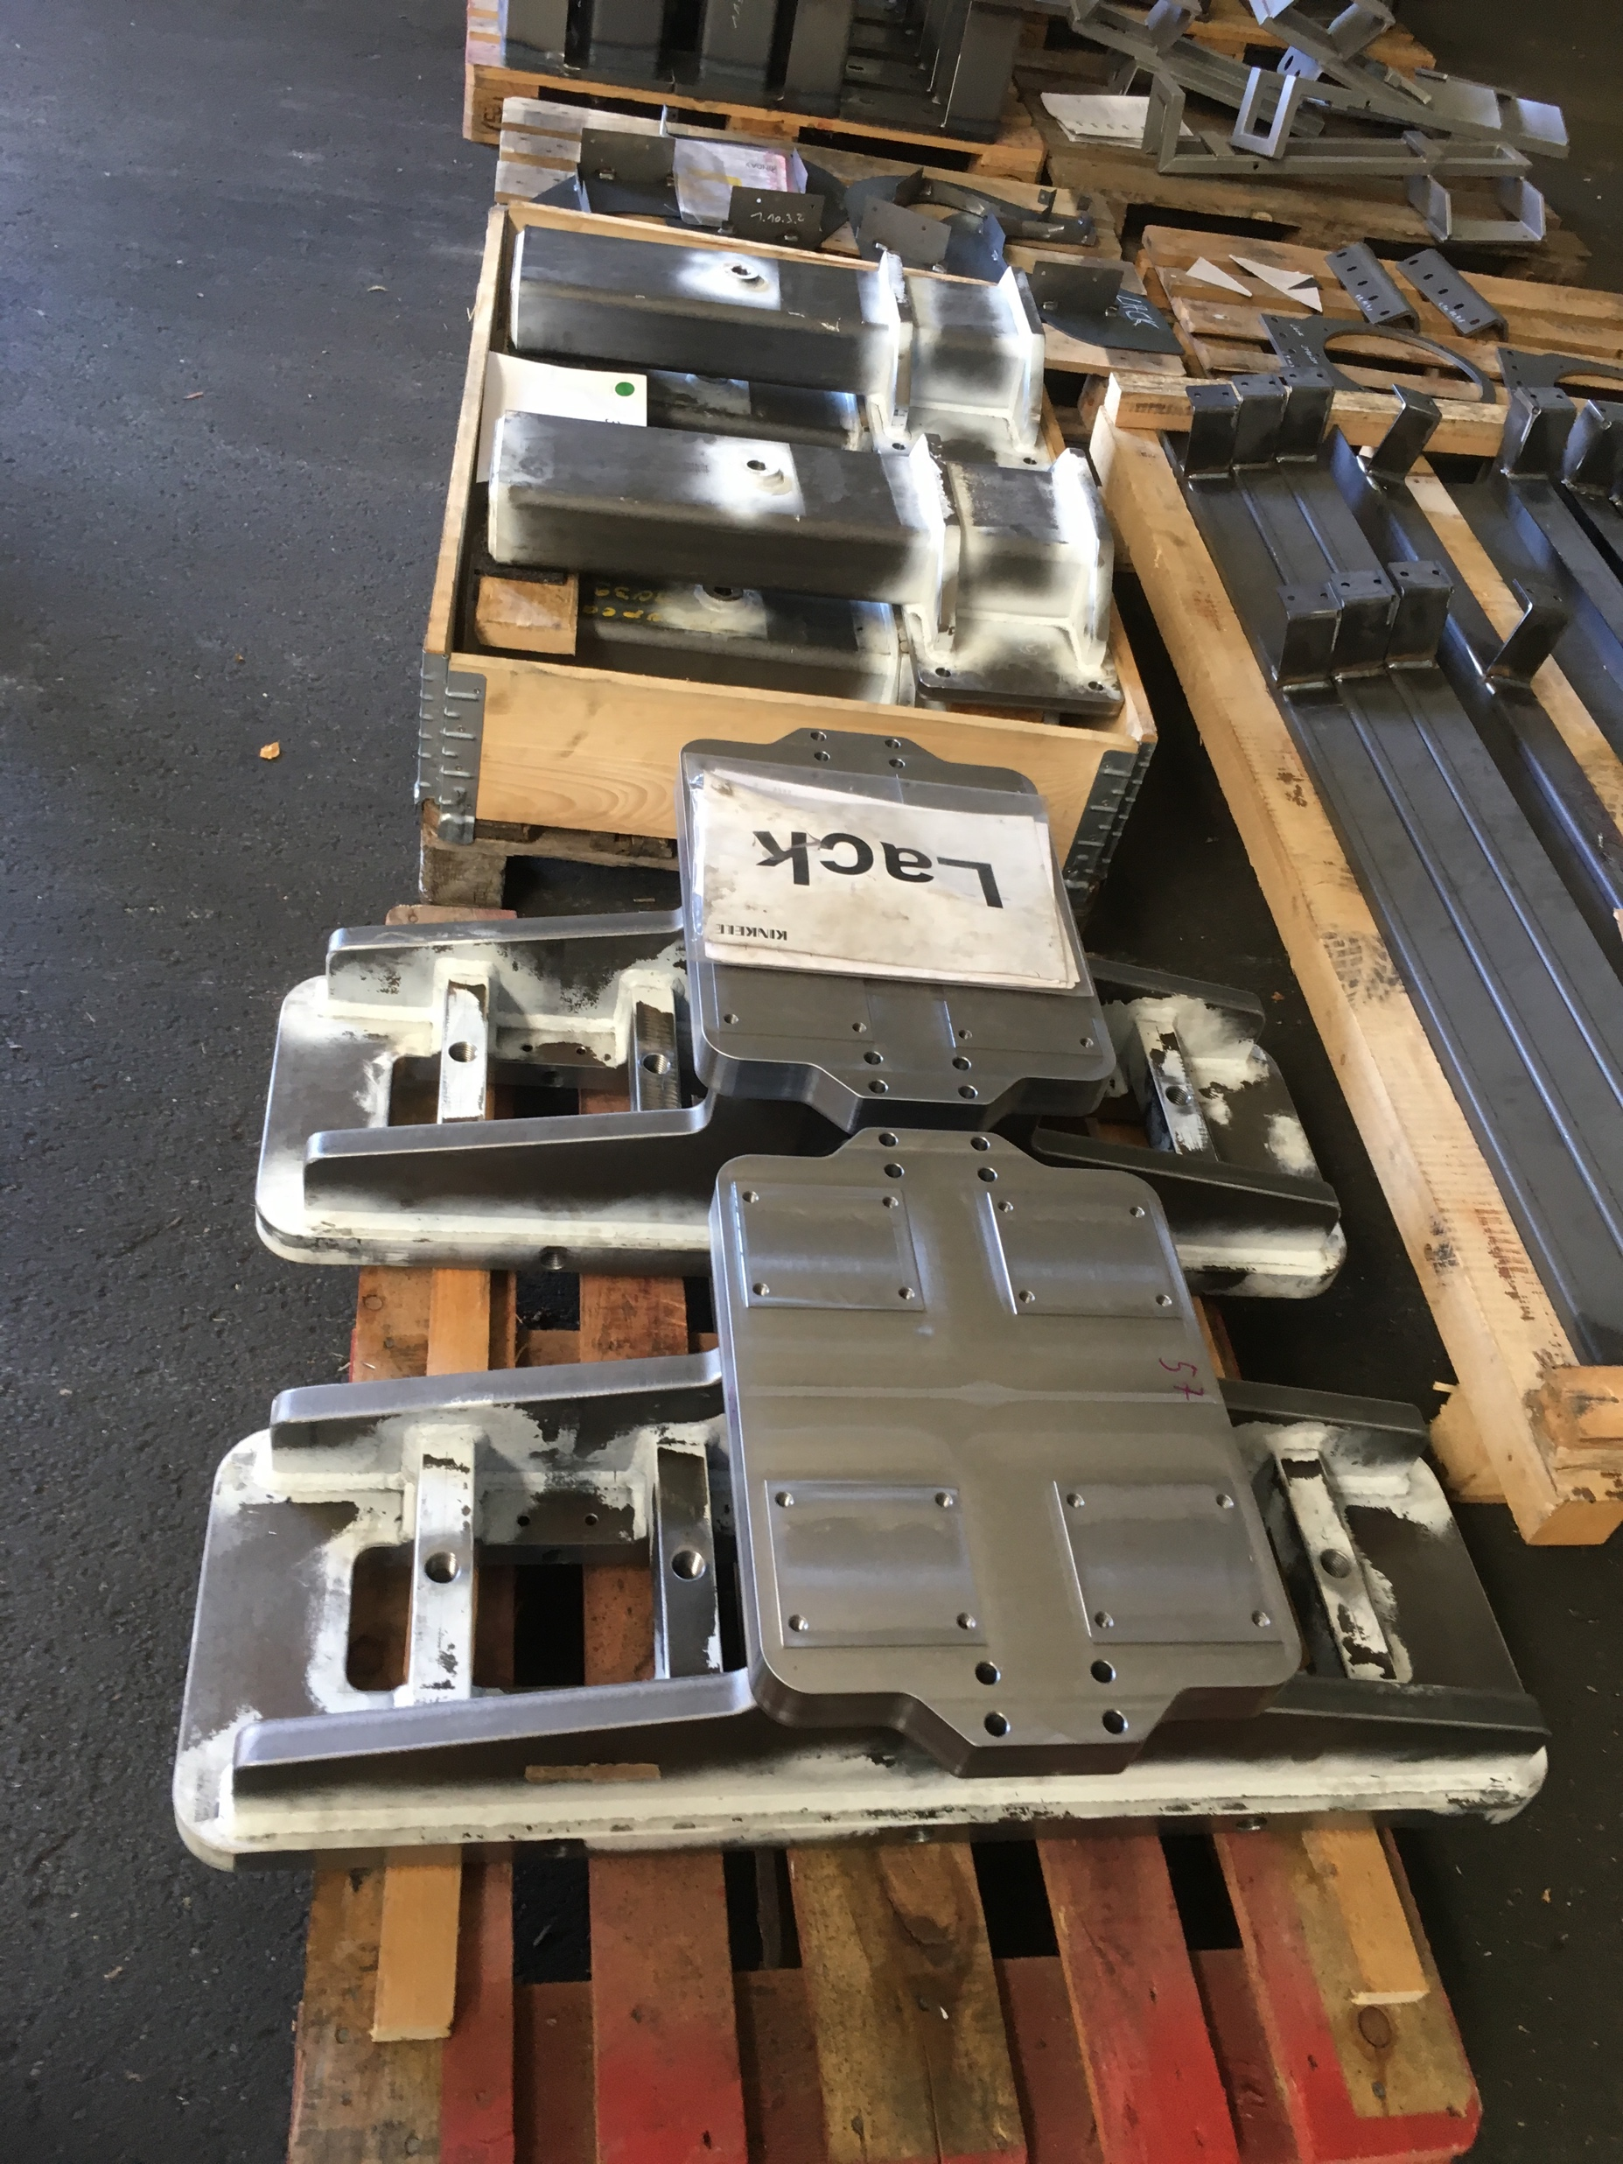
Insert Installation Tool
- In manufacturing

Slide 21
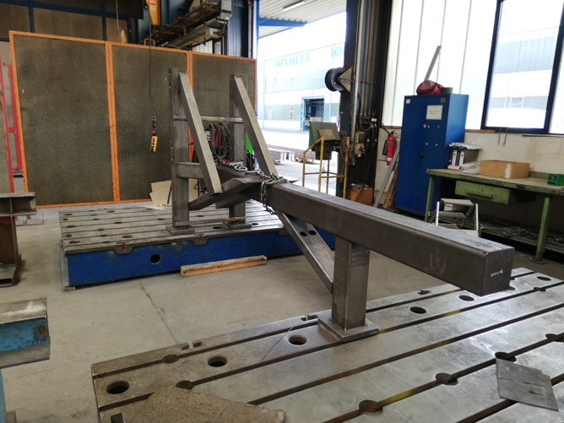
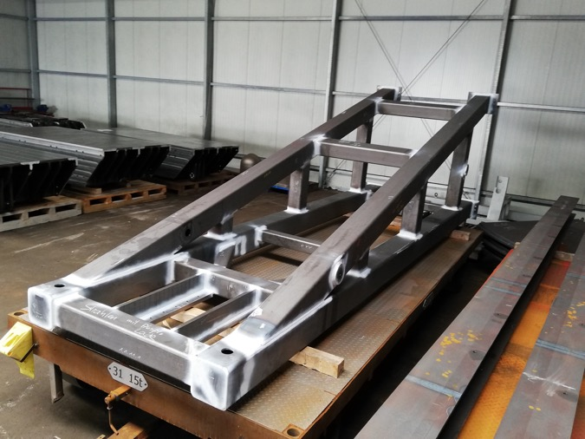
Neutron Beam Extraction System
- Test Stand Frames
Horizontal test stand frame
Vertical test stand frame

Slide 22
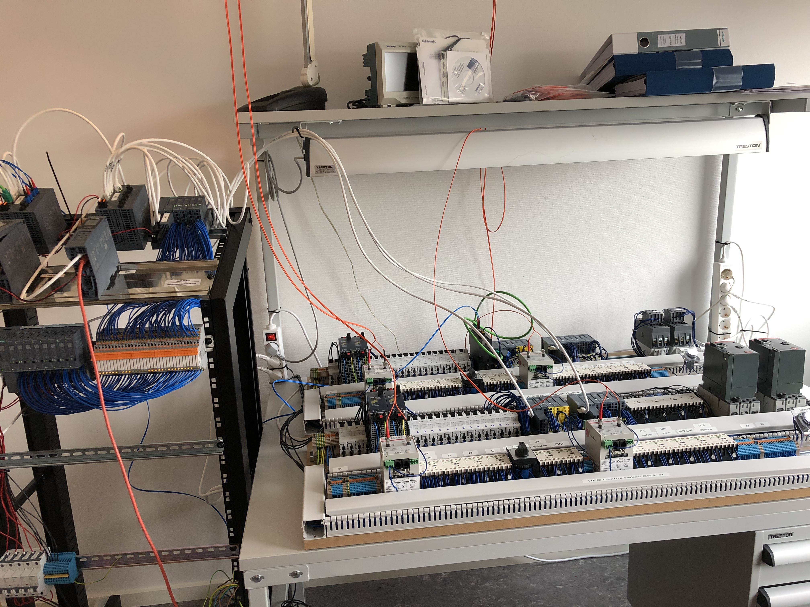
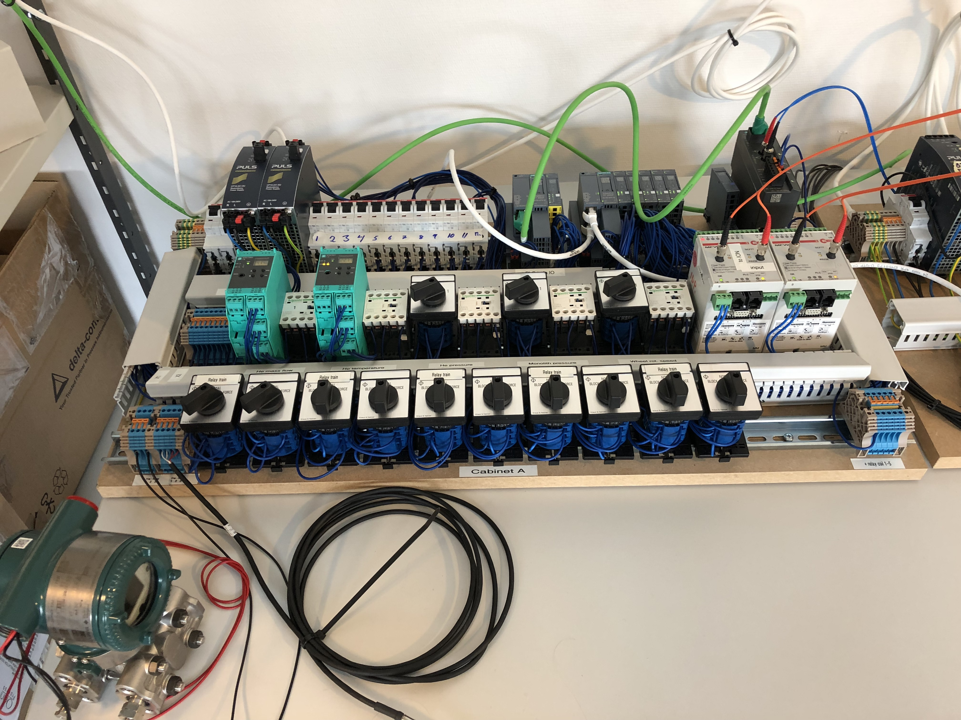
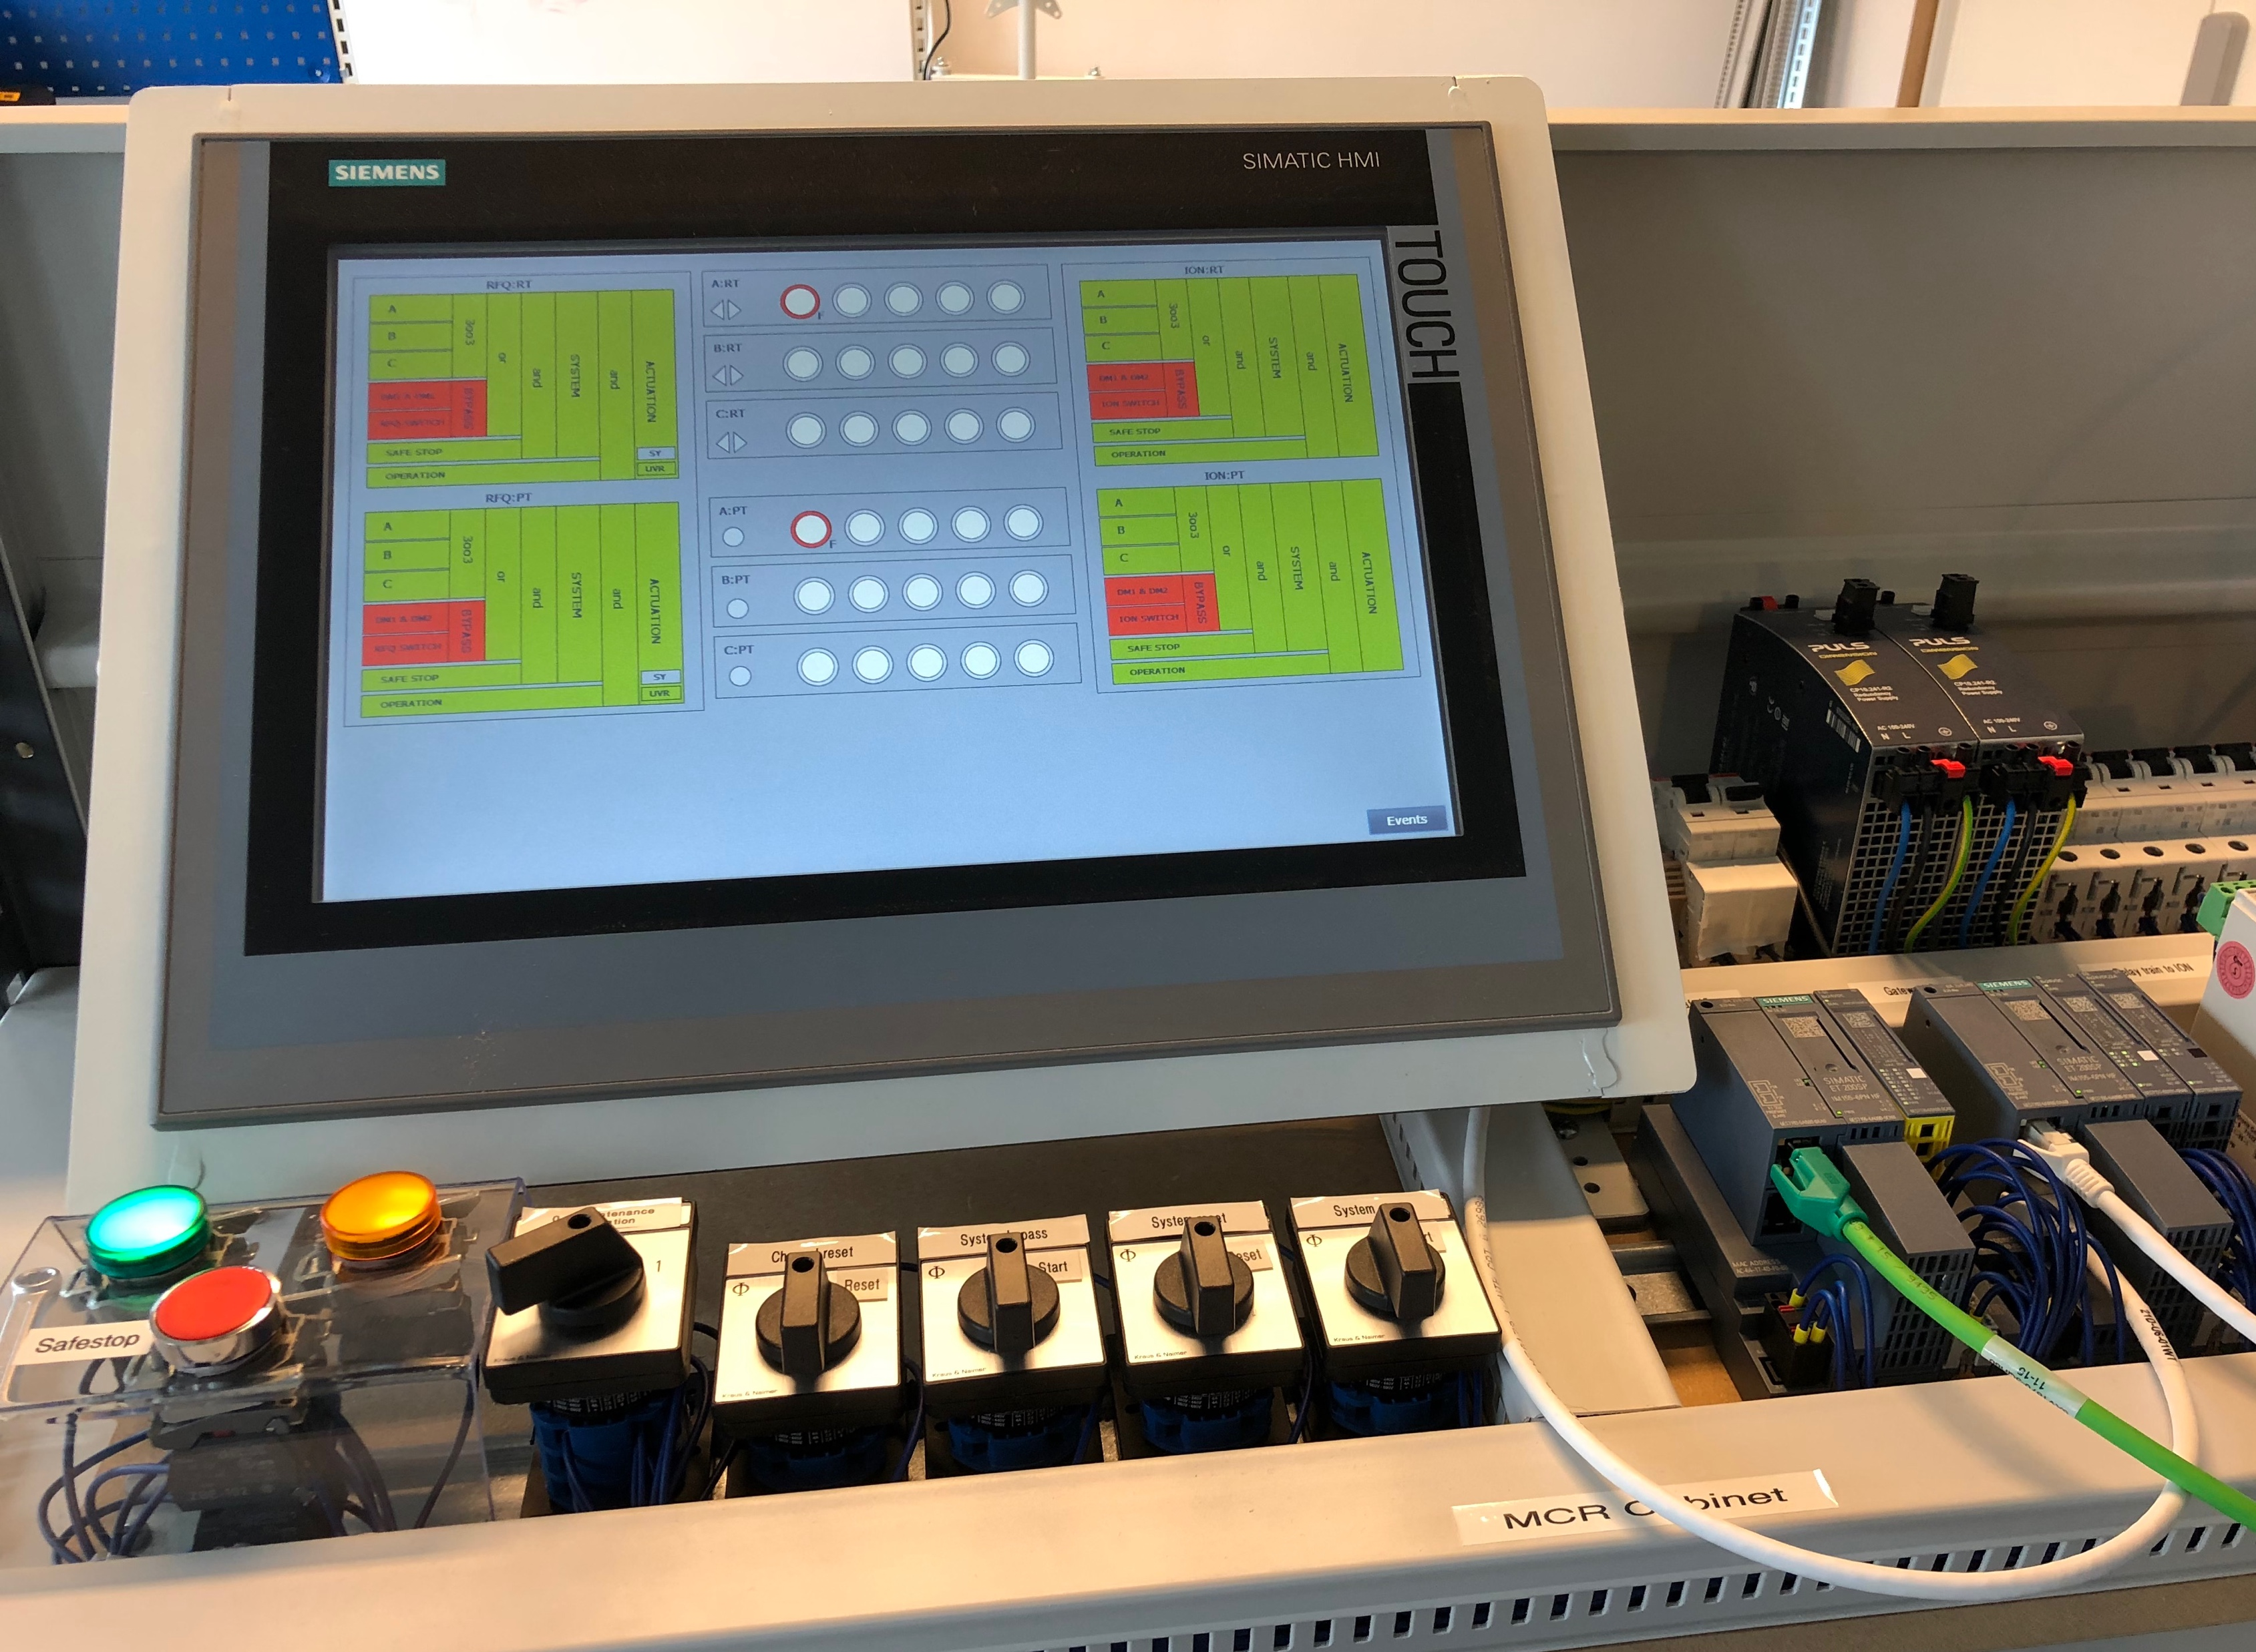
Target Safety System
- TSS mock-up operational!

Slide 23
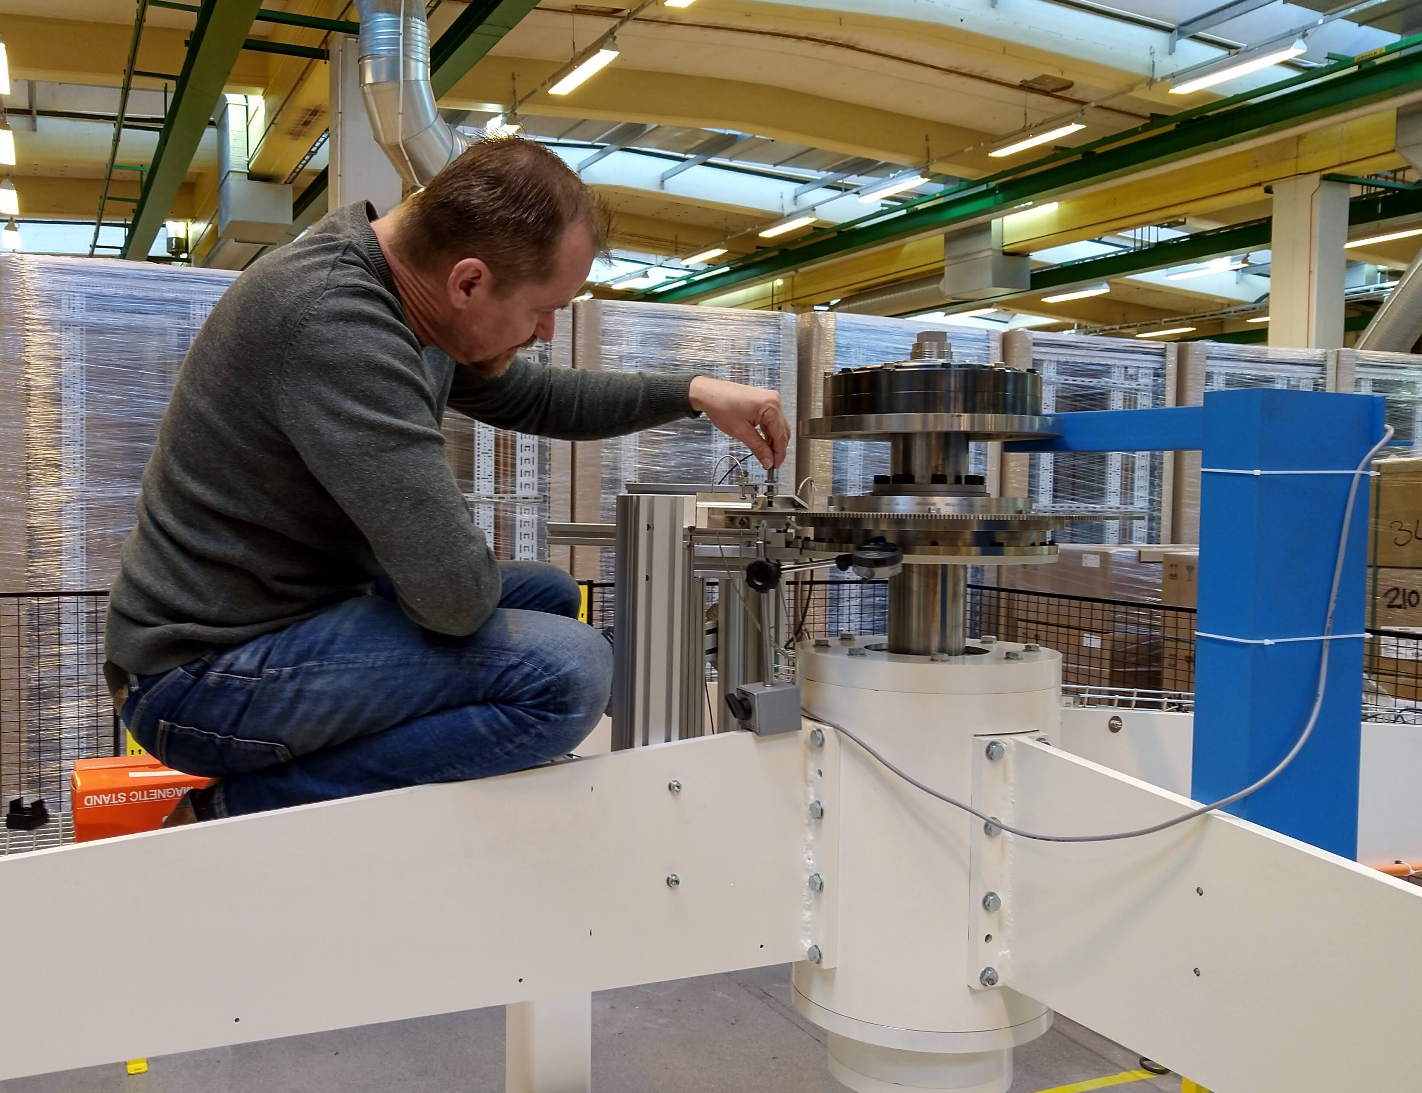
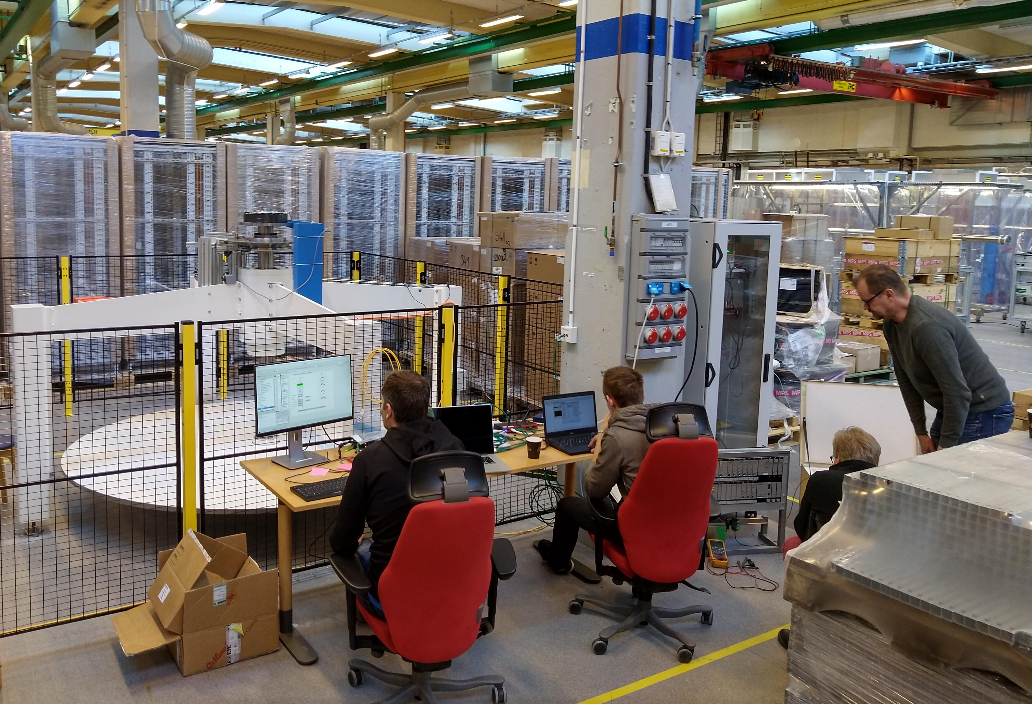
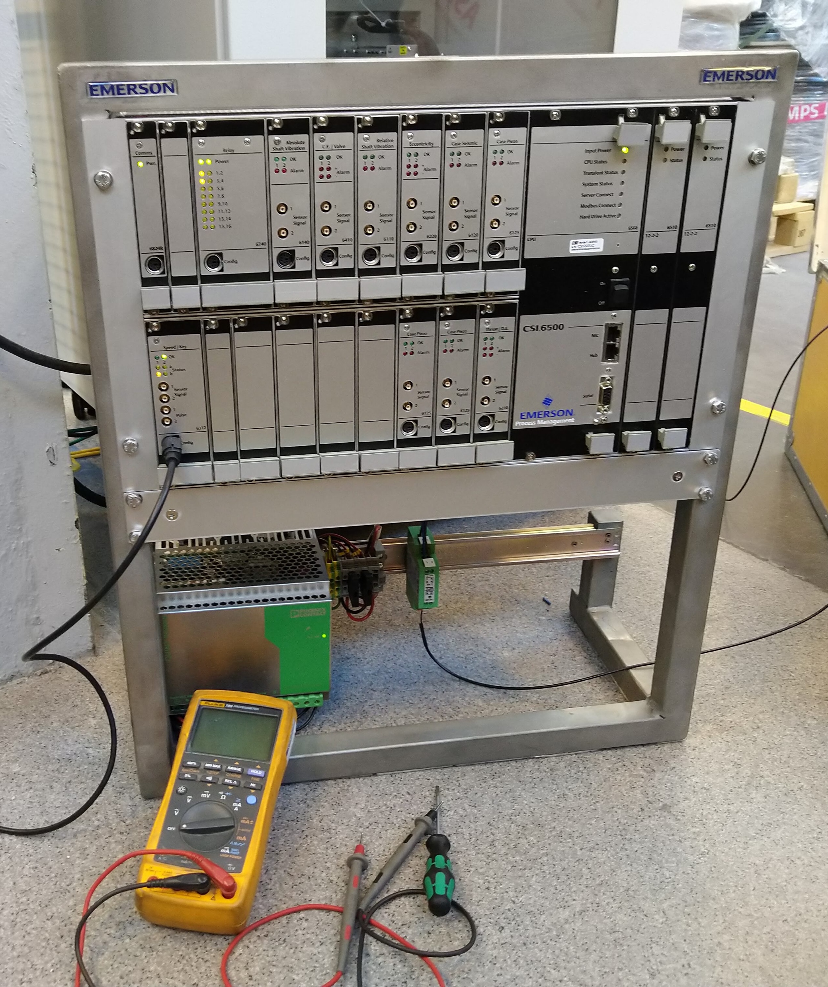
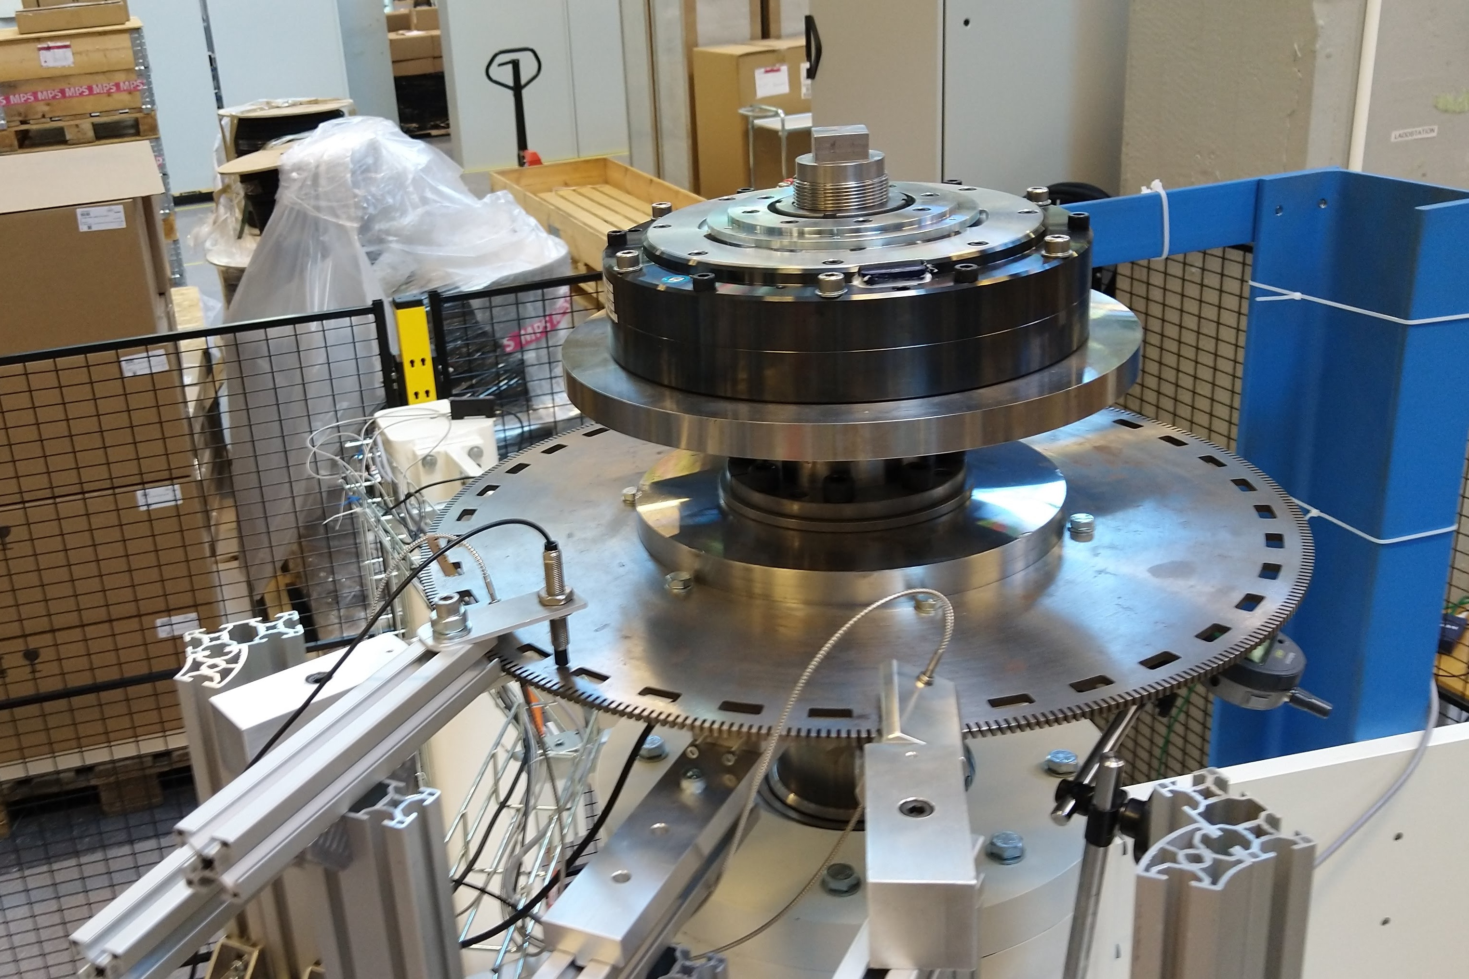
Target Safety System
- Mock-up tests of Target Wheel rotation sensors for the TSS

Slide 24
Concluding remarks
Several heavy steel structures (~700 tonnes) have been installed, including monolith vessel supports, baseplate, ground shielding, and D2T shielding.
Hardware deliveries are arriving continuously and are kept in storage, awaiting installation.
Main installations will ramp up to full speed by end of 2019.
Target Ready for Beam milestone is March 2022.

Slide 25
In-kind related schedule variances

Slide 26
Target In-Kind Packages
Target Sub-Project has 22 in-kind work elements
TA or CA signed for 10 work elements
Partner selected for another 4 work elements
Completed 2
Self Performing 6 work elements
78.2M€ total Inkind achieved, this represents 37% of Target Budget

