Slide 1
Open source event receiver and other firmware experiences
Hitoshi Sugimura
KEK
MRF Timing Protocol Users Workshop

Slide 2
Timing System at SuperKEKB
50 Hz with Pulse to Pulse Modulation
  Injector LINAC is switching parameters according to destination rings
Injection and extraction timing of each ring has opportunity every 96 ns.
114.24 MHz RF
EVG
EVR
e⁻
e⁺
Revolution/46/49 (~50Hz)
EVG
Damping
Ring
EVG
Main
Ring
EVR
EVR
EVR
EVR
EVR
EVR
EVR
EVR
EVR
EVR

Slide 3
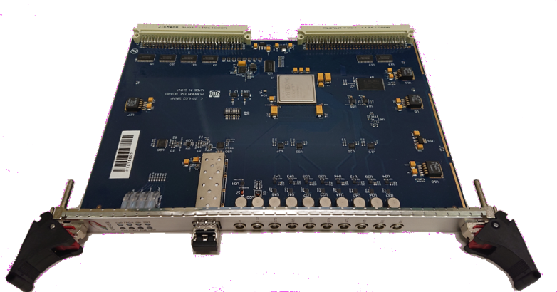
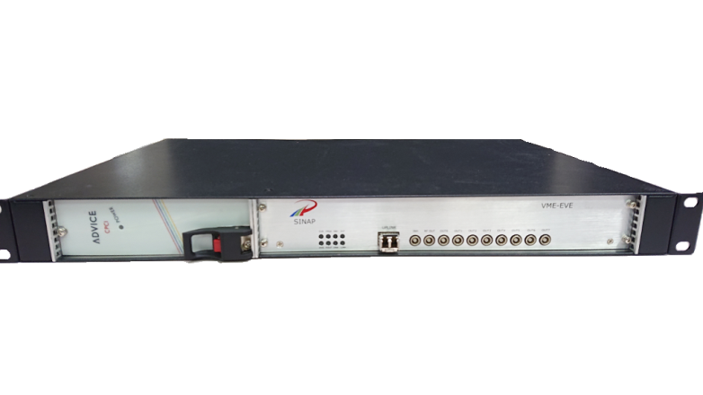
Event Receiver Development
We are using some types of event receivers.
VME-EVR230RF, cPCI-EVR (MRF)
  Mainly used this module
VME-EVE(EVO), STD-EVE (SINAP)
  Injection Timing for Kicker and Septum at SuperKEKB Ring
  Fine Delay (~ps) is very useful for injection tuning
What’s next
  mTCA-EVR300
  original EVR(in FPGA) similar to STD-EVE

Slide 4
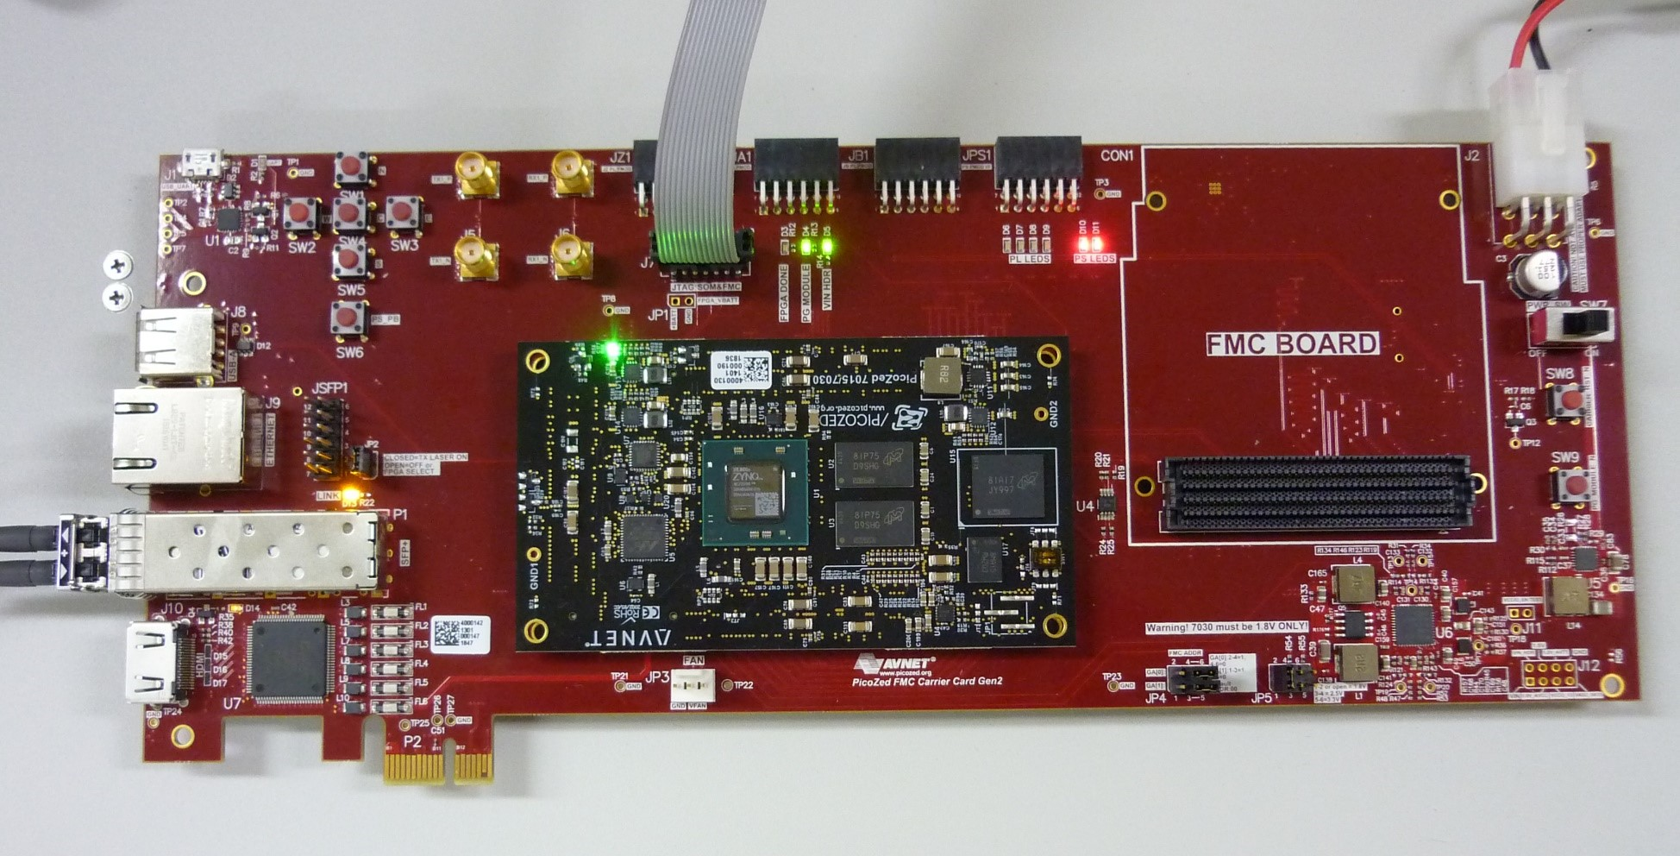
Evaluation board (picozed) for open source EVR
We bought 3 picozeds and carriers.
  picozed : AES-7ZPZ-7Z030-SOM-I-G
  (AES-7ZPZ-7Z030-SOM-G is end of production) “I” version is wider temperature range (-40℃~+100℃) than old one (0℃~85℃)
  Carrier : AES-PZCC-FMC-V2-G
[CAUTION] When I order it, there was no stock.
Hence, it took half year to produce parts.

Slide 5
VIVADO setup
Vivado is required version 2017.4
Board file
  https://github.com/Avnet/bdf
Design source
  https://github.com/jietari/mrf-openevr
  Edit “openevr.tcl” em.avnet.com:picozed_7030_fmc2:part0:1.2
  since Board version is changed
  In Vivado 2017.4 Tcl Shell -> source openevr.tcl
  Project file is generated

Slide 6
Hardware setup
3 types of configuration mode, SD card Boot, QSPI, JTAG
  Set JTAG mode [(2-3), (2-3)]
Insert optical fiber in SFP
Power ON
JTAG
SW1

Slide 7
Reference Clock setup
If self-loopback the optical fiber, configuration is done.
In the case of receive event from other EVG, it has to be configured the reference clock.
The default configuration of reference clock in clock synthesizer is about 250 MHz.
  To adjust Our Timing System, clock rate down to 114 MHz

Slide 8
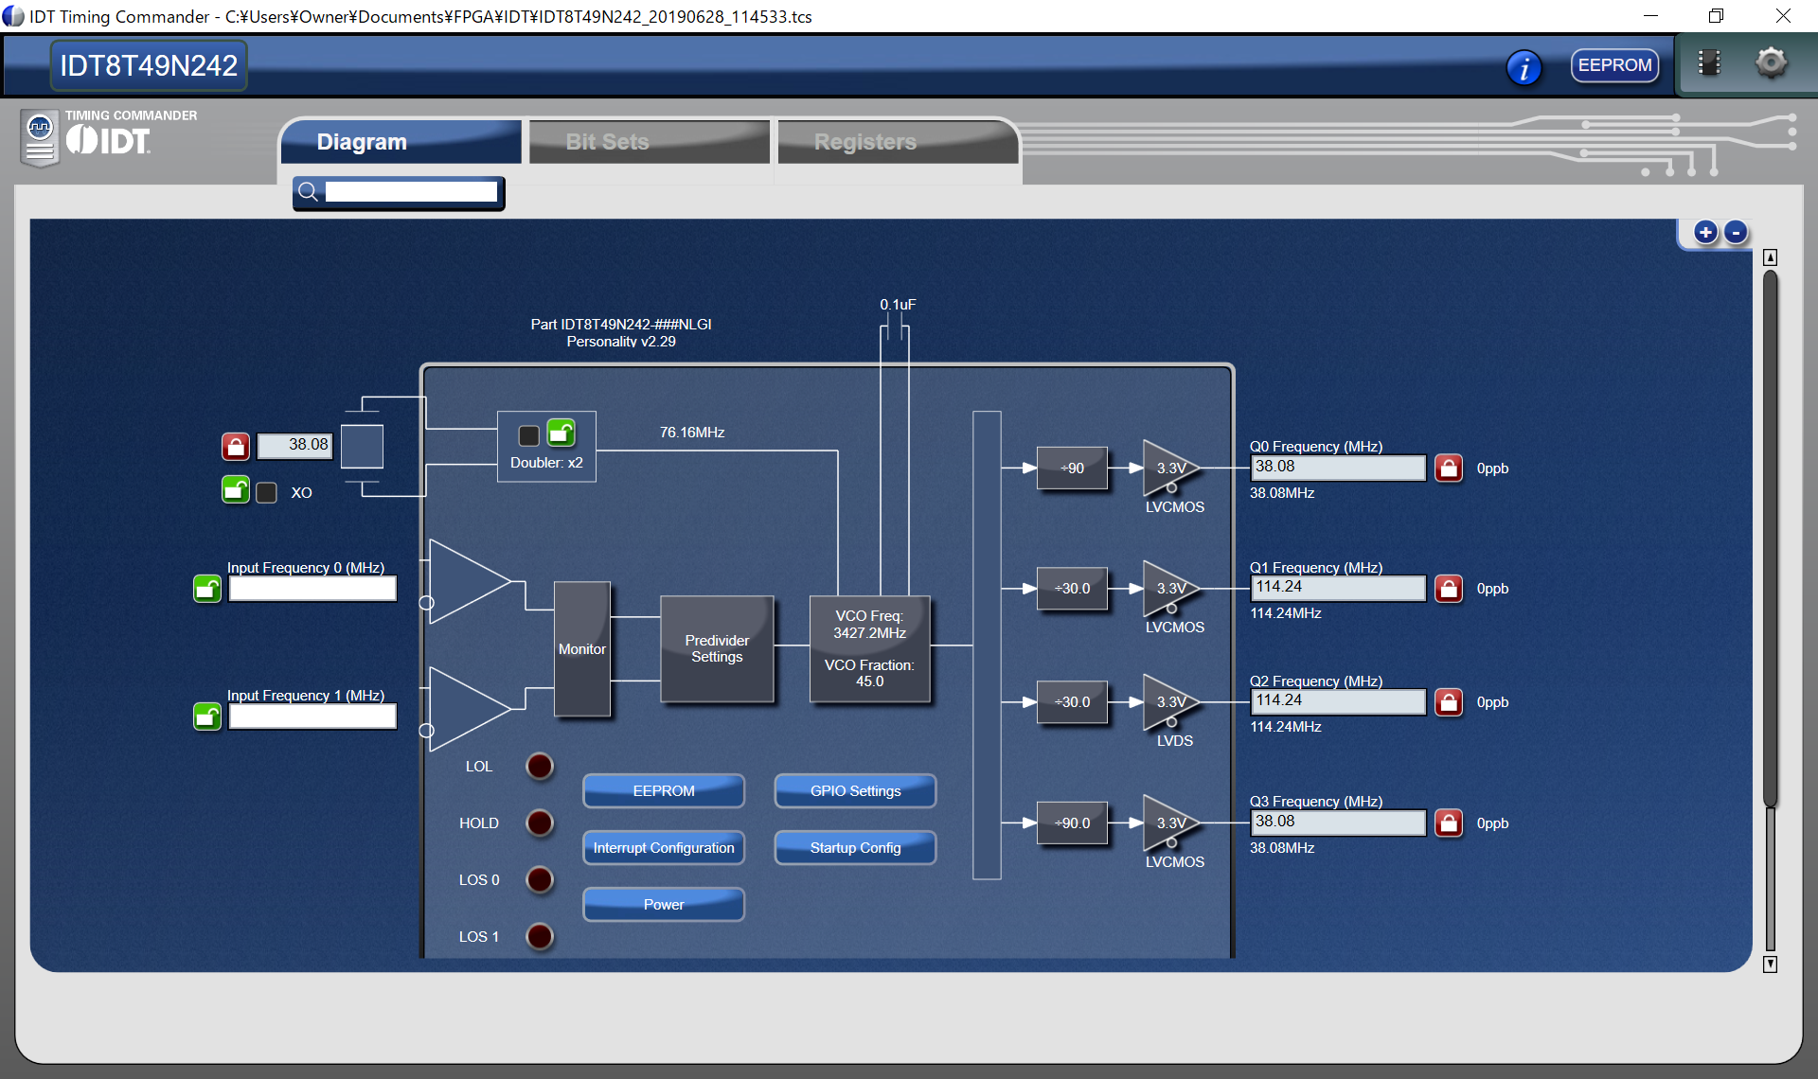
IDT configuration

Slide 9
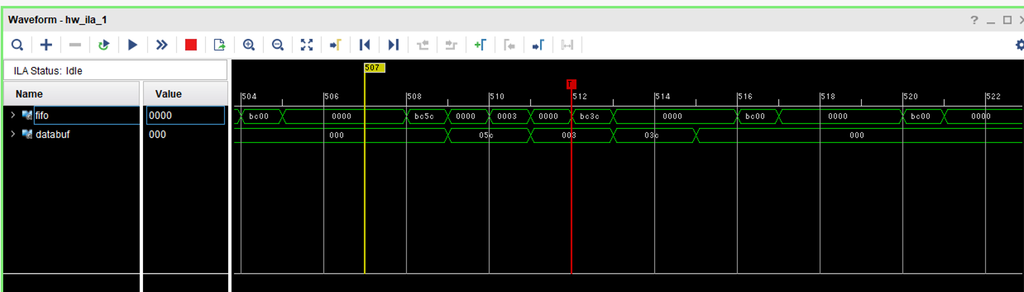
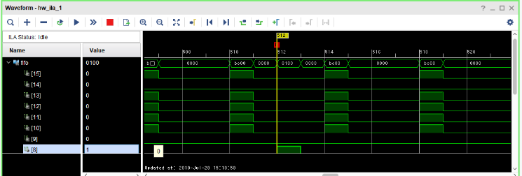
Monitor with ILA

Slide 10
Next step …
Digital output
Interruption
EPICS IOC build on zynq PS.

Slide 11
SINAP EVE modification
VME-EVE
  Normal VME module.
  data stream inherits MRF as it is.
STD-EVE
  Standalone type of 1U size. Linux is running in this unit.
  The System can operate independently
  as EPICS IOC

Slide 12
EVE advantages and disadvantages
advantage
  Minimum delay set value is 5ps
  The number of output terminal is larger
Disadvantage
  Event interruption is limited to 24(depends on pulser)
  Data buffer and Dbus is reduced.
    It became possible by modifying a little VHDL code.

Slide 13
Additional function to EVE
To compensate for the disadvantage of EVE, the following functions were added by modifying FPGA and device support.
  Data buffer function
    Retransmission to downstream is enabled.
  Dbus function
  Pulser enable/disable changing function according to dbus state.
    The logic is added by detecting pos-edge and neg-edge of the dbus
    Optimized for STD-EVE to reduce CPU load.
  Delay setting by using data buffer value.
Those 3 and 4 are specialized for SuperKEKB timing system

Slide 14
Pulser enable/disable
Dbus N
Pulser M
Pulser ON at “1” state, OFF at “0” state
It is possible to set to all 24 pulsers of EVE, and it is
possible to set which of DBus 0 – 7 is referred for each.
Of course, EPICS process can be used this structure with I/O Intr,
this method reduces CPU load.

Slide 15
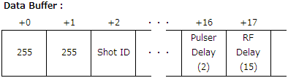
Delay setting from data buffer
The array No16 and 17 is delay of pulser and RF.
The value is set to pulser as (Databuffer[16]+[17])%20
Specialized our data buffer configuration

Slide 16
Summary
We tried to use Open Source EVR.
  Some configuration is modified, and works well.
  This has just begun. Additional configuration will be developed(hopefully).
SINAP VME/STD-EVE firmware is modified.
  data buffer and dbus receive and transmit functions were added.
  Gate logic function with dbus and delay add logic function with data buffer were added to suit SuperKEKB configuration.

