Slide 1
STAP Update - September 2019
On behalf of Loki team

Slide 2
Loki

Slide 3
Sub-Contracted
Guide
Order placed with SNAG - May 2019
Kick-off with SNAG - Sep 2019
Final Design Review at TG3.2 - Jan 2020
Jaws
Out for tender (bids under review)
Final Design Review at TG3.2 - Jan 2020
Collimation selector vessel
Order placed with AVS - Aug 2019
Kick-off with AVS - Aug 2019
Final Design Review at TG3.2 - January 2020
Detector vessel
Order placed with AVS - Jul 2019
Kick-off with AVS - Aug 2019
Final Design Review at TG3.2 - January 2020
Sample Stack
In CTV

Slide 4
TG3.1
Heavy Shutter
Excludes: motion control system, guide & guide vessel
Chopper 1 & Chopper 2
Excludes control system, remote handling & support structures
Collimation Selector
Excludes vessel, jaws, guide, motion control system
Detector Systems
Excludes vessel & monitors, motion control system

Slide 5
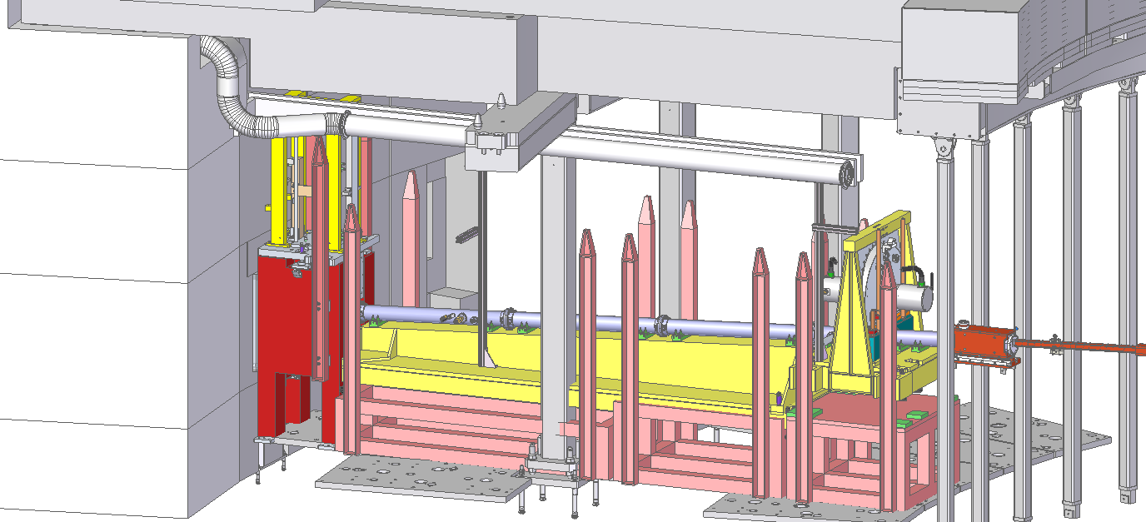
TG3.1 In-Bunker Elements
Chopper 1
Heavy Shutter

Slide 6
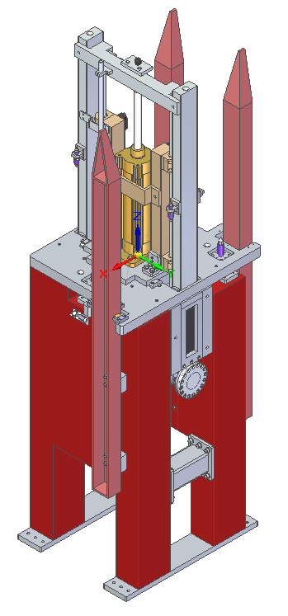
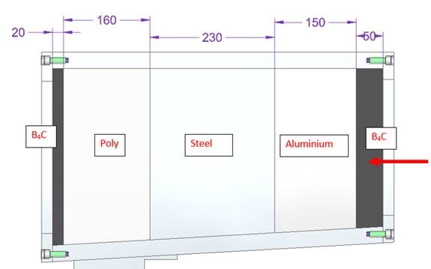
TG3.1 – Heavy Shutter

Slide 7
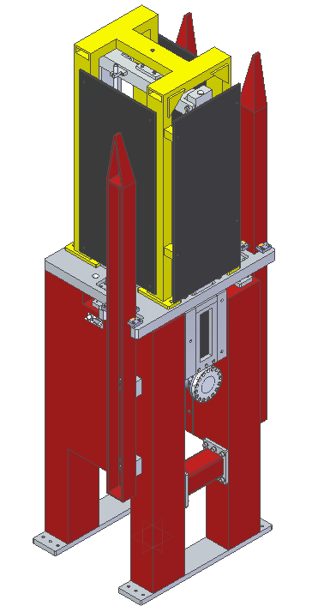
TG3.1 – Heavy Shutter

Slide 8
TG3.1 – Heavy Shutter
Sliding components
Remote handling
Guide
Shutter shielding
Rails
Shock absorbers
Air cylinder rod
Rail attachment bar

Slide 9
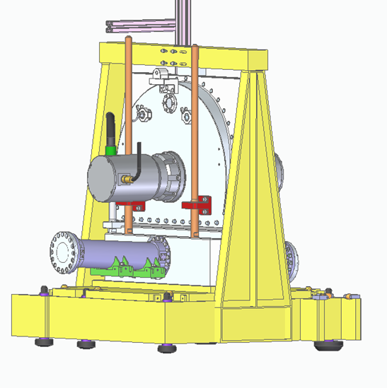
TG3.1 – Chopper 1
“Conventional” design, based on choppers in service at ISIS –low technical risk.
Similar to ESS “Horizontal Split” concept, but simplified due to remote handling capabilities being provided by separate mounting pallet.

Slide 10
TG3.1 – Chopper 2
Serviceable parts are housed within extractable cassettes.
Centre housing & rocker etc,, designed to remain in situ following installation, as removal would require disassembly of adjacent vacuum tank / collimator.

Slide 11
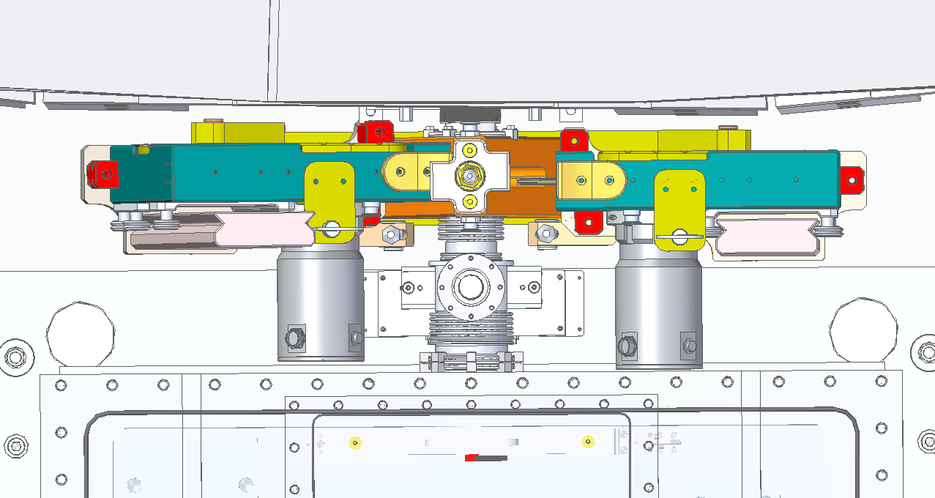
TG3.1 – Chopper 2

Slide 12
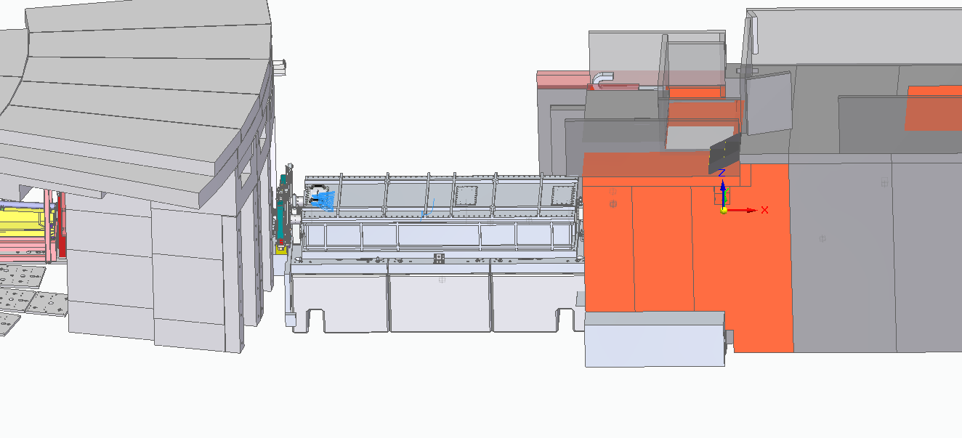
TG3.1 – Collimation Selector

Slide 13
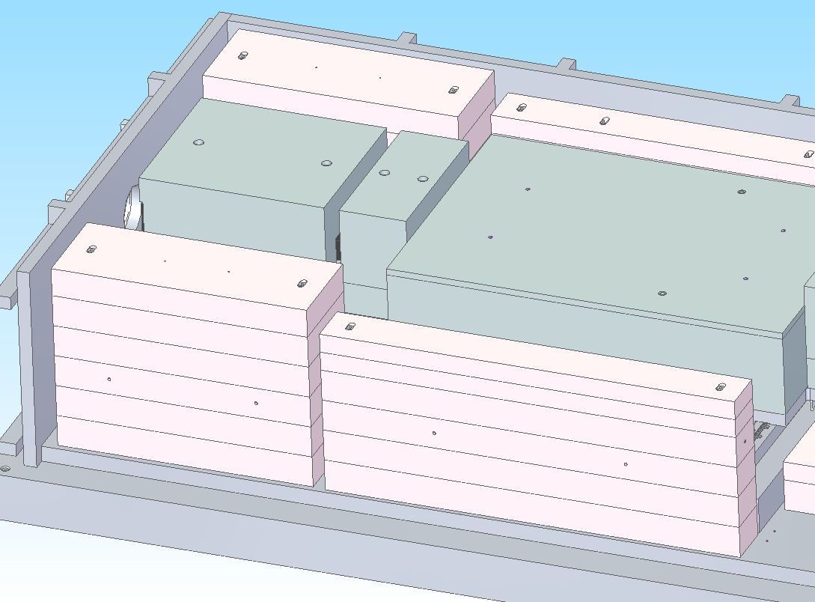
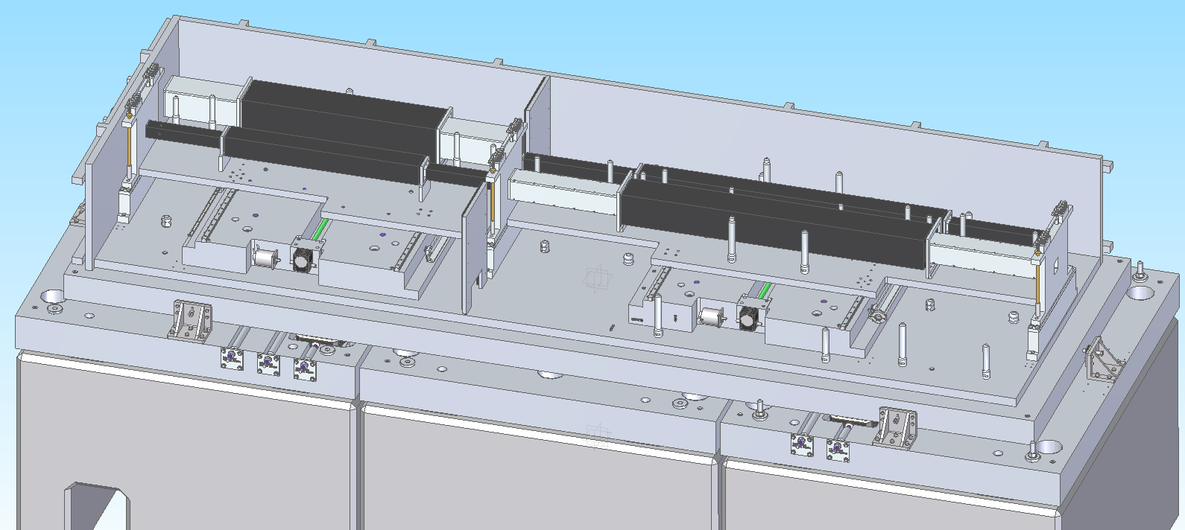
TG3.1 – Collimation Selector
Vacuum Vessel
Poly shine blocks
Selector assemblies
Slits sets
Concrete base blocks

Slide 14
Guide Collimation configurations
Selectors can provide Guide –Guide, or Guide –Collimation, etc

Slide 15
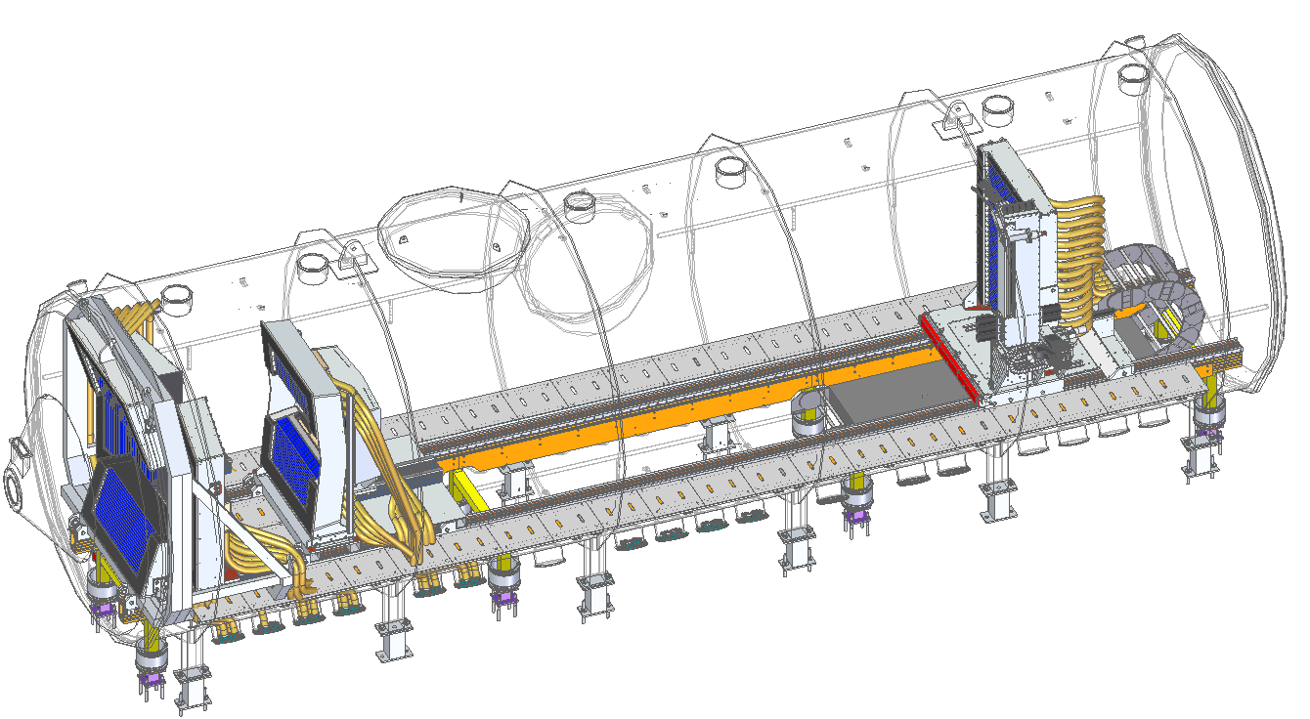
TG3.1 - Detector System

Slide 16
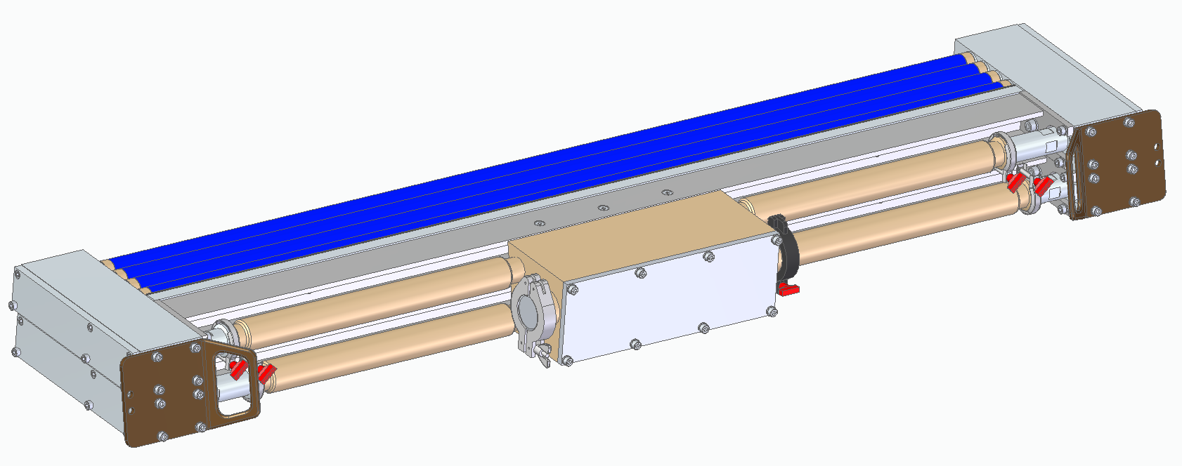
TG3.1 - Detector System
Pre-building
Mount the detector modules on the frames
Mount the frames on the rails
Move the rear detectors
Seven boron coated straws inside a 1” aluminium tube

Slide 17
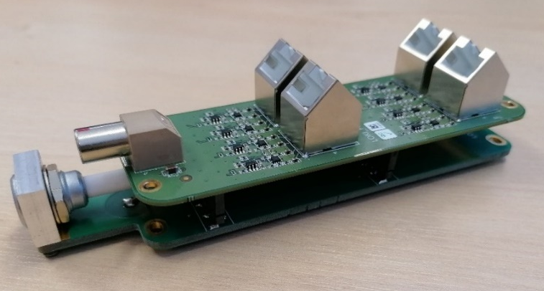
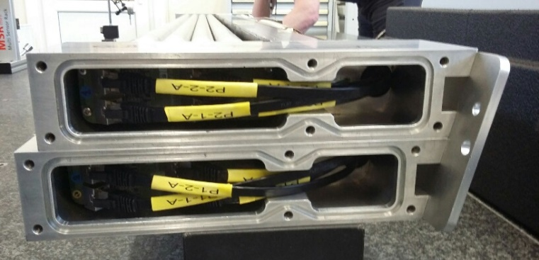
TG3.1 - Detector System
Preamplifier Boards

Slide 18
TG3.1 Beam Stop

Slide 19
TG3.1
Positive experience
ESS focused on the right detail and gave valuable feedback
ESS seem keen to work with us to push on to manufacture
The content requested was appropriate, but it was a lot of work (we under estimated how much work would be required)

Slide 20
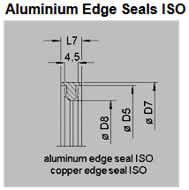
In-Bunker Vacuum Seal
Aluminium Wire Seal
tested – good confidence in sealing reliability, concern regarding cold welding
Copper Wire Seal
Initial tests – high torque required, more work planned to optimize anneal & compression %
Aluminium edge seal
procured, tests planned later this month
Copper edge seal
procured, tests planned later this month

Slide 21
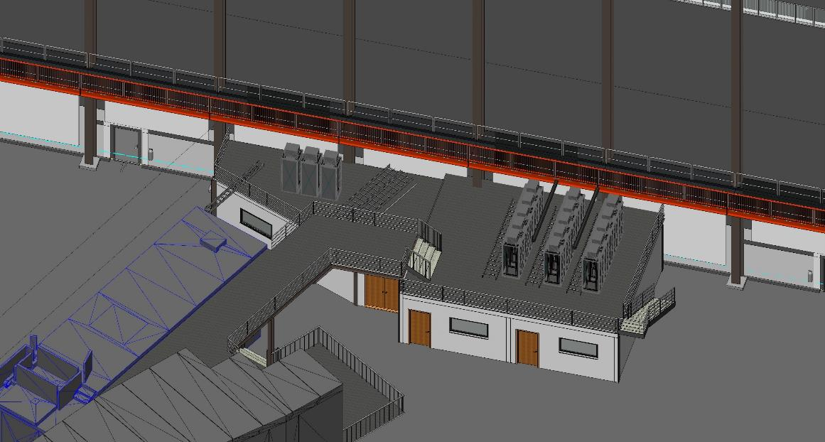
Rack Location

Slide 22
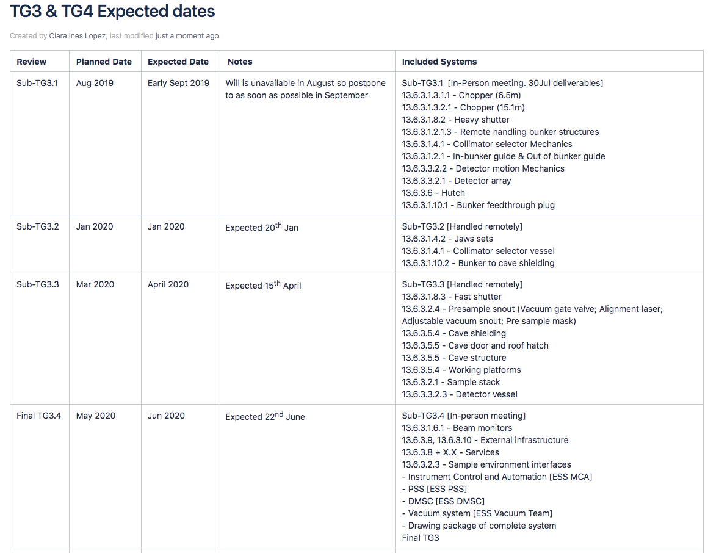
TG3’s

Slide 23
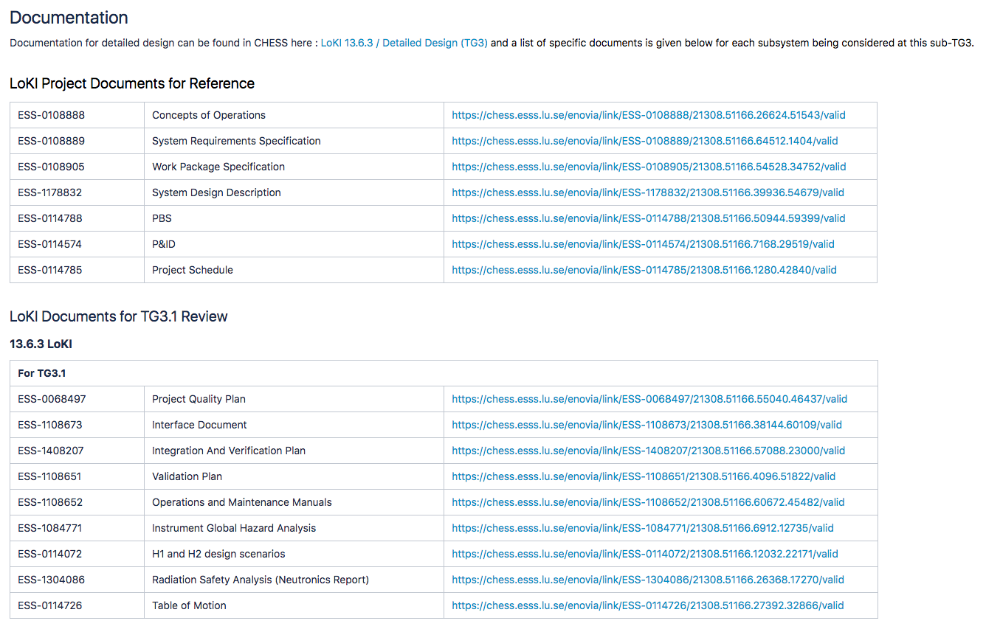
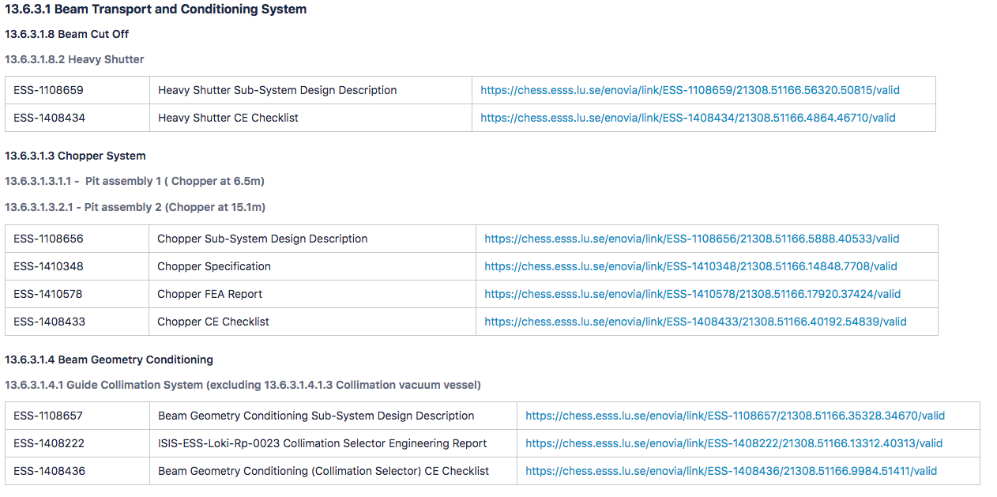
Documentation for TG3.1
+30 documents
736 Standard (Commercial items)
925 Prepared Drawings
1661 Total drawings

Slide 24
STAP Advice

Slide 25
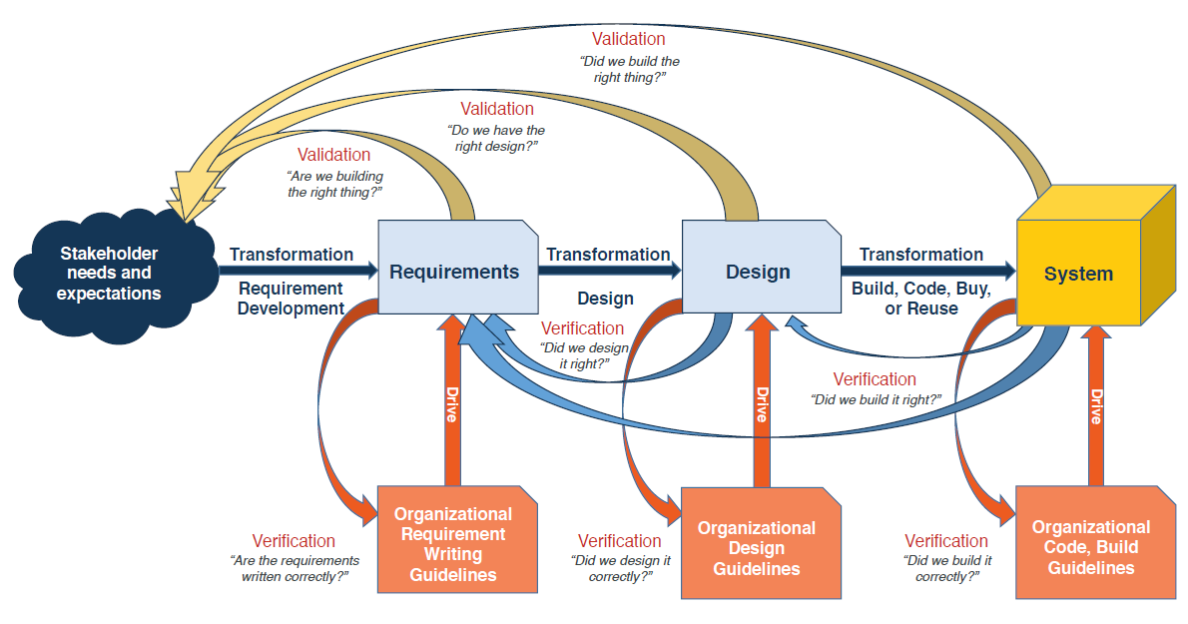
Verification process
Verification of the system requirements during installation.
Requires:
Clear procedures
Person responsible
When during the installation or integration
Definition of responsibilities during the verification
Resources to use: hardware and software
Fill the records needed
Clear procedures how to handle non-conformities or verification failures

Slide 26
STAP Advice
A brief description of verification activities for key components:
Choppers Detector systems Beam monitors
Guides SE equipment Collimations
Shutters More ….
Inputs:
Component:
Title:
Statement (Brief description):
Rationale:
Verification method:

