Slide 1
TG4 and Installation plan LoKI Instruments
Clara Lopez
Integration Engineer
on behalf of LoKI team
www.europeanspallationsource.se
25 September, 2019

Slide 2
Topics
TG4
Schedule for LoKI- integrated with NSS Master Schedule
Installation binders – information for IRR

Slide 3
TG4 Installation readiness review
Phase 4 (Installation and Integration)
Phase 3
(Manufacturing & Procuring)
Readiness of 1st set of components
Readiness of 2nd set of components
Readiness of n^{th} set of components
Phase 4
(Installation & Integration)
Phase 5
(Hot Commissioning)
Phase 4
(Installation & Integration)
Sub-TG4. 1
Phase 4
(Inst&Integ)
Sub-TG4. 2
Phase 4
(Inst&Integ)
Sub-TG4.n
and
Final TG4
Phase 4
(Inst&Integ)
Goal: Facilitate early installation, establish sequence and respect dependencies
Challenge: Complex review process and schedule

Slide 4
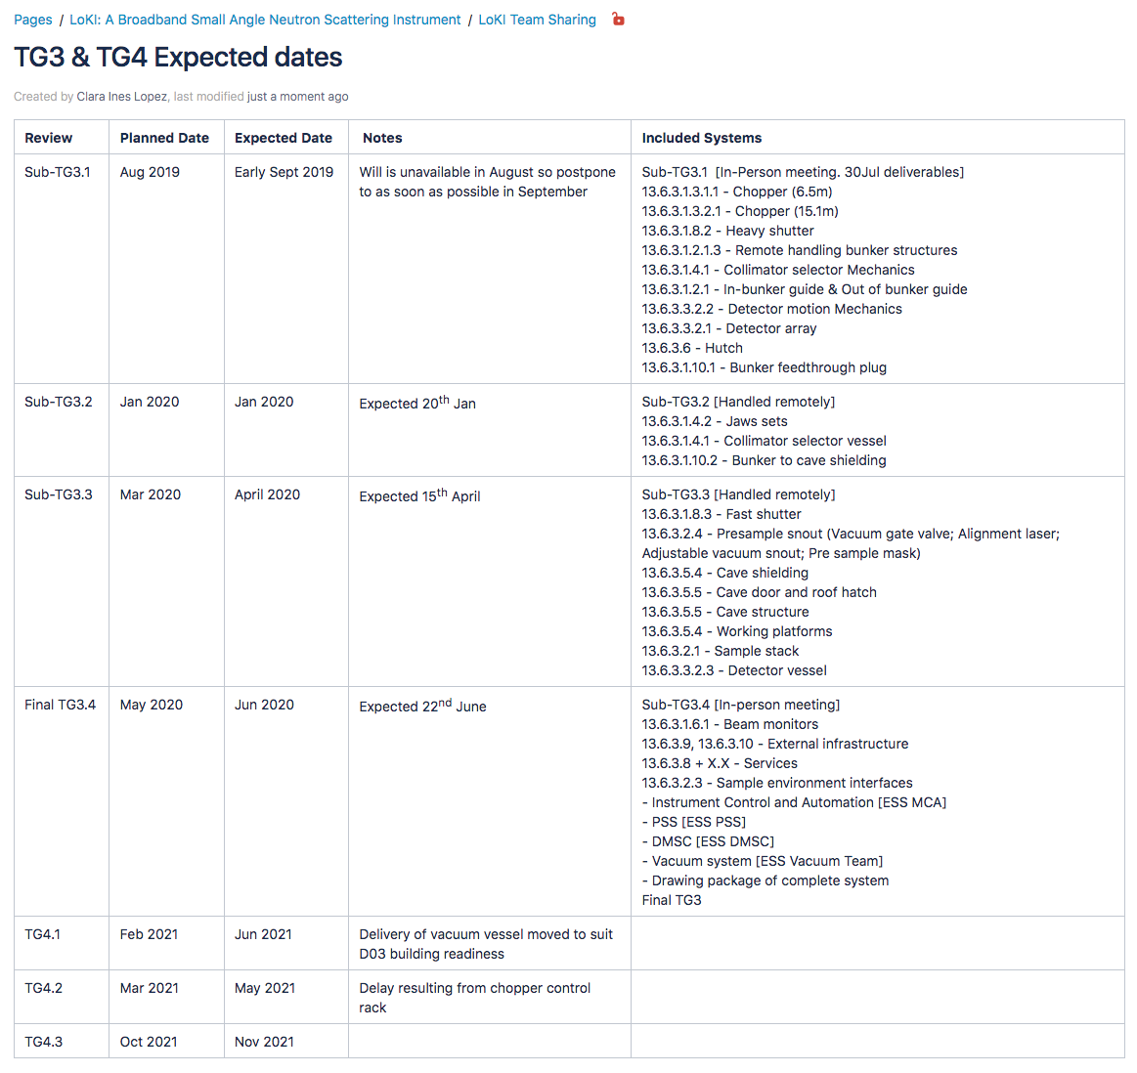
TG4 - LoKI

Slide 5
NSS Master schedule v4.2- North sector
Current date
BOT
& HC
FS
SOUP
(3NBI*)
8NBI* in User Program
March 2023:
First Science (FS) with expert teams on some of instruments above
Review progress of first 3 NBI for SOUP, implement backup plan if needed.
SOUP: Start Of User Program
BOT: Beam On Target
HC: Hot Commissioning
NBI: Neutron Beam Instruments

Slide 6
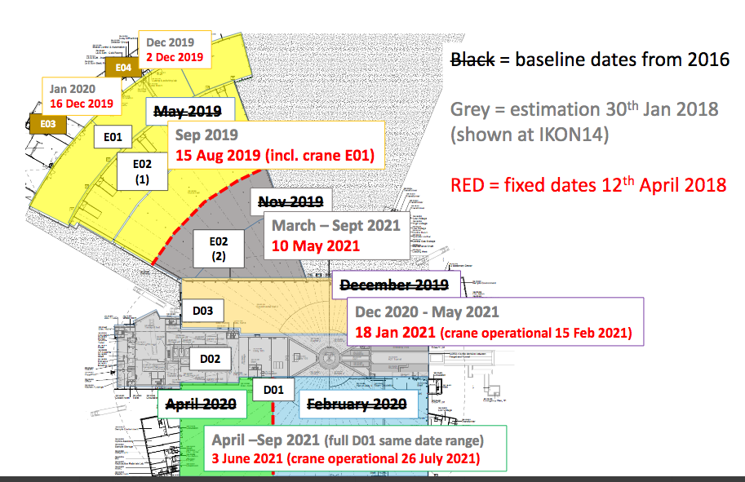
Building Access

Slide 7
Preliminary dates: September 2019 LoKI Pre-build and Installation
Pre-build at ISIS
Shipping UK to Sweden
Installation at ESS
In Bunker:
16/07/20 – 17/12/20
Bunker to Cave
16/10/20 - 17/12/20
Cave shielding:
18/05/21 - 18/08/21
Sample area:
12/03/21 - 18/08/21
Pre- build completed
18/11/21
Delivery package 1
(In Bunker components):
13/05/21-15/06/21
Delivery package 2:
(Detector Vessel)
18/11/21-27/01/22
Delivery package 3:
(Out of bunker component)
27/01/22-29/03/22
In Bunker:
09/07/21 – 28/10/21
Hutch
16/08/21-09/02/22
Services Installation
06/10/21 – 01/8/22
Bunker to Cave
29/10/21 - 23/12/21
Cave shielding:
24/02/22 - 25/04/22
Detector Installation:
25/04/22 – 21/07/22
Sample area:
25/04/22 - 04/08/22

Slide 8
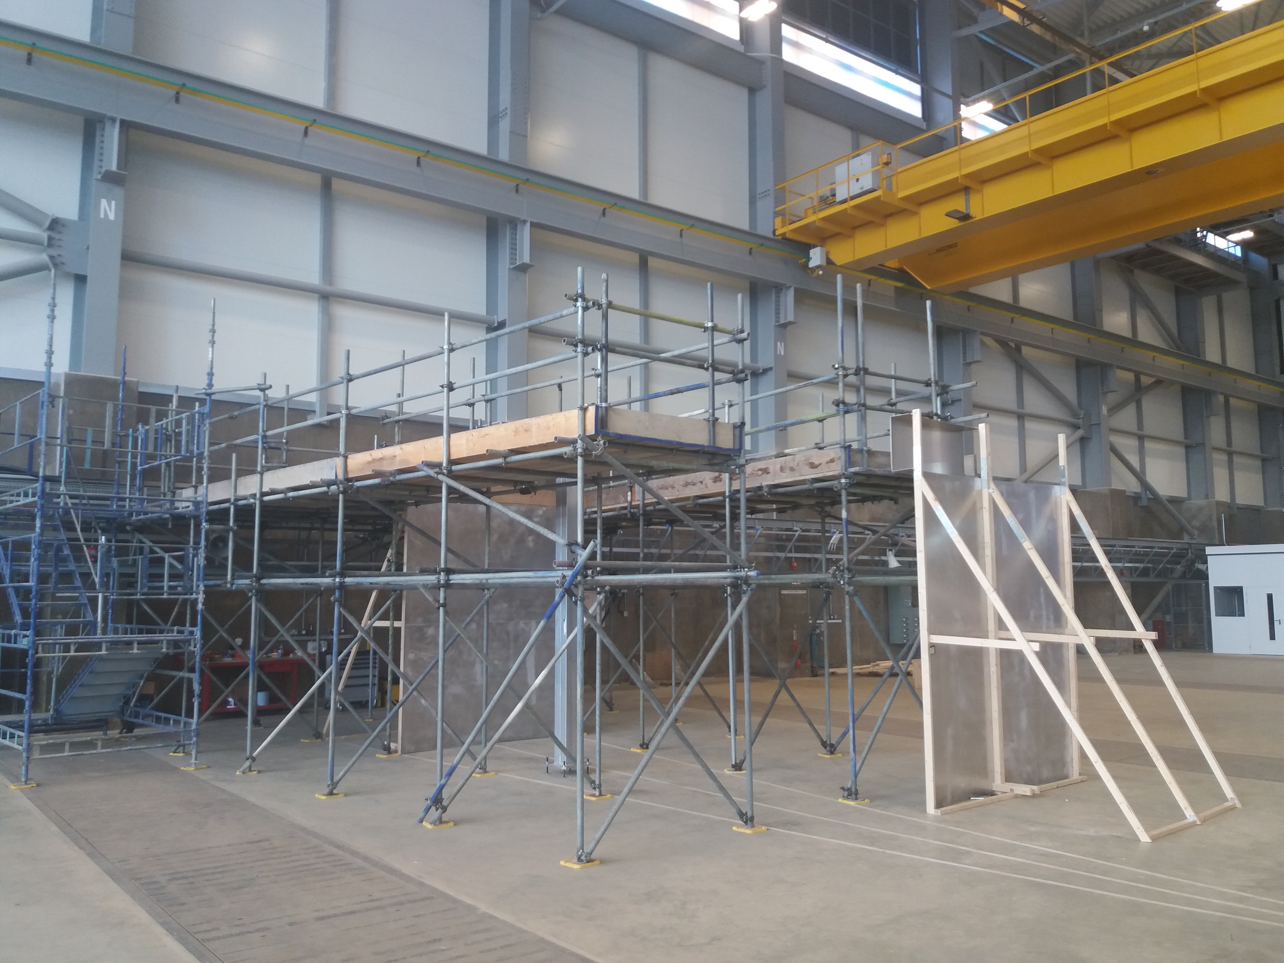
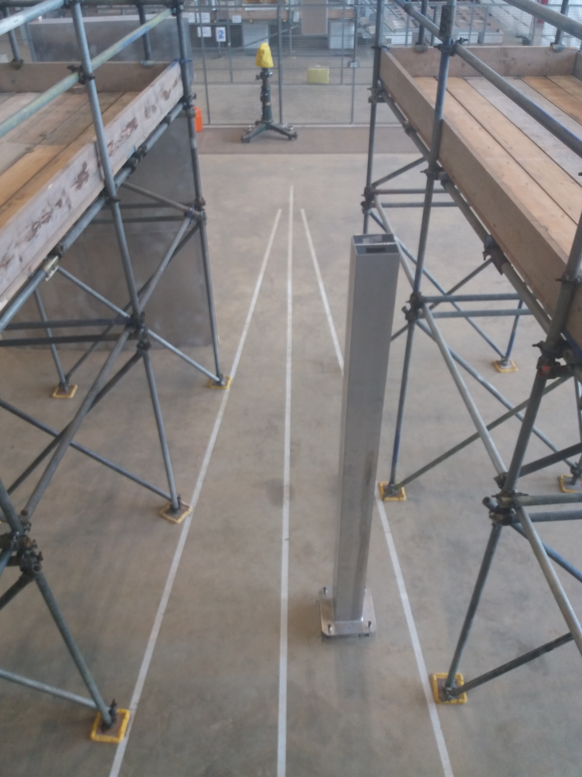
Pre-build Progress

Slide 9
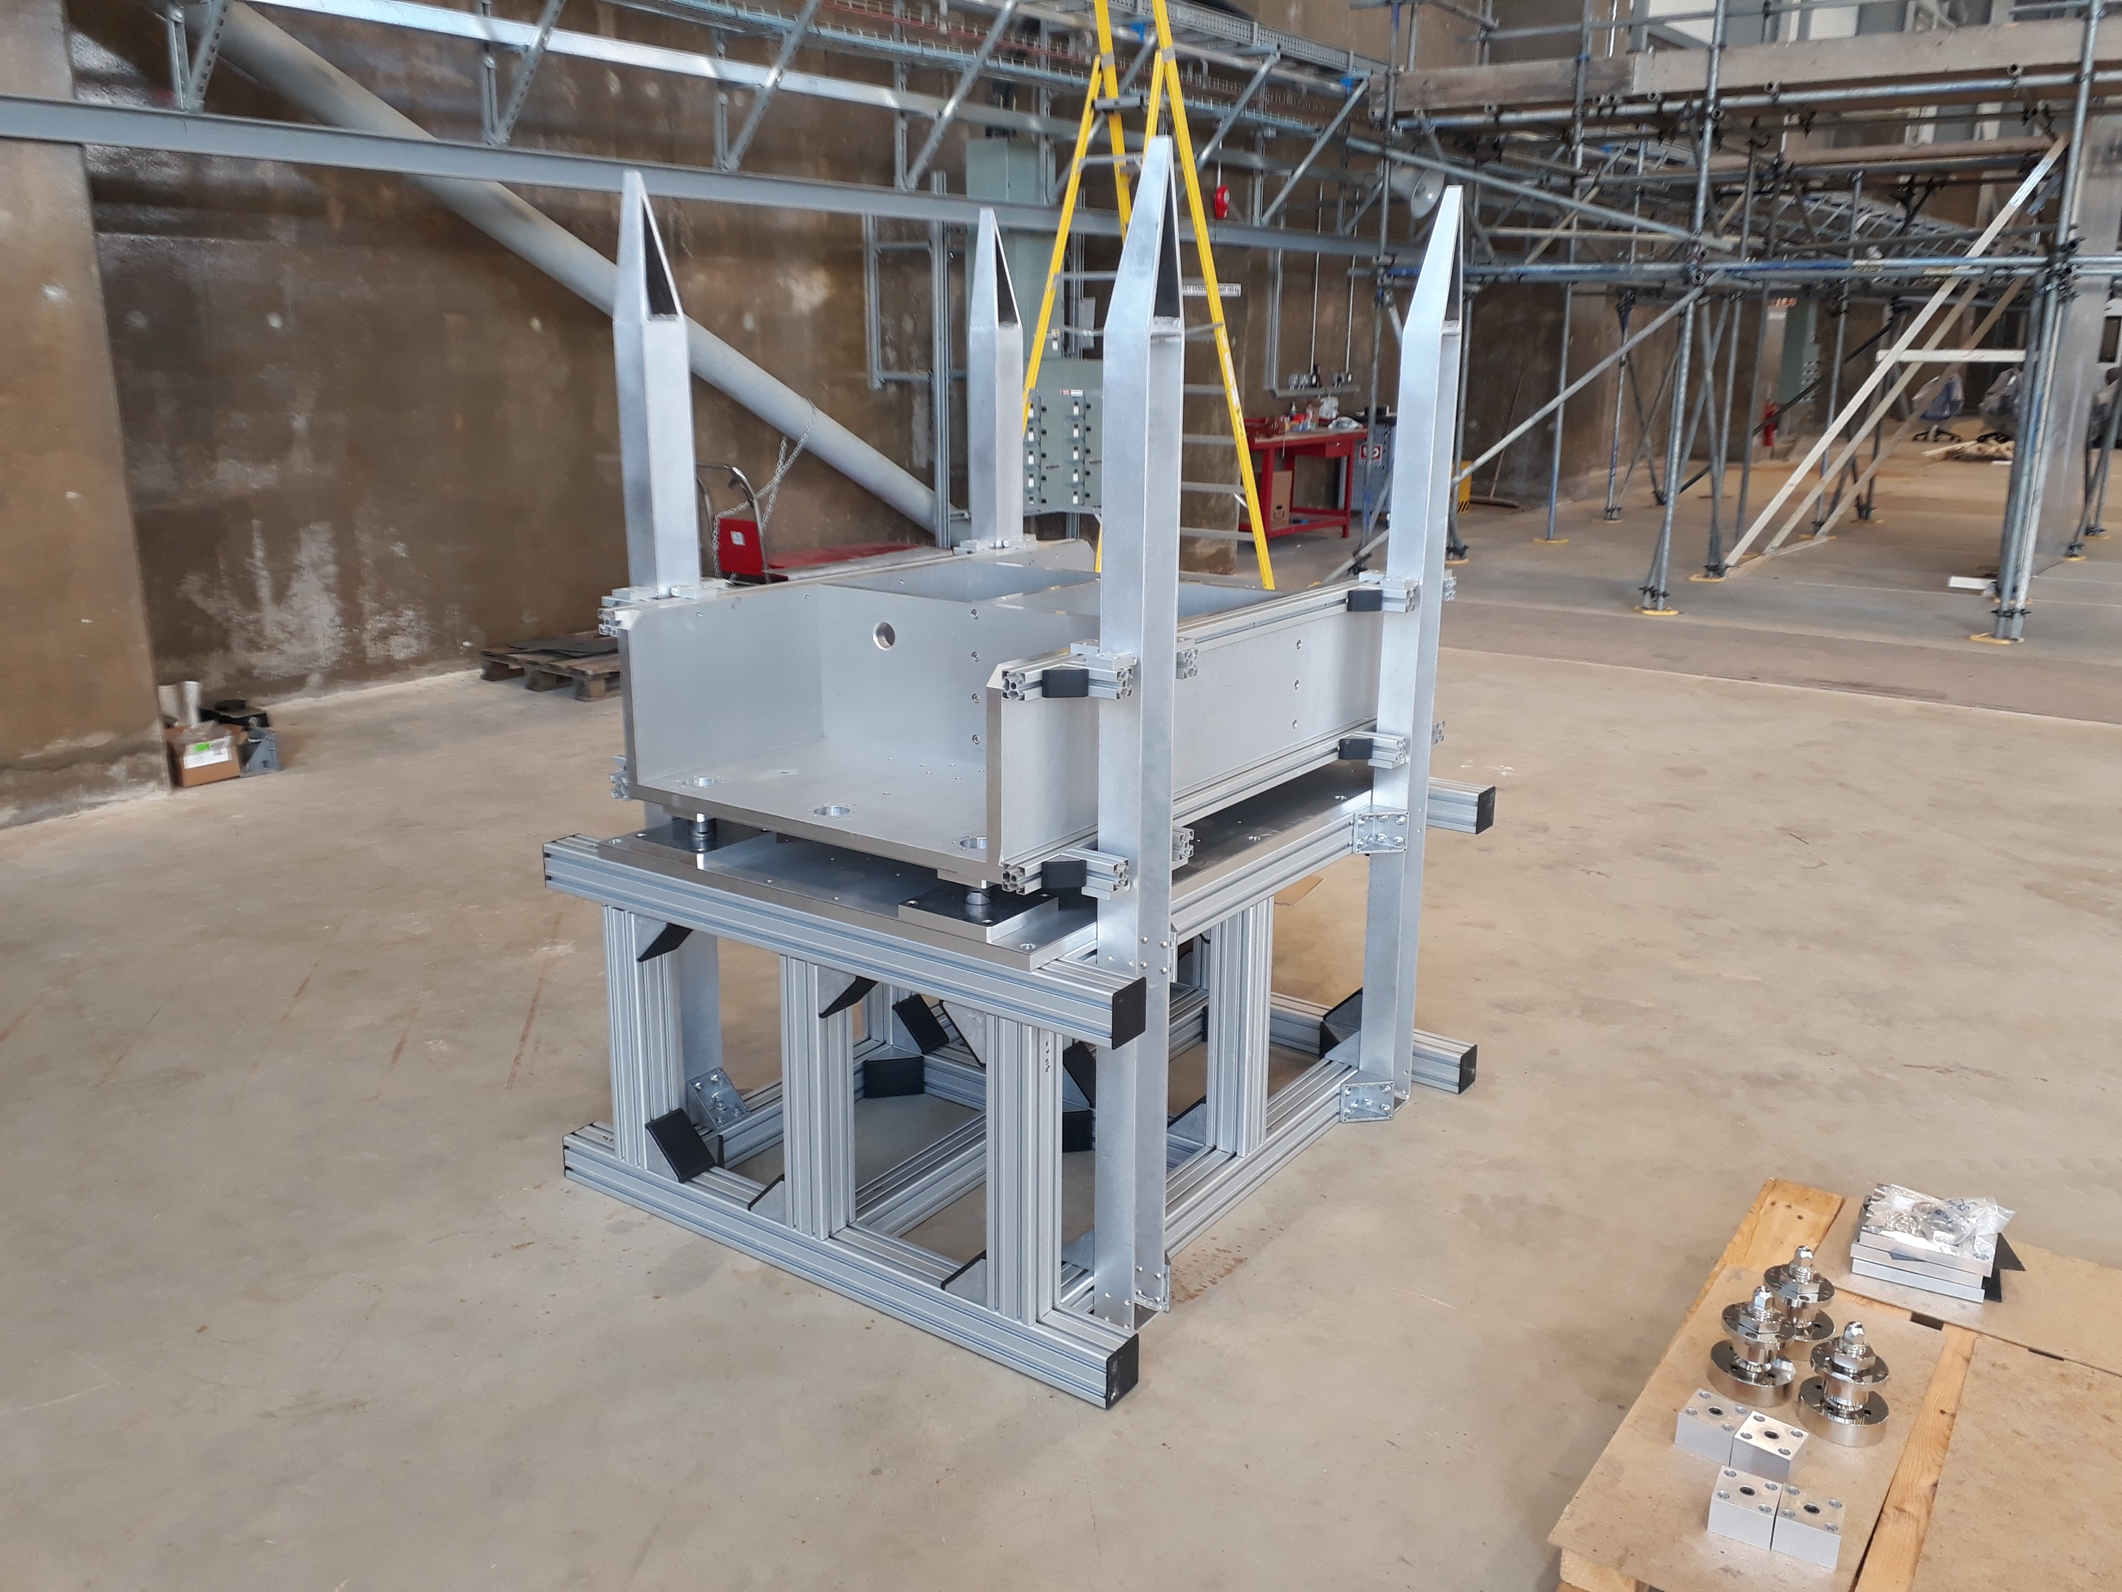
Pre-build progress

Slide 10
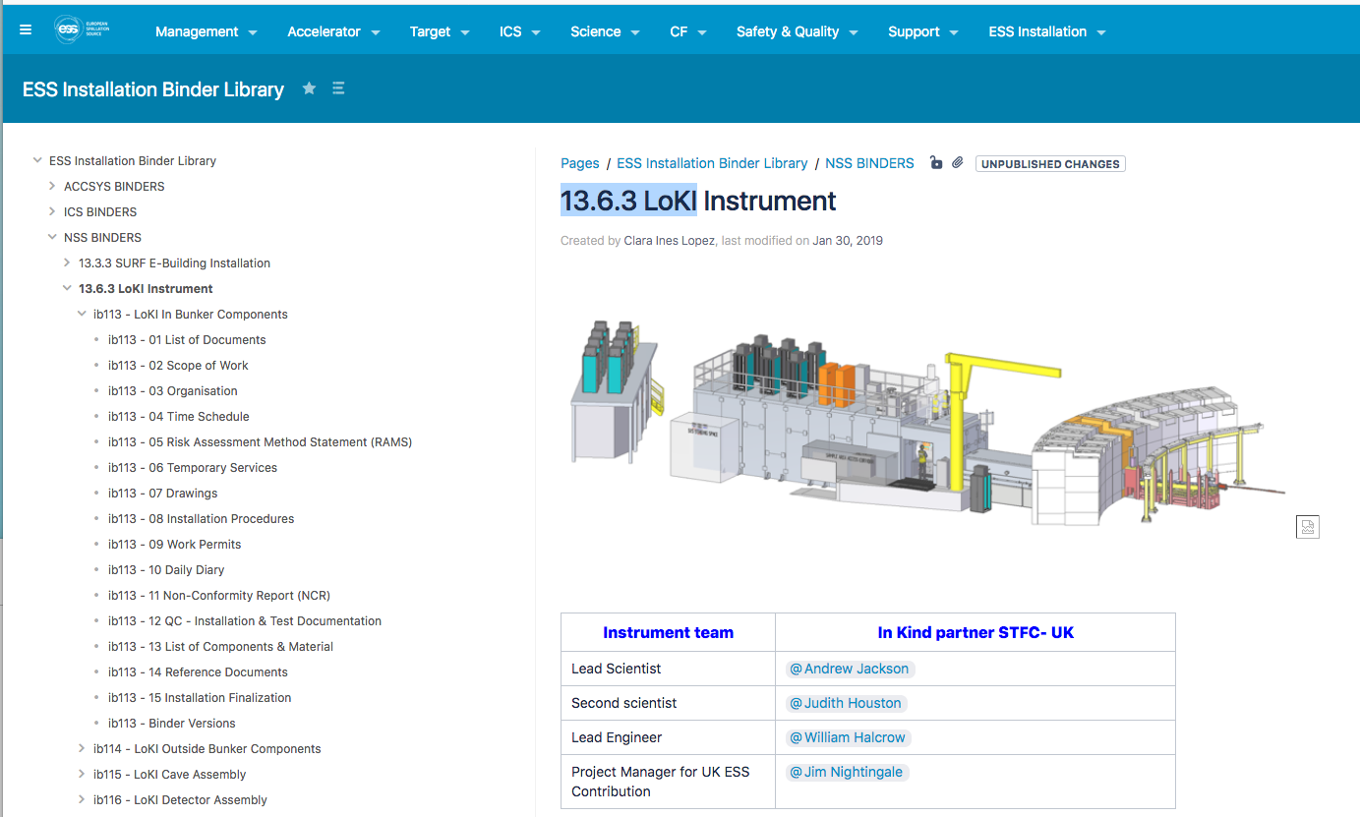
Installation binders LoKI Instrument

Slide 11
Installation binders – Scope divided in Field installation packages
ESS Work package
Field Installation packages

Slide 12
Field installation package document P1, P2,, Pn
Package ID. (logistic operations)
Work description: Scope of work
Schedule: time and man power estimation
Site preparation needed for field installation package (grouting, mounting supports, alignment plates, etc.)
Pre assembly activities for field installation packages
List of Drawings /Mounting instructions/Figures/ Electrical schemes/reference documents P&ID’s/specifications, 3d scans, photo archives, etc.
Particular considerations: access permits, regulatory requirements, risks, safety, temporary provisions, special limitations or recommendations for lifting equipment, subcontractors, vendors support, etc.
List of equipment, tools, consumables and materials
Location identification at site (bunker-hall-sectors)
Boundaries: dimensions LxWxH and mass
Utilities distribution preassembly needs: fluids, power, data, signals, etc. Check lists
Scaffolding, cranes and construction equipment requirements
Critical interface verification
Test validation to perform at site: ref document
Pn
P2
P1

Slide 13
Loki Instrument Build Sequence Depends of the schedule and access to building
Monolith Insert
Gamma Shutter
Loki within bunker
Generic Cables/pipes
Bunker wall
Bunker wall insert
Bunker wall
Services through wall
Bunker roof
concrete base
Alignment base
Post bunker components
Beamline shielding
PSS
Safety systems
First Neutrons
Sample area access floor
Sample area Components
Jib Crane
Vacuum pumps
End wall and beam-stop
Detector vessel
Cave walls & roof
Services from Gallery
Detectors
Loki cabin
DAE Racks
Racks and services

Slide 14
Field installation Packages
To facilitate management of installation an instrument will be divided into a set of field installation packages. These will be chosen to be of manageable size and defined by the sequence of engineering work and the assembly process. The FIPs will be prepared in an organized way to deliver the scope of work needed for the process of installation required at ESS by the partner and ESS installation teams.
This process is aligned with the detailed design phase, manufacturing process, installation, QA & safety requirements, and specific constraints and requirements specific to the relevant installation areas.

Slide 15
Information from instruments
Swedish certification for instrument personnel for installation
Updated Planning information
Documentation related to safety requirements, logistics, contractors, access, induction etc.
Contract agreements
Electrical coordination
Remote handling: details about lifting for components design, tools to be included in pre-build at ISIS

Slide 16
Questions
Thanks to LoKI team

