Slide 1
Welcome and Charge for the Meeting
Ken Andersen
Reflectometry STAP Meeting
Lund, 24th September 2019

Slide 2
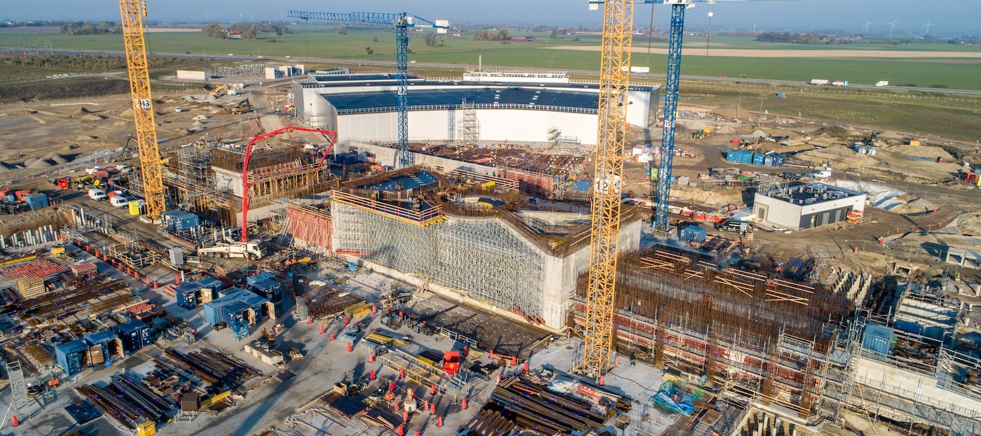
Welcome!
No need for ESS update: coming tomorrow in joint session with SANS STAP

Slide 3
Purpose and Remit of Instrument STAPs
Scientific and Technical Advisory Panels
one per instrument class
STAP: instrument advisory body
science case and functional requirements
all aspects which impact on scientific output of instrument (not just instrument project)
technical and project decisions
early science
Advice to both NSS management and instrument teams
collaborative & non-adversarial setting
NSS management & instrument teams take advice constructively
allows NSS management & instrument teams to make good, informed decisions
Each STAP meeting results in written recommendations
followed up in subsequent meeting(s)
presented at following SAC meeting
SAC report includes highlights of STAP reports – presented to Council

Slide 4
Charge for this Meeting
Instrument teams
Prepare progress reports and present them for discussion
Provide feedback on STAP actions
Identify hot topics and raise them
NSS management
Organise the meeting
Provide feedback on STAP actions
Inform of main developments since last meeting
STAP
Comment on instrument progress, given planned schedule
Advise on early science, given the foreseen operational environment
Provide feedback to instruments on progress and actions to be taken
Provide feedback to Science Director on progress and actions to be taken
Submit written report
Present at SAC meeting on 24-25/10

Slide 5
Thank You!

