Slide 1
Welcome and Charge for the Meeting
Andrew Jackson
SANS STAP Meeting
Lund, 25th September 2019

Slide 2
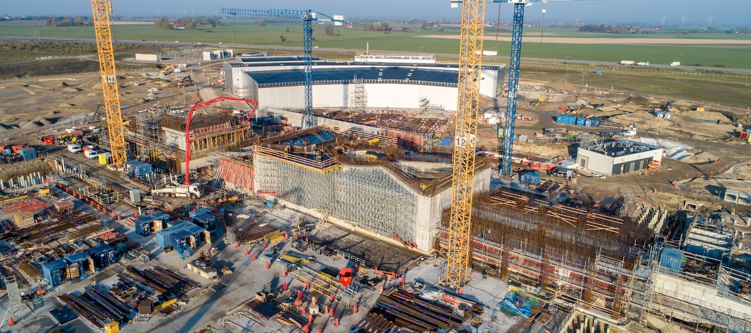
Welcome!
ESS Update Earlier this morning …

Slide 3
Purpose and Remit of Instrument STAPs
Scientific and Technical Advisory Panels
one per instrument class
STAP: instrument advisory body
science case and functional requirements
all aspects which impact on scientific output of instrument (not just instrument project)
technical and project decisions
early science
Advice to both NSS management and instrument teams
collaborative & non-adversarial setting
NSS management & instrument teams take advice constructively
allows NSS management & instrument teams to make good, informed decisions
Each STAP meeting results in written recommendations
followed up in subsequent meeting(s)
presented at following SAC meeting
SAC report includes highlights of STAP reports – presented to Council

Slide 4
Charge for this Meeting
Instrument teams
Prepare progress reports and present them for discussion
Provide feedback on STAP actions
Identify hot topics and raise them
NSS management
Organise the meeting
Provide feedback on STAP actions
Inform of main developments since last meeting
STAP
Comment on instrument progress, given planned schedule
Advise on early science, given the foreseen operational environment
Provide feedback to instruments on progress and actions to be taken
Provide feedback to Science Director on progress and actions to be taken
Submit written report
Present at SAC meeting on 24-25/10

Slide 5
Actions from last two meetings
From December 2018 …
1) Both instruments need a settled plan for beam monitors urgently.
ACTION : Present plan at next STAP meeting – DONE, more details at this meeting
2) Loki and Skadi teams need to devise a calibration procedure for the whole instrument. Both intensities and q – as much from first principles as possible. This is highly involved. No secondary or tertiary standards for calibration.
ACTION : Present progress on this at next STAP meeting. These procedures should be developed by the lead scientists to ensure that they fully understand them. – In progress, more details at this meeting
3) The STAP had serious concerns over the design of the SKADI collimator snout in terms of the optical reproducibility, robustness and safety of the design. More detailed thought should go into this.
ACTION : SKADI team to report further analysis in respect to the STAP concerns at the next STAP meeting. - In progress, SKADI team planning to build prototype, more tomorrow.
4) In regard to the VSANS collimation on SKADI, the STAP asked for information about potential radioprotection issues of using Gd (hard gammas) and as to the reflectivity of Gd foils at glancing incidence and long neutron wavelengths.
ACTION : SKADI team to report their progress on this analysis at next STAP meeting – DONE

Slide 6
Actions from last two meetings
From December 2018 …
5) What about technique specific ILL-ESS meetings?
ACTION : AJJ to discuss possibility of a joint SANS or LSS meeting with ILL SANS/LSS team – DONE, will likely organise something next year.
6) Adaptation of current instruments to do GISANS – show what can be done on LoKI/SKADI/ESTIA/FREIA
ACTION : Instrument teams to determine what GISANS experiments could be done on their instrument as is, or what would need to be done to accommodate them. AJJ to coordinate. – In Progress
7) Prioritisation and planning of SEE
ACTION : Instrument teams to present prioritized list of SEE at next STAP that has been agreed with SAD - DONE
8) Plan for standard system of movements at each instrument (goniometers)
ACTION : Instrument teams to show how they will integrate a standard set of motions into their instrument at the next STAP. - In Progress, to be shown at this meeting

Slide 7
Actions from last two meetings
From April 2019 …
9) SKADI Deflector m values?
ACTION : SKADI to check m values for sides of deflector – likely don’t need to be so high. – In Progress?
6) Labyrinths
ACTION : Teams to check need for complex SEE labyrinth, could they be straight as only unlikely event could cause dose (e.g. diffraction spot). – In Progress – see instrument presentations

Slide 8
Thank You!

