Slide 1
Early Science with the
ESS SANS & Reflectometry Instruments
Andrew Jackson
LSS Instrument Class Co-ordinator
European Spallation Source ERIC
2019-09-24

Slide 2
Instrument Performance
All Instruments are funded to be world-leading at 2MW power
Version 27/8/2019
Instrument Class | Instrument | Performance targets (2019) @ 2MW
Large Scale Structures | LoKI (Broad band SANS) | 5 x D22, 20 x SANS2D
 | SKADI (General Purpose SANS) (+SONDE funds) | 5 x D22
 | ESTIA (Focusing Reflectometer) | 10-100 x D17, depending on collimation mode
 | FREIA (Liquids Reflectometer) | 2-30 x FIGARO & INTER, depending on Q-range and resolution
Diffraction | DREAM (Bispectral powder diffractometer) | > 10 x POWGEN & WISH
 | HEIMDAL (Hybrid diffractometer) | ~ 8 x POLARIS, ~ 50 x GEM
 | MAGiC (magnetism single crystal diffractometer) | Cold: > 100 x world’s best, Thermal: 1mm³ crystals = 10 min
 | NMX (Macromolecular crystallography) | > 20 x LADI & Biodiff
Engineering & Imaging | BEER (Engineering diffractometer) | 1-2 x TAKUMI, 14-28 x ENGIN-X, depending on multiplexing
 | ODIN (multi-purpose imaging) | world leading for high spatial and temporal resolution, > 10 x best for TOF methods
Spectroscopy | BIFROST (extreme environment spectrometer) | > 10 x THALES & MACS
 | CSPEC (cold chopper spectrometer) | 6-150 x IN5 (3meV), depending on focusing and RRM
 | T-REX (bispectral chopper spectrometer) | 6-60 x IN5 (3meV), 10-100 x 4Seasons (100meV), depending on RRM
 | VESPA (vibrational spectroscopy) | 1-3 x VISION (ΔE < 160 meV) trading intensity for resolution
 | MIRACLES (backscattering spectrometer) | 4 x BASIS, 5 x DNA, for QENS at same resolution

Slide 3
Instrument Performance
All Instruments are funded to be world-leading at 2MW power
Version 27/8/2019
Instrument Class | Instrument | Performance targets (2019) @ 2MW
Large Scale Structures | LoKI (Broad band SANS) | 5 x D22, 20 x SANS2D
 | SKADI (General Purpose SANS) | 5 x D22
 | ESTIA (Focusing Reflectometer) | 10-100 x D17, depending on collimation mode
 | FREIA (Liquids Reflectometer) | 2-30 x FIGARO & INTER, depending on Q-range and resolution
Diffraction | DREAM (Bispectral powder diffractometer) | > 10 x POWGEN & WISH
 | HEIMDAL (Hybrid diffractometer) | ~ 8 x POLARIS, ~ 50 x GEM
 | MAGiC (magnetism single crystal diffractometer) | Cold: > 100 x world’s best, Thermal: 1mm³ crystals = 10 min
 | NMX (Macromolecular crystallography) | > 20 x LADI & Biodiff
Engineering & Imaging | BEER (Engineering diffractometer) | 1-2 x TAKUMI, 14-28 x ENGIN-X, depending on multiplexing
 | ODIN (multi-purpose imaging) | world leading for high spatial and temporal resolution, > 10 x best for TOF methods
Spectroscopy | BIFROST (extreme environment spectrometer) | > 10 x THALES & MACS
 | CSPEC (cold chopper spectrometer) | 6-150 x IN5 (3meV), depending on focusing and RRM
 | T-REX (bispectral chopper spectrometer) | 6-60 x IN5 (3meV), 10-100 x 4Seasons (100meV), depending on RRM
 | VESPA (vibrational spectroscopy) | 1-3 x VISION (ΔE < 160 meV) trading intensity for resolution
 | MIRACLES (backscattering spectrometer) | 4 x BASIS, 5 x DNA, for QENS at same resolution

Slide 4
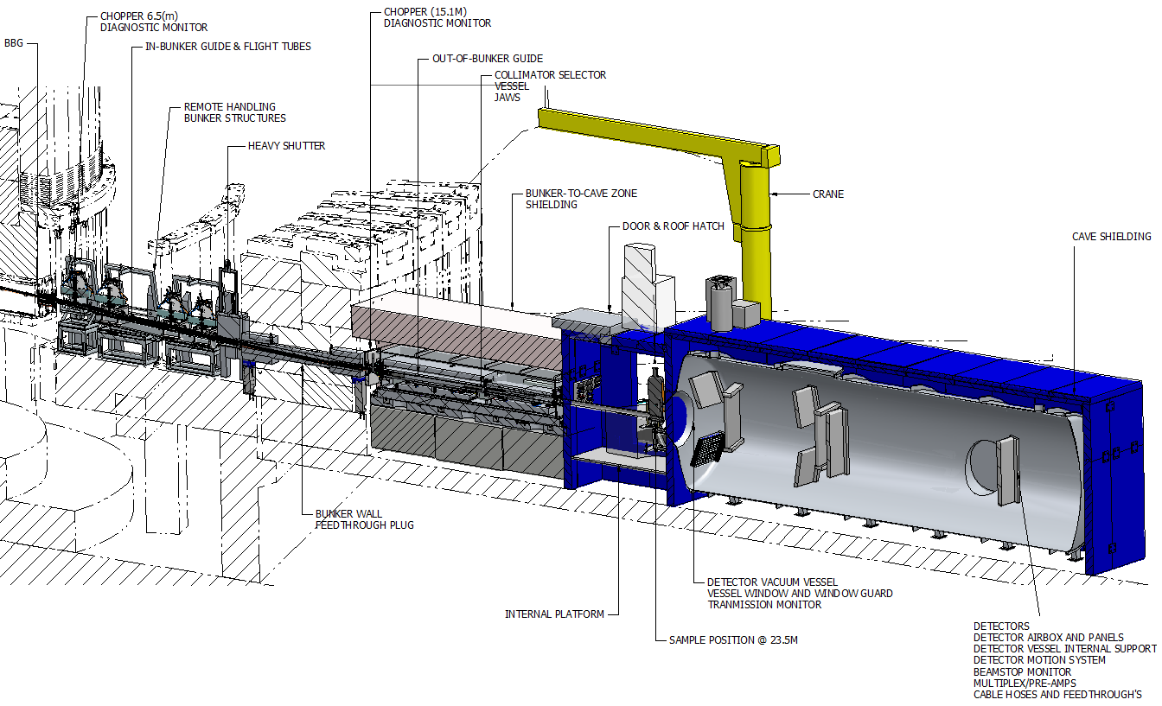
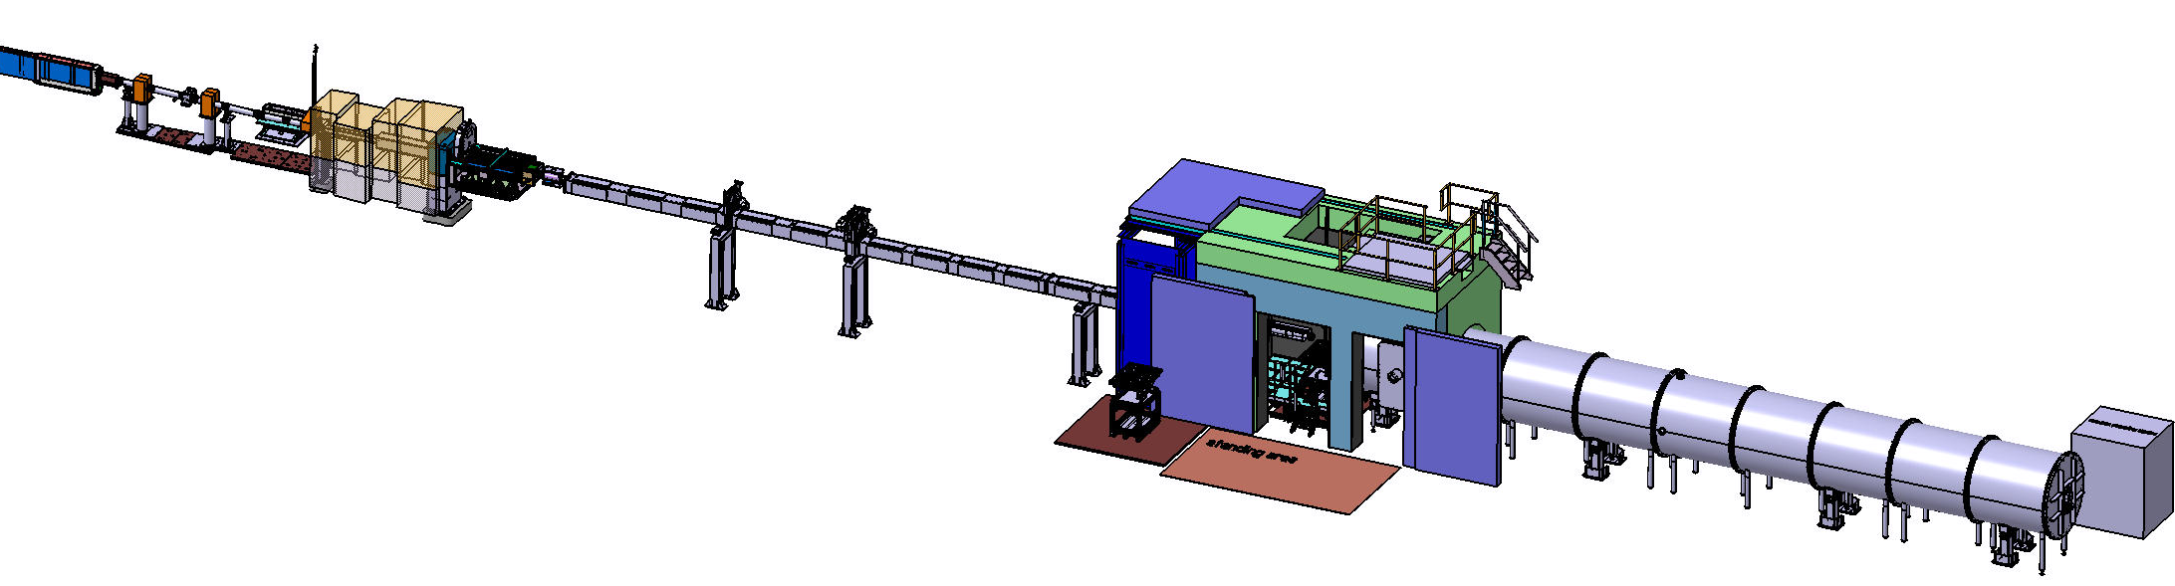
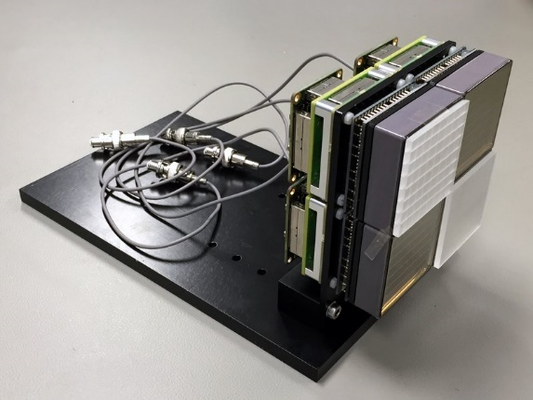
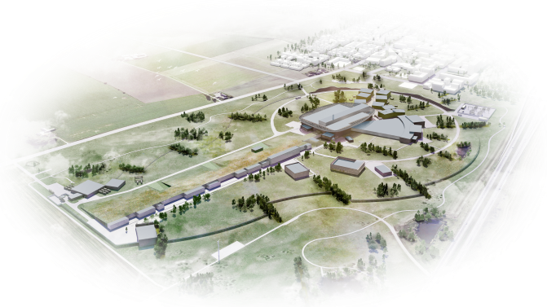

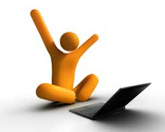
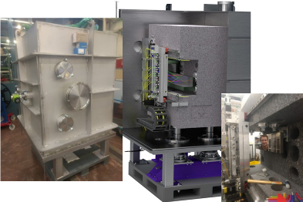
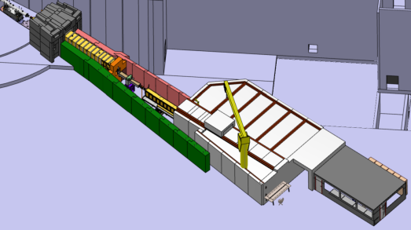
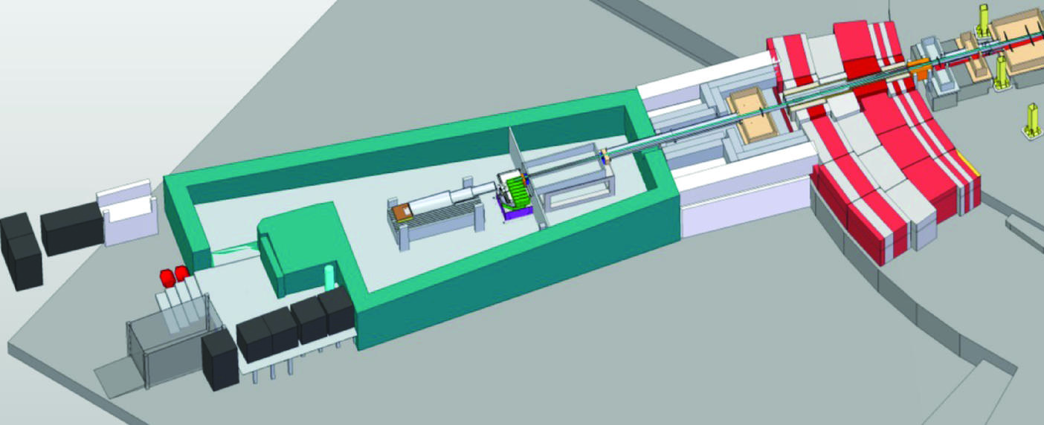
Instrument Timelines
SoNDE Detector
Project Complete
2019
LoKI user
operation 2023
SKADI user
operation 2025
LoKI Installation
2021
SKADI Installation
2022-24
ESS first beam
on Target 2022
Estia Installation
2021
Freia Installation
2023-24
Selene demonstrator
2018
Estia user
operation 2023
Freia user
operation 2025

Slide 5
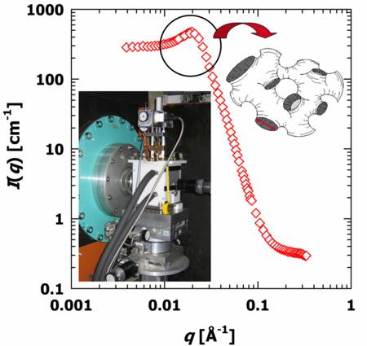
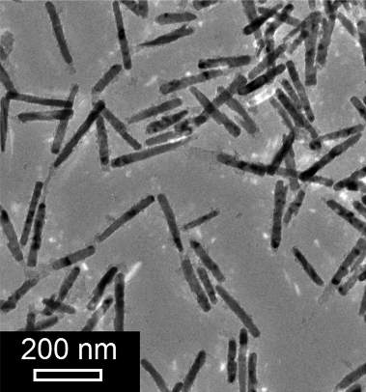
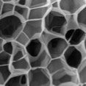
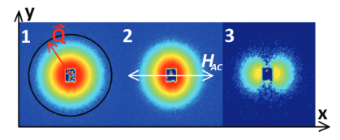
SANS - SKADI
Fast/high rate structural changes (on multiple scales)
Irreversible transitions
Polymerising nano foam
Nano-foams are excellent thermal insulators due to trapped gas limiting convection (Knudsen effect)
Super-critical CO₂ / water / monomer microemulsions can form basis for generating nano-foams more efficiently than sol-gel processes.
Need to study polymerisation process that occurs simultaneously with foam expansion.
Frequency scanning
Magnetic nanoparticles in a cycled magnetic field
Studying the response of magnetic nanoparticles to alternating or rotating magnetic fields.
Behaviour allows the use of the particles for nanorheology, protein binding assays and localized heating amongst other effects.
Need high time resolution and wide Q range.
Polarized neutron beam to extract both magnetic and nuclear structure
Experiment at D22 required repeating the same experiment 3 times (3 detector distances) – no polymerisation as needed multiple pressure cycles.
P. Bender et al. ,Nanoscale,2015,7,17122–17130
Courtesy of: Sottmann, Klemmer, Strey: U Köln
Performed at D22 using TISANE setup (no polarization)

Slide 6
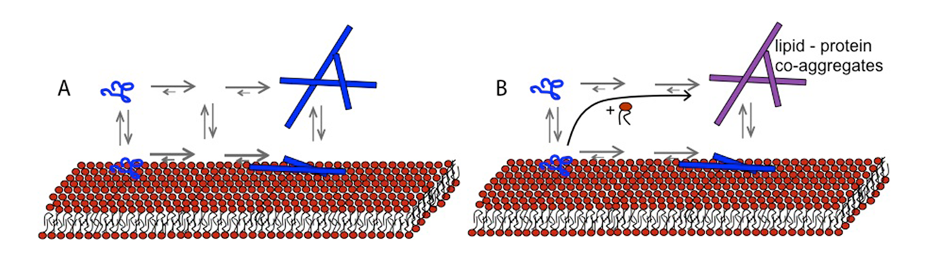
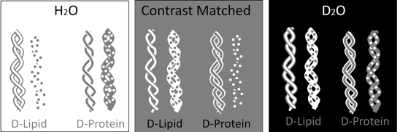
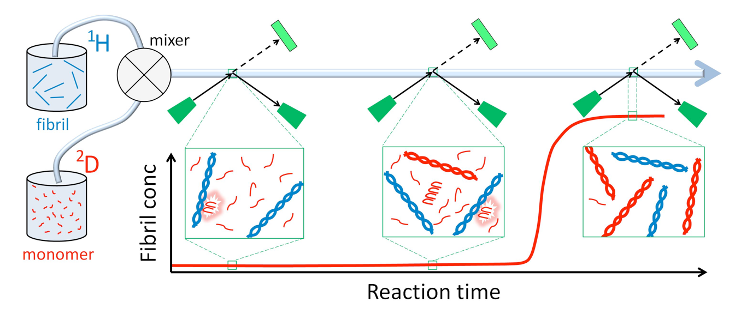
SANS - LoKI
Co-Aggregation of Amyloid Proteins and Lipids
Mechanical Deformation of Polymers and Polymer Composites
Amyloid plaques associated with neurodegenerative disease
Polymer blends and composites are key materials in modern manufacturing
In most cases, molecular mechanisms are not understood
Need to understand the deformation of these materials under strain - from macroscopic to microscopic
Need to understand role that lipids and membrane interactions play in formation of amyloid fibrils
Combination of digital image correlation (DIC) and SANS over a wide Q range
Focus is on α-synuclein which is involved in Parkinson’s disease
In-situ strain – mechanical, electro-deformation, and magneto-deformation.
Using small beams to scan over sample to get distribution of deformation / structural change
Bio-deuteration is required, as are advances in sample environment and data analysis
Chemical Deuteration is required, as are advances in sample environment and data analysis
S Linse, E Sparr (LU)
S Hall, M Ristinmaa, T Plivelic (LU)

Slide 7
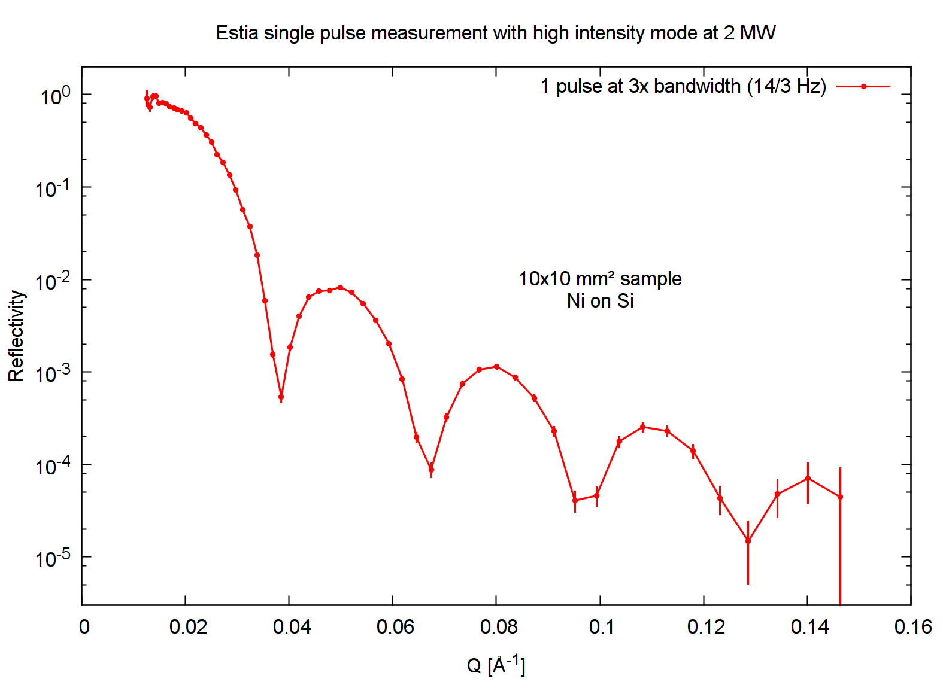
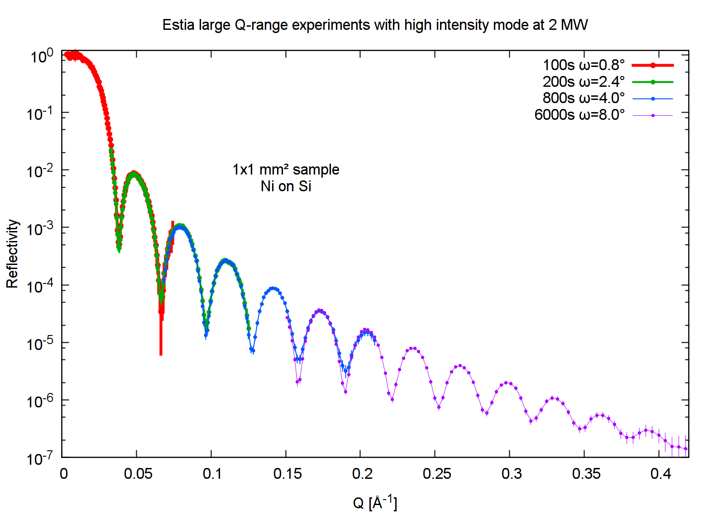
Reflectometry - ESTIA
Conventional reflectometry (collimated): Typical samples in seconds - minutes
High Intensity Mode
Very fast measurements on standard size samples (10x10mm²)
High Intensity Mode
Large Q coverage on tiny samples (1x1 mm²)
1cm² 20nm Ni on Si
1mm² 20nm Ni on Si ~2h
Perform typical Q-range experiment in a single pulse =>
Unprecedented time resolution (0.2 s)
Map parameter space with dense coverage
(4-300 K in steps of 0.1 K performed in <1h)
No need to move any motor during experiment
Experimental times comparable with current instruments on large samples.
Investigate selected sample surface regions
Attract users from new communities (e.g. microscopy samples of <5x5 mm² size)
Inhomogeneous systems
Devices in operation with e.g. electric contacts – avoid scattering from contacts, mountings etc.

Slide 8
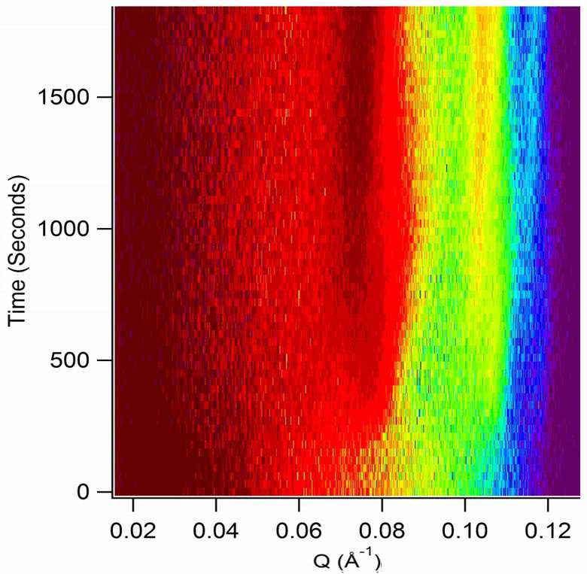
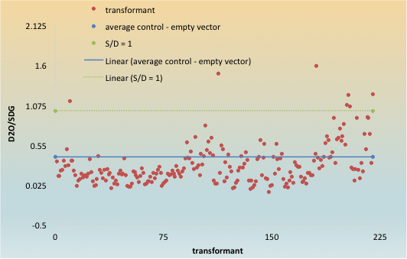
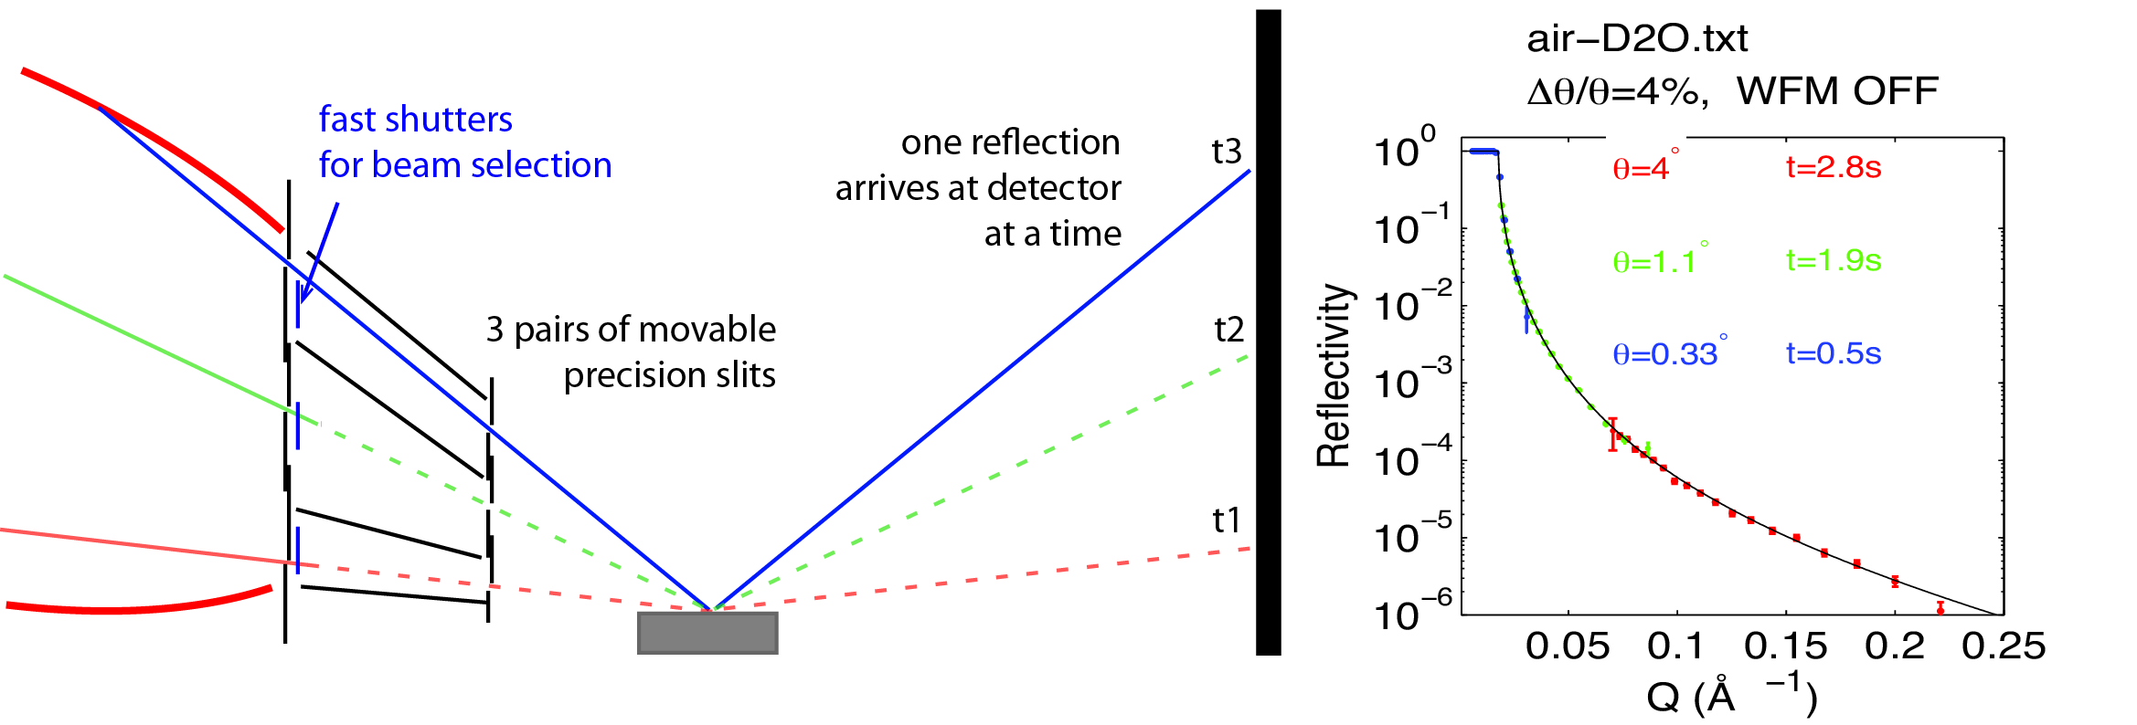
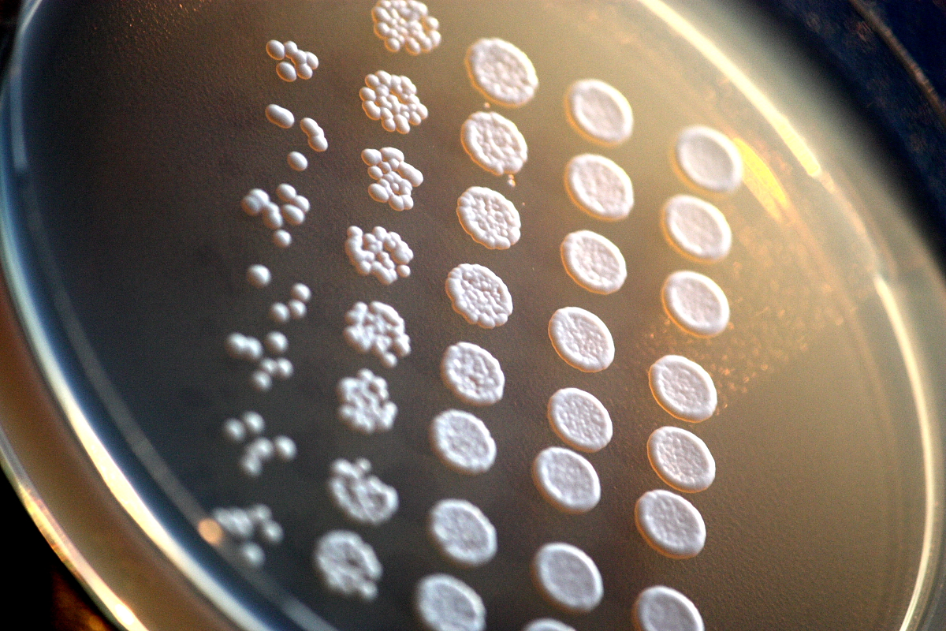
Reflectometry - FREIA
Time-resolved experiments of adsorption/desorption/reaction kinetics.
High throughput studies: (100s of samples/many contrasts)
Kinetics at interfaces:
  Lipid remodeling by enzymes: KIE in D2O. (2min data on FIGARO)
  Broad Q-range needed
  No movement of sample
SiO2 film templating at air-water interface (30s slices on FIGARO)
Complex systems of mixed lipids and proteins require many contrasts
Use of automated sample mixing to change buffers or sample.
Eur. Phys. J. Plus (2011) 126: 107
Screening for drug resistance / virulence factors
Comparing lipids produced in different cell cultures
High-flux mode:
FIGARO: R = 10⁻⁶ - 1 min + 1min moving time
FREIA @2MW: 3.75s
High-res mode:
FIGARO: R =10⁻⁷ ~ 8h
FREIA @ 2MW = 15 min.
+ Stroboscopic experiments: T_{r} = 2.86 x S/L = 339μs

Slide 9

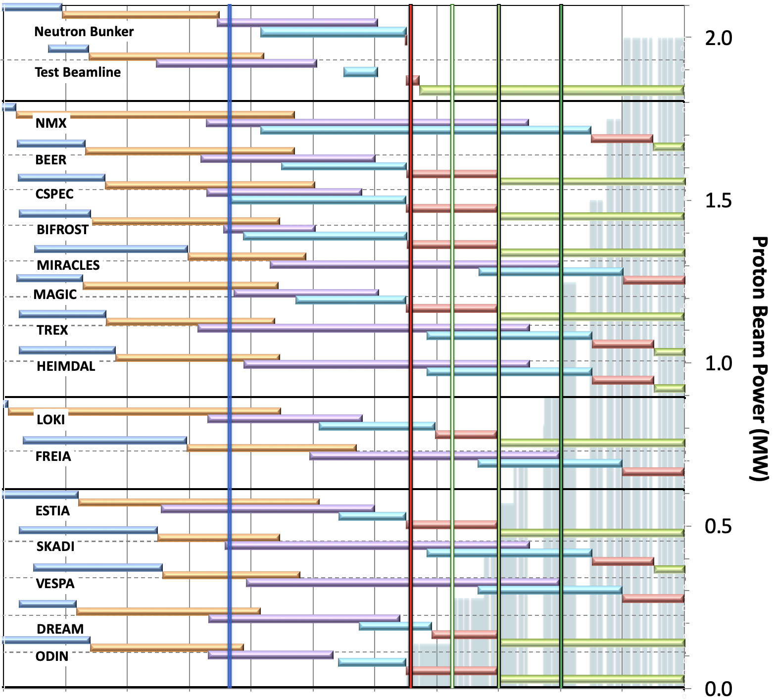
Reality Check …
Baseline schedule for Neutron Beam Instruments
(NSS MS V4.2)
Preliminary Design
Detailed Design
Manufacturing & Procurement
Installation & Integration
Hot Commission/Early science
Operation
Current date
BOT
& HC
SOUP
(3NBI*)
8NBI* in User Program
FS
FS
First 3 NBI selected for SOUP: DREAM, LOKI & ODIN (best chance for early impact, as agreed by NSS, SAC and ESS Council)
Back-up instruments: (for risk of late access to D01 & D03) BEER, CSPEC, MAGIC or BIFROST, ESTIA
West sector
North sector
March 2023:
First Science (FS) with expert teams on some of instruments above
Review progress of first 3 NBI for SOUP, implement backup plan if needed.
East and South sectors
2016 2017 2018 2019 2020 2021 2022 2023 2024 2025 2026
* NBI = Neutron Beam Instrument

Slide 10
Reality Check …
2022 | 2023 | 2024 | 2025 | 2026 | 2027 | 2028 | 2029 | 2030
5MW
Estia : < 1 MW at start of user programme, commissioning with lower power.
4MW
LoKI : < 1 MW at start of user programme, commissioning with lower power.
FREIA User Programme
SKADI User Programme
FREIA Hot Commissioning Start
3MW
SKADI : 2 MW at start of user programme, commissioning with 1.5 to 2 MW.
SKADI Hot Commissioning Start
Start of User Programme
2MW
FREIA : 2 MW for commissioning and start of user programme
First Science Milestone
LoKI Hot Commissioning Start
1MW
Estia Hot Commissioning Start

Slide 11
Approach to Early Science
Initial focus on providing confidence in the instruments – calibration samples, round robin samples with other facilities etc. [Advice from both SANS and Reflectometry STAPs]
Move into “First Science” – Early, publishable, test experiments beyond calibration. Done by instrument teams and their collaborators?
As we start the user programme:
  Graded introduction of instruments – work up to full user programme beam days over ~ 1 year.
  Begin user programme with expert users – how to make programme open whilst selecting proposals that are going to work and users that are going to help?!

Slide 12
Questions for discussion …
Topic areas for teams to be cultivating in preparation for early science activities?
How to engage possible early users?
What would the STAP members do if given beamtime on “Day 1”?
How does the lower initial operating power affect early science on LoKI and ESTIA?

