Slide 1
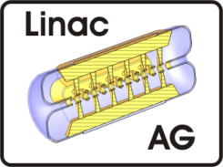
MYRRHA Injector Design and Related R&D
2nd Open Collaboration Meeting on Superconducting Linacs for
High Power Proton Beams (SLHiPP-2)
LNS-INFN Catania
3.-4. May 2012
Holger J. Podlech
H. Klein, D. Mäder, R. Ratzinger, A. Schempp, R. Tiede, M. Vossberg, C. Zhang
Institute for Applied Physics (IAP)
University of Frankfurt, Germany

Slide 2
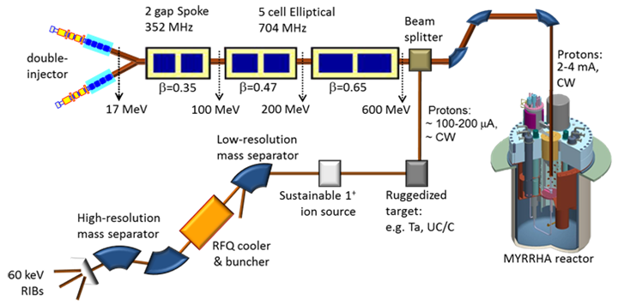
The MYRRHA Proton-Driver
Notes:
Struckturen durchgehen
Warum normalleitend / supraleitend
CH-Design
Solenoid-Design
Ein Kryomodul

Slide 3
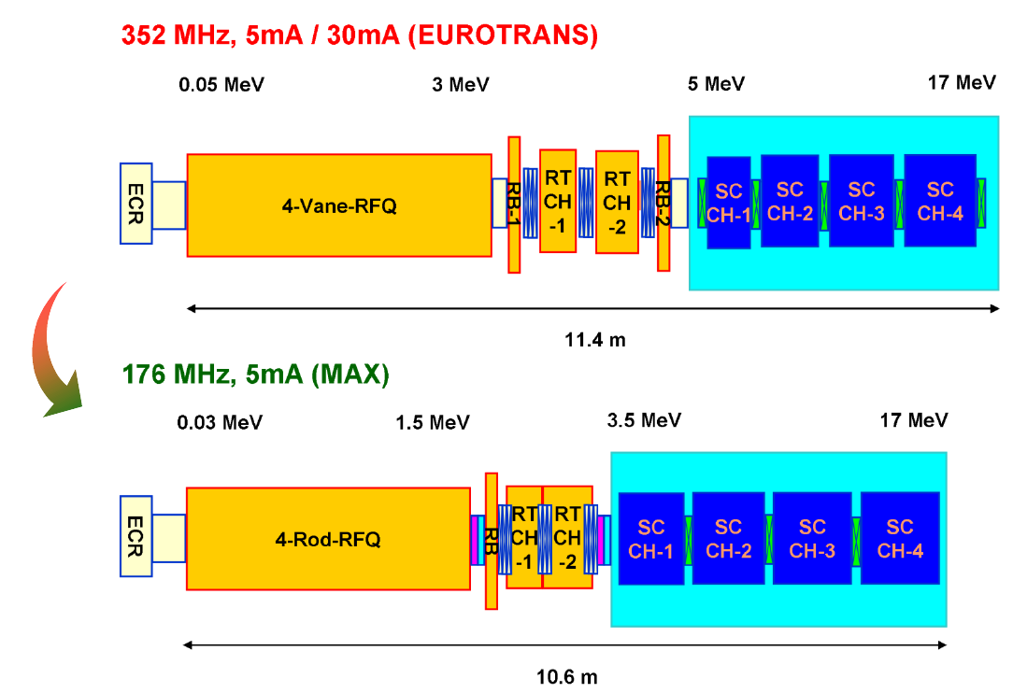
Scheme of the MYRRHA Injector
Notes:
Aufbau eines Teststandes

Slide 4
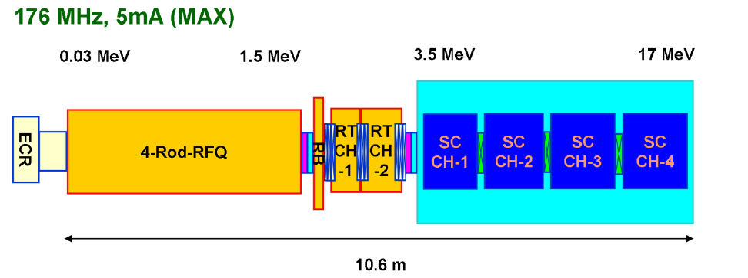
176 MHz: Advantages
Lower RFQ energy (1.5 MeV vs 3.0 MeV)
Use of 4-Rod RFQ (less expensive, less sensitive, lower voltage)
Thermal power RFQ: ≈25 kW/m → safe
Larger aperture in CH-cavities
Total injector length independent of f (almost)

Slide 5
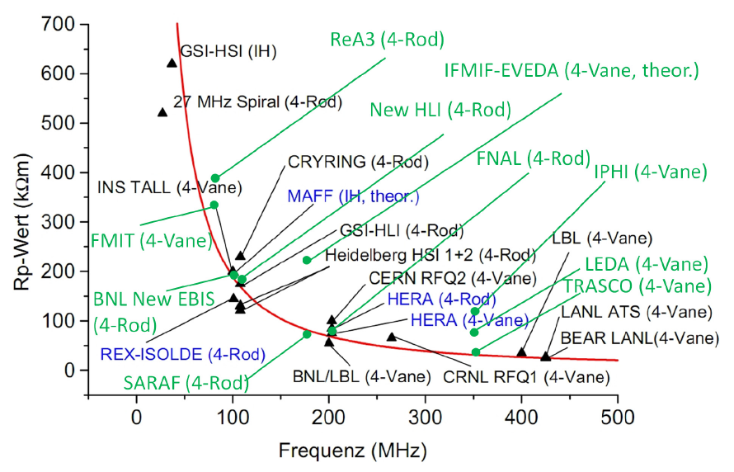
Shunt Impedance of RFQ-Structures
MYRRHA
Notes:
Struckturen durchgehen
Warum normalleitend / supraleitend
CH-Design
Solenoid-Design
Ein Kryomodul

Slide 6
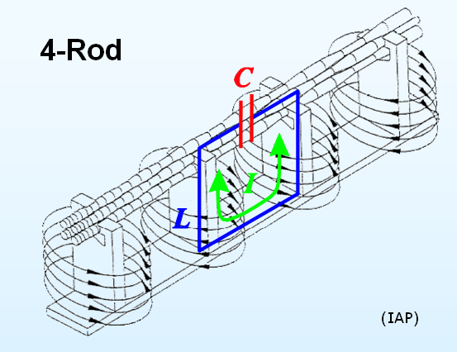
4-Rod-RFQ
+Transmission line resonator
+Excellent Tuning
+Easy acces (tuning, repair)
+Proven Technology
+„Inexpensive“
+Less sensitive against tolerances
-Locally higher power densities

Slide 7
176 MHz 4-Rod-RFQ
Voltage reduced to 40 kV (from 65 kV @ 352 MHz)
Expected shunt impedance: >67 kΩm
Specific power: 25 kW/m (47 kW/m demonstrated)
Length: ≈ 4m
Total losses: 100 kW
RF power with beam (5 mA): 107 kW
RF amplifier: 150-180 kW

Slide 8
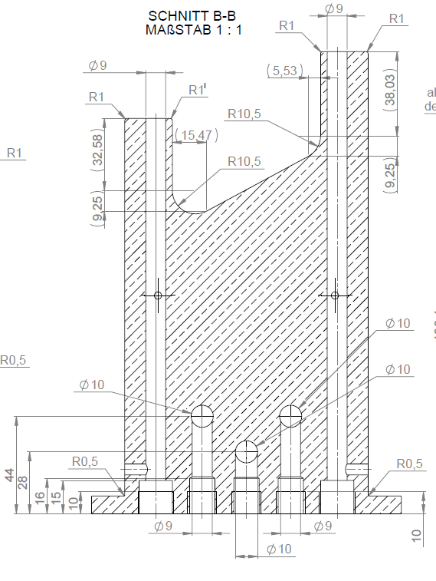
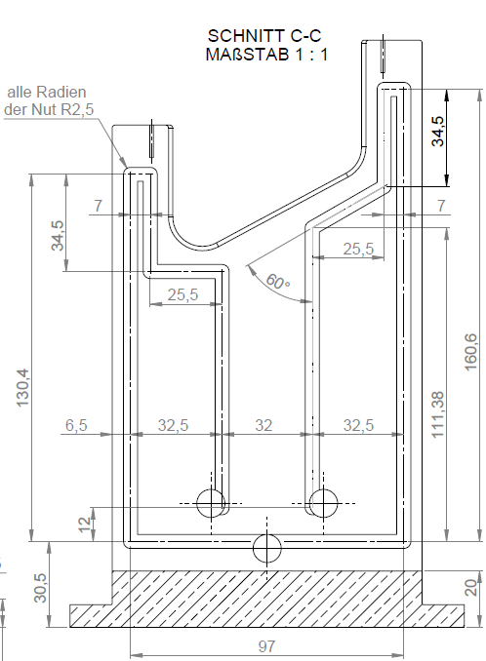
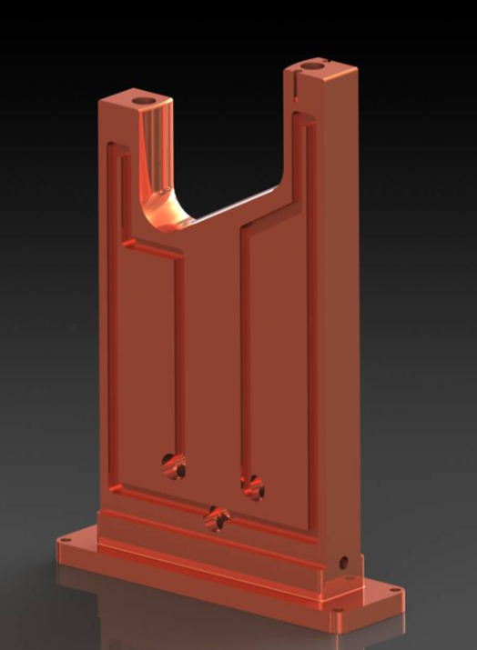
Stem Design 176 MHz RFQ

Slide 9
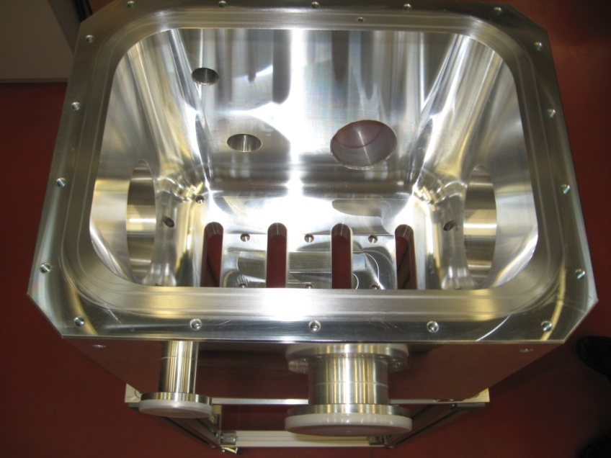
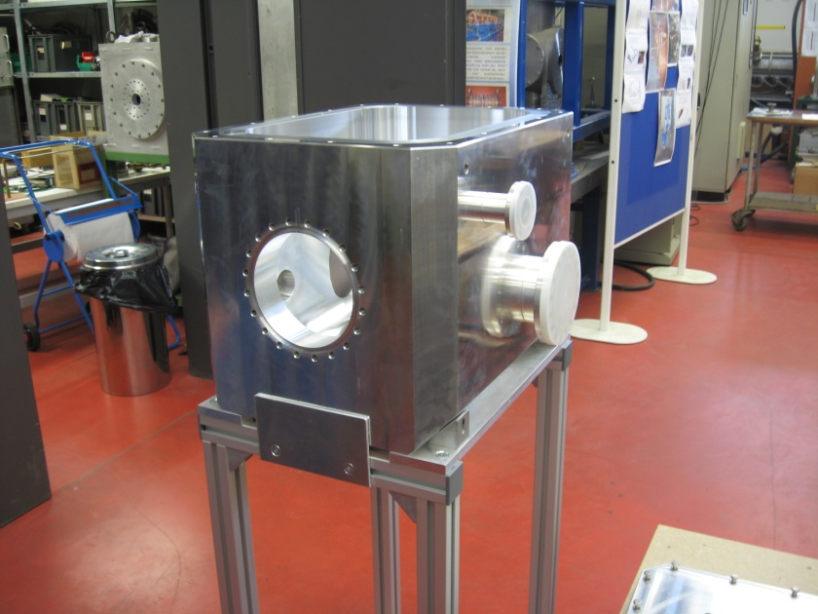
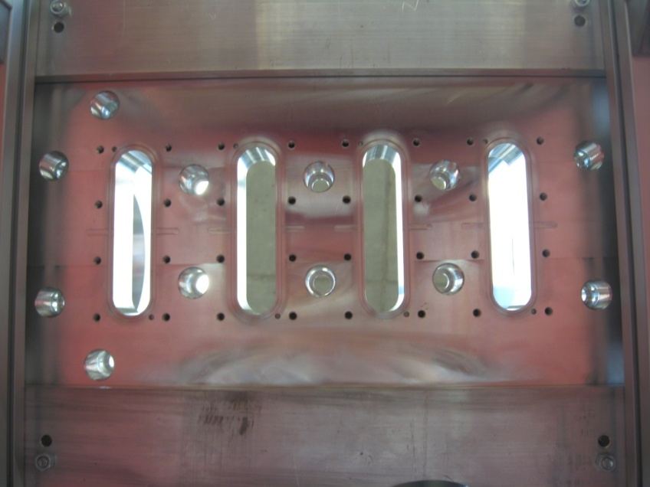
RFQ test cavity for thermal analysis
P/L up to 40 kW/m

Slide 10
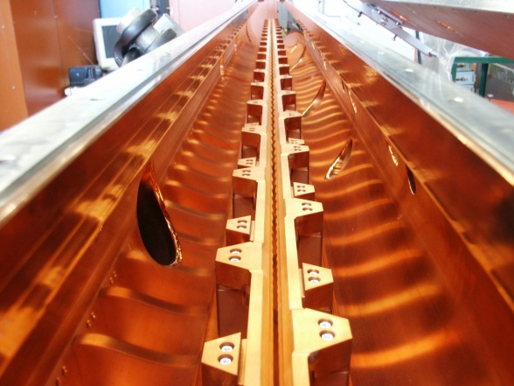
High Power cw-RFQ 50 kW/m thermal power load
(A. Schempp, IAP, A. Bechtold, NTG)

Slide 11
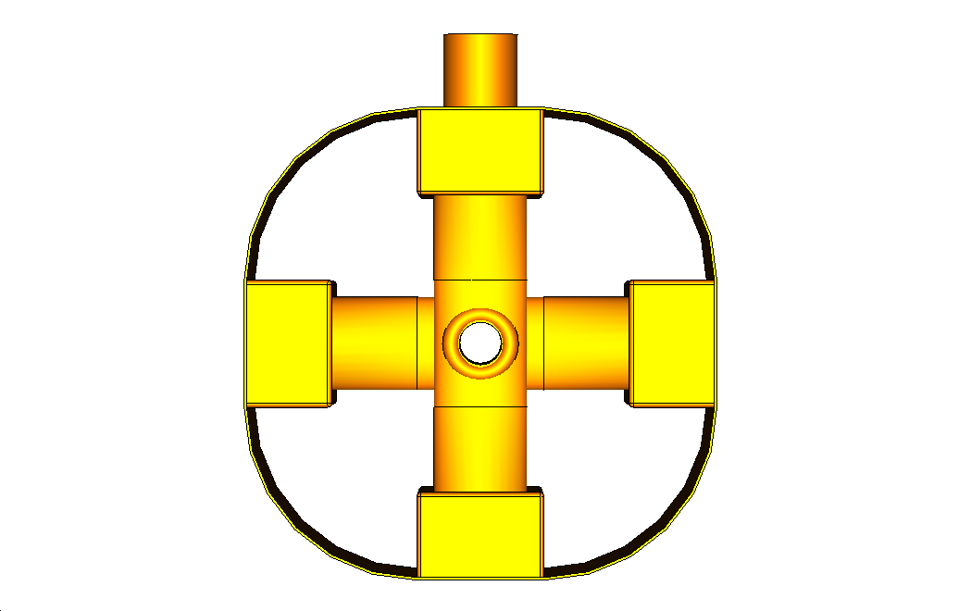
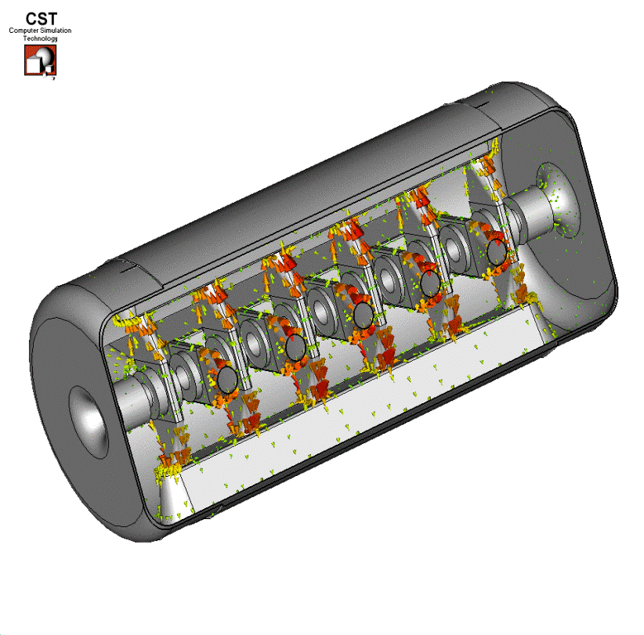
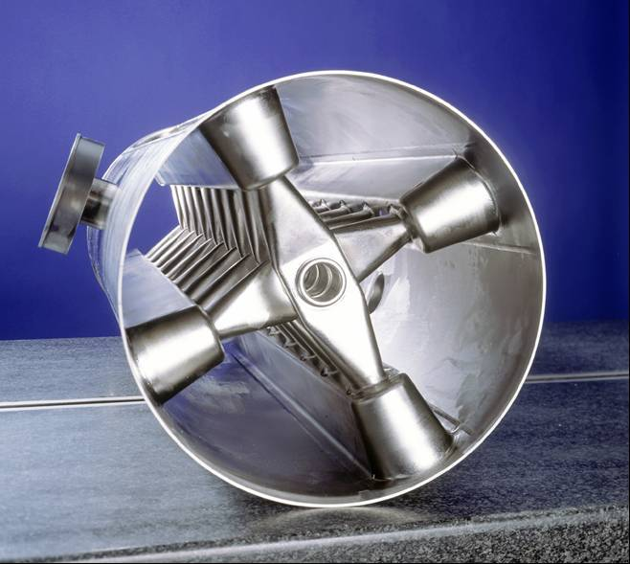
CH-Cavities
CH-Structure
Crossbar-H-Mode-Structure
rt or sc multi-cell cavity
KONUS or EQUUS Beam Dynamics

Slide 12
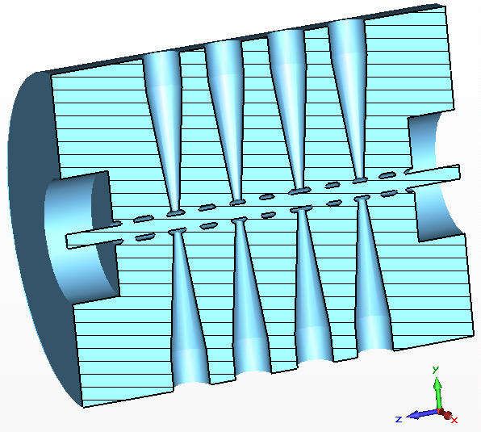
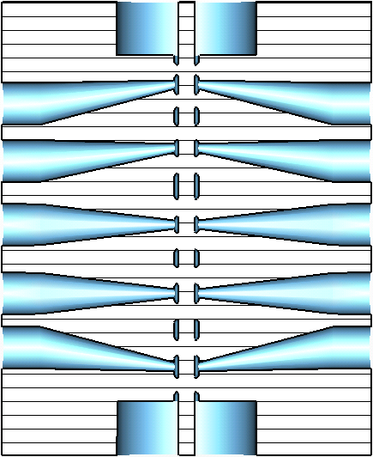
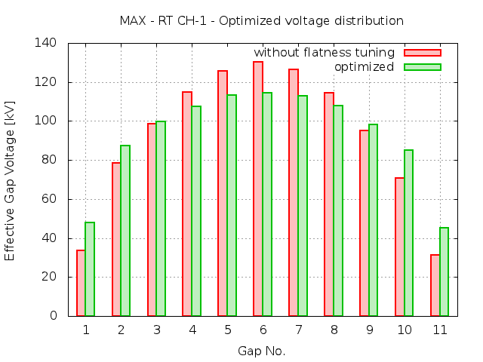
rt CH cavities
Dominik Mäder
Notes:
Schwingkreis
Design CH1/2 abgeschlossen
Einbuchtungen für Tripletts
H211 mode

Slide 13
MAX CH-Prototype (rt)
Notes:
Aufbau eines Teststandes

Slide 14
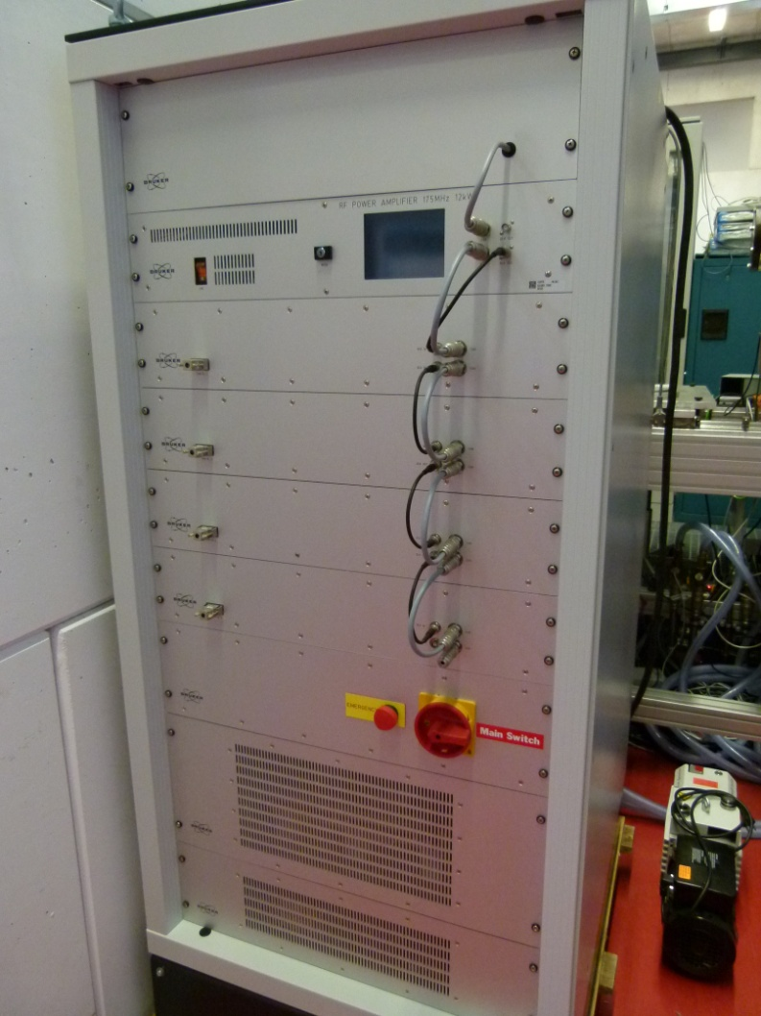
Parameters MAX CH-Prototype (rt)
Parameter | Unit | Value
RF Structure | --- | CH
Frequency | MHz | 175
Duty cycle | % | 100
Length (inner) | mm | 382.5
Diameter | mm | 674.6
Aperture diameter | mm | 24
Effective voltage | kV | 325
Q-value (90% MWS) | --- | 12300
Z_{eff} (90% MWS) | MΩ/m | 70
P_{c} | kW | 5
P max | kW | 12
P/L max | kW/m | 40
Notes:
Aufbau eines Teststandes

Slide 15
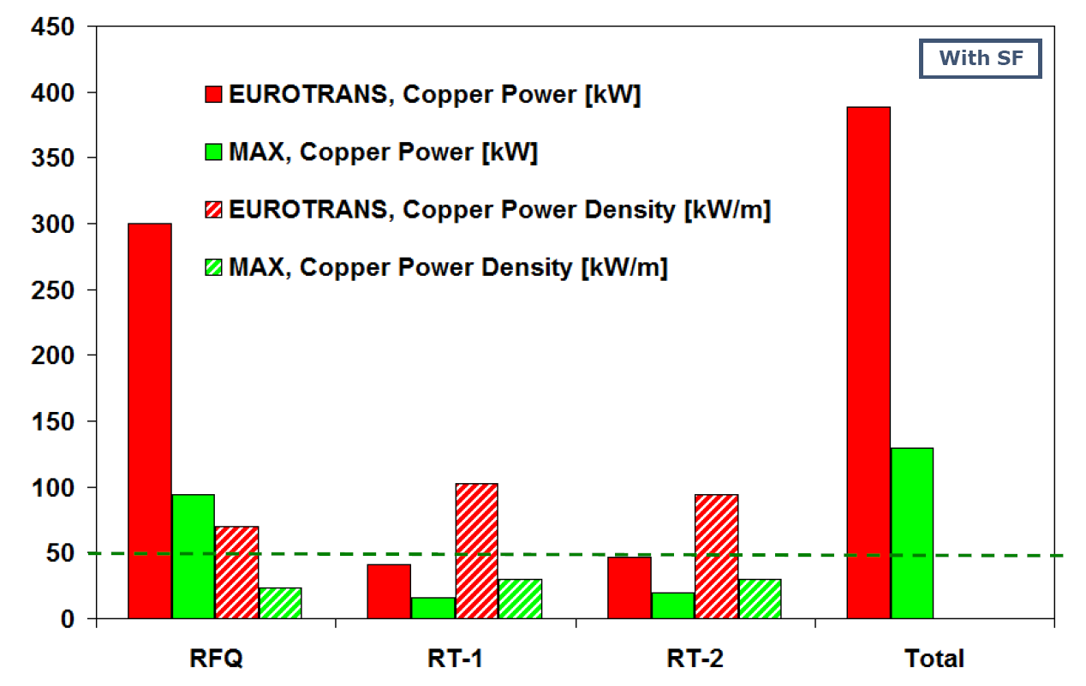
RT Part: Comparison RF Power
Notes:
Aufbau eines Teststandes

Slide 16
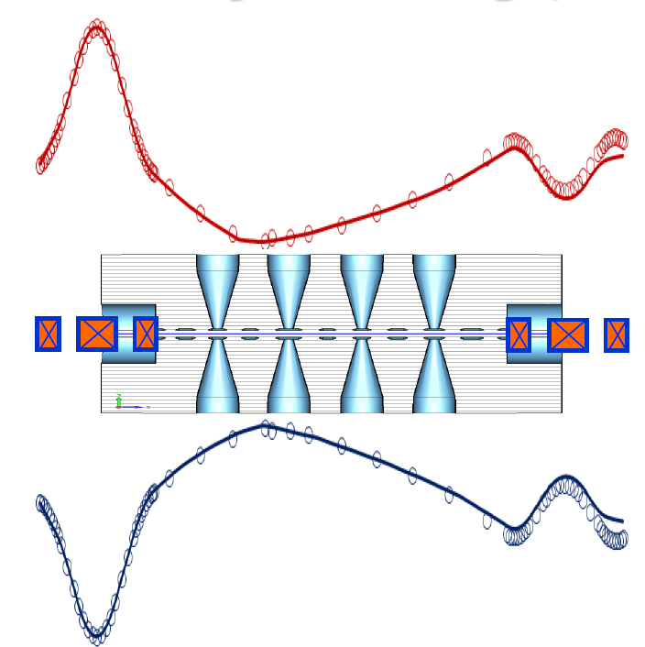
Code Benchmarking (LORASR-WINTRACE)
LORASR
WINTRACE
Notes:
Aufbau eines Teststandes

Slide 17
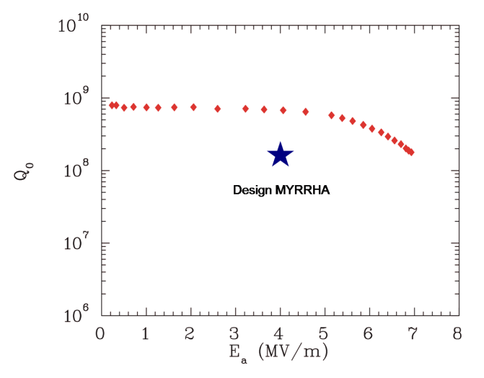
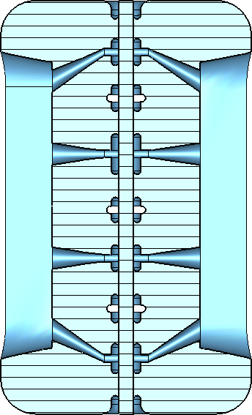
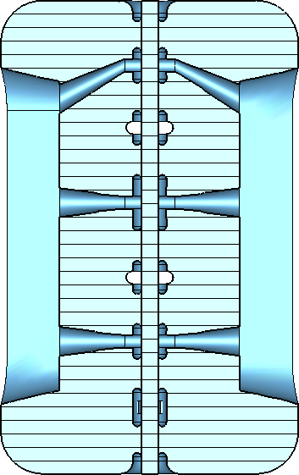
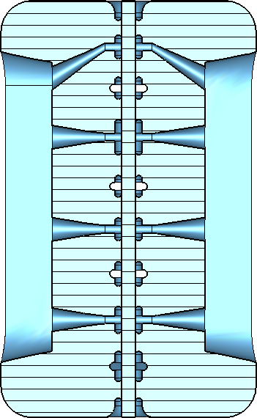
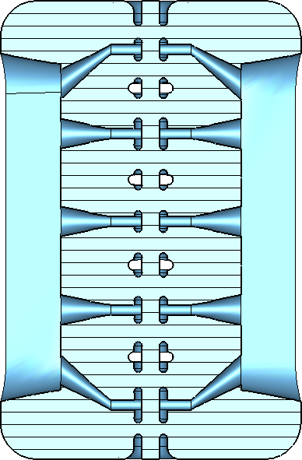
MYRRHA sc CH cavities
First CH (sc) prototype
CH5
CH6
CH4
CH3
Notes:
Peakfelder, Statistikprogramm
Predesign CH4-CH6
Rippen, mechanische Stabilität
CH3 → CH6, weniger Spalte, weniger Kapazität, größerer Radius (Thomsonsche Schwingungsforme))
KONUS Strahldynamik, Rebunching & Beschleunigen

Slide 18
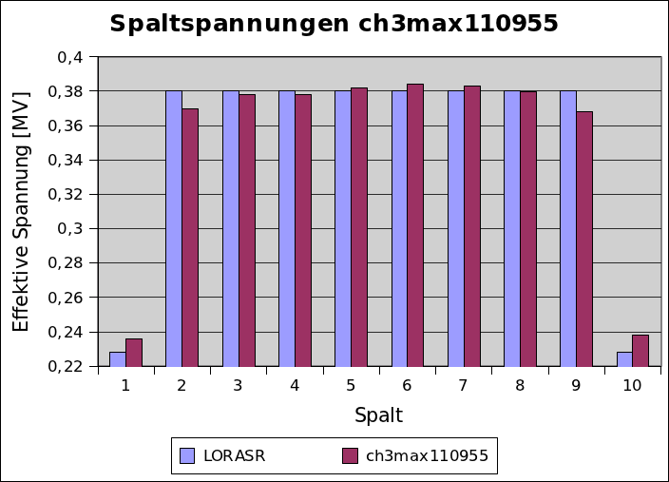
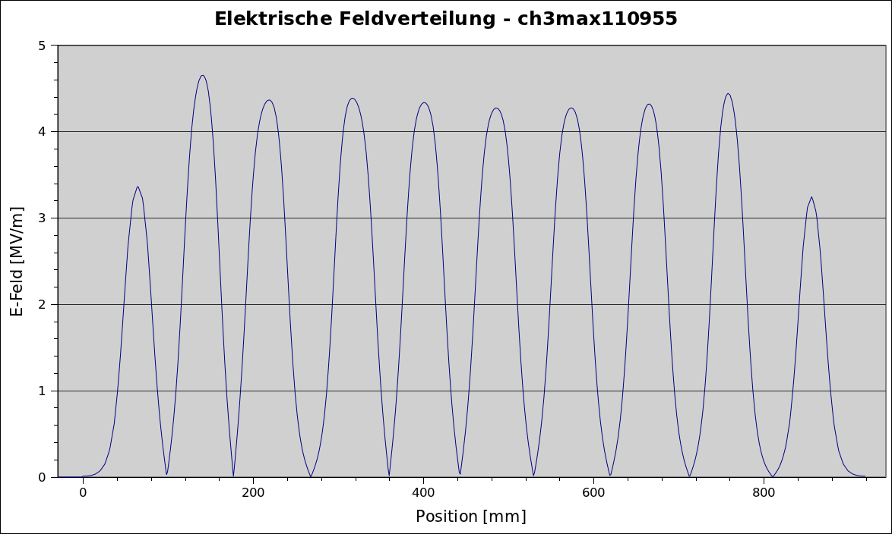
Field Distribution – Gap voltage
1. sc CH-cavity
Notes:
Vorgabe und erreichte Verteilung
Elektrische Spitzenfelder
residual resistance ratio (RRR)
impurities
crystal impurities
surface impurities (condensed gases)
buffered elecropolishing
buffered chemical polishing
multipacting
secondary electron emission
thermal breakdown

Slide 19
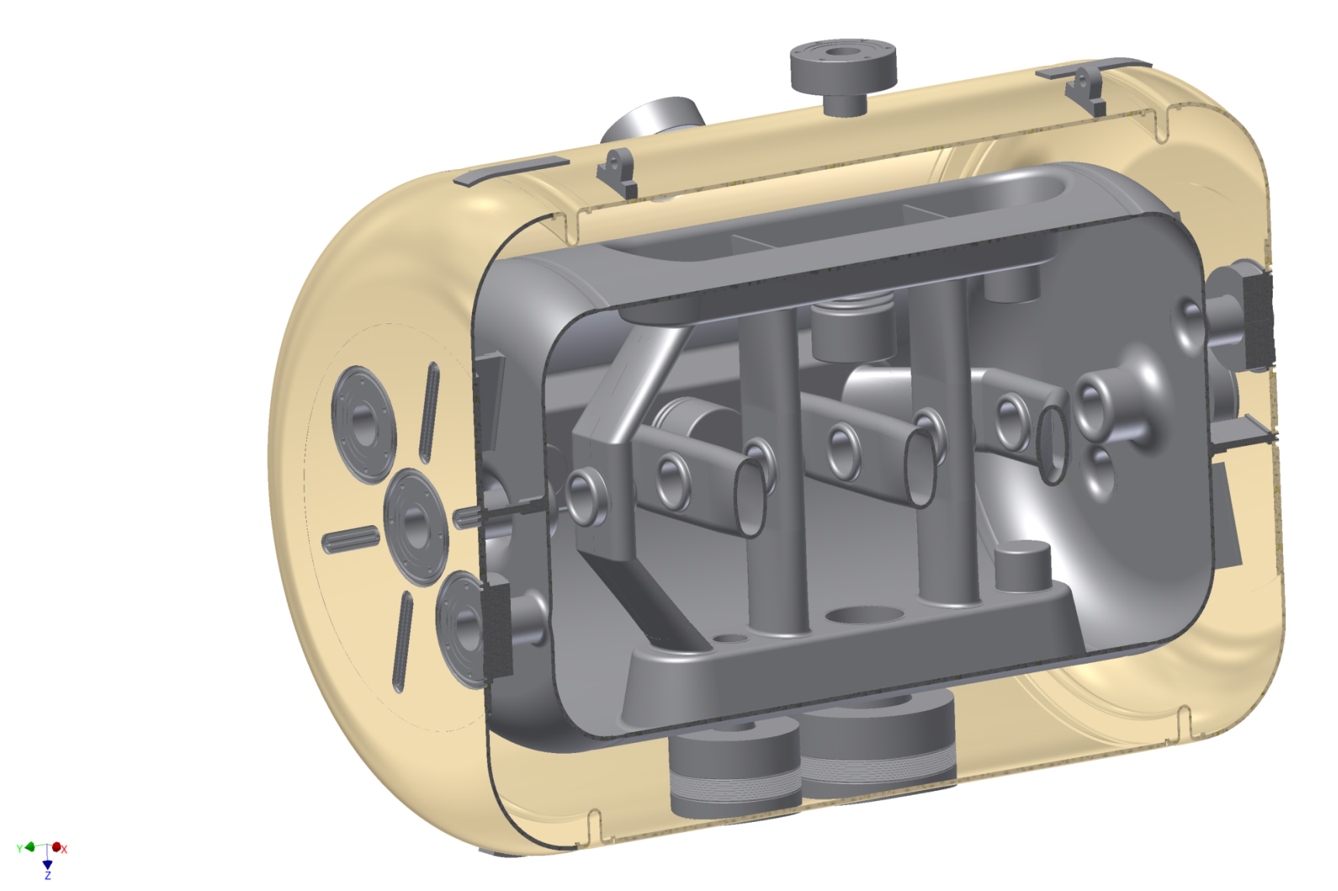
325 MHz CH-Prototype
β | 0.1545
Frequency (MHz) | 325.224
Cells | 7
Length βλ-def (mm) | 505
Diameter (mm) | 348
E_{a} (MV/m) | 5
E_{p}/E_{a} | 5.1
B_{p}/E_{a} [mT/(MV/m)] | 13
G (Ω) | 64
R_{a}/Q₀ (Ω) | 1248
R_{a}R_{s} (Ω²) | 80000
Bellow Tuner
Static Tuners
Praparation Flanges
Helium Vessel
Coupler Flanges

Slide 20
Strategy to Hit the Frequency
Bad circumstances:
Countermeasures:
fabrication inaccuracy (Δf = ? MHz)
thermal shrinkage (Δf ≈ +450 kHz)
pressure sensitivity (Δf ≈ +200 kHz)
surface preparation (Δf = ? kHz)
underground noise (Δf = ± 50 Hz)
helium bubbles
tank / end cell offset 10 mm (Δf ≈ ±1 MHz)
static tuners (Δf ≈ +1.3 MHz, -2.2 MHz)
slow bellow tuners (Δf ≈ ±250 kHz)
fast bellow tuner (Δf ≈ ± 700 Hz)

Slide 21
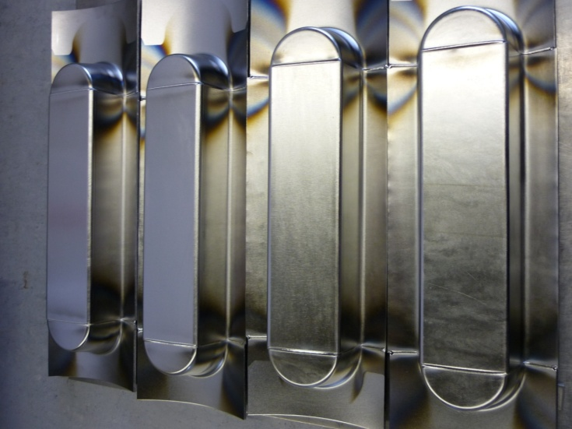
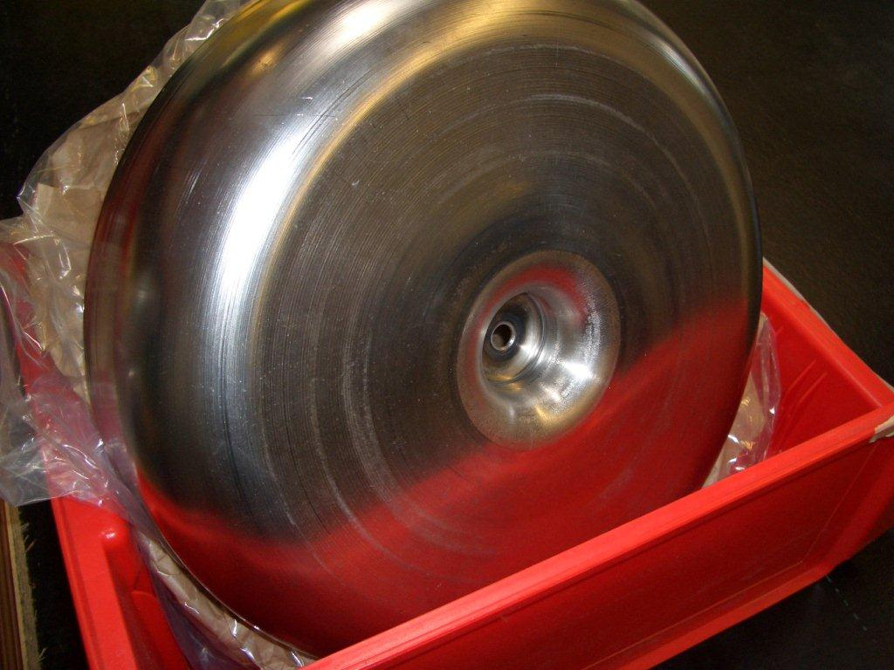
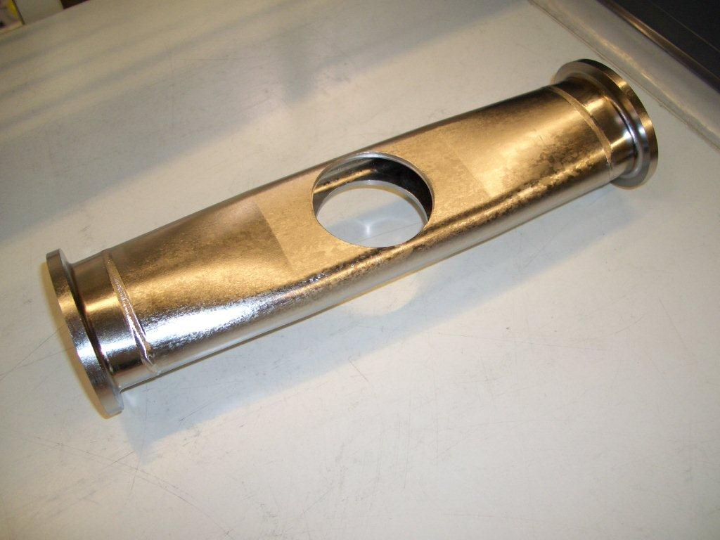
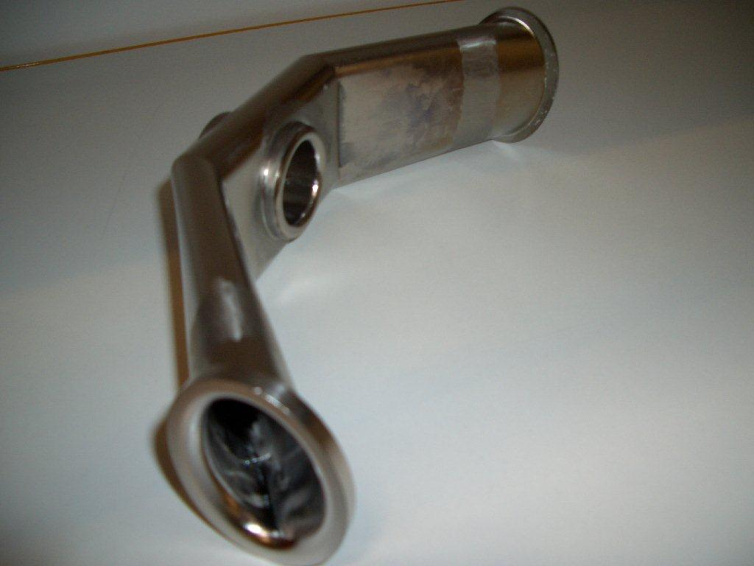
Cavity Fabrication

Slide 22
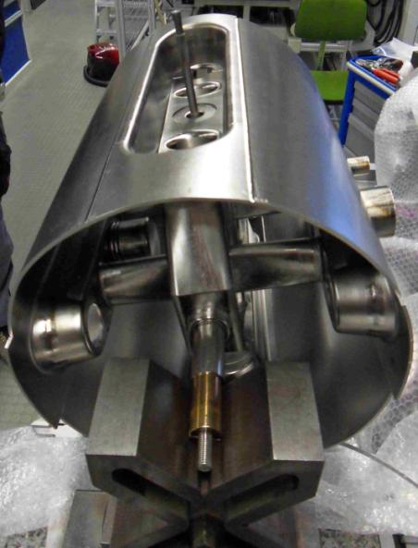
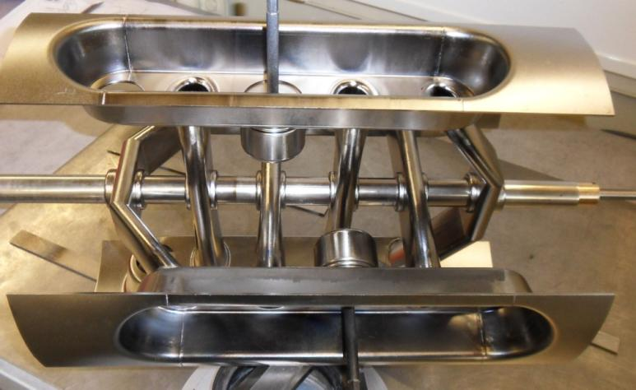
Cavity Fabrication

Slide 23
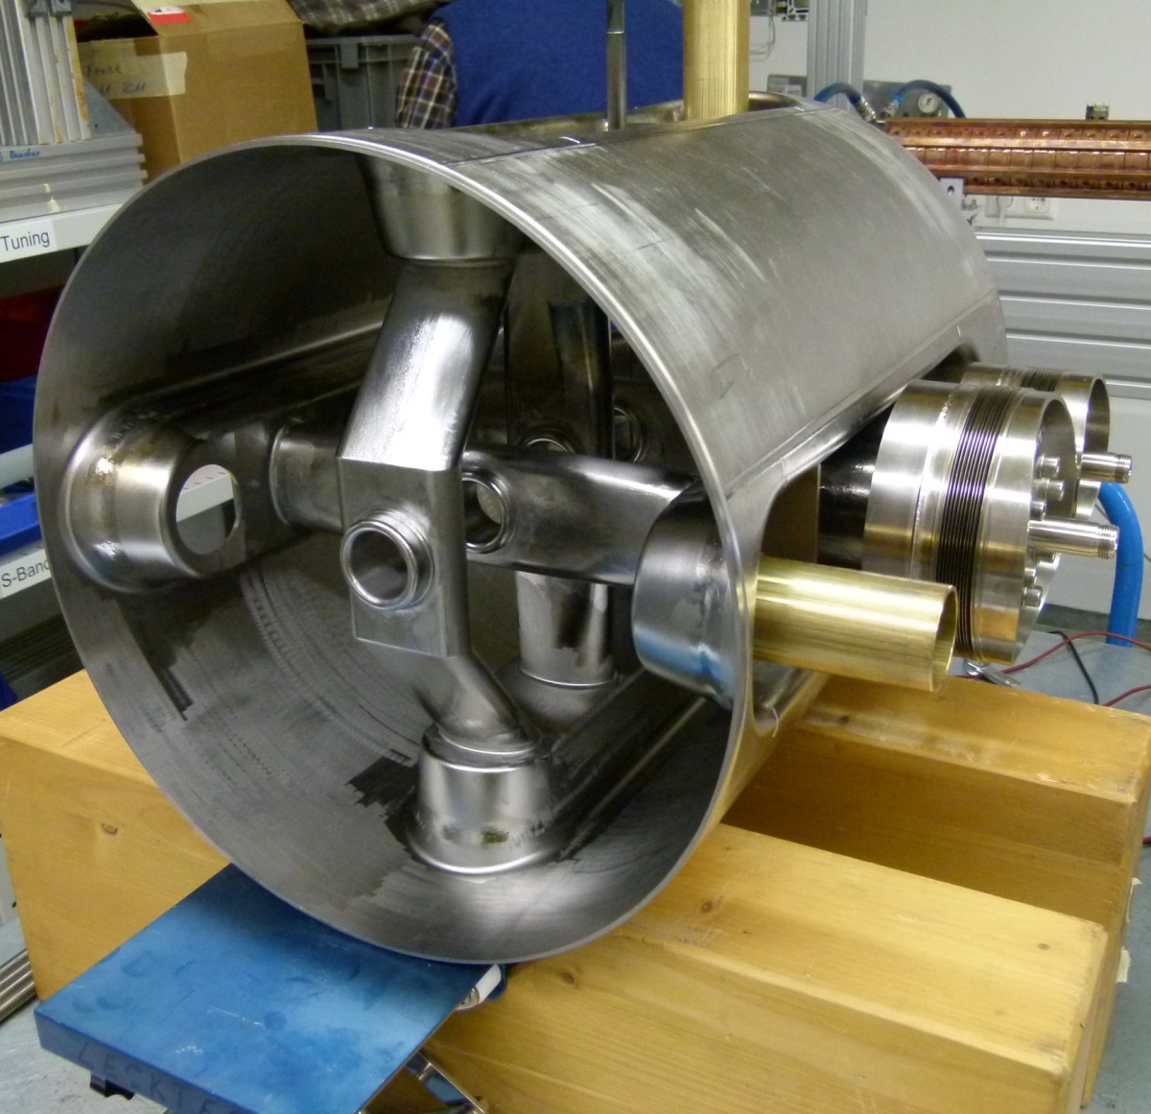
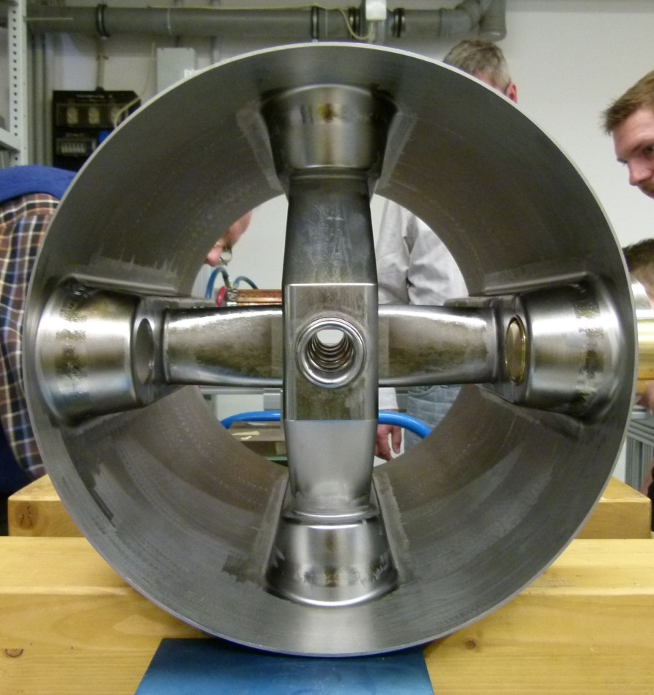
325 MHz CH-Prototype

Slide 24
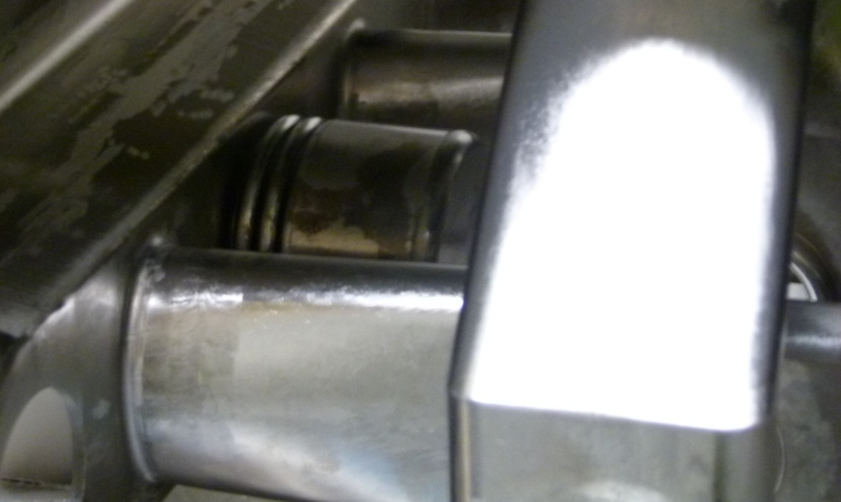
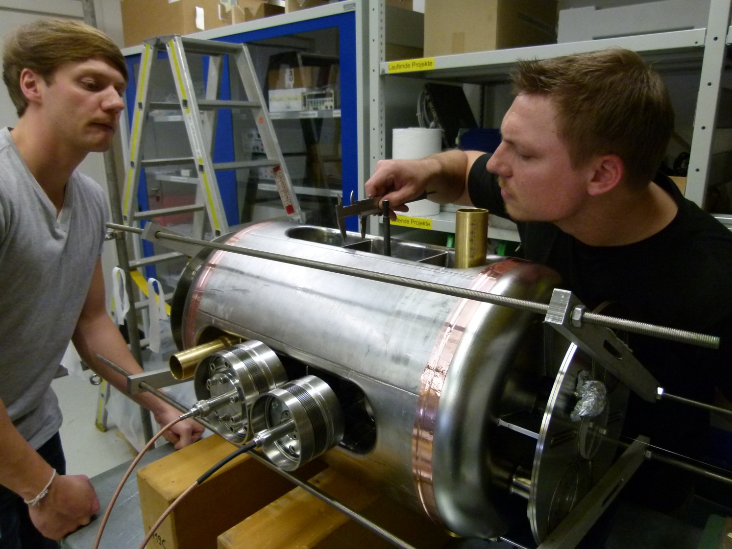
325 MHz CH-Prototype

Slide 25
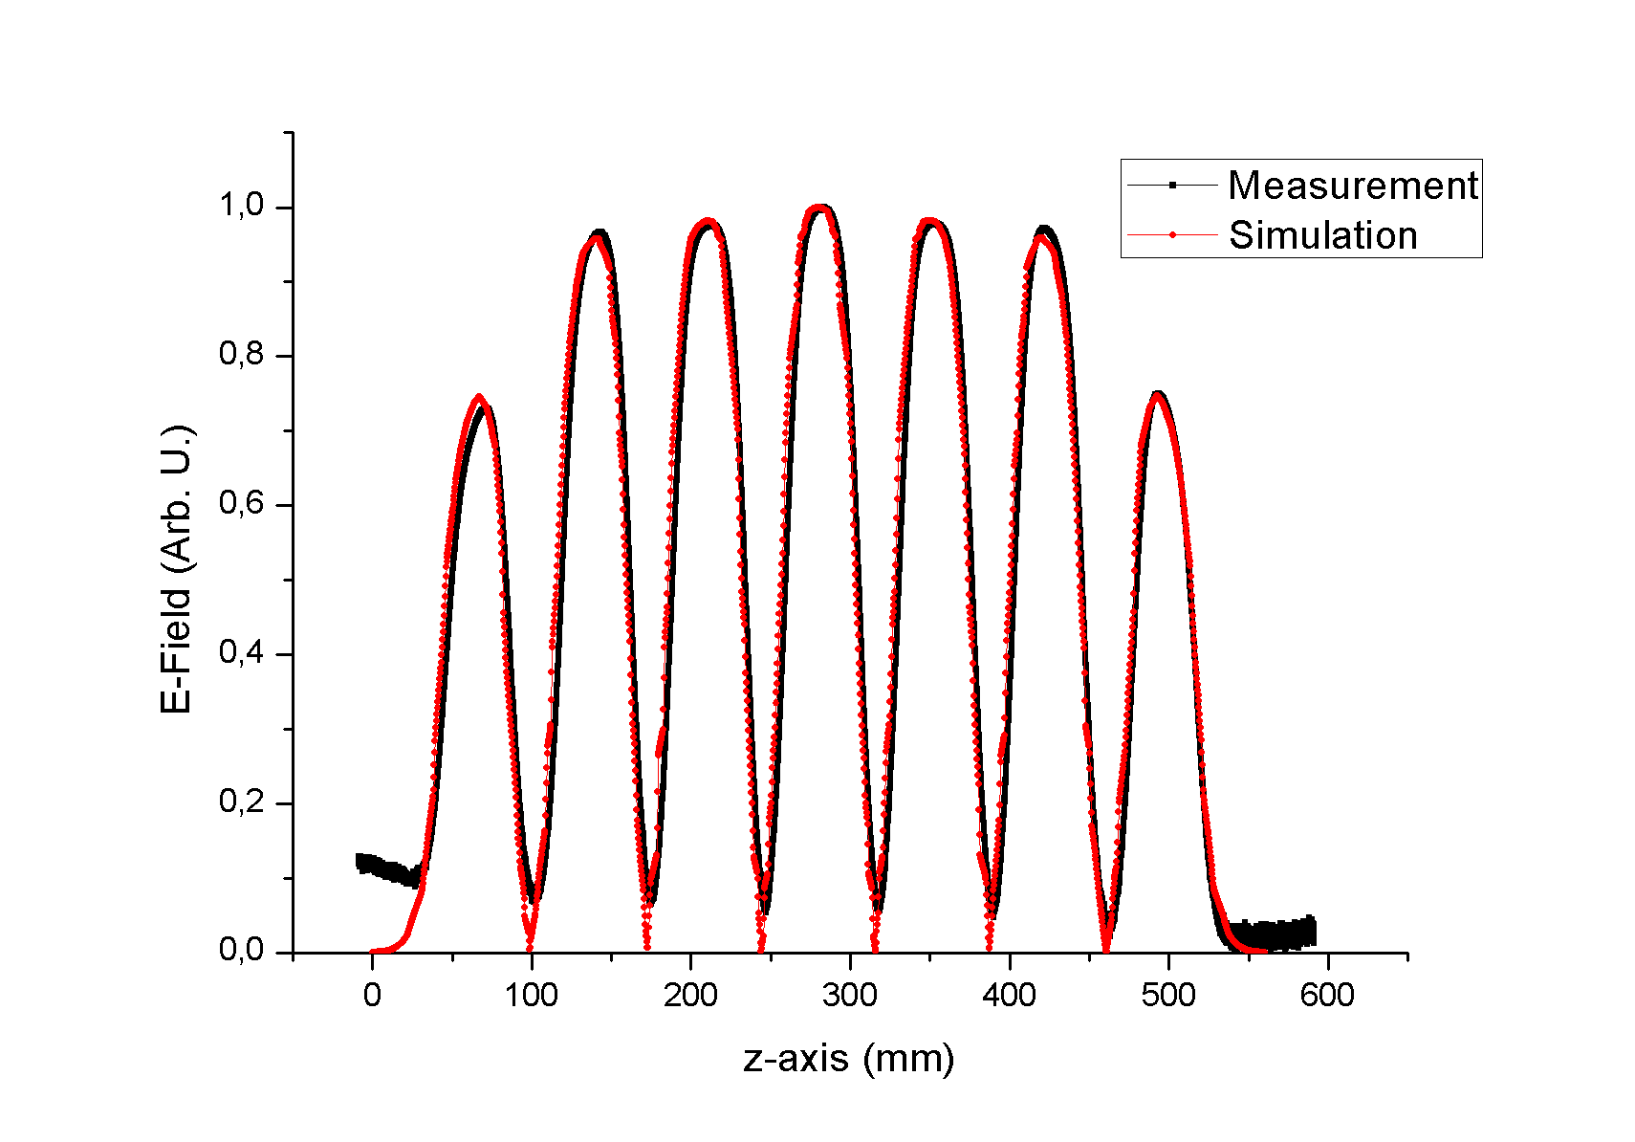
325 MHz CH-Prototype: First Measurements

Slide 26
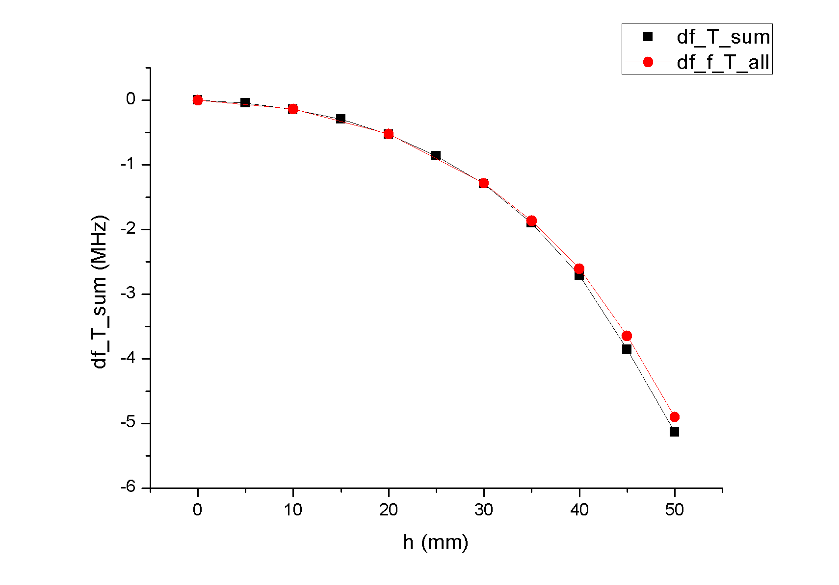
325 MHz CH-Prototype: First Measurements
Design Position
Deviation from Design frequency:
500 kHz < 0.2%

Slide 27
Future GSI/FAIR Injector Complex
f=217 MHz
A/q<6.5
9 sc CH-cavities
E_{a}=5 MV/m
U_{tot}=35 MV
Sc Solenoids (8T)
cw Linac I

Slide 28
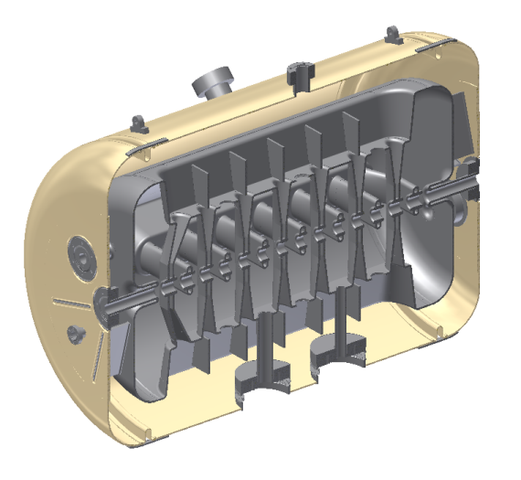
cw SHE-Linac Demonstrator
Cavity construction has started April 2012
Tuner flange
Main parameters of the 217 MHz CH-structure
Parameter | Unit | CH-1
Beta |  | 0.059
Frequency | MHz | 216.816
Gap number |  | 15
Total length | mm | 687
Cavity diameter | mm | 409
Cell length | mm | 40.82
Aperture | mm | 20
U_{a} | MV | 3.369
Energy gain | MeV | 2.97
Accelerating gradient | MV/ m | 5.1
E_{p}/ E_{a} |  | 6.4
B_{p}/ E_{a} | mT/ (MV/m) | 5.4
R/ Q | Ω | 3320
Static tuner |  | 9
Dynamic bellow tuner |  | 3
Helium vessel
Preparation
flange
Inclined
end stem
Pickup flange
Coupler flange
3D-view of the 217 Mhz cavity with helium vessel, without tuners

Slide 29
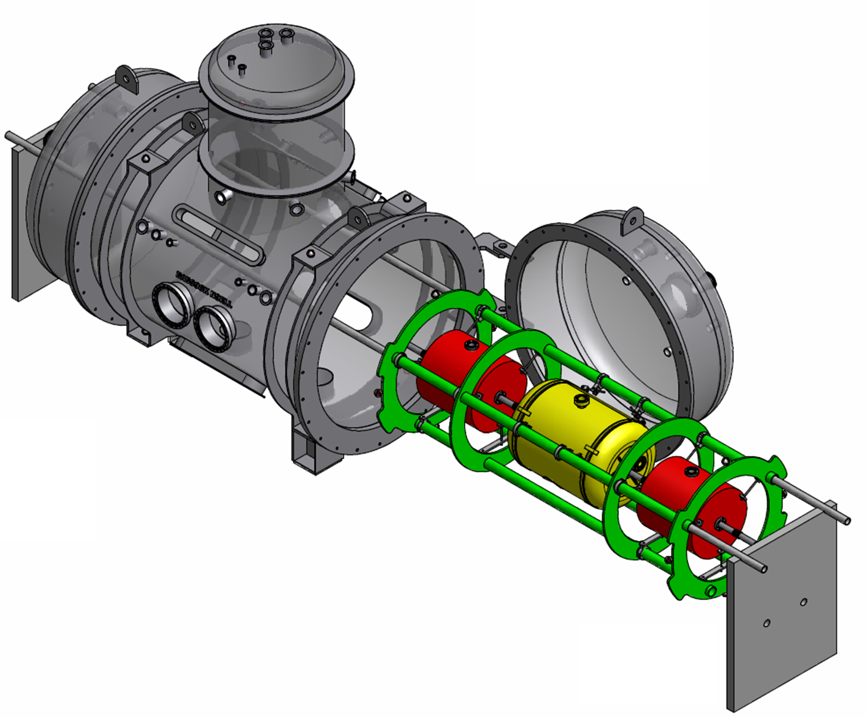
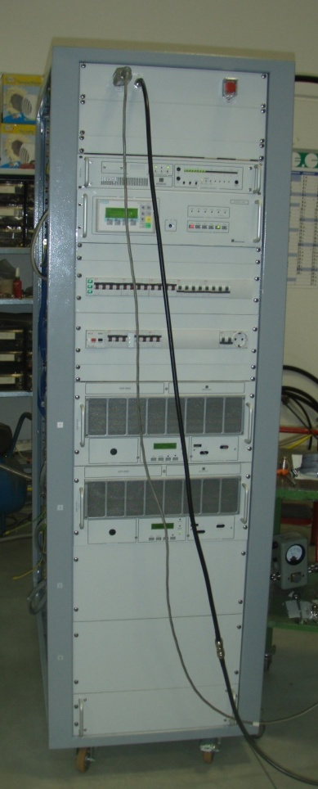
cw Linac Demonstrator
First sc CH-cavity will be tested with beam at GSI
β=0.059, f=217 MHz, 15 cells
RF power 5 kW (10 kW)
Cryo module and sc solenoids ordered
Cryo module
sc solenoids
CH-cavity

Slide 30
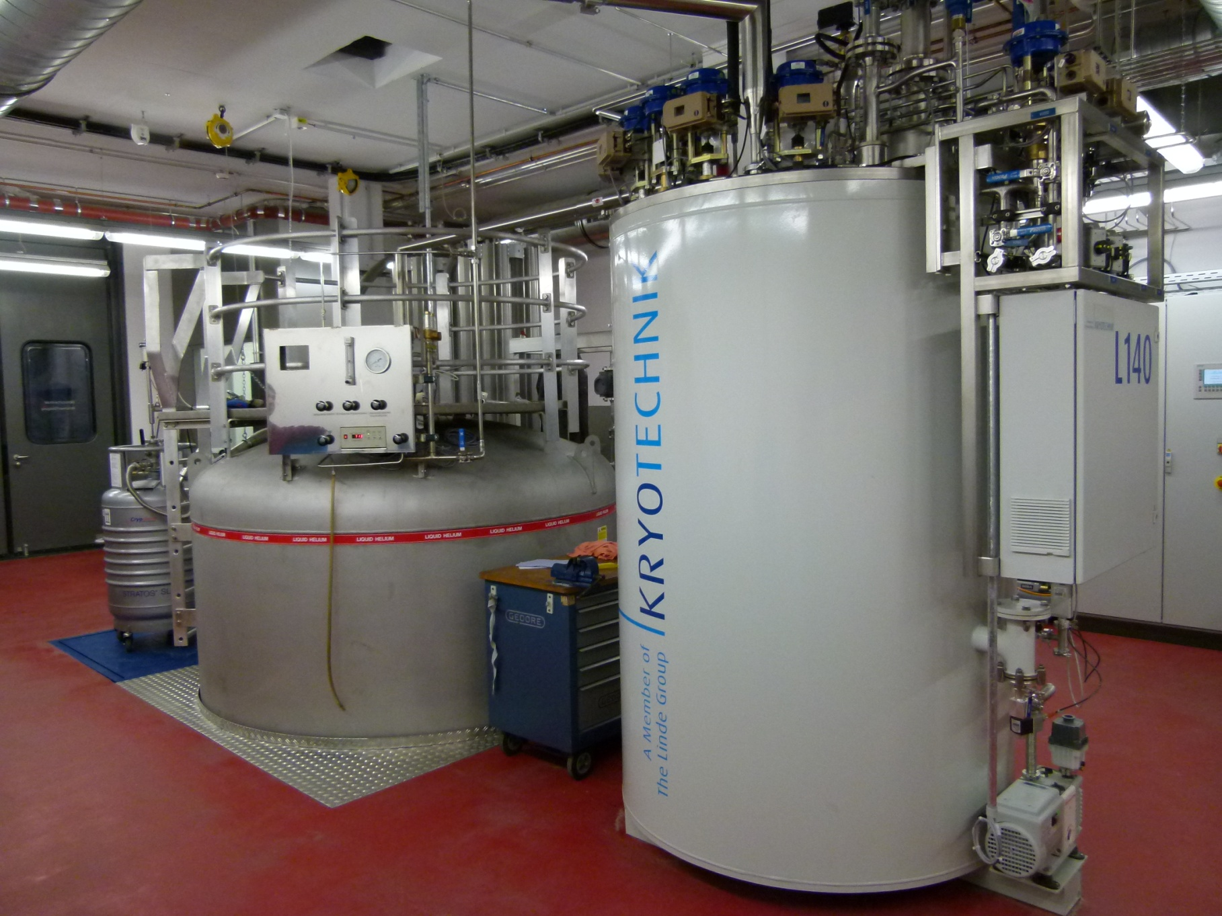
Infrastructure at IAP Frankfurt
Clean room 100/10000
Vertical cryostats (400mm, 600mm, 900mm diameter)
Horizontal cryostats
Amplifiers
Refrigerator
And everything you need for cavity testing
Linde L140 liquifier, 90 l lHe/hr @ 4K

Slide 31
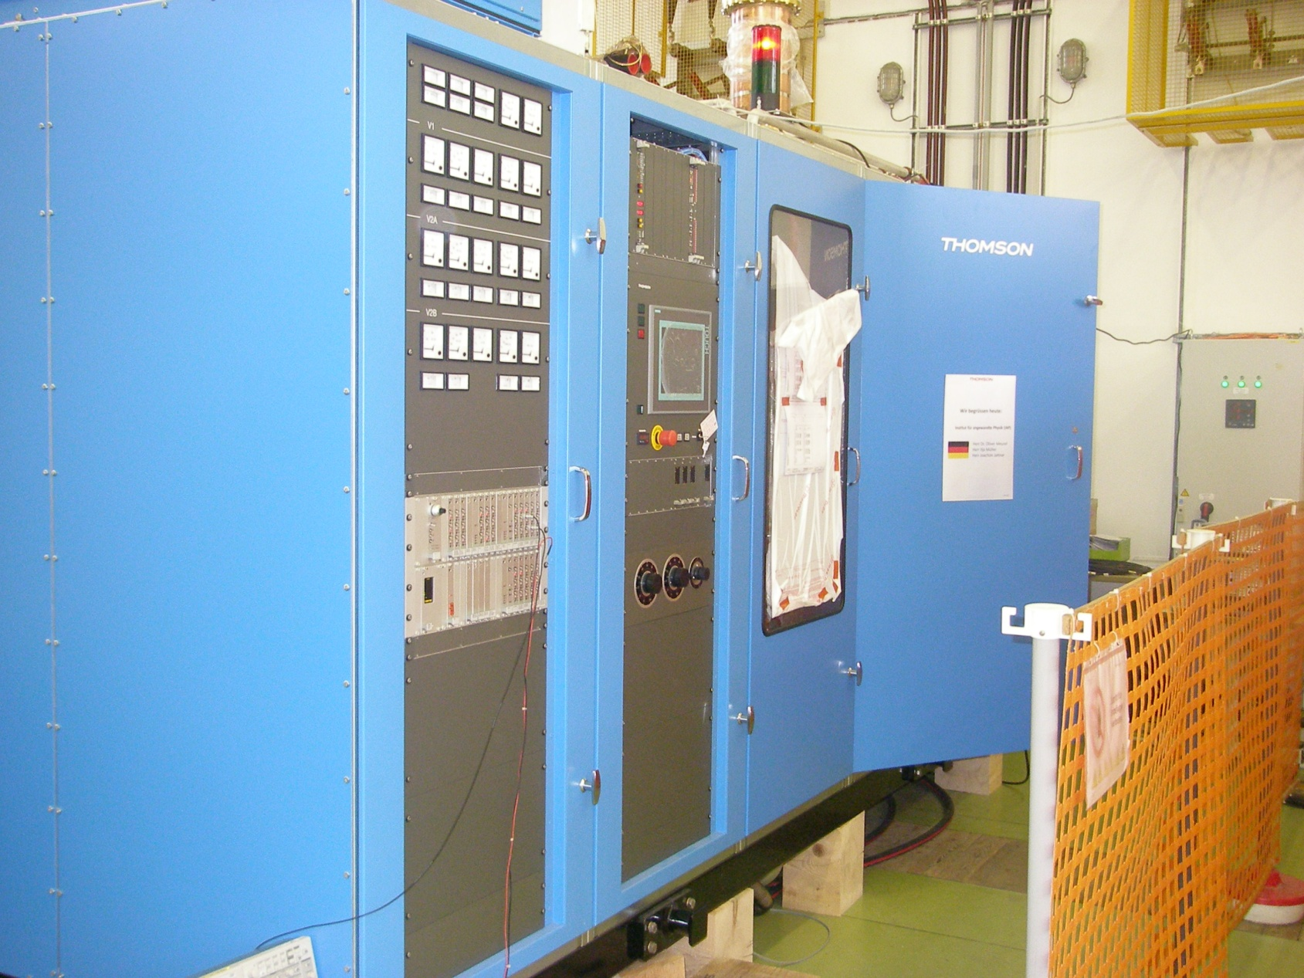
Amplifiers
175 MHz, 300 kW, cw
175 MHz, 12 kW, cw
108 MHz, 100 kW, 10%
87.5 MHz, 18 kW, cw
217 MHz, 5 kW, cw
330-370 MHz, 2 kW, cw
325 MHz, 40 kW, 1%
100-400 MHz, 500 W, cw
Notes:
Aufbau eines Teststandes

Slide 32
Next Steps
Tests of rt CH-cavity (RF+Beam)
Tests of sc CH-cavities (RF+Beam)
Coupler Test Stand
Test of RFQ-Protoype (RF)
Design of Cryomodule
Construction and Test of 4-Rod RFQ (RF+Beam)
Notes:
Aufbau eines Teststandes

Slide 33
Summary
Frequency of MYRRHA Injector changed from 352 to 176 MHz
4-Rod RFQ 1.5 MeV
2 rt CH-cavities as booster (1.5-3.5 MeV)
4 sc CH-cavities for main acceleration (3.5-17 MeV)
For required reliability two injectors are foreseen
Prototypes will be tested with beam
Notes:
Aufbau eines Teststandes

