Slide 1
Cavity Vertical Test and Diagnostics
Second Open Collaboration Meeting on Superconducting Linacs for High Power Proton Beams (SLHiPP-2)
Kitty Liao
kitty.liao@cern.ch

Slide 2
Cavity Vertical Test and Diagnostics
    Introduction
    Second sound studies & quench analysis
    Thermometric system design & development
    Summary & future work
Kitty Liao CERN BE-RF-SRF

Slide 3
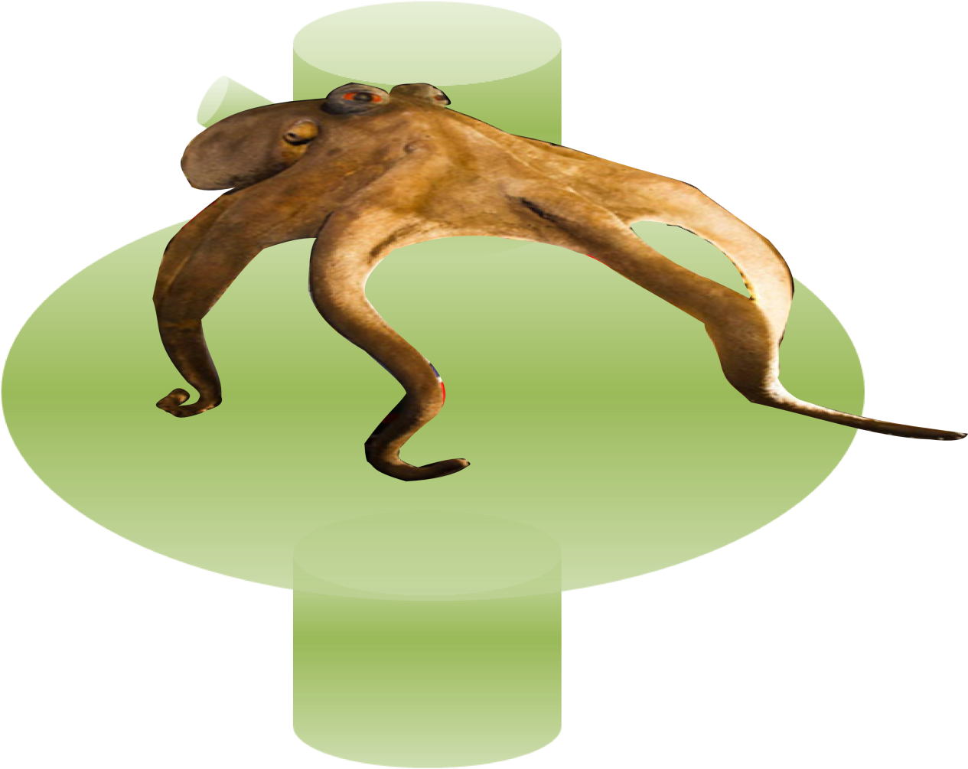
I. Introduction –
Diagnostics system
hot (quench) spot
II. second sound
OST
III. octopus
optical inspection
OSTs
(Oscillating Superleak Transducer)

antenna (RF)
Second sound wave
Quench
spot
Optical inspection camera
(J. Chambrillion)
Kitty Liao CERN BE-RF-SRF

Slide 4
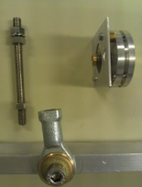
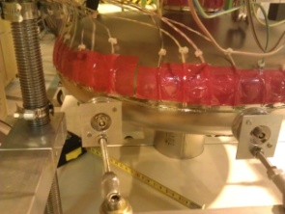
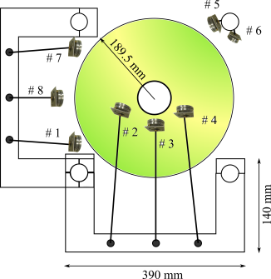
II. Second sound Study on the SPL test cavity
Setup
27 SMD heaters –
iris, equator, half cell area
8 OSTs
SMD heaters
OST
Result
heaters not in the coverage angle of an OST – no signal so far
need to resolve – heater attachment on the cavity
Kitty Liao CERN BE-RF-SRF

Slide 5
II. Cavity Quench Analysis discussion 1
Cavity quench at 3.1 MV/m (during helium processing), 2 K
second sound v~ 16.8 m/s
Repeated quench OST capture (10 data in 40 mins)
6 μs to go to max acc field:
8.6 MeV/m
28 μs breakdown time
Kitty Liao CERN BE-RF-SRF

Slide 6
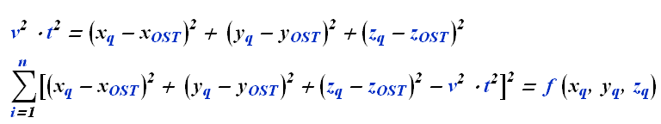
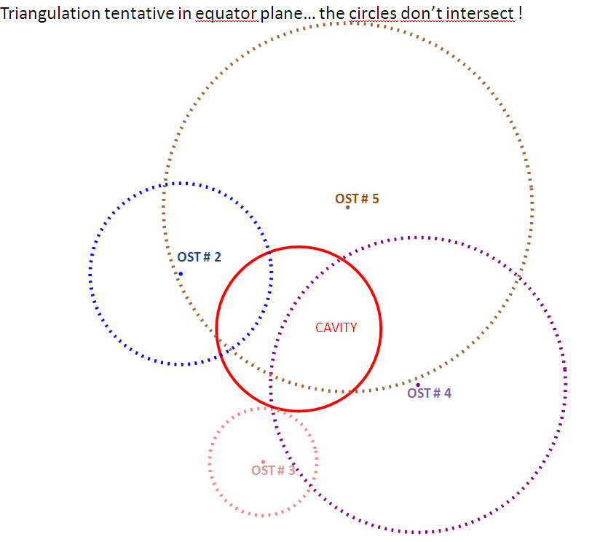
II. Where is the hot spot?
why? no intersection?
minimisation method & quench on cavity
~ 2 K (16.77± 2 m/s)
time-of-flight too short
same problem among labs (Saclay, Fermilab, DESY)
(x_{OST,} y_{OST,} z_{OST})
(x_{q,} y_{q,} z_{q})
courtesy of Juliette Plouin
Kitty Liao CERN BE-RF-SRF

Slide 7
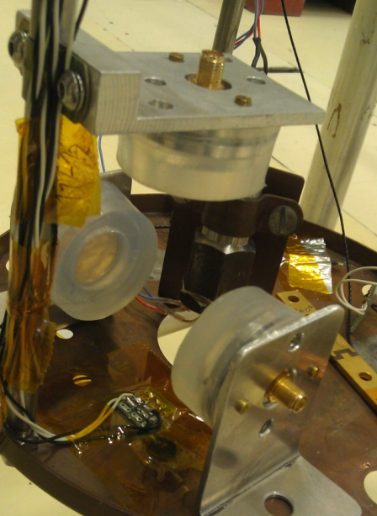
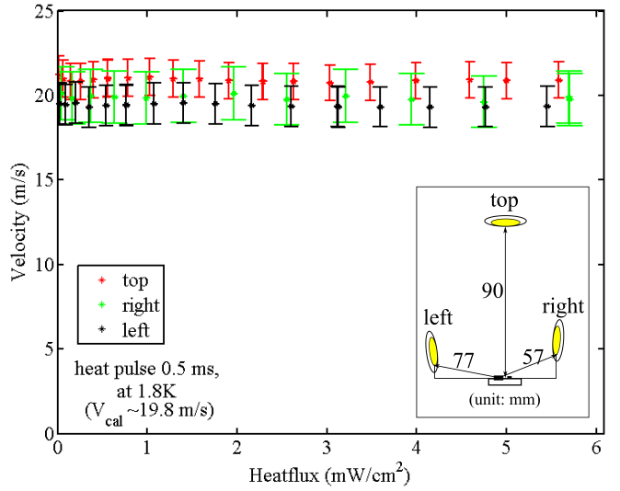
II. Search for “Fast Second Sound”
- discussion 2
0.5 ms pulse, 1.8K,
max. heatflux= 6mW/cm^{2,} max. power = 6W;
our quench power ~ 9 kW
breakdown time ~ 28 μs
the top OST receives faster signal than the side ones. (within 2nd sound measurement error)
→ need a more appropriate source!
Kitty Liao CERN BE-RF-SRF

Slide 8
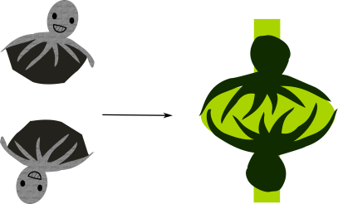
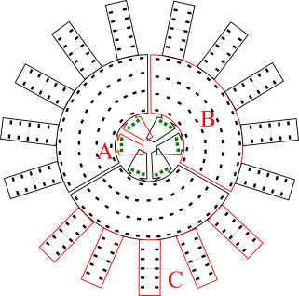
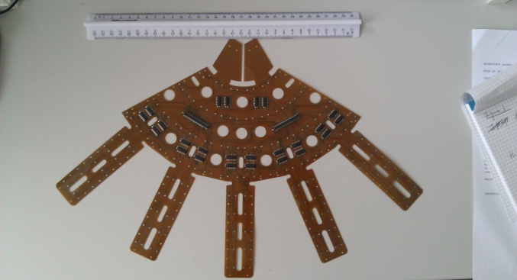
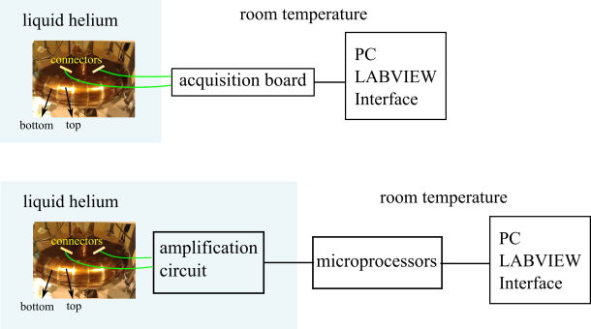
III. Design & Development
Octopus Thermometric System
A. Iris – diodes
B. main body –Allen-Bradley resistors (100Ω, 1/8W, ΔR/ΔT≈ 758 Ω/K); resolution 20 mm ~ 34 mm
C. equator region – Allen-Bradley resistors; resolution: max. 23 mm
Kitty Liao CERN BE-RF-SRF

Slide 9
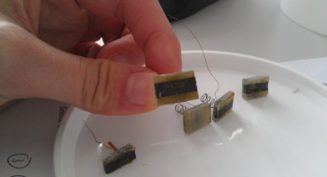
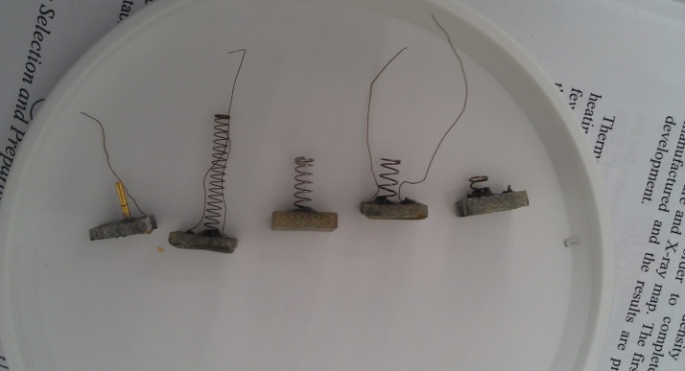
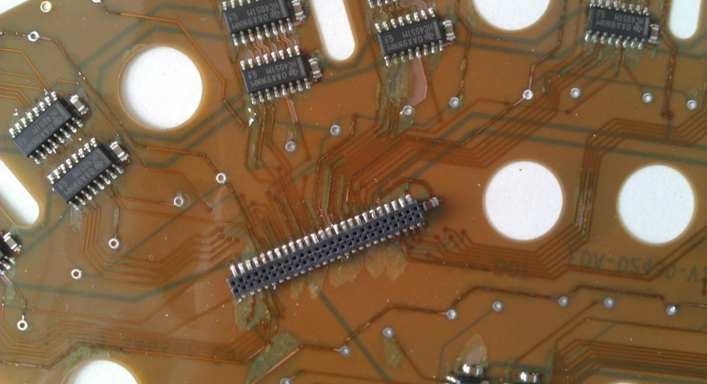
III. Octopus Thermometric System
Fabrication – Octopus assembly
Without and with spring support test
2nd PCB fabrication & flux cleaning investigation
mounting of AB sensors (96)
Kitty Liao CERN BE-RF-SRF

Slide 10
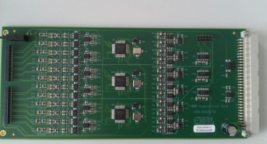
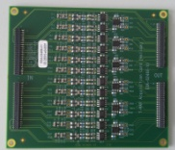
III. Octopus Thermometric System
Fabrication – Acquisition board
0 Ω resistor -- bypass the amplification circuit
 | Resistors | MUX | µc boards
1/3 octopus | 96 | 24 | 3
Half cell | 288 | 72 | 9
Complete cavity | 576 | 144 | 18
Kitty Liao CERN BE-RF-SRF

Slide 11
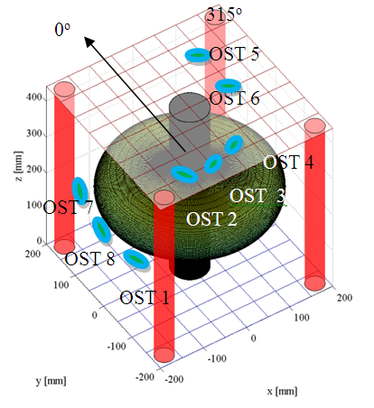
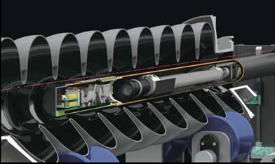
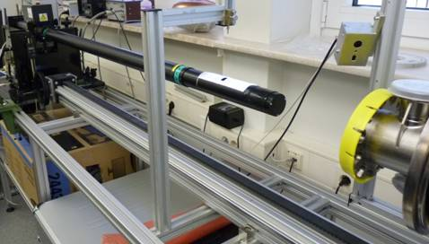
III. Octopus Thermometric System – Software Development
Microprocessor programme - acquisition
LABVIEW programme
optimal mode- integration of
    Temperature maps in 3D
    Second sound triangulation (MATLAB)
    Optical inspection data
Kitty Liao CERN BE-RF-SRF
courtesy of Janic Chambrillion

Slide 12
IV. Summary & Future work
Second sound | Octopus thermometry
Appropriate source for simulating a quench event Second sound studies to be continued for explaining physics and phenomenon in real quench test Cavity quench test | Programmes to be done and test with 2 boards (in and outside helium) Allen-bradley sensors fabrication PCB fabrication LabView program
Kitty Liao CERN BE-RF-SRF

Slide 13
Acknowledgements
Cryogenics team in SM18 & Cryolab
Second sound – P. Zhang, Murakami, Tsukuba University
Quench results discussion -J. Plouin, Saclay
T-mapping – Iwashita, KEK
Colleagues of the RF group, Wolfgang Weingarten
Kitty Liao CERN BE-RF-SRF

Slide 14
Q & A
Thank you very much
Kitty.Liao@cern.ch
Kitty Liao CERN BE-RF-SRF

Slide 15
Cavity Vertical Test and Diagnostics
Back up slides
Kitty Liao
Kitty Liao CERN BE-RF-SRF

Slide 16
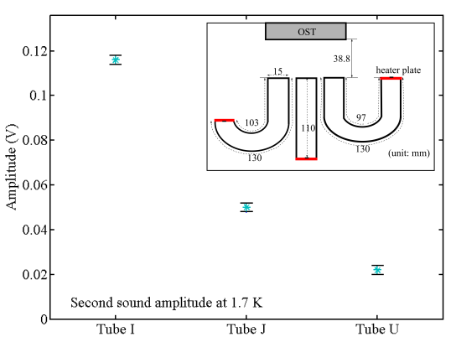
II. Second Sound Studies
Distance variation
amplitude max at ~ 9 cm
attenuated by 60% at 18 cm
Tube measurement
bending tube receives signal
smaller amplitudes
applicable for complicated structure with quench spots
Kitty Liao CERN BE-RF-SRF

Slide 17
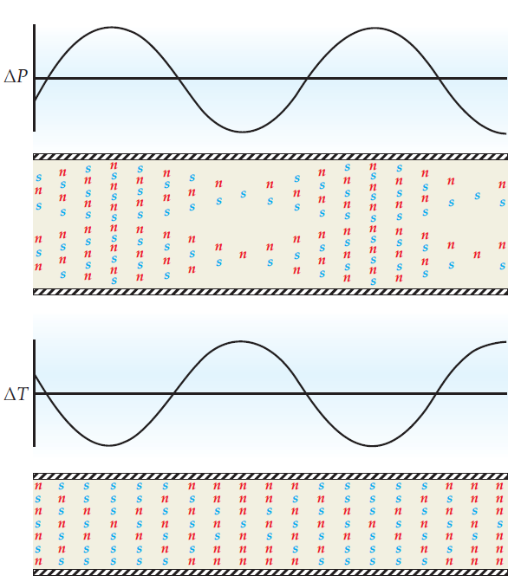
Second sound extra
Helium →Lambda point 2.17K → superfluid He
2 fluid model
normal component + superfluid component
1st sound: n, s in phase
Fluctuation in density, by changes of pressure
Normal fluid
Entropy, viscocity
Bose-Einstein condensate
2nd sound: n, s out of phase
With no entropy, no viscosity
Fluctuation in density, by changes of temperature
Source: R. Donnelly. Physics today 2009
Kitty Liao CERN BE-RF-SRF

Slide 18
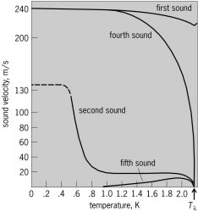
Second sound and first sound below the lambda point
First sound- pressure wave
Second sound- entropy (temperature) wave
Third sound- wave travels in very thin films of helium in which the thickness of the film varies.
Fourth sound- pressure wave travels in superfluid helium. When its confined in a porous material.
Fifth sound- temperature wave that propagates in helium confined in superleaks. (analogous to second sound)
Source: McGraw-Hill Concise Encyclopedia of Physics. © 2002 by The McGraw-Hill Companies, Inc.
Kitty Liao CERN BE-RF-SRF

