Slide 1
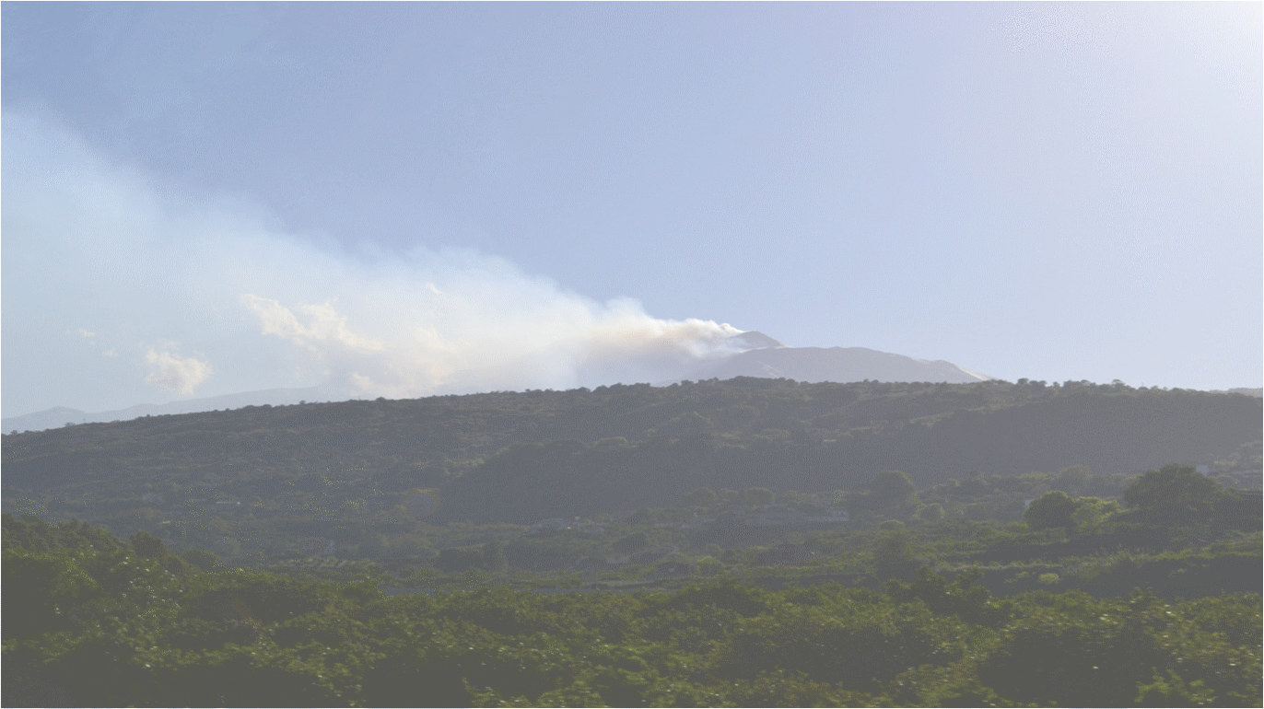
SPL Thermal Studies
R. Bonomi
Superconducting linacs for high power proton beams - SLHiPP2 @ Catania, 2012

Slide 2


Outline
Double-walled tube power coupler
Cold-warm transitions
Table of cryostat heat loads
What’s next

Slide 3
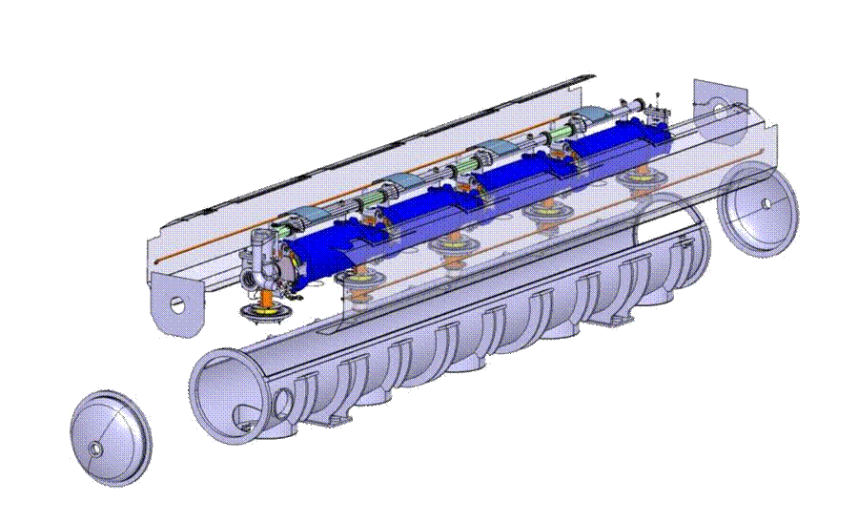
SPL Short Cryomodule overview
courtesy of P. Duthil

Slide 4
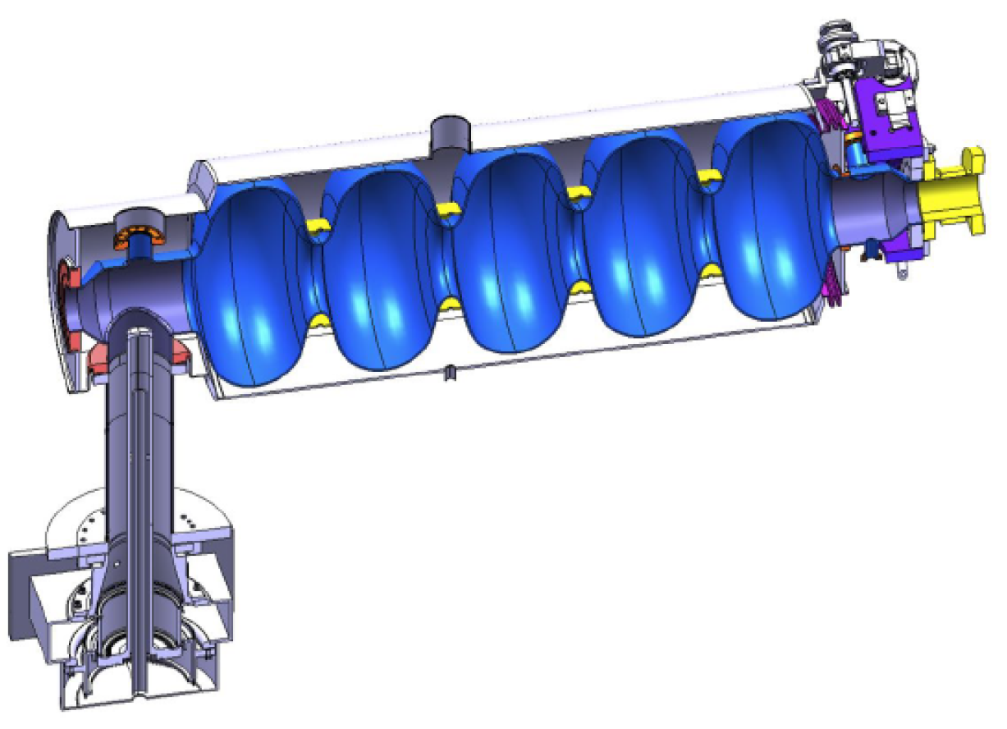
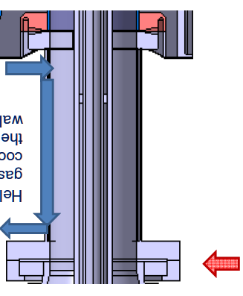
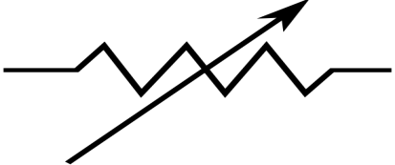
Double-walled tube coupler
Introduction
RF power coupler (coaxial line) for feeding and supporting
Actively cooled (He gas) in order to lower heat in-leaks
courtesy of A. Vande Craen
courtesy of O. Capatina
Notes:
What’s a coupler:
Coaxial line to feed the cavity with RF power
Most importantly it’s actively cooled with He gas in order to keep low thermal in-leaks to the cold mass

Slide 5
Double-walled tube coupler
Analysis
Analysis of thermal performances
  Semi-analytical; steady-state; 3 layers, 1D mesh
Interesting quantities
  Walls and gas temperature profiles
  Heat in-leaks
  Cooling power
  Thermal contractions

Slide 6
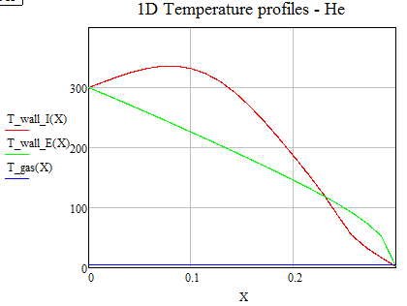
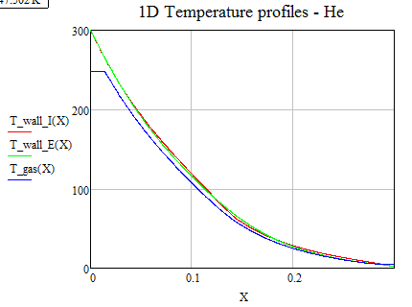
Double-walled tube coupler
Results: temperature profiles
Heat to bath lower than 2 W (instead of > 20 W!)
Contraction (RF off-on) lower than 40 um
RF on,
Cooling off
RF on,
Cooling on
(40 mg/s)

Slide 7
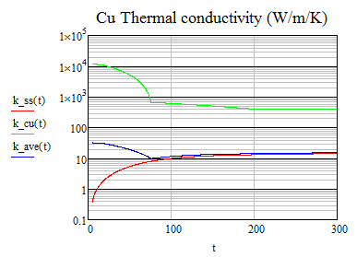
Double-walled tube coupler
With/without temperature drop on cold flange
Outer wall (SS 2 mm):
SS thermal conductivity
Inner wall (SS 1.5 mm + Cu 4 um):
Average SS-Cu thermal conductivity, weighted on thickness
Inlet gas @ 4.5 K | Q bath (W)
RF on, cooling on, cf @ 2 K | 5
RF on, cooling off, cf @ 2 K | 23
RF off, cooling off, cf @ 2 K | 15
RF off, cooling on, cf @ 2 K | 3
RF on, cooling on | < 2 (cf @ 10 K)
RF on, cooling off | 21 (cf @ 88 K)
RF off, cooling off | 12 (cf @ 51 K)
RF off, cooling on | 1 (cf @ 6 K)
Cold flange thermal resistance:
4 K/W

Slide 8
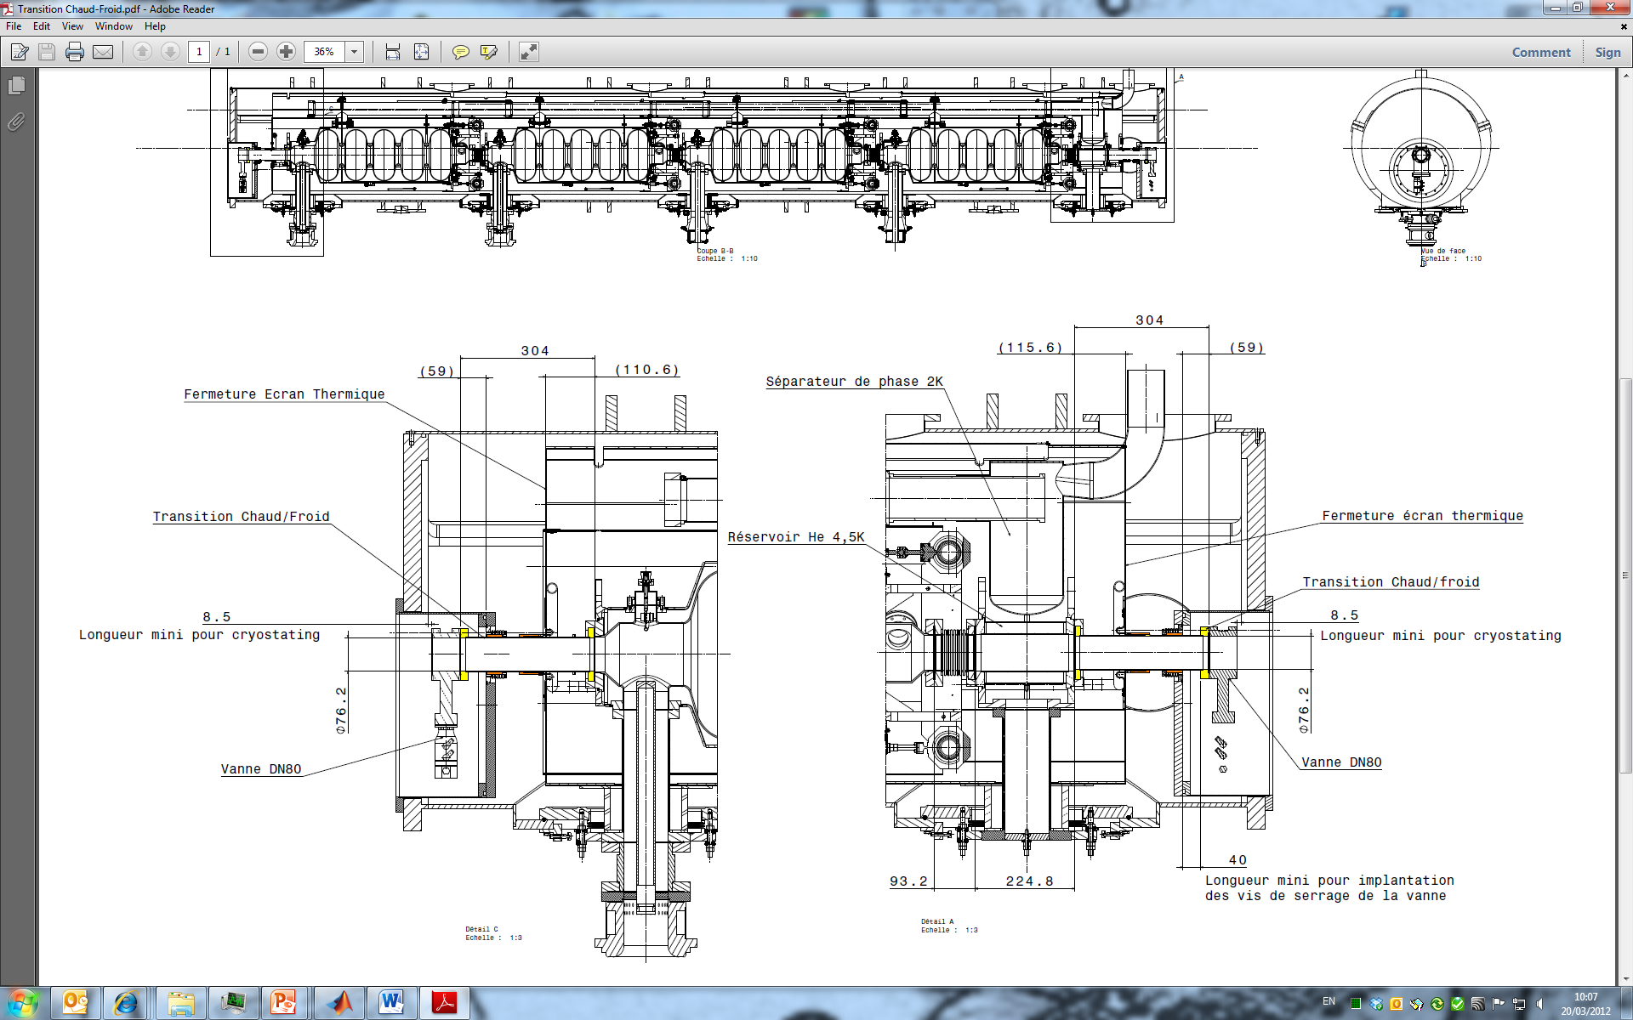
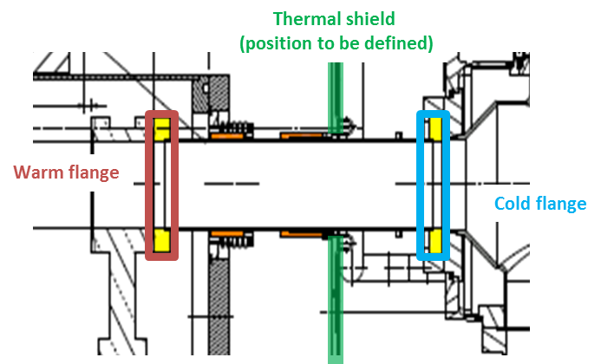
Cold-warm transition
Introduction
Subassembly allowing feedthrough of beam tube from cold to room temperature
(300 K)
(2 K)
courtesy of S. Rousselot

Slide 9
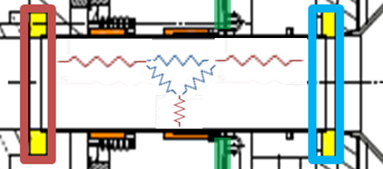
Cold-warm transition
Analysis
Cylindrical enclosure
  2 circular bottom-ends
  1 lateral surface
Radiation
  Equivalent electric
  System of linear equations
Conduction
  Fourier’s law

Slide 10
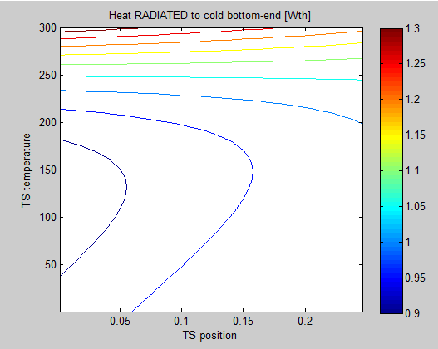
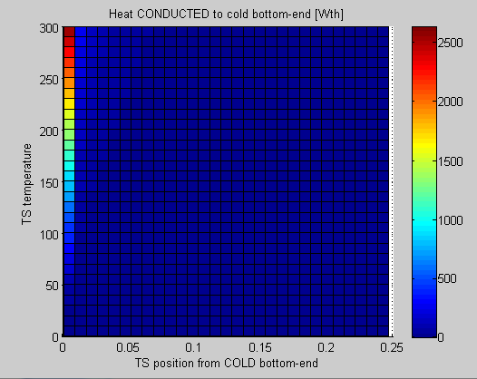
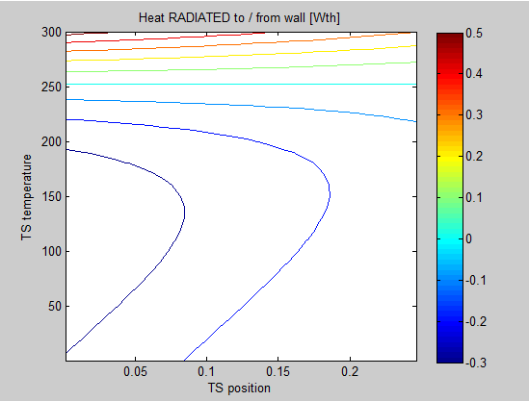
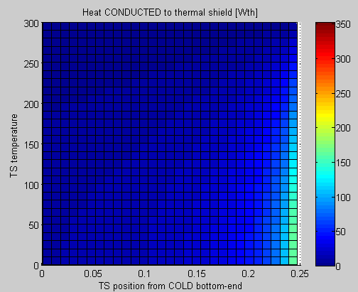
Cold-warm transition
Results: Radiation, Conduction
Heat radiated to CM
Heat conducted to CM
CF
WF
CF
WF
Heat radiated from/to TS
Heat conducted to TS
outwards
CF
WF
CF
WF

Slide 11
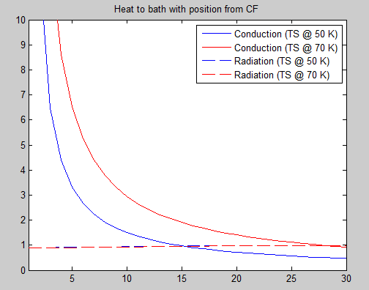
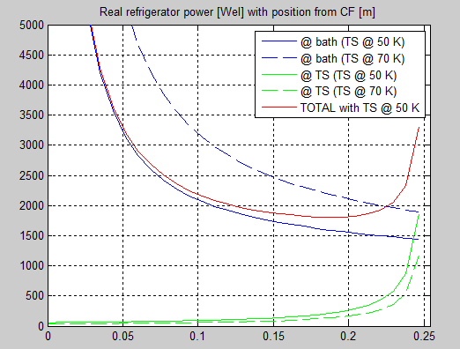
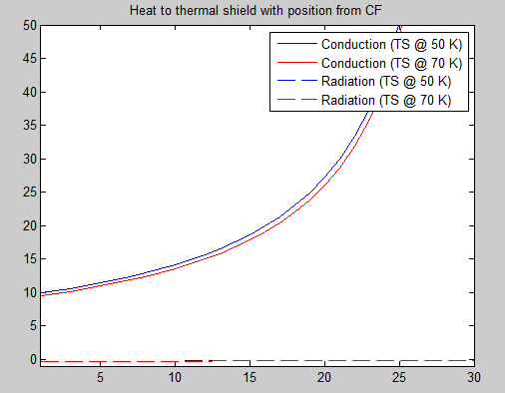
Cold-warm transition
Minimum refrigerator power (TS @ 50 K)
Heat to CM
Heat to TS
CF
WF
$$P_{real}=Q_{tot,bath}∗(C∗{η)}_{2K}+Q_{tot,TS}∗(C∗{η)}_{50K}$$
CF
WF

Slide 12
Cryostat heat loads
Temperature levels:
2 K (bath)
4.5 K (inlet He gas)
50-70 K (TS)
300 K (VV)
Contributions from:
Coupler (2 K, 4.5 K)
CWT (2 K, 50-70 K)
Vacuum tank (50-70 K)
Thermal shield (2 K)

Slide 13
Cryostat heat loads
Table of heat loads
Static heat loads
(1) RF off, cool off
(2) RF off, cool on
Dynamic heat loads
(3) RF on, cool on
(4) RF on, cool off
Subassembly | Type | Source | Desti-nation | 2 K |  |  |  | 4.5 K |  |  |  | 50-70 K
coupler | cd rad RF | coupler | bath | 12.3 ⁽¹⁾ | 1.1 ⁽²⁾ | 1.8 ⁽³⁾ | 21.3 ⁽⁴⁾ | - | - | - | - | -
 | cv | coupler | gas | - | - | - | - | - ⁽¹⁾ | 49.1 ⁽²⁾ | 52.0 ⁽³⁾ | - ⁽⁴⁾ | -
CWT | cd | wf | ts | - | - | - | - | - | - | - | - | 20.0
 | cd | ts | cm | 2.0 | 2.0 | 2.0 | 2.0 | - | - | - | - | -
 | rad | wf + wall | cm | 1.0 | 1.0 | 1.0 | 1.0 | - | - | - | - | -
 | rad | wf | ts | - | - | - | - | - | - | - | - | 0.2
 | rad | vv | ts | - | - | - | - | - | - | - | - | 12.2
 | rad | ts | cm | 0.3 | 0.3 | 0.3 | 0.3 | - | - | - | - | -
cavity | RF | cavity | cm | - ⁽¹⁾ | - ⁽²⁾ | 20.0 ⁽³⁾ | 20.0 ⁽⁴⁾ | - | - | - | - | -
TOT (W) |  |  |  | 15.6 ⁽¹⁾ | 4.4 ⁽²⁾ | 25.1 ⁽³⁾ | 44.6 ⁽⁴⁾ | - ⁽¹⁾ | 49.1 ⁽²⁾ | 52.0 ⁽³⁾ | - ⁽⁴⁾ | 32.4

Slide 14
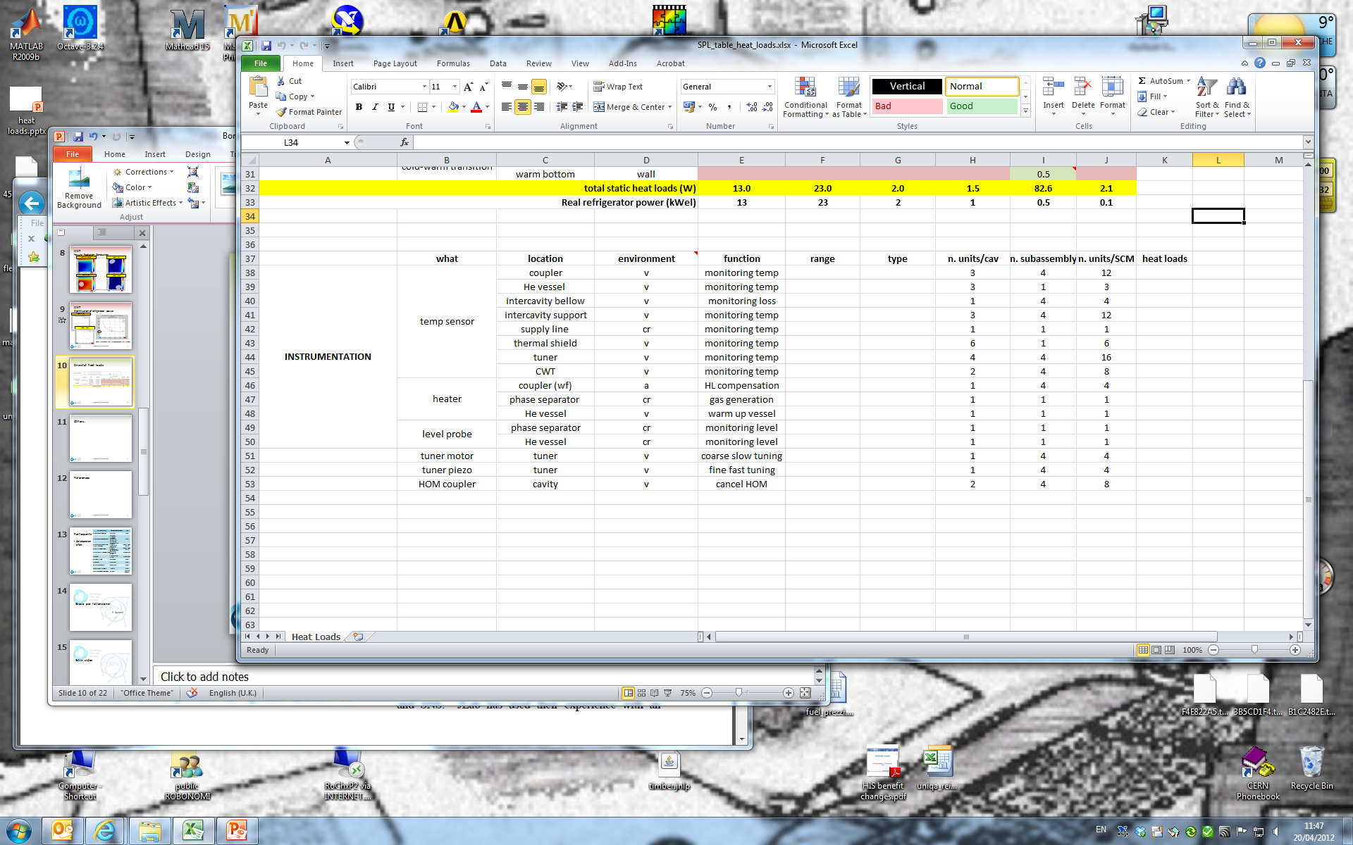
Cryostat heat loads
Table of instrumentation

Slide 15
What’s next..
Ongoing work on heat loads table and instrumentation (to follow-up)
Specific work done on some components allows for reduction of heat loads (optimization)
Experimental results (mock-up’s) to validate the analyses performed

Slide 16
References
O. Capatina, private communications, 2011
O. Capatina, T. Renaglia, “SPL power coupler double walled tube thermo-mechanical studies”, Review of the SPL RF power couplers, 2010
C, Maglioni, V. Parma, “Assessment of static heat loads in the LHC Arc, from the commissioning of Sector 7-8”, LHC Project Note 409, 2008

Slide 17


Slide 18
Extra slides

Slide 19
Participants
System/Activity | Responsible/member | Lab
Cryo-module coordination | V. Parma | CERN
Cryo-module conceptual design | V. Parma R. Bonomi P. Coelho O. Capatina D. Caparros T. Renaglia A. Vande Craen | CERN
Cryo-module detailed design & Integration CNRS | P. Duthil P.Duchesne CNRS Team | CNRS/IPNO-Orsay
Cryostat assembly tooling | P. Duthil P.Duchesne | CNRS/IPNO-Orsay
Cavities/He vessel/tuner, RF coupler) | W. Weingarten O. Brunner O. Capatina S.Chel | CERN/CEA-Saclay
RF Coupler | E.Montesinos S.Chel | CERN/CEA Saclay
Vacuum systems | G.Vandoni | CERN
Cryogenics | U.Wagner | CERN
Survey and alignment | D.Missiaen | CERN
SPL Machine architecture | F.Gerigk | CERN
ESS cryo-module requirements | W.Hees | ESS Lund (Sweden)
Collaboration effort

Slide 20
SPL coupler
Scheme
Wall, int
RT
(300 K)
Gas
BATH
(2 K)
Wall, ext
n=0
n=1
n=2
n=N-1
n=N
n=N+1

Slide 21
Double-walled tube coupler
With/without copper sputtering
Outer wall (SS 2 mm):
SS thermal conductivity
Inner wall (SS 1.5 mm + Cu 4 um):
SS thermal conductivity
Average SS-Cu thermal conductivity, weighted on thickness
Inlet gas @ 4.5 K | NO copper | WITH copper
 | Q bath (W) | Q bath (W)
RF on, cooling on, cf @ 2 K | 1 | 5
RF on, cooling off, cf @ 2 K | 22 | 23
RF off, cooling off, cf @ 2 K | 12 | 15
RF off, cooling on, cf @ 2 K | < 1 | 3
RF on, cooling on | 1 (cf @ 4 K) | 2 (cf @ 10 K)
RF on, cooling off | 21 (cf @ 86 K) | 21 (cf @ 88 K)
RF off, cooling off | 11.6 (cf @ 49 K) | 12.3 (cf @ 51 K)
RF off, cooling on | 0.3 (cf @ 3 K) | 1.1 (cf @ 6 K)
Cold flange thermal resistance:
4 K/W

Slide 22
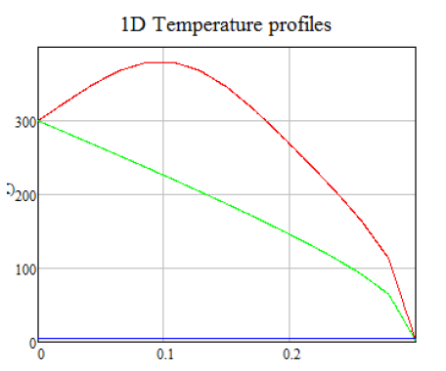
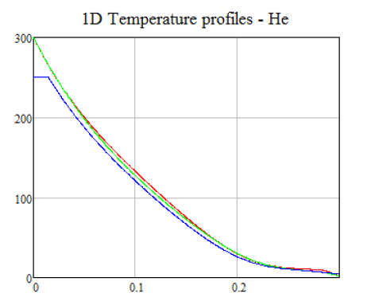
Double-walled tube coupler
Results: temperature profiles
RF on,
Cooling off
RF on,
Cooling on
(40 mg/s)
Without copper
12 W_{th} to bath !
Less than 1 W_{th} to bath

Slide 23
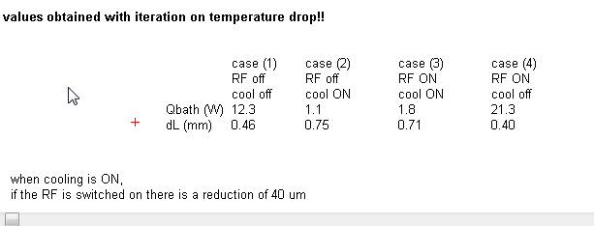
Double-walled tube coupler

Slide 24
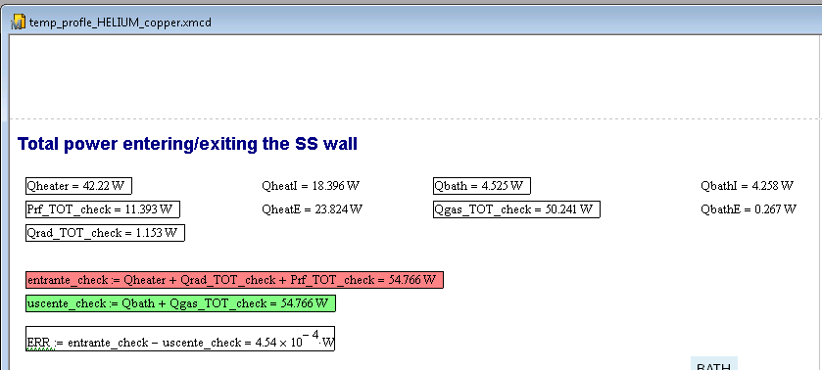
Double-walled tube coupler

Slide 25
Cryostat heat loads
Tables of heat loads
Operating condition | Value
Beam current/pulse lenght | 40 mA/0.4 ms beam pulse | 20 mA/0.8 ms beam pulse
cryo duty cycle | 4.11% | 8.22%
quality factor | 10 x 10⁹ | 5 x 10⁹
accelerating field | 25 MV/m | 25 MV/m
Source of Heat Load | Heat Load @ 2K
Beam current/pulse lenght | 40 mA/0.4 ms beam pulse | 20 mA/0.8 ms beam pulse
dynamic heat load per cavity | 5.1 W | 20.4 W
static losses | <1 W (tbc) | <1 W (tbc)
power coupler loss at 2 K | <0.2 W | <0.2 W
HOM loss in cavity at 2 K | <1 | <3 W
HOM coupler loss at 2 K (per coupl.) | <0.2 W | <0.2 W
beam loss | 1 W
Total @ 2 K | 8.5 W | 25.8 W

