Slide 1

Spoke cavities for ESS and MYRRHA
G. Olry, P. Duchesne (IPN Orsay)
SLHiPP-2, 3-4 May 2012, Catania

Slide 2
Outline
(A few) specifications for ESS and MYRRHA spoke cavities
RF design
Mechanical calculations

Slide 3
Specifications for cavities
 | ESS | MYRRHA
 | Double-spoke | Single-Spoke
Beam mode | Pulsed | CW
Frequency [MHz] | 352 | 352
Beta optimal | 0.50 | 0.37
Bpk [mT] | 70 | 50 to 70
Epk [MV/m] | 35 | 25 to 35
Temperature (K) | 2 | 2
Nominal gradient Ea [MV/m] | 8 | 5 to 6
Beam tube diameter [mm] | 50 (min) | 50 (min) to 60 (ideal)
P max [kW] | 300 (450 upgrade) | <10
Lacc (=beta optimal x nb of gaps x c / f) [m] | 0.639 | 0.158

Slide 4
Outline
(A few) specifications for ESS and MYRRHA spoke cavities
RF design
Mechanical calculations for ESS (P.Duchesne)

Slide 5
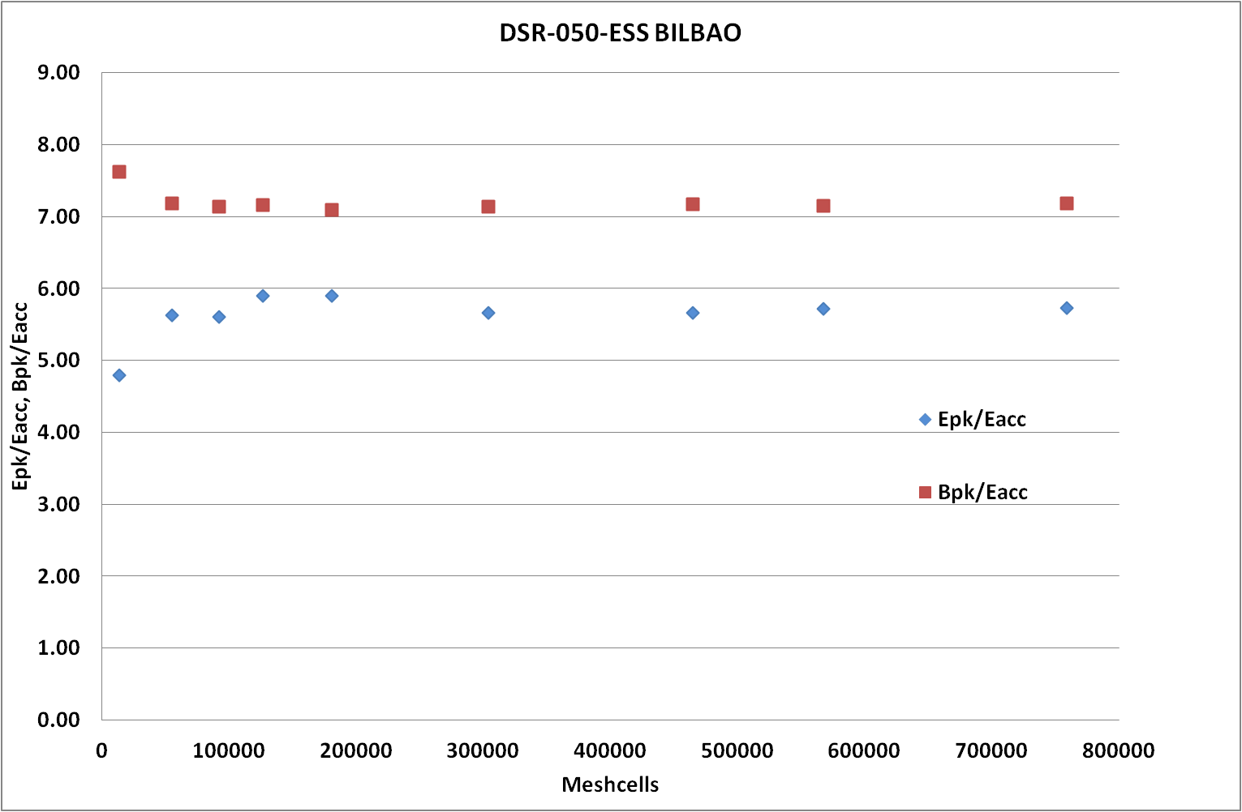
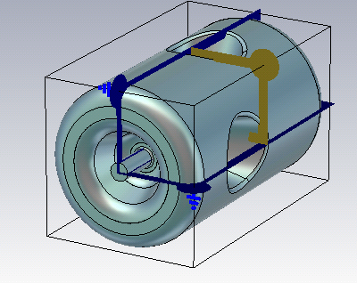
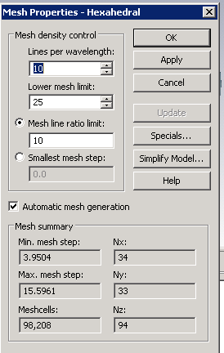
Double-Spoke for ESS
Main goal:
Epk/Eacc < 4.5
Bpk/Eacc (mT/MV/m) < 8.8
CST MicroWave Studio 2011
Model created with the 3D CAD tools of MWS
Symetries: ¼, BC: Magnetic planes, Nb meshcells~100 000points
1st mode calculated (TM010)

Slide 6
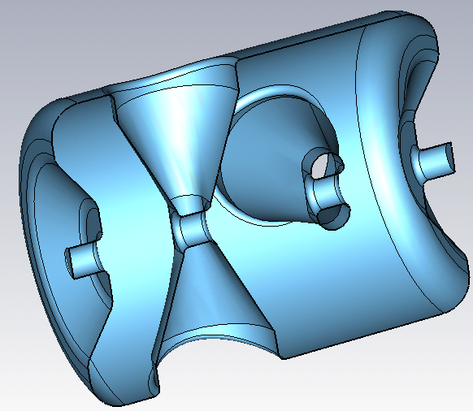
Double-Spoke for ESS
Some parameters that could be optimized…
Rspokebase
Hspokebase
Dspoke
rtop1
Htop
rtop2
Hspokecenter
rtop3
WSpokecenter
Hbottom
Liris-to-iris
Lcav

Slide 7
Double-Spoke for ESS
2 examples: with parameter Lcav (=overall length of the cavity from end-caps) and Rspokebase (=radius of the spoke base)
1/ Rspokebase varies : variation of d from 0 to 40 mm (Lcav unchanged)
2/ Lcav varies : Rspokebase is fixed and Lcav1 varies from 0 to 200 mm
Rspokebase= (Lcav/8)+d)
Lcav=3*beta*lambda/2+Lcav1

Slide 8
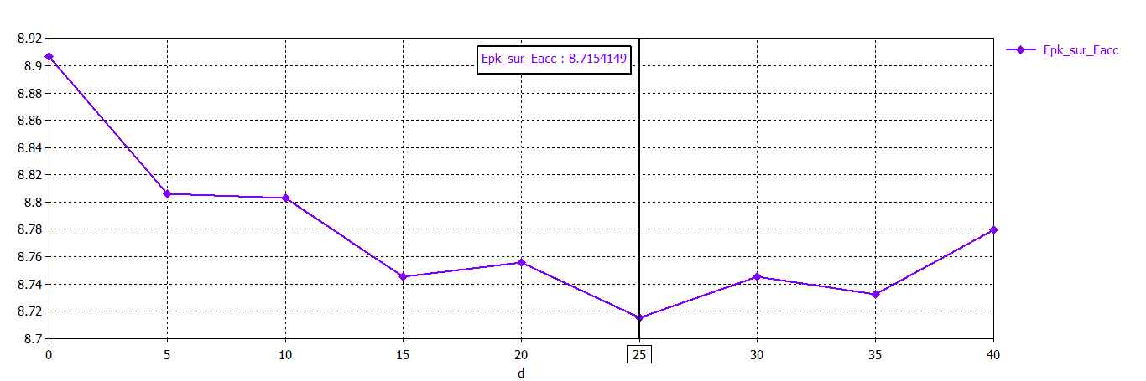
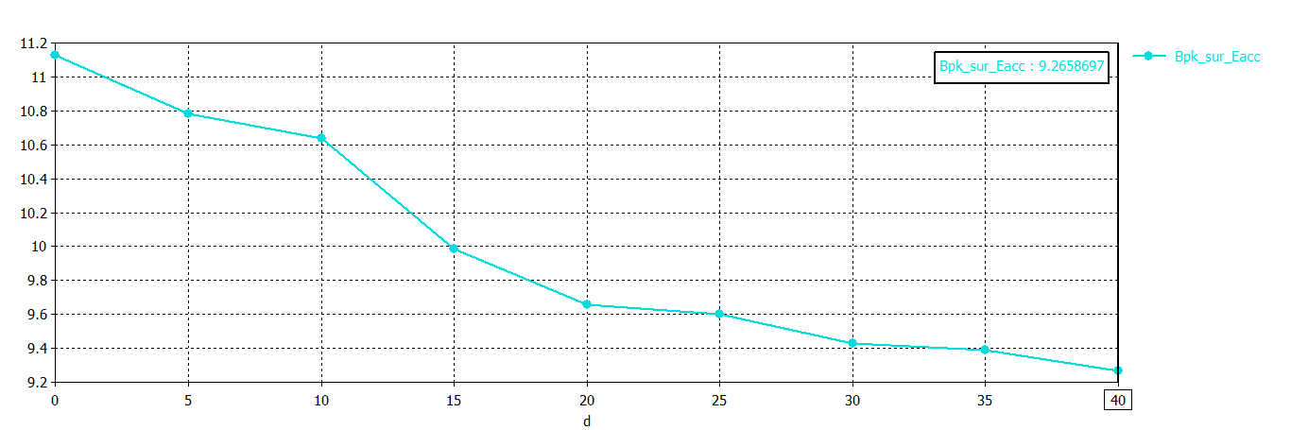
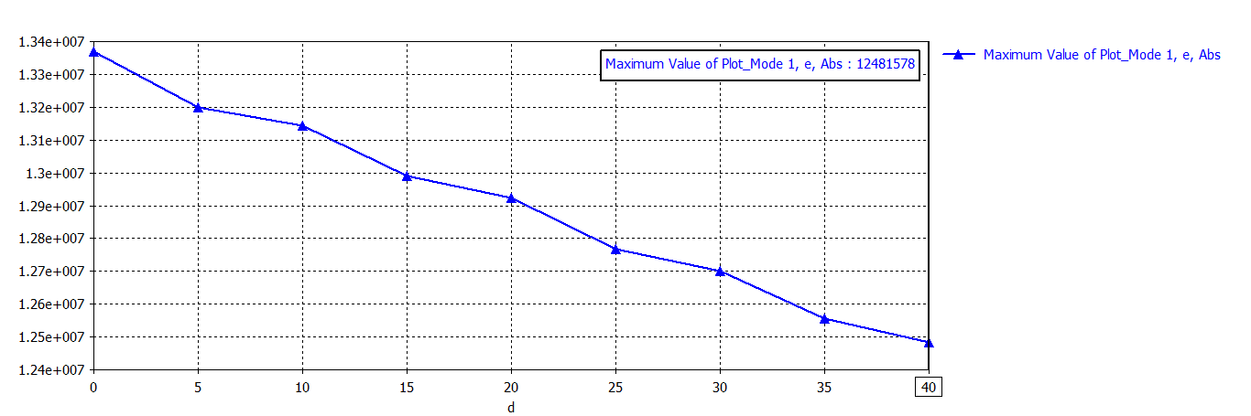
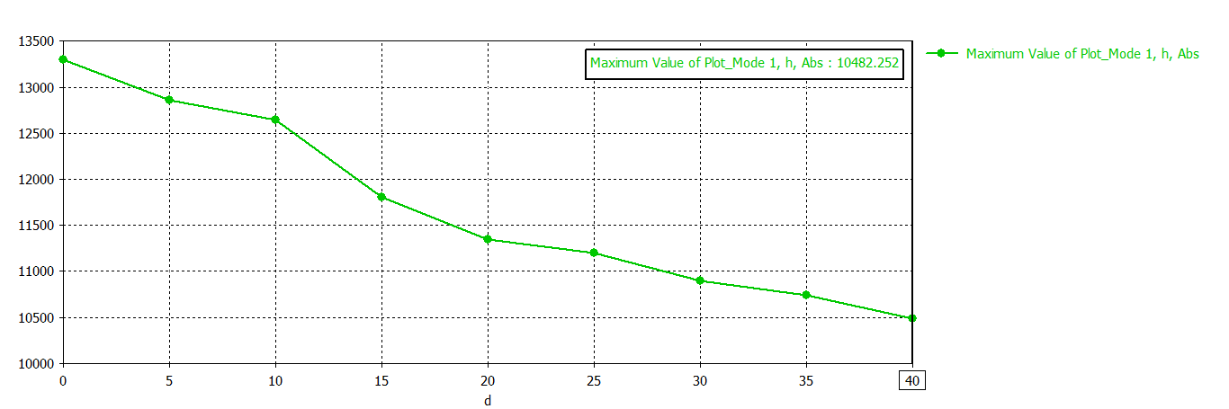
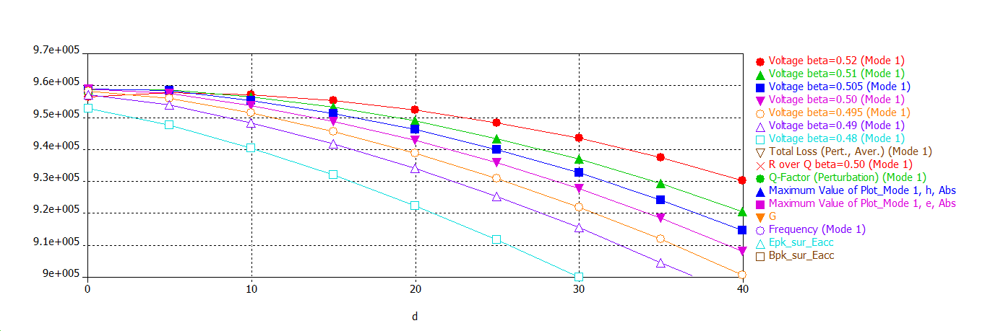
Double-Spoke for ESS
1/ Rspokebase varies : variation of d from 0 to 40 mm while Lcav unchanged

Slide 9
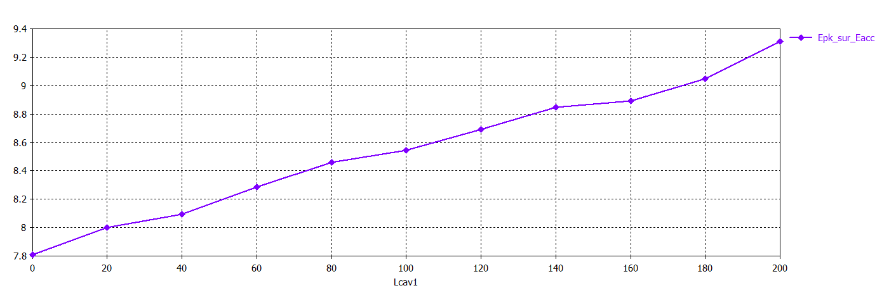
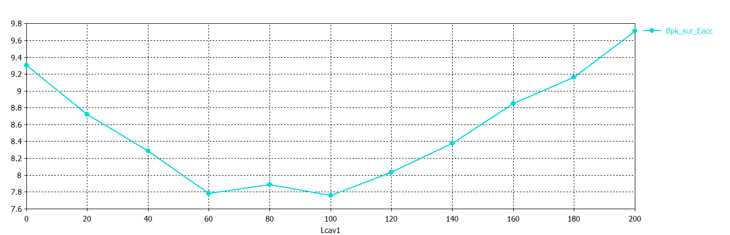
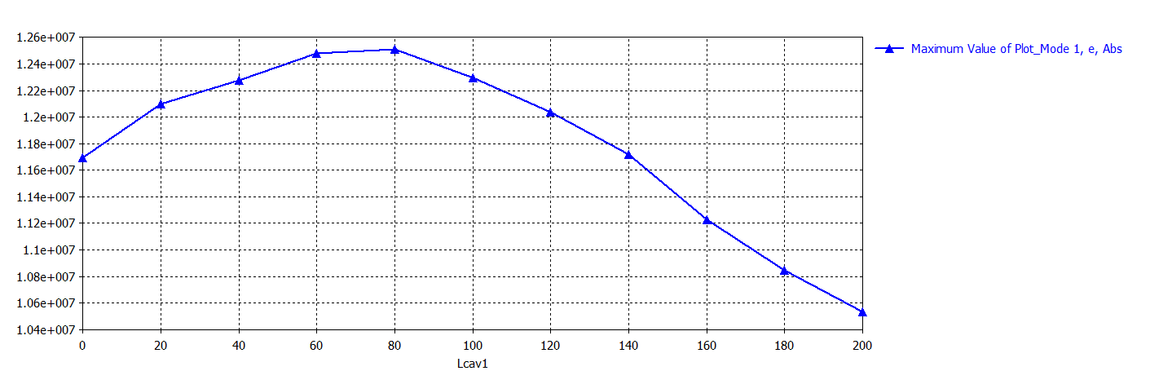
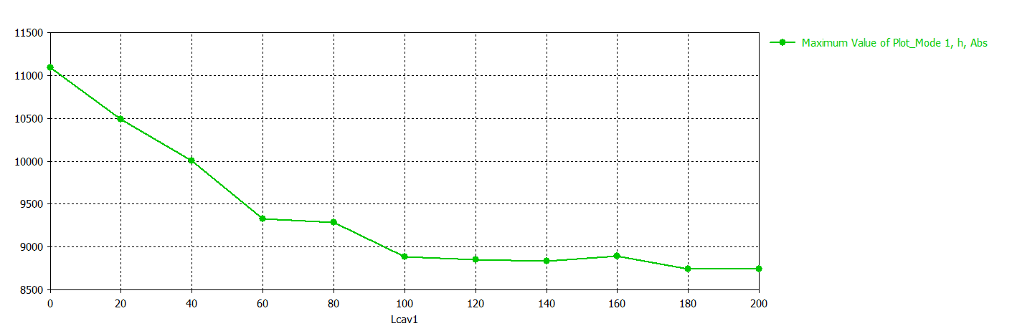
Double-Spoke for ESS
2/ Lcav varies : Rspokebase is fixed and Lcav1 varies from 0 to 200 mm
Lcav1 [mm] | Epk [V/m] | Variation (w.r.t Epk@Lcav1=0)
0 | 1.17E+07 | 0%
20 | 1.21E+07 | 3%
40 | 1.23E+07 | 5%
60 | 1.25E+07 | 7%
80 | 1.25E+07 | 7%
100 | 1.23E+07 | 5%
120 | 1.20E+07 | 3%
140 | 1.17E+07 | 0%
160 | 1.12E+07 | -4%
180 | 1.08E+07 | -7%
200 | 1.05E+07 | -10%
Lcav1 [mm] | Hpk [A/m] | Variation (w.r.t Hpk@Lcav1=0)
0 | 1.11E+04 | 0%
20 | 1.05E+04 | -5%
40 | 1.00E+04 | -10%
60 | 9330.50391 | -16%
80 | 9284.22754 | -16%
100 | 8883.86035 | -20%
120 | 8851.58008 | -20%
140 | 8832.0459 | -20%
160 | 8892.72461 | -20%
180 | 8741.48242 | -21%
200 | 8738.99023 | -21%

Slide 10
Power coupler port sizing
Empirical multipacting calculations
 |  | SNS | ESS
 |  |  |  |  | Max diam with DN100 flange |  |  |  |  |  |  |  | Max diam with DN160 flange
order (n) | Coupler port diam (mm) | 96 | 56 | 90 | 100 | 100 | 110 |  | 110 | 120 | 120 |  | 150 | 150
 | Impedance (Ohms) | 50 | 50 | 50 | 50 | 75 | 50 |  | 75 | 50 | 75 |  | 50 | 75
 | Antenna diam (mm) | 42 | 24 | 39 | 43 | 29 | 48 |  | 31 | 52 | 34 |  | 65 | 43
 |  | P[kW] = (f[MHz].Diam_port[mm])^4.Z[Ohm].h(1/(n+1))
1 |  | 8811 | 37 | 249 | 379 | 569 | 555 | 833 |  | 786 |  | 1180 | 1920 | 2880
2 |  | 6088 | 26 | 172 | 262 | 393 | 384 | 576 |  | 543 |  | 815 | 1327 | 1990
3 |  | 3499 | 15 | 99 | 151 | 226 | 221 | 331 |  | 312 |  | 468 | 762 | 1144
4 |  | 2069 | 9 | 58 | 89 | 134 | 130 | 196 |  | 185 |  | 277 | 451 | 676
5 |  | 1285 | 5 | 36 | 55 | 83 | 81 | 122 |  | 115 |  | 172 | 280 | 420
6 |  | 847 | 4 | 24 | 36 | 55 | 53 | 80 |  | 76 |  | 113 | 185 | 277
7 |  | 599 | 3 | 17 | 26 | 39 | 38 | 57 |  | 53 |  | 80 | 131 | 196
8 |  | 460 | 2 | 13 | 20 | 30 | 29 | 44 |  | 41 |  | 62 | 100 | 150
9 |  | 386 | 1.5 | 11 | 17 | 25 | 24 | 37 |  | 34 |  | 52 | 84 | 126
10 |  | 352 | 1 | 10 | 15 | 23 | 22 | 33 |  | 31 |  | 47 | 77 | 115

Slide 11
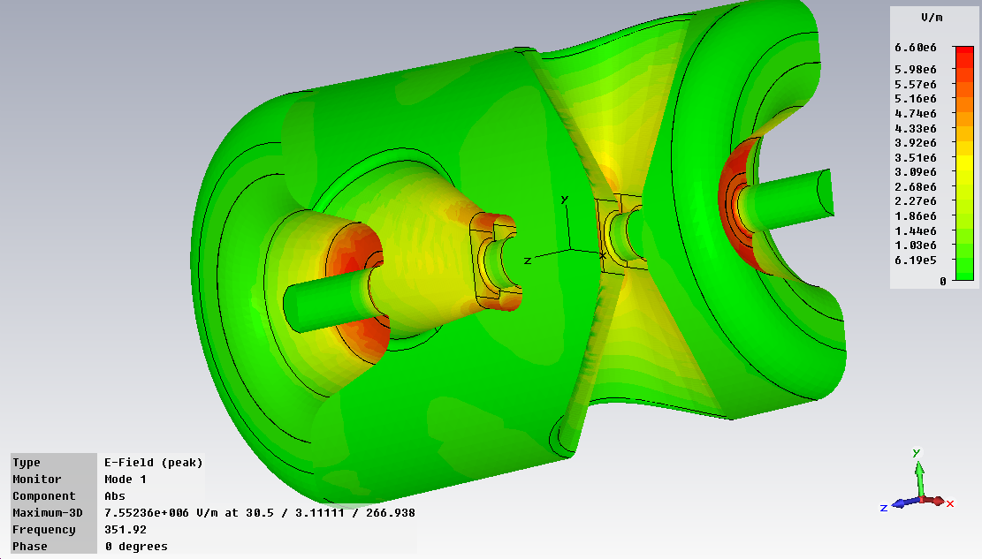
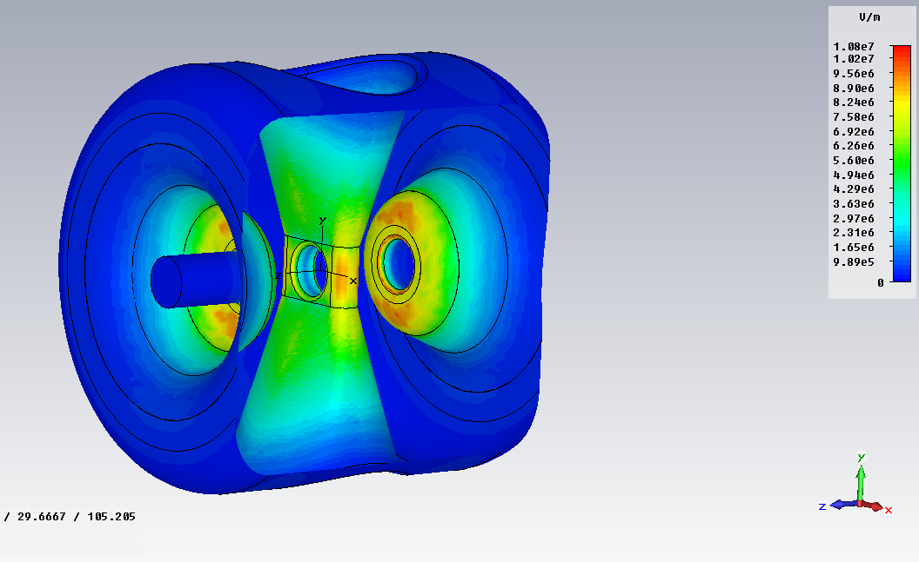
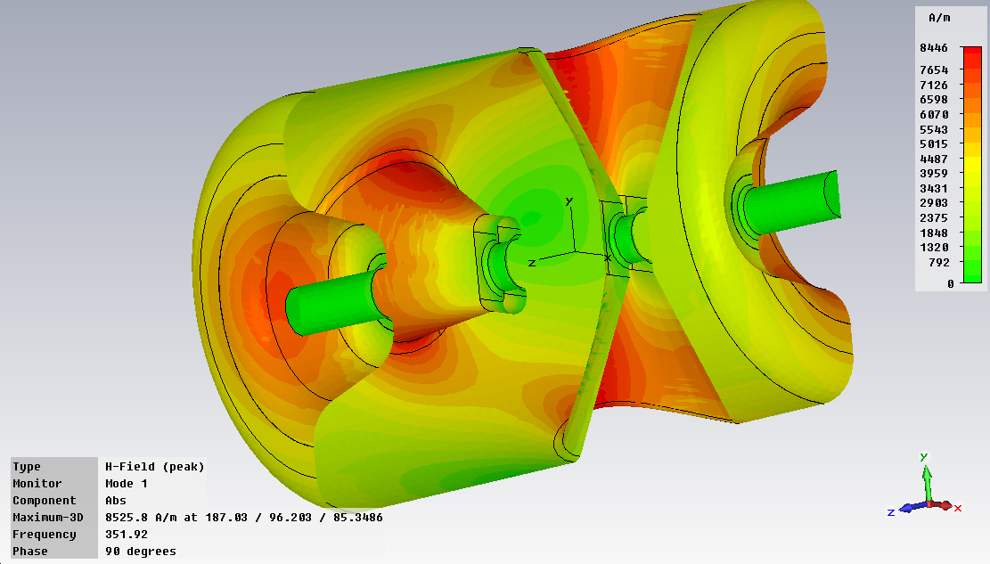
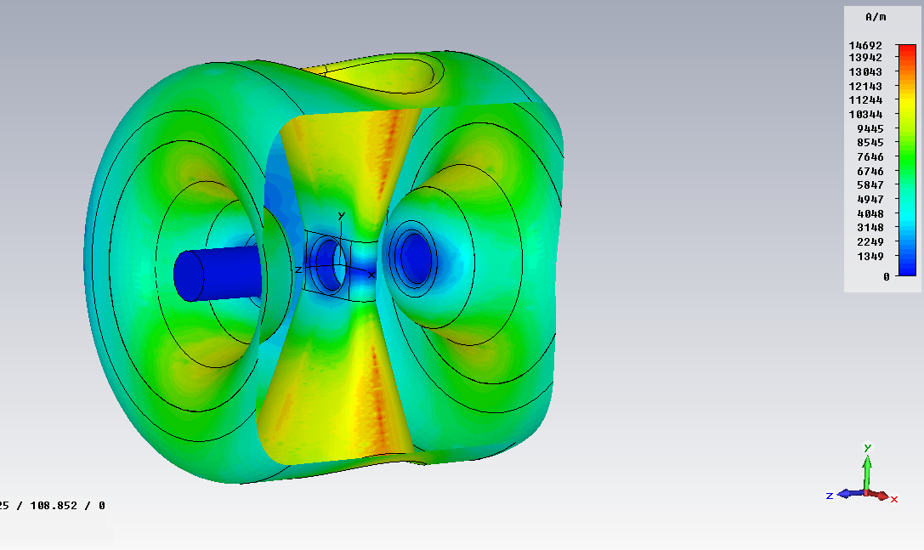
RF results
Simulation with 1.3 millions of meshpoints
 | ESS | MYRRHA
Beta optimal | 0.50 | 0.37
Epk/Ea | 4.96 | 4.92
Bpk/Ea [mT/MV/m] | 7.03 | 8.3
G [Ohm] | 133 | 115
r/Q [Ohm] | 428 | 244
E field
E field
H field
H field

Slide 12
Outline
(A few) specifications for ESS and MYRRHA spoke cavities
RF design
Mechanical calculations for ESS (P.Duchesne)

Slide 13
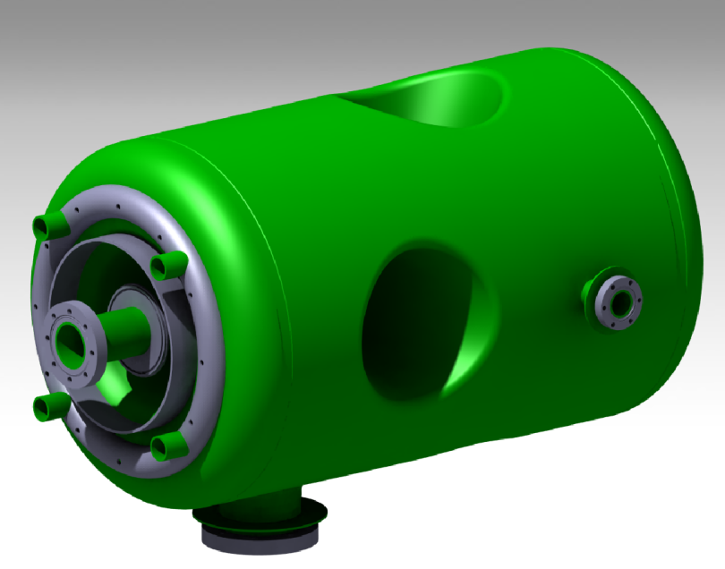
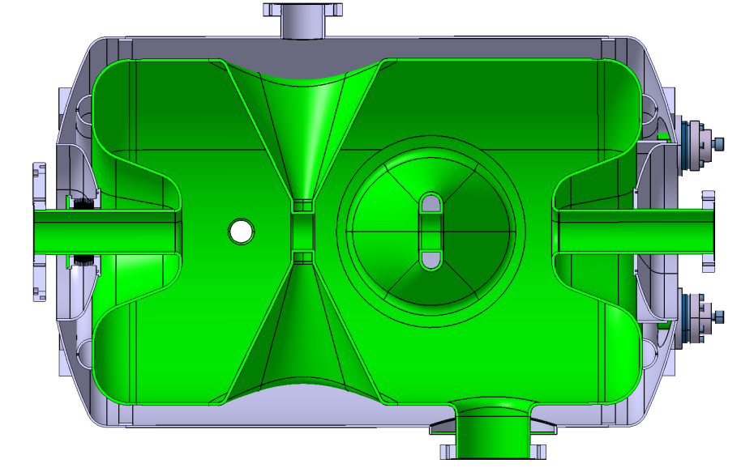
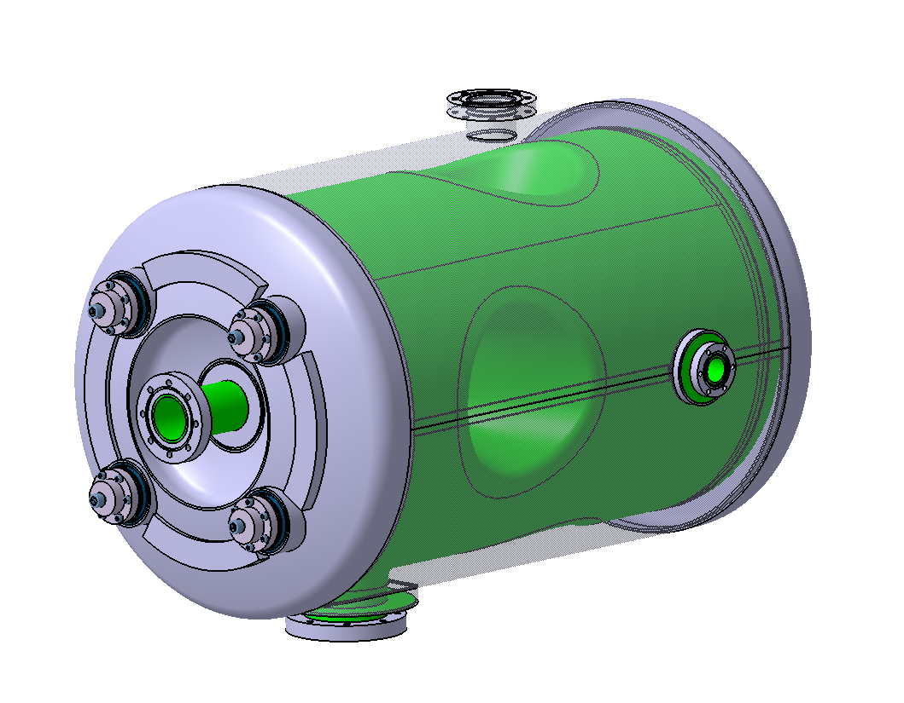
Design of the cavity with helium vessel
Design of the cavity
Niobium : 4 mm
Donut ribs (left and right side)
Beam tubes: 4,5mm
Pick-up port
4 HPR ports
Helium vessel
Coupler port
Titanium : 3 mm
Stiffener: donut (welded connection between cavity and tank)
Bellows
4 HPR Flanges

Slide 14
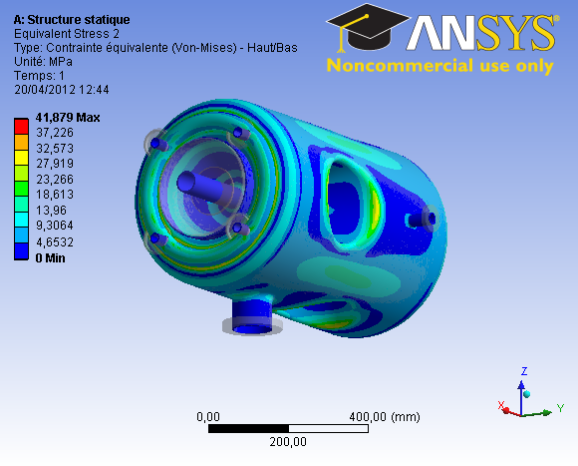
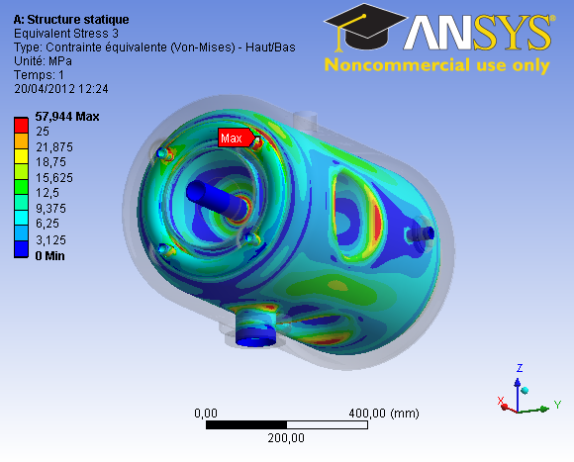
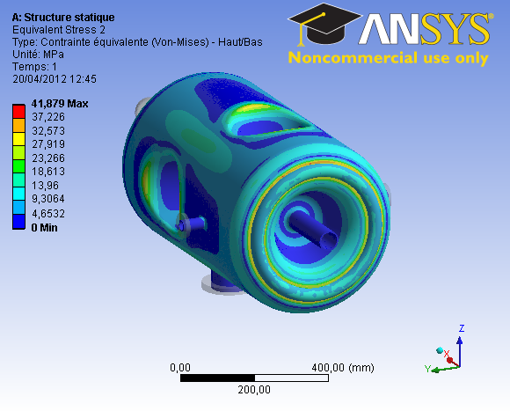
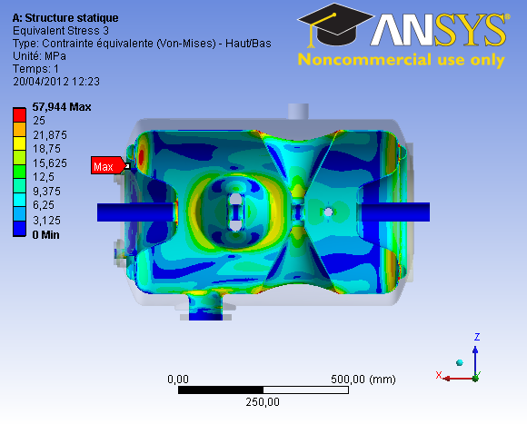
Mechanical behavior under pressure
Config. 1 : Cavity without helium vessel
(leak test)
Config. 2 : Cavity with helium vessel
(Cool down)
Hypothesis :
Loads:
Cavity walls : Pext = 1 bar
Boundary conditions:
Only one end beam tube fixed
Hypothesis :
Loads:
Cavity walls : Pext = 1 bar
Vessel walls : Pint = 1 bar
Boundary conditions:
Only one end beam tube fixed
Niobium:
E = 107 GPa
ν = 0,38
Re (20°C) = 50 MPa
Titanium grade 2:
E = 105 GPa
= 0,3
Re (20°C) = 350 MPa
σ = 30 MPa
σ = 30 MPa
σ = 30 MPa
σ = 26 MPa
max = 58 MPa
on HPR ports
σ = 28 MPa

Slide 15
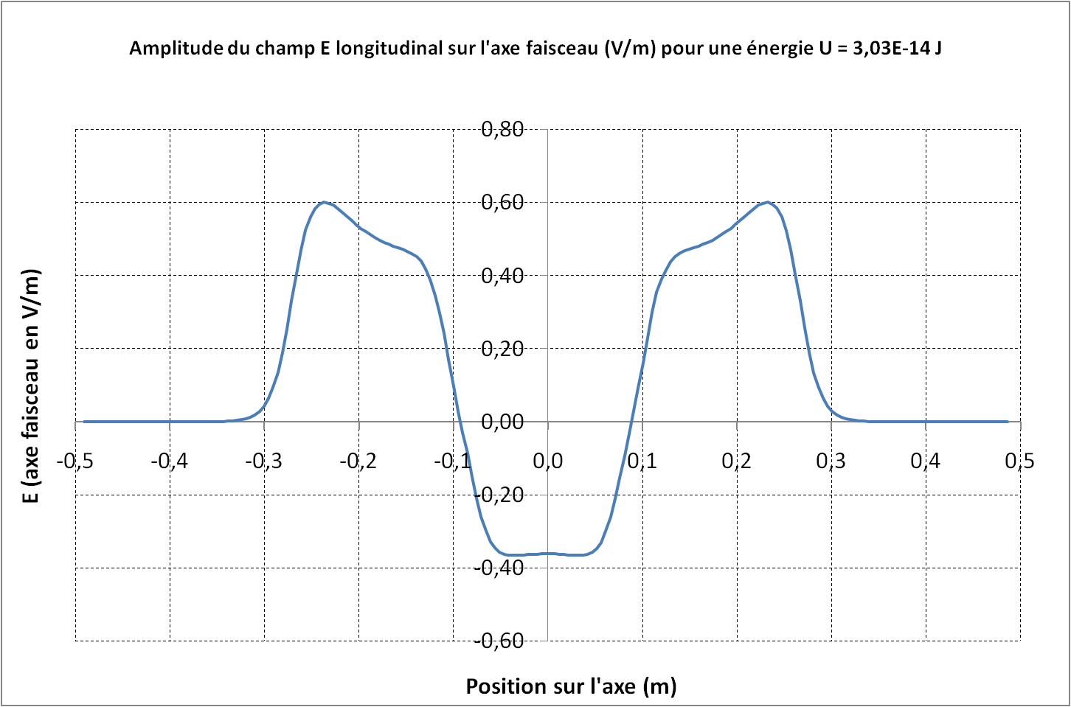
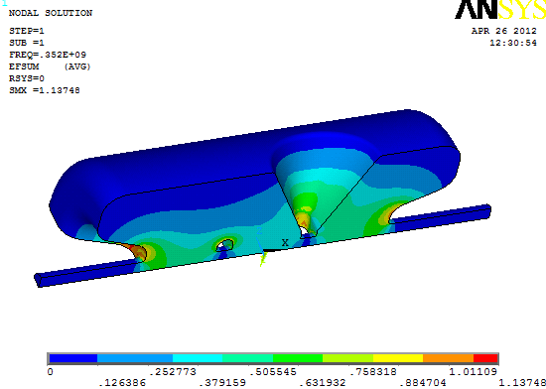
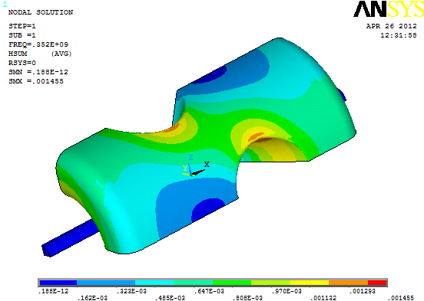
RF parameters with ANSYS
 | ANSYS
Frequency [MHz] | 352
Beta | 0.5
Bpk/Eacc [mT/(MV/m)] | 7,08
Epk/Eacc | 4.4
G [Ohm] | 130
r/Q [Ohms] | 407
Lacc = Ngap.b.l/2 [m] | 0.6386
Temperature (K) | 2
Q₀ Cu@ 300K | 27042
Q₀ Nb@ 2K | 1.22*10¹⁰

Slide 16
Mechanical-RF coupling analysis
Numerical analysis performed with ANSYS
Mechanical characteristics
Cavity with donut on each end-cap
Stiffness of the cavity Kcav [kN/mm] | 11.8
Tuning sensitivity Δf/Δz [kHz/mm] | 200
Sensitivity due to the pressure K_{P} [Hz/mbar] (free ends) | -141.
Sensitivity due to the pressure K_{P} [Hz/mbar] (fixed ends) | 4.2
Remark: Connections with helium vessel not taken into account

Slide 17
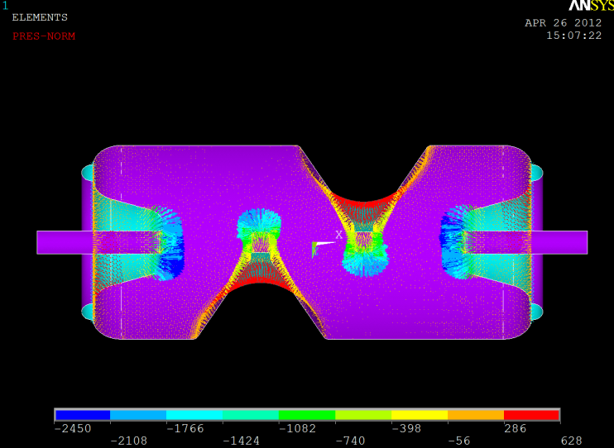
RF frequency change due to Lorentz detuning
Lorentz pressure: P = ¼ (µ₀ H² - ε₀ E²)
Pressure on cavity walls (Pa)
For Eacc = 8 MV/m
Pmax = 628 Pa (Push out)
Emax = 35 MV/m
Bmax = 57 mT
Pmin = -2450 Pa (Pull in)
Numerical analysis performed with ANSYS
Lorentz Factor: K_{L} = Δf / E²acc
cavity with donut ribs
K_{L} [Hz/(MV/m)²] (free ends) | -11
K_{L} [Hz/(MV/m)²] (fixed ends) | -3.7
Remark: Connections with helium vessel not taken into account

Slide 18
Outline
(A few) specifications for ESS and MYRRHA spoke cavities
RF design
Preliminary mechanical calculations for MYRRHA (P.Duchesne)

Slide 19
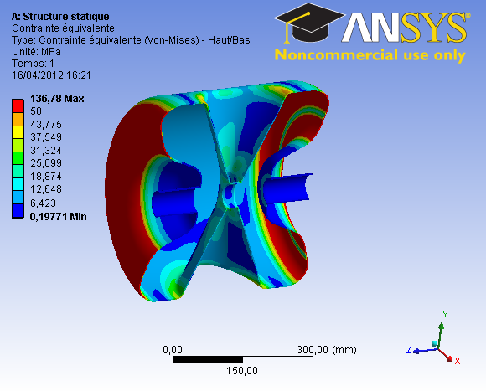
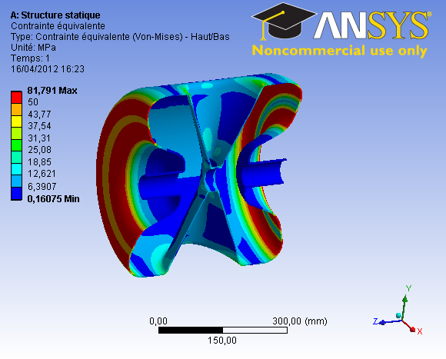
External pressure of 1 bar
Cavity without helium vessel
Boundary conditions: one free end
No external ribs, nor stiffeners…
Stresses with Nb = 3mm
Stresses with Nb = 4mm
In red: σ > 50 MPa

Slide 20
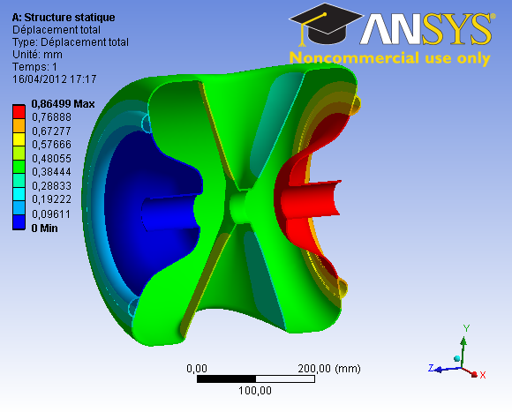
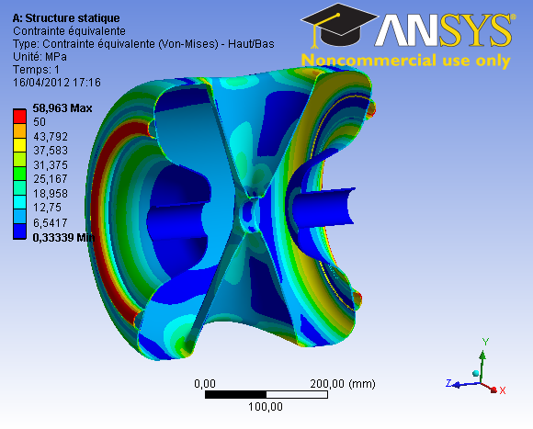
External pressure of 1 bar (con’t)
Cavity without helium vessel
Boundary conditions: one free end
External stiffener on each end-caps
Niobium and stiffeners thickness: 3mm
Displacements
Stresses
In red: stresses > 50 MPa
59 MPa on stiffener

Slide 21
THANK YOU FOR YOUR ATTENTION

