Slide 1
PDR Scope and PSS1 Pre start Review
PSS1 Preliminary Design Review
Stuart Birch
ESS/ICS/PS
2019-09-18

Slide 2
Purpose of this PDR
The purpose of this PDR is:
To confirm that all actions and recommendations from the Pre-Start Review have been addressed and that all open questions required for the PSS1 safety analysis are answered.
To confirm that the overall safety requirements, initiating events, safety functions, and safety integrity requirements are well understood, defined and documented;
To confirm that preliminary design and concepts of operation sufficiently cover the overall safety requirements (high-level system requirements).
The PDR also covers planning for future PSS1 activities.

Slide 3
The committee is asked to consider the following questions:
Have all action items from the Pre-Start Review been resolved properly to allow preparation of this PDR?
Are all or a sufficient coverage of requirements, safety objectives and specifications within the scope of this PDR documented and understood?
Have all initiating events been identified and sufficiently evaluated in the initiating events analysis?
Have all safety requirements from the NCL risk assessment been addressed in the PSS1 safety analysis and covered by the identified safety instrumented functions (SIFs)?
Are there any concerns on the presented set of identified SIFs and Event Tree Analysis (ETA) diagrams for PSS1?
Have all operating concepts for PSS1 been addressed and are they properly documented?
Are PSS1 interfaces with NCL hazardous equipment and other relevant NCL systems clear and mature enough for this stage of the project?
Is the Layer architecture for PSS1 clear and mature enough for this stage of the project?
Does the presented planning for PSS1 follow the Accelerator commissioning planning and deadlines for the SSM deliverables?
Are there any outstanding agreements to be made or other actions necessary to allow the PSS team to transition to detailed hardware and software design?

Slide 4

Introduction
Preliminary Design Review Scope
Pre-Start Review

Slide 5
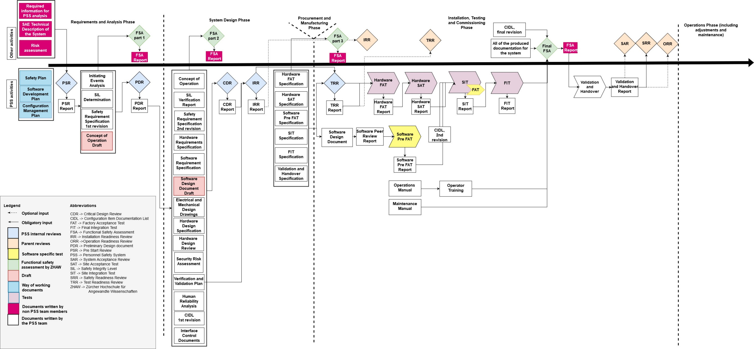
Scope of Preliminary Design Review

Slide 6
Scope of Preliminary Design Review
The outputs from a pre-start review are:
Approval from this pre start review meeting to enable start the analysis phase
A list of overall safety requirements.
Pre-Start Review Report
PSS1 Pre-Start Review
ESS-1525921
The outputs from the IE analysis are:
The overall safety requirements derived from the risk assessments
Carry out analysis of the IE’s that give rise to the hazards identified
Preliminary ETA for the IE’s
Identifies the SIF’s and links them to the corresponding hazards
Initiating Events Analysis
ESS-1099822
The outputs from the SIL Determination are:
Determined frequency and consequence of identified hazards;
Determined risk reduction provided by other measures and the resulting risk gap, if any;
Assigned SIL requirements for SIFs to any resulting risk gaps in accordance with IEC 61511.
SIL Determination
ESS-0121562
The outputs from the SRS are:
General safety requirements and requirements specific to each SIF
Description of all the SIF necessary to achieve the required functional safety
Requirements to identify and take into account common cause failures
Definition of the safe state for each SIF
Assumed sources of demand and demand rate on each SIF
Requirements relating to proof test intervals and proof test implementation
Response time requirements for each SIF to bring the system to safe state
Required SIL and mode of operation (demand/continuous) for each SIF
Safety Requirements Specification
ESS-0121565
Concept of operations
ESS-0100563

Slide 7
Pre-Start Review Meeting
NCL Risk Assessment
ESS-1076227
Required Information for PSS1 Analysis
ESS-1419309
The inputs for this pre-start review where:
NCL technical description ESS-0159957
Hazard and risk assessments ESS-1076227
Required Information for PSS1 Analysis ESS-1419309
NCL Technical Description
ESS-0159957
The outputs from this pre-start review where:
Approval from this meeting to start the PSS1 analysis phase
A preliminary list of PSS1 overall safety requirements.
Pre-Start Review Report ESS-1525921
PSS1 Pre-Start Review
ESS-1525921

Slide 8
Pre-Start Review Actions
Confluence page https://confluence.esss.lu.se/x/AI7FEg
Who | Due Date | What
Janet Schmidt | 2019-09-02 | The word magnetron has to be removed from requirement #44 (see above), since it should not be turned off during access mode.
Janet Schmidt | 2019-09-02 | In all actions to mitigate risks, the "should" have to be substituted by "shall"
Stuart Birch | 2019-09-06 | Check the risk assessment and send an updated appendix to risk assessment (or comments to the appendix) to Janet, with proper terms used for PSS related Actions to Mitigate Risk- Controls
Janet Schmidt, Annika Nordt | 2019-09-02 | Call for meeting to decide on logic for beam permit from PSS towards MPS
Annika Nordt, Helen Boyer | 2019-09-06 | The question whether a cryogenic hazard from outside the PSS1 area can affect people inside the PSS1 area needs to be followed up with John Weisend
Denis Paulic | 2019-09-06 | Update the list Overall safety requirements to include the comments from this meeting and new terms used in the risk assessment.
Denis Paulic, Morteza Mansouri, Stuart Birch, Meike Rönn, Paulina Skog, Fan Ye, Annika Nordt | 2019-09-09 | Discuss open questions concerning data in the Required information for PSS1 Analysis and send to relevant stakeholders to confirm them with clarification why they are needed.
Stuart Birch | 2019-09-09 | PSS should review the Operating instructions High Power Supply (ESS-0337871)
Denis Paulic | 2019-09-02 | Send out a new doodle link to check the availability for the PDR.
Joanna Weng | 2019-09-15 | Review new set of the Overall safety requirements once available on this page.
Complete
Complete
Complete
Complete
Complete
Complete
Complete
Complete
Complete
Complete

Slide 9
Overall Safety Requirements
PSS1 shall have a fail-safe design.
PSS1 shall provide means within the PSS1 controlled area allowing for a manual switch-off of the Ion Source High Voltage (HV) Power Supply (PS), proton beam and RF systems in case of emergency.
PSS1 shall prevent access to the PSS1 controlled area during operation of Ion Source High Voltage (HV) Power Supply (PS), operation of proton beam and RF conditioning of cavities.
PSS1 shall switch off the Ion Source High Voltage (HV) Power Supply (PS), proton beam and RF power for the cavities that are not isolated from the RF systems, upon access to PSS1 controlled area.
PSS1 shall ensure that the RF power is isolated from the cavities within the PSS1 controlled area for all RF systems that are under testing when the access to the PSS1 controlled area is allowed.
PSS1 shall monitor the formalised search process and prevent operation of the Ion Source High Voltage (HV) Power Supply (PS), proton beam and RF power for the cavities that are not isolated from the RF systems, if the PSS1 controlled area is not searched.
PSS1 shall switch off the proton beam and RF systems in case a high radiation signal is received from radiation monitors.

Slide 10
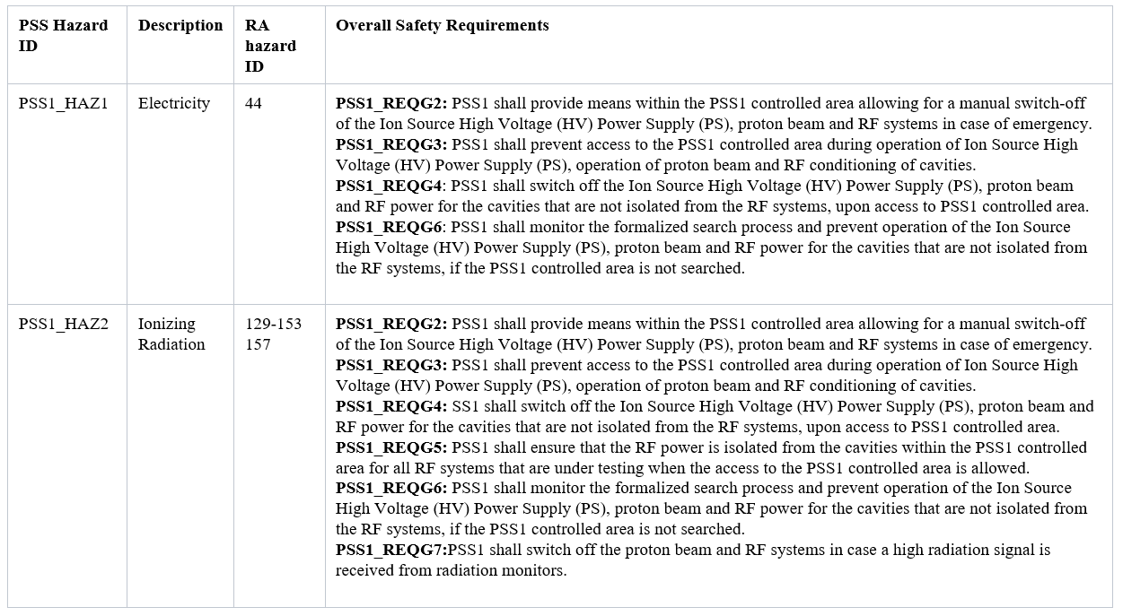
Mapping of Overall Safety Requirements to RA Hazards

Slide 11
Overall Safety Requirements WRSFs ESS-0118232
Radiation safety function | SSCI2S | Event class | Functional Group
WRSF-141 Detect elevated prompt dose outside PSS1 controlled area and shut the beam off | REMS & PSS1 | H2 | Operational
WRSF-94 Prevent entry into PSS1 controlled areas | PSS1 access control system and safety interlock system | H1, H2 | Operational
WRSF-95 Mitigate consequences upon entry into PSS1 controlled areas

Slide 12
Comments from TS2 SRR
Review the PSS operating modes and consider if they should be included as part of the safety functions.
Check for double counting credits in the level of protection analysis (LOPA).
Review the maximum time requirement for RF to be disabled within PSS documentation.
PSS needs to be configured and verified operational in the presented configuration except for integration of the MAD door interlocks.

Slide 13
Thank you
Questions?

