Slide 1
PSS1 Safety Analysis
PSS1 Preliminary Design Review
Dr Fan Ye
PSS Safety Engineer, Engineering Safety Consultants Limited (ESC), UK
ESS/ICS/PS
2019-09-18

Slide 2
Contents
PSS1 Initiating Events Analysis
PSS1 SIL Determination
PSS1 Safety Requirements Specification

Slide 3
Route map
NCL Risk Assessment
Initiating Events Analysis
SIL Determination
SRS
SIL Verification

Slide 4
Route map
NCL Risk Assessment
Initiating Events Analysis
SIL Determination
SRS
SIL Verification

Slide 5
PSS1 Initiating Events Analysis
Hazards requiring PSS1 [Initial Version]
Hazards identified from Normal Conducting Linac (NCL) Risk Assessment (preliminary)
A subset that require protection from PSS1
  PSS1_HAZ1, Ionising radiation (X-rays)
  PSS1_HAZ2, Non-ionising radiation (radio frequency)
First version of overall safety requirements for PSS1

Slide 6
PSS1 Initiating Events Analysis
Overall safety requirements [Initial Version]
Req. ID | Requirement Description
PSS1_REQG1 | The PSS1 controlled area shall be searched prior to lock-up and search shall be controlled by the PSS.
PSS1_REQG2 | PSS1 shall prevent access to the PSS1 controlled area during operation.
PSS1_REQG3 | PSS1 shall interface with the RF Distribution System (RFDS) during the testing of RF Systems for RFQ, DTLs and MEBT.
PSS1_REQG4 | PSS1 shall interface with the radiation monitors located outside the PSS1 controlled area to switch off the power in case of high radiation.
PSS1_REQG5 | PSS1 shall provide means within the PSS1 controlled area to switch off the power in case of emergency.
Notes:
Note to PSS1_REQG1: Optional, only if stakeholders insist to keep it in the risk assessment. It would have to be clarified in the risk assessment what is meant by "fail-safe design" if we keep it here.

Slide 7
PSS1 Initiating Events Analysis
Hazards requiring PSS1 [Working Version]
Hazards identified from Normal Conducting Linac (NCL) Risk Assessment (ESS-1076227)
A subset that require protection from PSS1
  Agreed during PSS1 PSR
  PSS1_HAZ1, Electricity (contact with ion source HV platform)
  PSS1_HAZ2, Ionising Radiation (X-rays & gammas, prompt radiation from proton Linac)
Lead to a list of overall safety requirements for PSS1
Feedback/recommendations from TS2 SRR
Notes:
Should we consider X-rays and prompt radiation from linac as 2 different hazards?

Slide 8
PSS1 Initiating Events Analysis
Overall safety requirements [Working Version]
Req. ID | Requirement Description
PSS1_REQG1 | PSS1 shall have a fail-safe design.
PSS1_REQG2 | PSS1 shall provide means within the PSS1 controlled area allowing for a manual switch-off of the Ion Source High Voltage (HV) Power Supply (PS), proton beam and RF systems in case of emergency.
PSS1_REQG3 | PSS1 shall prevent access to the PSS1 controlled area during operation of Ion Source High Voltage (HV) Power Supply (PS), operation of proton beam and RF conditioning of cavities.
PSS1_REQG4 | PSS1 shall switch off the Ion Source High Voltage (HV) Power Supply (PS), proton beam and RF power for the cavities that are not isolated from the RF systems, upon access to PSS1 controlled area.
PSS1_REQG5 | PSS1 shall ensure that the RF power is isolated from the cavities within the PSS1 controlled area for all RF systems that are under testing when the access to the PSS1 controlled area is allowed.
PSS1_REQG6 | PSS1 shall monitor the formalised search process and prevent operation of the Ion Source High Voltage (HV) Power Supply (PS), proton beam and RF power for the cavities that are not isolated from the RF systems, if the PSS1 controlled area is not searched.
PSS1_REQG7 | PSS1 shall switch off the proton beam and RF systems in case a high radiation signal is received from radiation monitors.
Notes:
Note to PSS1_REQG1: Optional, only if stakeholders insist to keep it in the risk assessment. It would have to be clarified in the risk assessment what is meant by "fail-safe design" if we keep it here.

Slide 9
PSS1 Initiating Events Analysis
IE identification [Initial Version]
IE ID | Initiating Event Description | Hazard
PSS1_IE1 | PSS1 operation started inadvertently | PSS1_HAZ1, PSS1_HAZ2
PSS1_IE2 | Intrusion into PSS1 controlled area during PSS1 operation | PSS1_HAZ1, PSS1_HAZ2
PSS1_IE3 | Failure to remove the removable part of the RFDS prior to testing of RF systems for the RFQ and DTLs. OR Failure to close the RF switch on the RF coaxial cable prior to testing of RF systems for the MEBT Bunchers. | PSS1_HAZ1, PSS1_HAZ2
PSS1_IE4 | High radiation outside PSS1 controlled area during PSS1 operation | PSS1_HAZ1, PSS1_HAZ2

Slide 10
PSS1 Initiating Events Analysis
IE identification [Working Version]
IE ID | Initiating Event Description | Hazard
PSS1_IE1 | NCL operation inadvertently started | PSS1_HAZ1, PSS1_HAZ2
PSS1_IE2 | Intrusion into PSS1 controlled area whilst NCL operation is on-going | PSS1_HAZ1, PSS1_HAZ2
PSS1_IE3 | Failure to disconnect the RF power supply from the cavities prior to testing | PSS1_HAZ2
PSS1_IE4 | Equipment failure leading to full beam loss. | PSS1_HAZ2
PSS1_IE5 | Faraday Cup in incorrect position (high radiation behind Emergency exit door 2). | PSS1_HAZ2
Notes:
One IE for each RF system.

Slide 11
PSS1 Initiating Events Analysis
IE analysis [Initial Version]
IE ID | IE Description | Hazard ID | Hazard | IE Likelihood | Risk
PSS1_IE1 | PSS1 operation inadvertently started | PSS1_HAZ1 | Ionising radiation | Justification: PSS1 is expected to be operated 248 days per year, 1 operation per day. Human error 1/100 trained personnel following written procedure, under low level of stress The overall frequency: 2.48 per year | Ref. [NCL RA]
 |  | PSS1_HAZ2 | Non-ionising radiation |  | Ref. [NCL RA]

Slide 12
PSS1 Initiating Events Analysis
IE analysis [Working Version]
IE ID | IE Description | Hazard ID | Hazard | IE Likelihood | Risk
PSS1_IE1 | NCL operation inadvertently started | PSS1_HAZ1 | Electricity | Justification: NCL is expected to be operated 248 days per year (number is taken for the accelerator in steady-operation), 1 operation per day. Human error 1/100 trained personnel following written procedure, under low level of stress The overall frequency: 2.48 per year | Ref. [NCL RA]
 |  | PSS1_HAZ2 | Ionising radiation |  | Ref. [NCL RA]

Slide 13
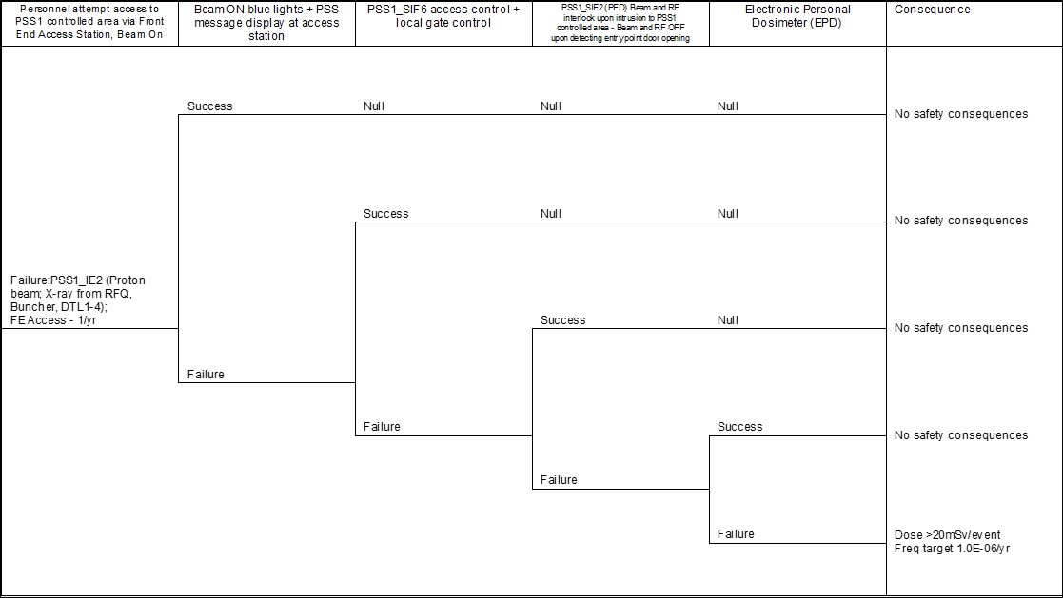
PSS1 Initiating Events Analysis
ETA01A (PSS1_IE2) – Intrusion into PSS1 Controlled Area [Initial Version]
IE: Intrusion into PSS1 area
Beam ON Warning
PSS1_SIF6:
Access Control
PSS1_SIF2: Intrusion Interlock
Electronic Personal Dosimeter
Consequence

Slide 14
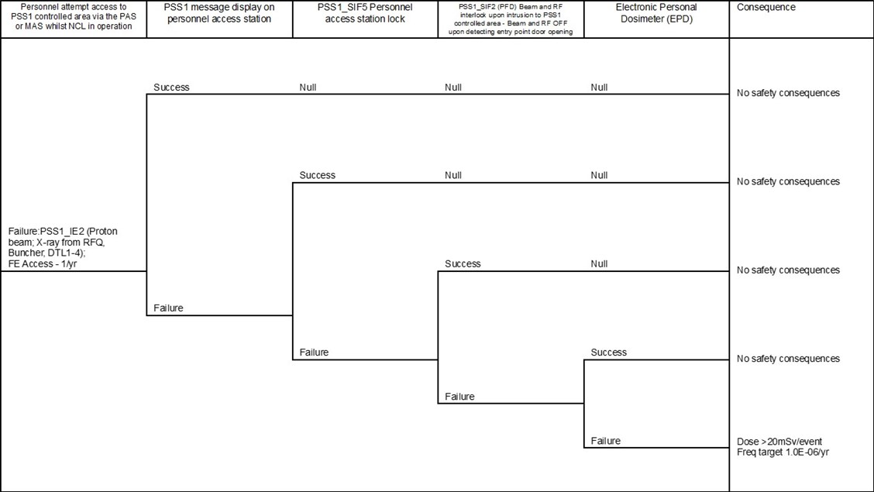
PSS1 Initiating Events Analysis
ETA01A (PSS1_IE2) – Intrusion into PSS1 Controlled Area [Working Version]
IE: Intrusion into PSS1 area
PAS Message Display
PSS1_SIF5:
PAS Lock*
PSS1_SIF2: Intrusion Interlock
Electronic Personal Dosimeter
Consequence

Slide 15
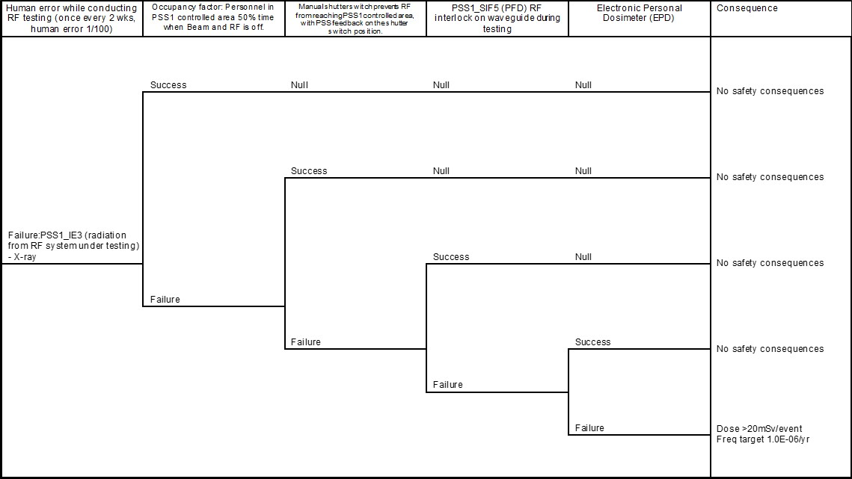
PSS1 Initiating Events Analysis
ETA04 (PSS1_IE3) – Failure to Remove Waveguide Prior to Testing [Initial Version]
IE: Human Error during RF Test
Occupancy Factor
Shutter Switch
PSS1_SIF5: Waveguide Interface
Electronic Personal Dosimeter
Consequence

Slide 16
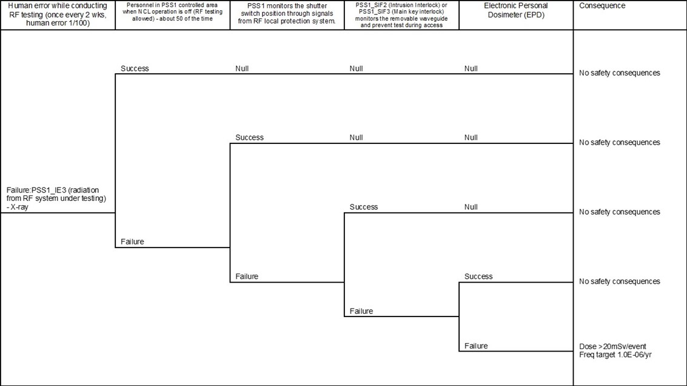
PSS1 Initiating Events Analysis
ETA04 (PSS1_IE3) – Failure to Disconnect RF Power Supply Prior to Testing [Working Version]
IE: Human Error during RF Test
Occupancy Factor
Shutter Switch
PSS1_SIF2 & SIF3 Monitor Waveguides
Electronic Personal Dosimeter
Consequence

Slide 17
PSS1 Initiating Events Analysis
SIFs [Initial Version]
SIFs
  PSS1_SIF1 Emergency switch-off button
  PSS1_SIF2 Intrusion interlock
  PSS1_SIF3 Main key interlock
  PSS1_SIF4 High radiation interlock
  PSS1_SIF5 Waveguide interface during RF testing
  PSS1_SIF6 Personnel access station lock
SIFs action (except PSS1_SIF6)
  Remove permit to energise system
PSS1_SIF6 action
  Electrically lock the access station door

Slide 18
PSS1 Initiating Events Analysis
SIFs [Working Version]
SIFs
  PSS1_SIF1 Emergency switch-off button
  PSS1_SIF2 Intrusion interlock
  PSS1_SIF3 Main key interlock
  PSS1_SIF4 High radiation interlock
  PSS1_SIF5 Personnel access station lock*
PSS1_SIF1-4 action
  Remove permit to energise system
PSS1_SIF5 action
  Lock the PAS* door 2 to prevent access to the PSS1 controlled area
Notes:
Initial PSS1_SIF5 (Waveguide interface) has been combined with PSS1_SIF2 (intrusion interlock) and PSS1_SIF3 (main key interlock). However, this requires further review.
For SIF5 (PAS lock), the SIF function is TBD as the design of PAS/MAS locks needs to be confirmed

Slide 19
Route map
NCL Risk Assessment
Initiating Events Analysis
SIL Determination
SRS
SIL Verification

Slide 20
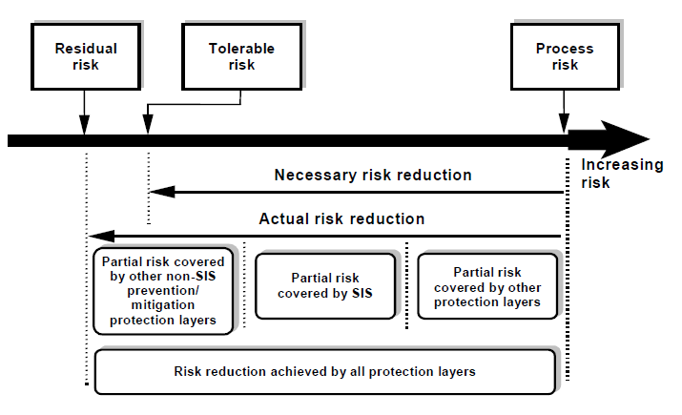
PSS1 SIL Determination
Methodology – LOPA
IEC 61511-3
Notes:
Figure A.1 illustrates the general concepts of risk reduction. The general model assumes that:
– there is a process and an associated basic process control system (BPCS);
– there are associated human factor issues;
– the safety protection layers features comprise:
• mechanical protection system;
• safety instrumented systems;
• non-SIS instrumented systems;
• mechanical mitigation system.

Slide 21
PSS1 SIL Determination
Methodology – LOPA
9. Community Emergency Response
8. Plant Emergency Response
7. Fire & Gas System
6. Physical Containment (Bunds)
5. Physical Protection (Relief Devices )
4. E/E/PE safety-related
3. Alarms & Operator Intervention
2. Basic Process Control System
1. Process
Protection Layers: 1,2,3,4,5
Mitigation Layers: 6,7,8,9

Slide 22
PSS1 SIL Determination
Methodology – LOPA
Target Risk
Risks arising from dangerous failures in the process & in the BPCS
Demands
F3
Risk
Risk reduction achieved by Conditional Modifiers
Risk reduction achieved by Other Risk Reduction Measures
Risk reduction
achieved by SIS/SIF

Slide 23
PSS1 SIL Determination
Methodology – LOPA
Target Risk
Risks arising from dangerous failures in the process & in the BPCS
Demands
F3
Risk
Risk reduction achieved by Conditional Modifiers
Risk reduction achieved by Other Risk Reduction Measures
SILs
4
3
2
1

Slide 24
PSS1 SIL Determination
Results [Initial Version]
Low Demand (demands <1/yr) SIFs
High Demand (demands >1/yr) SIFs
SIF ID | SIF Description | Risk Target (/yr) | PFD Target | SIL Target
PSS1_SIF1 | Emergency switch-off button | 1.0E-6 | 8.1E-1 | <SIL 1
PSS1_SIF2 | Intrusion interlock | 1.0E-6 | 9.1E-3 | SIL 2
PSS1_SIF4 | High radiation interlock | 1.0E-6 | 9.1E-4 | SIL 3
PSS1_SIF5 | Waveguide interface during RF testing | 1.0E-6 | 7.7E-3 | SIL 2
SIF ID | SIF Description | Risk Target (/hr) | PFH Target | SIL Target
PSS1_SIF3 | Main Key interlock | 1.1E-10 | 2.3E-6 | SIL 1
PSS1_SIF6 | Personnel Access Station lock | 1.1E-10 | 1.1E-6 | SIL 1

Slide 25
PSS1 SIL Determination
Results [Working Version]
Low Demand (demands <1/yr) SIFs
High Demand (demands >1/yr) SIFs
SIF ID | SIF Description | Risk Target (/yr) | PFD Target | SIL Target
PSS1_SIF1 | Emergency switch-off button | 1.0E-6 | 8.1E-1 | <SIL 1
PSS1_SIF2 | Intrusion interlock | 1.0E-6 | 4.2E-3 | SIL 2
PSS1_SIF4 | High radiation interlock | 1.0E-6 | TBD | TBD
SIF ID | SIF Description | Risk Target (/hr) | PFH Target | SIL Target
PSS1_SIF3 | Main Key interlock | 1.1E-10 | 2.3E-6 | SIL 1
PSS1_SIF5 | Personnel Access Station* lock | 1.1E-10 | 1.1E-6 | SIL 1
Notes:
SIF2 – PFD target reduces to 4.2E-3 (more difficult to achieve) when merged with SIF5, due to additional initiating event (RF testing error)

Slide 26
Route map
NCL Risk Assessment
Initiating Events Analysis
SIL Determination
SRS
SIL Verification

Slide 27
PSS1 SRS (ESS-0121565)
Safety Requirements Specification (SRS) for PSS1
  Inputs
    Results from SIL Determination
    Requirements from IEC 61511
    ConOps
  Outputs
    SRS document (ESS-0121565), used for
      Design and engineering
      SIL Verification (ESS-0483346)
        To confirm the design meet SIL targets from SIL Determination
      Subsequent safety lifecycle stages
      FAT, SAT, commissioning, operation, maintenance, etc.
Planned actions to support the SRS:
Human reliability analysis
Information security analysis
Notes:
Add security risk assessment and human reliability analysis

Slide 28
Route map
NCL Risk Assessment
Initiating Events Analysis
SIL Determination
SRS
SIL Verification

Slide 29
Work in Progress
Additional initiating events
  E.g. person in contact or working near ISrc HV PS.
Update of the PSS1 SIFs
  SIF2 and SIF3 to be updated to make sure the ISrc HV PS is always switched-off if triggered (regardless of RF system isolation).
  SIF5 to be updated to separate between PAS, MAS and Emergency exit doors.
Confirm the functionality of locking/closing mechanisms for PAS and MAS.
Confirm shielding as a protection layer to finalise the SIL target for SIF4.

Slide 30

Questions?
Thank you for your attention!

Slide 31
Backup slides

Slide 32
PSS1 Initiating Events Analysis
(ESS-1099822)
Inputs
  Risk Assessment (ESS-0118232, ESS-1076227 – Appendix of ESS-0512890) (hazard identification and analysis)
  PSS1 Concepts of Operations (ConOps) (ESS-0100563)
  PSS1 Required Information (ESS-1419309)
Outputs
  List of initiating events (IEs) and associated hazards requiring PSS1 protection, and their frequencies
  List of high level safety requirements for PSS1
  List of PSS1 safety functions (SIFs in IEC 61511 terms)

Slide 33
PSS1 SIL Determination
(ESS-0121562)
Safety Integrity Level determination for PSS1 SIFs
Inputs
  PSS1 Initiating Events Analysis (ESS-1099822):
    List of SIFs
    List of IEs and frequencies
  List of Independent Protection Layers (IPLs)
    ConOps
    Assumptions and Technical Details
Outputs
  SIL targets for SIFs
  Safety Requirements Specification (SRS) (ESS-0121565)

Slide 34
PSS1 SIL Verification
(ESS-0483346)
To verify that the design meets the SIL targets
Inputs
  SIL Determination (ESS-0121562) results
Outputs
  SIL Verification (ESS-0483346)
  Updated SRS (ESS-0121565) with SIL Verification results
Method
  Fault Tree Analysis (FTA)
  Reliability Block Diagram (RBD)

Slide 35
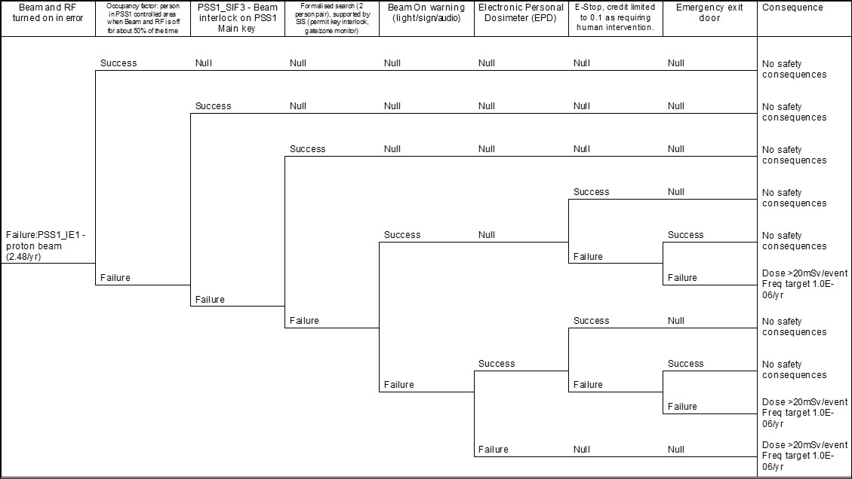
PSS1 Initiating Events Analysis
ETA – PSS1 operation inadvertently started [Initial Version]

Slide 36
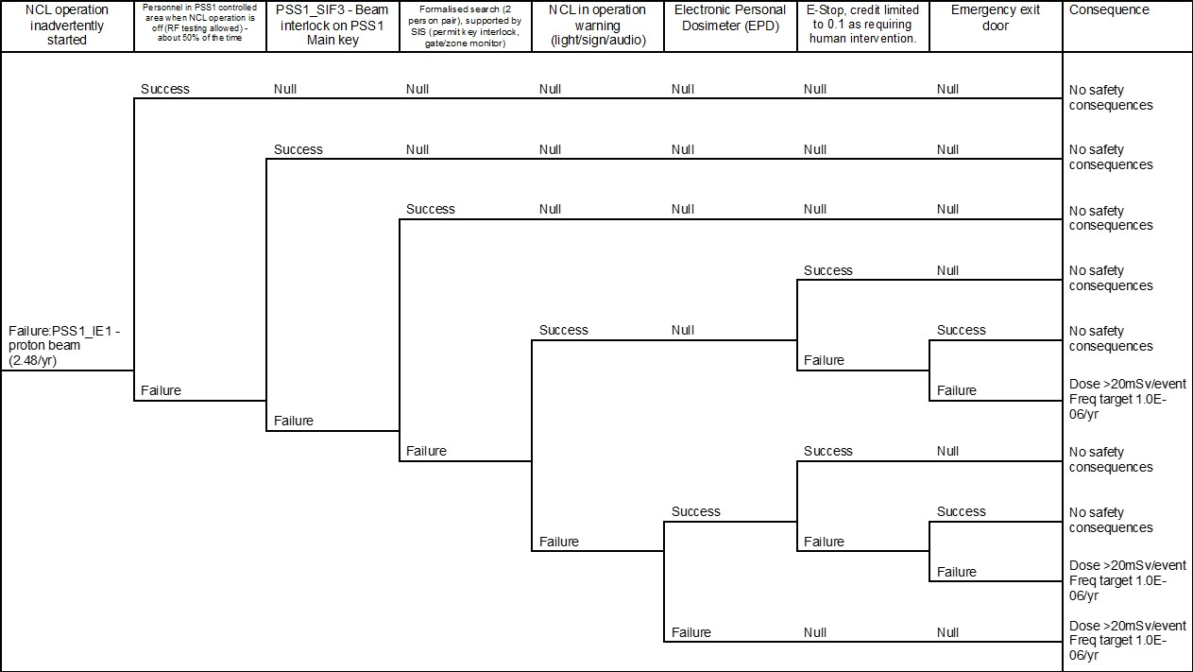
PSS1 Initiating Events Analysis
ETA – PSS1 operation inadvertently started [Working Version]

Slide 37
PSS1 SIL Verification
RBDs
PSS1_SIF1, Emergency switch-off button

Slide 38
PSS1 SIL Verification
RBDs
PSS1_SIF2, Intrusion interlock
PSS1_SIF3, Main key interlock

Slide 39
PSS1 SIL Verification
RBDs
PSS1_SIF4, High radiation interlock
PSS1_SIF5, Personnel access station lock
Note. SIF architecture TBD as the PAS/MAS designs are not confirmed

