Slide 1
PSS1 Planning - Overview A. Nordt
PSS1 Preliminary Design Review
Date: 2019-09-18

Slide 2
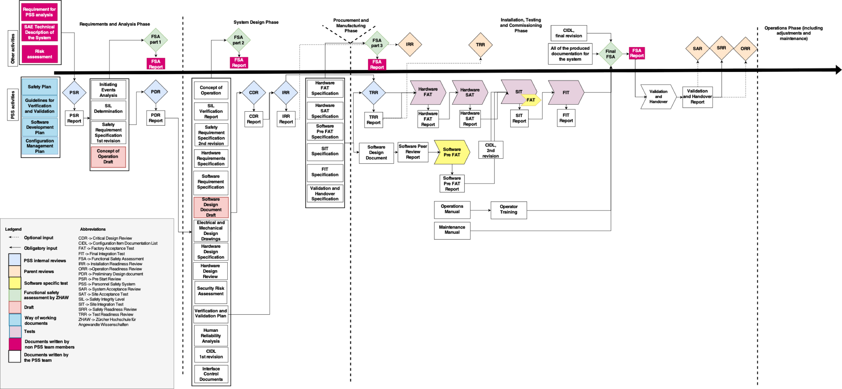
What Do We Have To Do And When?
Pre-Start Review: 2019-08-23
Preliminary Design Review: 2019-09-18
Critical Design Review: 2019-12-01
Installation Readiness Review: xxx
Test Readiness Review: 2020-01-01
Handover: 2020-03-25
Safety Readiness Review #2: 2020-04-06
In P6 (ESS official schedule):
2020-02-26 - 2020-03-24 for PSS1 SIT + FIT

Slide 3
Overall PSS1 Activities up until Handover
1) PSS1 Reviews
PSR PSS1
PDR PSS1
CDR PSS1
IRR PSS1
TRR PSS1
SRR#2
2019-08-23 2019-09-18 2019-12-01 xxxxxx 2020-01-01 2020-04-06
2) PSS1 SW, FSA, SIT, FIT/End Dates
Decision on SIFs
SW Develop-ment
SW
Review
SW Simula-tion
SW
Pre-FAT
Pre FSA Report
Implement findings from Pre FSA Report
SIT
FIT
FSA
Report
Hand-over
2019-09-20 2019-12-22 2020-01-20 2020-02-01 2020-02-10 2020-02-20 2020-02-26 2020-03-05 2020-03-24 2020-03-20 2020-03-25
3) PSS1 HW FAT, SAT, SIT, FIT/End Dates
El. And mech. design
HW Design specs
HW Design review
Insta-llation
HW
FAT
HW
SAT
Implement findings from Pre FSA Report
SIT
FIT
FSA
Report
Hand-over
2019-11-30 2019-11-30 2019-11-30 2020-01-17 2020-01-25 2020-02-15 2020-02-26 2020-03-05 2020-03-24 2020-03-20 2020-03-25

Slide 4
To Be Kept in Mind
SSM
We have no feedback yet from SSM regarding the NCL trial ops license application (sent 2019-07-15)
In case SSM does comment on how we do SW development/deployment or on PSS1 design (e.g. 1 train), then
this can impact on schedule (severity is not predictable at this point in time)
PSS1 Lifecycle/SW verification
Challenging to find a “free” independent reviewer of PSS1 software and we may have to reduce review scope
PSS1 Phases (i.e. re-validation of PSS1)
AD foresees two NCL commissioning phases:
Beam from Ion Source up to DTL 1 (starting in 2020-04 after SRR)
Beam from Ion Source up to DTL 4 (2020-? → tbd)/ originally planned for 3 months after phase I)
However AD also needs PSS1 for RF conditioning (before beam operation):
RFQ RF conditioning may be needed before 2020-03
Potential solution is to exclude access control system, implying a major change in the PSS1 design

Slide 5
Other Aspects
TS2 PSS has not been finalised yet and is planned to be handed over by 2019-10-16.
ODH detection system phase 2 (for whole accelerator) is planned to be handed over by 2020-02.
PSS1 is planned to be handed over by 2020-03-25.
Careful and effective planning of priorities, limited amount of time and resources required.
Frequent and constructive communication with all stakeholders required.
THANK YOU ☺

