Slide 1
First & Early Science

Slide 2
Measurements on day-one
Hot commissioning (first science) and early science
Scientific hot commissioning (first science) – instrument paper
Simple experiments with standard samples
Using different modes pulse shaping/modulation
Test of the positioning system
sample environment in a second step
Early science – advanced user participation
Texture measurement with robot (rotation needed)
Strain scanning of complex shape sample/ two phases using modulation technique
Deformation rig experiment
Deformation rig with furnace experiment

Slide 3
Hot commissioning
Definition and Requirements
Measurement on a standard powder sample, e.g. Si, Ni, diamond … / polycrystalline engineering sample e.g. duplex-steel, … using pulse shaping mode with different resolution
  DMSC
  Needed data reduction procedure to 1D I(Q), I(d)
  Individual peak fitting procedure (I, FWHM, d, …)
  No special data analysis software needed
  Duration: 4 weeks
Strain measurement on already characterized sample using pulse shaping mode
  MCA & DMSC
  Movement of hexapod integrated into control software
  Strain -> stress recalculation procedure
  Ability to plot strain/stress as a function of position
  Duration: 4 weeks

Slide 4
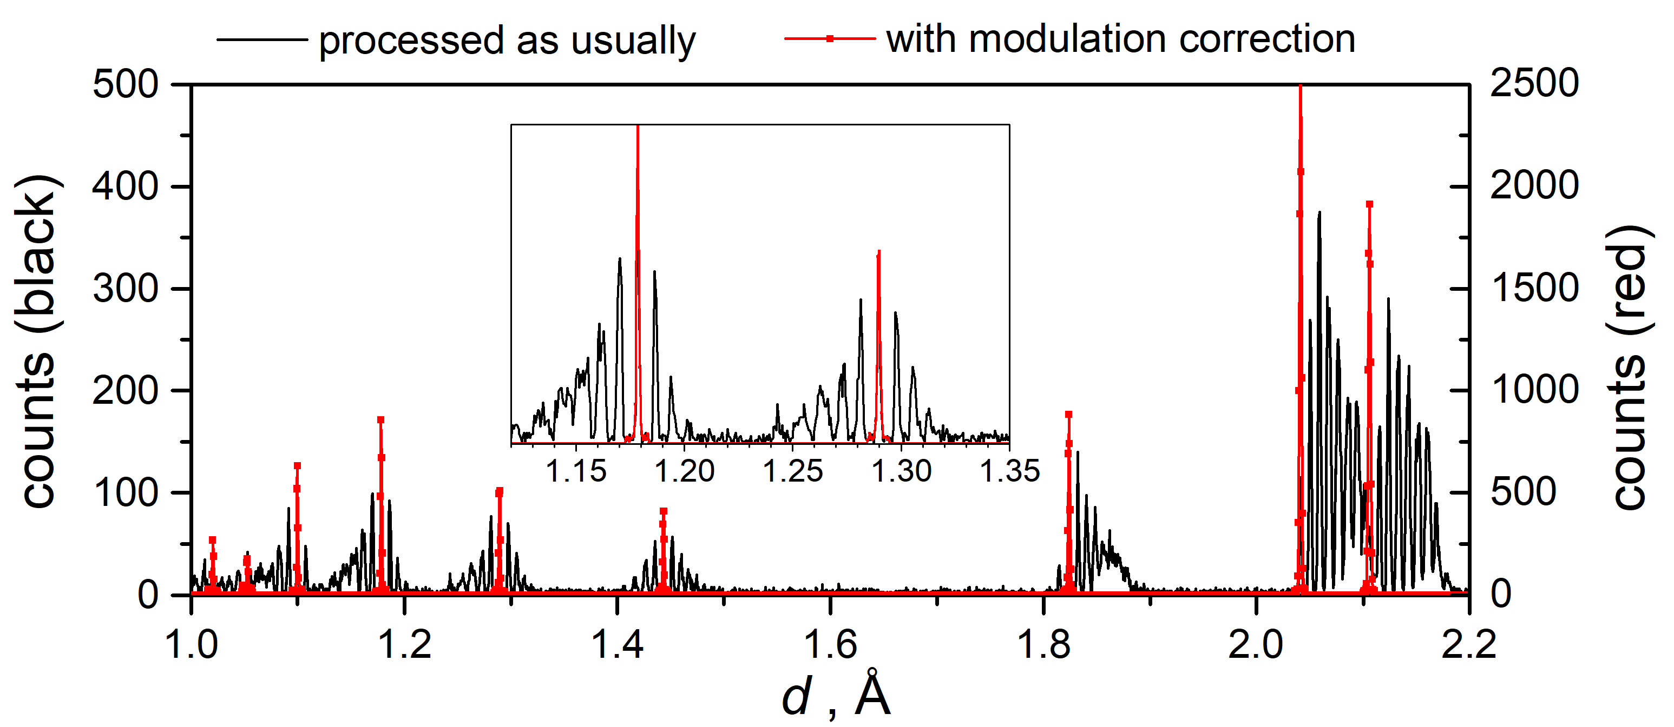
Hot commissioning
Definition and Requirements
Measurement on a standard powder sample, e.g. Si, Ni, diamond … / polycrystalline engineering sample e.g. duplex-steel, … using modulation mode with different resolution
  DMSC
  Data reduction procedure for
    modulation technique to 1D
  Duration: 8 weeks
Strain measurement on already characterized sample (tbd) using modulation mode
  DMSC
  Automatic data reduction for modulation technique
  Plot of strain/stress as a function of trajectory
  Duration: 12 weeks
Stress

Slide 5
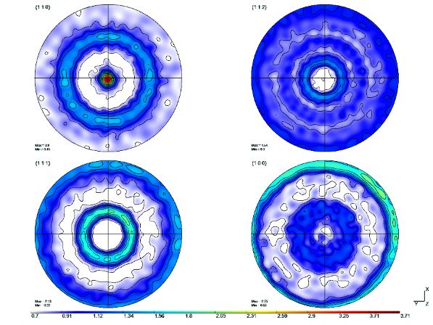
Early Science
Definition and Requirements
Texture measurement on already characterized sample, e.g. Cu
  DMSC & MCA
  Data reduction procedure with detector area slicing
  Intensity binning by angular position (𝜑, 𝜒)
  Integration of robot movement into the control software
  Full pole figure plots
  ODF analysis not needed (m-Tex, jTex, Bartex, …)
  Duration: 4 weeks
Texture measurement on user defined sample (ex. additive manufacturing, …)
  DMSC
  Automatic routine for the pole figure data reduction
  Duration: 4 weeks
Slice 1 – 5∘
Slice 2 – 5∘
Slice 3 – 5∘
Slice 4 – 5∘
…
Slice n – 5∘

Slide 6
Early Science
Definition and Requirements
In-situ measurement using stress rig (pulse shaping or modulation technique)
  DMSC + SAD
  Ready to use deformation rig (for tests by Q2 2023)
  SE parameters integrated into control software
  Automatic data reduction by SE status
  Peak search and fitting routine
  Duration: 4 weeks
Advanced strain scanning using modulation technique
  DMSC + SAD
  3D scanning of the sample -> scanning path definition
  2D (3D) strain/stress maps
  Precise positioning of the sample
  Duration: 4 weeks

Slide 7
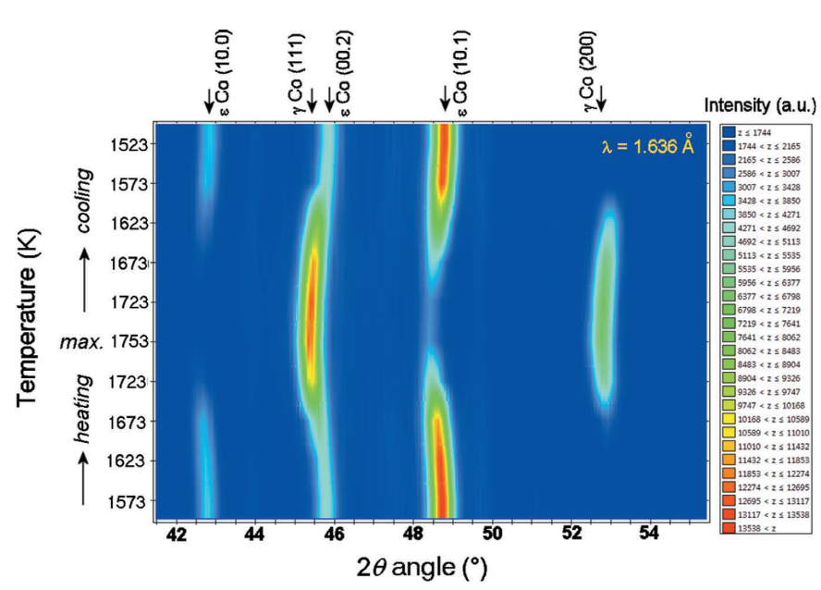
Early Science
Definition and Requirements
In-situ measurement of phase transformation using furnace
  DMSC + SAD
  Ready to use pool furnace
  SE parameters integrated into control software
  Automatic data reduction by SE status
  Data reduction to 1D – I(Q), I(d)
  Data analysis done in FP, GSAS, …
  Duration: 2 weeks
In-situ measurement using deformation rig and furnace
  DMSC + SAD
  Ready to use furnace on deformation rig
    (for tests by Q4 2023)
  Automatic peak search and fitting routine
  SE driven experiment (active feedback in future)
  Duration: 4 weeks

