Slide 1
STAP meeting for Imaging & Engineering 15-16 October 2019 Welcome & Organization
Premek Beran
www.europeanspallationsource.se
Notes:
Let me also take this opportunity to thank Markus for all the work he has done in his role as the instrument class coordinator up to now! He will remain closely involved in ODIN of course and also through collaborations in BEER.

Slide 2
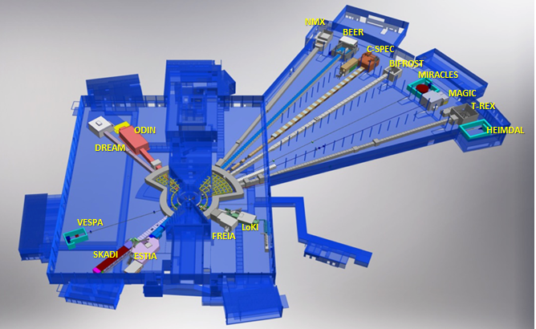




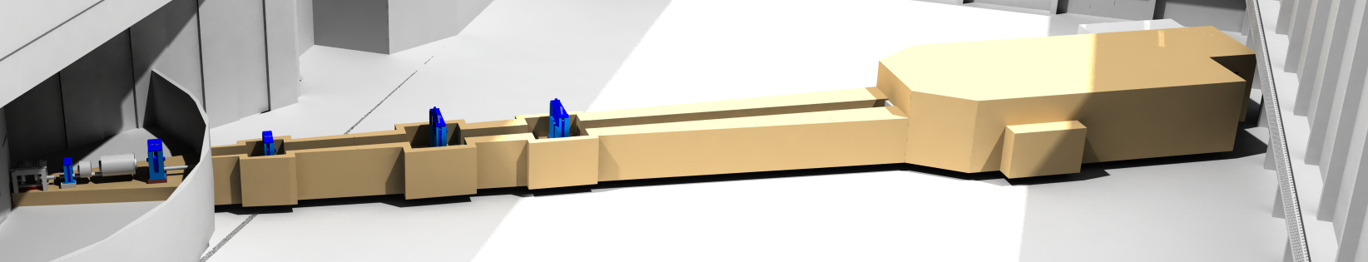






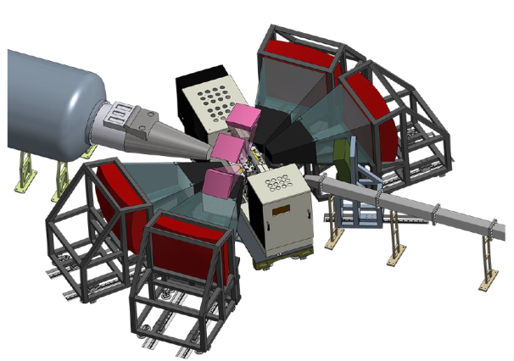

STAP meeting for Imaging & Engineering
Optical and Diffraction Imaging with Neutrons (ODIN)
ODIN imaging
SKADI GP-SANS
LOKI Broadband SANS
Surface Scattering
FREIA Hor. Refl.
ESTIA Ver. Refl.
HEIMDAL Pow. Diffr.
DREAM Pow. Diffr.
Monochromatic Powder Diffractometer
BEER Eng. Diffr.
Extreme Conditions Diffractometer
MAGIC Magn. Diffr.
NMX Macromol. Diffr.
CSPEC ColdChopSp
VOR BroadbandSp
T-REX ThChopSpec
BIFROST Xana Spec
VESPA Vibr.Spec.
MIRACLES BckScatt
High-Resolution Spin-Echo
Wide-Angle Spin-Echo
Fundamental & Particle Physics
Large-Scale Structures
Spectroscopy
Diffraction
life sciences | magnetism & superconductivity
soft condensed matter | engineering & geo-sciences
chemistry of materials | archeology & heritage conservation
energy research | fundamental & particle physics
Beamline for European Materials Engineering Research (BEER)

Slide 3
Wi-Fi
eduroam
ESS Guestnetwork (password “akeyspecialforess”)

Slide 4
STAP meeting for Imaging & Engineering
History of STAP meetings
STAP on 17 June 2016 in Lund https://indico.esss.lu.se/event/581/
STAP on 20 – 21 Nov 2017 in Lund https://indico.esss.lu.se/event/911/
STAP on 12 – 13 April 2018 per Video https://indico.esss.lu.se/event/1000/
STAP on 16 – 17 Oct 2018 in Berlin https://indico.esss.lu.se/event/1087/
STAP on 12 – 22 Mar 2019 per Video https://indico.esss.lu.se/event/1215/
STAP on 15 – 16 Oct 2019 in Lund https://indico.esss.lu.se/event/1306/
STAP members
Sven Vogel (chair, LANSCE)
Luise Theil Kuhn (DTU)
Francesco Grazzi (CNR-ISC)
Stephen Hall (Lund University)
Nikolay Kardjilov (HZB)
Javier Santisteban (Centro Atomico Bariloche) excused, will try join partly by video

Slide 5
Charge
Get informed of current instrument status and associated tasks
AGENDA
The instrument teams from the two instruments in this class, ODIN and BEER, will provide an overview of the instrument progress on day 1 of the meeting.
Day 2 of the meeting will start with the open discussion about the first and early science and followed by update status of the software development
Excursion of the ESS construction site is planed at the end of the second day
https://indico.esss.lu.se/event/1306/attachments/9396/15105/Charge_for_Imaging_and_Engineering_STAP_meeting_-_Fall2019.pdf

Slide 6
Some organizational things…
Visitor badge:
Return it when leaving
Sign-off when leaving
Wear them visibly all the time
Access to site:
30 min training arranged
60 min walk visit E01-E02 and accelerator tunnel gallery
Let me know final decision about your interest
Dinner:
tonight at 19.00 at Mediteranean Restaurant in Lund center
Walk distance from Lund C or cathedral

Slide 7
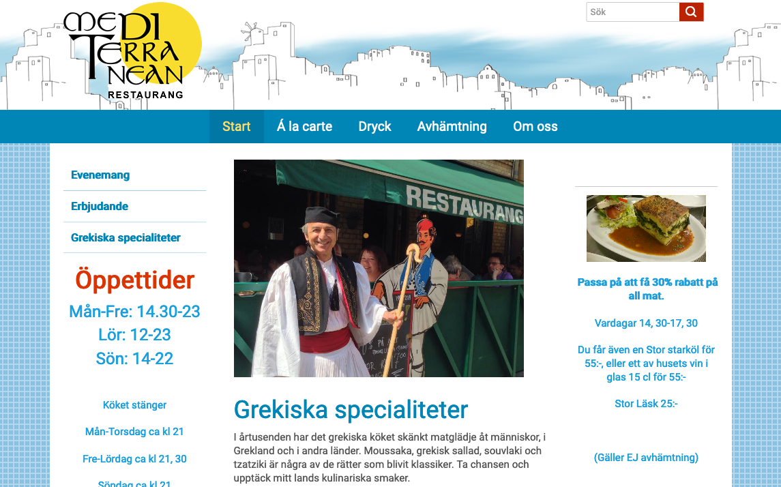
Some organizational things…

Slide 8
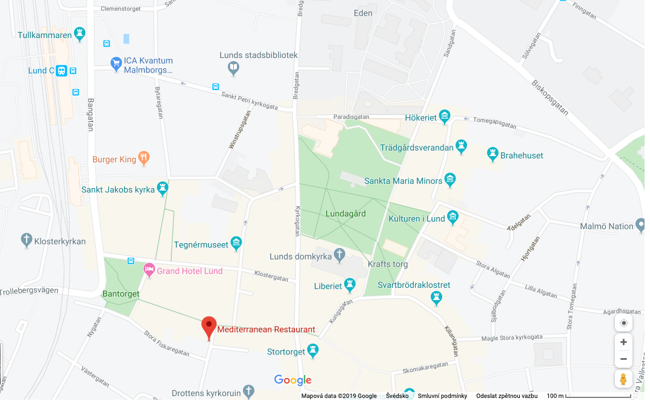
Some organizational things…

