Slide 1
ODIN: Optical and Diffraction Imaging with Neutrons at the ESS Status and perspectives of the ODIN Project
PSI: M. Morgano, M. Strobl
TUM: E. Calzada, A. Tartaglione, M. Schulz
Notes:
Phase 2, May 31st. 2017

Slide 2
Outline
ODIN overview
ODIN General overview
High level requirements
Instrument main layout
In Bunker – Ex Bunker components
Life cycle
ODIN Project Update (since last STAP)
Update TUM
Next milestones and actions
Update PSI (by Manuel)
Technical and Design update (by Elbio later)

Slide 3
ODIN General Overview
Optical and Diffraction Imaging with Neutrons: Neutron radiography and ToF imaging with variable wavelength resolution
It will be a “first round” instrument.
(Currently) one of the three “day-1” instruments (SOUP 31.12.2023)
Joint project of PSI and TUM with TUM as lead institution
Total Budget 11.6M€
Notes:
Proposed by Markus, Linda and Henrik
It was a collaboration of more partners (e.g. ESS) but now there is two…

Slide 4
ODIN General Overview
Multi purpose imaging instrument
50m Source to pinhole
Sample located up to 14m from the pinhole
Straight beamline (direct view of the source)
Chopper cascade consisting of 9 axis (plus 1 T₀)
Range of operational modes:
“White beam” imaging with spectral choice
Low Time of Flight resolution
Grating interferometry
SEMSANS imaging
Medium Time of Flight Resolution
Polarized and polarimetric neutron imaging set-up, Bragg-edge and diffraction
High Time of Flight Resolution: Bragg-edge and diffraction geometry set-up
Perpendicular X-ray imaging set-up

Slide 5
High Level Requirements
Field of View up to 20✕20cm² with a homogeneity of more than 75%
High resolution: Real space resolution of 10µm (smaller FOV)
ODIN shall cover a wavelength range from 1 to 20 Å to make optimal use of ESS’s spectrum.
Wavelength resolutions of 10%, 1% and down to below 0.5% for spectra from 1 Å to 10 Å and 1 Å to 5.5 Å shall be available.
Bandwidths of about 4.5 Å and 9 Å in every pulse and single pulse suppression modes shall be freely selectable between 1-20 Å.

Slide 6
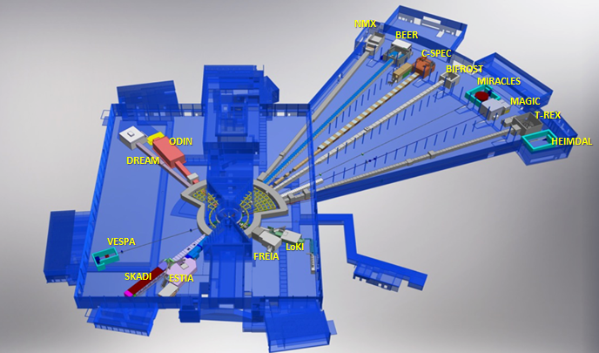
Instrument main layout
Notes:
One of 7 German instruments, two of which are lead by TUM, (One by Jülich @ MLZ, three by Jülich, two by HZG, former GKSS?)

Slide 7
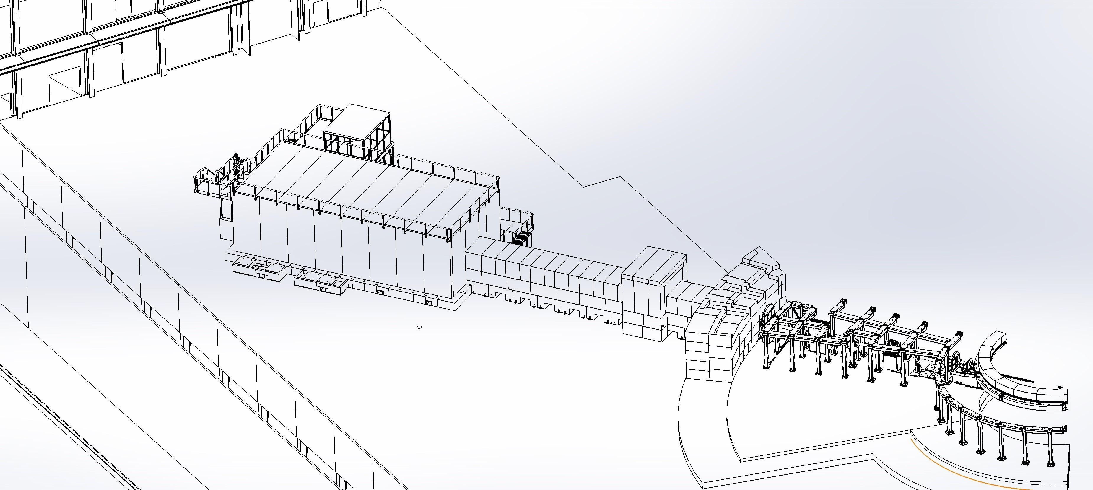
Instrument main layout
Ex-Bunker
In-Bunker
Notes:
1) Conflicts with DREAM solved
2) Add remote handling area (11m from source which means 5m downstream from NBOA output)

Slide 8
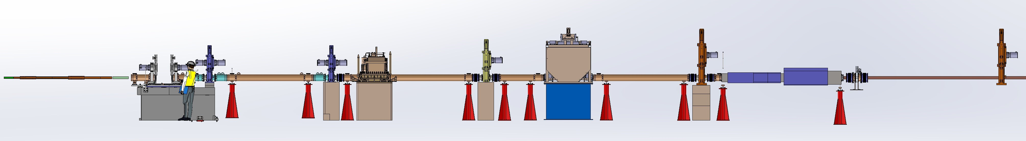
In-Bunker main components
FOC2,BP2
FOC3
FOC4
FOC5
WFM1&2
NBOA
Feedthrough
FOC1,BP1
T0
Heavy shutter

Slide 9
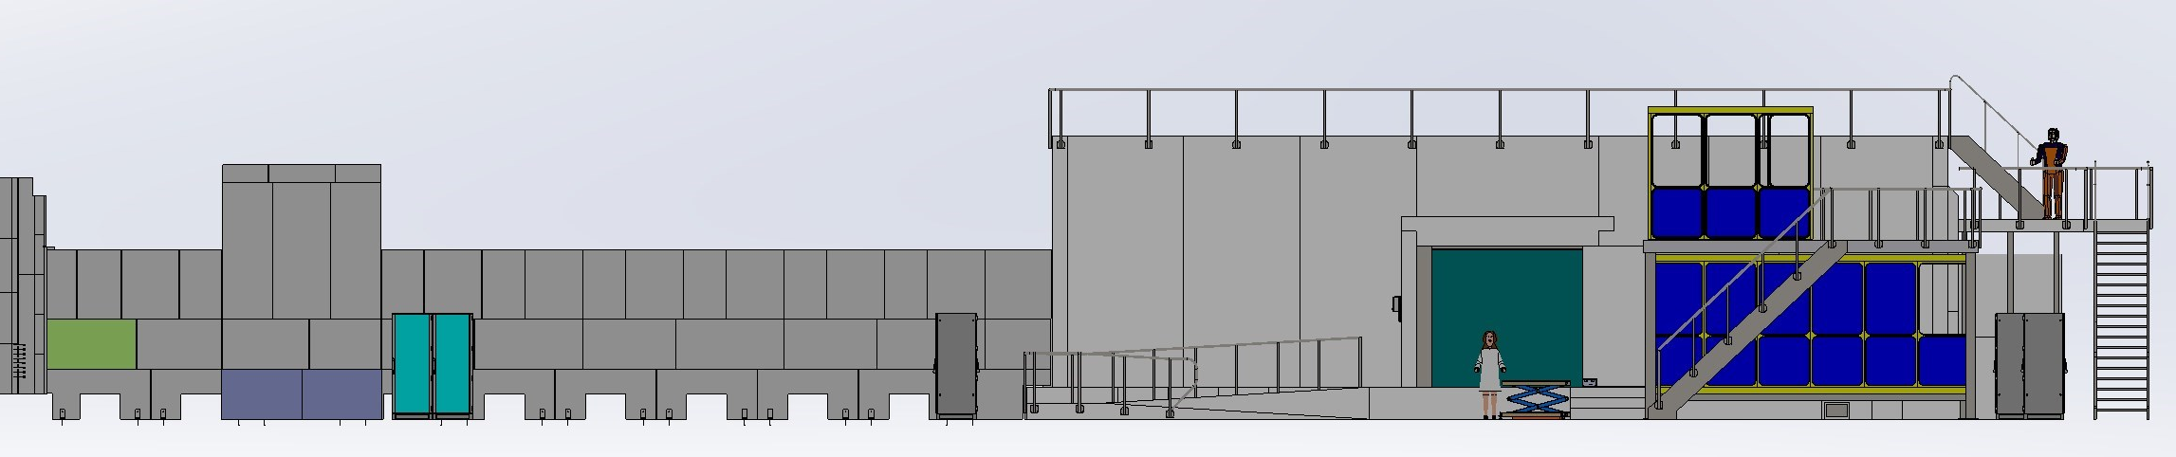
Ex-Bunker main components
Sample preparation & Storage
Guide shielding
Cave
FOC5
Hutch
Racks

Slide 10
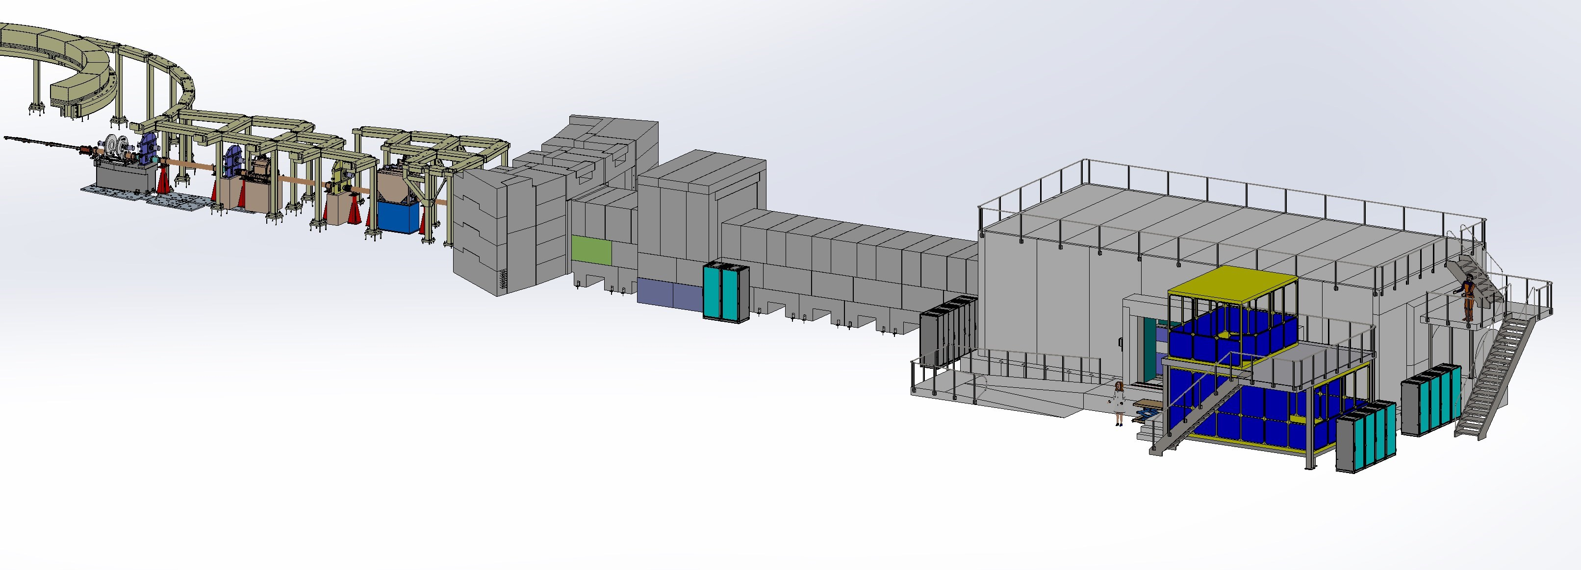
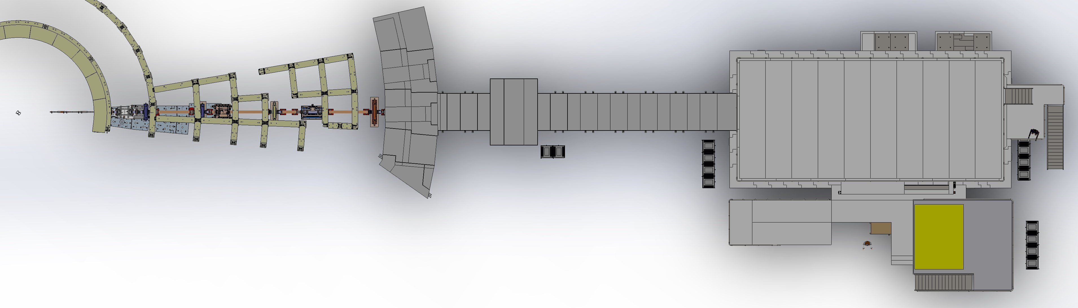
Main layout

Slide 11
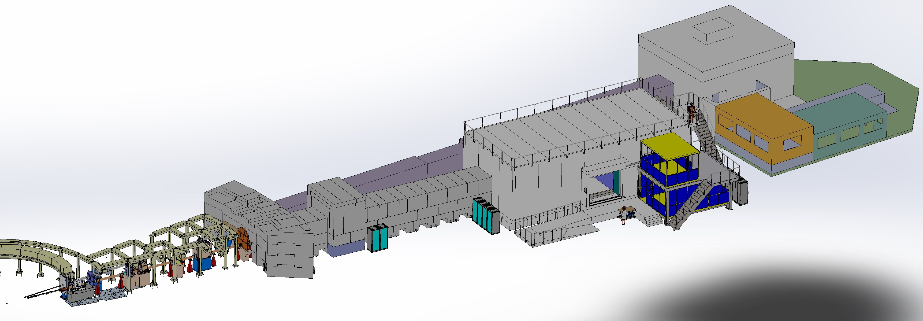
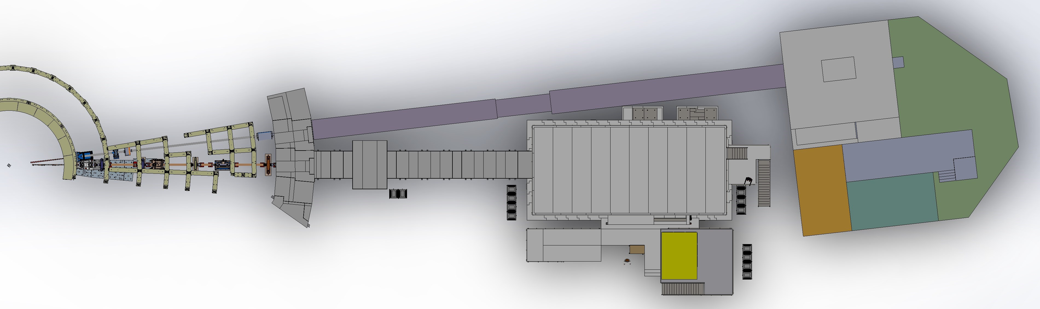
Main layout: Dream

Slide 12
Work Units (TUM-PSI)
Heavy shutter (TUM)
T0 Chopper (TUM)
Choppers (TUM)
Guides + NBOA (PSI)
Motion control and electric engineering (TUM)
Shielding
Cave shielding (TUM)
Guide shielding (TUM)
Cave interior (PSI)
Instrument infrastructure (TUM)
Control Hutch (TUM)
Sample preparation area & storage (TUM)

Slide 13
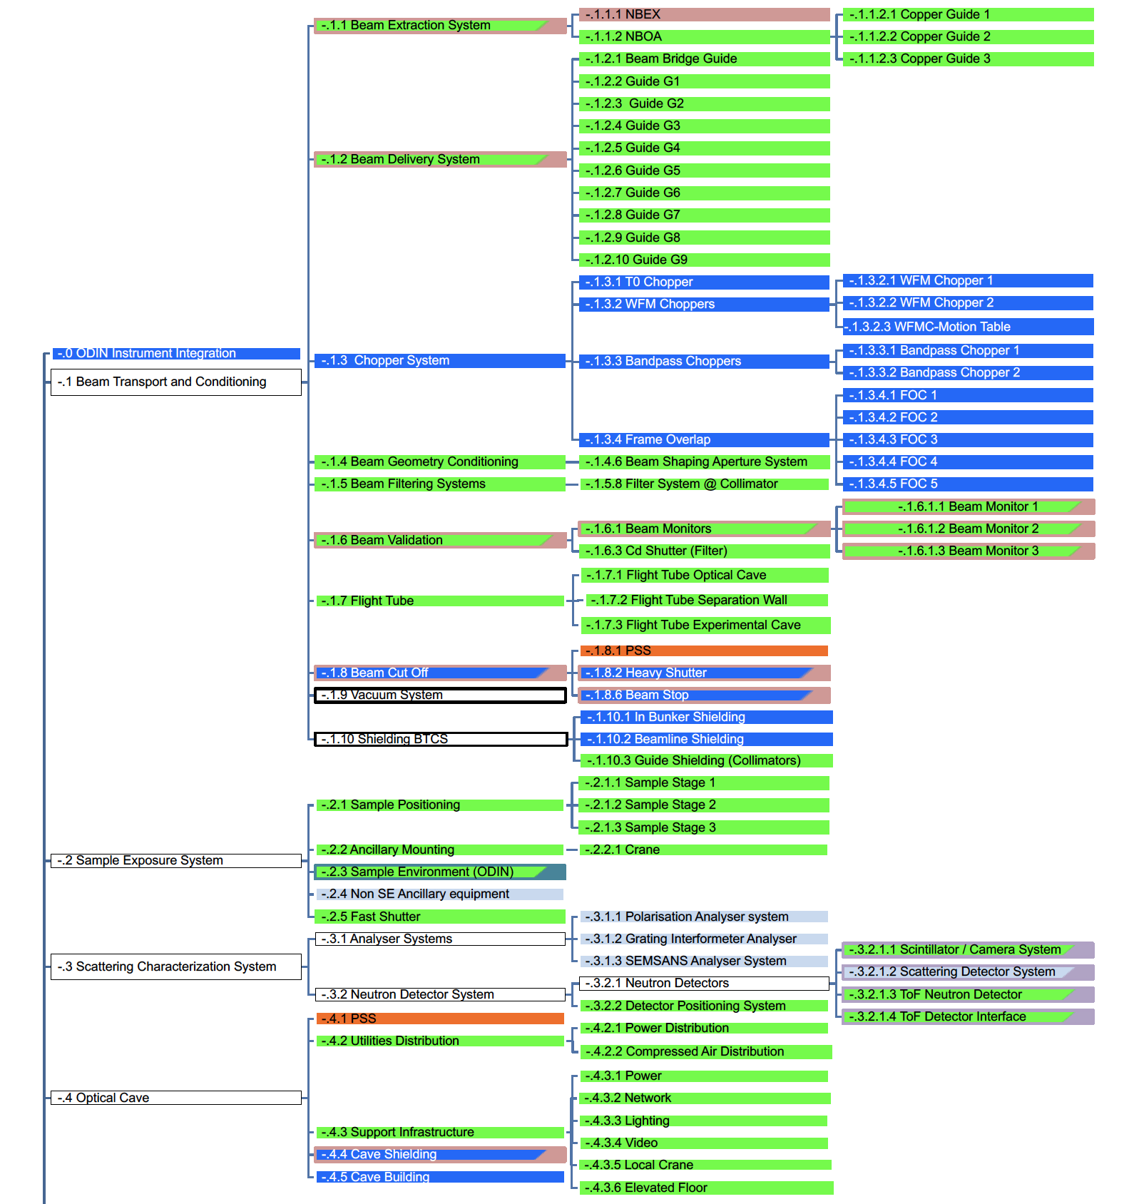
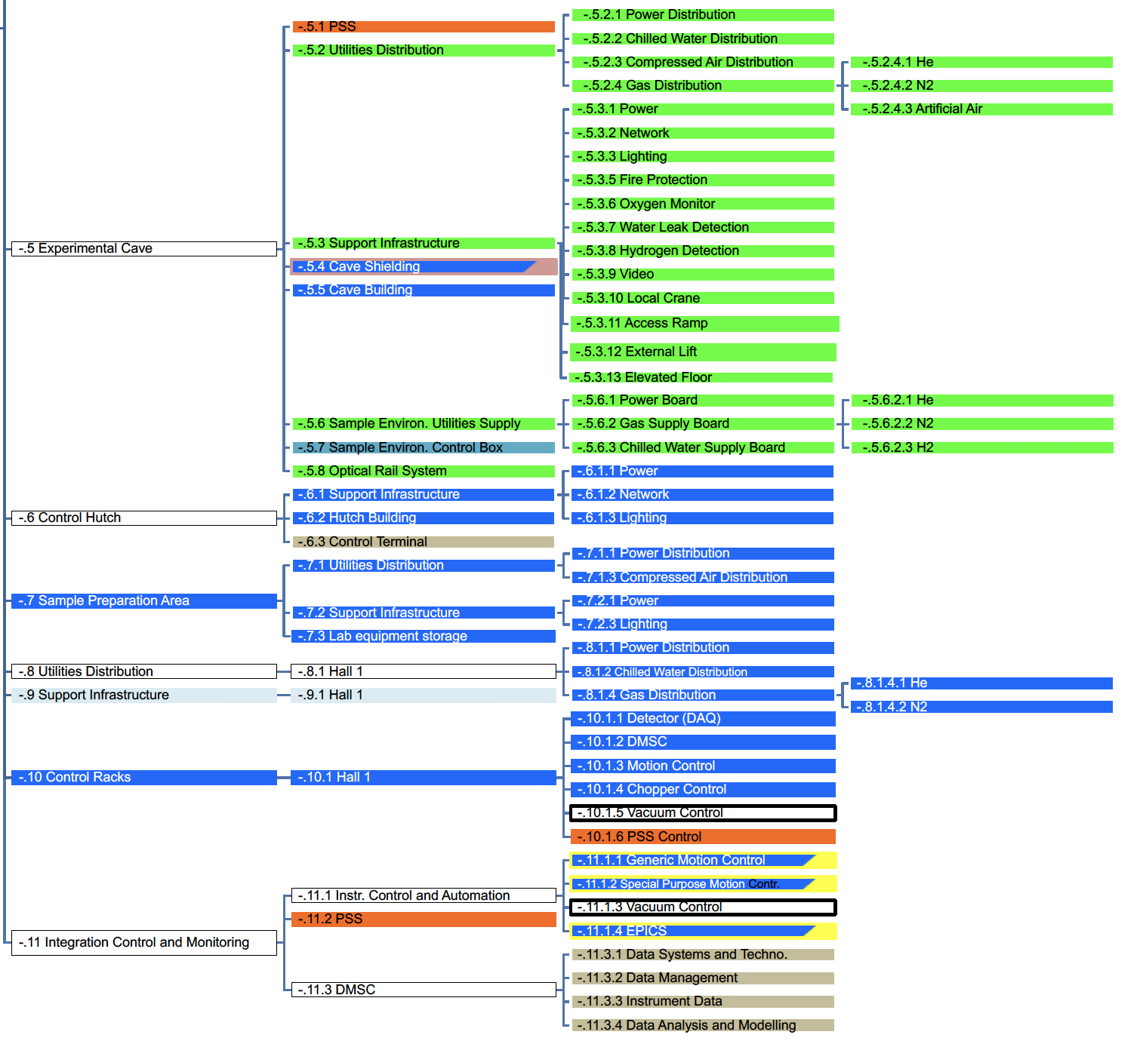
PBS

Slide 14
Instrument life cycle
Design
Manufacturing,
Procurement
Construction,
Installation
Operations
Decommissioning
2017
2018
2020
2022
2023
2065?
First beam
on target 07.07.2022
Handover to operations
Final engineering design
Manufacturing and Procurement
Construction Installation
Beam test &
Commissioning
Operation and continuous upgrade and development period
Decomm. period
Staging to full scope
TG2
TG3
TG4
TG5
TG6
Upgrade and/or modernization work
PDR
CDR
IRR
SAR
ORR
bunker wall penetration design | design monolith insert envelop | arrival in-monolith optics to ESS site | bunker wall insert delivered to ESS | Partial Access D01 | Start In-bunker installation | End In-bunker installation | Hot Commissioning (TG5) | User Programme
03-Mar-17 | 31-Jun-18 | 24-Jan-19 | 15-Nov-20 | 03-Jun-21 | 11-Aug-21 | 25-Feb-22 | 06-Jul-22 | 31-Dec-23

Slide 15
ODIN Project Update: update TUM
MOU signed
IKA TUM signed – TA Endorsed

Slide 16
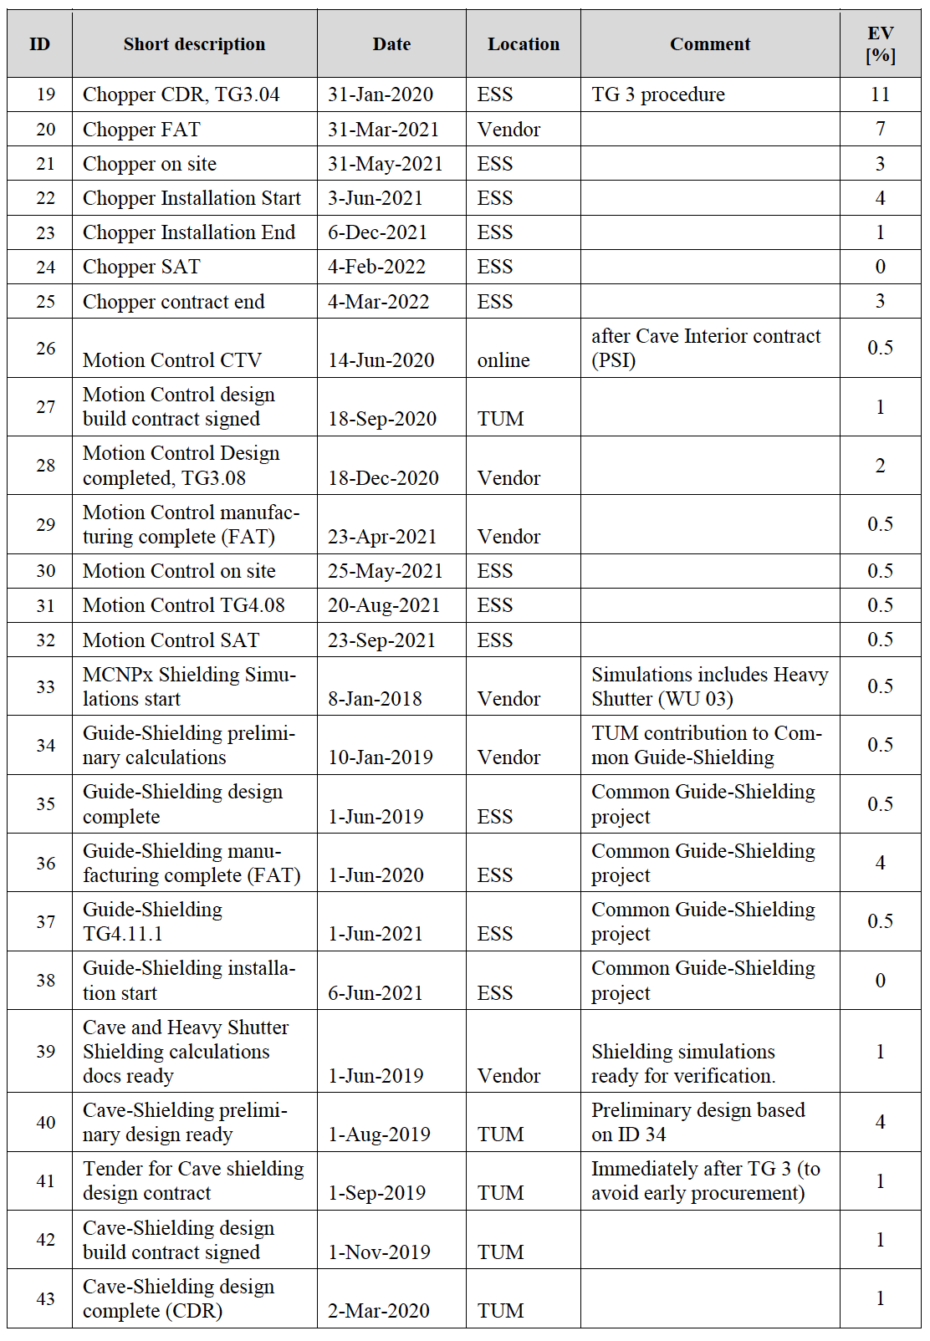
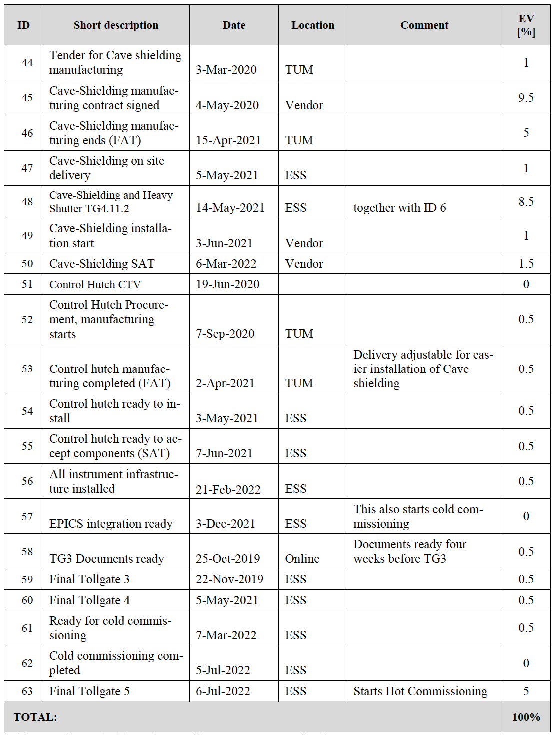
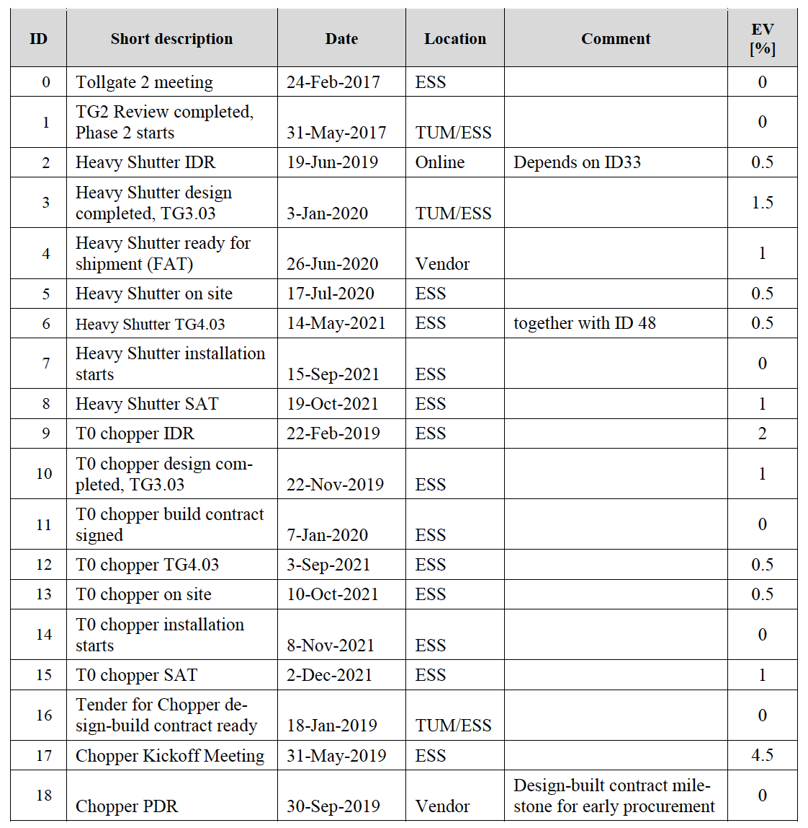
ODIN Project Update: update TUM
Technical Annex: Milestones TUM and progress reports

Slide 17
ODIN Project Update: update TUM
Technical Annex: Milestones TUM and progress reports
Three progress reports delivered since TA signed: July, August, September
Progress reports follows TA milestones achievement, date deviations, general activities updates and SPI = EV/PV
Notes:
Cost book value??? Why in some cases is it not the same as in table 5??

Slide 18
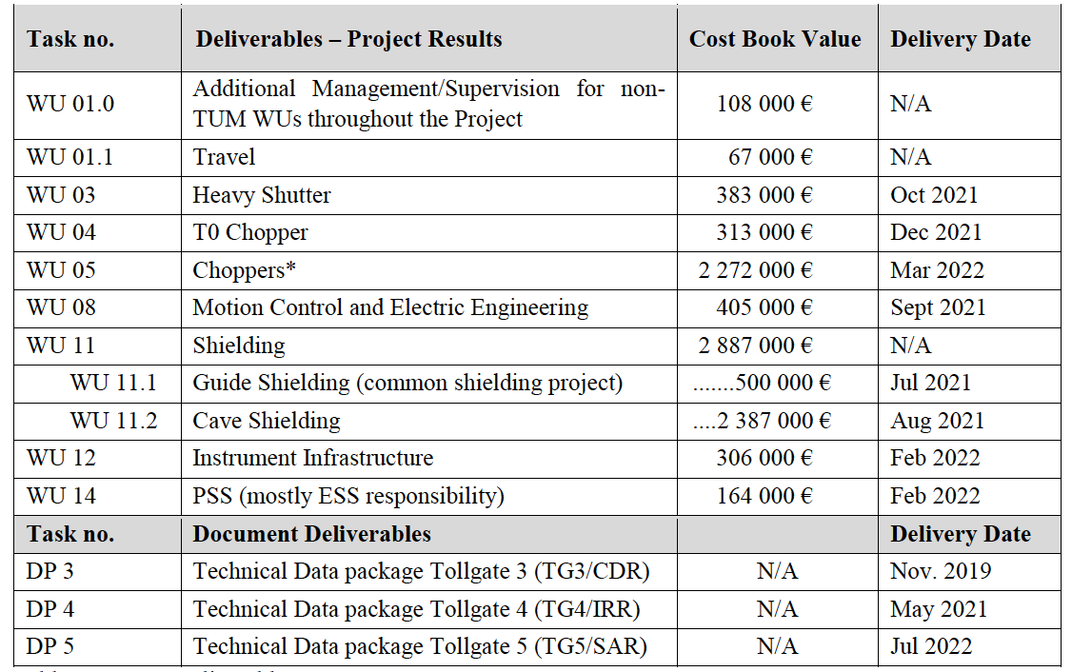
ODIN Project Update: update TUM
Technical Annex: work packages TUM
Notes:
Show results of Florian… Also mention calculations for T0 chopper

Slide 19
ODIN Project Update: update TUM
Shielding calculations
TUM has a contract with Florian Grunauer for MCNP simulations
Based on H1/H2 scenarios
Preliminary results of “cave” were ready in May 2019
Cave mechanical design revised → Impact on floor loading
Solution for floor loading needed and complementary shielding simulations for cave (optimization) and heavy shutter as well
New results & preliminary reports ready (two days ago!): CTV for shielding is in November 2019
Notes:
Show results of Florian… Also mention calculations for T0 chopper

Slide 20
ODIN Project Update: update TUM
Shielding calculations
TUM has a contract with Florian Grunauer for MCNP simulations
Based on H1/H2 scenarios
Preliminary results of “cave” were ready in May 2019
Cave mechanical design revised → Impact on floor loading
Solution for floor loading needed and complementary shielding simulations for cave (optimization) and heavy shutter as well
New results & preliminary reports ready (two days ago!): CTV for shielding is in November 2019
See later talk by Elbio for more tech. detail
Notes:
Show results of Florian… Also mention calculations for T0 chopper

Slide 21
ODIN Project Update: update TUM
WU 03: Heavy shutter
Two conceptual designs proposed by ESS
TUM had his own
After internal evaluation in TUM and afterwards also agreed with PSI, one of the ESS concepts seems to be the best: Reliability and safety issues
Notes:
Update with ESS Milestones….

Slide 22
ODIN Project Update: update TUM
WU 03: Heavy shutter
Now waiting for shielding calculations results to elaborate specifications (Goal: November 2019)
Procurement in 2020 by ESS for TUM
Estimated cost by ESS: 40kEuro (only mechanics)
MCA, CE marking, Interlocks and optics not included
Delivery time est.: five months
Pro:
Reliable: motors and pneumatics are far from beam
Vacuum failure limited to its guide section
More space for beam monitor
Con:
Four extra window in the beam (but there are 25 windows in total)

Slide 23
ODIN Project Update: update TUM
WU 04: T0 chopper
CDR of prototype acomplished by ESS-Mirrotron
Prototype (DREAM) expected finishing FAT in June 30th, 2020
ODIN T0 chopper will be procured for TUM by ESS:
Specifications elaborated w/ ESS chopper (First draft submitted to chopper group last week)
Goal: CTV in December 2019, Call for tender in January 2020, Contract signed in March 2020 (the latest)
Estimated SAT between 15 and 18 months after contract signed
Estimated cost (ESS): 350kEuro
Cost might be an issue: Planned in TA 313kEuro
Notes:
Check assigned cost for T0 chopper in the TA. Verify with EV sum over the 6.9M

Slide 24
ODIN Project Update: update TUM
WU 04: T0 chopper
CDR of prototype acomplished by ESS-Mirrotron
Prototype (DREAM) expected finishing FAT in June 30th, 2020
ODIN T0 chopper will be procured for TUM by ESS:
Specifications elaborated w/ ESS chopper (First draft submitted to chopper group last week)
Goal: CTV in December 2019, Call for tender in January 2020, Contract signed in March 2020 (the latest)
Estimated SAT between 15 and 18 months after contract signed
Estimated cost (ESS): 350kEuro
Cost might be an issue: Planned in TA 313kEuro
See later talk by Elbio for more tech. detail
Notes:
Check assigned cost for T0 chopper in the TA. Verify with EV sum over the 6.9M

Slide 25
ODIN Project Update: update TUM
WU 05: Choppers
Contract signed with AIRBUS in June 2019
9 chopper disks with ball bearings:1.887.528 Euro (excluding VAT)
Kick-Off Meeting was in June 19th, 2019
PDR scheduled in October 15th, 2019 (TG3)
CDR scheduled in February 2nd, 2020 (TG3)
McStas simulations for PDR (jitter requirement & boron content) finished and submitted to AIRBUS
Chopper windows final optimization (CDR) ongoing

Slide 26
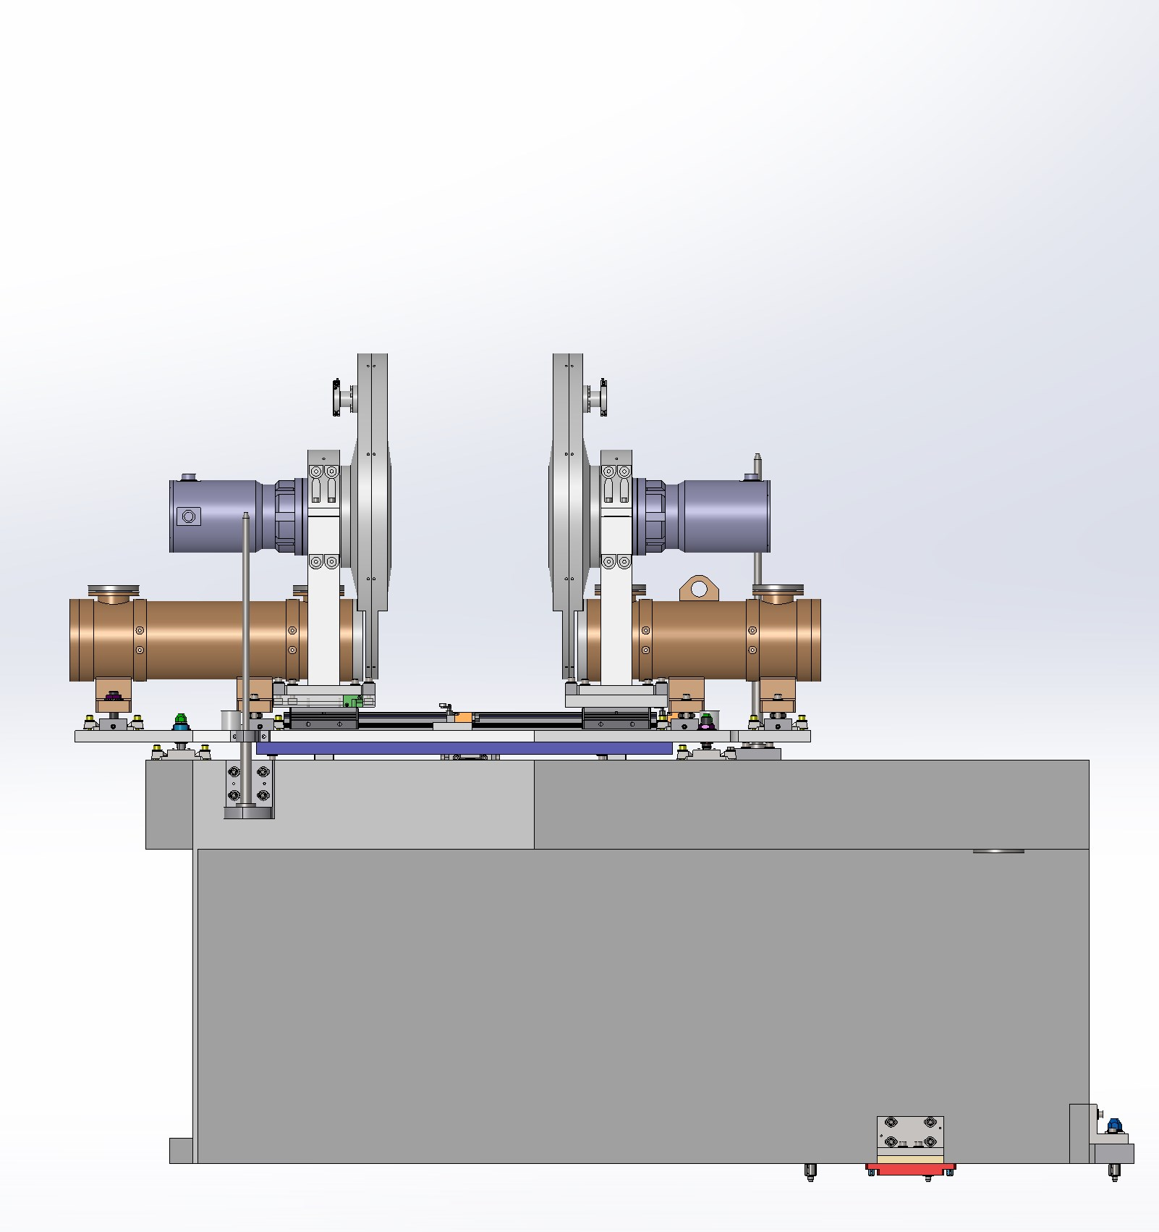
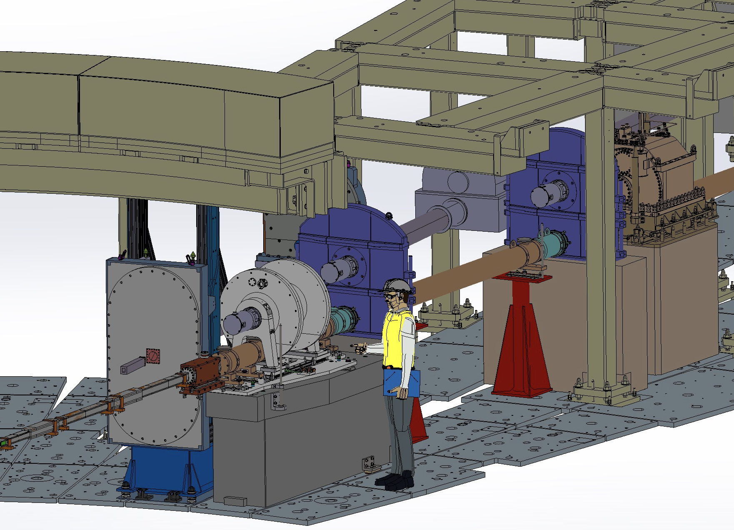
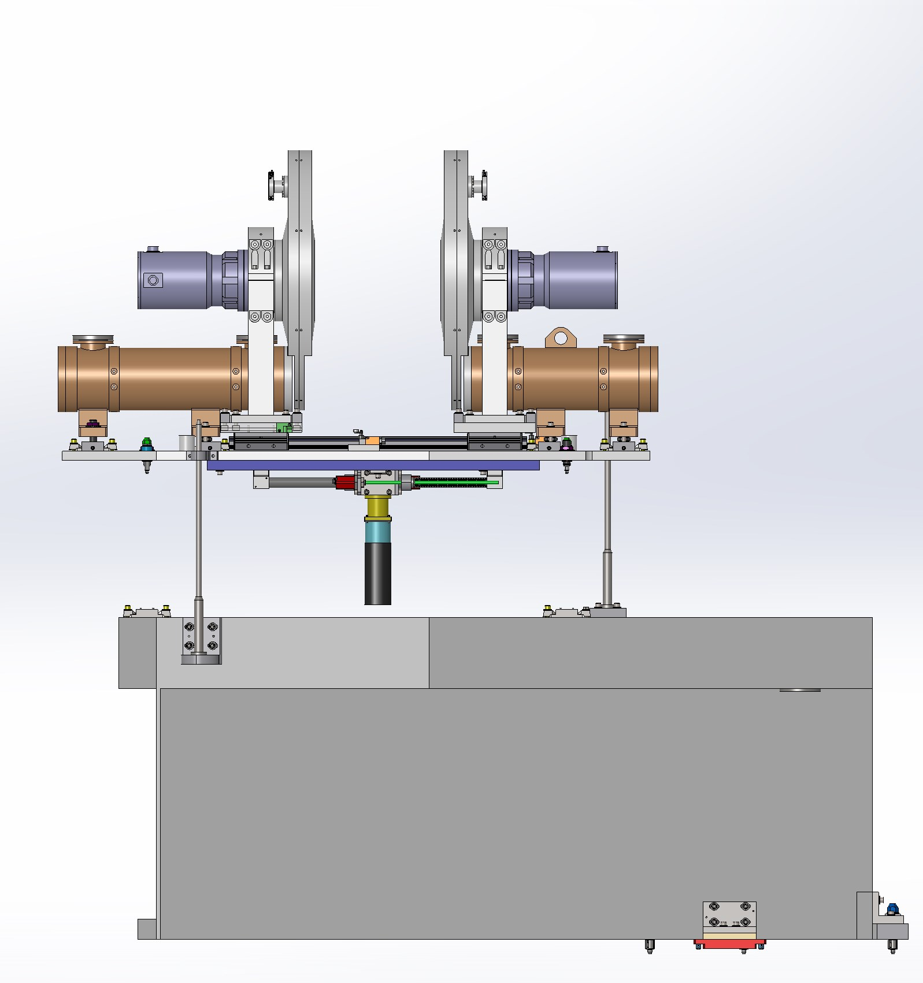
ODIN Project Update: update TUM
WU 05: Choppers
WFM chopper translation table:
Not included in the offer of AIRBUS
TUM has a revised preliminary design (conflict with DREAM solved). Now under evaluation by AIRBUS
Strategy: finishing an agreed design with AIRBUS by CDR. IDR at ESS and procure & fabricate at TUM in 2020
Shall be tested during FAT in AIRBUS

Slide 27
ODIN Project Update: update TUM
WU 05: Choppers
WFM chopper translation table:
Not included in the offer of AIRBUS
TUM has a revised preliminary design (conflict with DREAM solved). Now under evaluation by AIRBUS
Strategy: finishing an agreed design with AIRBUS by CDR. IDR at ESS and procure & fabricate at TUM in 2020
Shall be tested during FAT in AIRBUS
See later talk by Elbio for more tech. detail

Slide 28
ODIN Project Update: update TUM
WU 08: Motion control (MCA)
Advanced conversations with ESS MCA Group Head, Thomas Gahl
They can (and they want) work for ODIN´s MCAS
Preliminary specifications („Motion table“) already exists
ESS MCA Group Head will send us an offer in the next weeks
Also agreed: One shared resource from ESS MCA Group for working in ODIN and CSPEC documentation for TG3
Notes:
Update with ESS Milestones….

Slide 29
ODIN Project Update: update TUM
WU 11: Shielding
Beam cut-off: Heavy shutter, Beam stop
Beamline shielding: Feedthrough, Guide shielding
Cave shielding: Optical cave and experimental cave
Notes:
Update with ESS Milestones….

Slide 30
ODIN Project Update: update TUM
WU 11: Shielding
Beam cut-off: Heavy shutter, Beam stop
- Heavy shutter: thickness and material selection waiting for ongoing shielding calculations. Results will be delivered in October to elaborate technical specifications
- Beam stop: Included in cave calculations. Present design satisfy requirements
Notes:
Update with ESS Milestones….

Slide 31
ODIN Project Update: update TUM
WU 11: Shielding
2) Beamline shielding: Feedthrough
Bunker wall in south zone scheduled to be assembled in Dec 2020
Optimal: delivering feedthrough including optics on time to assembly the whole system vertically in the bunker wall
TUM has a preliminary design ready for elaborate specifications
A company is interested and technically could be able to manufacture it (informal contact at IKON 17)
If the optic has a delay, horizontal assembling might be possible. The detail design should then consider both assembling options. Feasible.
Notes:
Update with ESS Milestones….

Slide 32
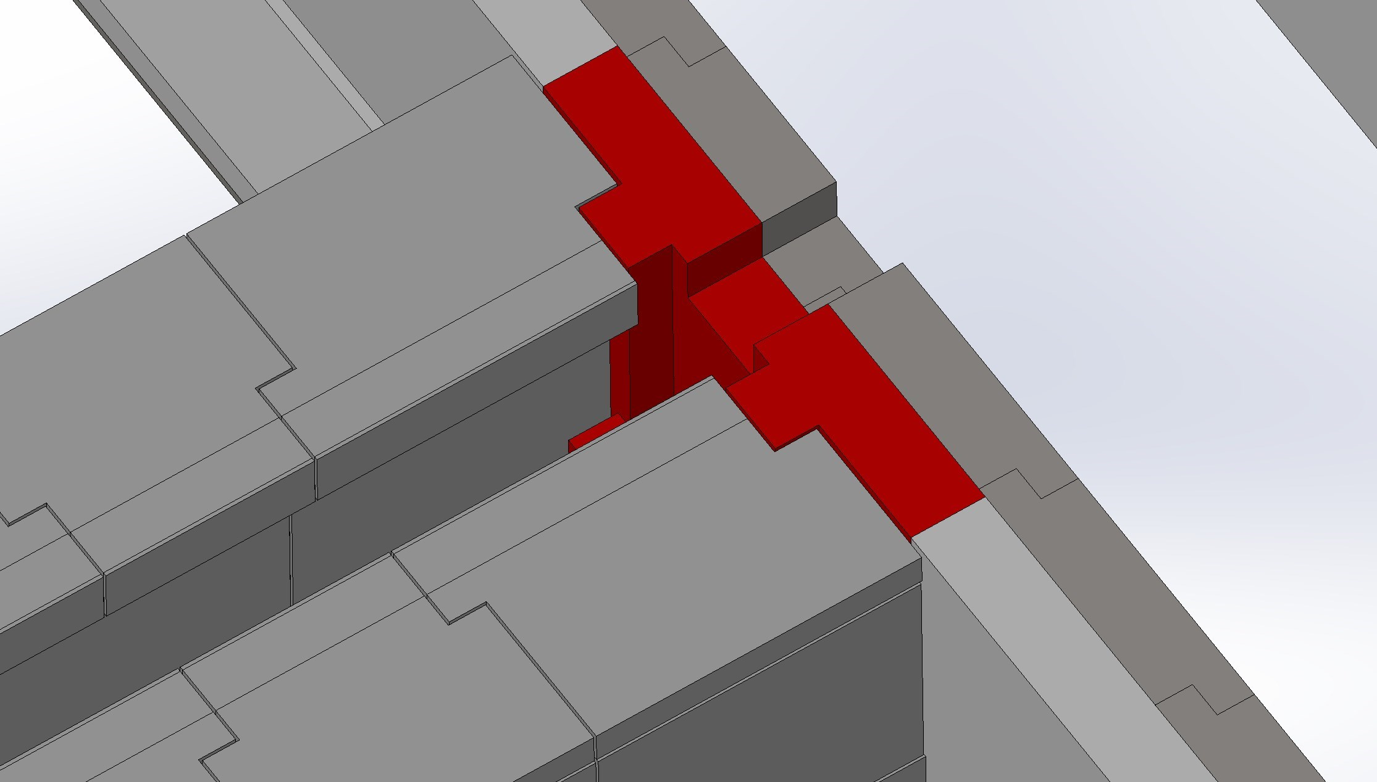
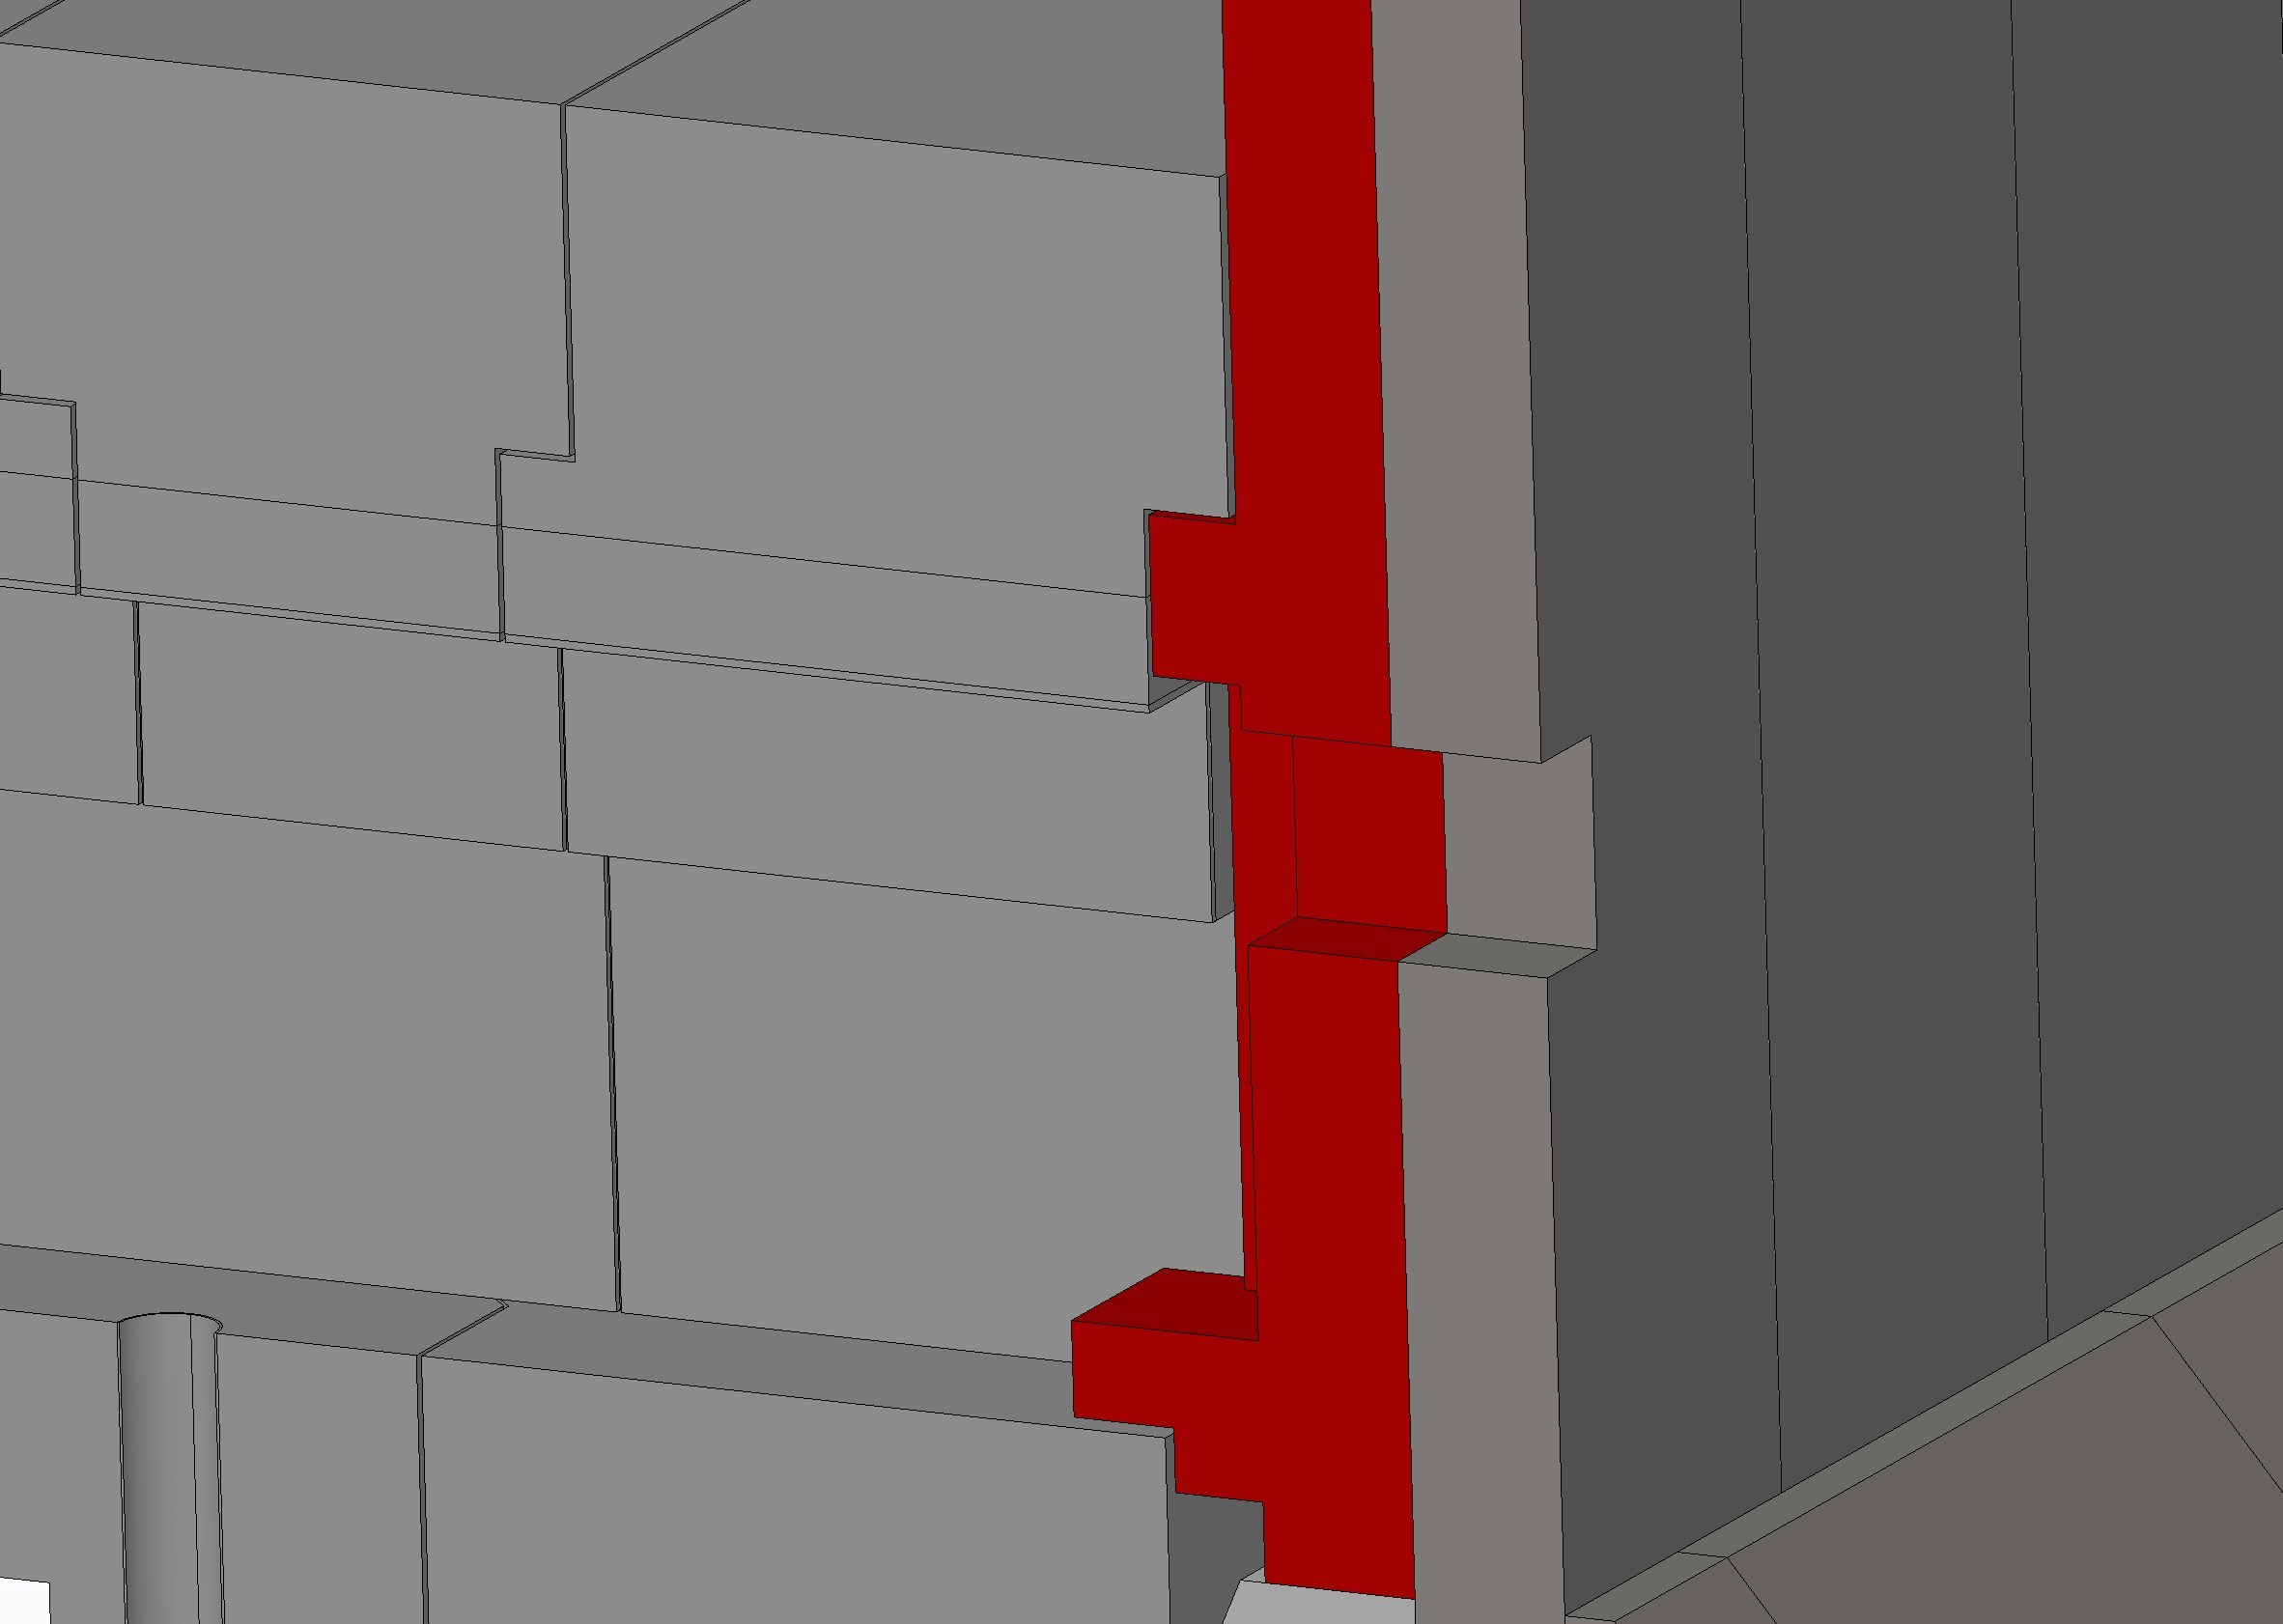
ODIN Project Update: update TUM
WU 11: Shielding
2) Beamline shielding: Guide shielding
Shielding between bunker and cave: guide shielding and FO5 chopper
Also known as the Common Shielding Project at ESS
On time: Detail design will be ready before end of this year (interface w/cave solved)
Notes:
Update with ESS Milestones….

Slide 33
ODIN Project Update: update TUM
WU 11: Shielding
2) Beamline shielding: Guide shielding
Shielding between bunker and cave: guide shielding and FO5 chopper
Also known as the Common Shielding Project at ESS
On time: Detail design will be ready before end of this year (interface w/cave solved)
See later talk by Elbio for more tech. detail
Notes:
Update with ESS Milestones….

Slide 34
ODIN Project Update: update TUM
WU 11: Shielding
3) Cave shielding: Optical cave and experimental cave
Radiologically the model works, according to proposed scenarios H1/H2
Calculations almost finished. Delivery time: third week of September for internal revision. Sending to ESS in October as part of TG3
Notes:
Update with ESS Milestones….

Slide 35
ODIN Project Update: update TUM
WU 11: Shielding
3) Cave shielding: Optical cave and experimental cave
Floor loading:
Floor loading requirement (14t/sqm) exceeded after implementing first shielding simulations recommendations
Redesign of the cave was necessary (keeping the original height and width)
A company from Sweden is doing the cave for another instrument (NMX) and might be a good option. Informal communications during IKON 17. Their timelines in principle are compatible with ODIN´s planification
Goal: Cave shielding manufacturing contract signed before May 2020. Achievable.
CTV scheduled for November 2019
Notes:
Update with ESS Milestones….

Slide 36
ODIN Project Update: update TUM
WU 11: Shielding
3) Cave shielding: Optical cave and experimental cave
Floor loading:
Floor loading requirement (14t/sqm) exceeded after implementing first shielding simulations recommendations
Redesign of the cave was necessary (keeping the original height and width)
A company from Sweden is doing the cave for another instrument (NMX) and might be a good option. Informal communications during IKON 17. Their timelines in principle are compatible with ODIN´s planification
Goal: Cave shielding manufacturing contract signed before May 2020. Achievable.
CTV scheduled for November 2019
See later talk by Elbio for more tech. detail about shielding and simulations
Notes:
Update with ESS Milestones….

Slide 37
ODIN Project Update: update TUM
WU 12: Instrument infrastructure
Control hutch/Sample preparation area: Hutch building + Lab equipment storage
Possible common project with ESS
Pros: Swedish regulations might be an issue also in this case, and a common project might be advantageous
Ongoing: Specifications for CTV, scheduled for November 2019
We decided a two floor hutch and sample manipulation
Notes:
Update with ESS Milestones….

Slide 38
ODIN Project Update: update TUM
WU 12: Instrument infrastructure
Control hutch/Sample preparation area: Hutch building + Lab equipment storage
Possible common project with ESS
Pros: Swedish regulations might be an issue also in this case, and a common project might be advantageous
Ongoing: Specifications for CTV, scheduled for November 2019
We decided a two floor hutch and sample manipulation
See later talk by Elbio for more tech. detail
Notes:
Update with ESS Milestones….

Slide 39
ODIN Project Update: update TUM
WU 13: Vacuum
For TG3 must elaborate the vacuum requirements and distribution. Done
Good communication with Laurence Paige (ESS Vacuum Head)
The main vacuum requirements and design are already agreed and ODIN has ready the vacuum layout for TG3.
Notes:
Update with ESS Milestones….

Slide 40
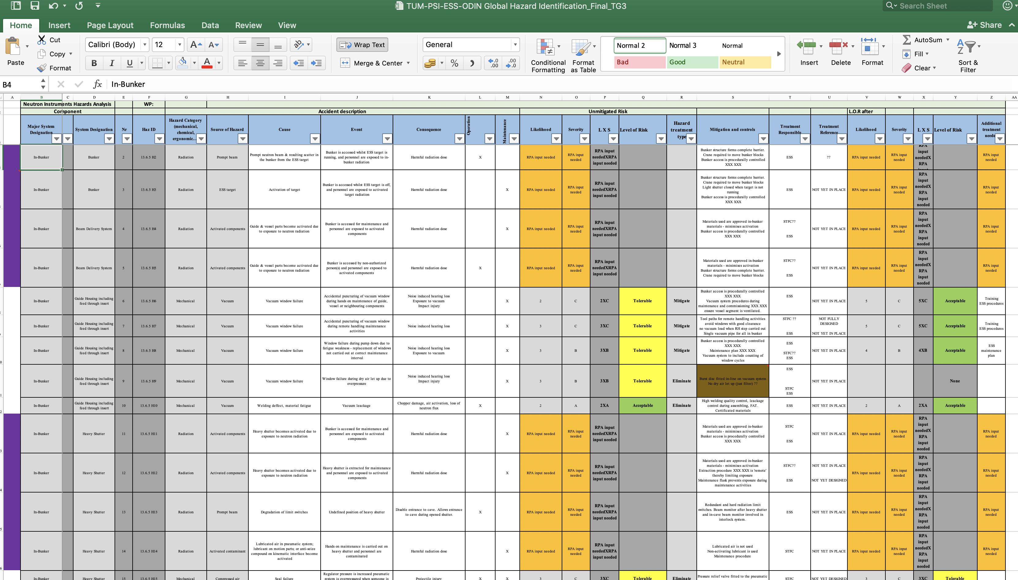
ODIN Project Update: update TUM
WU 14: PSS
For TG3 we must complete PSS and CE marking worksheets: Instrument hazard analysis, Radiation safety analysis. Status: Ongoing
During IKON we had a good feedback from ESS PSS responsible Stuart Birch
Notes:
Update with ESS Milestones….

Slide 41
Next milestones and actions
Toll Gate 3 includes:
Intermediate design review (IDR)
Call for Tender Verification (CTVs)
TG3.1
TG3.2
…

Slide 42
Next milestones and actions
For each stage it is necessary to prepare and update documentation
Next for ODIN is CTV (Cave and hutch) & IDR (Choppers): Nov 15, 2019 (in person at Lund)
Documents will be uploaded for revision Oct 25, 2019 the latest
Sub-System Design Description (SSDD) (draft) for Chopper system. AIRBUS is elaborating PDR documentation
Specifications for Cave and Hutch: ongoing
Updated TG2 documentation (ongoing): WP specification, PBS, WBS…
Plus: Vacuum diagram (Done), Material inventory (Activation analysis), Complete 3D model (almost done), Installation and verification plan (ongoing)
Updating MS Project ongoing: expanding with installation details of in-bunker components (choppers, guides, T0 chopper, heavy shutter, feed-through, monitors, vacuum, MCA, verifications and testings), and ex-bunker (guide shielding, FOC5, cave assembling, hutch, cave interior, racks, etc.)

Slide 43
Next milestones and actions

Slide 44
The core team

Slide 45
ODIN Team
Elbio Calzada, Lead Engineer TUM
Manuel Morgano, Instrument Scientist PSI
Aureliano Tartaglione, Instrument Scientist TUM
Robin Woracek, Coordination ESS
TUM-PSI. Video call every two weeks for general update
Frequent communication and very useful support of Robin and Clara Lopez from ESS

Slide 46
Thank You!

Slide 47
Outstanding issues
VAT issue for guides
Potential risk for:
Chopper interfaces detail design (CDR) – Feb 2020
Chopper translation table detail design
Feedthrough final design. Installation scheduled date: Dec 2020
Heavy shutter detail design
T0 chopper detail design (interfaces)
Floor loading
We have a feasible solution on the way, keeping cave dimensions and versatility. No interferences

