Slide 1
ODIN: Optical and Diffraction Imaging with Neutrons at the ESS
Technical and design update
PSI: M. Morgano, M. Strobl
TUM: E. Calzada, A. Tartaglione, M. Schulz
Notes:
Phase 2, May 31st. 2017

Slide 2
Outline
ODIN Technical Design update in Bunker
  WFMC
  T0 Chopper
  Heavy Shutter
ODIN Technical Design update outside the Bunker
  Cave – MCNP Results - Technical design
  Control Hutch
  Neutron guide Shielding interface

Slide 3
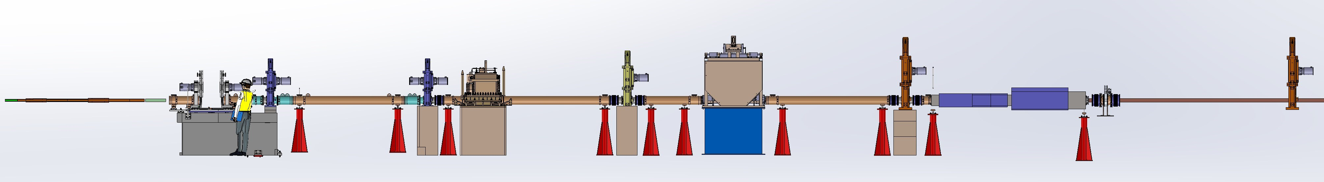
Instrument design in Bunker
In Bunker
Outside theBunker
Monolith
FOC1 – BP1
FOC2 – BP2
FOC3
HS
FOC4
Bunker Wall
FOC5
WFMC
T0
11m Zone

Slide 4
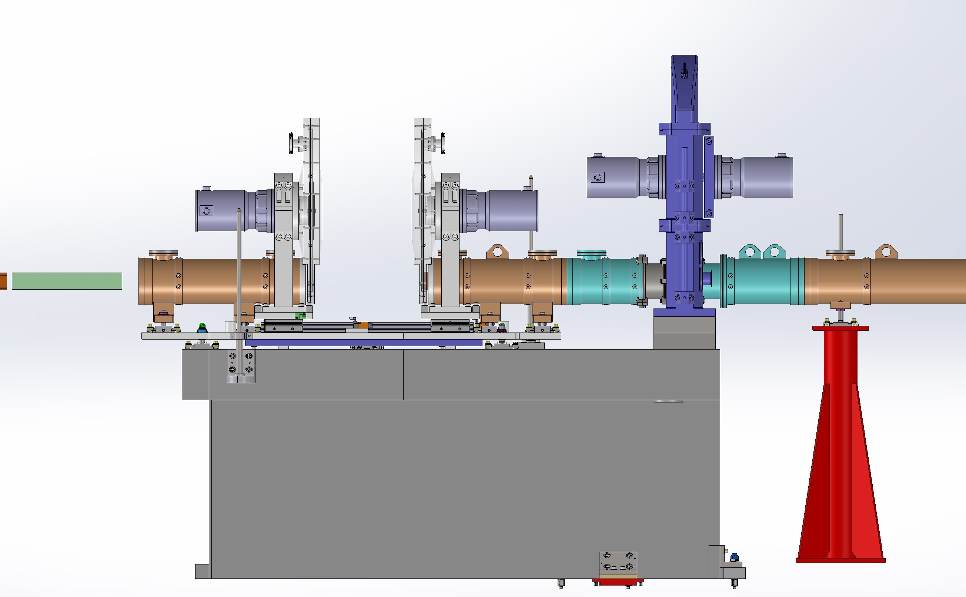
Remote Handling Unit 1
WFMC1
WFMC2

Slide 5
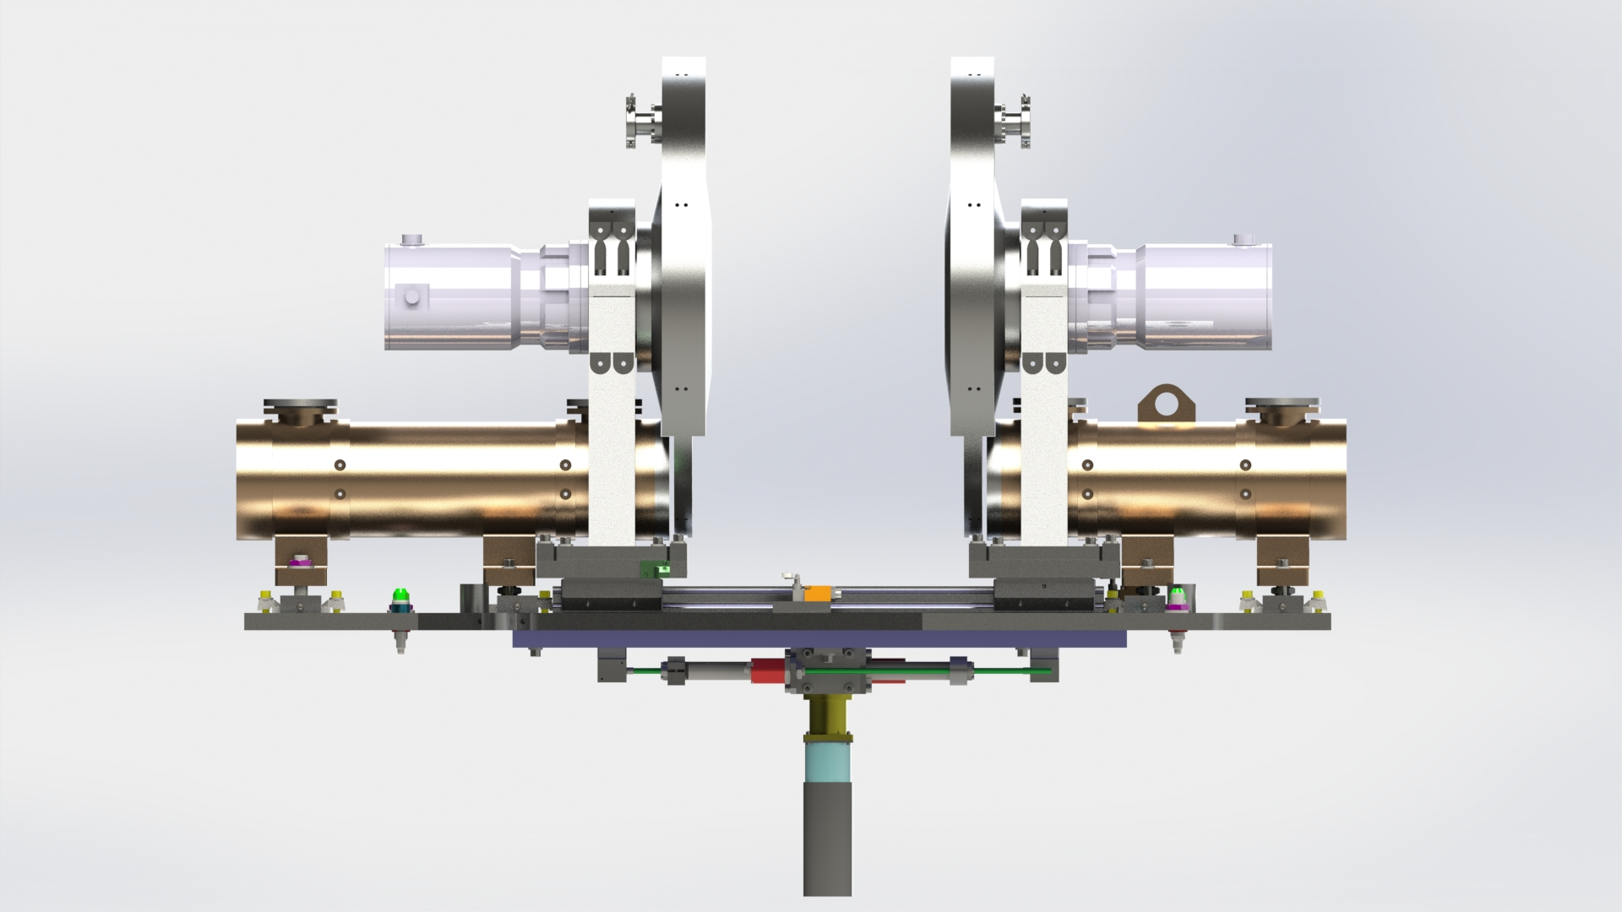

Slide 6
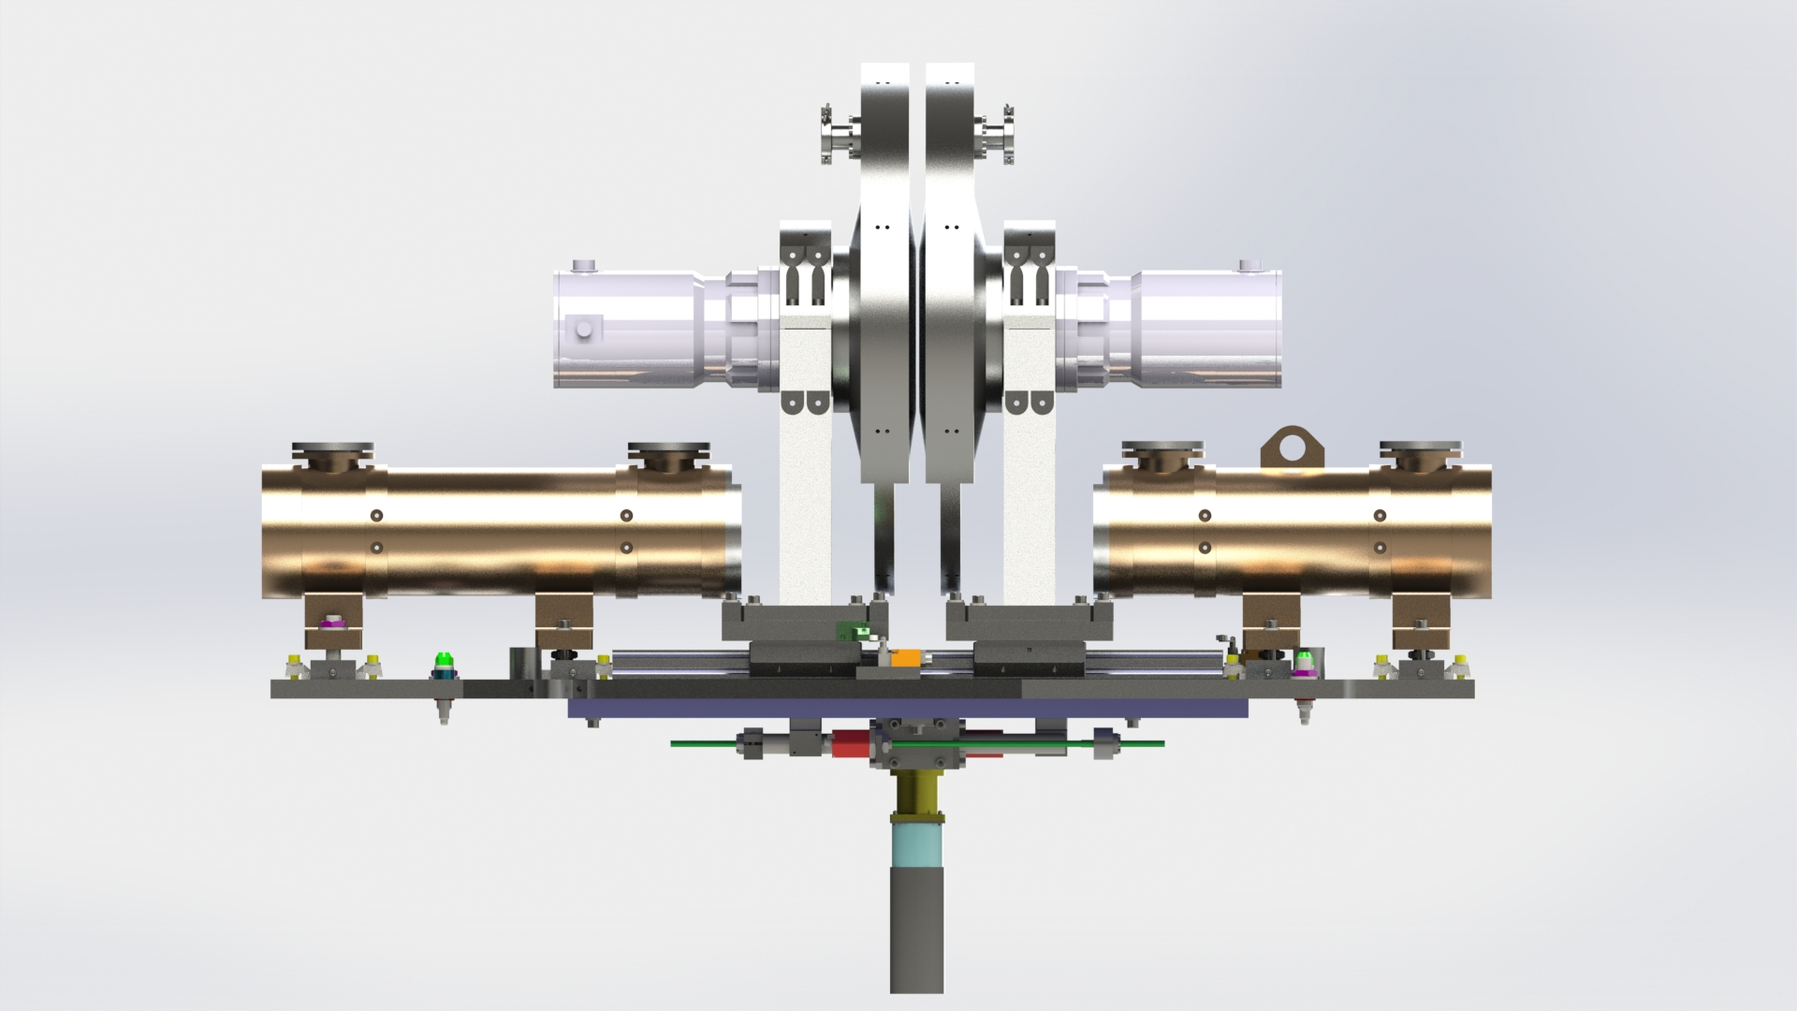

Slide 7
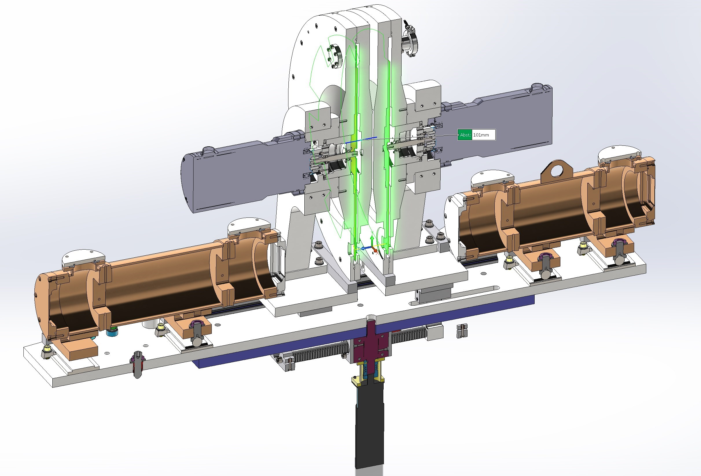

Slide 8
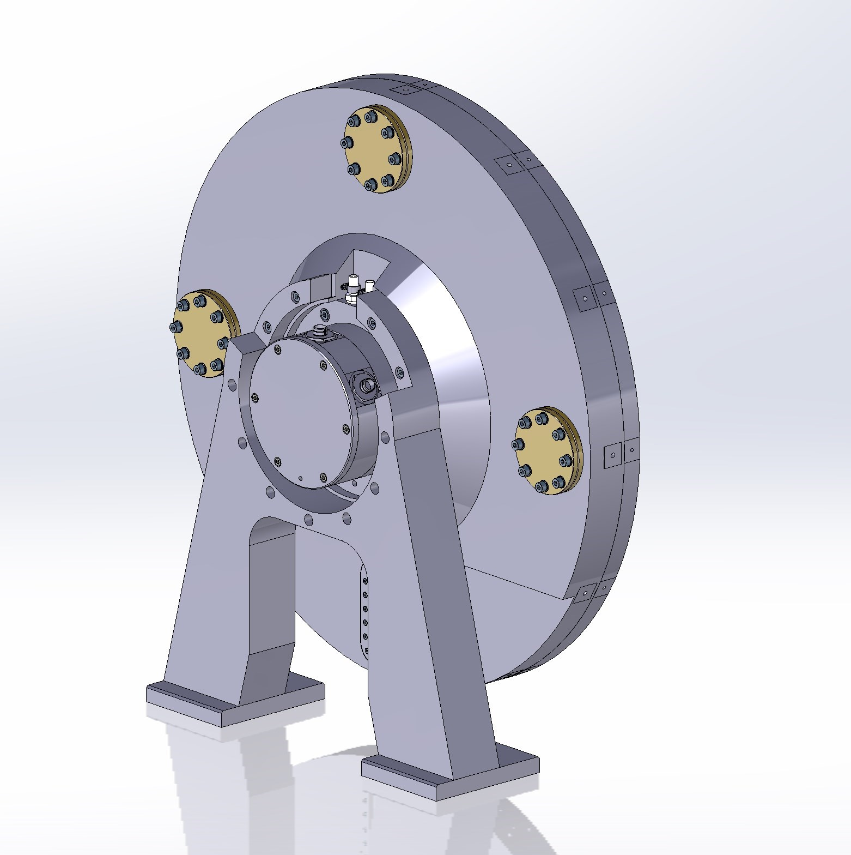
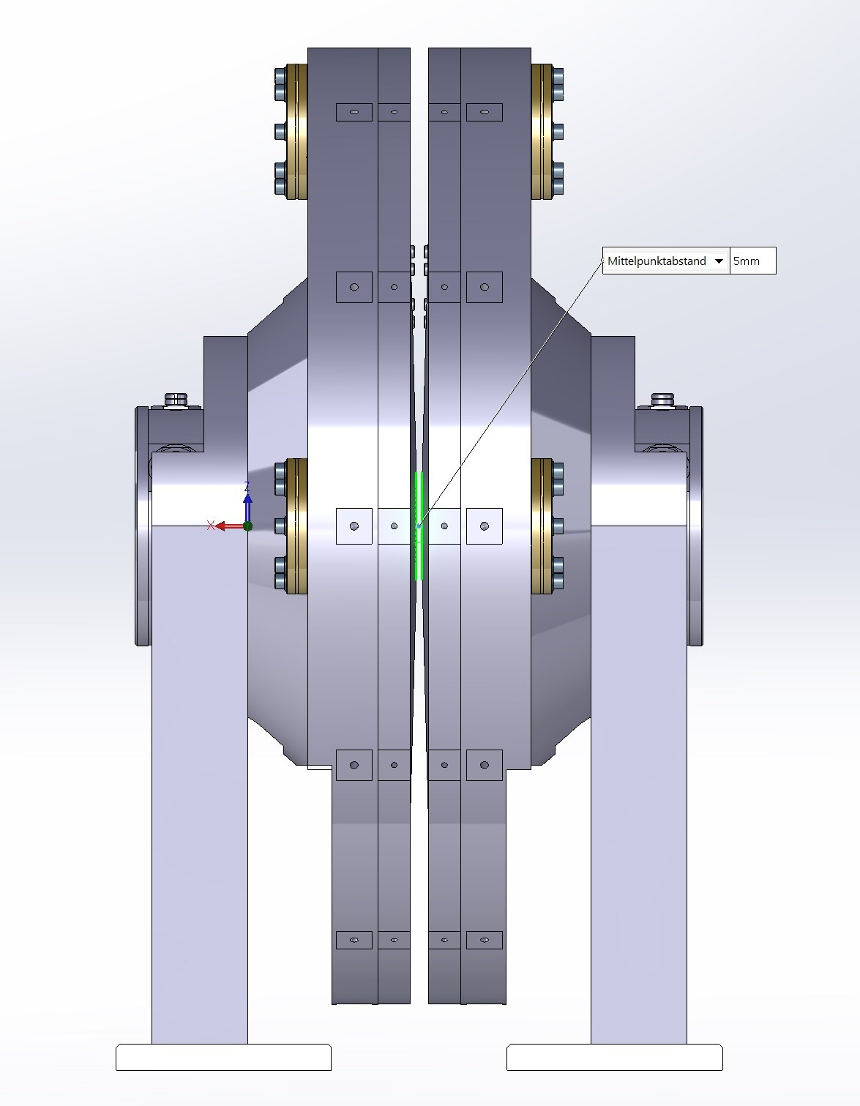

Slide 9
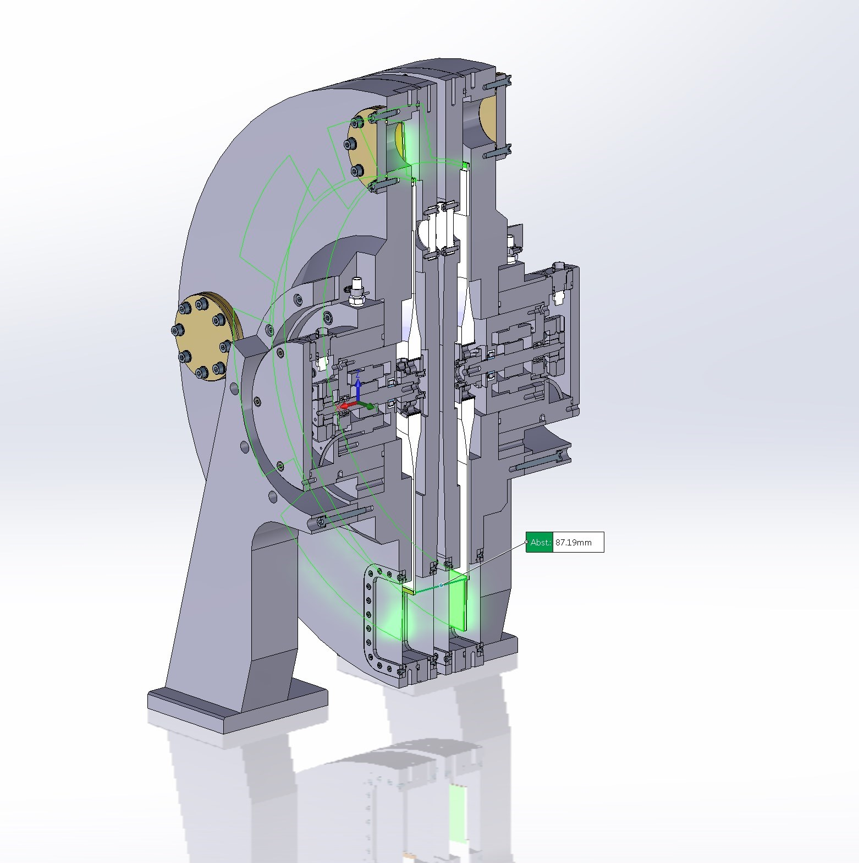

Slide 10
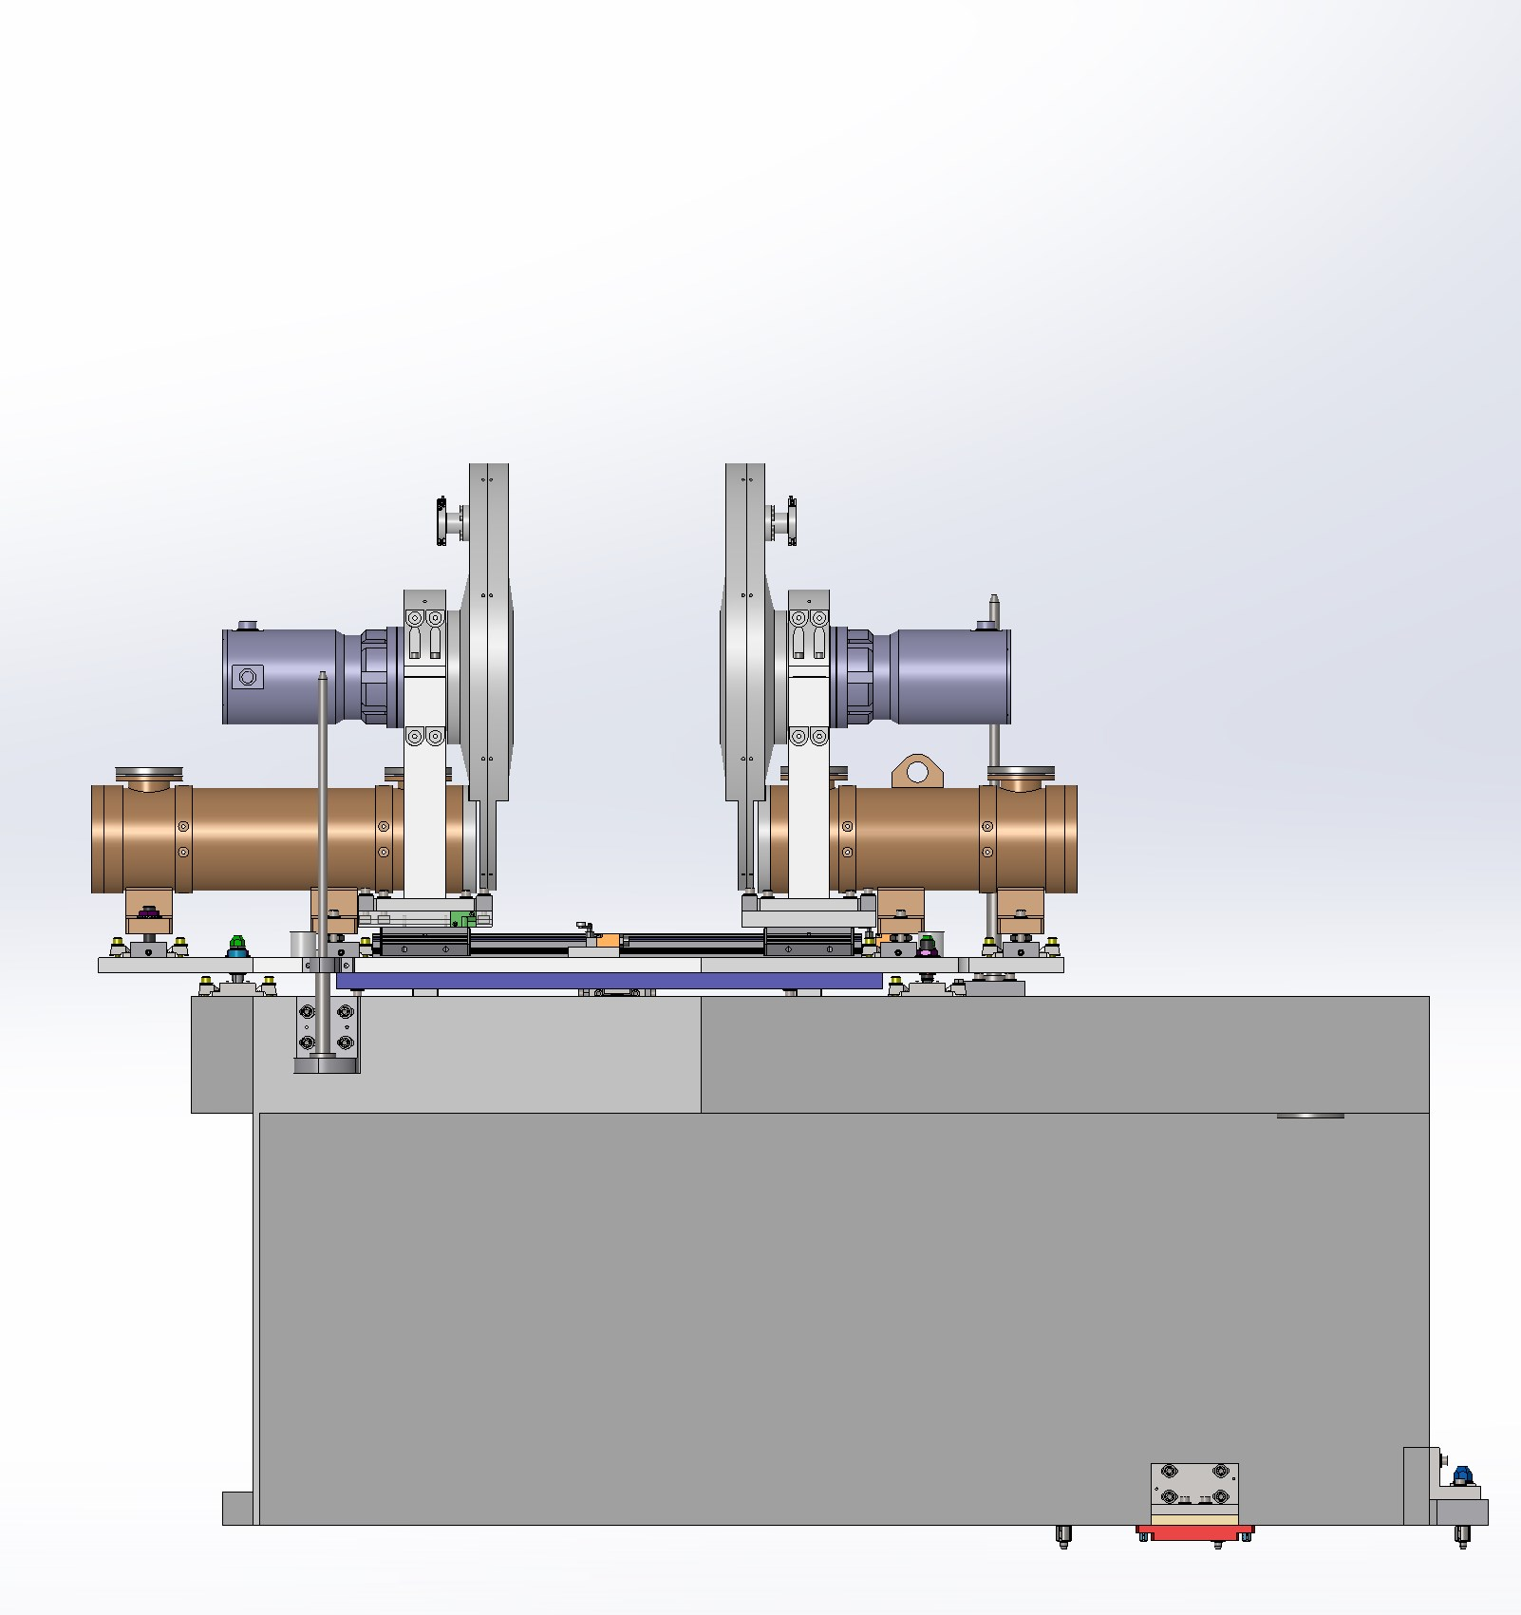

Slide 11
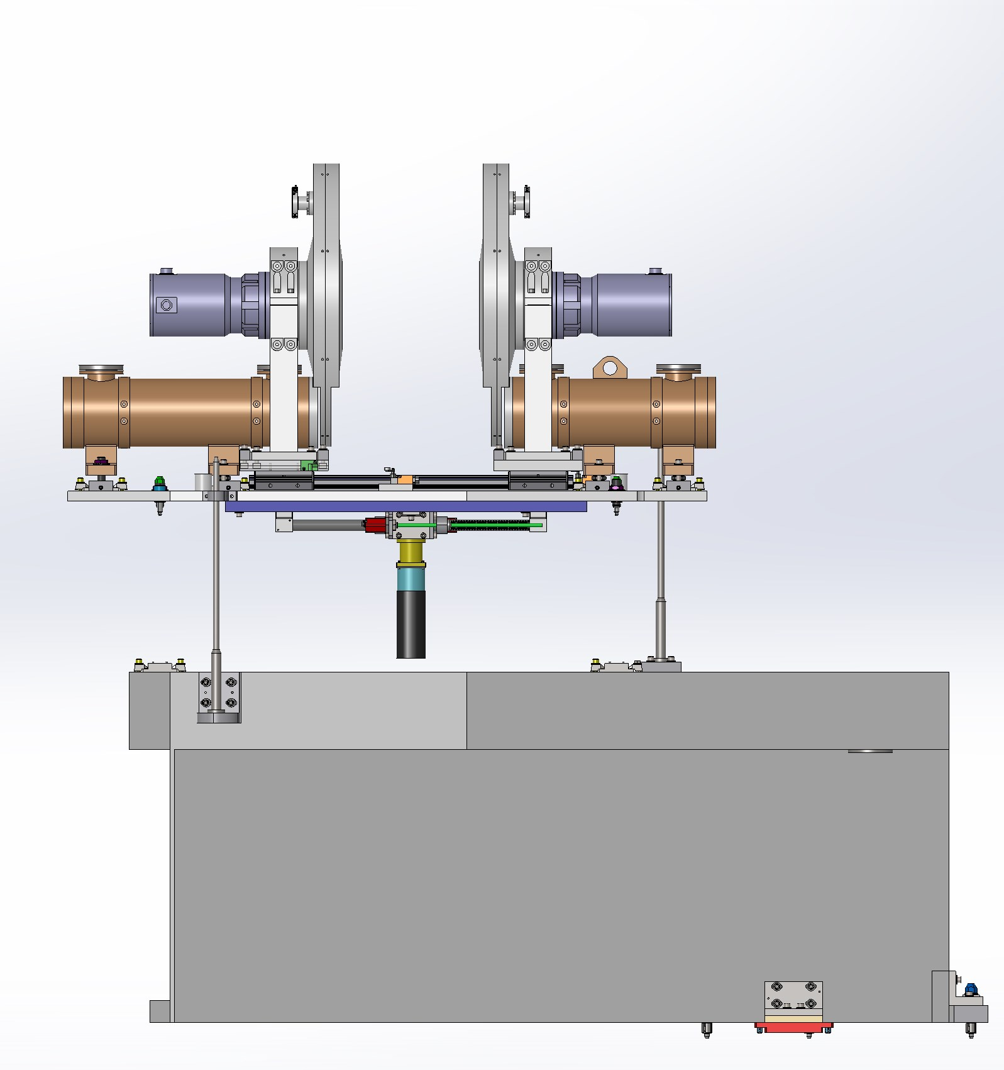

Slide 12
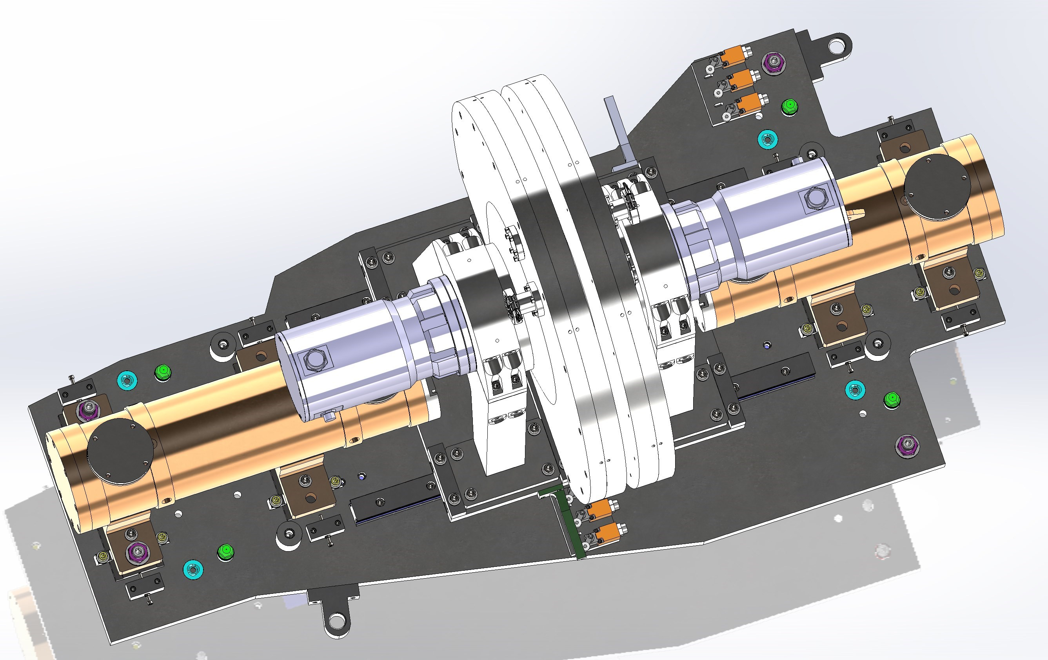
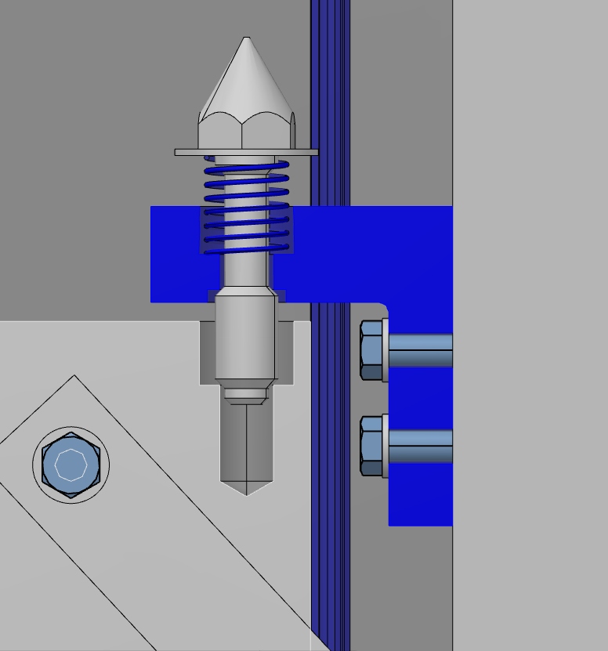
Kinematic Mounting
Captive Bolt
Holders for Laser tracker reflectors
Captive Bolt
Kinematic Mounting
Redundant limit switches

Slide 13
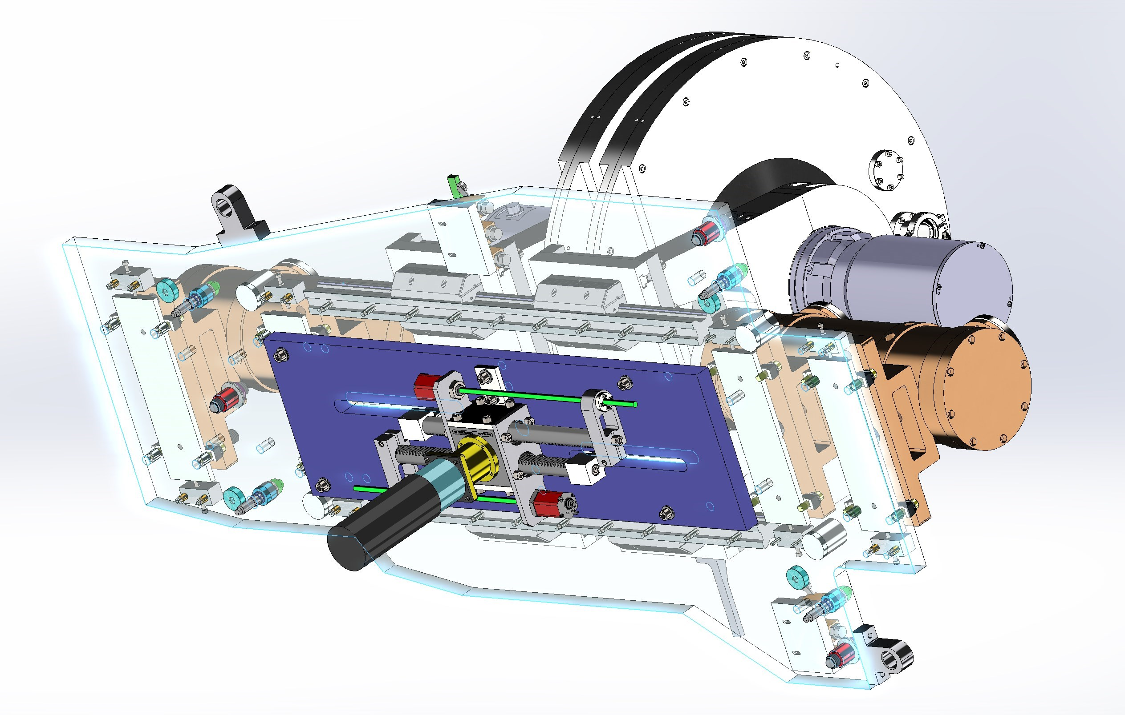
Displacement measuring system
B4C
Drive Unit
Rack and Pinion

Slide 14
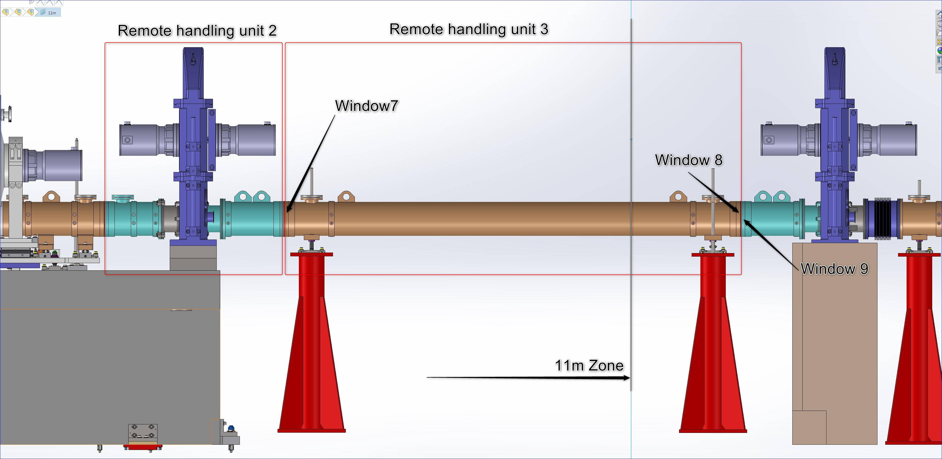
FOC2 – BP2

Slide 15
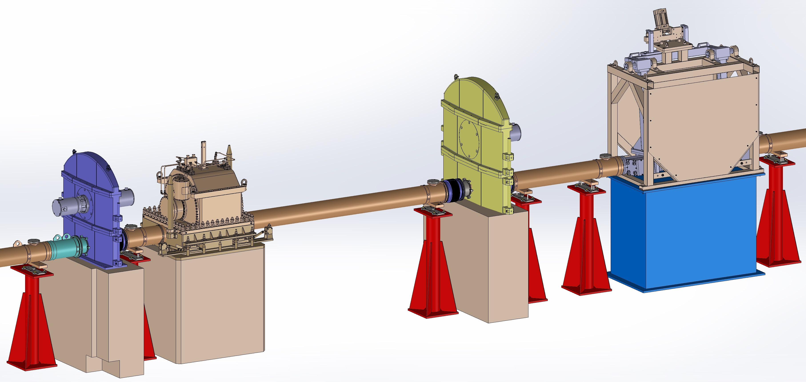
FOC3
T0 Chopper
Heavy Shutter
FOC2 – BP2

Slide 16
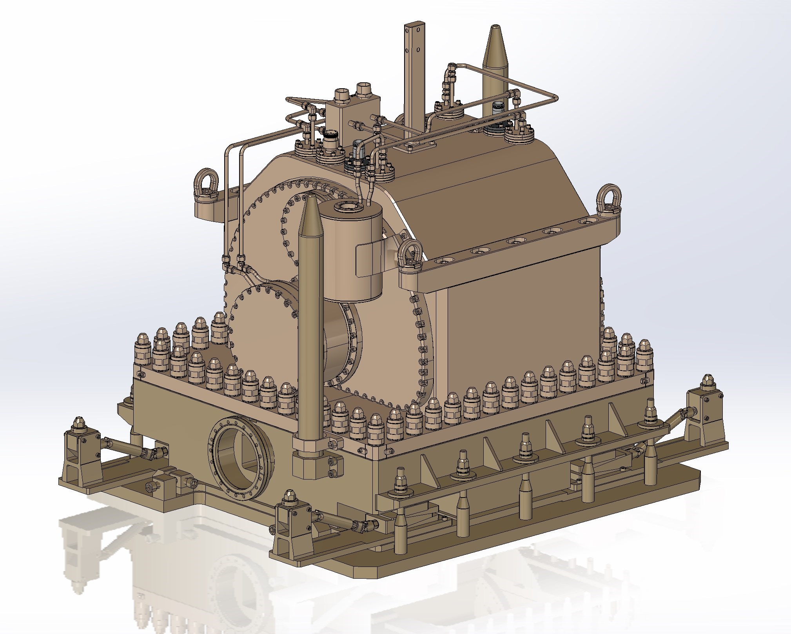
T0 Chopper
Leveling Wedges

Slide 17
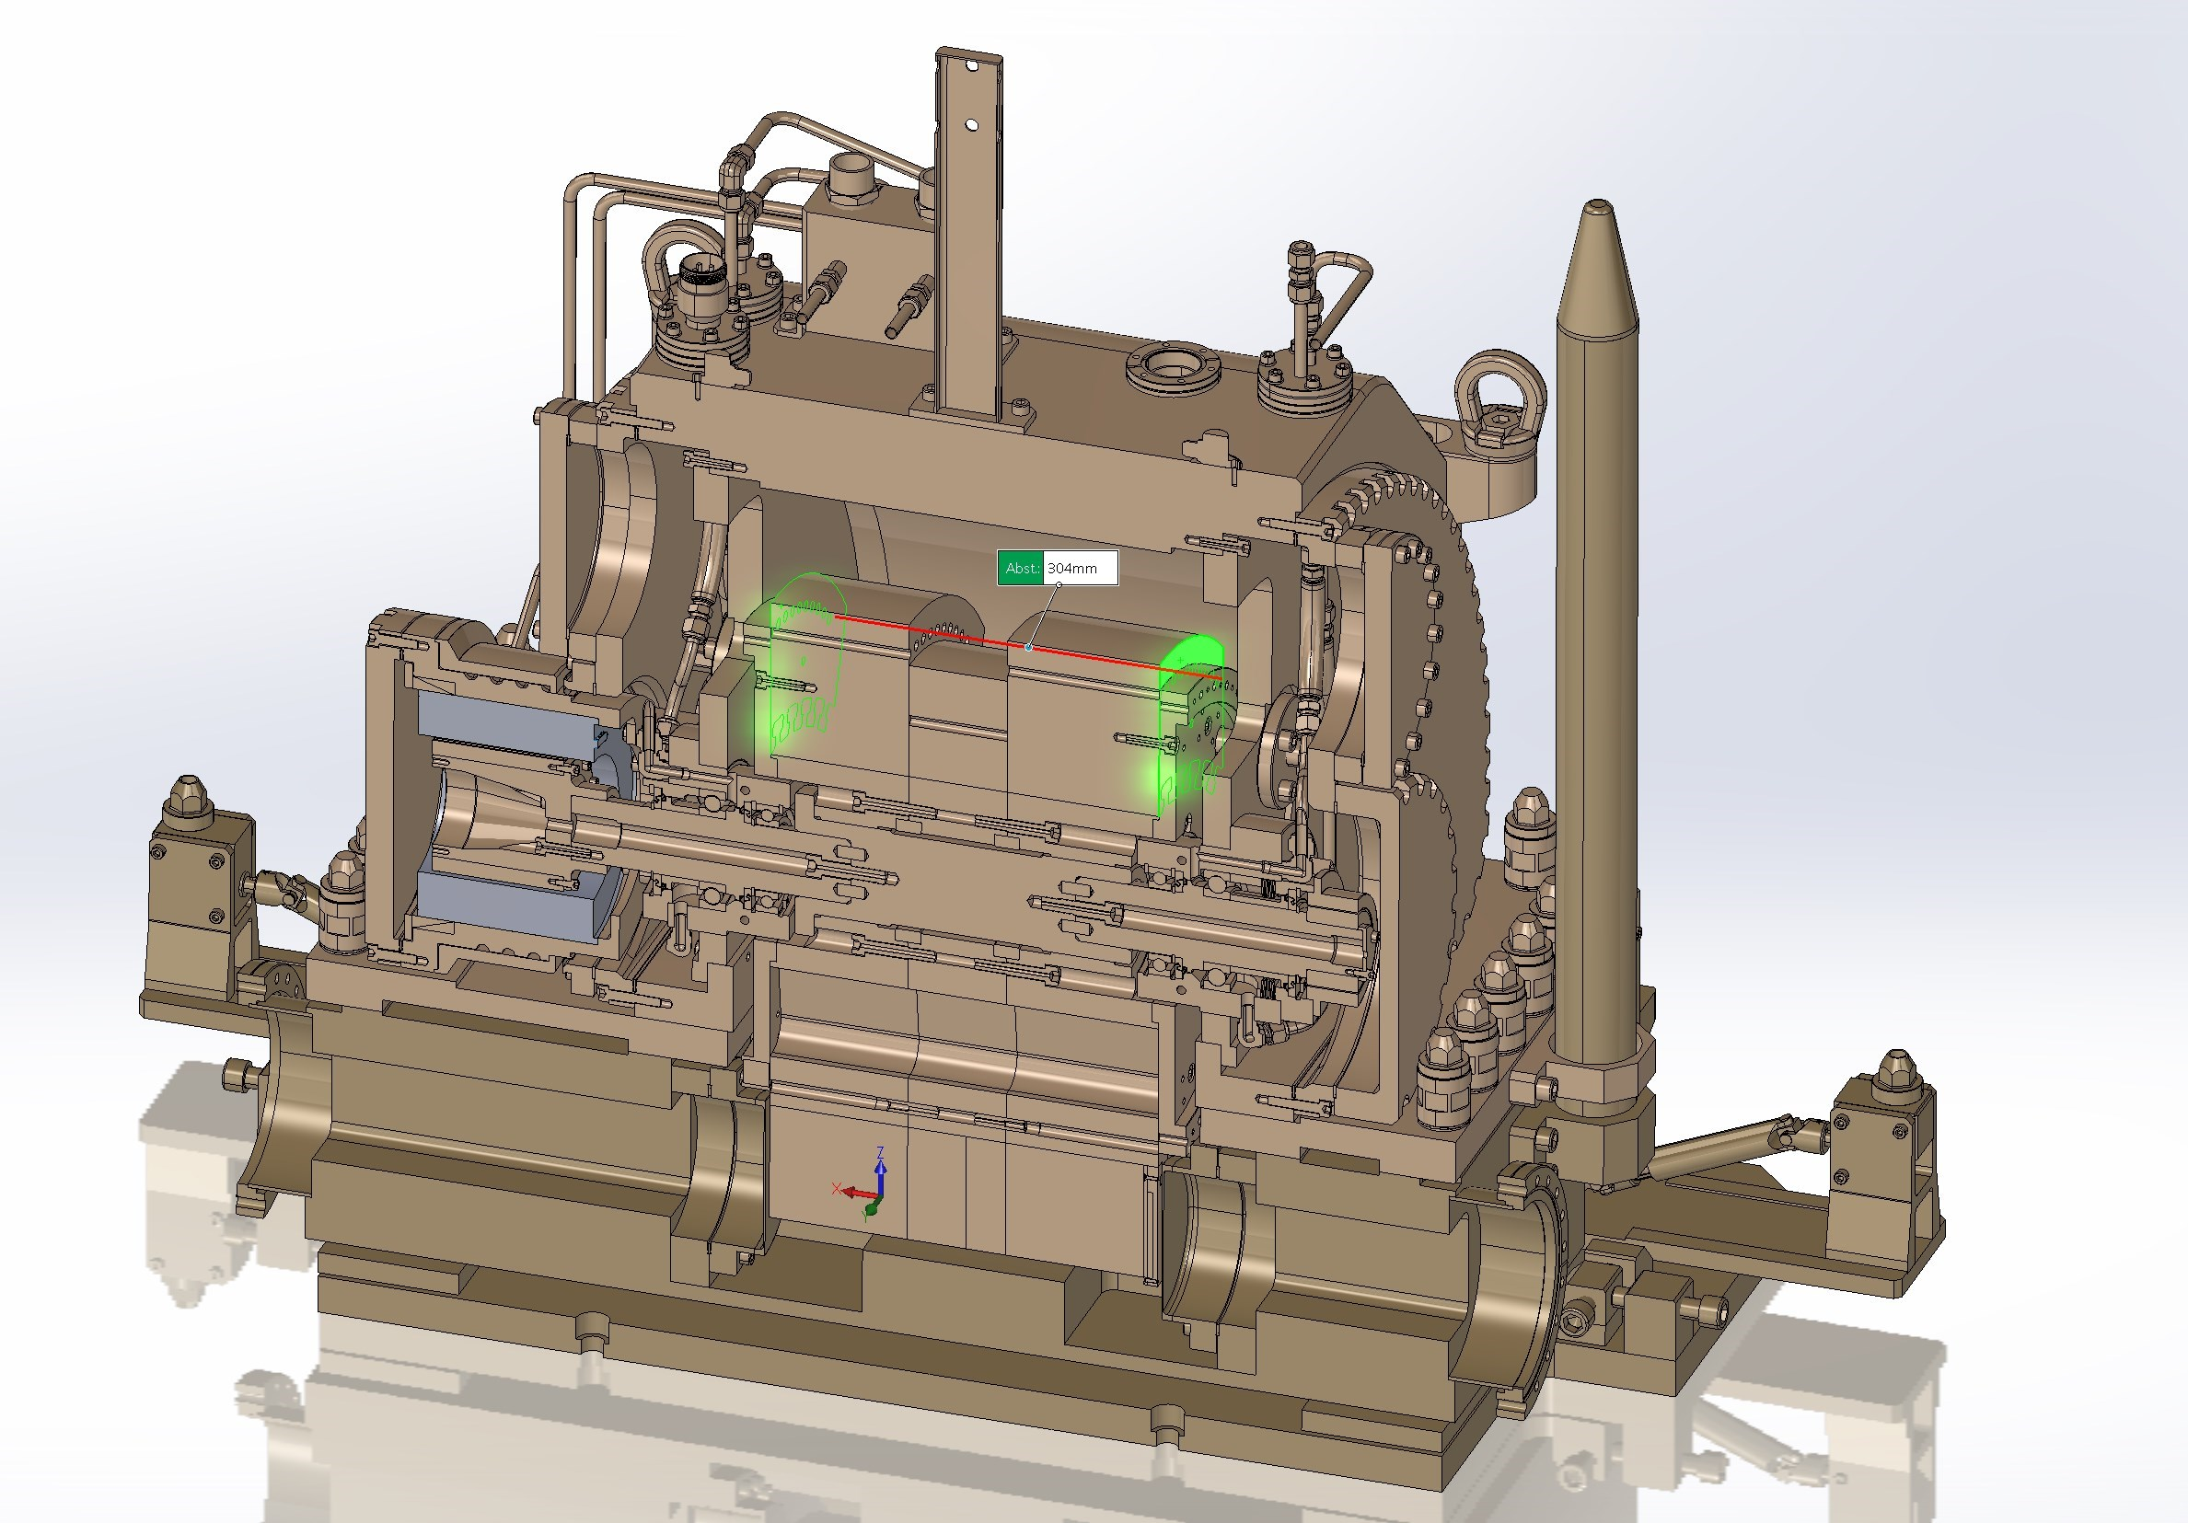
Simulated Attenuation Materials:
10B4C: 3mm
Tungsten: 100mm
Copper : 30mm
Nickel: 30mm
Tungsten: 100mm
Total thickness: 263 mm
Attenuation<1E-4 for 1keV - 1MeV Neutrons
Frequency: 28Hz

Slide 18
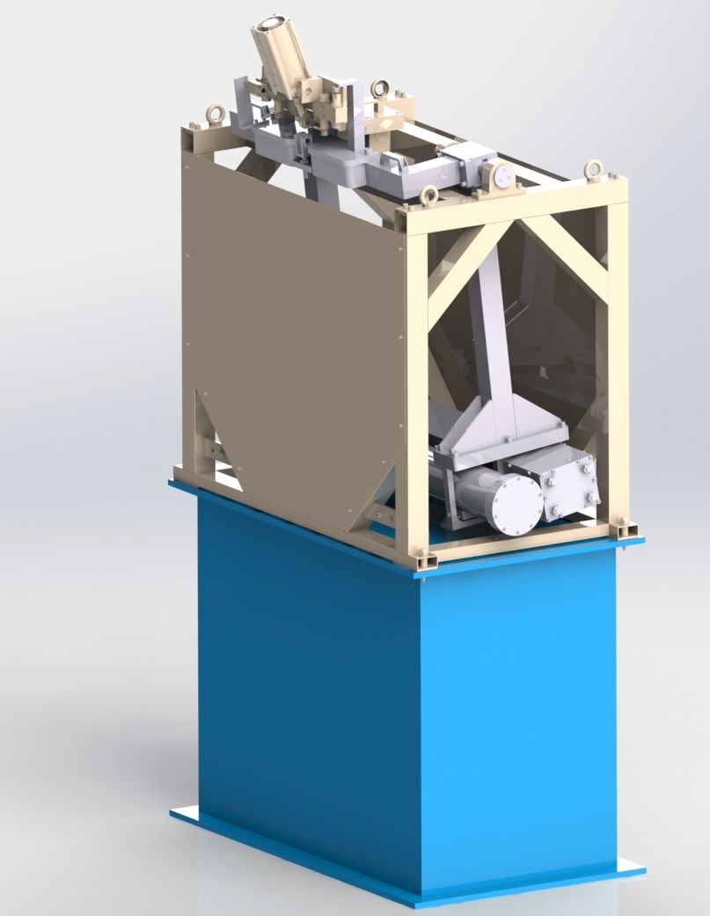
Heavy Shutter
Heavy Shutter requirements:
The basic requirement is to have 3µSv/h inside the cave and 25µSv/h in the Chopper Pit for the FOC5
Design life >15yrs
Service interval >5 years
Reliability >98% (measured over 100 days of beam distribution)
Construction materials shall be selected to achieve activation to levels compatible with access requirements (in the bunker), and instrument maintenance strategies. (i.e. levels comparable or lower than the activation of the current bunker rear wall).
Material selection and construction compatible with facility requirements for decommissioning and disposal of activated equipment (i.e. level of activation, size of components compatible with disposal casks).
Designed for 'hands on' serviceable within 30 days of beam off (full power) if service interval <15years.
Serviceability in-situ strongly preferred.
Installed mass <17t.
Closing time after close command should be less than 2 minutes.
Shutter Block
Neutron Guide

Slide 19
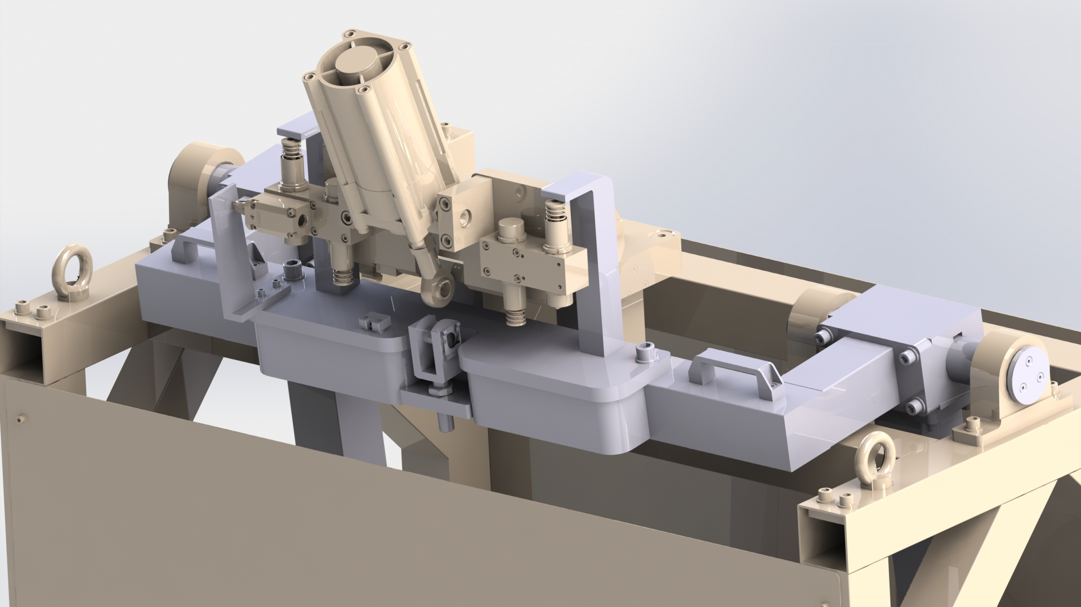
Heavy Shutter
Pneumatic Actuator
Non-lubricated plain bearings
Shock Absorbers
Shutter Block
Neutron Guide

Slide 20
Instrument design outside the Bunker
Cave:
Radiation Requirements:
Walls 3µSv/h. Roof 25 µSv/h
Safety factor by ESS: 2
Requires surface detectors of all walls and roof
Operational Scenarios: Steel sample and water sample in experimental cave. Gd slice (2mm) (grating interferometer)
Worst case scenarios: Cd (2mm) in optical or experimental cave

Slide 21
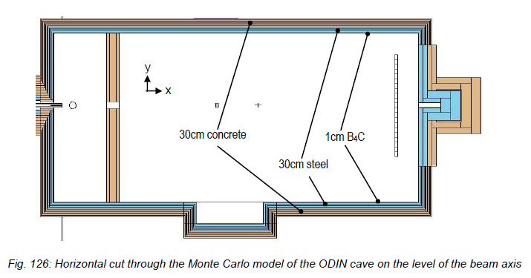
Cave: MCNP Results: Version “L”
18m
2.4m
13.6m
7m
8.2m
3m

Slide 22
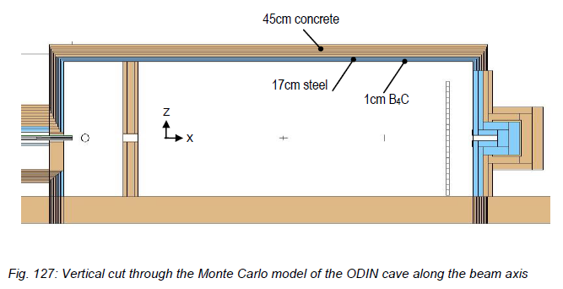
Cave: MCNP Results
N- Beam
2.137m

Slide 23
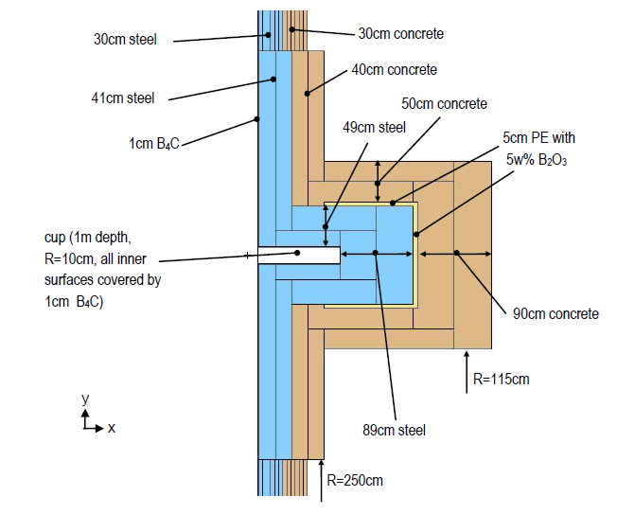
Cave: MCNP Results

Slide 24
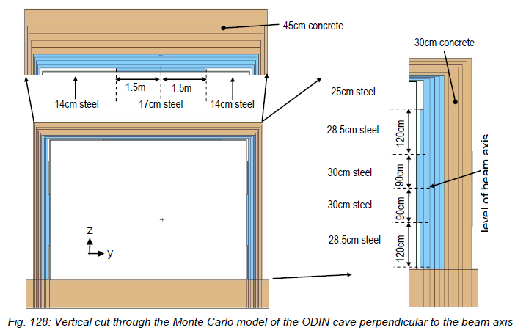
Cave: MCNP Results

Slide 25
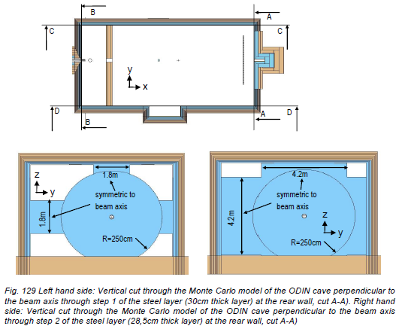
Cave: MCNP Results

Slide 26
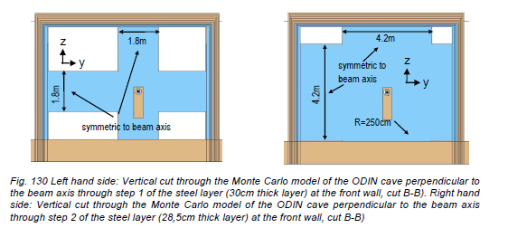
Cave: MCNP Results

Slide 27
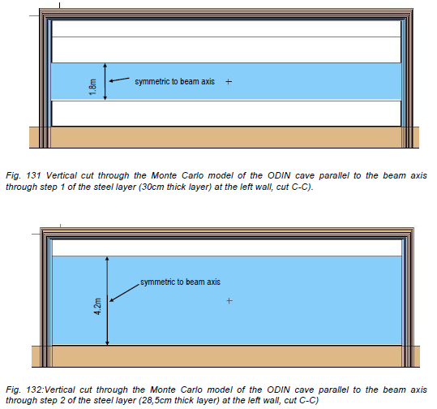
Cave: MCNP Results

Slide 28
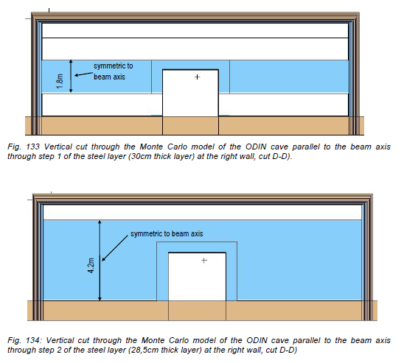
Cave: MCNP Results

Slide 29
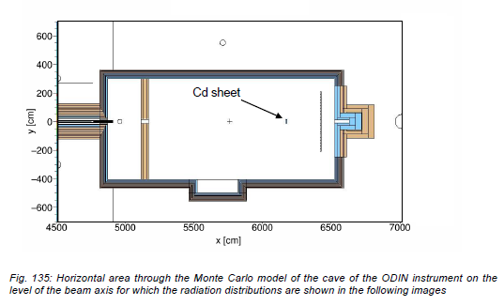
Cave: MCNP Results

Slide 30
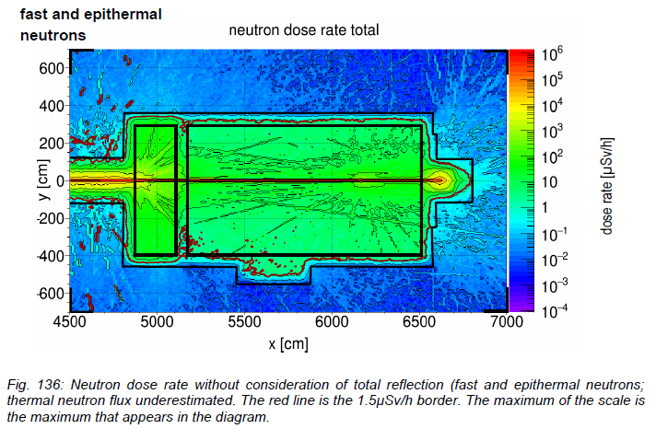
Cave: MCNP Results

Slide 31
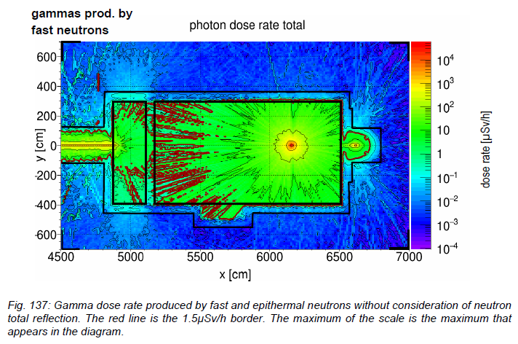
Cave: MCNP Results

Slide 32
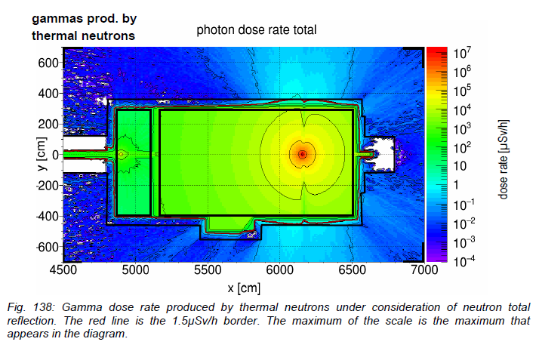
Cave: MCNP Results

Slide 33
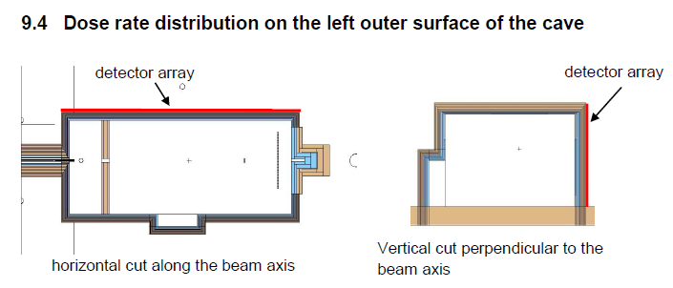
Cave: MCNP Results

Slide 34
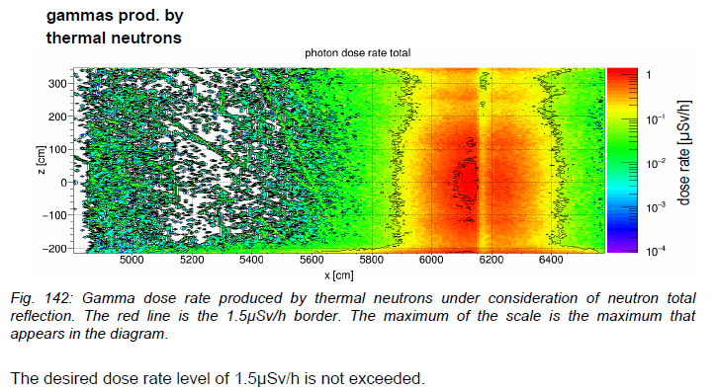
Cave: MCNP Results

Slide 35
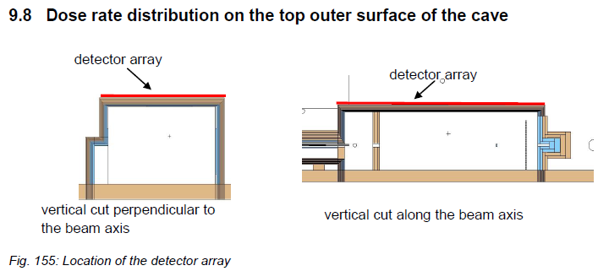
Cave: MCNP Results

Slide 36
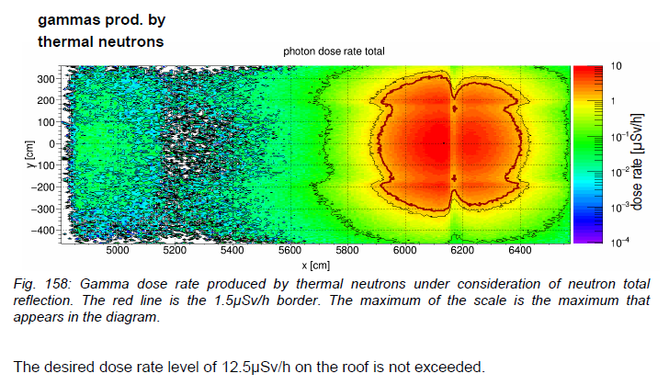
Cave: MCNP Results

Slide 37
Cave - MCNP Conclusion:
With version “L” of the ODIN cave the desired dose rate levels are not exceeded.

Slide 38
Instrument design outside the Bunker
Cave: Technical Design

Slide 39
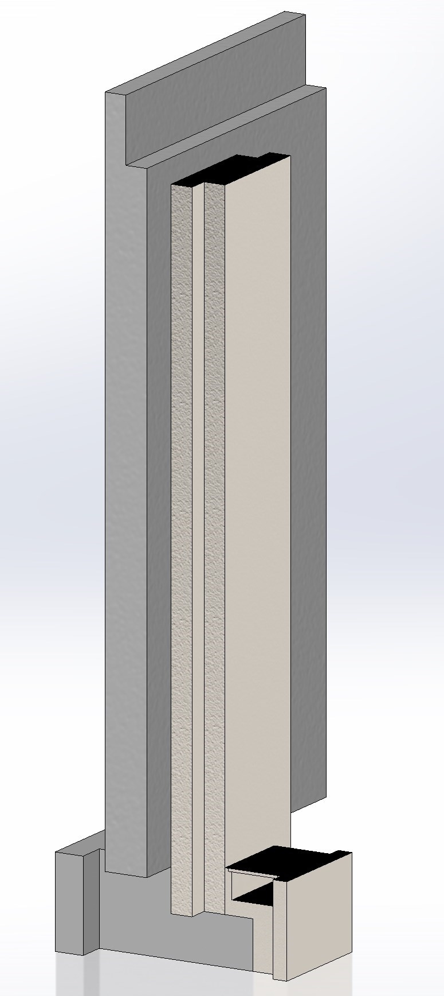
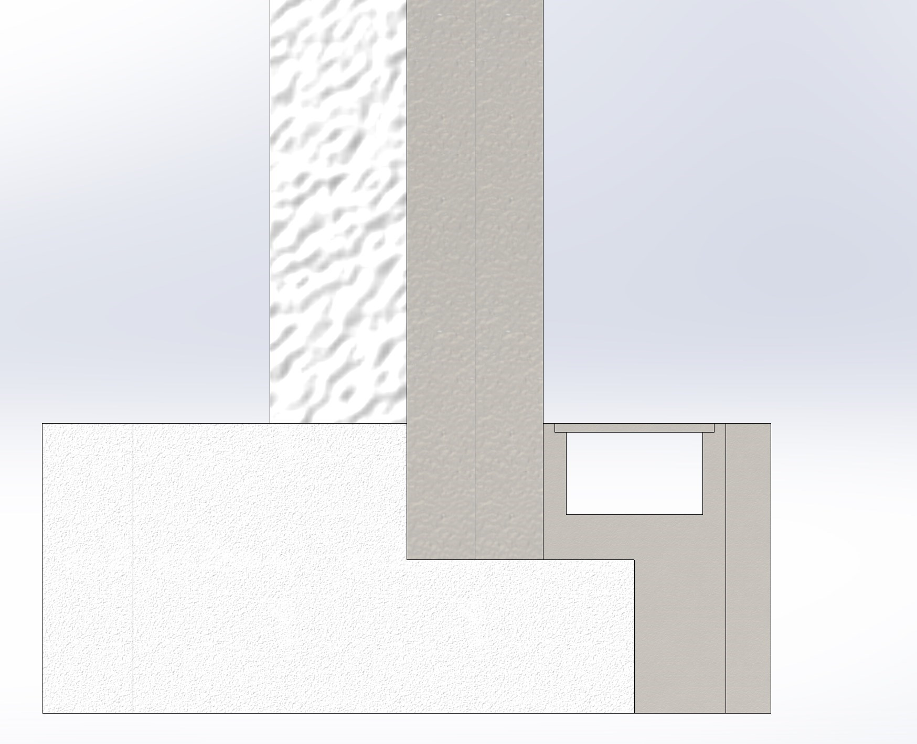
Cave: Technical Design
Floor load <14t/m²
30cm
30cm
63.7cm
1.5m
Design of a possible option on the bases to transmit the load from the walls and roof to the floor keeping the load on the floor within the required limits

Slide 40
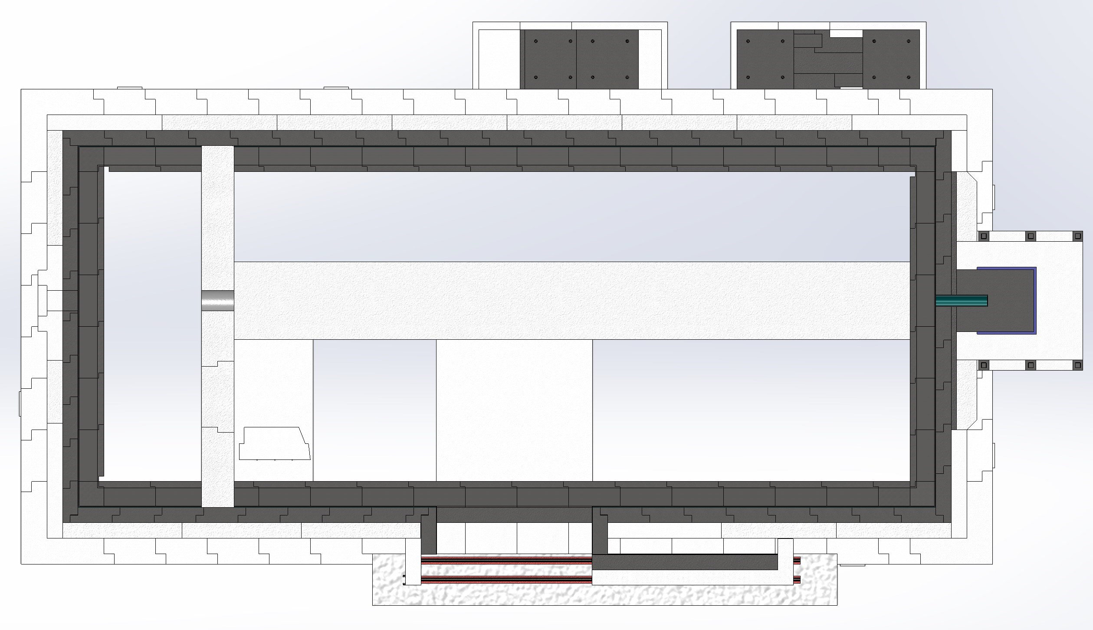
Cave: Technical Design
18m
2.4m
13.6m
Optical Cave
Experimental Cave
8.2m
7m
Internal Door
Sliding Door
3m

Slide 41
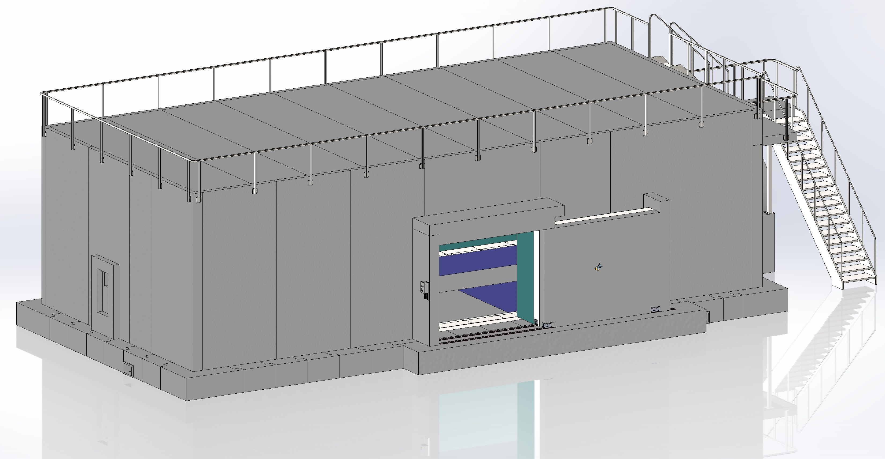
Cave: Technical Design

Slide 42
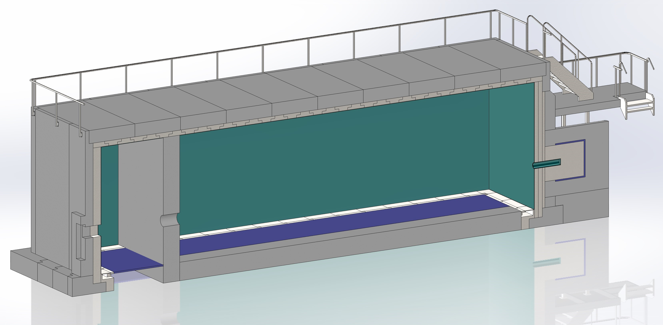
Cave: Technical Design
45cm Concrete
17cm Steel
63cm Concrete
1.5m
Beam Stopper
False Floor

Slide 43
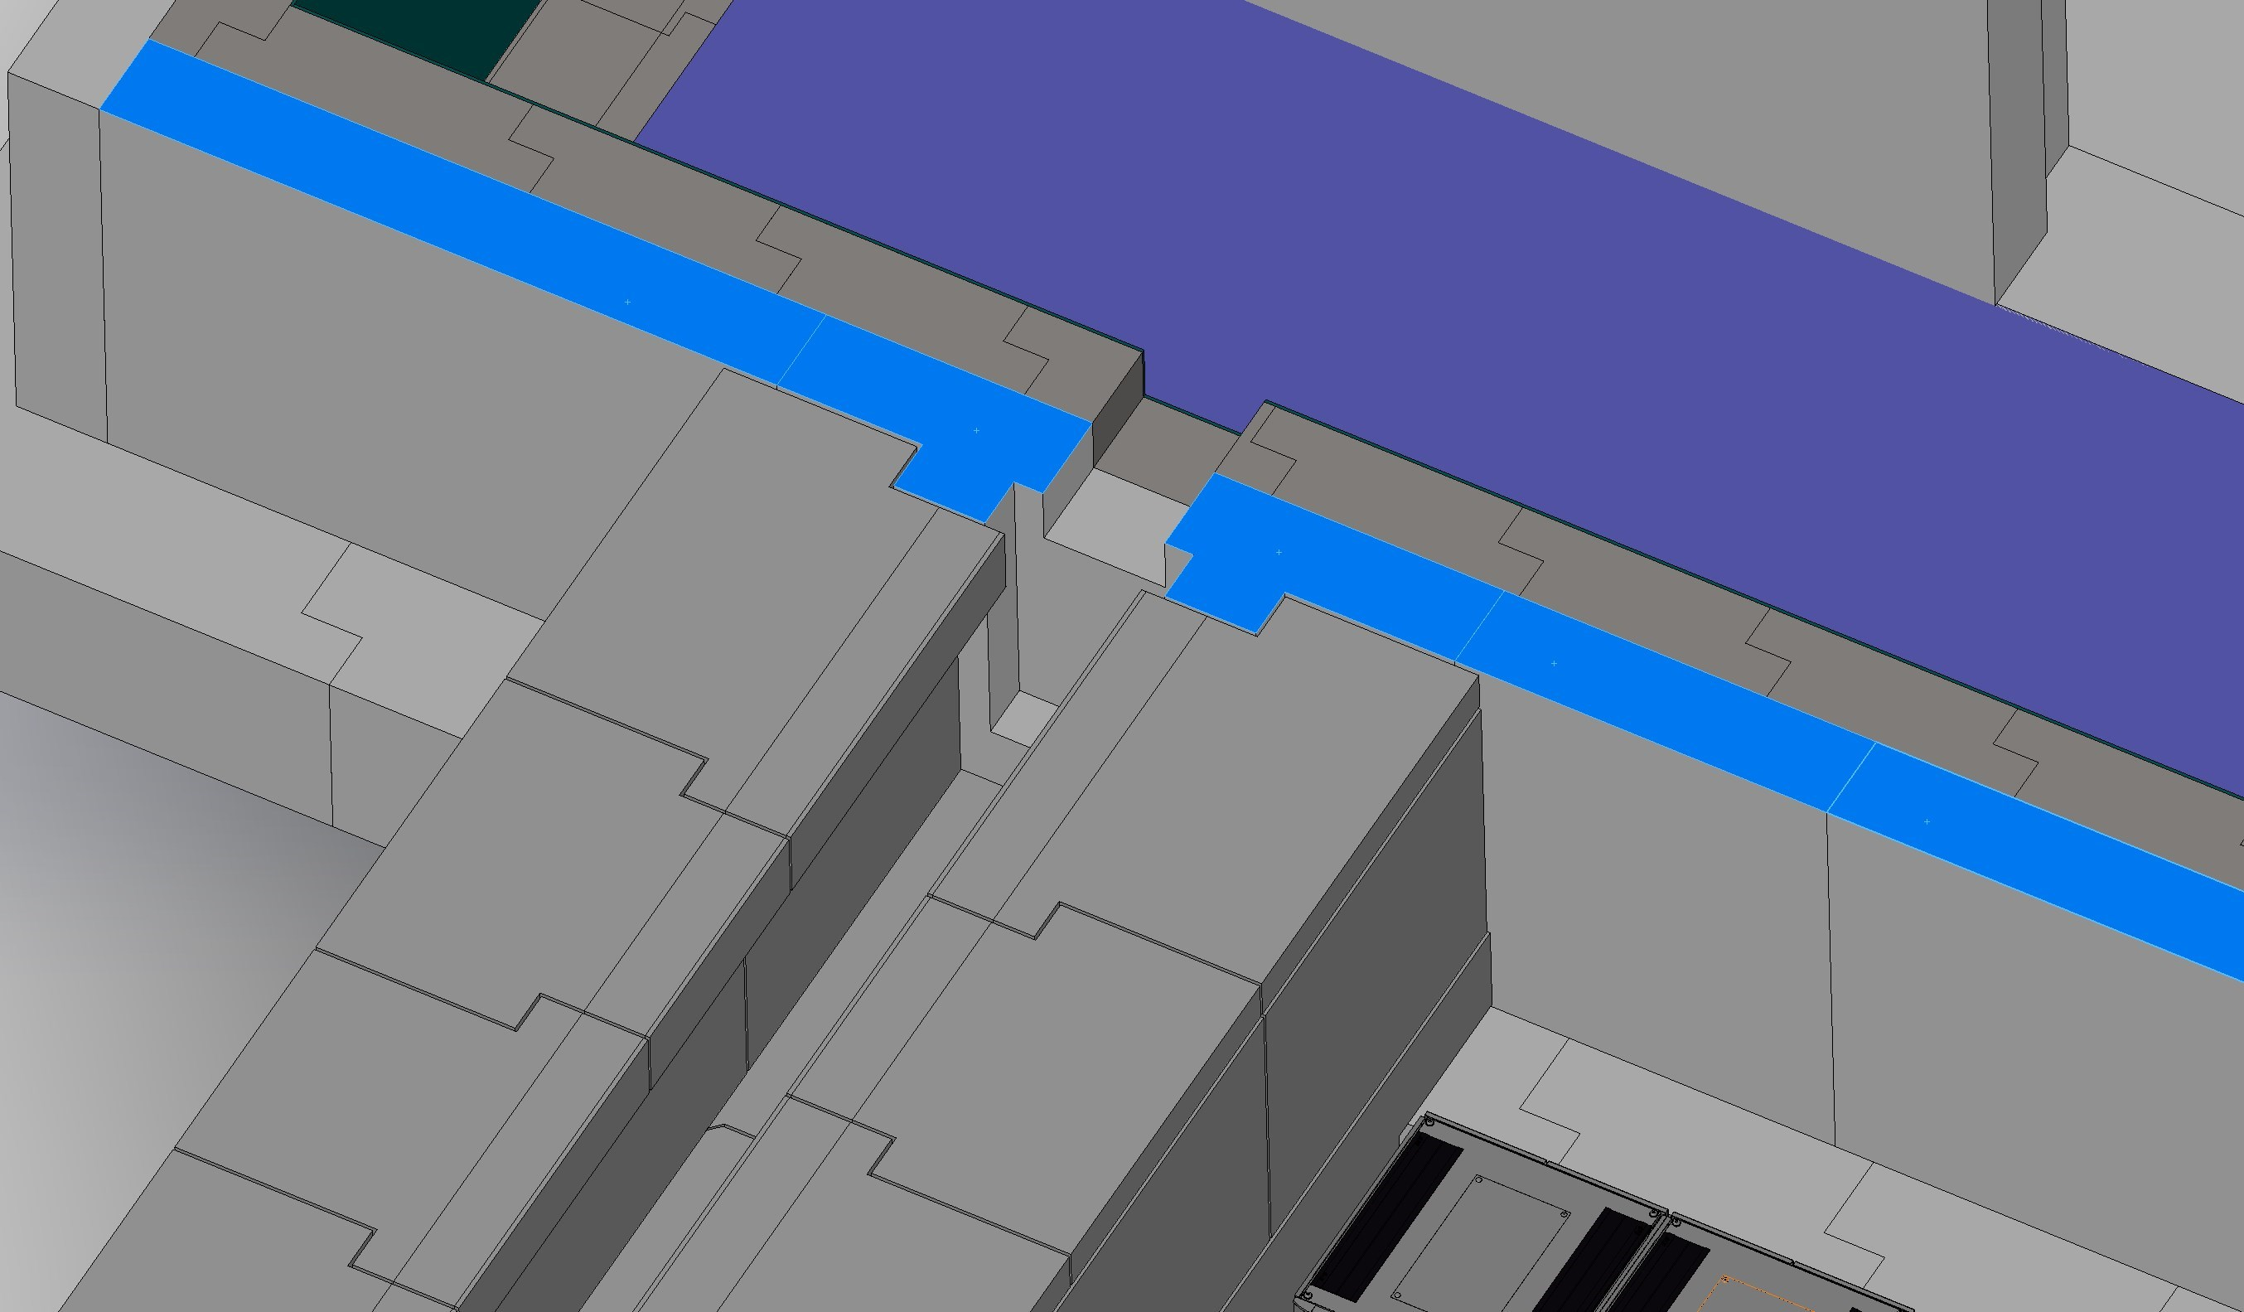
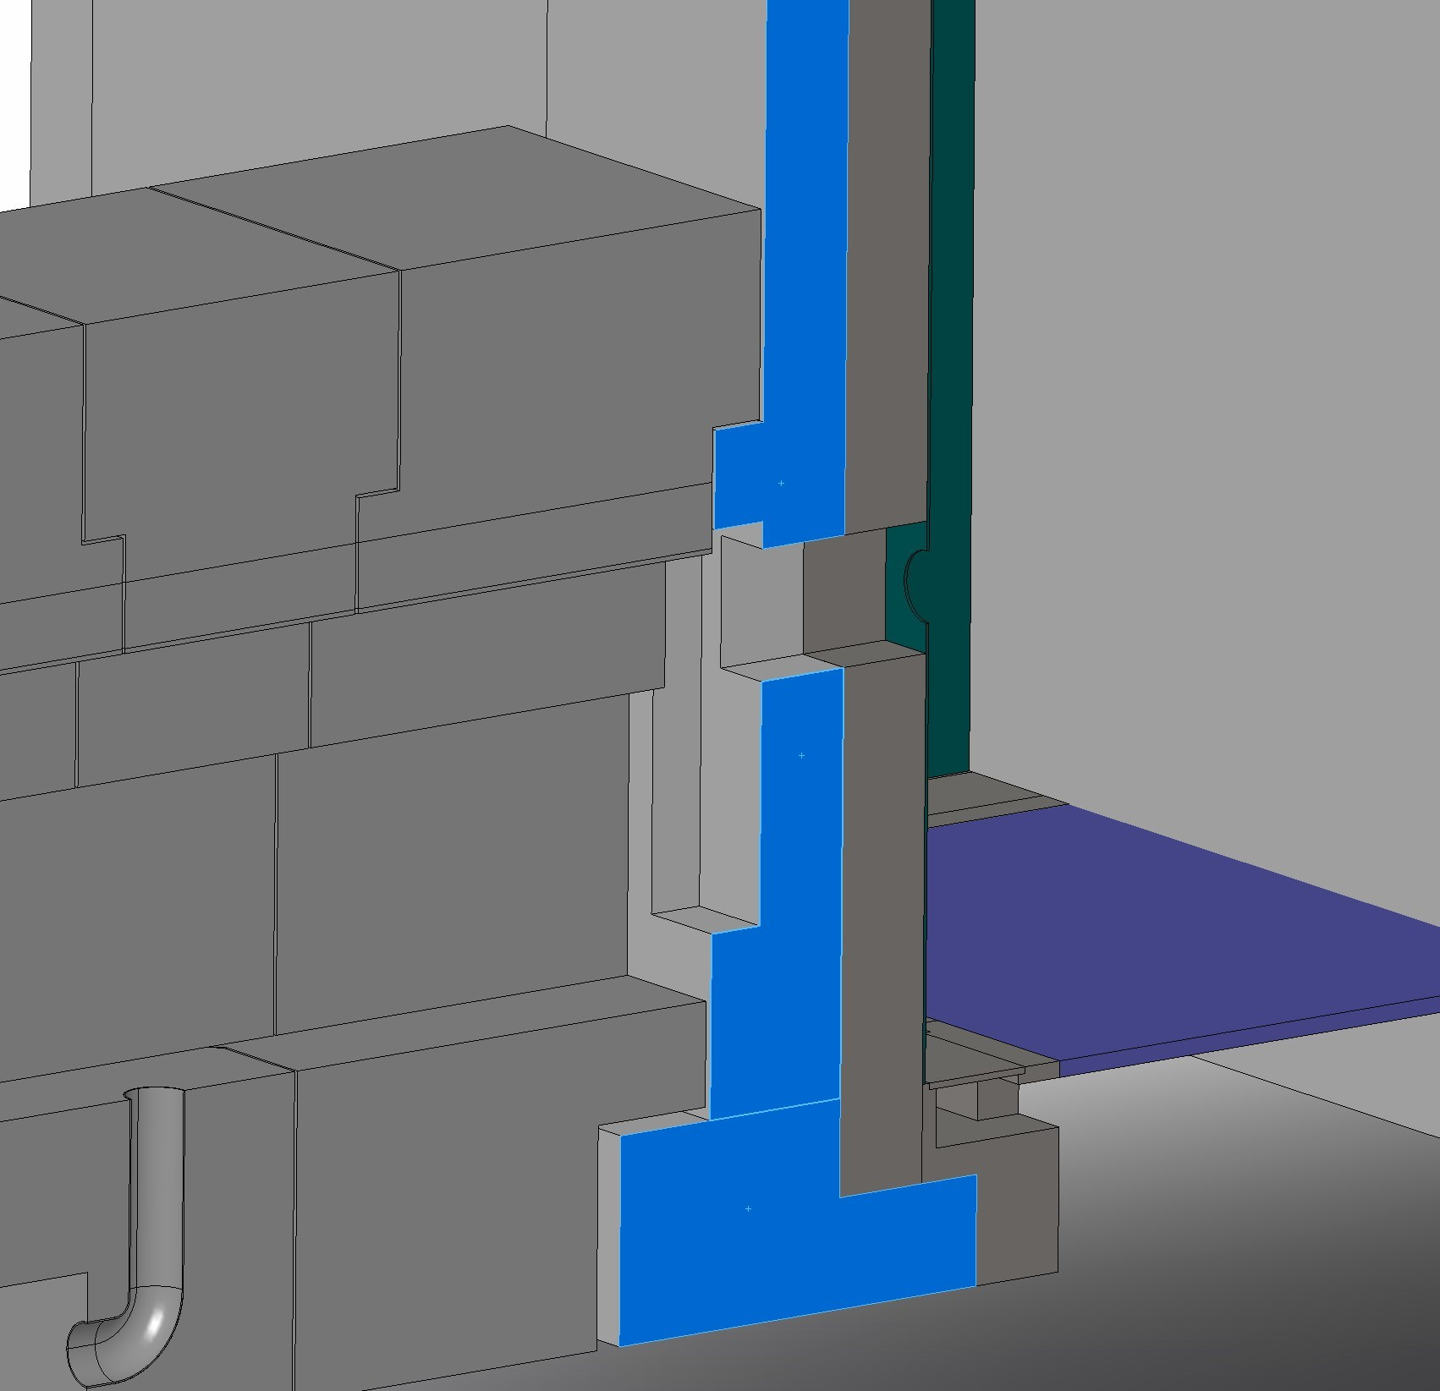
Cave: Technical Design
Interface Guide Shielding – Cave
Horizontal Cut
Interface Guide Shielding – Cave
Vertical Cut

Slide 44
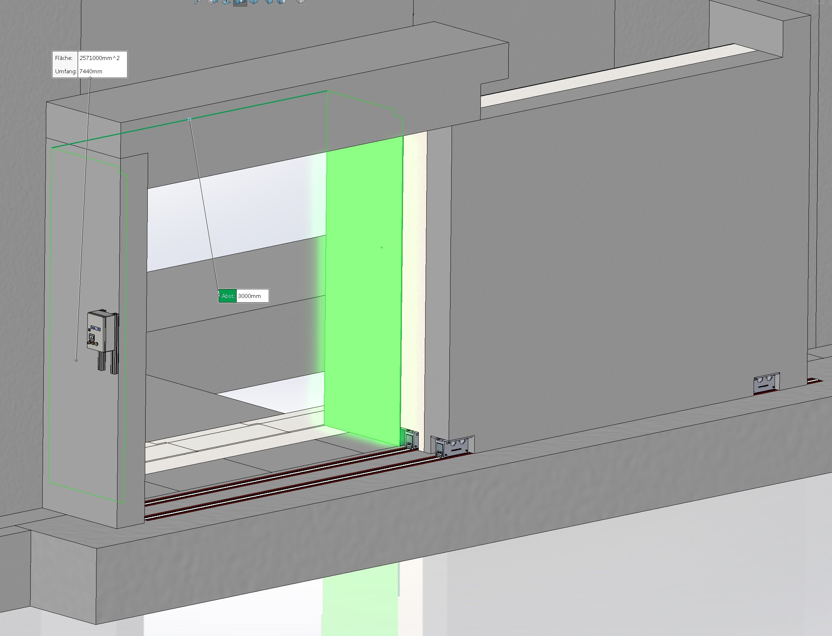
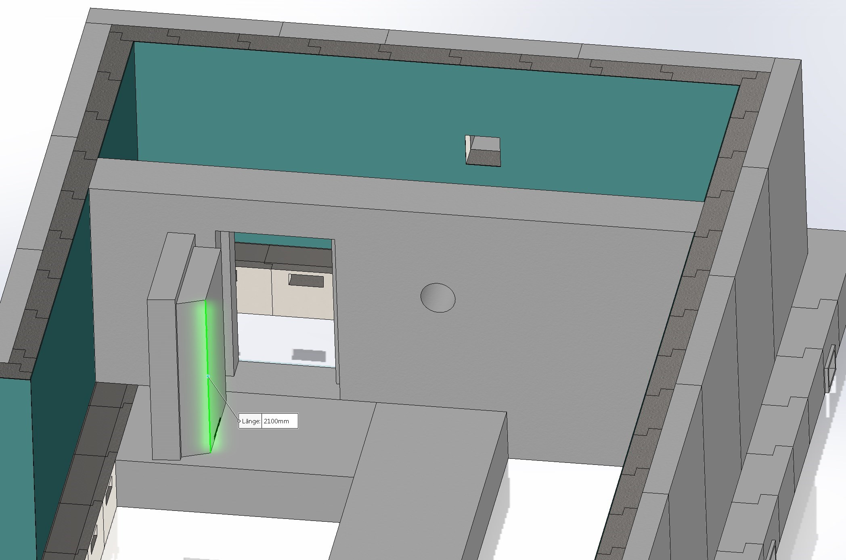
Cave: Technical Design

Slide 45
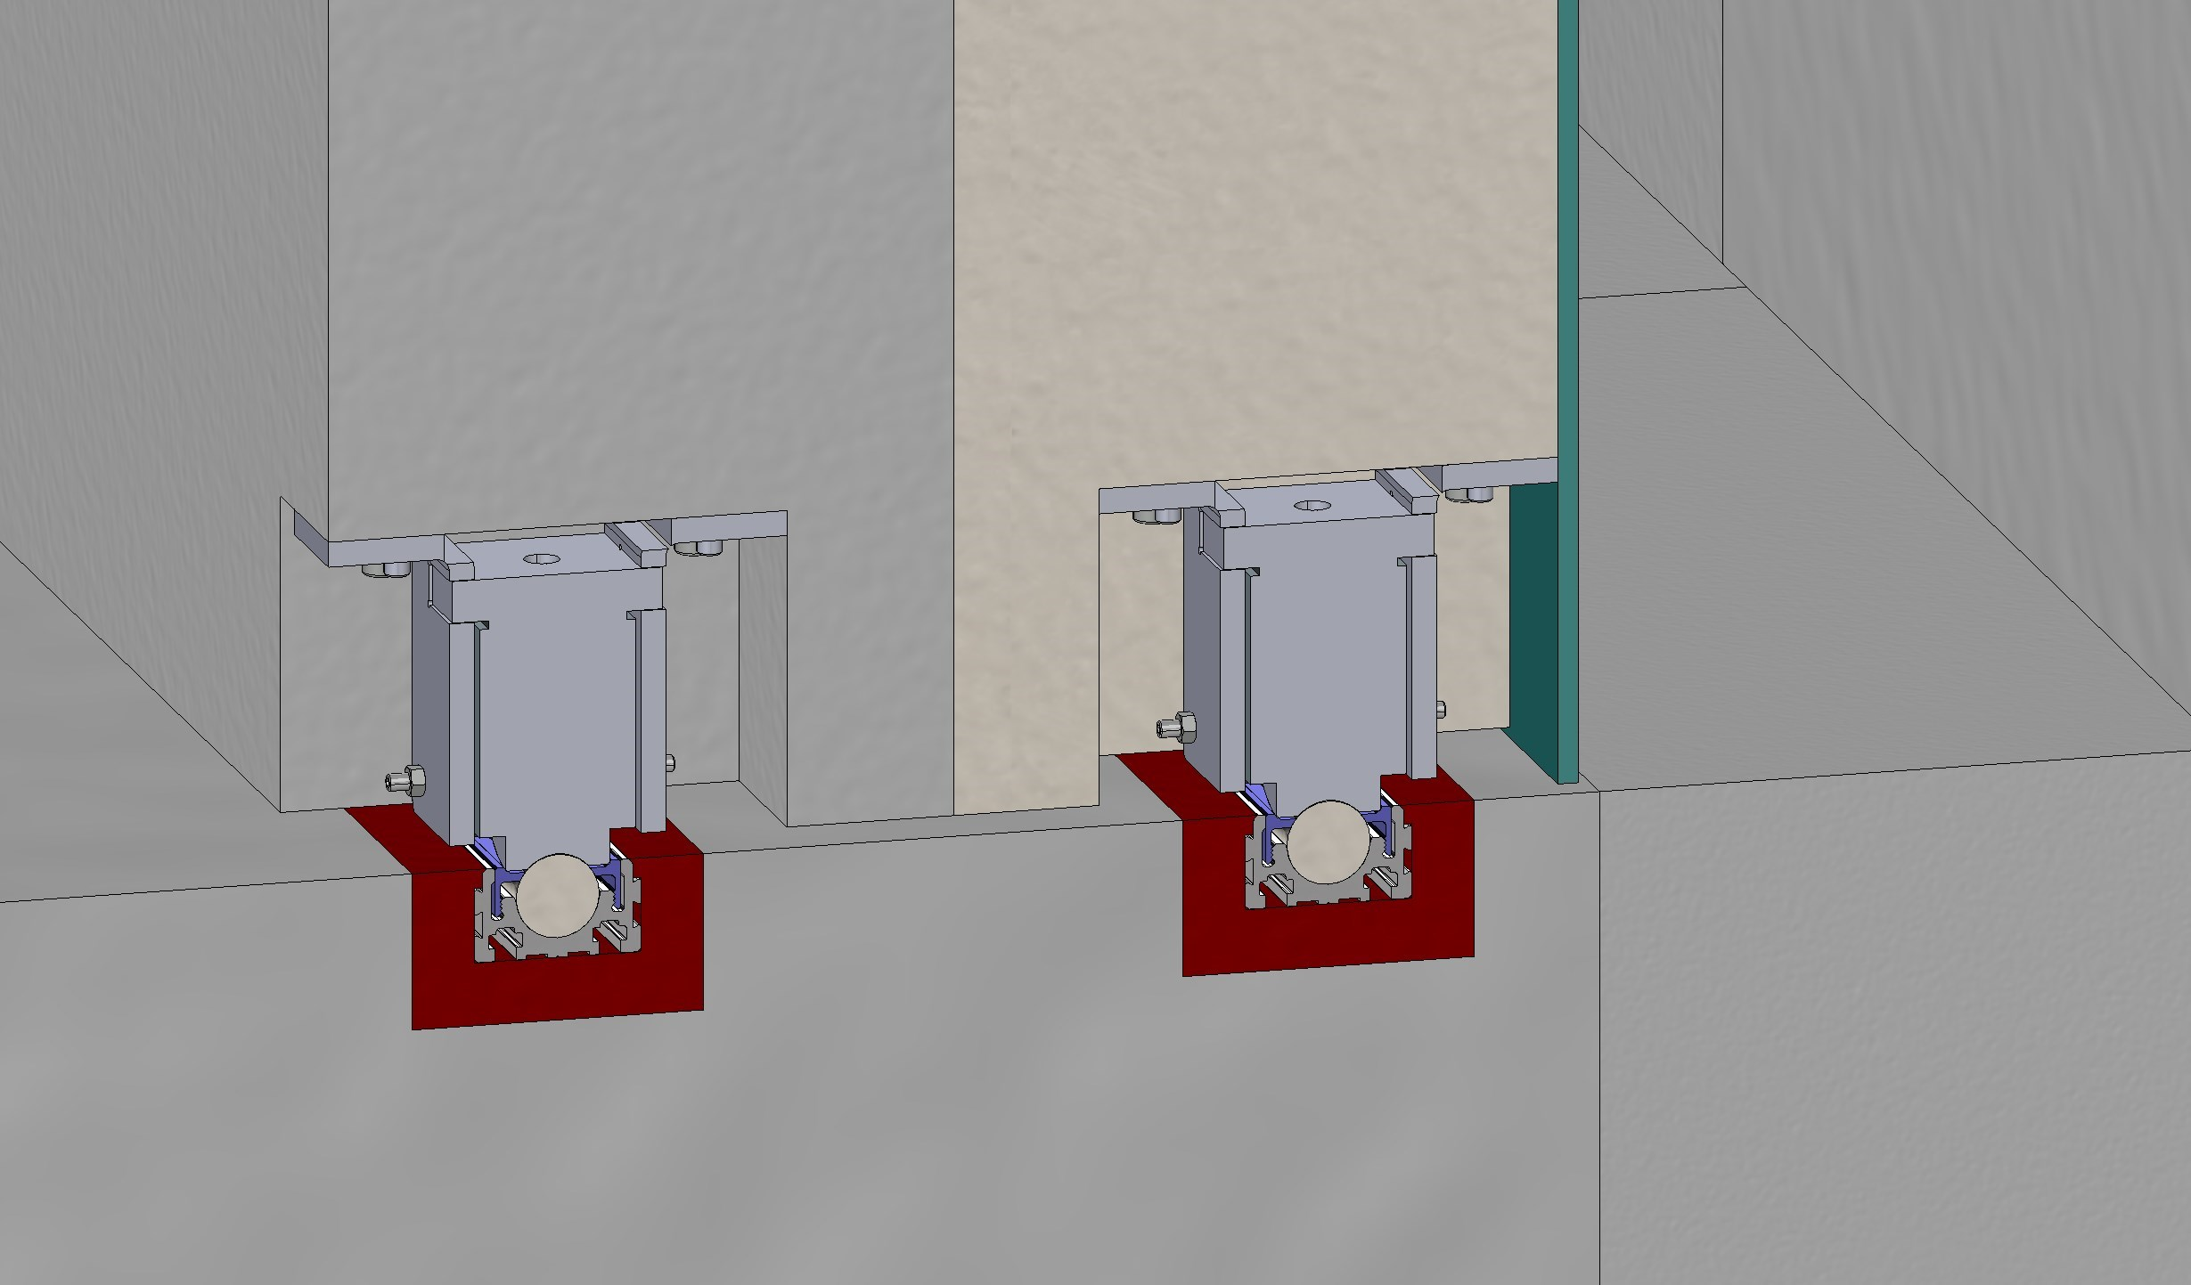
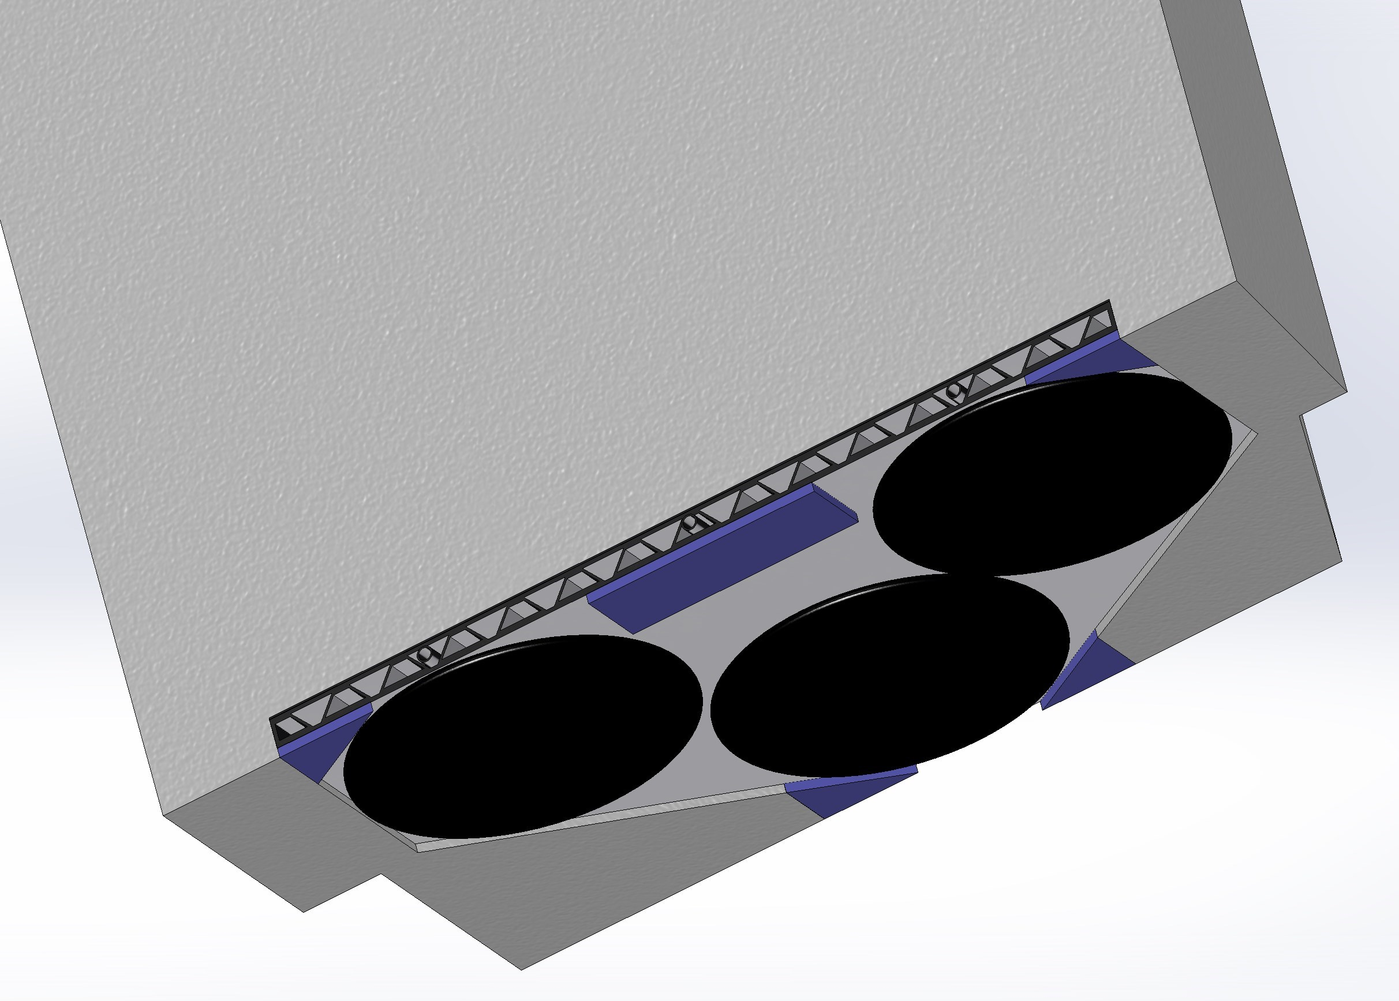
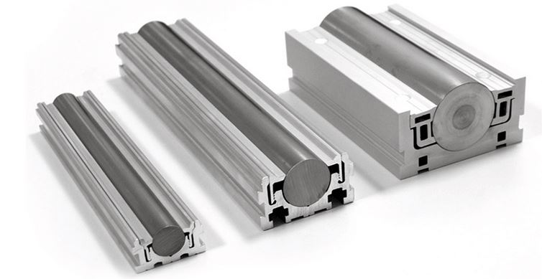
Cave: Technical Design
Sliding Door:
Round track system
Internal Door:
Air cushion modules

Slide 46
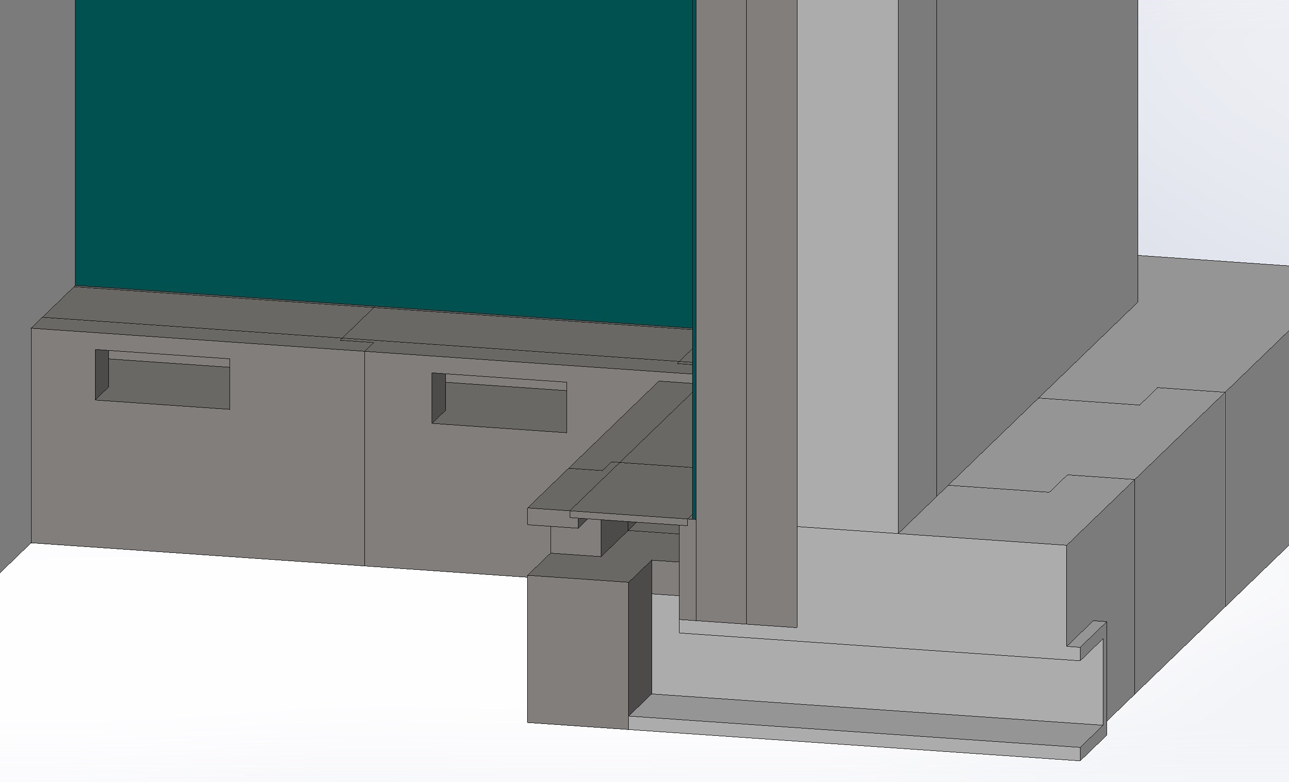
Cave: Technical Design
Removable plates

Slide 47
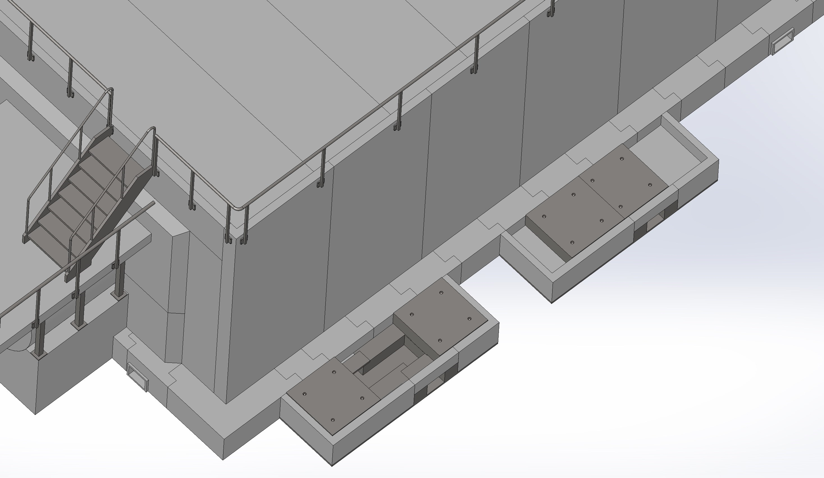
Cave: Technical Design
External Chicanes

Slide 48
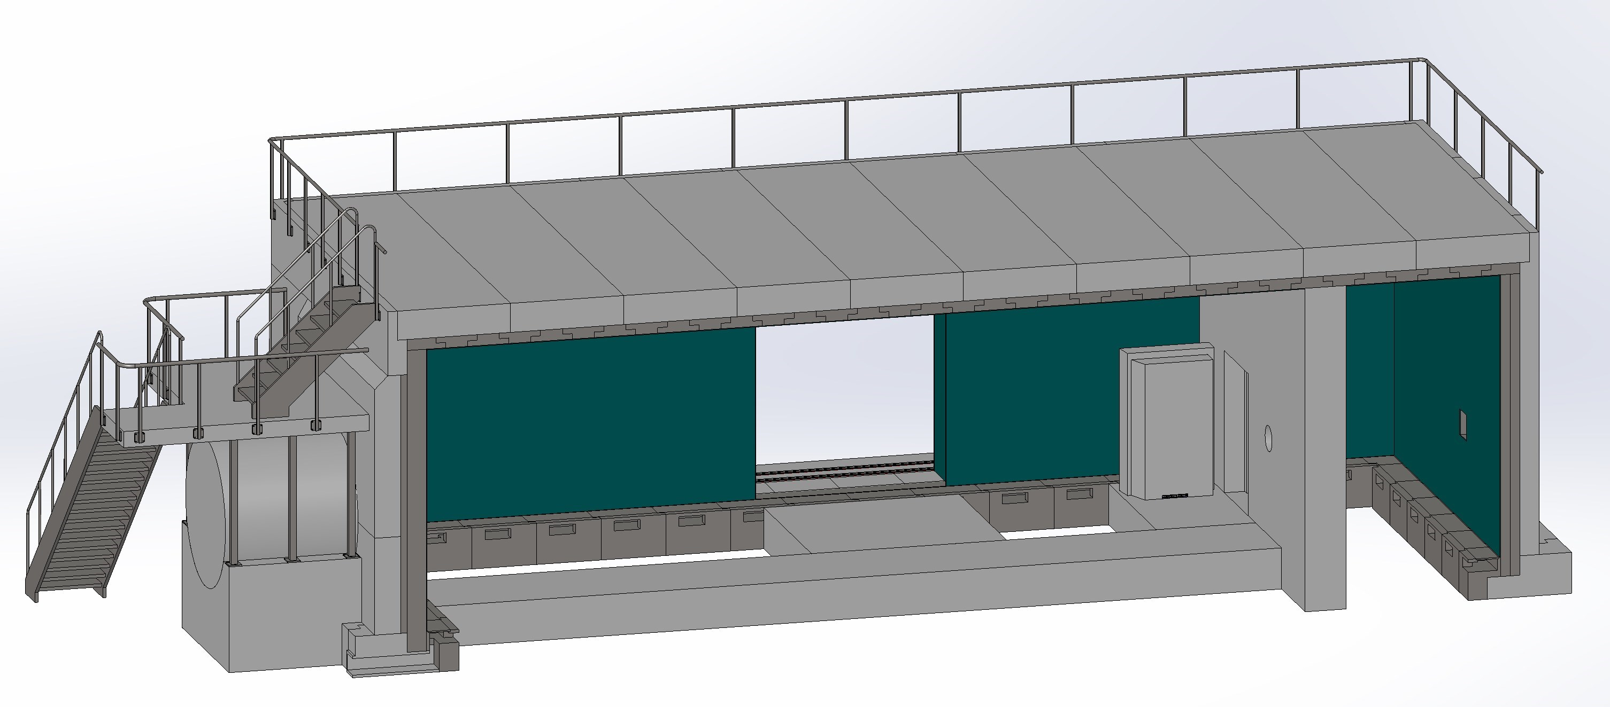
Cave: Technical Design
Self-supporting
removable roof Slabs
Feed through
Outputs from the supply channel
below the false floor
Concrete block along the beam
Removable plates

Slide 49

Cave: Technical Design
Cave
Neutron guide Shielding

Slide 50

Cave: Technical Design

Slide 51

Cave: Technical Design

Slide 52

Cave: Technical Design

Slide 53

Cave: Technical Design

Slide 54

Cave: Technical Design

Slide 55

Cave: Technical Design

Slide 56

Cave: Technical Design
Sample preparation Area
Lift
Racks:
Motion Control
Ramp
Platform
Racks:
Choppers and Vacuum
Control Hutch

Slide 57

Cave: Technical Design
Racks:
Choppers and Vacuum
Racks:
Data Management
PSS
Racks:
Motion Control

Slide 58
Thank You!

Slide 59


