Slide 1
Progress Update
NPI

Slide 2
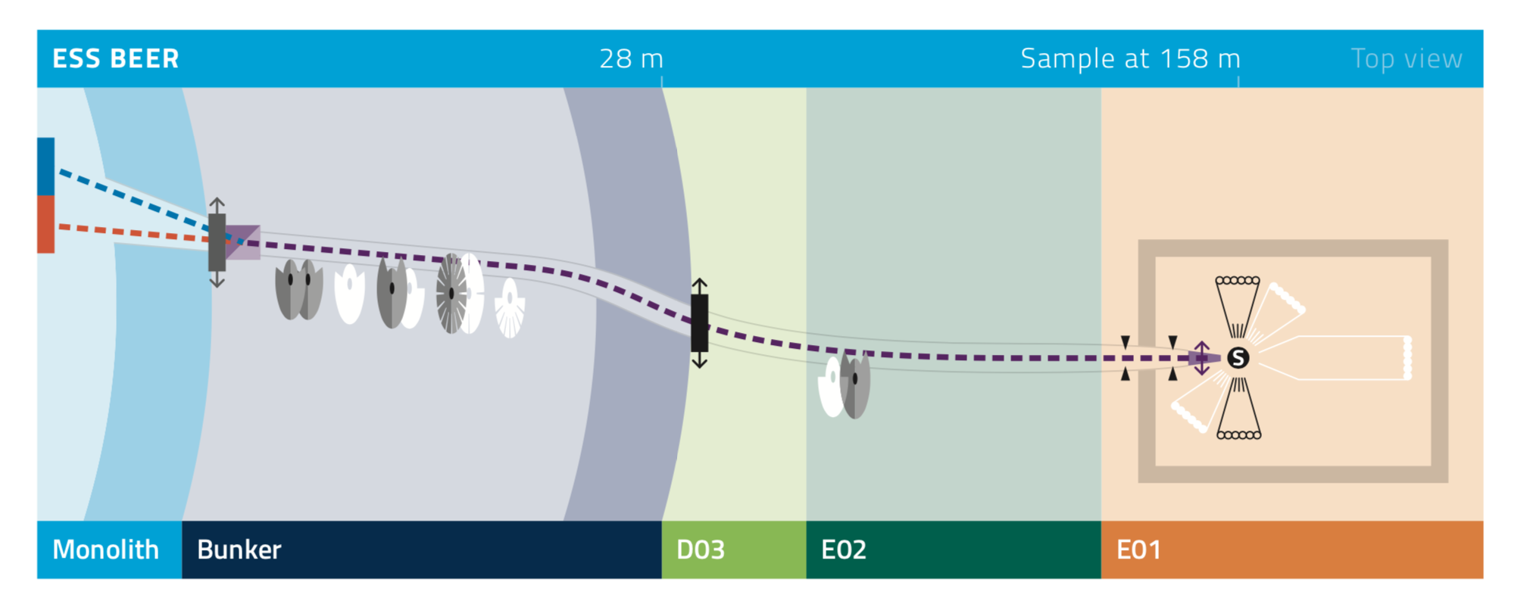
BEER layout
Drawing for “Instruments paper”

Slide 3
Progress Update
Cave, shielding, shutter, … construction - summary
Big cave redesign for the redefined H1&H2 scenarios
Cave walls now 55/60 cm of heavy concrete
Ceiling redefined to blue-control zone (25 𝜇Sv/h)
Ceiling 70 cm of normal concrete
All sub-TG3 documentation submitted (sub-TG3 October 20, 2019)
Budget estimation for construction > CBV + 1.2 MEur
Contract terminated after design phase
Cost break-down exercise – expensive items identified (el. design, HVAC, …)
Joining Common-Shielding project to keep schedule and budget flow
For other parts new tender processes – possible delays
New funding project for the rest of construction submitted Jun 2019
No engineer in place! Difficulties with definition of requirements
TA might be signed soon – agreement between ESS and NPI
Issue with leading institution – responsible for integration

Slide 4
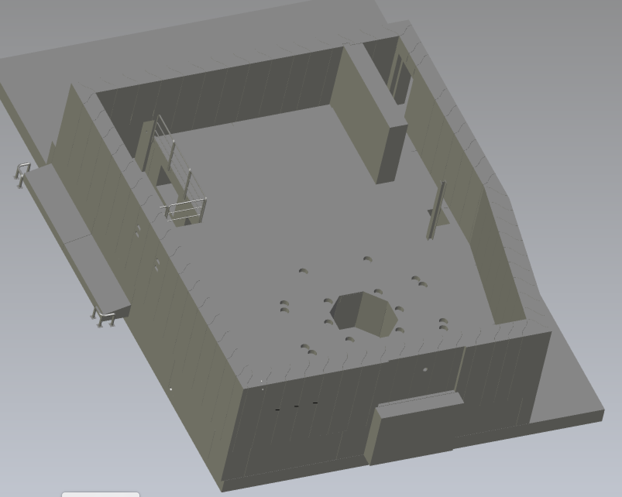
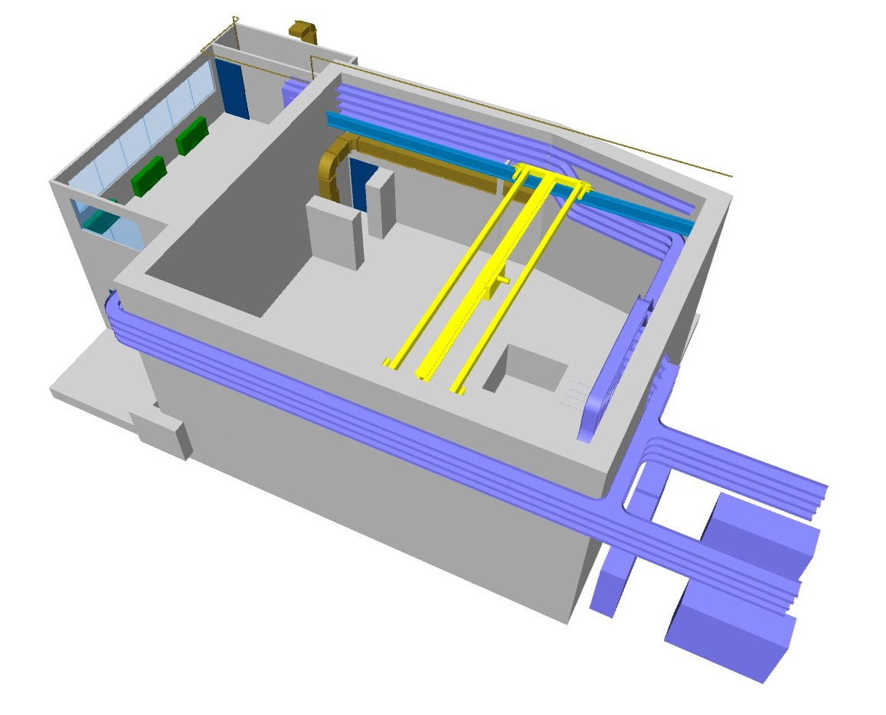
Cave chicane
Redesign of chicane to accommodate SANS tank

Slide 5
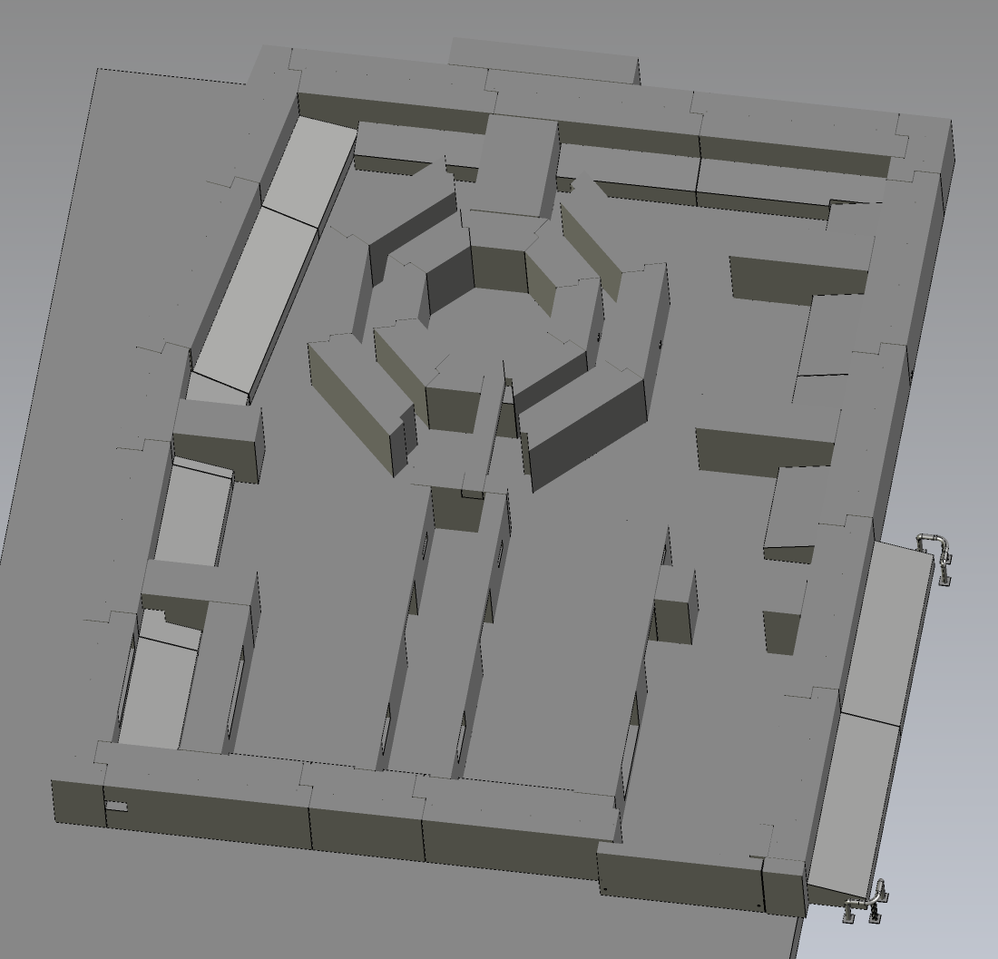
Cave floor load
Solution for the cave floor load

Slide 6
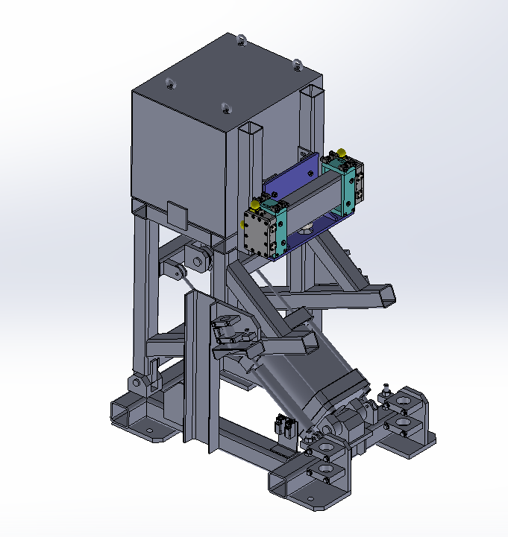
Safety shutter
Detail design of shutter and related optics

Slide 7
H1&H2 scenarios
Beam definition for shielding design
ID | Description | Choppers |  |  |  |  |  | Slits
 |  | Pulse shaping |  | Modulation |  | Frame overlap |  | SL1 |  | SL3
 |  | PSC1 | PSC3 | MCA | MCC | FC1a | FC2a | w | h | w | h
Maximum beams
F0 | Maximum white beam | - | - | - | - | - | - | o | o | o | o
F1 | Accident full beam | - | - | - | - | 28 | 14 | o | o | o | o
F2 | Maximum operational beam | - | - | - | - | 28 | 14 | o | o | 10 | 20
Diffraction modes using pulse shaping or modulation technique
PS0 | Maximum pulse shaping | 168 | 168 | - | - | 28 | 14 | o | o | 10 | 20
M0 | Maximum modulation | - | - | 70 | - | 28 | 14 | o | o | 10 | 20
Imaging mode
IM0 | Maximum imaging | - | - | - | - | 28 | 14 | 10 | 10 | o | o
SANS modes for pure SANS or diffraction + SANS setup
SANS | Maximum SANS | - | - | - | - | 28 | 14 | 20 | 20 | 10 | 10
DS0 | Modulation + SANS | - | - | - | 70 | 14 | 7 | 40 | 40 | 5 | 10
id | Description | Intensity, 1E+8/s
F0 | Maximum white beam | 406.8
F1 | Accident full beam | 226.2
F2 | Maximum operational beam | 48.0
PS0 | Maximum pulse shaping | 5.73
M0 | Maximum modulation | 3.2
IM0 | Maximum imaging | 4.867
SANS | Maximum SANS | 0.25
DS0 | Modulation + SANS | 1.22

Slide 8
H1&H2 scenarios
Samples definition for shielding design
For the purpose of the definition of H1 and H2, three “worst-case” samples in the sense of composition and size were selected and their characteristics are described below:
The worst γ emitting sample (WGE) – pure Ni sample with the size of 4.4x4.4x1.5 cm³ (1.5 cm is the thickness along the beam) considered in combination with the maximum beam cross-section (AFB and MWB) or with the size of 1.2x2.2x1.5 cm³ (1.5 cm is the thickness along the beam) considered in combination with MOB.
The worst neutron scattering sample (WNS) – ideal neutron point source with isotropic neutron scattering of the full incoming beam.
Cd sheet in the beam (CDB) – 1 mm thick Cd sheet covering the beam size and rotated by 45˚ in both directions.

Slide 9
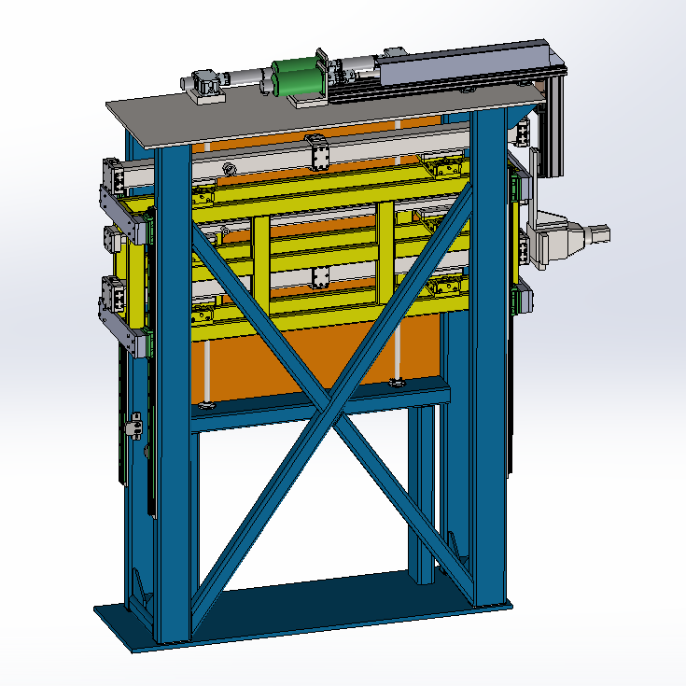
Progress update
Transport neutron guide and guide exchanger summary
Design progress well (realignment issues will need to be resolved)
IDR documents submitted 3 weeks ago
IDR meeting on Thursday 17/10
Pre-manufacturing of long part started
Try to include the guide support in the contract
Exchangeable guide lift inside the cave
Sample slit movable with aperture 10x20 mm²
Sample slit removable

Slide 10
TG3‘s
NPI
 | Oct ‘18 | Dec ‘18 | Oct ‘19 | Oct ‘19 | Aug ‘20
CTV | Neutron guide and guide exchanger
IDR |  | Cave, hutch, shiedling | Neutron guide and guide exchanger
TG3‘s |  |  | Cave, hutch, shiedling | Neutron guide and guide exchanger
Final TG3 |  |  |  |  | TG3

