Slide 1
Progress Update

Slide 2
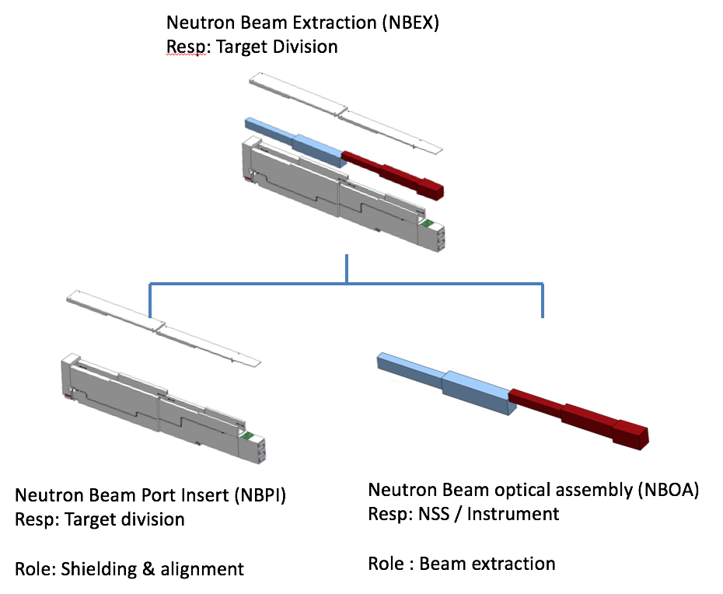
Progress Update
Contracts
Draft of Contribution agreement passed ESS council in December
→ signatures pending
Work on TA on going
NBOA taken over by ESS
Delays in procurement and delivery
→ Changes in schedule necessary
pre-financing by HZG not longer possible

Slide 3
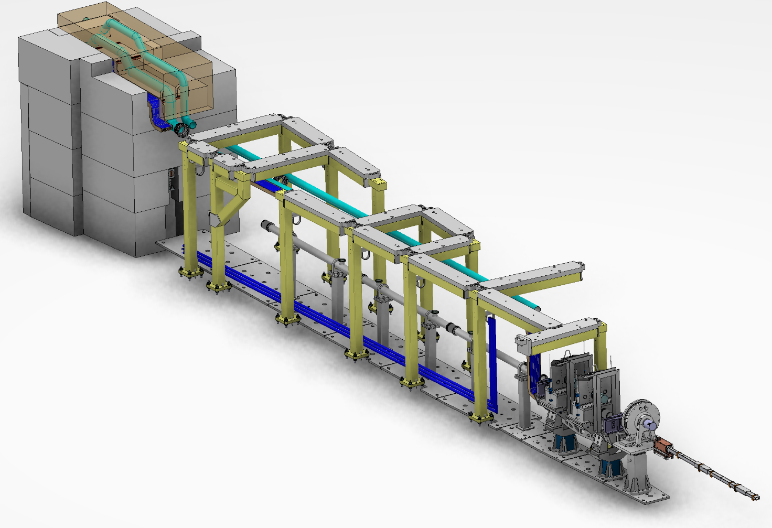
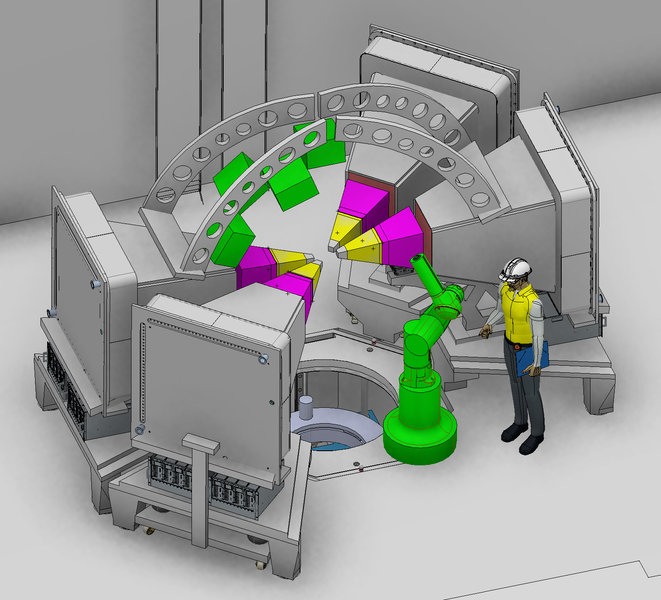
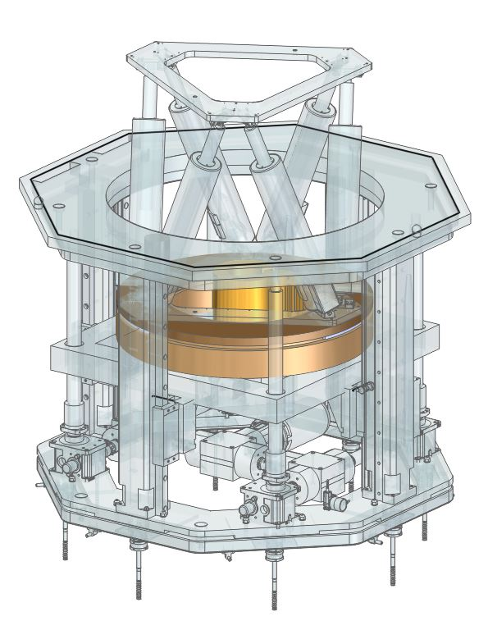
Progress Update
In-bunker & SEE
Call for tender verification - CTV:
Chopper
Neutron guides in-bunker
BBG
Bunkerwall insert
Hexapod and Rotary stage
6-axis robot arm
Approved
Radial collimators
Nov ‘19

Slide 4
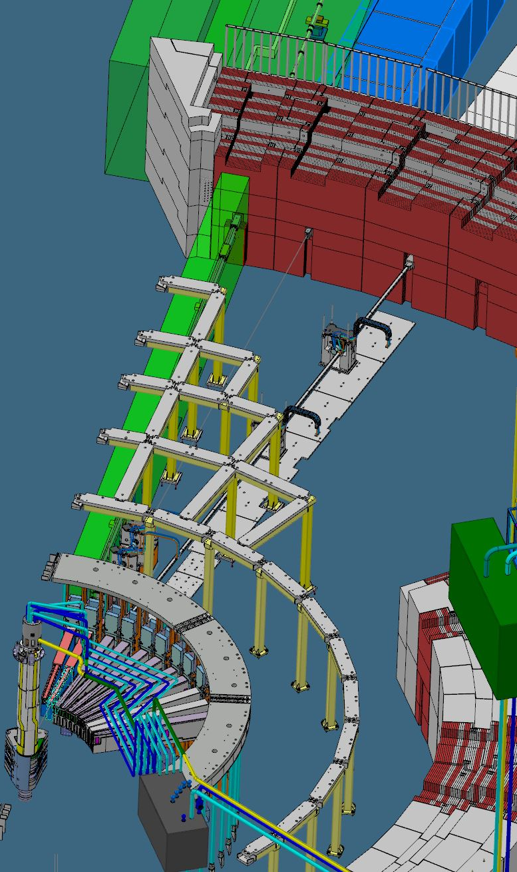
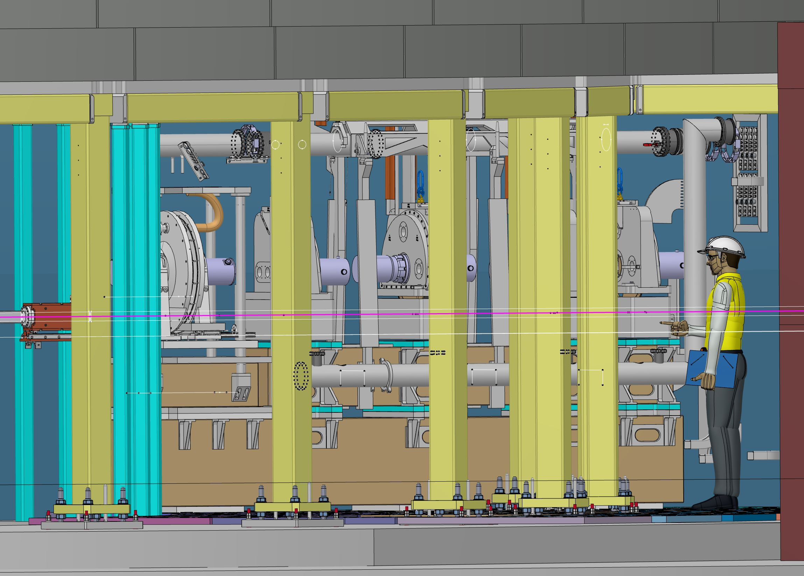
Technical Update
In-bunker
Chopper and Neutron Optics Support
Tight space
NMX and CSPEC
Bunker roof and support

Slide 5
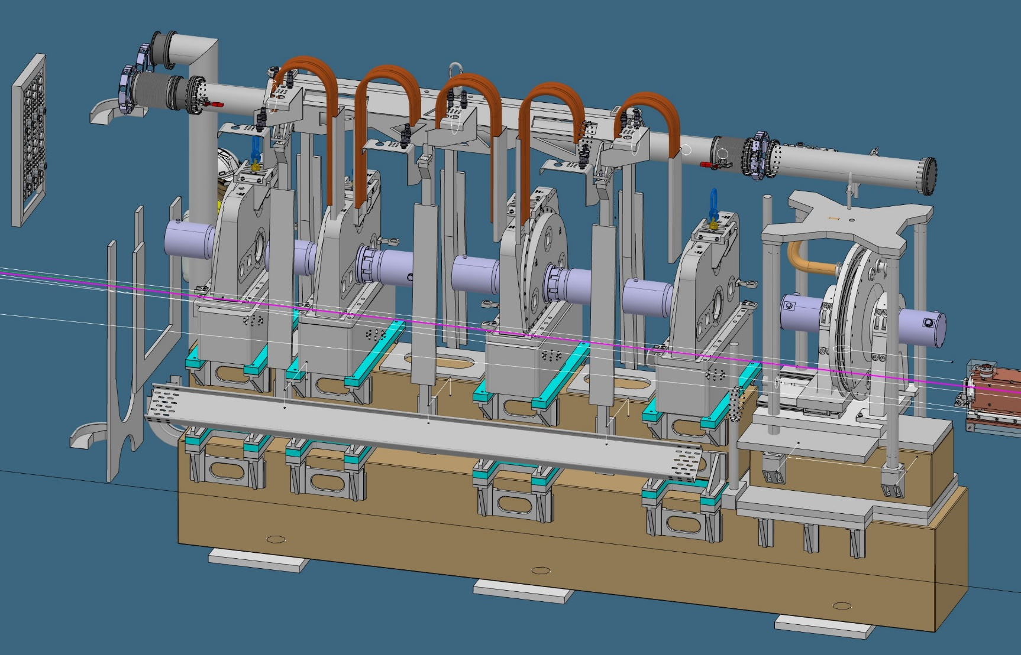
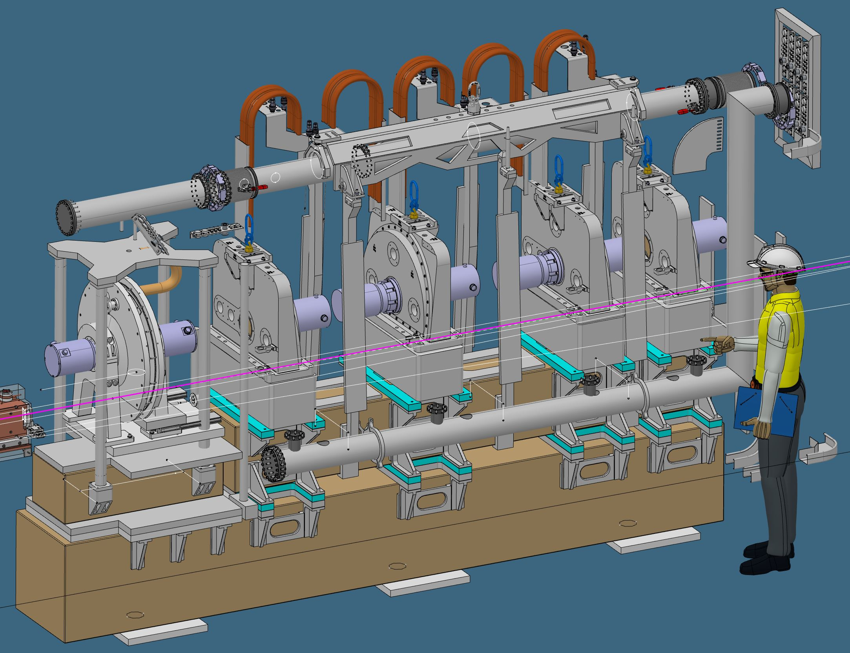
Technical Update
In-bunker
Chopper and Neutron Optics Support
support structure
damping of vibrations
remote Handling
all vs. single Chopper
cable and pipe routing
→ remote handling
Close connection with ESS
→ remote handling
→ vacuum

Slide 6
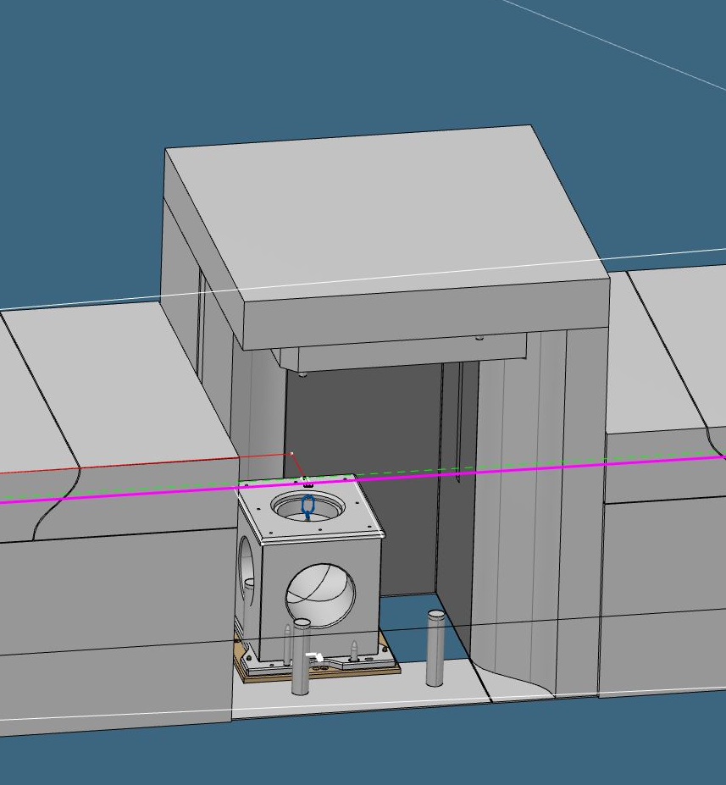
Technical Update
Out-of-bunker
Chopper Suport for 80 m Chopper
Damping of vibrations
Remote handling

